Slide 1
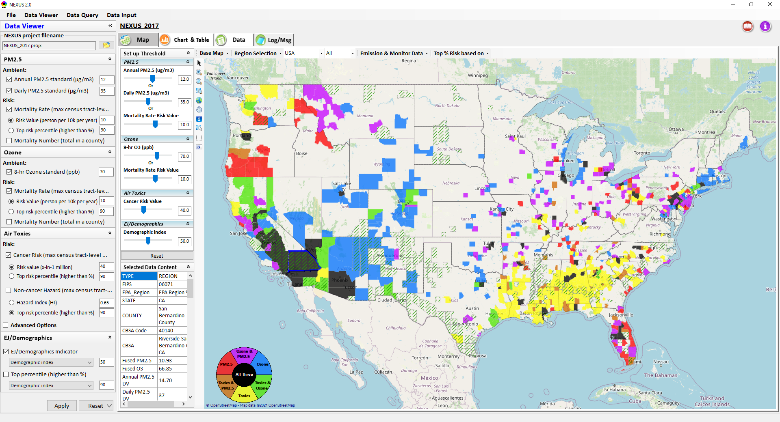
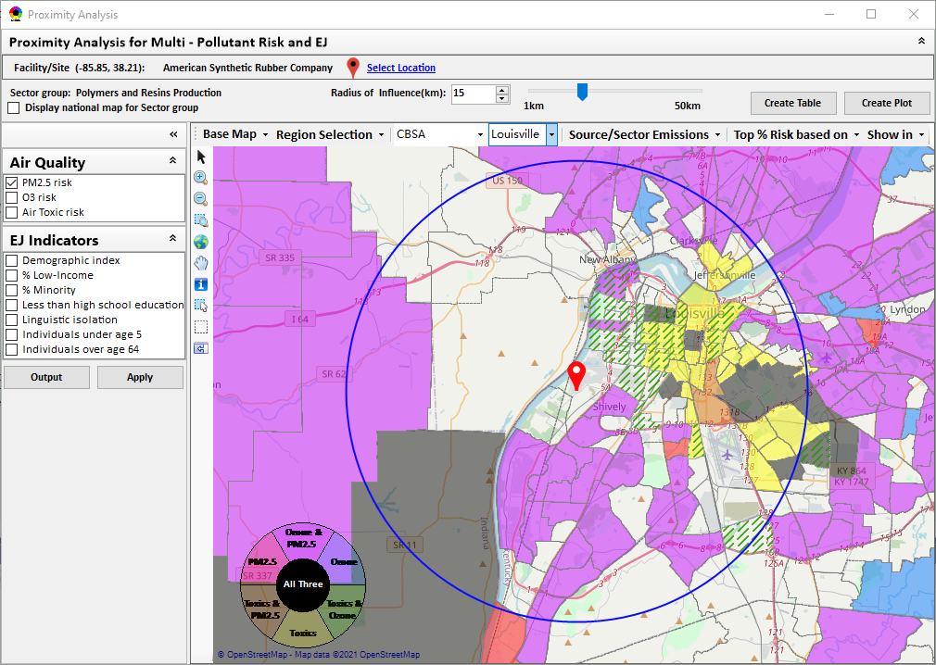
“NEXUS” Multi-Pollutant Advanced Screening Tool
OEJ Briefing
Data Viewer: National/Regional Level
Proximity Analysis: Community Level
Beth Landis, HEID/Climate, International, & Multi-Media Group
Carey Jang, AQAD/Air Quality Modeling Group
10/31/22
1

Slide 2
Multi-Pollutant Team Members
HEID
  Beth Landis / Kimber Scavo
  Matt Woody / Kelly Rimer
  Robin Langdon / Darryl Weatherhead
  Sara Terry
  Carrie Wheeler
  Rob Pinder
  Chris Davis
  Conor Mulderrig
  Kayla McCauley
OID
  Amanda Kaufman
  James Payne
  Loren Fox
AQAD
  Carey Jang / Tyler Fox
  Jim Kelly
  Shannon Koplitz
  Joe Mangino
  Jeanette Reyes
AQPD
  Rich Damberg / Megan Brachtl
  Mia South
SPPD
  Lisa Conner
2

Slide 3
Overview
Multi-Pollutant (MP) Background
NEXUS 3.3
  Background & Overview
  Data Inputs and Major Functions
  NEXUS & EJSCREEN
  Current and Potential Uses
    Examples
  Briefings/Demos
  Feedback
  Next Steps
Live Demo
3

Slide 4
Multi-Pollutant Background
Support a comprehensive, MP treatment of air quality problems to effectively improve air quality and make the most efficient use of available resources
  Primary Goal - identify & evaluate local control strategies targeting emissions of O₃ & PM_{2.5} and their precursors while at the same time reducing Air Toxics of concern for communities to maximize both health benefits and air quality improvements
MP planning has the potential to reduce the costs and increase benefits associated with air quality management (AQM)
Supports S/L/T air agencies in developing MP, risk-based AQM plans and implementing strategies that reduce air pollution emissions & improve public health
Success has been demonstrated in Detroit and SC; another project is currently underway in Louisville, KY
Tools needed to analyze MP data are either available currently or being developed in OAQPS (e.g., NEXUS)
4

Slide 5
NEXUS: Overview
“NEXUS” is an advanced screening tool for multi-pollutant (MP) air quality planning developed by OAQPS’s MP team that allows for account of MP risks and EJ/Demographic analysis
The NEXUS tool will essentially provide a ‘conceptual model’ of an area’s MP issues to facilitate engagement with state/local/tribal agencies & community stakeholder groups
“NEXUS” integrates a suite of MP data, including emissions, monitoring, modeling, fused AQ data and health risk data for PM_{2.5}, O₃ & air toxics as well as EJ/demographic data, into one single platform to allow national and areal overlay mapping & analysis of MP ambient & risk data
“NEXUS” provides MP analysis across from national level “Phase 1” to regional (EPA region/State/CBSA) level “Phase 2”, and now down to community level “Phase 3” (Proximity analysis” in census tract-level)
We expect to use this tool in conjunction with Regions and identify areas that would potentially benefit most from MP approaches to reduce emissions (including current NA areas)
We also expect that it can have additional value-added uses across the Office for Air Toxics, Environmental Justice and other programs
5

Slide 6
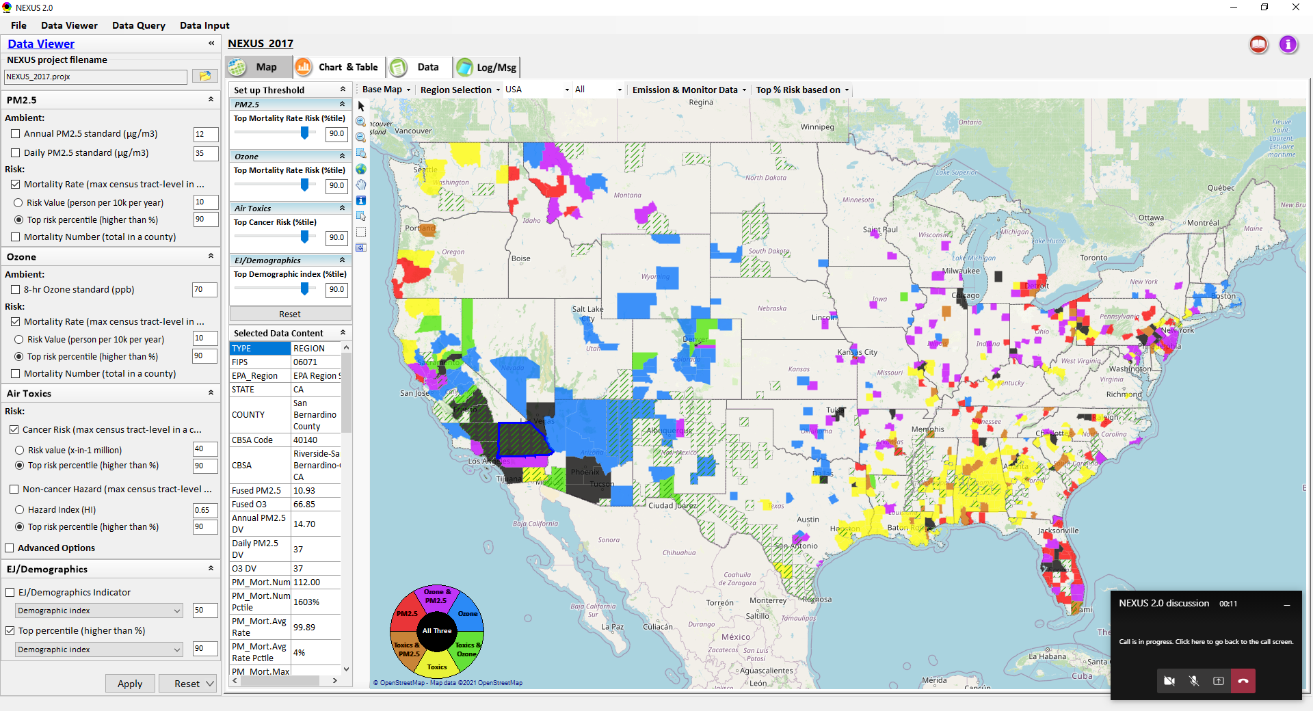
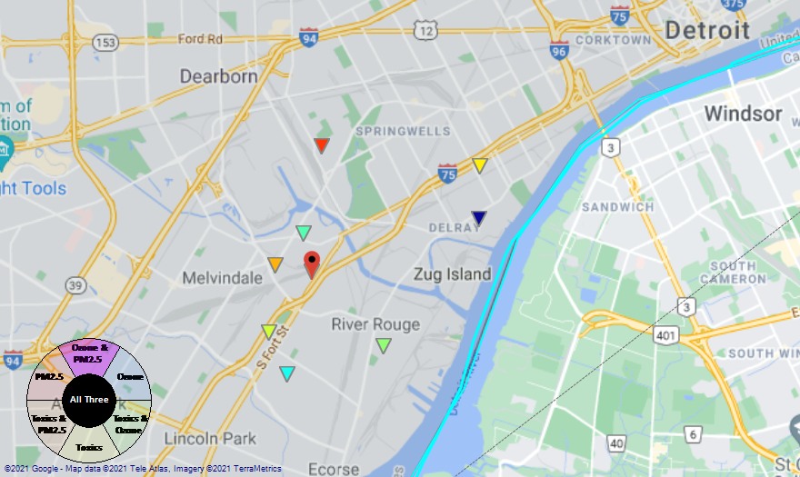
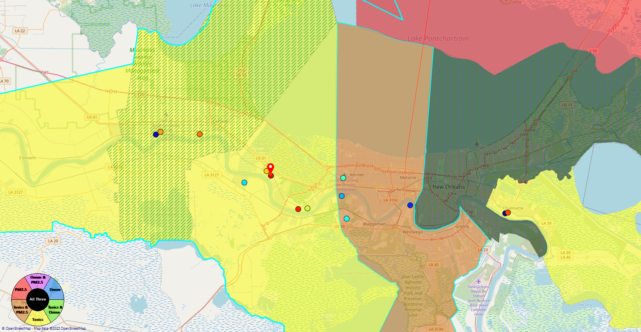
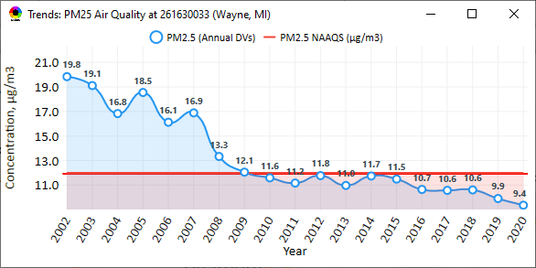
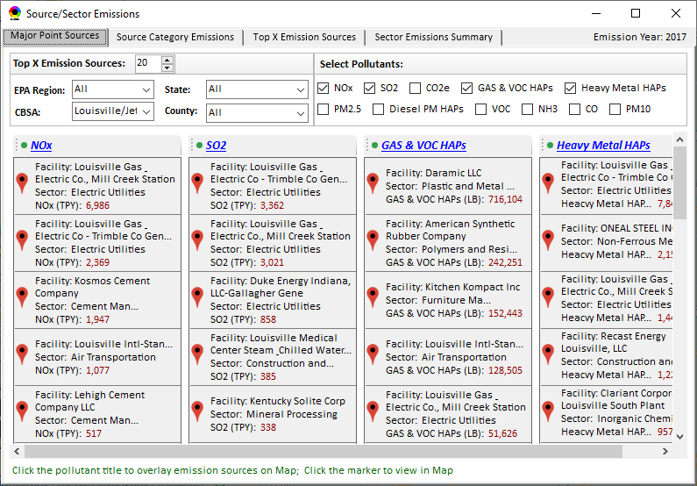
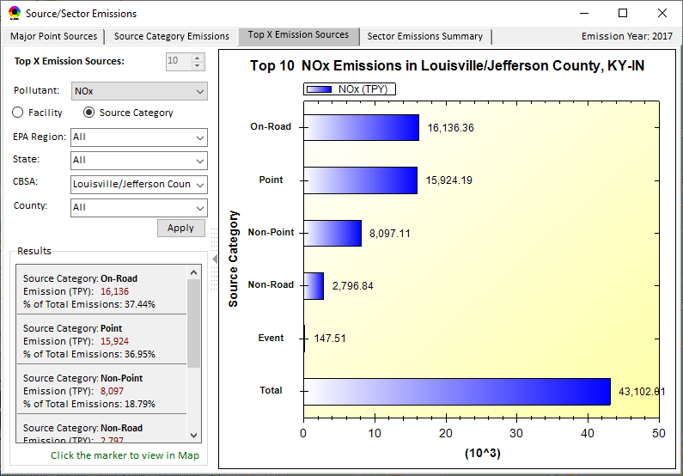
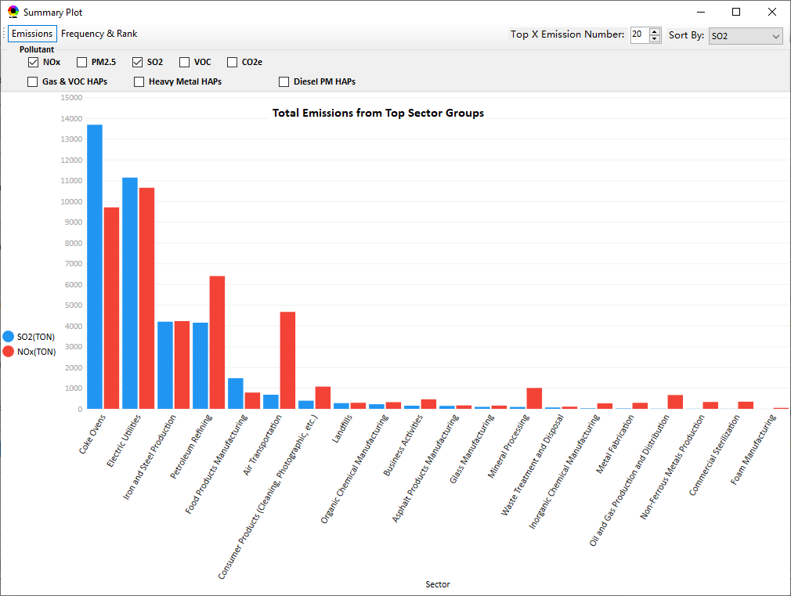
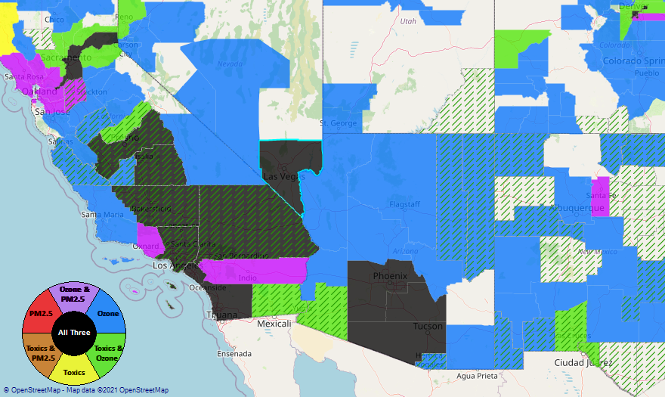
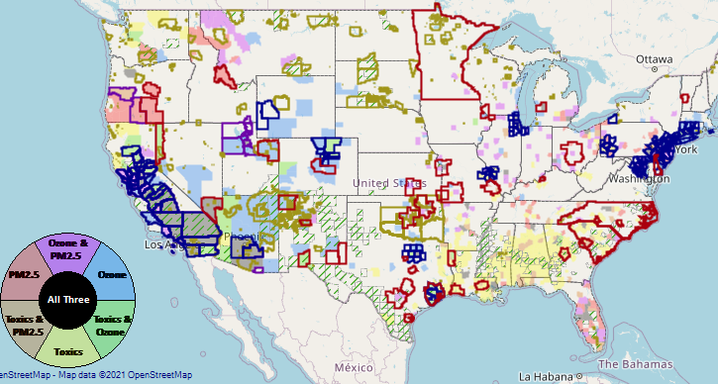
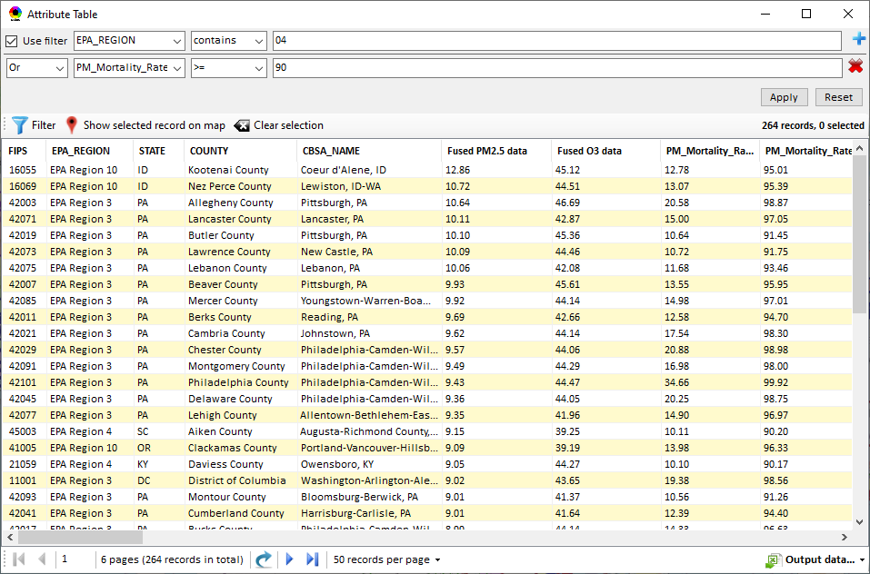
NEXUS: Data Inputs and Major Functions
O₃ & PM_{2.5}
Ambient/Design Value
(2012-2020)
(County-level)
Multi-Pollutant
Ambient and/or Risk National & Areal Mapping
Display Monitoring Sites & Trend Data
O₃, PM_{2.5} & Air Toxics Risk Data &
Conc. (fused AQ) Data
(2017 & 2014)
(Census tract-level)
Display Major Point Emissions Sites/Data
Provide Source Category Emissions
NEXUS
O₃, PM_{2.5} & Air Toxics Monitoring Data
(2002-2020 & -2018)
Provide Sector Emissions Summary
NEI County &
Facility Emissions
(2017 & 2014)
Include EJ/Demographic Indicators
Map Overlay with NAA, Advance Area, Class-I Area, or Tribal Area
Environmental Justice & Demographic Data
(from EJSCREEN)
Data Query, Search, Filter & Export
Advance Area
Class-I Area
Tribal Area
Proximity Screening Analysis
6

Slide 7
NEXUS & EJSCREEN
  EJ Layers
    Hazardous waste
    EJ Grants
    Water features
    Places
    Schools & Parks
    Transportation
    Boundaries
    Prisons
    Public Housing
    Subsidized Housing
    Climate
    Sites reporting to the EPA
    Superfund (NPL)
    RSEI
  Environmental Indicators
    Wastewater Discharge Indicator
    Hazardous Waste Proximity
    Superfund Proximity
    Lead Paint Indicator
    Traffic Proximity
    RMP Proximity
Ozone and PM_{2.5}
Emissions and source data
Monitoring data
Fused concentration data
Mortality & morbidity risk data
Air Toxics
Emissions and source data
Monitoring data
Modeled concentration data
AirToxScreen cancer & noncancer risk data for air toxic species
GHG emissions
NEI’s GHG (CO2e) emissions
Facilities and county level
Source categories (point, on-road, non-road, etc.)
Common Information
Tribal Areas
Nonattainment Areas
  Environmental Indicators*
    AirToxScreen Cancer Risk
    AirToxScreen Noncancer Risk
    Ozone Fused Concentrations
    PM_{2.5} Fused Concentrations
Demographic Indicators
    People of Color Population
    Less Than HS Educated
    Low Income Population
    Linguistically Isolated
    Demographic Index
    Under Age 5
    Over Age 64
*Provided to OEJ by OAQPS (AQAD & HEID)
7

Slide 8
NEXUS: Current and Potential Uses
MP Risk Priority Areas: develop a list of high MP risk areas to share with Regions and engage in potential MP area projects/efforts
  “Regional packets”— tabular and graphical data for each high MP risk area to discuss with Regions and determine which may be most ‘ripe’ for MP solutions
Advance area/Regional SIP planning efforts: develop conceptual model information consistent with EPA’s SIP modeling guidance that addresses nature of air quality within the area
  “Conceptual model” area packet—tabular and graphical data for each planning area to discuss with AQPD and/or Regions to be value added in AQ planning efforts and identify potential for MP considerations as part of these efforts.
OAQPS Monitoring Group exploring use of NEXUS to inform assessment of the nation’s PM_{2.5} monitoring network and determine if sites located in/near communities with potential EJ concerns (driven by current PM NAAQS review)
  AAMG noted that NEXUS could be useful in Regional review of their states’ Annual Monitoring Network Plans
EJ Screening for outreach purposes and to inform CAA programs such as Federal permitting
  Demographic proximity screening capabilities similar to EJSCREEN but with more air quality data, e.g., O₃ and PM_{2.5} risks
Engage with EPA Beta Testing Team to define additional uses of need/value to Regions
8

Slide 9
NEXUS: Beta Team Feedback - Uses
SIP Related Activities
  Address NAAs and areas close to NAAQS
  Develop conceptual models
  Areas preparing path forward document to join Advance program
  Future weight-of-evidence analysis
Air Quality Planning Activities
  Identity areas to focus reduction efforts with possible lowering of NAAQs
  Evaluate permit applications
  Visually understand MP issues
  Visualize areas of concern, run reports & focus efforts
  Response to citizen complaints about sources
  Determine where to focus emission reduction efforts
Environmental Justice
  Generate maps and reports for EJ workgroup
  Identify areas with air quality and EJ concerns
  Review Tribal areas
  Ensuring MP cumulative impacts are considered
  Robust evaluation of potential EJ concerns and plans to address community needs
Outreach
  Support AQ planning conversations with SLT air agencies
  EtO community outreach
  Briefings with RAs and management
Monitoring Activities
  Review Annual Monitoring Network Plans and site/monitor relocation requests
  Review new development proposals
  Ongoing network assessments
Assessments
  Evaluate air quality impacts in local communities
  Supplement AirToxScreen Assessments
  Assess burden of individual or combination of air pollutants
  Complement existing techniques for emissions, modeling, monitoring & risk assessment
  Identity air quality and human health focus areas
Other
  Help new employees learn about areas with O₃, PM_{2.5}, toxics and/or EJ concerns
  Assist with determining distribution of grant funding
9

Slide 10
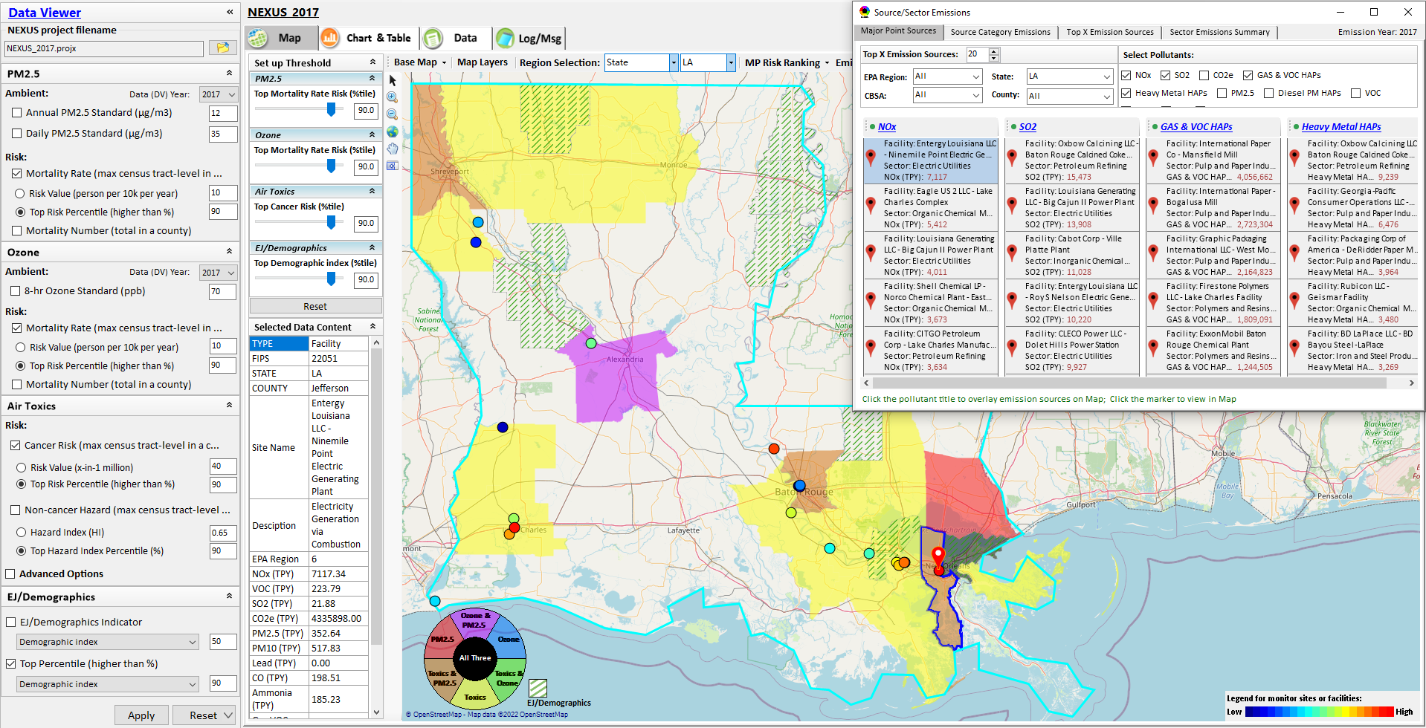
NEXUS Example: Display Major Point Sources
10

Slide 11
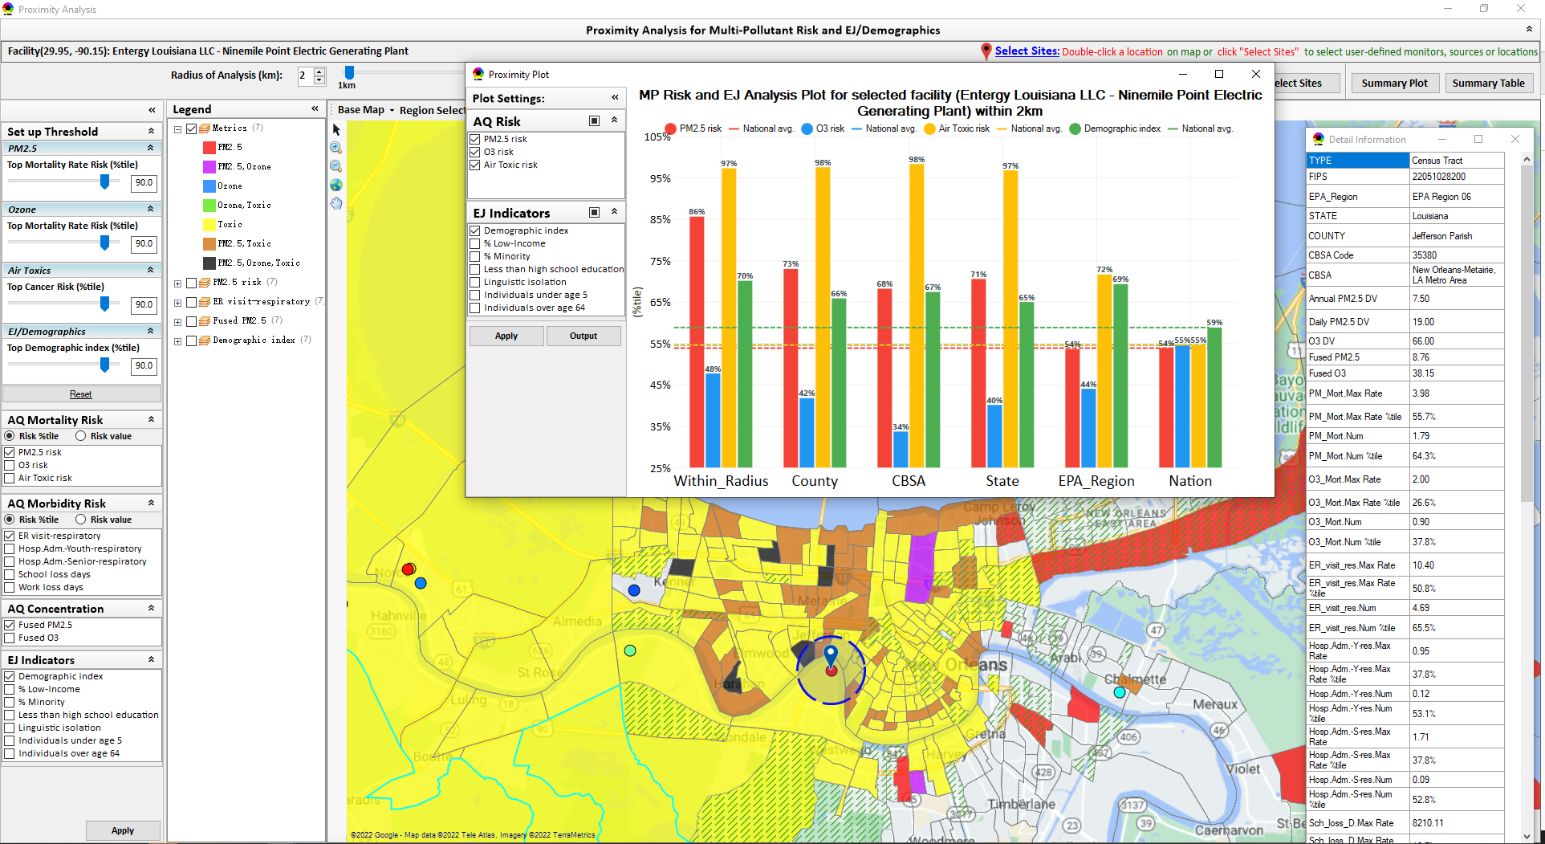
NEXUS Example: Proximity Analysis for Facility
11

Slide 12
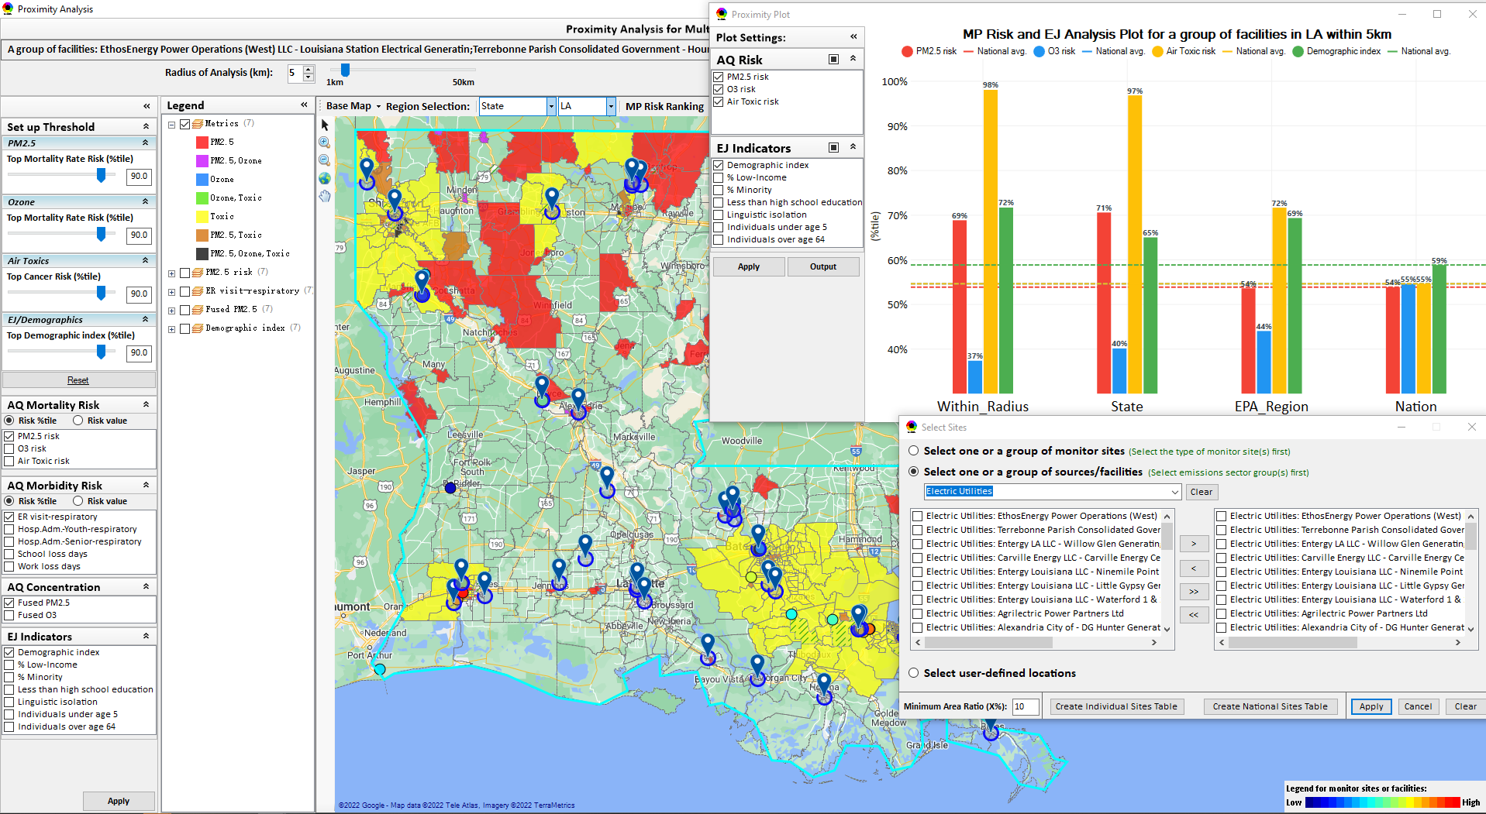
NEXUS Example: Proximity Analysis for Electric Utilities
12

Slide 13
NEXUS: Briefings and Demos
9/25/2020– AQAD & HEID
11/3/2020 – MP Team
11/4/2020 – Air Toxics Group
12/10/2020 – AQPD
1/25/2021 – OID
1/28/2021 – SPPD
2/1/2021 – Peter/SMT
4/12/2021 – HEID & AQAD
5/17/2021 – Peter/SMT
5/24/2021 – MP Team
6/29/2021 – ORD
7/12/2021– HEID & AQAD
7/19/2021 – OID
8/10/2021– OAP
8/26/2021 – OAR
8/27/2021 - OP
8/30/2021 – OEJ
8/30/2021 - Region 4/Louisville
9/7/2021 – RO ADDs
9/20/2021 – OAR Demo
10/14/2021 – OP/NCEE
11/2/2021 – RO APMs
11/8/2021- RO APMs Demo
11/16/2021 – R1 (RARE) Project
11/28/2021 – AQAD All-Hands
11/23/2021 – R3 NEXUS Beta Testers
2/15/22 – AQPD (NSRG, OPG & SLPG)
2/17/22 – AT Strategy Mgmt & Mitigation Team
3/15/22 – OID (CTPG)
4/26/22 – EPA NEXUS Beta Testing Team
4/28/22 – AQAD (AAMG)
5/3/22 – HEID & AQAD
5/4/22 – Air Toxics Data Analysis Team
5/10/22 – ADVANCE Workgroup
5/26/22 - OAP/CCD
6/15/22 – Regional Ambient Air Monitoring
6/23/22 – SPPD All-Hands
7/21/22 – EJ in Rulemaking Comm. Of Practice
8/15/22 – OGC & ECRCO – Title VI
8/16/22 – Pre-brief for HEID & AQAD
8/17/22 – Peter
8/22/22 – OID/CTPG – Liz
8/31/22 – BenMAP Team
9/12/22 – OAPPS/AAOP (Economists)
9/14/22 – CAAAC
9/15/22 – Title VI / SIP Workgroup
9/29/22 – AAPCA
10/6/22 – OAP Pre-Brief
10/19/22 – OTAQ Pre-Brief
10/19/22 – APMs
10/31/22 – OEJ
11/1/22 – Regional Air Division Directors
TBD –MJOs
13

Slide 14
NEXUS: Feedback from Briefings & Demos
“Fascinating… phenomenal… I’m blown away!”
- Caroline Freeman (R4 ADD)
“The R3 air program has evaluated 18 web tools … NEXUS overall has been the most useful to our air program”
- Cynthia Stahl, PhD
(R3 Integrated Assessment Analyst)
“Your presentation of the NEXUS tool was absolutely awesome!!! … The NEXUS tool looks very promising”
- Osmond Lindo (OAPPS Lead Economist)
“Breathtaking… incredibly powerful… I feel like we discovered nuclear fusion!”
- Joe Goffman
(OAR Acting AA)
“The tool is well designed and provides a wealth of information that is useful for evaluating air quality impacts in local communities”
- Rick Gillam
(R4 Air Modeling Team Lead)
“Dr. Nance [R6 RA] will be thrilled with the NEXUS tool and excited with its capabilities.”
- Fran Verhalen
(recently retired R6 Monitoring Section Chief)
14

Slide 15
NEXUS: Next Steps
Schedule briefings for OAP, OTAQ & OAR Senior Management (Nov/Dec 2022)
Partner within EPA on use of NEXUS for programmatic purposes
NEXUS Improvements:
  Address comments and feedback from EPA Beta Testing Team
  Incorporate / revise “Climate risk” indicators (as 5th metric)
  Update EJ/demographics data to be consistent with new “EJScreen 2.0” dataset
  Include top air toxic cancer risk drivers in the “proximity analysis” module
  Update to 2018/2019 MP platform (O₃, PM_{2.5}, and Air Toxics data)
  Explore the feasibility of developing a web-based NEXUS version (similar to EJScreen)
  Work towards making the tool publicly available
Stay tuned on implications of IRA on MP planning / NEXUS
15

Slide 16
“NEXUS 3.3” Live Demo
**NEXUS is currently an advanced screening tool for internal EPA use. A beta version is available for EPA staff to use and provide feedback on for improvement. Additional updates/improvements are necessary before the NEXUS tool is ready to be released to the public.**
16

Slide 17
Important Caveats
NEXUS Caveat
The NEXUS screening tool uses data from a variety of sources. This data is publicly available, except for the BenMAP data at the tract level. EPA is currently still in an internal review process and is not using this tool to support regulatory analyses.
BenMAP Caveat
The estimated number of PM and ozone-attributable deaths and illnesses reported at each tract are subject to important uncertainties and should be interpreted with caution. When using the BenMAP-CE tool to calculate these tract-level results, EPA lacked information regarding the baseline health status of individuals living at each tract; these data are a key input to the calculation of benefits. EPA instead used data available at the county- or state-level, which does not account for differences in baseline health between tracts. Estimating benefits in this way is not consistent with the peer-reviewed methods EPA follows when estimating air quality benefits in a Regulatory Impact Analysis. EPA will continue to refine its methods with the goal of reporting tract-level health benefits with confidence.
17

