Slide 1
Example Multi-Pollutant Packets by Region
8/25/22

Slide 2
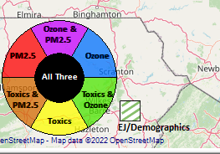
Criteria
PM2.5 Top Mortality Rate Risk Percentile ≥ 75%
Ozone Top Mortality Rate Risk Percentile ≥ 75%
Air Toxics Top Cancer Risk Percentile ≥ 75%
EJ/Demographics Top Demographic Index Percentile ≥ 75%

Slide 3
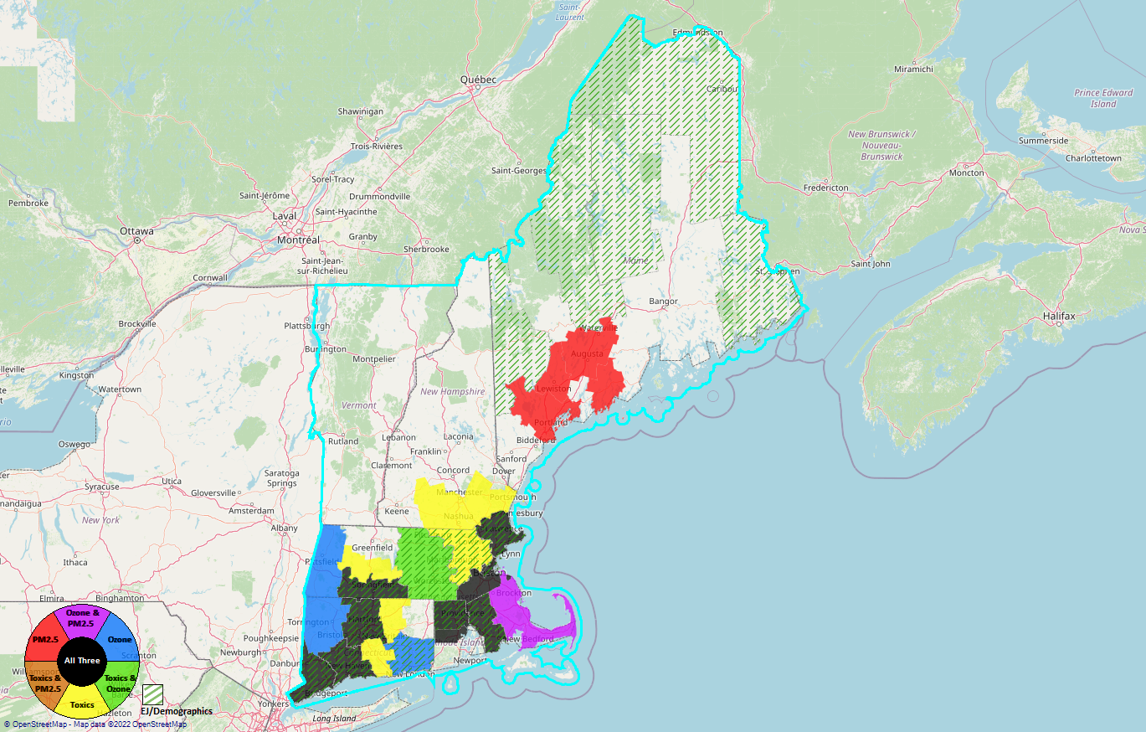
Region 1

Slide 4
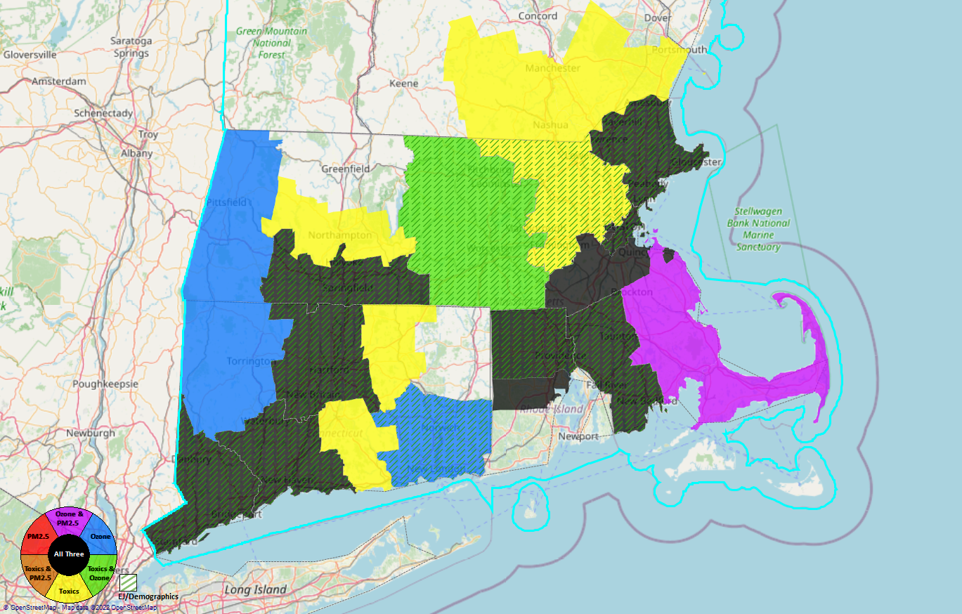
Fairfield County, CT
New Haven County, CT
Hartford County, CT
Hampden County, MA
Providence County, RI
Bristol County, MA
Suffolk County, MA
Essex County, MA
8
7
4
5
6
3
2
1

Slide 5
Region 1 Counties/CBSAs
County | CBSA
Fairfield County, CT | Bridgeport-Stamford-Norwalk, CT
New Haven County, CT | New Haven-Milford, CT
Hartford County, CT | Hartford-West Hartford-East Hartford, CT
Hampden County, MA | Springfield MA
Providence County, RI | Providence-Warwick, RI-MA
Bristol County, MA
Suffolk County, MA | Boston-Cambridge-Newton, MA-NH
Essex County, MA

Slide 6
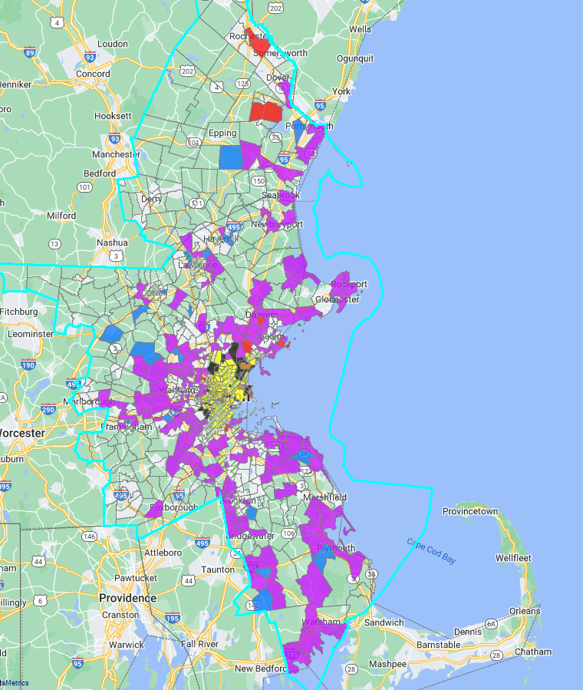
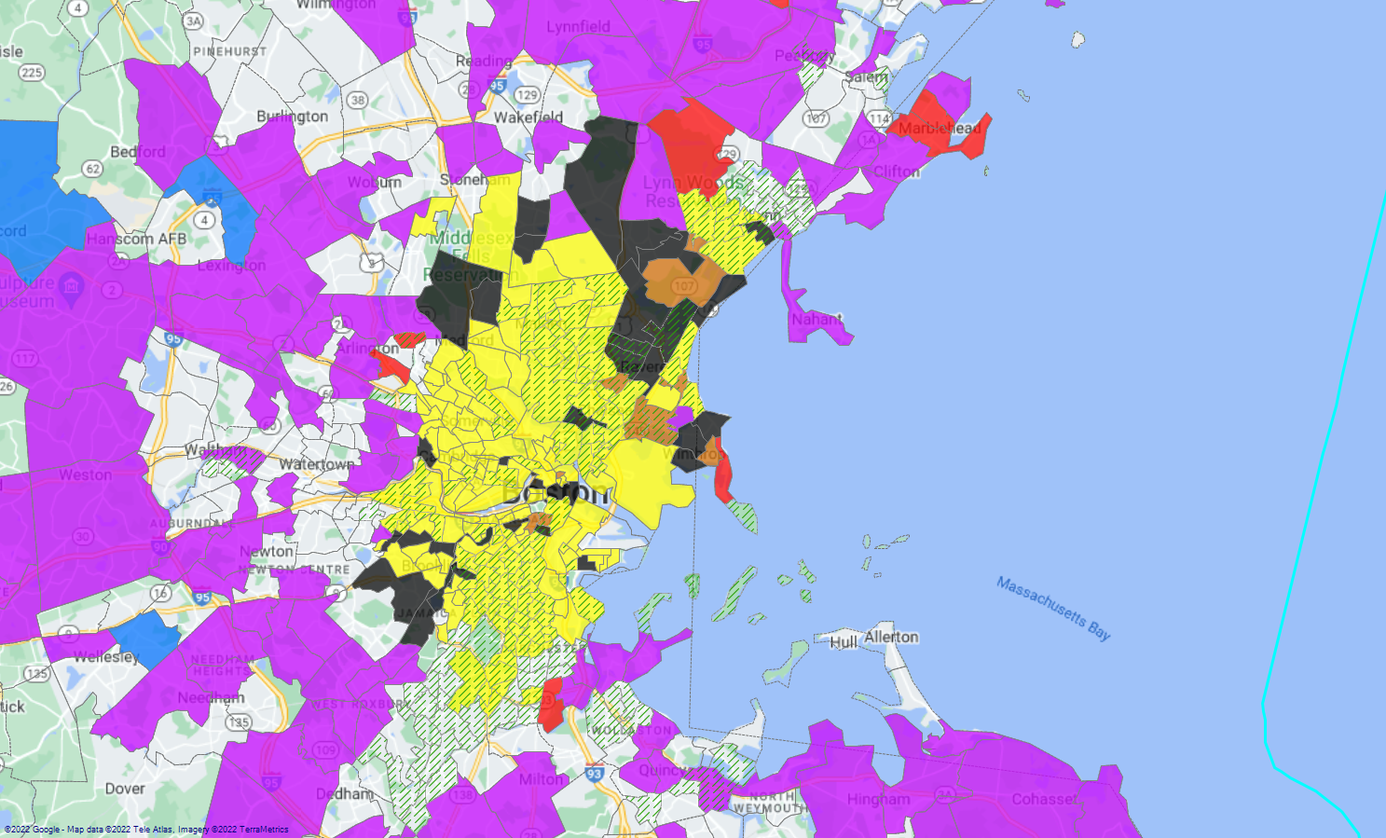
Boston-Cambridge-Newton, MA-NH

Slide 7
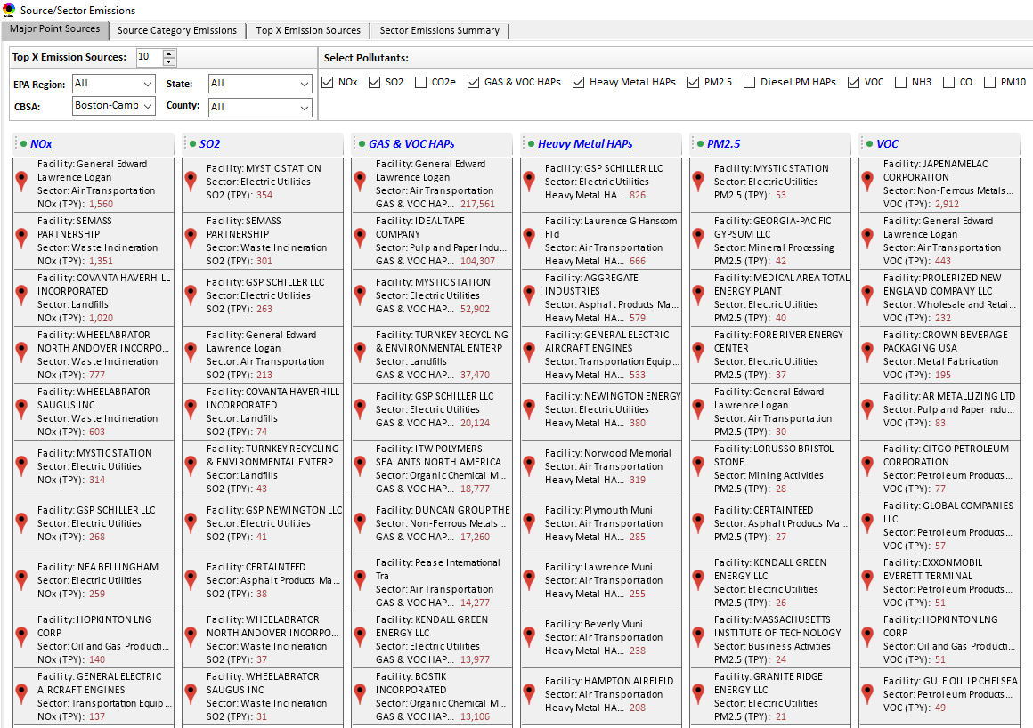
Boston-Cambridge-Newton, MA-NH CBSA
Top Emission Sources

Slide 8
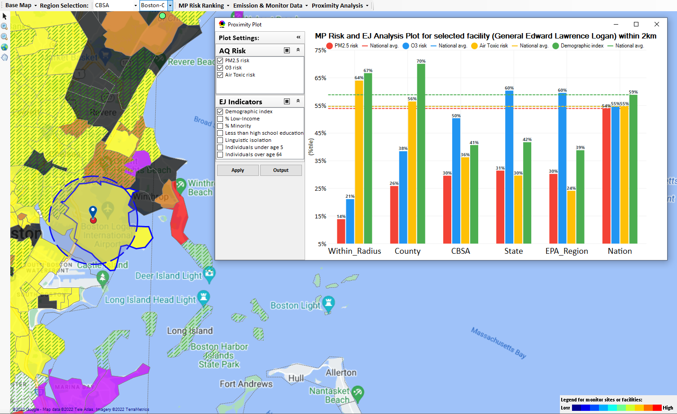
Boston-Cambridge-Newton, MA-NH CBSA
General Edward Lawrence Logan Airport
Top emitter in CBSA for NOx and Gas & VOC HAPs.
Top 10 emitter in the CBSA for SO2, PM2.5 & VOC

Slide 9
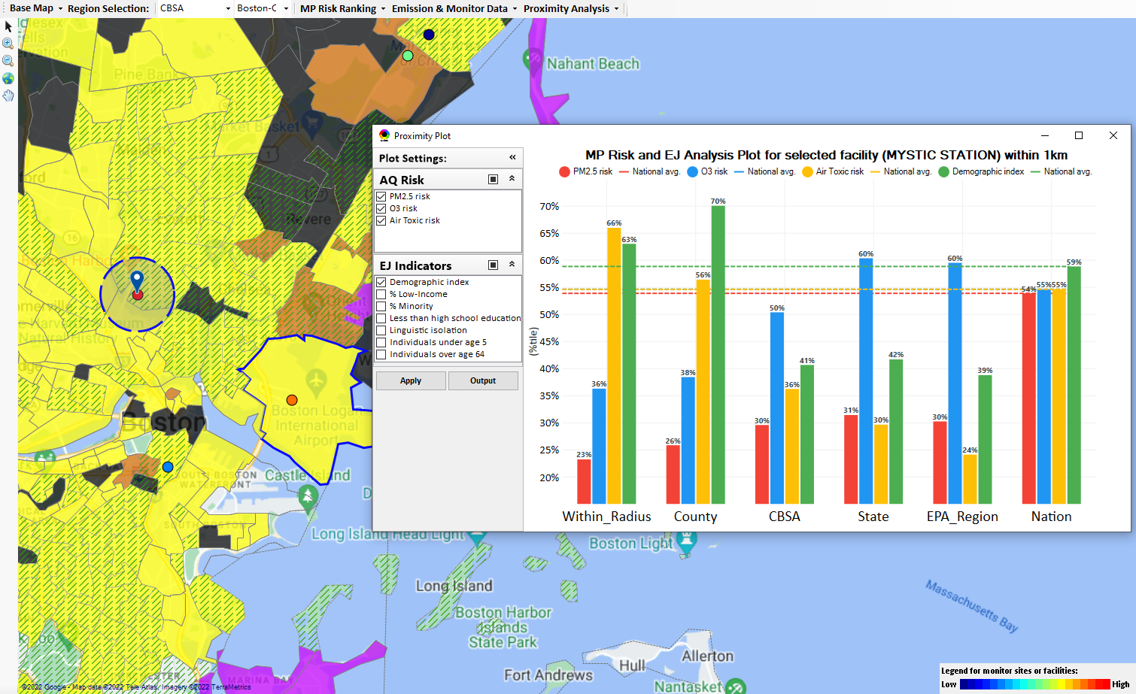
Boston-Cambridge-Newton, MA-NH CBSA
Mystic Station EGU
Top emitter in CBSA for SO2 & PM2.5
Top 10 emitter in the CBSA for NOx & Gas & VOC HAPs

Slide 10
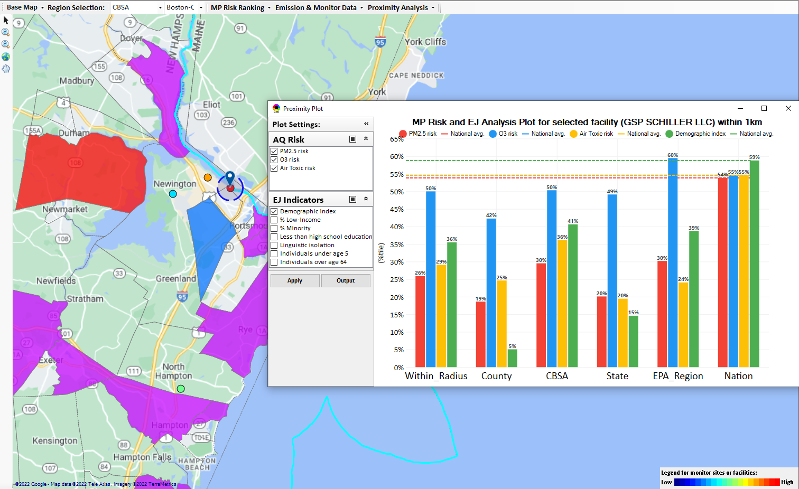
Boston-Cambridge-Newton, MA-NH CBSA
GSP Schiller LLC EGU
Top emitter in CBSA for Heavy Metal HAPs
Top 10 emitter in the CBSA for NOx, SO2 & Gas & VOC HAPs

Slide 11
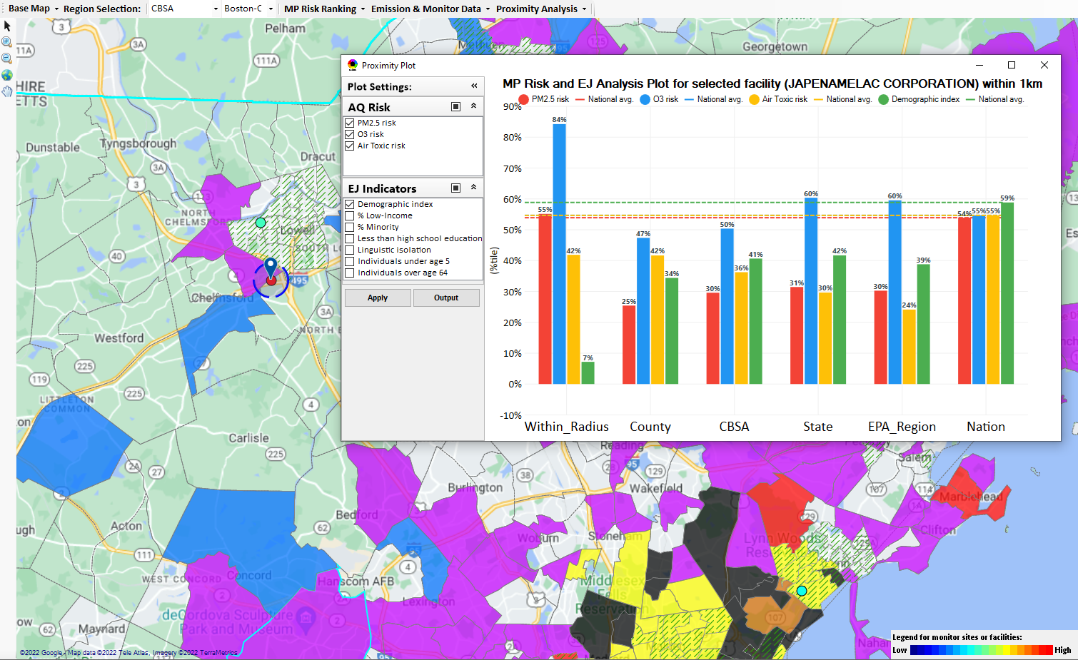
Boston-Cambridge-Newton, MA-NH CBSA
Japenamelac Corp
Top emitter in CBSA for VOC

Slide 12
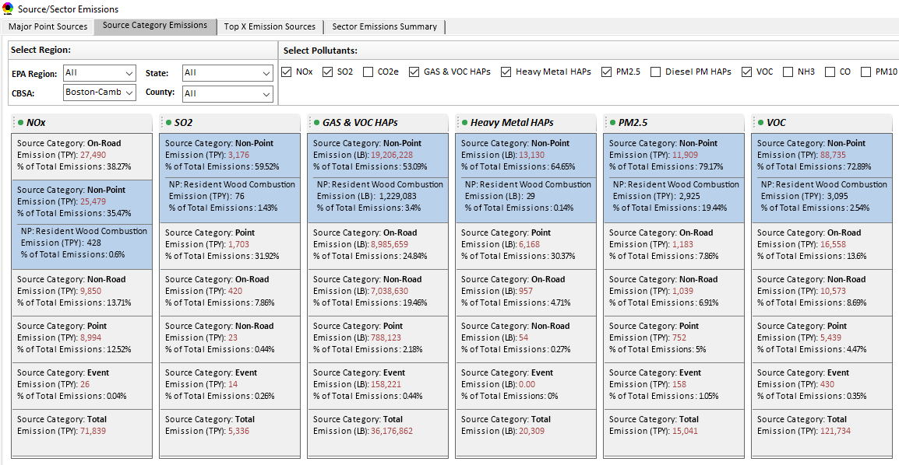
Boston-Cambridge-Newton, MA-NH CBSA
Top Emission Source Categories

Slide 13
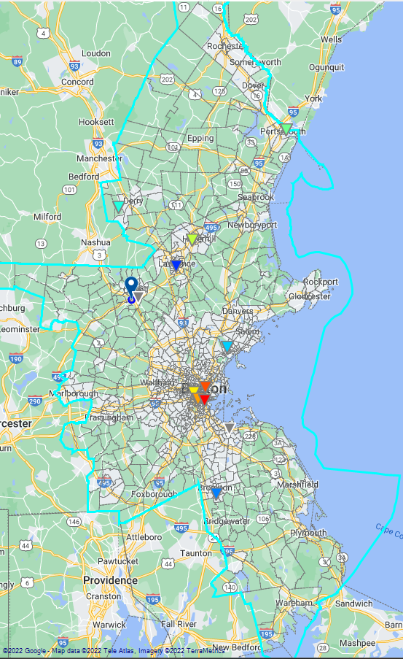
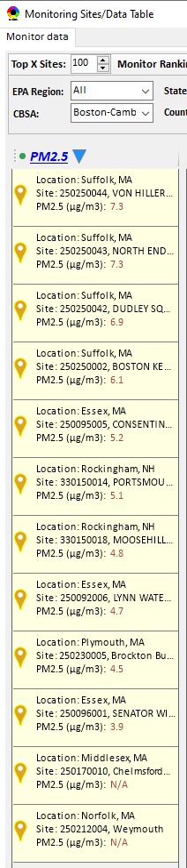
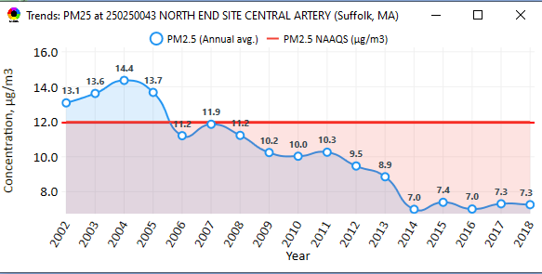
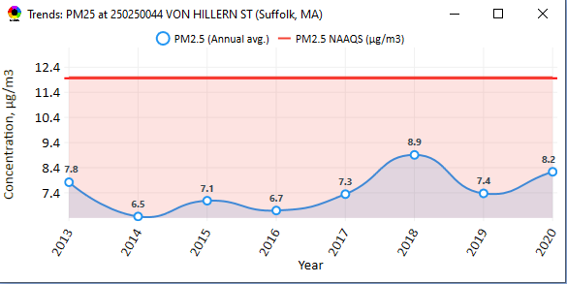
Boston-Cambridge-Newton, MA-NH CBSA
PM2.5 Monitoring Sites

Slide 14
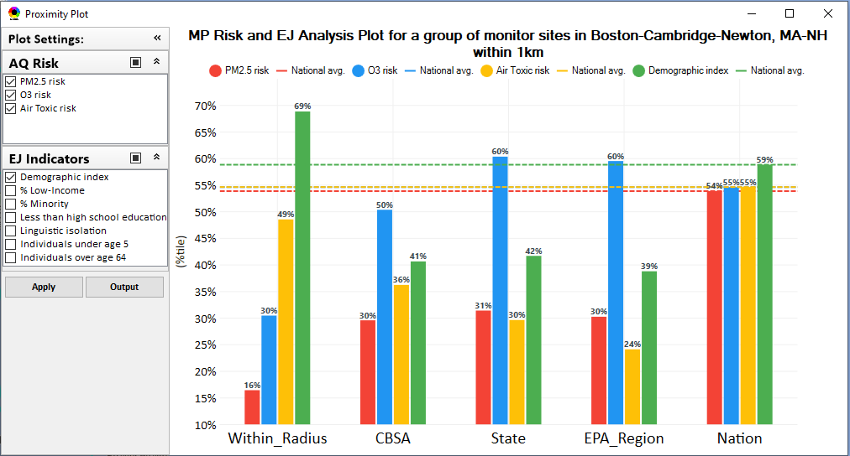
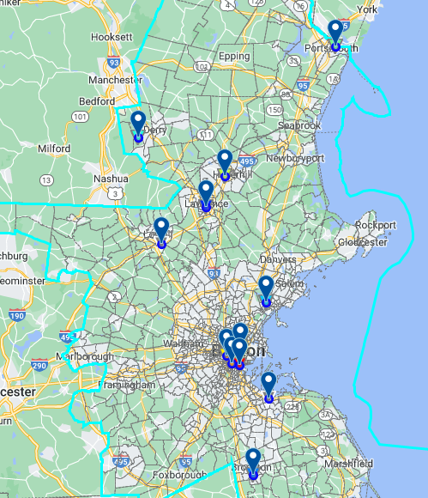
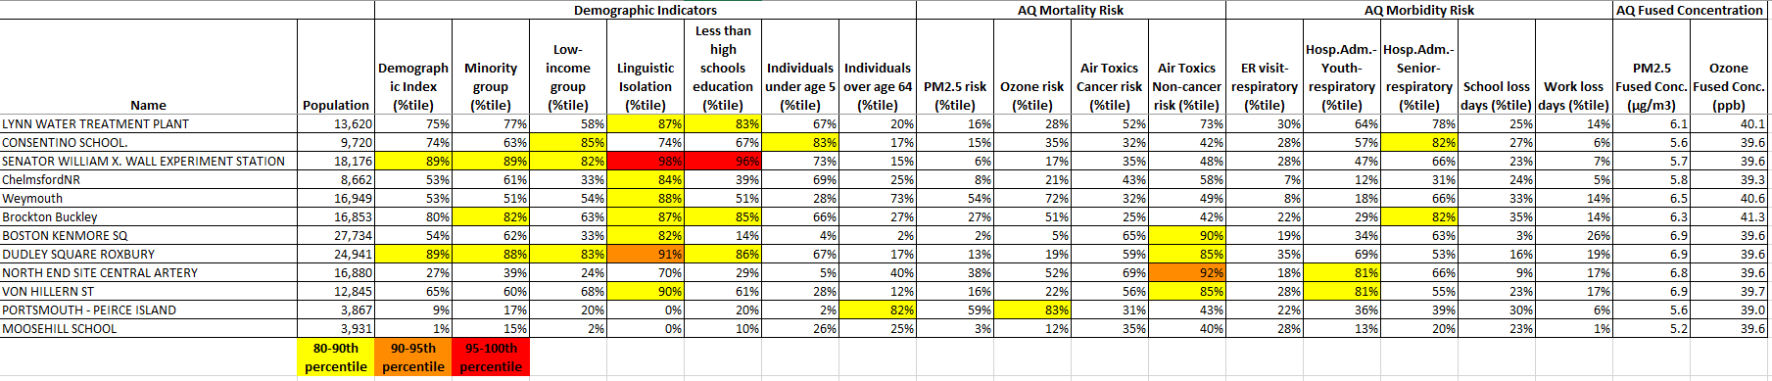
Boston-Cambridge-Newton, MA-NH CBSA
PM2.5 Monitoring Sites

Slide 15
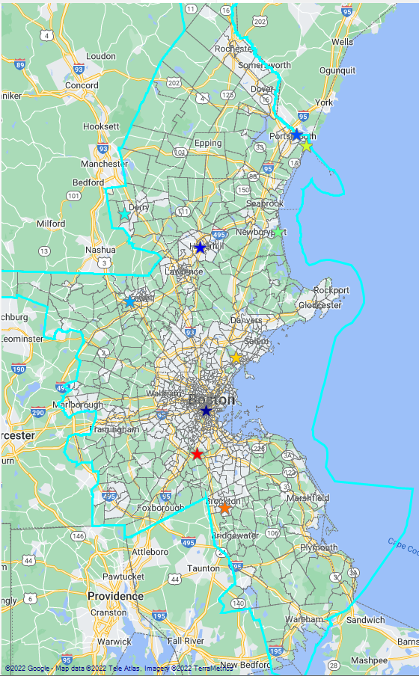
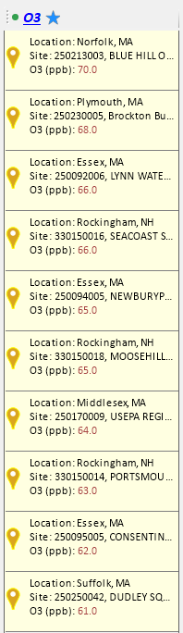
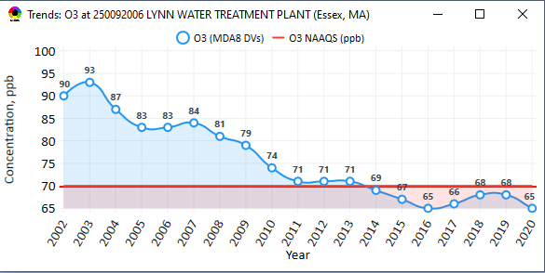
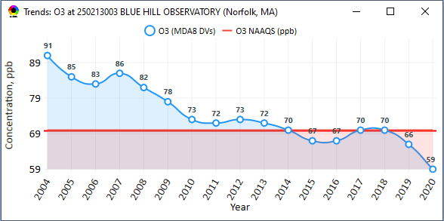
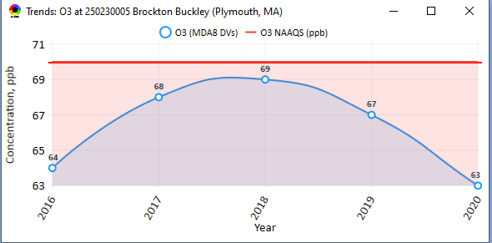
Boston-Cambridge-Newton, MA-NH CBSA
Ozone Monitoring Sites

Slide 16
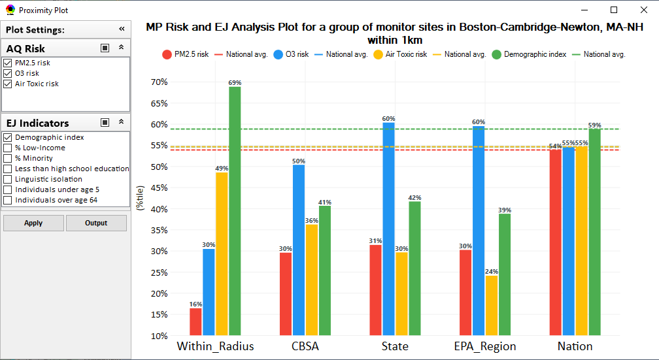
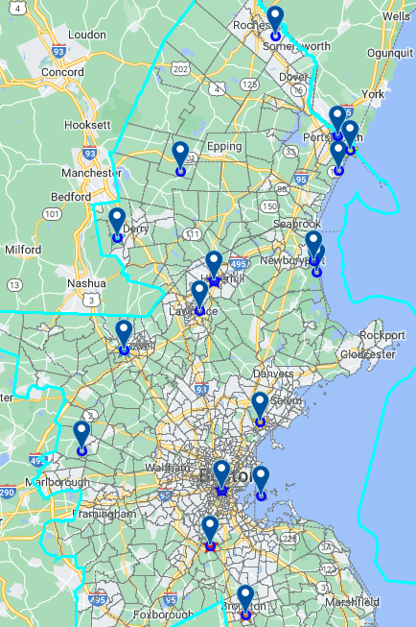
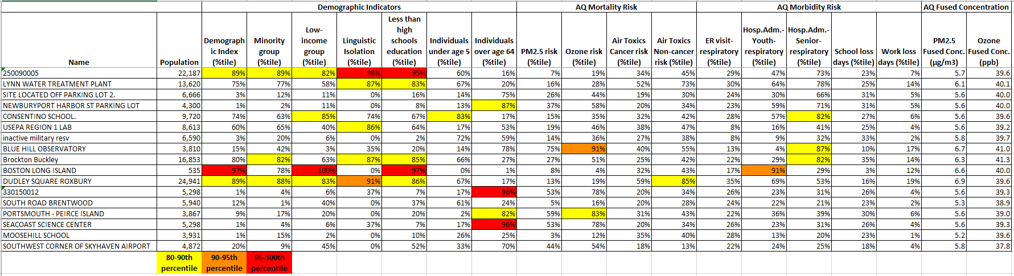
Boston-Cambridge-Newton, MA-NH CBSA
Ozone Monitoring Sites

