Slide 1
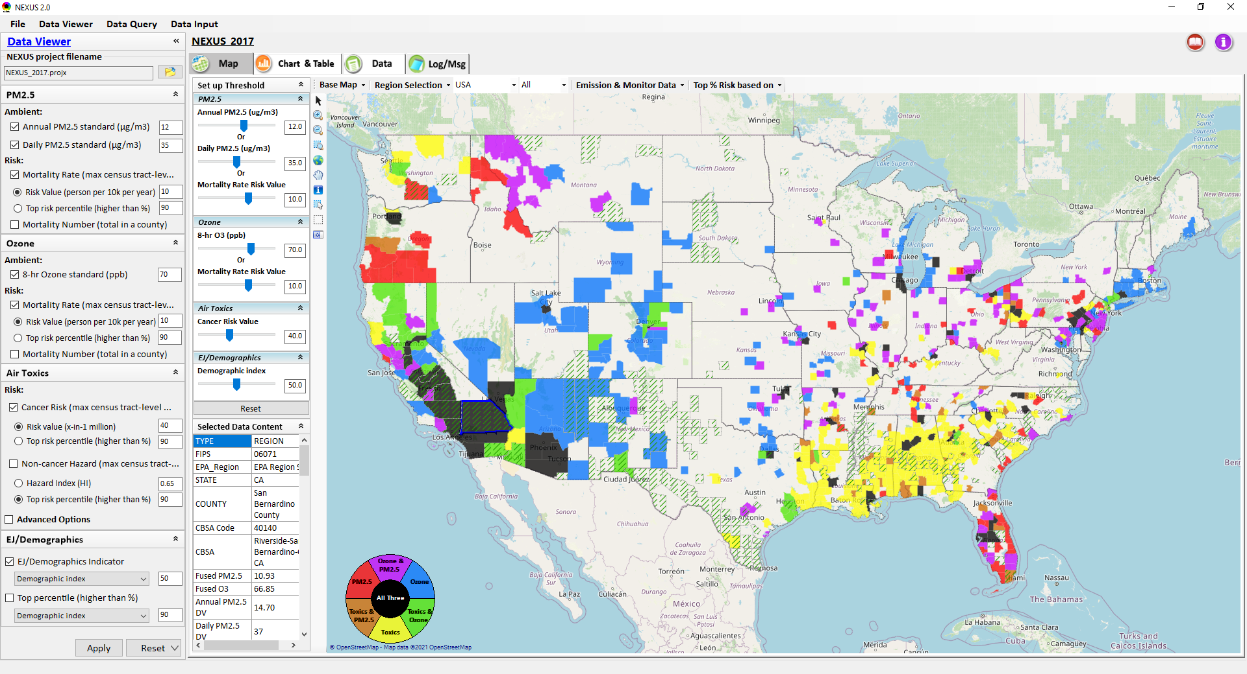
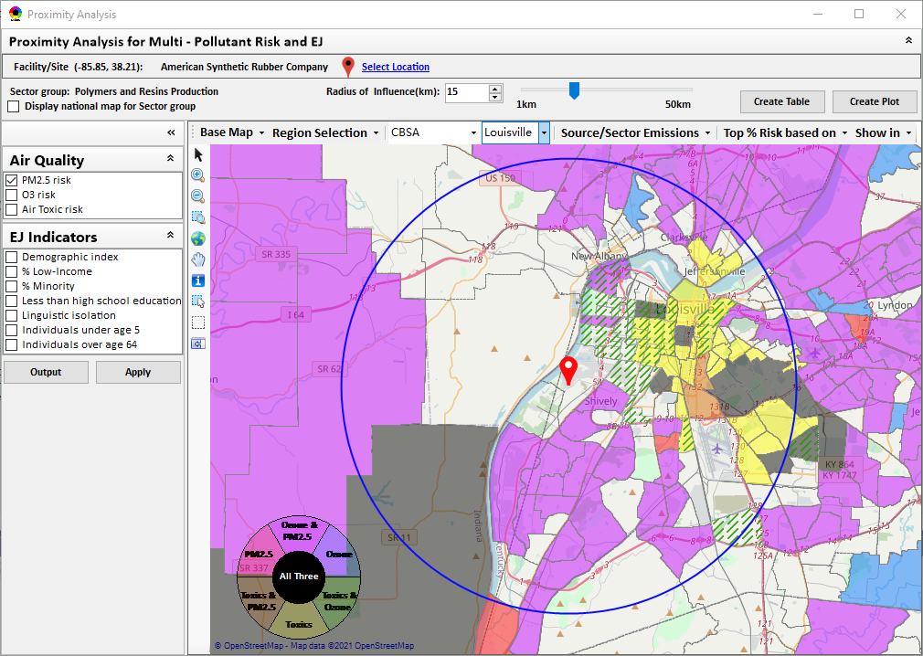
“NEXUS” Multi-Pollutant Advanced Screening Tool
Game Plan and Next Steps
Data Viewer: National/Regional Level
Proximity Analysis: Community Level
Beth Landis, HEID/Climate, International, & Multi-Media Group
Carey Jang, AQAD/Air Quality Modeling Group
05/03/22
1

Slide 2
Overview
NEXUS Recap
Briefings and Demos
NEXUS 2.0 Review & Feedback
EPA Beta Testing Team
NEXUS Recent Updates
Current and Potential NEXUS Uses
Next Steps/Discussion
2

Slide 3
NEXUS: Recap
Coordinated effort between AQAD (tool development lead) and HEID (MP lead)
Goal – create a MP advanced screening tool to help SLTs develop more cost-effective control strategies that maximize both health benefits and air quality improvements
Added use/benefit
  Inform EJ screening efforts as part of air quality planning by OAQPS and Regions (Permitting, SIPs, monitoring plans, etc).
3

Slide 4
NEXUS/MP: Briefings and Demos
9/25/2020– AQAD & HEID
11/3/2020 – MP Team
11/4/2020 – Air Toxics Group
12/10/2020 – AQPD
1/25/2021 – OID
1/28/2021 – SPPD
2/1/2021 – Peter/SMT
4/12/2021 – HEID & AQAD
5/17/2021 – Peter/SMT
5/24/2021 – MP Team
6/29/2021 – ORD
7/12/2021– HEID & AQAD
7/19/2021 – OID
8/10/2021– OAP
8/26/2021 – OAR
8/27/2021 - OP
8/30/2021 – OEJ
8/30/2021 - Region 4/Louisville
9/7/2021 – RO Air Division Directors
9/20/2021 – OAR Demo
10/14/2021 – OP/NCEE
11/2/2021 – RO APMs
11/8/2021- RO APMs Demo
11/16/2021 – R1 (RARE) Project
11/28/2021 – AQAD All-Hands
11/23/2021 – R3 NEXUS Beta Testers
2/15/22 – AQPD (NSRG, OPG & SLPG)
2/17/22 – AT Strategy Mgmt & Mitigation Team
3/15/22 – OID (CTPG)
4/26/22 –EPA NEXUS Beta Testing Team
4/28/22 – AQAD (AAMG)
5/4/22 – Air Toxics Data Analysis Team
5/10/22 – ADVANCE Workgroup
TBD – OAP, SPPD, MJOs
“Fascinating… phenomenal… I’m blown away!”
- Caroline Freeman (R4 ADD)
“Breathtaking… incredibly powerful… I feel like we discovered nuclear fusion!”
- Joe Goffman (OAR Acting AA)
4

Slide 5
NEXUS: Review of Version 2.0
NEXUS 2.0 shared with Regions on 11/2/21 and 11/8/21
  Feedback requested by late January 2022
    Suitability for air quality planning efforts and engagement with SLTs
    Interest in a region-specific discussion regarding NEXUS use
    Suggested improvements in NEXUS regarding data, visualization, screening capabilities, etc.
    Any errors/bugs/concerns
  Feedback received from R3, R5, R6, R9 & MP team
17-page document summarizing comments and categorizing as:
  Underway or Planned
  To-Do-List (Higher Priority)
  To-Do-List (Lower Priority)
  Wish List (If Resources Allow)
  Beyond Scope or Needs Clarification
Most addressed in NEXUS 3.0
May not be addressed without additional funds
5

Slide 6
NEXUS: Summary of Version 2.0 Feedback
Overarching comments:
  Interest in proximity screening capabilities
  Update MP risks, AQ & emissions data to recent year
  Update/additions to legends for clarity
  Minor spelling errors, edits & glitches
  Installing software difficult/burdensome
  Interest in incorporating climate risk indicators and meteorological data
6

Slide 7
NEXUS: High Level Summary of Version 2.0 Feedback
R3 | R5 | R6* | R9 | MP Team
Include morbidity | Update to 2017 NEI & NATA (AirToxScreen) | Agencies may not have regulatory authority to address issues highlighted | Include meteorological data | Terminology recommendations
Ability to import other data sets | Easier ability to export data related to the area viewing | Should be cautious about EtO emissions & monitoring data |  | Consolidate data query and data viewer module
Ability to see data for all facilities and not just top # | Include top air toxic cancer risk drivers | Denka controls will not be captured in the current data
Consistency with EJSCREEN |  | Concern about including ODEQ AT data
Delaware Co. PA missing |  | Concern about exceptional events causing false concerns
Addressed in NEXUS 3.0
May not be addressed without additional funds
*Comments sent based on briefing/presentation, not based on download and review of NEXUS
7

Slide 8
NEXUS: EPA Beta Testing Team
Vision
  We envision the EPA Beta Testing Team as a group of OAR and regional office members that see the benefit of NEXUS and plan to use it on a routine basis to assist in their job duties.
  We would like feedback to help shape the direction of future tool development and ensure we are making updates and additions that are most beneficial to those Regions who are encouraging a multi-pollutant approach to air quality management.
  We would like to identify specific applications to collaborate on with Regions, e.g.:
    Select area with MP and potential EJ concerns and explore a MP approach using NEXUS.
    Support EJ screening and related analysis for Federal permit or related action.
Participants from R1, R2, R3, R4, R5, R6, R9 & OAQPS
8

Slide 9
NEXUS: EPA Beta Testing Team Timeline
Early May – release NEXUS 3.0 and Quick Tutorial
Mid-May - demo NEXUS 3.0 to EPA Beta Testing Team
Mid-June - review and provide written comments on NEXUS 3.0
Late June/Early July - meet to discuss NEXUS 3.0 comments
Fall – release updated version of NEXUS incorporating comments from EPA Beta Testing Team (assuming funding available)
Fall/Winter 2022 - update NEXUS with 2018 data, when available
9

Slide 10
NEXUS: Recent Updates
NEXUS “2.2” (Dec. 2021)
  Updated 2017 BenMAP risk and fused concentration data for PM & O₃
  Upgraded “Monitoring sites/data” module
  “Proximity analysis module” prototype for MP risks and EJ screening
NEXUS “2.3” (Jan. 2022)
  Includes updated 2017 air toxics risk data (received in Dec. 2021)
  Improved “Proximity analysis module” for MP risks and EJ screening
NEXUS “2.4” (March 2022)
  Includes “Morbidity risk” in summary table and summary plot in “proximity analysis” module
  Added “Map layers” tab in “Data Viewer” module to provide map overlaying for MP risks & EJ indicators, PM_{2.5} & O₃ NA areas, Advance areas, Tribal areas, Class I areas, etc.
NEXUS “2.5” (April 2022)
  Added “Select Sites” functions for selecting multiple census tracts, monitoring sites, emissions sector group, and locations under “Proximity Analysis” module
  Consolidated “Data Query” module into “Data Viewer” module and added “Attribute Table” to view census tracts information of MP risk & EJ attributes
10

Slide 11
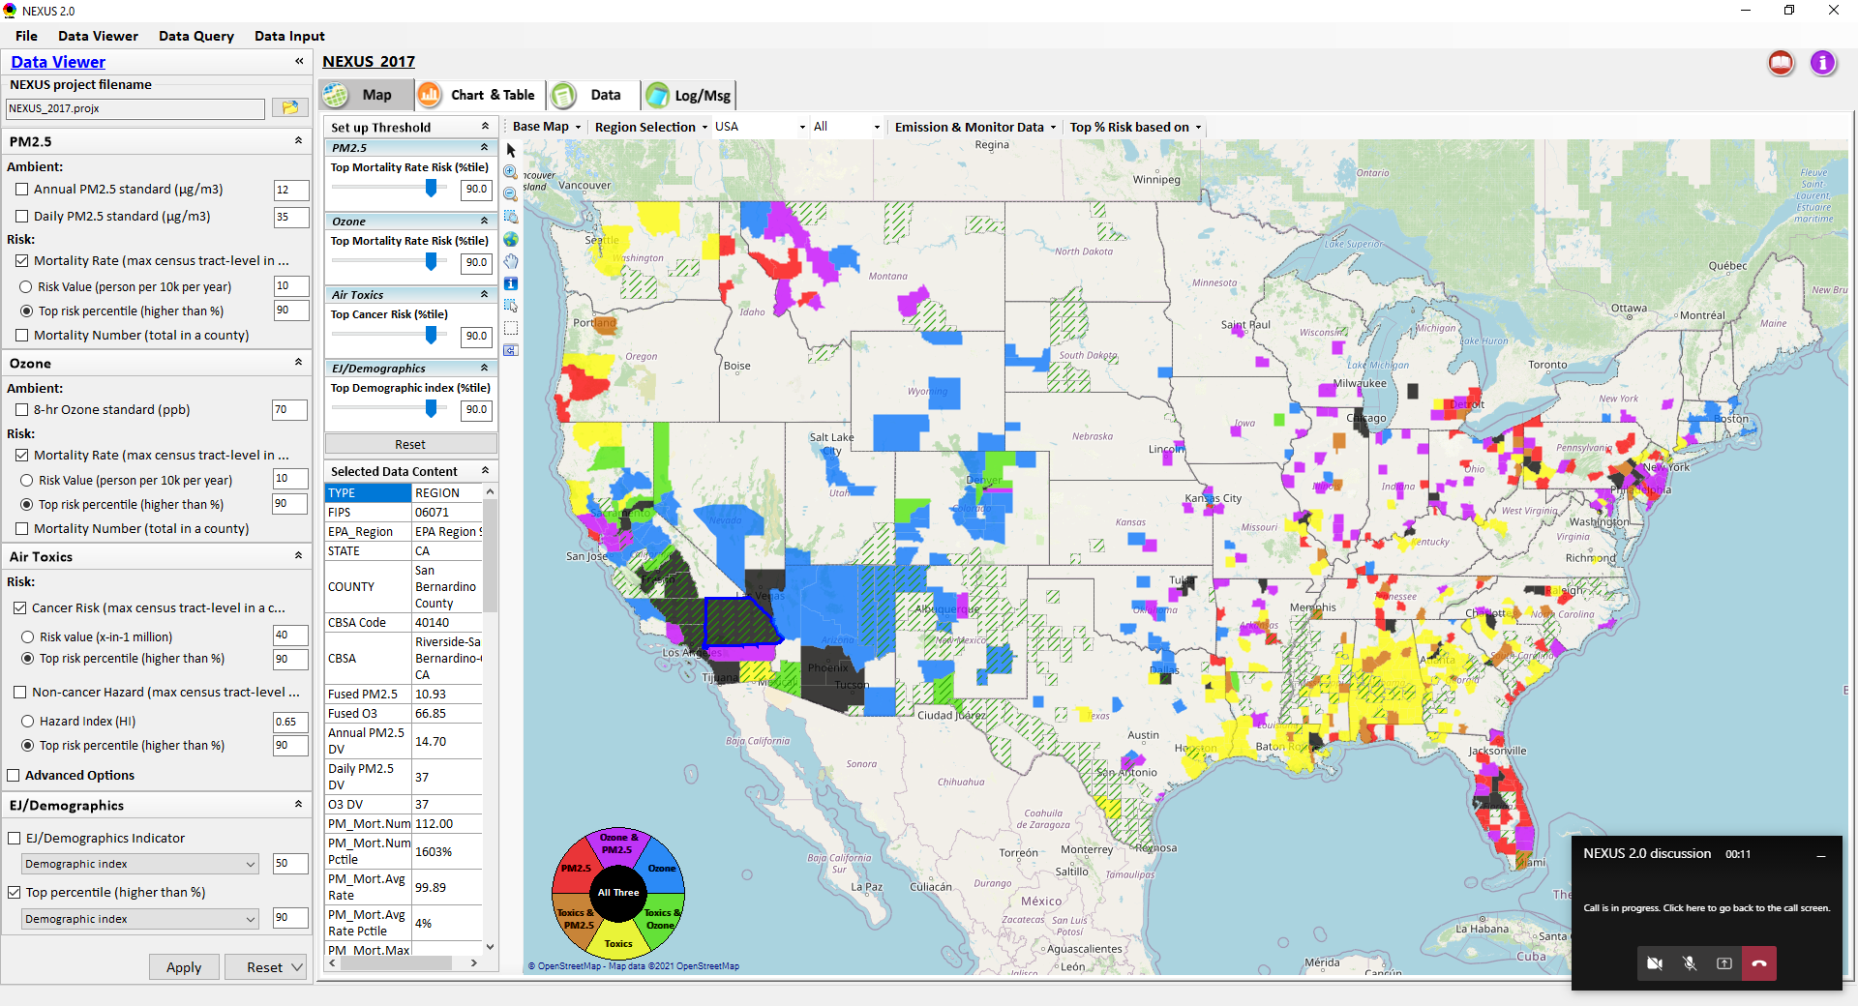
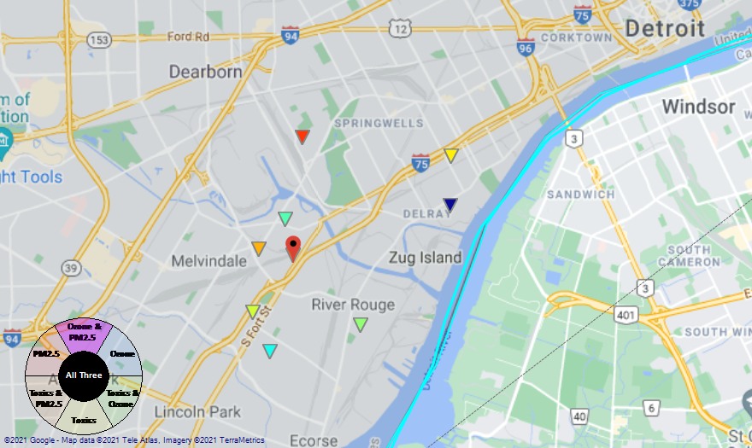
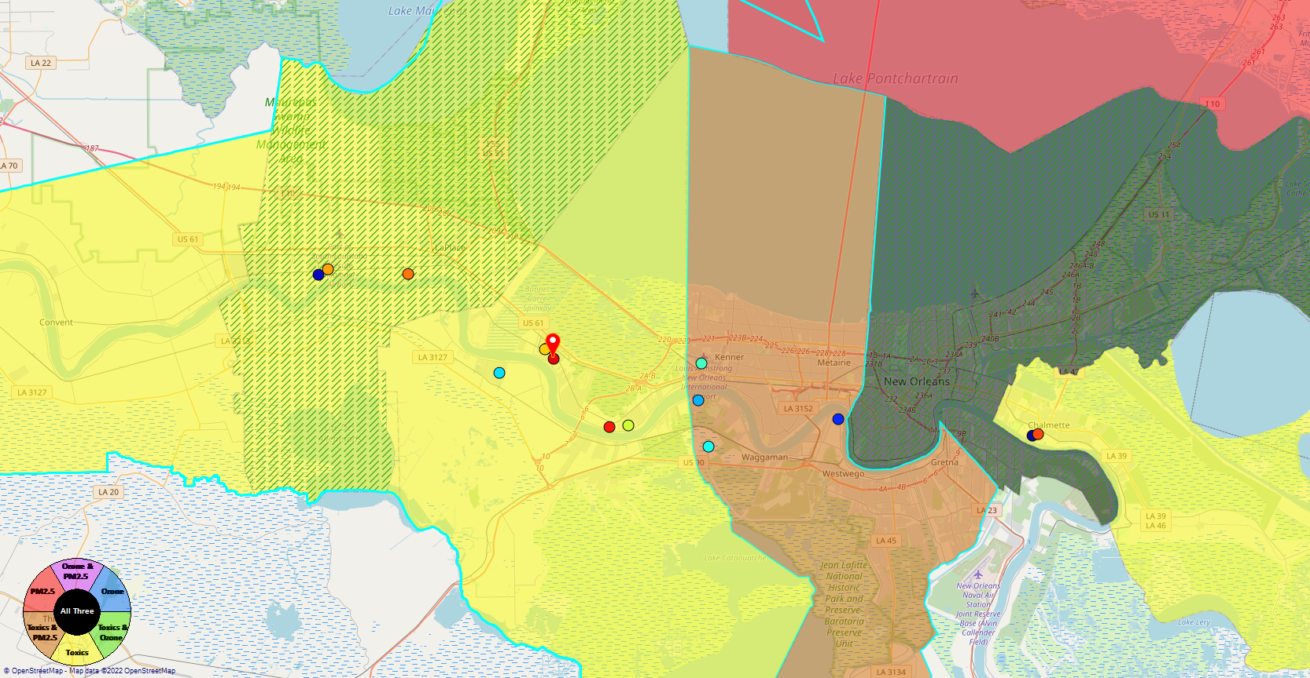
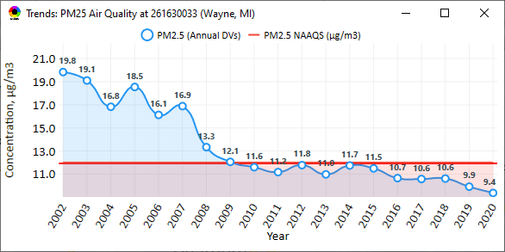
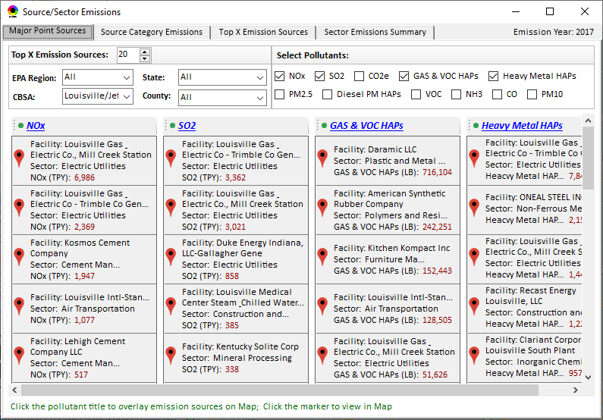
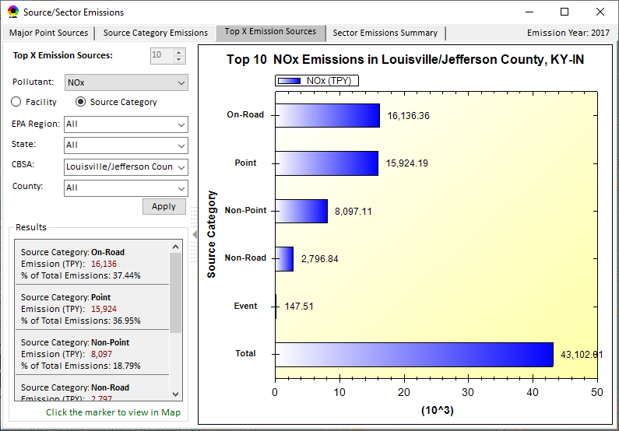
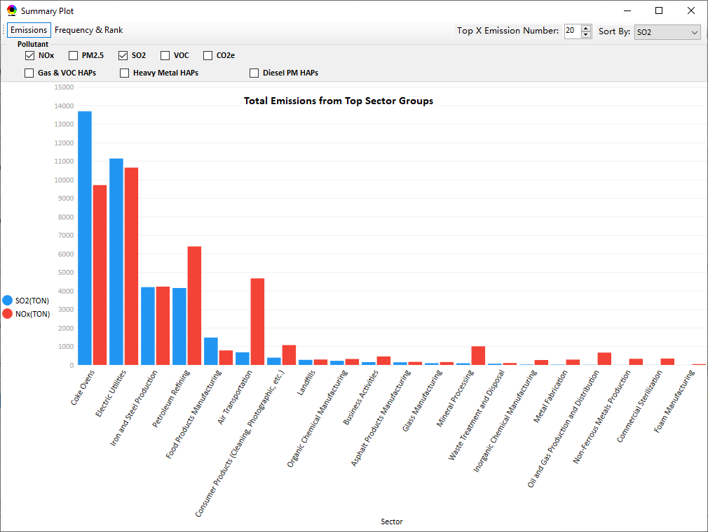
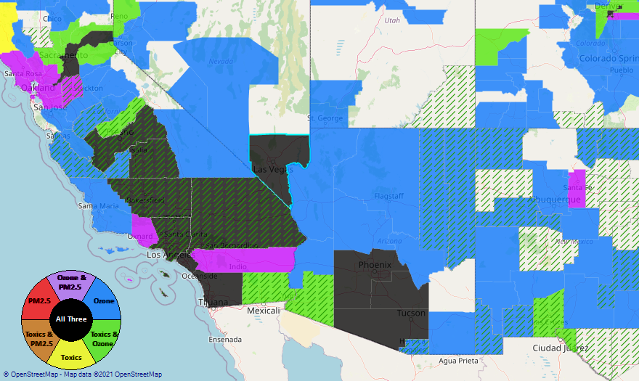
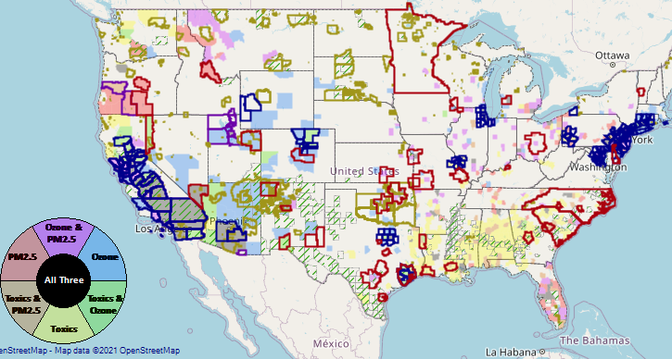
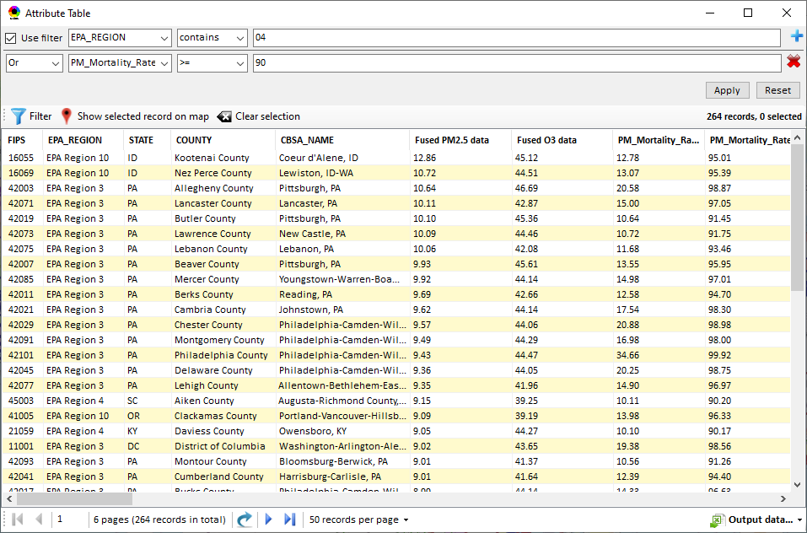
NEXUS: Data Inputs and Major Functions
O₃ & PM_{2.5}
Ambient/Design Value
(2012-2020)
(County-level)
Multi-Pollutant
Ambient and/or Risk National & Area Mapping
Display Monitoring Sites & Trend Data
O₃, PM_{2.5} & Air Toxics Risk Data &
Conc. (fused AQ) Data
(2017 & 2014)
(Census tract-level)
Display Major Point Emissions Sites/Data
Provide Source Category Emissions
NEXUS
O₃, PM_{2.5} & Air Toxics Monitoring Data
(2002-2020 & -2018)
Provide Sector Emissions Summary
NEI County &
Facility Emissions
(2017 & 2014)
Include EJ/Demographic Indicators
Map Overlay with NAA, Advance Area, Class-I Area, or Tribal Area
Environmental Justice & Demographic Data
(from EJSCREEN)
Data Query, Search, Filter & Export
Advance Area
Class-I Area
Tribal Area
Proximity Screening Analysis
11

Slide 12
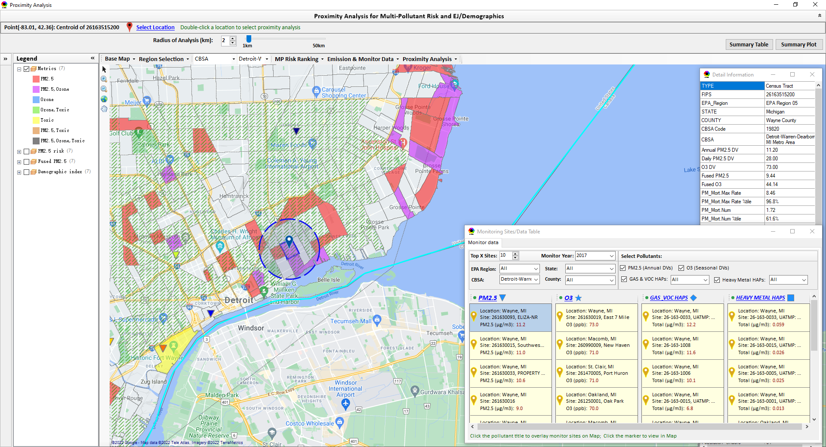
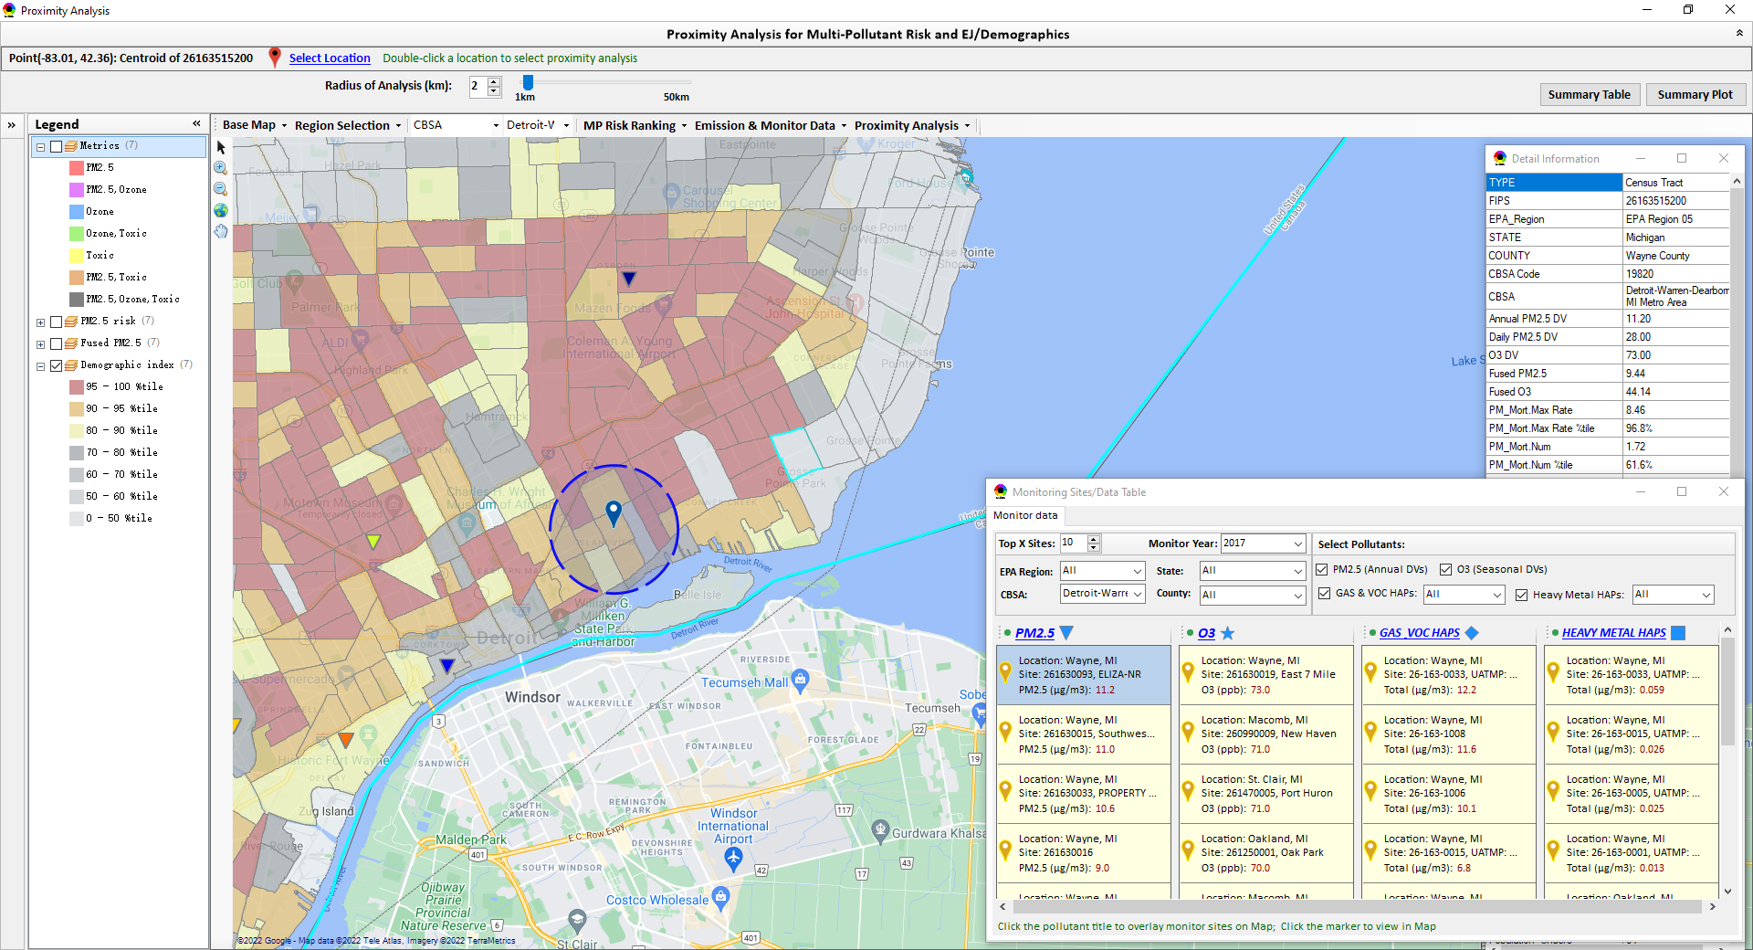
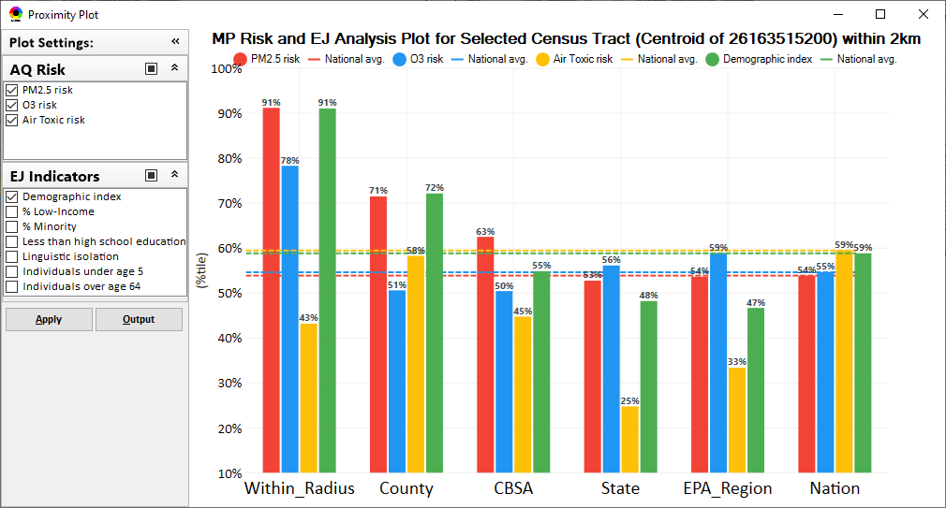
Example of Potential NEXUS Application:
Assessment of New Source or Monitoring Location
Detroit
Detroit
Assessment of potential new source or monitoring site,
Detroit, MI
12

Slide 13
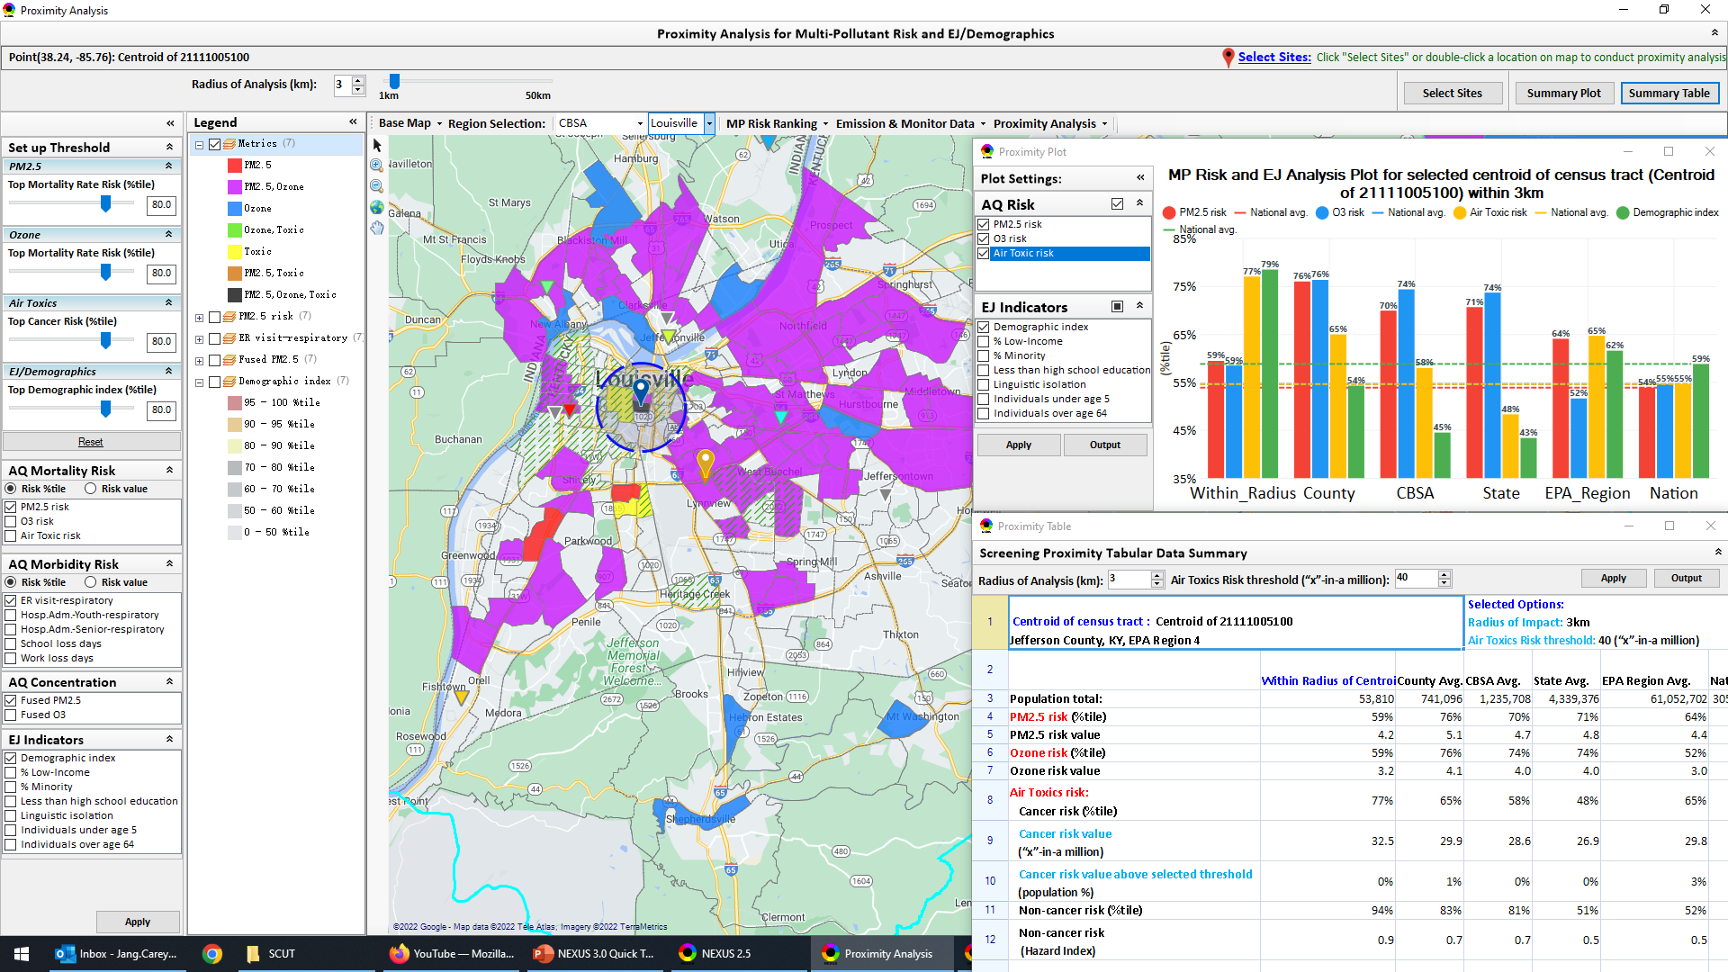
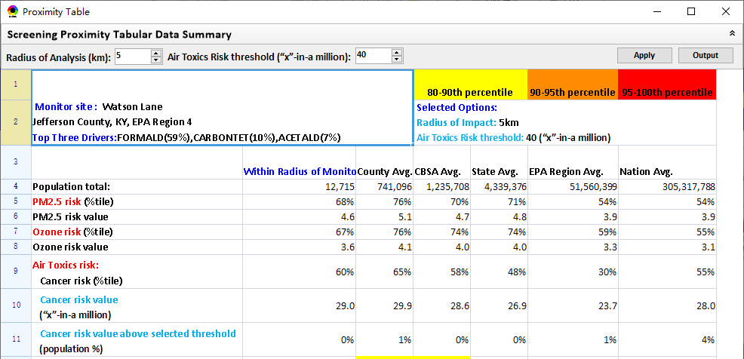
Proximity Analysis Module: Summary Plot & Summary Table
Create “Summary Plot” and “Summary Table” for a selected census tract, monitor site or emitting facility
Summary Plot
Summary Table
13

Slide 14
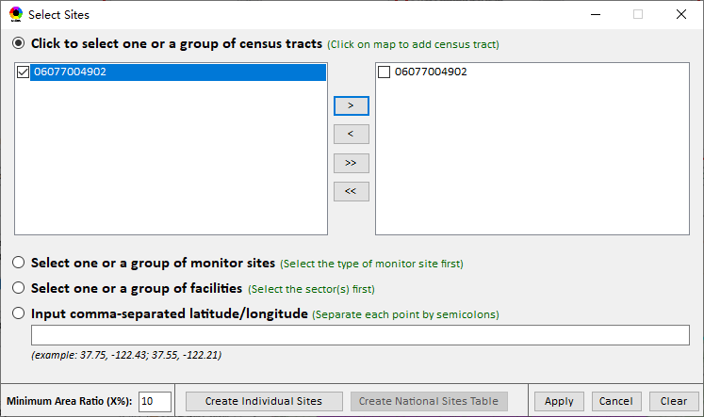
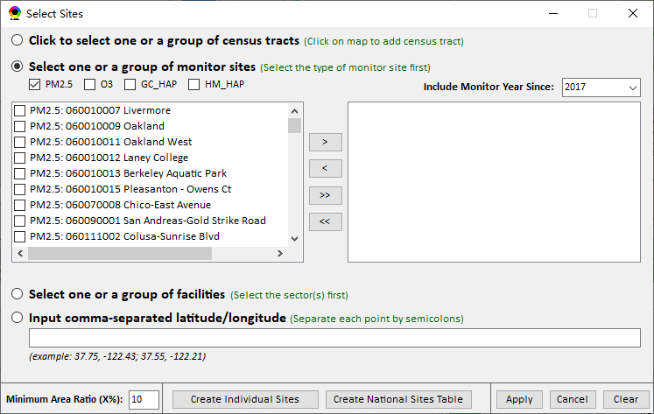
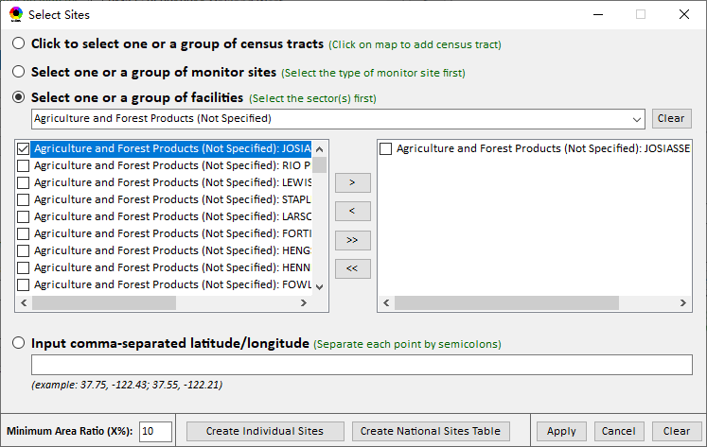
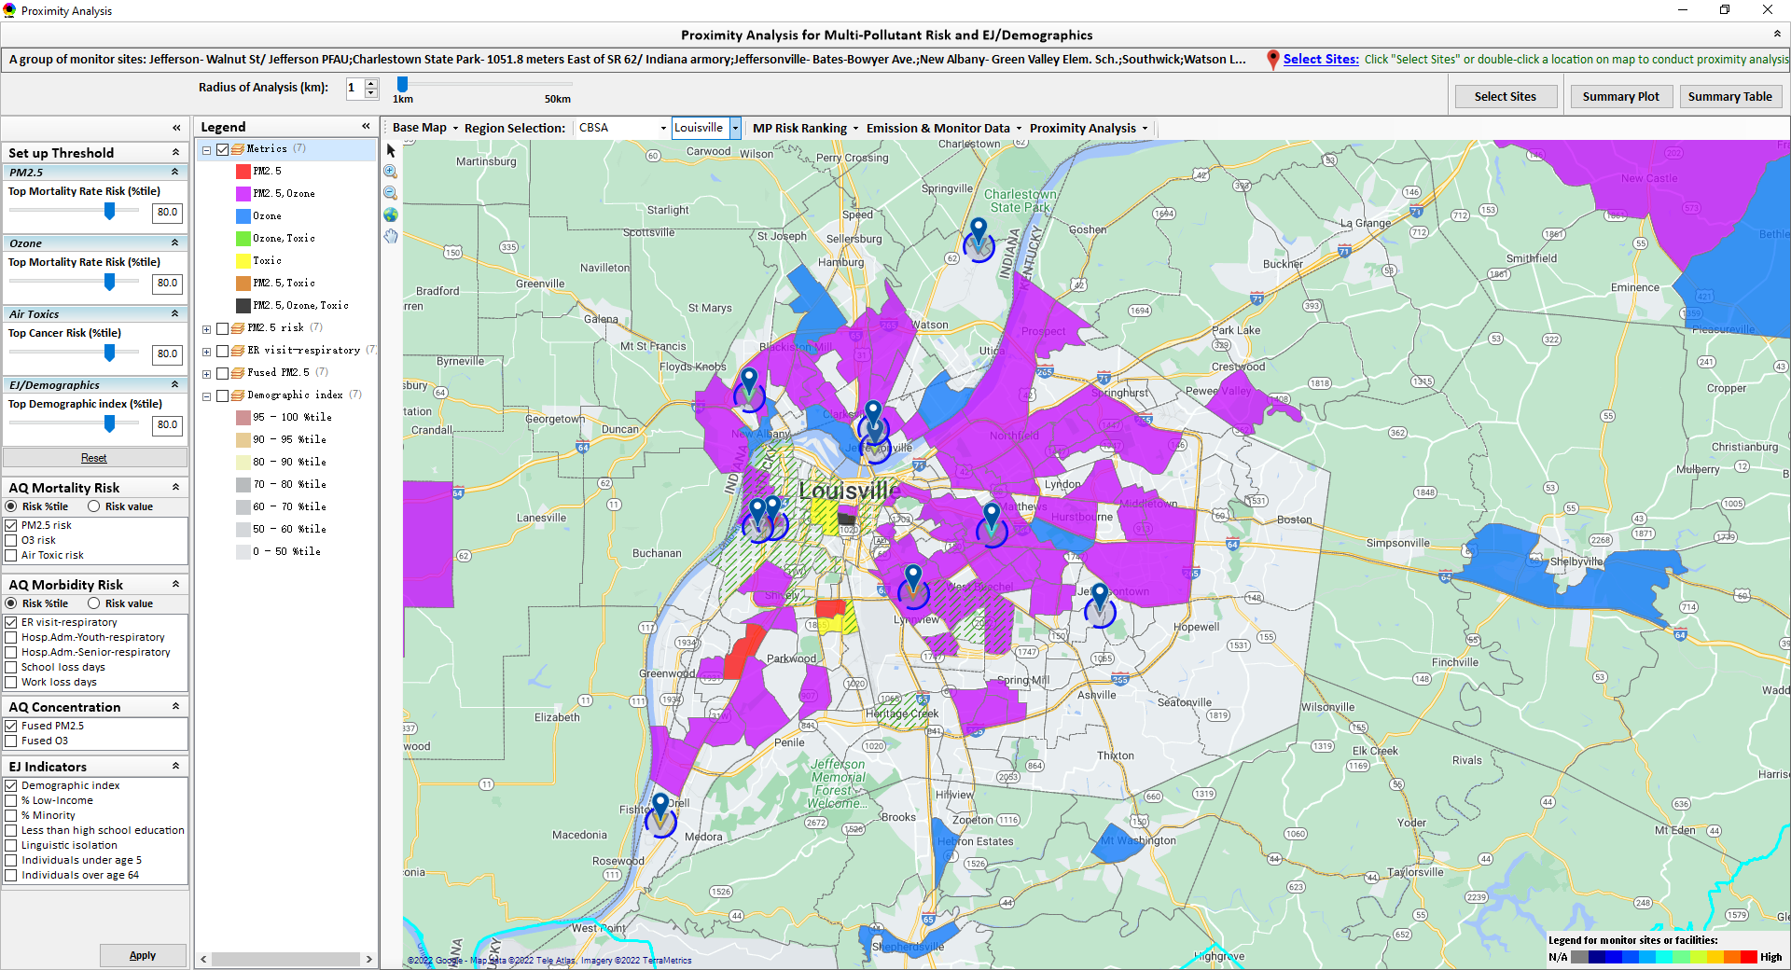

Proximity Analysis Module: “Select Sites” Functions
Click “Select Sites” to select one or a group of monitor sites, facilities, census tracts, or locations (lat & lon) under “Select Sites” pop-up window
14

Slide 15
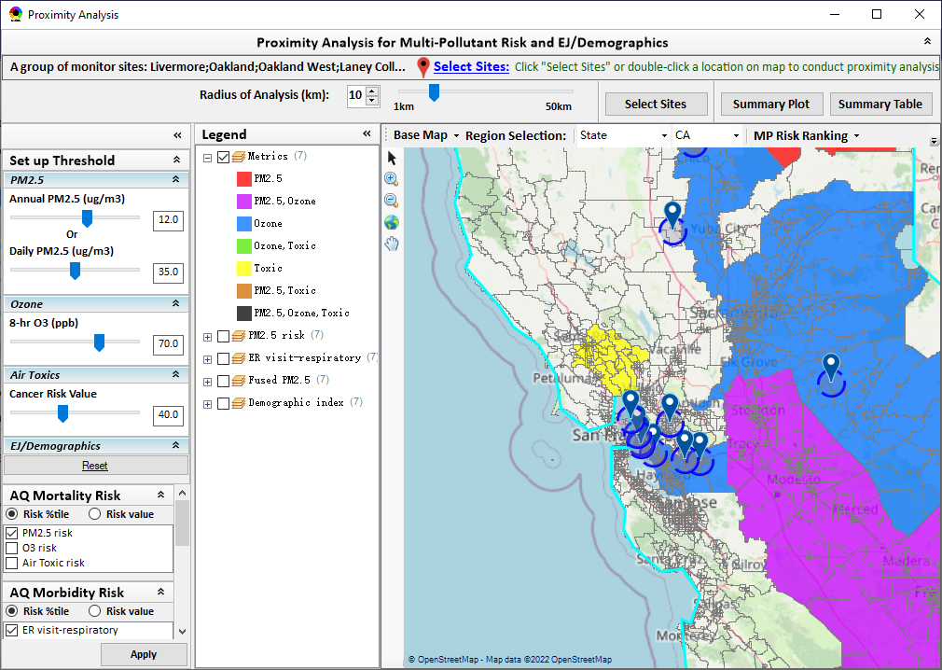
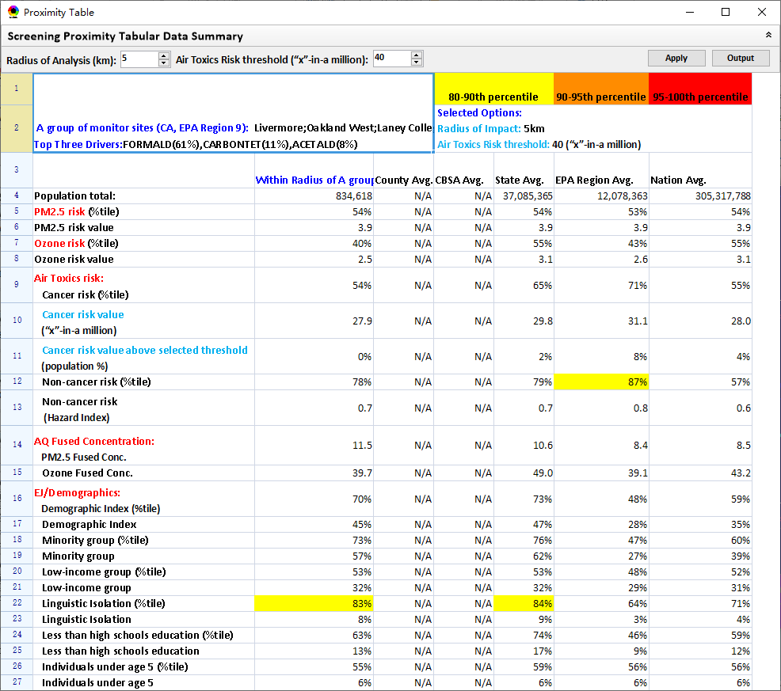
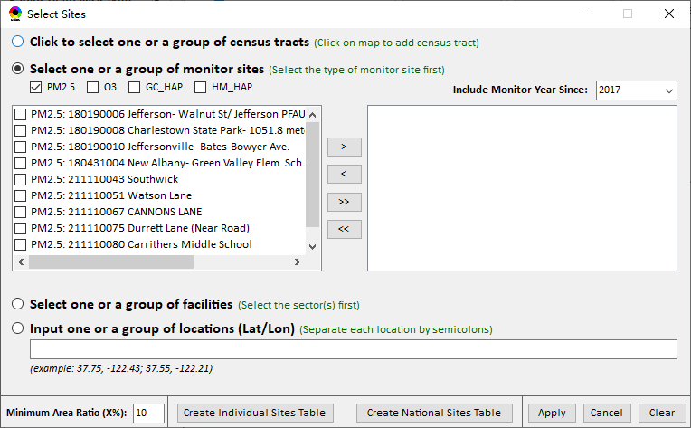
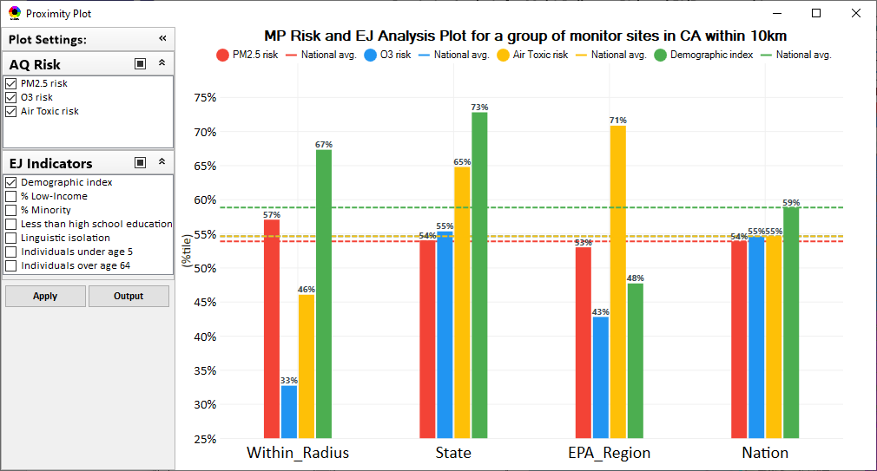
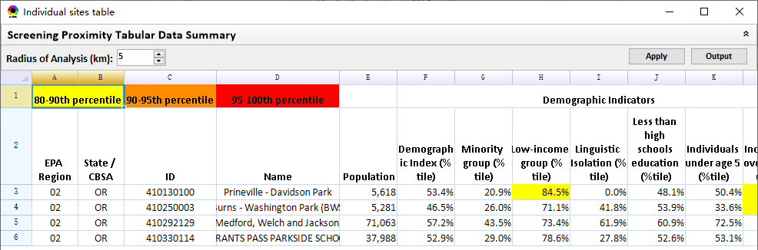
“Group” Proximity Analysis: Individual/National Sites Reporting Table
Proximity analysis for a group of census tracts, monitor sites, facilities or locations (latitude/longitude)
Summary table
Select sites
Summary Plot
“Create Individual or National Sites Table” to conduct proximity analysis for individual sites
15

Slide 16
NEXUS: Current and Potential Uses
AAMG exploring use of NEXUS to inform assessment of the nation’s PM_{2.5} monitoring network and determine if sites located in/near communities with potential EJ concerns (driven by current PM NAAQS review)
  AAMG noted that NEXUS could be useful in Regional review of their states’ Annual Monitoring Network Plans
MP Risk Priority Areas: develop a list of high MP risk areas to share with Regions and engage in potential MP area projects/efforts
  “Regional packets”— tabular and graphical data for each high MP risk area to discuss with Regions and determine which may be most ‘ripe’ for MP solutions
Advance area/Regional SIP planning efforts: develop conceptual model information consistent with EPA’s SIP modeling guidance that addresses nature of air quality within the area
  “Conceptual model” area packet—tabular and graphical data for each planning area to discuss with AQPD and/or Regions to be value added in AQ planning efforts and identify potential for MP considerations as part of these efforts.
EJ Screening with OID and AQPD: inform programs with an emphasis on Federal permitting
  Possible EPA Regional Beta tester project
Engage with EPA Beta Testing Team to define additional uses of need/value to Regions
16

Slide 17
NEXUS: Next Steps
Complete updates in NEXUS and internally release version 3.0 in early May
EPA Beta Testing Team review and provide comments on NEXUS 3.0
Determine if funding available for requested updates:
  Address comments and feedback from EPA Beta Testing Team
  Include “Climate risk” indicators (as 5th metric)
  Update EJ/demographics data to be consistent with new “EJScreen 2.0” dataset
  Include top air toxic cancer risk drivers in the “proximity analysis” module
  Update to 2018 MP platform (O₃, PM_{2.5}, and Air Toxics data)
  Explore the feasibility of developing a web-based NEXUS version (similar to EJScreen)
Briefings for Peter/SMT? OAR?
17

Slide 18
Questions?
18

