Slide 1
Discussion of National Screening Capabilities within NEXUS: Proximity Analysis
Multi-pollutant Team, 5/24/2021

Slide 2
Background
NEXUS assembles a variety of air pollution related data across pollutants and programs in one easily accessible place to inform multi-pollutant air quality planning efforts by EPA and ultimately state/local/tribal air agencies.
It supports these efforts by identifying important emissions sources/sectors within a particular area; however, users need screening analysis capabilities to best utilize the tool for their planning purposes.
Proximity screening analysis is a recommended capability within NEXUS to assist users in better understanding the source(s)/pollutant(s) to focus their efforts on, i.e., identify emissions reductions to reach attainment and/or reduce harmful exposures to air pollution.

Slide 3
Need for Proximity Screening in NEXUS
Proximity Screening Analysis helps answer:
What are the risks in close proximity to my monitor and/or community of interest?
What source(s) are in close proximity to my monitor and/or community of interest?
What are the demographics of communities in close proximity to monitor(s) and/or source(s) of interest?
How do the demographics of communities near my monitor/source compare to area/state/national averages?
How do the risks within communities near my monitor/source compare to area/state/national average?

Slide 4
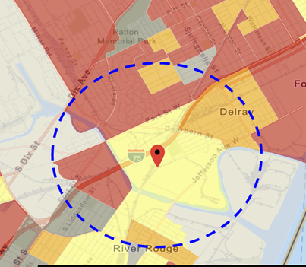
Current Practice for Proximity Screening: EJ Example
“Proximity analysis” is the primary EJ screening approach because close proximity to air pollutant sources, such as industrial plants and major highways, is correlated with exposure and adverse health risks.
Involves comparison of demographic distributions near source(s) (e.g., within 5, 10, 50 km) to those for the state, region, and nation
Types of Proximity Analysis
Demographic analysis
Risk-based demographic analysis
Can consider other factors for use (next slide)
Current Tools Used
EJSCREEN by OID for initial screening and rules (with added GIS scripting)
Project specific efforts for criteria and toxic rules (in-house or contractor)

Slide 5
Considerations for Use within NEXUS
Codify and augment proximity screening analyses for AQ planning and outreach
Incorporate EJSCREEN data layers into NEXUS to be consistent with past practice and codify an approach for OAQPS EJ purposes
Ease of use, transparency of data, efficiently and consistently apply across programs
Codify and expand demographic proximity analyses to include emissions density, pop-weighted concentrations, and risk across all pollutants
improved screening approach as it better reflects air pollutant exposure by source/sector
Account for multi-pollutant exposure/risk to EJ communities rather than single pollutant to better measure harm from air pollution exposures
Consistency in data, approach, tool for use in screening for our outreach efforts and in potentially in regulatory/policy context

Slide 6
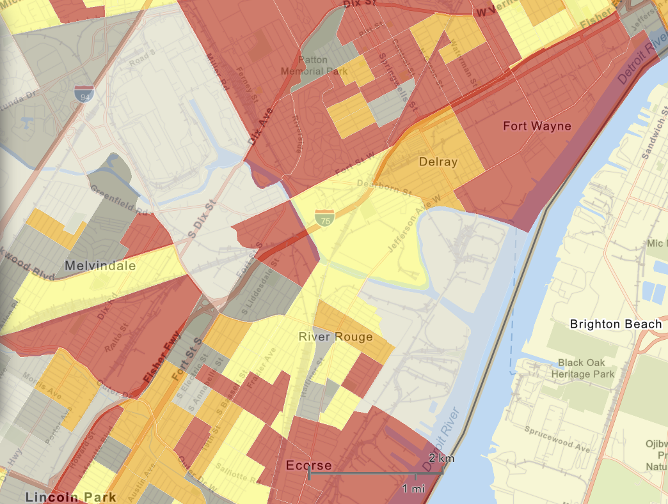
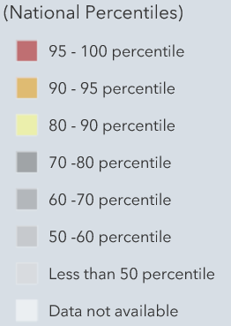
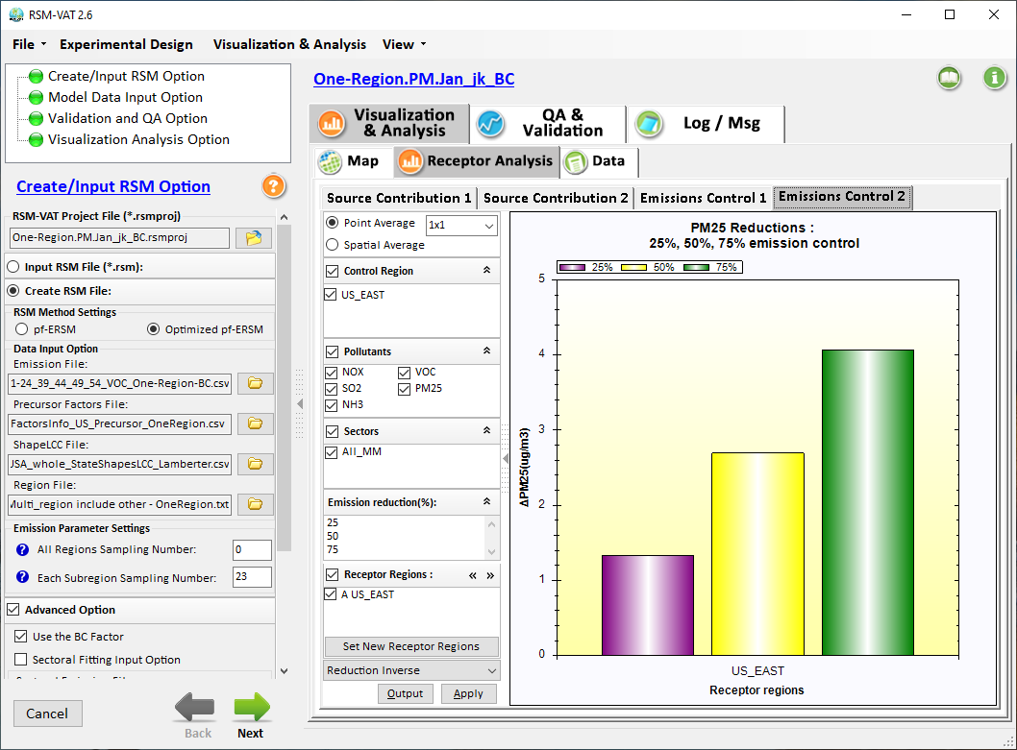

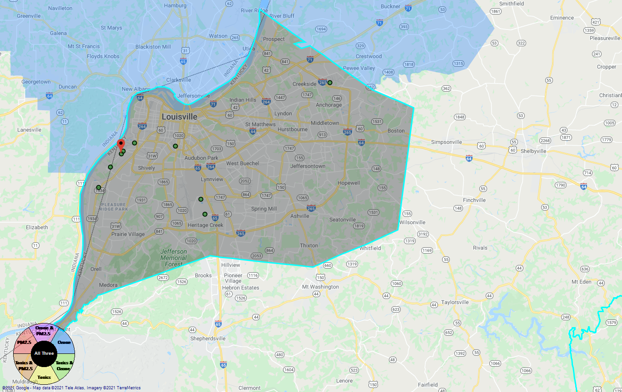
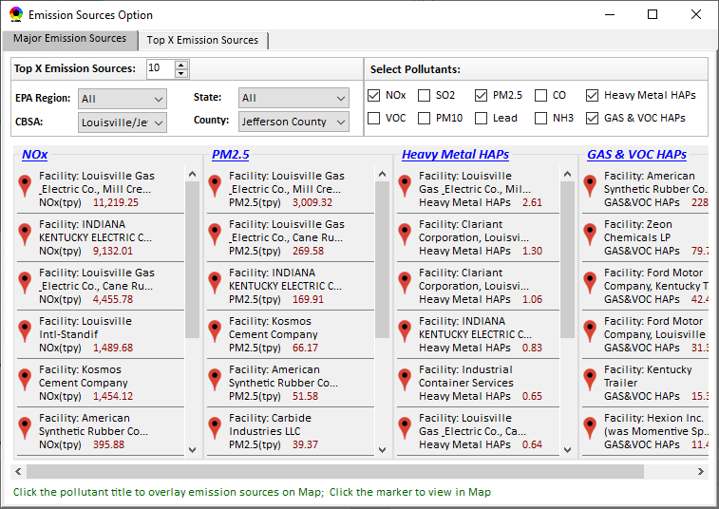
Developing Screening Capabilities for “Proximity & Spatial Analysis for MP Risks & EJ”
NEXUS now can be used to quickly identify top emitters of NOx, SO₂, PM_{2.5}, and heavy-metal & VOCs HAPs near EJ areas of concern; plan to develop proximity & spatial analysis capabilities
Air Quality
Spatial
Analysis
PM2.5 risk
O3 risk
Air Toxics risk
Cancer risk
Non-Cancer risk
EJ Indicators
Climate Risks
Population
Minority
Income
Education
Language
Flood
Fire
Sea Level Rise
Heat
Disease
Proximity Analysis
(Selected Facility or Monitoring Site)
Climate Risks
Flood
Fire
Sea Level Rise
Heat
Disease
Proximity and Spatial Analysis for MP Risk and EJ
Proximity Analysis
Spatial Analysis
MP Risk
Air Toxics
EJ Indicator
Minority
Facility: American Synthesis Rubber Co., Louisville, KY Sector Group: Polymers and Resins Production Top Risk Drivers: ETO, Formaldehyde (examples) |  |  |  |  | Selected Options: Radius of Impact: 10km Number of CBSAs: 25 (top MP risk ranking) Air Toxics Risk threshold: 10 (“x”-in-a million)
 | Within Radius of Facility | County Avg. | State Avg. | EPA Region Avg. |  | Nation Avg. | Sector Group (within radius) National avg. | Sector Group (within radius) Top 25 CBSAs
Population total | x,xxx | xx,xxx | xxx,xxx | xxx,xxx |  | 317,xxx,xxx | xxx,xxx | xxx,xxx
PM2.5 risk (%tile) | x% | x% | x% | x% |  | x% | x% | x%
Ozone risk (%tile) | x% | x% | x% | x% |  | x% | x% | x%
Air Toxics risk: Cancer risk (%tile) | x% | x% | x% | x% |  | x% | x% | x%
Cancer risk value (“x”-in-a million)) | x.x | x.x | x.x | x.x |  | x.x | x.x | x.x
Cancer risk value above selected threshold (population %tile) | x% | x% | x% | x% |  | x% | x% | x%
Non-cancer risk (%tile) | x% | x% | x% | x% |  | x% | x% | x%
Non-cancer risk (Hazard Index) | x.x | x.x | x.x | x.x |  | x.x | x.x | x.x
Climate risks: Flood (%tile) | x% | x% | x% | x% |  | x% | x% | x%
Sea level rise (%tile) | x% | x% | x% | x% |  | x% | x% | x%
Fire (%tile) | x% | x% | x% | x% |  | x% | x% | x%
Disease (%tile) | x% | x% | x% | x% |  | x% | x% | x%
EJ/Demographics: Minority group (%tile) | x% | x% | x% | x% |  | x% | x% | x%
Low-income group (%tile) | x% | x% | x% | x% |  | x% | x% | x%
Demographic Index (%tile) | x% | x% | x% | x% |  | x% | x% | x%
Linguistic Isolation (%tile) | x% | x% | x% | x% |  | x% |  | x%
Proximity and Spatial Analysis for MP Risks and EJ
Proximity Analysis
Spatial Analysis
Graphical
& Tabular
Analysis
Facility: American Synthesis Rubber Co., KY Sector group: Polymers and Resins Production
[ x Display national map for Sector group
Radius of Influence
5
50km
Create Table
Create Plot
6

Slide 7
Developing Capabilities for Proximity and Spatial Analysis
Proximity analysis will allow to set a flexible “Radius of Influence” for a selected facility or monitoring site (based on census tract- and/or block group-level)
NEXUS now can quickly identify top emitters of CAPs & HAPs; Plan to develop proximity screening capabilities to include EJ/demographic indicators
Proximity and Spatial Analysis for MP Risks and EJ
Proximity Analysis
Spatial Analysis
Facility: American Synthesis Rubber Co., KY Sector group: Polymers and Resins Production
[ x Display national map for Sector group
Radius of Influence
5
50km
Create Table
Create Plot
7

Slide 8

Developing Capabilities for Proximity and Spatial Analysis
Air Quality
PM2.5 risk
O3 risk
Air Toxics risk
Cancer risk
Non-Cancer risk
EJ Indicators
Climate Risks
Population
Minority
Income
Education
Language
Flood
Fire
Sea Level Rise
Heat
Disease
Climate Risks
Flood
Fire
Sea Level Rise
Heat
Disease
Proximity and Spatial Analysis for MP Risk and EJ
Proximity Analysis
Spatial Analysis
MP Risk
Air Toxics
EJ Indicator
Minority
8

Slide 9
Screening Proximity Analysis in NEXUS: Example Tabular Data Summary
Facility: American Synthesis Rubber Co., Louisville, KY Sector Group: Polymers and Resins Production Top Risk Drivers: ETO, Formaldehyde (examples) |  |  |  |  | Selected Options: Radius of Impact: 10km Number of CBSAs: 25 (top MP risk ranking) Air Toxics Risk threshold: 10 (“x”-in-a million)
 | Within Radius of Facility | County Avg. | State Avg. | EPA Region Avg. |  | Nation Avg. | Sector Group (within radius) National avg. | Sector Group (within radius) Top 25 CBSAs
Population total | x,xxx | xx,xxx | xxx,xxx | xxx,xxx |  | 317,xxx,xxx | xxx,xxx | xxx,xxx
PM2.5 risk (%tile) | x% | x% | x% | x% |  | x% | x% | x%
Ozone risk (%tile) | x% | x% | x% | x% |  | x% | x% | x%
Air Toxics risk: Cancer risk (%tile) | x% | x% | x% | x% |  | x% | x% | x%
Cancer risk value (“x”-in-a million)) | x.x | x.x | x.x | x.x |  | x.x | x.x | x.x
Cancer risk value above selected threshold (population %tile) | x% | x% | x% | x% |  | x% | x% | x%
Non-cancer risk (%tile) | x% | x% | x% | x% |  | x% | x% | x%
Non-cancer risk (Hazard Index) | x.x | x.x | x.x | x.x |  | x.x | x.x | x.x
Climate risks: Flood (%tile) | x% | x% | x% | x% |  | x% | x% | x%
Sea level rise (%tile) | x% | x% | x% | x% |  | x% | x% | x%
Fire (%tile) | x% | x% | x% | x% |  | x% | x% | x%
Disease (%tile) | x% | x% | x% | x% |  | x% | x% | x%
EJ/Demographics: Minority group (%tile) | x% | x% | x% | x% |  | x% | x% | x%
Low-income group (%tile) | x% | x% | x% | x% |  | x% | x% | x%
Demographic Index (%tile) | x% | x% | x% | x% |  | x% | x% | x%
Linguistic Isolation (%tile) | x% | x% | x% | x% |  | x% |  | x%
9

Slide 10
Proximity Analysis for Selected Facility/Sector or Monitoring Site: Example Chart
Air Quality
PM2.5 risk
O3 risk
Air Toxics risk
Cancer risk
Non-Cancer risk
(%tile)
EJ Indicators
Climate Risks
Population
Minority
Income
Education
Language
Flood
Fire
Sea Level Rise
Heat
Disease
Climate Risks
Flood
Fire
Sea Level Rise
Heat
Disease

Slide 11
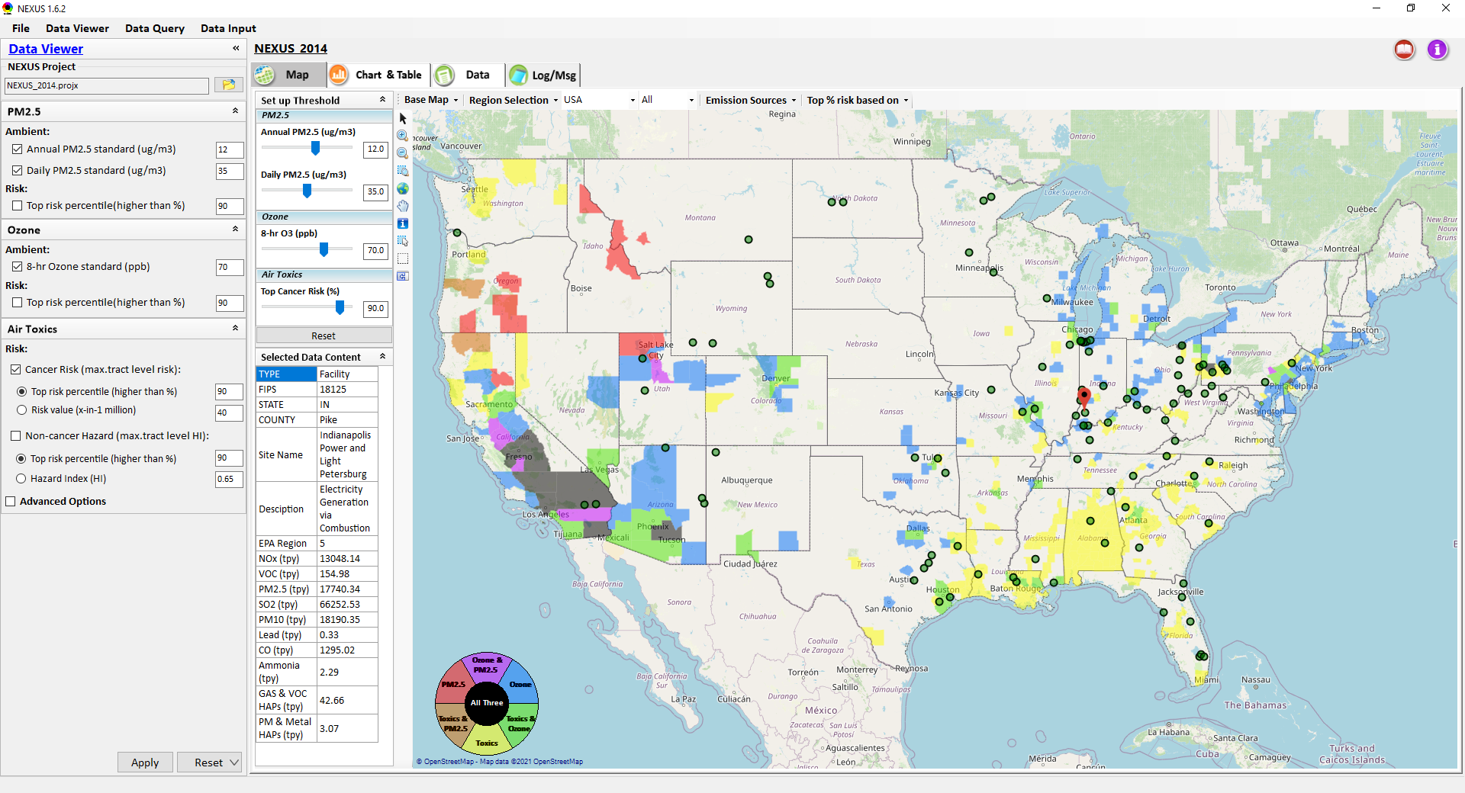
Proximity & Spatial Analysis: Allow to “Zoom-out” & “Zoom-in” Nationally for all Facilities under same “Sector Group”
Display all facilities within same “Sector group”
Allow to “zoom out” nationally and “zoom-in” back to facility level
Provide color scale for selected MP risk value (e.g., red w/ high MP risk)
Proximity Analysis for Source/Sector
Zoom-out
Proximity and Spatial Analysis for MP Risks and EJ
Proximity Analysis
Spatial Analysis
Zoom-in
Facility: American Synthesis Rubber Co., KY Sector group: Polymers and Resins Production
[ x Display national map for Sector group
Radius of Influence
5
50km
Create Table
Create Plot
11

