Slide 1


US EPA
Advance Program
Advance Program Overview for OAR Management
Rich Damberg and Mia South
EPA Office of Air Quality Planning and Standards, Air Quality Policy Division
Briefing for OAR Management
June 21, 2021

Slide 2
background
The Advance Program is a voluntary, collaborative initiative between EPA, state and local governments, and tribes​
Areas designated as attainment for the Ozone and/or PM2.5 NAAQS develop plans and take actions in their communities to proactively reduce emissions, improve air quality, and remain in attainment
  Currently: 45 areas with combined population of 54 million
The Advance Program was established by OAQPS in 2012​
  To date, Advance has been managed by about 1 FTE, with no contract assistance
Focus has been on partnerships and collaboration with other OAR offices
Past experience: interest in Advance will increase with PM NAAQS review
Program offers opportunities to address climate, toxics, and environmental justice concerns consistent with Administration priorities

Slide 3
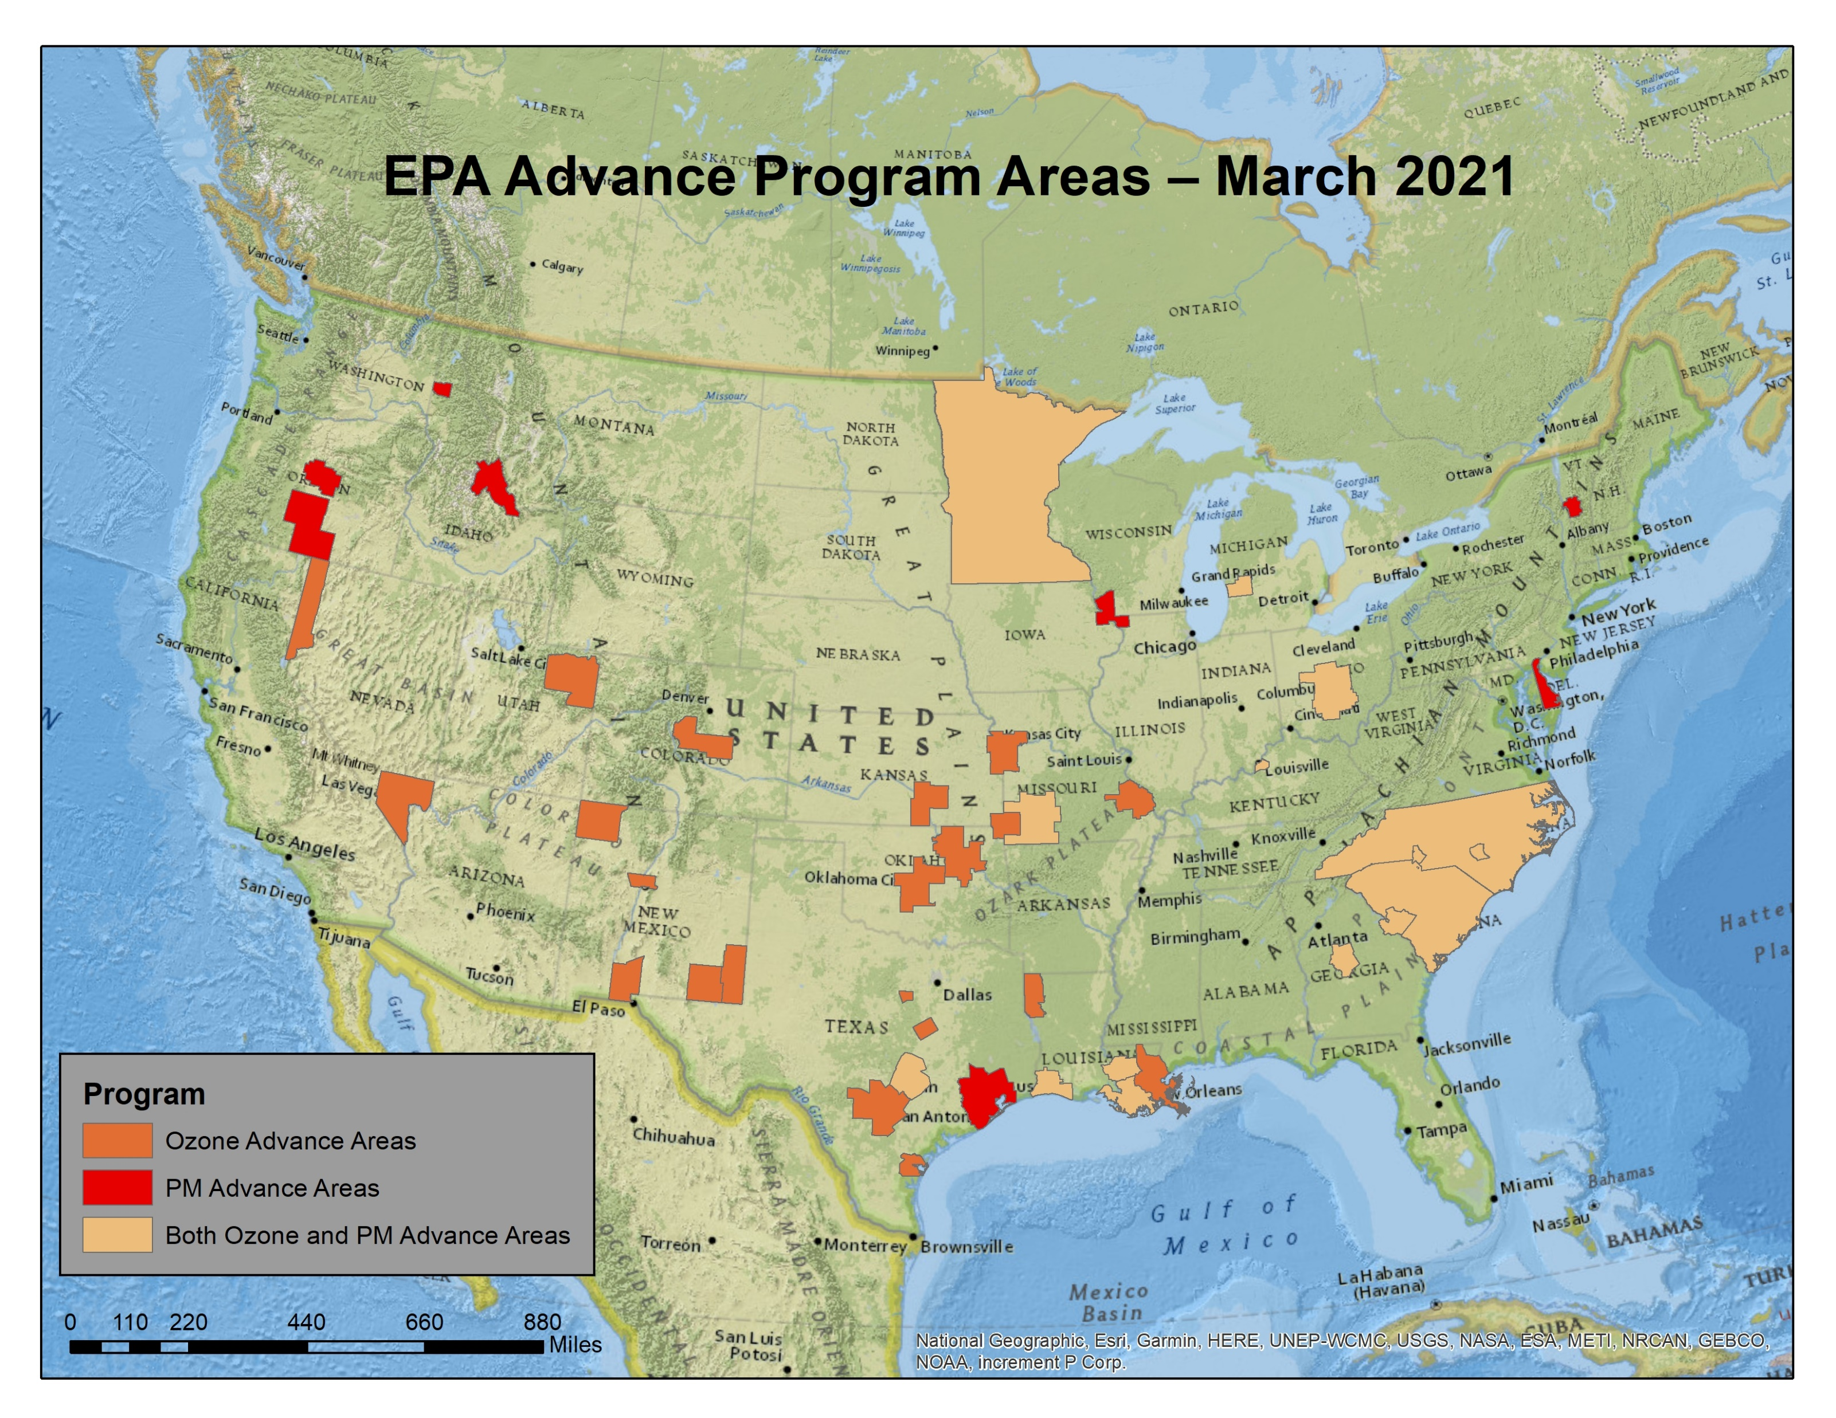
See
Area
List
In
Appendix
45 Areas
(23 Ozone, 8 PM2.5,
14 Both)
54 million population

Slide 4
Goals for advance program
Limit the number of new PM2.5 and ozone nonattainment areas
  Improves public health
  Saves resources at state/local/tribal and EPA levels
Increase number of state/local/tribal Advance areas
Expand our network of collaborating organizations (within EPA and externally) and broaden the technical assistance we can provide
Pursue significant opportunities to integrate Advance program with other agency priorities:
  Climate planning
  Air toxics
  Environmental justice communities

Slide 5
Program requirements
  Joining the Advance Program.
    Identify your lead governmental organization(s).
    Identify geographic area and jurisdictions covered by your program.
    Indicate if joining Ozone Advance, PM Advance, or both.
    Identify the federal air quality monitor(s) for ozone and/or PM2.5 in the area.
    Certify that your state has provided a submission to the most recent update of the National Emission Inventory

Slide 6
Program Requirements
Conduct stakeholder meetings and identify priority emission reduction actions to include in your plan.
Within one year, submit the initial “Path Forward” plan for the area, in consultation with EPA.
Provide an annual Advance plan revision.
    Review progress made under most recent plan.
    Provide updated plan and proposed new actions for the next year.

Slide 7
BENEFITS for advance partners
Cost of remaining in attainment is less than cost of meeting nonattainment/maintenance area requirements
Reduce emissions, improve air quality, improve public health, achieve climate co-benefits
Provides forum for community and stakeholder collaboration on clean air and related issues
Participation with EPA provides credibility and demonstrates the area’s clean air commitment
Access to EPA expertise and technical assistance opportunities
Monthly webinars and collaboration with other Advance areas
EPA monthly newsletter for Advance community provides info on grants, trainings, and webinars

Slide 8
BENEFITS of advance program (cont.)
Educates public and community about air quality and health
Promotes positive actions by industry, government, public stakeholders
Commitment to update Advance annual plan serves as a driver for action and stakeholder input
Advance areas have flexibility to include broad array of programs and initiatives
  Air quality, sustainable economic development, energy efficiency and climate, environmental justice, cleaner transportation, etc.
Learn best practices from other Advance areas through collaboration and EPA index of programs and initiatives in previously submitted Advance plans

Slide 9
ADVANCE AREAS: AIR QUALITY IMPROVEMENT FROM YEAR JOINED TO 2017-19
NAAQS | NO. OF AREAS | AVERAGE IMPROVEMENT | NUMBER THAT IMPROVED OR STAYED SAME
ANNUAL PM2.5 | 15 | -1.6 ug/m3 | 13 OF 15
24HR PM2.5 | 16 | -1.3 ug/m3 | 13 OF 16
OZONE | 32 | -5.4 ppb | 26 OF 32
More than 80% of Advance areas have seen air
quality improve since joining the program.

Slide 10
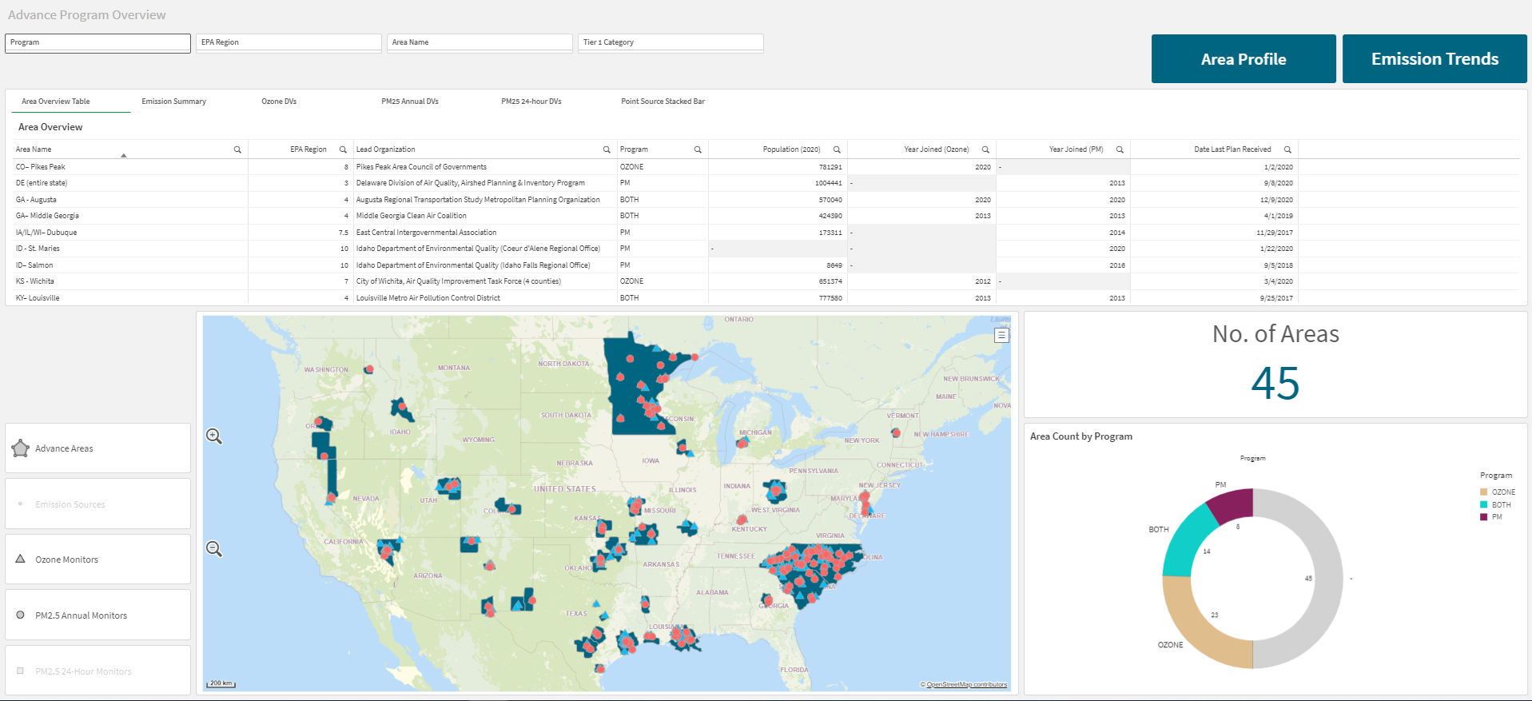
QLIK TOOL WITH AIR QUALITY AND EMISSIONS DATA
FUTURE ADDITION TO ADVANCE WEBSITE

Slide 11
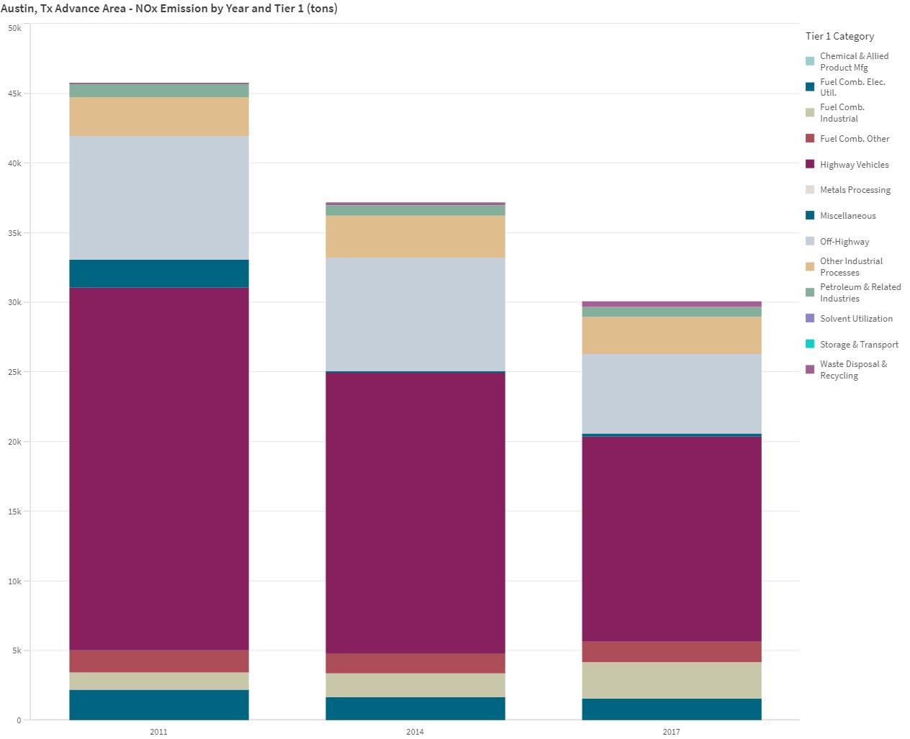
emissions trends austin, tx NOx example
Austin joined Advance in 2012

Slide 12
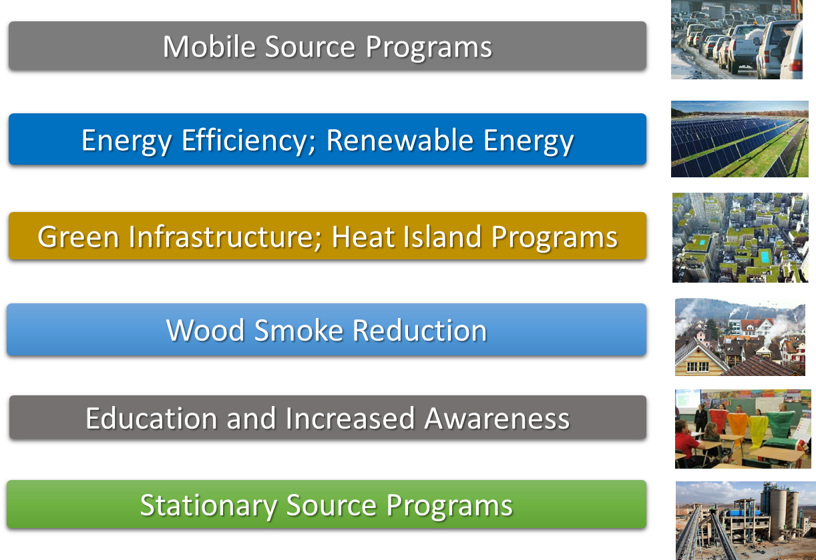

Programs and initiatives
All plans submitted to EPA are on website at www.epa.gov/Advance

Slide 13
TECHNICAL ASSISTANCE WE CAN PROVIDE OR FACILITATE
Mobile/Transportation
Electric vehicles and charging infrastructure
Smartway / fleets / goods movement
Ports Initiative – community programs
Innovative transportation programs
Bike/pedestrian/Complete Streets
Energy Efficiency/Renewable Energy/Climate
Coordination with climate and sustainability programs
Tools for estimating cost savings, emission reductions, and health benefits from renewable energy/energy efficiency
Green power partnership communities
Building energy management
Energy Star industrial partnerships
Clean energy and clean power purchasing
Energy efficient building codes
Overall Planning/Green Infrastructure/Heat Island
Expanding Ozone Advance to include PM programs
Community revitalization / smart growth / urban planning
Urban forestry. Cool Roof rebates
Education/Outreach/Grants/Program Mgmt.
Air quality Action Day programs
Environmental education curricula
Social media and outreach
Air quality FLAG program
Grant opportunities / innovative program financing
Metrics for tracking progress
Stationary and Area Sources
Burnwise wood smoke reduction
Multi-pollutant/toxics reduction in disadvantaged communities
Voluntary reductions on high pollution days
Air monitoring / low-cost sensor projects

Slide 14
Since 2019…
Number of participants has grown by 20%
Held series of program evaluation calls with Advance areas
Program changes in response to what we heard:
  Started monthly webinars / opportunities for greater collaboration among areas
  Streamlined monthly newsletter
  Developed index to control strategies and programs included in past Advance area plans
  Updating website: Qlik tool for air quality and emissions; easier access to Advance area plans
  Providing more area-specific assistance (e.g., PM technical assistance for Austin plan)
  Expanding network of collaborators

Slide 15
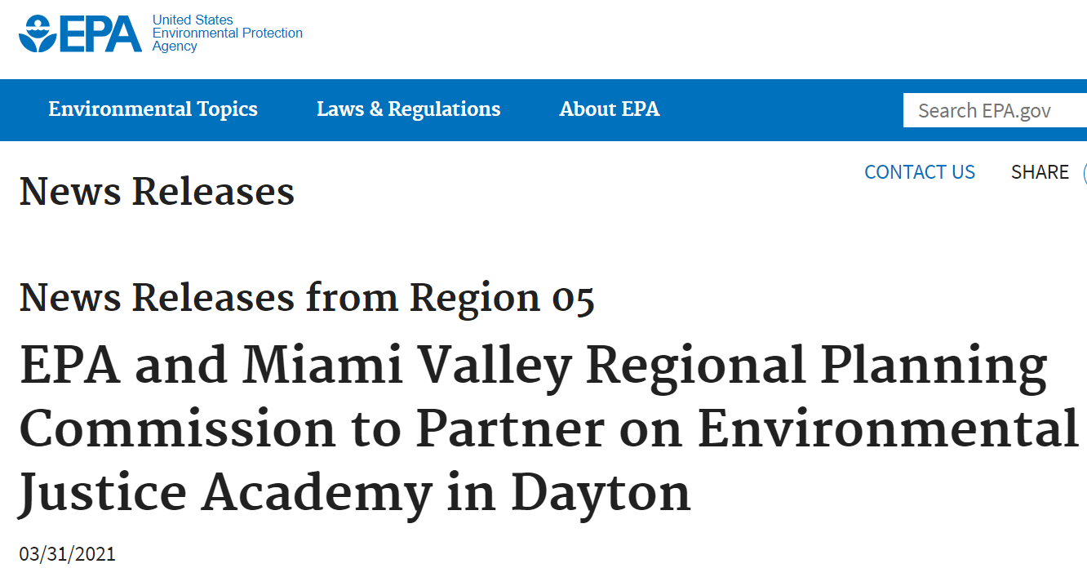

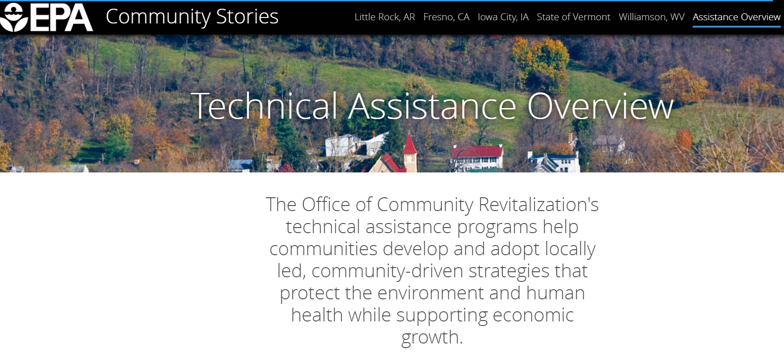





Expanding our network of collaborators
  Regional office air planning and voluntary program staff
  OAQPS Multipollutant Team
  OAQPS Burn Wise Team
  State/Local Residential Wood Smoke group
  OAQPS Environmental Justice Team
  OAP State and Local Energy and Environment Program
  OAP Green Power Partnership
  Energy Star Industrial
  OTAQ Ports Initiative
  OP Office of Community Revitalization
  OP Community Driven Solutions
  R4 / R5 EJ Academy
  R3 Renewable Energy / Energy Efficiency sublead
  OECA Clean Renewable Energy Opportunities group
  U.S. Dept of Energy and other agencies

Slide 16
Future Direction
Recruit new State/Local/Tribal Areas
  Coordinate with Regional Office team
  Focus on:
    Areas where most recent air quality data is exceeding or close to NAAQS
    Forward-thinking areas interested in realizing the benefits of the program
    Additional candidate areas in light of PM NAAQS review
Voluntary Advance program complements regulatory work
  PM NAAQS review will increase interest in program
Continue collaboration across agency (OAP, OTAQ, ORD, etc.)
Develop new partnerships on Air Toxics / Multipollutant projects, OP Office of Community Revitalization, other agencies
Identify additional opportunities for integrating agency priorities related to:
  Climate planning
  Environmental justice communities

Slide 17
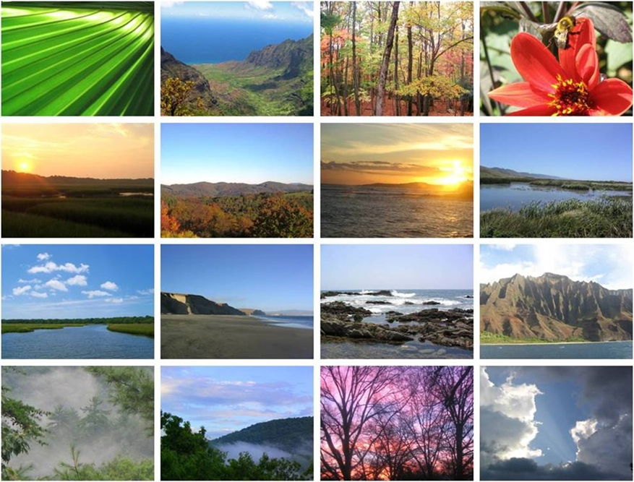
Thank you
Questions?
Rich Damberg, damberg.rich@epa.gov, 919-541-5592
Mia South, south.mia@epa.gov, 919-541-5550

Slide 18
APPENDIX

Slide 19
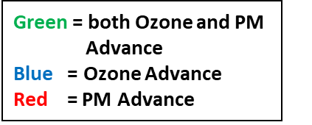
Current advance partner areas
CO Colorado Springs Pikes Peak Area Council of Governments
DE Entire State Delaware Dept. of Natural Resources and
Environmental Control
GA Augusta Augusta Regional Transportation Study Metropolitan Planning
GA Macon Middle Georgia Clean Air Coalition
ID Salmon Idaho Dept. of Environmental Quality
ID St. Maries Idaho Dept. of Environmental Quality
IA/IL/WI Dubuque Dubuque Metro. Area Transportation Study; City of Dubuque;
Greater Dubuque Development Corp.
KY Jefferson County Louisville Metro Air Pollution Control District
LA Baton Rouge Capital Region Planning Comm.; Baton Rouge Clean Air Coalition; LA Clean Fuels
Houma-Thibodaux South Central Planning & Development Commission; Houma-Thibodaux Metropolitan Planning Organizations
Lake Charles Imperial Calcasieu Regional Planning & Development Commission
New Orleans New Orleans Regional Planning Commission
Shreveport Cities of Shreveport and Bossier City; Caddo Parish Commission; Bossier and DeSoto Parish Police Juries

Slide 20
Current advance partner areas
MI Grand Rapids Grand Valley Metropolitan Council; The Lower Grand River Organization of Watersheds (LGROW); The West Michigan Clean Air Coalition (WMCAC)
MN Entire State Minnesota Pollution Control Agency
MO/KS/OK Joplin City of Joplin; Four States Clean Air Alliance; Joplin Area Transportation
Study Organization; Inter-Tribal Council of North Eastern OK; Board of
Commissioners for Cherokee County, KS
MO/KS Kansas City Mid-America Regional Council Air Quality Forum
MO Southeast MO Southeast Missouri Regional Planning & Economic Development Commission
Southwest MO Ozarks Clean Air Alliance
NV Clark County Clark County Dept. of Air Quality
Washoe County Washoe County Health District, Air Quality
Management Division
NM Albuquerque / Bernalillo County City of Albuquerque / Bernalillo County
Doña Ana County (partial) New Mexico Environment Dept.
Eddy County New Mexico Environment Dept.
Lea County New Mexico Environment Dept.
San Juan County New Mexico Environment Dept.

Slide 21
Current advance partner areas
NC Cumberland County Cumberland County Board of Commissioners
Entire State North Carolina Dept. of Environmental Quality Division of Air Quality
Mecklenburg County Mecklenburg County Air Quality
OH Columbus Mid-Ohio Regional Planning Commission
OK Oklahoma City Oklahoma Dept. of Environmental Quality
Tulsa Oklahoma Dept. of Environmental Quality
OR Lakeview Oregon Dept. of Environmental Quality; Lake County; Town of Lakeview
Prineville Oregon Dept. of Environmental Quality
SC Catawba Reservation Catawba Indian Nation
Entire State South Carolina Dept. of Health and Environmental Control
TX Austin Central Texas Clean Air Coalition
Corpus Christi Corpus Christi Air Quality Group
Hood County Hood County Clean Air Coalition
Houston Houston-Galveston Area Council
San Antonio Alamo Area Council of Governments, Air Improvement Resources Committee
Waco Heart of Texas Council of Governments (HOTCOG)
UT Uinta Basin State of Utah
VT Rutland Vermont Dept. of Environmental Conservation, Air Quality and Climate Division

Slide 22
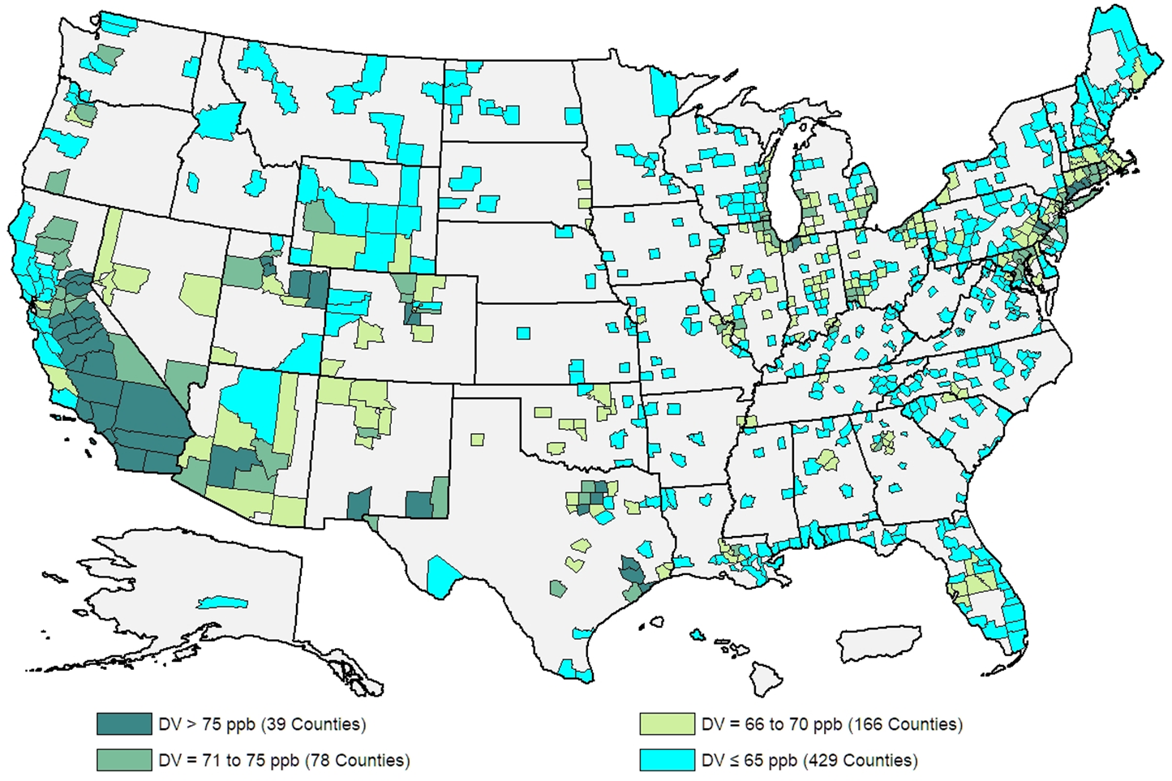
Ozone air quality data (2017-19)
CANDIDATE AREAS
65-70 PPB INCLUDE:
Amarillo, TX
Bloomington, IL
Brookings, SD
Laramie, WY
Nashville, TN
Orlando, FL
Portland, OR
Tucson, AZ

Slide 23
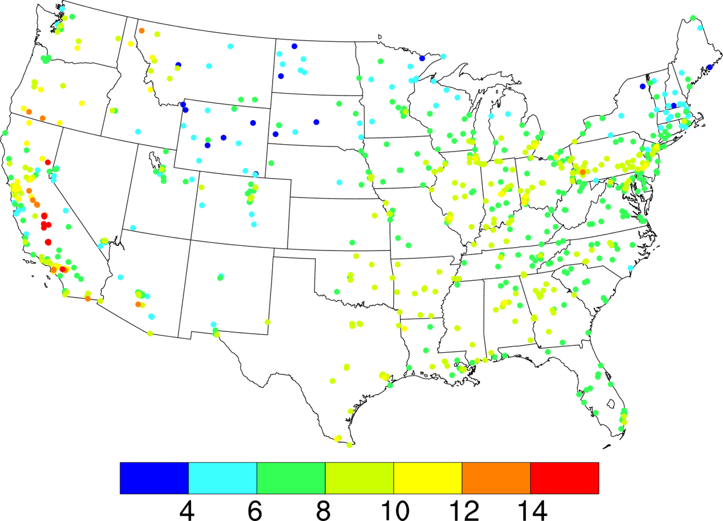
Annual PM2.5 air quality data (2017-19)
CANDIDATE AREAS 12+
Medford, OR
CANDIDATE AREAS 11-12
San Jose, CA
Several areas in CA, OR, WA?
CANDIDATE AREAS 9-11
Little Rock, AR
Denver, CO
Las Vegas, NV
Oklahoma City, OK
San Diego, CA
Topeka, KS
Jackson, MS
Greeley, CO
Portland, OR
Spokane, WA
Tucson, AZ
* Could include Maintenance areas as well.

Slide 24
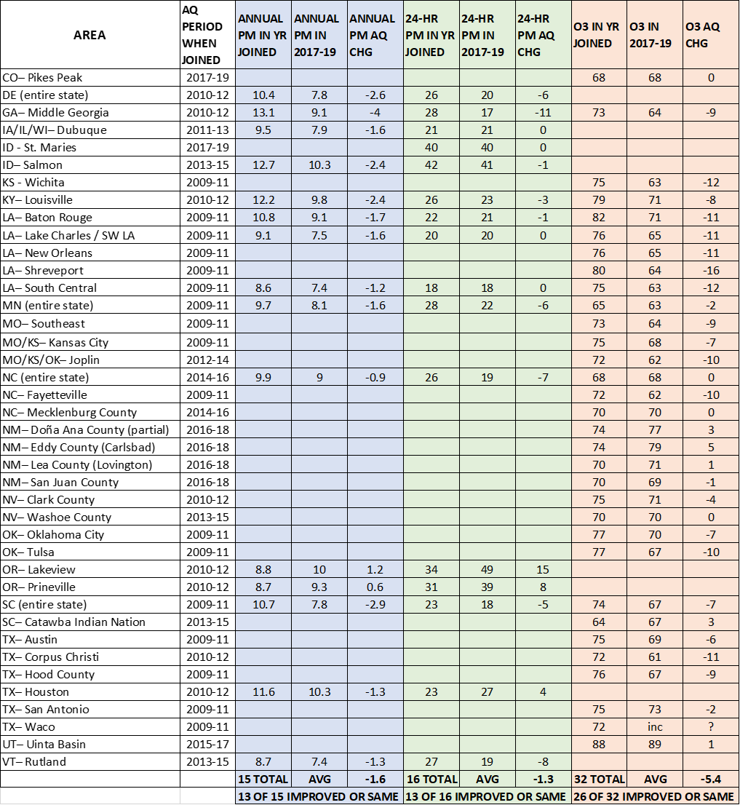
ADVANCE AREAS
AIR QUALITY IMPROVEMENT
FROM “YEAR JOINED”
TO 2017-2019

