Slide 1
Pilot Climate Layer for NEXUS

Slide 2
Approach
Top 10 temperature days are combined with monthly mean RH (currently available) to produce “Heat Index” from CESM and CM3 outputs – (downscaled climate model outputs provided by C. Nolte/ORD)
Climate model outputs are combined and averaged for several years at each three time periods: present day (~2000), mid-century (~2050), and end of century (~2100)
Census tract means are extracted from the gridded model domain using R (raster and tidycensus packages)

Slide 3
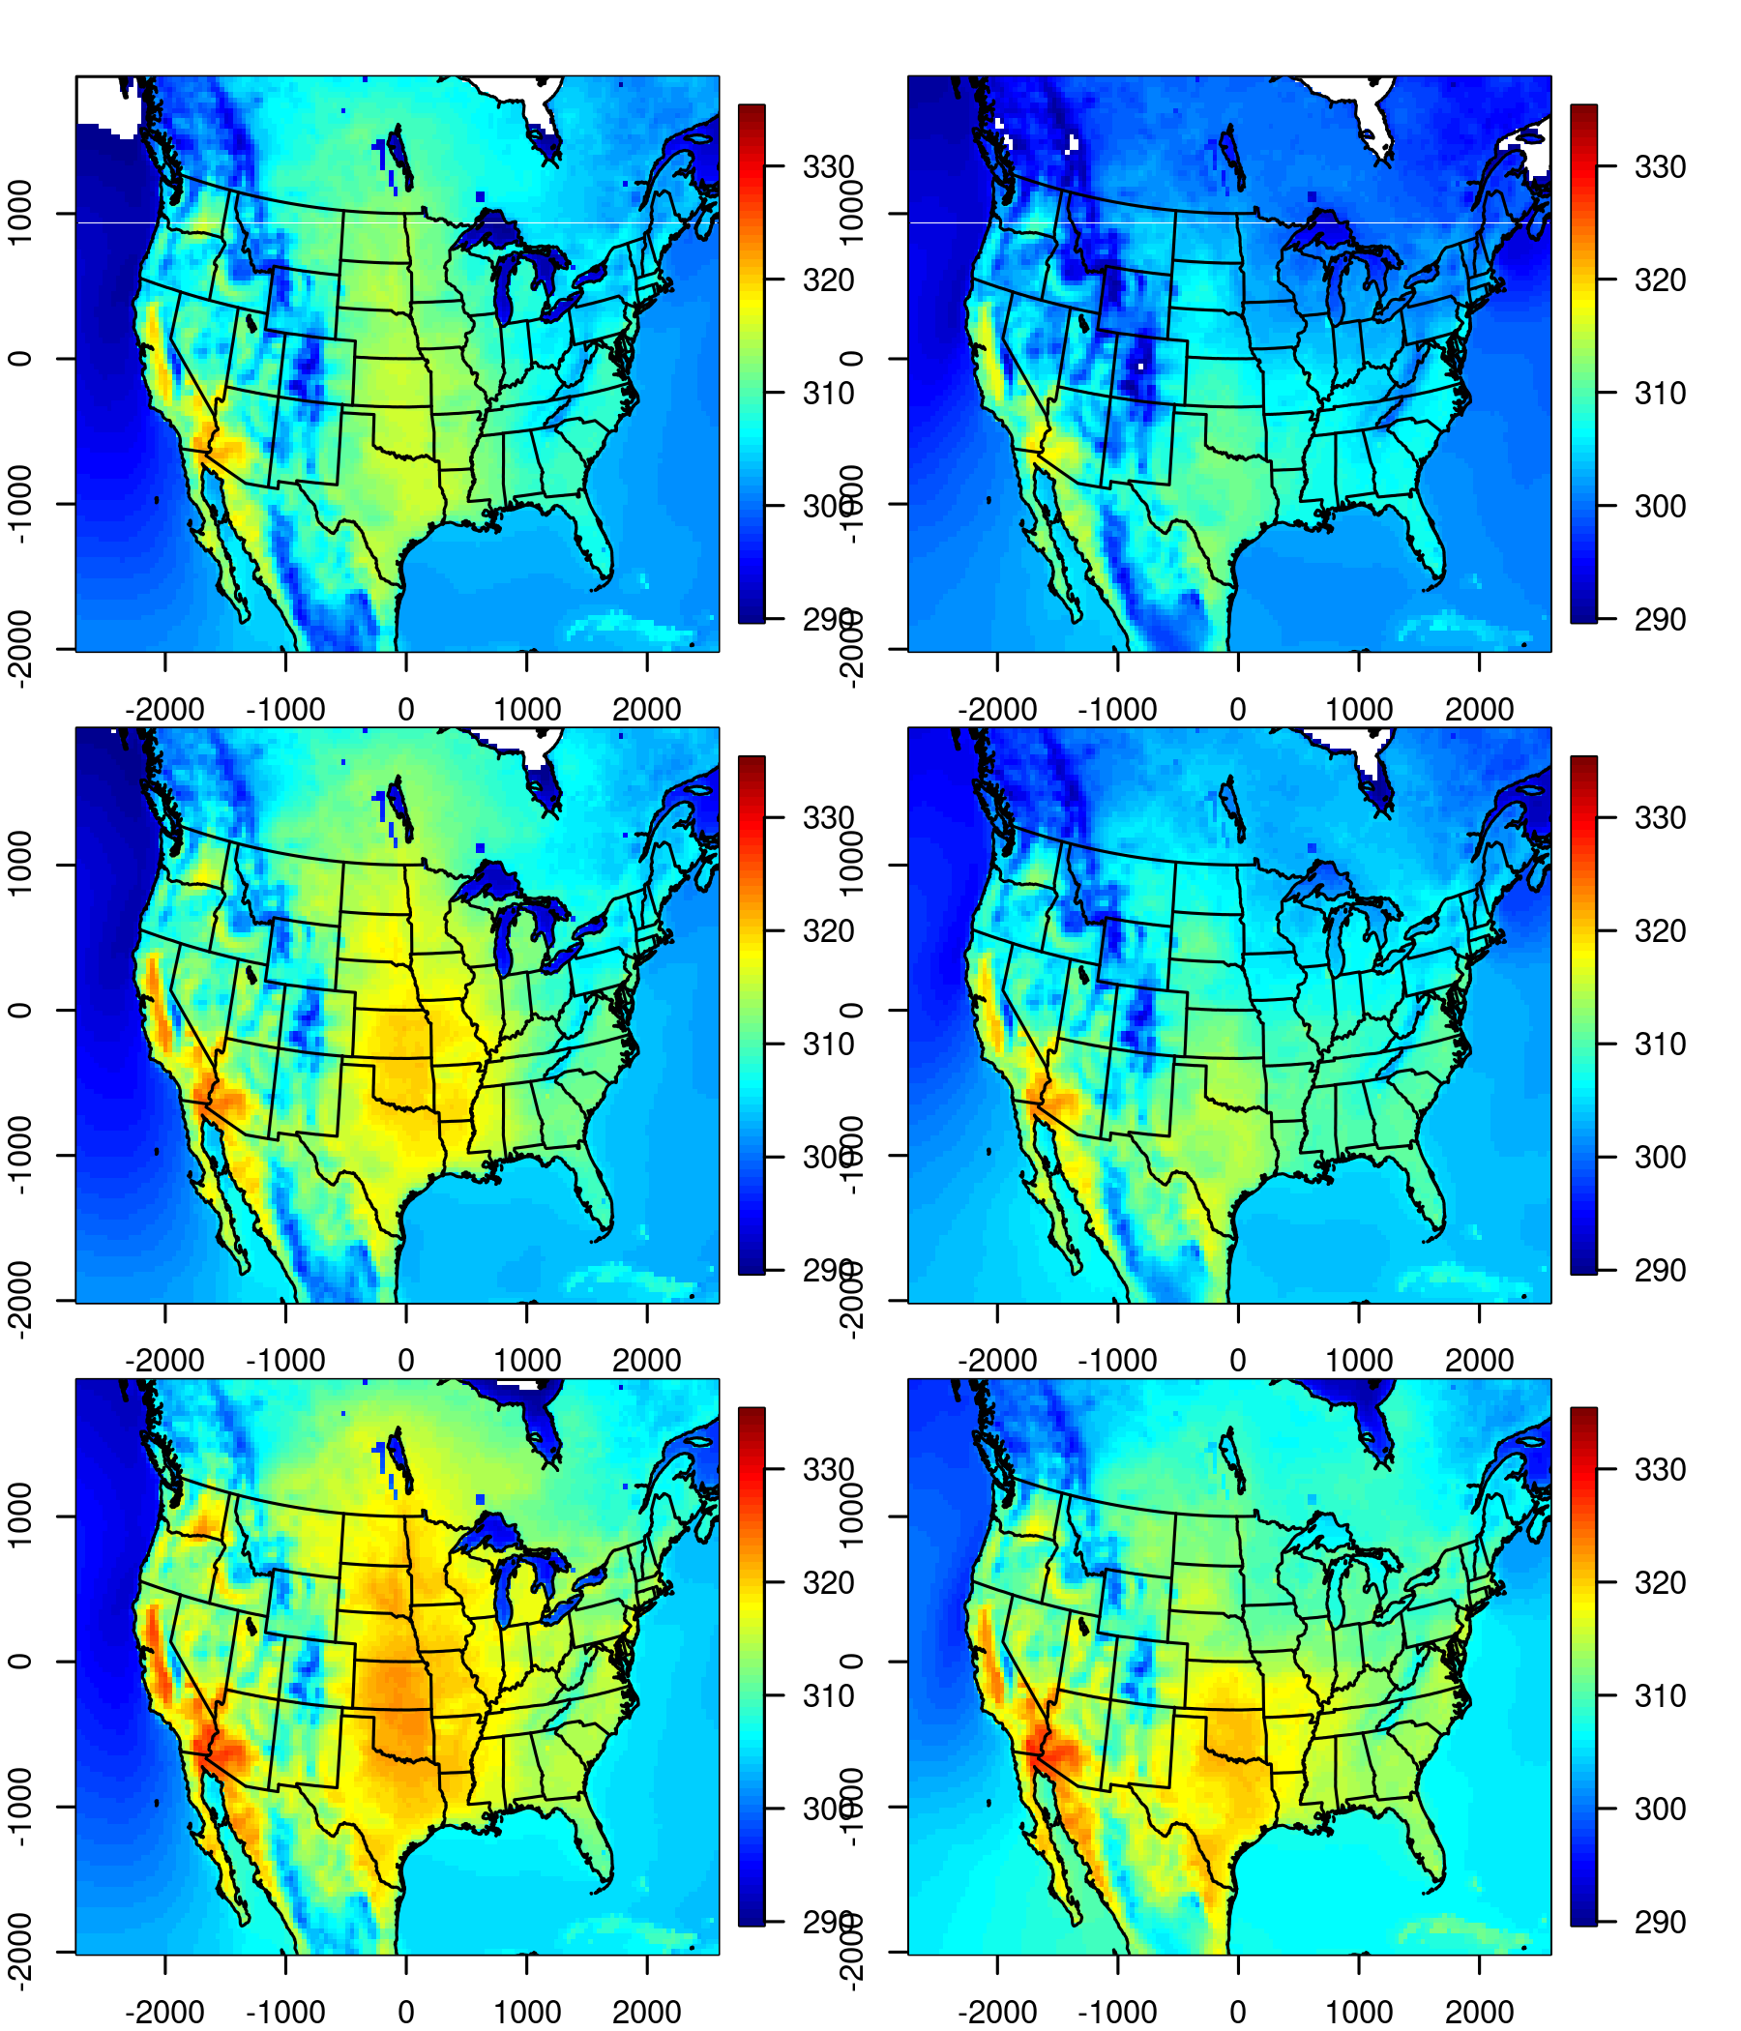
Average max temperature on top 10 days
CESM
CM3
Present (~2000)
Each time horizon represents a 5-year average: 2000-2005, 2050-2055, 2096-2100
CESM starts warmer, especially in the central U.S.
CM3 shows more accelerated warming, especially in south central U.S. (i.e. Texas)
Mid-century (~2050)
Late-century (~2100)

Slide 4
Heat Index combines T and RH
National Weather Service (NWS) Heat Index (HI) metric captures how hot it feels given the relative humidity
The NWS equation has been applied/evaluated in the literature, e.g. Anderson et al 2013*
NWS issues alerts when HI exceeds 105 degrees F, also provides hazard bins for 5 temperature ranges
* https://doi.org/10.1289/ehp.1206273

Slide 5
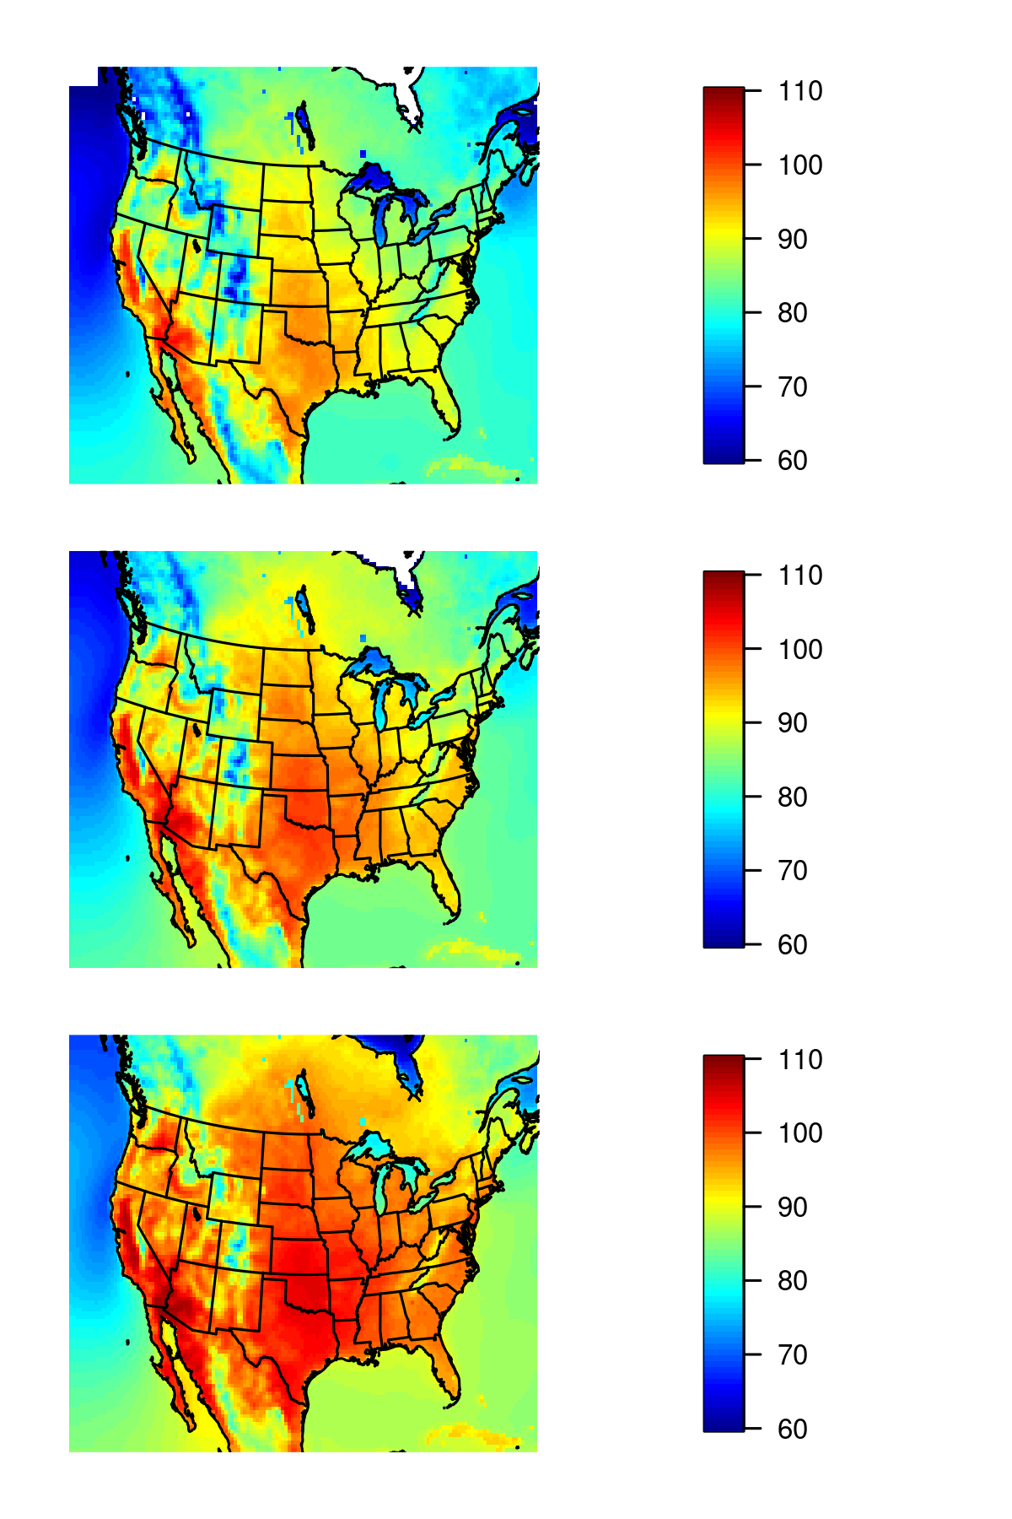
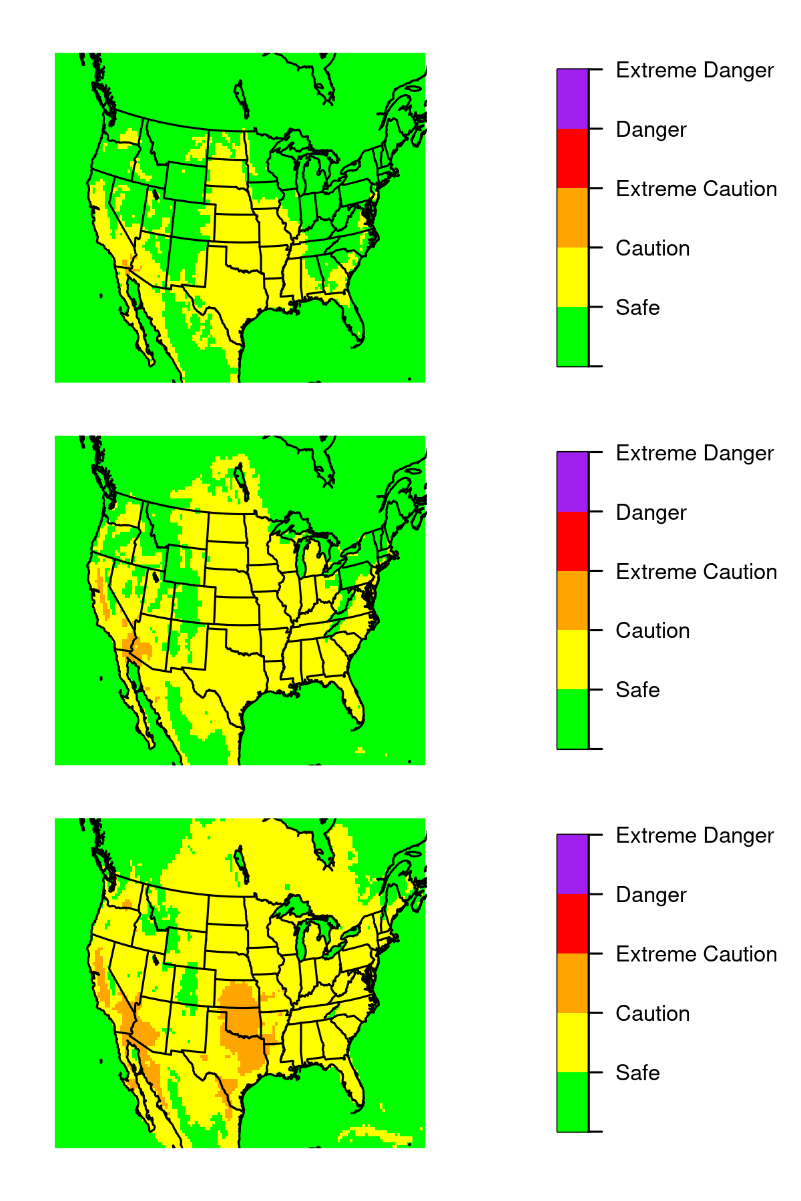
Calculated Heat Index
Binned Heat Index
~2050
>125
103-125
90-103
80-90
<80
~2100
degrees F

Slide 6
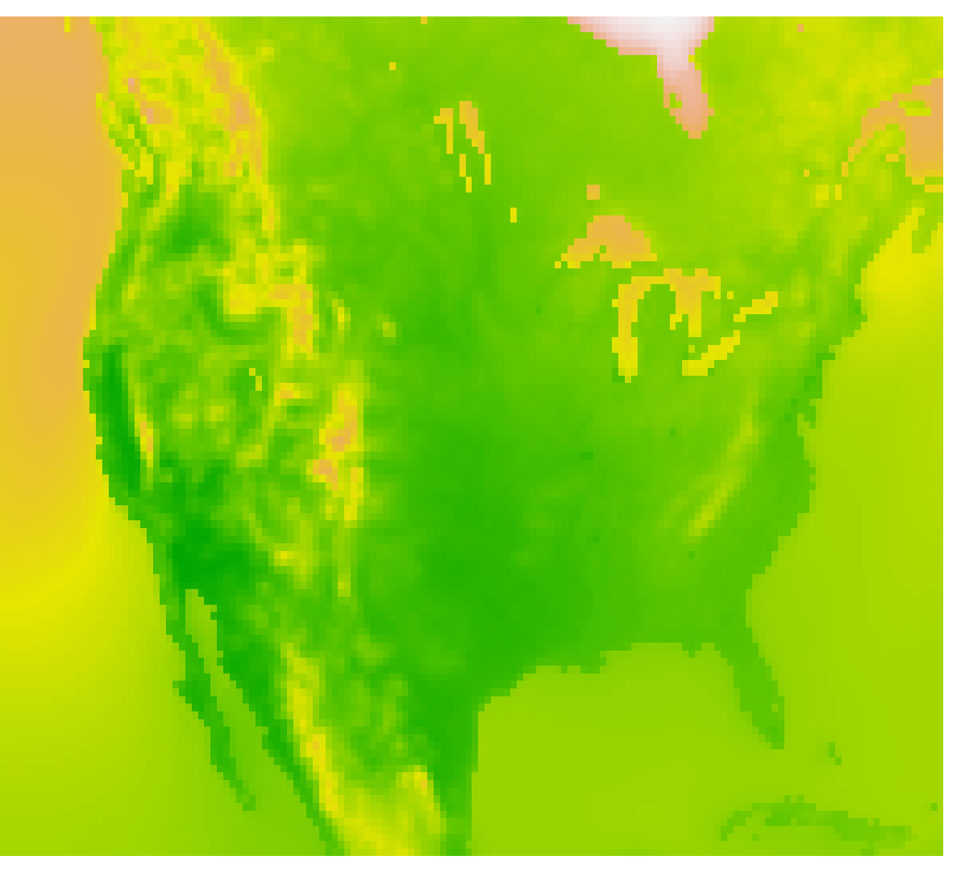
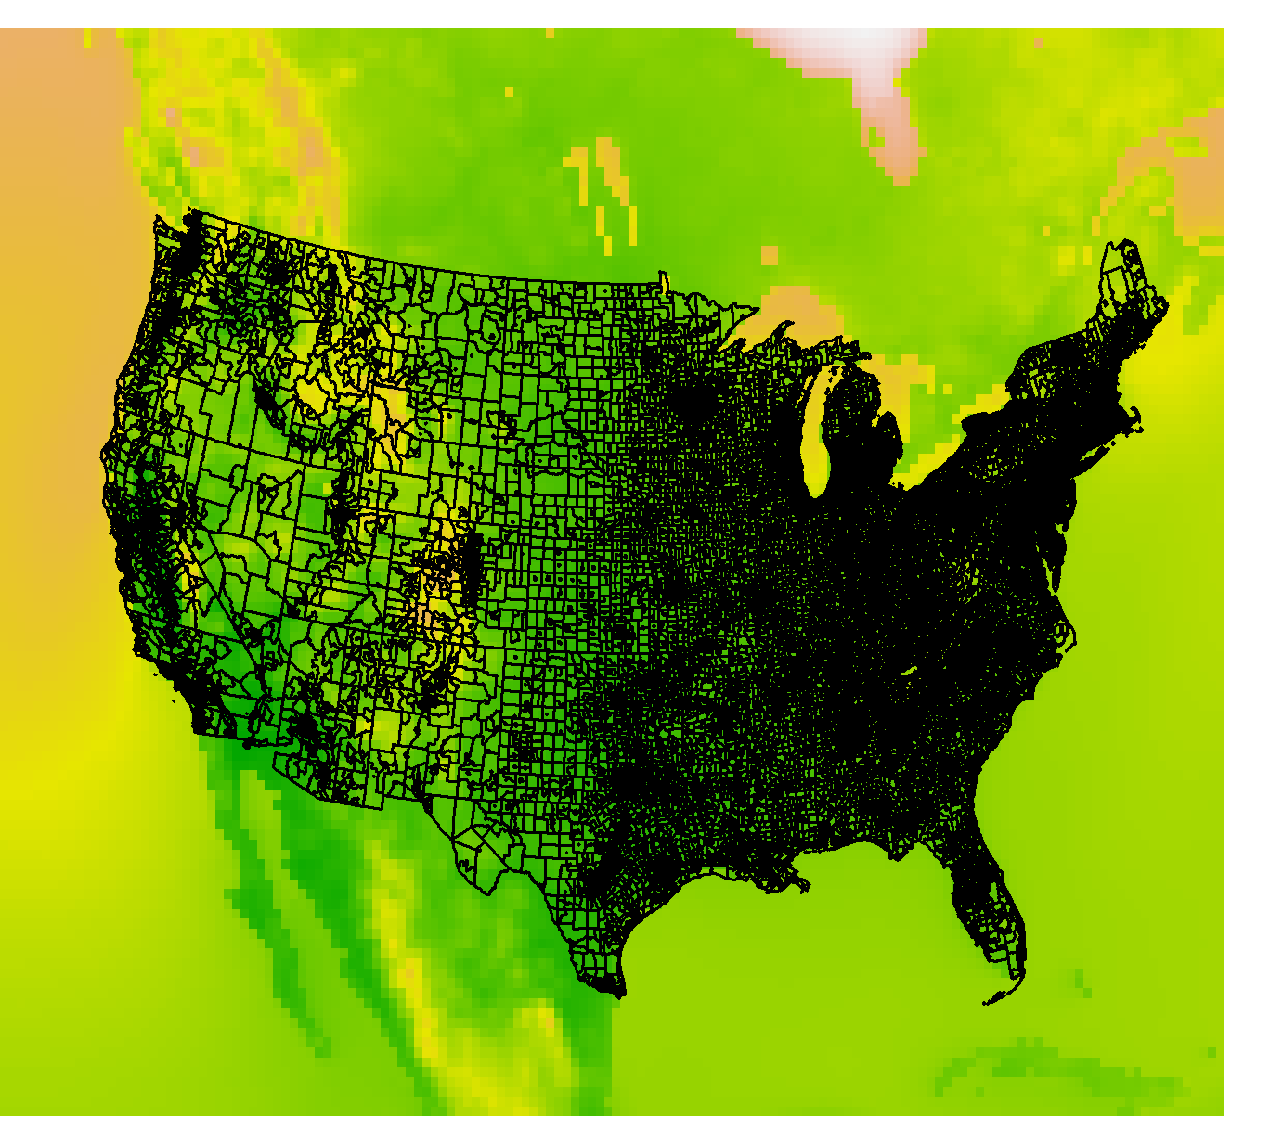
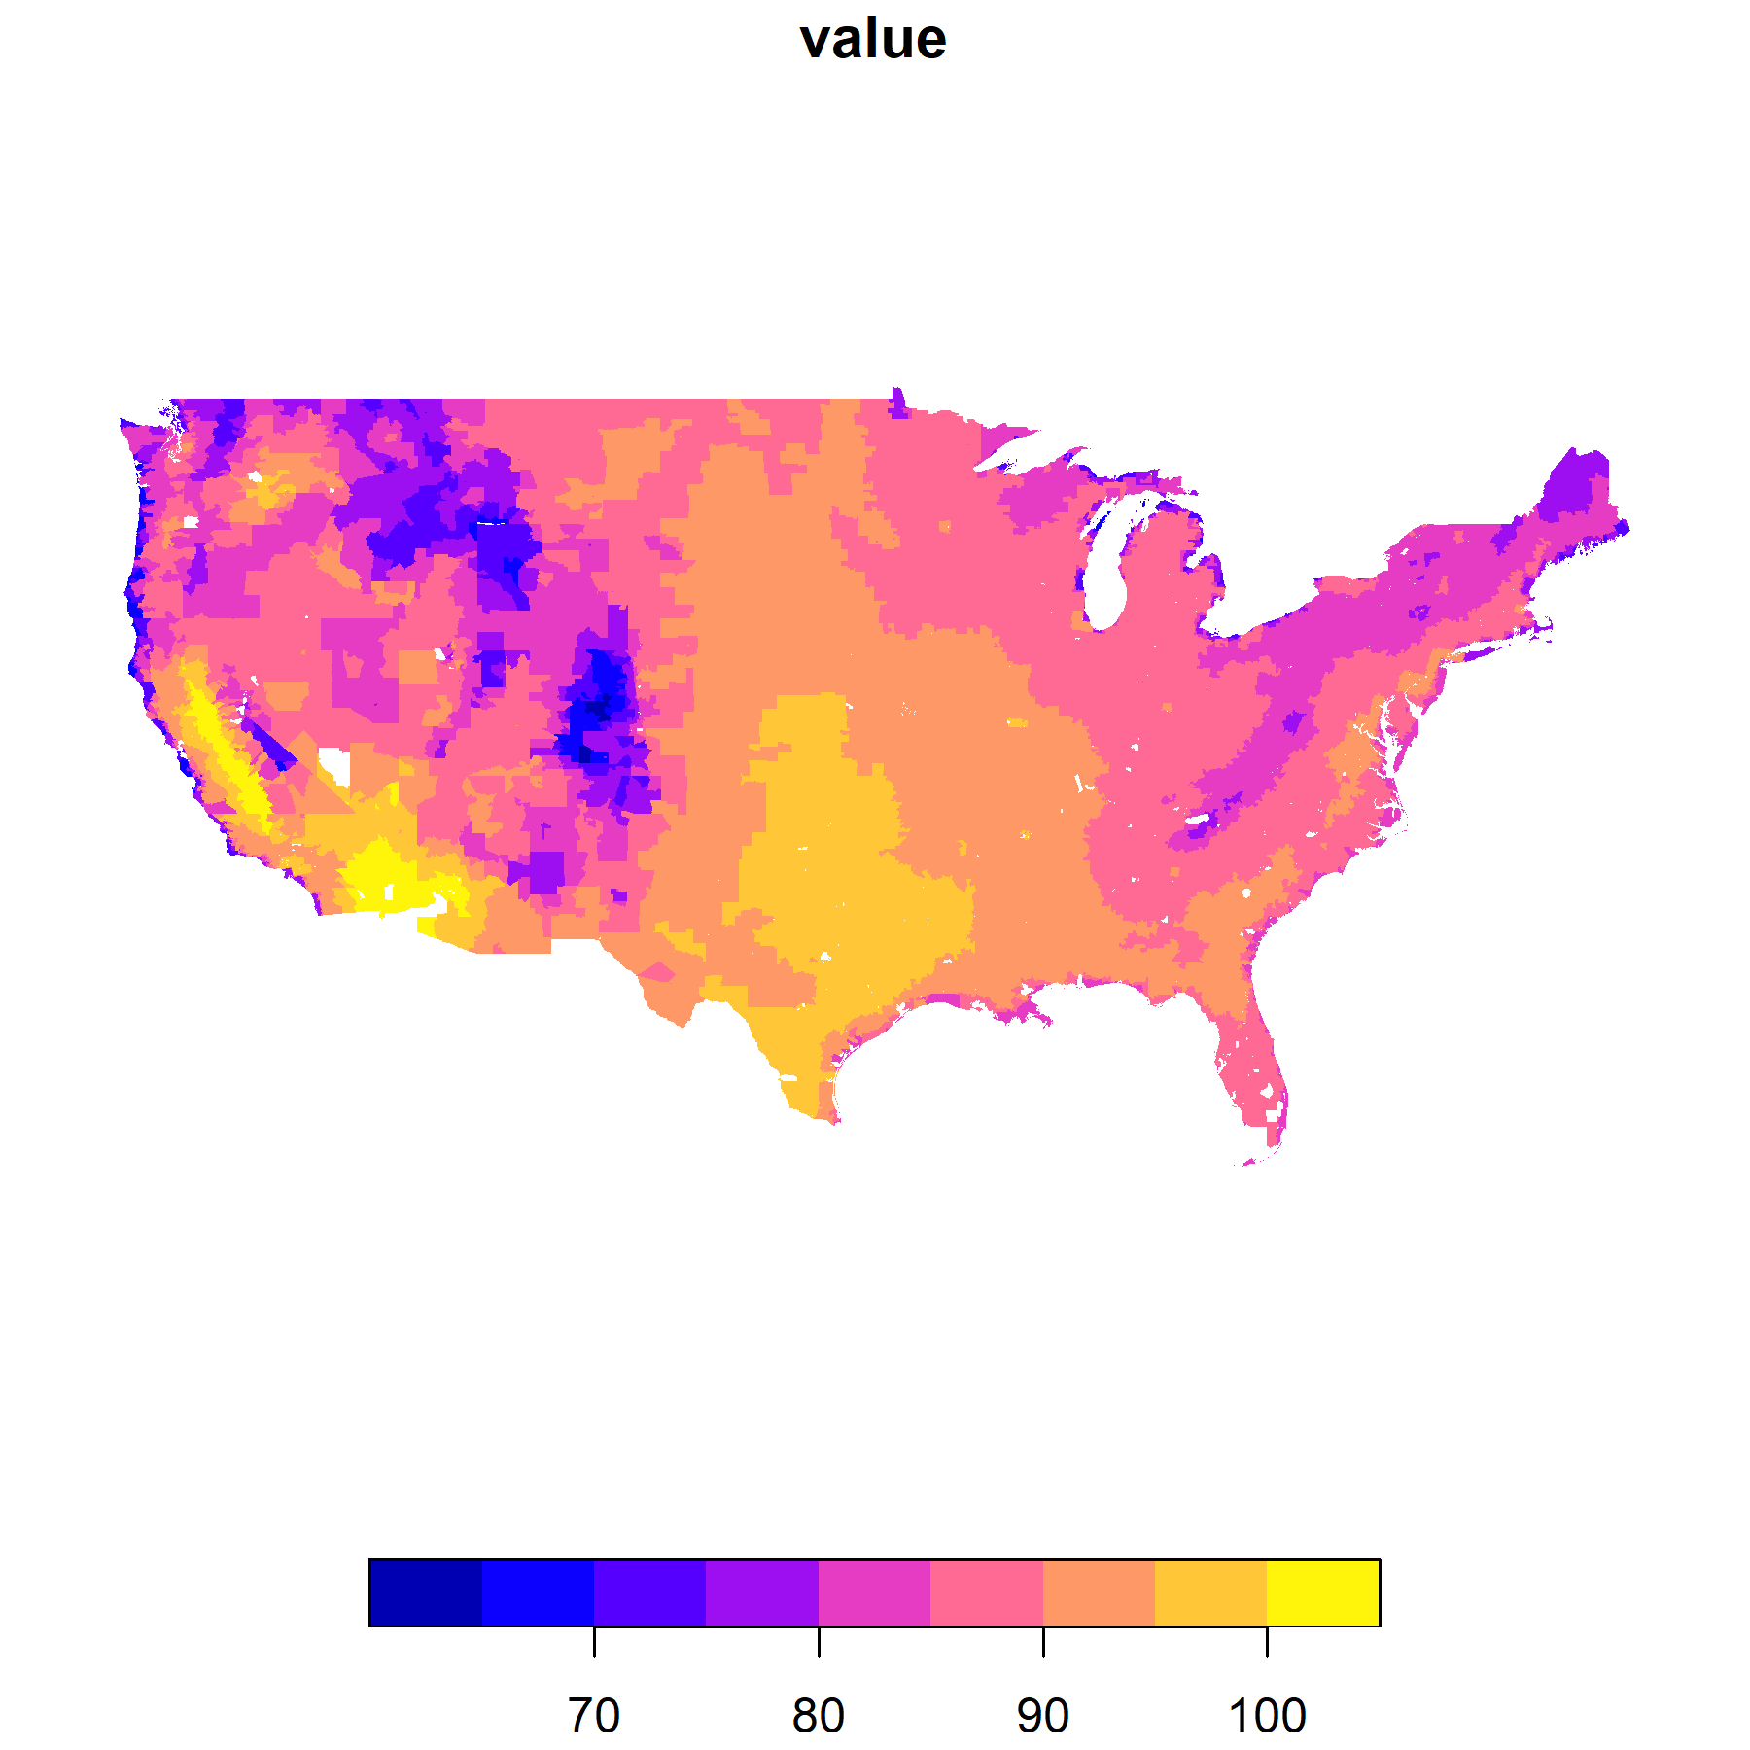
Values extracted to census tract level means with R libraries
+

Slide 7
Considerations/Next Steps
Is it reasonable to combine the CESM and CM3 outputs together?
Is it reasonable to average across 5 years at each time horizon? Would more/fewer be appropriate?
Currently using monthly mean RH for July (assumed to be hottest month) because that is archived on atmos – is it possible to get RH values sampled concurrently with top ten T day calculation?
Heat Index can be binned by hazard category (caution, extreme caution, etc) – is it more useful for NEXUS to have 5 discrete hazard bins rather than actual values?

