Slide 1
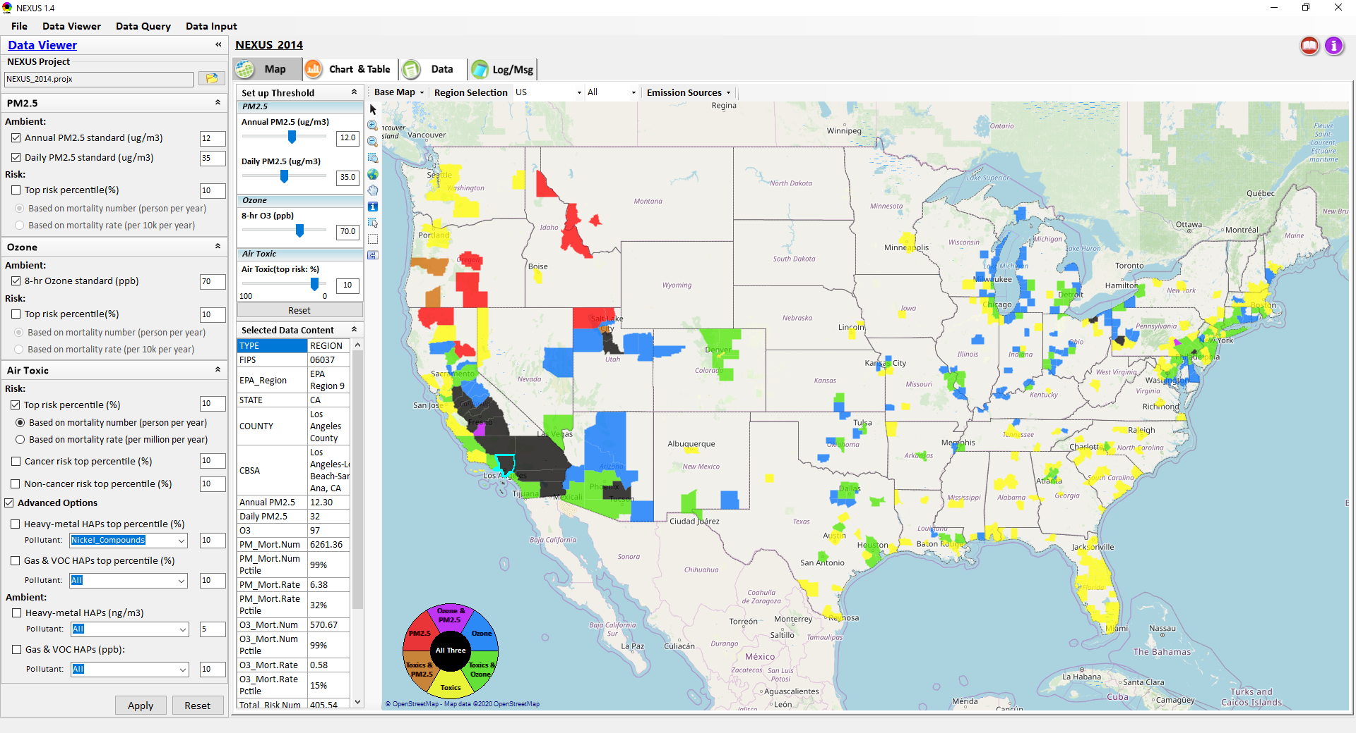
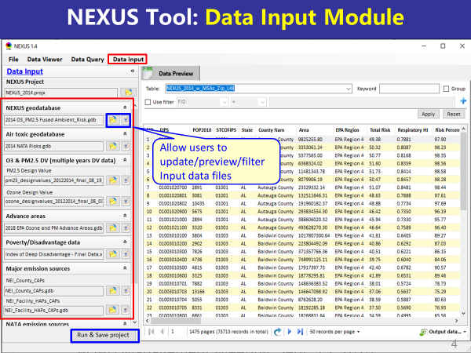
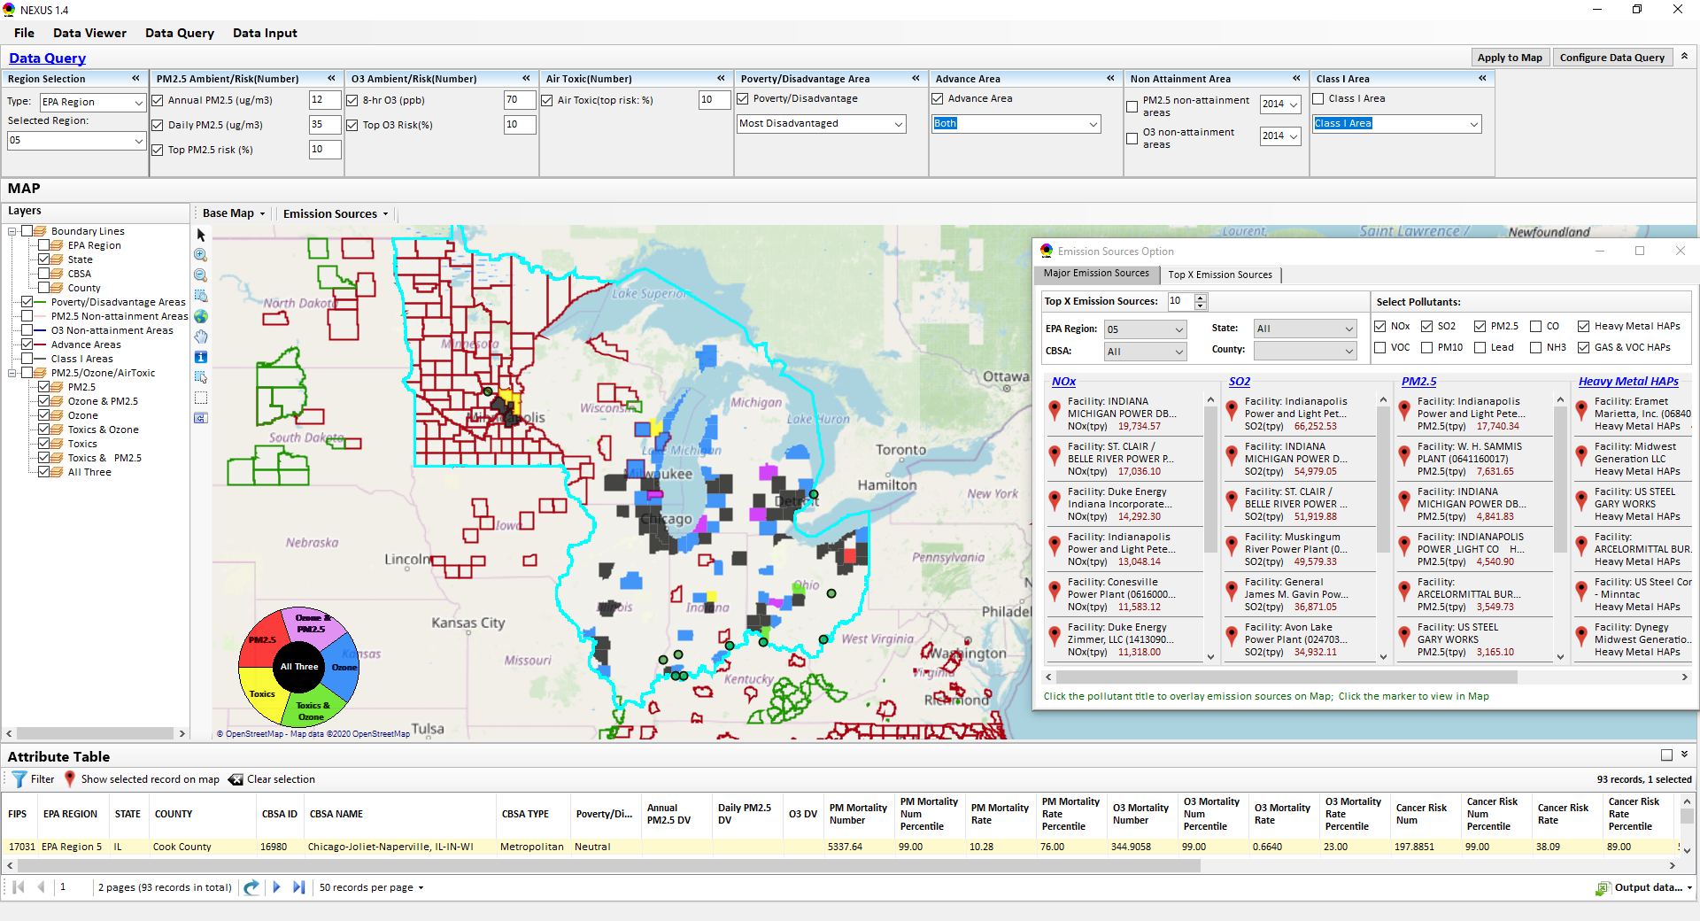
“NEXUS” Multi-Pollutant Analysis Tool Development: Status and Progress
Data Viewer Module
Data Input Module
Data Query Module
“NEXUS 1.5” available on OAQPS’s Shared Drive at: “G:\SHARE\NEXUS\NEXUS 1.5\”
or at EPA’s new FTP site: ftp://newftp.epa.gov/aqmg/cjang/NEXUS/NEXUS 1.5/
Carey Jang, AQAD/Air Quality Modeling Group
AQ Model Apps Team meeting, Jan. 13, 2021

Slide 2
NEXUS Tool Development
Motivation: Develop a new multi-pollutant analysis tool to identify and assess areas with high ambient levels and/or health risks associated with PM2.5, O3, and air toxics
Phase-1: Develop a GIS-based NEXUS prototype with a user-friendly graphical interface to provide analysis and visualization functions of potential multi-pollutant AQ issues at national level (continental US)
Phase-2: Expand the NEXUS tool to allow users to dial into an EPA region, State, or metropolitan area and provide data query and V/A functions for “AQ and emissions” information over the selected region of interest
2

Slide 3
Expected Use of NEXUS Tool
The NEXUS tool will allow users to do the following:
National screening for areas with MP issues: Phase 1 development will provide ability to quickly screen areas across nation that have combination of high air quality and/or risk levels for O3, PM2.5 and air toxics.
Area screening to understand nature of MP problem: Phase 2 development will provide ability to ‘dial-into’ specific areas to determine extent to which common emissions sources are causing the MP issues.
OAQPS expects to use this tool to engage with Regions and identify areas that would potentially benefit most from MP approaches to reduce emissions (including current NAs and Advance areas).
The NEXUS tool will essentially provide a ‘conceptual model’ of MP issues to facilitate engagement with state/local/tribal agencies and community stakeholder groups.
3

Slide 4
NEXUS Tool : Schedule & Installation
Work Plan | Date
Developed a NEXUS prototype to provide MP analysis at national level (Phase 1) | April 2020
Developed a working NEXUS version with a new three-module design and regional level analysis (Phase-2) | August 2020
Developed a fully functional NEXUS tool and on-line User’s Manual | Dec. 2020
Upgrading NEXUS tool for Beta test & preparing for public release | Jan. ~ July 2021
Download “NEXUS” tool: The “NEXUS 1.5” package (“NEXUS v1.5 setup.exe” & “NEXUS 1.5 Data.exe”: run both to install) is available at OAQPS’s Shared Drive at G:\SHARE\NEXUS\NEXUS 1.5\ or at EPA’s new FTP site ftp://newftp.epa.gov/aqmg/cjang/NEXUS/NEXUS 1.5/
(Note: Require software installation privilege to install “NEXUS tool” at EPA’s PCs)
4

Slide 5
NEXUS Tool : Briefing Schedule
Audience | Date
AQAD & HEID – DD & Management Team | Sept. 25, 2020
Air Toxics Team | Nov. 3, 2020
AQPD – DD & Management Team | Dec. 10, 2020
OID – DD & Management Team | Jan. 25, 2021
SPPD – DD & Management Team | Jan 27, 2021
OAQPS – Office Director | Feb 1, 2021

Slide 6
NEXUS Tool: Three Key Modules
Data Viewer module
Data Input module
Data Query module
View and create interactive Map/Data/Chart/Table
Provide flexible selections & mapping of “Ambient” and/or “Risk” levels of PM2.5, O3 and air toxics
Provide regional analysis for “EPA region”, “States”. CBSA”, and “County”
Link and display major emission sources locations & emitted pollutants info.
Allow to update & change input data files
Provide data preview and filter functions
Extend to use 10 input data files now (publicly available, ~4 GB)
Quick turnaround to run & save to a new “project” using new input data files
Expand data field selections and flexibility for exploratory/advanced users
Provide overlaying map and summary table for data query results
Current data query based on selected data fields: “Ambient/Risk, Advance area, Socio-demographic (EJ) area, NA Area, Class I area”

Slide 7
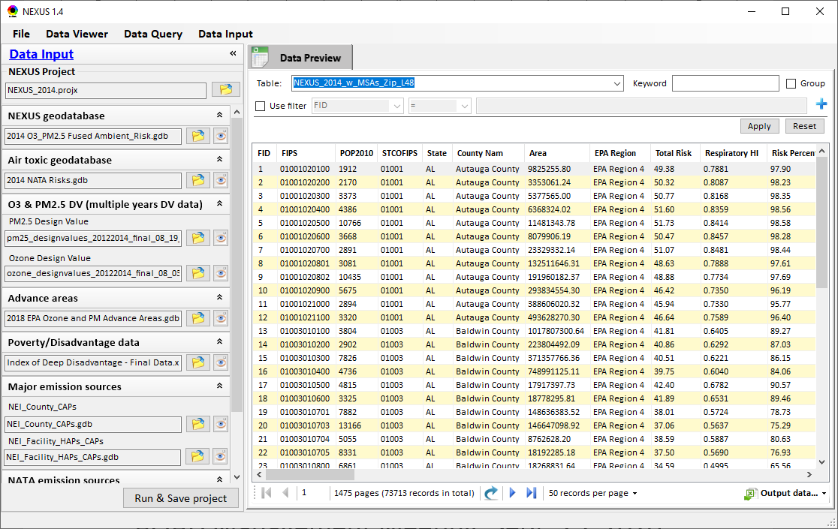
NEXUS Tool: Data Input Module
Allow users to update/preview/filter Input data files
Currently, there are 10 input data files used (publicly available)
Total files size ~4 GB
Run and Save to a new project after loading new input data files
7

Slide 8
Data Input File Names | Data Format | Data Description | Data Source | Data Period
“2014 O3 & PM2.5 fused Ambient & Risk” | Geodataset | O3/PM2.5 ambient & risk data at county/census tract level | from OAQPS MP team | 2014
“2014 NATA Risk” | Geodataset | Air toxics ambient & risk data at county/census tract level | from OAQPS MP team | 2014
“O3_DV_2009_2018” | Excel | O3 design values at county level | From EPA public website: https://www.epa.gov/air-trends/air-quality-design-values | 2009 to 2018
“PM_DV_2009_2018” | Excel | PM2.5 design values at county level | From EPA public website: https://www.epa.gov/air-trends/air-quality-design-values | 2009 to 2018
“Advance areas O3_PM” | Geodataset | O3 & PM2.5 Advance Areas | from OAQPS MP team | 2018
“Index of Poverty_ Disadvantage” | Excel | Index of poverty/disadvantage at county level | from Univ. of Michigan website: https://poverty.umich.edu/projects/understanding-communities-of-deep-disadvantage/ | 2017
“NEI_County_CAPs” “NEI_Facility_HAPs_ CAPs” | Geodataset | Major emission sources and facility info. of CAPs & HAPs at county level | From OAQPS public website: ftp://newftp.epa.gov/EPADataCommons/OAR/OAQPS/NEI/NEI_Facility_HAPs_CAPs.zip ftp://newftp.epa.gov/EPADataCommons/OAR/OAQPS/NEI/NEI_County_CAP.zip | 2008, 2011, 2014
“2014 NEI_NATA Emissions” | Access Database (*. accdb) | NATA emissions data from 2014 NEI database, including various source groups | From EPA public website: https://www.epa.gov/national-air-toxics-assessment/2014-nata-assessment-results#emissions | 2014
“Class1_FederalAreas” | Geodataset | Mandatory Class 1 Federal Areas | From Mandatory Class 1 Federal Areas Web Service: https://edg.epa.gov/data/public/OAR/OAQPS/Class1/Class1Areas.zip | —
Data Input Module: Input Files & Attributes
8

Slide 9
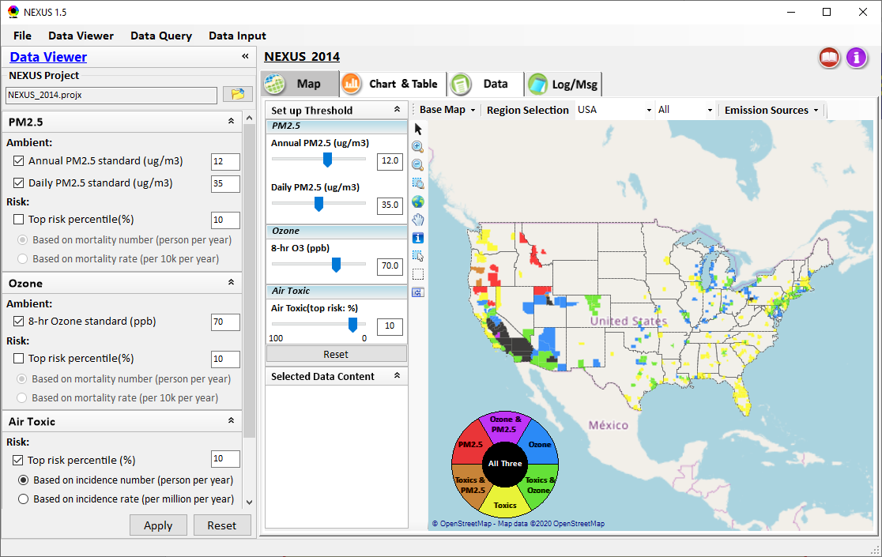
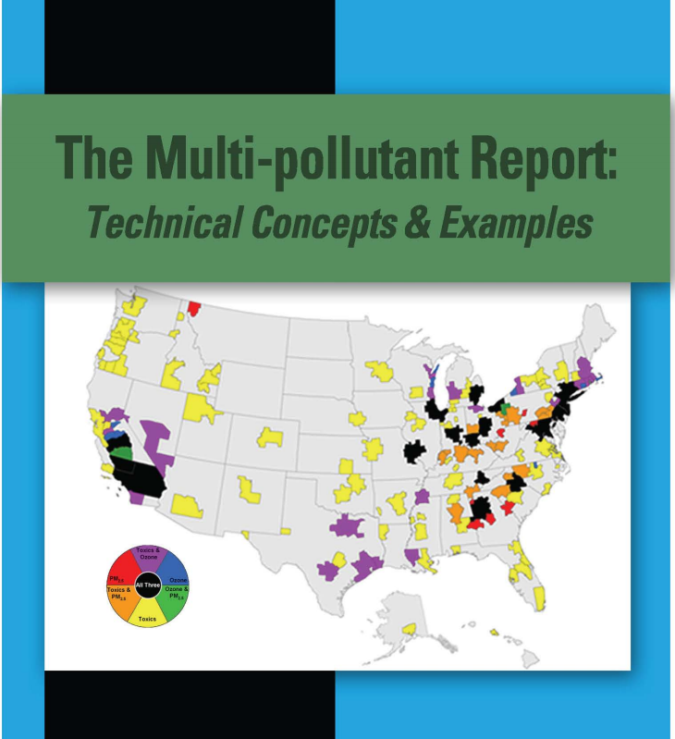
NEXUS Tool Demo: 2014 NEXUS Case
Launching Page
Roadmap for Demo:
(Use example cases)
National View: Use “NEXUS” across pollutants to provide an initial “SCREEN” at the national level by providing an indicator where there may be a common set of sources contributing to Multi-pollutant issues.
Regional View: Dial into a region or area of interest to understand the pollutant/source connections, and potential for more effective and efficient multi-pollutant solution.
2008
9

Slide 10
Discussion and Next Steps (1)
Short-term:
GOAL: Upgrade/improve NEXUS tool to reflect latest data & information and MP team’s feedbacks
Currently expect FY21 funding to support NEXUS -- perhaps $50k from AQAD
Update NEXUS data to 2017
2017 data for O3, PM2.5 & Air Toxics risk/ambient/emissions
Tribal boundaries & socioeconomic/demographic data for EJ
Add O3, PM2.5, and Air Toxics monitoring data
Update metrics/indicators (e.g., risk metrics, EJ indicators)
Engage across Office to determine how this tool may best inform or be used for OAQPS’s Air Toxic Strategy programs
Consider addition of screening-level analysis & assessment capabilities (e.g., proximity analysis w/ EJ)
10

Slide 11
Discussion and Next Steps (2)
Long-term:
Upgrade and prepare NEXUS for Beta test with EPA Regions followed by public release & training
Based on Office wide engagements, exercise updated NEXUS tool with 2017 data to inform Multi-pollutant, Air Toxics, and EJ efforts as appropriate
Develop plan for routine updates and maintenance of the NEXUS tool to best support OAR/OAQPS programs and determine appropriate extensions as need and resources provide.
11

Slide 12
“NEXUS 1.5”: Quick Tutorial
Carey Jang
Download “NEXUS” tool: The “NEXUS 1.5” package (“NEXUS v1.5 setup.exe” & “NEXUS 1.5 Data.exe”: run both to install) is available at OAQPS’s Shared Drive at: G:\SHARE\NEXUS\NEXUS 1.5\
or at EPA’s new FTP site:
ftp://newftp.epa.gov/aqmg/cjang/NEXUS/NEXUS 1.5/
(Note: Require software installation privilege to install “NEXUS tool” at EPA’s PC)
12

Slide 13

NEXUS Tool: On-line User’s Manual
Click “book” icon to launch “User’s manual”
Hot link to User’s manual’s “Data Viewer” chapter (same for “Data Input” & “Data Query”
13

Slide 14
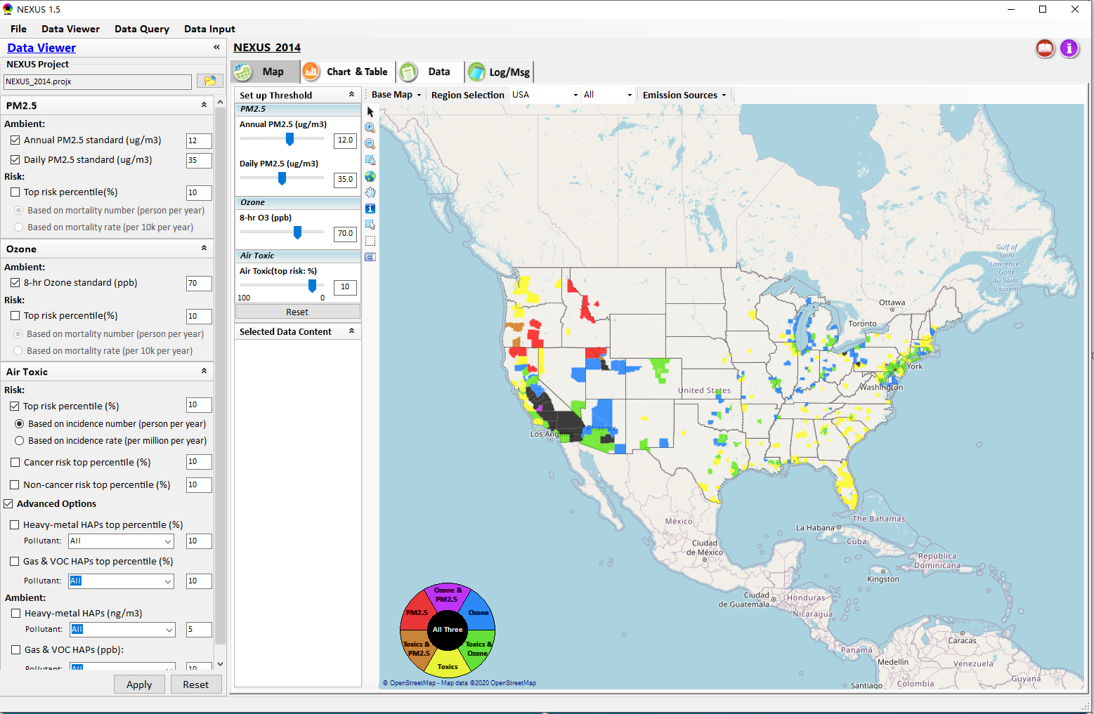

NEXUS Tool: Data Viewer Module
Click “File” to open or save a project
Switch between 3 key modules
Loaded NEXUS project file name
Select & adjust “Ambient” & “Risk” levels
“Advanced Option”: provide HAPs & species selections
14

Slide 15
Data Viewer Module: Selections & Map Display
Select & adjust “Ambient” & “Risk” threshold levels for color map display
“Apply” new selections to “Radio button” panel
15

Slide 16
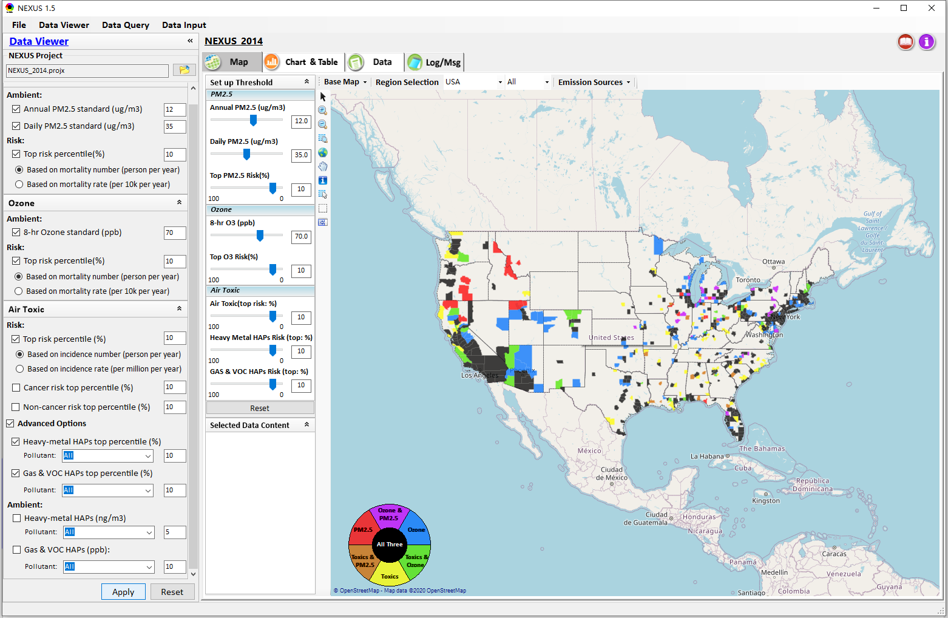
Data Viewer: “Apply” New Selections
“Check” new selections
New selections will appear on-the-fly in “radio button” panel and map display
“Apply” new selections
16

Slide 17
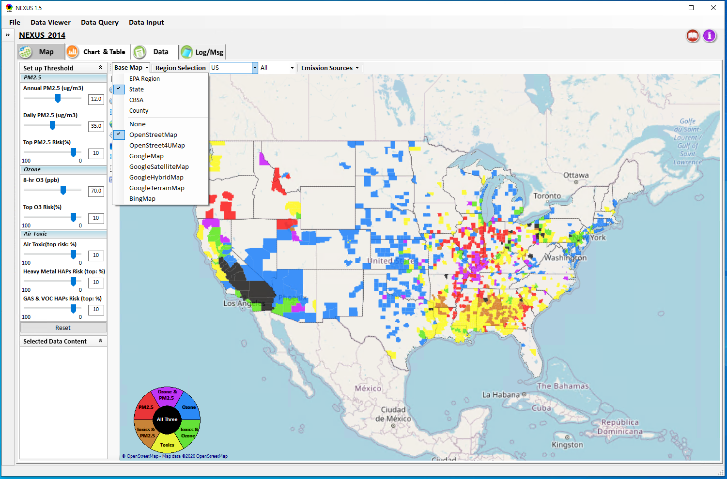
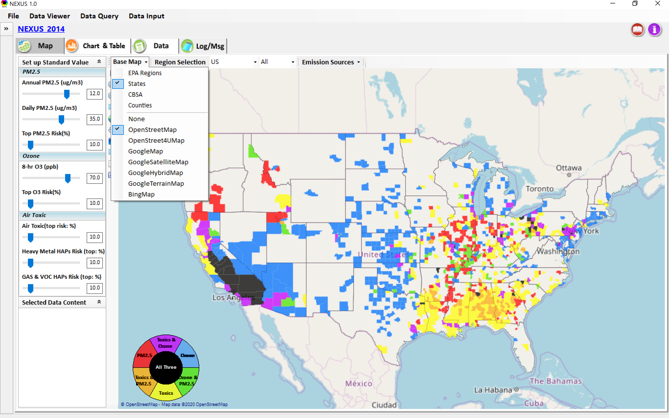
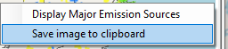
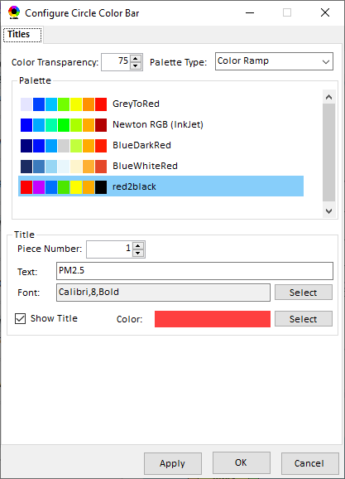
Data Viewer Module: Base Map & Color
“Base Map”: Change boundary lines and background map
“Right-click” map to save image
Click to change color & transparency
17

Slide 18
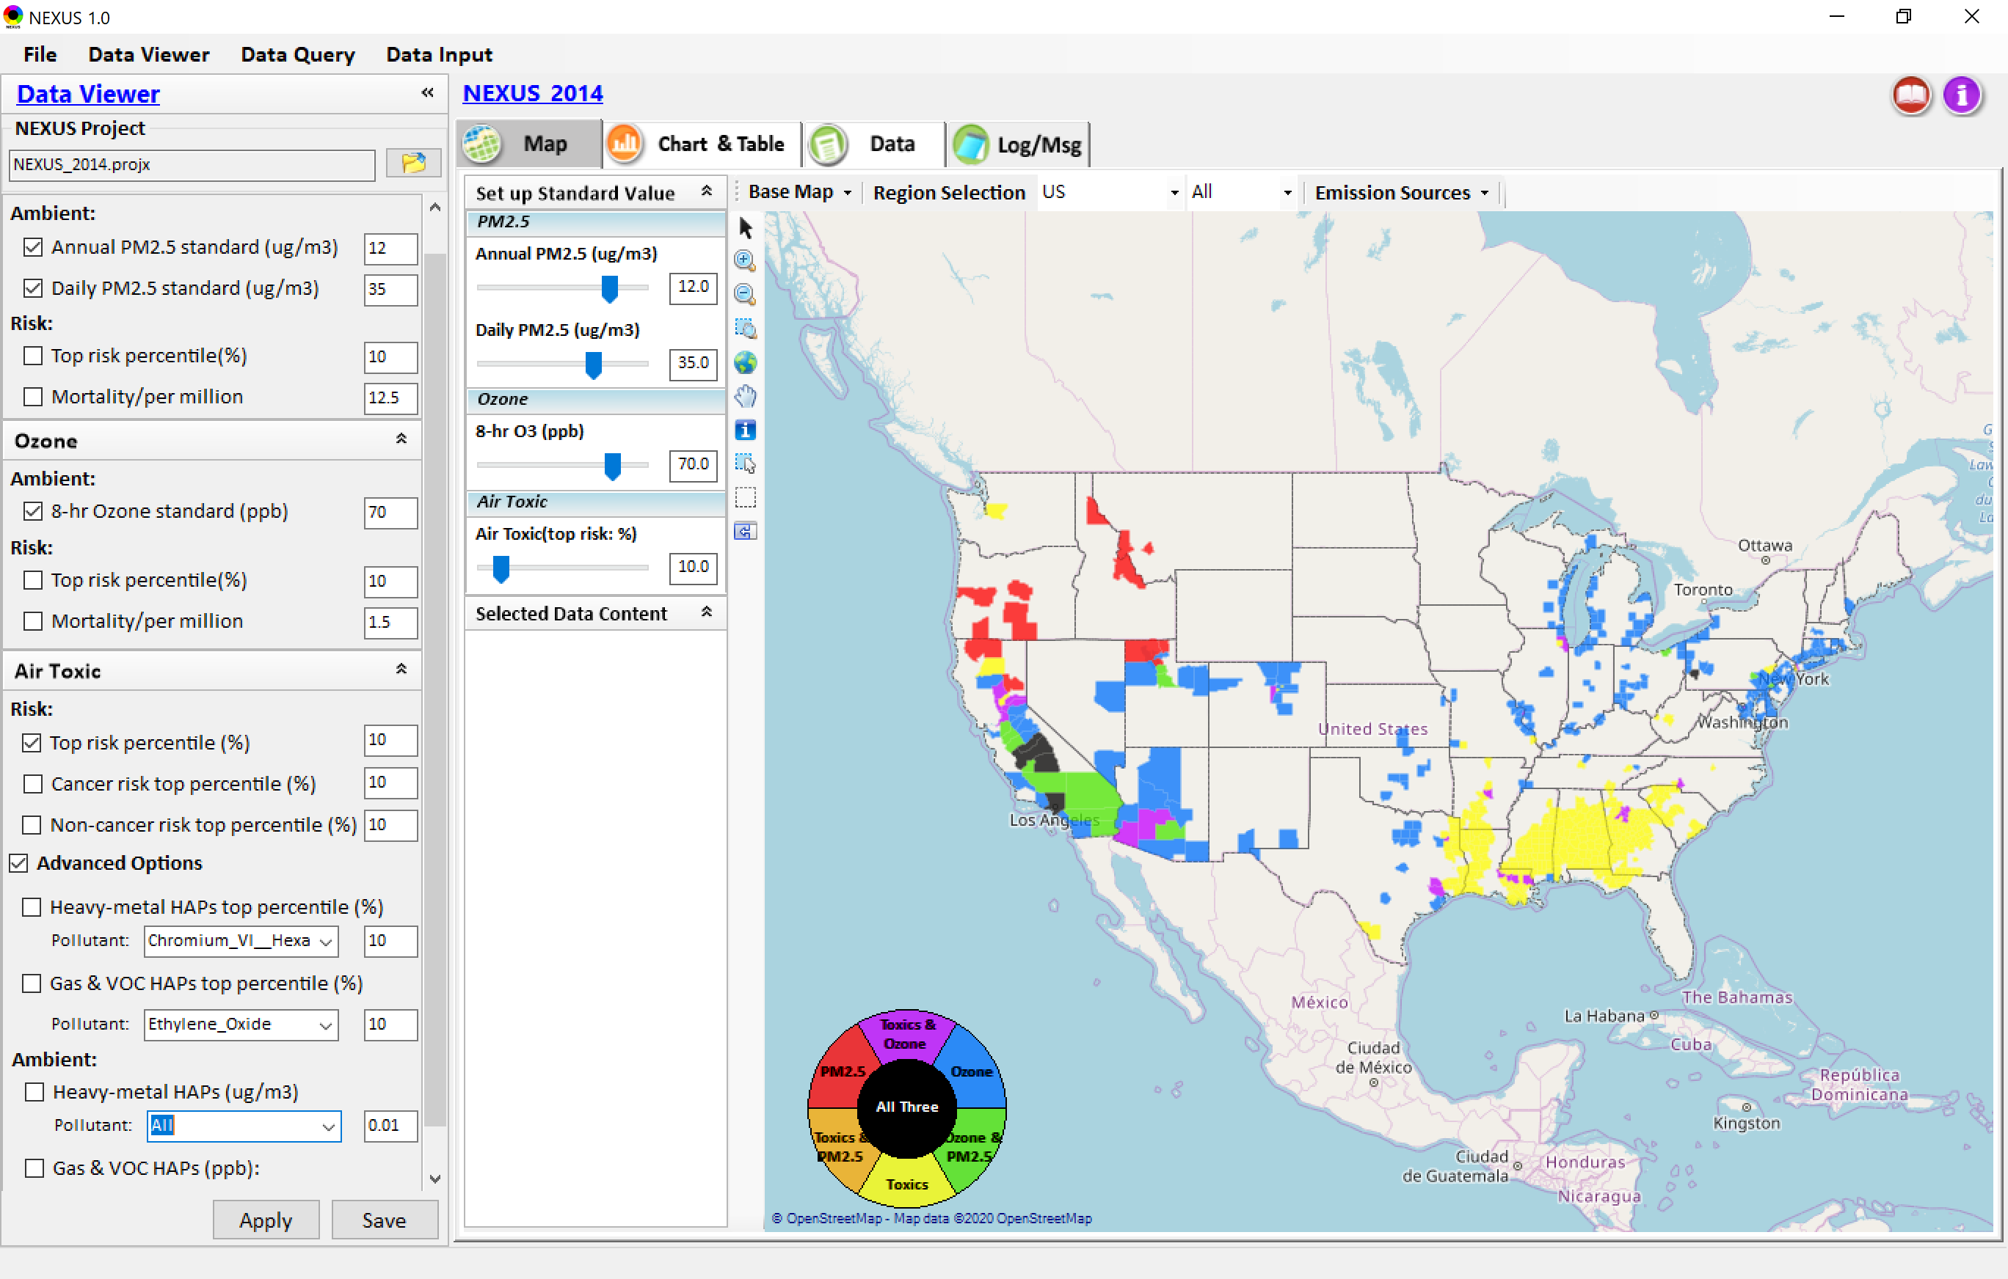

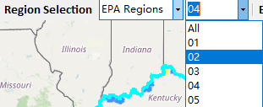
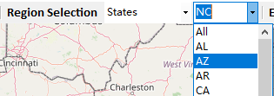
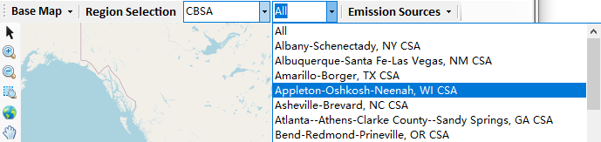
Data Viewer: “Region Selection”
Allow to select “EPA regions”, “States”, or “CBSA”
18

Slide 19
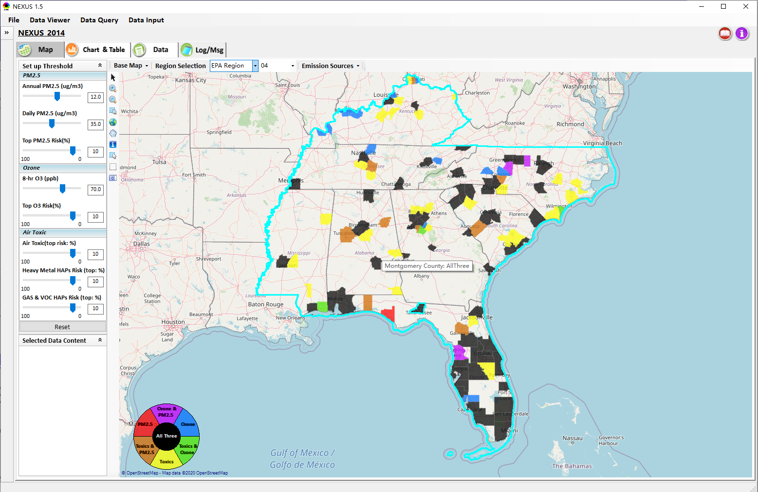
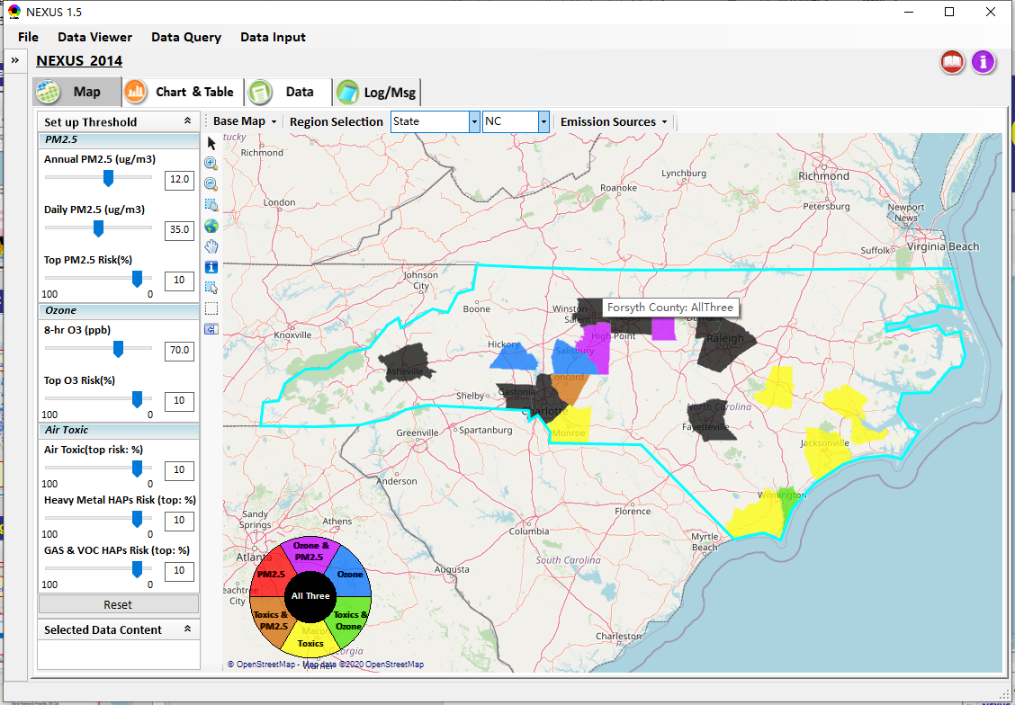
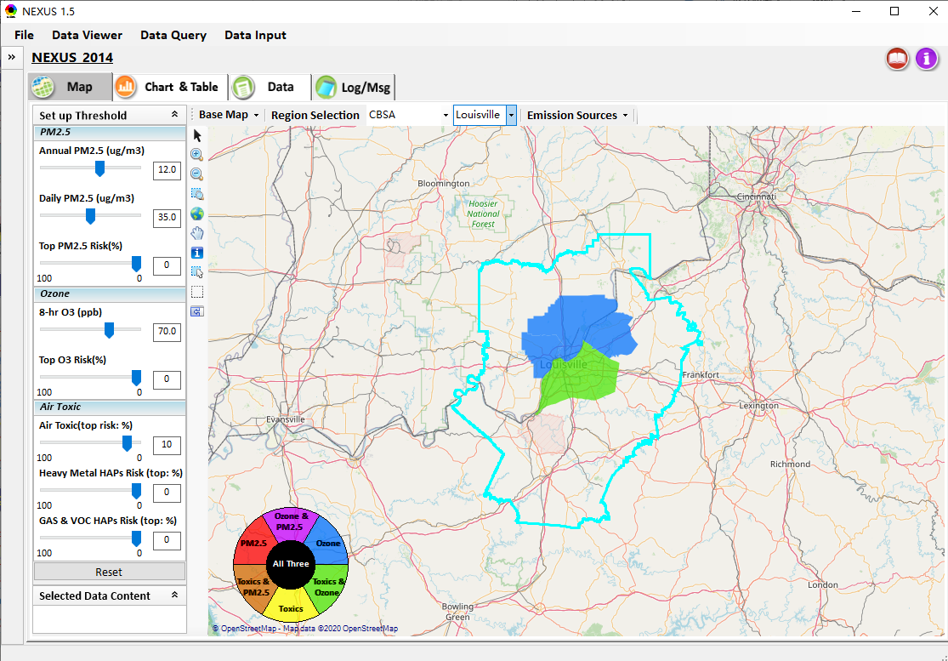
Data Viewer: Select EPA Region/State/CBSA
Examples:
EPA Region 4
NC
Louisville CBSA
19

Slide 20
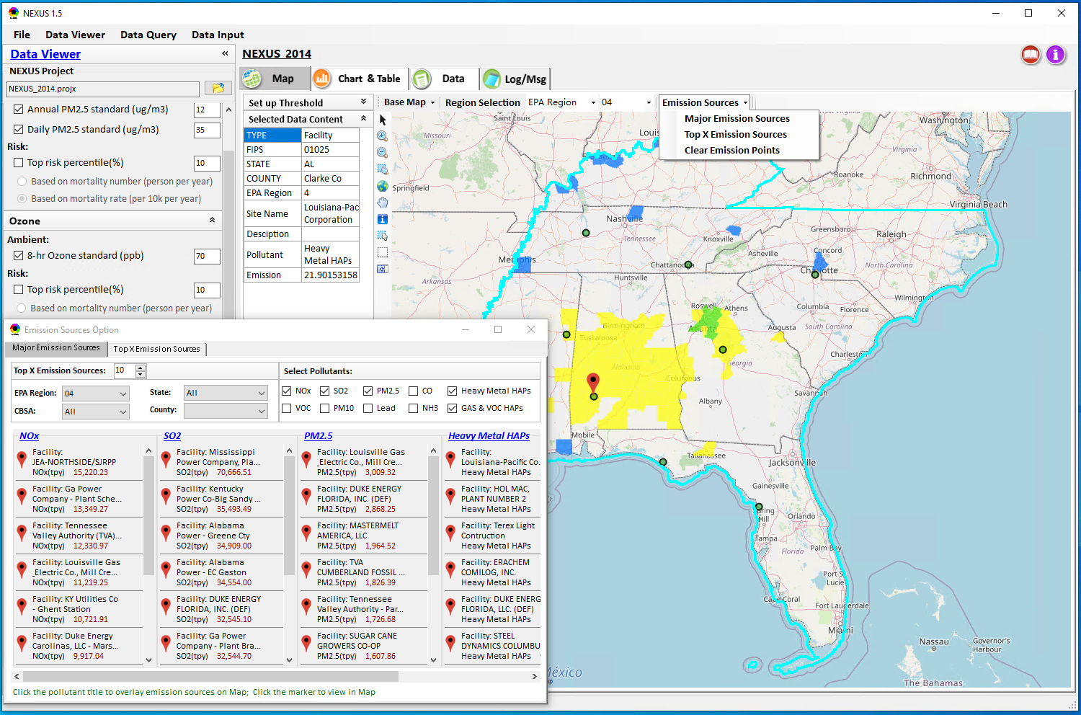
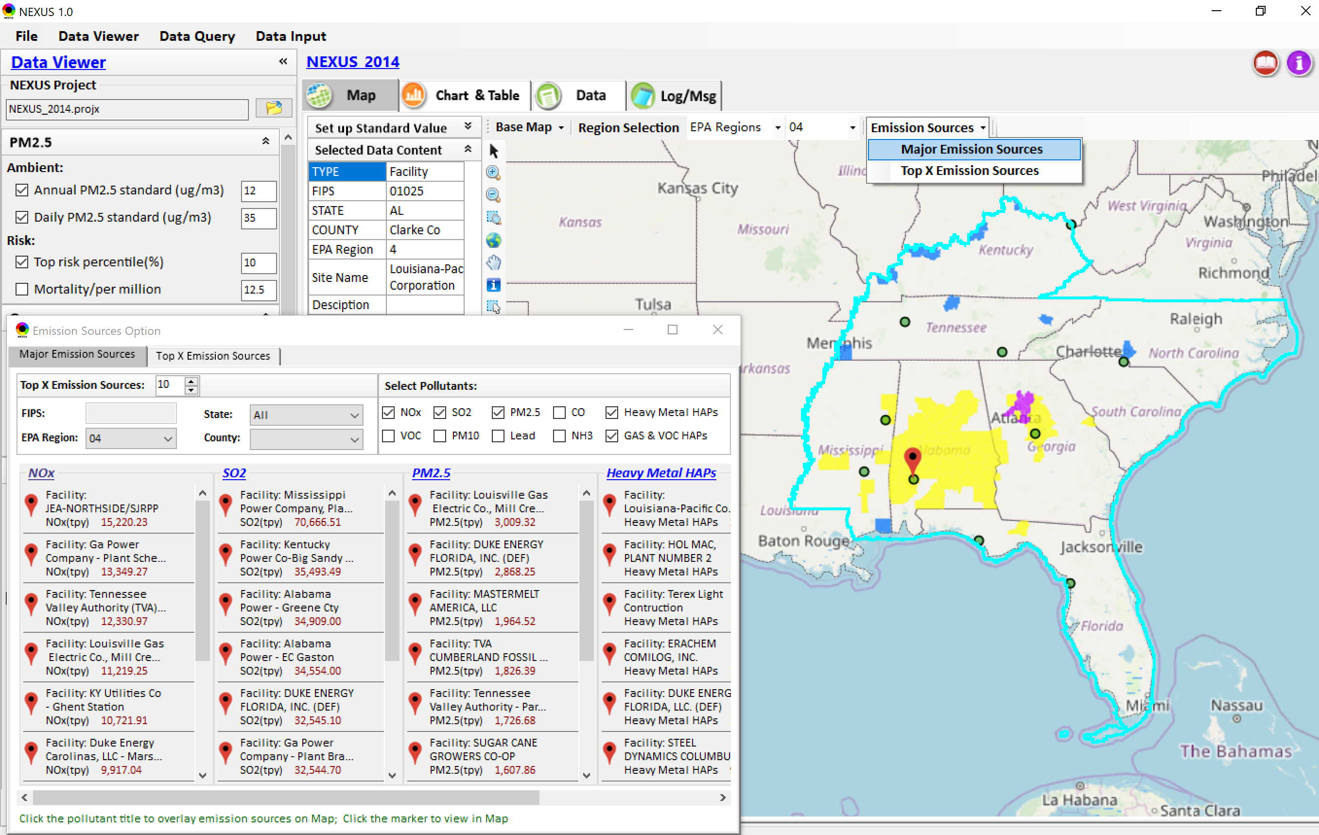
Data Viewer: Major Emission Sources
Click “Emission Sources” tab to display emission sources (green dots) and launch new window
Click any “facility” to link & display source location and emission information
20

Slide 21
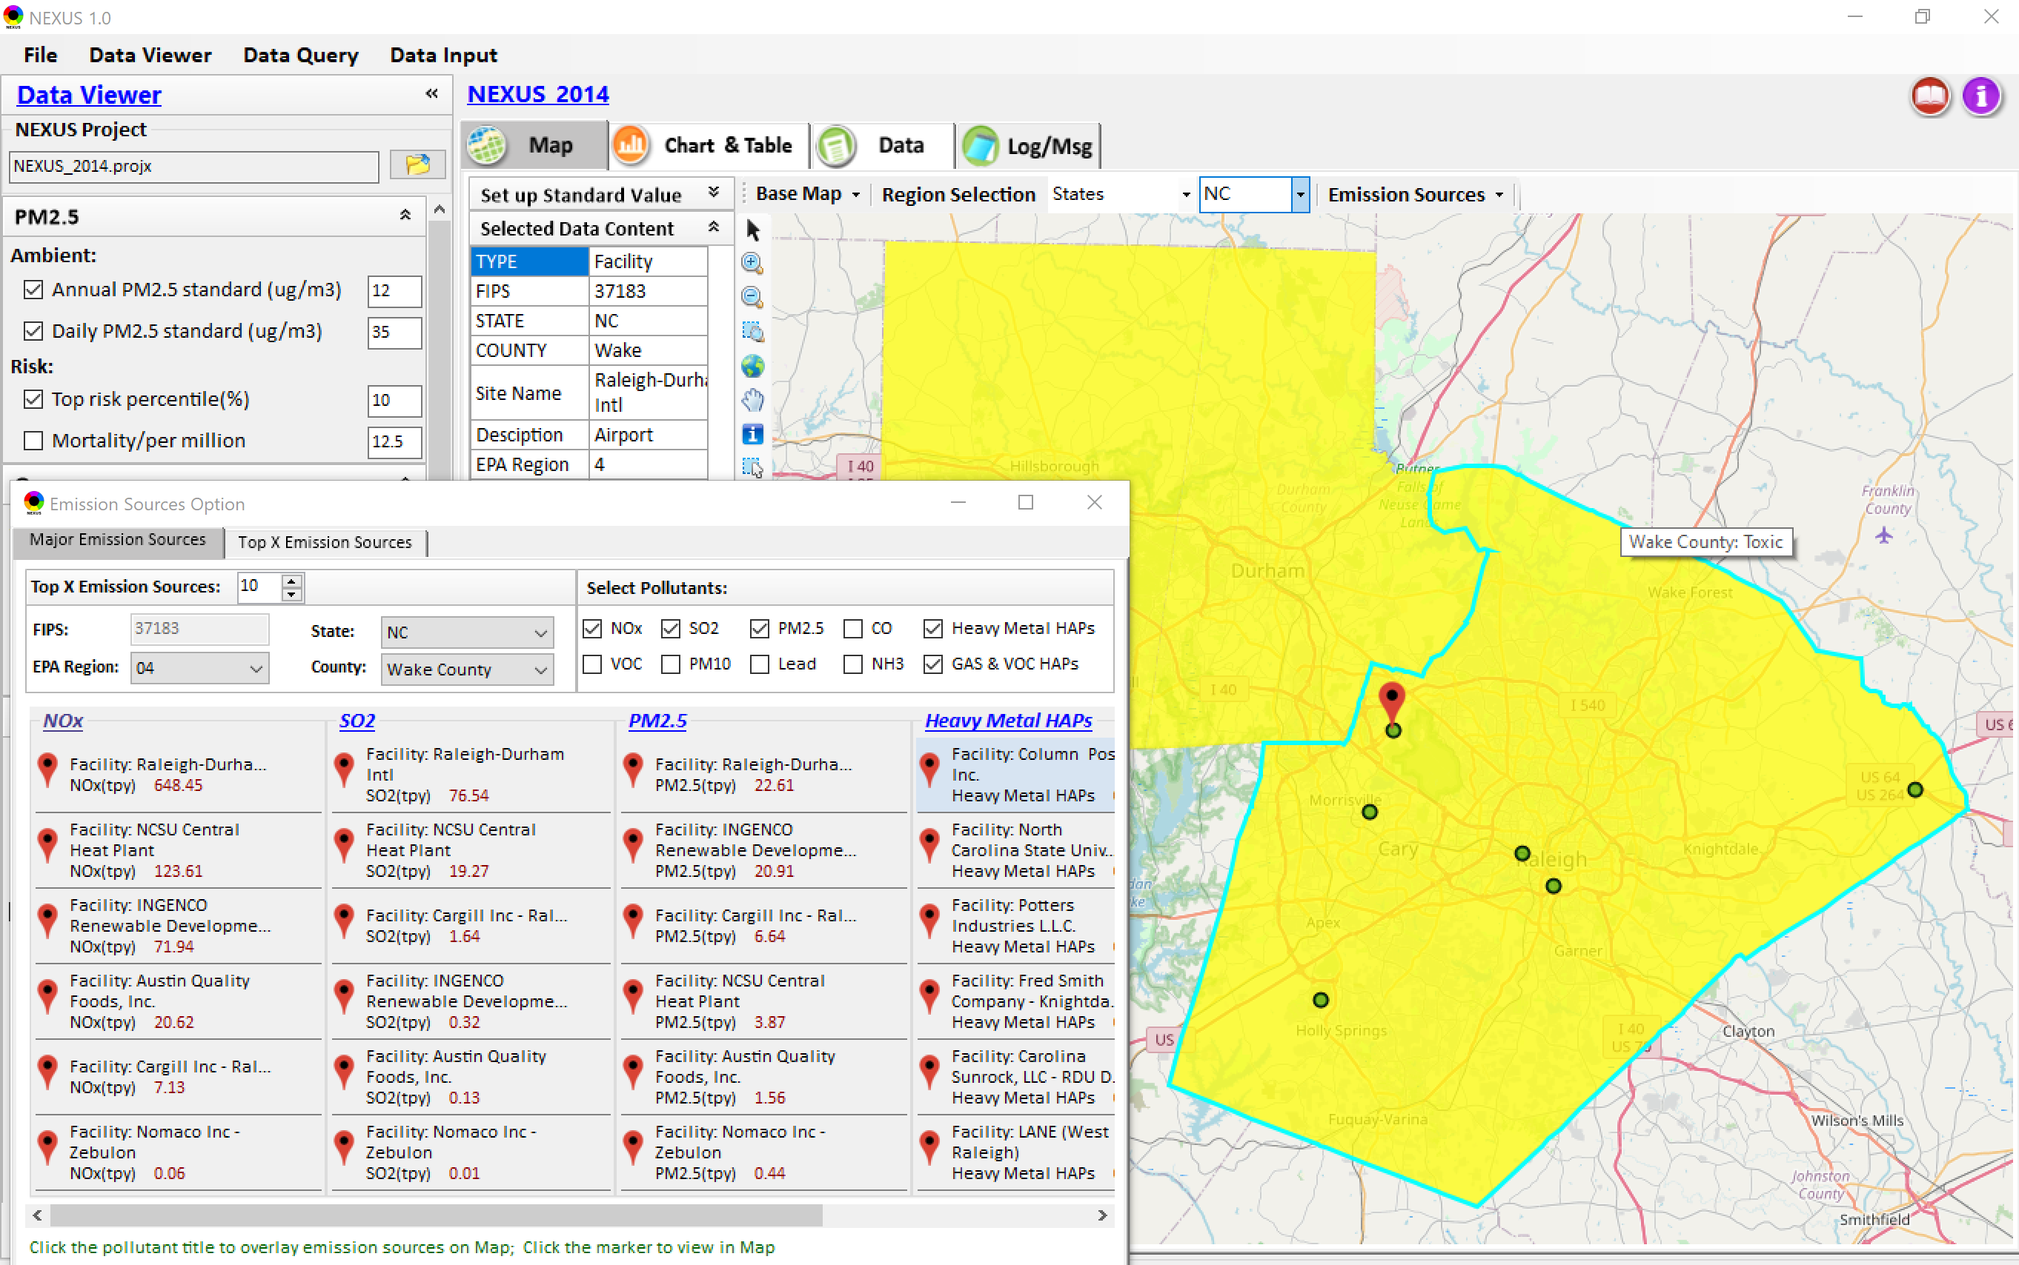
Data Viewer: Major Emission Sources
Allow to scroll down to county-level (e.g., Wake County, NC)
Wake county, NC
21

Slide 22
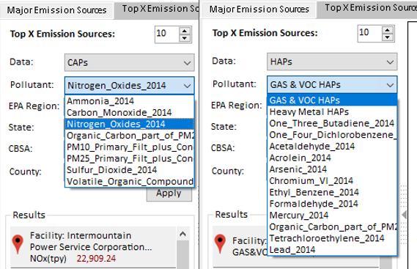
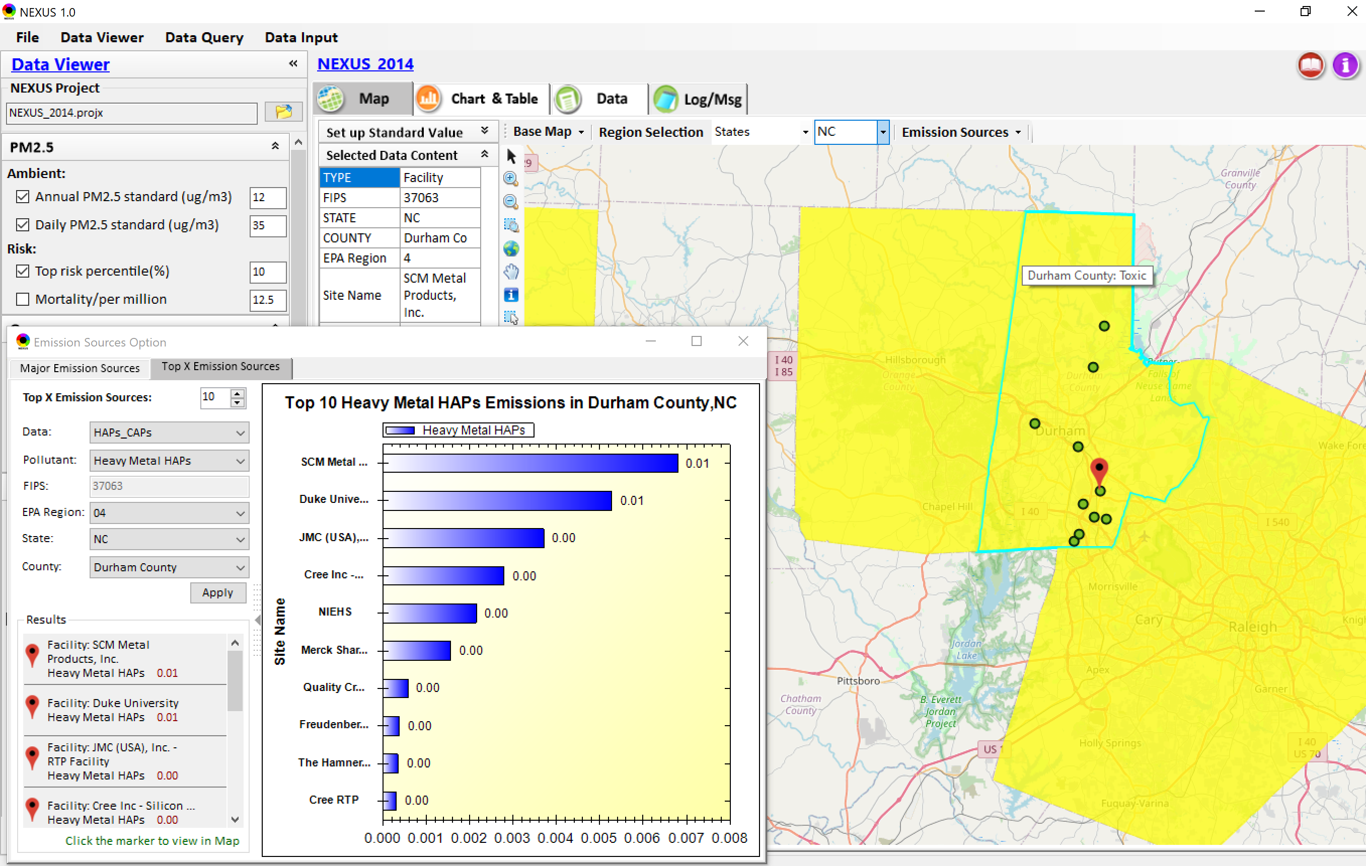
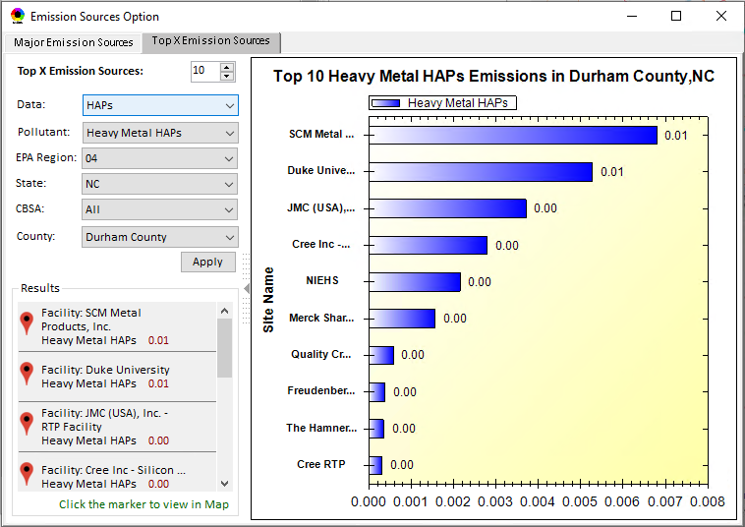
Data Viewer: Top “x” Emission Sources
Provide selection of CAPs precursors & HAPs species
Durham county, NC
22

Slide 23
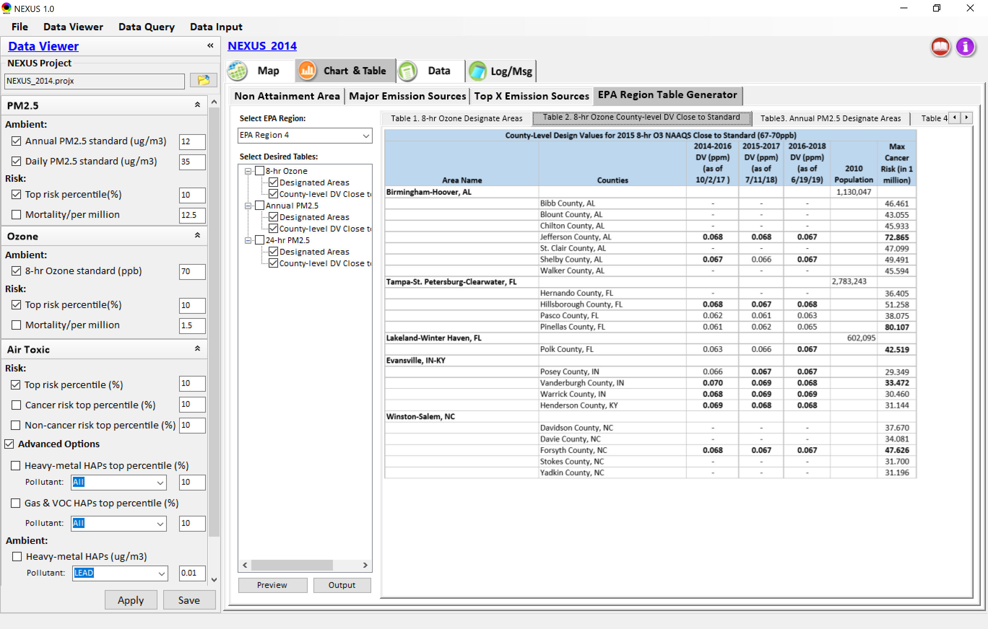
Data Viewer: EPA Region Table Generator
“EPA Region Table Generator” is still under development, but a preview of example “EPA Region 4” tables can be provided
23

Slide 24
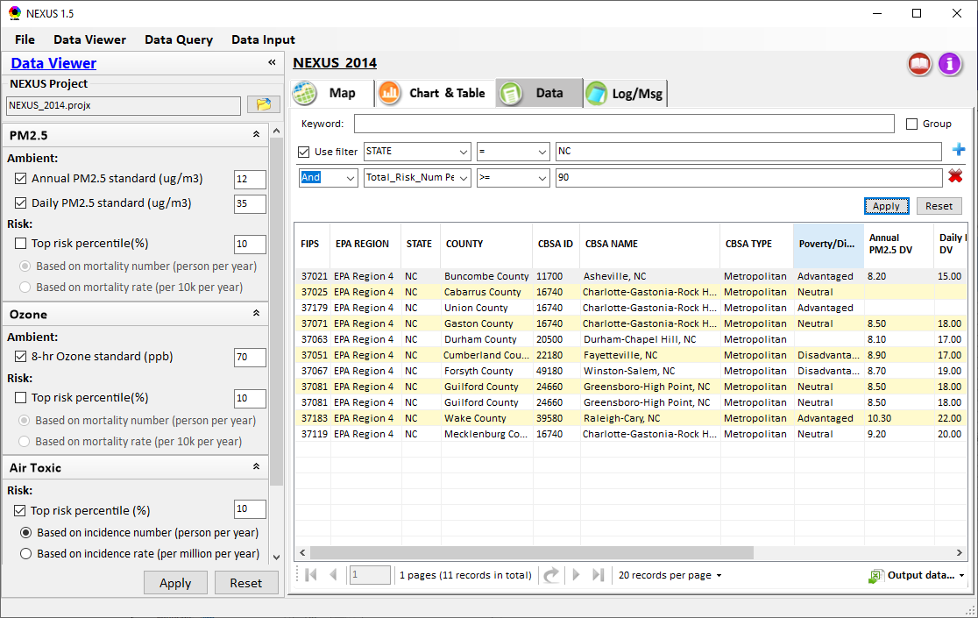
Data Viewer: Data Search & Filter
Click “+” to add filters; Click “x” to remove current filter;
Show specified records per page.
Click “Output data…” to output current page records or all records

Slide 25
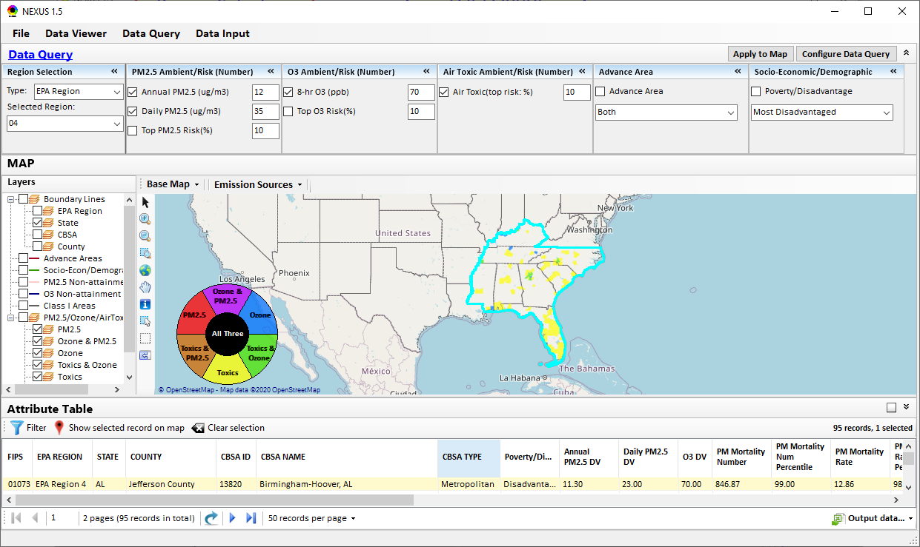
Data Query Module: Main Page
Region Selection
Data Query qualifier selection
Data Query Configuration
Map Overlaying selection
Detachable “Attribute Table”
11111111
25

Slide 26
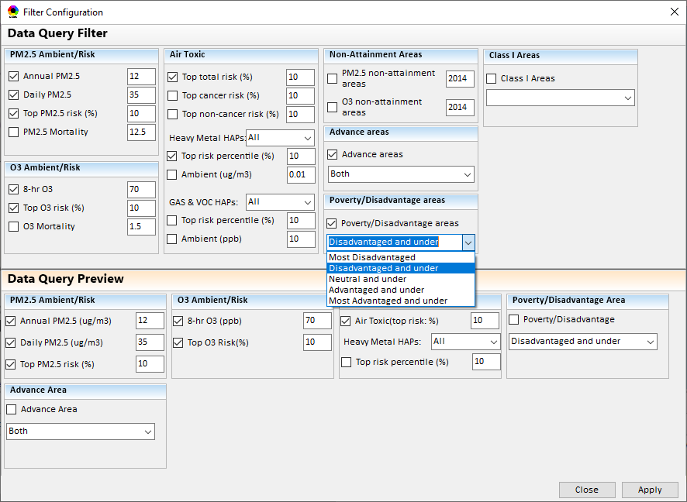
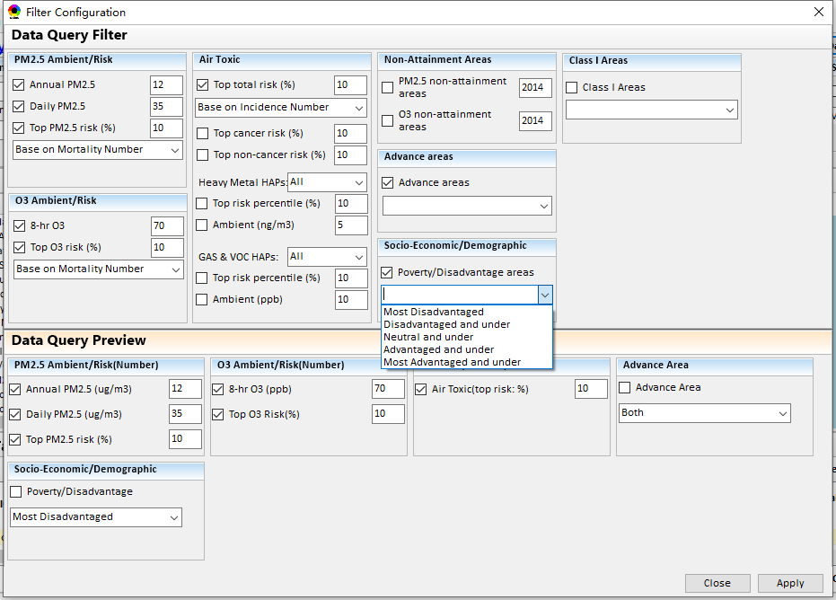
Data Query Module: Configure Data Query
“Data Query Filter” allows to select “qualifiers” for query
“Data Query Preview” displays the selected “qualifiers” at the same time
26

Slide 27
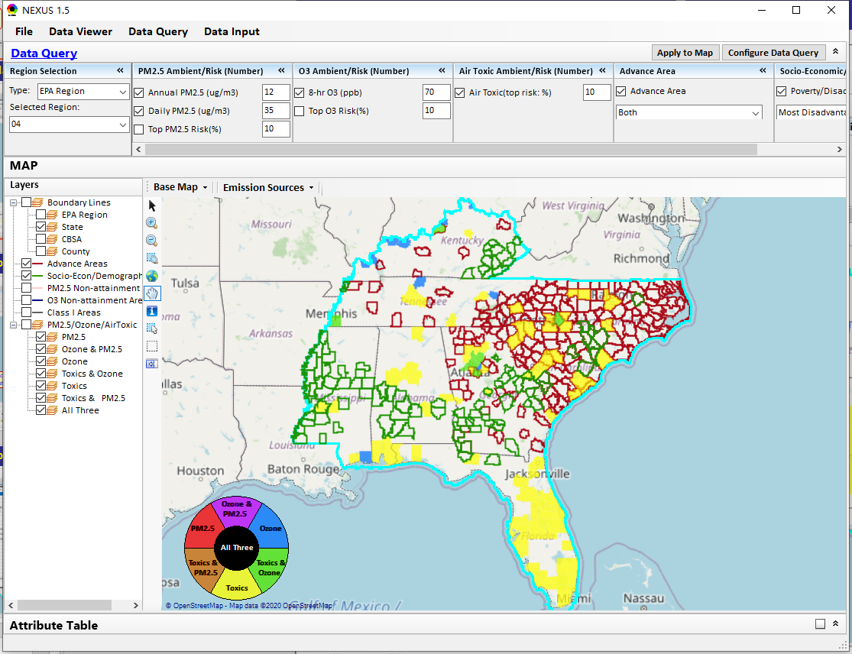
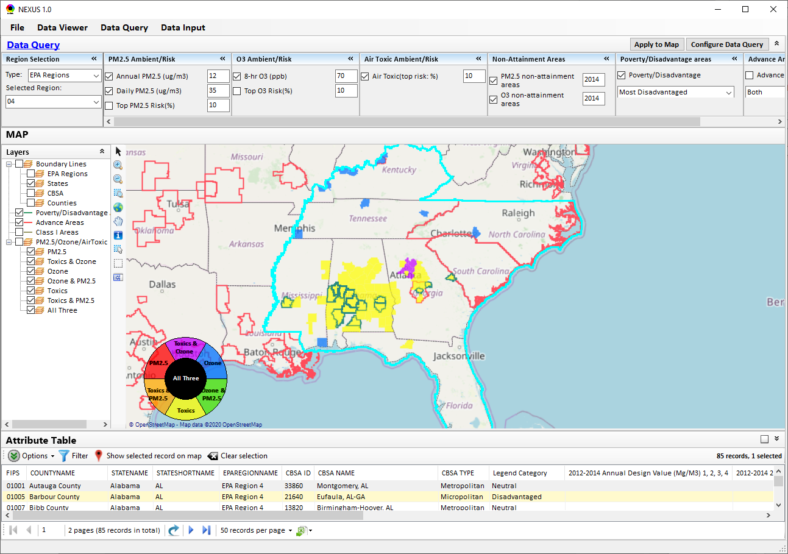
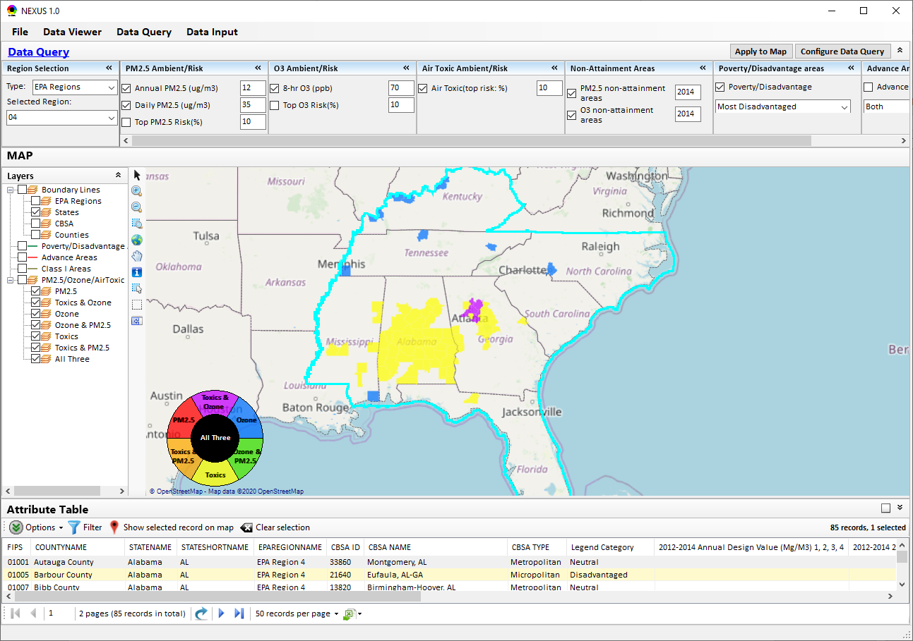
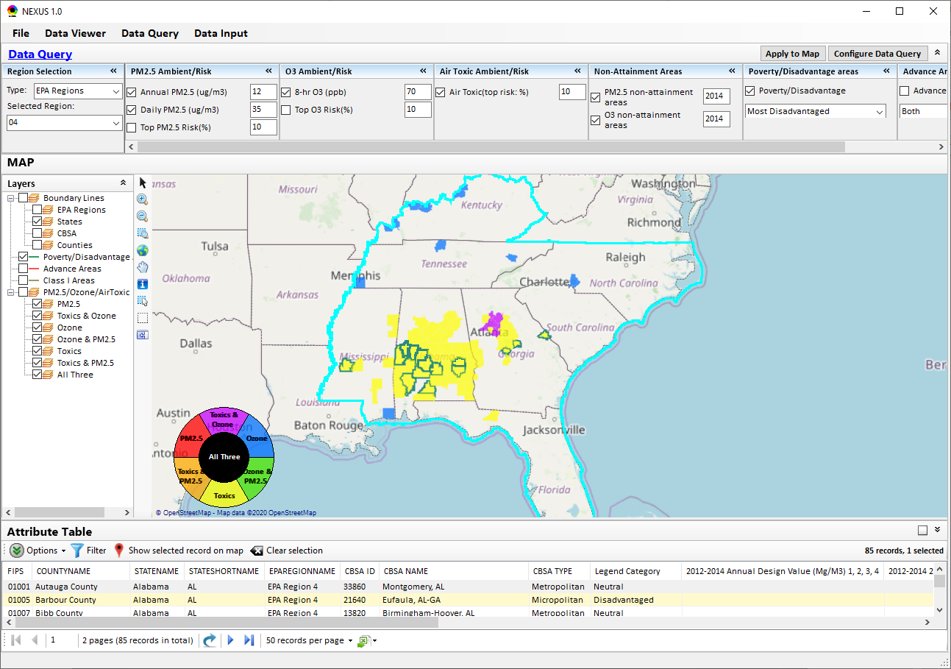
Data Query Module: Overlaying Map
Overlaying Map selection
27

Slide 28
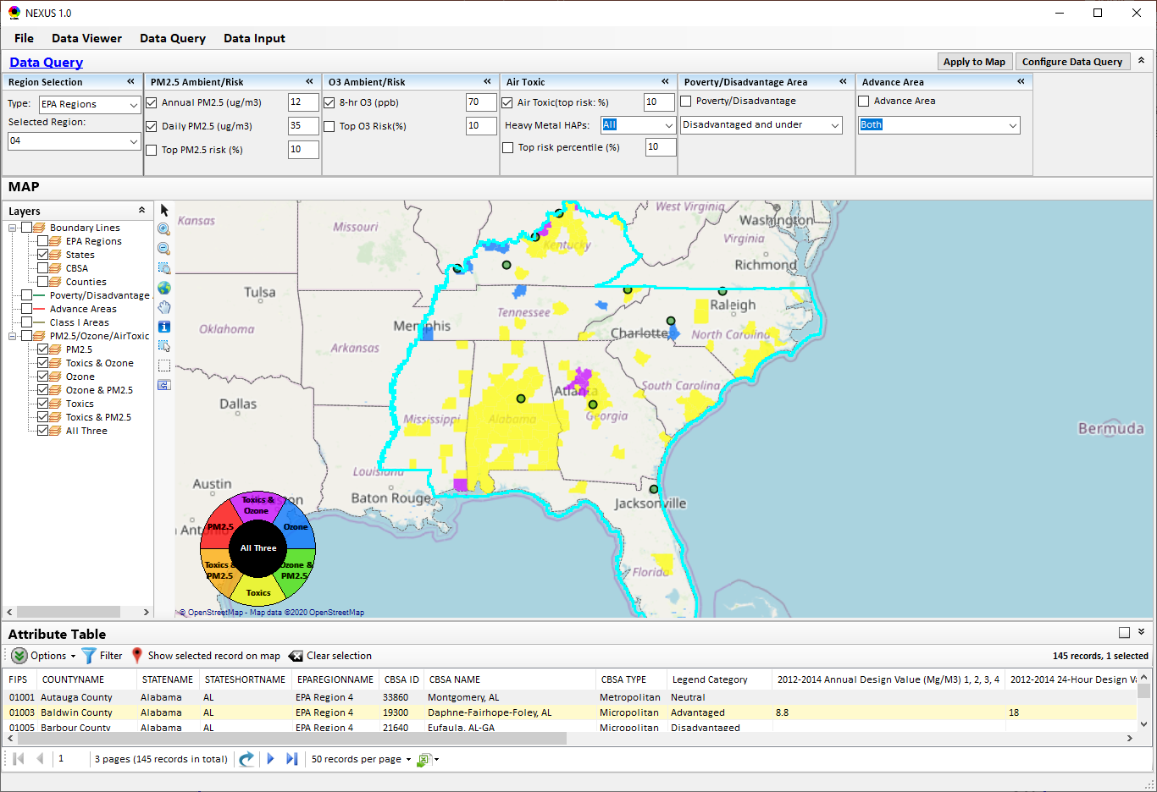
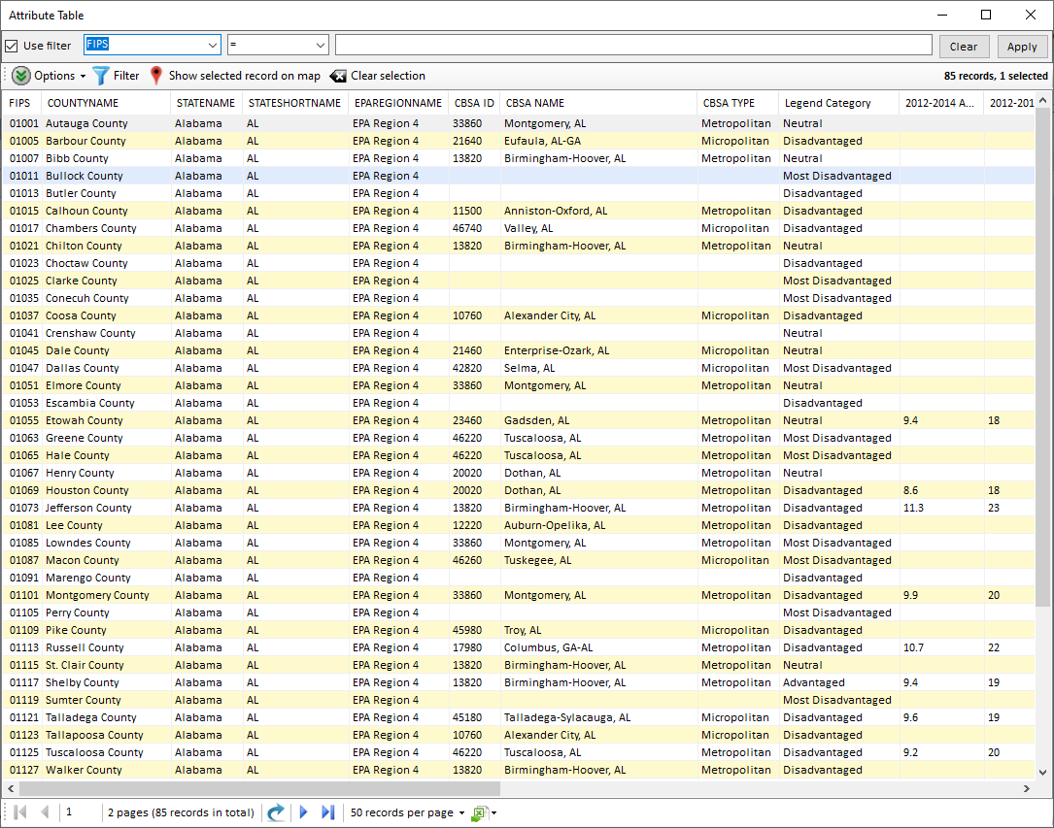
Data Query Module: Attribute Table
Filter/link/export functions (to be completed)
Detachable “Attribute Table”
28

Slide 29
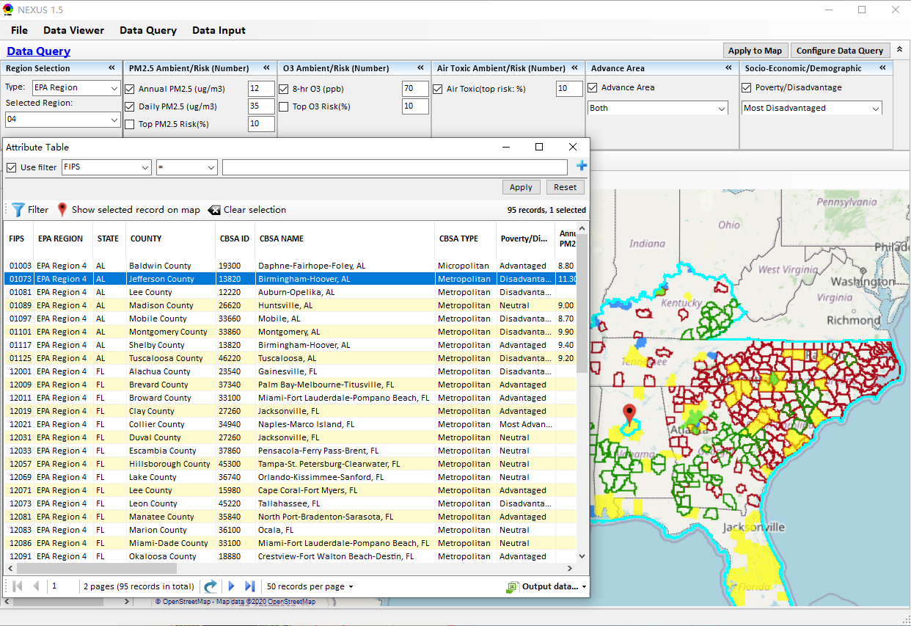
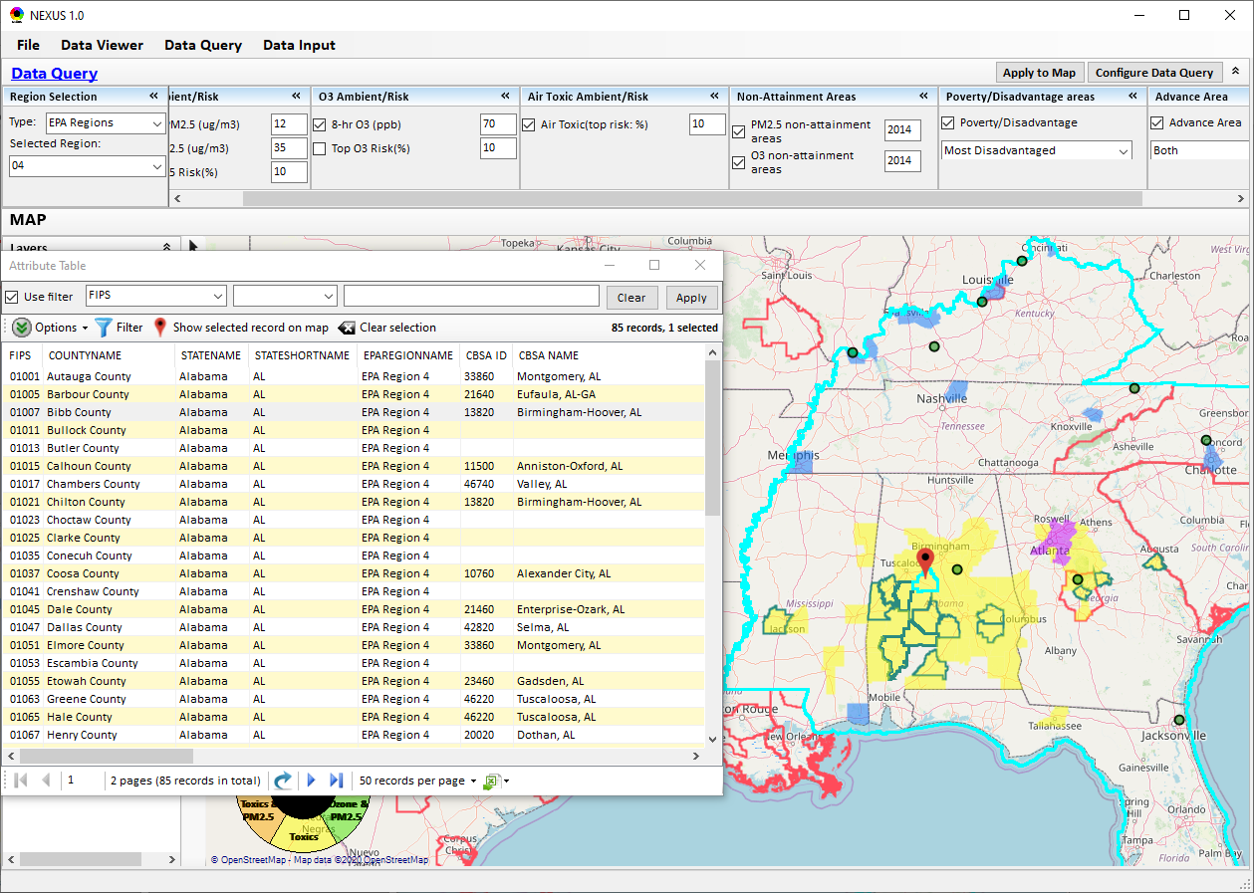
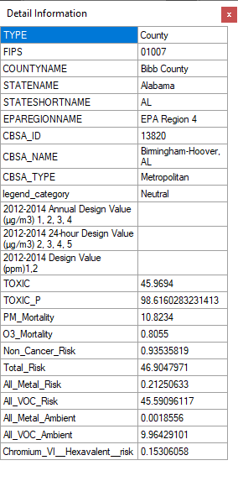
Data Query Module: Attribute Table
Click a “record” to link and display its location & info.
29

Slide 30
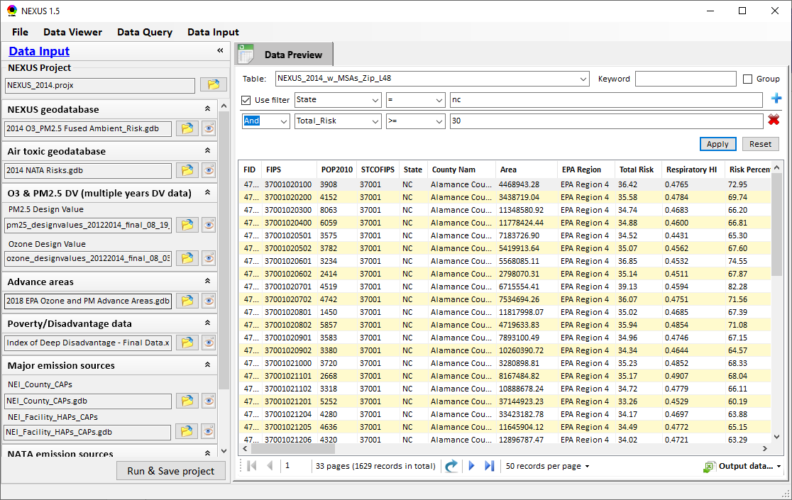
Data Input Module: Data Preview
Click to view data
Click to change input data file
Click to view data
Select a table to view if there are multiple tables in the selected data source file
Check to use filter to query data
Click to run & save project

Slide 31
End
31

Slide 32
RoadMap for NEXUS Tool Demo (1)
National Screening (2014 Data)
Replicate 2008 NEXUS map with O3/PM2.5 concentrations above NAAQS and NATA risk estimates above selected percentile of top 10%
What happens to areas at lower O3/PM2.5 NAAQS levels?
What happens to areas current over O3/PM2.5 NAAQS if change HAP risk percentile?
Provide NEXUS map on risk basis: O3/PM2.5 BenMAP mortality risk based on fused surfaces and NATA risk estimates above selected percentile of top 10% for all pollutants
What happens to MP areas as one changes percentile to top 20% or others?
What is relationship between Heavy Metal HAPs risk (top 10%) and PM2.5 risk to identify potential co-pollutant issues?
What is relationship between Gas/VOC HAPs risk (top 10%) and O3 risk to identify potential co-pollutant issues?
32

Slide 33
RoadMap for NEXUS Tool Demo (2)
Regional/State/CBSA/County Screening
EPA Region 4 Example
Areas with MP risk in top 10% across O3, PM2.5 and HAPs
Louisville CBSA: General view and then dial into “Jefferson County” with transparent map color
What are the top 10 emissions sources in county by pollutant?
What specific sources are common across pollutants that may indicate co-control potential?
Can view these sources on the map with summary data available.
33

Slide 34
RoadMap for NEXUS Tool Demo (3)
Data Query: State/CBSA/County Views
Advance Areas
Initial view of national level information using the Advance Area definition to show overlay with MP areas
Region 5 => Minneapolis Example: General view and then dial into “Dakota County” with transparent map color
What are the top 10 emissions sources in county by pollutant?
What specific sources are common across pollutants that may indicate co-control potential?
Can view these sources on the map with summary data available.
34

Slide 35
RoadMap for NEXUS Tool Demo (4)
Data Query: State/CBSA/County Views
Socio-Economic/Demographic (EJ) Areas
Initial view of national level information using the Poverty/Disadvantaged indicator to show overlay with MP areas
Region 5 => Detroit Example: General view and then dial into “Wayne County” with transparent map color
What are the top 10 emissions sources in county by pollutant?
What specific sources are common across pollutants that may indicate co-control potential?
Can view these sources on the map with summary data available.
35

Slide 36
NEXUS Demo: Example Cases
Main GUI:
Mimic 2008 MP report; County-based map
Color/legend setup; Exceed “Ambient or risk” threshold defined in “Center panel”
Click “county” to show “Data Content”
Center panel & Left panel
On-line User’s Manual & PPT Tutorial
Nation View :
“Ambient”: PM2.5: 12 -> 10 ug/m3; O3: 70 -> 65 ppb; “Risk”: Air Toxic 10% ->0%-> 20%
All Risk only: O3:10%, PM:10%, AT: 10%
Advanced: Heavy-metal HAPs, G&V:10%
Co-PM risk: PM: 10%, H.M. HAPs: 10%
Co- PM/NA: 12 ug/m3, H.M HAPs:10%
Co-O3 risk: O3: 10%, G&V HAPs: 10%
Co- O3/NA: 70 ppb, G&V HAPs:10%
Advanced: H-M: Chromium & G-V: HCHO
EPA Region/State/CBSA View:
“dial-in” for regional (all risk: 10%)
EPA Regions: R4/R5/R9 -> States: NC/CA -> CBSA: RDU
“right-click” -> Major Emis. Sources
Change color transparency/Google Map
Major Emission Sources:
CBSA: Louisville -> Jefferson Co. -> Facility (Louisville G&E)
SO2/NOx/HAPs, Facility, Data Content;
Top X Emission Sources: CAPs & HAPs
Data Input module:
Expand 1->10 inputs data files; Plan to update to 2017 (CDC & NATA)
Data Query Module:
Expand fields/flexibility: Exploratory users
Configure DQ” window: Select Advance Area, EJ, 2017 DVs => Apply map
Overlay Map & Detachable table summary
Select “EPA Region 5” => “Advance + EJ”
Change color transparency & Google Map
CBSA: Minneapolis-> Major emis. sources
Facility (Xcel Energy - Black Dog)
Dakota Co. ->
“PM2.5 + H.M.HAPs” (Xcel Energy)
“VOC + NOx + G&V HAPs” (Flint Hills)
Back to “EPA Region 5” -> EJ: Select “Disadvantage & under”
CBSA: Detroit -> Wayne Co. ->
“NOx + SOx” (DTE Elec.)
“PM2.5 + H.M.HAPs” (AK Steel, US Steel)
CBSA: Cincinnati -> Butler Co. (AK Steel) (Cincinnati News article)
36
Notes:
1. Thank Cen/Gao/Luo/Chen; 2. HZ more visits; 3. AP on HZ

