Slide 1
“pf-RSM” Issue in predicting PM_OM response to VOCs emissions cut
East U.S. July case (monthly avg.): RSM vs. CMAQ
Slide #2: PM2.5 responses to 100% man-mad VOCs emissions cut
Slide #3: PM-OM responses to 100% man-mad VOCs emissions cut
Slide #4: O3-MDA8 responses to 100% man-mad VOCs emissions cut
Slide #5: PM-OM responses to 100% man-mad VOCs emissions cut (January case)
Slide #6: PM-OM responses to 80% man-mad VOCs emissions cut (with “100% VOCs cut” included in “RSM Creation”: BC run)
Slide #7: PM-OM responses to 80% man-mad VOCs emissions cut (without 100% VOCs cut included in “RSM Creation”)

Slide 2
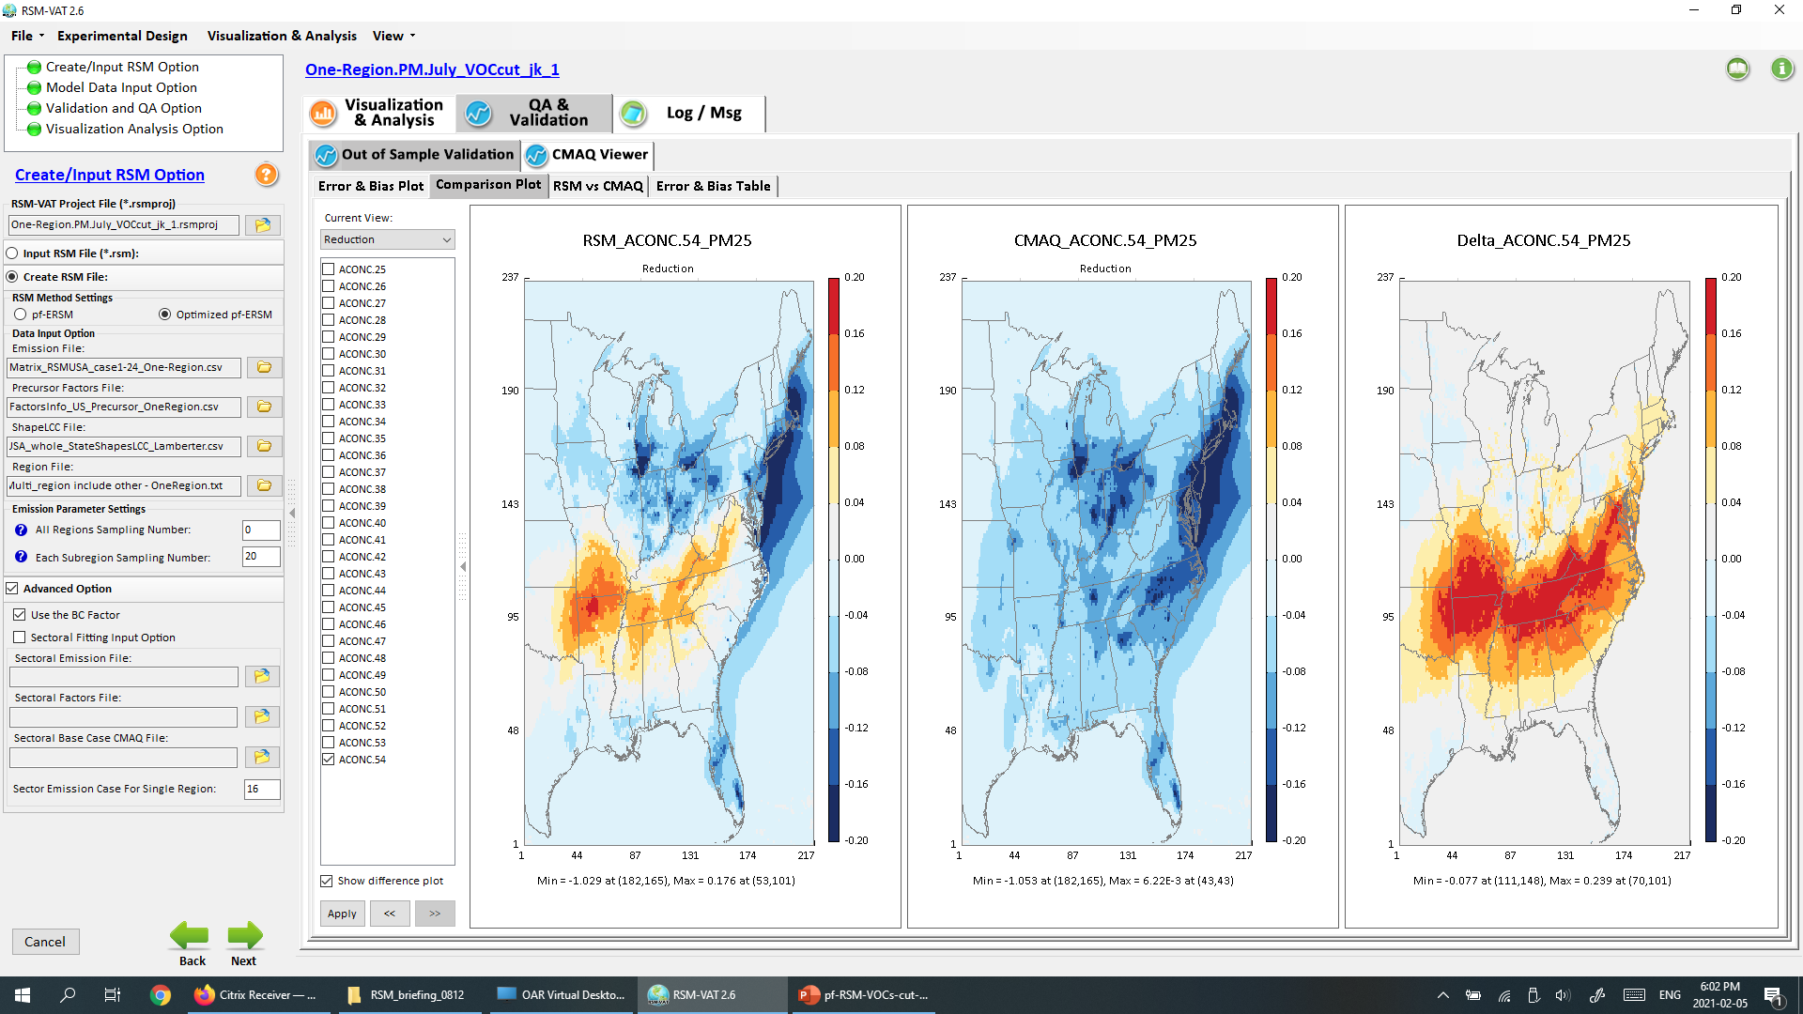
PM2.5 responses to 100% man-mad VOCs emissions cut
(July case)
2

Slide 3
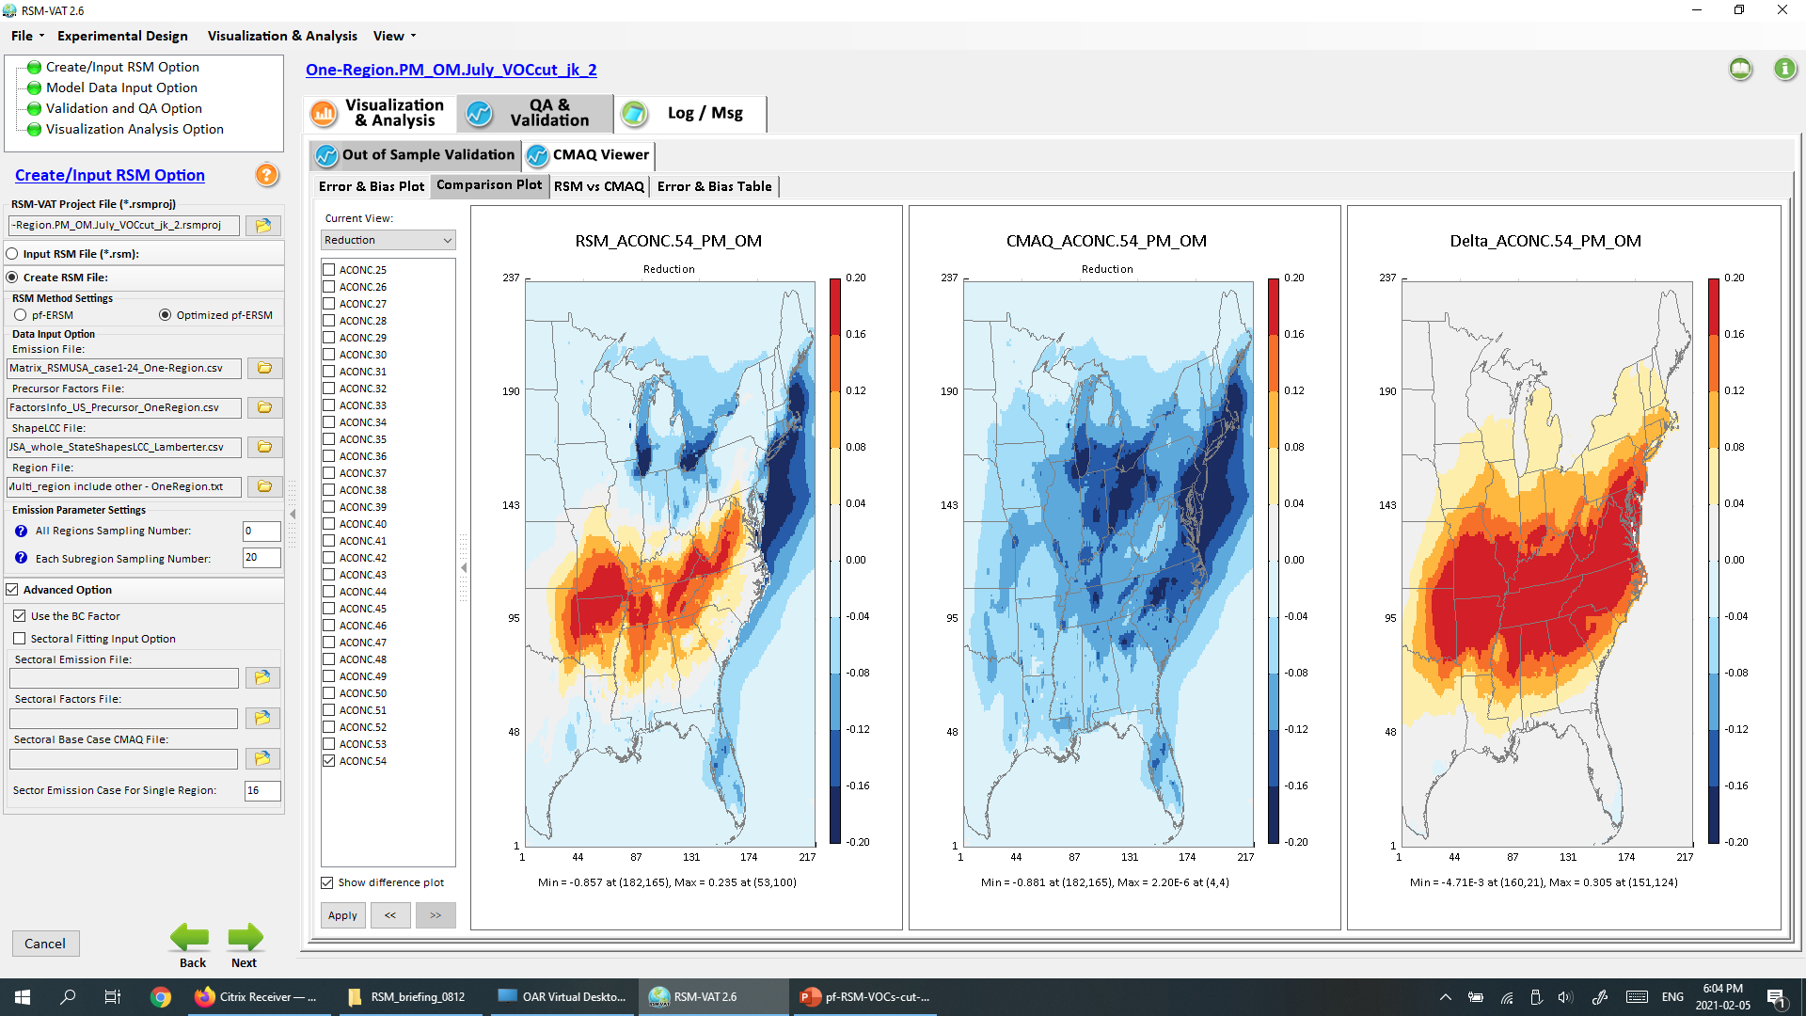
PM-OM responses to 100% man-mad VOCs emissions cut
(July case)
3

Slide 4
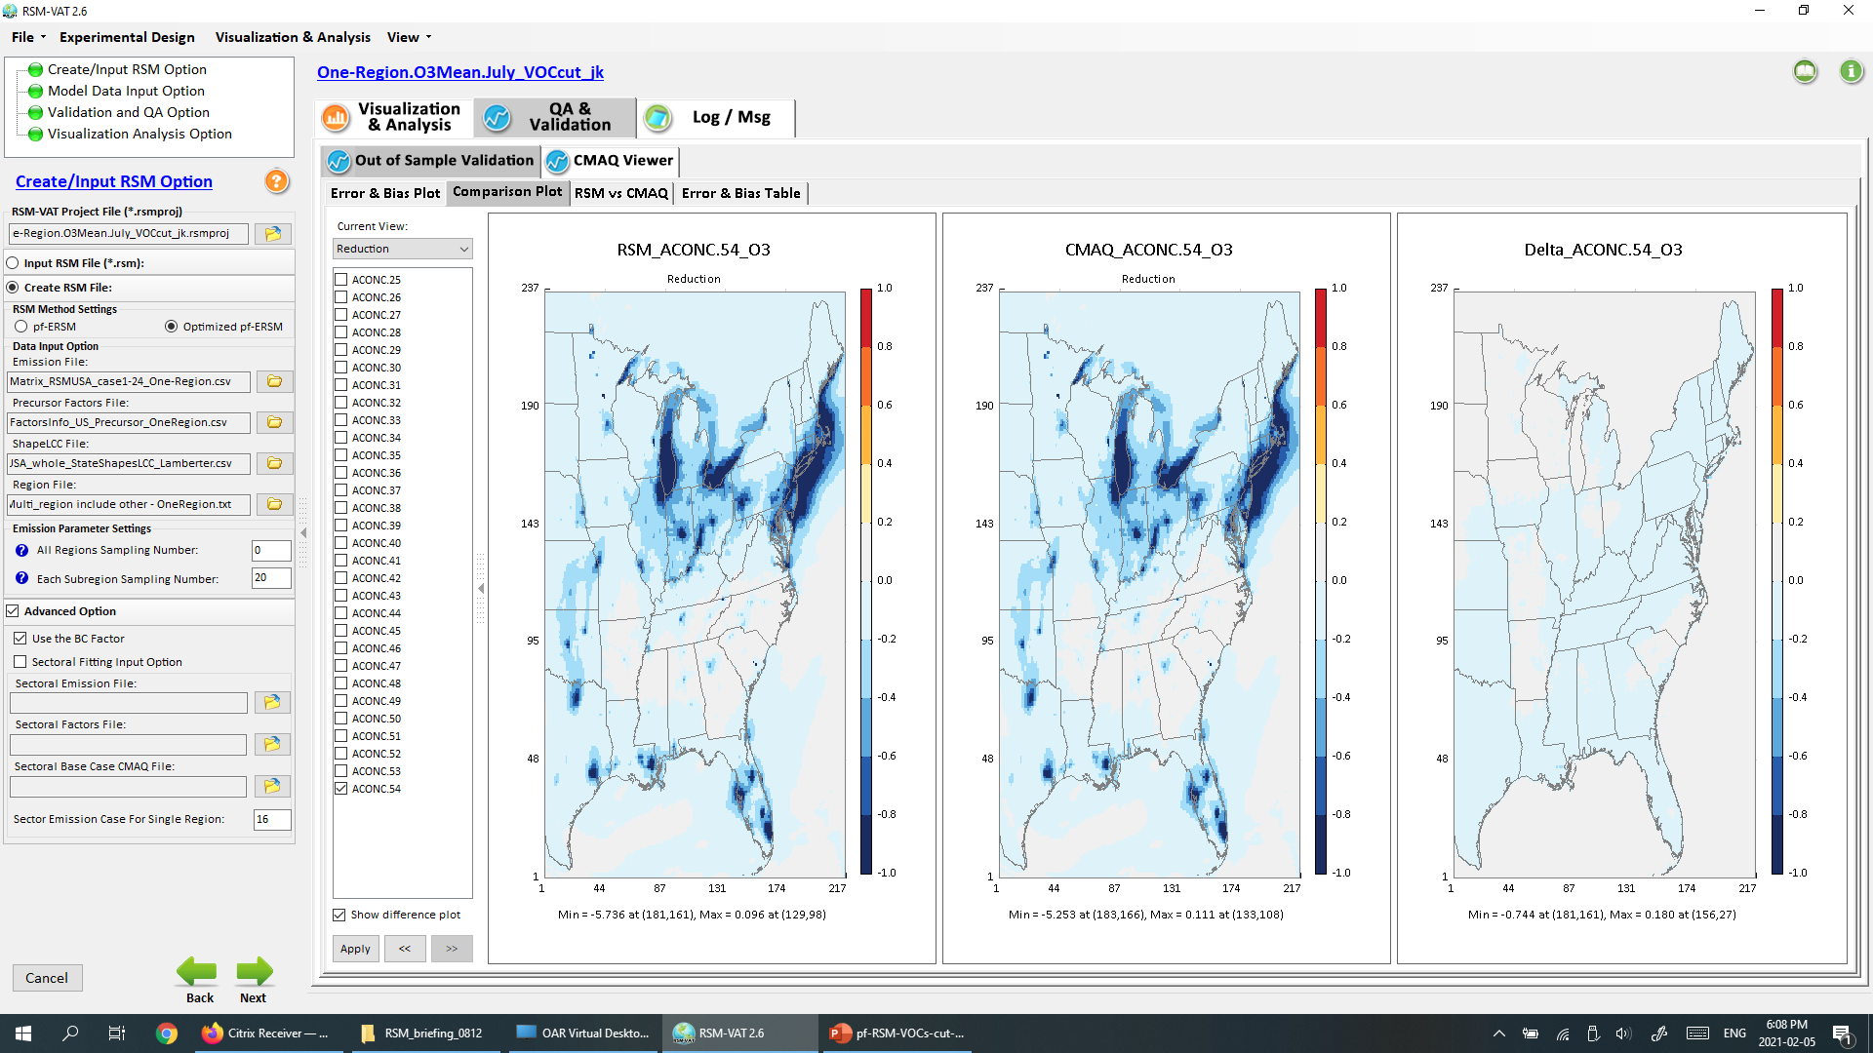
O3MDA8 responses to 100% man-mad VOCs emissions cut
(July case)
4

Slide 5
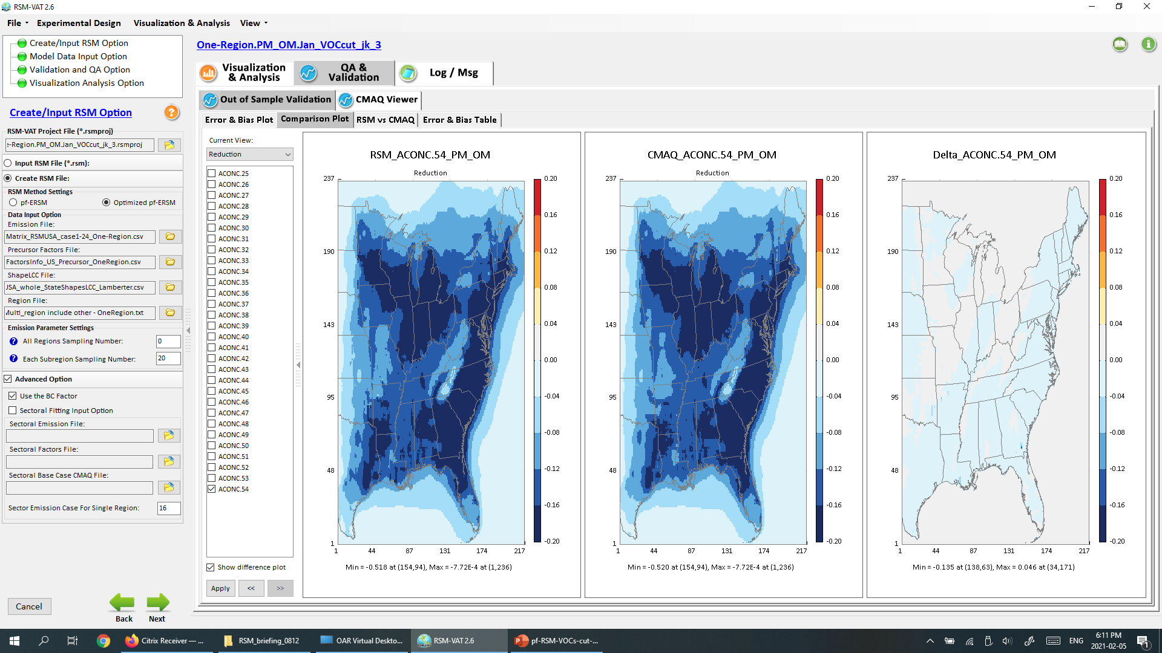
PM-OM responses to 100% man-mad VOCs emissions cut
(January case)
5

Slide 6
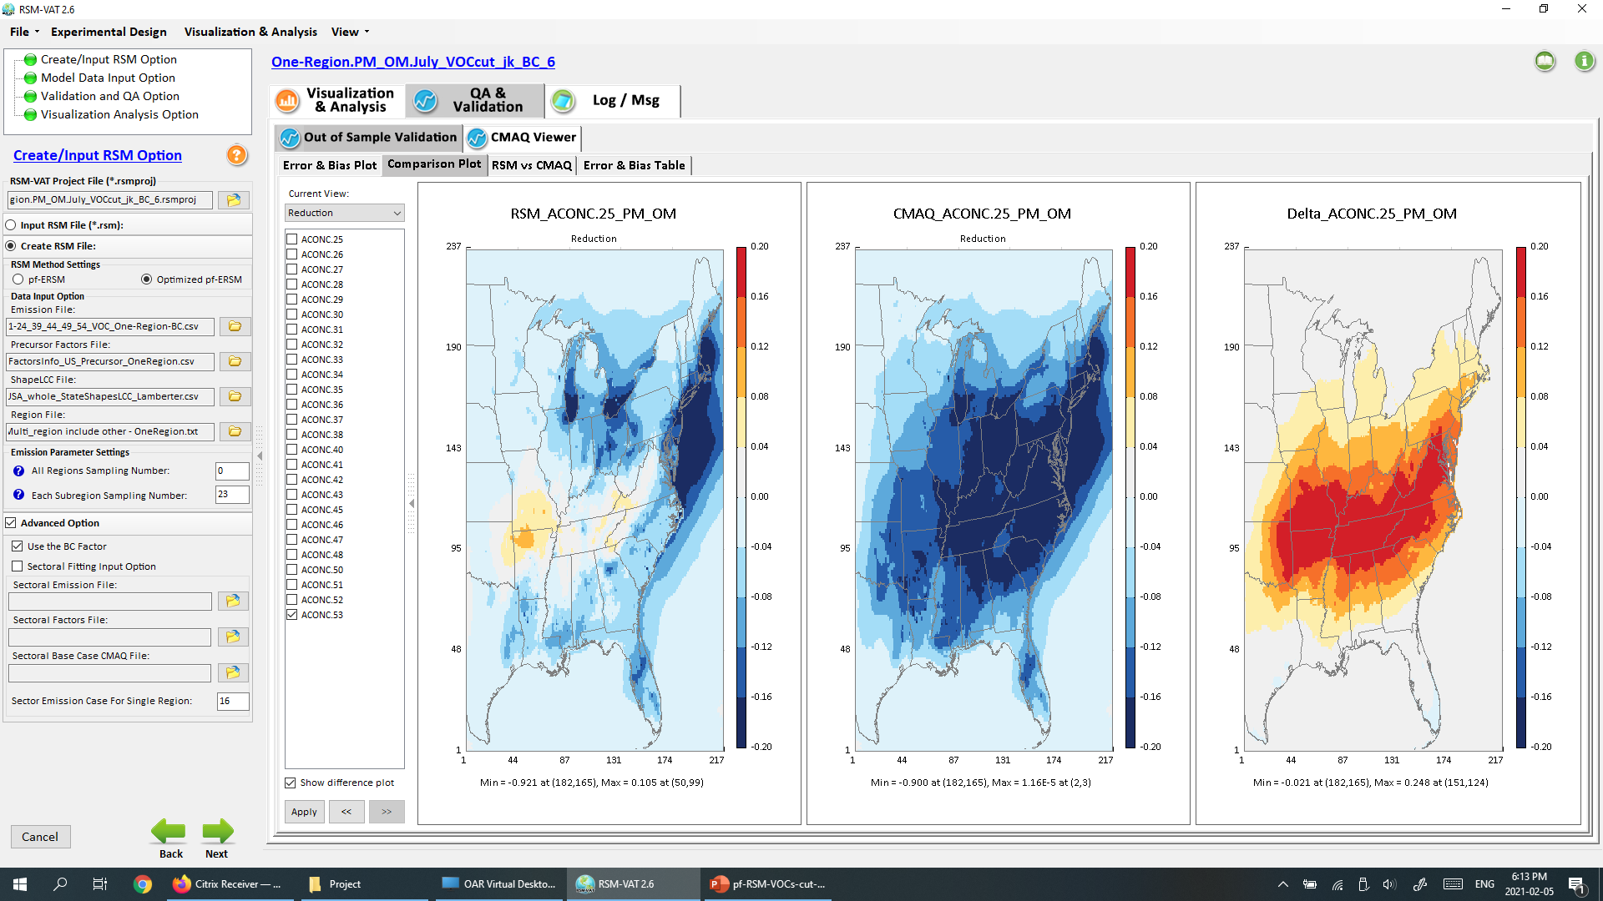
PM-OM responses to 80% man-mad VOCs emissions cut
(with “100% VOCs run” included as BC in creating RSM)
6

Slide 7
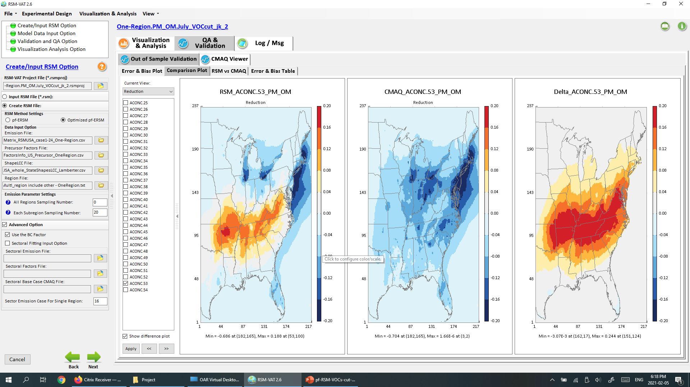
PM-OM responses to 80% man-mad VOCs emissions cut
(with “100% VOCs run” included as BC in creating RSM)
7

Slide 8
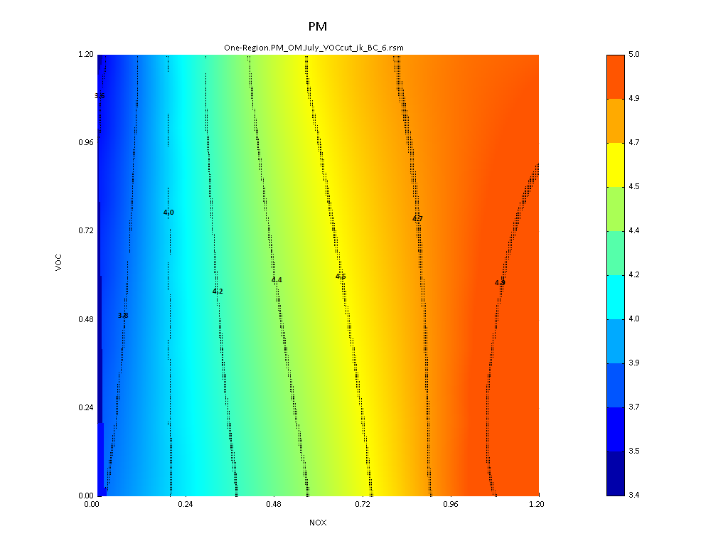
PM-OM Contour plot (July case)
(X-axis: NOx, Y-axis: VOCs)
8

Slide 9
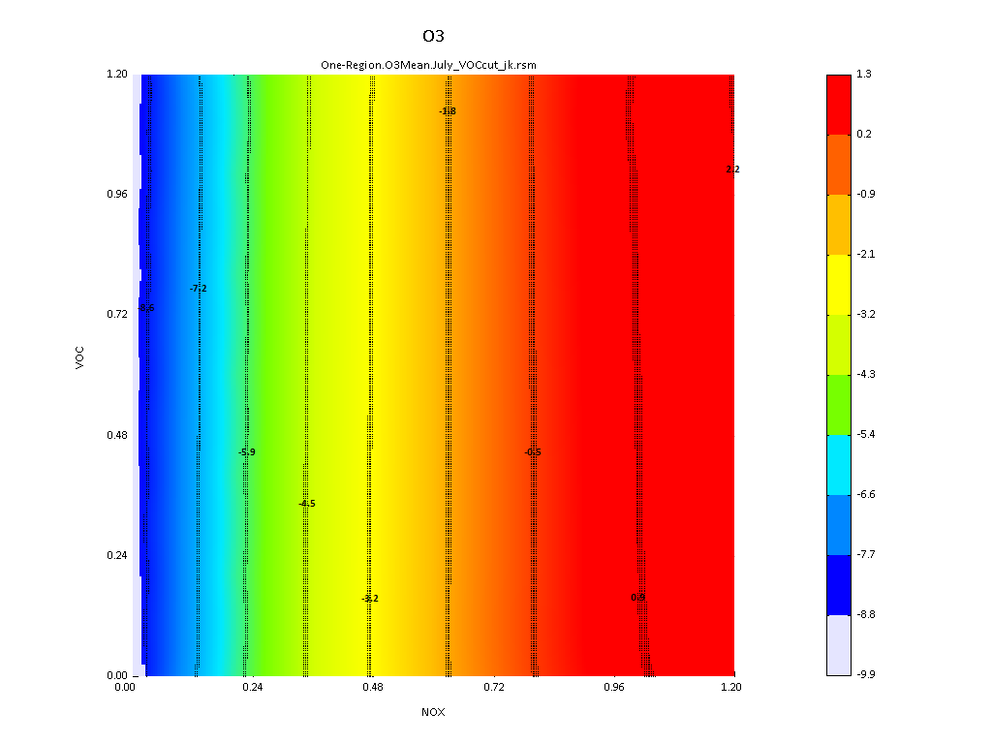
O3 Contour plot (July case)
(X-axis: NOx, Y-axis: VOCs)
9

