Slide 1
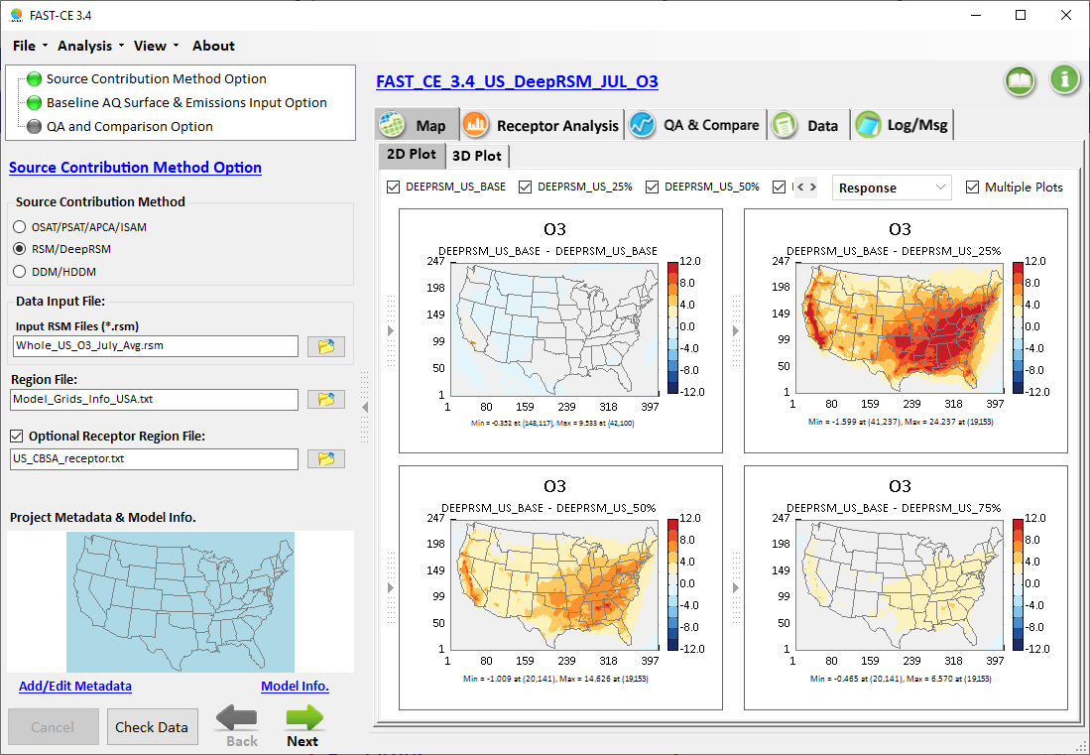
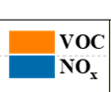
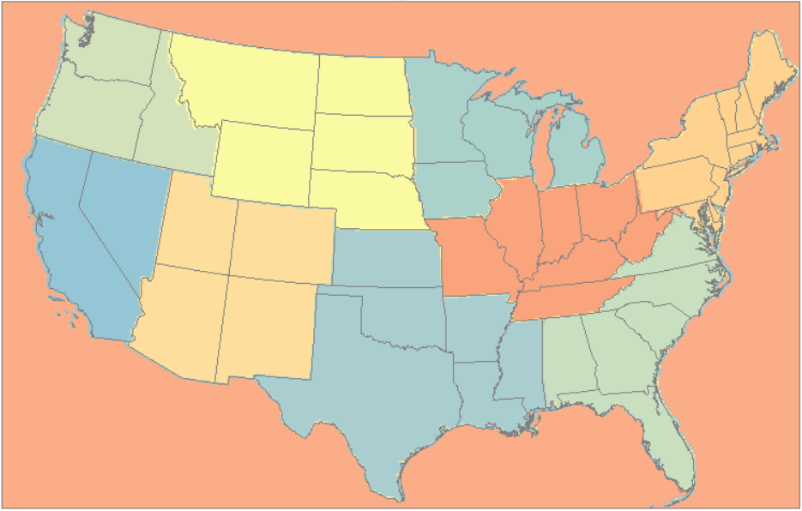
Pilot Application of Deep Learning Response Surface Model (DeepRSM) and Preliminary Comparisons with Other Source Contribution Methods
NOx and/or VOC reduction
CMAQ BF: NOx or VOC
pf-RSM BF: NOx or VOC DeepRSM BF: NOx or VOC
pf-RSM
DeepRSM
HDDM
ISAM
CMAQ BF: Total
ISAM/O_PSAT
RSM/DeepRSM
DDM/HDDM
VOC 75% reduction
NOx 75% reduction
USA domain or
10 Climate regions
NOx 50% reduction
NOx 25% reduction
(NOx & VOC)
O₃ MDA8 (ppb), 2018 July Avg
DeepRSM/HDDM/ISAM in “FAST-CE 3.5”
DeepRSM in “RSM-VAT 2.9”
CMAQ BF vs. DeepRSM, HDDM & ISAM
Carey Jang, Jim Kelly and Joey Huang,
Model App Team Briefing, 5/10/2023
“FAST-CE 3.5” package (“FAST-CE 3.5 Setup.exe” & “* Data.exe”: run both to install) is available at EPA’s NewFTP site: https://gaftp.epa.gov/aqmg/cjang/FAST-CE/FAST-CE 3.5/* (or /RSM-VAT/RSM-VAT 2.9/*)
Notes:
spatial field: A Spatial Field refers to air pollution estimates made at the center of each grid cell in a specified modeling domain. For example, MATS might calculate ozone design values for each grid cell in the modeling domain. Several types of Spatial Fields can be calculated for ozone and PM.
利用环境监测数据、模型数据（主要是CMAQ模拟的结果）作为模型输入，并利用优化的数理统计技术对大气复合污染状况进行模拟，实现对环境空气质量标准的达标评估。其中包括point estimate和spatial field estimate。

Slide 2
Outline
  Overview of Source Contribution & Control/Response Modeling
  Development & Evolution of Response Surface Modeling (RSM)
  Original RSM → Extended RSM (E-RSM) → Polynomial Function RSM (pf-RSM) -> → “Deep Machine Learning” RSM (DeepRSM)
  Ongoing and Recent RSM Applications/Comparisons & Publications
    DeepRSM: 2018 CMAQ PM-NAAQS pilot study for USA domain & 10 climate regions
    Appendix A:
    pf-RSM/CMAQ E-US case: O3 & PM2.5 nonlinear responses (Kelly et al., 2021, Atmosphere)
    pf-RSM/BFM/OSAT/HDDM comparisons: O3 case study (Fang et al., 2021, Environ. Pollution)
    BFM/PSAT/RSM comparisons: PM2.5 case study (Li et al., 2021, Frontier ES&E)
  DeepRSM Prototype in “FAST-CE 3.5” & “RSM-VAT 2.9“
    FAST-CE 3.5: DeepRSM V/A & compare vs. “ISAM/O_PSAT/HDDM”
    RSM-VAT 2.9: “Prepare CMAQ”, “Running RSM”, and “QA & validation” modules
Summary & Next Steps: “DeepRSM”
2

Slide 3
Source Contribution & Control/Response Modeling
(Emission-based, “Reduced Form Modeling”)
“Source Apportionment & Sensitivity” Modeling (Chem. regime: Baseline case)
  “Source Apportionment Modeling” (Chem. approximation)
    CAMx’s OSAT/PSAT/APCA, CMAQ’s ISAM &TSSA, etc.
  “Source/Receptor Sensitivity Modeling” (Math. approximation)
    Decoupled Direct method (DDM/HDDM), Adjoint method, etc.
“Control/Response” Modeling (Chem. regime: Control case)
  “Brute Force” Modeling (e.g., “zero-out” region/sector/pollutant)
  “Response Surface Modeling” (RSM): Rapid AQ responses of emissions control
    Previous USA applications: REMSAD (PM2.5):2008, CAMx (O3):2009, CMAQ (EGU-RSM): 2011 (Math./Stat. approximation)
    Original RSM → Extended RSM (E-RSM): 2015 → Polynomial Functions RSM (pf-RSM): 2019 → Deep Machine Learning RSM (DeepRSM): 2022 (Math. & Chem. approximation)
3

Slide 4
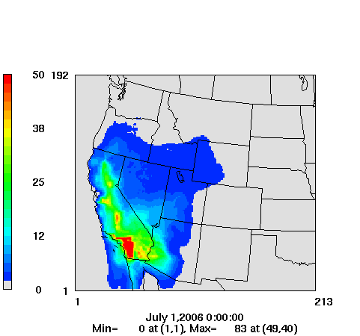
Source Contribution & Control/Response Modeling for Supporting Policy Assessment
Inform control strategy development:
  O3, PM2.5, Reg haze SIPs & RIAs
Transport rules or Transport SIPS:
  Assess “significant contribution” of sources in upwind states to downwind states
Sector impact assessments:
  EGU, Transportation, Industrial Boiler, etc.
NAAQS Area designations:
  Provide analysis for States to assess impacts from boundaries
Single source Impact assessments:
  PSD/NSR permitting
Exceptional events demonstrations:
  Assess impacts of special events such as fire
Characterizing international contribution:
  179b demonstrations
U.S. EPA Source apportionment modeling for assessing source contributions to PM2.5 & O3 from emissions
Local Contribution
Ozone (ppb)
Upwind States
International
4
Natural
Ozone Source Contribution
(example, not to scale)
(Courtesy of Dr. Kirk Baker)
4

Slide 5
RSM: Instant AQ Responses to Emissions Control
Response Surface Model (RSM):
A reduced form model built upon multiple “brute-force” AQ model simulations to provide rapid response of AQ (O3 & PM2.5 species) to emission changes
Major advantage: provide “instant” & “infinite” emissions control (region/sector/pollutant) scenarios with effective representation of non-linear chemistry of O3 and PM2.5 species
Ambient Concentration
Sensitivity (e.g., DDM, HDDM)
“real atmosphere”
RSM
Source Apportionment (e.g., OSAT/PSAT, ISAM)
0
1
Emission ratio
Base
5

Slide 6
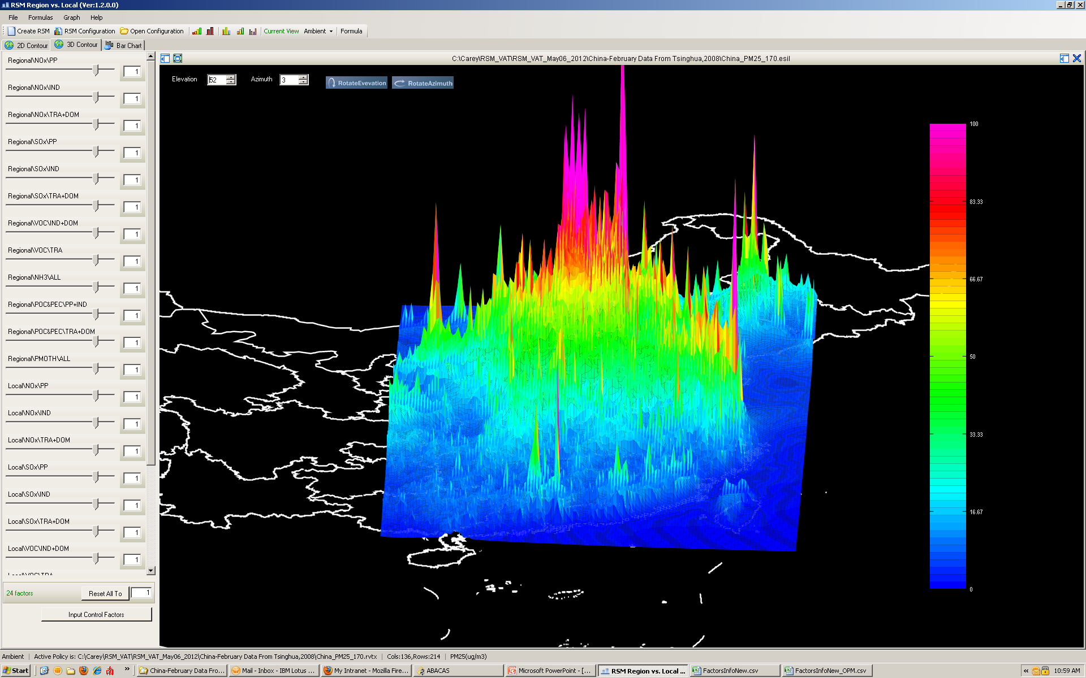
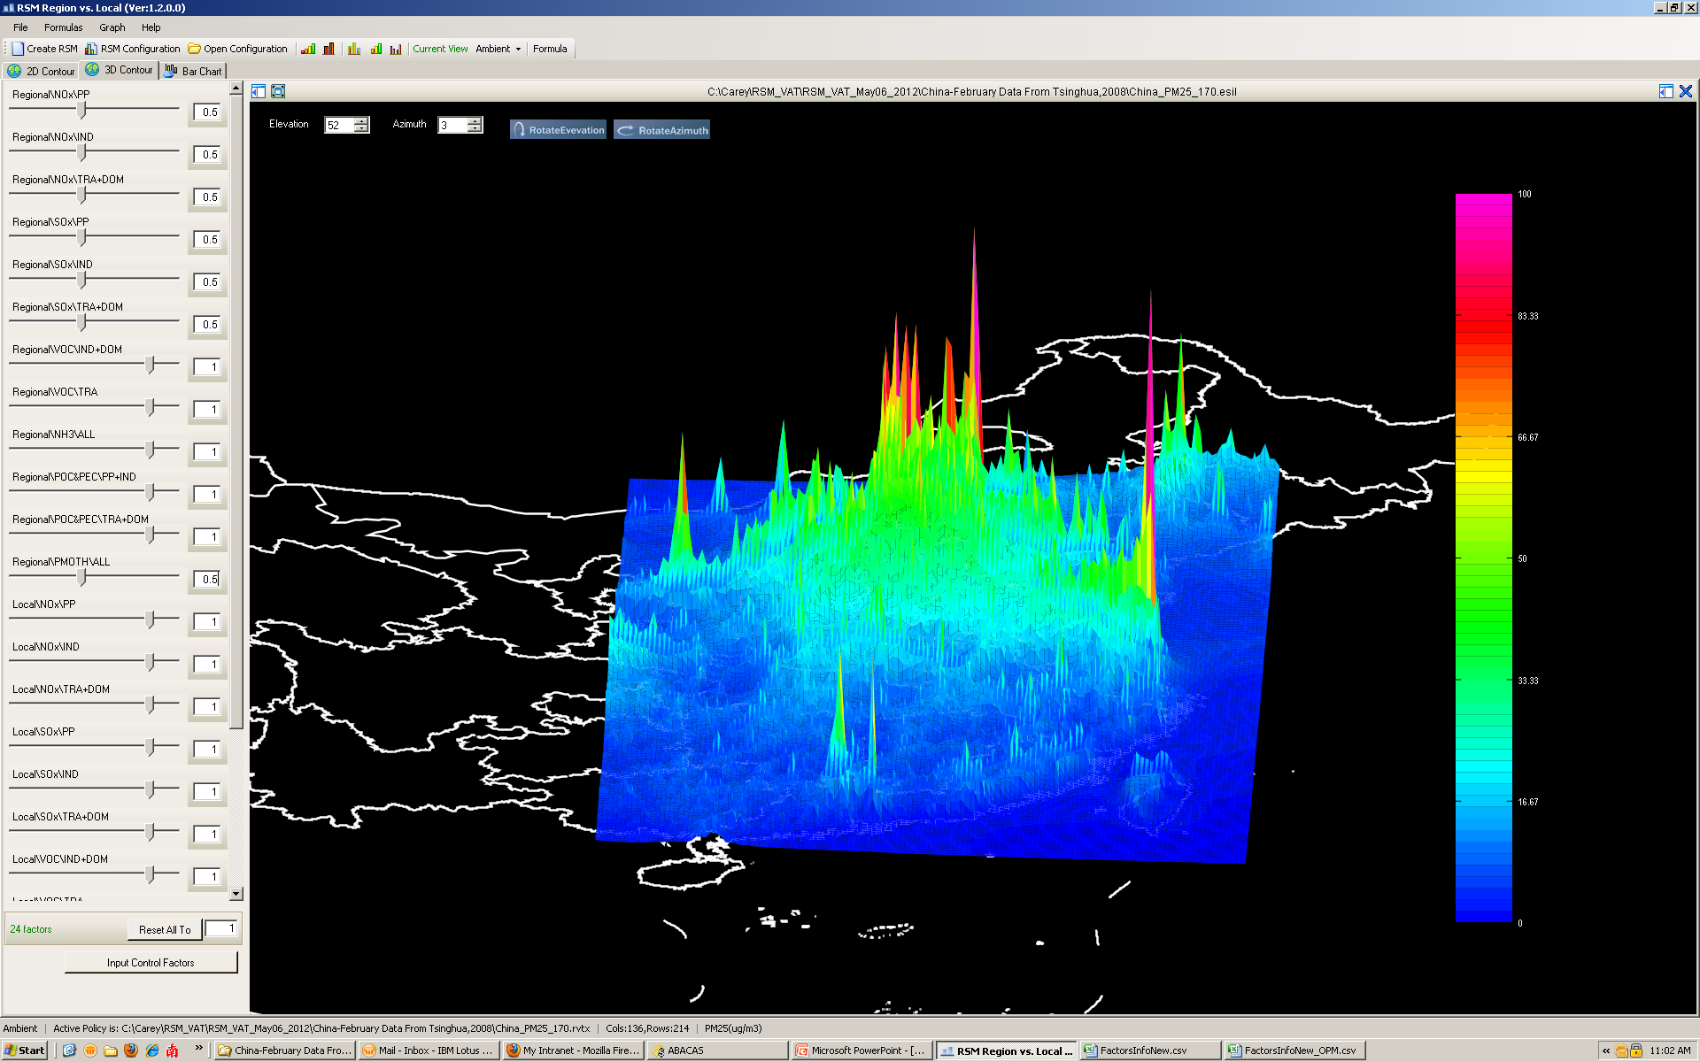
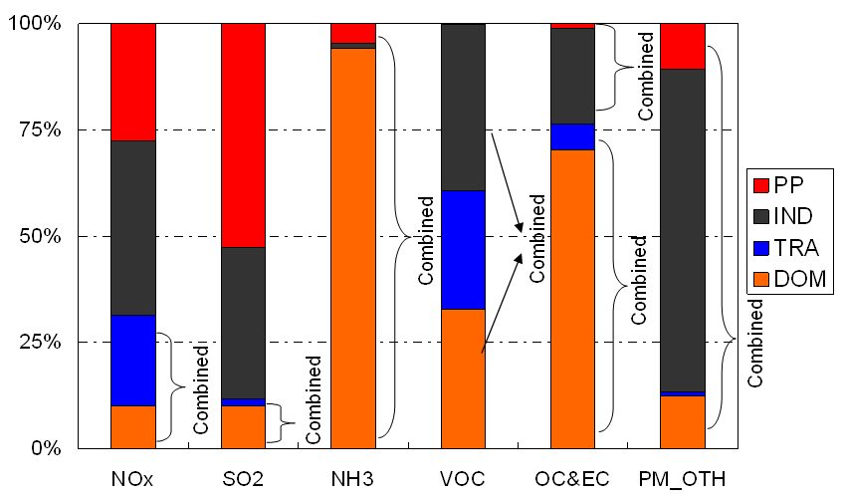
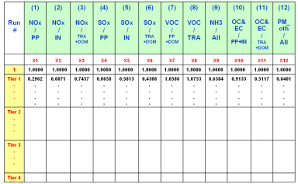
“4S” Steps in RSM (Traditional RSM)
Policy Factors
(Emission Factors)
Air quality
RSM
Instant AQ
Response Surface
1.Selection
Control
Base
“Region/Pollutant
/Sector” Factors
Source A- Local NOx
Source B- Regional VOC
Source C- Area NOx
…
4.Statistic
Create RSM
2.Sampling
Source C
Empirical Best Linear Unbiased Predictors (EBLUPs)
Control Matrix
Source B
Source A
Latin Hypercube Sample (LHS)
Hammersley quasi-random Sequence Sample (HSS)
3.Simulation
Multi-case CMAQ simulations
6
Experimental Design
Resource-intensive

Slide 7
How to reduce number of model runs while improving/maintaining RSM accuracy?
Motivation for Advanced “RSM” Development:
7

Slide 8
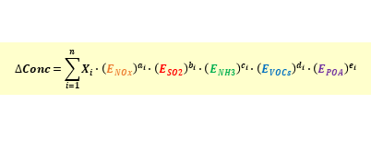
Evolution and Development of RSM
Region A
Pollutant A (PM)
How to further reduce number of model runs required in RSM?
Pollutant A (PM)
Air
Air
Air
Pollutant A (PM)
pollutant
pollutant
Region B
Pollutant B (O3)
Pollutant B (O3)
Pollutant B (O3)
•
Chemistry
RSM w/
Temporal
Polynomial
Functions
•
Transport
•
Indirect
Real-time pollutant responses
to emissions change
Real-time pollutant responses
Multi-pollutant responses
Single scenario
to multi-region sources
based on polynomial functions
Region A
$$∆Conc=\sum_{i=1}^{n}{X_{i}∙{\left(E_{NOx}\right)}^{a_{i}}∙{\left(E_{SO2}\right)}^{b_{i}}∙{\left(E_{NH3}\right)}^{c_{i}}∙{\left(E_{VOCs}\right)}^{d_{i}}∙{\left(E_{POA}\right)}^{e_{i}}}$$
Emissions
Emissions
Change
Region B
NO_{x}
NH₃
POA
SO₂
VOC
Region C
AQM
RSM
E-RSM
pf-RSM
Deep-RSM
Zhao et al., GMD, 2015
Xing et al., ES&T, 2020
Xing et al., Atm. Res., 2022
Xing et al., ACP, 2011
Zhao et al., ACP, 2017
Xing et al., ACP, 2018
Wang et al., ES&T, 2011
Xing et al., ES&T, 2017
2 (Base & Control)
Model runs required: > 1000s >100s >20
8

Slide 9
“pf-RSM” Methodology
Polynomial Functions
Chemistry:
Degree of
Non-linearity
Chemistry:
Term of
Interactions
Modeling:
Coefficients of Polynomial term
Only 3rd step involved in training samples (i.e., model runs), and thus significantly reduces
# of model runs required for accuracy (20~30 runs per selected control region)
“pf-RSM”: Response Surface Model based on Polynomial Functions
9
Xing et. al., 2018, Atmos. Chem. & Phys., https://doi.org/10.5194/acp-18-7799-2018

Slide 10
Deep Machine Learning “DeepRSM”
DeepRSM: “Deep Learning” “Indicator-based” pf-RSM
Combine
pf-RSM
and
Deep Learning CNN
to predict
Nonlinear PM2.5 & O3 responses to emissions control
# of model runs needed for maintaining RSM accuracy in predicting control responses （* for each selected control region or sector）
Traditional RSM | “pf-RSM” | “DeepRSM”
>100s | 20~30* | 1*
10
Xing et. al., ES&T, 2020 (Further details please see Appendix B)

Slide 11
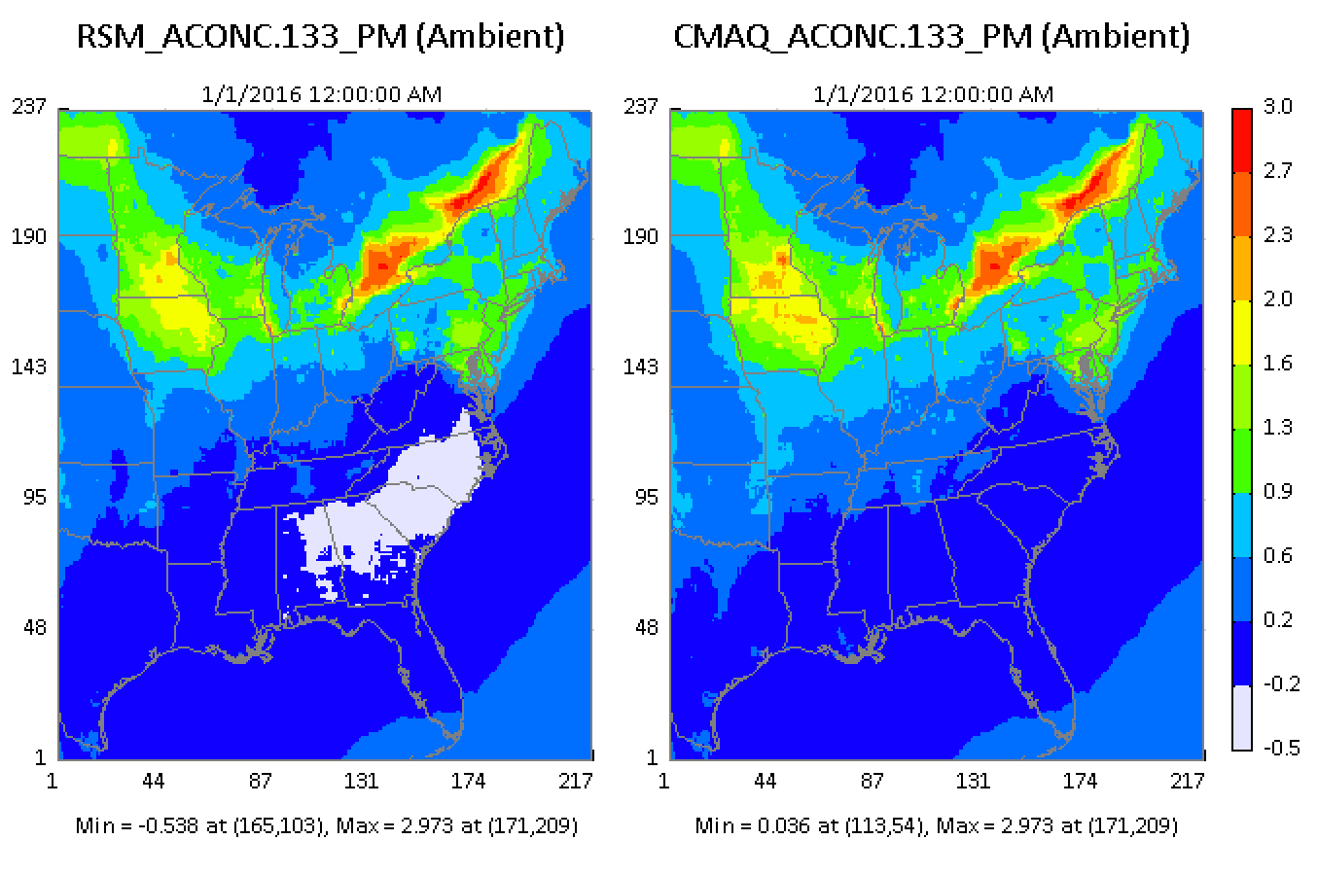
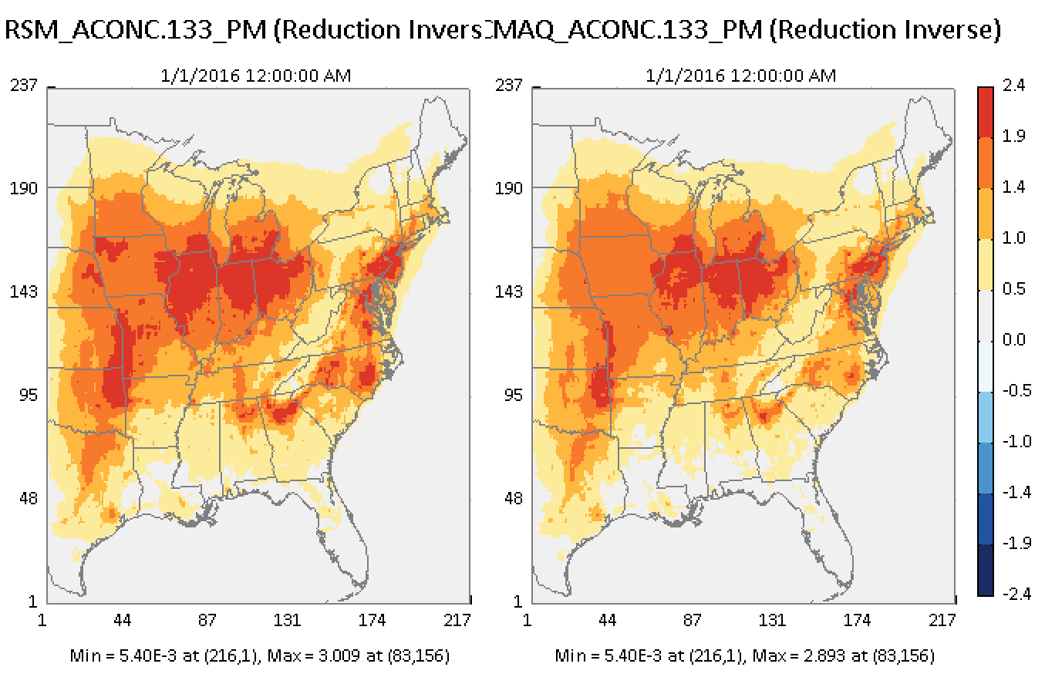
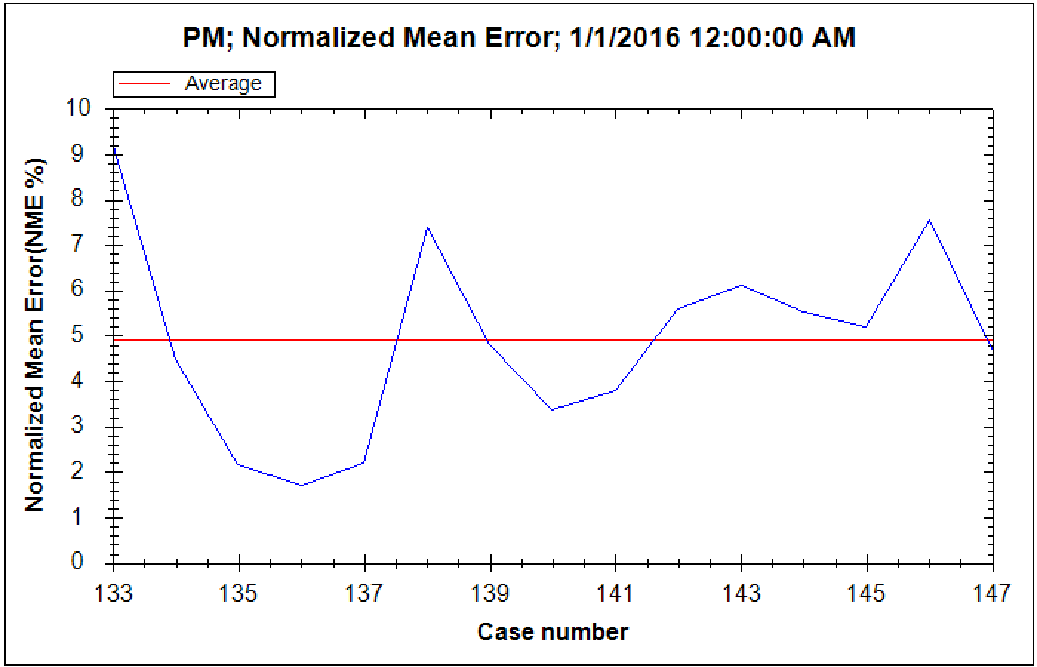
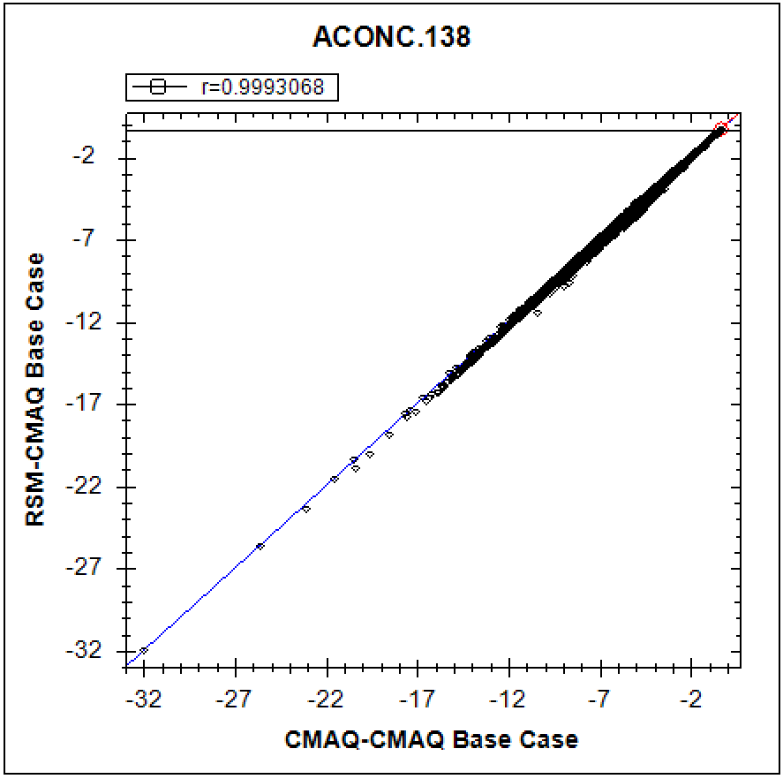
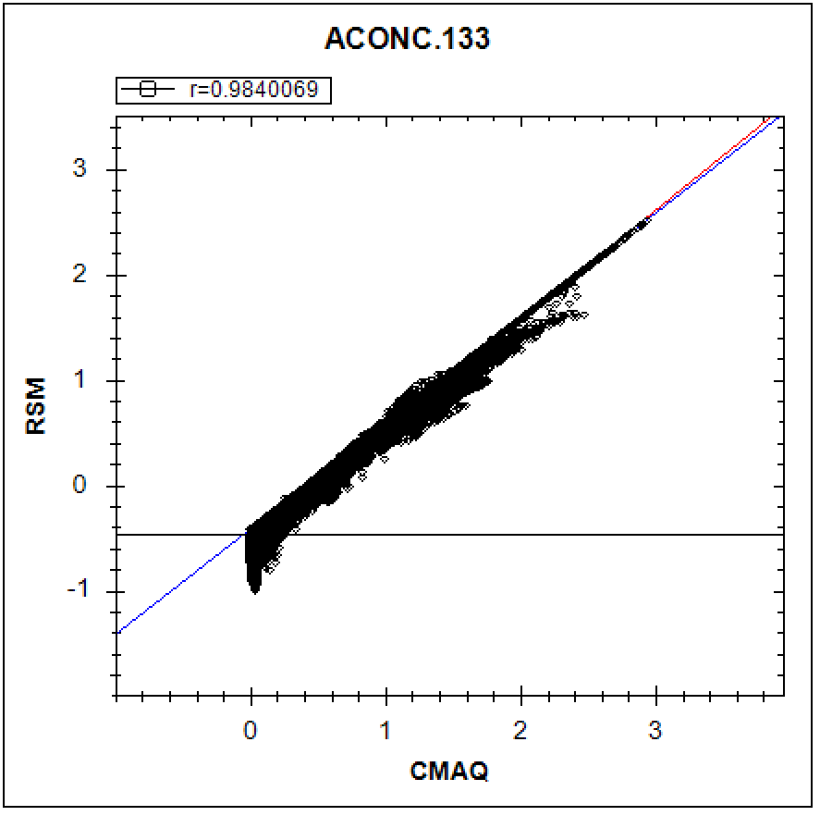
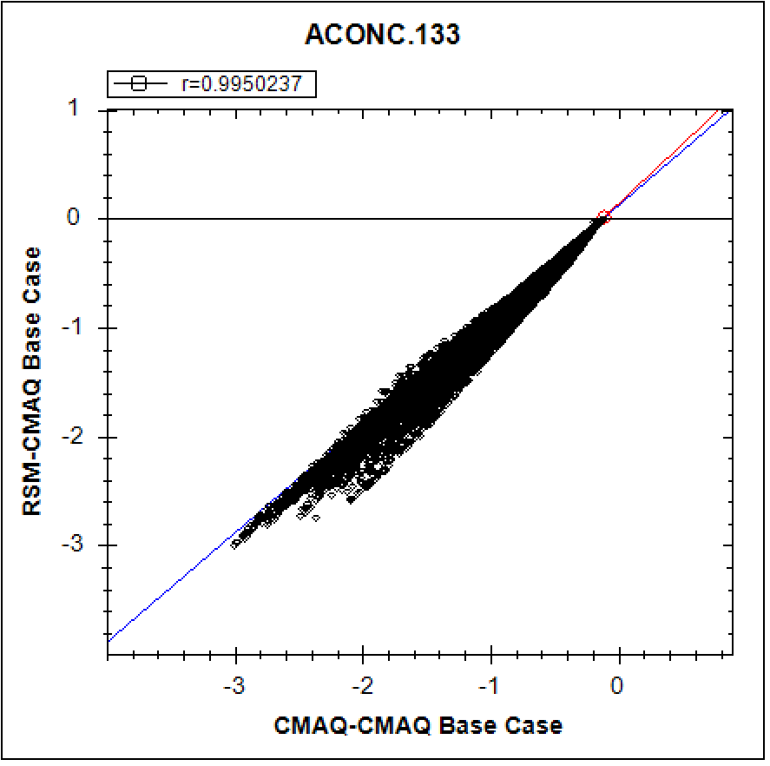
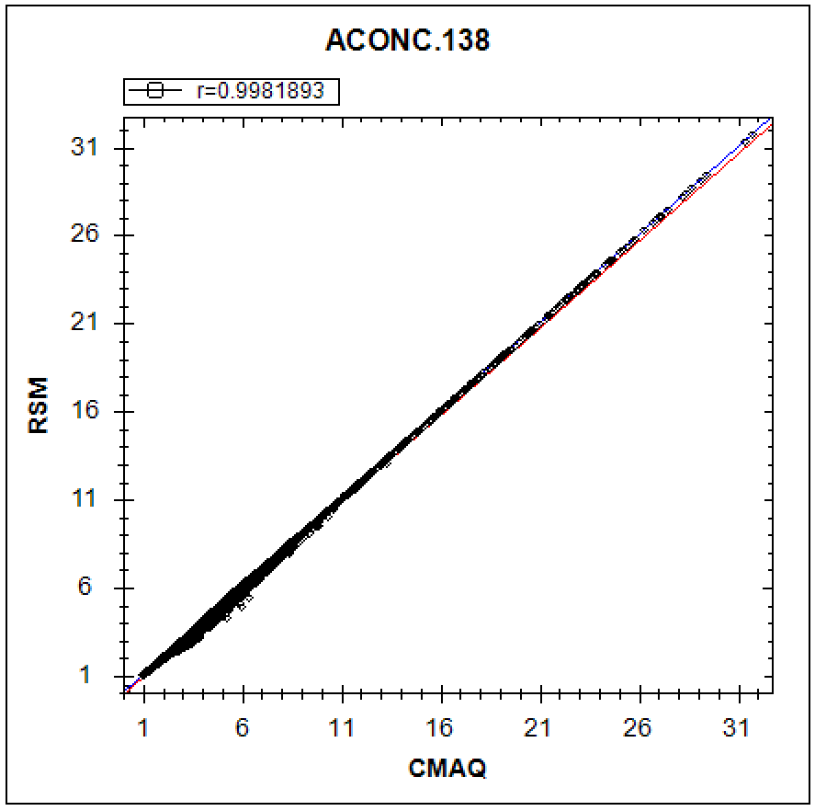
“PM_NO3” serves as a good indicator for QA & Validation (nonlinearity)
(“PM_NO₃“ Jan. monthly avg., “Out-of-Sample Validation”)
How good is RSM in replicating CMAQ?
QA & Validation:
“ O3,
PM2.5, PM_SO4
PM_NO3 “
for Jan. & July 2016
are given in Appendix C
PM_NO3
Conc.
PM_NO3
Response
PM 2.5
Conc.
PM 2.5
Response
11

Slide 12
Appendix A: Recent pf-RSM Applications/Publications
Appendix B: DeepRSM Supplemental Information
Appendix C: Running DeepRSM in “FAST-CE” & “RSM-VAT”
  Appendix A:
  Recent RSM Applications/Comparisons & Publications
    pf-RSM/CMAQ E-US pilot study: O3 & PM2.5 nonlinear responses (Kelly et al., 2021, Atmosphere)
    CMAQ-BF//pf-RSM/OSAT/HDDM comparisons: O3 case study (Fang et al., 2021, Environ. Pollution)
    CMAQ-BF/pf-RSM/PSATcomparisons: PM2.5 case study (Li et al., 2021, Frontier ES&E)
12

Slide 13
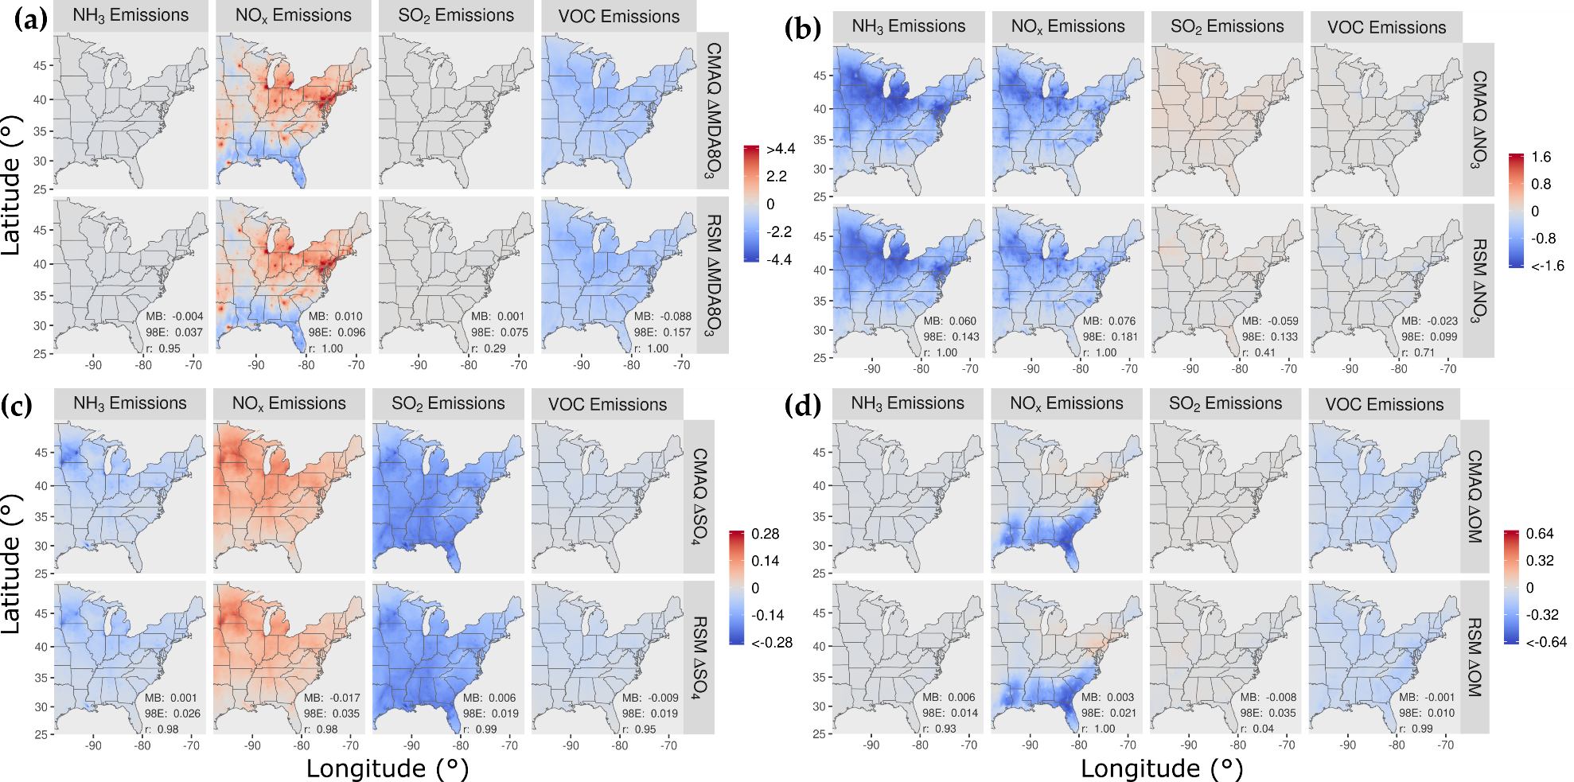
1. RSM/CMAQ E-US Case: “RSM” vs. “CMAQ” Responses
CMAQ
ΔO3_MDA8
CMAQ
ΔPM_NO3
vs.
vs.
RSM
ΔO3_MDA8
RSM
ΔPM_NO3
CMAQ
ΔPM_SO4
CMAQ
ΔPM_OM
vs.
vs.
RSM
ΔPM_SO4
RSM
ΔPM_OM
Comparisons of AQ changes (monthly avg.): pf-RSM vs. CMAQ for a 60% reduction in anthropogenic NH₃, NO_{x}, SO₂, and VOC emissions
Jan. 2016
13

Slide 14
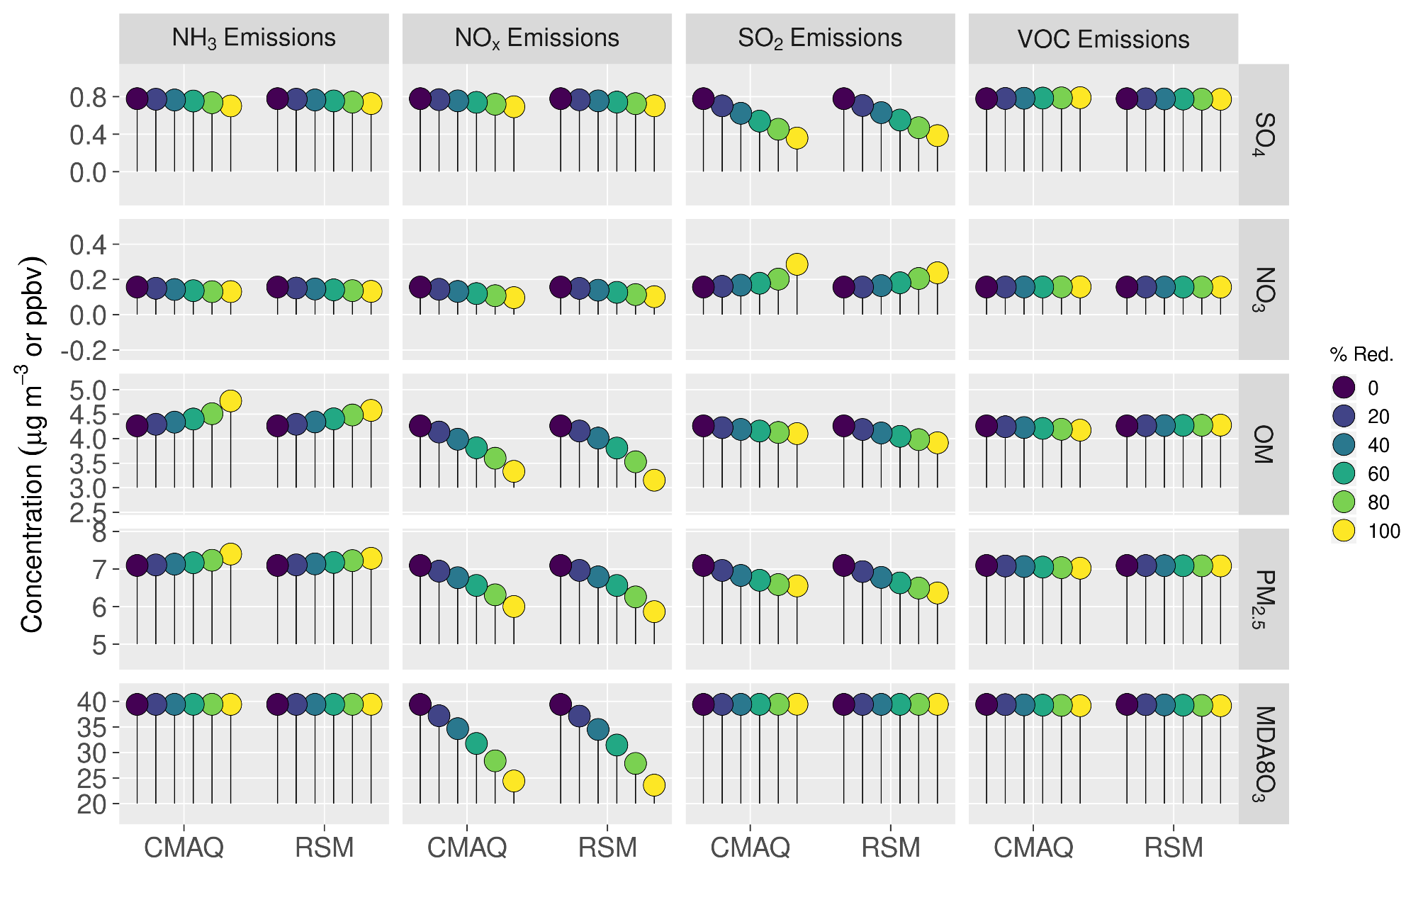
1. RSM/CMAQ E-US Case: PM2.5 nonlinear chemistry
Comparisons of AQ conc. predicted by pf-RSM vs. CMAQ over all CBSAs for man-made emission reductions from 0 to 100%.
July 2016
(Jan. 2016 given in Appendix A)
Summary - NO_{x} emission reductions were more effective for reducing PM_{2.5} and O3 concentrations than SO₂, NH₃, or VOC emission reductions. NH₃ emission reductions effectively reduced nitrate concentrations in January but increased secondary organic aerosol (SOA) concentrations in July.
14
14

Slide 15
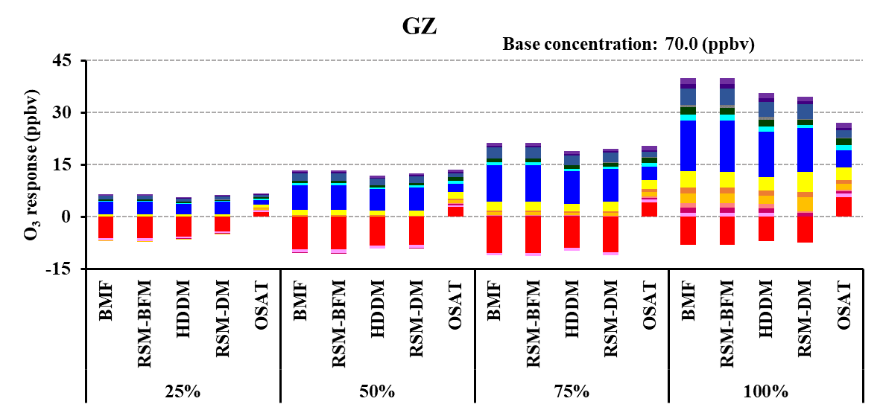
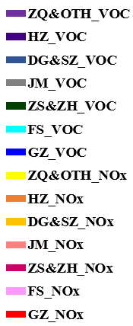
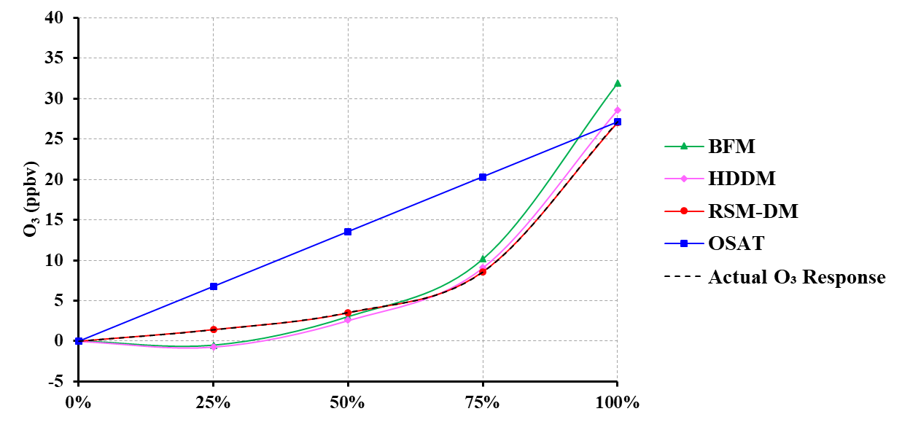
2. CMAQ-BF/OSAT/HDDM/pf-RSM comparisons: O3 case study
Comparisons of O₃ source impacts & contributions by 25%/50%/75/100% multi-region emission cuts
Receptor region: Guangzhou (September, 2017)
Source impact analysis:
BFM, HDDM & RSM-BFM: Predict consistently the impacts of accumulative source emissions; HDDM deviates from BFM under larger perturbations;
Source contribution analysis:
RSM-DM: Represent well for accumulative source contribution and non-linear O₃ chemistry
OSAT: fails to represent the nonlinear response of O₃ to incremental emission changes.
Accumulative source impacts and contributions
15

Slide 16
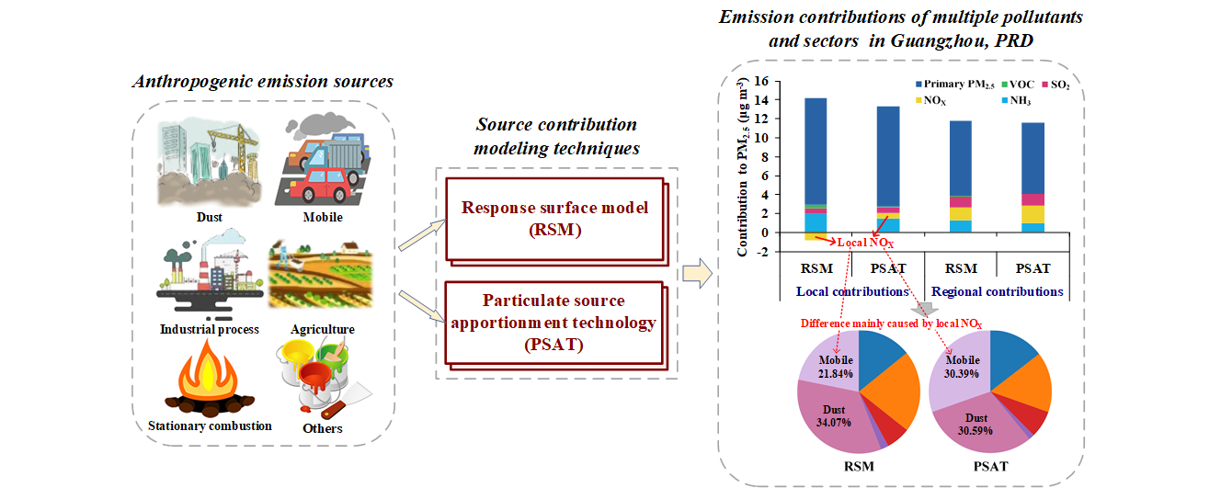
3. CMAQ-BF/PSAT/RSM comparisons: PM2.5 case study
“Source contribution analysis based on advanced modeling approaches for PM_{2.5} over the PRD region, China“ (Li et al., 2021, submitted to J. of Environ. Modeling)
16

Slide 17
3. BFM/PSAT/RSM comparisons: PM2.5 Sectoral Responses
BFM
RSM
PSAT
Industrial
processes
36
Sectoral contributions of PM2.5 predicted by BFM and RSM are very similar
BFM and RSM predicted lower contributions of “Mobile“ sector than PSAT and modestly higher contribution of “Agriculture“ sector
36
Mobile
Stationary
sources
9
4.5
Agricultrue
36
Dust
PM2.5 Jan. Avg.
17

Slide 18
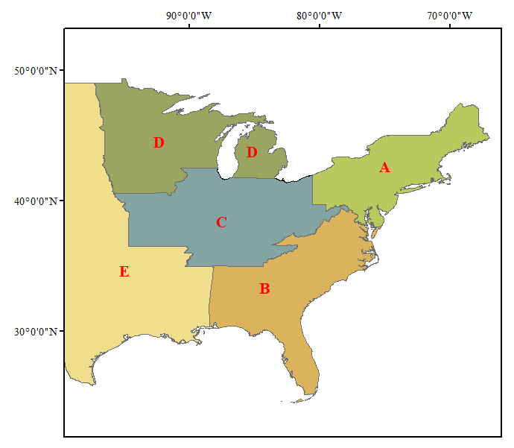
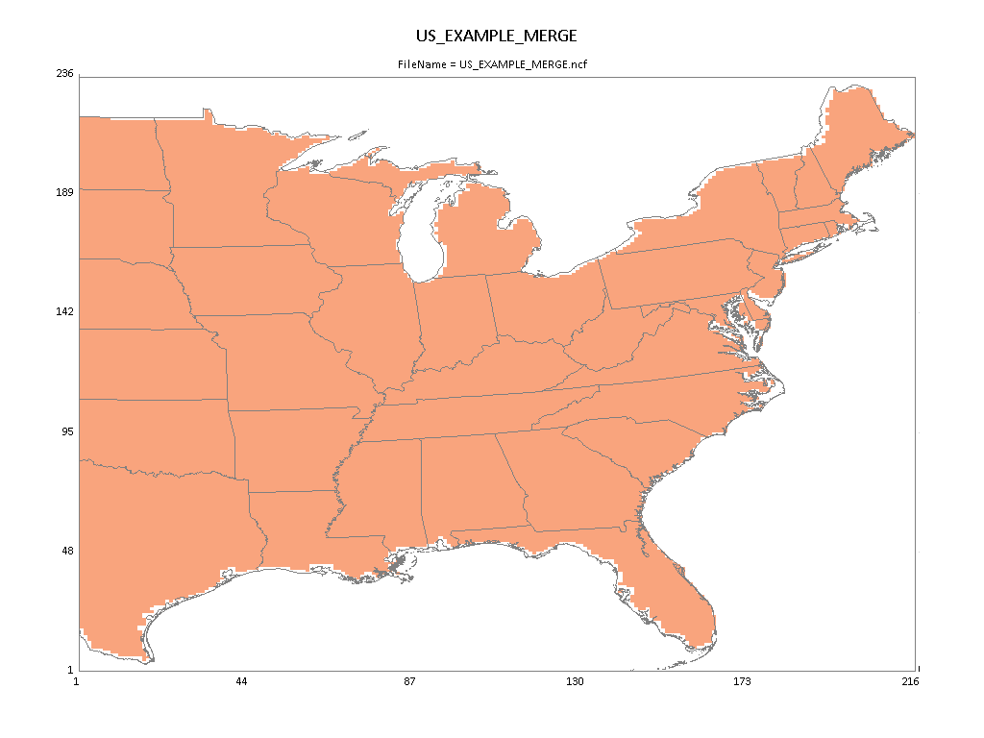
Appendix C
Easier than you think !
  Running RSM Using “FAST-CE” and
  “RSM-VAT” Tool
  Experimental Design: “Prepare CMAQ” module
  Running “pf-RSM”
  Performance evaluation: QA & “Out-of-Sample Validation”
  (Further details of “Quick Tutorial” and QA provided in “Appendix C”)
    CMAQ “Eastern US” 12-km pilot cases based on “pf-RSM”
Five-Region RSM/CMAQ
One-Region RSM/CMAQ
18

Slide 19
    2018 CMAQ PM-NAAQS pilot case for O3 and PM2.5 over USA domain & 10 climate regions
DeepRSM Pilot Application in USA
19

Slide 20

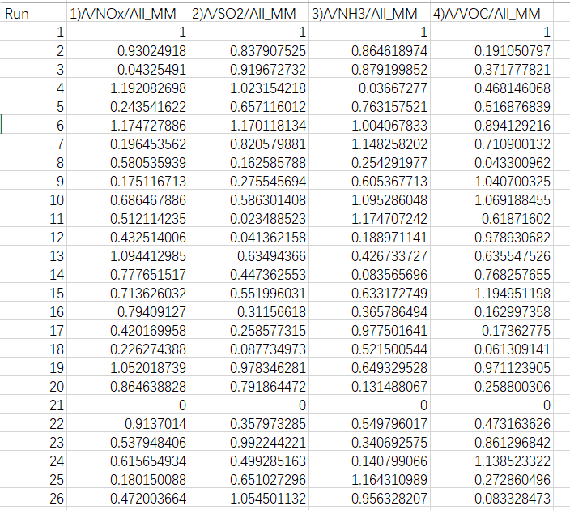
2.1 Model configuration and control matrix design of Entire US domain
2.1.1 CMAQ Configuration
2.1.2 Control Matrix Design for Entire US domain 2018
CMAQ Version: CMAQ5.3.2
Model domain grids: 396 * 246
Grid resolution：12km * 12km
Chemical mechanism: cb6r3_ae7_aq
Simulation Period: The whole year of 2018
1 Region: USA
4 Pollutants: NOx, SO₂, NH₃, VOCs
1 Sector: All manmade(ALL_MM)
4 factors = 4 pollutants * 1 region * 1 sector
26 CMAQ simulation cases: 1 base case, 19 cases created by HSS method (0-1.2) for non-linear factors, 1 clean boundary conditions, 5 cases for out of sample (OOS)
2.1.3 Data set of DeepRSM
Training cases: 21 US 2018 daily cases from January to December of 2018
（#1 - #21：21 cases * 12 months = 252 monthly runs）
OOS cases: 5 US 2018 daily cases from January to December of 2018
（#22 - #26：5 cases *12 months = 60 monthly runs）
1-21： training cases
Model domain: Entire US domain
22-26： Out of sample validation
Control Matrix

Slide 21
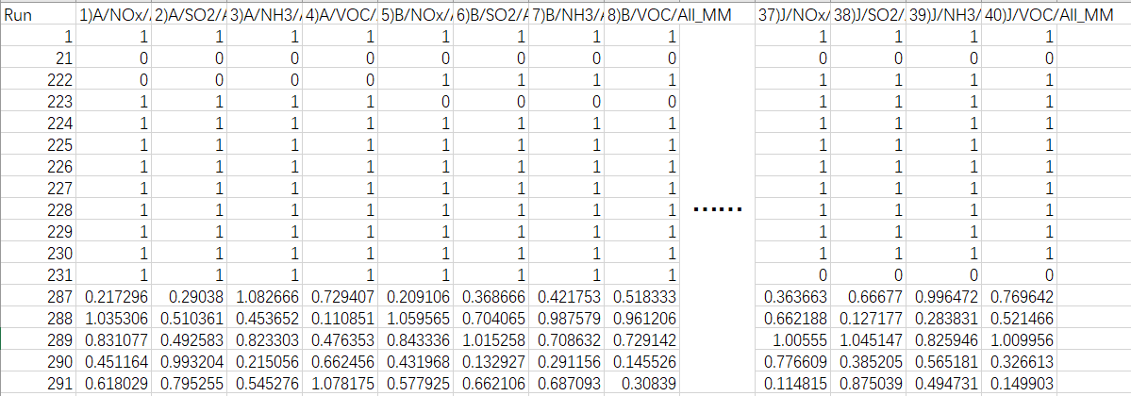
3.1 Model configuration and Data set of Climate-Region
3.1.1 CMAQ Configuration
3.1.3 Data set of building climate-region RSM
CMAQ Version: CMAQ5.3.2
Model domain grids: 396 * 246
Grid resolution：12km * 12km
Chemical mechanism: cb6r3_ae7_aq
Simulation Period: July 2018
DeepRSM Model: obtained from US 2018 daily cases training (January to December, not divided into regions, treating the entire United States as a single region)
Building multi-region RSM cases: 11 daily cases in July(1 base case, 1 clean boundary conditions per region)
OOS cases: 5 daily cases in July
3.1.2 Climate-Region division
The continental United States was divided into 10 regions based on climate zones:
10 Regions: CEN_CR, NE_CR, NPR_CR, NW_CR, S_CR, SE_CR, SW_CR, UPMW_CR, W_CR, OTHER
NW_CR
NPR_CR
1,222-231: used to build climate-region RSM
UPMW_CR
NE_CR
W_CR
CEN_CR
SW_CR
S_CR
SE_CR
OTHER
287-291: Out of sample validation
Control Matrix
Model domain: 10 regions

Slide 22
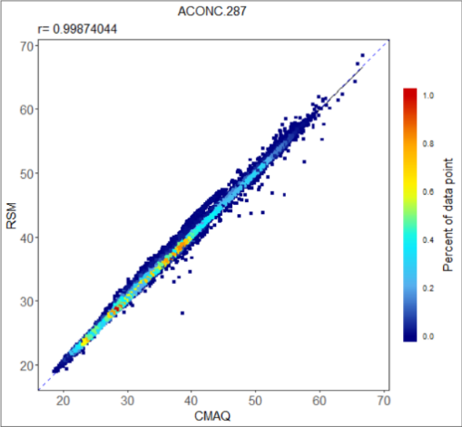
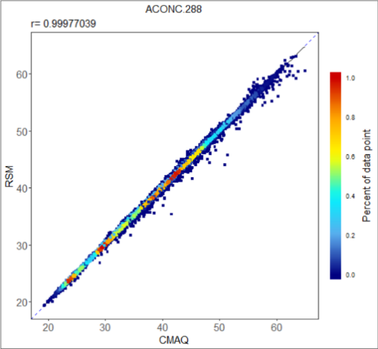
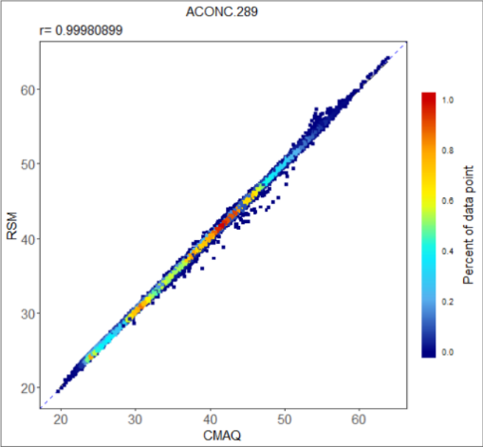
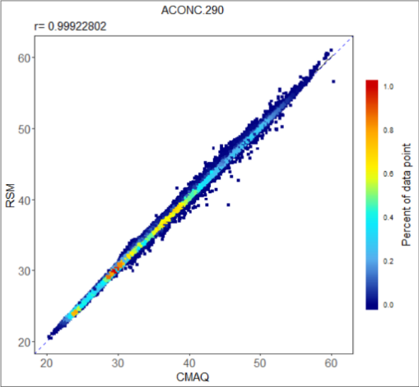
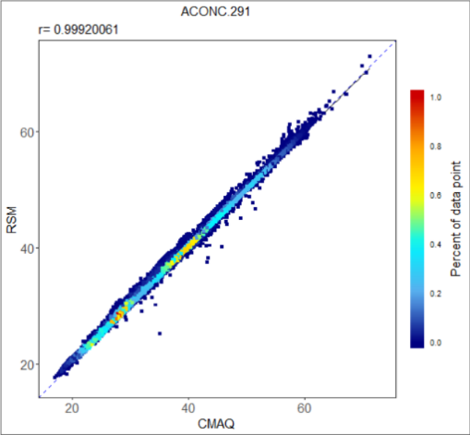
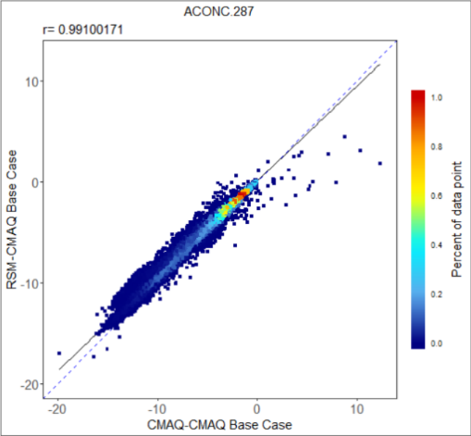
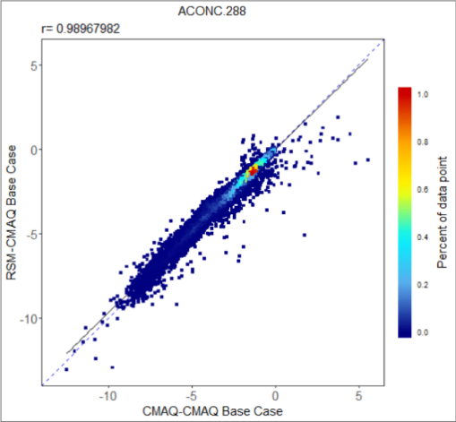
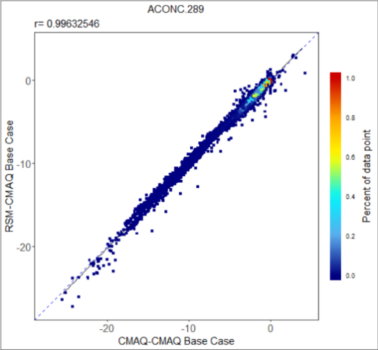
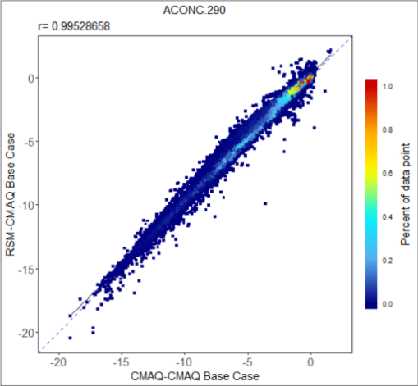
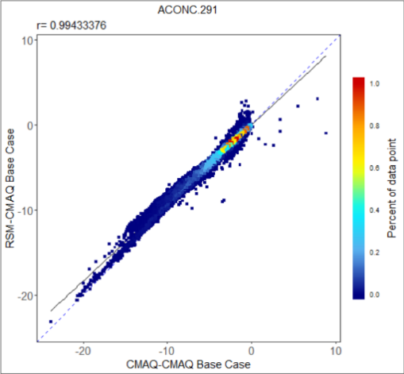
3.2 Validation of US Climate-Region July 2018 DeepRSM
Case (July) for monthly average MDA8 O₃ in Scatter plot with color density
RSM VS CMAQ:
RSM VS CMAQ (Base Response):

Slide 23
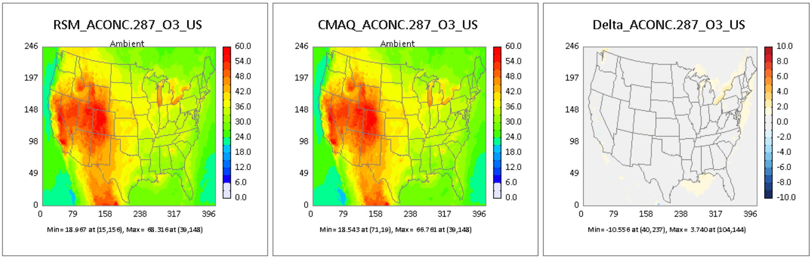
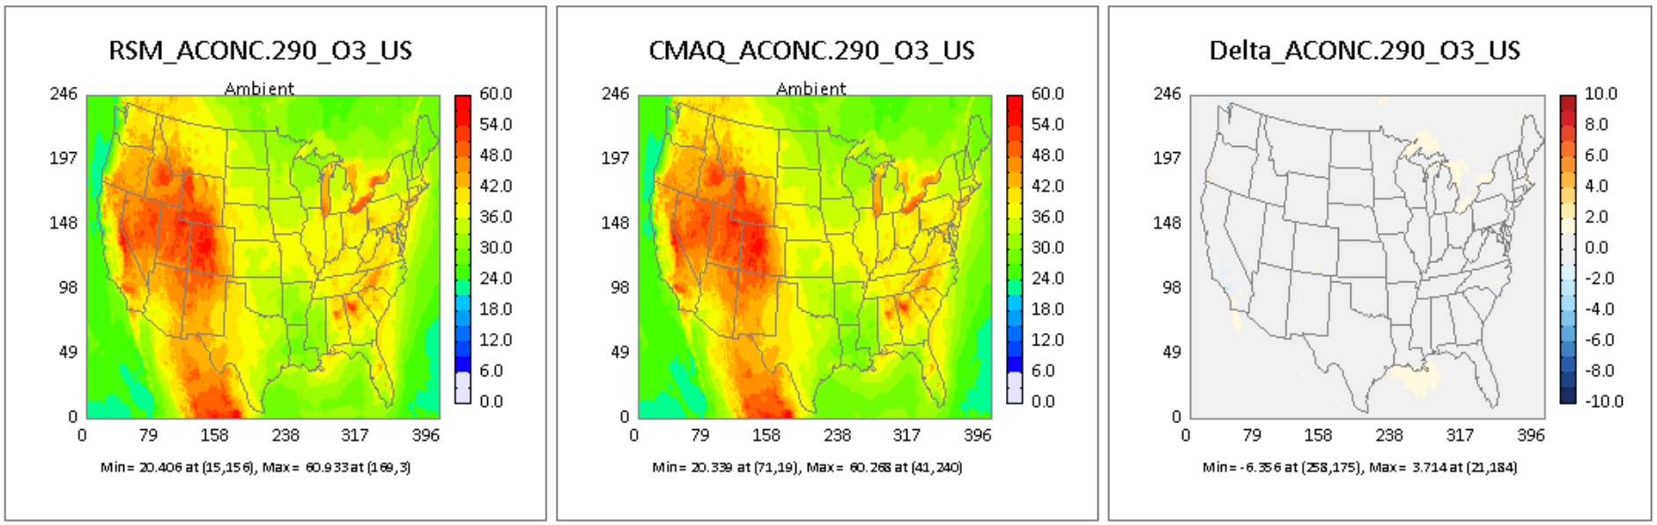
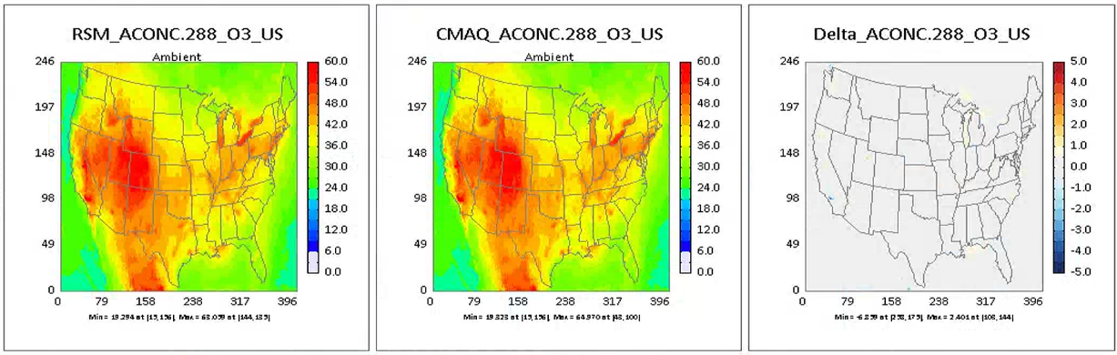
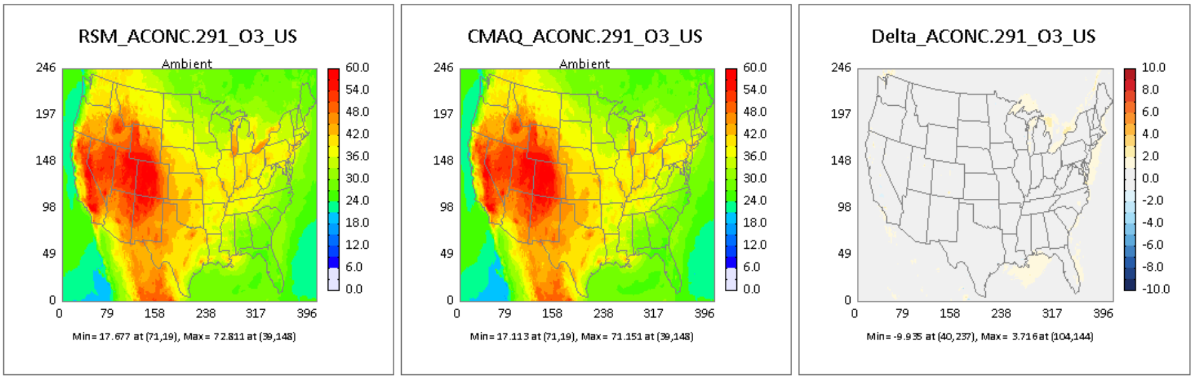
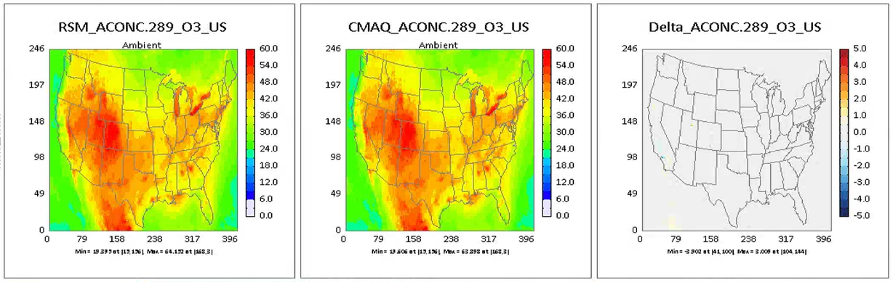
3.2 Validation of US Climate-Region July 2018 DeepRSM
Case (July) for monthly average MDA8 O₃ in concentration map
ACONC.287
ACONC.290
ACONC.288
ACONC.291
ACONC.289
Notes:
Ambient： Spatial distribution of pollutant concentration in control scenario

Slide 24
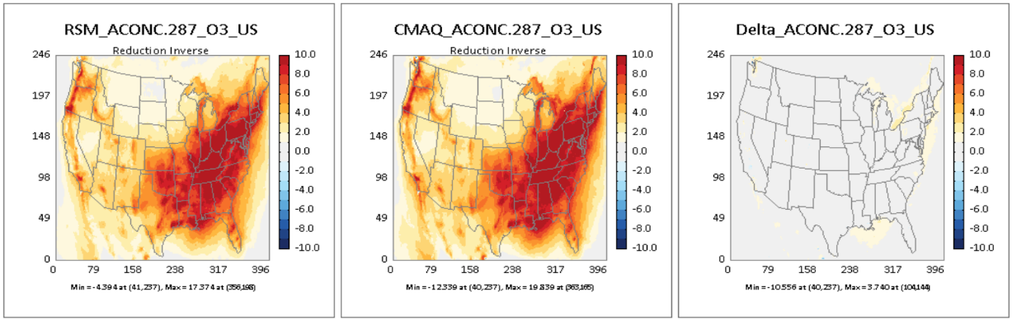
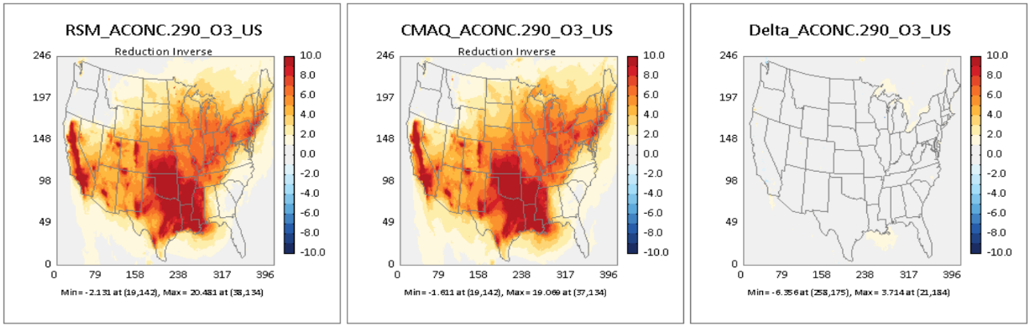
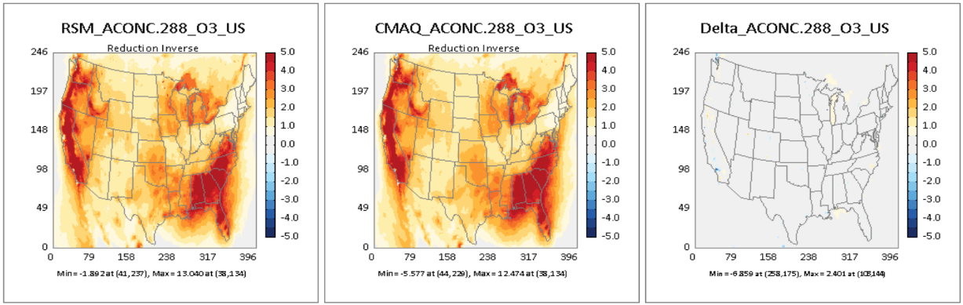
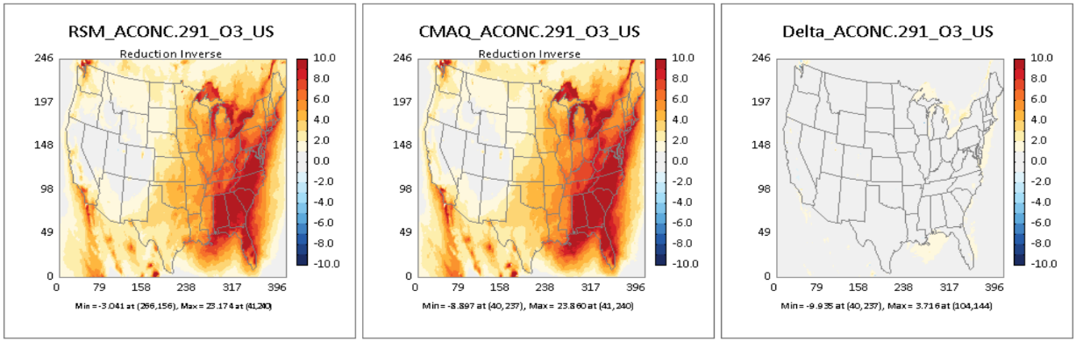
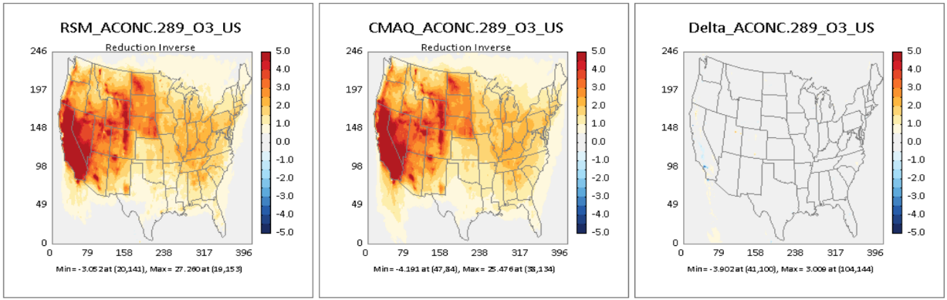
3.2 Validation of US Climate-Region July 2018 DeepRSM
Case (July) for monthly average MDA8 O₃ in concentration response map
ACONC.287
ACONC.290
ACONC.288
ACONC.291
ACONC.289
Notes:
Response： The difference between the baseline scenario and the control scenario

Slide 25
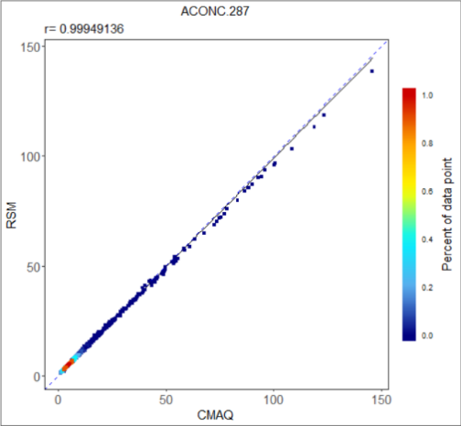
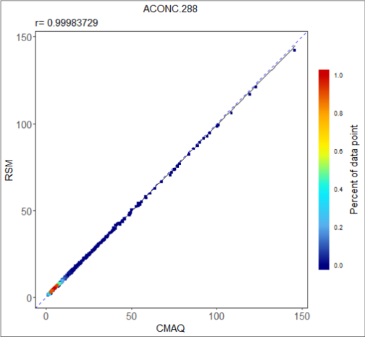

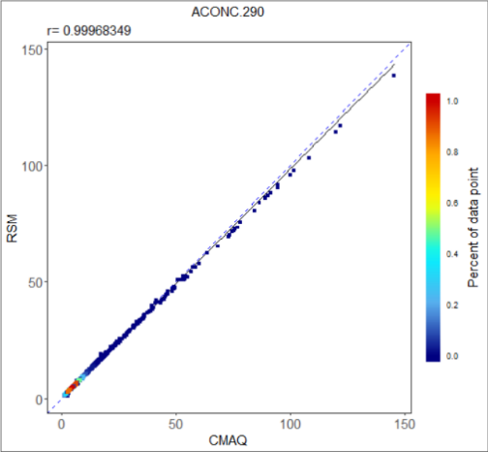

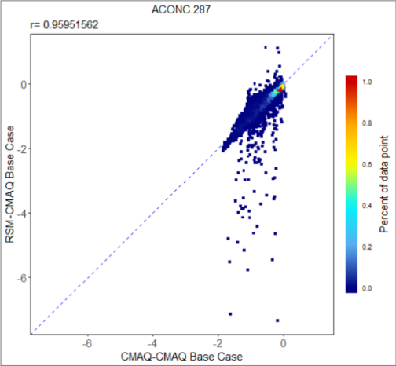




3.2 Validation of US Climate-Region July 2018 DeepRSM
Case (July) for monthly average PM_{2.5} in Scatter plot with color density
RSM VS CMAQ:
RSM VS CMAQ(Base Response):

Slide 26





3.2 Validation of US Climate-Region July 2018 DeepRSM
Case (July) for monthly average PM_{2.5} in concentration map
ACONC.287
ACONC.290
ACONC.288
ACONC.291
ACONC.289
Notes:
Ambient： Spatial distribution of pollutant concentration in control scenario

Slide 27





3.2 Validation of US Climate-Region July 2018 DeepRSM
Case (July) for monthly average PM_{2.5} in concentration response map
ACONC.287
ACONC.290
ACONC.288
ACONC.291
ACONC.289
Notes:
Response： The difference between the baseline scenario and the control scenario

Slide 28


4.2 Comparison of source attribution evaluation method results
4.2.1 The result of NO_{x} or VOC reduction with different method in July
NOx or VOC each reduction in Jul 2018
The total amount of DeepRSM and Opf-RSM source contribution is generally consistent with “Total”, demonstrating the accuracy of their simulations, but both their VOCs exhibit a slight negative contribution, indicating that there are still problems with the algorithms.
CMAQ BF: NOx or VOC
Opf-RSM BF: NOx or VOC
DeepRSM BF: NOx or VOC
Opf-RSM
DeepRSM
HDDM
CMAQ BF: Total
CMAQ BF: NOx or VOC
Opf-RSM BF: NOx or VOC
DeepRSM BF: NOx or VOC
Opf-RSM
DeepRSM
HDDM
CMAQ BF: Total
CMAQ BF: NOx or VOC
Opf-RSM BF: NOx or VOC
DeepRSM BF: NOx or VOC
Opf-RSM
DeepRSM
HDDM
CMAQ BF: Total
CMAQ BF: NOx or VOC
Opf-RSM BF: NOx or VOC
DeepRSM BF: NOx or VOC
Opf-RSM
DeepRSM
HDDM
ISAM
CMAQ BF: Total
Note: “Total” means the difference between the base case and the control case (100%, 75%, 50% and 25% reduction of NO_{x}, VOC, NH₃ and SO₂).
O₃ MDA8 Jul Avg (ppbv)
Note: All source attribution results in section 4 are for the entire US domain.

Slide 29
4.1 Comparison of source attribution evaluation method results
4.1.1 The result of NO_{x} & VOC reduction with different method in July
NOx & VOC reduction in July 2018
CMAQ BF: NOx & VOC
Opf-RSM BF: NOx & VOC
DeepRSM BF: NOx & VOC
Opf-RSM
DeepRSM
HDDM
ISAM
CMAQ BF: Total
O₃ MDA8 (ppb), 2018 July Avg

Slide 30
DeepRSM Training Report and Source Apportionment
1. What is DeepRSM?
2. DeepRSM Training Report of Entire US domain 2018 Case
Contents
3. DeepRSM Training Report of US Climate-Region July 2018
4. O₃ Source Attribution Evaluation in US Cases
5. PM_{2.5} Source Attribution Evaluation in US Cases

Slide 31
4.1 Configuration of source attribution evaluation method
4.1.1 Configuration of DDM and HDDM
4.1.2 Configuration of ISAM
CMAQ Version: CMAQ5.3.2
Model domain grids: 396 * 246
Grid resolution：12km * 12km
Chemical mechanism: cb6r3_ae7_aq
Simulation Period: July in 2018
Model domain: the entire of US
CMAQ Version: CMAQ5.3.2
Model domain grids: 396 * 246
Grid resolution：12km * 12km
Chemical mechanism: cb6r3_ae7_aq
Simulation Period: July in 2018
Model domain: the entire of US
1 Sector: All manmade(ALL_MM)
1 Sector: All manmade(ALL_MM)
2 Pollutants: NOx, VOCs
Species:
NOx : NO, NO₂
VOCs : TOL, XYLMN, BENZENE, NAPH, PAR, PRPA, MEOH, ETH, ETOH, OLE, ACET, FORM, GLY, KET, ETHY, ALD2, ETHA, IOLE, ALDX, ISOP, TERP, APIN
The 12 built-in sources were merged into three. For NOx (VOCs), set all species to zero except those belonging to NOx (VOCs):
 | EGGNOx | EPTNOx | ECMVNOx
NOx | GR_EMIS_N, GR_FIRE_N | PT_EGU_N, PT_NEGU_N, PT_OILG_N, PT_RXF_N, PT_F_N, PT_OTHF_N, PT_AGF_N, PT_OTH_N | PT_C1C2_N, PT_C3_N
 | EGGVOC | EPTVOC | ECMVVOC
VOCs | GR_EMIS_V, GR_FIRE_V | PT_EGU_V, PT_NEGU_V, PT_OILG_V, PT_RXF_V, PT_F_V, PT_OTHF_V, PT_AGF_V, PT_OTH_V | PT_C1C2_V, PT_C3_V
The results of HDDM and DDM will be compared with the results of Opf-RSM and DeepRSM, and the specific comparison chart will be shown on the next slides.

Slide 32


4.2 Comparison of source attribution evaluation method results
4.2.1 The result of NO_{x} or VOC reduction with different method in July
NOx or VOC each reduction in Jul 2018
The total amount of DeepRSM and Opf-RSM source contribution is generally consistent with “Total”, demonstrating the accuracy of their simulations, but both their VOCs exhibit a slight negative contribution, indicating that there are still problems with the algorithms.
CMAQ BF: NOx or VOC
Opf-RSM BF: NOx or VOC
DeepRSM BF: NOx or VOC
Opf-RSM
DeepRSM
HDDM
DDM
CMAQ BF: Total
CMAQ BF: NOx or VOC
Opf-RSM BF: NOx or VOC
DeepRSM BF: NOx or VOC
Opf-RSM
DeepRSM
HDDM
DDM
CMAQ BF: Total
CMAQ BF: NOx or VOC
Opf-RSM BF: NOx or VOC
DeepRSM BF: NOx or VOC
Opf-RSM
DeepRSM
HDDM
DDM
CMAQ BF: Total
ISAM
CMAQ BF: NOx or VOC
Opf-RSM BF: NOx or VOC
DeepRSM BF: NOx or VOC
Opf-RSM
DeepRSM
HDDM
DDM
CMAQ BF: Total
Note: “Total” means the difference between the base case and the control case (100%, 75%, 50% and 25% reduction of NO_{x}, VOC, NH₃ and SO₂).
O₃ MDA8 Jul Avg (ppbv)
Note: All source attribution results in section 4 are for the entire US domain.

Slide 33
4.2 Comparison of source attribution evaluation method results
4.2.2 The result of NO_{x} or VOC reduction with different method in August
NOx or VOC each reduction in Aug 2018
Opf-RSM BF: NOx or VOC
DeepRSM BF: NOx or VOC
Opf-RSM
DeepRSM
Opf-RSM BF: NOx or VOC
DeepRSM BF: NOx or VOC
Opf-RSM
DeepRSM
Opf-RSM BF: NOx or VOC
DeepRSM BF: NOx or VOC
Opf-RSM
DeepRSM
Opf-RSM BF: NOx or VOC
DeepRSM BF: NOx or VOC
Opf-RSM
DeepRSM
O₃ MDA8 Aug Avg (ppbv)

Slide 34

4.2 Comparison of source attribution evaluation method results
4.2.3 The result of NO_{x} or VOC reduction with different method in September
NOx or VOC each reduction in Sep 2018
Opf-RSM BF: NOx or VOC
DeepRSM BF: NOx or VOC
Opf-RSM
DeepRSM
Opf-RSM BF: NOx or VOC
DeepRSM BF: NOx or VOC
Opf-RSM
DeepRSM
Opf-RSM BF: NOx or VOC
DeepRSM BF: NOx or VOC
Opf-RSM
DeepRSM
Opf-RSM BF: NOx or VOC
DeepRSM BF: NOx or VOC
Opf-RSM
DeepRSM
O₃ MDA8 Sep Avg (ppbv)

Slide 35

4.2 Comparison of source attribution evaluation method results
4.2.4 The result of NO_{x} or VOC reduction with different method in October
NOx or VOC each reduction in Oct 2018
Opf-RSM BF: NOx or VOC
DeepRSM BF: NOx or VOC
Opf-RSM
DeepRSM
Opf-RSM BF: NOx or VOC
DeepRSM BF: NOx or VOC
Opf-RSM
DeepRSM
Opf-RSM BF: NOx or VOC
DeepRSM BF: NOx or VOC
Opf-RSM
DeepRSM
Opf-RSM BF: NOx or VOC
DeepRSM BF: NOx or VOC
Opf-RSM
DeepRSM
O₃ MDA8 Oct Avg (ppbv)

Slide 36
DeepRSM Training Report and Source Apportionment
1. What is DeepRSM?
2. DeepRSM Training Report of Entire US domain 2018 Case
Contents
3. DeepRSM Training Report of US Climate-Region July 2018
4. O₃ Source Attribution Evaluation in US Cases
5. PM_{2.5} Source Attribution Evaluation in US Cases

Slide 37
5.1 PM_{2.5} Source Attribution Evaluation in US Cases
As shown in the figure below, the results of DeepRSM and Opf-RSM source contribution analysis are almost similar.
Opf-RSM BF
DeepRSM BF
Opf-RSM
DeepRSM
Opf-RSM BF
DeepRSM BF
Opf-RSM
DeepRSM
Opf-RSM BF
DeepRSM BF
Opf-RSM
DeepRSM
Opf-RSM BF
DeepRSM BF
Opf-RSM
DeepRSM
Note: “BF” means controlling NO_{x}, VOC, NH₃ , SO₂ or PM_{2.5} in turn.

Slide 38
Summary of Source Contribution & Control Impact Modeling Techniques
Modeling Techniques | Strengths | Limitations
Brute Force (BF) Method | Conceptually simple and easy to implement Traditionally served as baseline for AQ control response & impact assessment | Computationally expensive Not suitable for source apportionment
OSAT/PSAT/APCA (CAMx) & ISAM (CMAQ) | Computationally efficient Well documented and broadly applied Effective for multi-source (region/sector) apportionment assessment | Treatment of nonlinear chemistry Predict only positive contributions so it may not provide disbenefit analysis (e.g., NOx disbenefit to O3 & PM2.5) Each precursor contributing only to a single PM2.5 species (e.g., NOx/SO2/NH3 only to PM-NO3⁻/ PM-SO4²⁻/PM-NH4⁺, respectively), and no SOA treatment
DDM/HDDM | Computationally efficient Well documented and broadly applied Can be used other than region/sector analysis (e.g., VOCs reactivities: “IR” ) | Limitations in predicting large emission reductions (e.g., > 30% cut) PM2.5 applications not fully supported yet
RSM & pf-RSM | Instant AQ response to emissions control Can replicate BFM effectively Well documented and applied | Computationally intensive Limited applications in USA May not be suitable for source apportionment
DeepRSM | Effective for control/response and multi-source contribution assessment Deep Learning “DeepRSM” is very promising in computational efficiency and accuracy | Need further performance evaluation & applications in USA
38

Slide 39
Take Home Messages & Next Steps
  “No one best tool to fit for all”:
    Each modeling technique has its own strengths & limitations
    Selecting a “best-fit” technique is depending upon policy analysis objectives
  “Source contribution” vs. “Control/Response” modeling:
    They seem similar but two different modeling assessment techniques
      Source Contribution: Chemistry regime based on “Baseline” case
      Control Response: Chemistry regime based on “Control” case
  Suggested Work Plan & Next steps:
  Complete “2018 CMAQ” pilot case study for O3 & PM2.5 (species) and DeepRSM implementation on “FAST-CE” & “RSM-VAT”
    QA/evaluate & compare “DeepRSM” vs. CMAQ-BF, ISAM (O3 & PM2.5) & HDDM (O3)
    Develop pilot applications of “DeepRSM” to support regulatory modeling analysis
39

Slide 40
Appendix A:
    CMAQ/RSM E-US O3 & PM2.5 nonlinear responses (Kelly et al., 2021, Atmosphere)
    BFM/OSAT/DDM/RSM comparisons: O3 case study (Fang et al., 2021, Environ. Pollution)
    BFM/PSAT/RSM comparisons: PM2.5 case study (Li et al., 2021, Submitted to JEM)
Appendix B:
“DeepRSM” Supplemental information
Appendix C:
1. Running DeepRSM in “FAST-CE 3.5”
2. Running DeepRSM in “RSM-VAT 2.9”:
Note: Based on 2018 CMAQ 12-km pilot case with one USA domain or 10 climate regions
Carey Jang, U.S. EPA, Jang.carey@epa.gov
40

Slide 41
Appendix A
  Recent RSM Applications/Comparisons
  & Publications
    RSM/CMAQ E-US pilot study: O3 & PM2.5 nonlinear responses (Kelly et al., 2021, Atmosphere)
    BFM/OSAT/HDDM/RSM comparisons: O3 case study (Fang et al., 2021, Environ. Pollution)
    BFM/PSAT/RSM comparisons: PM2.5 case study (Li et al., 2021, Frontier ES&E)
41

Slide 42

1. RSM/CMAQ E-US Case: O3 & PM2.5 nonlinear responses
Atmosphere 2021, 12(8), 1044; https://doi.org/10.3390/atmos12081044
2016 Eastern U.S. CMAQ case using “pf-RSM” (Jan. & July)
5 control factors = 5 Pollutants (NOx, SO2, NH3, VOC & primary PM2.5)
22 total CMAQ runs (12-km, January & July) used for “RSM Training Samples”
20 (runs for non-linear NOx, SO2, NH3, VOC factors)
+ 2 (runs for linear primary PM2.5)
30 “out-of-sample” runs for QA & validation (20 “NOx, SO2, NH3, & VOCs emission cuts: 20/40/60/80/100%” + 10 “random”)
42
42

Slide 43


1. RSM/CMAQ E-US Case: “RSM” vs. “CMAQ” Responses
July
2016
Jan.
2016
Comparison of AQ changes (monthly avg.) predicted by pf-RSM vs. 30 “Out-of-sample” (OOS) CMAQ simulations
43
43

Slide 44
1. RSM/CMAQ E-US Case: “RSM” vs. “CMAQ” Responses
CMAQ
ΔO3_MDA8
CMAQ
ΔPM_NO3
vs.
vs.
RSM
ΔO3_MDA8
RSM
ΔPM_NO3
CMAQ
ΔPM_SO4
CMAQ
ΔPM_OM
vs.
vs.
RSM
ΔPM_SO4
RSM
ΔPM_OM
Comparisons of AQ changes (monthly avg.): pf-RSM vs. CMAQ for a 60% reduction in anthropogenic NH₃, NO_{x}, SO₂, and VOC emissions
Jan. 2016
44

Slide 45
1. RSM/CMAQ E-US Case: PM2.5 nonlinear chemistry
Comparisons of AQ conc. predicted by pf-RSM vs. CMAQ over all CBSAs for man-made emission reductions from 0 to 100%.
July 2016
(Jan. 2016 given in Appendix A)
Summary - NO_{x} emission reductions were more effective for reducing PM_{2.5} and O3 concentrations than SO₂, NH₃, or VOC emission reductions. NH₃ emission reductions effectively reduced nitrate concentrations in January but increased secondary organic aerosol (SOA) concentrations in July.
45
45

Slide 46

1. RSM/CMAQ E-US Case: PM2.5 nonlinear responses
pH
H2O
July
2016
Change in (a) pH and (b) fine-particle water conc. for 60% NH₃ emissions reduction
Summary - NO_{x} emission reductions were more effective for reducing PM_{2.5} and ozone concentrations than SO₂, NH₃, or traditional VOC emission reductions. NH₃ emission reductions effectively reduced nitrate concentrations in January but increased secondary organic aerosol (SOA) concentrations in July.
46

Slide 47
2. OSAT/DDM/BFM/RSM comparisons: O3 case study
Flow scheme for O₃ source impact and contribution analysis using multiple modeling approaches
Emission sources (i.e., precursors, regions, sectors)
2017 PRD emission inventories
WRF-CMAQ
2017 PRD meteorological data
WRF-CAMx
Source impact modeling
Response surface modeling
Source contribution modeling
BFM
HDDM
RSM-BFM
RSM-DM
OSAT
NO_{x} and VOC emission impacts from multiple regions on O₃
NO_{x} and VOC emission contributions from multiple regions to O₃
NO_{x} and VOC emission contributions from multiple sectors in multiple regions to O₃
BFM: brute-force method; RSM-BFM: response surface modeling with BFM; HDDM: high-order decoupled direct method;
RSM-DM: response surface modeling with differential method; OSAT: ozone source apportionment technology

Slide 48
2. OSAT/DDM/BFM/RSM comparisons: O3 case study
Correlation between the CMAQ and CAMx
CMAQ simulations .vs CAMx simulations for O₃ time series in four representative sites of the PRD
CMAQ simulations .vs CAMx simulations for baseline O₃ concentration in all grids of the D3
(September, 2017)
The magnitude and variation of CMAQ and CAMx simulations are in good agreement.

Slide 49
2. OSAT/DDM/BFM/RSM comparisons: O3 case study
Out-of-sample validation of the RSM performance
(a) Case 1
Slight control
(b) Case 1
Moderate control
(September, 2017)
CMAQ simulations .vs RSM predictions for O₃ concentration (left) and response (right) in all grids of the D3

Slide 50
2. BFM/OSAT/HDDM/RSM comparisons: O3 case study in PRD, China
WRF-CMAQ: BFM/HDDM/RSM
WRF-CAMx: OSAT
Domain: Nesting (27km, 9km, and 3km)
14 vertical layers
Period: July & Oct. 2015, and Sept. 2017
7 Source regions (urban clusters):
  7 source cities (Guangzhou, Foshan, Zhongshan & Zhuhai, Jiangmen, Dongguan & Shenzhen, Huizhou, Zhaoqing & Others)
  Sector & pollutant emissions source factors:
  NO_{x} from on-road, non-road, stationary sources, and others (industries, and biomass burning);
  VOC from on-road, industries, solvent utilization, and others (storage & transportation, waste treatment, biomass burning, and non-road)
Fang, et al., 2021, “Source impact & contribution analysis of ambient ozone using multi-modeling approaches
over the PRD region, China”, Environmental Pollution; https://doi.org/10.1016/j.envpol.2021.117860
50

Slide 51



Source Contribution: “RSM-BFM” (Brute Force) vs. “RSM-DM” (Differential)
RSM-BFM：regards the difference in O₃ concentrations under the base and single source control scenarios as the source impact;
RSM-DM：differentiates the emission changes into small incremental intervals and sums up the O₃ response in each interval as the source contribution.
Accumulated source contributions now agree with actual O₃ response derived from the CMAQ under the simultaneous control of NO_{x} and VOC emissions
Accumulated source impacts are different (typically higher than) from actual O₃ response because of the non-linear interactions between NO_{x} and VOC on O₃)
$${Cont}_{k}_VOC$$
$${Cont}_{k}_NOx$$
……
VOCs only
control impact
NOx & VOCs simultaneous control impact
NOx only
control impact
Fang et al., EP, 2021
51

Slide 52
2. BFM/OSAT/HDDM/RSM comparisons: O3 case study in PRD, China
Comparisons of O₃ source impacts & contributions by 25%/50%/75/100% multi-region emission cuts
Receptor region: Guangzhou (September, 2017)
Source impact analysis:
BFM, HDDM & RSM-BFM: Predict consistently the impacts of accumulative source emissions; HDDM deviates from BFM under larger perturbations;
Source contribution analysis:
RSM-DM: Represent well for accumulative source contribution and non-linear O₃ chemistry
OSAT: fails to represent the nonlinear response of O₃ to incremental emission changes.
Accumulative source impacts and contributions
52

Slide 53




2. OSAT vs. RSM-DM : O3 Sectoral Contribution Analysis
Multi-sectoral O₃ source contributions predicted by RSM-DM vs. OSAT
Receptor region: Guangzhou (September, 2017)
Sectoral contribution from each source region
Urban
Receptor
Major contributing sectors to O₃ in Guangzhou:
OSAT vs. RSM-DM : Local NOx Mobile contribution makes the key difference; regional NOx transport all show positive contributions to urban receptors
OSAT: local on-road mobile NO_{x} and solvent utilization VOC emissions.
RSM-DM: local industrial process and solvent utilization VOC emissions;
RSM-DM
OSAT
Percentage of sectoral contribution from the entire D3 domain
53

Slide 54
2. RSM-DM: O3 Seasonal Source Contribution Analysis
Multiregional dynamic O₃ source contributions predicted by RSM-DM
July, 2015 (Summer)
October, 2015 (Fall)
Receptors
Major contributors (July):
NO_{x} emissions from upwind areas are major contributors; local NOx emissions also show positive contributions
Major contributors (Oct.):
VOC emissions from local and upwind areas are major contributors; Local NO_{x} emissions can be negative contributors unless stringent control (100%)
54

Slide 55
3. BFM/PSAT/RSM comparisons: PM2.5 case study
“Source contribution analysis based on advanced modeling approaches for PM_{2.5} over the PRD region, China“ (Li et al., 2021, submitted to J. of Environ. Modeling)
55

Slide 56
3. BFM/PSAT/RSM comparisons: PM2.5 Sectoral Responses
BFM
RSM
PSAT
Industrial
processes
36
Sectoral contributions of PM2.5 predicted by BFM and RSM are very similar
BFM and RSM predicted lower contributions of “Mobile“ sector than PSAT and modestly higher contribution of “Agriculture“ sector
36
Mobile
Stationary
sources
9
4.5
Agricultrue
36
Dust
PM2.5 Jan. Avg.
56

Slide 57
3. BFM/PSAT/RSM-DM comparisons: PM2.5 case study
(receptor)
(receptor)
“RSM-DM“ generally predicted lower “NOx“ & “Mobile“ sector contributions and higher other sectors contributions than “PSAT“ in major cities mainly due to lower (or negative) predictions of local NOx contributions
(Urban receptor: GZ-Guangzhou, PM2.5 January avg.)
(receptor)
57

Slide 58
3. PSAT/BFM/RSM comparisons: PM2.5 case study
58

Slide 59
3. PSAT/BFM/RSM comparisons: PM2.5 case study
Comparison of the contributions to monthly mean PM_{2.5} concentrations from different source regions and pollutants in GZ and SZ in January. GZ: Guangzhou, SZ: Shenzhen, FS: Foshan, DG: Dongguan, ZS: Zhongshan, OTH: all the other areas in the d03 domain.
59

Slide 60
3. PSAT/BFM/RSM comparisons: PM2.5 case study
Comparison of the contributions to monthly mean PM_{2.5} concentrations from different source regions and sectors in GZ and SZ in January. GZ: Guangzhou, SZ: Shenzhen, FS: Foshan, DG: Dongguan, ZS: Zhongshan, OTH: all the other areas in the d03 domain.
60

Slide 61
3. PSAT/BFM/RSM comparisons: PM2.5 case study
Comparison of the percentage contributions to monthly mean PM_{2.5} concentrations from different source sectors in GZ and SZ in January. GZ: Guangzhou, SZ: Shenzhen.
61

Slide 62
3. PSAT/BFM/RSM comparisons: PM2.5 case study
Comparison of PM_{2.5} source contributions calculated by BFM, RSM, and PSAT respectively for emissions from (a) industrial process, (b) mobile, (c) stationary combustion, (d) agriculture, (e) dust, and (f) other sources at national-controlled air-monitoring sites of the PRD in January (each point represents the monthly averaged source contribution value at each monitor site).
62

Slide 63
“DeepRSM” Supplemental information
Appendix B:
63

Slide 64

“DeepRSM, Deep-learning-based RSM”
Air pollutant 1
Air pollutant 1
Air pollutant
Air pollutant
Further reduce the number of air quality simulation cases required to build the RSM model.
Air pollutant 2
Air pollutant 2
Specific 3D mode control scenario
High dimensional Kriging interpolation
High dimensional Kriging interpolation
Polynomial equation
Source emission in region A
$$∆Conc=\sum_{i=1}^{n}{X_{i}∙{\left(E_{NOx}\right)}^{a_{i}}∙{\left(E_{SO2}\right)}^{b_{i}}∙{\left(E_{NH3}\right)}^{c_{i}}∙{\left(E_{VOCs}\right)}^{d_{i}}∙{\left(E_{POA}\right)}^{e_{i}}}$$
Source emission in region B
POA
NO_{x}
NH₃
Source emission
Source emission
Source emission in region C
VOC
CTM
RSM
ERSM
pf-RSM
DeepRSM
SO₂
2009-2011
2015-2016
2018-2019
2019-2020
Xing et al., ACP, 2011
Zhao et al., GMD, 2015
Xing et al., ACP, 2018
Xing et al., ES&T, 2020
Xing et al., Atm. Res., 2022
Wang et al., ESorT, 2011
Zhao et al., ACP, 2017
Xing et al., ESorT, 2017

Slide 65

RSM with Polynomial Functions: pf-RSM
$$∆Conc=\sum_{i=1}^{n}{X_{i}∙{\left(E_{NOx}\right)}^{a_{i}}∙{\left(E_{SO2}\right)}^{b_{i}}∙{\left(E_{NH3}\right)}^{c_{i}}∙{\left(E_{VOCs}\right)}^{d_{i}}∙{\left(E_{POA}\right)}^{e_{i}}}$$
14/15 coefficients of polynomial terms can be derived from 20~30 samples
(per control region)
O₃
PM_{2.5}
1st
1st
2nd
1st
POA
NO_{x}
3rd
1st
VOC
2nd
1st
4th
SO₂
NH₃
2nd
3rd
5th
3rd
High order (non-linear) for NOx, NH3 and VOC
Low order (linear) for
SO₂ and POA
65
Xing et al., 2018, Atmos. Chem. & Phys. (18) : https://doi.org/10.5194/acp-18-7799-2018

Slide 66
Deep Machine Learning “DeepRSM”
DeepRSM: “Deep Learning” “Indicator-based” pf-RSM
Combine
pf-RSM
and
Deep Learning CNN
to predict
Nonlinear PM2.5 & O3 responses to emissions control
# of model runs needed for maintaining RSM accuracy in predicting control responses （* for each selected control region or sector）
Traditional RSM | “pf-RSM” | “DeepRSM”
>100s | 20~30* | 1*
66
Xing et. al., ES&T, 2020 (Further details please see Appendix B)

Slide 67

“DeepRSM” Publication (2020)
“DeepRSM”
Still needs to be tested for U.S. pilot cases and implemented in RSM-VAT
Xing et. al., ES&T, 2020
67
https://pubs.acs.org/doi/10.1021/acs.est.0c02923

Slide 68

DeepRSM: Deep Machine Learning with pf-RSM
The CNN architecture of the DeepRSM with optimized polynomial structure for predicting the air quality response functions. (“Conv3x3BN”: 3x3 convolution followed by batch normalization; “LeakyReLU”: leaky rectified linear unit activation function; “FC”: fully connected layer)
68

Slide 69
“Indicator-based” DeepRSM
14 coefficients of terms in in responding to 18 chemical indicators for O₃ and PM_{2.5} (example)
O3
_{PM2.5}
69

Slide 70












DeepRSM: Deep Machine Learning with pf-RSM
pf-RSM and DeepRSM performance in predicing PM_{2.5} responses to emissions in different numerical experiments. -TT: training based on same spatial domain but different days than testing; -DT: training based on different spatial domains than testing; -DTF5, -DTF20, and -PolyDTF20: -DT experiments based on fine-tuning procedure. Results are based on Jan. 30 for control scenario #35 in Table S1 (emission change ratios of NO_{x}, SO₂, NH₃ and VOC are 92.0%, -84.2%, -98.0%, and -33.6%, respectively).
70

Slide 71
DeepRSM: Deep Machine Learning with pf-RSM
The isopleths of PM_{2.5} response to NO_{x}/VOC (a) and SO₂/NH₃ (b) emission change (baseline = 1) predicted by pf-RSM and DeepRSM for the CN27 domain (the values are averages of all grid cells and days; the color dots represent the simulated value in CMAQ)
71

Slide 72
Appendix A:
    CMAQ/RSM E-US O3 & PM2.5 nonlinear responses (Kelly et al., 2021, Atmosphere)
    OSAT/DDM/BFM/RSM comparisons: O3 case study (Fang et al., 2021, Environ. Pollu.)
    PSAT/BFM/RSM comparisons: PM2.5 case study (Li et al., 2021, Submitted to JEM)
Appendix B:
“DeepRSM” Supplemental information
Appendix C:
1. Running DeepRSM in “FAST-CE 3.5”
2. Running DeepRSM in “RSM-VAT 2.9”:
Note: Based on 2018 CMAQ 12-km pilot case with one USA domain or 10 climate regions
Carey Jang, U.S. EPA, Jang.carey@epa.gov
72

Slide 73
Appendix C
Easier than you think !
  Running DeepRSM in “FAST-CE” and
  “RSM-VAT” Tool
  Experimental Design: “Prepare CMAQ” module
  Running “pf-RSM”
  Performance evaluation: QA & “Out-of-Sample Validation”
  (Further details of “Quick Tutorial” and QA provided in “Appendix C”)
    CMAQ “Eastern US” 12-km pilot cases based on “pf-RSM”
Five-Region RSM/CMAQ
One-Region RSM/CMAQ
73

Slide 74


“RSM” in “FAST-CE” : O3 & PM2.5 Nonlinear Responses
ISAM/O_PSAT
RSM/DeepRSM
DDM/HDDM
“FAST-CE
2.5”
With
RSM
USA domain or
10 Climate regions
DeepRSM/HDDM/ISAM in “FAST-CE 3.5”
DeepRSM in “RSM-VAT 2.9”
Five Climate Regions:
NE
SE
Cen
Up_MW
Other
74
Notes:
1. Thank Cen/Gao/Luo/Chen; 2. HZ more visits; 3. AP on HZ

Slide 75
“DeepRSM” in “FAST-CE 3.5”
Running
DeepRSM in
“FAST-CE”
ISAM/OSAT&PSAT
RSM/DeepRSM
DDM/HDDM
One USA domain
Or
10 Climate Regions:
75
Notes:
1. Thank Cen/Gao/Luo/Chen; 2. HZ more visits; 3. AP on HZ

Slide 76

RSM EUS example: “O3” Non-linear Chemistry under NOx incremental control
NOx emissions cut could lead to disbenefit (increase) of “O3”
in January
Jan. O3 responses to NOx Emissions cut %
NOx Emissions cut only
100%
benefit
“O3”
could turn from disbenefit to benefit under incremental
NOx emissions control (25%/50%/75%/100%)
25%
75%
50%
Select 25%, 50%, 75%, 100% NOx Emissions cut only (corresponding CMAQ results provided in Appendix)
disbenefit
76

Slide 77




O3 responses to NOx cut (Jan.)
O3 responses to NOx cut (July)
“O3” & “PM_SO4”
non-linear
interactions under incremental NOx emissions control (25%/50%/75%/100%)
benefit
benefit
disbenefit
PM_SO4 responses to NOx cut (Jan.)
PM_SO4 responses to NOx cut (Jan.)
NOx emissions cut
led to disbenefits (increases) of
“O3” & “PM_SO4”
in January,
but led to benefits (decreases) in July
benefit
disbenefit
77
Notes:
1. Thank Cen/Gao/Luo/Chen; 2. HZ more visits; 3. AP on HZ

Slide 78
Workflow to Create & Run “RSM” in “RSM-VAT”
Experimental Design
(RSM-VAT)
Emission control matrix
Prepare CMAQ
(Control Matrix module)
Region control NetCDF file
(CMAQ Preparation module)
Emissions control (DESID) run script
(CMAQ Preparation module)
Run CMAQ
CMAQ results
Run RSM Project
(RSM-VAT)
RSM results
Main Workflow for
Running “RSM-VAT”
Visualization & Analysis
(RSM-VAT)
  “RSM-VAT Quick Tutorial” provided in “Appendix C”
78

Slide 79




1. Create/Input RSM Option
2. Model Data Input Option
3. Validation & Q/A Option
4. Vis./Analysis
Option
“RSM-VAT” Quick Tutorial is available
Running RSM-VAT to create RSM
79

Slide 80


“ CMAQ Preparation ” Module in RSM-VAT:
Set up model domain and create CMAQ run scripts
Step 2: Create region control NetCDF file based on regional GIS shapefile (.shp)
Pre-set (default) regions/areas for
1. NOAA Climate
regions
2. States
3. CBSAs
1. Select the step ①.
2. Click to select regions used to merge（CEN_CR,NE_CR,SE_CR,UPMW_CR,OTHER）
80
3. Click to start generating NetCDF file for selected regions.

Slide 81

”The Detailed Emissions Scaling, Isolation, and Diagnostic (DESID) module in the Community Multiscale Air Quality (CMAQ) Modeling
System version 5.3”,
Murphy, et al., 2020, GMD
“CMAQ Preparation” Module in RSM-VAT:
Create CMAQ run scripts based on “DESID” emissions control module
Step #4: Generate CMAQ run scripts using “DESID” module’s “region/sector/pollutant” emissions control functions
1. Select the step ③.
Use the NetCDF file generated from step ② as the input.
2. Click to create CMAQ run scripts
based on DESID module.
81

Slide 82

RSM-VAT: Main Page & Key Modules
“Visualization & Analysis” module to display map/data/chart & QA rsults
“Experimental Design” module to prepare CMAQ data for creating RSM）
Main panel to set up RSM input files and run/create RSM results
For first test run, Click “Next” all the way thru until all “green lights” flash
82

Slide 83



QA & Evaluation: “Compare” and “Out-of-Sample” Validation
“Out-of-Sample Validation” Tab provides “RSM” vs. “CMAQ” comparisons (Con. & Response)
QA & Validation:
“ O3,
PM2.5, PM_SO4
PM_NO3 “
for Jan. & July 2016
are given in Appendix C
83

Slide 84


RSM-VAT: Launching Page & User’s Manual
Click module name to invoke online User’s manual
For first test run, Click “Next” all the way thru until all “green lights” flash
84

Slide 85
End
Carey Jang, U.S. EPA, Jang.carey@epa.gov
85

