Slide 1
DFT results in Census tract level & County level for US annual PM2.5

Slide 2
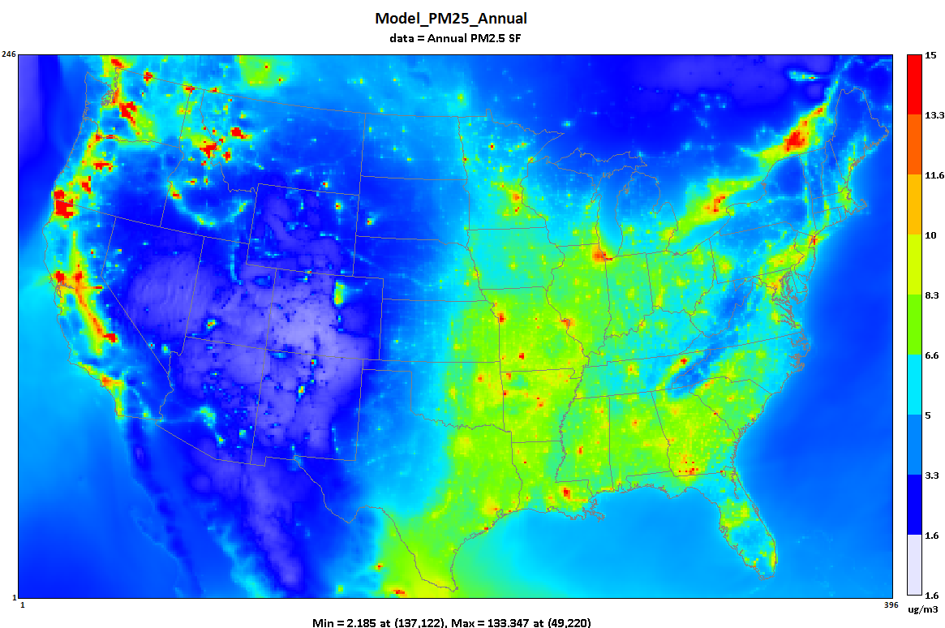
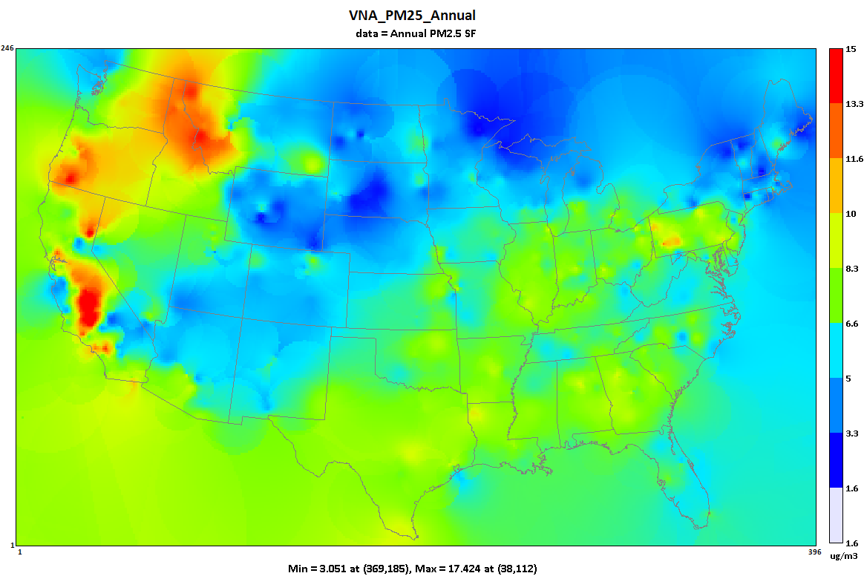
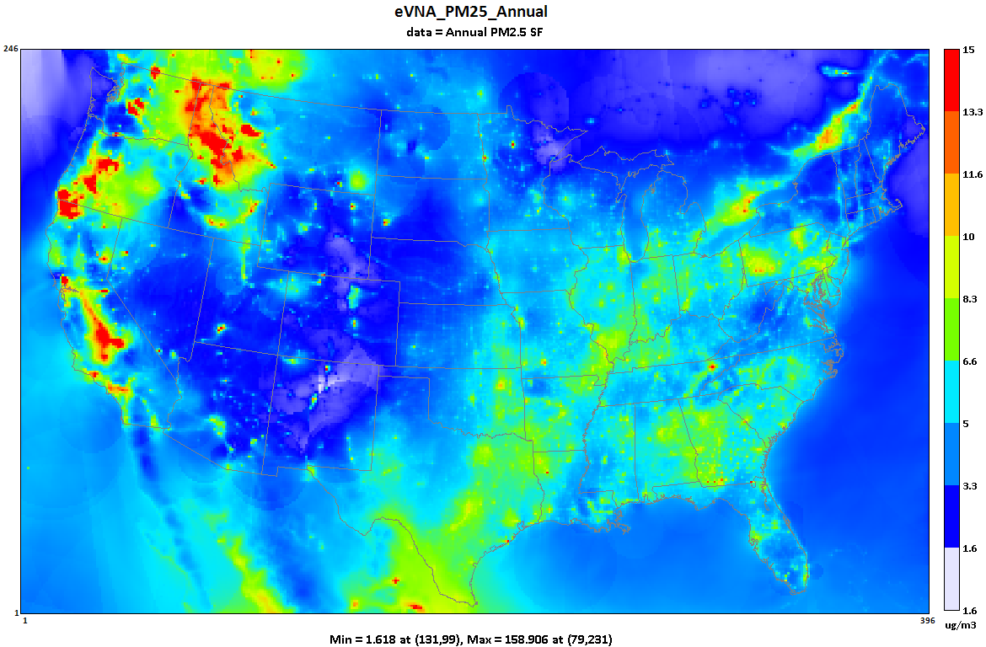

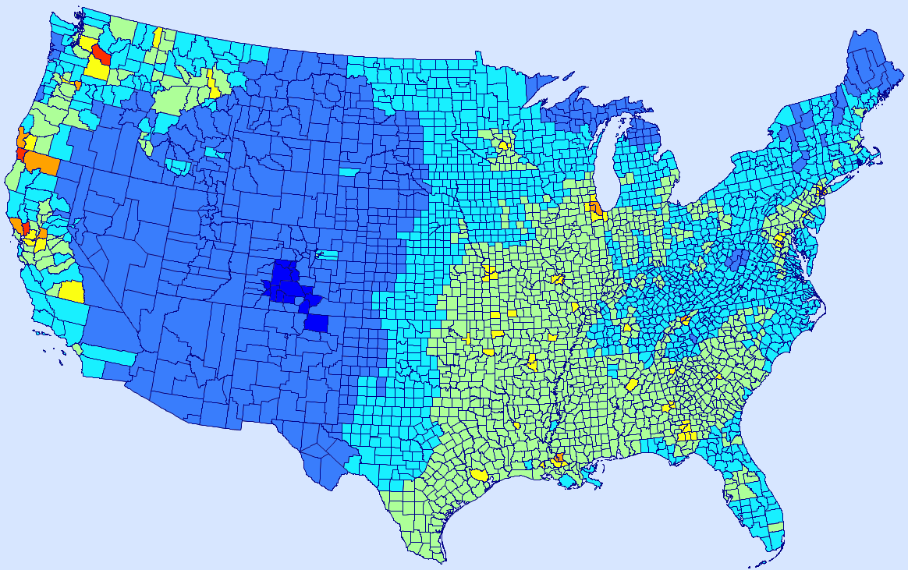
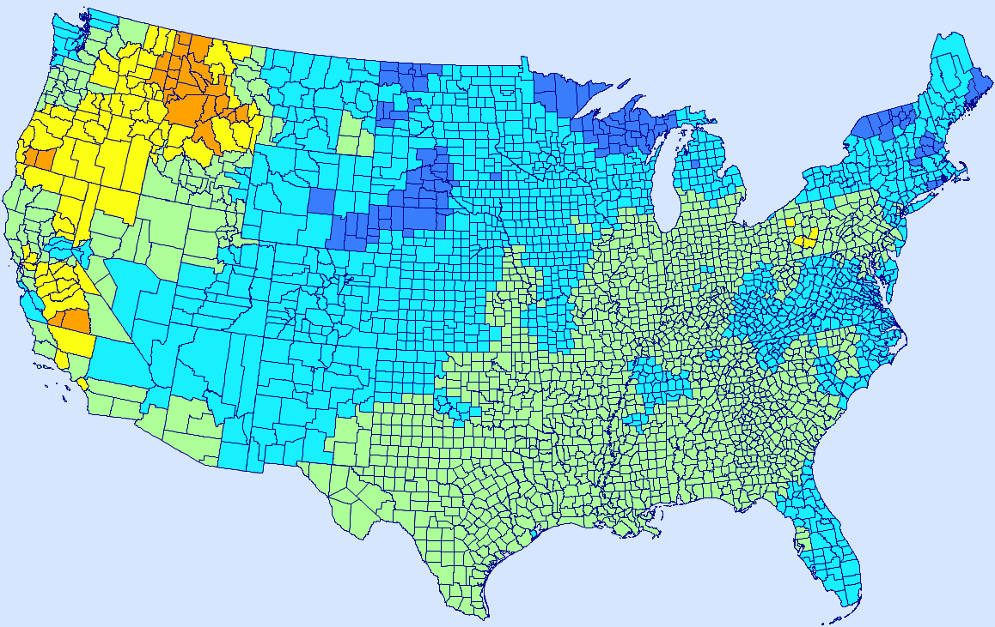
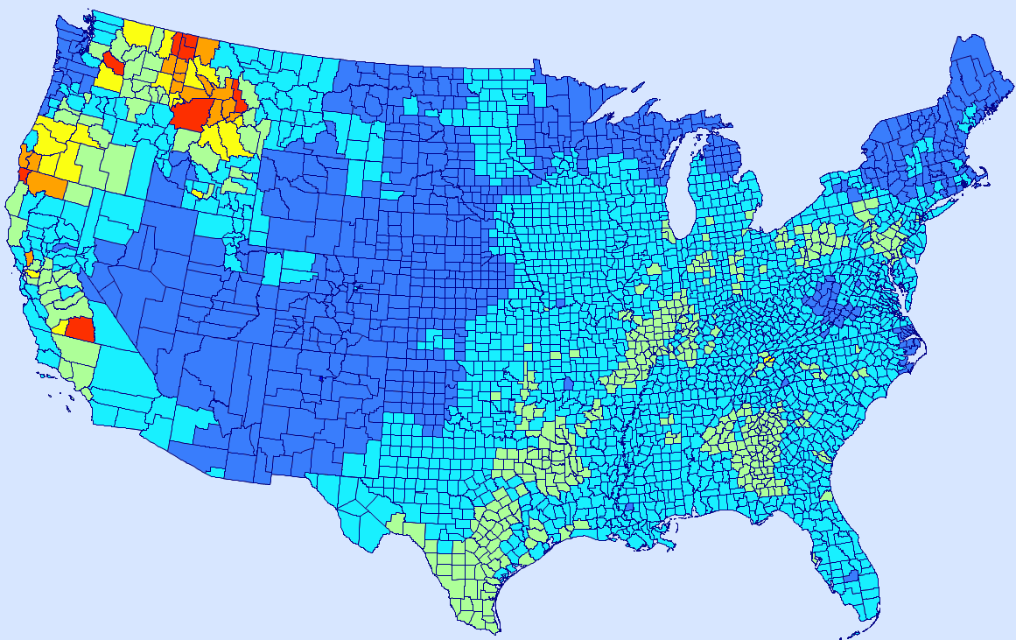

DF Tool results in Grid Cell (12km) vs County level for US annual PM2.5
CONUS case （CMAQ_daily_PM_O3_Species_2017.ioapi）
Model
VNA
eVNA
Model
VNA
eVNA

Slide 3
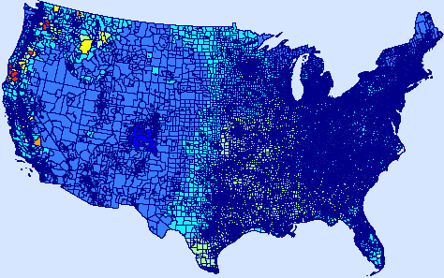
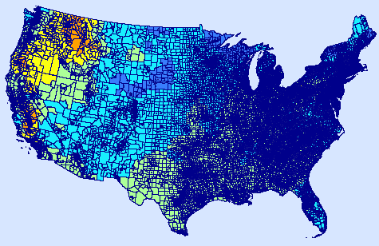
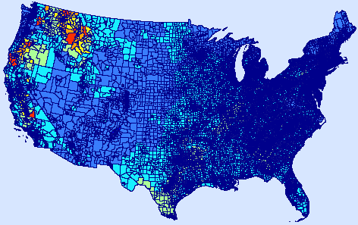
DFT results in Grid Cell (12km) vs Census tract level for US annual PM2.5
CONUS case （CMAQ_daily_PM_O3_Species_2017.ioapi）
Model
VNA
eVNA
Model
VNA
eVNA

Slide 4
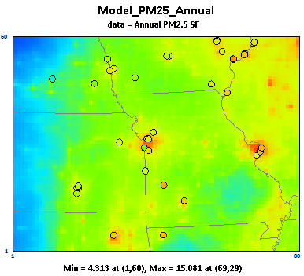
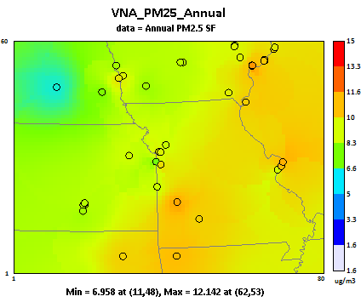
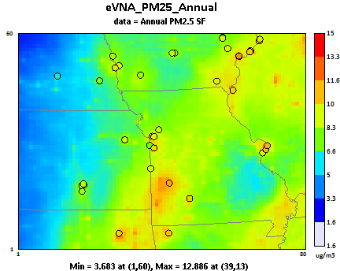
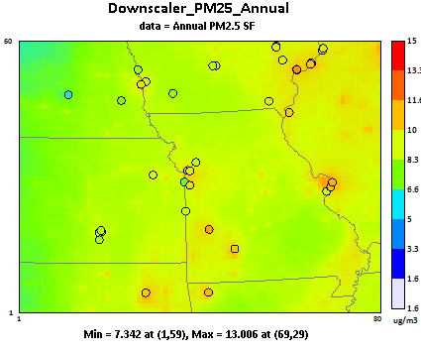
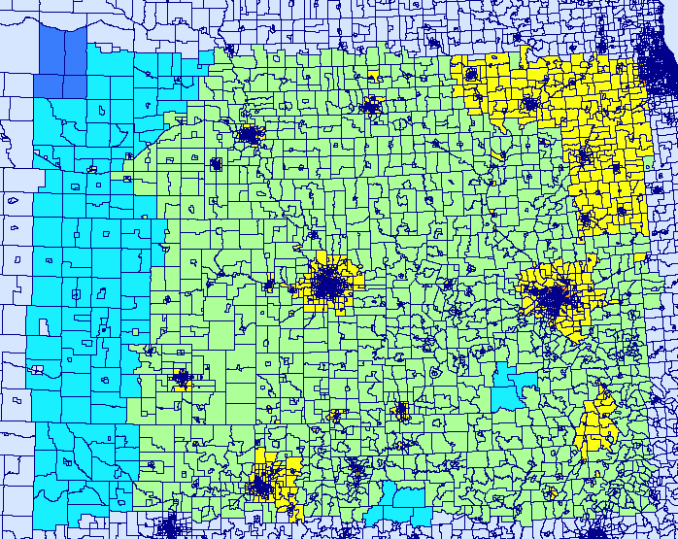
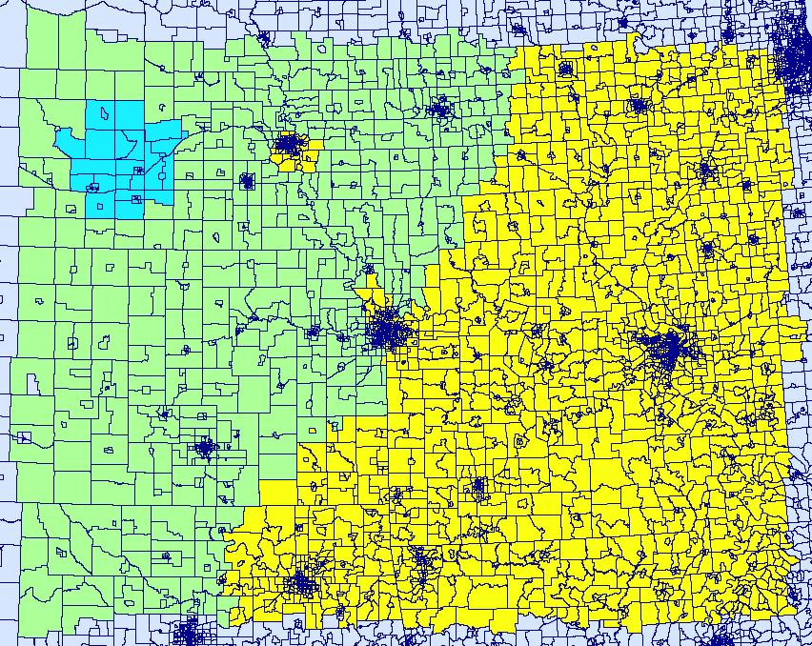
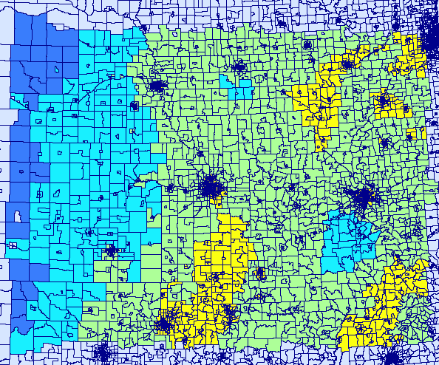
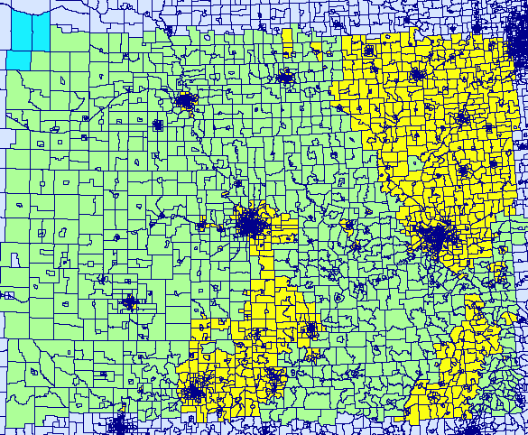

DF Tool results in Grid Cell (12km) vs Census tract level for US annual PM2.5
Small Kansas Domain (default) case （PM_large_12KC1_2011_base_GMT.csv）
Model
VNA
eVNA
Downscaler
Model
VNA
eVNA
Downscaler

Slide 5
End
5

