Slide 1
ECHO Clean Air Tracking Tool (ECATT)
Version 2
Fall 2020

Slide 2
Why ECATT?
ECATT fills a need to integrate info about regulated facilities, including their permitting status, reported emissions data, and evaluation and compliance data, with monitored ambient air quality data, risk calculations, and modeled air quality data.
ECATT leverages EPA’s extensive and well-used ECHO integration platform to make it easy to find pollutant and cancer-risk hotspots and then map back to possible nearby contributors to monitored risk.
EPA previously used the same analytical method to target under a prior National Enforcement Initiative. ECATT automates the methods developed within that initiative.

Slide 3
What is ECATT?
Government-only tool makes it easy to find pollutant and cancer-risk hotspots and identify potential contributors.
Includes emissions data from Toxics Release Inventory (TRI), Greenhouse Gas Reporting Program (GHGRP), Emissions Inventory System (EIS), and Clean Air Markets Division (CAMD) programs, as well as enforcement and compliance data, facility classifications, air monitoring station data, and toxic risk data.
Can help identify facilities that may be under-permitted (e.g. minor instead of major) based on reported emissions.

Slide 4
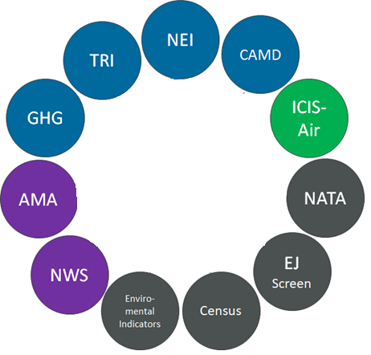
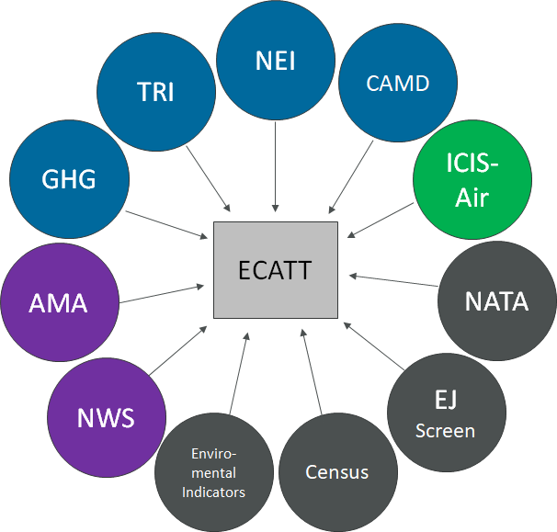
Data Flowing Into ECATT
Many stove-piped data sources with useful information are integrated in this tool.
Emissions Inventories
TRI – Toxics Release Inventory
NEI – National Emissions Inventory
CAMD – Clean Air Markets Division
GHG – Greenhouse Gas Reporting Program
Compliance Data
ICIS-Air – Integrated Compliance Information System
Ambient Conditions
NWS – National Weather Service
AMA – Ambient Monitoring Archive
AQS – Air Quality System
Other Sources
NATA – National Air Toxics Assessment
EJSCREEN – Environmental Justice Data

Slide 5
How CAA Compliance and Enforcement Programs are Using ECATT
Working backwards from Air Toxics or CAP hotspots to find potential contributors.
Comparing how well monitored pollutant readings align with reported emissions from nearby facilities.
Finding which facilities fit the profile of high pollutant releases, but do not have major permit status.
To see which industries or pollutants are contributing to overall pollutant loadings and/or risk.
Seeing which pollutants are being released and where.
Finding Air Toxics or CAP monitoring stations and their readings based on pollutants of interest.
To support the CCAC NCI
Notes:
what, where and how much?
– meaning less regulatory scrutiny
3. Are they hotspots for modeled cancer risk, etc?
4. Based on wind data and modeled risk data and emissions data.

Slide 6
TRI and NEI
TRI – Toxic Release Inventory
  Tracks the management of certain toxic chemicals that may pose a threat to human health and the environment
  Self reported by facilities in certain industrial sectors such as manufacturing, metal mining, electric power generation, chemical manufacturing and hazardous waste treatment.
NEI – National Emissions Inventory
  A comprehensive and detailed estimate of air emissions of criteria pollutants, criteria precursors, and hazardous air pollutants from air emissions sources.
  Released every three years based primarily upon data provided by State, Local, and Tribal air agencies for sources in their jurisdictions and supplemented by data developed by the US EPA.
  Built using the Emissions Inventory System (EIS)

Slide 7
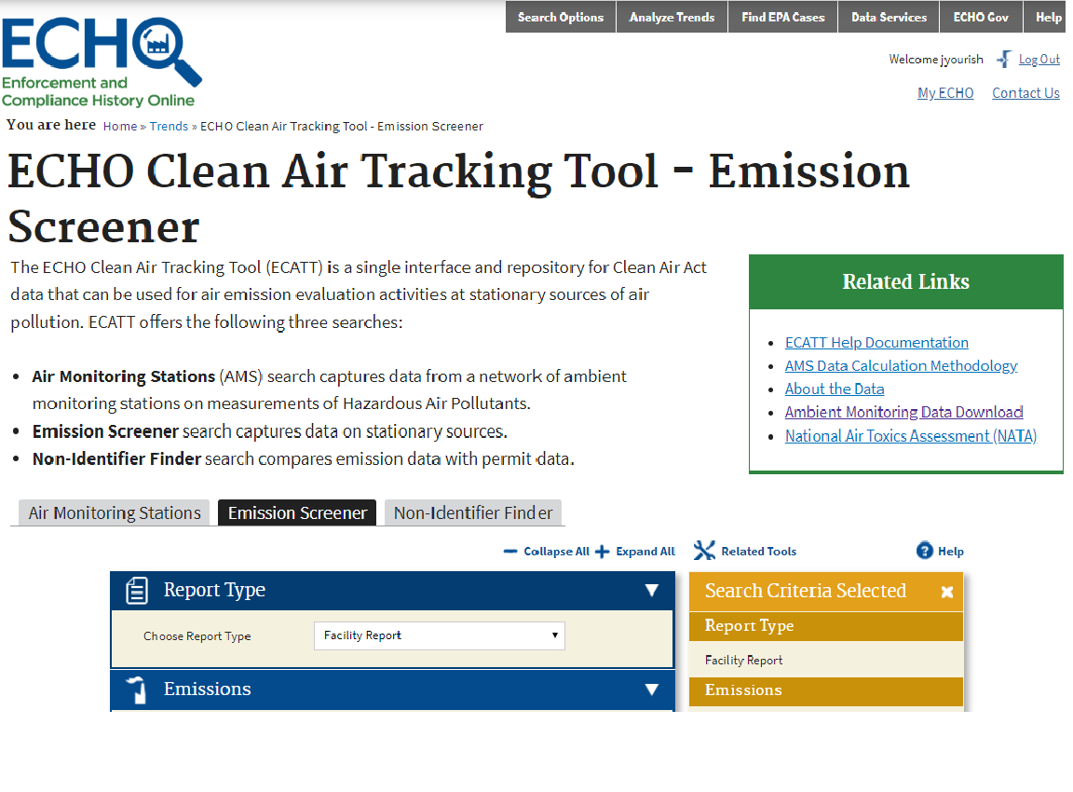
Three Search Tools in ECATT

Slide 8
1. Air Monitoring Stations search
  Data from air monitoring stations.
    HAPs ranked by cancer risk, hazard risk, or individual pollutant readings.
    CAPs ranked by average reading, max reading, or exceedances.
    Other map layers (such as non-attainment areas and EJ screen) are available to provide more context.
  Search options incorporate NATA data so user can compare modeled results to monitored results.
  Use cases -
    Identifying pollution hotspots and potential nearby contributors.
    Comparing monitored readings with reported emissions from nearby facilities to identify discrepancies.
    Ranking cancer risk, hazard risk, or pollutant readings between different monitors.

Slide 9
2. Emission Screener Search
  Single query tool for emissions data sorted by facility, industry, and pollutant. Allows for definition of parameters such as location, data year, pollutant category, facility characteristics, compliance history, and more.
  Use Cases –
    Finding major contributors of hotspot-creating pollutants which are not located near monitors.
    Identifying discrepancies between NEI and TRI.
    Determining which industries or pollutants are contributing to overall pollutant loadings and/or risk.
    Finding facilities included in NCI.

Slide 10
3. Non-Identifier Finder
  Compares emission data with permit data to find facilities with potentially incorrect permit type.
  5 types of search, each with default settings to guide users.
    For example, when using the Potential Major HAP Sources search, tool prepopulates emission threshold of 10 tons per year.
  Use Cases –
    Finding facilities which should have major permits but do not.
    Identifying data quality issues in NEI, TRI, and ICIS – Air.

Slide 11
Key Reports Available Within ECATT
Air Pollutant Report
  Only place which combines stationary source permit info and an integrated view of all releases (individual and aggregated) over the last 10 years with trend charts and other information.
    Facility-level view
    Allows trend view of Greenhouse Gas Data, Acid Rain Data, National Emissions Inventory and Toxics Release Inventory – air releases.
    Public and available from ECHO Facility Search.
Air Monitoring Station Report
  Lists all pollutants recorded at a monitor with readings, trends, meteorological data, and information about nearby facilities.
    Interactive report at monitoring station level.
    Ranks and maps all stationary sources within 5 km, then allows users to choose pollutant of interest and analyze likely nearby sources based on monitored data, reported emissions and wind readings.

Slide 12
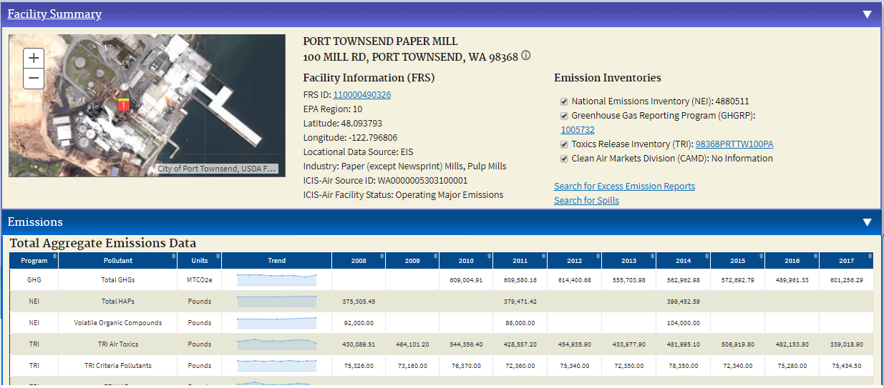
Air Pollutant Report

Slide 13
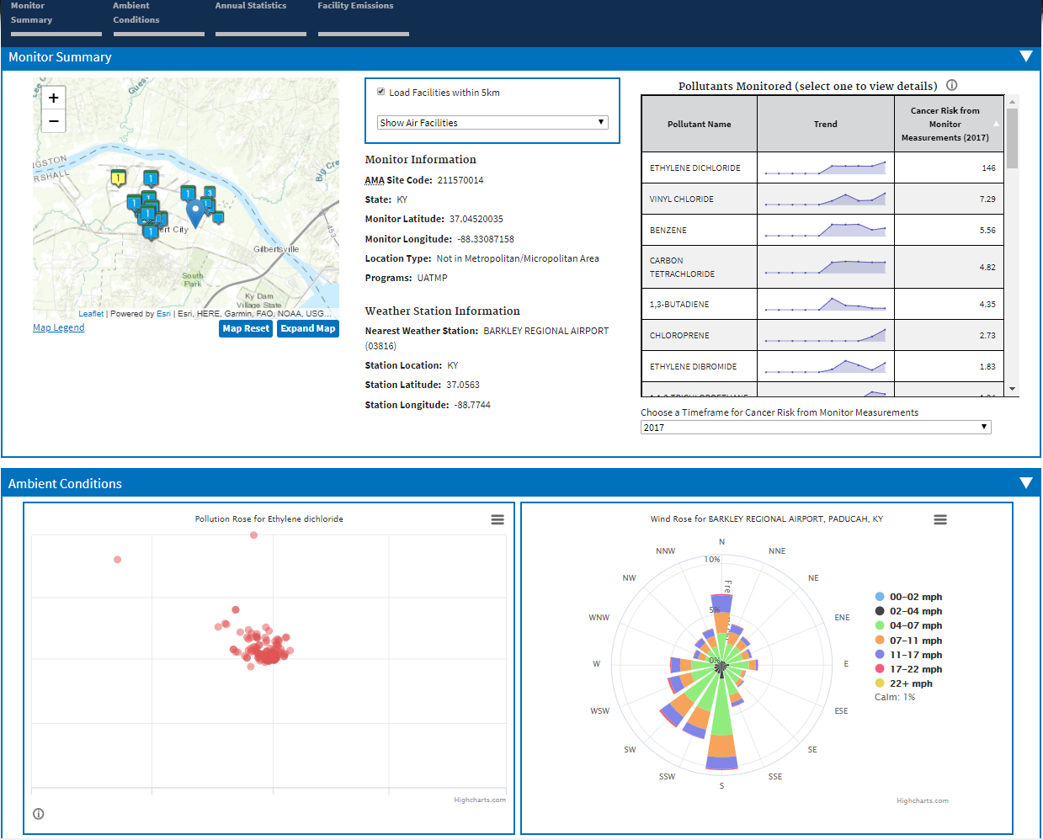
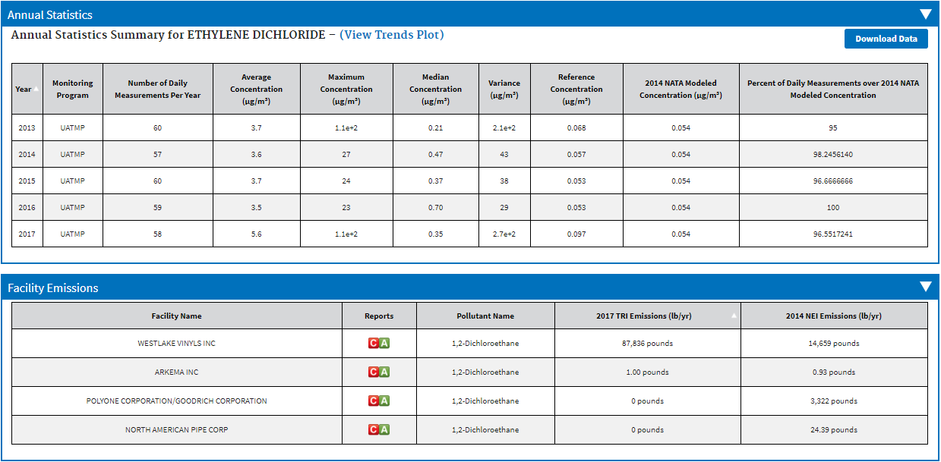
Air Monitoring Station Report
Monitoring Station with > 100 in a million cancer risk

Slide 14
Caveats/Known Issues
Age of data
  ECATT includes the most recent data inventories available.
  TRI – Currently 2018. Updated when TRI preliminary dataset is released to the public.
  NEI – Currently 2017.
  AMA – Currently 2017. We are looking into the possibility of incorporating more real-time data.
Data Linkages
  ECATT relies on EPA’s Facility Registry Service (FRS) to properly link all data systems together at the facility level. If linkages are missing, then a facility may appear to have very high releases of a pollutant in one program (e.g., TRI), but no releases in another program (e.g,. NEI). ECATT makes it easy to spot those problems, and users can submit error reports.
ICIS-Air
  ECATT assumes ICIS-Air is the definitive source of facility permit status information, so any data quality problems will confound results.
  ICIS-Air does not have complete violation data.

Slide 15
Development Cycle - ECATT
Version 1 was released in June 2017.
Version 2, based on user feedback, is now on ECHO Gov for review.
  Improved mapping component and data methodology (see next slides for details).
  Version 2.1 was finished in February to better support the NCI.
  Criteria Air Pollutant monitoring data was added October 2020
Outreach
  Improve integration with CAA targeting strategies and policies.
    Expected “shake-out” period for data quality and linkage issues as use increases.
  Please contact Jesse Yourish (Yourish.jesse@epa.gov) with any questions or comments.

Slide 16
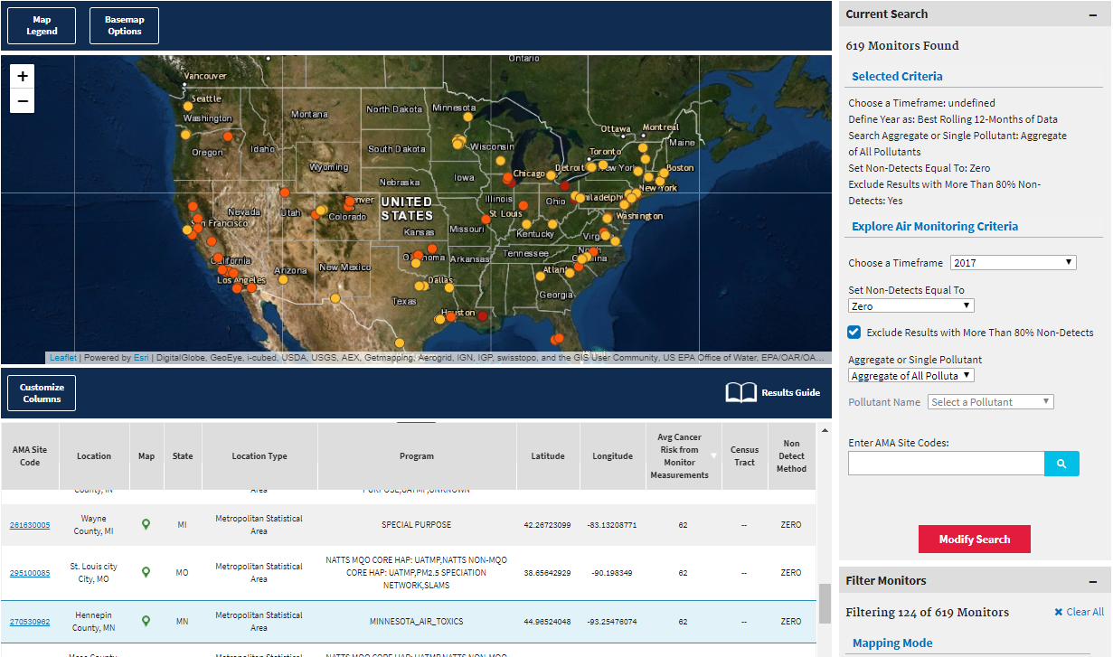
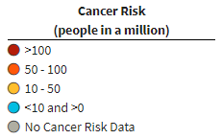
Version 2 – New Features
  Map symbology improvements - users can rank Cancer Risk, Hazard Index, and pollutant readings using color-coded system for station pins.
    Map symbology dynamically updated based on metrics in the “current search” panel.
    Makes it much easier to find different kinds of pollutant hotspots.

Slide 17
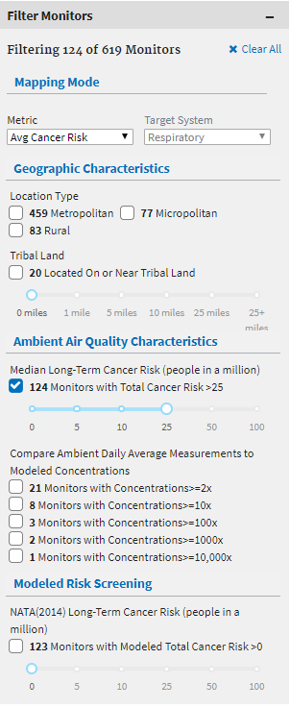
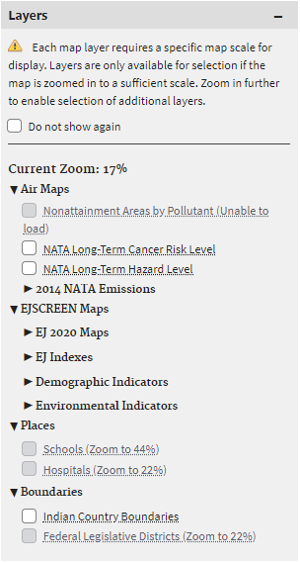
Version 2 – New Features
  Ability to modify the search directly on the search results page.
    Users can filter results using criteria related to:
      Geographic Characteristics
      Ambient Air Quality Characteristics
      Modeled Risk Screening
  Ability to overlay map layers, including Air Maps, EJSCREEN, places, and boundaries.

Slide 18
Additional Version 2 Updates
Annual Completeness Methodology for Ambient Air Quality Monitoring - cancer and hazard risks are calculated based on the assumption of continued, long-term exposure. A completeness criterion of 70% of expected days per quarter, for at least 3 quarters in a year, is available using the “Best Rolling 12-months of Data” option.
Third non-detect option added - Regression on Order Statistics (ROS).
Added ability to search for monitors by ID. Multiple IDs are accepted.
Quick Map Access Icon - A button is available near the top of the AMS search page to take users directly to the results page with no filters selected.

Slide 19
NCI Support Changes
Emission Screener tab has been updated to allow users to generate list of facilities which fall into “Geographic Areas of Concern” as defined by CCAC NCI.
  Criteria 1 – In ozone nonattainment or an ozone transport region
  Criteria 2 – Located within elevated risk area
  Criteria 3 – Located in (or near) census tract above 80th percentile for any air EJ Screen
Results feature optional column flagging which facilities are part of the “Area of Concern” for any of the 3 criteria.

Slide 20
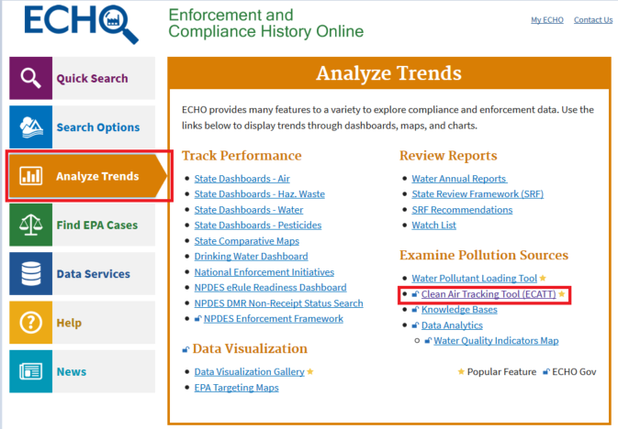
How to Access ECATT
Go to https://echo.epa.gov.
  Must login to ECHO Gov account.
  EPA LAN users can access using single sign-on credentials, state users must register (https://echo.epa.gov/user/help).
  https://echo.epa.gov/trends/emission-screener
Send comments to:
  yourish.jesse@epa.gov

Slide 21
Demo/Screen Shots

Slide 22
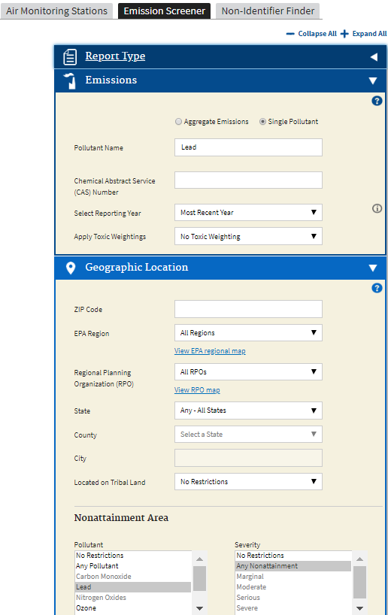
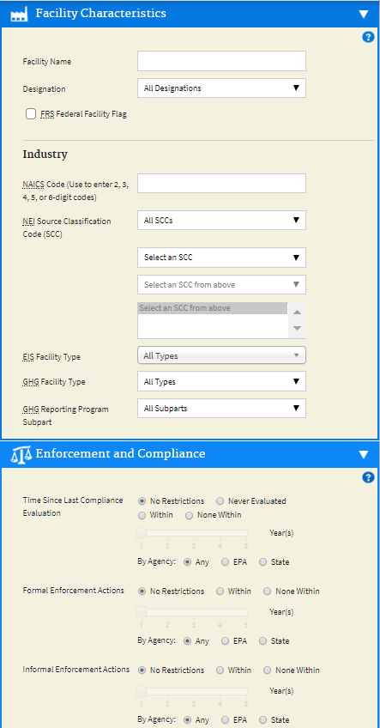
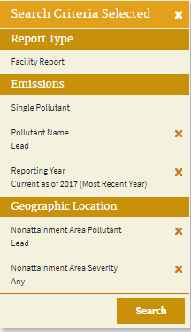
Emission Screener Search Example
A basic, national search to rank all facilities that:
Report Lead emissions.
Are in Lead nonattainment areas.

Slide 23
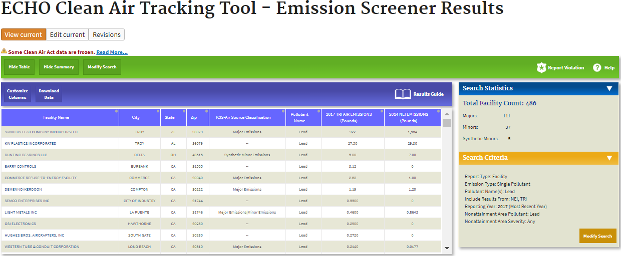
The results of the previous Lead search.

Slide 24
If the information you are looking for isn’t visible, check the “Customize Columns” button to see what else is available.

Slide 25
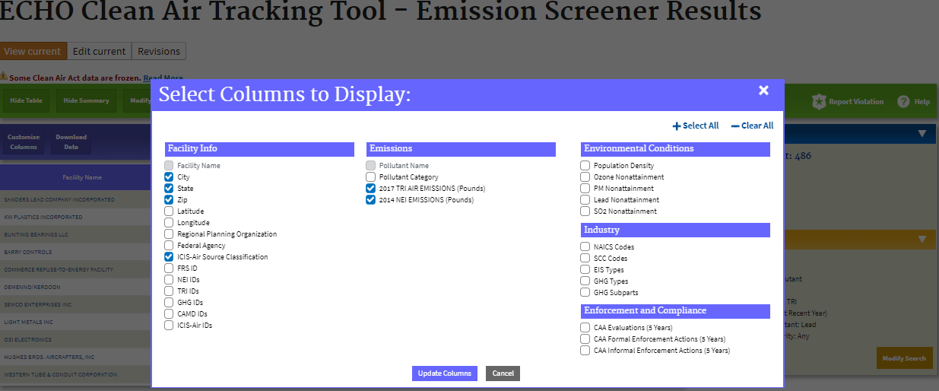

Slide 26
To view the Air Pollutant Report, select the hyperlink for any facility.

Slide 27

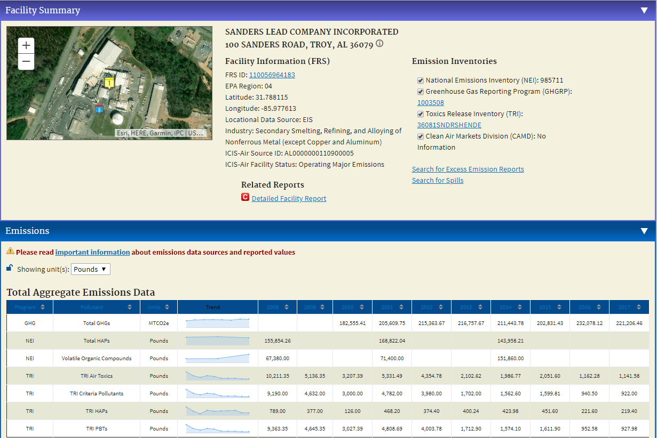
This report shows basic facility info and pollutant release trends.

Slide 28
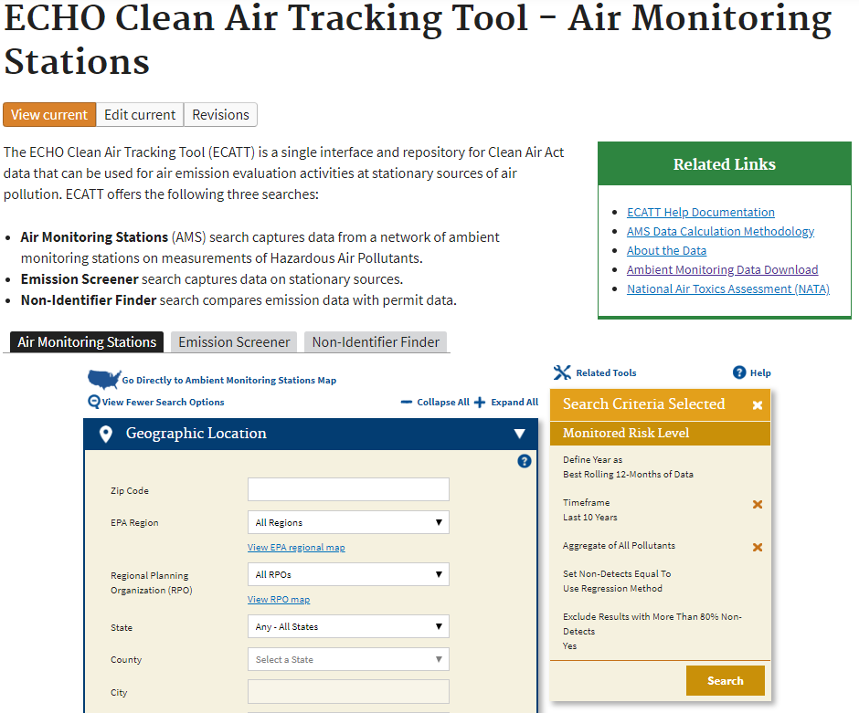
Air Monitoring Station Search Options
Search from search form.
Search from interactive map.
1
2

Slide 29
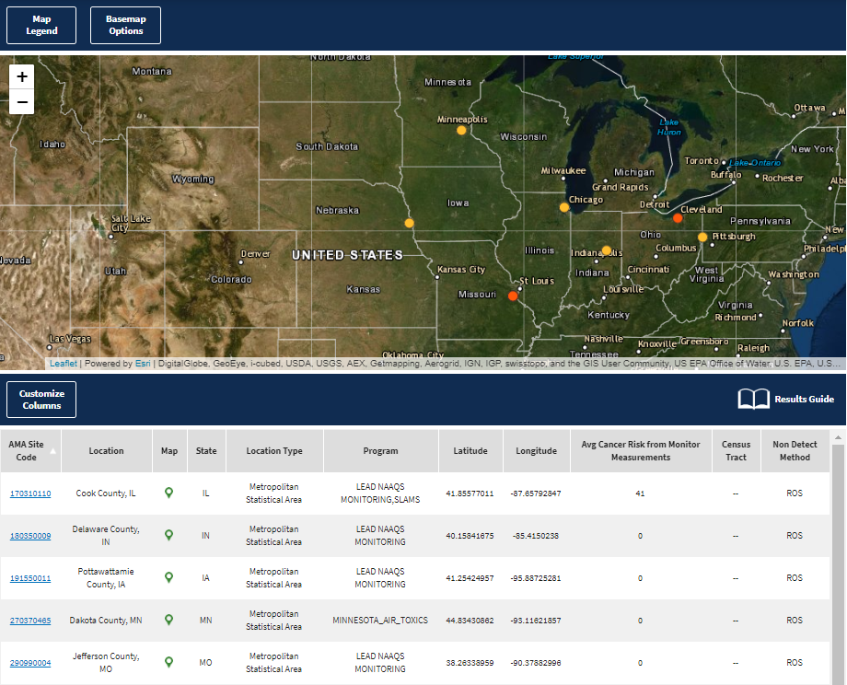
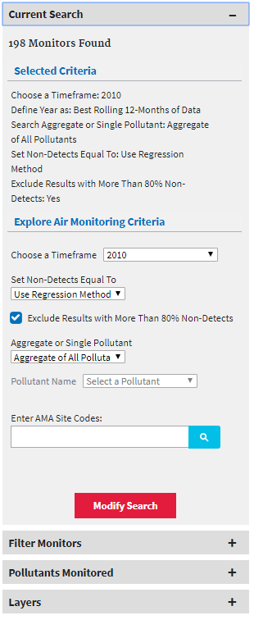
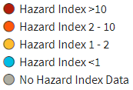
Air Monitoring Station Search Example
This is an example of searching from the interactive map using the Go Directly to Ambient Monitoring Stations Map option.
Search Criteria:
Year = 2010
Non-Detects = ROS
Developmental Hazard Index > 1
Metropolitan area
Measured readings >2x NATA modeled readings
*Note - using 2010 example to show proof of concept but avoid highlighting any potentially ongoing issues.

Slide 30
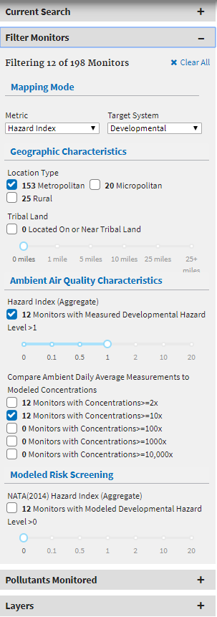
Air Monitoring Station Search Example
This is an example of searching from the interactive map using the Go Directly to Ambient Monitoring Stations Map option.
Search Criteria:
Year = 2010
Non-Detects = ROS
Developmental Hazard Index > 1
Metropolitan area
Measured readings >2x NATA modeled readings
*Note - using 2010 example to show proof of concept but avoid highlighting any potentially ongoing issues.

Slide 31
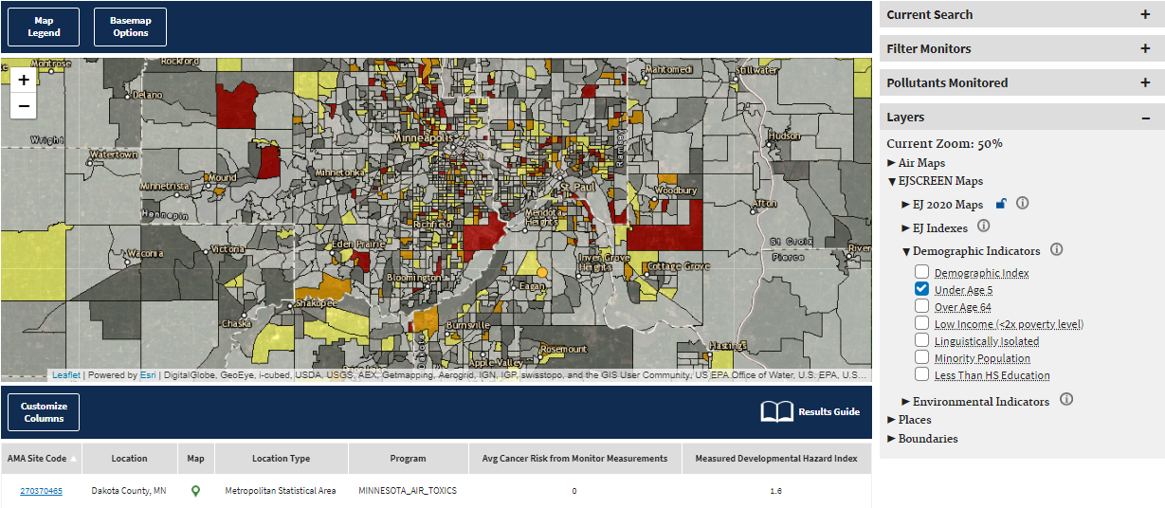
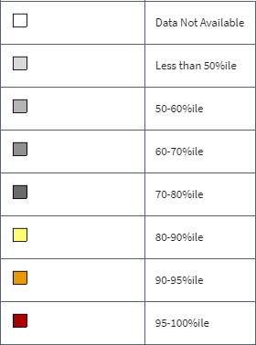
Air Monitoring Station Search Example
Once you select an area and zoom in, you can add different layers for more analysis. In this case, the monitor with high Measured Developmental Hazard Index is also in a census tract with a large percentage of its population under 5. You can select either the monitor itself or the link in the data table to view the Air Monitoring Station Report.

Slide 32
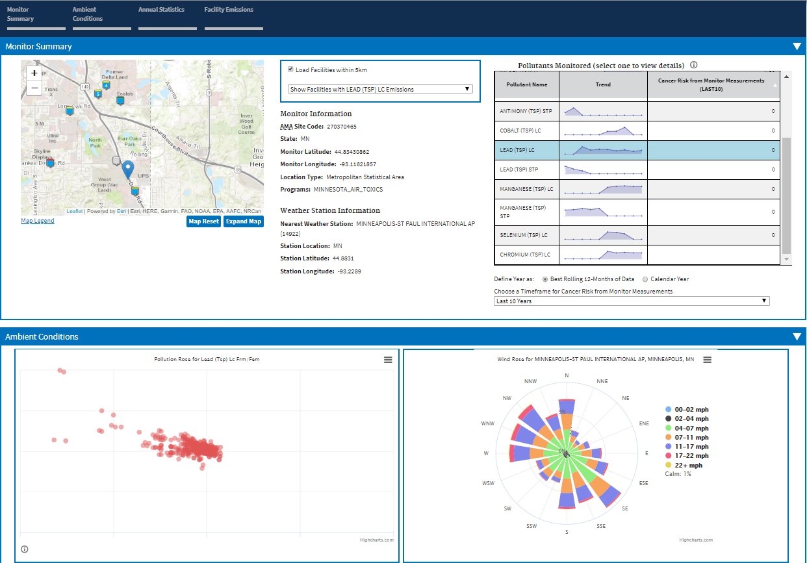
Air Monitoring Station Report Example
The Monitor Summary shows the location of the monitor and nearby facilities as well as information about the monitor. The monitor is represented by the blue tear drop icon. All other icons are facilities.
The Pollutants Monitored table gives trend lines and cancer risks for all monitored pollutants. Select any pollutant to see more details.
The Ambient Conditions section has a pollution rose and a wind rose. On the pollution rose, each point represents one monitored reading. Its direction in relation to the center represents the cardinal direction of the wind that day, and its distance from the center represents the magnitude of the reading.

Slide 33
Air Monitoring Station Report Example
The pollution rose shows that all of the worst readings come on days when the wind is blowing from the NW.
Note that there is one facility directly to the NW of the monitor.

Slide 34
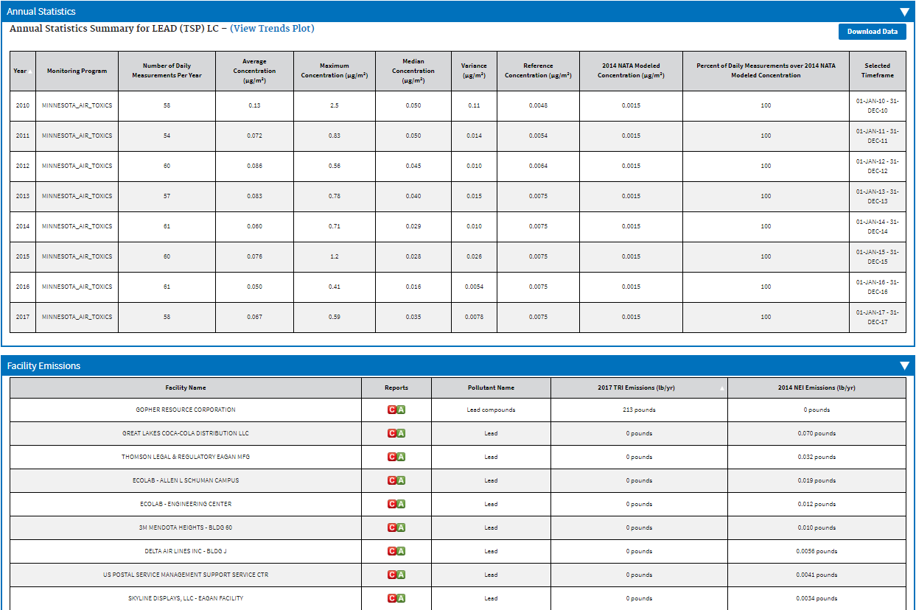
Air Monitoring Station Report Example
Air Monitoring Station Report Continued
Note that 100 percent of daily lead measurements are over the NATA Modeled Concentration and that the highest lead emitter within 5km is the same facility highlighted in the previous slide.

