Slide 1
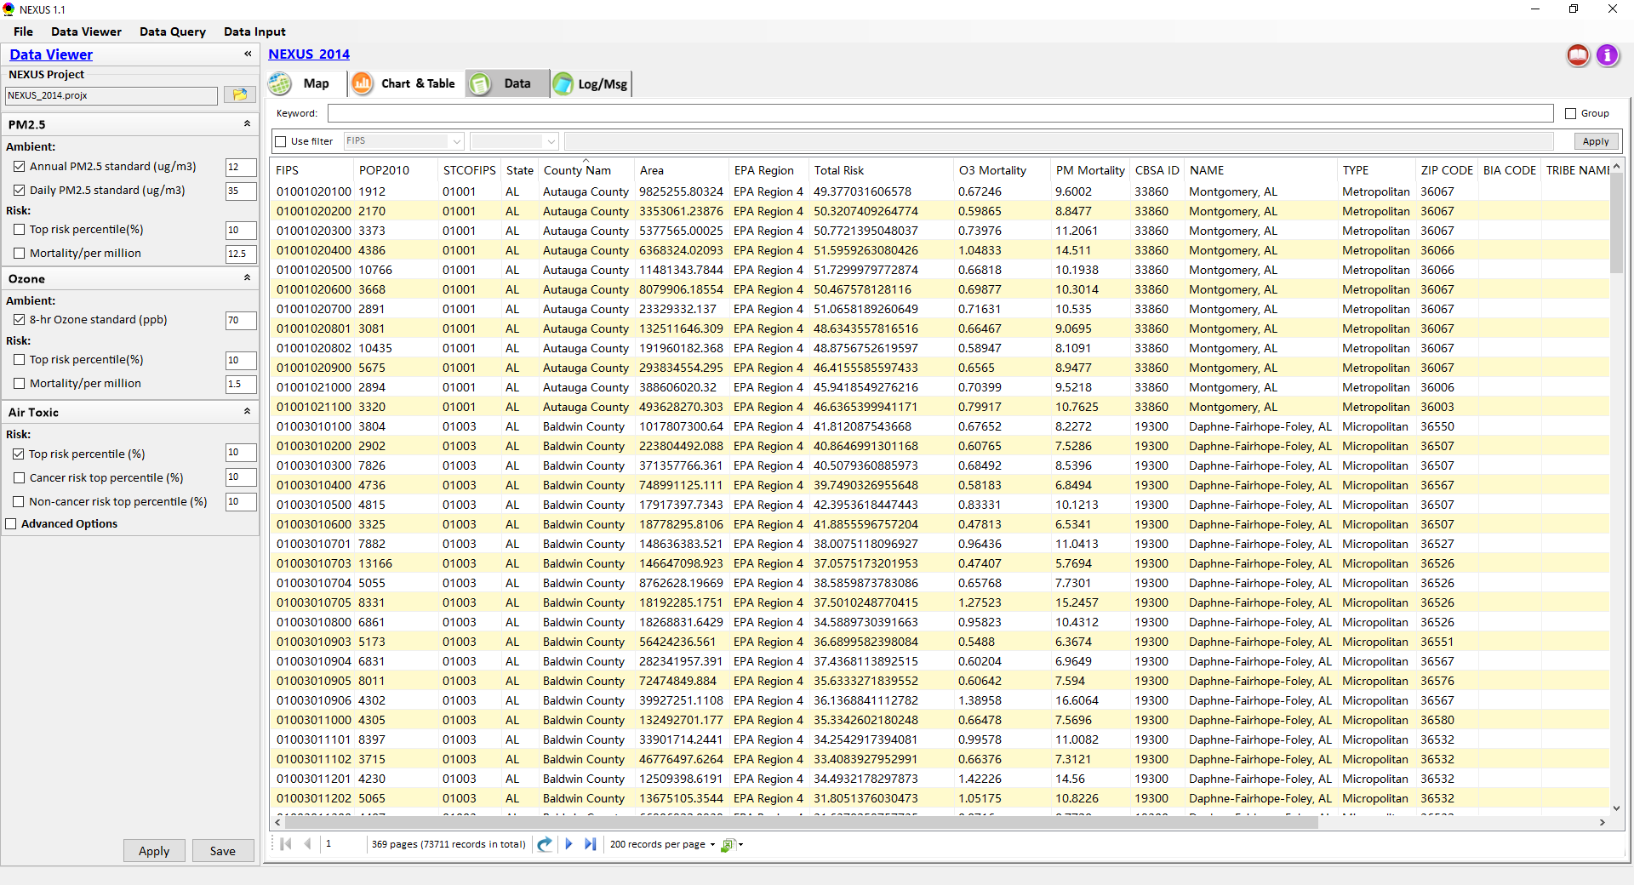
NEXUS Tool: Mortality Calculation
Q1: O3 & PM2.5 Mortality (unit in “pop/million”)?
Q2: How to calculate a county’s total mortality?
Population (2010)
FIPS code
ZIP code
1
Notes:
Need more data info about CBSAs and corresponding counties

Slide 2
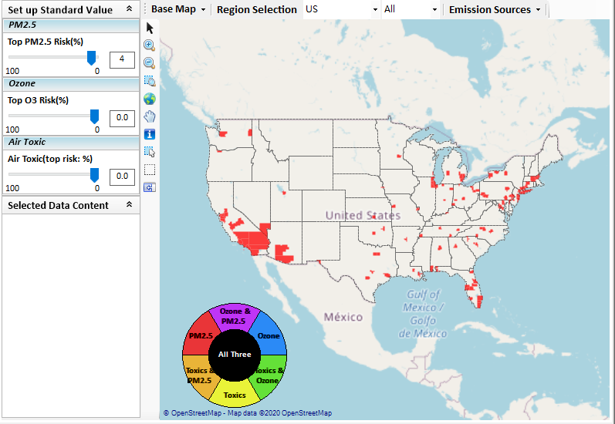
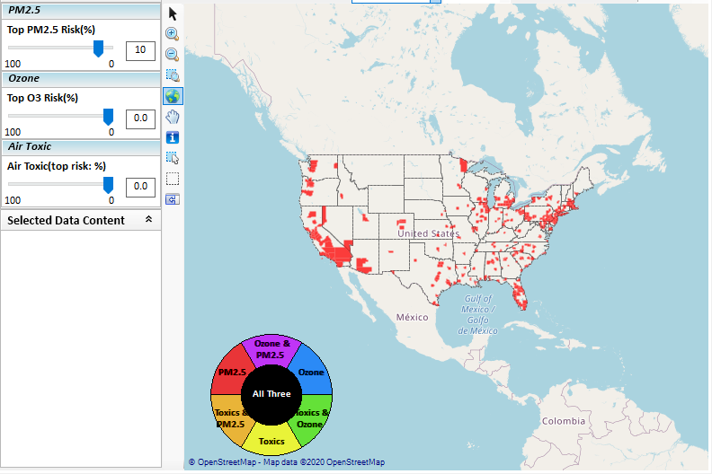
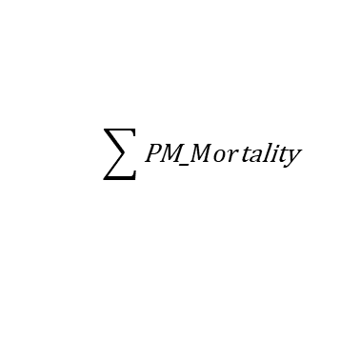
Issues discussion: PM2.5 Risk problem
$$\sum{\text{PM}\text{_}Mor\text{tality}}$$
Top 4% PM2.5 Risk: 16 counties in CA
Top 10% PM2.5 Risk: 24 counties in CA

Slide 3
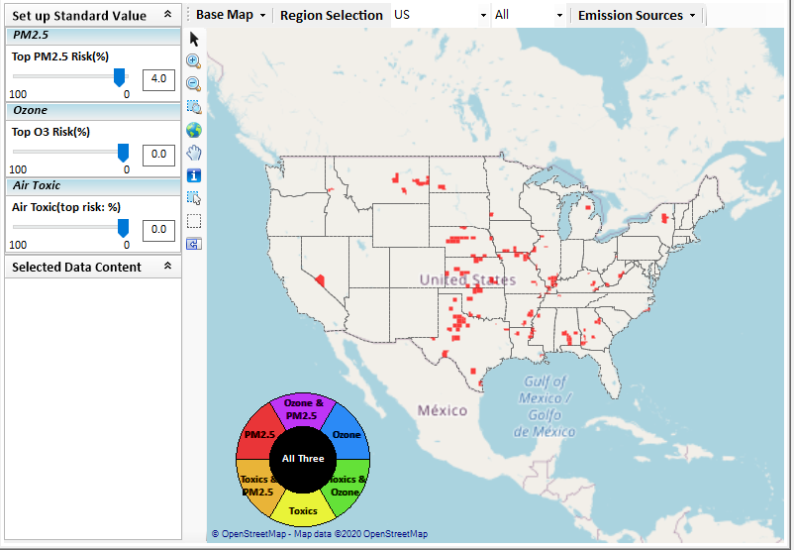
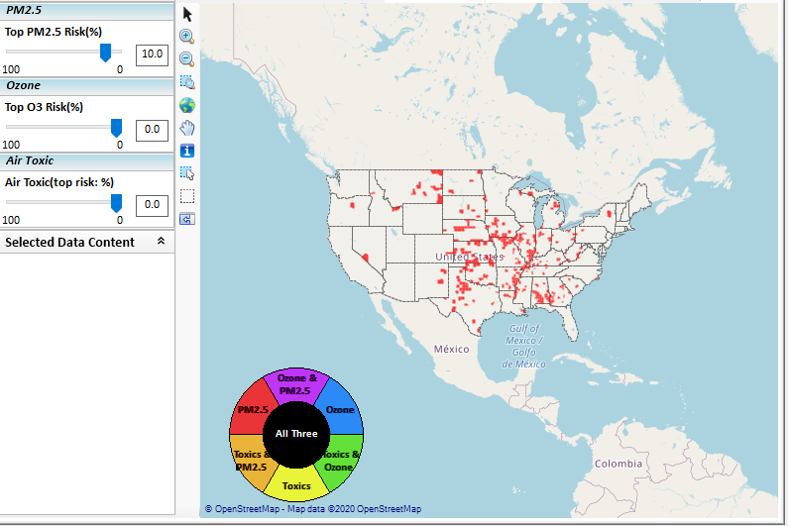
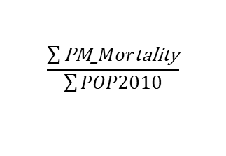
Issues discussion: PM2.5 Risk problem
$$\frac{\sum{\text{PM}\text{_}Mor\text{tality}}}{\sum{POP2010}}$$
Top 4% PM2.5 Risk: 0 counties in CA
Top 10% PM2.5 Risk: 0 counties in CA

Slide 4
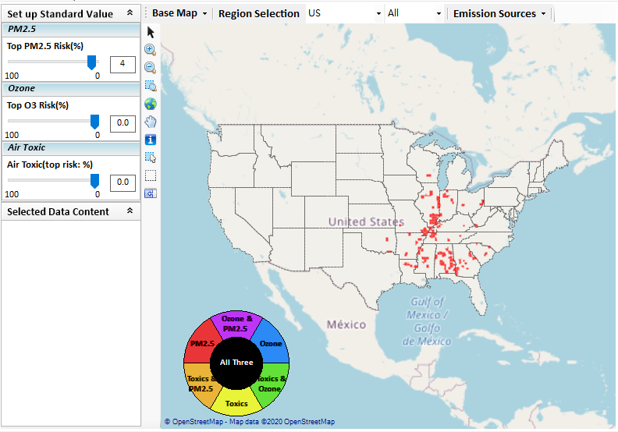
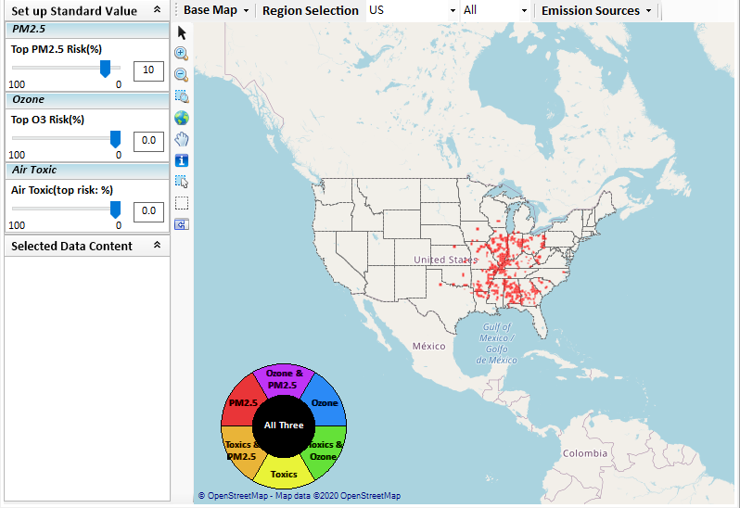
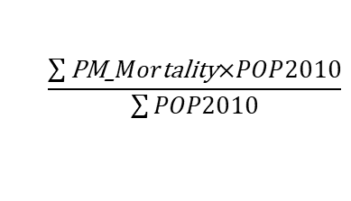
Issues discussion: PM2.5 Risk problem
$$\frac{\sum{\text{PM}\text{_}Mor\text{tality}\text{×}POP2010}}{\sum{POP2010}}$$
Top 4% PM2.5 Risk: 0 counties in CA
Top 10% PM2.5 Risk: 0 counties in CA

