Slide 1
NEXUS 1.5:
List of Improvements/Upgrades
Carey Jang, Jan. 13, 2021
“Part 1” slides is attached. There may be a “Part 2” for “
Data Query” improvements to be sent later.
Please send me the new/updated version and updated PPT slides (Tutorial slides can wait until “Part 2” gets done) no later than 2/01/2021 if feasible. Thanks!

Slide 2
“NEXUS 1.6”
To Do List for Updated “NEXUS 1.6”
(before Chinese New Year):
Complete the Table Generator module
Upgrade “Data Query” module & “Data Input” module to make their functions and graphic displays more stable (Note: “Data Query” screen flashing when the module starts and refreshes. So is “Data Input” module when larger dataset is displayed or refreshed. Try to make it look more professional; for example, send a “working” pop-up “hint” (if taking some time to display), and then display just one snapshot without flashing)
Update Online-User’s manual and Quick tutorial PPT slides
2

Slide 3
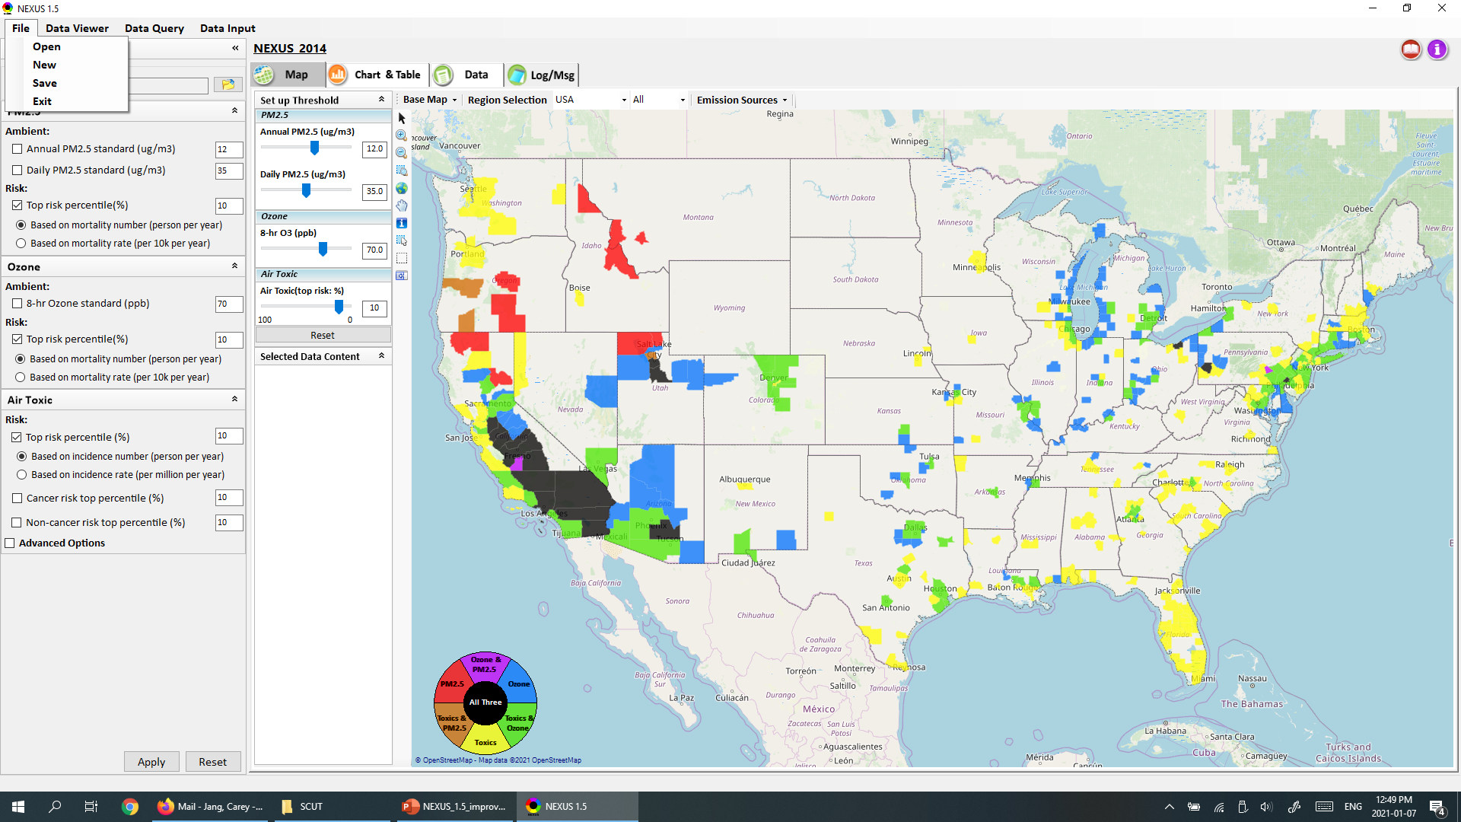
NEXUS 1.6 : Data Viewer Module
Change to: (similar to FAST-CE)
Open Project (*.proj)
New Project
Save Project
Change to:
O Based on mortality rate (mean tract-level in the county)
(note: “Air Toxics” also changed, given next)
Also add a new option for both PM & O3 risk:
O Based on mortality rate (max tract-level in the county)
3

Slide 4
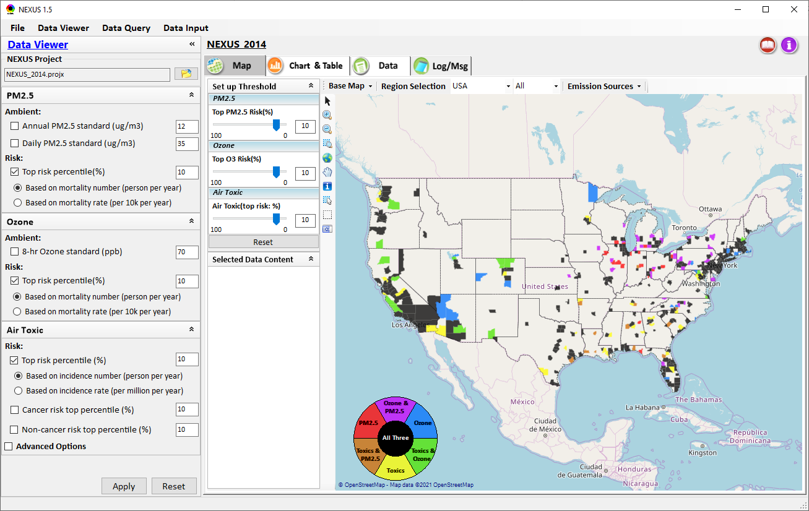
NEXUS 1.6 : Data Viewer Module
Change to:
□ Top risk percentile (higher than x%)
All default: 90%
[Note: reverse scale “100-0” now to “0-100”)
Allow to select top risk %tile based on either “nation” or selected region. Suggest to add an icon/menu here to provide a toggle option:
“Top risk % based on (x) Nation ( ) Selected region”
(default: “Nation”) (also the same in “Data Query”
Change to (PM, O3 & Air Toxics):
Top PM2.5 Risk (%)
Top O3 Risk (%)
Top Air Toxics Risk (%)
[Note: “Air Toxics (risk value)” should be displayed if “Risk value” is selected, see next slide]
All default: 90%
[Note: Reverse scale now to “0 - 100”]
Change all “Air Toxic” to “Air Toxics”)
4

Slide 5
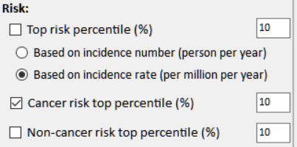
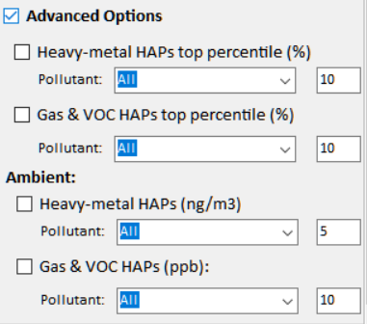
NEXUS 1.6 : Air Toxics
Current
New
Risk:
□ Cancer Risk (max tract-level risk in the county): (default checked)
o Top risk Percentile (higher than x%) 90 (Note: default checked)
o Risk value (x-in-1 million) ? (Note: use 90 %tile risk value)
□ Non-cancer Hazard (max tract-level HI in the county):
o Top risk Percentile (higher than x%) 90 (default if above box checked)
o Hazard Index (HI) ? (Note: use 90 %tile value, find a reasonable range)
(Note: Add up all “HI” in “NATA_2014_Tract_HIs_FINAL” file.
“HI” > 1 means likely adverse non-cancer hazard; <1 means unlikely
Cancer Risk (max tract-level risk in the county):
□ PM & Metal HAPs
Pollutant: All
○ Top risk percentile (higher > %) 90
○ Risk value (x-in-1 million) ?
□ Gas & VOC HAPs
Pollutant: All
○ Top risk Percentile (higher > %) 90
○ Risk value (x-in-1 million) ?
[ ] Advanced Options:
5

Slide 6
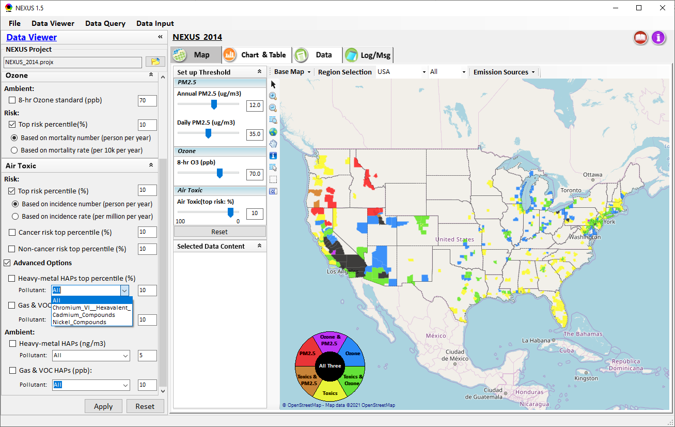
NEXUS 1.6 : Data Viewer Module
List of “PM & Metal HAPs”
CAS No. | Metal HAP
7440-36-0 | Antimony
7440-38-2 | Arsenic
7440-41-7 | Beryllium
7440-43-9 | Cadmium
7440-47-3 | Chromium
7440-48-4 | Cobalt
7439-92-1 | Lead
7439-96-5 | Manganese
7439-97-6 | Mercury
7440-02-0 | Nickel
7782-49-2 | Selenium
1854-02-99 | Chromium-VI
Change to “PM & Metal HAPs”
(also change in every elsewhere here & “Major Emissions Source” tables & “Data Query”)
Add “Arsenic” & “Beryllium” to “PM & Metal HAPs”
(delete “_Compounds” & “_Hexvalent” here)
Also remove ““Arsenic” & “Beryllium” in “Gas & VOC HAPs”
Remove “Ambient” from Air Toxics (see previous slides)
6

Slide 7
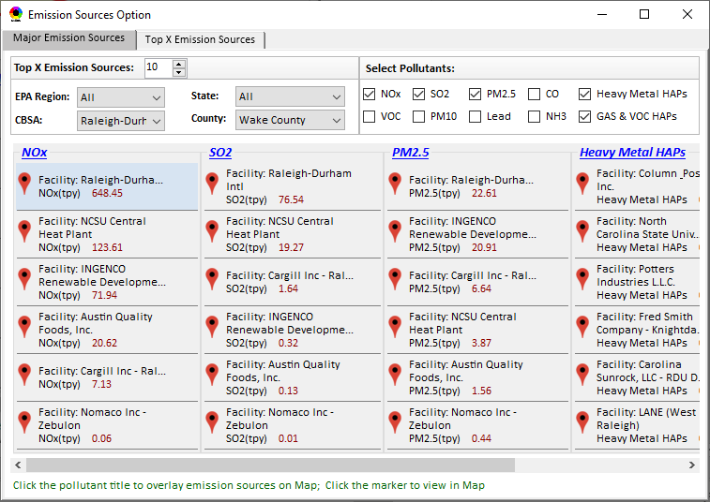
NEXUS 1.6 : Data Viewer Module
When a “Facility” is selected/clicked , “highlight” all the same facility displayed in this table (now w/ a light blue background, please make it a little more obvious; for example, a darker background color or an outline)
7

Slide 8
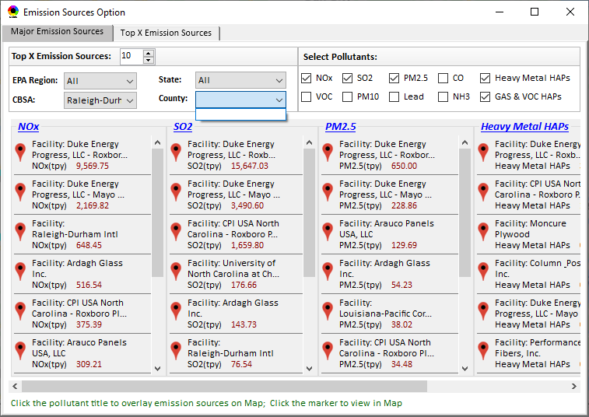
NEXUS 1.6 : Data Viewer Module
Countries should be automatically provided (now need to select/click CBSA again in order to show county names)
Make the table size “re-sizable” (allow to change table size)
8

Slide 9
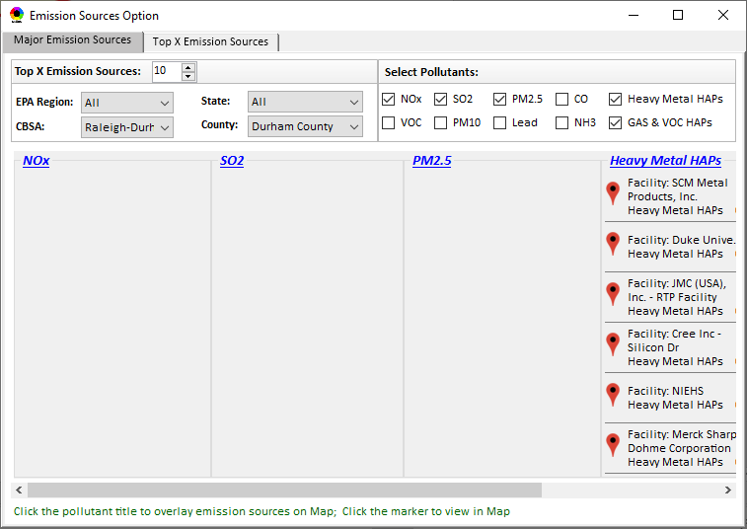
NEXUS 1.6 : Data Viewer Module
Please check again why “Durham Country” does not have any CAPs facility emissions (but HAPs have emissions). EPA (my office) is in Durham county is it is important to make this correct!
9

Slide 10
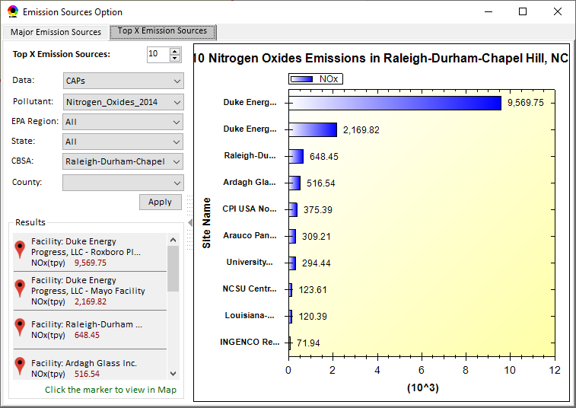
NEXUS 1.6 : Data Viewer Module
When switching from “Major Emission Sources” to “Top X Emission Sources”, default to give the same selected region/CBSA/county
Same problem here. Countries should be automatically provided (now need to select CBSA again to show county names)
10

Slide 11
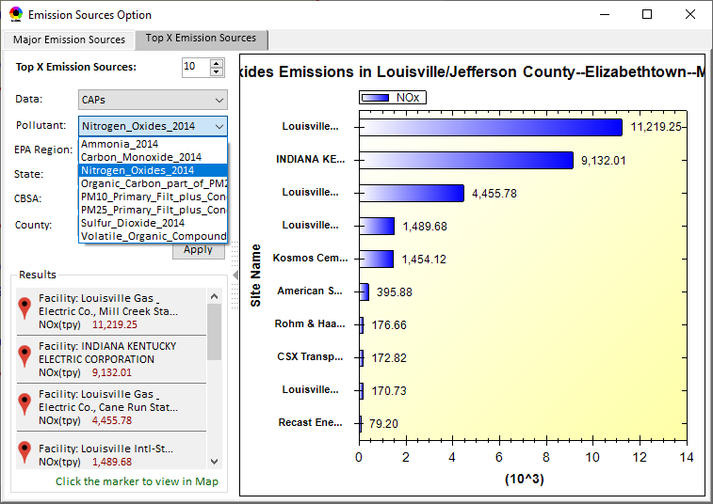
NEXUS 1.6 : Data Viewer Module
Use “left justified” for title to show at least first part of title (now important part is missing)
Shorten these CAPs names (e.g., NH3, CO, POC, PM10, PM2.5, SO2, VOCs)
(Note: Under “HAPs”. also remember to change “Heavy metal HAPs” to “PM & Metal HAPs”)
11

Slide 12
NEXUS 1.6 : Data Viewer Module
Major Sector Emissions
Add a “Major Sector Emissions” to display/rank sector emissions (Point, NonPoint, Road, NonRoad, Total)
(Note: now only has CAPs sector, but expect to include HAPs sector in the future)
Display/rank CAPs’ sector emissions
12

Slide 13
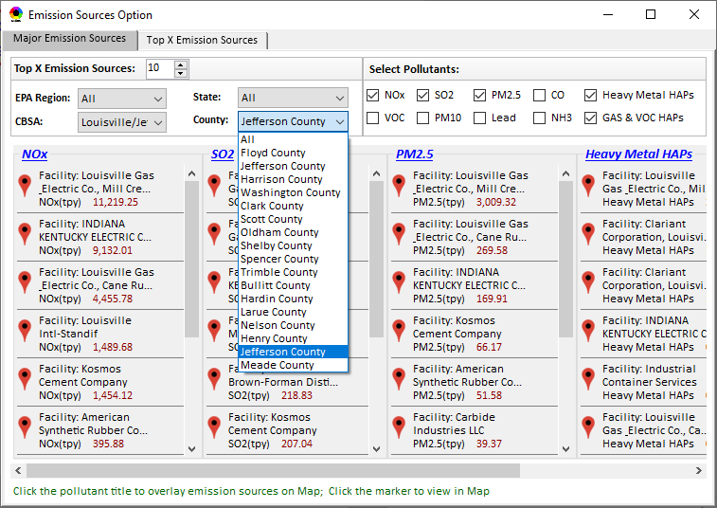
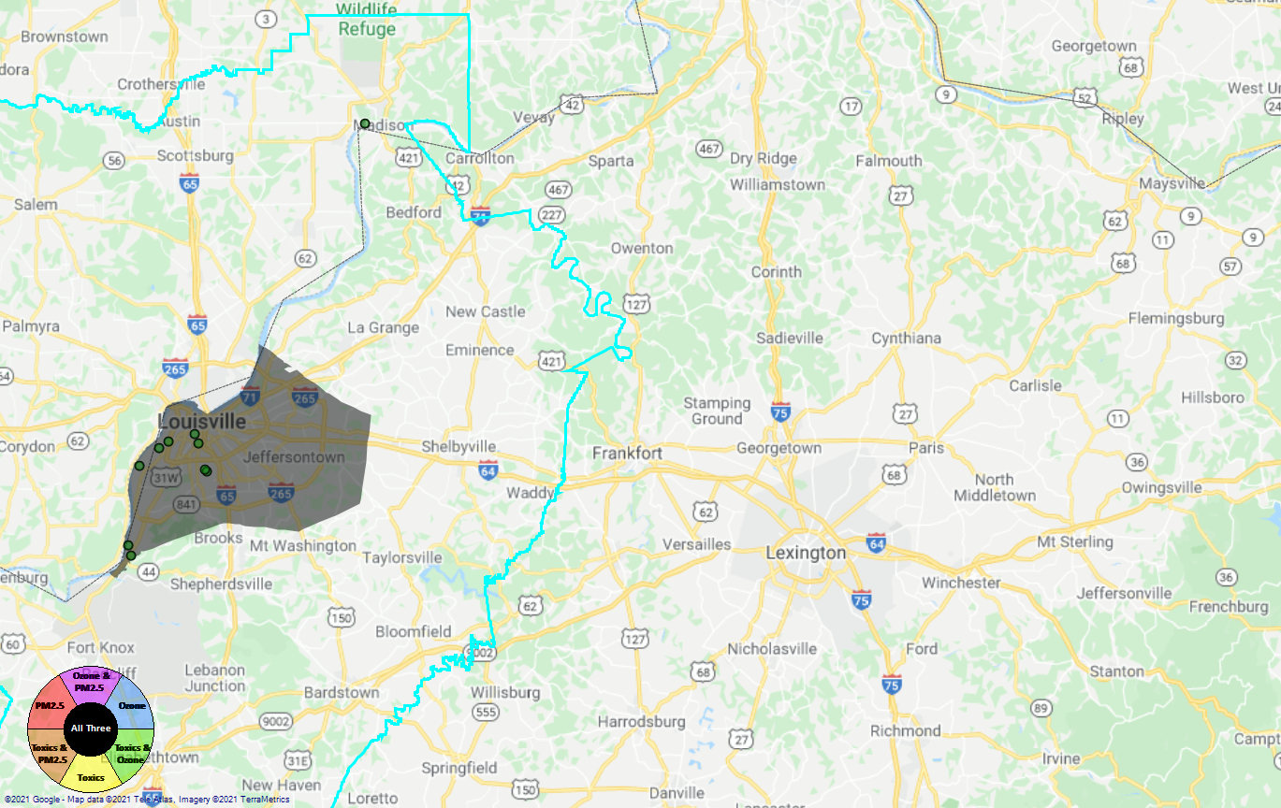
NEXUS 1.6 : Data Viewer Module
There are two duplicated “Jefferson County”. Need to check FIPs code or add State name. There is one “Jefferson County” in KY state and another in IN state. Louisville CBSA is an important example case we will use for demo
This emission source in the (IN) State should not appear when Louisville CBSA (KY) Jefferson county is selected
(there are two “Jefferson county” in this CBSA)
13

Slide 14
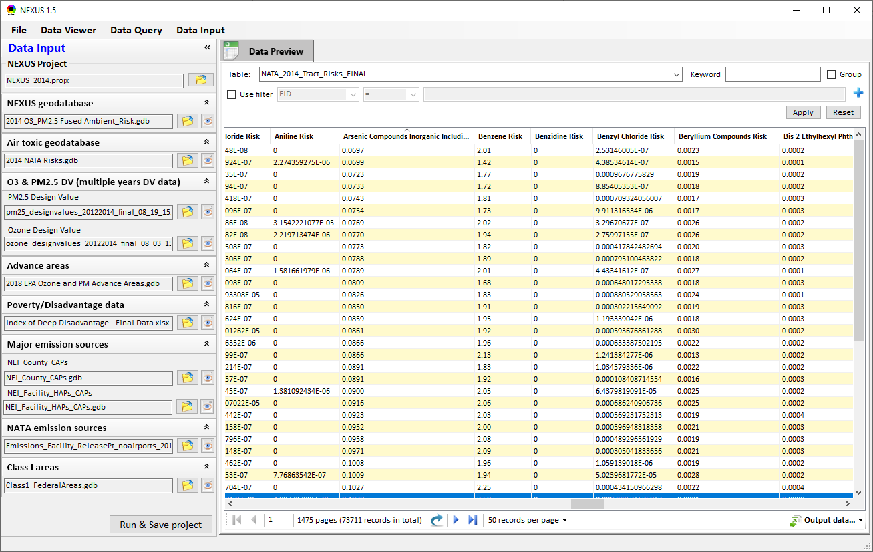
NEXUS 1.6 : Data Input Module
Add these two HAPs to “PM & Metal HAPs” list in “Data Viewer”
“Advanced areas” input data file:
Use updated “Advance_areas_9_12_18.mpk”
Sent to you previously already, also under EPA’s newftp “/aqmg/cjang/NEXUS/Input_Data”
Change to:
“Socio-economic/Demographic data
Add “Tribal areas” input data file:
Use ”Tribal_Boundaries_022117.gdb”
under EPA’s newftp at: “/aqmg/cjang/NEXUS/Input_Data”, similar to “Class I areas”, include “Tribal areas” into “Data Query” module as part of “map overlaying” menu selection
14

Slide 15
End
15

Slide 16
“NEXUS 1.6”:
Quick Tutorial
Update the following slides (based on “NEXUS 1.5”) to “NEXUS 1.6”
Add new slides or functions as relevant (will be great!)
16

Slide 17
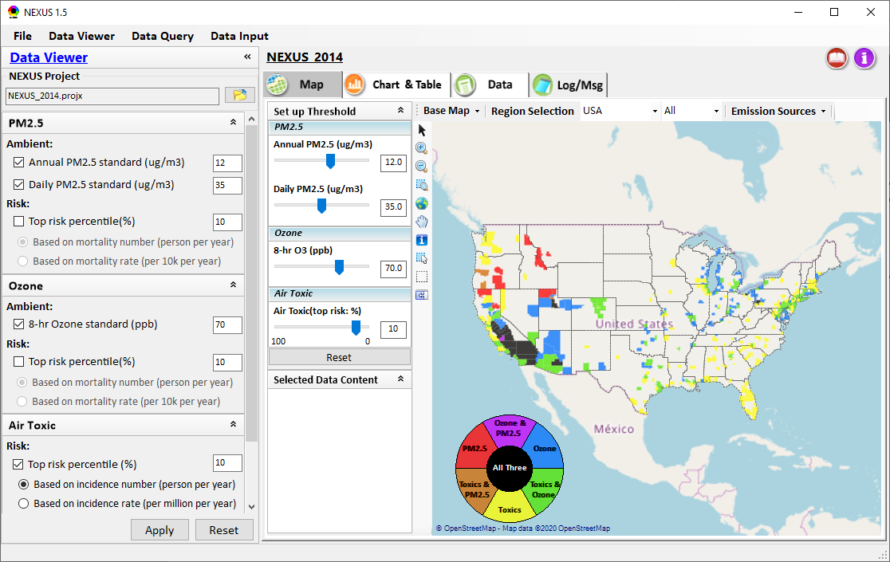
NEXUS Tool: On-line User’s Manual
Click “book” icon to launch “User’s manual”
Hot link to User’s manual’s “Data Viewer” chapter (same for “Data Input” & “Data Query”
17

Slide 18
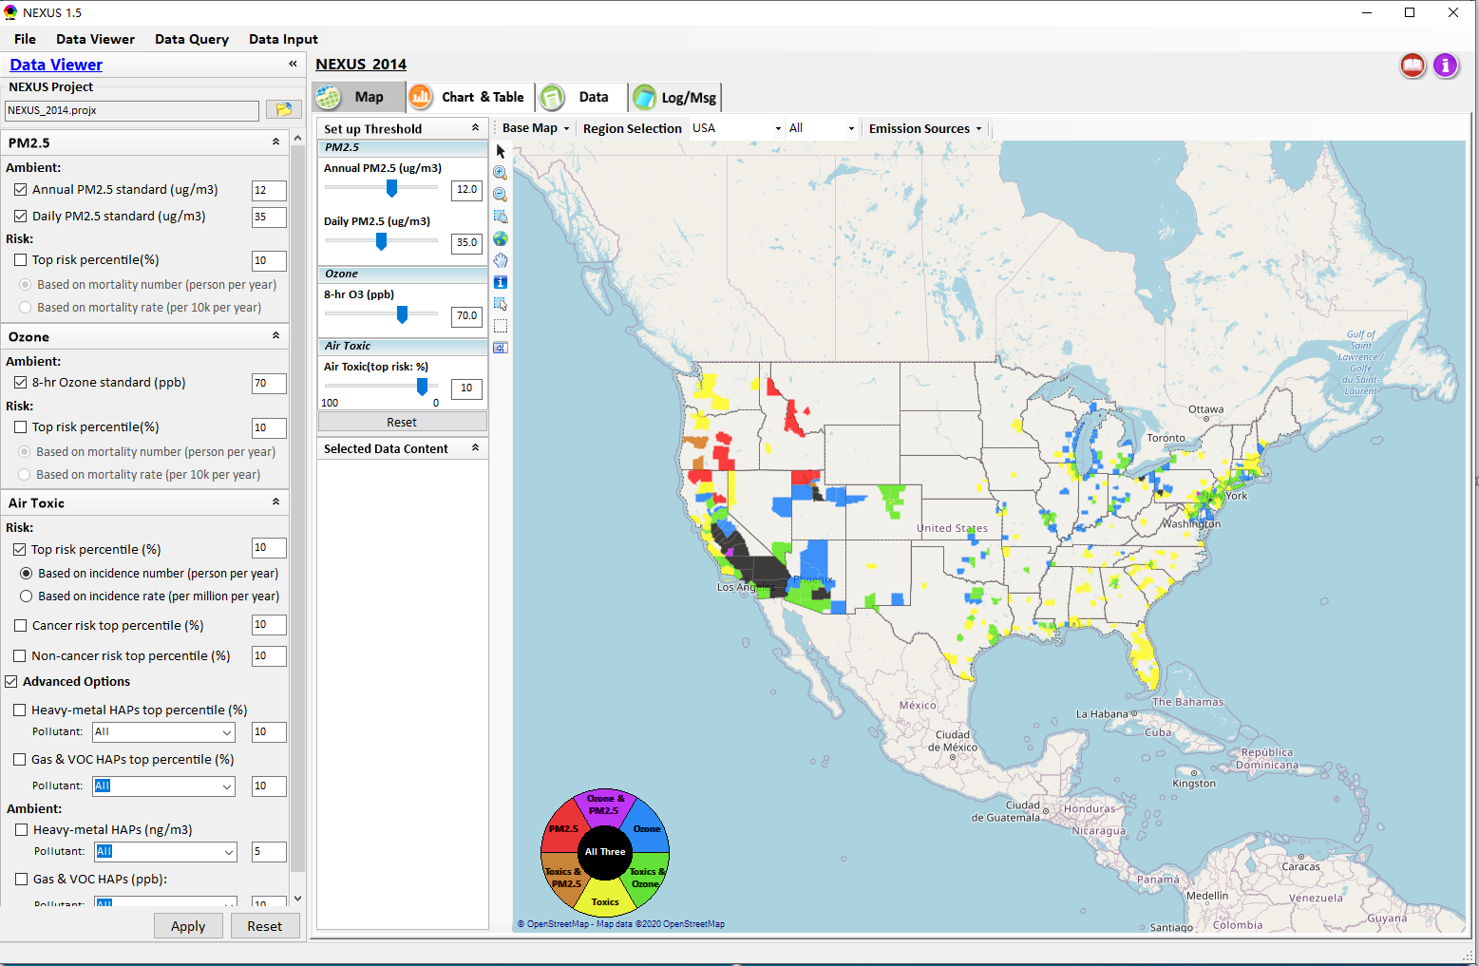

NEXUS Tool: Data Viewer Module
Click “File” to open or save a project
Switch between 3 key modules
Loaded NEXUS project file name
Select & adjust “Ambient” & “Risk” levels
“Advanced Option”: provide HAPs & species selections
18

Slide 19
Data Viewer Module: Selections & Map Display
Select & adjust “Ambient” & “Risk” threshold levels for color map display
“Apply” new selections to “Radio button” panel
19

Slide 20
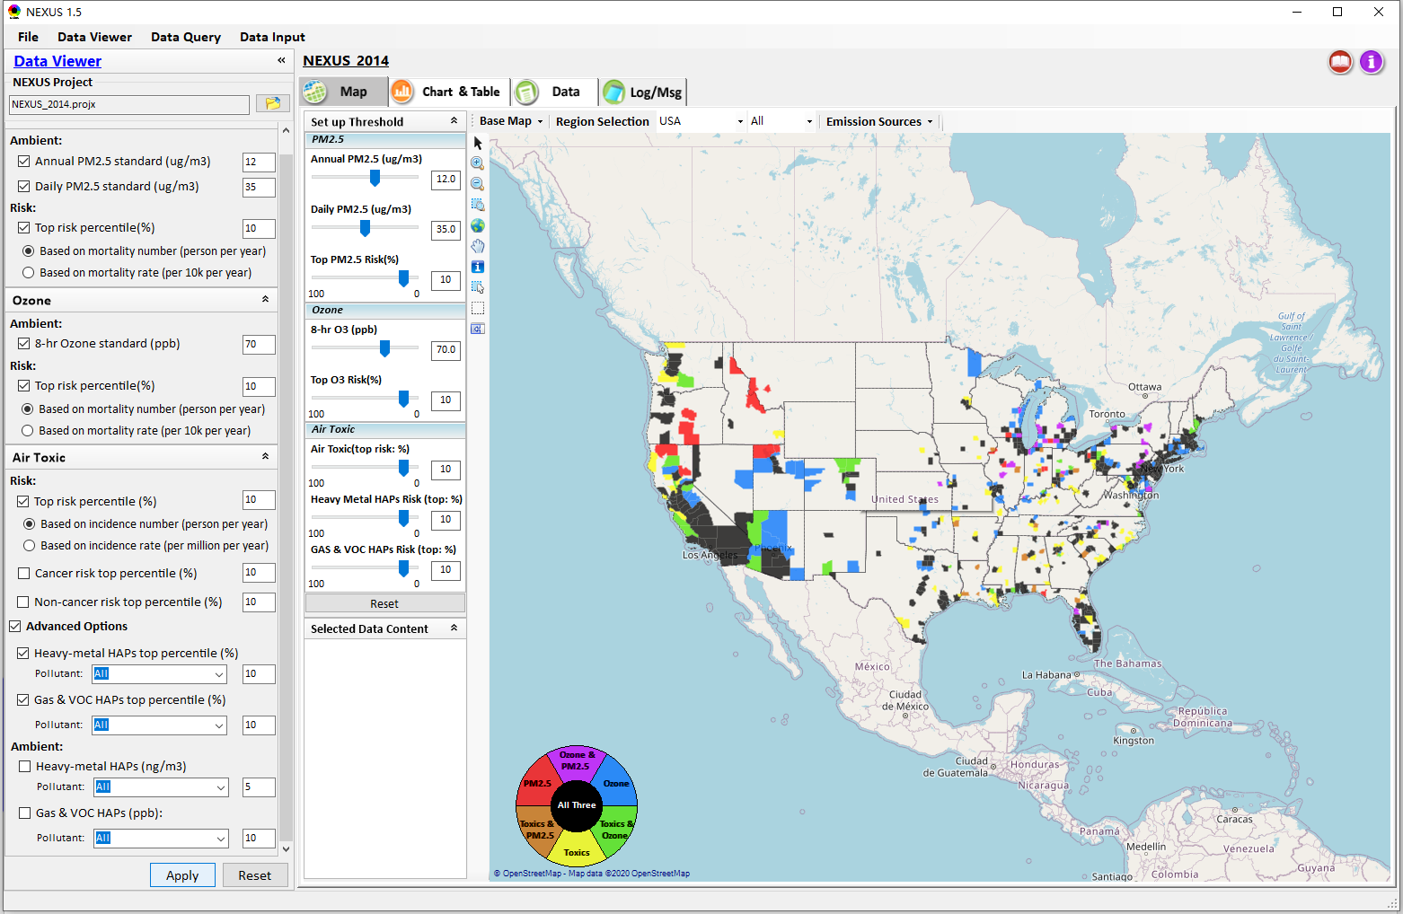
Data Viewer: “Apply” New Selections
“Check” new selections
New selections will appear on-the-fly in “radio button” panel and map display
“Apply” new selections
20

Slide 21
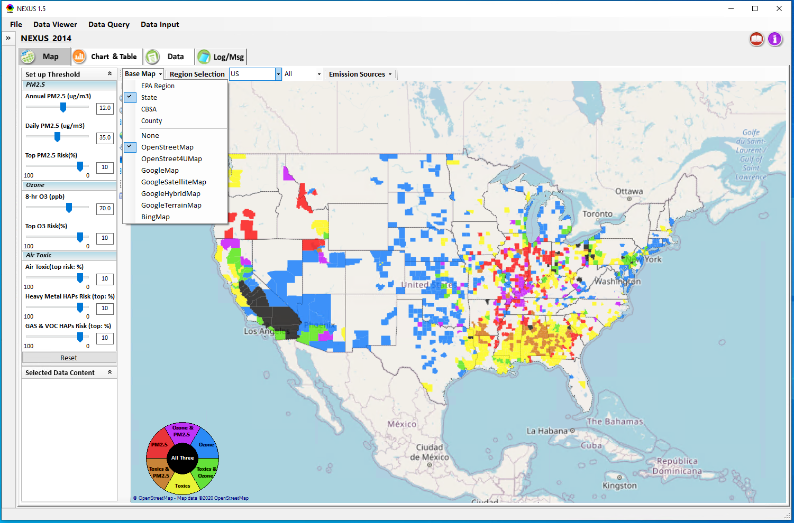
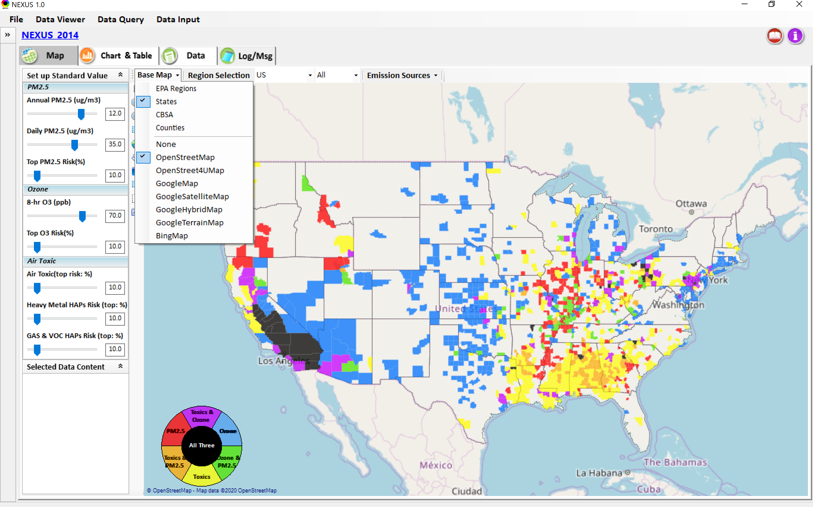
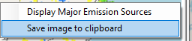
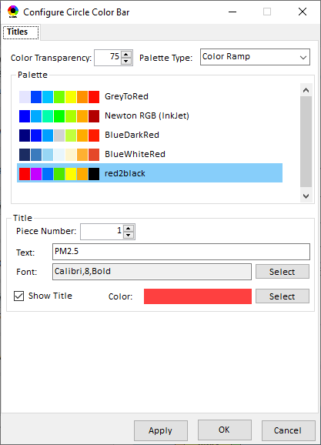
Data Viewer Module: Base Map & Color
“Base Map”: Change boundary lines and background map
“Right-click” map to save image
Click to change color & transparency
21

Slide 22
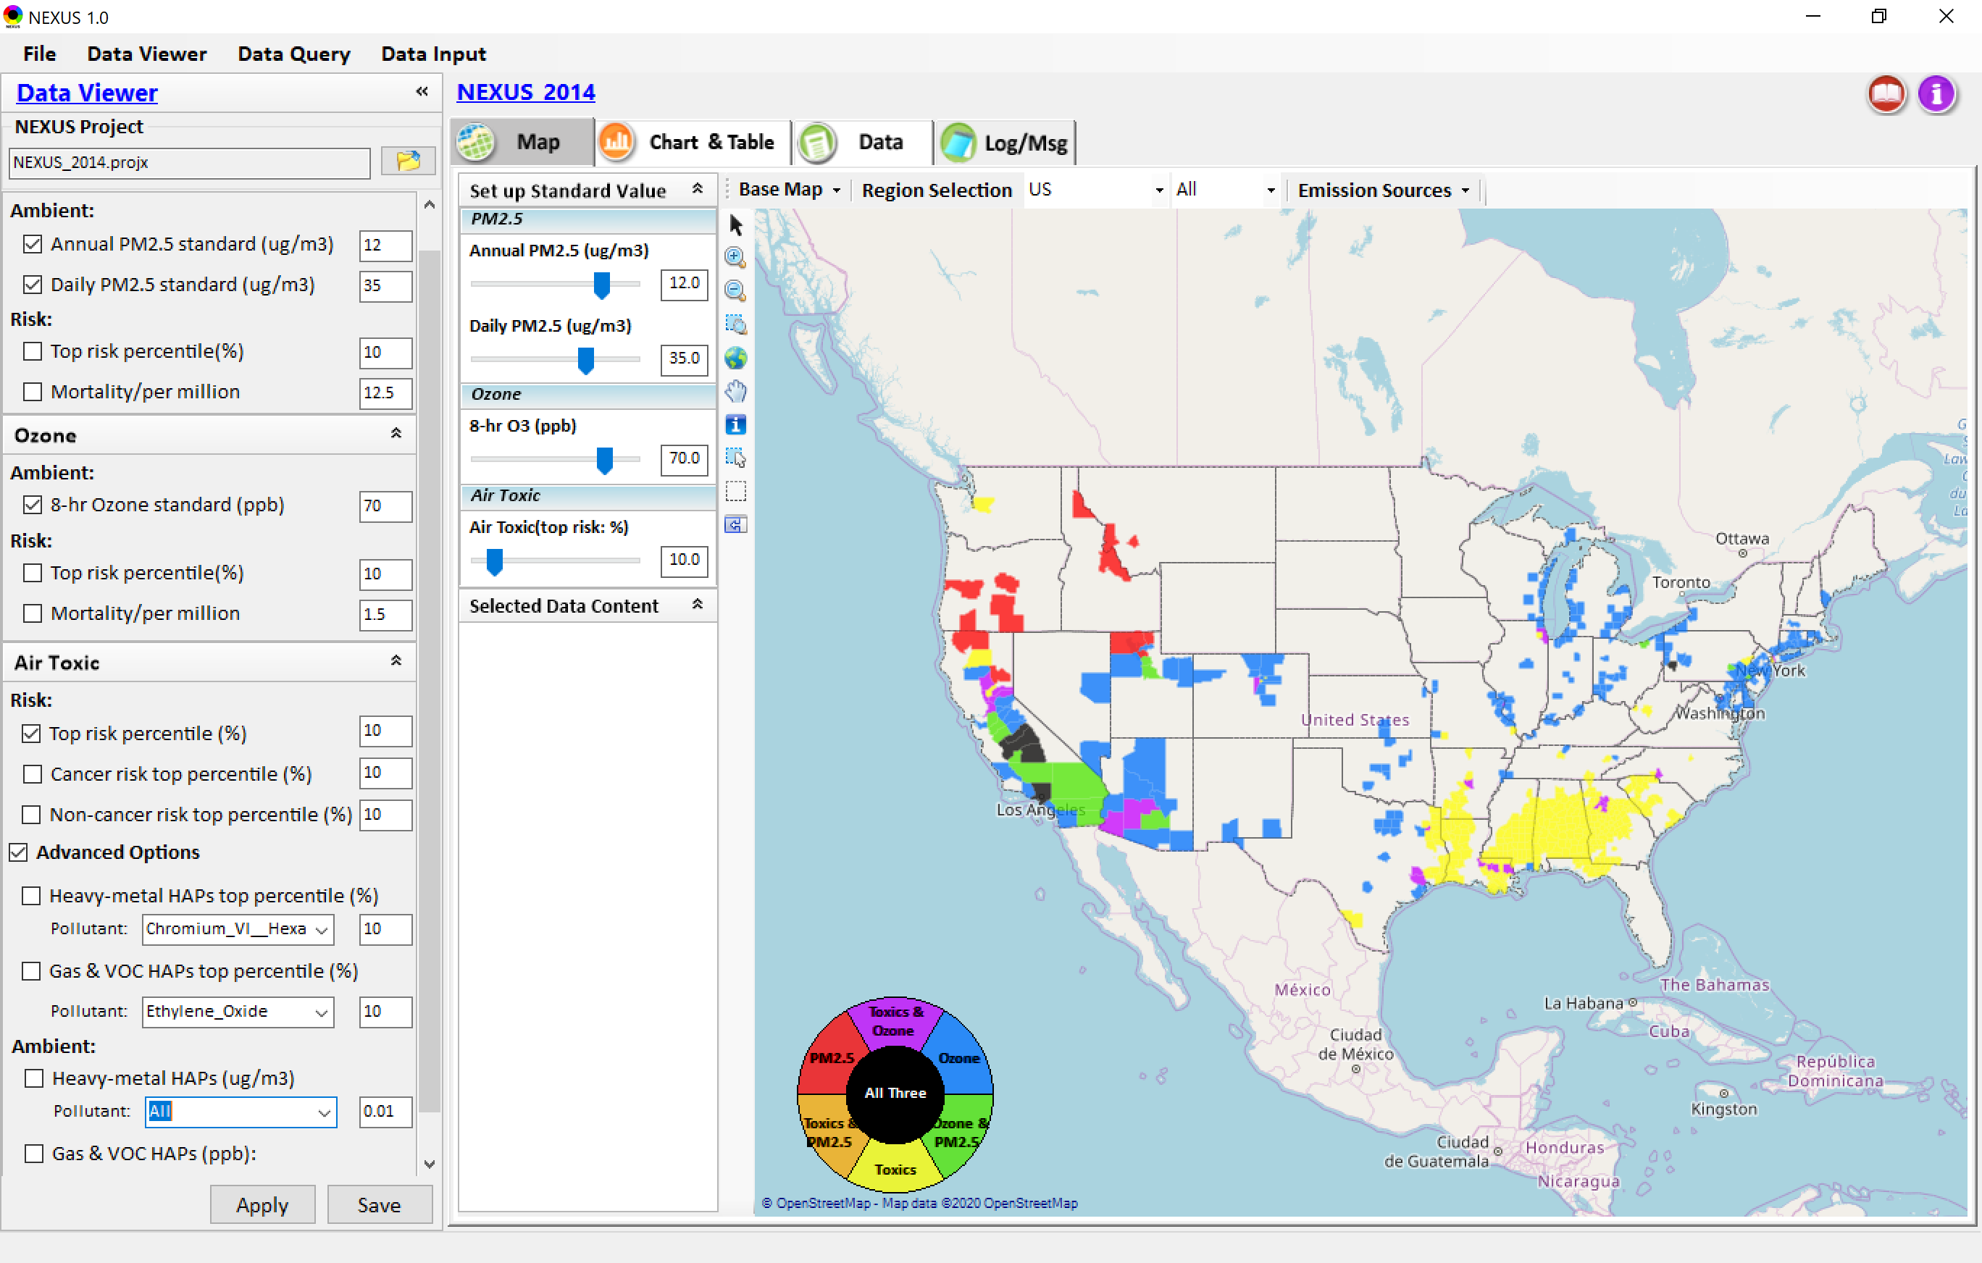

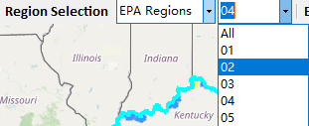
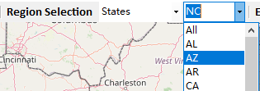
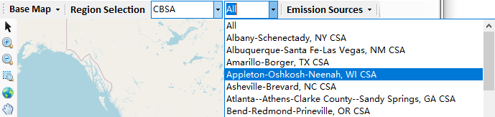
Data Viewer: “Region Selection”
Allow to select “EPA regions”, “States”, or “CBSA”
22

Slide 23
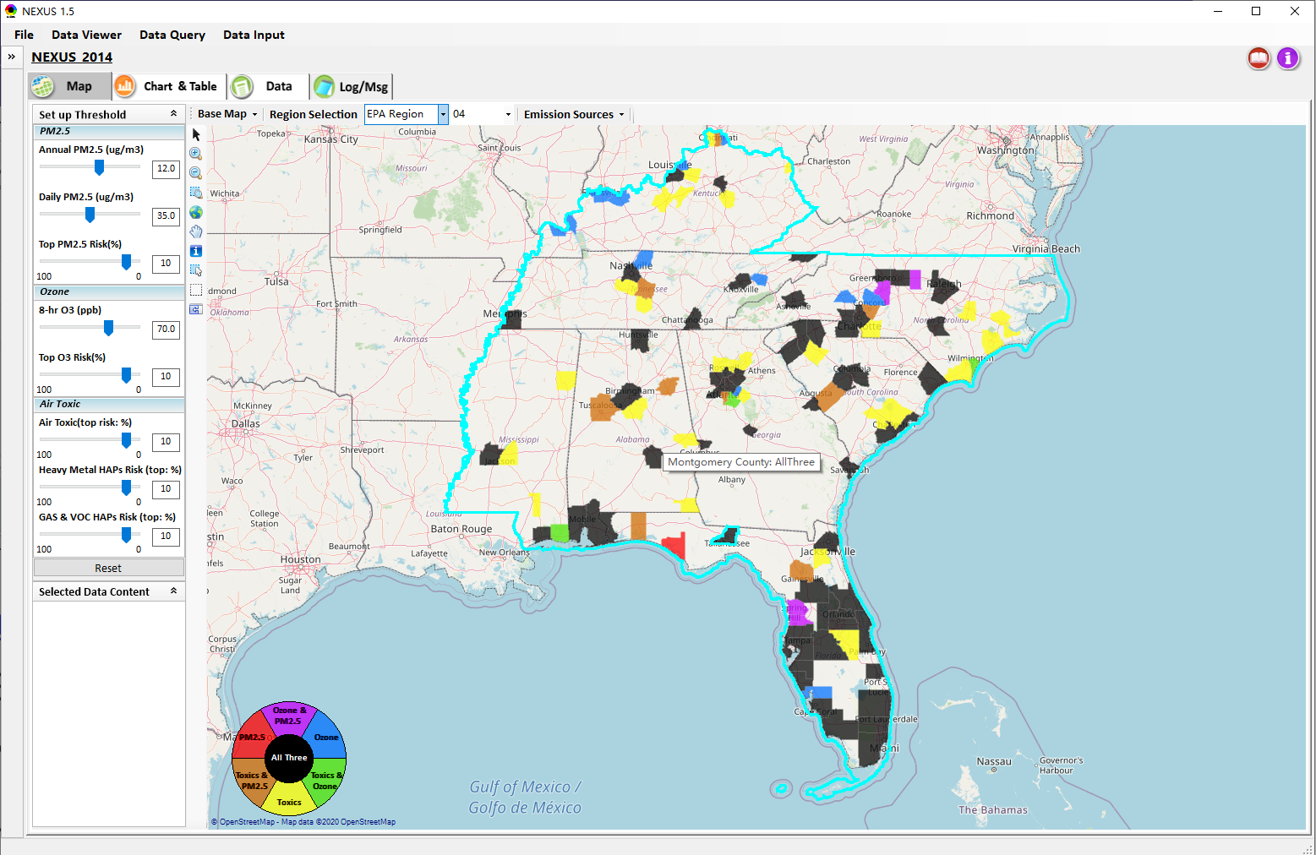
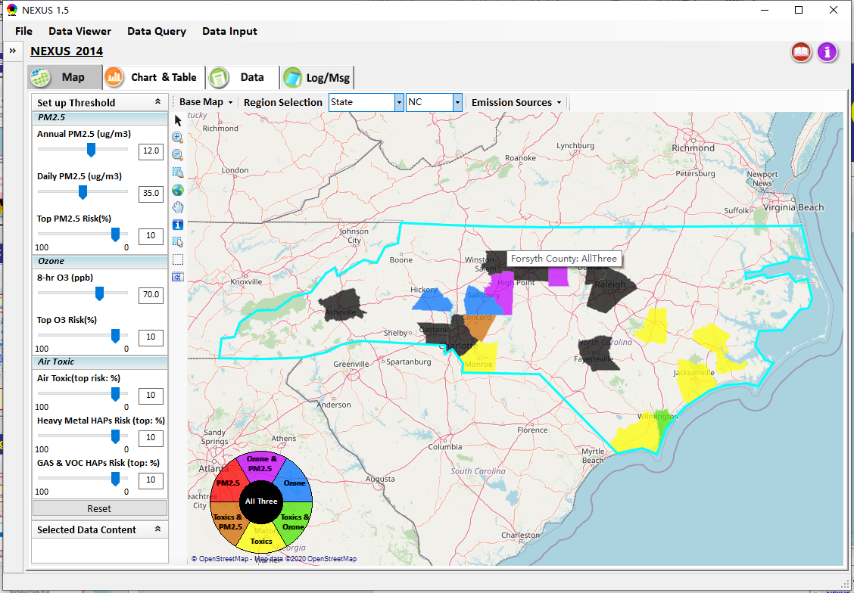
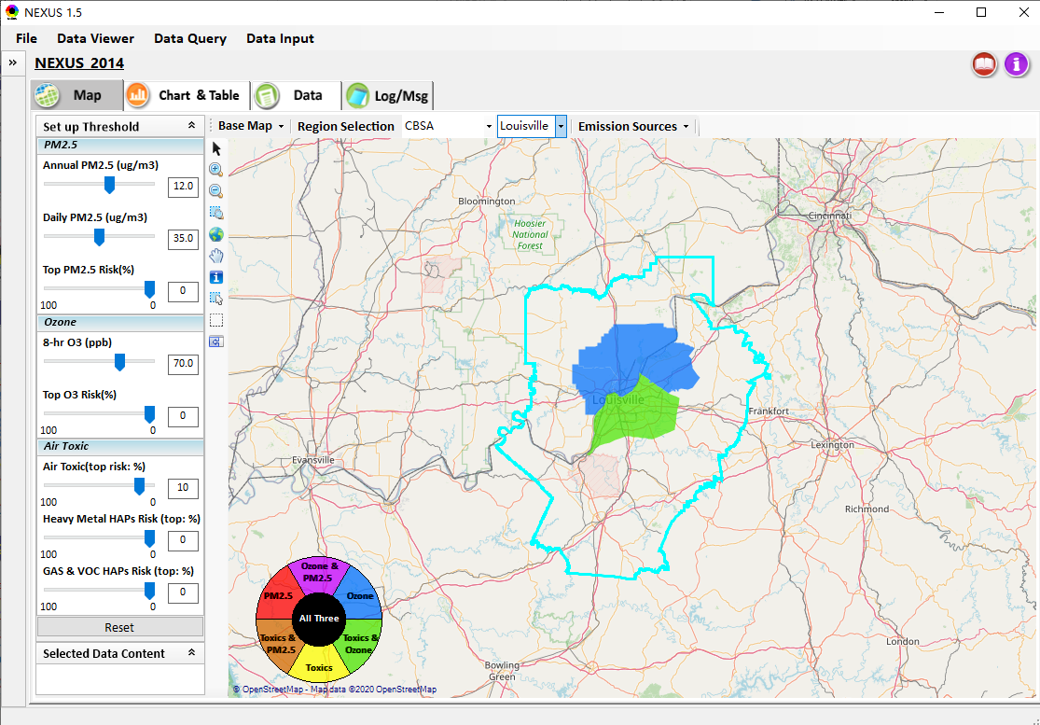
Data Viewer: Select EPA Region/State/CBSA
Examples:
EPA Region 4
NC
Louisville CBSA
23

Slide 24
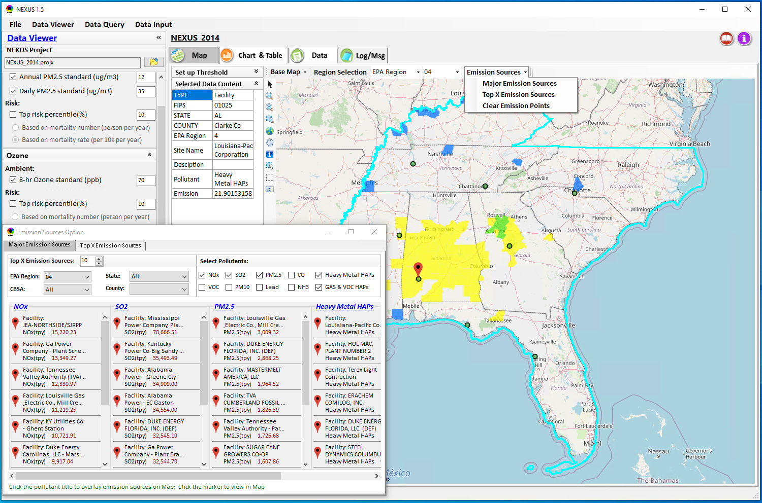
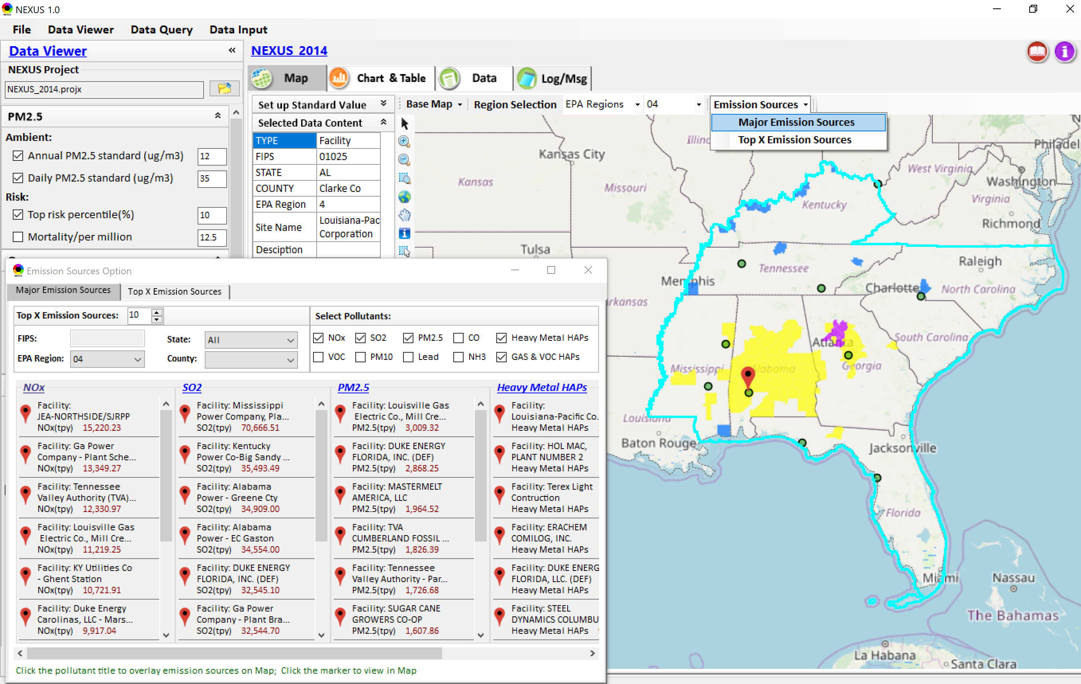
Data Viewer: Major Emission Sources
Click “Emission Sources” tab to display emission sources (green dots) and launch new window
Click any “facility” to link & display source location and emission information
24

Slide 25
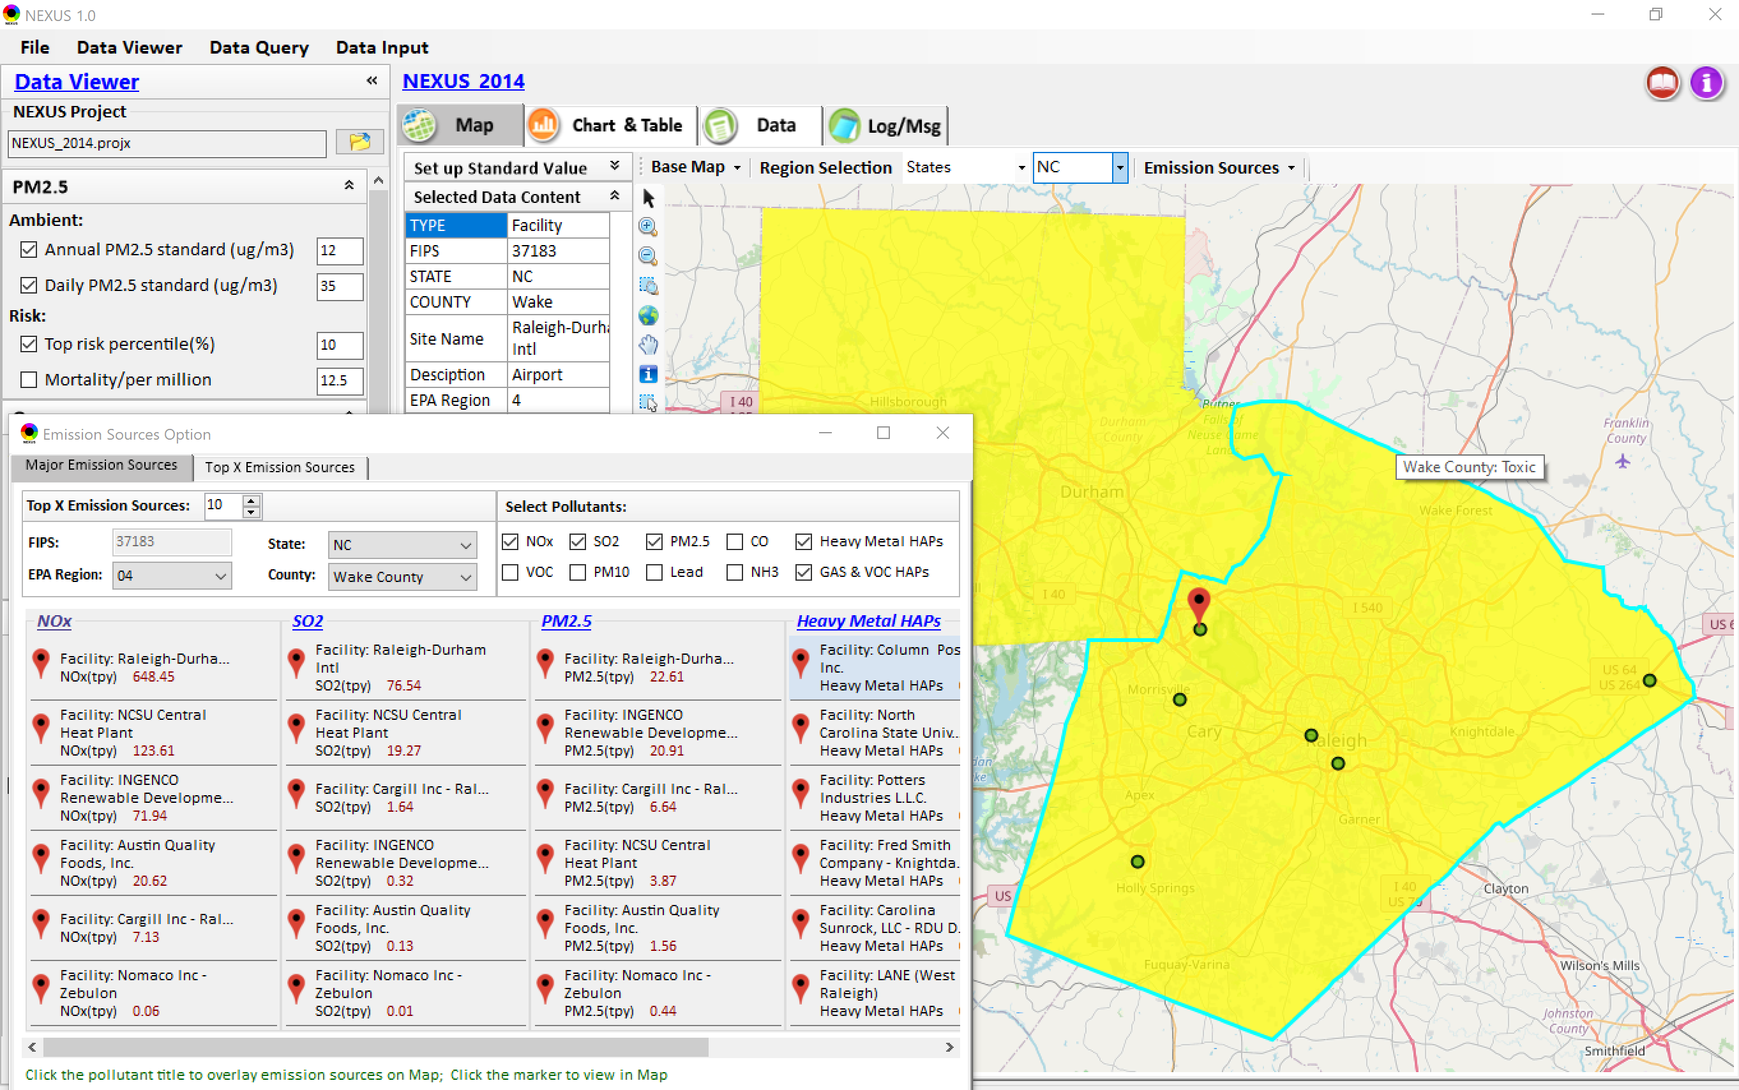
Data Viewer: Major Emission Sources
Allow to scroll down to county-level (e.g., Wake County, NC)
Wake county, NC
25

Slide 26
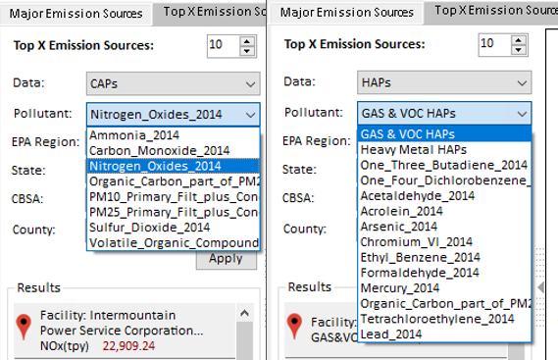
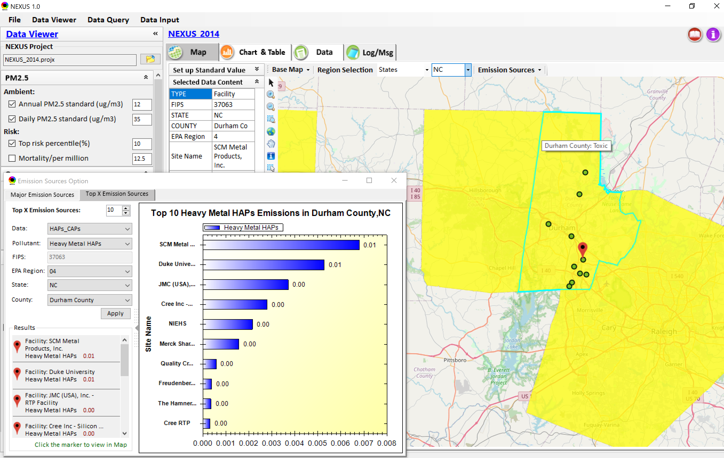
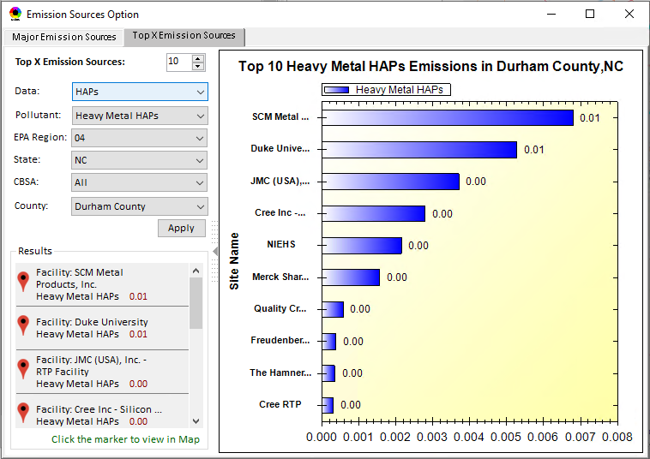
Data Viewer: Top “x” Emission Sources
Provide selection of CAPs precursors & HAPs species
Durham county, NC
26

Slide 27
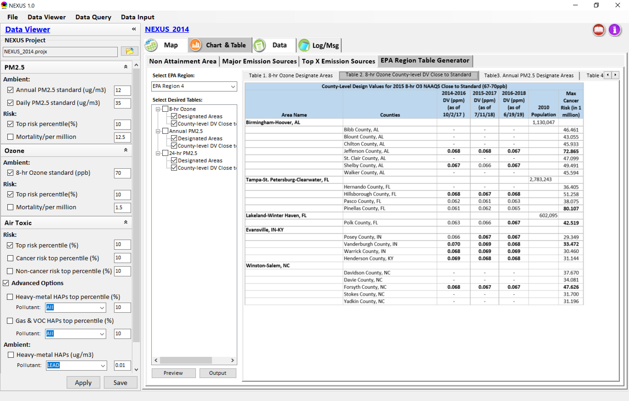
Data Viewer: EPA Region Table Generator
“EPA Region Table Generator” is still under development, but a preview of example “EPA Region 4” tables can be provided
27

Slide 28
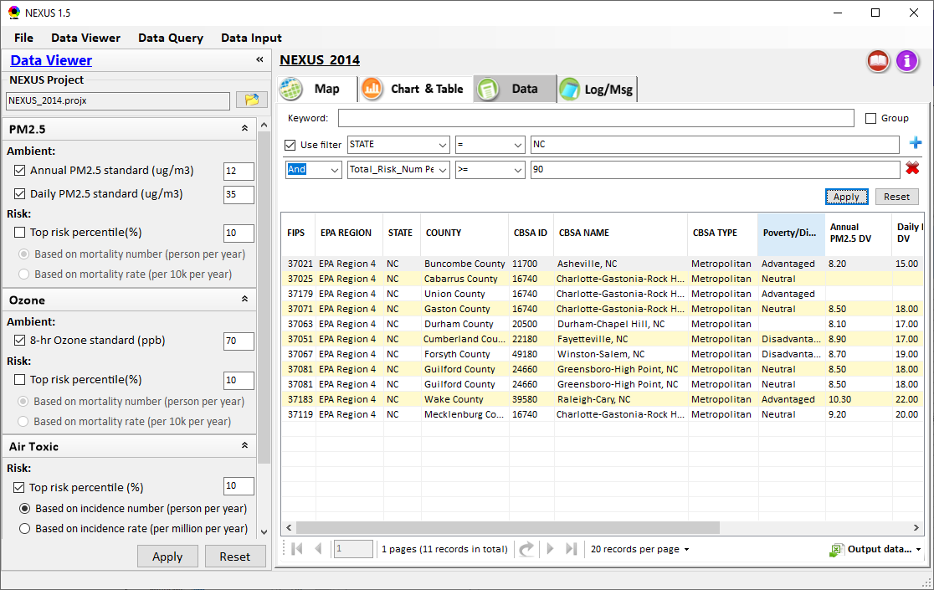
Data Viewer: Data Search & Filter
Click “+” to add filters; Click “x” to remove current filter;
Show specified records per page.
Click “Output data…” to output current page records or all records
28

Slide 29
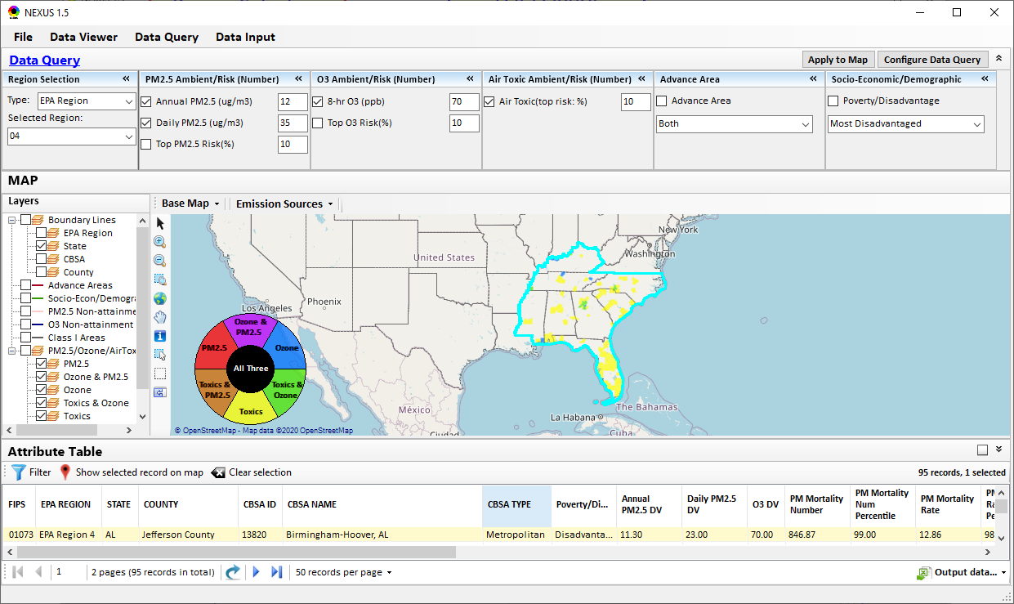
Data Query Module: Main Page
Region Selection
Data Query qualifier selection
Data Query Configuration
Map Overlaying selection
Detachable “Attribute Table”
11111111
29

Slide 30
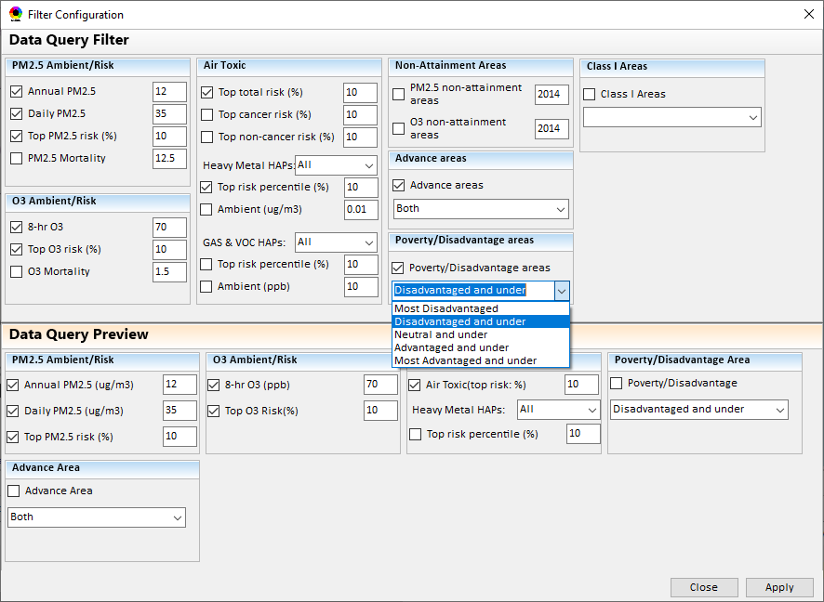
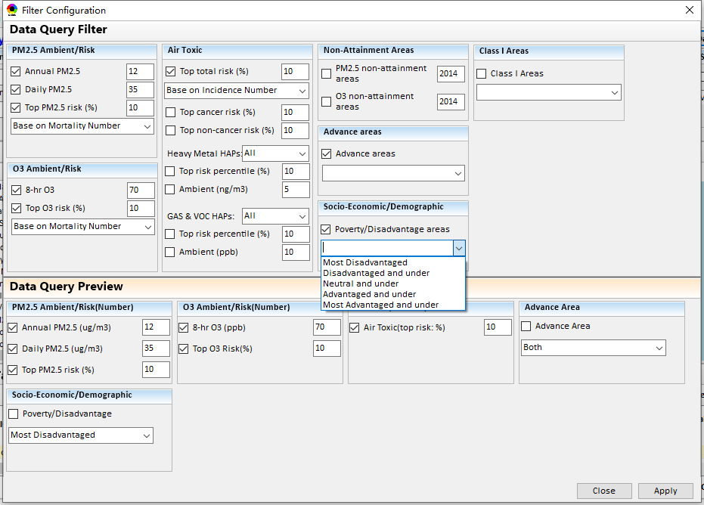
Data Query Module: Configure Data Query
“Data Query Filter” allows to select “qualifiers” for query
“Data Query Preview” displays the selected “qualifiers” at the same time
30

Slide 31
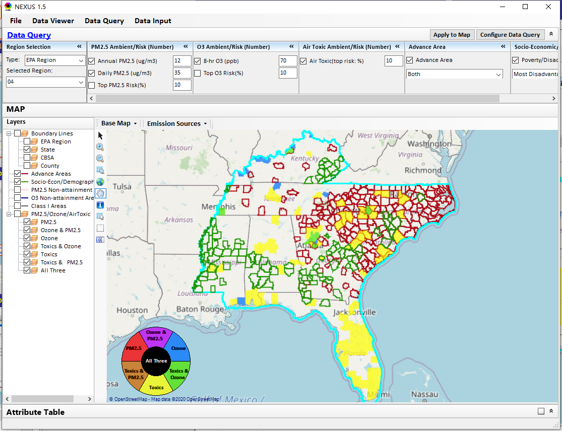
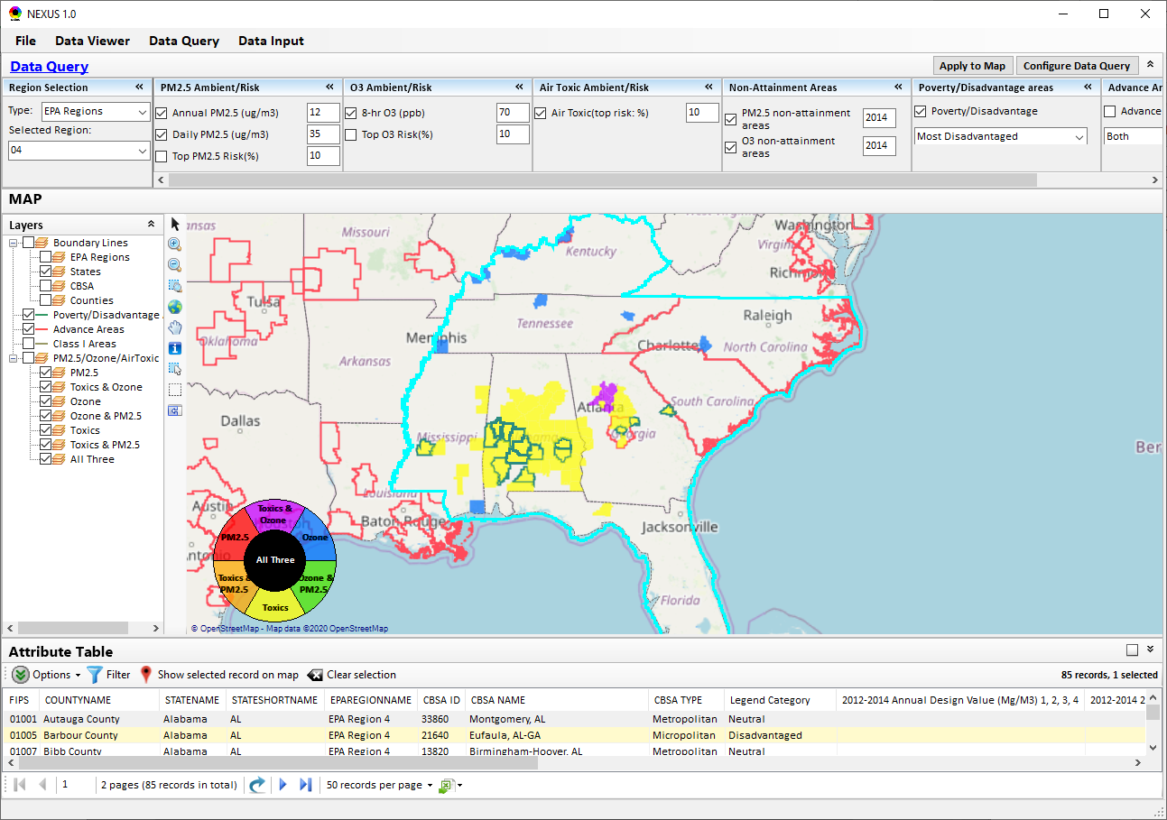
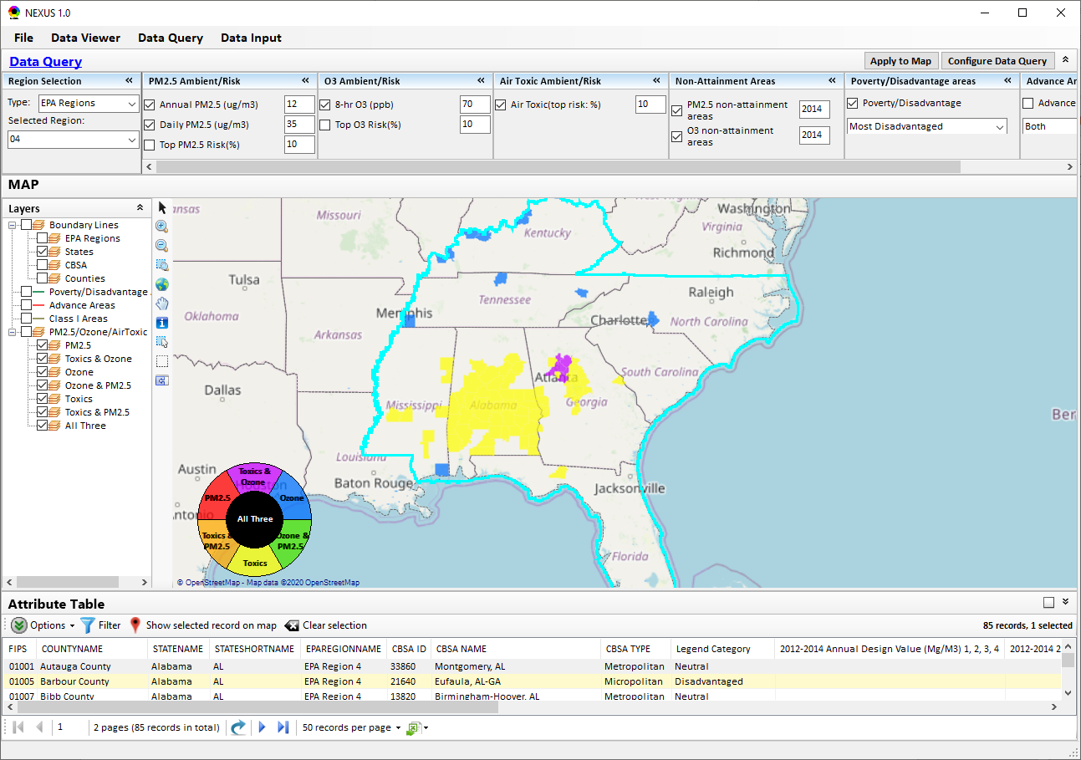
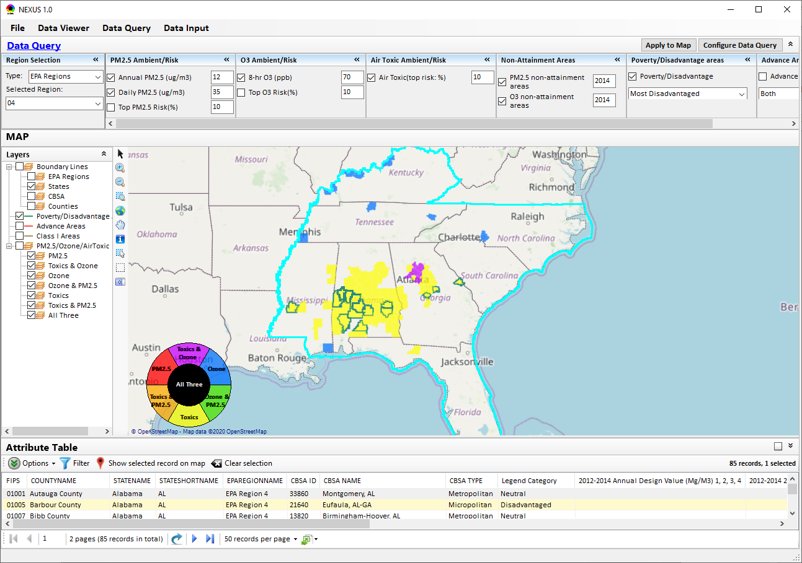
Data Query Module: Overlaying Map
Overlaying Map selection
31
31

Slide 32
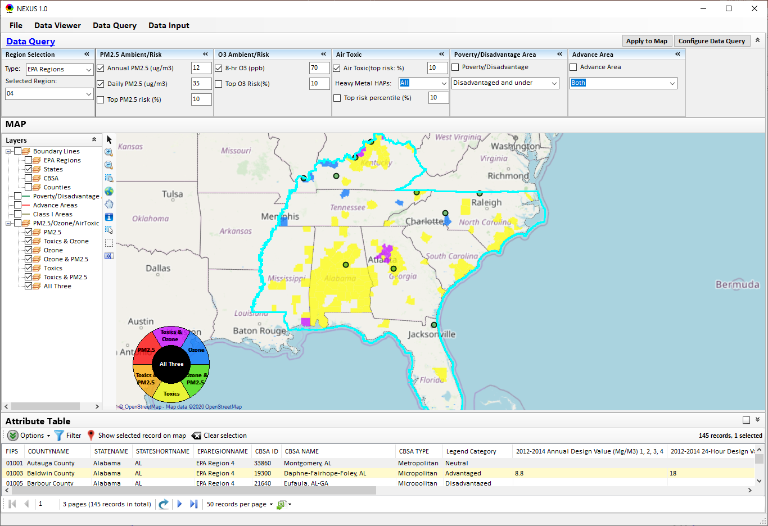
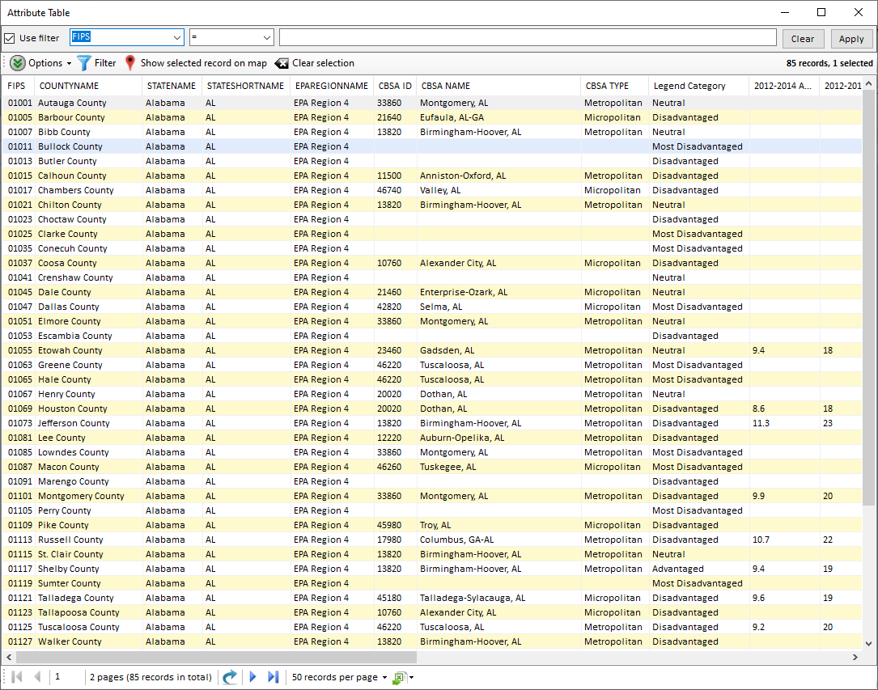
Data Query Module: Attribute Table
Filter/link/export functions (to be completed)
Detachable “Attribute Table”
32

Slide 33
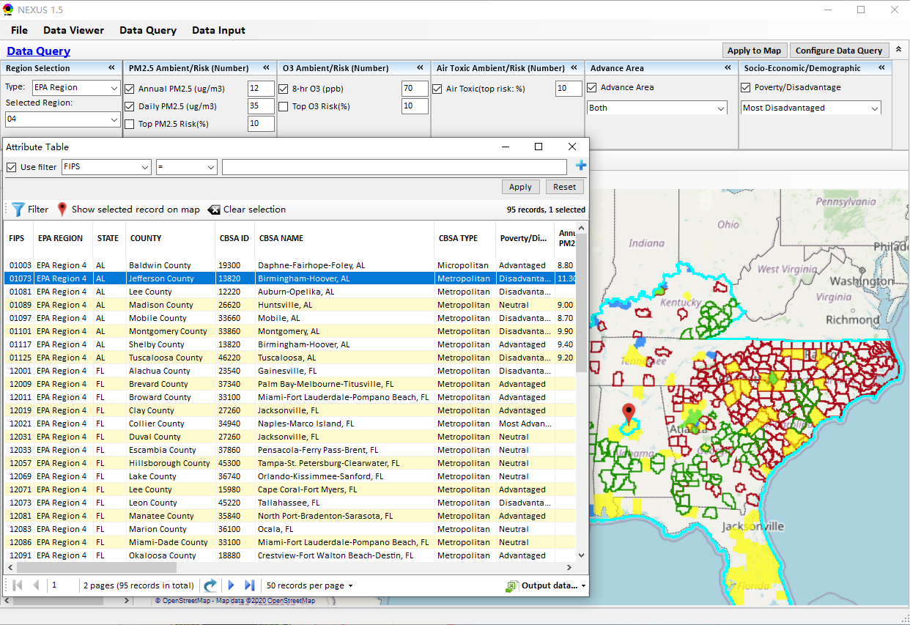
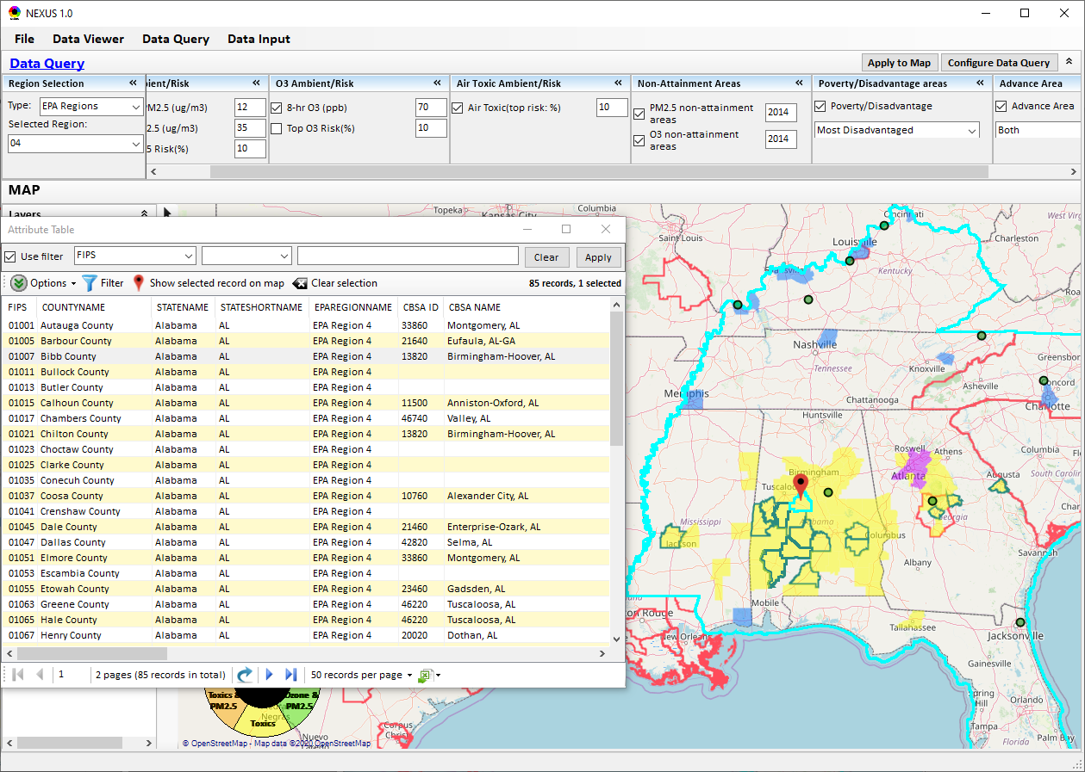
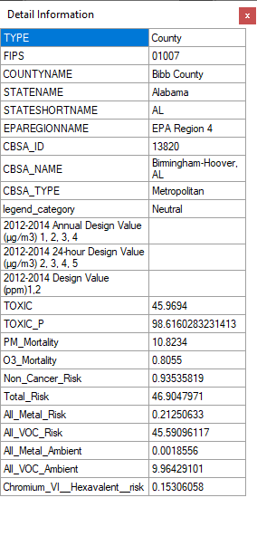
Data Query Module: Attribute Table
Click a “record” to link and display its location & info.
33

Slide 34
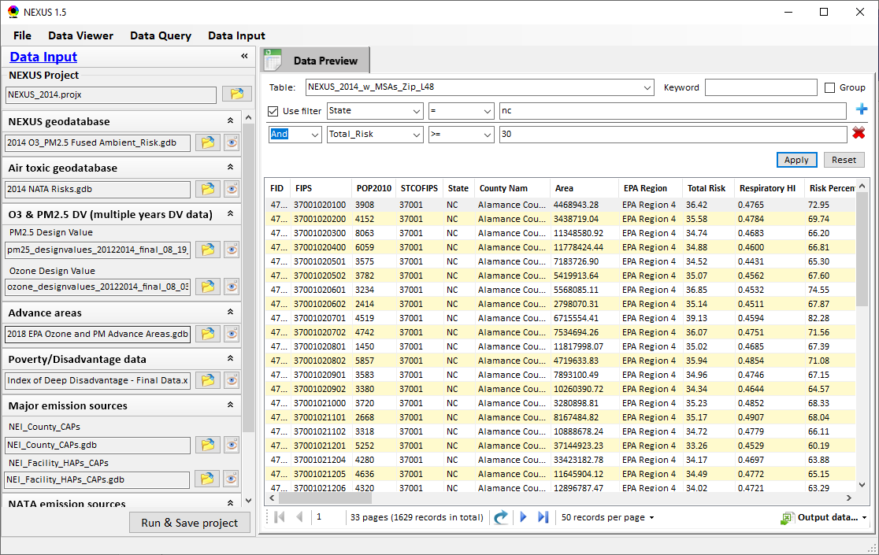
Data Input Module: Data Preview
Click to view data
Click to change input data file
Click to view data
Select a table to view if there are multiple tables in the selected data source file
Check to use filter to query data
Click to run & save project
34

Slide 35
End
35

