Slide 1
“NEXUS 1.5”: Tutorial
Carey Jang, 9/22/2020
1

Slide 2
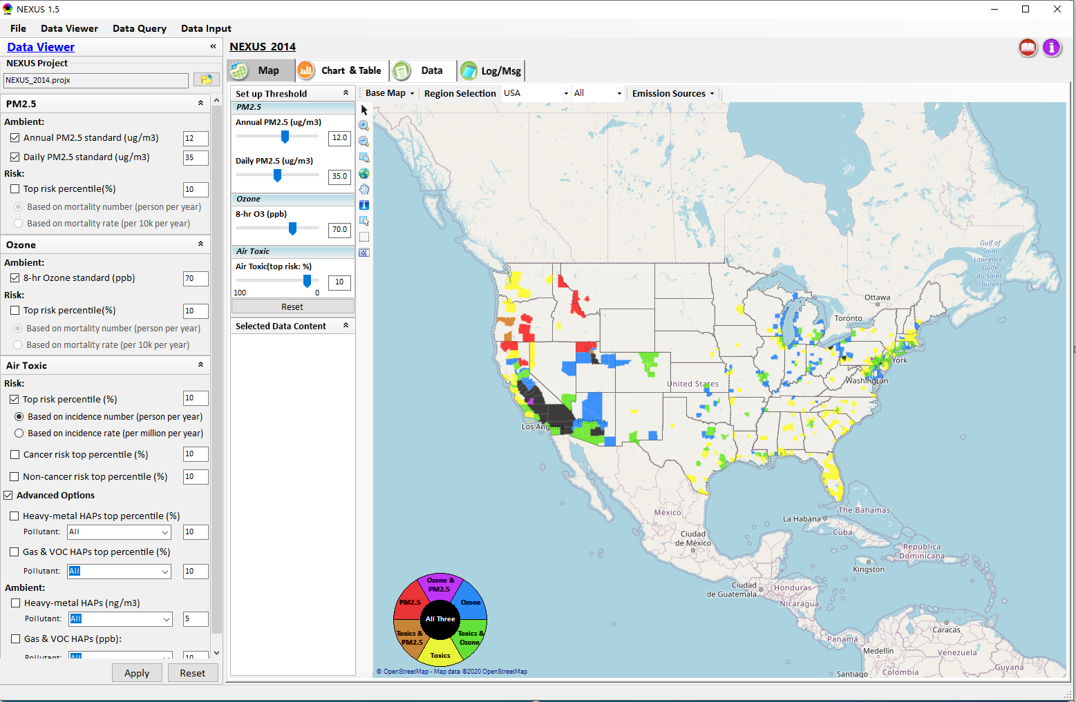

NEXUS Tool: Data Viewer Module
Click “File” to open or save a project
Switch between 3 key modules
Provide “Hot link” to User’s manual’s “Data Viewer” chapter (same for “Data Input” & “Data Query”)
Loaded NEXUS project file name & project file loading icon
Select & adjust “Ambient” & “Risk” levels
“Advanced Option”: provide HAPs & species selections
2

Slide 3
Data Viewer Module: Selections & Map Display
Select & adjust “Ambient” & “Risk” levels for color map display
“Apply” new selections to “Radio button” panel
3

Slide 4
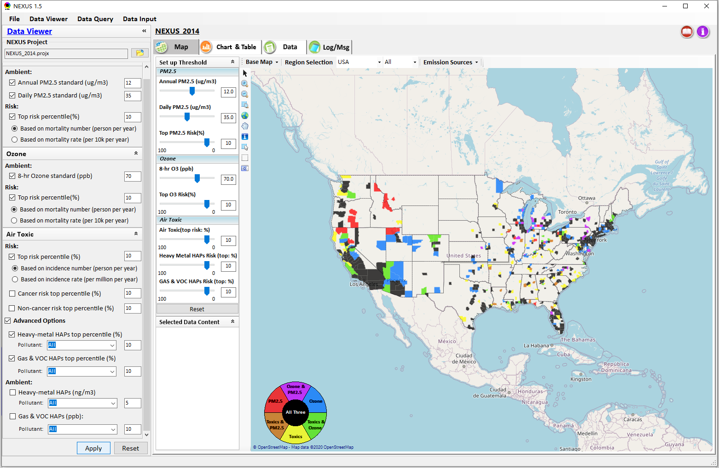
Data Viewer: “Apply” New Selections
“Check” new selections
New selections will appear on-the-fly in “radio button” panel and map display
“Apply” new selections
4

Slide 5
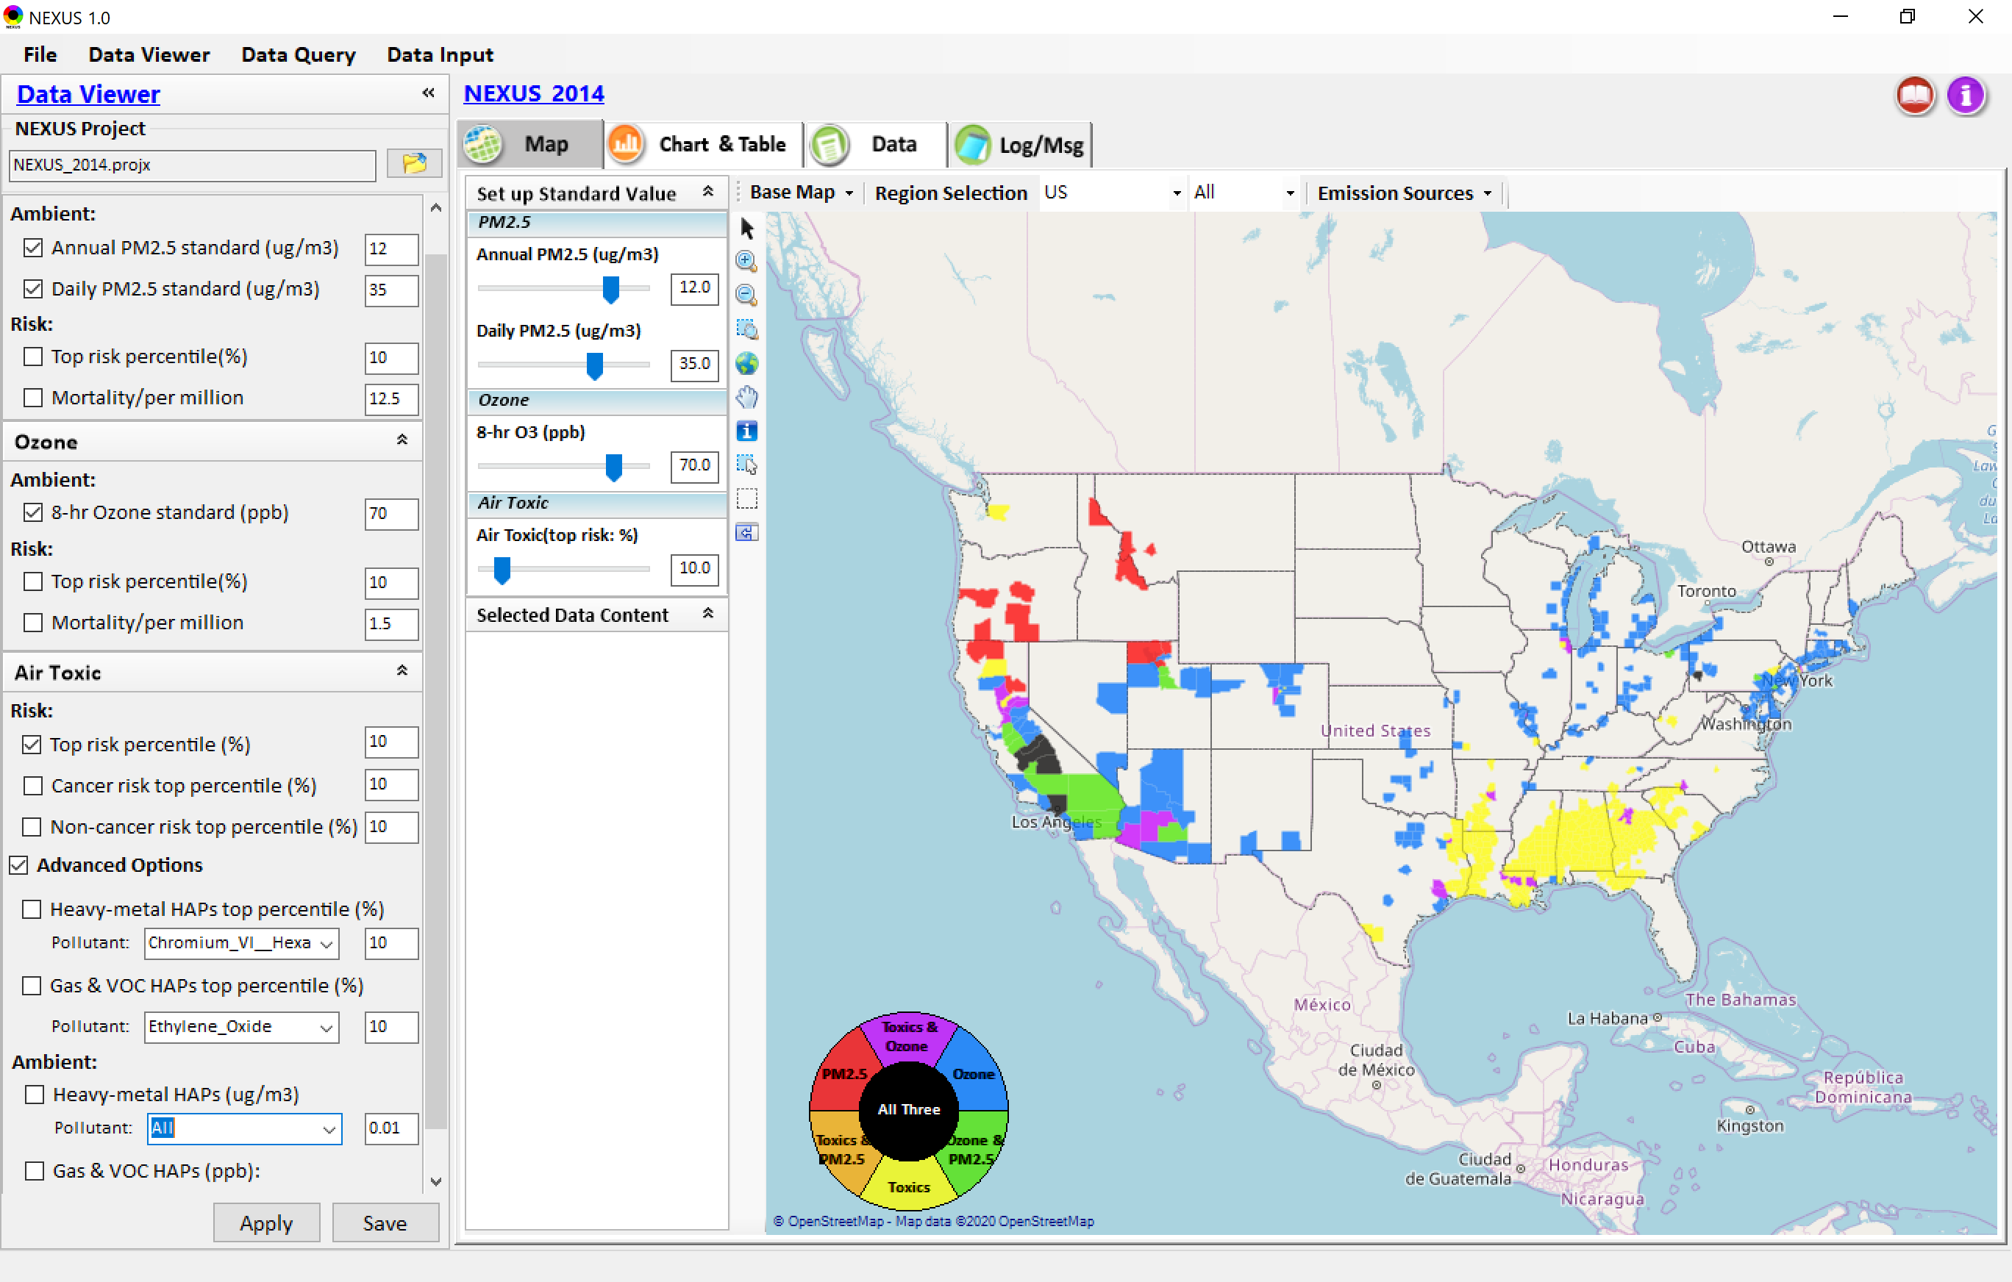
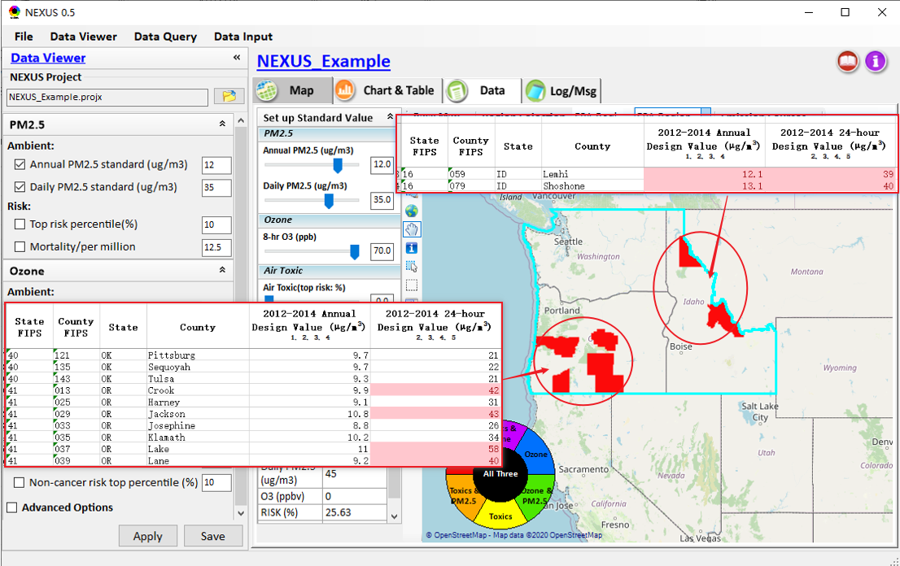
Data Viewer Module: Map & Data QA
High PM2.5 DVs real?
Questionable high PM2.5 DVs in Oregon (daily PM) and Idaho (annual & daily PM) appear to be “real”
5
5

Slide 6
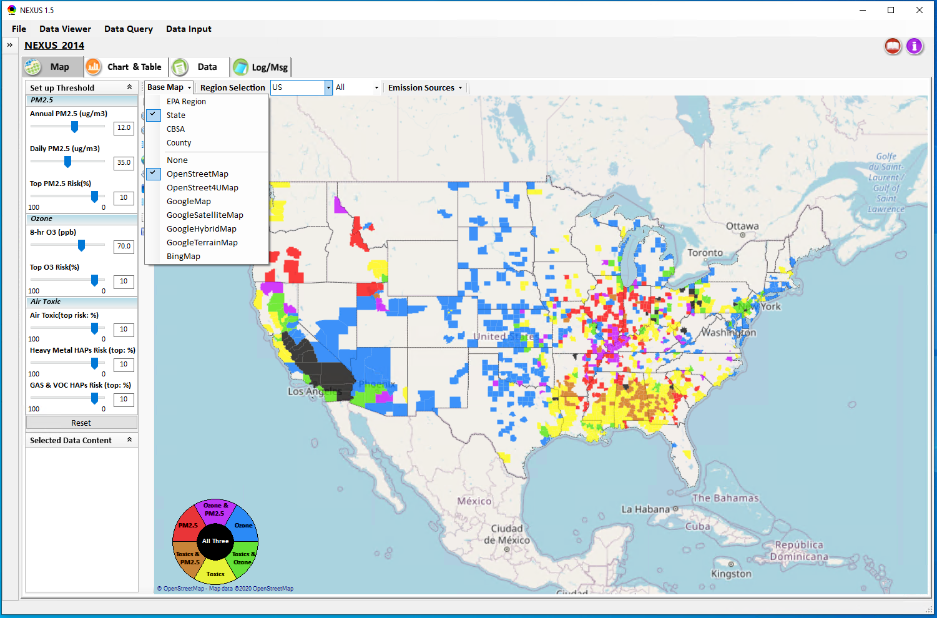
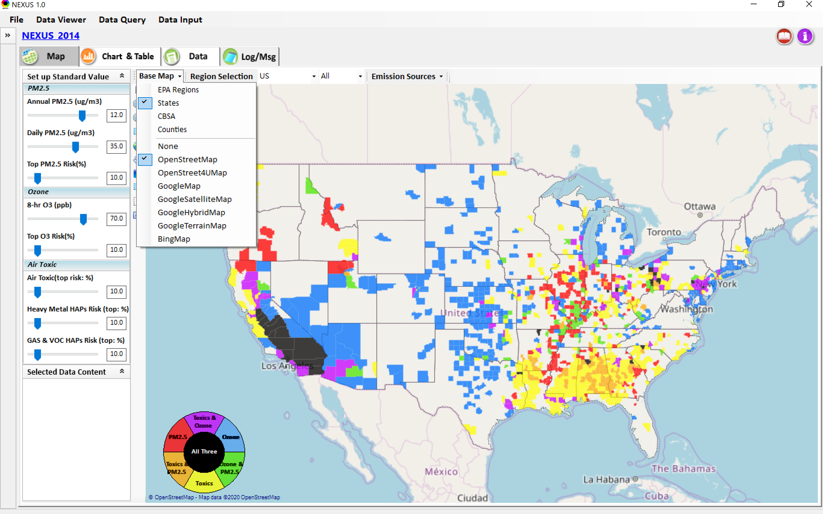
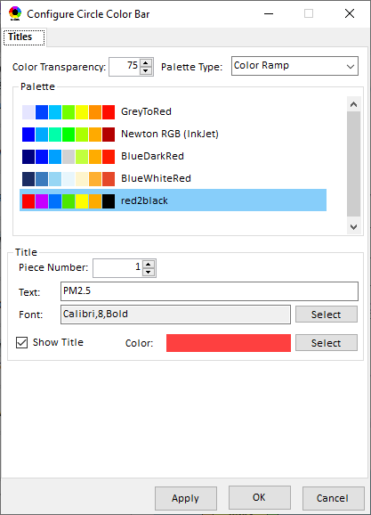
Data Viewer Module: Base Map & Color
“Base Map”: Change boundary lines and background map
Click to change color & transparency
6

Slide 7

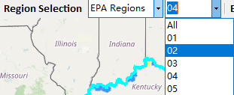
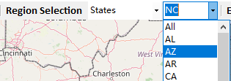
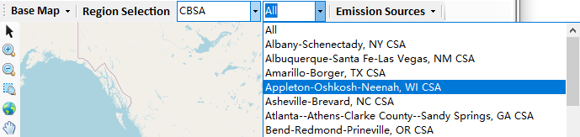
Data Viewer: “Region Selection”
Allow to select “EPA regions”, “States”, or “CBSA”
7

Slide 8
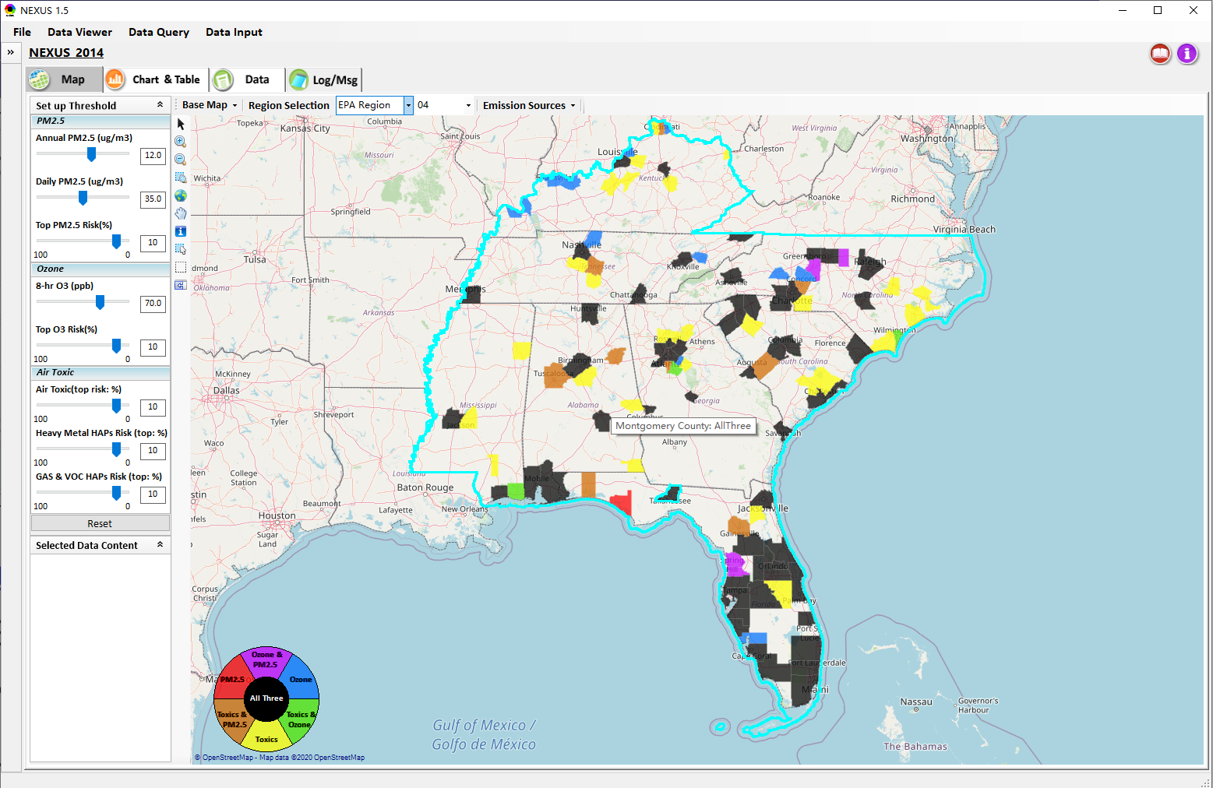
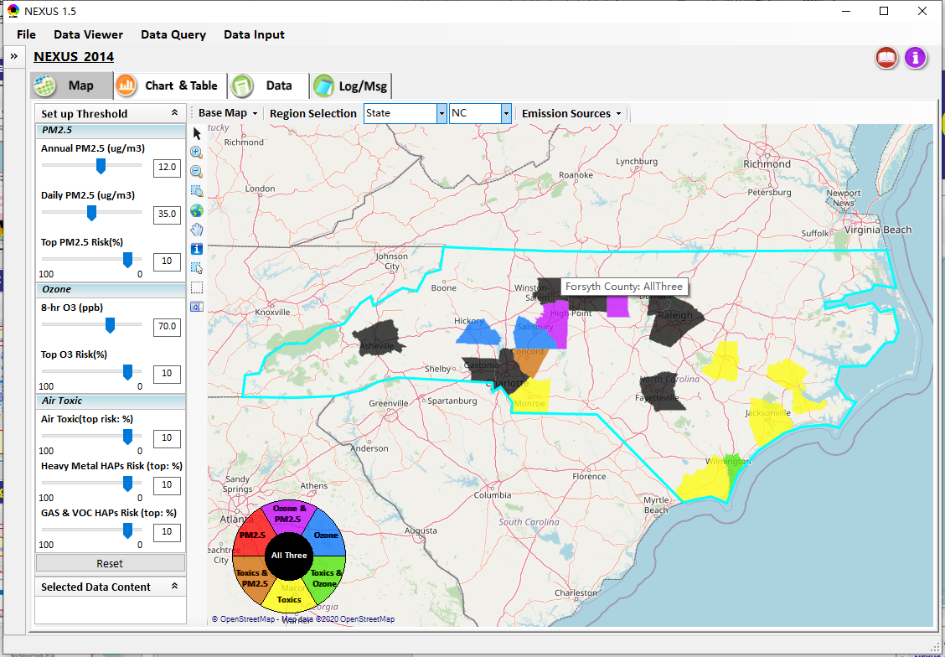
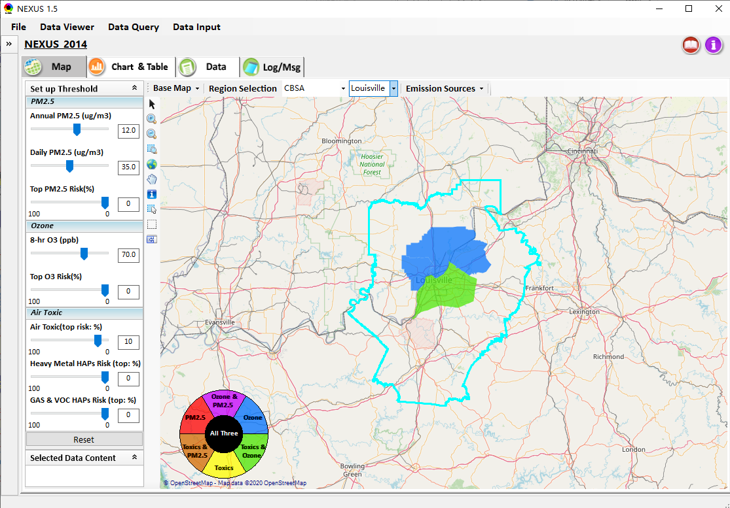
Data Viewer: Select EPA Region/State/CBSA
Examples:
EPA Region 4
NC
Louisville CBSA
8

Slide 9
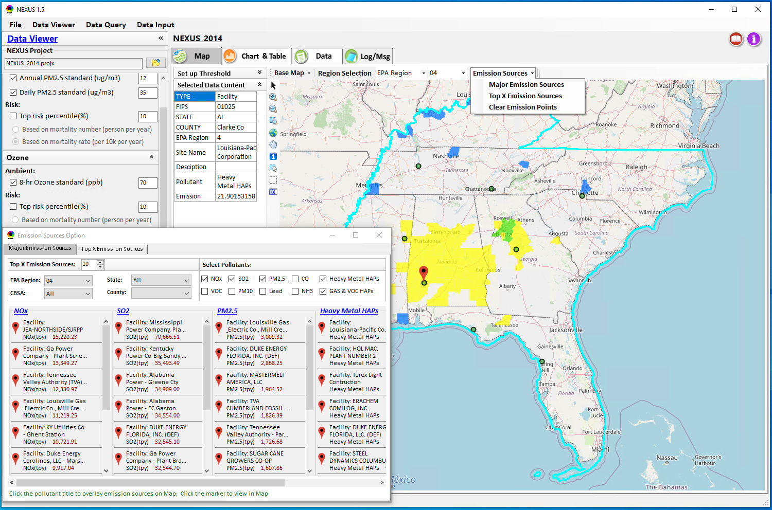
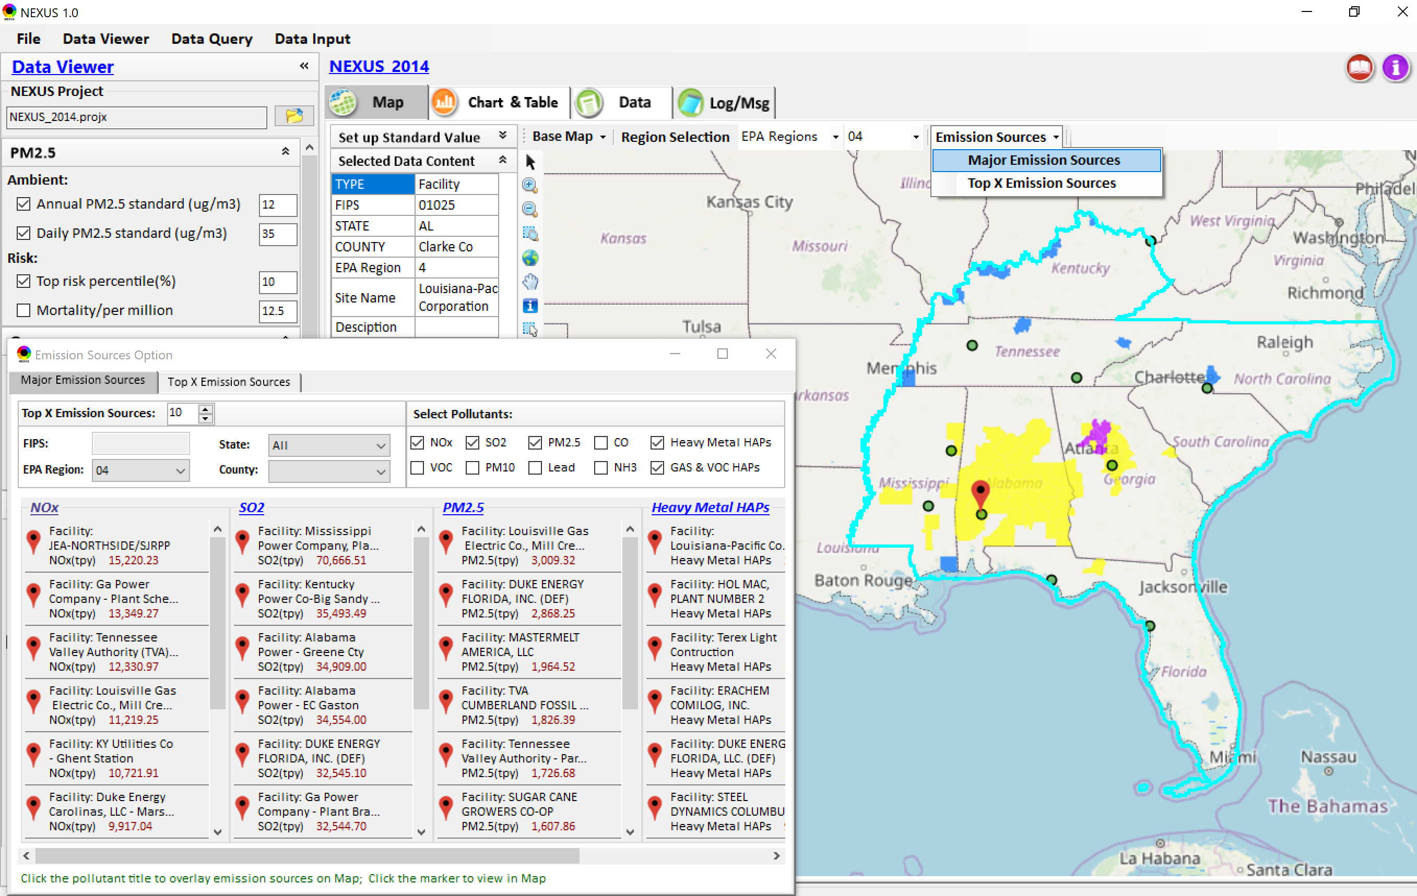
Data Viewer: Major Emission Sources
Click “Emission Sources” tab to display emission sources (green dots) and launch new window
Click any “facility” to link & display source location and emission information
9

Slide 10
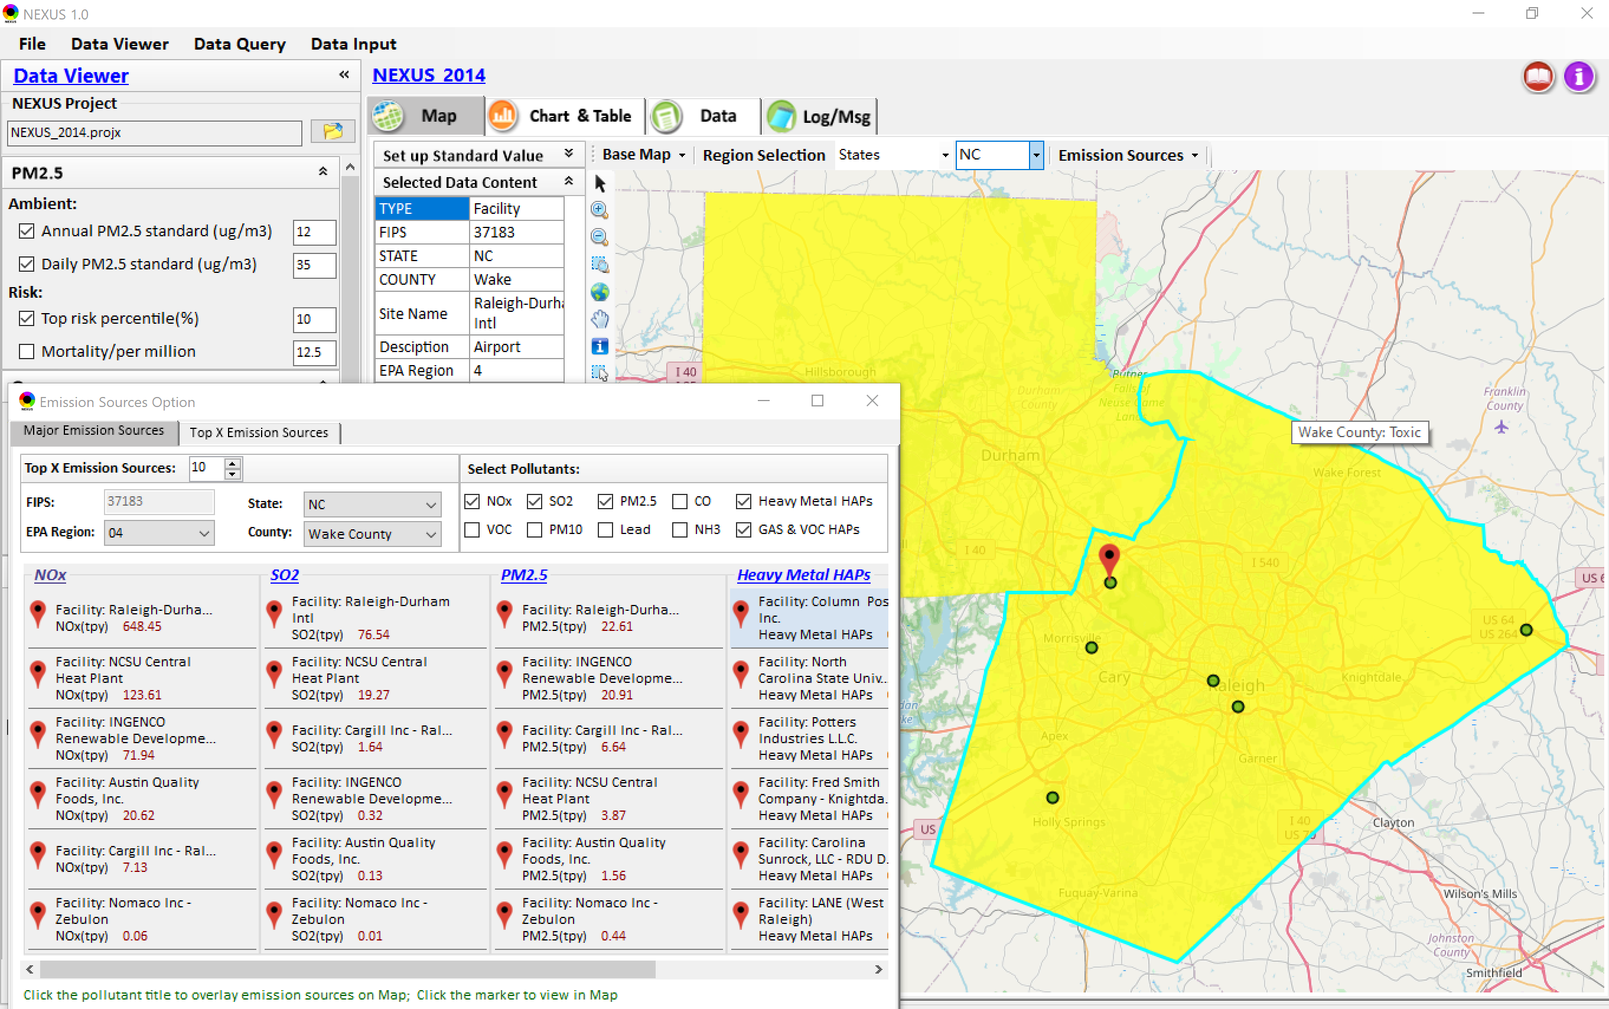
Data Viewer: Major Emission Sources
Allow to scroll down to county-level (e.g., Wake County, NC)
Wake county, NC
10

Slide 11
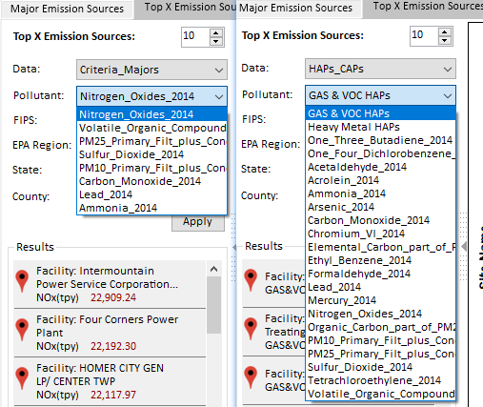
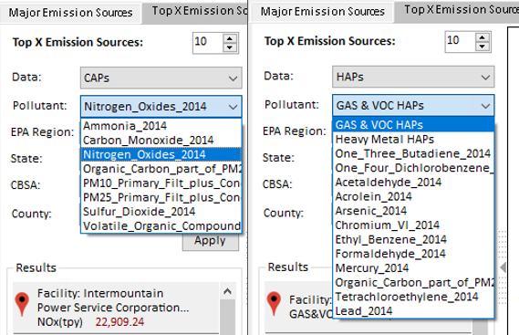
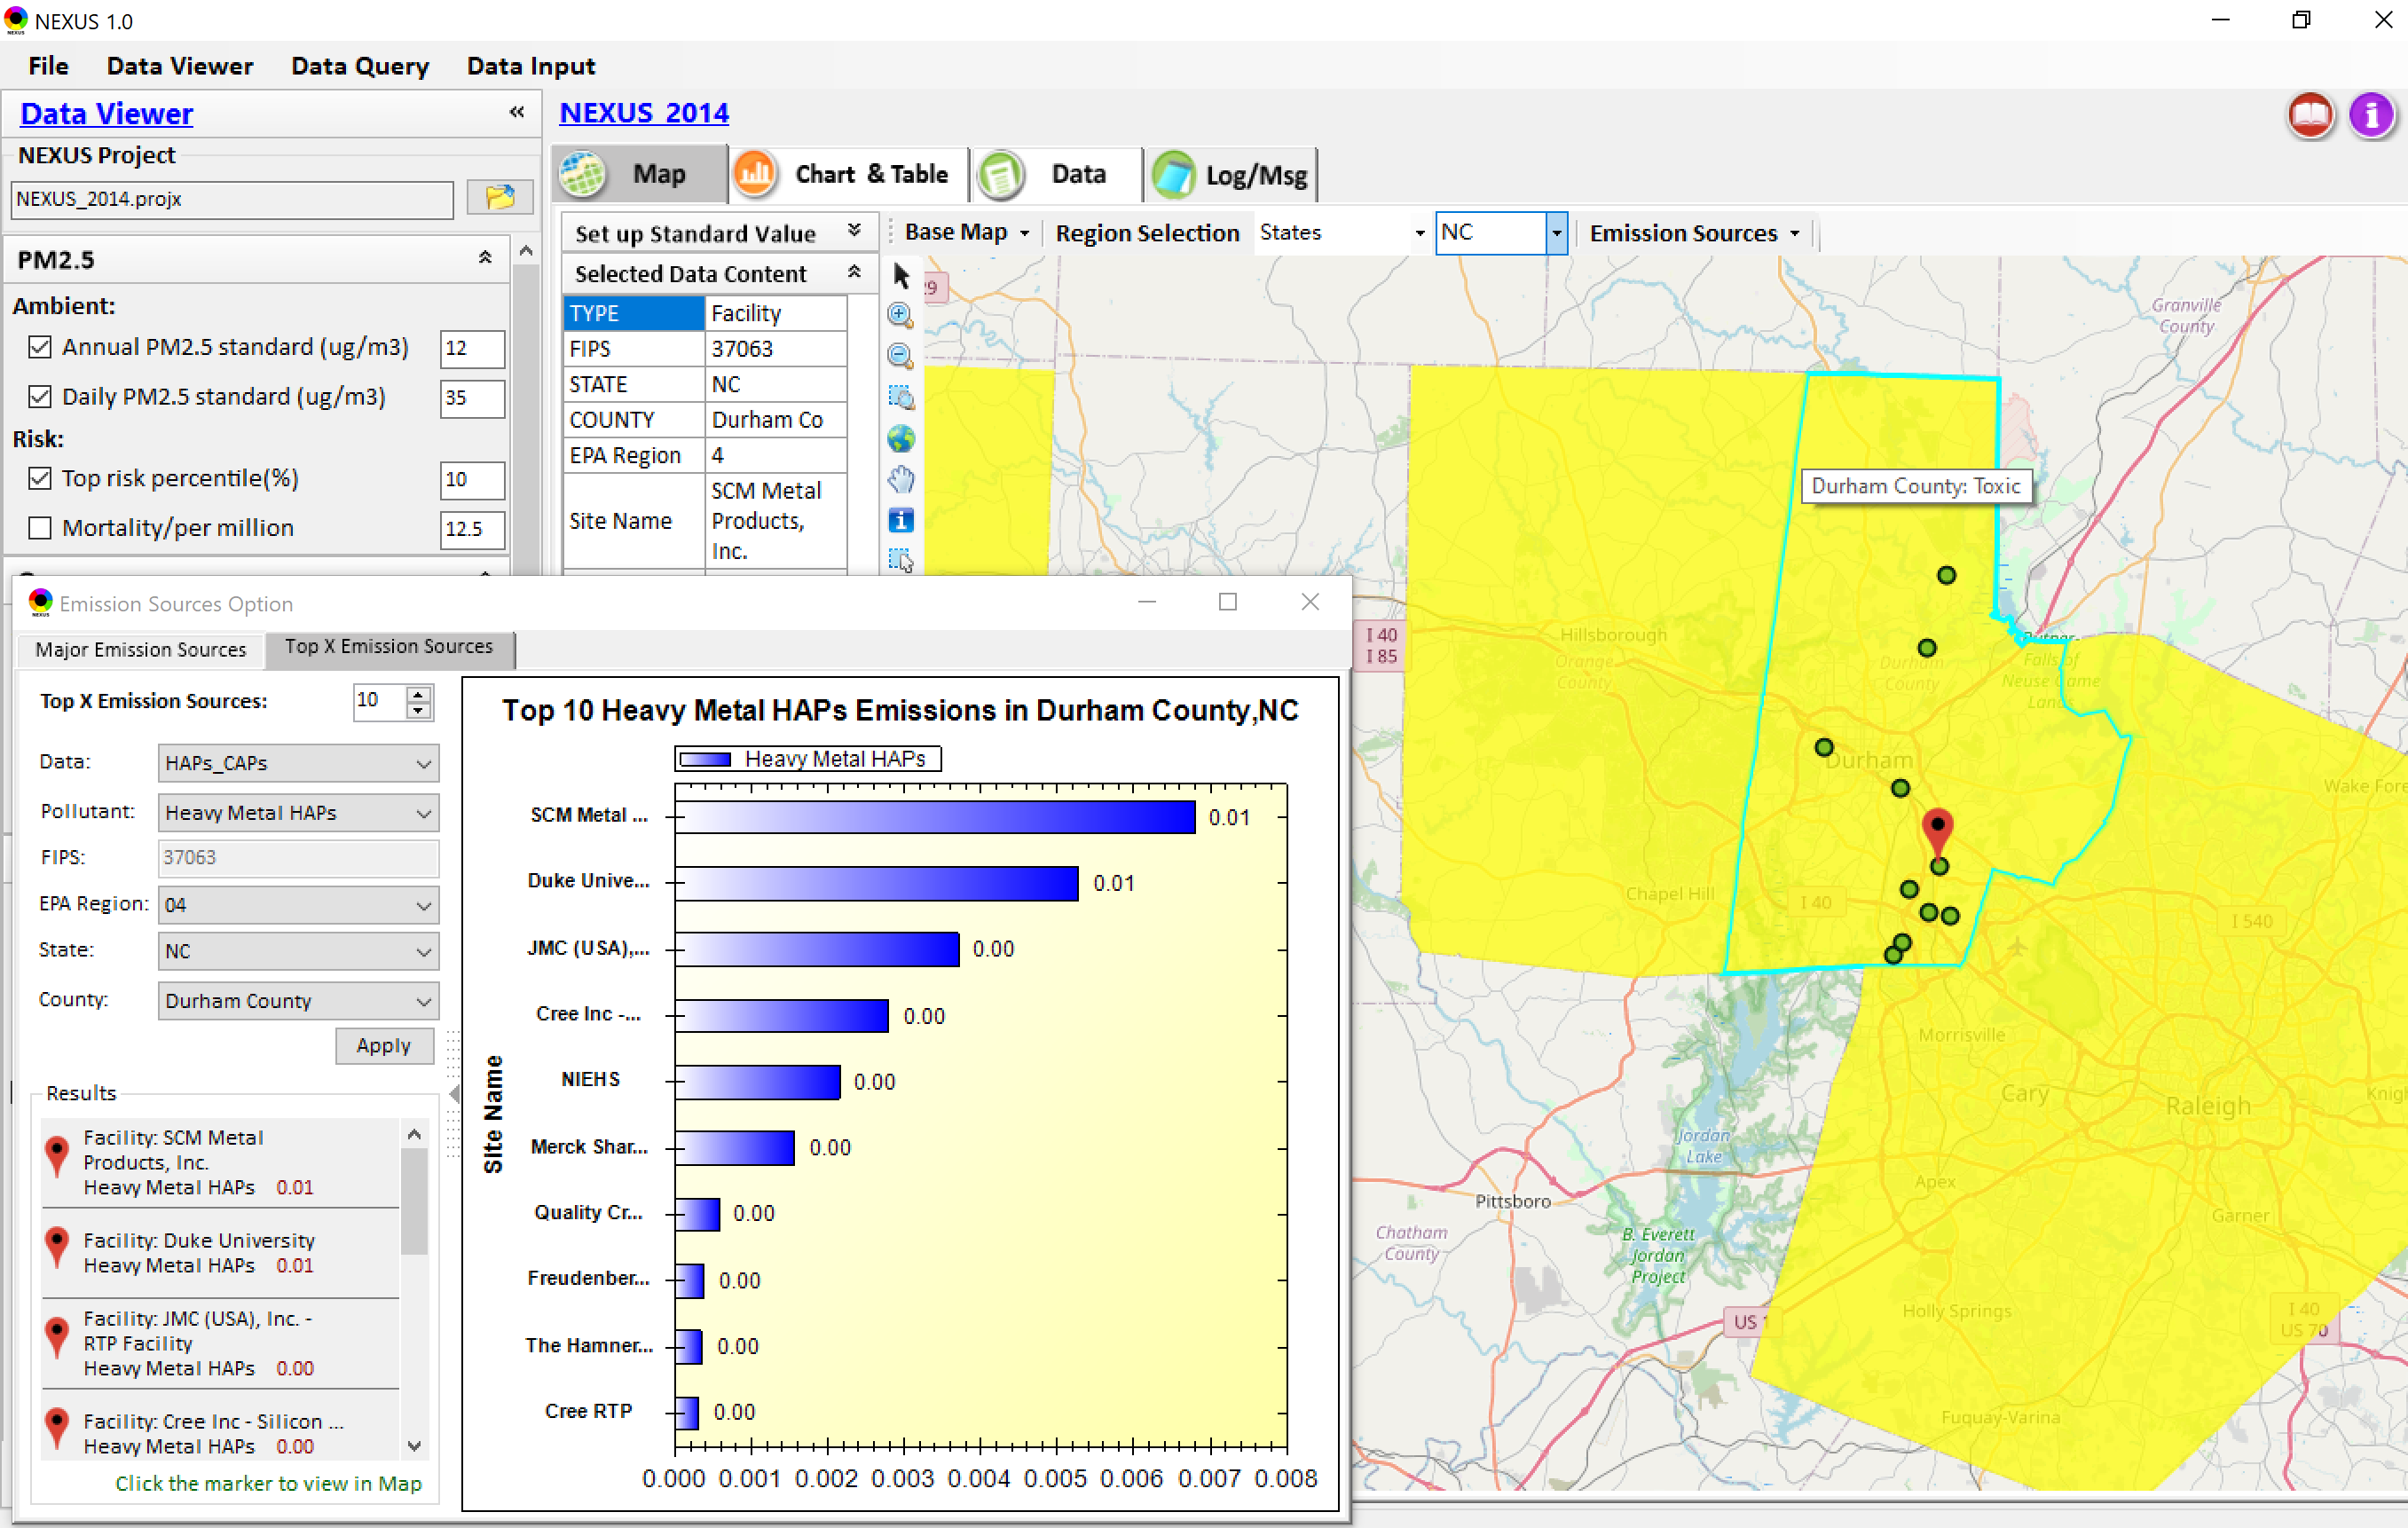
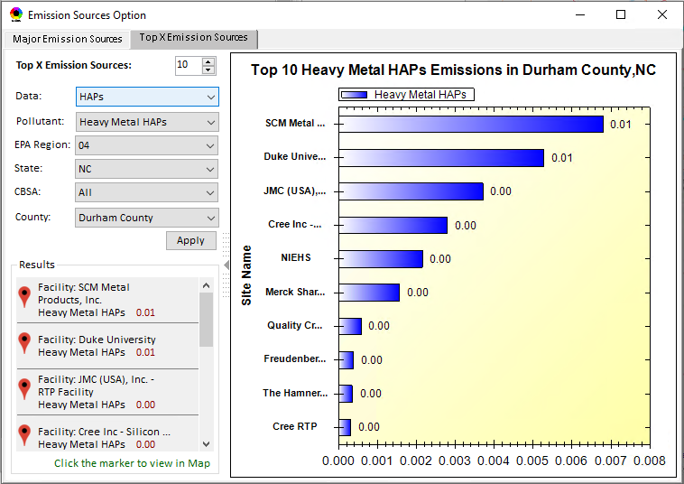
Data Viewer: Top “x” Emission Sources
Provide selection of CAPs precursors & HAPs species
Durham county, NC
11

Slide 12
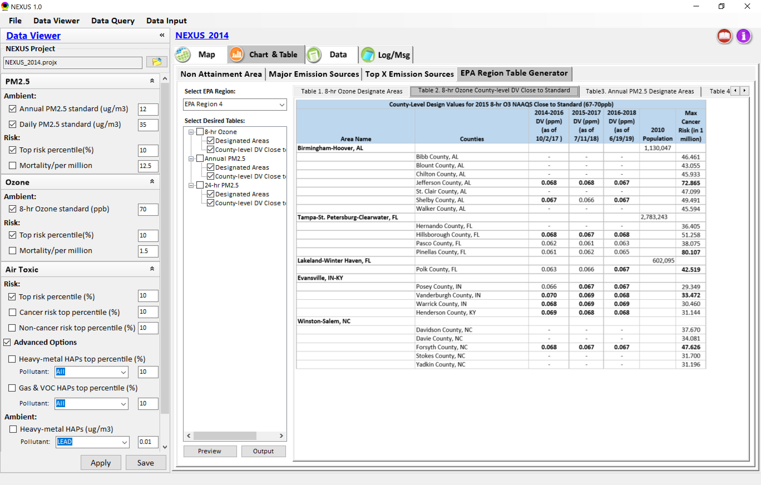
Data Viewer: EPA Region Table Generator
“EPA Region Table Generator” is still under development; the output format & info. needs the MP team’s suggestion (e.g., how the HAPs info. to be added or provided).
12

Slide 13
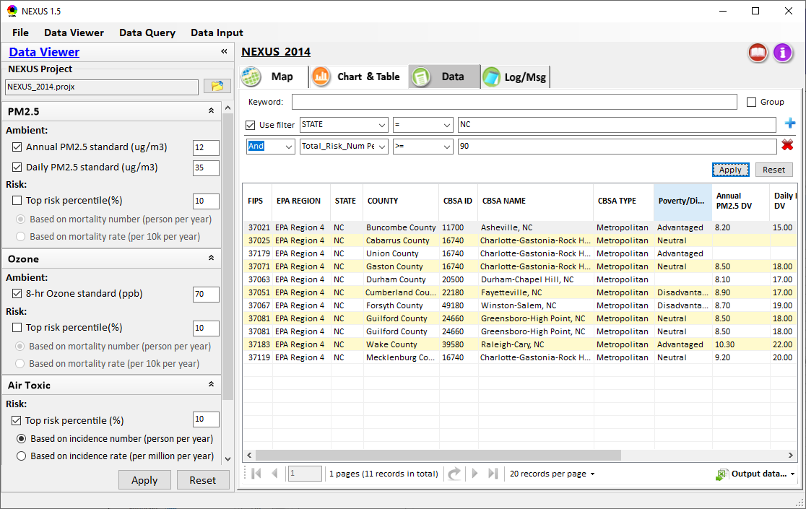
Data Viewer: Data
Click + to add filters; Click X to remove current filter;
Show specified records per page.
Click “Output data…” to output current page records or all records

Slide 14
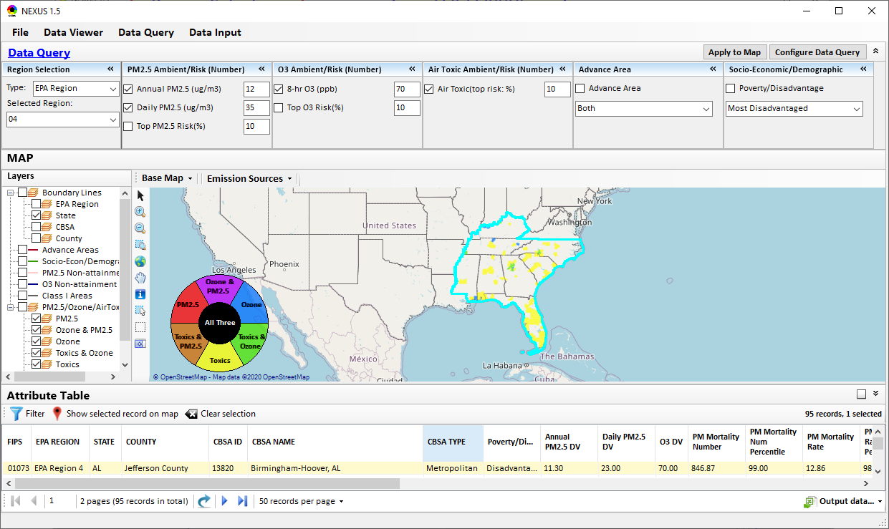
Data Query Module: Main Page
Region Selection
Data Query qualifier selection
Data Query Configuration
Map Overlaying selection
Detachable “Attribute Table”
11111111
14

Slide 15
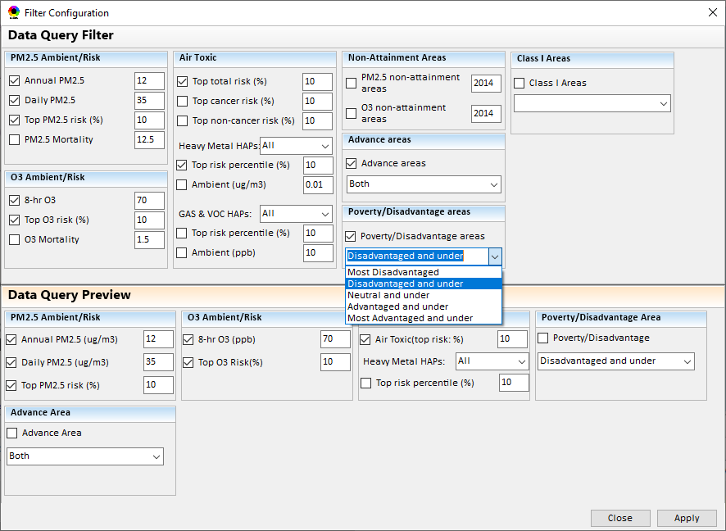
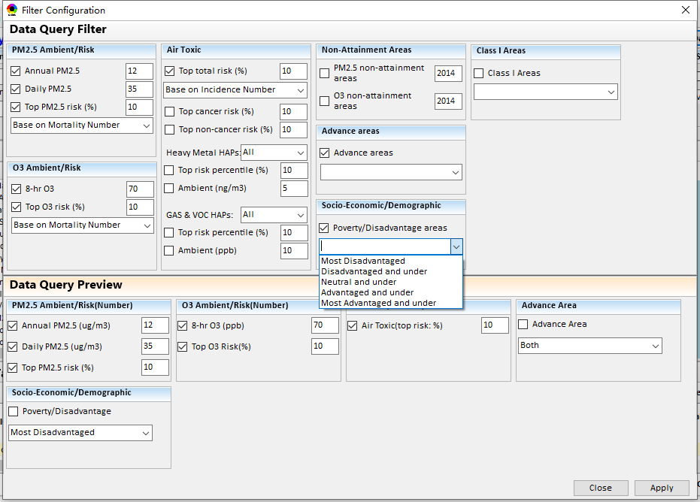
Data Query Module: Configure Data Query
“Data Query Filter” allows to select “qualifiers” for query
“Data Query Preview” displays the selected “qualifiers” at the same time
15

Slide 16
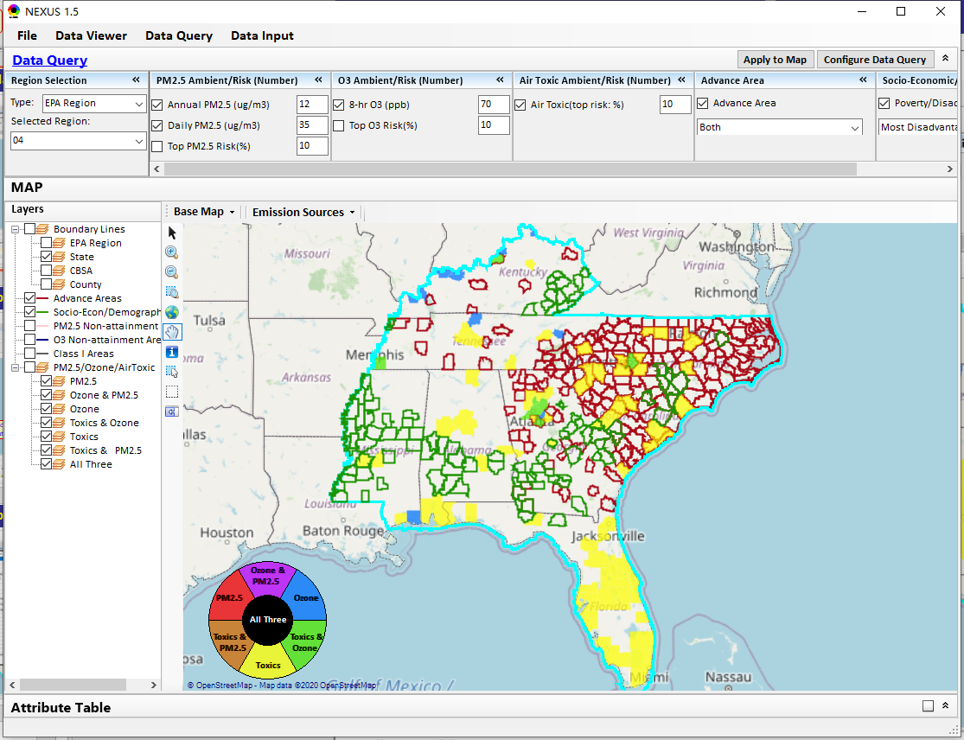
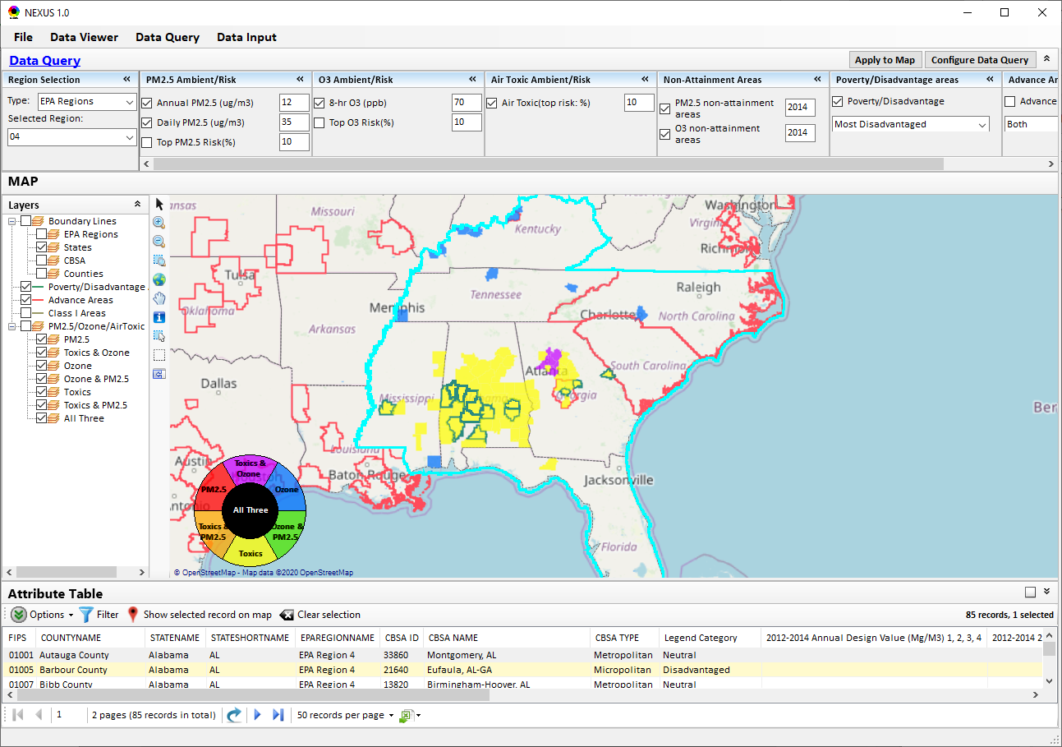
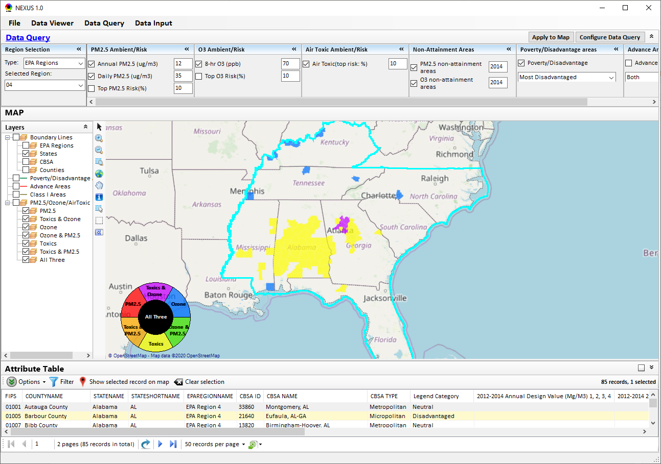
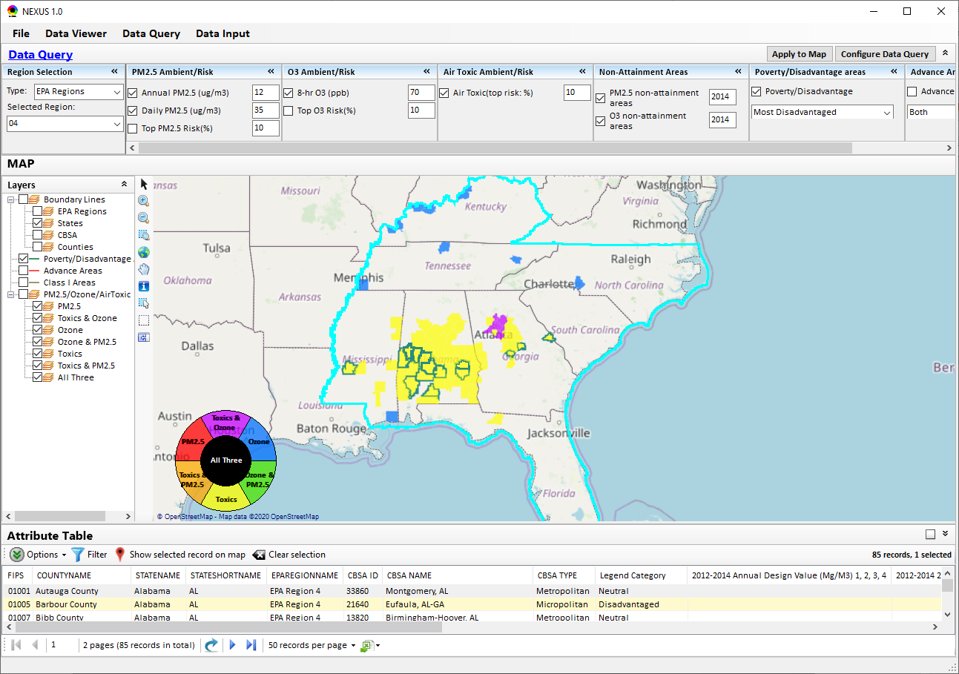
Data Query Module: Overlaying Map
Overlaying Map selection
16

Slide 17
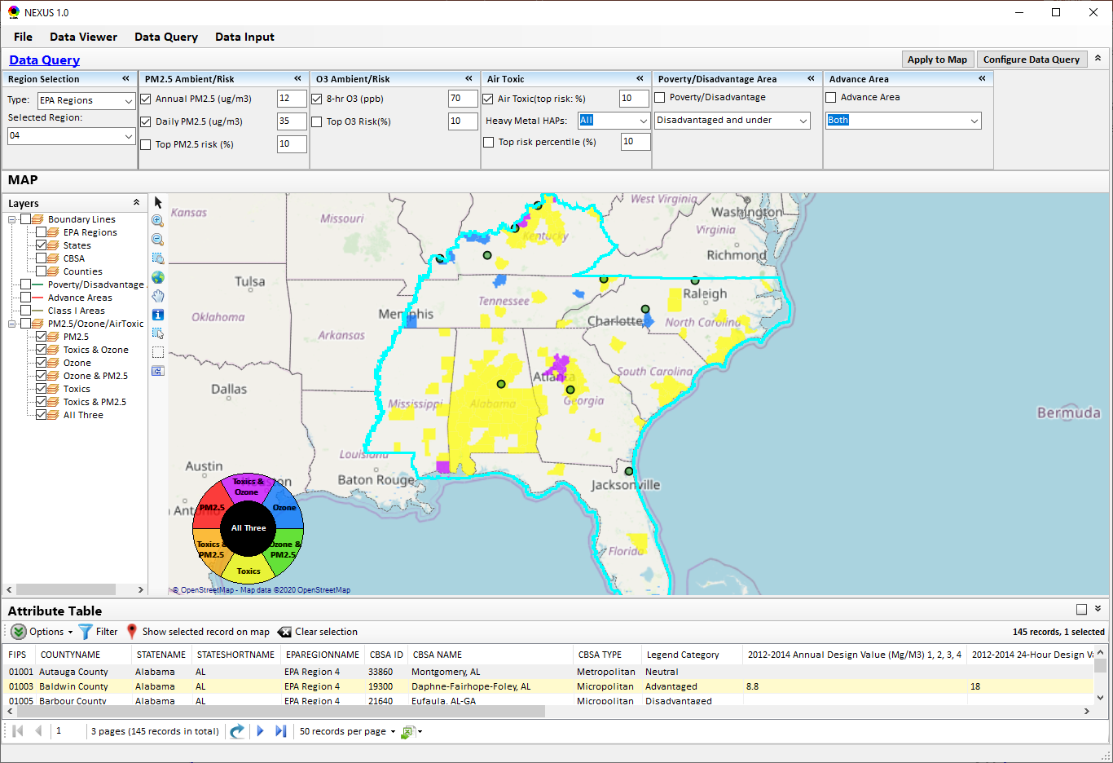
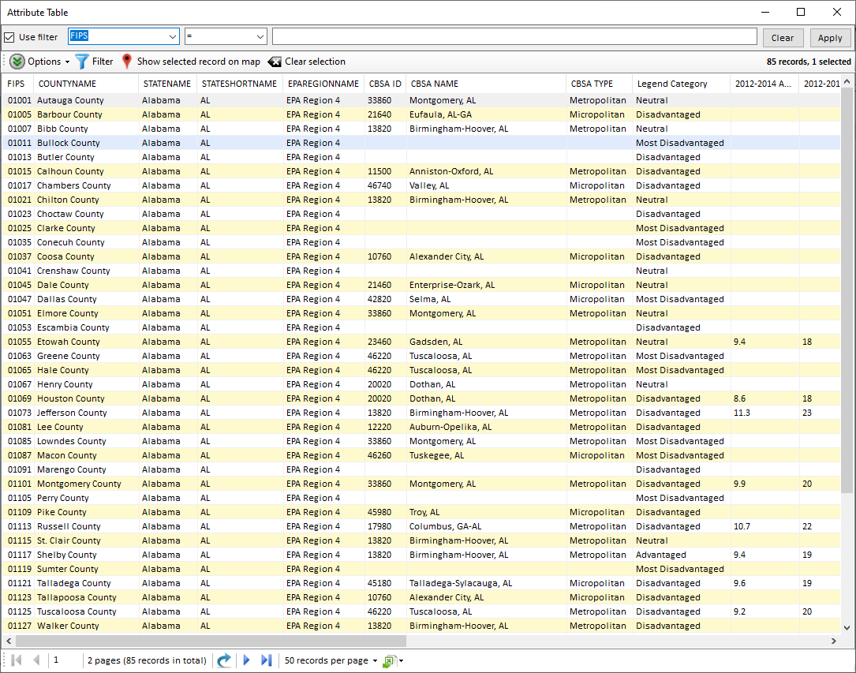
Data Query Module: Attribute Table
Filter/link/export functions (to be completed)
Detachable “Attribute Table”
17

Slide 18
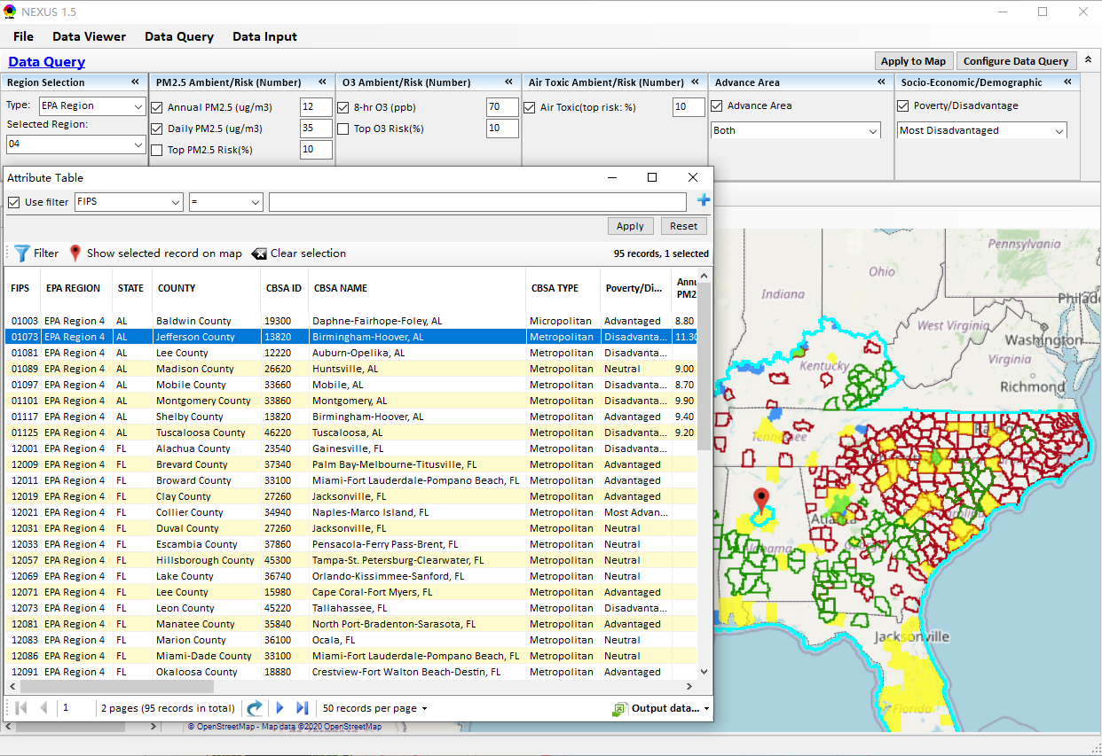
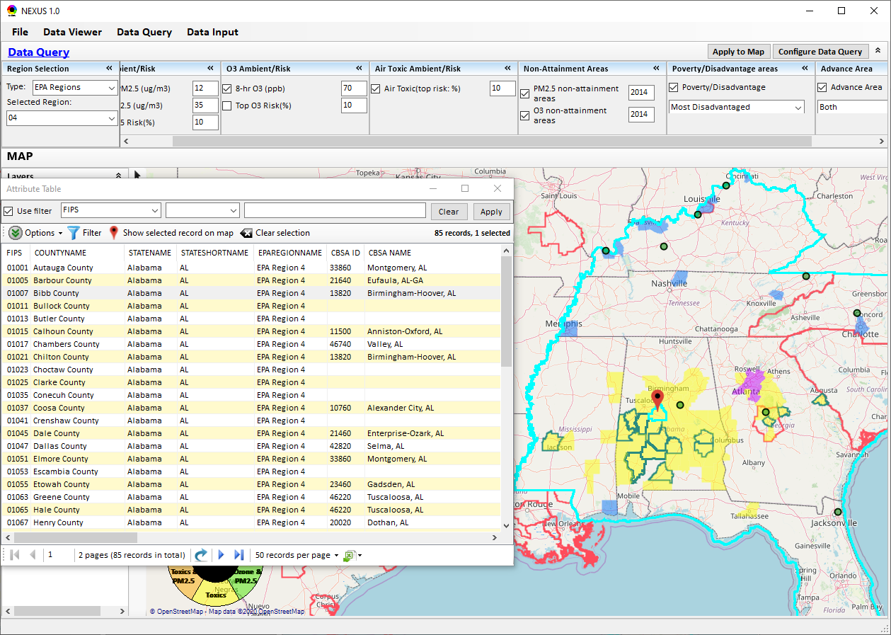
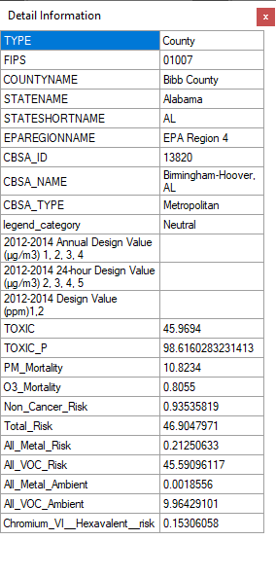
Data Query Module: Attribute Table
Click a “record” to link and display its location & info.
18

Slide 19
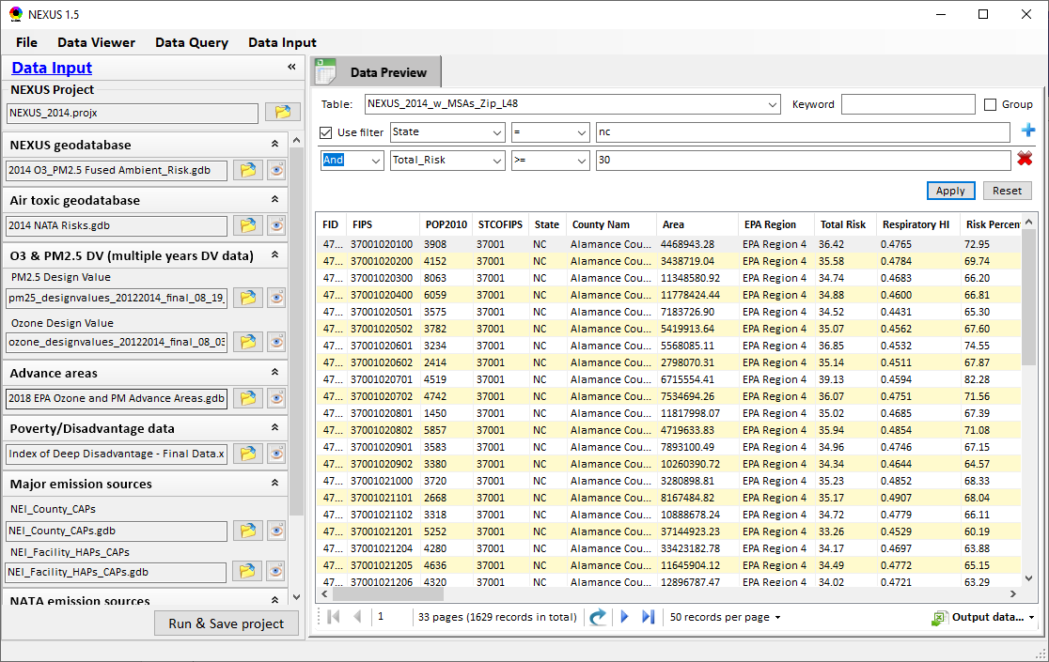
Data Input Module: Data Preview
Click to view data
Click to select data source file
Click to view data
Select a table to view if there are multiple tables in the selected data source file
Check to use filter to query data
Click to run & save project

Slide 20
End
20

