Slide 1
Managing Air Quality in the U.S.
A trip back in time…..

Slide 2
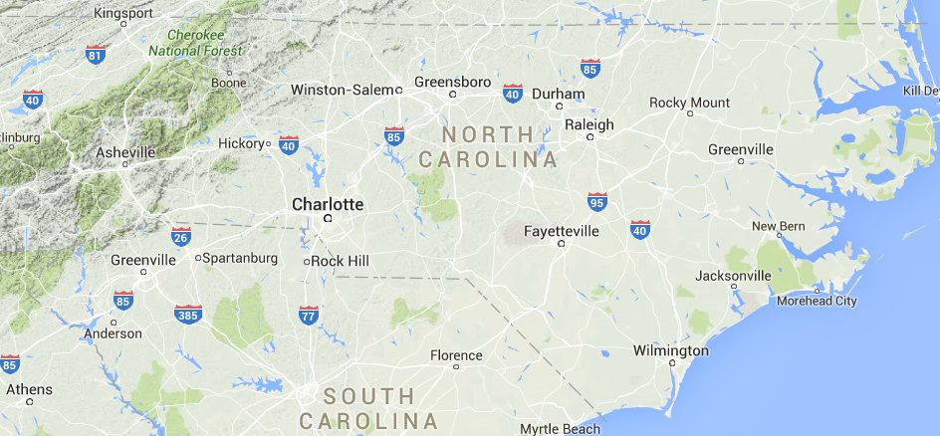
Charlotte to the Mountains – about 100 miles

Slide 3
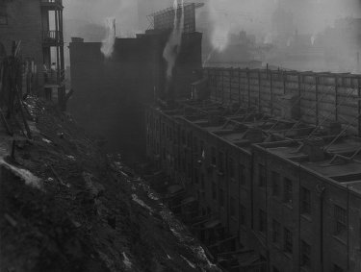
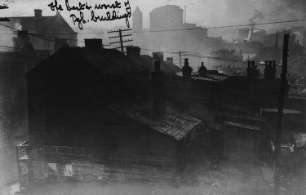
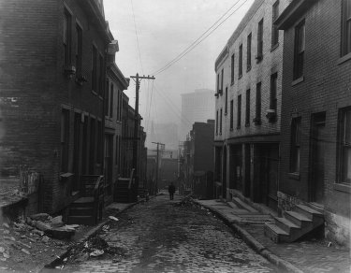
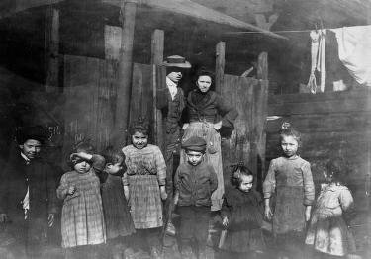
The Smoky City – Pittsburgh
1906-1910

Slide 4
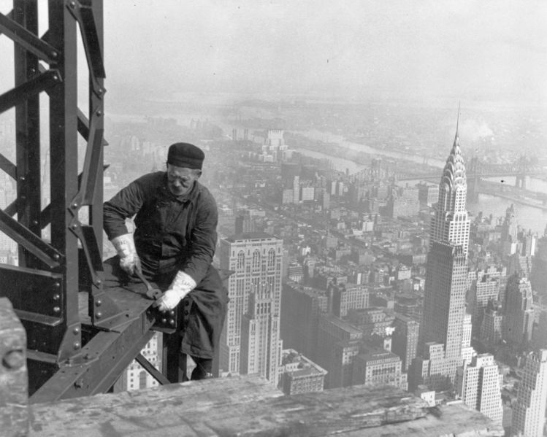
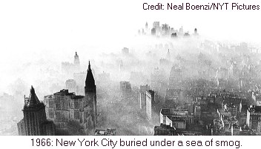
New York City
Constructing the Empire State Building in the NY smog - 1930

Slide 5
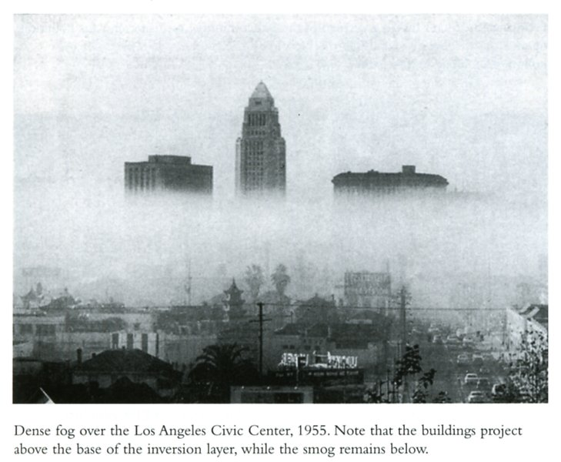
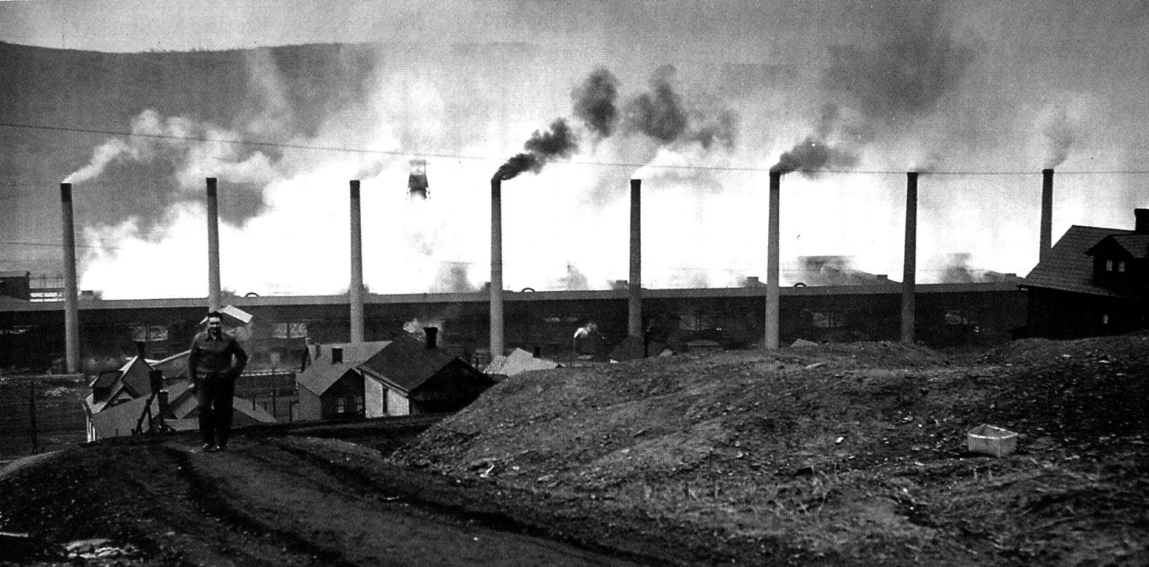
Donora PA 1948
Los Angeles 1955

Slide 6
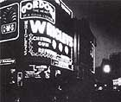
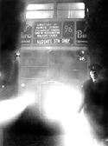
London – 1952

Slide 7
Air Pollution – A Brief History
1306: Queen Eleanor (wife of Edward the 1st) complained about dirty air – led to first air pollution ordinances
1902: Charlotte, NC
1930: 60 die in Belgium
1948: 20 die in Donora PA
1952: 4,000 die in London

Slide 8
Its July 9, 1970 …
President Nixon is looking for the first Administrator of the Environmental Protection Agency
What are you going to do?

Slide 9
