Slide 1
Bringing Hands-on Exploration of Air Quality Technology to the Classroom
Air Quality Workshop for Teachers, July 9, 2019
Rachelle Duvall
U.S. EPA Office of Research and Development

Slide 2
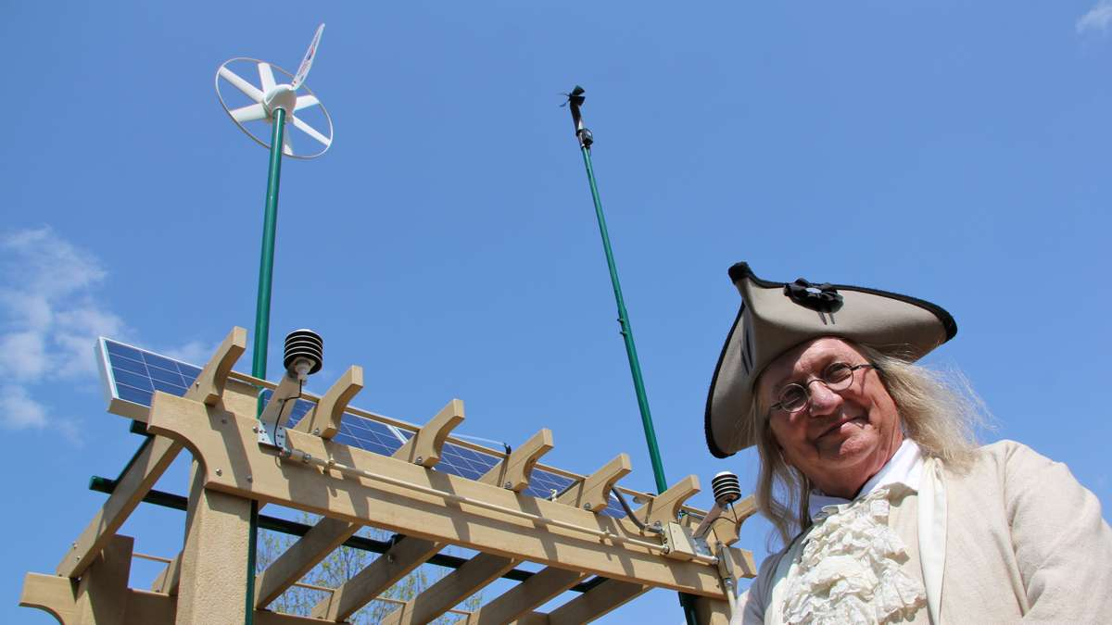
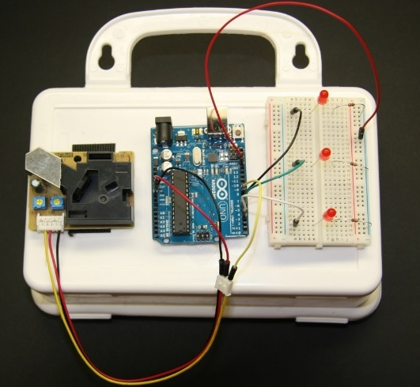
Getting Hands-on!
Briefly Covering:
In-Depth: PM Sensor Kit
Village Green Project
AirMapper
RETIGO

Slide 3
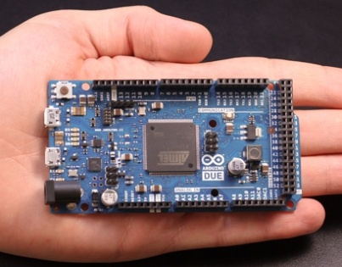
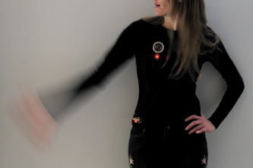
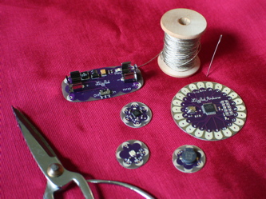
The emerging world of low cost sensors and electronics
A growing world of electronics supporting creative projects:
Arduino microprocessor – a simple computer
Lilypad Arduino – electronics meets home ec!
Image: http://web.media.mit.edu/

Slide 4
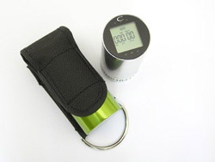
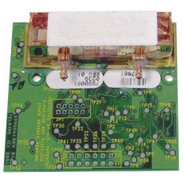
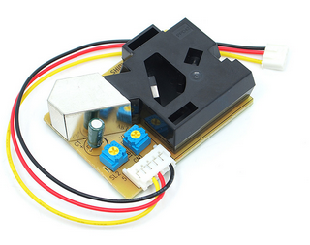
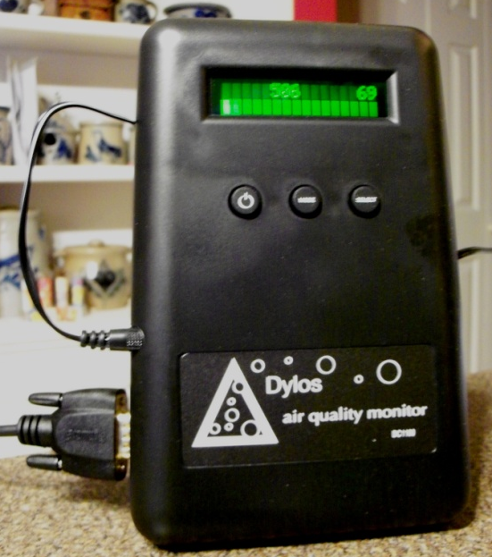
The emerging world of low cost sensors and electronics – an opportunity for STEM outreach and air science
Example air sensor components:
Nitrogen dioxide sensor
(Images courtesy of Ron Williams)
Carbon dioxide sensor
Particle sensor
Particle sensor
Some are “raw” components that need additional electronics work (an opportunity to build and learn!)
Some are ready to turn on and collect data (an opportunity to measure!)
All are portable, data quality is variable

Slide 5
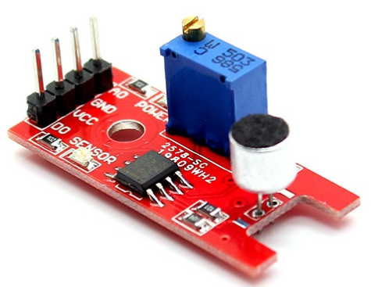
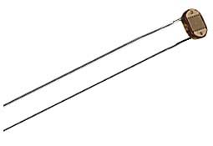
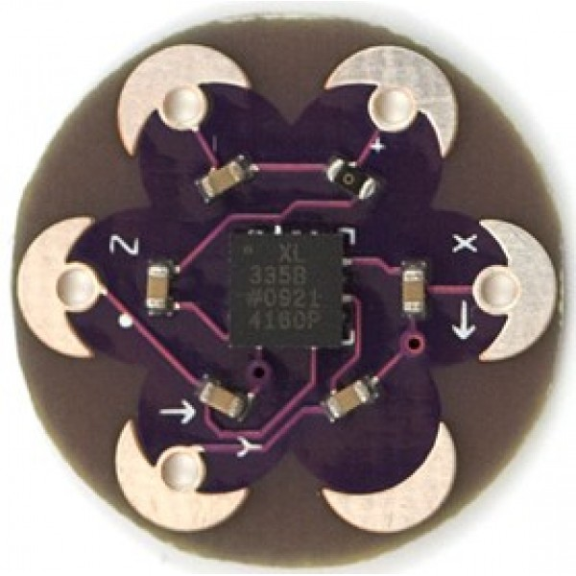
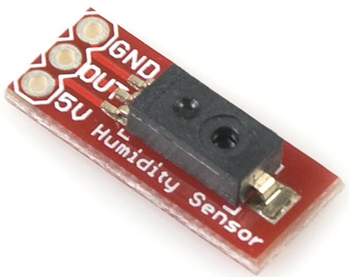
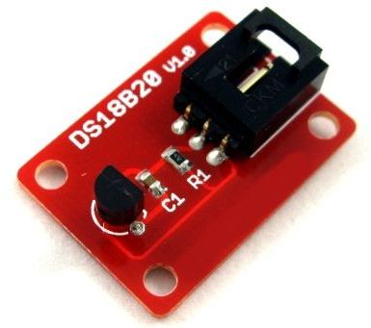
The emerging world of low cost sensors and electronics – an opportunity for STEM outreach and air science
Other sensors beyond air:
Noise
Light
Motion (accelerometer)
Relative Humidity
Temperature

Slide 6
Design of an air sampler: the basics
Learning how an air sampler is designed: the basic elements
Air sensor
Computer (“data in, display out”)
Data display

Slide 7
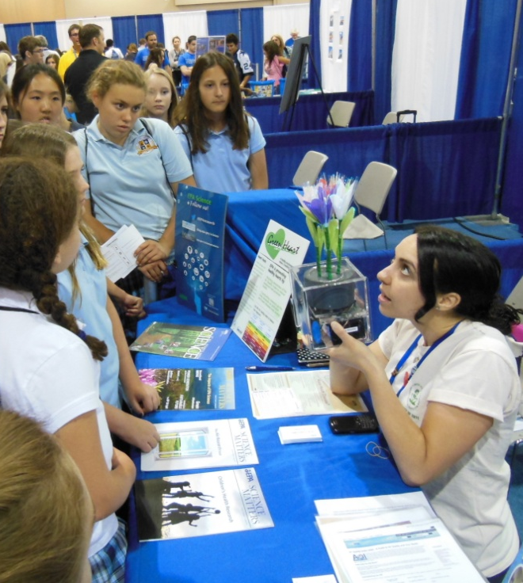
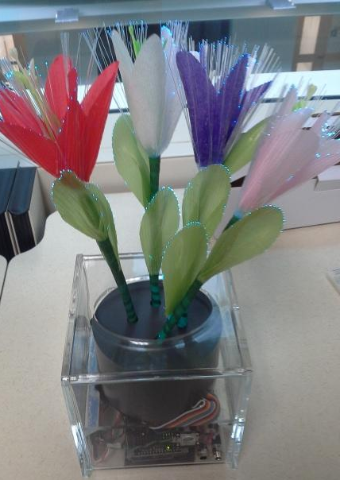
Design of an air sampler: the basics
Many examples emerging:
Air sensor
Computer (“data in, display out”)
Data display
Carbon dioxide-sensing flower
Carbon Dioxide
(CO₂) sensor
Arduino board
Light-up flowers displaying color based on concentration

Slide 8
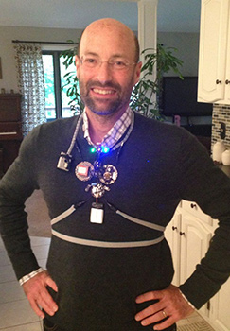
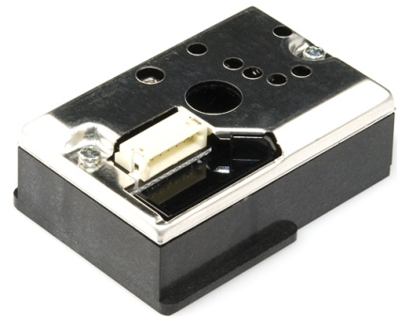
Design of an air sampler: the basics
Many examples emerging:
Air sensor
Computer (“data in, display out”)
Data display
Wearable particle sensor
Particle sensor
Lilypad board
Wearable sensor with light indicator of concentrations
Winner of DHHS/EPA’s My Health/My Air contest:
David Kuller, Gabrielle Dockterman, and Dot Kelly

Slide 9
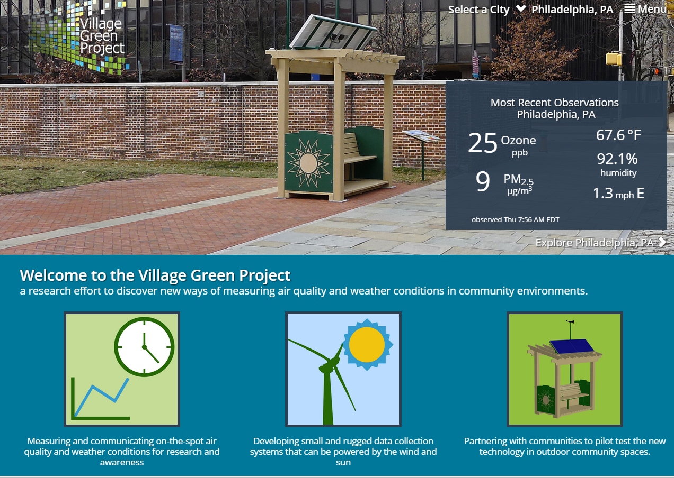
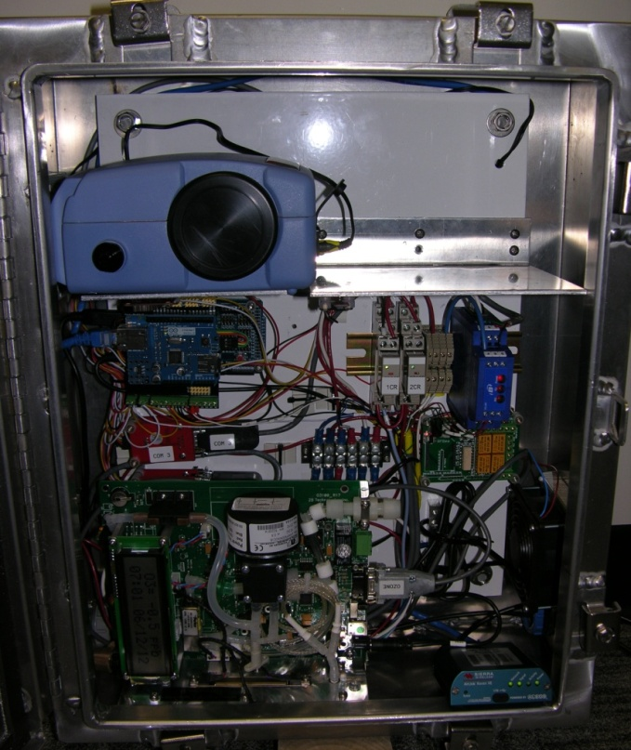
A slightly more complicated example!
Air Monitors/ Sensors
Computer (“data in, display out”)
Data display
Village Green Project
PM
Ozone
Village Green Website: www.epa.gov/villagegreen
Village Green Data: www.airnow.gov/villagegreen

Slide 10

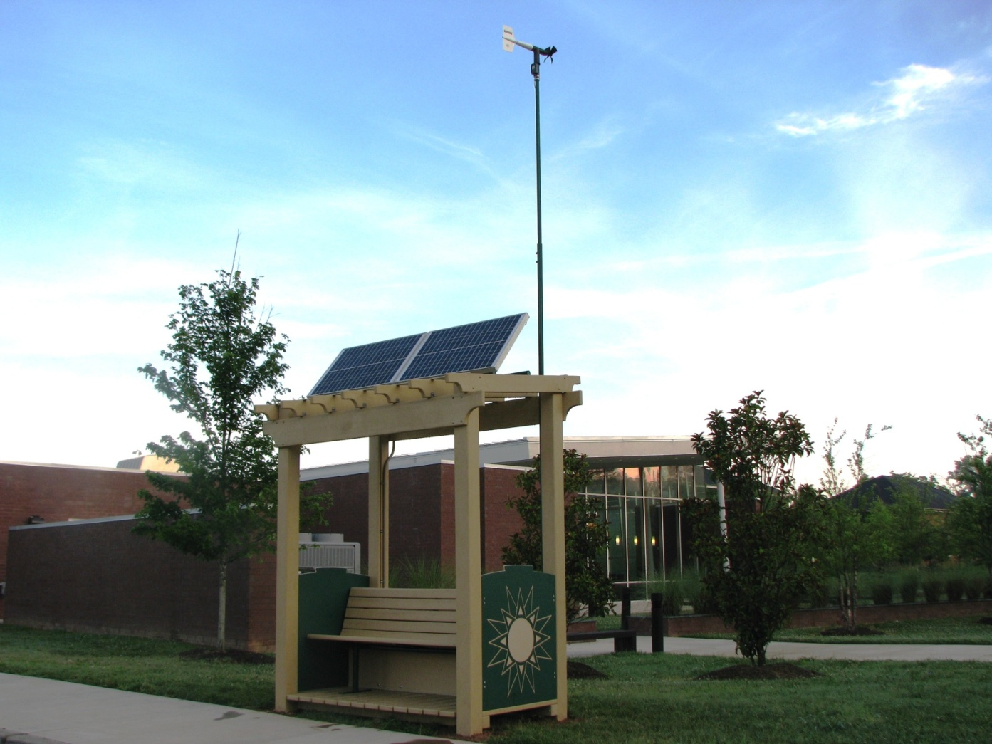
The Village Green Project
Solar-powered, air and meteorology monitoring bench:
Sustainable materials: manufactured from recycled milk jugs
Tamper-proof: Instruments secured in bench or base of play structure
Designed to add value to public environments
Formal agreement with Durham County on collaboration

Slide 11
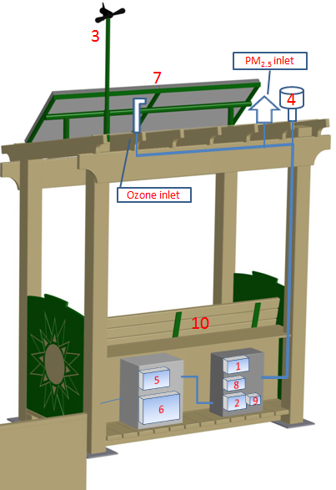
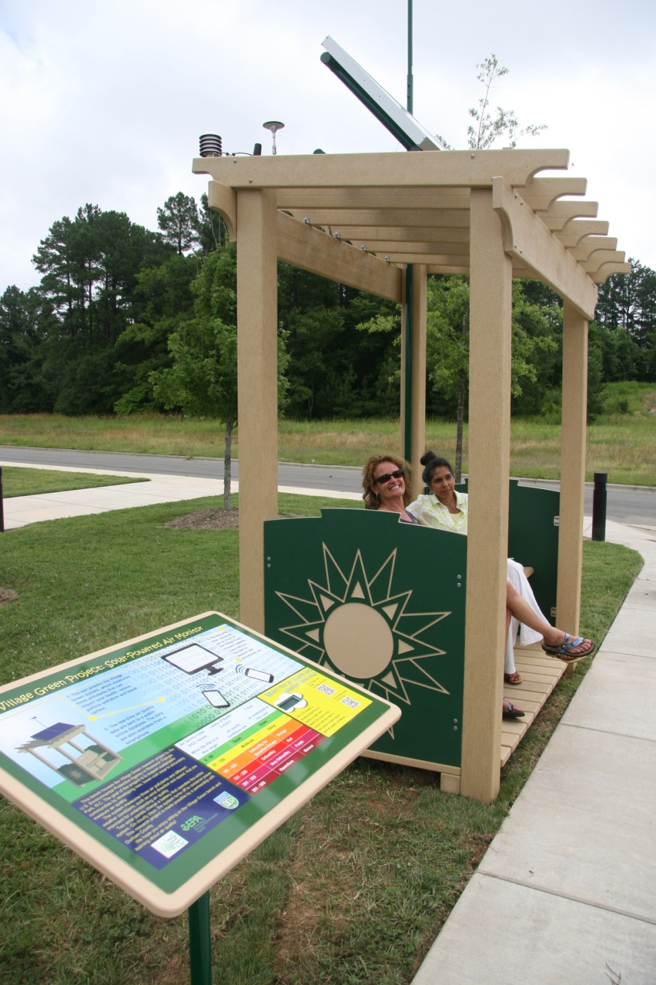
The Village Green Project
Wind sensor
Solar Power
Battery and solar power controller
Air instruments and communications

Slide 12
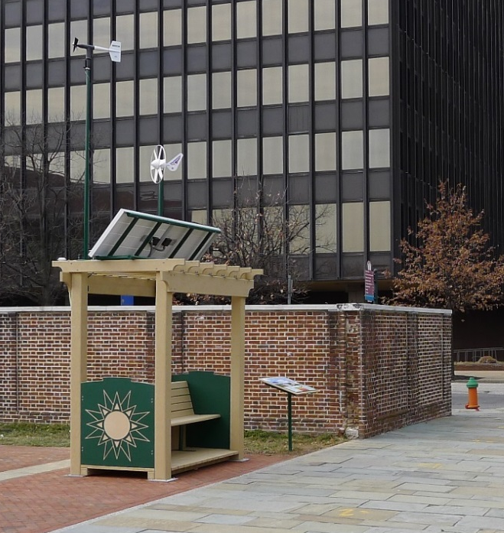
The Village Green Project
Locations:
Durham, NC (public library)
Philadelphia, PA (Independence Mall)
Washington, DC (National Zoo)
Kansas City, KS (public library)
Oklahoma City, OK (children’s garden)
Hartford, CT (science museum)
Chicago, IL (elementary school)
Houston, TX (health museum)
“Ben Franklin” visits the Philadelphia station
Photo credit: Emma Lee (WHYY)

Slide 13
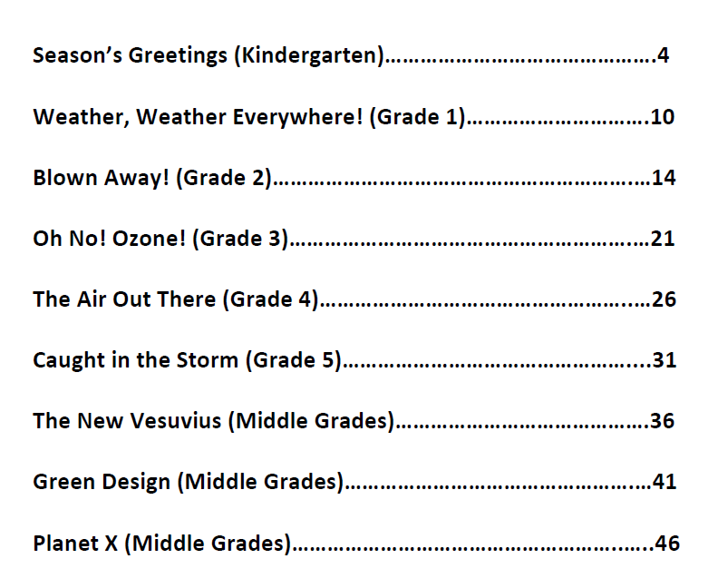
Lesson plans
Developed by EPA ORD and Region 5
Consistent with the next-generation science standards (K-5, middle school)
Follows Bloom’s Revised Taxonomy (recall, understand, apply and analyze, extend, and create)
Generally do not require having a Village Green bench nearby, but can use data available on the Village Green Project website: www.airnow.gov/villagegreen
Contact for lesson plans: hagler.gayle@epa.gov

Slide 14
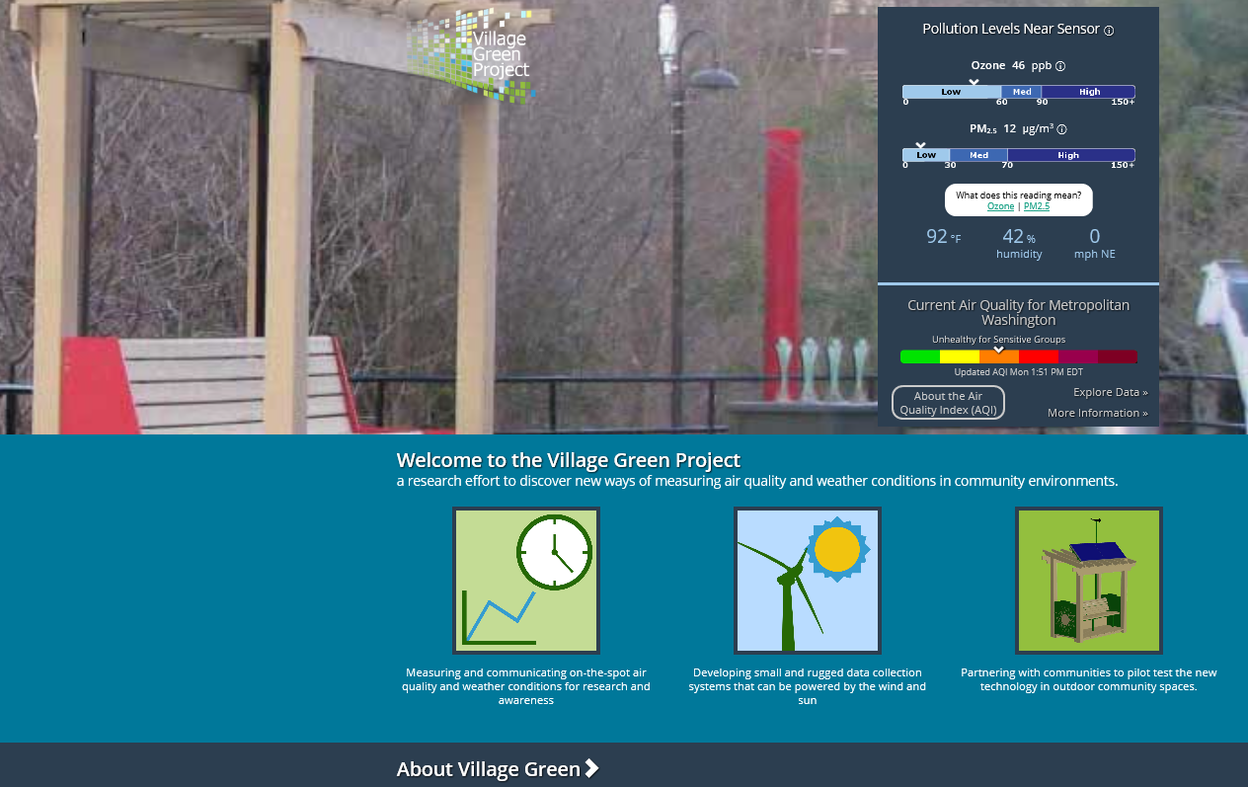
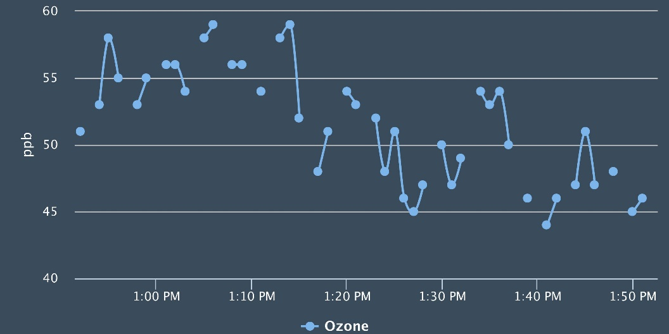
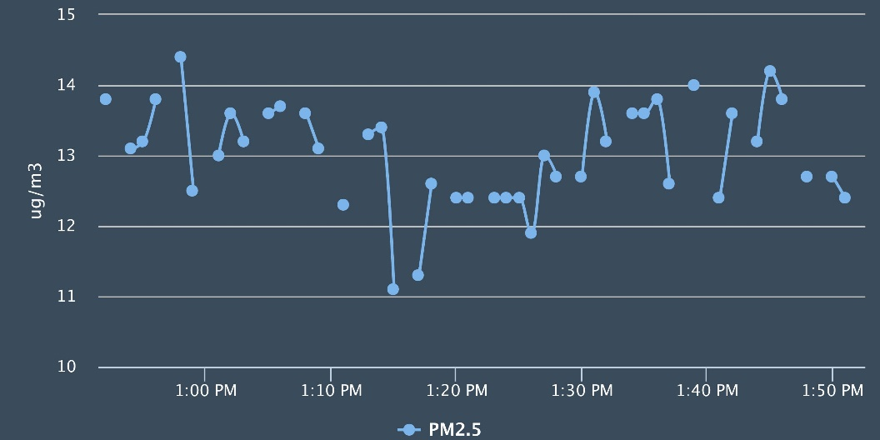
Real-time data to explore
Ozone
PM_{2.5}

Slide 15
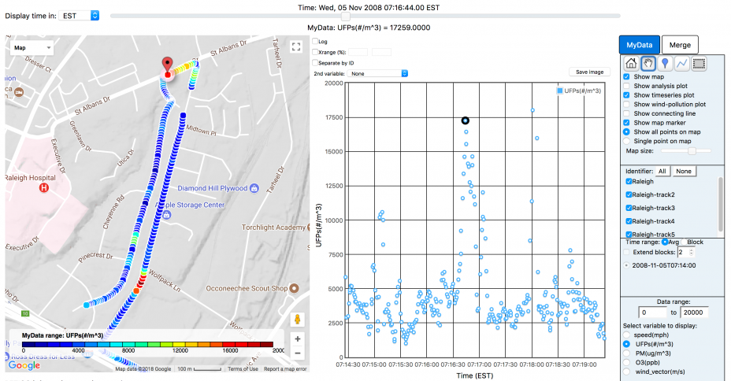
AirMapper and RETIGO
AirMapper: custom-designed portable air monitoring device
RETIGO: Interactive website for exploring data
Measures PM_{2.5}, CO₂, noise, temperature, humidity, and location every 10 seconds.

Slide 16
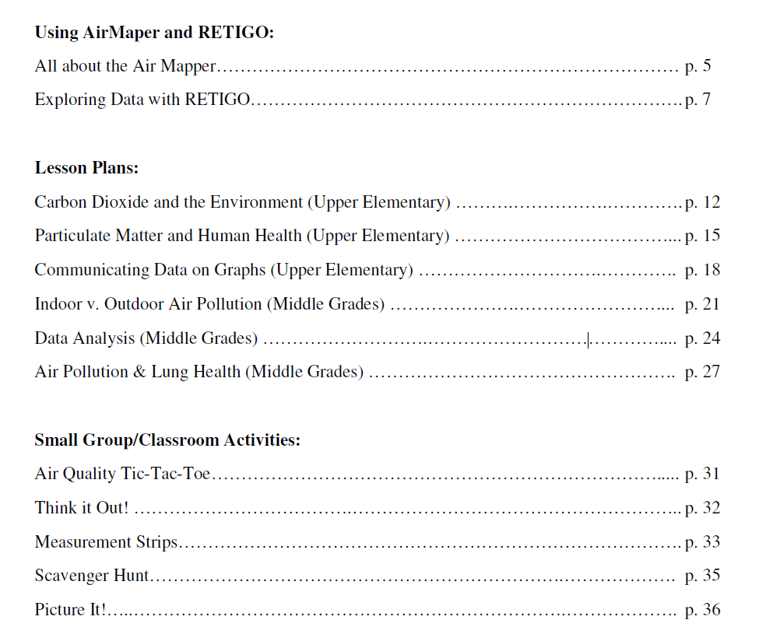
AirMapper and RETIGO
Lesson plans available!
Contact for lesson plans: hagler.gayle@epa.gov
RETIGO website:
www.epa.gov/retigo

Slide 17
Air Quality Sensor Kit

Slide 18
Air sensor kit for outreach
Same general design strategy:
Air Sensor
Computer (“data in, display out”)
Data display
Goals:
1. Hands-on learning about multiple STEM topics: air measurement science, electronics, computer programming.
2. Real-time and interactive data collection on an air pollutant of interest.
3. A fun, memorable experience that fits within a classroom hour!

Slide 19
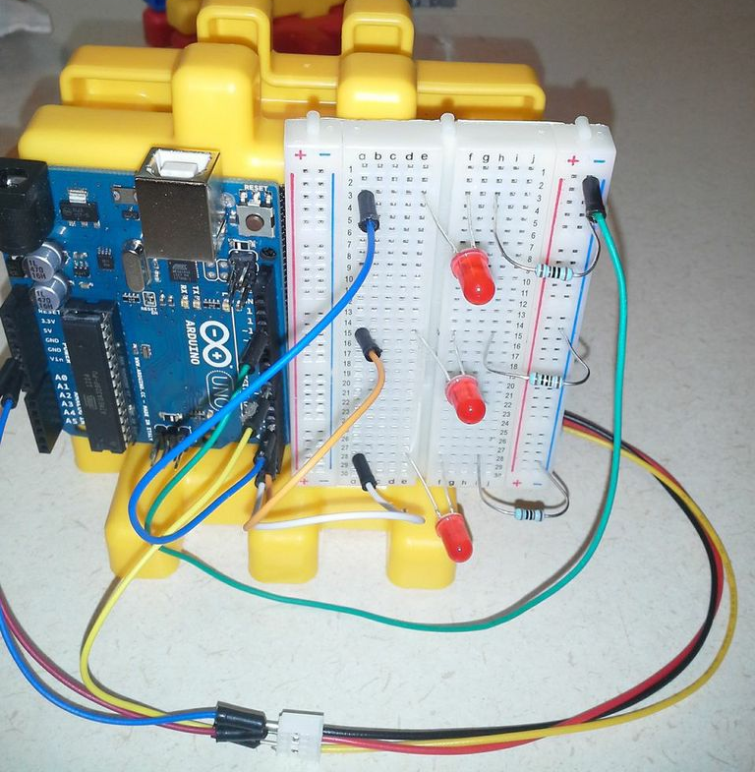
Air sensor kit for outreach
Air sensor
Computer (“data in, display out”)
Data display
Arduino board
Portable “particle monitor” with LEDs lighting up to indicate concentration
Additional components:
Resistors and wires
Small battery
3 LEDs
Total kit cost: ~$65
Reusable!

Slide 20
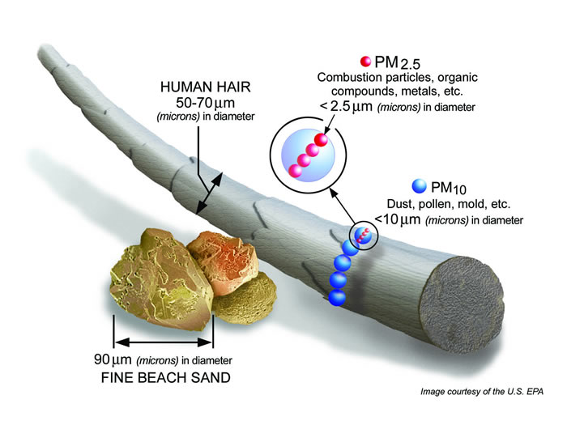
1. Give the big picture: What is Particulate Matter?
Introduction to the basics of air quality, particulate matter, and health

Slide 21
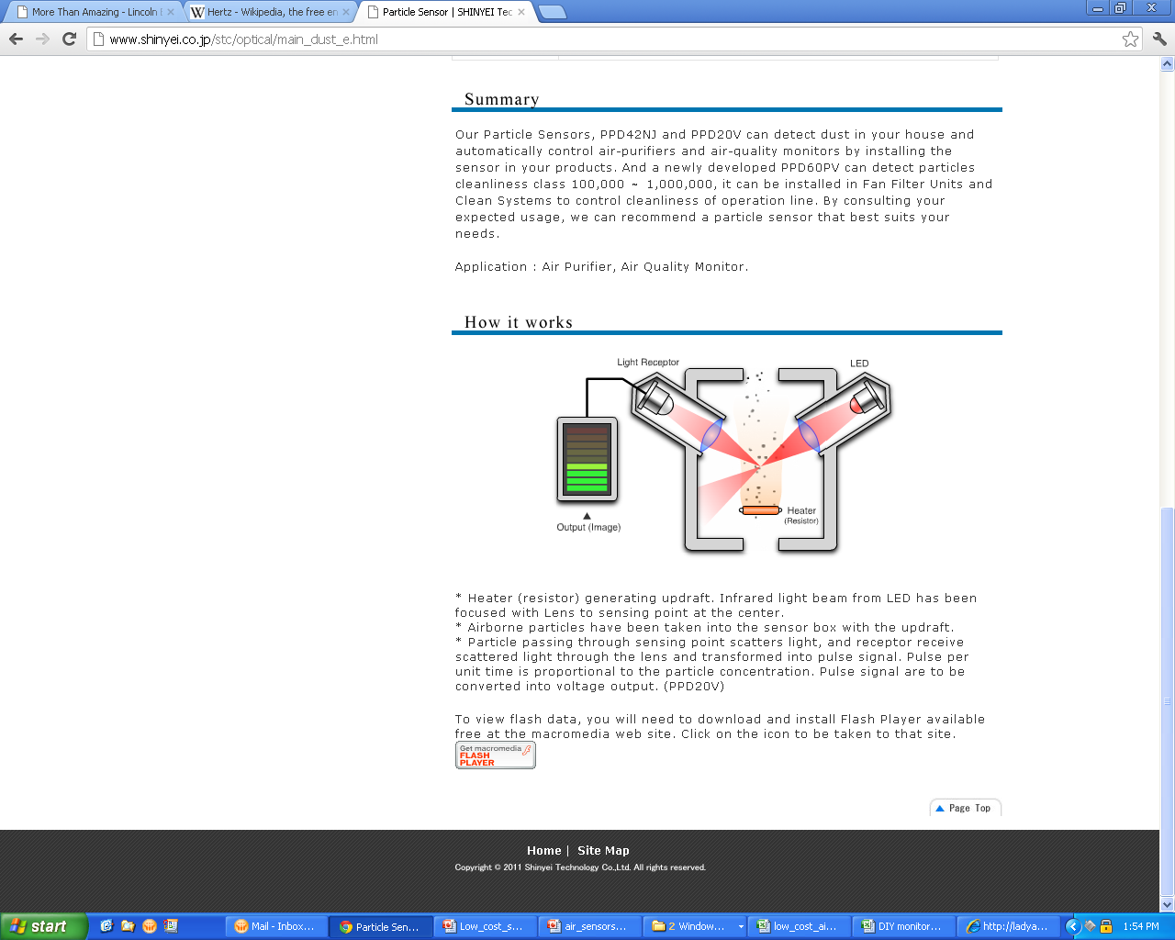
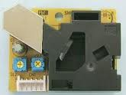
2. Primer on measuring particles
Works best oriented up (“hot air rises”)
Air intake small white heater resistor visible in this opening
Photo Credit: www.shinyei.co.jp

Slide 22
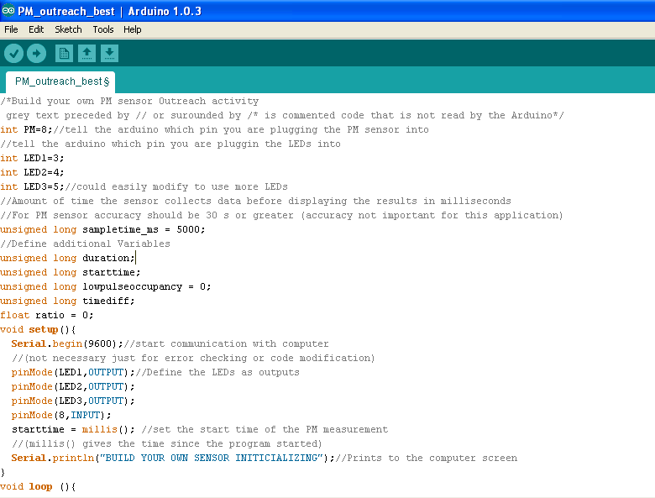
3. Explanation of the Arduino code
“These are the important pins! One will receive the PM signal, three will control the lights”
“Check the PM signal every 5 seconds”
“Turn these lights on if PM level = …”

Slide 23
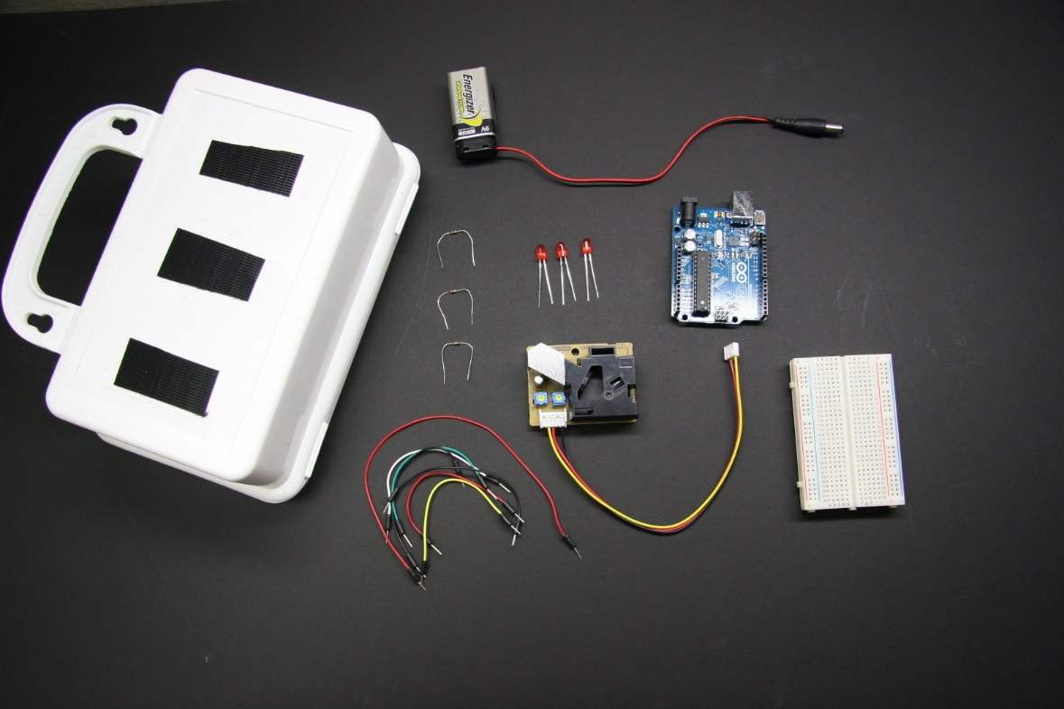
First, lay out all the parts.
Tip: Store all the bags in the box during the activity.

Slide 24
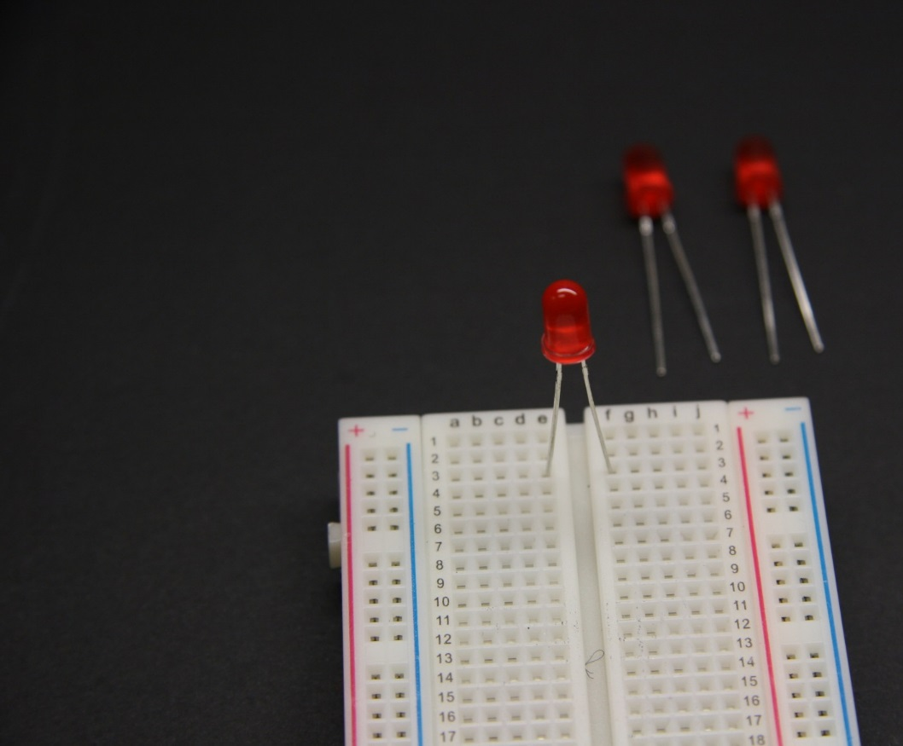
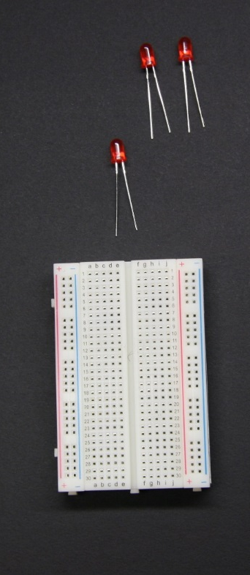
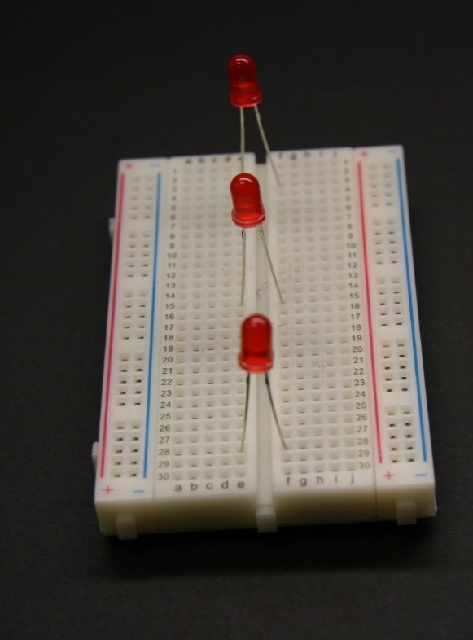
Put the 3 red LED lights on the breadboard.
Long LED legs in e
Short LED legs in f
Row 3
Row 15
Row 28

Slide 25
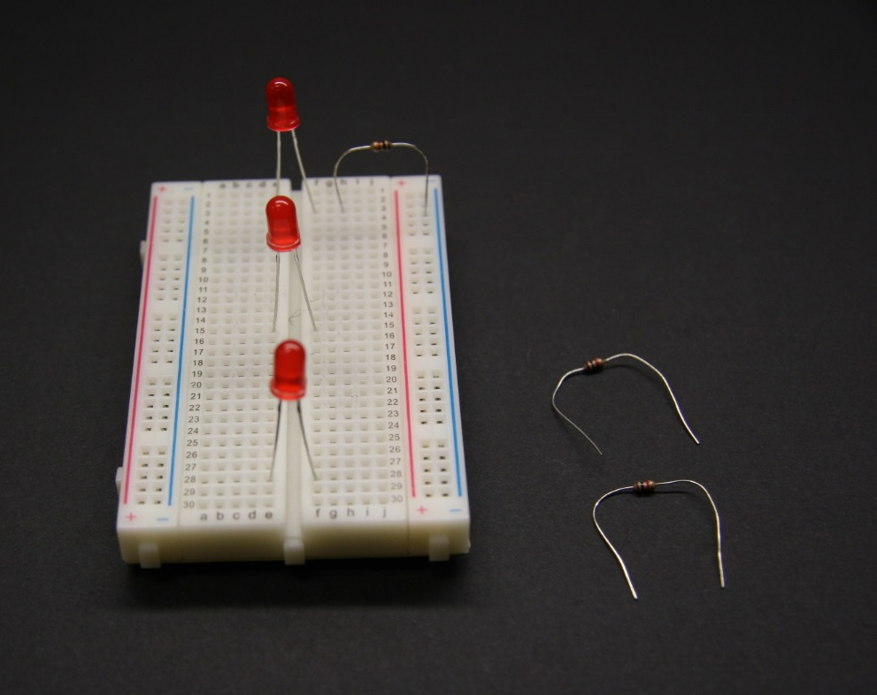
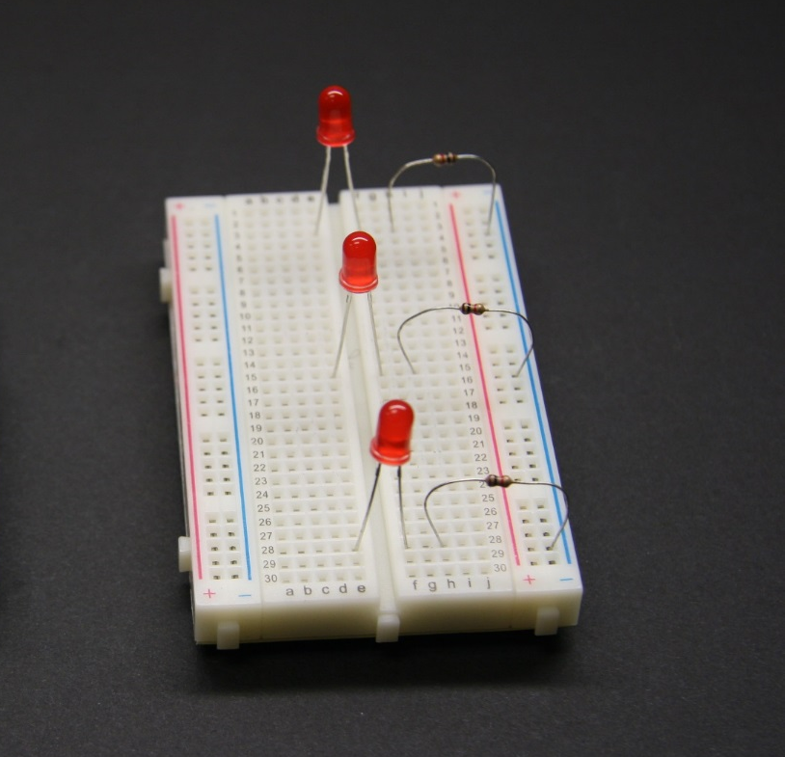
Put the 3 resistors on next to the LED lights.
One leg in h
the other leg in blue
Row 3
Row 15
Row 28

Slide 26
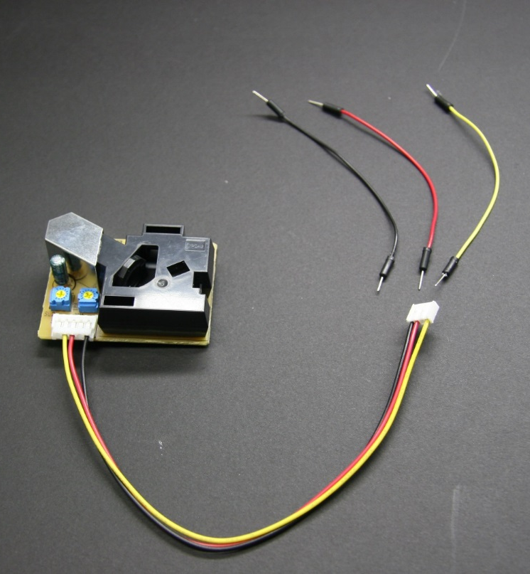
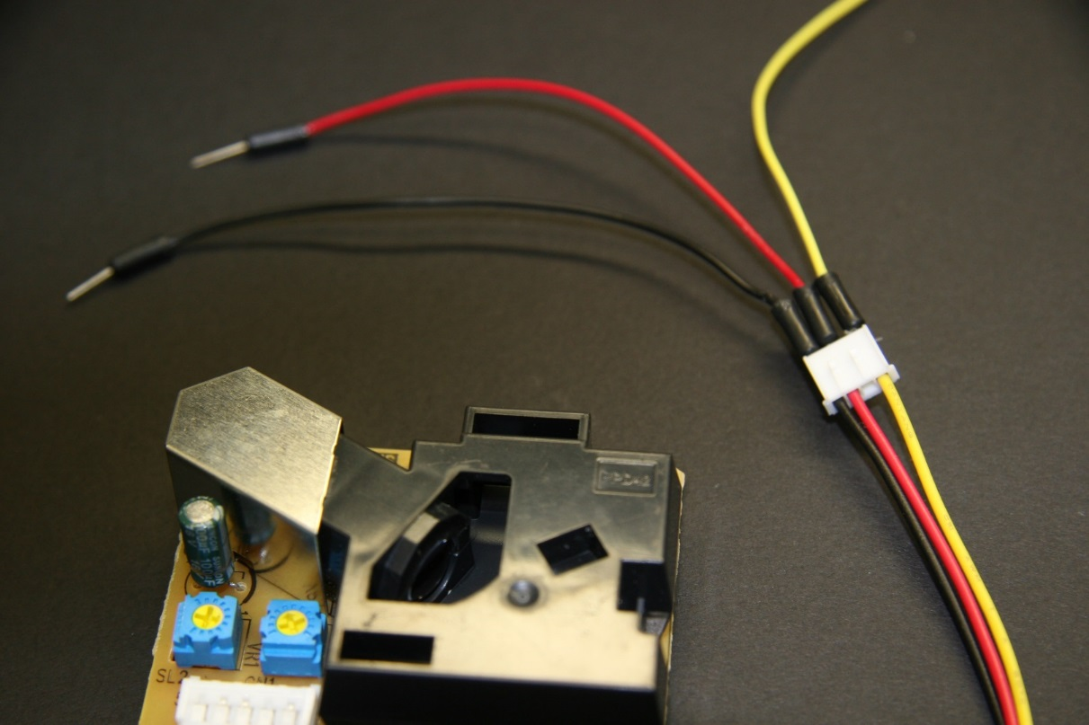
Attach 3 wires to the PM sensor like this:
Use black, red, and yellow if you have them, but any color wire will work.

Slide 27

Great job! Next, you will wire the Arduino computer to the breadboard.
Set them on the table like this:

Slide 28
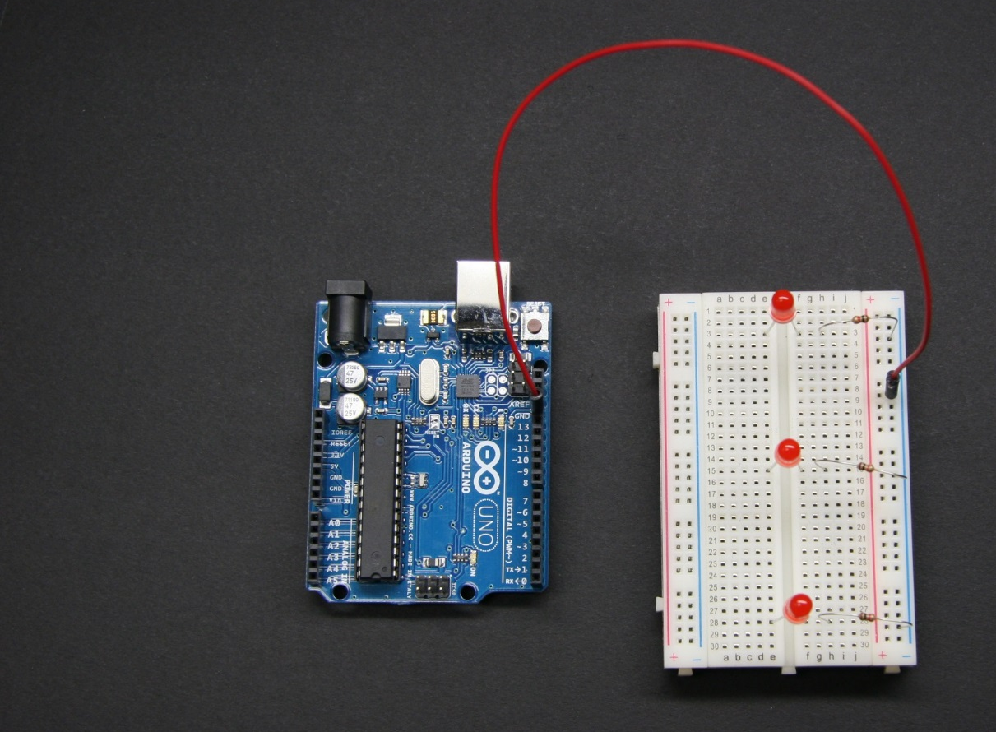
It doesn’t matter what color wires you use, but look carefully to see where they go.
The longest wire connects anywhere in the Blue column on the breadboard and to GND on the Arduino

Slide 29
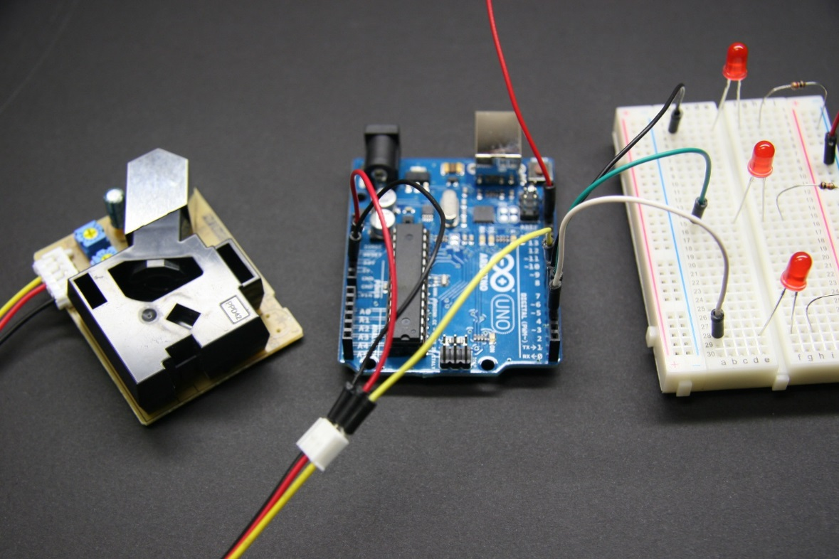
Follow the wiring diagram on the next page to attach all 7 wires.

Slide 30
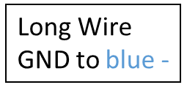
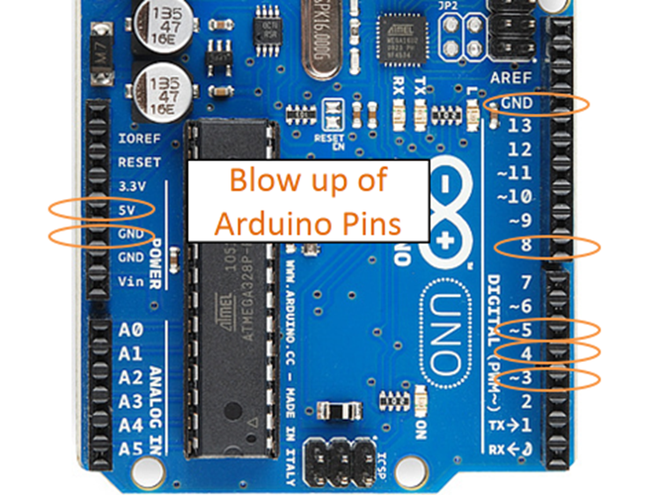
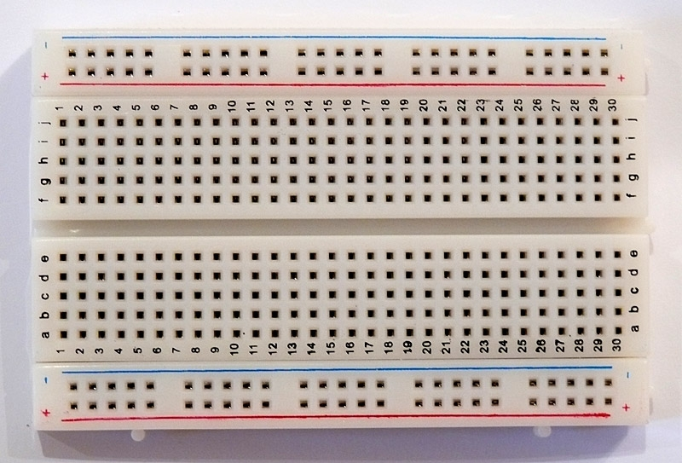
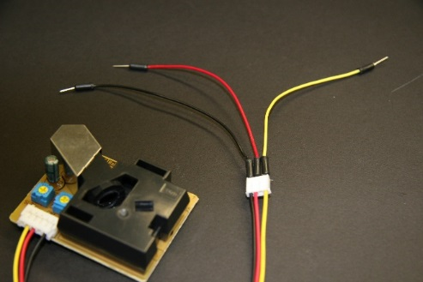
Wiring Diagram
~5 to a3
4 to a15
PM Sensor:
red to 5V
black to GND
yellow to 8
~3 to a28

Slide 31

Velcro the parts to the box like this:

Slide 32
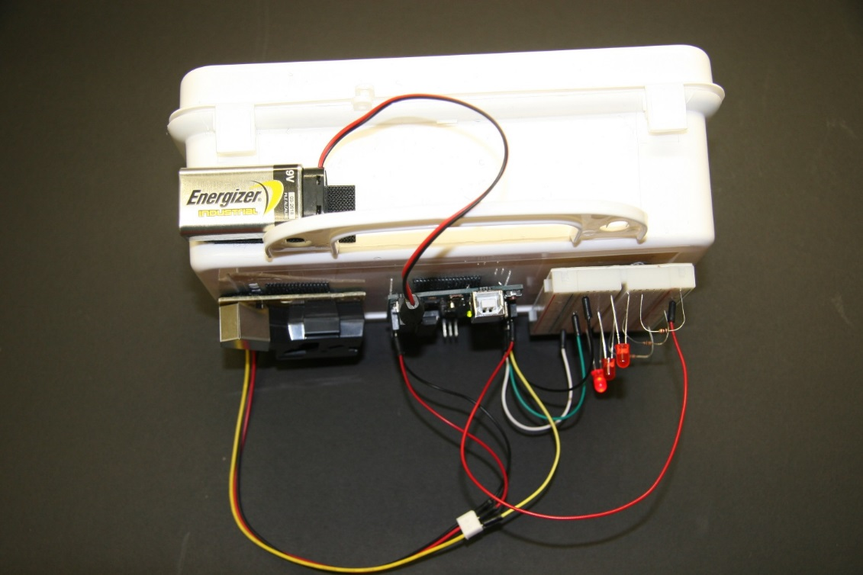
Ask your teacher to help you check the wiring. If everything is correct you will get a battery to plug into the Arduino.
*Unplug the battery before changing any wiring to prevent damage*

Slide 33


Try out the sensor around your classroom by creating particles in the air. Rip paper, shake fabric, or stomp the carpet to make dust near the sensor.

Slide 34



When the sensor detects more particulate matter (PM), the computer tells more lights to turn on: 1, 2, 3!

Slide 35

Congratulations, air scientist! Now you have made a working air sensor. Great work!

Slide 36

Summary: Air sensor kit for outreach
Instructions here: https://www.epa.gov/air-research/air-quality-and-energy-choice-stem-activities-educators
Or search for “EPA teacher air sensor kit”
Highlights:
Hands-on exploration of air quality science and electronics
Memorable and fun activity for all ages
Many ways to build into a lesson plan series
  Programming the Arduino board
  Trying to build other sensor systems
  Games to learn about computer programming
  Designing new ways to show sensor readings

Slide 37

Acknowledgements
Whitney Richardson
Ann Brown
Karoline Johnson
Dana Buchbinder
EPA-RTP Outreach Program
EPA A-E Program
Kelly Witter
Rachel Clark
Carol Lenox
Katie Lubinsky
Lauren Bamford
Rebecca Dodder
Gayle Hagler
Citizen Schools apprenticeship program students

