Slide 1
Updated 2021 vs 2020
CMV Emissions
February 2024

Slide 2
Development of 2021 CMV Emissions
Data were requested from US Coastguard for the same boxes as were used for 2020 NEI – they cover our 36US3 grid AK, HI, and PR+VI
Data were processed by EPA with C1C2 separated from C3
ERG developed C1C2 emissions using methods similar to 2020 NEI
EPA developed C3 emissions using methods similar to 2020 NEI
Updates since 2020:
  22% more Automated Identification System (AIS) records received than 2020
  More commercial fishing vessels have AIS transmitters
  More satellite data was available to gap fill locations too far from VHS towers
  Better gap filling method was used to address missing data
  SCCs were refined to include ship type

Slide 3
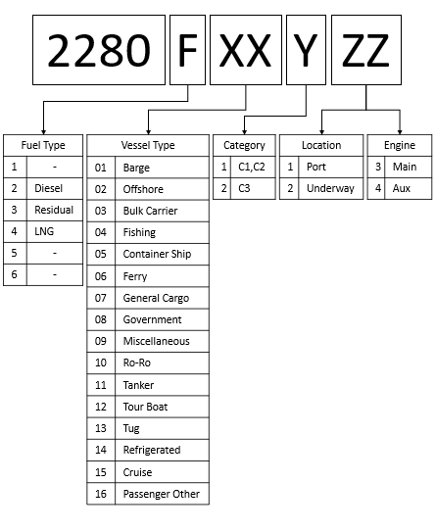
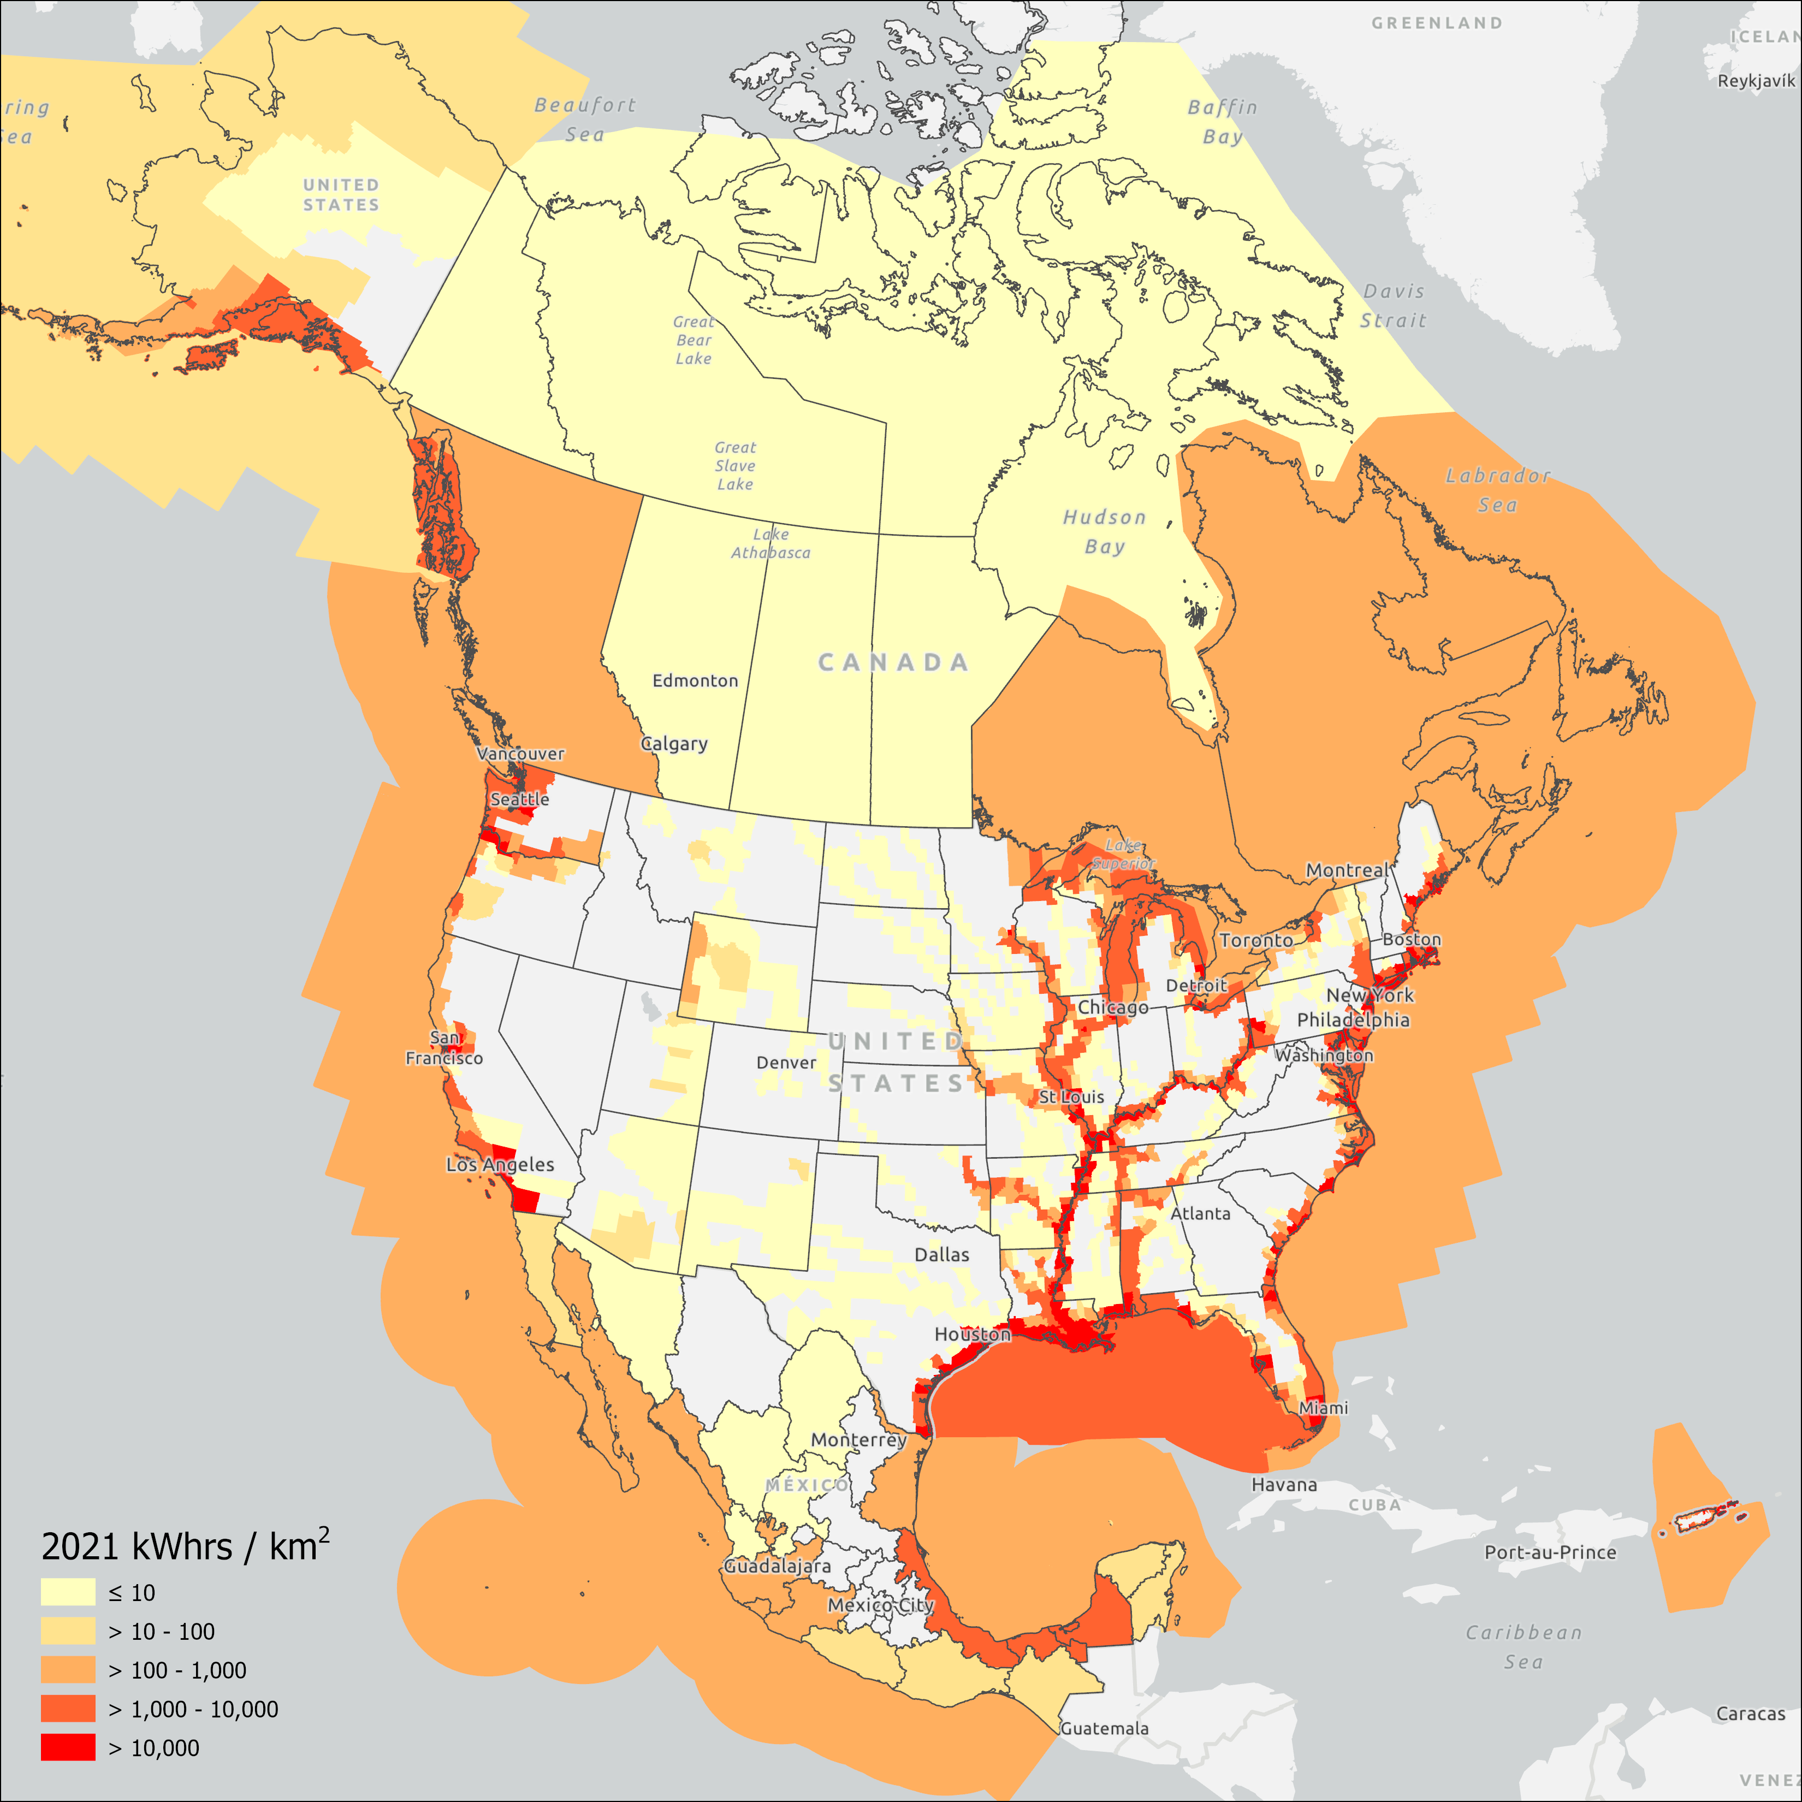
Area Covered by Full 2021 Inventory
Decoder for new SCCs

Slide 4
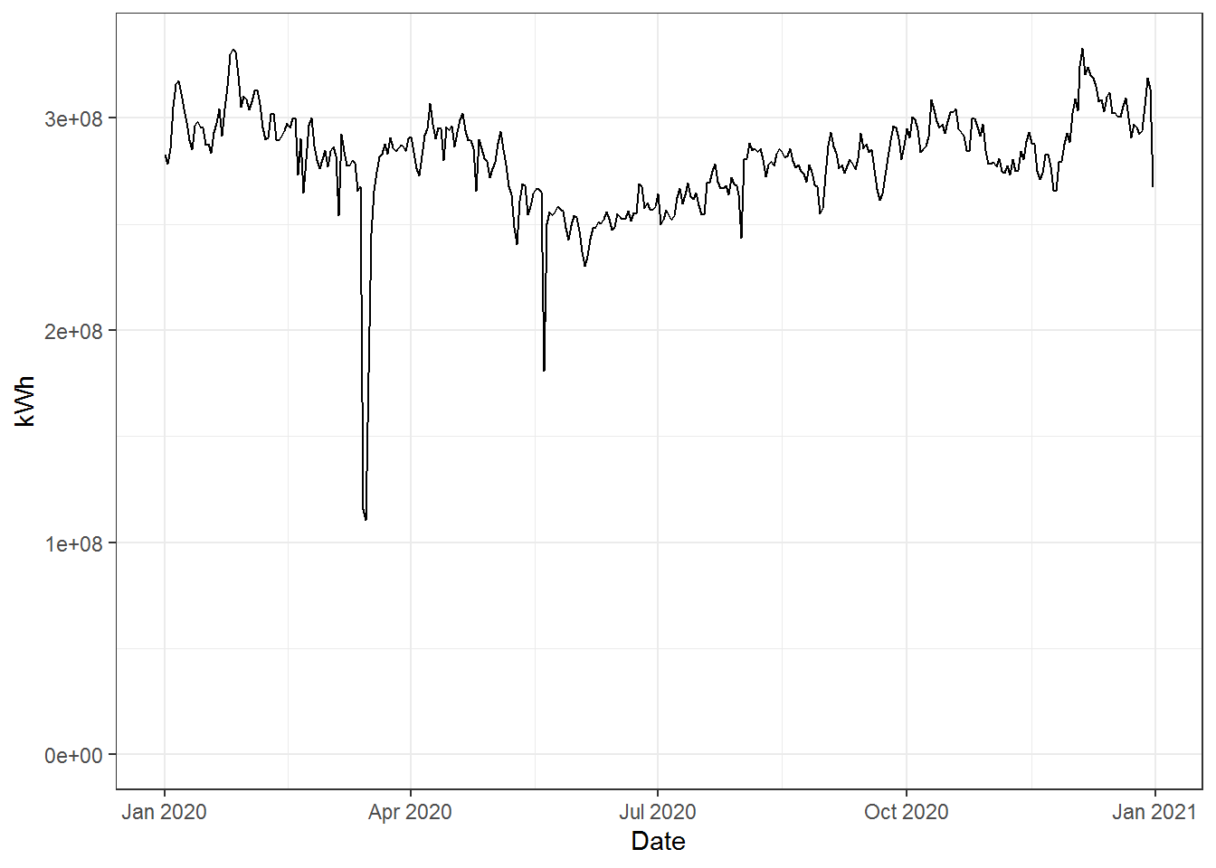
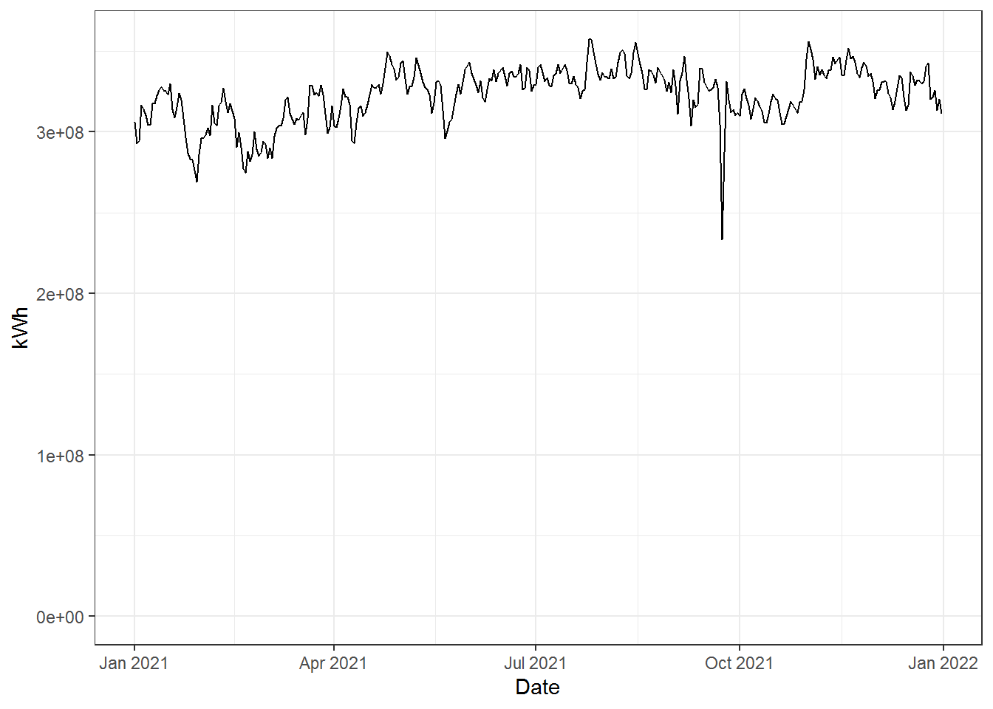
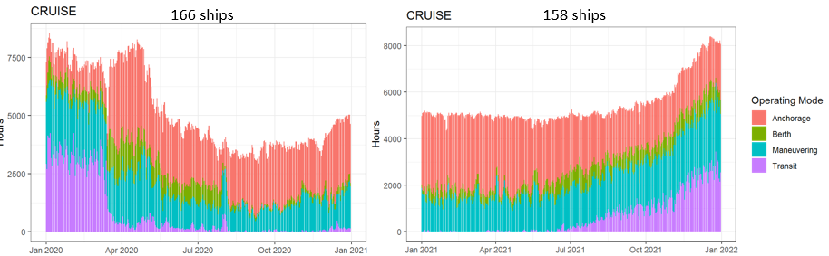
Recent year activity trends for C3
2020 and 2021 Fleet-wide Energy consumption
Overall energy
consumption was
a bit higher in
2021 vs 2020
AIS data
Outage
AIS data
Outage
COVID
Cruise ship activity
rebounded in 2021
especially by the
end of the year
Notes:
Note the cruise ship rebound in 2021 – especially by the end of the year

Slide 5
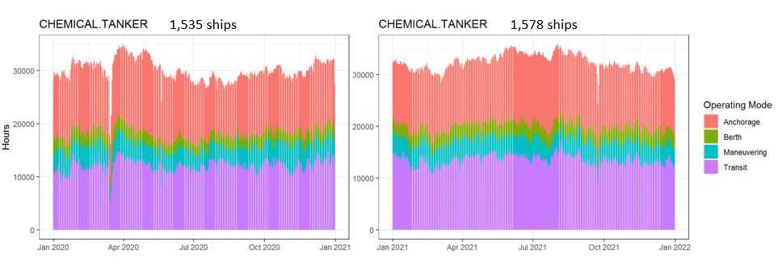
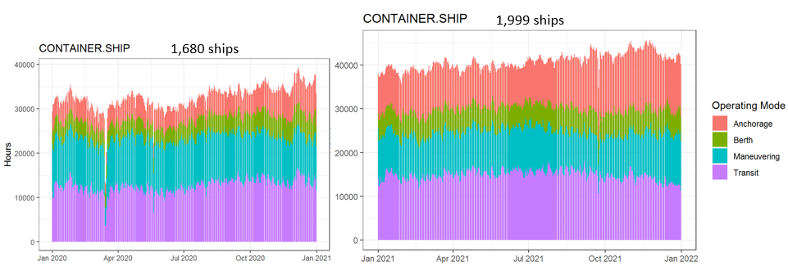
Additional 2020 and 2021 C3 activity by operating mode
Tankers showed a little growth in 2021 vs 2020
Container ships grew by almost 20% in 2021 vs 2020

Slide 6
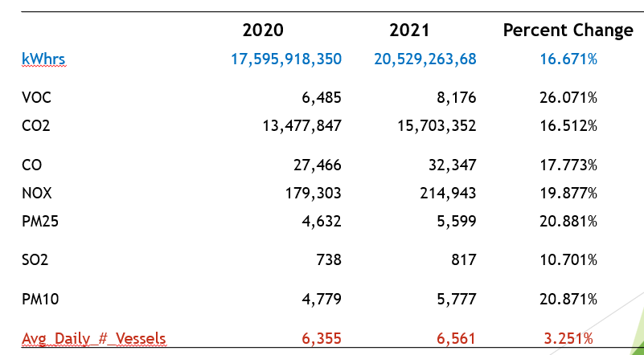
2021 and 2020 C1C2 Emissions and Activity Comparison (from the September call)

Slide 7
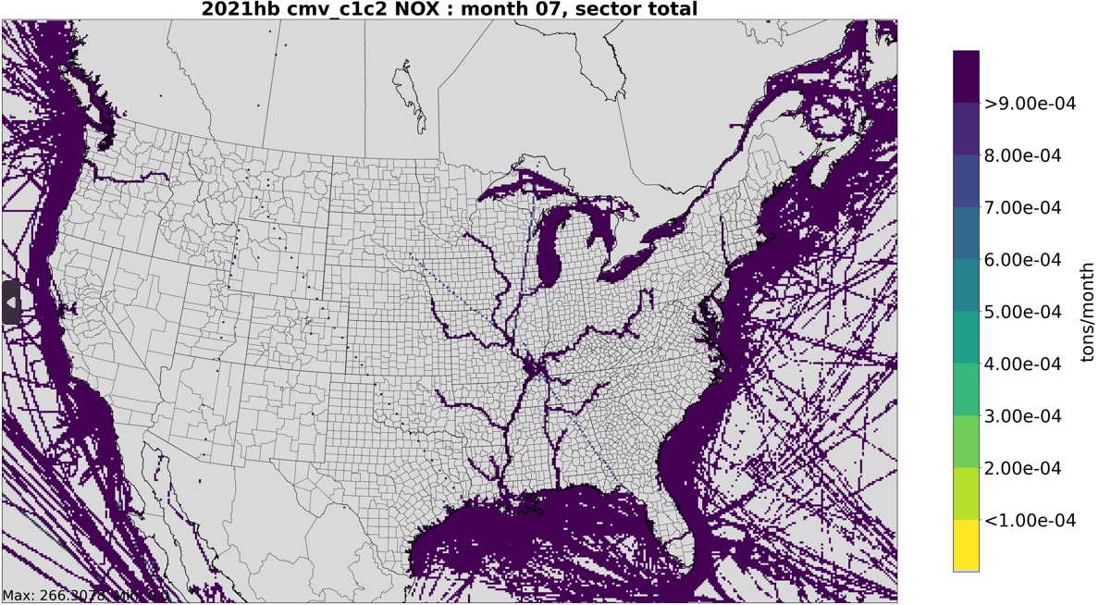
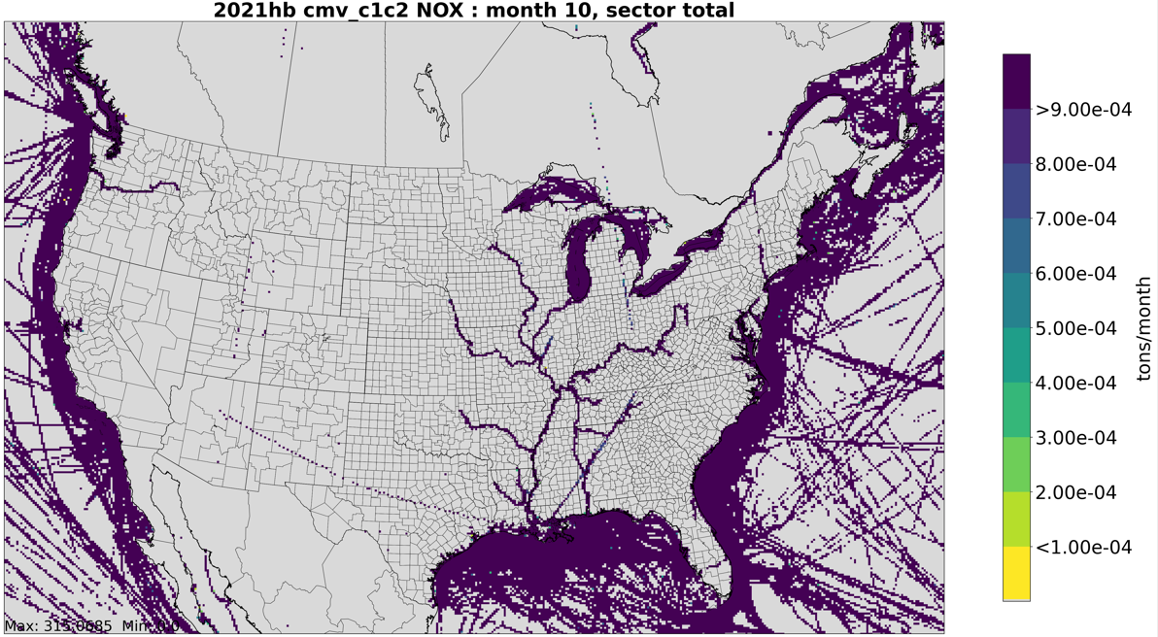
Issue from original version:
C1C2 Emissions in Unexpected States
It was determined that some stray transponder signals were provided with the 2021 AIS data – some are diagonal and others along lines of longitude. The emissions are small but these should be cleaned up before finalizing the data.

Slide 8
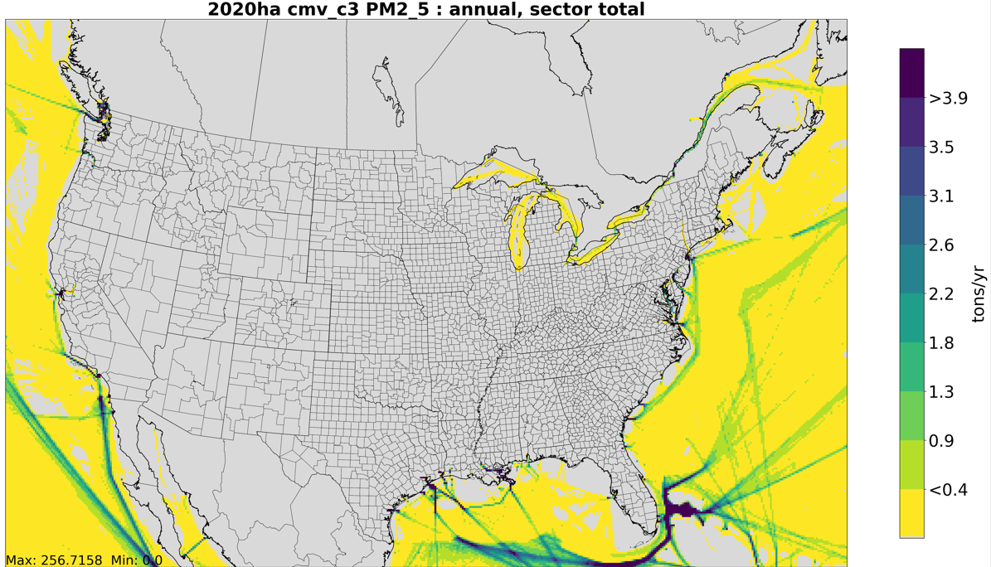
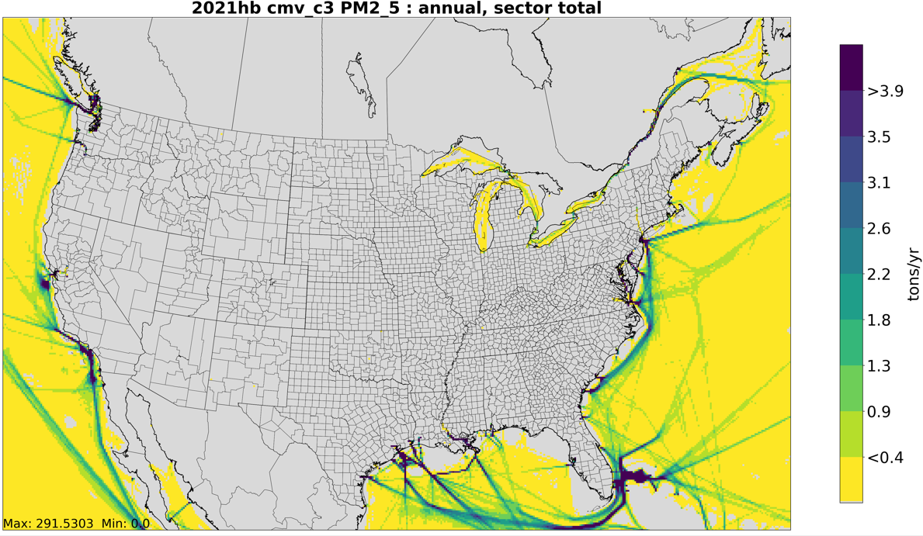
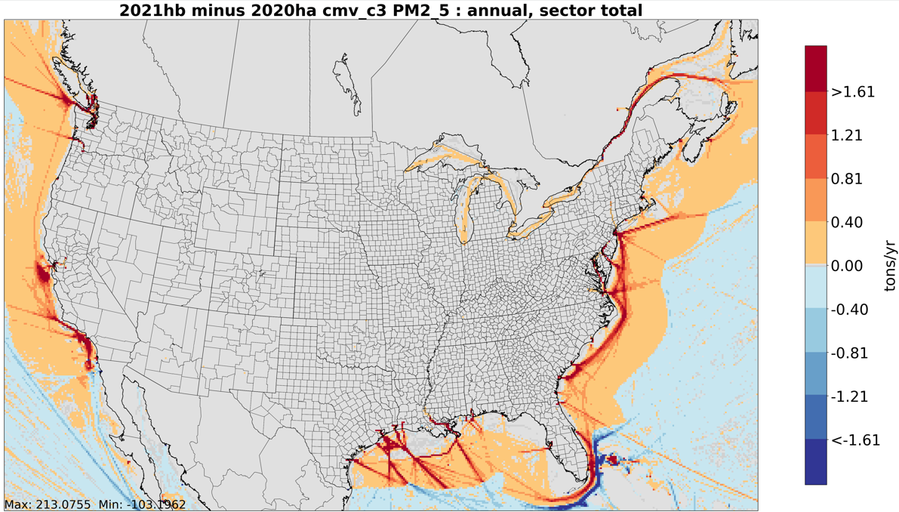
2020 and 2021 CMV C3 PM2.5 emissions – initial version
We note higher PM and SO2 emissions in the emissions control area (ECA)

Slide 9
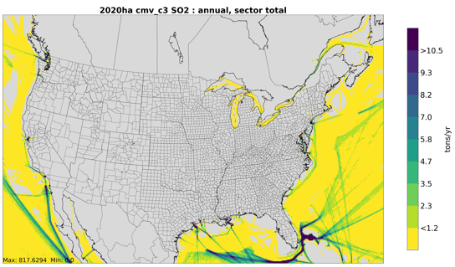
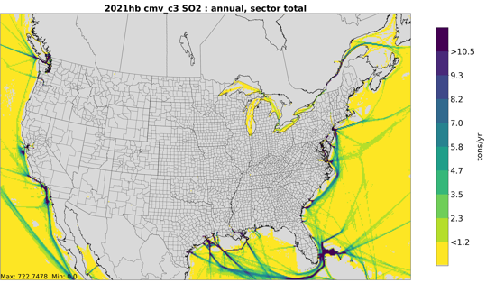
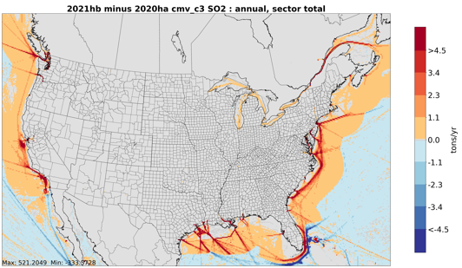
2020 and 2021 CMV C3 SO2 emissions –
initial version
We see elevated emissions in the ECA as compared to 2020 in this version
(Note there is no ECA around Mexico)

Slide 10
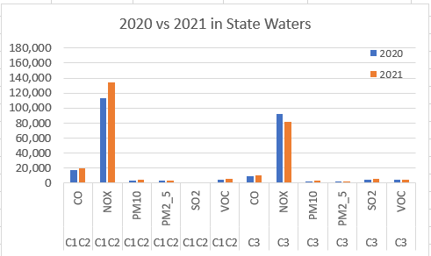
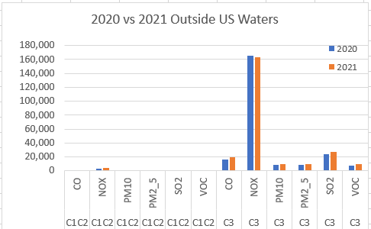
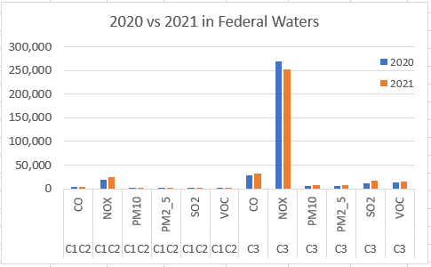
Updated Emissions for CONUS 12US1 Grid
Observations:
NOx is the dominant pollutant (and CO2 – not shown here)
In state waters, there is more NOx from C1C2 than from C3
Outside of state waters, more emissions are from C3
In state and federal waters, NOx increased in 2021 (20%) for
C1C2 but decreased for C3 (-19% state and -9% federal)
C3 SO2 and PM increased over 100% within state and federal
waters but decreased outside of US waters
Note
larger
scale

Slide 11
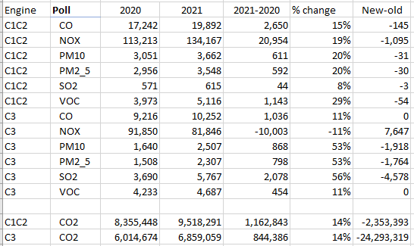
Total 2021-2020 and New-old changes in state waters (tons)
Corrections:
C1C2: stray tracks
were removed
C3: recomputed
with correction
Total NOx higher
PM and SO2 lower

Slide 12
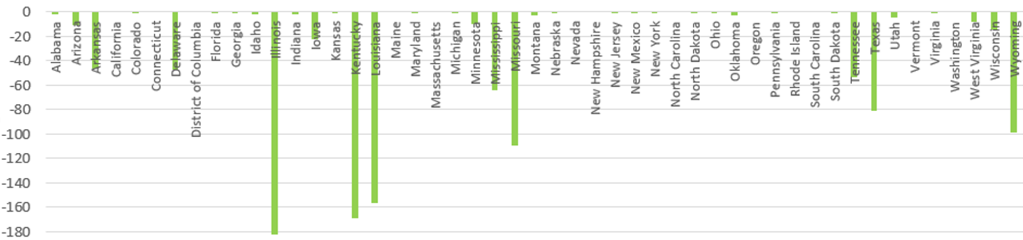
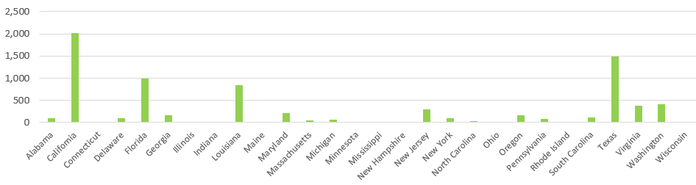
NOx Changes by State due to Corrections
C1C2
C1C2 emissions zeroed out in AZ, CO, ID, MT, NV, NM, ND, SD, UT, WY
Probably should have also removed all emissions in KS, NE
C3

Slide 13
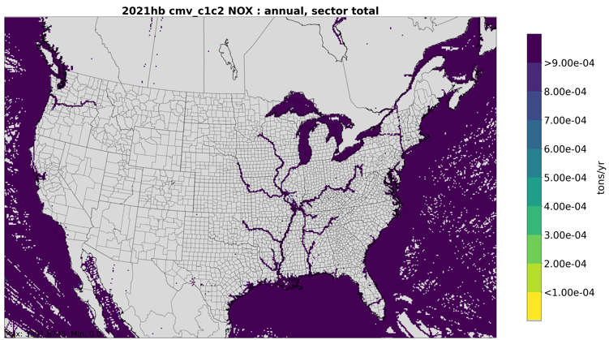
Updated 2021 C1C2 CMV with low scale
Many anomalies are removed, but there are a still a couple that show up in Canada, Mexico, Texas, and OH
We will need to do a more thorough job on removing these for 2022

Slide 14
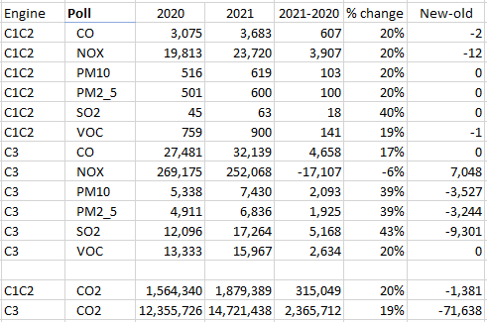
2021-2020 and new-old changes in Federal Waters (tons)

Slide 15
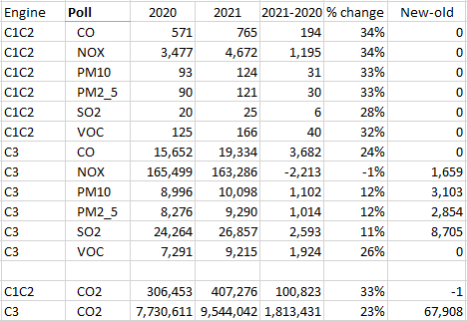
2021-2020 and new-old changes outside of U.S. Waters (tons)

Slide 16
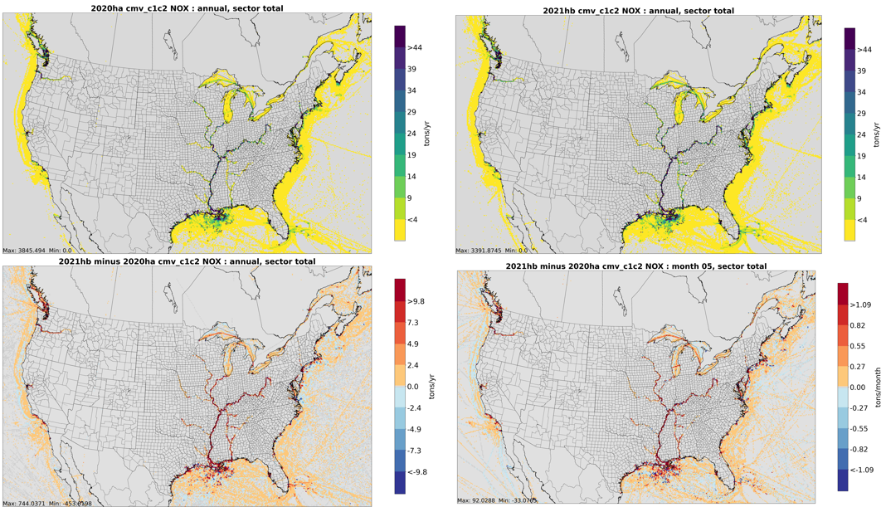
Notes:
Note difference in Great Lakes ferry in May

Slide 17
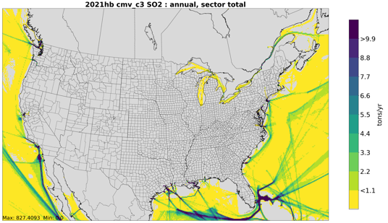
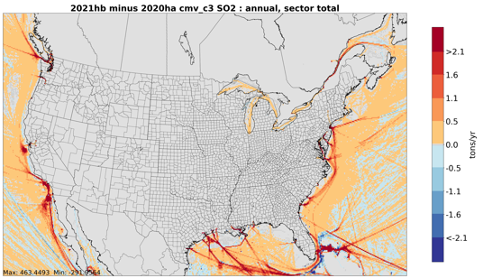
2020 and 2021 CMV C3 SO2 emissions –
Updated version
Differences between ECA and outside ECA are substantially reduced. Scale is lower here than before: 4.5 vs 2.1.
(Note there is no ECA around Mexico)

Slide 18
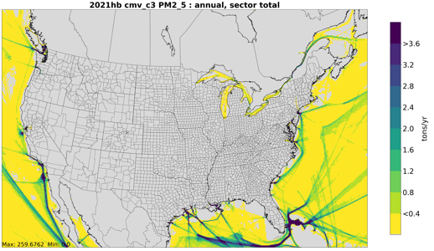
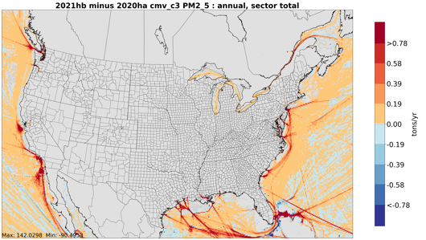
2020 and 2021 CMV C3 PM2.5 emissions – updated version
The differences in the ECA are significantly reduced (note smaller scale on map – 0.78 vs 1.6) and no big difference ECA vs outside ECA

Slide 19
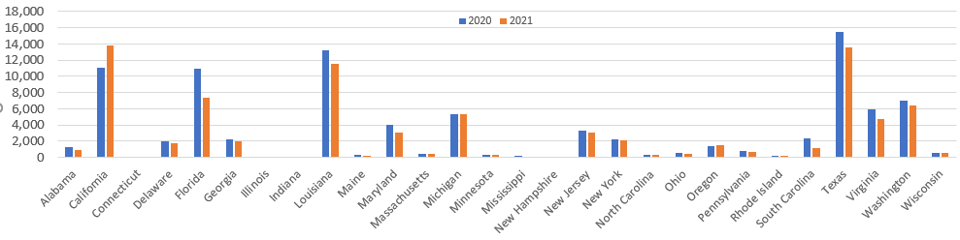
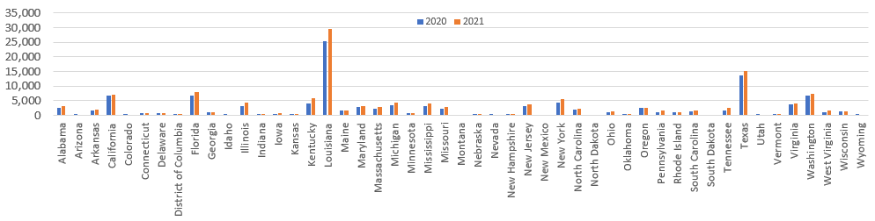
2020 vs Updated 2021 CMV C3 NOx Emissions by state
2020 vs Updated 2021 CMV C1C2 NOx Emissions by state
Notes:
LA, CA, TX, and WA have the most C3 emissions – NOx went down in 2021 in all but CA
LA, TX, FL, and CA have the most C1C2 emissions – all of these had increased NOx in 2021.

Slide 20
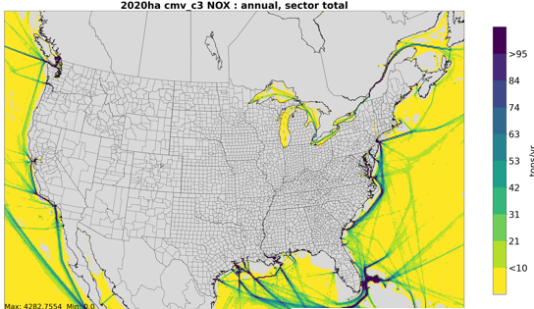
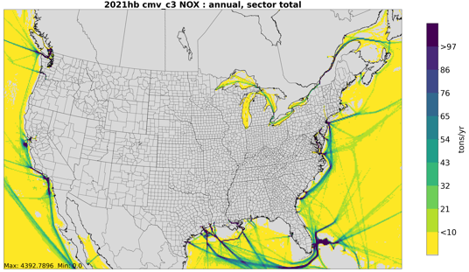
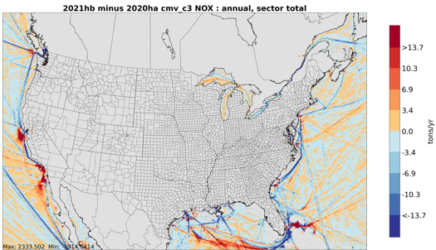
2020 and Updated 2021 CMV C3 NOx emissions
C3 NOx emissions grew in CA in 2021 but decreased in the Gulf of Mexico, south of Florida, ad off coast of Oregon

Slide 21
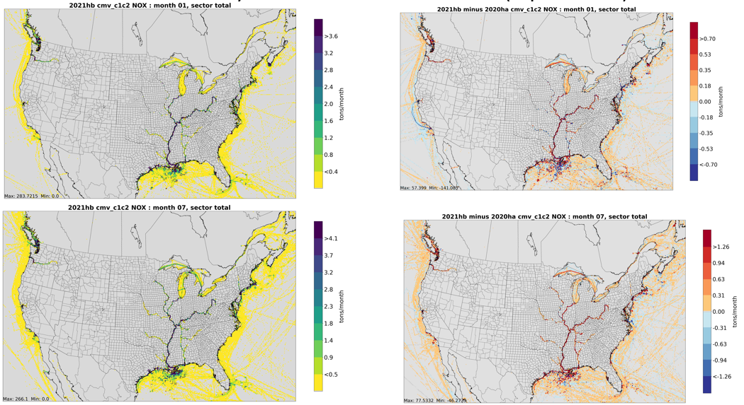
Monthly Plots are Available (updated)
Notes:
Notice the additional emissions in the Great Lakes and in northern latitudes in July vs January. The scales are slightly different.

Slide 22
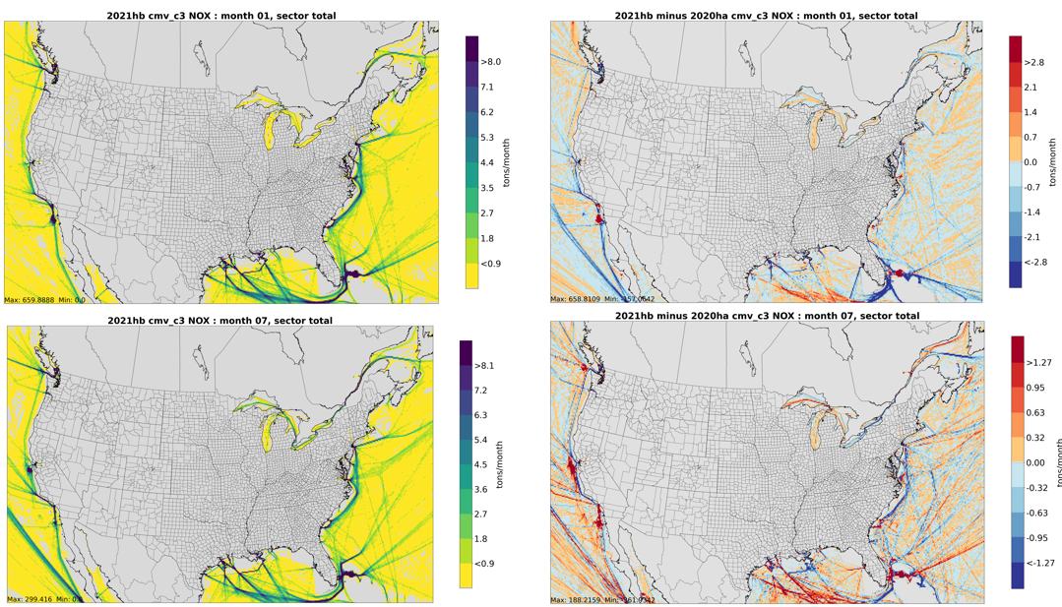
Notes:
Notice the additional emissions in the Great Lakes and in northern latitudes in July vs January.

Slide 23
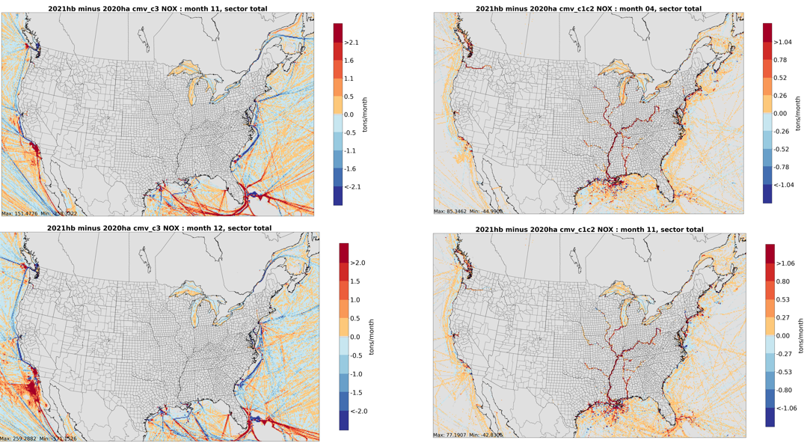
Interesting differences from the pandemic year
Notes:
Notice the large differences between 2020 and 2021 emissions off CA, and FL – ships being stuck waiting to unload, and resumption of cruise ship traffic + idling
These months show the maximum differences from late 2021. Notice the increase in traffic off Mexico (cargo ships waiting to doc)
For C1C2, notice the ferry across Lake Michigan, and the different pattern in December without the north-south track through the center of the lake.

Slide 24
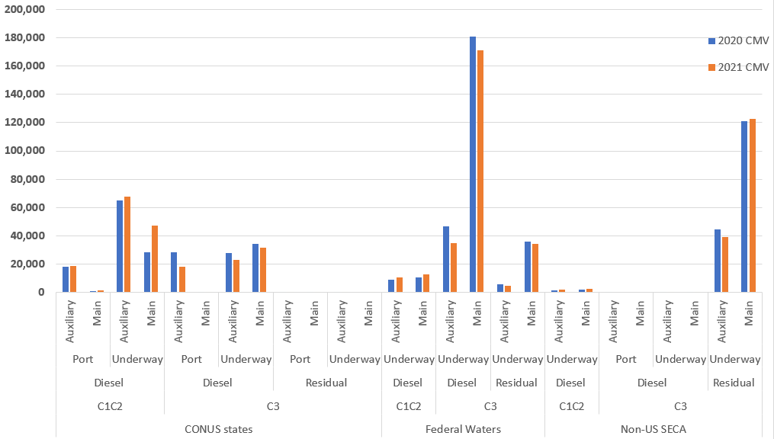
Where are most of the NOx emissions from?
(not updated for corrected emissions)
CONUS States
Federal Waters
Non-US
Notes:
In state waters, C1C2 use the Aux engines in port, and both Aux and Main when underway. Residual emissions are essentially 0 in state waters.
In Federal waters, you can see that most emissions are from Diesel main engines, with some Aux, and some residual. Diesel underway emissions are small.
Outside of US waters, almost all emissions are residual – mostly with main and some aux.

Slide 25
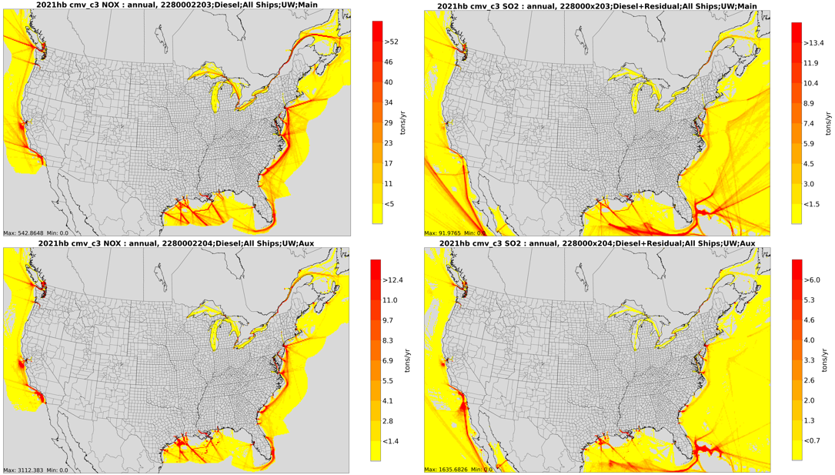
Notes:
NOx (diesel only) on left, SO2 (all fuels) on right, main on top, Aux on bottom

Slide 26
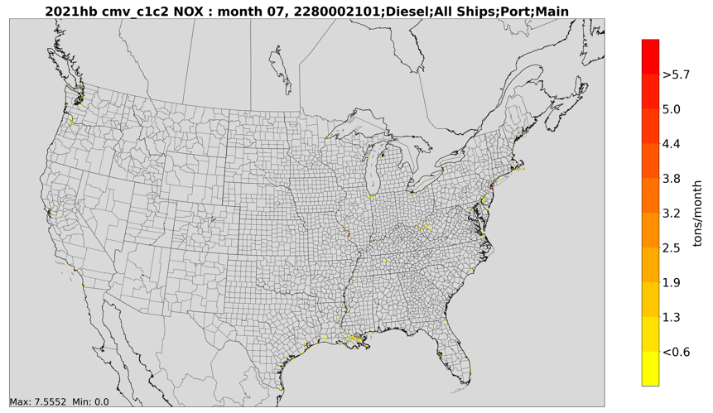
C1C2 Port emissions

Slide 27
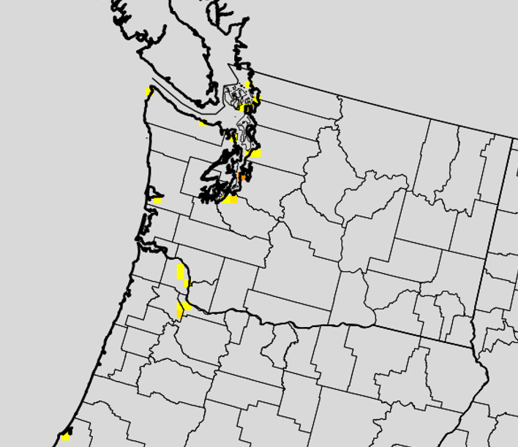
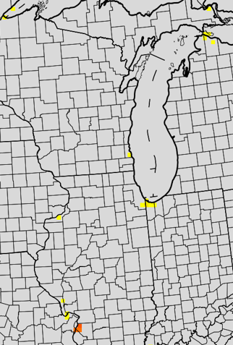
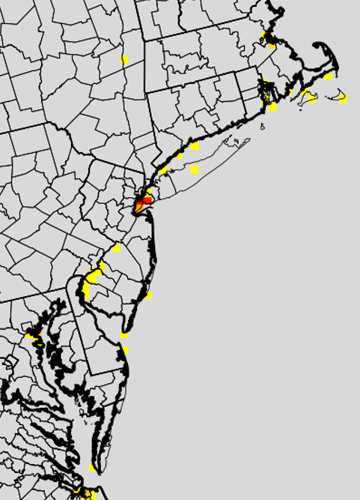
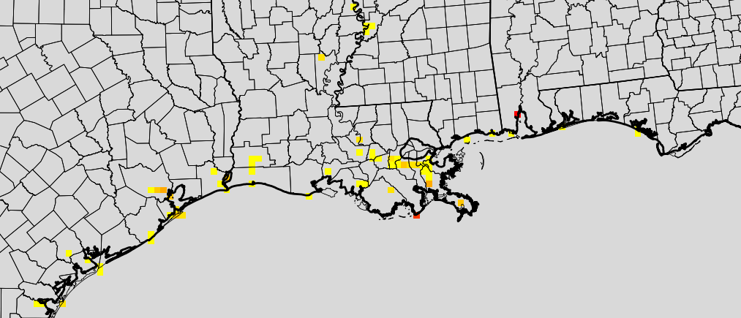
c
C1C2 Emissions at Key Ports

Slide 28
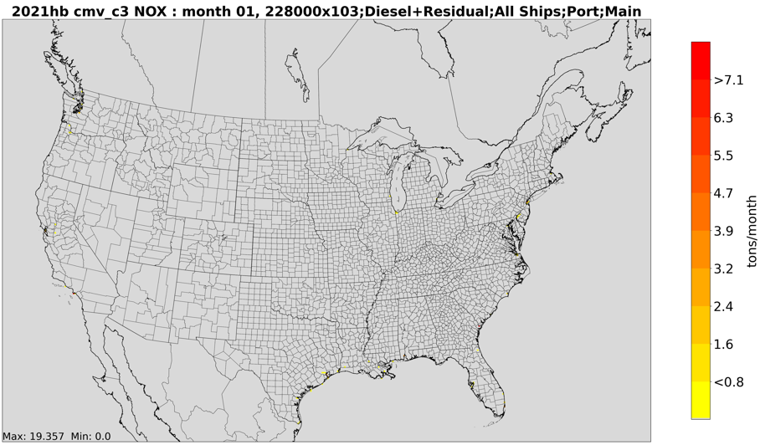
C3 Port Emissions

Slide 29
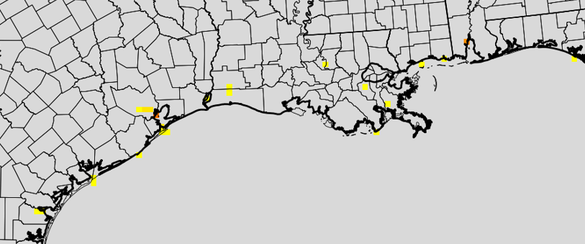
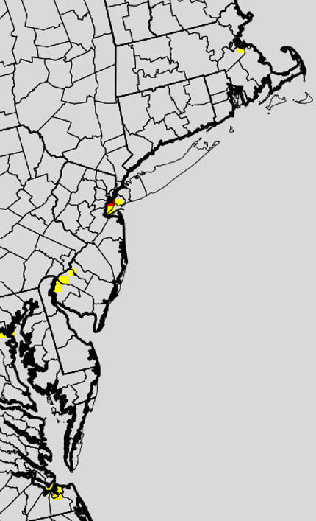
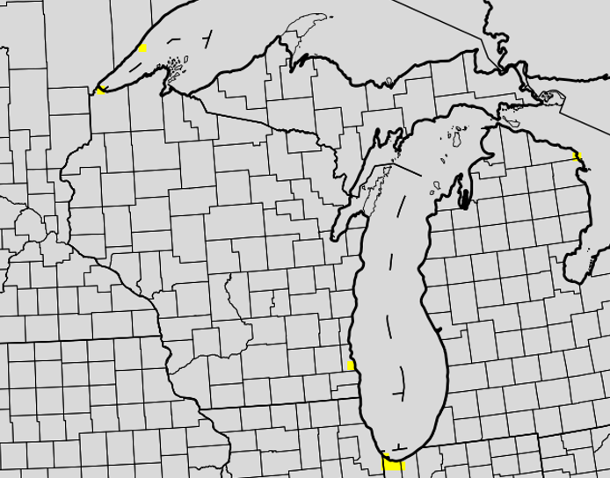
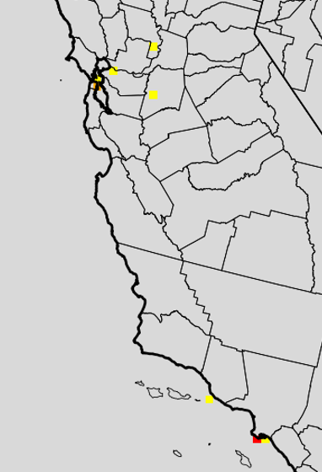
Emissions at Key C3 ports

Slide 30


Top SCCs of Emissions for 2021 –
State and Federal Waters (Updated)

Slide 31
Plots of Emissions by SCC – now including ship type (not yet updated)
With the new SCCs, it is possible to visualize where the emissions are occurring for each ship type, fuel type, and engine type
Note that the scales vary on the following slide, depending on the magnitude of the emissions

Slide 32
C3 examples by ship type, fuel, engine type

Slide 33

Notes:
C3 ships (including cruise ships) use diesel near shore and residual outside the ECA

Slide 34

Notes:
Main and Aux engines for Container ships and tankers

Slide 35

Notes:
Bulk carrier, roll on roll off, tug, fishing

Slide 36
C1C2 by ship type

Slide 37





Slide 38





Slide 39





Slide 40



Slide 41

Counties with the most CMV NOx emissions in 2021
Total, C1C2, and C3 NOx
emissions are shown here.
The new SCC assignments
support analyses of the main
ship types that contributing
to the CMV emissions
by county (see next slide)

Slide 42


SCCs with the most NOx for Plaquemines Parish

Slide 43
Next Steps
Finish updating SCC-specific plots
Post summaries and plots on EPA ftp site as a preview to 2022: https://gaftp.epa.gov/Air/emismod/2021/

