Slide 1
Understanding the Inventory of U.S. GHG Emissions and Sinks and the GHG Reporting Program for Landfills
Katherine Bronstein and Jeffrey Coburn
RTI International
Rachel Schmeltz
U.S. EPA
2012 International Emission Inventory Conference
Tampa, Florida
August 14, 2012

Slide 2
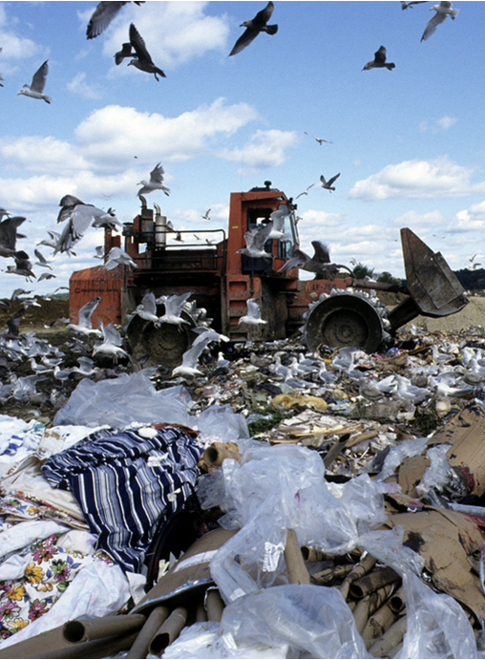
Goals of this Presentation
Methodological differences between the Inventory and the GHGRP for landfills
How (and when) the GHGRP landfills data could potentially improve the Inventory

Slide 3
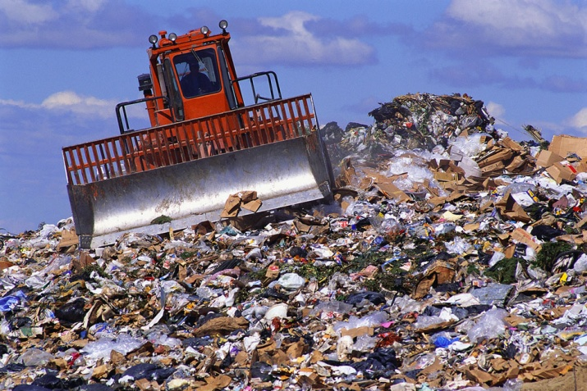



Landfill Gas Background
CH₄ directly emitted to atmosphere
No
Landfill biogas:
~50% CO₂ + ~50% CH₄
Is there a GCS?
Yes
CH₄ recovered and flared or combusted
No O₂ +
Notes:
The waste we throw away contains inorganic material and also organic material, such as food, paper, wood, and garden trimmings. Once the waste is deposited in a landfill, microbes begin to consume the carbon in organic material,
which causes decomposition. Under the anaerobic conditions prevalent in landfills, the microbial communities contain methane-producing bacteria. As the microbes gradually decompose
organic matter over time, they form landfill biogas. This biogas consists of approximately 50% methane and 50% carbon dioxide with trace amounts of other non-methane organic compounds.
The Inventory and GHGRP for landfills only consider the methane in their emissions estimates because the CO2 is of biogenic origin.
The CH₄ generated in the landfill may be emitted directly to the atmosphere at landfills with no gas collection systems. Or, if a landfill has a gas collection system, the CH4 can be collected through a series of pipes and gas wells and then flared or combusted to produce electricity or heat.

Slide 4
Why do we care about landfill gas?
Notes:
Atmospheric methane levels have tripled since pre-industrial times, and although there is less CH₄ in the atmosphere compared to carbon dioxide as shown in this pie chart, CH₄ is 21 to 25 times more potent as a GHG than CO2.
When looking strictly at CH4 emissions by source, landfills constitute the third largest source in the US behind natural gas systems and enteric fermentation.

Slide 5
How is the USEPA Tracking Landfill Emissions?
Solid Waste Inventory (solid waste portion of the Inventory of U.S. GHG Emissions and Sinks)
Subparts HH (Municipal Solid Waste Landfills) and TT (Industrial Waste Landfills) of the Greenhouse Gas Reporting Program (GHGRP)
Notes:
The EPA is tracking landfills emissions two ways. The first is through the Solid Waste Inventory and Subparts HH and TT of the GHGRP.
The EPA has prepared the Inventory on an annual basis to meet the US Government’s reporting requirements to the United Nations Framework Convention on Climate Change since 1990. The Inventory is considered an impartial and policy-neutral mechanism to compare relative GHG contributions between source categories and countries. Therefore, all countries use the recommended IPCC 2006 Guidelines to promote consistency and comparability.

Slide 6
Overview of the Inventory of U.S. GHG Emissions and Sinks
Conducted annually since 1990 to meet UNFCCC requirements
Impartial and policy-neutral
Follows IPCC 2006 Guidelines
Uses a combination of secondary datasets
Current and archived U.S. GHG inventories available at: http://www.epa.gov/climatechange/emissions/usinventoryreport.html
Notes:
Since 1990, the EPA has prepared the Inventory on an annual basis to meet the US Government’s reporting requirements to the United Nations Framework Convention on Climate Change. The Inventory is considered an impartial and policy-neutral mechanism to compare relative GHG contributions between source categories and countries. Therefore, all countries use the recommended IPCC 2006 Guidelines to promote consistency and comparability.

Slide 7
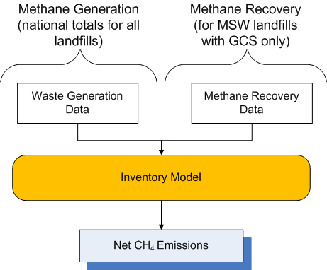
How the Solid Waste Inventory Works
CH₄ generation estimated from national waste totals (i.e., not landfill-specific)
CH₄ recovery only for MSW landfills with GCS (i.e., is landfill-specific)
No data on GCS at industrial waste landfills
Notes:
CH₄ generation is estimated from national waste generation totals for MSW and industrial waste landfills (i.e., not landfill-specific)
CH₄ recovery is only determined for MSW landfills with GCS (i.e., is landfill-specific)
Inventory currently has no data on GCS at industrial waste landfills
Estimates CH₄ emissions via a source-specific “Landfill Model” for MSW and industrial waste landfills

Slide 8
Overview of the GHGRP for Landfills
Only landfills meeting the thresholds have to report
HH (Municipal Solid Waste Landfills)
Accepted waste on or after 1/1/1980
CH₄ generation ≥ 25,000 MT or more of CO₂e
TT (Industrial Waste Landfills)
Accepted waste on or after 1/1/1980
Located at a facility whose total landfill design capacity is ≥ 300,000 MT
Combined GHG emissions ≥ 25,000 MT
Notes:
The GHGRP, on the other hand, is a relatively new EPA program that requires certain landfills to report CH₄ emissions and landfill-specific characteristics under subpart HH for MSW landfills or subpart TT for industrial waste landfills. Only those landfills meeting the thresholds shown here are subject to the GHGRP. So there will be lots of landfills that won’t be subject to the rule, but it capture the largest landfills in terms of CH4 generation.
- What percent of landfills does this include?

Slide 9

GHGRP Reporting Details
Data reported through e-GGRT
Extensive verification process
Reporting schedule (annually)
HH first reported in 3/2011 for 2010
TT first reporting in 9/2012 for 2011
Some data (emissions equation inputs) deferred from reporting until 3/2013 or 3/2015
Notes:
Subparts HH and TT are on different reporting schedules because TT was added into the rule at a later date. Facilities subject to HH just finished their second reporting cycle while the first GHG reports for subpart TT facilities are due next month.
Facilities submit their reports through the EPA’s electronic greenhouse gas reporting tool called e-GGRT. And the data in each report undergoes an extensive verification process.
Some data in the rule have been deferred from reporting until March 2013. This includes the majority of the emissions equation inputs for all subparts, including HH and TT.

Slide 10
Outline for Methodology Discussion
CH₄ generation
1
CH₄ emissions for landfills without GCS
2
CH₄ emissions for landfills with GCS
- Forward calculation approach (Inventory and GHGRP)
3
CH₄ emissions for landfills with GCS
- Back calculation approach (only used by the GHGRP)
4
Notes:
Now we’ll move on to the methodologies for both the Inventory and the GHGRP. For the most part, the methodology doesn’t differ between MSW landfills and industrial waste landfills, but there is a distinction between landfills with gas collection systems and landfills without gas collection systems.
Additionally, the GHGRP requires landfills with gas collection systems to report emissions in two ways that we’re calling the forward calculation and the back calculation. The forward calculation approach is the same methodology that is used by the Inventory. The back calculation approach is only used by the GHGRP.
The GHGRP requires facilities to calculate CH4 emissions two ways because . . .
We are still assessing the variability between the two approaches at this time.

Slide 11
CH₄ Generation: IPCC FOD Model
1
CH₄ generation is modeled using the IPCC first order decay (FOD) model
Inventory and GHGRP use the same FOD equation, but different equation inputs
Notes:
Because there isn’t an accepted method to directly measure CH₄ emissions from landfills, CH₄ generation estimates are based on the IPCC’s first order decay model where the rate of methane generation is proportional to the amount of degradable waste placed in the landfill.
Both the Inventory and GHGRP use the first order decay model to determine the amount of CH4 generated, but there are differences in the values used for some of the equation inputs.

Slide 12
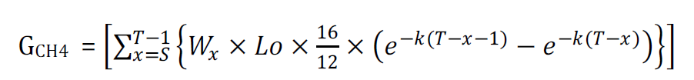
CH₄ Generation: IPCC FOD Model
1
where
G_{CH4} = Total amount of CH₄ generated
T = Reporting year for which emissions are calculated
x = Year in which waste was disposed
S = Start year of calculation
W_{x} = Quantity of waste disposed of in the landfill in a given year
Lo = Methane generation potential
16/12 = conversion factor from CH₄ to C
k = Decay rate constant (yr⁻¹)
Inventory W_{x} = national waste generation; L_{o} = default inputs; CH₄ generation by climate (k = wet, moderate, arid)
GHGRP Facility- and/or waste type-specific inputs (W_{x}, L_{o}, k)
Notes:
CH₄ generation estimates are based on the IPCC’s first order decay model where the rate of methane generation is proportional to the quantity of degradable waste placed in the landfill.
The key terms affecting CH₄ generation are the methane generation potential (Lo) and the decay rate (k).
(Lo = DOC_{x} * MCF * DOC_{F} * F)

Slide 13
CH₄ Generation: IPCC FOD Model
1
open
closed

Slide 14
CH₄ emissions for landfills without GCS
2
CH₄ emissions = G_{CH4} x (1 – OX)
where
G_{CH4} = the result from the FOD model
OX = a default oxidation factor of 10%
Both the Inventory and the GHGRP use this equation; no differences
Notes:
Both the Inventory and the reporting program use this equation for landfills without gas collection systems. It’s essentially subtracting the amount of CH4 that’s oxidized as it passes through the landfill cover from the amount of CH4 generated. So no differences here.

Slide 15
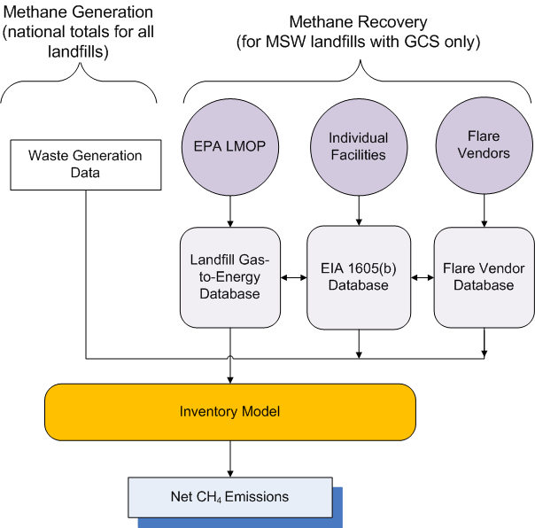
CH₄ Recovery from Landfills with GCS
There are significant differences!
Inventory uses 3 databases to determine CH₄ recovery (R)
LMOP = Landfill Methane Outreach Program (annually)
EIA 1605(b), last updated in 2005
U.S. flare vendors (contacted annually)
= high uncertainty
Notes:
There are significant differences between how the amount of CH₄ recovered by landfill gas collection systems is calculated by the Inventory and the GHGRP.
In the Inventory, methane recovery is determined using a combination of 3 databases shown in purple. The first is the EPA’s Landfill Methane Outreach Program or LMOP, which is a voluntary database with data about landfill gas to energy programs. The second is the EIA’s 1605(b) program, which contains facility-reported information. This database was last updated in 2005. The third is the Flare Vendor database, which consists of sales data obtained each year from 3 of the largest flare vendors. The EIA database has been considered the least uncertain of these data sources because data were directly reported, but now it may be out of date.
Unlike methane generation, methane recovery is determined on a landfill-by-landfill basis.
There are overlapping landfills in these 3 databases, and a significant amount of effort is expended each year to avoid double counting recovery. The bottom line is that Inventory CH4 recovery estimates result in high uncertainties.

Slide 16
CH₄ Recovery from Landfills with GCS (continued)
GHGRP requires direct measurements of flow rates and CH₄ concentration of the recovered landfill gas
= less uncertainty
GHGRP requires facilities to calculate CH₄ emissions 2 ways:
Forward calculation: Based on IPCC FOD Model (same as the Inventory)
Back calculation: Based on gas collection data
Notes:
The GHGRP, on the other hand, requires direct measurements of flow rates and CH₄ concentration of the recovered landfill gas that’s used to calculate R, so it’s a more accurate R value by landfill.
The GHGRP also requires facilities to use two different methodologies to assess and report their GHG emissions.
Landfills that have gas collection systems must calculate their emissions using both the IPCC First Order Decay Model and the measured CH4 collection rates and estimated gas collection efficiency. This provides a means by which all landfills would report emissions and generation consistently using the same (IPCC First Order Decay Model) methodology, while also providing reporting of site-specific emissions and generation estimates based on gas collection data.

Slide 17
Forward calculation for landfills with GCS
3
Net CH₄ emissions = (G_{CH4} – R) x (1 – OX) + R x (1 – (DE x f_{Dest}))
where
G_{CH4} = CH₄ generated from the FOD model
R = amount of CH₄ recovered by the landfill GCS
OX = oxidation factor
DE = destruction efficiency
f_{Dest} = fraction of hours the destruction device was operating
In the GHGRP, G_{CH4} is either G_{CH4} from the FOD model or the measured value of R, whichever is greater (to avoid negative net emissions)
Forward calculation means based off of the FOD Model
Notes:
The equation shown here relies primarily on the modeled CH4 generation rates determined from the mass of waste disposed.
The Inventory and GHGRP use the same equation, but different values for DE and f_{Dest.}
More uncertainty with Inventory estimates b/c of 2nd data sources for R, less uncertainty in GHGRP estimates b/c rule requires direct measurement of R

Slide 18
Back calculation for landfills with GCS
4
“Back calculation” means estimating G_{CH4} from directly measured R, CE, and f_{REC}
Only used by the GHGRP
where
CE = collection efficiency estimated at the landfill, taking into account system coverage, operation, and cover system materials from Table HH-3 of the GHGRP
f_{Rec} = fraction of hours the recovery system was operating
Notes:
The second methodology required by the GHGRP relies primarily on the measured quantity of gas recovered and an estimate of the collection efficiency of the gas collection system.
The big difference between the forward and back calculation equations lie with this first term. The forward calculation uses GCH4 from the FOD model while here, the measured recovery is divided by the collection efficiency as a proxy for CH₄ generation.

Slide 19
Back to the point of this presentation . . .
What are the key methodological differences between the Solid Waste Inventory and the GHGRP for landfills?
How (and when) can the GHGRP data potentially improve the Solid Waste Inventory?

Slide 20
Comparing the Methodologies
Data Element | U.S. GHG Emissions Inventory | GHGRP
Applicability | Entire U.S. economy (all GHG emissions) | Facilities meeting thresholds (85–95% of GHG emissions)
Waste generation data | Aggregated national data “bottom up” | Facility-specific data “top down”
CH₄ generation | IPCC FOD model, default inputs, 3 climate types | IPCC FOD model, facility-specific inputs
CH₄ emissions, no GCS | GCH4 - OX | GCH4 - OX
CH₄ recovery | Estimated from 3 secondary databases = high uncertainty | Direct measurements = low uncertainty
CH₄ emissions, GCS | Forward calculation approach | Forward and back calculation approaches

Slide 21
How and when can the GHGRP data improve the Inventory?
When = the deferral expires in 3/2013, so 2014
Potentially improve CH₄ generation estimates by:
Potentially revising the default FOD equation inputs (k, Lo)
Updating the standard MSW waste composition (affects Lo)
Incorporating industrial waste composition data
Potentially improve CH₄ recovery estimates using:
Direct recovery measurements for MSW landfills and industrial waste landfills with GCS
Methane recovery will be the most meaningful improvement to the Inventory!

Slide 22
Thanks for your attention!
For more information:
Katherine Bronstein
RTI International
kbronstein@rti.org
Jeffrey Coburn
RTI International
cob@rti.org
Rachel Schmeltz
U.S. EPA
schmeltz.rachel@epa.gov

Slide 23
Extra Slides
Current and archived U.S. GHG inventories available at: http://www.epa.gov/climatechange/emissions/usinventoryreport.html

Slide 24
 | Inventory (MSW only) | GHGRP (HH) | GHGRP (TT)
LFs with GCS | 1,165 (MSW only) | 866 out of 1202 | No data yet
2010 CH₄ generation (MMT CO₂e) | 264 (280 for MSW and industrial) | 209 | No data yet
2010 CH₄ recovery (MMT CO₂e) | 160 (MSW only) | Forward: 83 (92%) Back: 54 (60%) | No data yet
2010 net CH₄ emissions (MMT CO₂e) | 94 (108 for MSW and industrial) | 91 (as of 8/2012) | No data yet
Uncertainty level | High | Low | Low
Notes:
Number with GCS may be higher b/c there landfills with multiple flares listed in the flare database.

Slide 25
A Closer Look at CH₄ Emissions from Landfills in the U.S.
Recovery
Source: USEPA, 2012
Notes:
Over time, the amount of methane generated by landfills in the US has increased significantly as shown by the blue dashed line. However, despite an increase in generation, net methane emissions have decreased by about 27% since 1990 as shown by the red line. The decrease in emissions is primarily due to an increase in landfill gas recovery projects and an increase in composting, which diverts degradable waste from a landfill.

Slide 26
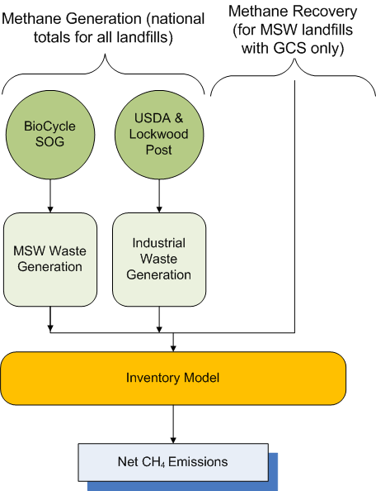
CH₄ Generation Differences
1
Inventory:
Models CH₄ generation for 3 landfill types by climate (k = wet, moderate, arid)
Uses standard default values in the FOD equation
GHGRP:
Allows facilities to use facility- and/or waste type-specific values for parameters in the FOD equation
Notes:
The big differences between the Inventory and the reporting program lie in the values used in the FOD equation. The Inventory uses a national total quantity of waste for all landfills and models CH4 generation in three different climate types. It’s not landfill specific.
MSW waste generation and disposal data are collected and published every 2 years by the BioCycle State of Garbage reports. To determine industrial waste generation, production data for the food industry are obtained from the USDA and the Lockwood Post Directory for the pulp and paper sector. No other industrial waste sources are considered. The amount of methane generated is determined on a national-scale and not on a landfill by landfill basis. The Inventory uses national waste generation data because no one knows the exact number of open and closed landfills in the U.S. There are about 2 to 3 thousand active landfills and as many as 10,000 closed landfills and dumps.
The Reporting Program allows facilities to use facility and/or waste type-specific values for the parameters in the FOD equation.

