Slide 1
TRI Data Access Overview
1

Slide 2
TRI Data Access
Multiple reports available
Not all reports include all data elements
Many reports link to other reports
What is optimal path to specific data ?
Largely dependent on personal preference and experience with each tool

Slide 3
Common Issue With Some Data pulls
Multiple submissions for same chemical
Portion of the facility under one NAICS and another portion reports under a different NAICS (multi-establishment)
Not required by TRI but is permitted.
Some Totals are not actual totals just data element ‘total’.
For air releases, TRI database has 2 data elements labeled ‘Total’. If a facility reported 5 lbs for fugitive and 5 lbs for stack releases, total releases may only display as 5 pounds. If values were 5 and 6, total would display as 11. For Air, need to include data element ‘Environmental Medium.’

Slide 4
My Recommended Starting Point
Form R Search
Quick to access
Essentially a view of the reported data laid out as a facility reports the data
Displays the data elements and their relationship to other data elements
Is a good reference sheet to identify desired data elements when using other access tools
Limited to one facility / one chemical at a time

Slide 5
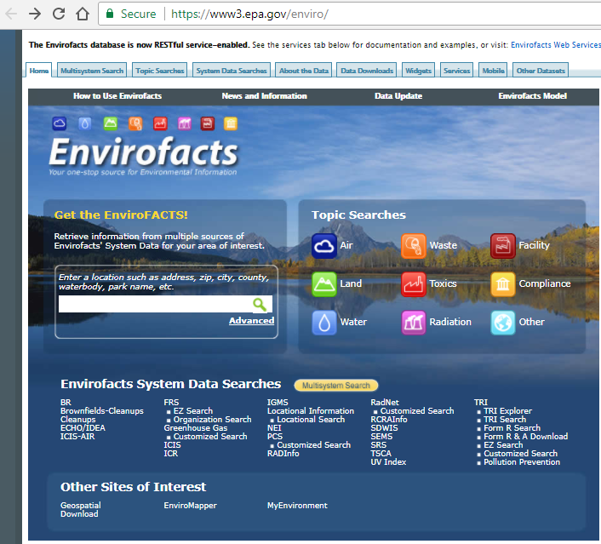
www.epa.gov/enviro

Slide 6
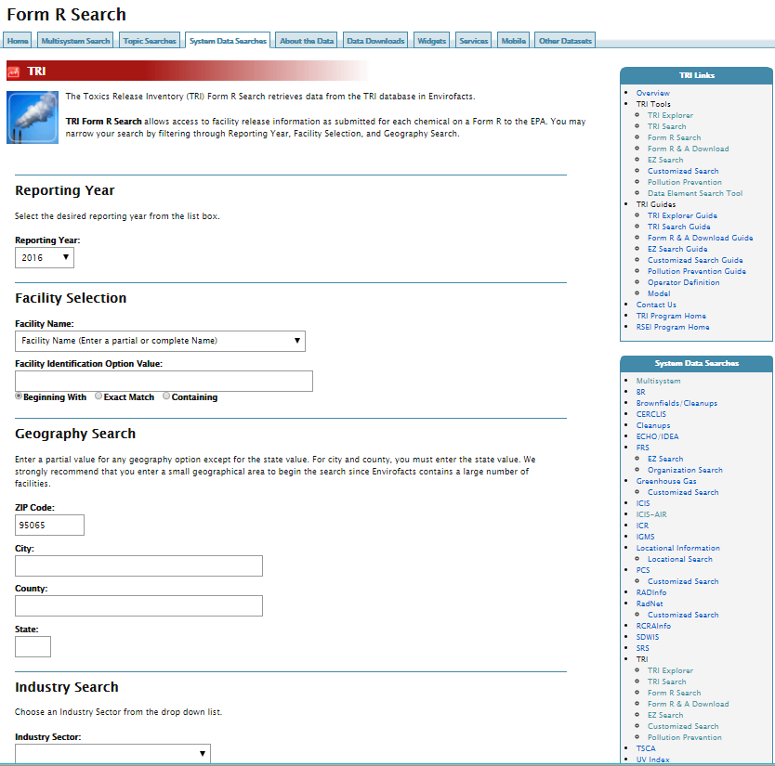
Depending on individual query results, you will see 1 of 2 possible views after this screen
If only 1 facility matches search criteria:
Results will be a list of TRI forms from the facility.
If multiple facilities match the search criteria:
Results will be a list of facilities.

Slide 7
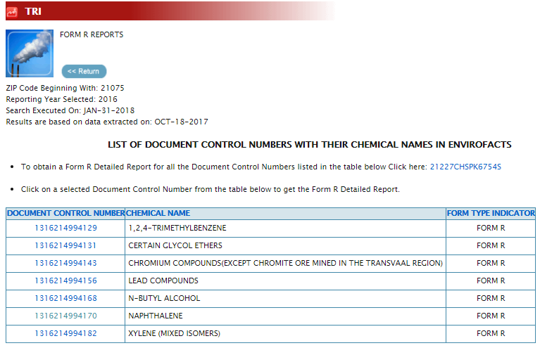
Results For A Single Facility
A misnomer. Results will include both form R and form A submissions
Click to see the form populated with data

Slide 8
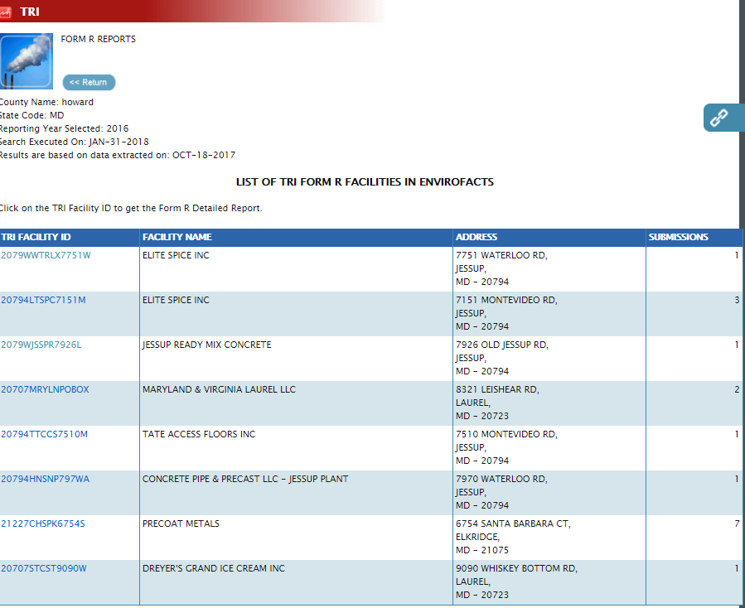
Results For Multiple Facilities
Depending on # of submission, you will see 1 of 2 possible views after this screen.
If multiple submissions:
Results will be as shown on the previous slide
If 1 submission:
Results will display the form containing data.

Slide 9
General Anatomy of a Form R
Non TRI Data
Latitude / Longitude
RCRA, NPDES, UIC ID numbers
Part I – Facility identification
Name, Address, primary NAICS, other NAICS, parent co, and more
Part II – Chemical Information
Section 1. – Chemical Identity
Section 2. – Mixture Component Identity
Section 3. – Activities and Uses of the Toxic Chemical
Section 4. – Maximum Amount of the Toxic Chemical Onsite During the Calendar Year
Section 5. – On-site Emissions
Section 5.1 – Fugitive Air Emissions
Section 5.2 – Stack Air Emissions
Section 6. – Transfers to Off-site locations
Section 7. – On-Site Waste Treatment
Section 8. – Source Reduction and Recycling Activities
Section 8.10 – Source Reduction Activities
Section 8.11 – Additional Data

Slide 10
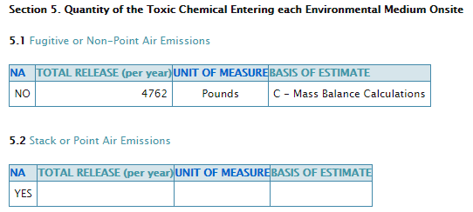

Detail Anatomy of a Section 5
Method used by facility to determine estimated release. (10 possible codes). Click header to see possible codes
Will be either pounds or grams
Will be a single value or a range of values for the estimated release. A range means facility entered a range code for this data field. Example
Yes means this section is not applicable

Slide 11
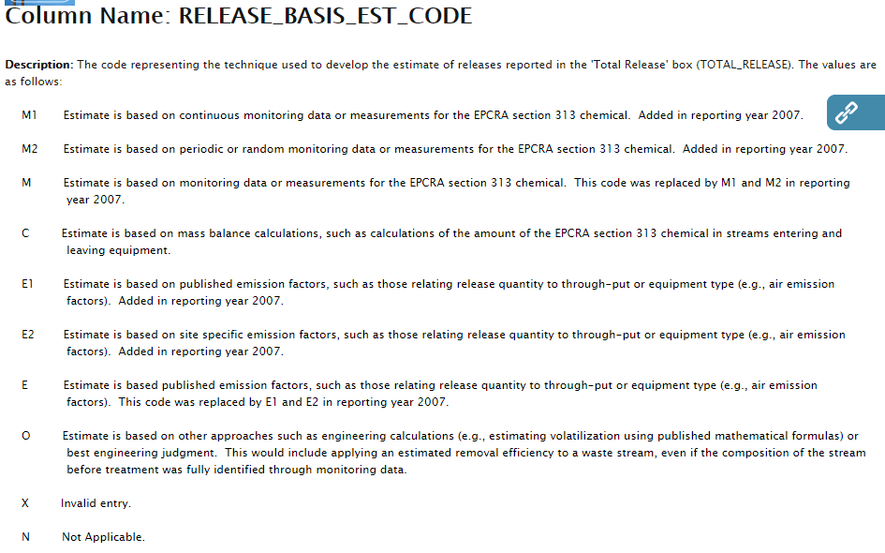
List of Possible Basis of Estimate Codes

Slide 12
How to Search for Multiple Facilities or Multiple Chemicals at Once
Form R and A Download
Access to all data elements on form R (492)
18 Available search parameters
Selection of data elements by data element name
OR
TRI EZ Search
Select Subject Area = “Chemical releases to Air”
35 data elements
Most (or all) data elements may be a search parameter
6 additional elements to describe ‘Coded’ elements
Selection of data elements by Plain English text
Options to modify layout of output table
Both searches have very powerful search capabilities (Click ‘Operator Definition’ or ‘Search Options help’ column header for assistance.

Slide 13
Live Demonstrations Form R and A Download and TRI EZ Search
Following slides are for example only and may differ from the live demo

Slide 14
Form R & A Download
Example data pulls
How to find the method of calculation for air release estimate
How to find waste treatment method for gaseous waste streams

Slide 15
Method
Elements to pull
Chemical information
Facility information
Air release information (stack and fugitive releases)
Release calculation estimation method code
Waste stream treated
Waste treatment method

Slide 16
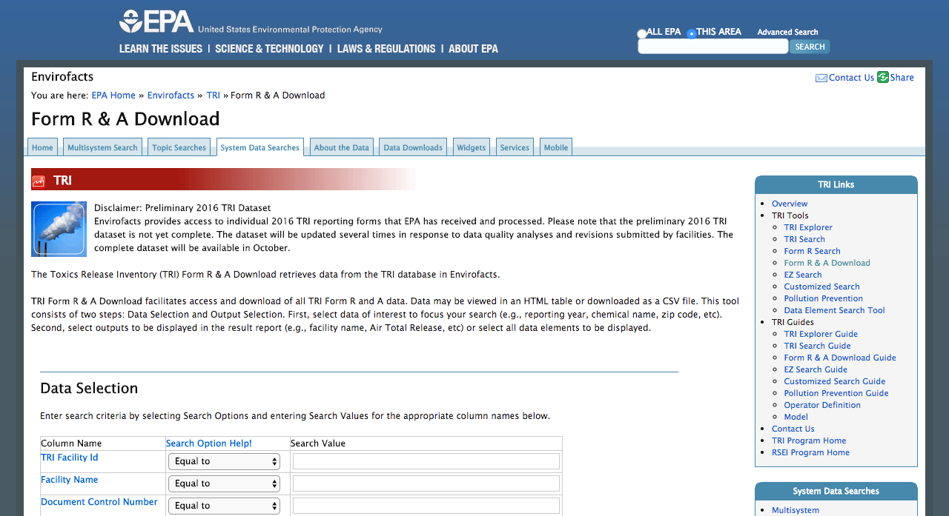
Form R & A Download

Slide 17
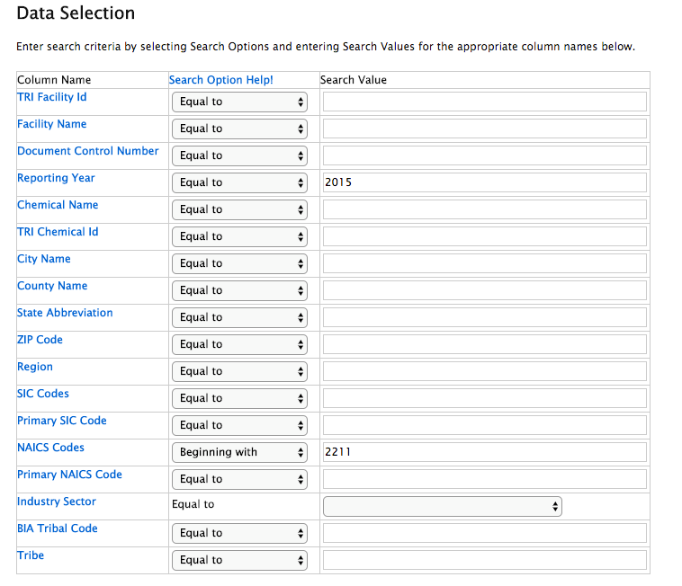
Form R & A Download: Filter

Slide 18
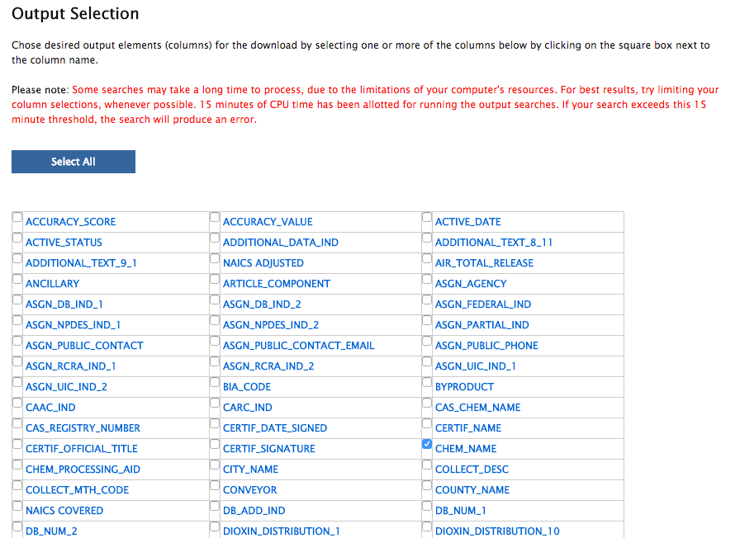
Form R & A Download: Data Elements

Slide 19
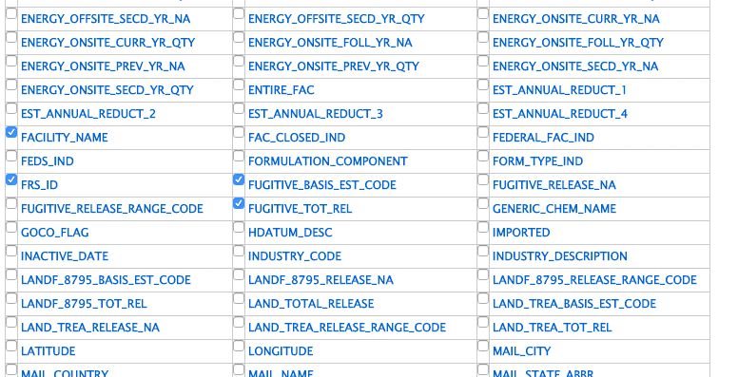
Form R & A Download: Data Elements

Slide 20
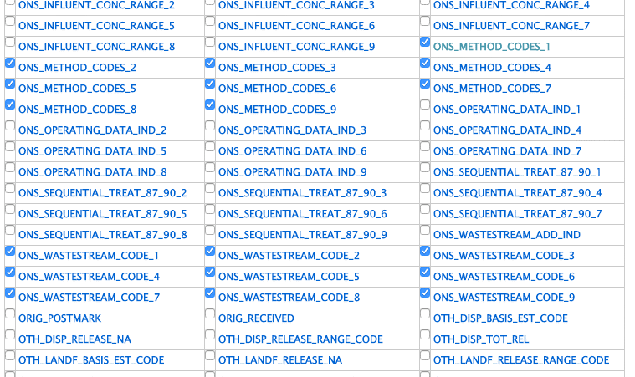
Form R & A Download: Data Elements

Slide 21
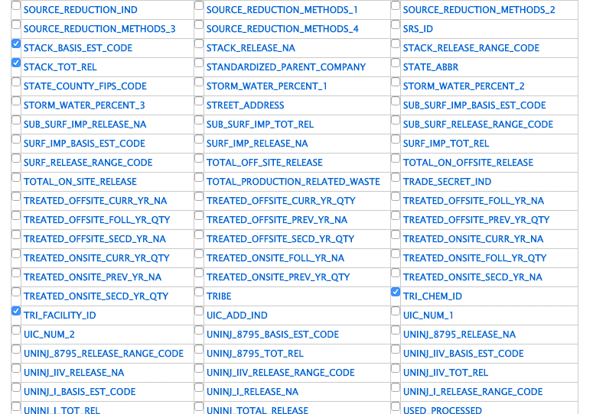
Form R & A Download: Data Elements

Slide 22
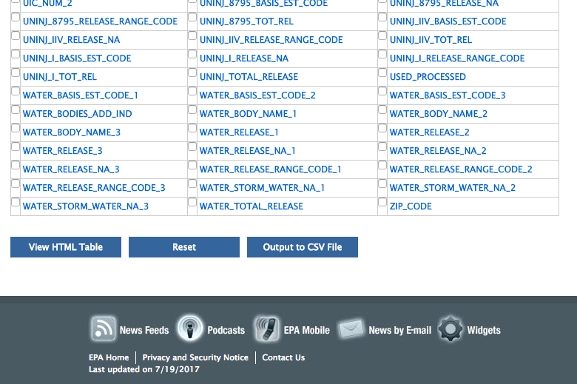
Form R & A Download: Output

Slide 23
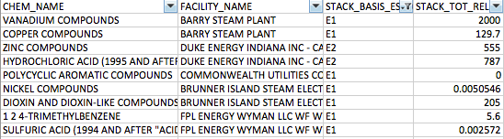
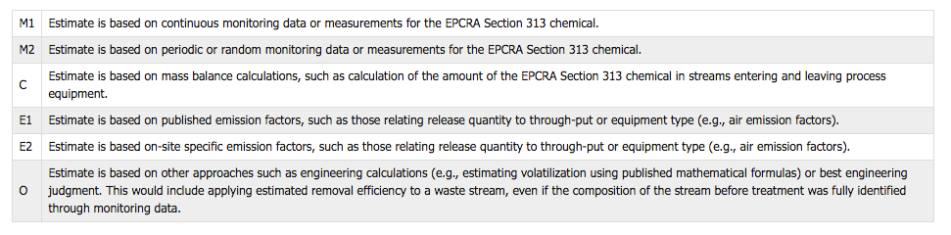
Output Example

Slide 24
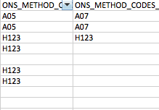
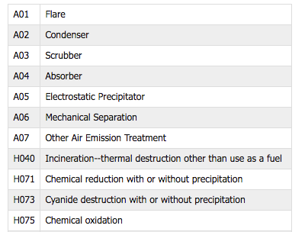
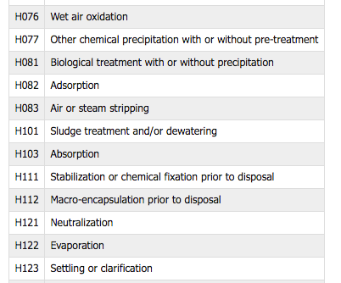
Output Example

Slide 25
Basis of Estimate Codes
Notes:
You are required to indicate the principal method used to determine the amount of release and otherwise managed waste reported. You should enter a letter code identifying the method that applies to the largest portion of the total estimated release and otherwise managed waste quantity.

Slide 26
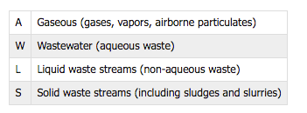
Waste Stream Codes
Notes:
7A column a: general Waste Stream

Slide 27
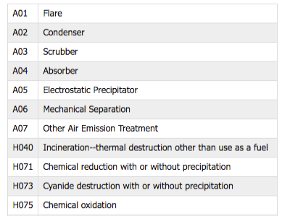
Waste Treatment Codes
Notes:
Hypothetical section 7A waste treatment codes

Slide 28
TRI EZ Search
The following example will return most of the same data elements as the previous Form R and A Download report.
Information on the waste stream treatment is not included.

Slide 29
www.epa.gov/enviro

Slide 30
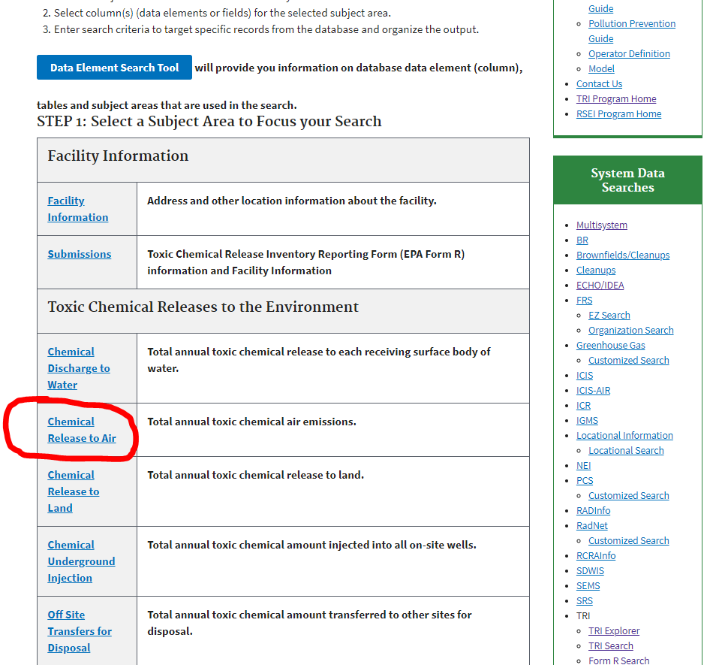

Slide 31
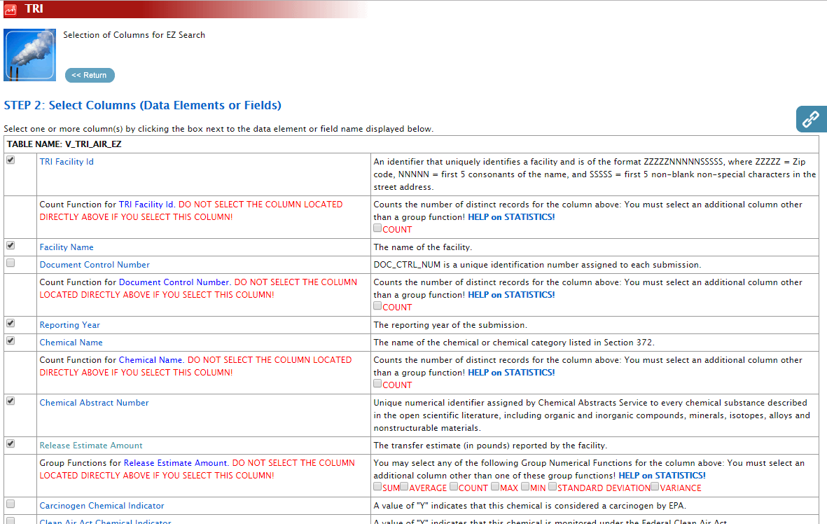
EZ Search (Releases to Air): Data Elements

Slide 32
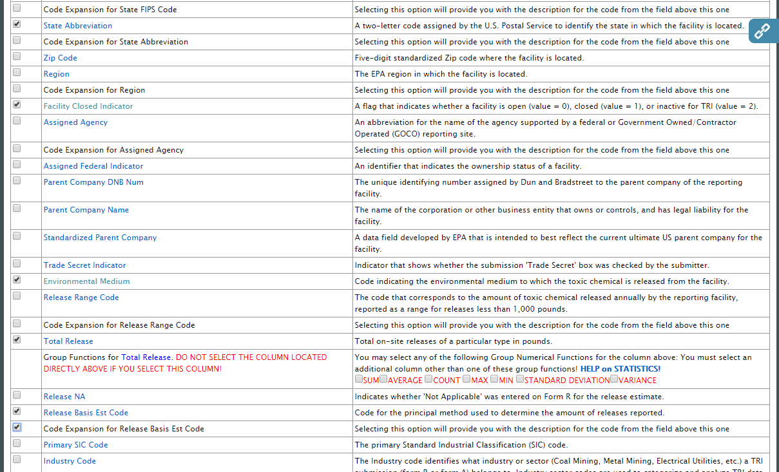
EZ Search (Releases to Air): Data Elements

Slide 33
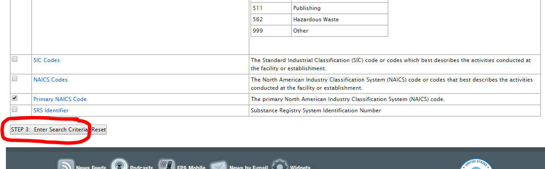
EZ Search (Releases to Air): Data Elements

Slide 34
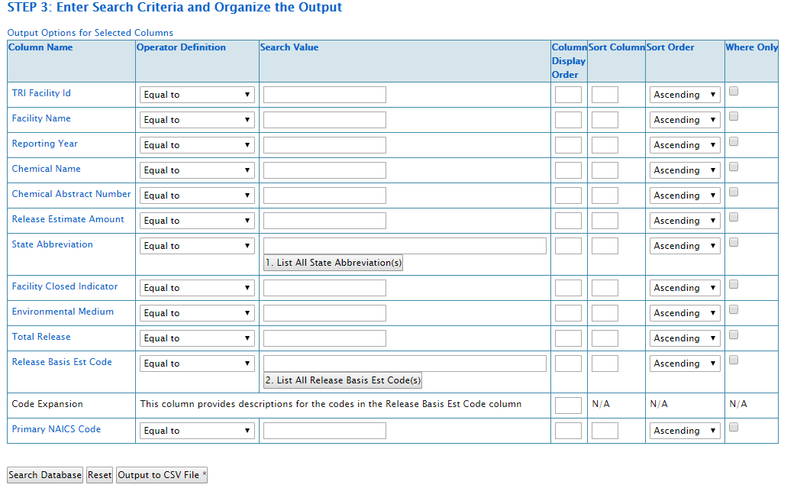
EZ Search (Releases to Air): Filters

Slide 35
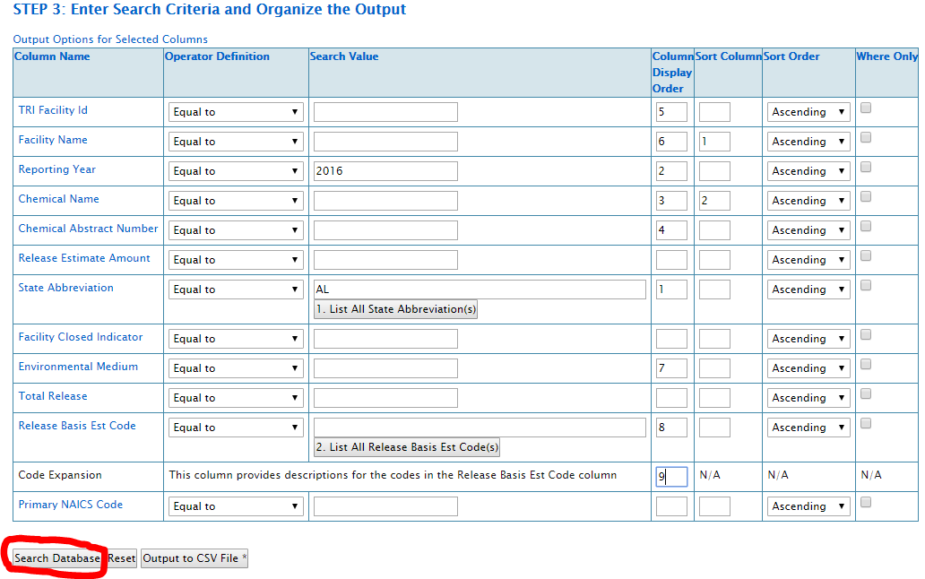
EZ Search (Releases to Air): Filters
Preferred option
Suggest you avoid this data element for now

Slide 36
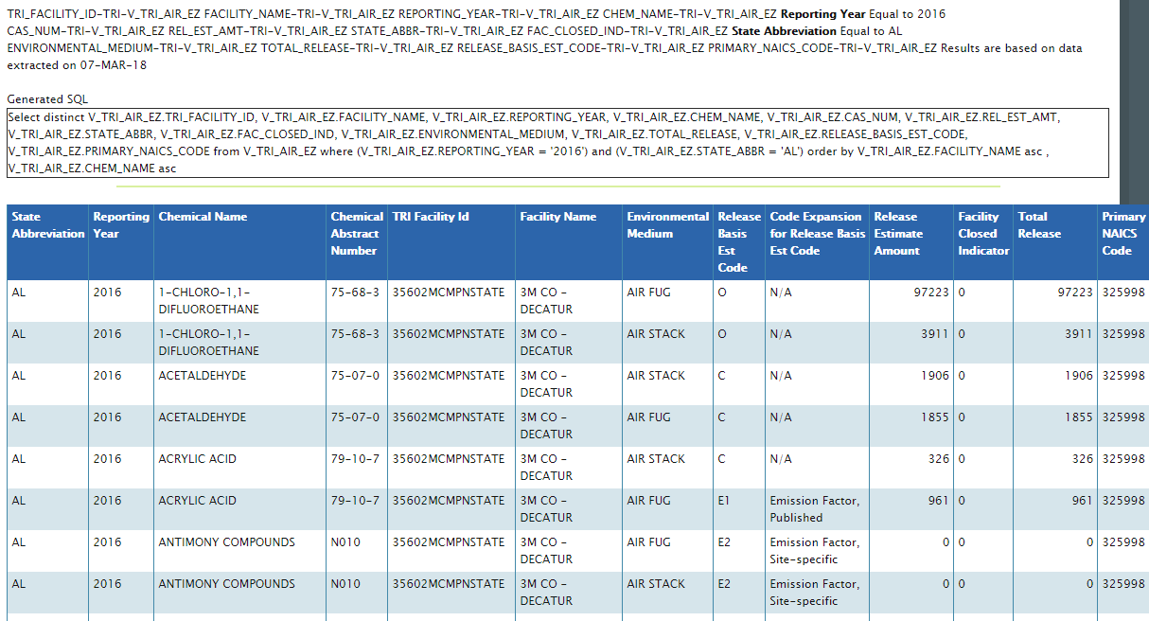
EZ Search (Releases to Air): Output Example

Slide 37
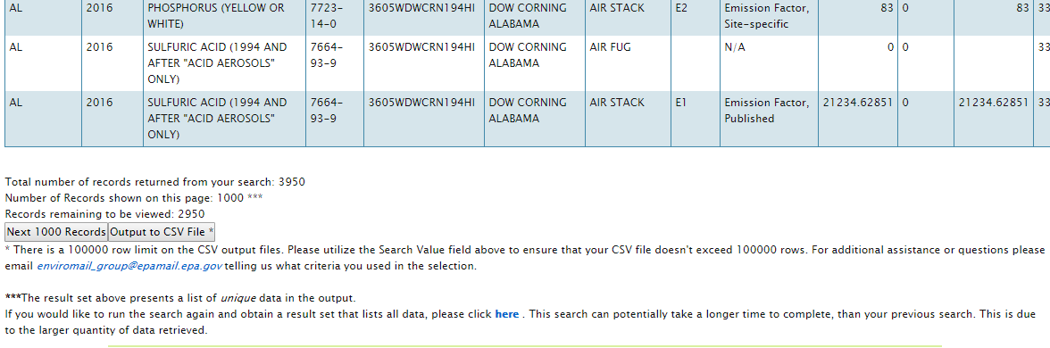
EZ Search (Releases to Air): Output Example
In previous example, with the data elements used, you likely will not identify any difference in release amounts compared to using “all data” for the specific focus area. If media type was not included AND if the same value was reported for stack and for fugitive, then the results would only display this value once and not add the two together.

Slide 38
Other TRI Tool Options:
TRI Explorer
Higher level summary data
Fewer detailed data fields available
Output is pre-formated
Fast / More interactive links / More on-line help
Downloadable Files (Decent Documentation)
Basic
Lacks “Basis of Estimate” data element
Single file for each state / year combination
Basic plus
Includes practically all data elements
No individual State Files
8 individual data files / year for all data elements

Slide 39
Help us Improve!
You will receive an email with a link to a survey to review the course(s) you attend at the Emissions Inventory Training Workshop.
Please take a few moments to let us know about your experience this week.
We welcome your feedback!

