Slide 1
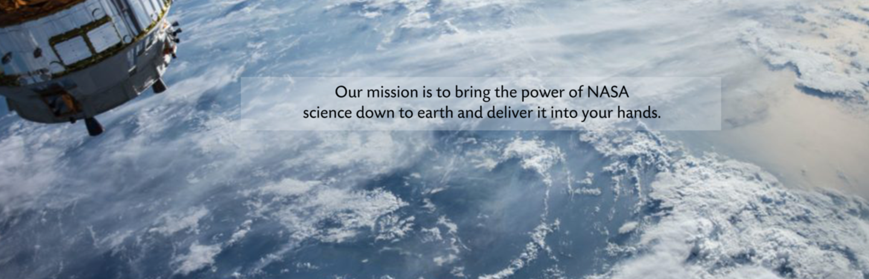


Satellite Data for Air Quality and Health
The NASA Health and Air Quality Applied Sciences Team (HAQAST)
3rd Generation; 2021-2025
Tracey Holloway, University of Wisconsin—Madison

Slide 2
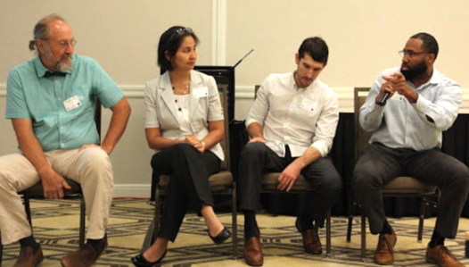
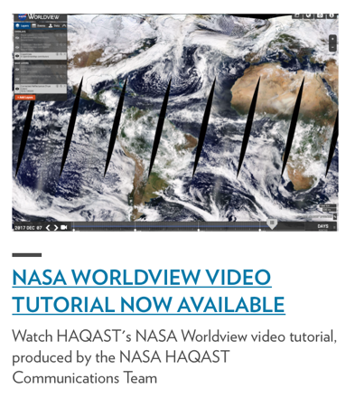
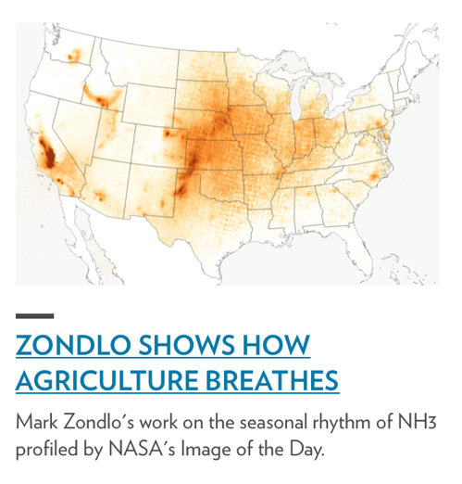
What is “hay-kast”?
Health and Air Quality Applied Sciences Team
NASA-funded Applied Sciences Team
4 year initiative through 2025
14 Members and 70+ co-investigators
Mission: Connect NASA science with air quality and health applications
Three types of work:
Member projects
Tiger team projects (collaborative)
Outreach, engagement, rapid response

Slide 3
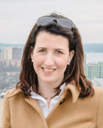
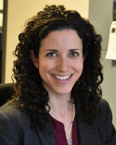
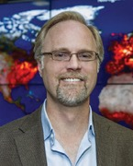
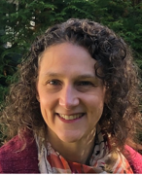
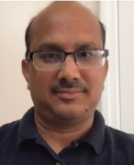
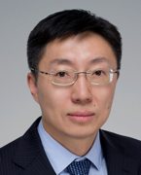
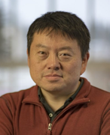
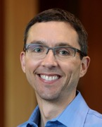
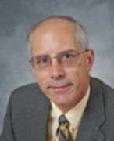
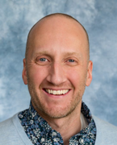
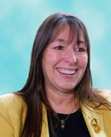
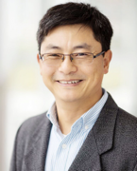
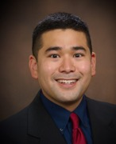
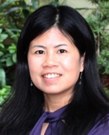
14 NASA Health and Air Quality Applied Sciences Team Members (HAQAST)
Tracey Holloway (Team Lead, UW-Madison)
Susan Anenberg (George Washington University)
Bryan Duncan (NASA GSFC)
Arlene Fiore (Columbia University)
Pawan Gupta (Universities Space Research Association)
Yang Liu (Emory University)
Jingqiu Mao (University of Alaska, Fairbanks)
Randall Martin (Washington University)
Ted Russell (Georgia Tech)
Jeffrey Pierce (Colorado State University)
Amber Soja (National Institute of Aerospace)
Daniel Tong (George Mason University)
Christopher Uejio (Florida State University)
Qian Xiao (University of Texas Health Science Center at Houston)
haqast.org

Slide 4
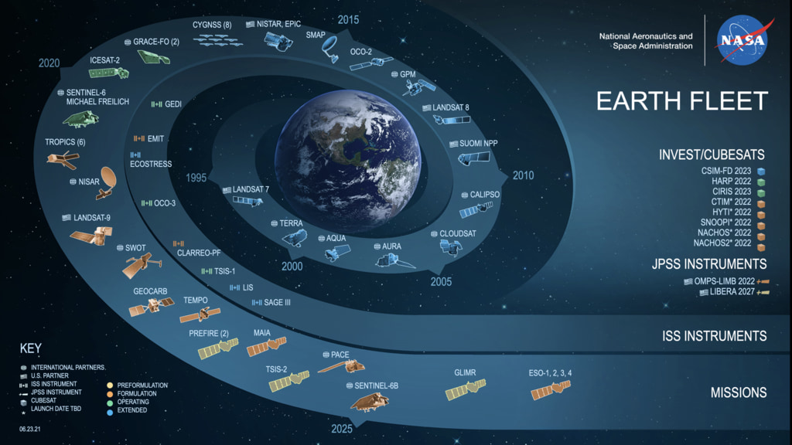
https://svs.gsfc.nasa.gov/vis/a030000/a030000/a030065/earth-spiral-06.23.21.001_print.jpg

Slide 5

The team structure fundamentally changes outcomes.
Increased visibility of work and resources to end-users
Culture to support and promote collaborations and synergies
Growth of two-way dialogue
Increased collaborations to meet stakeholder needs
Rapid spin-up of high-value activities
HAQAST1:
2011-2016
HAQAST2: 2016-2020
HAQAST3: 2021-2025

Slide 6
HAQAST Supports Two Types of Projects:
Individual & Tiger Team
March. 2021
2022
2024
2024
2025
14 HAQAST Members’ Proposed Initiatives
with stakeholders & Co-I collaborators
Year 1 “Tiger Teams”
larger collaborations
Focused, stakeholder-based, short-term
Year 2 “Tiger Teams”
TBD

Slide 7
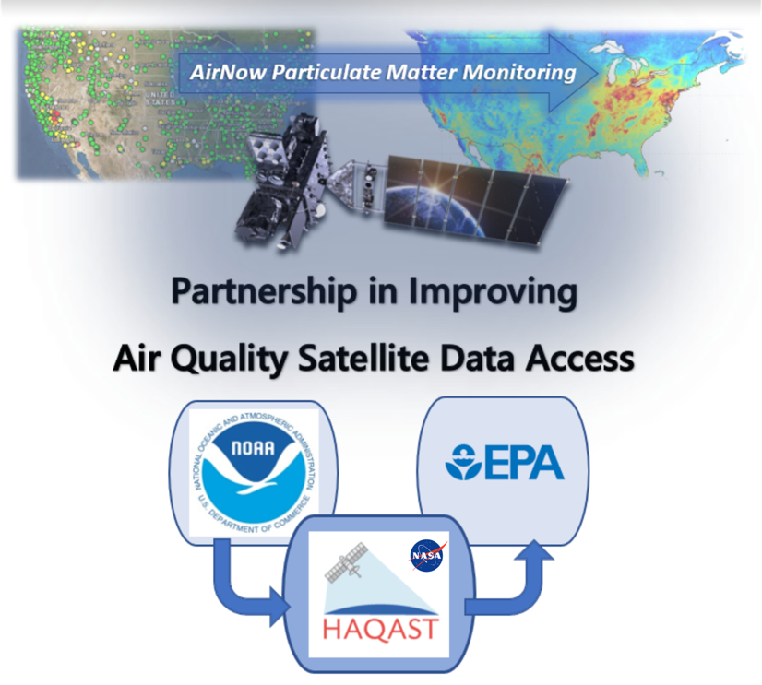
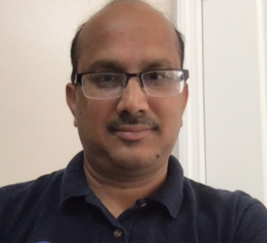
Enabling high-frequency satellite data in the USEPA AirNow system
Team Lead: Pawan Gupta
Partners: Phil Dickerson and Barron Henderson with the US Environmental Protection Agency (EPA), and Shobha Kondragunta with the National Oceanic and Atmospheric Administration (NOAA)
This project …[will] develop a value added hourly and daily PM_{2.5} dataset covering [the continental U.S.] region and
integrate it into the AirNow system.

Slide 8


Slide 9
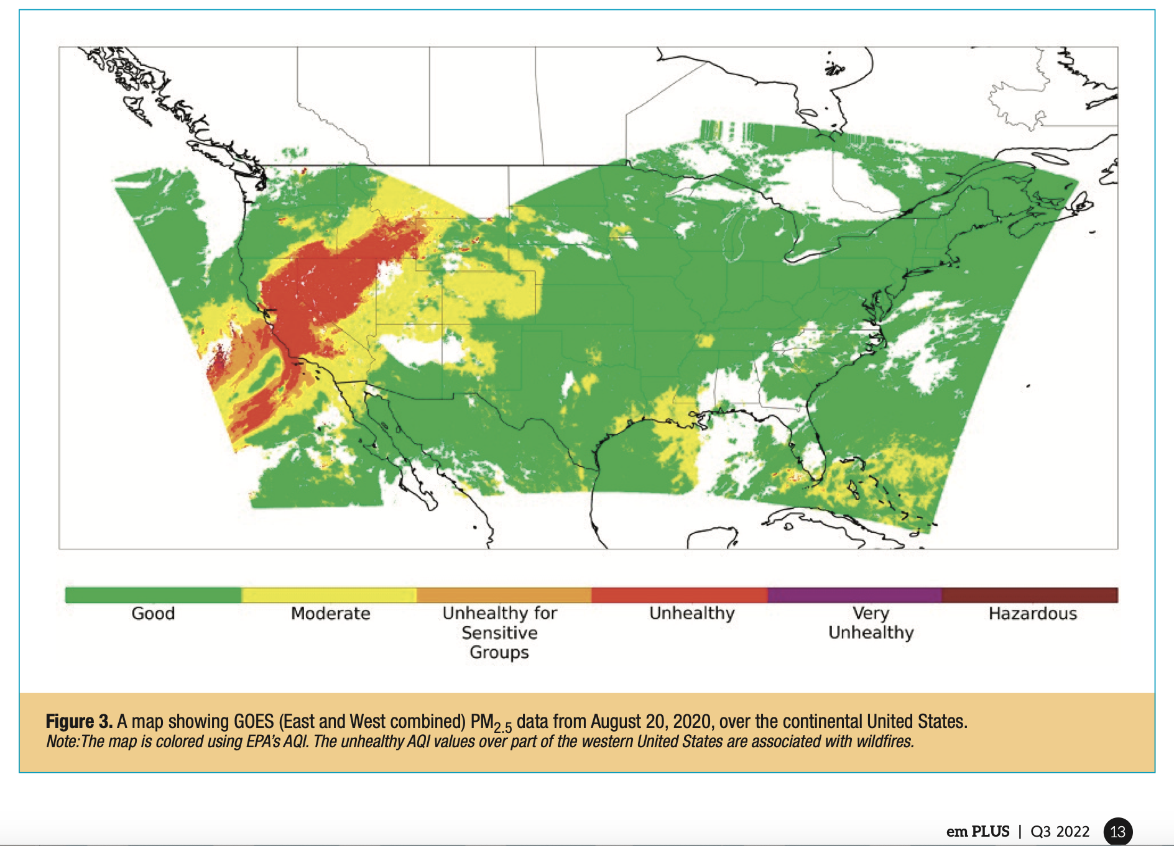

Slide 10
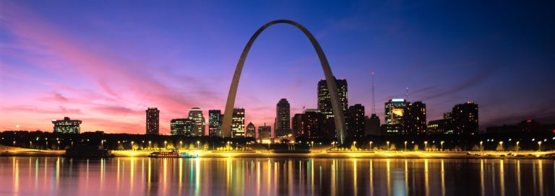
Come to the next HAQAST meeting!
Next public meeting
HAQAST Missouri, at Washington University in St. Louis
April 18th and 19th, 2023
Free and hybrid
Funding stipends for stakeholder travel is available ($1,500)
Mix of stakeholder and academic speakers

Slide 11



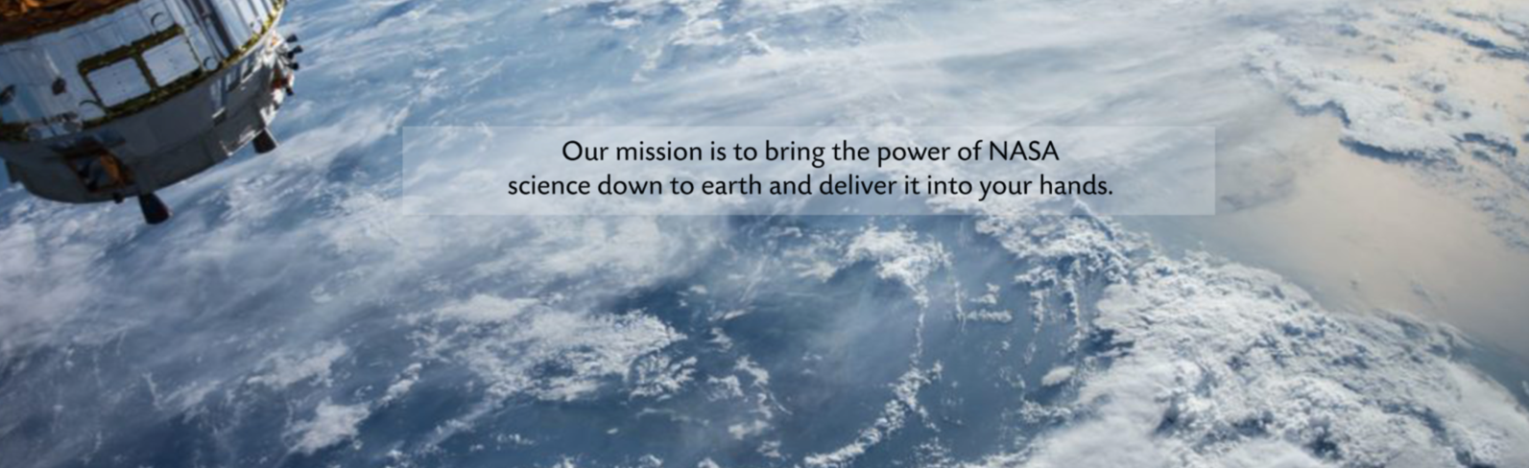
Welcome to HAQAST Launch21
HAQAST.org
Notes:
2. a “how we work” or “menu of services” some other sort of menu or flowchart (explicitly or implicitly) could be helpful. I tried to put this together in the attached document.
If the credibility stuff could be added to an early “about us” slide (like with our photos) that is highest priority for Wed. I’d say — and the how-we-work is something that we can just talk about, whether or not there’s a slide.
Easy:
1. Change background color to the steel blue of the hollowaygroup website https://hollowaygroup.org
— just to build a more cohesive branding. If you can grab other aspects of the website - even a screenshot of the first page - that might also fit.
2. Add a photo/image on each slide - these can be free stock photos like on the website, or images from our past work/presentations (I’m attaching the presentation I gave at the energy funders meeting in August - this may have images to use too).
3. Include pictures of you, me, Monica, and take from the hollowaygroup website. Since these are phone meetings, it can help them see who’s who.

