Slide 1


HAQAST Tiger Team
Phil Dickerson, OID/OAQPS
March 1, 2023

Slide 2
The AirNow Vision
AirNow is the authoritative source for reliable, accurate, clear and actionable air quality and health information.
To achieve that, AirNow must:
Be the real-time air quality gold standard and most trusted source
Communicate air quality information clearly to the public through web and smart phone applications
Empower individuals to act to reduce exposure when air quality is unhealthy
Partner with stakeholders to shape and influence the use of air quality data from AirNow and other available and emerging air data sources to maintain and enhance the AirNow vision and brand

Slide 3
Cornerstones for Success
Modern, fully functional and user-friendly website and mobile application that provides scalable local, real-time air quality data and forecasts to enable the public to make health-based decisions
State of the art information technology infrastructure to support the collection, processing, storage and distribution for air quality information and forecasts

Slide 4
Cornerstones for Success
Strong partnerships and collaboration within EPA (OAQPS divisions/EPA Regions) to ensure there is an integrated agency-wide strategy to support the AirNow vision and brand
Strong partnerships between EPA and external stakeholders: (1) to identify common approaches and consistent public messaging to address rapidly evolving trends in air quality data technology; and (2) to influence, maintain and enhance the AirNow brand

Slide 5
Meeting Shifting Demands
Small sensors are suddenly flooding the market, even reaching the consumer market
There is now widespread demand for air quality information
Private industry is responding with products.
Those products are currently developed by individual companies and conflict with each other and with AirNow.
Users trust AirNow as the government source of air quality data. The brand is well established, both with consumers and in the private sector.
To maintain that brand, while meeting the growing demand for hyperlocal air quality information, AirNow must develop new capabilities.

Slide 6
New capabilities needed to realize vision
Creating Highly-resolved Real-time Products to Fill Gaps
Address spatial gaps by improving real-time interpolation methods
Bring hyperlocal data to users, moving away from monitor-centric data products and towards gridded, high-resolution local data
Explore using other datasets that may help fill spatial gaps between monitors, i.e. sensor, models
Close temporal gaps by improving forecast timeliness
Move from daily forecasting towards hourly
Work with SLTs to improve how the AQI and AQI estimates (NowCasts and forecasts) are communicated to the public

Slide 7
New capabilities needed to realize vision
Integrating Other Air Quality Datasets
Develop a “fused” approach in which satellite, model, monitored, and/or small sensor data (as well as other data sources that may not exist today) contribute to the most accurate air quality surface possible for all localities
Scaling Infrastructure to Meet Demand
AirNow.gov must be ported to a cloud infrastructure so that AirNow staff can quickly increase resources during an air quality event, but decrease those resources once the event has passed
Develop a new AirNow app to divert some load from the website and to provide hyperlocal air quality information

Slide 8
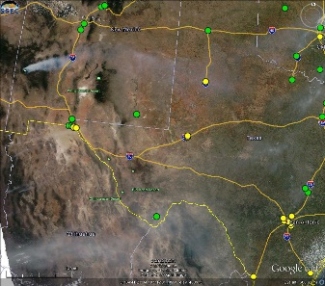
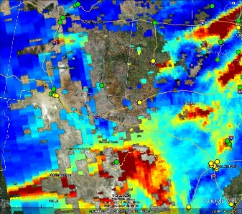
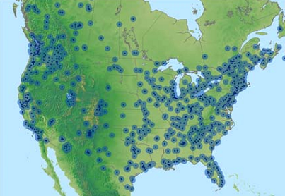
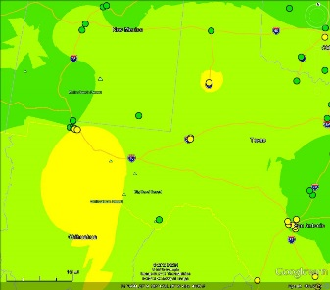
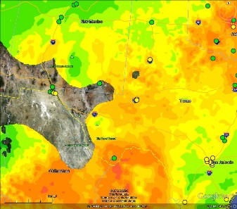
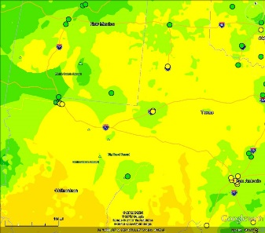
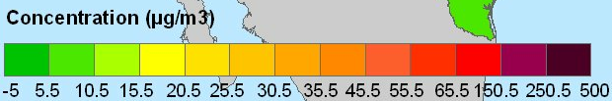
2008 work – important proof-of-concept
Spatial coverage of current AirNow maps is limited. There are data gaps where over 36 million people are (~40% of the area) not covered by a monitoring network.
Satellite data, specifically AOD can provide information to “fill-in” these gaps.
The AirNow Satellite Data Processor (ASDP) produces a daily fused surface using in-situ and remotely-sensed observations
MODIS True Color: Smoke
MODIS AOD
Current continuous AirNow PM_{2.5} monitoring sites
AirNow OBS
Satellite Data
Fused Data
Satellite data captures the smoke and observed aerosols not in the AirNow data.
Concentration (µg/m³)
Example: New Mexico and Mexican Fires 5/24/2012

Slide 9
Which brings us to today…
Integrating Other Air Quality Datasets
The HAQAST Tiger Team has taken the idea of supplementing in-situ data with satellite products and extended it
Newer measurements have far less latency
Using geo-stationary satellites
Creating a fusion technique that can be expanded

