Slide 1
GOES-R PM_{2.5} Evaluation and Bias Correction - A Deep Learning Approach
Presenter: Alqamah Sayeed, Ph.D.
Associate Scientist, USRA/NASA-MSFC
HAQASAT, March 2022
Co-authors: Alqamah Sayeed, Pawan Gupta, Hai Zhang, Shobha Kondragunta, Barron Henderson, Yang Liu, Dimple Purthi, Jingqiu Mao, Sunder Christopher, Robert Levy, Phillip Dickerson

Slide 2
Introduction
Background
PM_{2.5} has emerged as a pollutant of concern
Sudden or prolonged exposure to particulate matter (PM) might lead to serious health implications and/or premature death.
Regulatory grade monitors (RGM) provide high-quality near real-time PM_{2.5} measurements.
Low-cost sensors (LCS) and satellites are new ways the air quality community is exploring to monitor surface PM_{2.5} at varying spatiotemporal scales.

Slide 3
Introduction
Motivation:
Due to cost and logistics, a dense network of RGM is limited
The quality of measurements from LCS is still an issue
Polar-orbiting satellites have limited temporal coverage
Objective
Estimation of hourly PM_{2.5} concentration at a resolution of ~2 km using DNN, numerical models, and satellite AOD

Slide 4
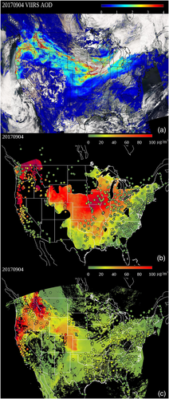
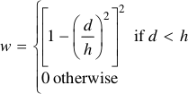
Review : GOES PM_{2.5} Data Evaluation
PM_{2.5} estimated using Geographically Weighted Regression (GWR)
Instead of using LUT for slope and coefficient dynamical weighted average was used.
Source: Zhang, H., Kondragunta, S., 2021. Daily and Hourly Surface PM2.5 Estimation From Satellite AOD. Earth Space Sci. 8, e2020EA001599. https://doi.org/10.1029/2020EA001599
Notes:
In Equation 2, i, j represent the time and location. In this model, PM2.5 is assumed to be a linear function of AOD. As shown, the coefficients (a_{0ij}, a_{1ij}) are different for different location and time. For daily PM2.5, the coefficients are derived from the daily matchup data set of PM2.5 and AOD through GWR algorithm. To matchup satellite AOD at a site, AOD pixels within 27.5 km PM2.5 site are averaged; the choice of 27.5 km radius is the standard approach used widely in the validation of satellite AODs (e.g., Levy et al. 2010; Huang et al., 2016). Although the Equation 2 and Equation 1 look the same, the coefficients are derived differently. The coefficients in Equation 2 are derived dynamically at the time of the PM2.5 estimates, while those in Equation 1 are climatological values and stored in a LUT.
There are different ways to assign the weight in the regression. In this approach, a bisquare function is used for the weight:
In Equation 3, d is the distance between the point of interest and the point with matchup data and h is the maximum distance of the closest N points to the point of interest. The number N here is called bandwidth which are the number of points used for the regression. The bandwidth can be assigned with fixed value or be assigned adaptively using some algorithms. The value h is not a fixed value throughout the space if the bandwidth is fixed. It depends on the density of the matchup points. In areas with high data density, h is small, and vice versa.

Slide 5
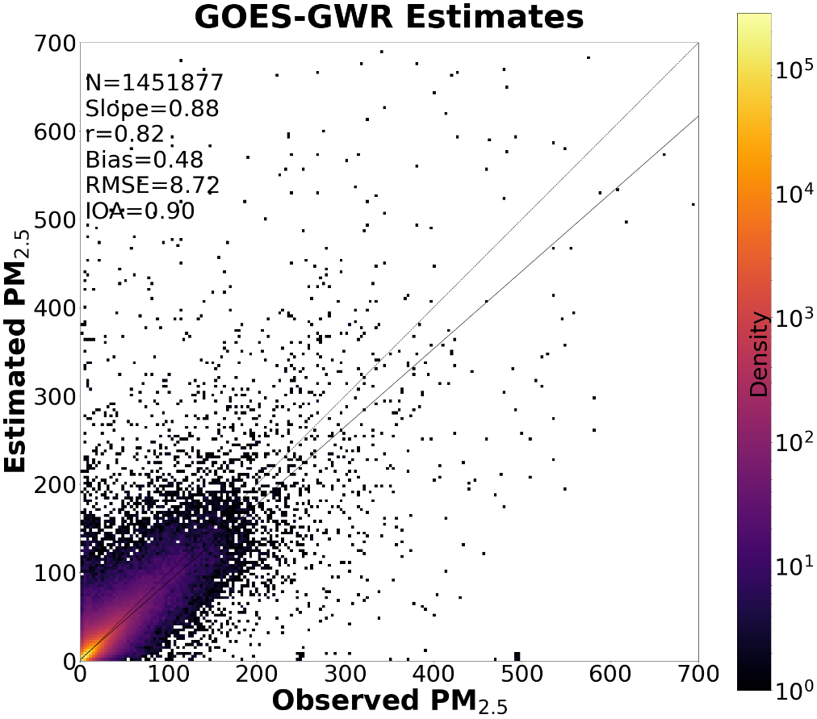
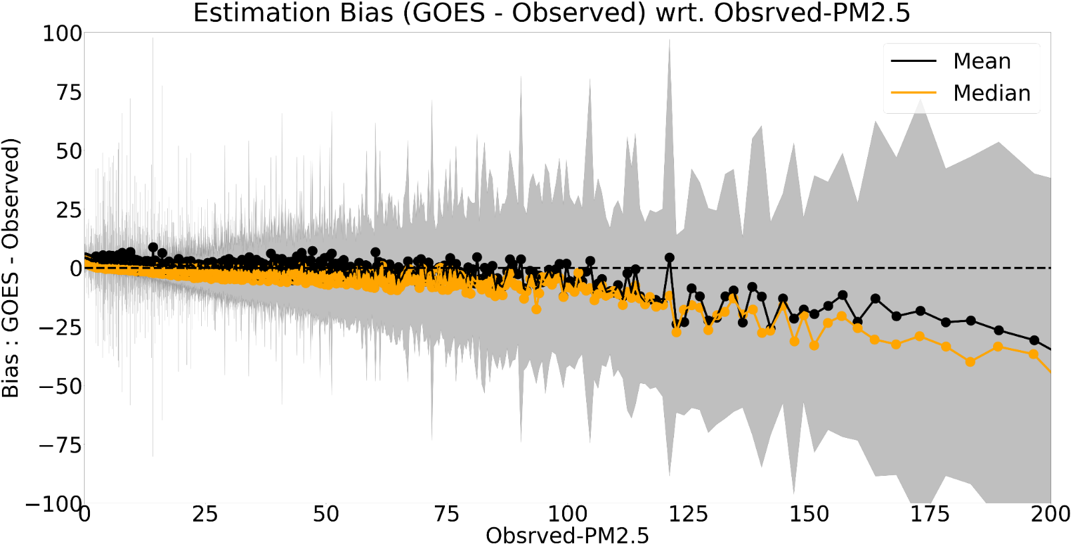
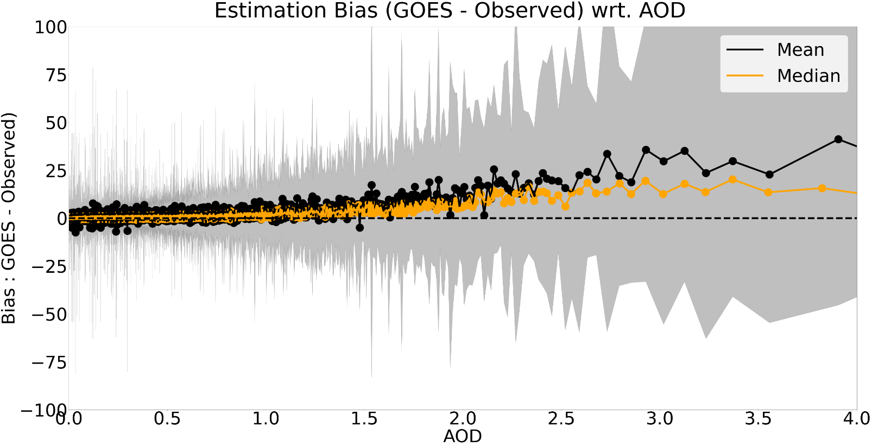
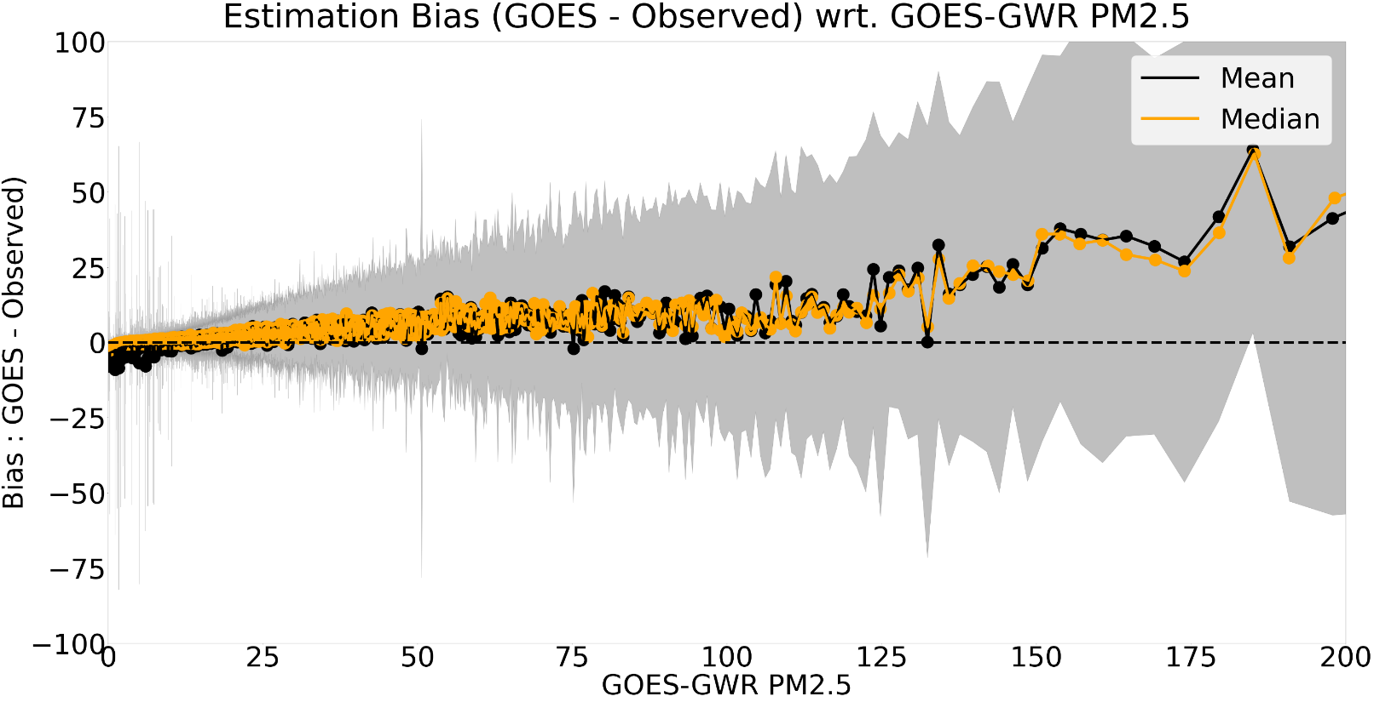
GOES PM_{2.5} Data Evaluation contd…
Notes:
Figure 2a shows the scatter density of GOES-GWR estimated PM_{2.5} with respect to observed PM_{2.5} from July 01, 2020 to Nov 30, 2021. The overall correlation was 0.82 with mean bias (MB) ~0.48 µg/m³, root mean squared error (RMSE) of 8.72 µg/m³, and index of agreement (IOA) of ~0.90.

Slide 6
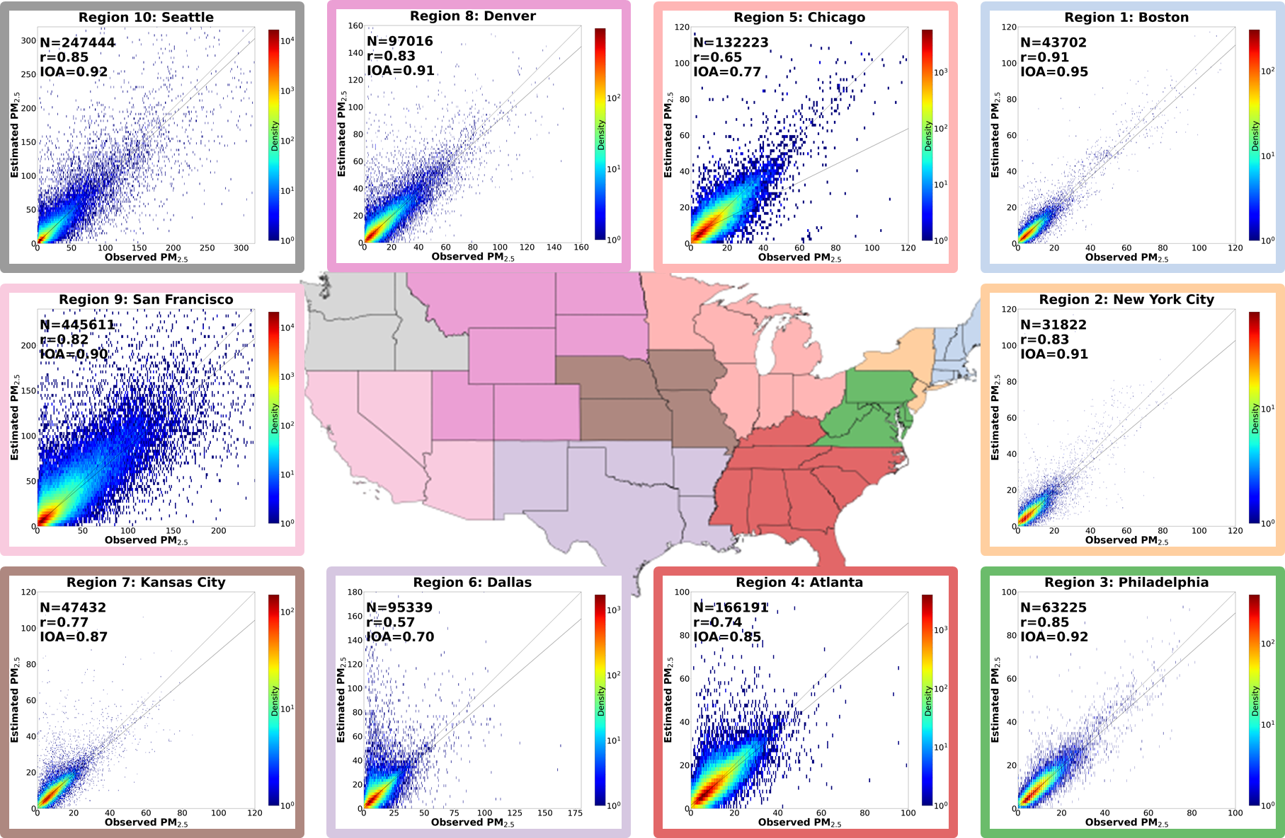
GOES PM_{2.5} Data Evaluation contd…

Slide 7
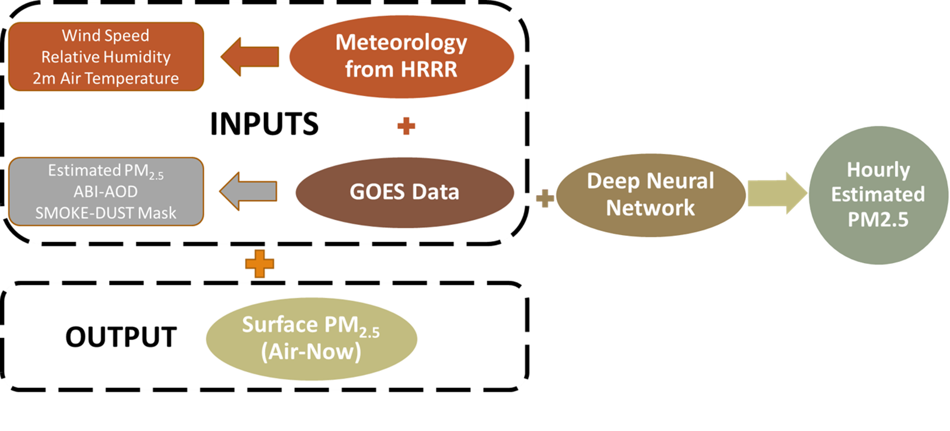
Model and Methods
MODEL
DNN model with 5 fully connected dense layers.
Customized loss function based on Index of Agreement (IOA).
METHODS
Temporal and Spatial collocation of input and target data
Splitting dataset into 14 blocks
Training a DNN model for each block of data

Slide 8
DNN Modelling
Identification of Study Domain
Parameter Selection
Design of DNN model
Merging GOES-E and GOES-W
Data Preprocessing
Training of DNN model
Evaluation of DNN model
Operational Implementation

Slide 9
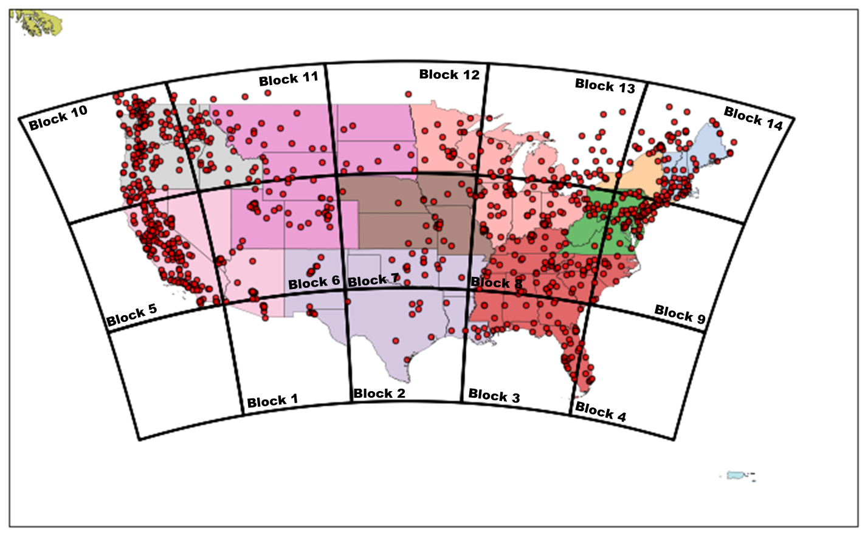
Study Area and Domain
Domain - CONUS
Time Periods-
Training - Jul 1, 2020, to Nov 30, 2021
Evaluation - Jan 1, 2020, to Jun 30, 2020
Resolution-
Horizontal - ~2 kms at Nadir
Temporal - Hourly

Slide 10
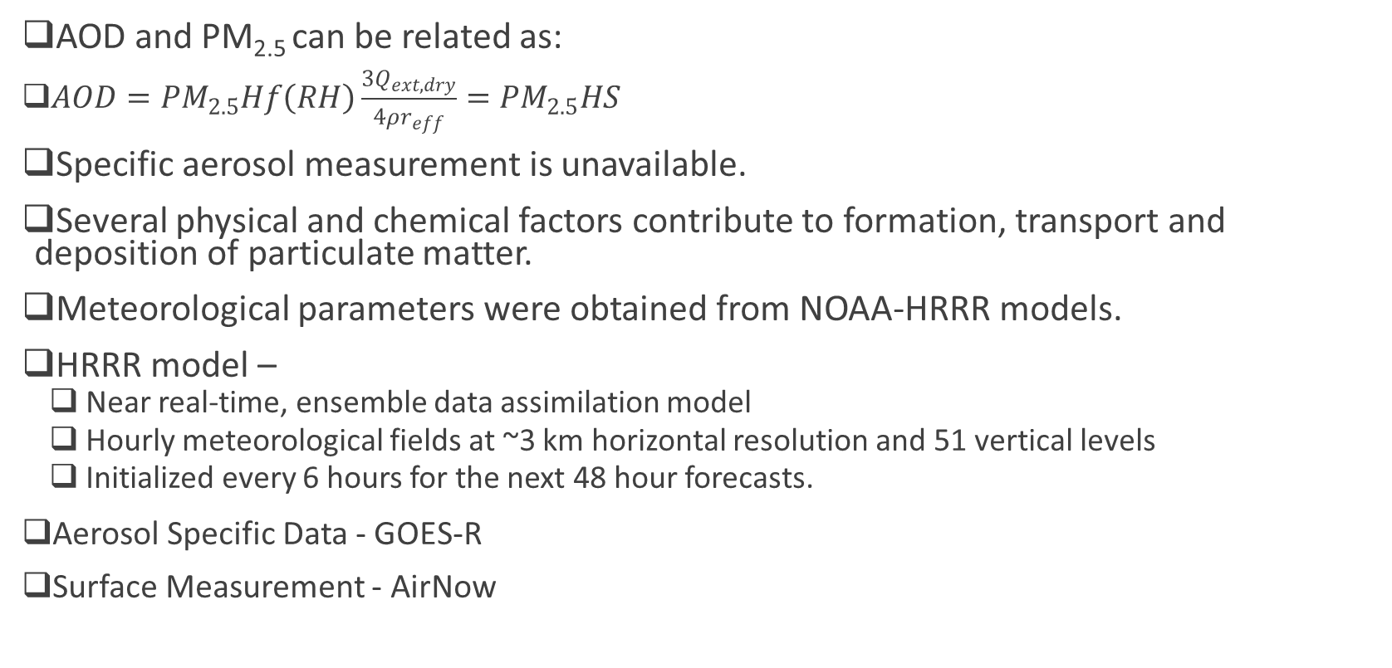
Parameter Selection
AOD and PM_{2.5} can be related as:
$AOD={PM}_{2.5}Hf\left(RH\right)\frac{{3Q}_{ext,dry}}{4ρr_{eff}}={PM}_{2.5}HS$
Specific aerosol measurement is unavailable.
Several physical and chemical factors contribute to formation, transport and deposition of particulate matter.
Meteorological parameters were obtained from NOAA-HRRR models.
HRRR model –
Near real-time, ensemble data assimilation model
Hourly meteorological fields at ~3 km horizontal resolution and 51 vertical levels
Initialized every 6 hours for the next 48 hour forecasts.
Aerosol Specific Data - GOES-R
Surface Measurement - AirNow
Equation source: Koelemeijer, R.B.A., Homan, C.D., Matthijsen, J., 2006. Comparison of spatial and temporal variations of aerosol optical thickness and particulate matter over Europe. Atmos. Environ. 40, 5304–5315. https://doi.org/10.1016/j.atmosenv.2006.04.044
Notes:
Assuming a well-mixed boundary layer height (H) with no overlaying aerosol layers, cloud-free skies, and particles with similar optical properties (Hoff and Christopher, 2009) PM_{2.5} can be estimated from satellite AOD, where f(RH) is the ratio of ambient and dry extinction coefficients, ρ is aerosol mass density (g/m³), Q_{ext} is Mie extinction efficiency, and r_{eff} is the particle effective radius. We don't have proper measurements of these specific aerosol properties, and actual atmospheric conditions often violate the assumptions made in equation 2.

Slide 11
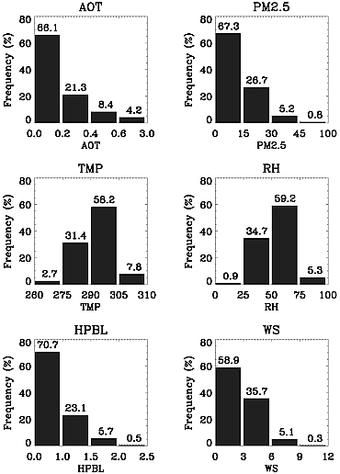
Parameter Selection
Based on previous studies and effect of meteorological parameter on PM_{2.5} following parameters were obtained form HRRR model:
Wind Speed – Accumulation, deposition and/or transport
Surface Pressure –Accumulation, transport and mixing
2m- Temperature - Formation
Soil Moisture - Formation
Dew Point Temperature, Relative Humidity, Specific Humidity - Formation and Size growth
Accumulated Rainfall – Deposition and Size
PBL height - Mixing
Vegetation Type - Formation
Figure Source: Gupta, P., Christopher, S.A., 2009. Particulate matter air quality assessment using integrated surface, satellite, and meteorological products: Multiple regression approach. J. Geophys. Res. Atmospheres 114. https://doi.org/10.1029/2008JD011496
Notes:
Frequency distribution of all the relevant variables used in assessment of particulate matter air quality. AOT is from MODIS satellite; PM2.5 is from ground measurements; and TMP, RH, HPBL, and WS are from RUC reanalysis.

Slide 12
Parameter Selection contd.
Aerosol specific parameters:
PM2.5
AOD
Smoke Dust Mask – to classify pixel
Other parameters:
Time of Data – Solar Zenith angle
Period of year – Sun-Earth Distance
Eliminate and Evaluate Methodology was used to select the input parameters
Selected Variable: WS, RH, 2m-Temeprature, PM2.5, AOD, Smoke-Dust Mask

Slide 13
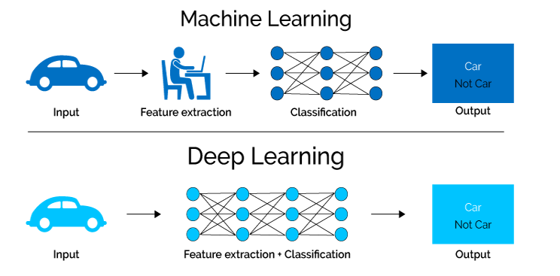
Deep Learning
Artificial Intelligence
Machine Learning
DATA Mining &
DATA Science
Deep Learning
Big DATA
Notes:
I used best of num modeling and deep learning and integraded them to have better spatial and temporal forecasts
Let us first discuss what is an AI
AI – program that can sense ,reason, act and adapt
ML – Ai whose performance improvement with more data
DeepL – multi layered like human brain and each layer has a specific task to perform

Slide 14
Process Flow of an Intelligent System
Final Output
Training Set
NO
Training DATA
Input
Output
Model Training
Model Testing
Is Loss function minimum?
YES
Save Model
Testing Set
Unseen Inputs
Notes:
Explain in detail slowly

Slide 15
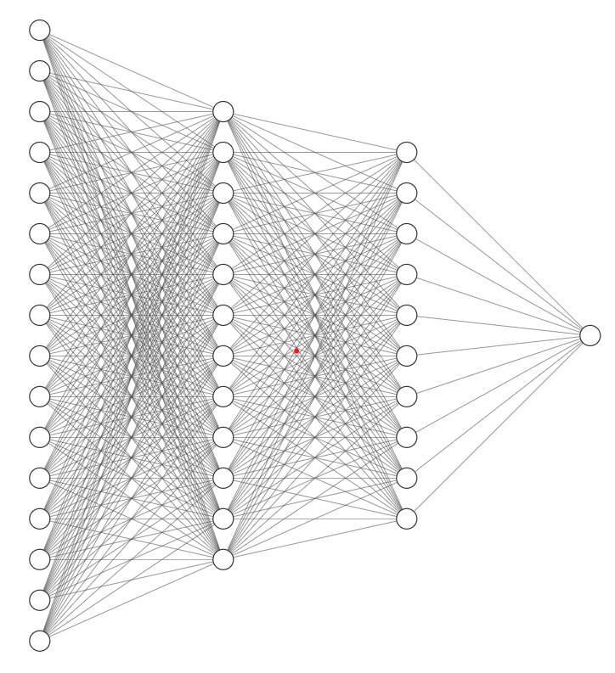
DNN
DNN Model - Logistic Regression thorough multiple hidden layers
Nodes performs regression and connection performs logistic operations through activation function.
Output is validated using loss function.
Weights are optimized at each iterations.
DNN architecture in this study:
Six Fully connected layers (one input, four hidden and one output layer)
Activation Function – ELU at hidden layer and ReLU at output layer
Optimizer – Adam
Customized Loss Function based on Index of Agreement
Notes:
(a perfect model in terms of IOA is a model that has both correlation and slope of 1).
$IOA = 1 − \frac{\sum{{\left(O_{i} − P_{i}\right)}^{2}}}{\sum{{\left({abs(O}_{i} − \overline{O})+{abs(P}_{i} − \overline{O})\right)}^{2}}}$
model = Sequential()
model.add((Dense(32*2*2, input_shape=(nbase_X_train.shape[1],), activation='relu')))
model.add(ELU(alpha=1))
model.add(Dense(16,))
model.add(ELU(alpha=1))
model.add(Dense(8,))
model.add(ELU(alpha=1))
model.add(Dense(4,))
model.add(ELU(alpha=1))
model.add(Dense(2,))
model.add(ELU(alpha=1))
model.add(Dense(n_out,activation='relu'))
model.add(ReLU(max_value=None, negative_slope=0.0, threshold=0.0,))
adam = Adam(lr=0.01)
model.compile(loss=customLoss1,
optimizer=adam)#(lr=0.01))

Slide 16
Data Preprocessing
Merge GOES-E and GOES-W
Spatial Collocation of HRRR and AirNow on GOES merged grid
Data from nearest (<2kms) HRRR and AirNow are palced on GOES grid point
Temporal Collocation-
All data are temporally collocated in UTC
Split Collocated Data in 14 blocks
Train-test split – Each block dataset is split in 70:30 ratio for training and testing (July 1, 2020 to Nov 30, 2021)
Fourteen DNN models were trained for specific blocks.
Independent Evaluation dataset – Jan 1, 20202 to June 30, 2020

Slide 17
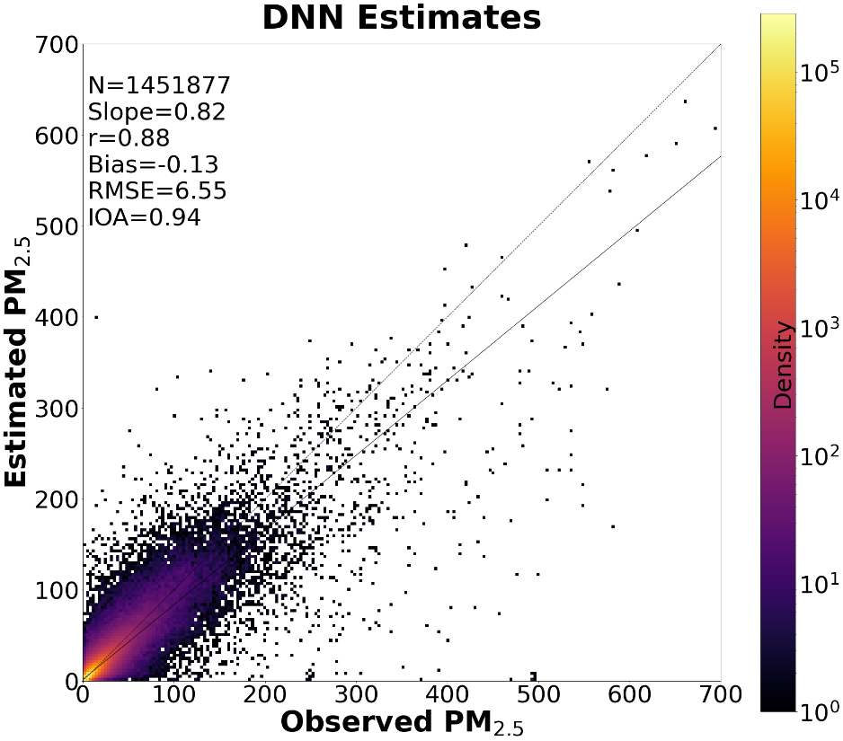
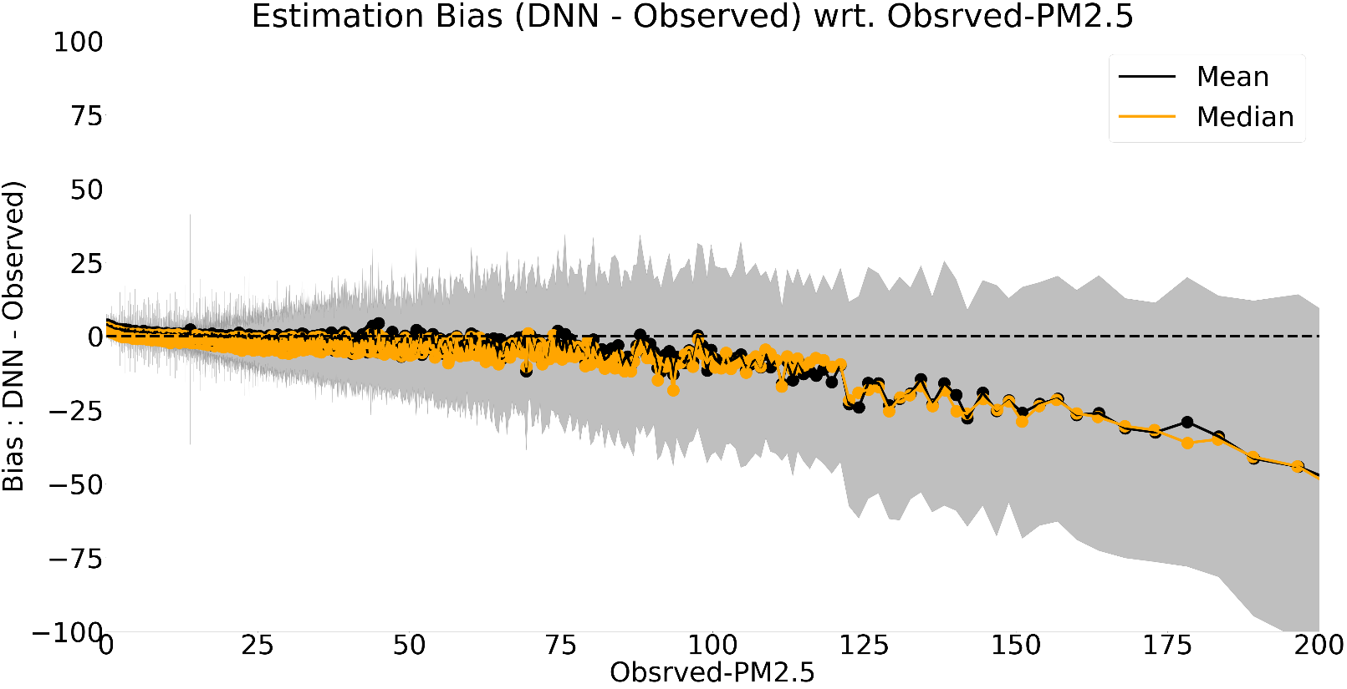
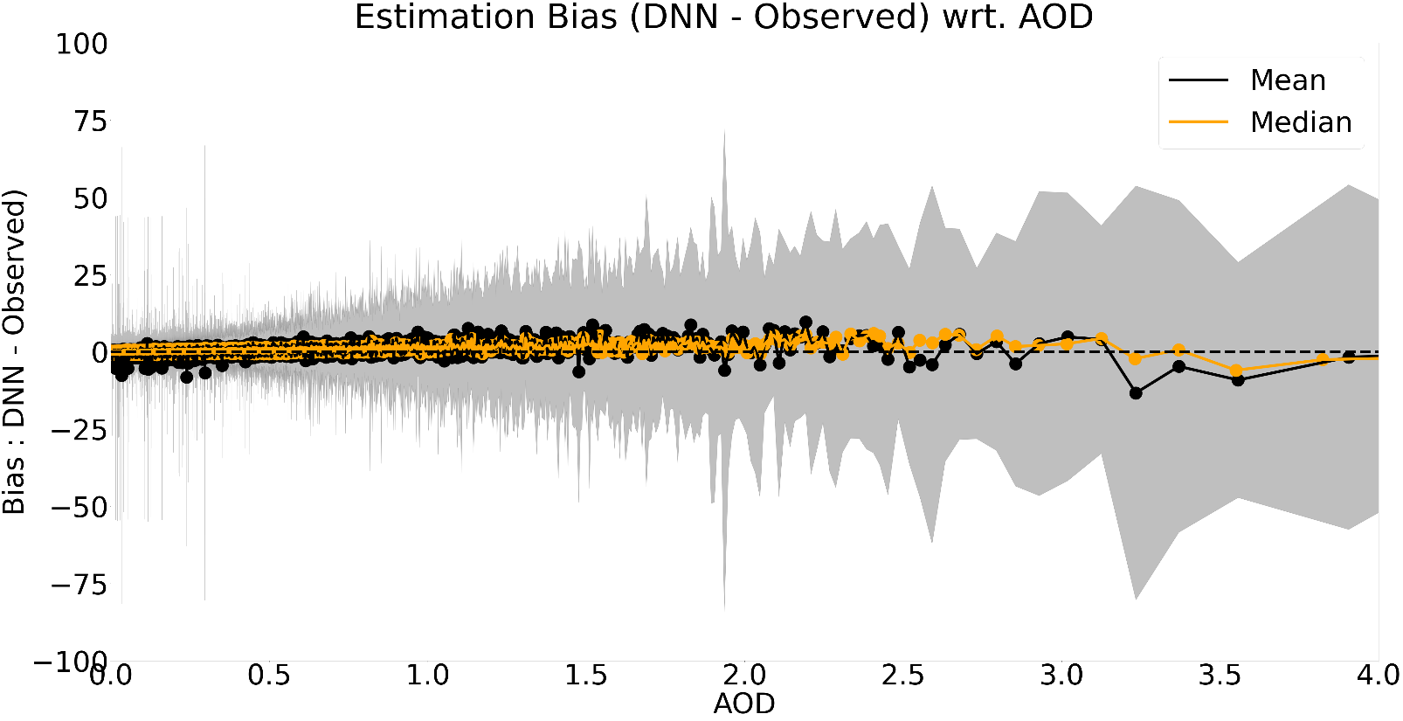
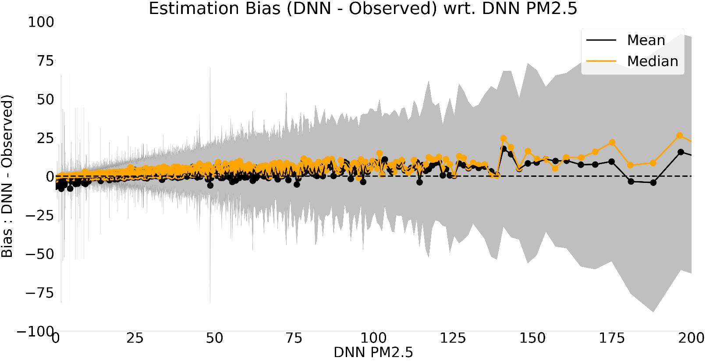
Results

Slide 18
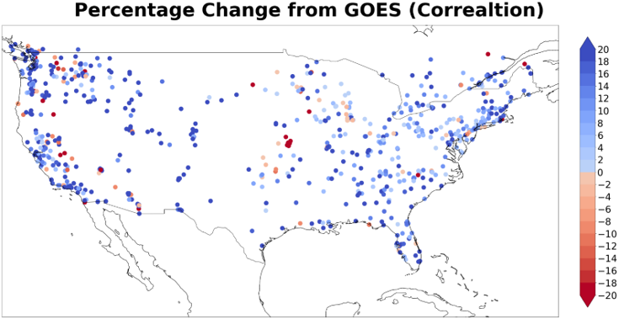
Results

Slide 19
Results
Blocks | N | GOES-GWR | DNN | GOES-GWR | DNN | GOES-GWR | DNN | GOES-GWR | DNN
 |  | IOA |  | r |  | MB (µg/m³) |  | RMSE (µg/m³)
Block 1 | 32638 | 0.40 | 0.73 | 0.32 | 0.55 | 2.21 | -0.07 | 14.06 | 5.73
Block 2 | 21169 | 0.81 | 0.84 | 0.69 | 0.73 | 0.42 | -0.14 | 5.75 | 4.72
Block 3 | 53950 | 0.78 | 0.89 | 0.66 | 0.79 | 0.20 | -0.02 | 4.92 | 3.19
Block 4 | 6306 | 0.81 | 0.80 | 0.68 | 0.65 | 0.22 | -0.56 | 3.81 | 3.59
Block 5 | 337437 | 0.91 | 0.93 | 0.84 | 0.86 | 0.72 | -0.14 | 11.37 | 10.18
Block 6 | 176252 | 0.79 | 0.89 | 0.67 | 0.80 | 0.97 | -0.14 | 8.45 | 5.49
Block 7 | 71701 | 0.89 | 0.93 | 0.81 | 0.87 | 0.23 | -0.10 | 4.21 | 3.21
Block 8 | 201813 | 0.88 | 0.91 | 0.79 | 0.83 | 0.06 | 0.09 | 3.91 | 3.43
Block 9 | 84932 | 0.90 | 0.94 | 0.82 | 0.88 | 0.17 | -0.30 | 3.66 | 2.92
Block 10 | 204659 | 0.92 | 0.94 | 0.85 | 0.88 | 0.52 | 0.01 | 11.00 | 8.95
Block 11 | 91490 | 0.93 | 0.95 | 0.87 | 0.91 | 0.48 | 0.02 | 9.59 | 7.20
Block 12 | 38818 | 0.67 | 0.69 | 0.53 | 0.55 | -0.25 | 0.03 | 11.97 | 11.71
Block 13 | 51040 | 0.91 | 0.94 | 0.83 | 0.89 | 0.30 | -0.18 | 3.58 | 2.85
Block 14 | 79672 | 0.93 | 0.95 | 0.88 | 0.90 | -0.04 | 0.14 | 3.24 | 2.88
Aggregate | 1451877 | 0.90 | 0.93 | 0.82 | 0.86 | 0.48 | -0.06 | 8.72 | 7.13

Slide 20
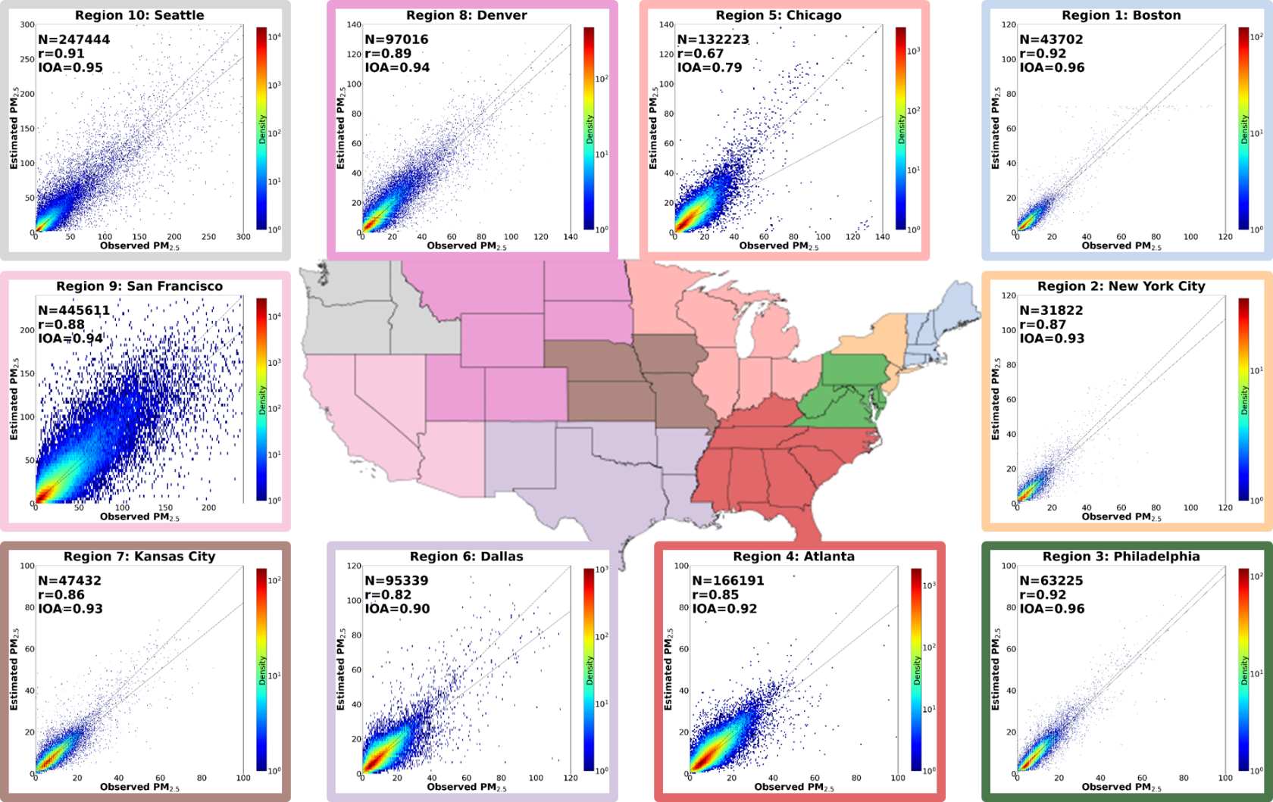
Results

Slide 21
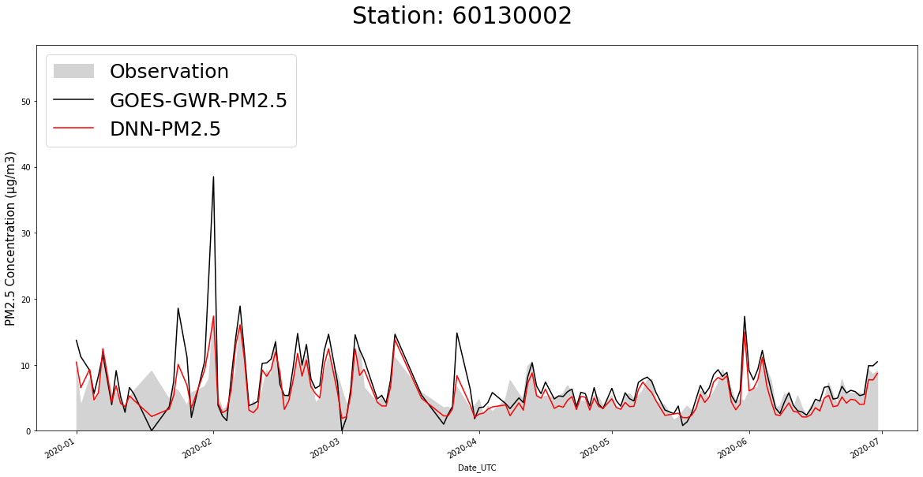
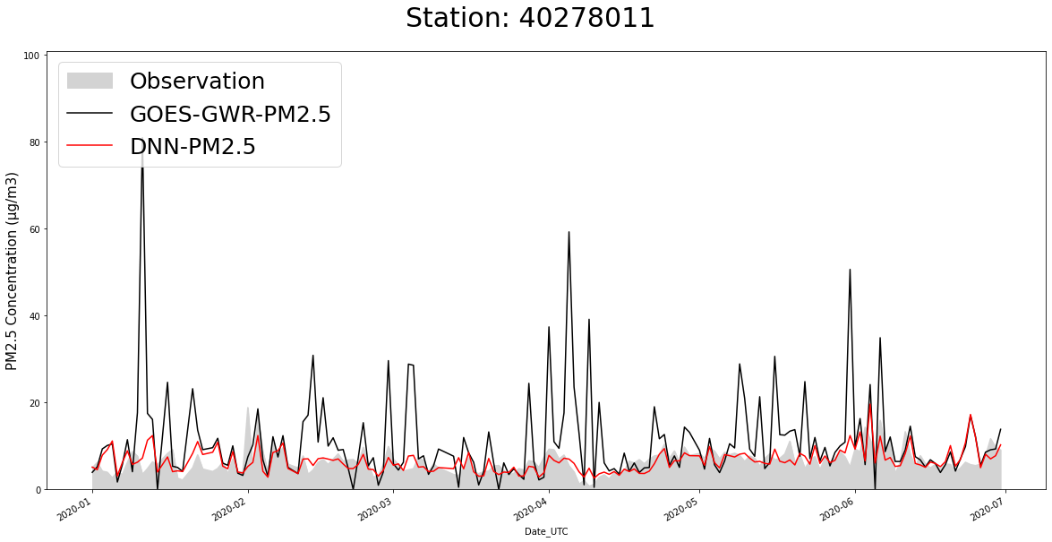
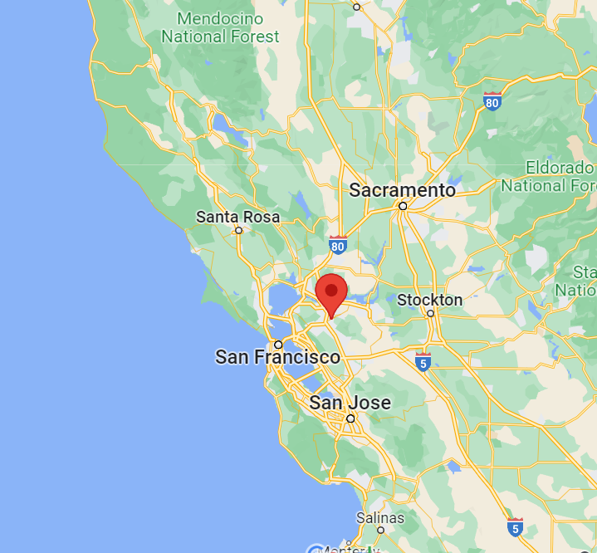
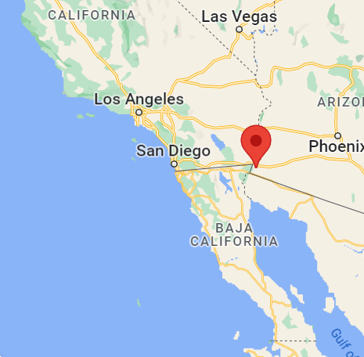
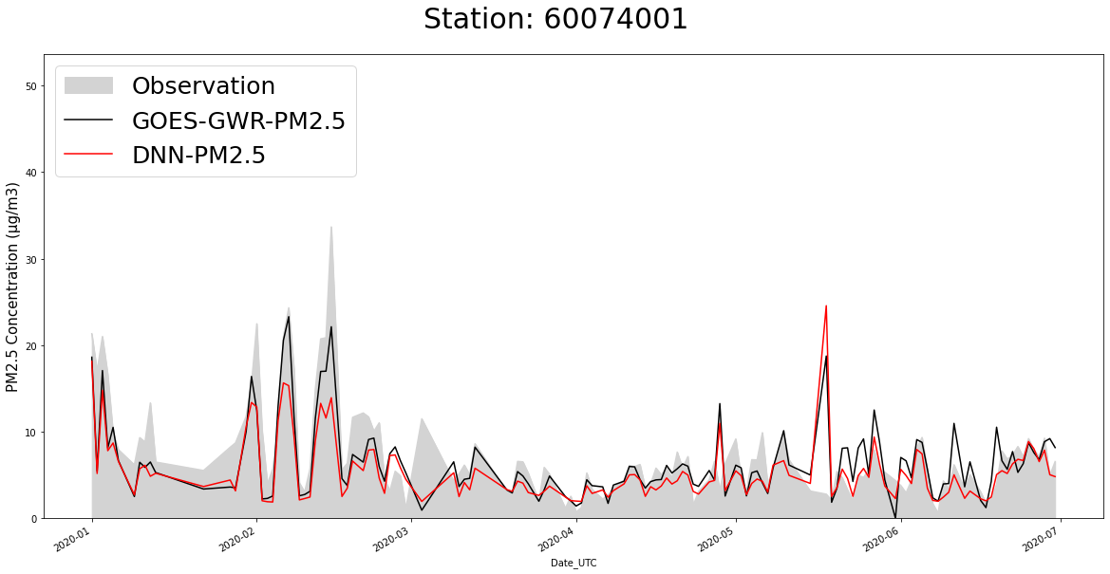
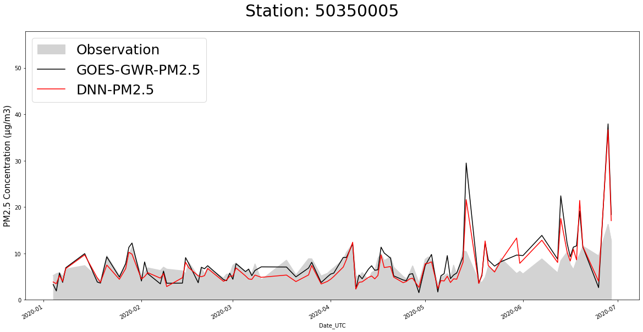
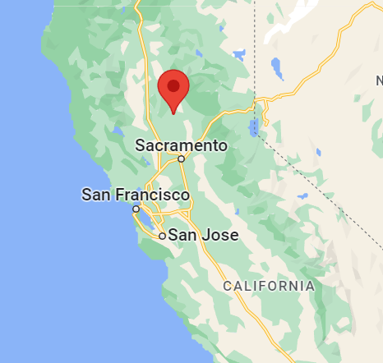
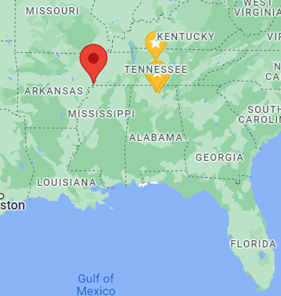
Result – Daily Day Time Average

Slide 22
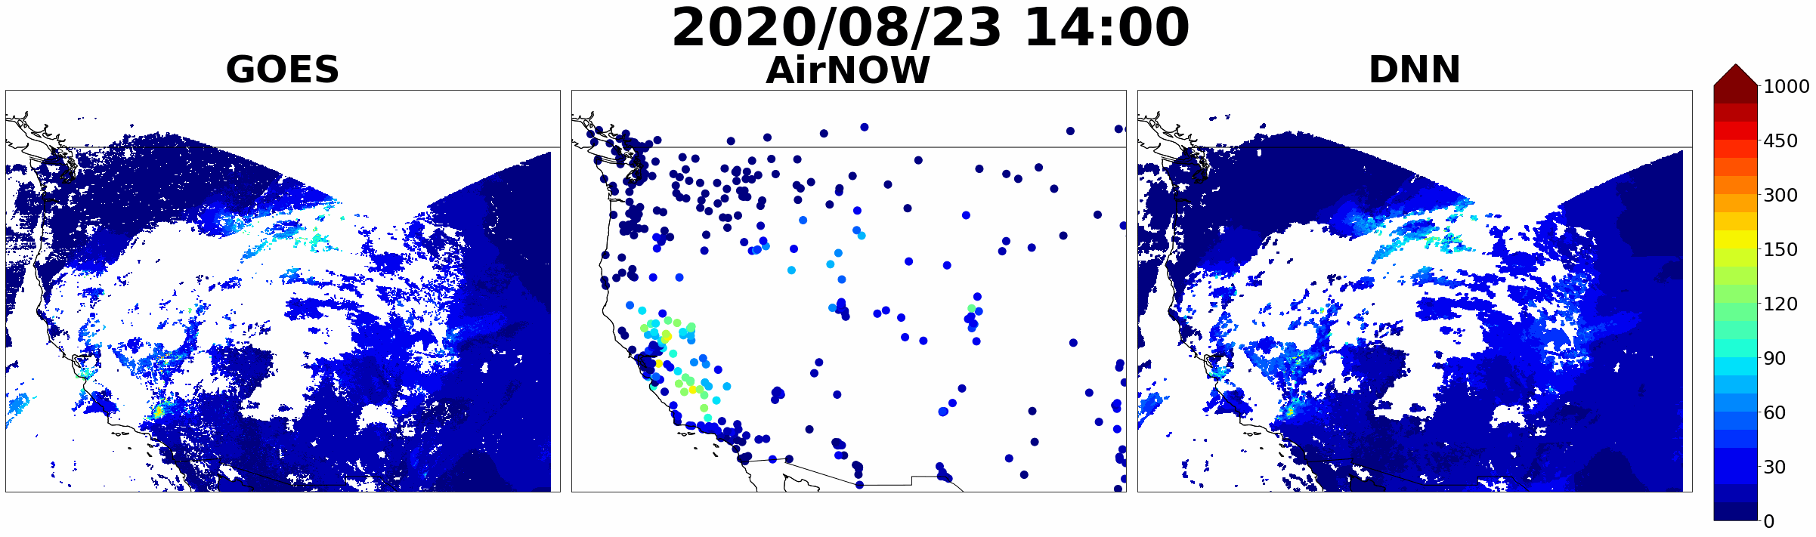
Results

Slide 23
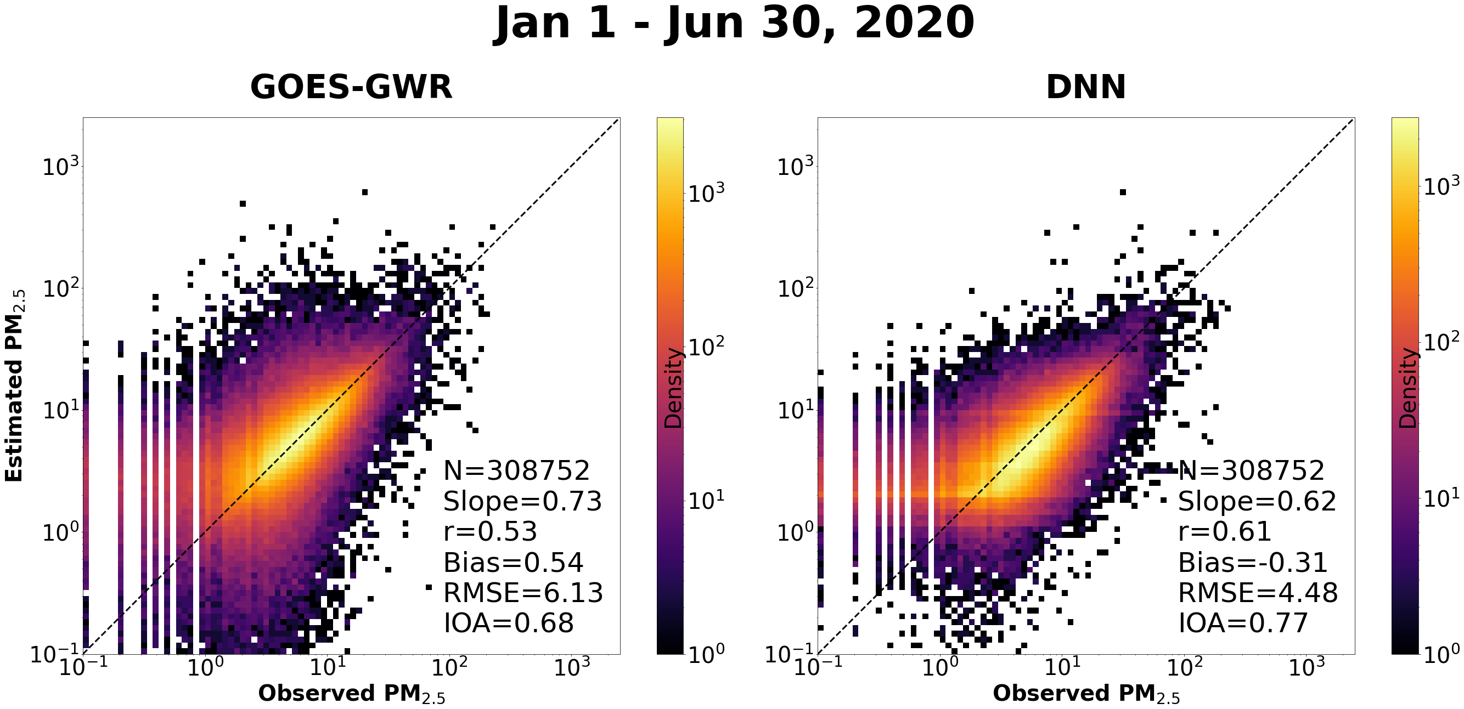
Results: Out of Box Dataset

Slide 24
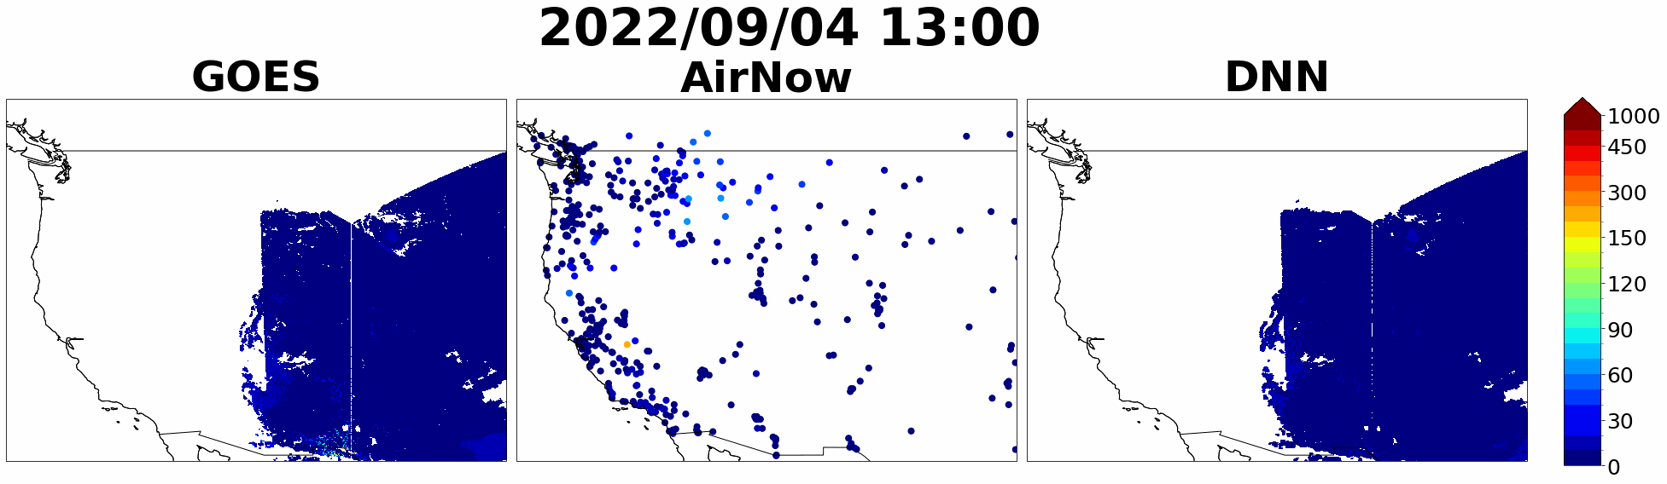
Result: Out of Box Dataset

Slide 25
Summary
DNN model for all blocks shows a ~3% increase in IOA, 5% increase in r, 18% reduction in RMSE and 87.5% reduction in absolute bias on the aggregate of test set of 10-fold evaluations
DNN model as compared to GOES-GWR station-wise -
increased the correlation (r) by 0.5-330% for 80% of stations
reduce RMSE by 0-82% for 74% of stations over GWR estimates.
Evaluation for the independent dataset (Jan 1, 2020 to Jun 30, 2020)-
IOA - 0.77 (GOES-GWR: 0.68)
r - 0.61 (GOES-GWR: 0.53)
RMSE - 4.48µg/m³ (GOES-GWR: 6.13 µg/m³)

