Slide 1


Ozone Chemistry and Trends in the United States
Presented by: Barron H. Henderson, Physical Scientist, US EPA
Co-authors: Carey Jang, Heather Simon, Jiaoyan Huang, Shannon Koplitz, Benjamin Wells
2023-05-29
Disclaimer: The views expressed in this presentation are those of the authors and do not necessarily reflect the views or policies of the U.S. Environmental Protection Agency.

Slide 2
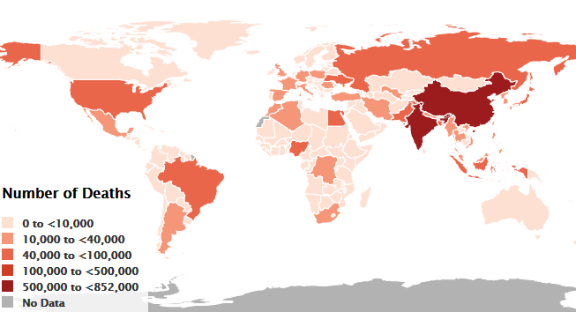
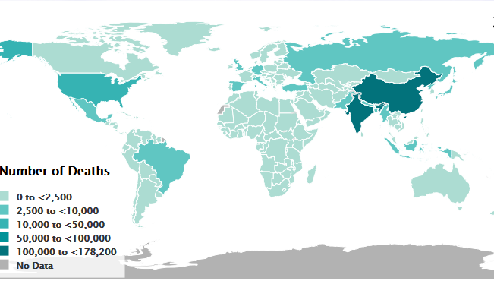
Air Quality remains an important issue in both our countries
These maps are from the Heath Effects Institute’s 2019 study.
These maps highlight that our countries have a lot in common.
We both share the responsibility to reduce the pollution that our people breath.
Our population sizes are different, our industrial capacities are different, our current controls are different.
But we share the need to understand the sources of pollution.
I am going to highlight air quality management and science from the US over the last decades, and hope that there are useful insights.
PM2.5 attributable deaths 2017
Figure Source: HEI 2019
O3 attributable deaths 2017

Slide 3

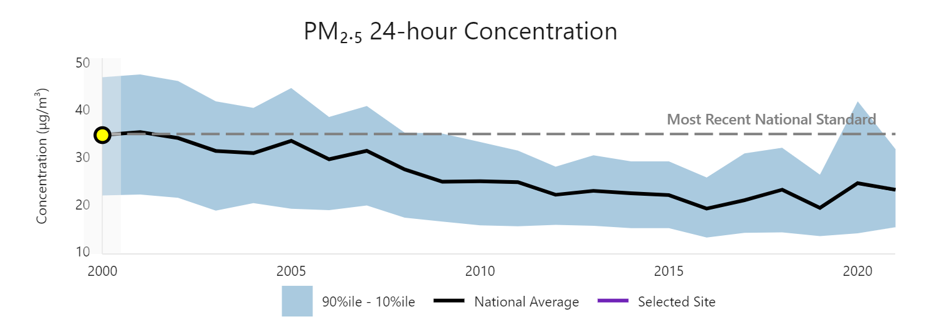
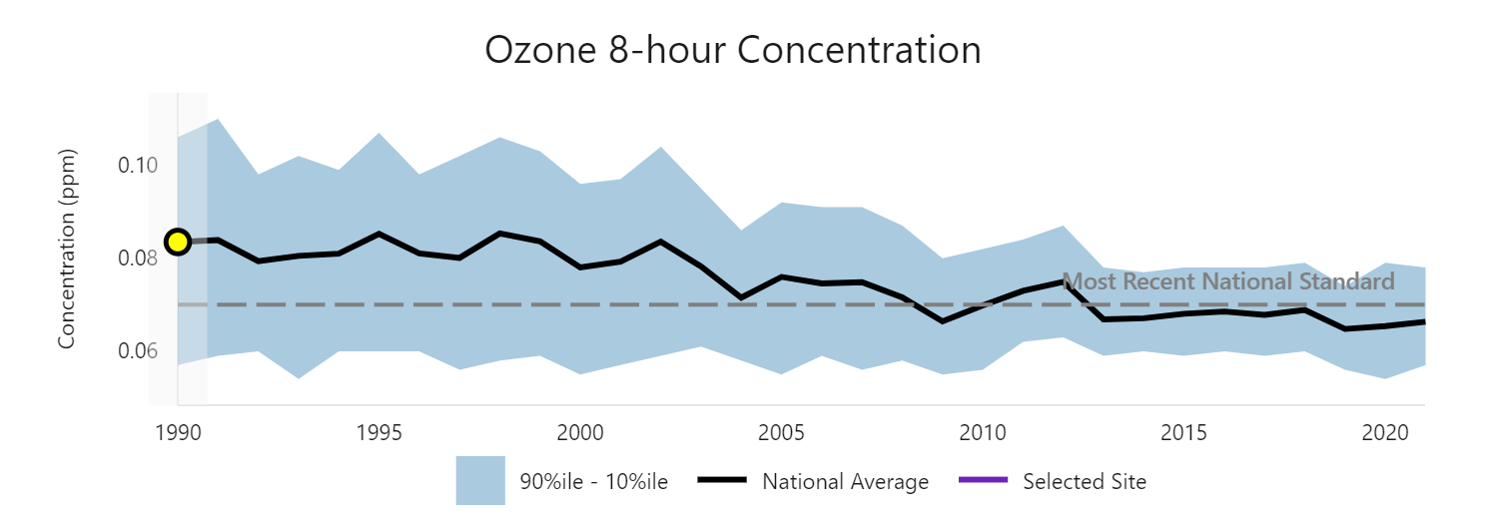
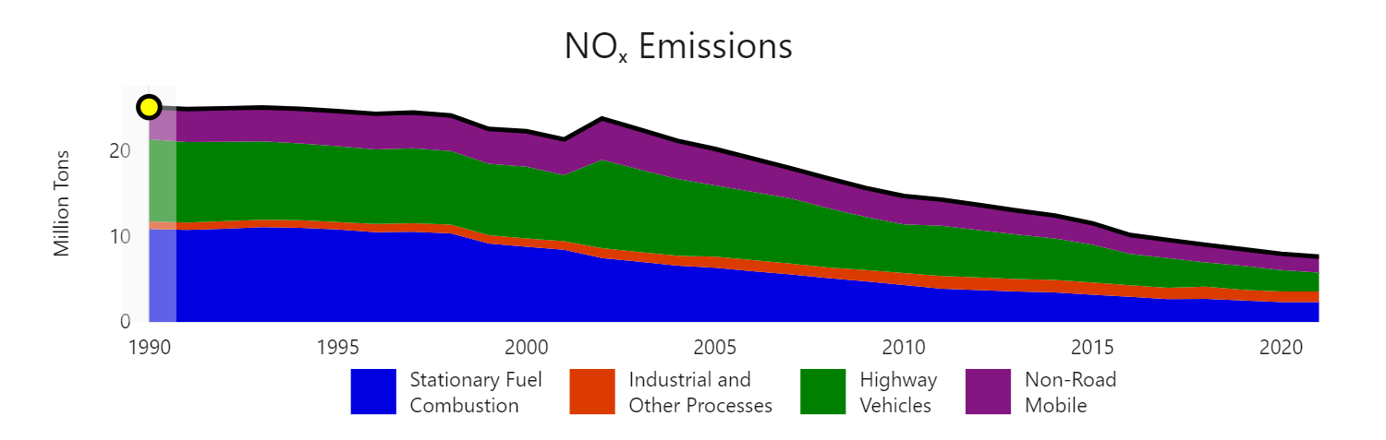
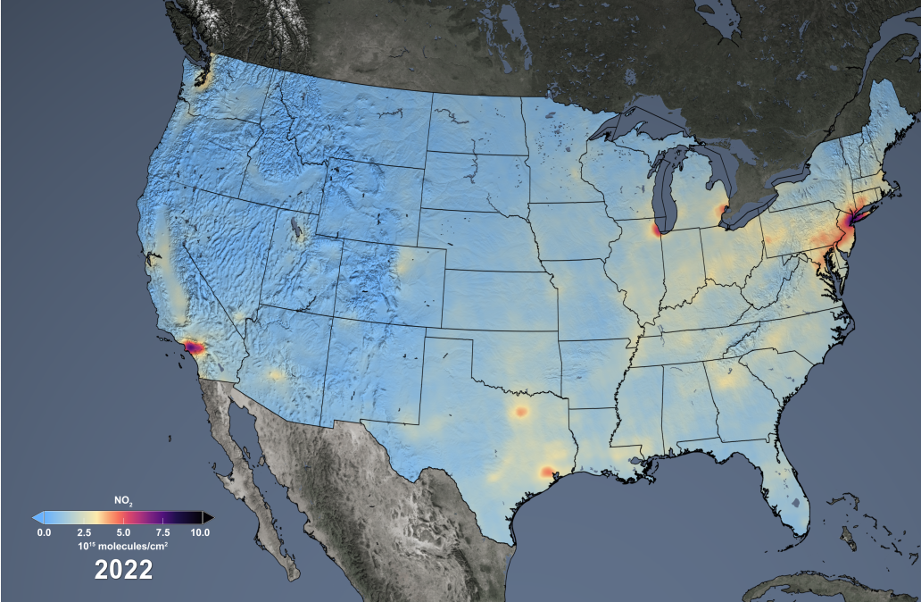
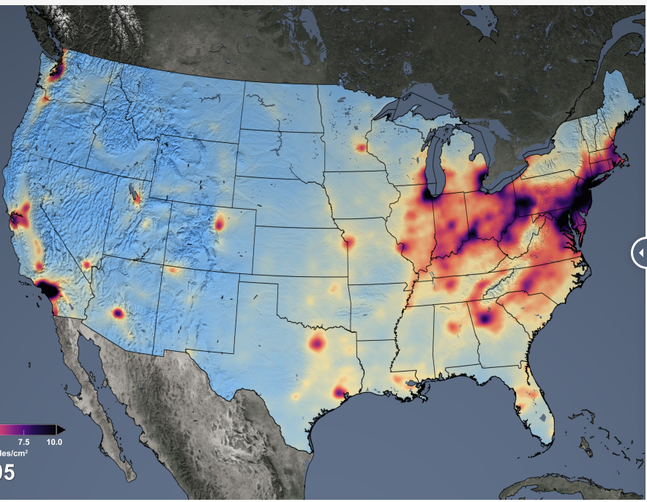
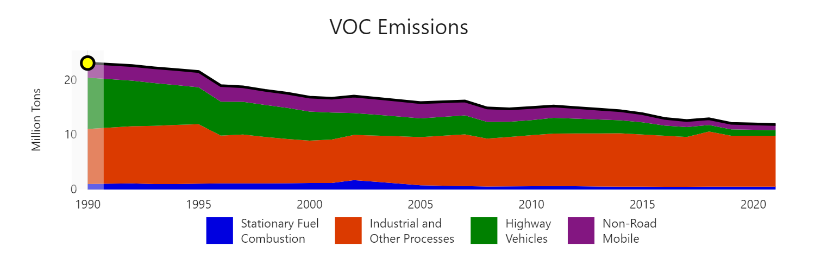
US Air Quality Progress
PM_{2.5}
flickr.com/photos/usepagov/albums/72157631778902432/
2000
2020
Ozone
Boston 1973
Boston 2012
NOx emissions
OMI 2022
OMI 2005
VOC emissions
1990
2020
Notes:
Over the last 30 years, the US has made a lot of progress in ozone and particulate matter.
The images in the background highlight that smog has impact our country from the West Coast to the East Coast.
It also highlights that urban pollution can transport long distances and affect how we see even our natural areas.
In the middle, I am highlighting that PM2.5 concentrations have been rapidly decreasing as have ozone concentrations.
We have been measuring and controlling ozone for longer. You can see in the VOC and NOx emission that VOC reductions started earlier, but that NOx has been reduced by a lot!
The relationship of NOx and VOCs is important to controlling ozone, and the relationship depends on where you are.

Slide 4
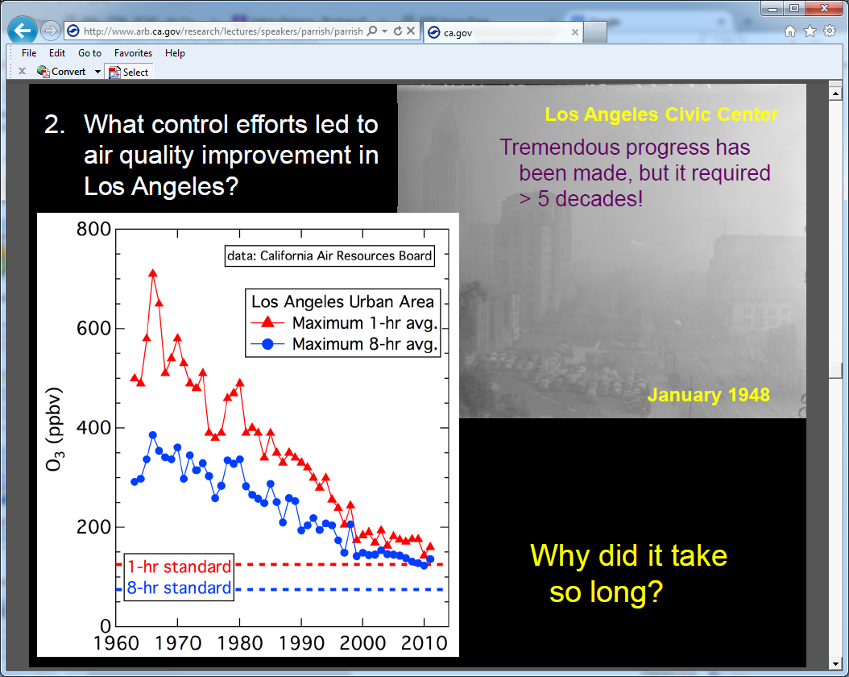
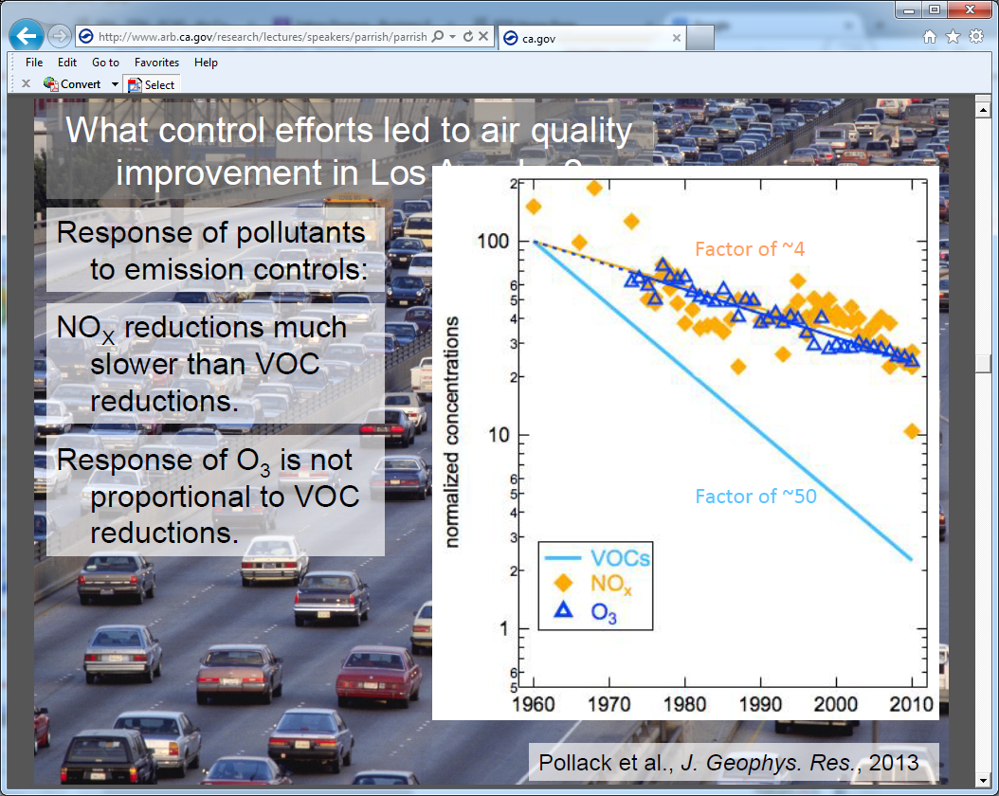
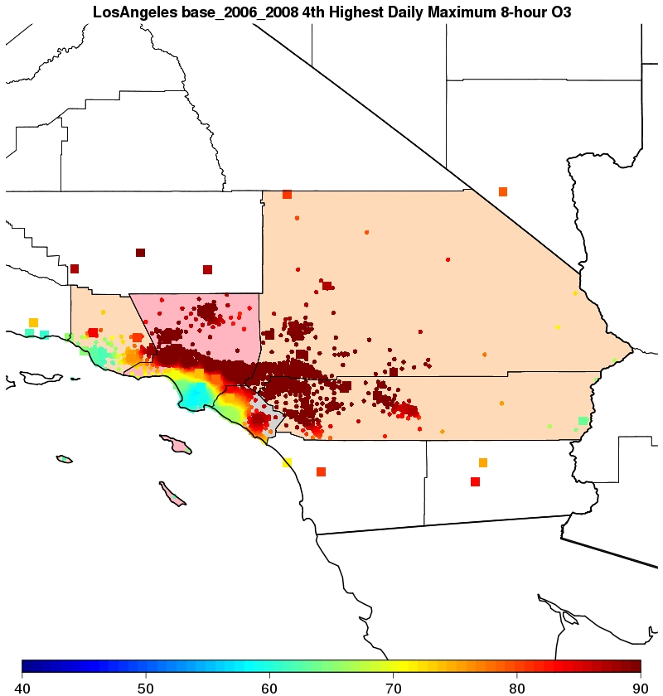
O3 in Los Angeles
Pollack et al., JGR, 2013
NOx
O3
VOC
Urban Core
Urban Core
40
60
90
Los Angeles highlights ozone sensitivity; Major reductions in both VOC and NOx
VOC control is important for reducing in urban area O3, but it needs to come hand-in-hand with NOx control to be effective at downwind sites.
Notes:
“This analysis demonstrates that significant reductions in secondary pollutants have been the direct result of reduced precursor emissions, with the largest changes related to increased emission standards and improved technology in motor vehicles. Through the decades, VOCs were the initial primary target for emissions reductions in the SoCAB, followed more recently by increasing efforts to control NO_{x}. As shown in our assessment and previous analyses, these control measures have been effective in reducing ambient ozone levels over the past 50 years.”
https://agupubs.onlinelibrary.wiley.com/doi/full/10.1002/jgrd.50472
https://agupubs.onlinelibrary.wiley.com/doi/10.1029/2011jd016772

Slide 5
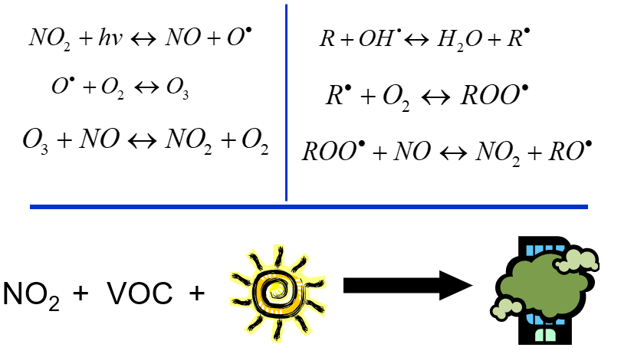
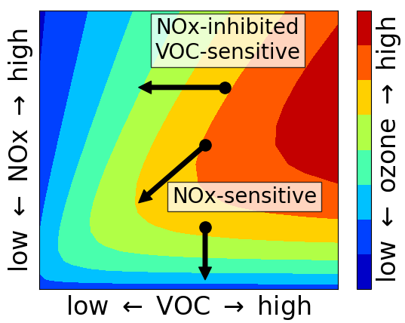
Non-linear Ozone Chemistry
Ozone is part of odd oxygen (O_{x})
O_{x} is made primarily by transferring an oxygen atom (O) from a radical (RO₂/HO₂) to nitric oxide (NO) to make nitrogen dioxide (NO₂).
From NO₂, the oxygen can move between species including ozone (O₃).
  Not enough NO or VOC, fewer O_{x} made
  Too much NO, the O_{x} will go to NO₂
Ozone control efficiency depends non-linearly on NOx and VOC (see lower right)
Is an area NOx-limited or VOC-limited?
Adapted from: Seinfeld & Pandis 2006
Notes:
Ozone is one part of photochemical oxidants, but has been the measured value used for policy.
Odd oxygen is the group of chemicals that have a particularly reactive oxygen, which was usually added by radical chemistry oxidizing nitric oxide to nitrogen dioxide.
To make ozone, you need oxidation of NOx by radicals that usually come from VOC.
If you don’t have enough VOC-derived radicals, ozone production is slow.
If you don’t have enough nitric oxide, ozone production is slow.
However, too much NOx and nitric oxide will react with ozone – reducing ozone and increasing NO2.
Some VOCs are natural, so not controllable. But, anthropogenic VOCs can be controlled and are sometimes toxic and controlled both as ozone precursors and as toxics.
If you want to control ozone, how do you decide if an area is NOx or VOC limited?

Slide 6
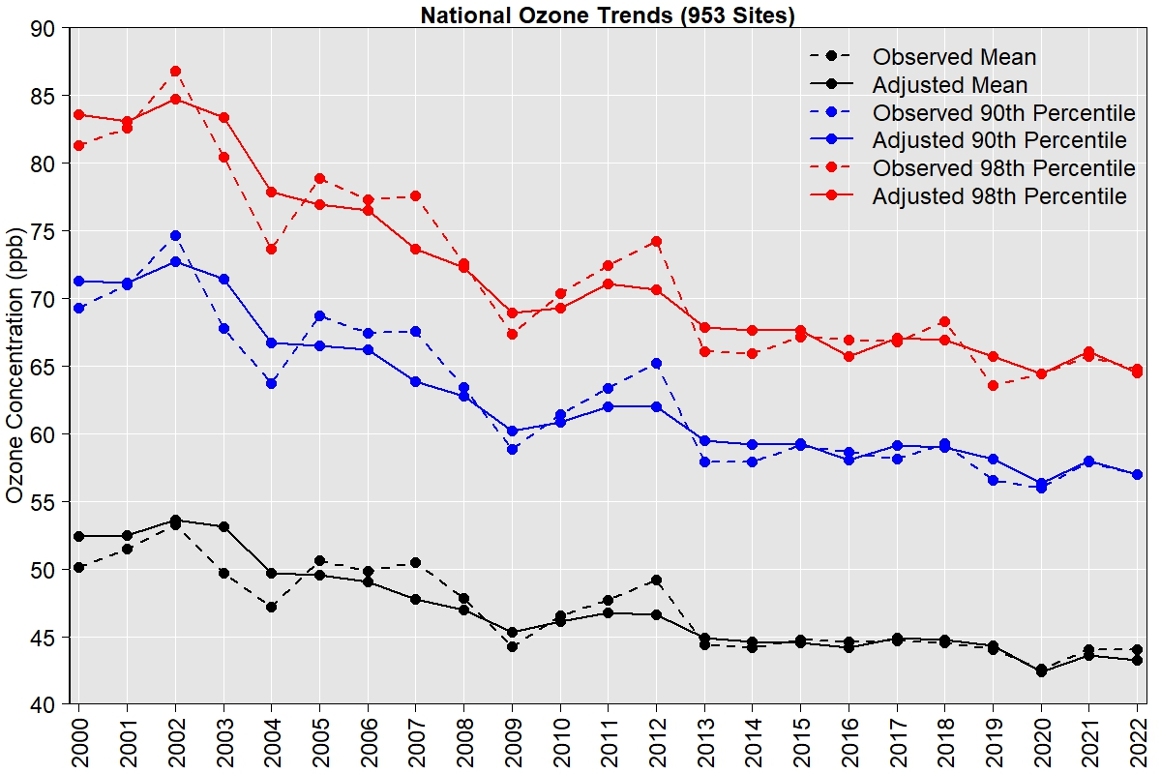
Meteorologically Adjusted Ozone Trends
https://www.epa.gov/air-trends/trends-ozone-adjusted-weather-conditions
EPA uses a statistical model to adjust the trends at long-term ozone monitoring sites for weather-related variability in order to provide a more accurate assessment of the underlying trend in ozone caused by changes in precursor emissions.
  Ozone conducive weather (e.g., hot, sunny, stagnant) is adjusted downward.
  Less conducive weather (e.g., cool, cloudy, rainy, windy) is adjusted upward.
Green box highlights that meteorology could mask trends, especially when looking at short time periods (less than 10 years)
Wells et al, 2021 doi.org/10.1016/j.atmosenv.2021.118234

Slide 7
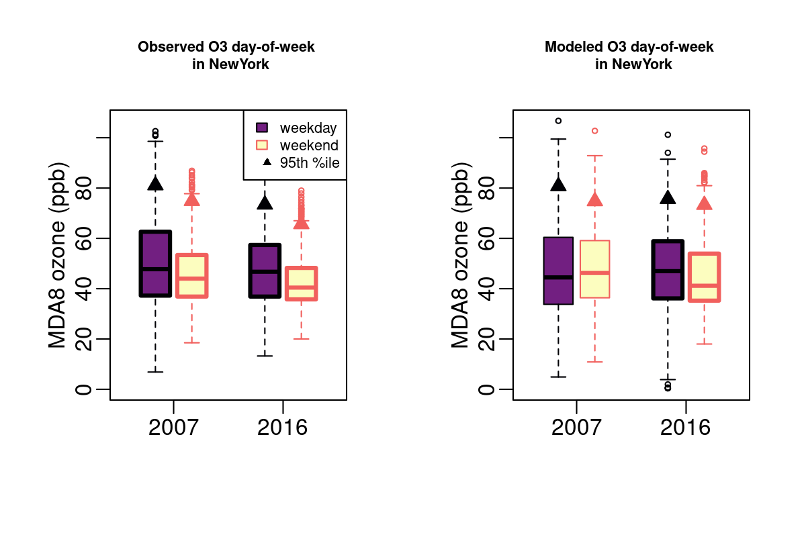
United States Weekend Weekday Analysis
May-Sep New York City Example from
Koplitz et al. doi:10.1021/acsenvironau.1c00029
Observed WE-WD change in MDA8 O3
Modeled WE-WD change in MDA8 O3
Since the 1970s showed differential day-of-week traffic patterns provide NOx/VOC-limited insight
  LD gasoline activity decreased by ~10% on weekends (VOC + NOx)
  HD diesel activity decreased by 70-80% on weekends (NOx-only)
  VOC remained steady while NOx decreased on weekends
If ozone goes:
  down on the weekend: NOx-limited
  Up on the weekend: NOx-titration and VOC-limited
We can look at monitors and models
I’m going to use 2007 and 2016 as past and nominally present throughout the presentation.
95th %ile
Medians
Observations
2007: NOx limited
2016: NOx limited
Model
2007: Mixed
2016: NOx limited
Notes:
One way of testing NOx and VOC-limitations is by looking at weekend-weekday effect.
On the weekends in the US, there is less diesel traffic, so NOx decreases a lot.
If ozone goes down on the weekend, it is NOx-limited.
If it goes up, it is likely both VOC-limited and NOx-titrated.
The example on the right is for all monitors in the New York nonattainment area.
New York observations consistently show NOX-limitations both at the high end (95%) and the median.
This is consistent in both 2007, shown in purple and in 2016 a relatively recent year in red.
Looking further to the right, the model suggests that the past sensitivity was more mixed, but the agrees that in 2016 the area is NOx-limited for controls.

Slide 8
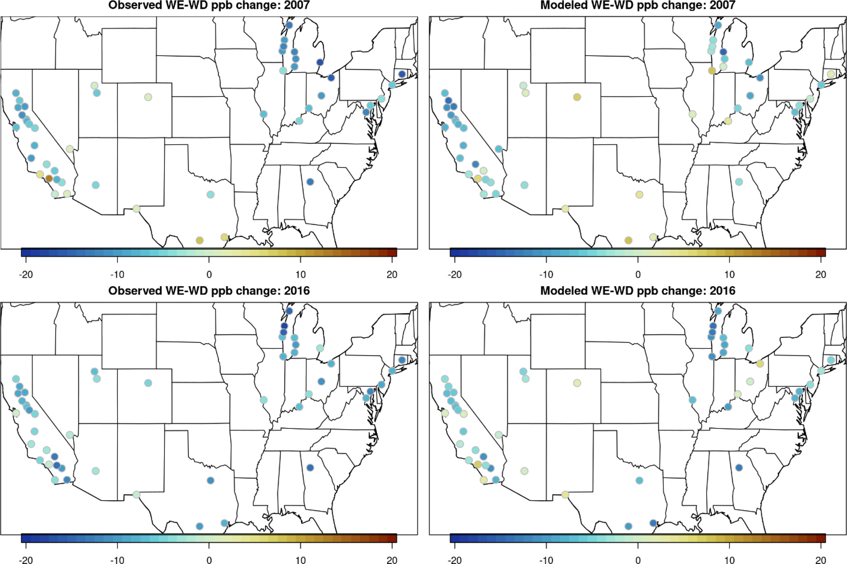
National View of Ozone Sensitivity
WE-WD change in 95th %ile Ozone MDA8
2007 Obs
2007 Model
Both observations and model suggest that
  only a small number of nonattainment areas were VOC limited in 2007
  the number of VOC-limited nonattainment areas decreased between 2007 and 2016
  Observations: 7 (2007) → 1 (2016)
  Model: 11 (2007) → 4 (2016)
DOW-based sensitivity matches monitor-based characterizations in
  33 out of 49 nonattainment areas in 2007
  42 out of 49 nonattainment areas in 2016
NYC from last slide
-20
-10
0
10
20
-20
-10
0
10
20
Δppb
Δppb
2016 Obs
2016 Model
-20
-10
0
10
20
-20
-10
0
10
20
NOx-limited
→
Δppb
→
VOC-limited
NOx-limited
→
Δppb
→
VOC-limited
Notes:
We can expand this view from a single area to all nonattainment areas. Now, NOx limitations are shown in shades of green and VOC-limitations are shown in pinks. At the national scale, we would say that NOx-limitations are broadly applicable with only a few monitors showing VOC-sensitivity and almost all were in 2007. Present day has only one VOC-limited area. Generally, the models agree although they predict a few more VOC-sensitive areas. The differences in the model and observations should be explored, but the general consistency is encouraging.

Slide 9
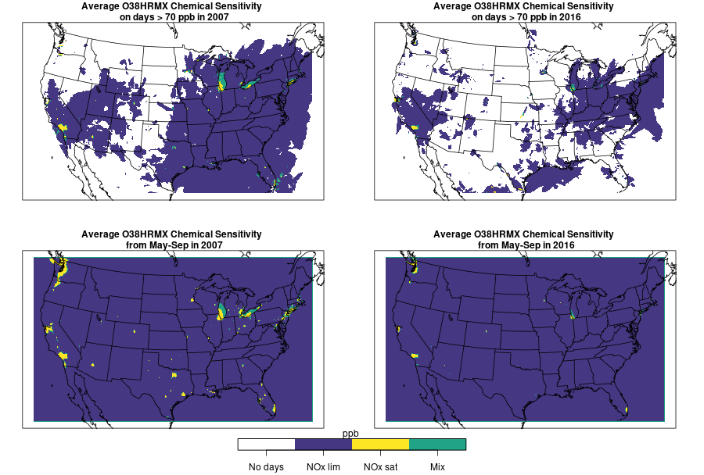
Model-based Ozone Production Chemistry
Additional model tools
Source Apportionment
  Sillman and Kleinman in the 1990s derived ozone sensitivity P(H2O2):P(HNO3)
  Using this apportionment can identify VOC and NOx limitations.
Derivative Methodologies
  Direct Decoupled Method (DDM)
  Higher-order DDM
  Adjoint
Results from HDDM (right)
  Most of the US is spatially NOx-limited
  Some urban cores still are VOC-limited.
  Most locations move to NOx-limited by 2016; on high O3 days only Los Angeles and Chicago still showing mixed or VOC-limited behavior on average
Ozone Season (May-Sep) 2007
Ozone Season (May-Sep) 2016
No days
NOx-lim
VOC-lim
Mixed
High Ozone Days (>70 ppb) 2007
High Ozone Days (>70 ppb) 2016
Notes:
The weekend-weekday approach has some limitations because there are fewer weekends and meteorology isn’t always perfectly uncorrelated. The model also provides tools to explore VOC and NOx sensitivity.
Sillman and Kleinman derived limitations based on chemical gross production.
Derivative tools like HDDM and adjoints allow us to investigate the model.
These results show HDDM sensitivity surfaces based on response to 20% changes in NOx or VOC to identify NOx and VOC limited areas.
The top is the whole ozone season and the bottom are high ozone days in the model. These results agree strongly with the weekend-weekday analyses. It shows that most of the area is NOx-limited, but many urban cores are VOC-limited. Thus, reductions of just NOx in 2007 might have increased ozone in the urban cores. But, reductions of just VOC would not have been effective downwind.
Fewer locations experiencing ozone above 70 ppb in 2016 compared to 2007
While there are a few areas still showing mixed or VOC-limited behavior, e.g. Los Angeles and Chicago, most locations that were VOC-limited or mixed in 2007 have moved to NOx-limited by 2016
This broader national pattern towards NOx-limited ozone chemistry is consistent with what a number of other studies have found

Slide 10
Air Quality Research in China Provide Context for Ozone Managment
More PM
More Ozone
Air Quality Management requires knowledge about each specific context.
  clear focus on particles and particles have improved!
  ozone literature is catching up with particle research.
What does ozone research in China tell us about NOx-limited, VOC-limited, or other key limitations?

Slide 11
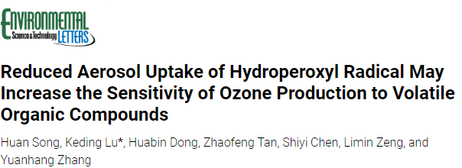
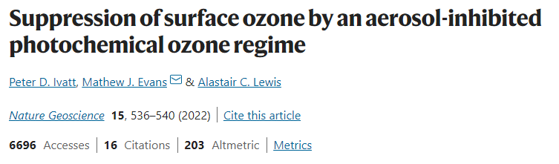
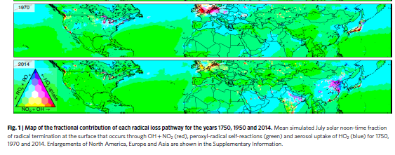
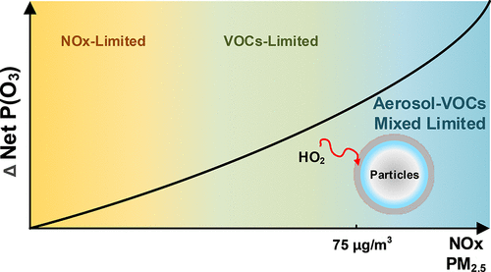
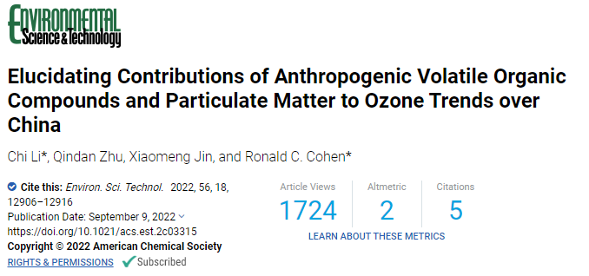
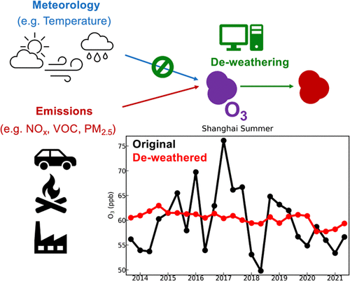
Notes:
Li et al. https://doi.org/10.1021/acs.est.2c03315
Song et al. https://pubs.acs.org/doi/pdf/10.1021/acs.estlett.1c00893
Ivatt et al. https://www.nature.com/articles/s41561-022-00972-9

Slide 12



ABaCAS cooperation
Thank you to Carey Jang for his dedication and service to our nations air quality!
Carey Jang’s officially retired last week.
He had spent decades advancing air quality research and strengthening ties between our countries.
Publication cooperation since 2011
Jia Xing, Shuxin Zheng, Siwei Li, Lin Huang, Xiaochun Wang, James T. Kelly, Shuxiao Wang, Chang Liu, Carey Jang, Yun Zhu, Jia Zhang, Jiang Bian, Tie-Yan Liu, Jiming Hao.(2022) Mimicking atmospheric photochemical modeling with a deep neural network. Atmospheric Research, Volume 265, 2022, 105919.
James T. Kelly, Carey Jang, Yun Zhu, Shicheng Long, Jia Xing, Shuxiao Wang, Benjamin N. Murphy, Havala O. T. Pye.(2021) Predicting the Nonlinear Response of PM2.5 and Ozone to Precursor Emission Changes with a Response Surface Model. Atmosphere Vol.12.
Tingting Fang, Yun Zhu*, Carey Jang, Shuxiao Wang, Jia Xing, Pen-Chi Chiang, Shaojia Fan, Zhiqiang You, Jinying Li.(2020) Real-time Source Contribution Analysis of Ambient Ozone Using an Enhanced Meta-Modeling Approach over the Pearl River Delta Region of China. Journal of Environmental Management, 268, 110650.
Shuxiao Wang, Jia Xing, Carey J. Jang, Yun Zhu, Joshua S.Fu, Jiming Hao.(2011) Impact Assessment of Ammonia Emissions on Inorganic Aerosols in East China Using ResponseSurface Modeling Technique. Environmental Science & Technology, 45(21), 9293-9300.

Slide 13
Carey’s reflections: USA and China ozone
 | USA | China
O3 & PM policy | O3 first, then PM2.5 | PM2.5 first, then O3
NOx & VOC control | VOC control first, then NOx control | NOx control first, then VOC control
Control Efficacy | NOx-limited (regional) VOC-limited (some urban) | NOx-limited (regional) VOC-limited (Urban)
NAAQS (Primary) | 8-hr Max Daily Avg.: 70 ppb (2015) | 8-hr (1-hr) MDA: 160 (200) ug/m³ [~80 (~100) ppb]
Attainment Criteria (city) | 4th highest of 3-yr avg., (All individual monitors) | 90 percentile (annual) (National control monitors avg.)

Slide 14
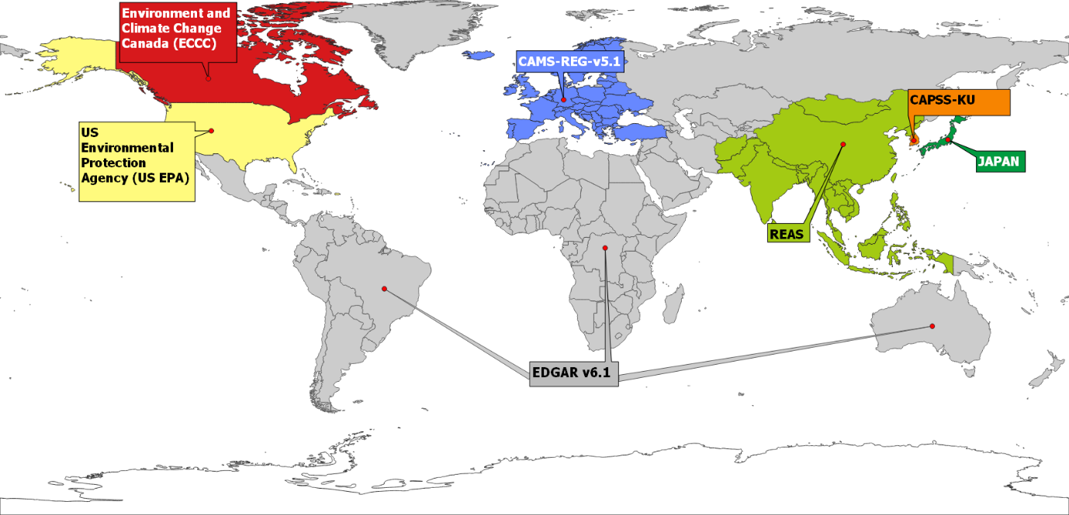

Hemispheric Transport of Air Pollutants Task Force
https://doi.org/10.5194/essd-2022-442
Notes:
Ozone is both a local issue and a global issue. In the summer time, hot temperatures facilitate faster ozone production, but limit the lifetime of ozone, which tends to emphasize local sources. In the spring-time, low temperatures allow long-range transport of ozone. Long-range transport is not just an Asia to US issue. Everyone’s precursors emissions create The Hemispheric Transport of Air Pollution working group has done a lot of great research on this and helps to create a global community of research. By participating in HTAP, the EPA facilitates broad use of its emission inventories by the global community.

Slide 15
Global community needs to work together to address air quality!
Questions?
henderson.barron@epa.gov

