Slide 1

OAQPS Analytical Tools Discussion:
Subset of Multipollutant Tools
SMT Discussion: 07/13/2021

Slide 2
Objective of discussion
2
Several analytical tools are being developed or have been proposed for development and/or enhancement, to inform specific questions relevant to OAQPS programs, outreach and policy development purposes.
This conversation is intended to provide context for the use and need for these OAQPS tools, describe how these development efforts meet our current and emerging needs, clarify individual tool functions where needed, and help inform any future office-level resource allocation decisions.
The OAQPS tools discussed here are part of a larger universe of analytics with diverse and complimentary purposes (e.g., EJSCREEN, BenMAP, etc.). These intersections are important to recognize and can influence how we choose to configure our analytics, but for this briefing we are primarily focusing on:
  OAQPS Multi-pollutant Platform, and
  Four specific new multipollutant tools (FAST, CABOT, SaRA, NEXUS).

Slide 3
Background
3
OAQPS has a longstanding core responsibility to provide analytical support to assess the emissions, air quality, and cost/benefit impacts resulting from regulatory action:
  Across a variety of regulatory contexts, geographic scales, and pollutants
AQAD and HEID are continually evaluating ways to provide the best possible information as efficiently as possible by:
  Identifying opportunities for improvements to our existing suite of data, tools and models
  Developing new analytics to meet emerging regulatory and policy needs, as warranted
Many of these analytics have already been introduced in the context of specific OAQPS activities:
  Air Toxics Data Analytics Team
  EJ analytical capabilities
  Sector prioritization
  OAQPS economic analyses
  Multi-pollutant risk-based analyses

Slide 4
Application Areas for OAQPS Data/Tools/Models
Benefit-Cost Analyses
NAAQS Reviews
(e.g., RIAs)
Risk
Assessments
State/Local/Tribal & Community Efforts
NAAQS Implementation
(e.g., O3 transport)
Sector-based rules
NAAQS Reviews
(e.g., REAs)
Multi-pollutant
air quality planning
NAAQS Implementation
(e.g., Advance Program)
Sector-based rules
Environmental Justice
Environmental Justice
Environmental Justice
National risk screening
for air toxics

Slide 5
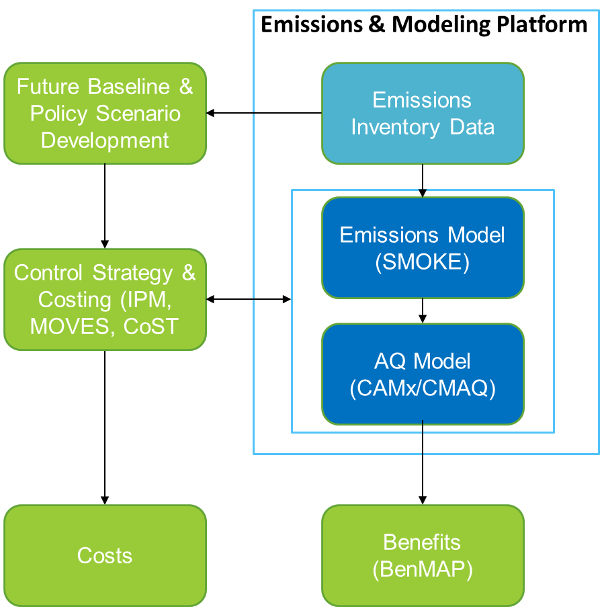
Application: Benefit-Cost Analyses
Overview: Regulatory Impact Analyses (RIAs) as conducted for all major rules necessitate an integrated system of data, tools, and models to estimate the benefits and costs of environmental policies and decisions under the Clean Air Act.
Current analytical data/tools/models:
Emissions and Modeling Platform
  National Emissions Inventory
  Emissions Modeling (SMOKE)
  Air Quality Models (CAMx/CMAQ, AERMOD)
Benefits: BenMAP
Control Strategies/Costs: IPM, MOVES, CoST
Analytics designed to meet emerging needs:
Multi-pollutant platform: Allows regulatory use of platform data/models representing more recent year(s).
FAST: Allows credible estimation of air quality impacts when full scale AQ modeling of policies not feasible.
CABOT: Allows for optimization of costs and benefits in using reduced form air quality techniques.

Slide 6
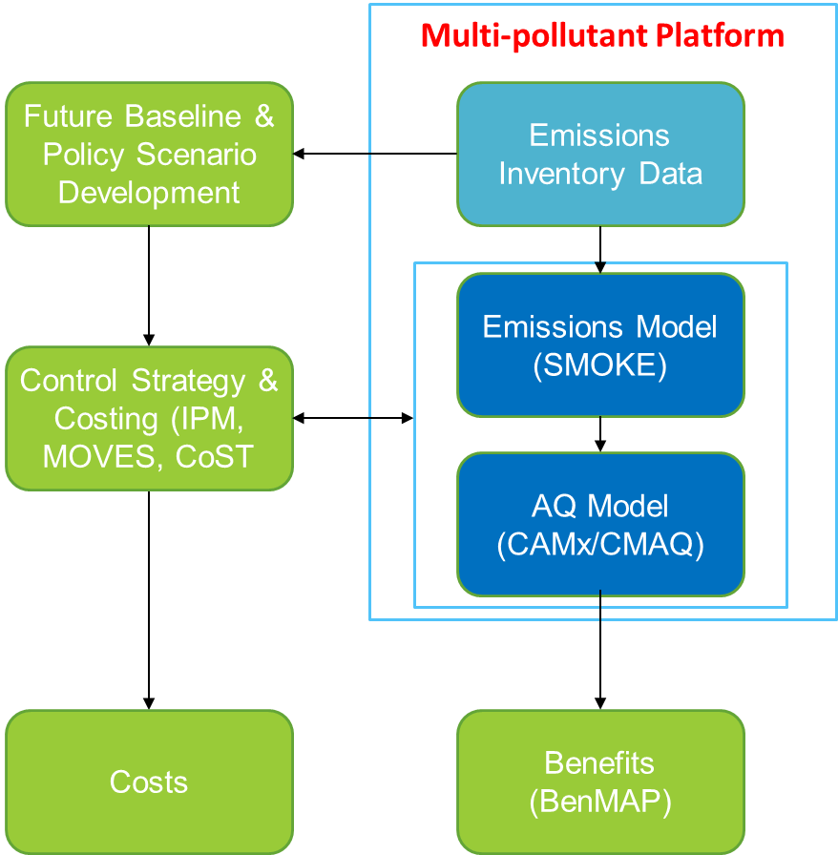
Benefit-Cost Analyses: Multi-Pollutant Platform
Background: OAQPS develops an annual platform that provides O3 and PM2.5 emissions and air quality concentrations data (CDC). We are leveraging this ongoing effort to now include air toxics as part of OAQPS Air Toxics strategy.
Description: A single, “harmonized” emissions and modeling platform for assessments of criteria pollutants (e.g., ozone and PM) and hazardous air pollutants (HAPs) that provides a consistent, transparent, and state of science basis for a variety of technical assessments across the Office and programs.
Current Status: 2018 MP platform development underway
Resource implications:
  Developmental: Costs of NEI, tools and models is covered separately
  Recurring (operation/maintenance): $240k/year CONUS ($125k) & non-CONUS ($115k)
  Enhancements: NA—costs to improve data, tools, models would be incurred separately or through regulatory project funding

Slide 7
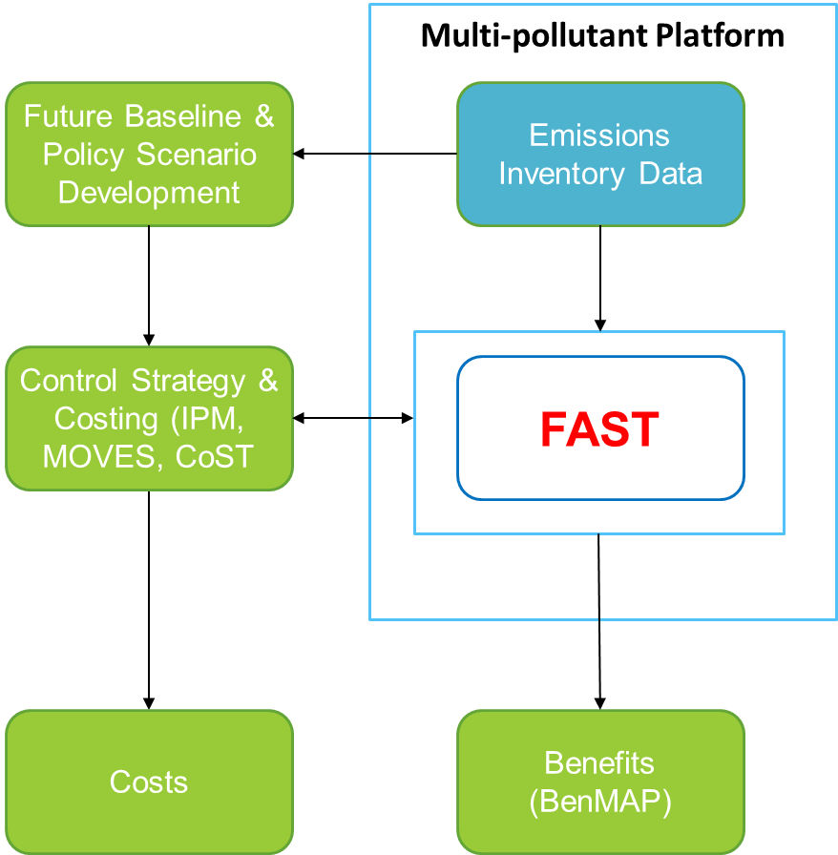
Benefit-Cost Analyses: Flexible Air quality Scenario Tool (FAST)
Background: For some benefit-cost applications it may be necessary to apply reduced-form modeling techniques because the regulatory schedule and policy scenario development process does not allow for full scale air quality modeling to be done.
Description: As part of next phase “Reduced Form Modeling” (RFM) project, AQMG pursued development of a reduced form tool that provides real-time and credible impacts of O3 and PM2.5 to emissions changes.
Current Status: A FAST-CE prototype was built based on the ACE rule methodology with source apportionment modeling of EGUs—it is being expanded to include other sectors based on additional photochemical source apportionment modeling.
Resource implications:
  Developmental: ~$150k
  Recurring (operation/maintenance): NA—tool allows EPA to incorporate new SA modeling so recurring costs would be project related for new SA modeling.
  Enhancements: As necessary to meet regulatory and policy needs.

Slide 8
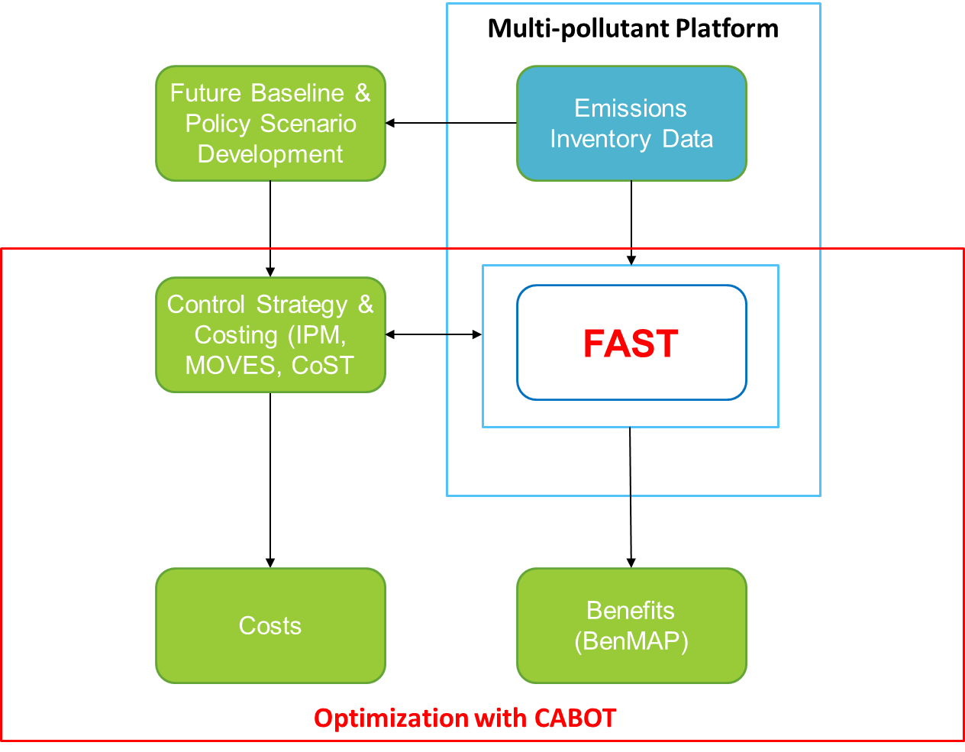
Benefit-Cost Analyses: Cost And Benefit Optimization Tool (CABOT)
Background: Optimizing cost-benefit analyses is time and resource intensive. CABOT is developed to assist in this optimization to expedite criteria pollutant cost-benefit analyses.
Description: CABOT is a mathematical programming model that identifies control strategies to attain ozone air quality standards at minimum cost or maximize net benefit. The tool draws upon data from CoST, reduced-form air quality modeling and BenMAP.
Current Status: CABOT-O3 has been developed for Ozone and published in peer reviewed journals.
Resource implications:
  Developmental: Staff time and GAMS modeling software; no contract funds used
  Recurring (operation/maintenance): Software renewals
  Enhancements: Ability to optimize on particulate matter; incorporating connections to FAST.

Slide 9
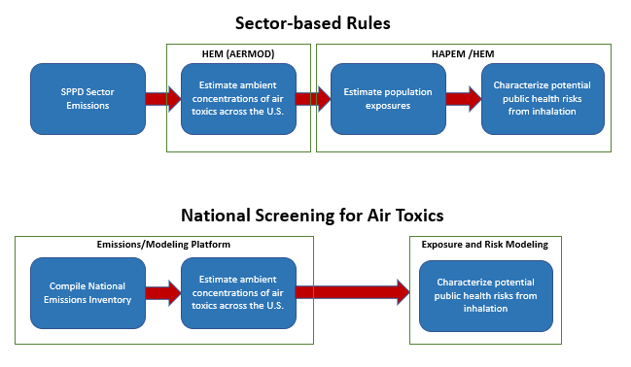
Application: Risk Assessment
Overview: OAQPS conducts sector and source level risk assessments for sector rules and national screening estimates for HAP risks for informational, prioritization and tracking
Current analytical data/tools/models:
Emissions
  National Emissions Inventory
  SPPD sector emissions
Air Quality Models: AERMOD, CMAQ
Exposure/Risk Models: HEM, HAPEM
Analytics designed to meet emerging needs:
Multi-pollutant platform: Provide analytical foundation for national risk screening that can support the OAQPS air toxics strategy and associated programs/outreach.
SaRA: Used for national risk screening and more refined assessments that provide actionable results (i.e., what sources, pollutants, or source categories are contributing to risk that OAQPS can prioritize and act on?). Responsive to time sensitive requests while quickly being able to incorporate new risk data

Slide 10
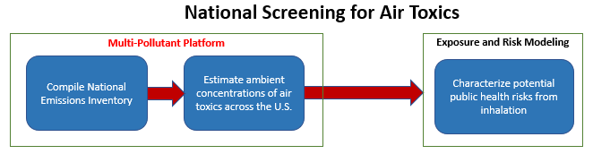
Risk Assessment: Multi-Pollutant Platform
Background: OAQPS develops an annual platform for CDC that provides O3 and PM2.5 emissions and air quality concentrations data. We are leveraging this ongoing effort to now include air toxics as part of OAQPS Air Toxics strategy
Description: Routine development of a single, “harmonized” emissions and modeling platform for assessments of criteria pollutants (e.g., ozone and PM) and hazardous air pollutants (HAPs) that provides a consistent, transparent, and state of science basis for a variety of technical assessments across the Office and programs.
Current Status: 2018 MP platform development underway
Resource implications: (See above)
  Developmental: NA—costs of NEI, tools and models is covered separately
  Recurring (operation/maintenance): $240k/year for CONUS ($125k) & non-CONUS ($115k) platforms
  Enhancements: NA—costs to improve data, tools, models would be incurred separately or through regulatory project funding

Slide 11
Risk Assessment: Source and Receptor Analysis (SaRA) Tool
Background: When conducting a risk assessment, the primary goal is to determine which sources, pollutants, and/or source categories are contributing to risk that OAQPS can prioritize and act on.
Description: The SaRA tool combines ambient concentrations from multiple data streams to estimate combined risks (i.e., risks from multiple sources and sectors).
Current Status: Current version (point sources), expected fully operational (all source categories) by Spring 2022
Resource implications:
  Developmental: $110k
  Recurring (operation/maintenance): Costs to maintain the database
  Enhancements: Data Visualization and Interface
Risk-based EJ analysis
National Risk Screening results
Multi-pollutant Platform
Compile National Emissions Inventory
Estimate ambient concentrations of air toxics across U.S.
HAPEM and SaRA
Estimate population exposures
Characterize potential public health risks from inhalation
HEM (AERMOD)
SPPD Sector Emissions
Estimate ambient concentrations of air toxics across U.S.
Support Air Toxics Strategy (e.g., ATEST or other inquires)
Sector based Analysis (e.g. RTRs)
Notes:
Sector based analysis include identifying high risk pollutants, facilities, and source sectors

Slide 12
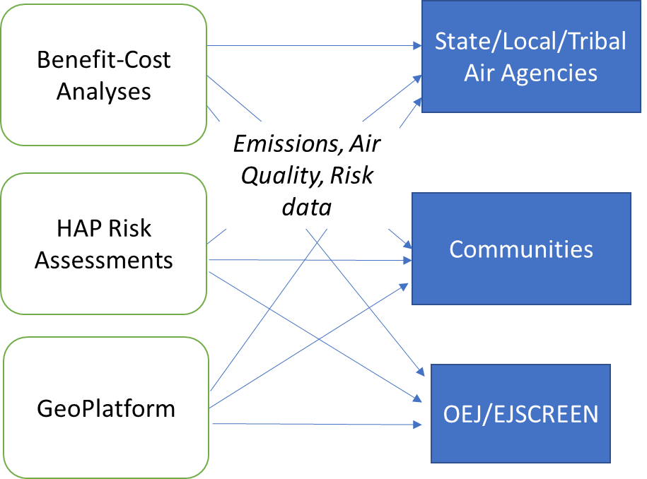
Application: State/Local/Tribal & Community Outreach
Overview: OAQPS provides analytic data and analyses to support air quality planning including NAAQS implementation and regulatory/outreach efforts by other EPA offices, S/L/T air agencies, communities, and stakeholders. The current state of OAQPS’s data provision in this context does not support leveraging our technical efforts across programs nor provide consistency in what technical data/information is made available.
Current analytical data/tools/models:
OAQPS Analytics to inform S/L/T & C
  Benefit-Cost Analysis
    Emissions, air quality concentrations, risks
  Risk assessments
    Emissions, air quality concentrations, risks
Geo-platform data
Analytics designed to meet emerging needs:
NEXUS: This tool allows OAQPS to assemble our analytic data across pollutants and programs in one easily accessible place to better inform multi-pollutant air quality planning by providing emissions, air quality and risk metrics in a manner not done elsewhere. By doing so, it allows for better internal review and coordination of data generation and provision to others within EPA and outside.

Slide 13
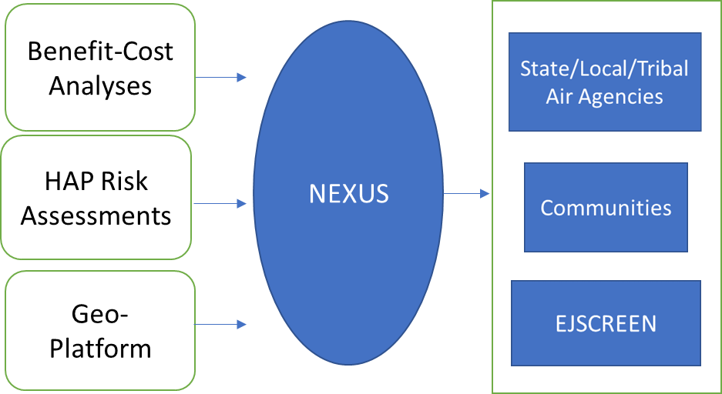
State/Local/Tribal & Community Outreach: NEXUS
Background: OAQPS has engaged with S/L/T air agencies for over a decade on multi-pollutant air quality planning. To facilitate MP considerations, we have leveraging our technical efforts to provide access to high-quality emissions, air quality and risk data along with advanced screening techniques.
Description: The NEXUS tool allows OAQPS to assemble our analytic data across pollutants and programs in one easily accessible place, develop key metrics and overlay data for use by EPA, state/local/tribal agencies and communities. It supports MP planning efforts by S/L/T air agencies to identify important emissions sources/sectors and can also aid in EJ screening analyses.
Current Status: Prototype version completed so currently updating with 2017 data and refined toxics and EJ metrics to provide Beta version for feedback from EPA regional offices.
Resource implications:
  Developmental: ~$200k
  Recurring (operation/maintenance): Data updates completed in-house based on routine generation of emissions, air quality and risk data
  Enhancements: As determined by EPA needs for new metrics or screening capabilities

Slide 14
How do these tools inform potential EJ analytics?
Multipollutant Platform
FAST
CABOT
SaRA
NEXUS

Slide 15
Discussion / Next Steps
15
Each of the “tools” discussed here (the MP Platform, FAST, CABOT, SaRA, NEXUS) are being developed to inform specific questions relevant to OAQPS programs or for outreach and/or policy development purposes. Each has a specific and distinct role in the analytic processes that support OAQPS actions.
Developing and maintaining these tools into the future will have budget implications. We will continue to look for leveraging opportunities across OAR, EPA, or with other Federal partners.
AQAD and HEID are active participants in the newly formed Data Tools and Models workgroup to ensure that these tools are part of the IT Data Tools / Models inventory that is being compiled officewide to help inform IT resource allocation.

