Slide 1
“NEXUS” Advanced Screening Tool (Multi-pollutant risk & EJ analysis based on 2017 PM2.5/O3/AT risk data) for Emissions of Air Toxics from Atlantic Alumina (formerly Noranda Alumina) Gramercy Louisiana
AQAD/Air Quality Modeling Group, 1/28/2022

Slide 2
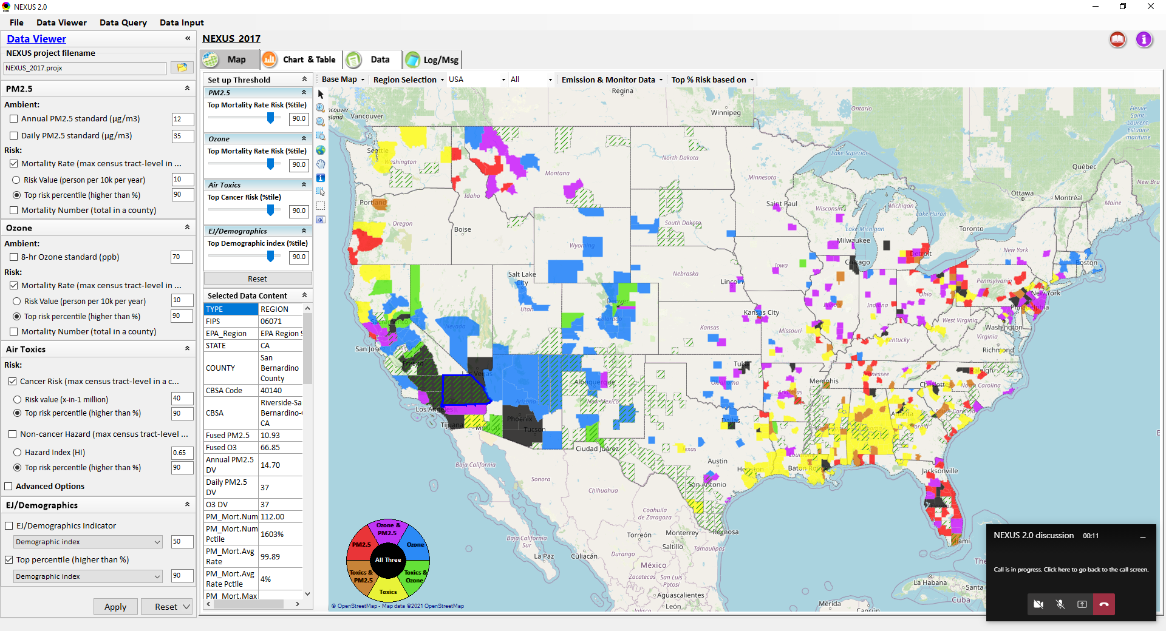
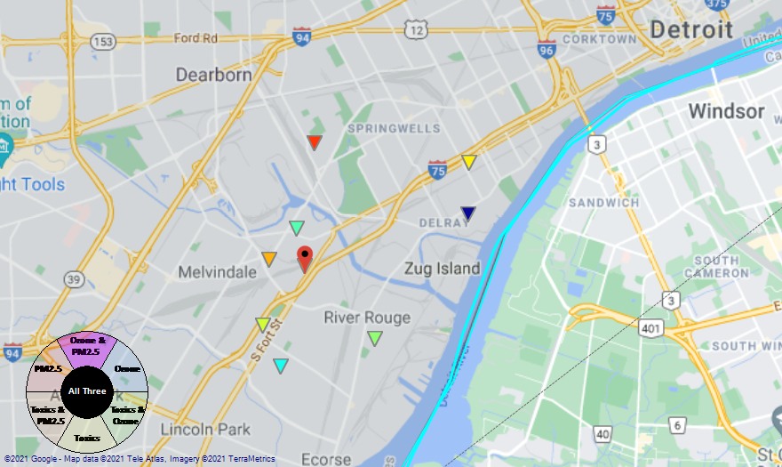
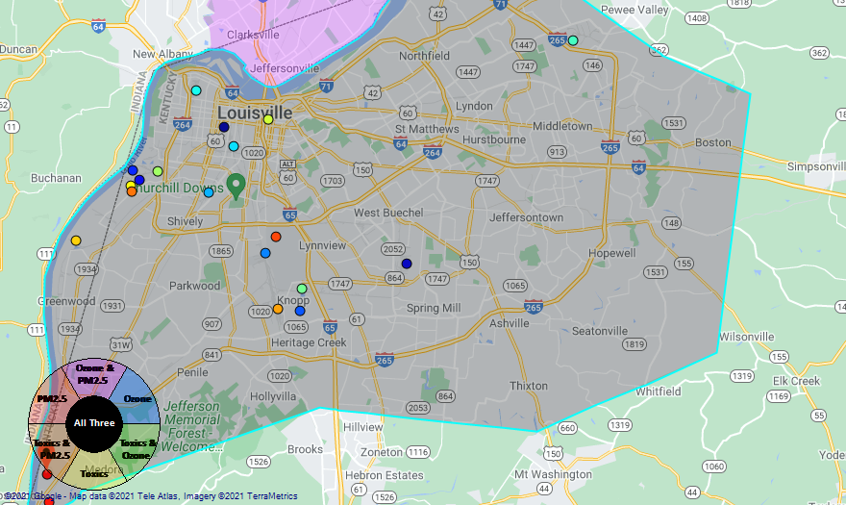
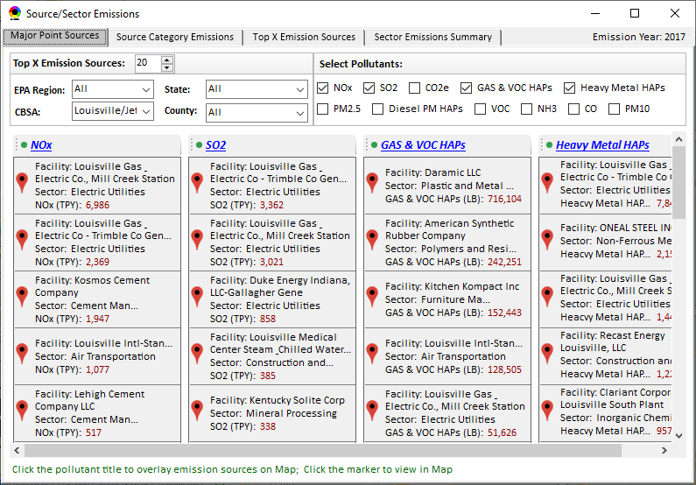
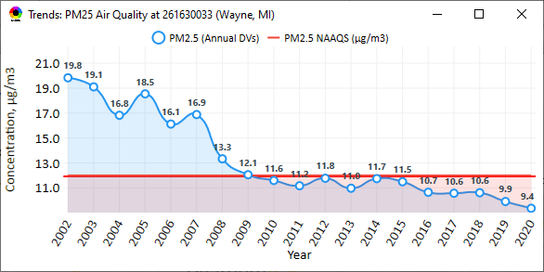
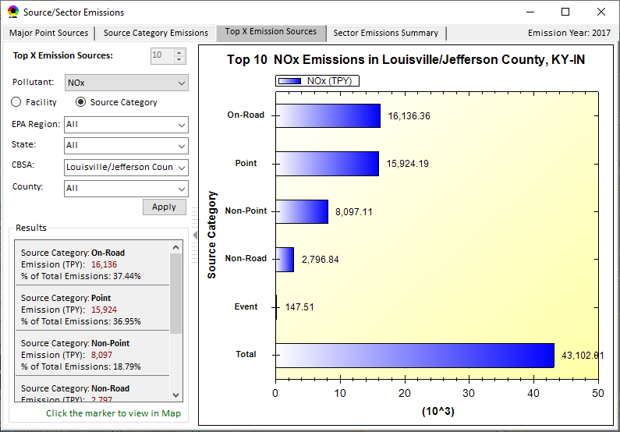
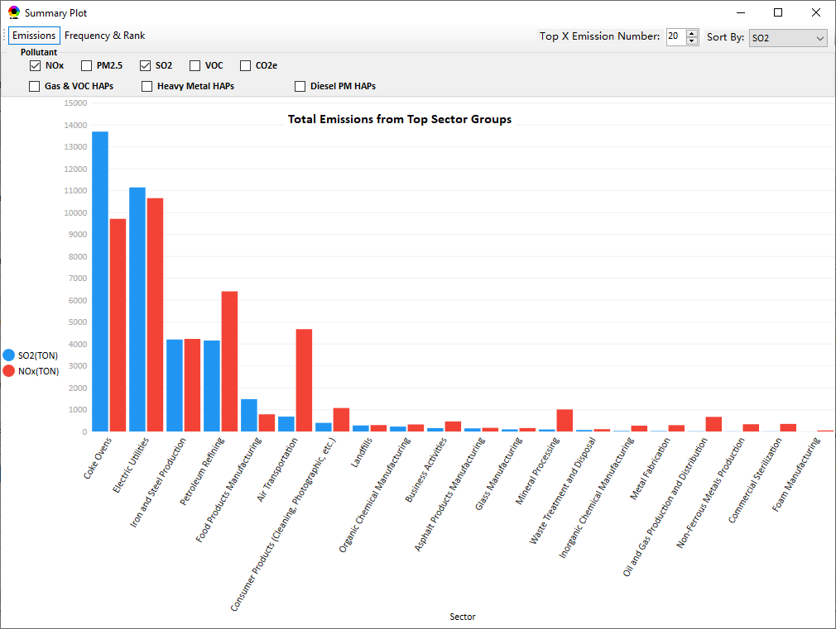
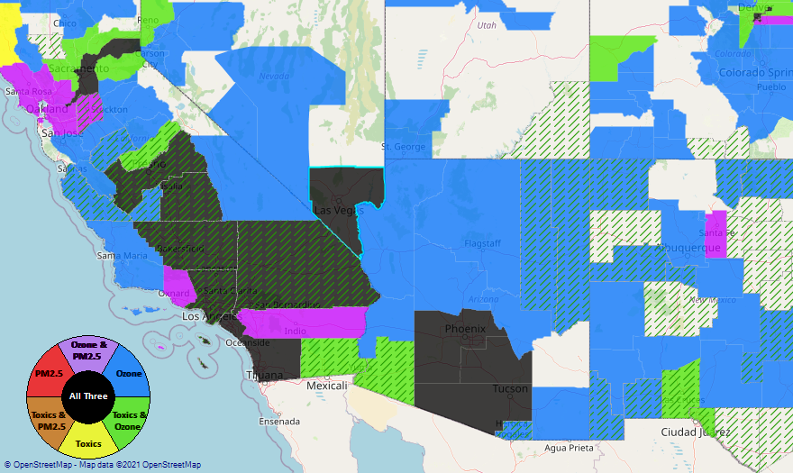
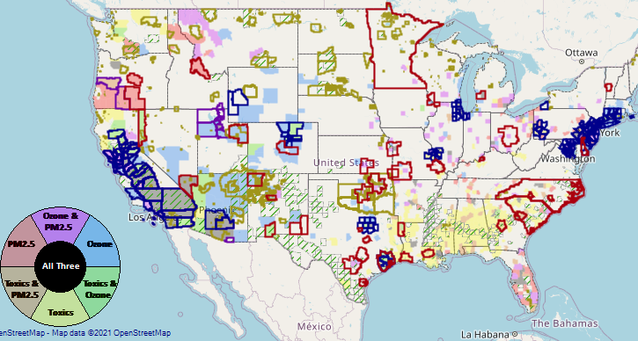
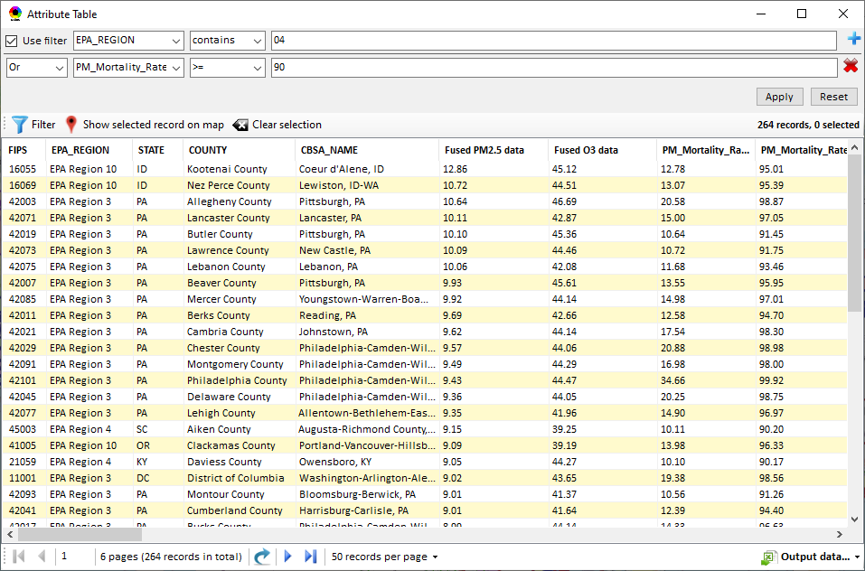
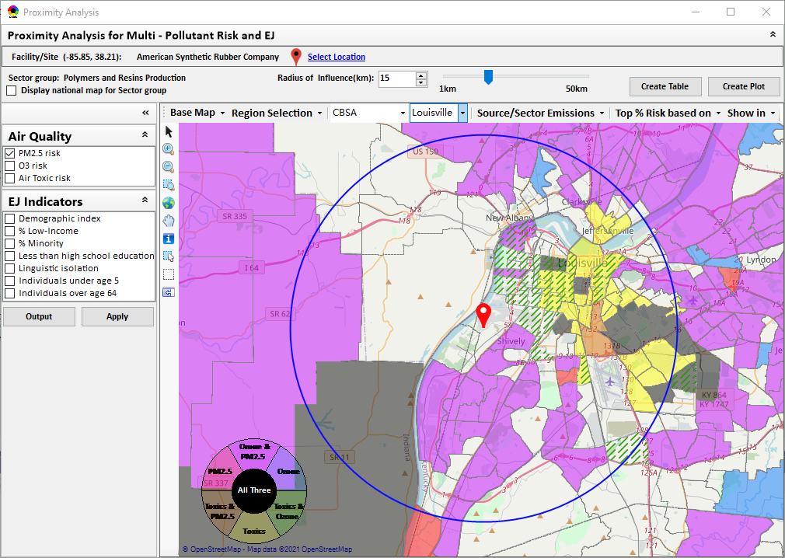
NEXUS: Data Inputs and Major Functions
O₃ & PM_{2.5}
Ambient/Design Value
(2012-2020)
(County-level)
Multi-Pollutant
Ambient and/or Risk National & Areal Mapping
Display Monitoring Sites & Trend Data
O₃, PM_{2.5} & Air Toxics Risk Data &
Conc. (fused AQ) Data
(2017 & 2014)
(Census tract-level)
Display Major Point Emissions Sites/Data
Provide Source Category Emissions
NEXUS
O₃, PM_{2.5} & Air Toxics Monitoring Data
(2002-2020 & -2018)
Provide Sector Emissions Summary
NEI County &
Facility Emissions
(2017 & 2014)
Include EJ/Demographic Indicators
Map Overlay with NAA, Advance Area, Class-I Area, or Tribal Area
Environmental Justice & Demographic Data
(from EJSCREEN)
Data Query, Search, Filter & Export
Advance Area
Class-I Area
Tribal Area
Proximity Screening Analysis (ongoing)

Slide 3
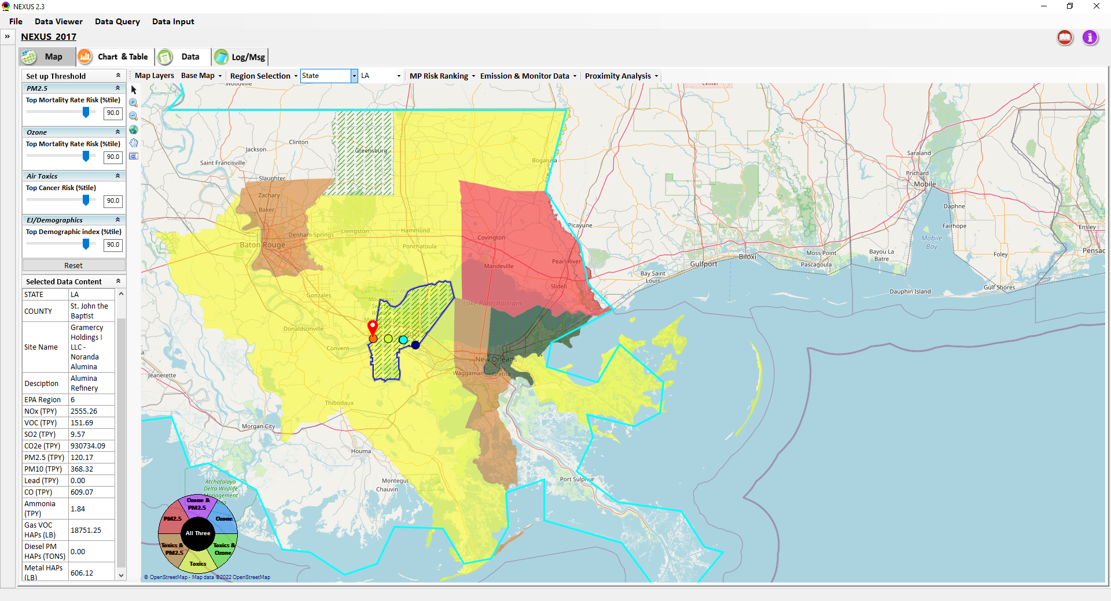
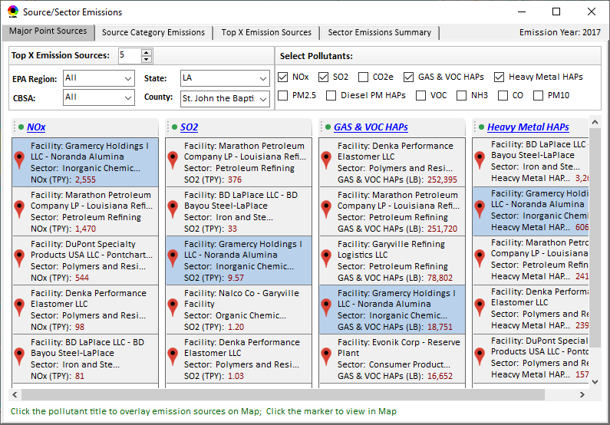
“NEXUS” Advanced Screening Tool: MP & EJ Analysis (County-level)
Baton Rouge
“Noranda Alumina” Facility Gramercy, Louisiana
New Orlean

Slide 4
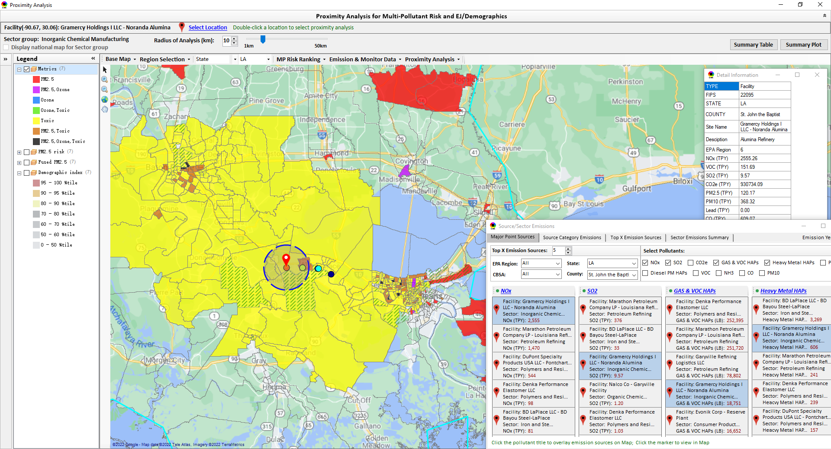
“Proximity Analysis”: Community MP & EJ Analysis (Census tract-level)
Baton Rouge
“Noranda Alumina” Facility Gramercy, Louisiana
New Orlean

Slide 5
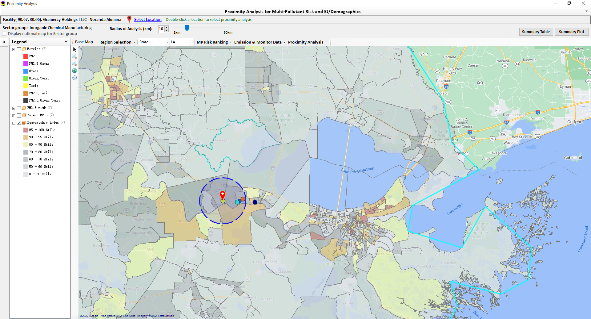
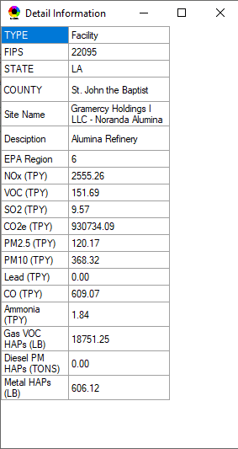
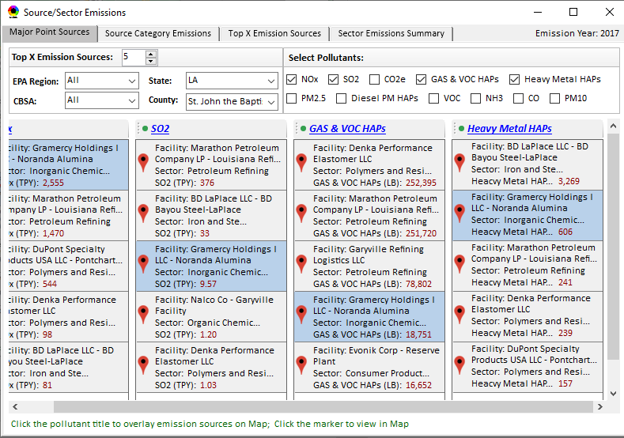
“Proximity Analysis”: EJ/demographics (EJSCREEN data)
Baton Rouge
“Noranda Alumina” Facility Gramercy, Louisiana
New Orlean

Slide 6
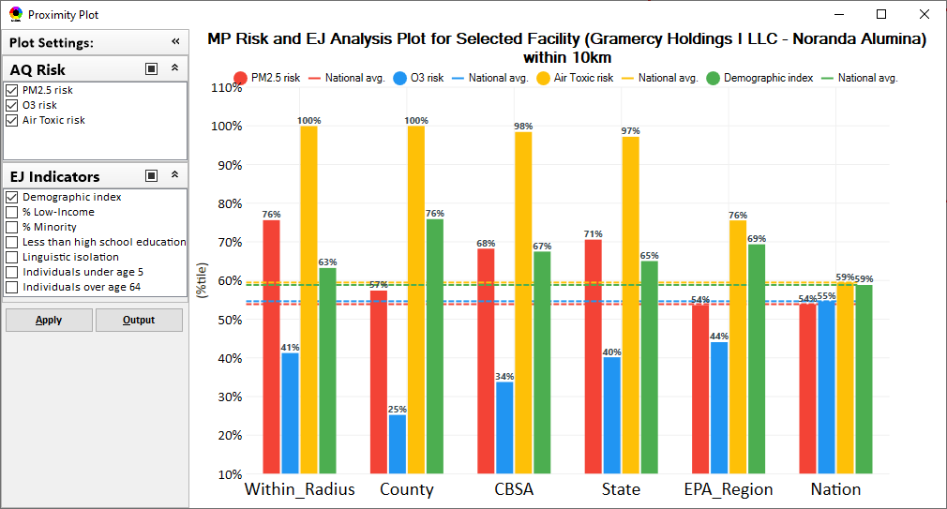
“Proximity Analysis” (Radius of Analysis) : Summary Plot

Slide 7
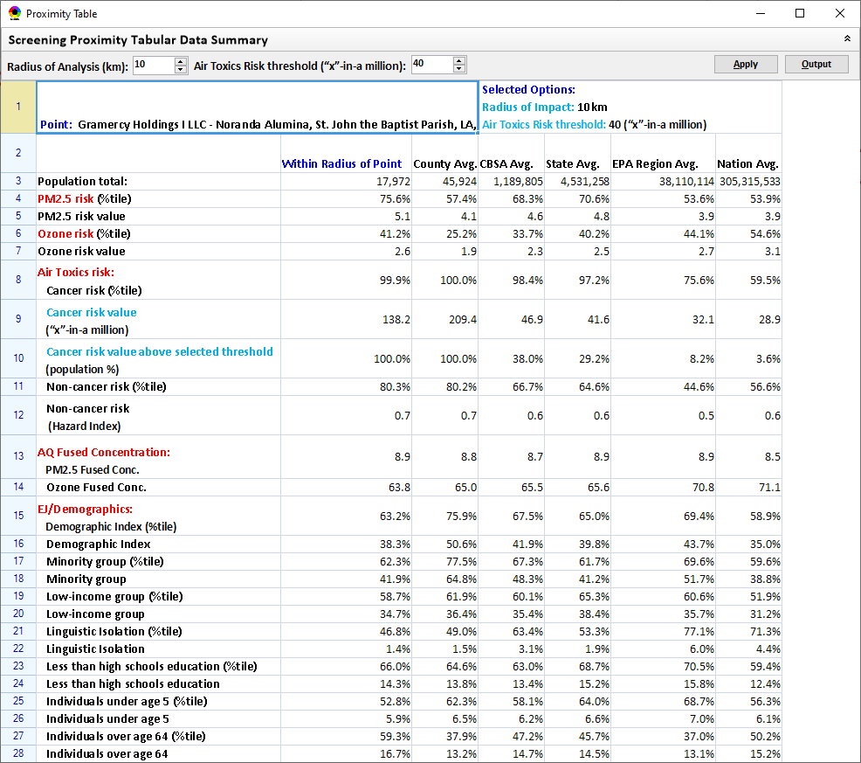
“Proximity Analysis” (Radius of Analysis) : Summary Table

Slide 8
Emissions of Air Toxics from Atlantic Alumina (formerly Noranda Alumina) Gramercy Louisiana
1/26/2022

Slide 9
Overview
Facility has Title V Permit
Lead emissions not mentioned in permit documents
Total HAP emissions reported in EIS approximately 10 tpy (2017-2019)
Facility reports Chlorine (since 2009) and Mercury (since 2013) to TRI
LADEQ did not report any HAP for this facility to EIS for NEI
NEI HAPs from TRI and HAP Augmentation profiles (no Lead was augmented)
AirToxScreen SLT Review of 2017 Emissions & AERMOD-based chronic risks show low cancer and non-cancer risks
Lead and mercury did not undergo multipathway modeling in this analysis
MIR Cancer Risk 0.021 per million
MIR Respiratory Hazard Index 0.0012
MIR Neurological Hazard Index 0.0068

Slide 10
Mercury augmented from TRI reports (2015 forward).
Permit mentions mercury allowable emissions from Bauxite Processing Area Relief tank (1500 lb/year prior to 10/2020)

Slide 11
Lead augmented from boiler and turbine PM10-Filterable emissions in triennial inventories through 2014 (sometimes carried over from previous triennial inventory)
No lead emissions/limits in permit.

Slide 12
Chromium augmented from boiler and turbine PM10-Filterable emissions in triennial inventories through 2014 (sometimes carried over from previous triennial inventory) No chromium emissions/limits in permit.

Slide 13
Ni & Cd augmented from boiler and turbine PM10-Filterable emissions in triennial inventories through 2014 (sometimes carried over from previous triennial inventory)
No Ni or Cd emissions/limits in permit.

Slide 14
Mn Co & As augmented from boiler and turbine PM10-Filterable emissions in triennial inventories through 2014 (sometimes carried over from previous triennial inventory)
No Mn Co or As emissions/limits in permit.

Slide 15
Chlorine augmented from TRI reports (2014 forward).
Permit mentions allowable emissions from Bauxite Processing Area cooling tower and water treatment (50 lb/year)

Slide 16
BTX augmented from boiler turbine and IC engine VOC emissions in triennial inventories through 2011 and annually thereafter (2009 carried over from previous triennial inventory) Permit limits: Benzene 312 lb/yr Toluene 5066 lb/yr Xylenes 52 lb/yr

Slide 17
CH20 augmented from boiler turbine and IC engine VOC emissions in triennial inventories through 2014 (sometimes carried over from previous triennial inventory) Permit limit: 9616 lb/yr (mostly from boilers)

Slide 18
Hexane augmented from boiler turbine and IC engine VOC emissions in triennial inventories through 2011, and annually thereafter (sometimes carried over from previous triennial inventory) Permit limit: 170 lb/yr (Bauxite Processes Relief Tank)

Slide 19
Naphthalene augmented from boiler turbine and IC engine VOC emissions in triennial inventories through 2011 and annually thereafter (sometimes carried over from previous triennial inventory) Permit limit: 730 lb/yr

Slide 20
Acetaldehyde augmented from IC engine VOC emissions in recent inventories
Permit limits: Acetaldehyde 9026 lb/yr
Acrolein 8 lb/yr
Permit does not mention ethylene dibromide or ethylene dichloride.

Slide 21
PAHs augmented from boiler turbine and IC engine PM10-Filterable emissions in inventories (sometimes carried over from previous triennial inventory) Permit limit: 16 lb/yr (mostly from Red Mud Management Area pumps)

