Slide 1
Multi-Pollutant (MP) NCEE Briefing
OAQPS’s Multi-Pollutant Team
Beth Landis & Carey Jang
October 14, 2021

Slide 2
MP Team Members
HEID
  Beth Landis / Kimber Scavo
  Robin Langdon / Darryl Weatherhead
  Matt Woody/ Kelly Rimer
  Sara Terry
  Carrie Wheeler
  Ben Gibson
  Rob Pinder
  Scott Voorhees
  Chris Davis
AQPD
  Rich Damberg / Megan Brachtl
AQAD
  Carey Jang / Tyler Fox
  Jim Kelly
  Joe Mangino
  Jeanette Reyes
OID
  Amanda Kaufman
  James Payne
SPPD
  Lisa Conner

Slide 3
Outline
Multi-Pollutant (MP)
  Background
  Projects (Detroit, SC & Louisville)
NEXUS MP Tool
  Expected Use
  Examples
  NEXUS and EJSCREEN
Next Steps
Briefings, Demos & Planned Outreach
NEXUS Recent and Ongoing Development
NEXUS 2.0 Demo

Slide 4
MP Background
Support a comprehensive, MP treatment of air quality problems to effectively improve air quality and make the most efficient use of available resources
  Primary Goal - identify & evaluate local control strategies targeting emissions of O₃ & PM_{2.5} and their precursors while at the same time reducing Air Toxics of concern for communities to maximize both health benefits and air quality improvements
MP planning has the potential to reduce the costs and increase benefits associated with air quality management (AQM)
Supports S/L/T air agencies in developing MP, risk-based AQM plans and implementing strategies that reduce air pollution emissions & improve public health
Success has been demonstrated in Detroit and SC; another project is currently underway in Louisville, KY
Tools needed to analyze MP data are either available currently or being developed in OAQPS (e.g., NEXUS)

Slide 5
Detroit – MP Case Study
Partners: EPA, MDEQ, SEMCOG & LADCO
Goals: Assess and compare two contrasting air quality control strategies
“Status Quo” approach – controls selected separately to address O₃ & PM nonattainment
“Multi-pollutant, risk-based” approach – aimed at further reducing population risk from exposure to O₃, PM and select air toxics while still addressing ozone and PM nonattainment
Results showed the multi-pollutant approach:
Achieved the same or greater reductions of PM and O₃
Improved air quality regionally and across the Detroit urban core for multiple pollutants
Produced ~2x greater monetized benefits for PM and O₃
Reduced non-cancer risk
Resulted in greater net benefits & was more cost effective

Slide 6



South Carolina MP Project
Partners: EPA, SC DHEC & local community and business leaders in 10 upstate South Carolina counties
Goals:
Develop and analyze a multi-pollutant, risk based AQM strategy
Maximize both health benefits and air quality improvements, identify and evaluate a local control strategy targeting emissions of O₃, PM & their precursors while also reducing air toxics of concern for communities
Results demonstrated improving air quality in areas already attaining the NAAQS can yield significant health benefits

Slide 7
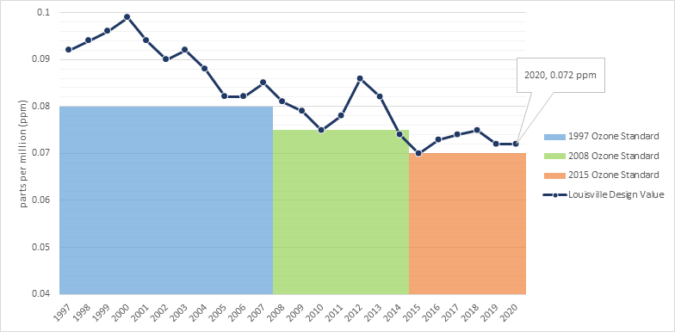
Louisville MP Project
Partners: EPA, Louisville Metro Air Pollution Control District (LMAPCD) & Louisville Metro Department of Public Health and Wellness (LMPHW)
Goals:
Identify local- and state-level emission reduction measures that address multiple pollutants, with a focus on attainment of the 2015 O₃ NAAQS
Build a plan to achieve and maintain compliance of all NAAQS
Demonstrate that the selected strategies can reduce health risk from exposure to O₃, PM and selected air toxics
Integrate existing health risk-based pollution control programs into a multi-pollutant air quality management plan
Build institutional capacity among LMAPCD and LMPHW to perform air quality modeling and health benefit analysis projects
Results pending
Graphic provided by LMAPCD

Slide 8
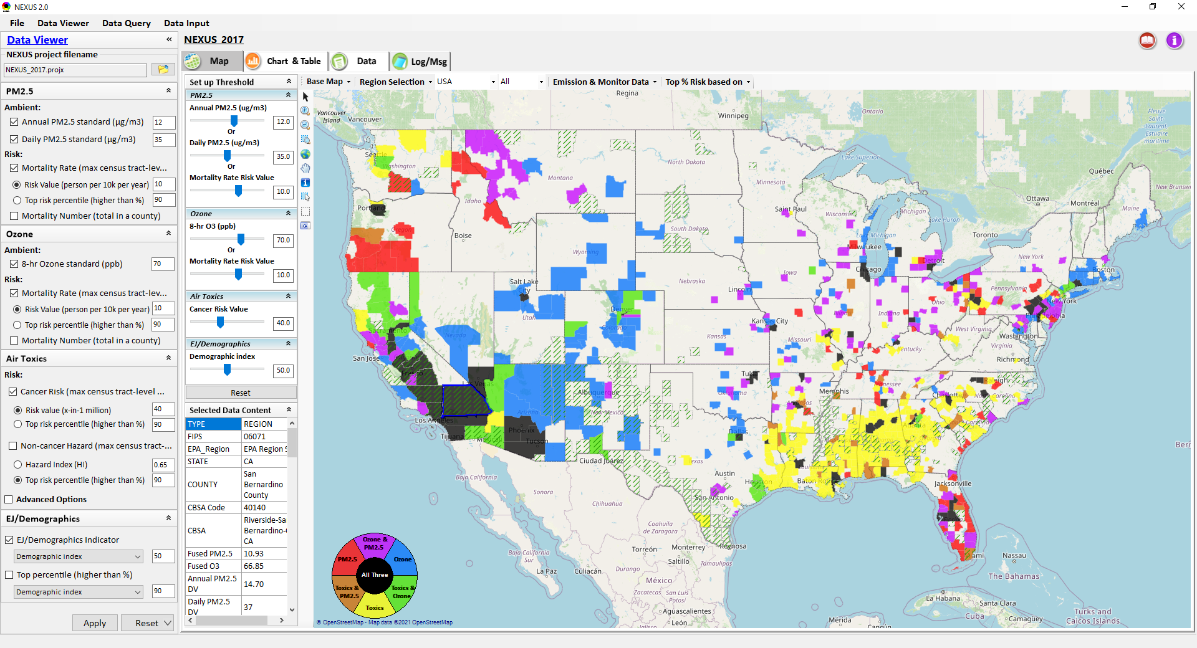
NEXUS: Tool Development
A new Multi-Pollutant (MP) Advanced Screening Tool (NEXUS) is being developed to:
Identify geographic areas where health risks related to O₃, PM_{2.5} and air toxics overlap
Identify areas for MP collaboration

Slide 9
NEXUS - Expected Use
The NEXUS tool will allow users to do the following:
  National screening to identify areas with MP issues: Phase 1 development provides ability to quickly screen areas across nation that have combination of high air quality and/or risk levels for O₃, PM_{2.5} and Air Toxics.
  Area screening to understand nature of MP problem: Phase 2 development provides ability to ‘dial-into’ specific areas to determine extent to which common emissions sources are causing the MP issues.
We expect to use this tool in conjunction with Regions and identify areas that would potentially benefit most from MP approaches to reduce emissions (including current NA areas).
The NEXUS tool will essentially provide a ‘conceptual model’ of an area’s MP issues to facilitate engagement with state/local/tribal agencies and community stakeholder groups.
We also expect that it can have additional value-added uses across the Office for Air Toxics, Environmental Justice and other programs.

Slide 10
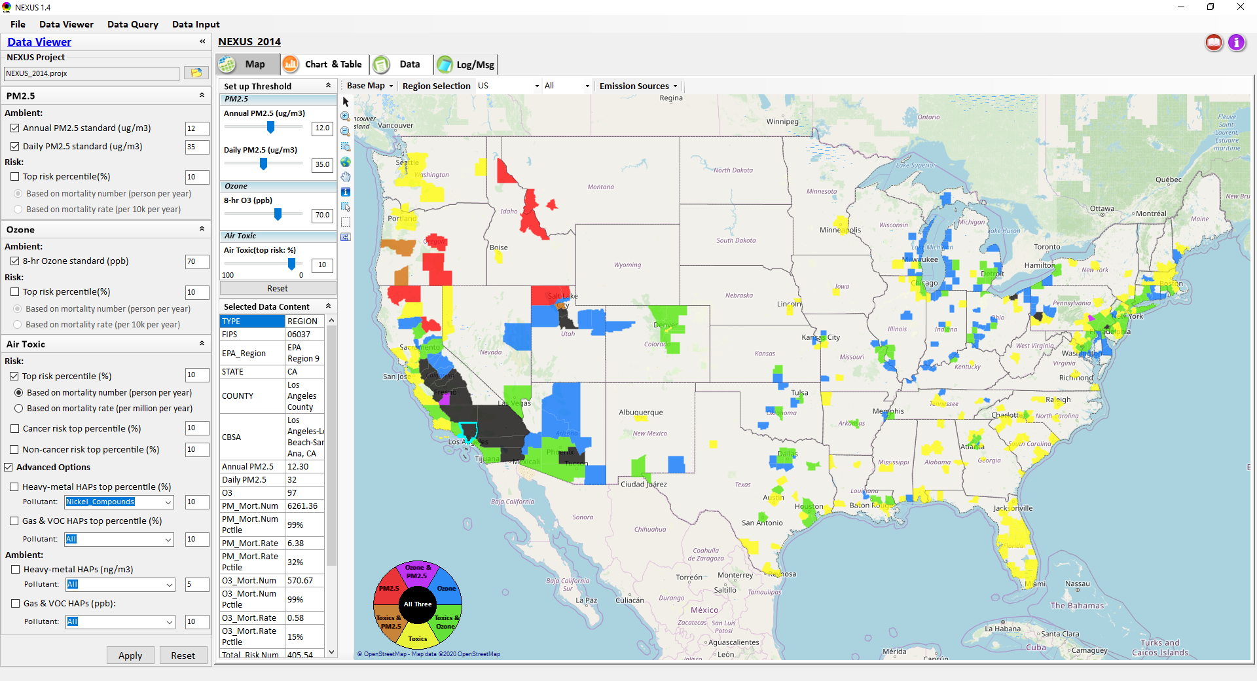
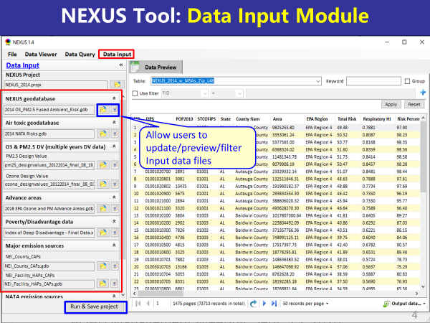
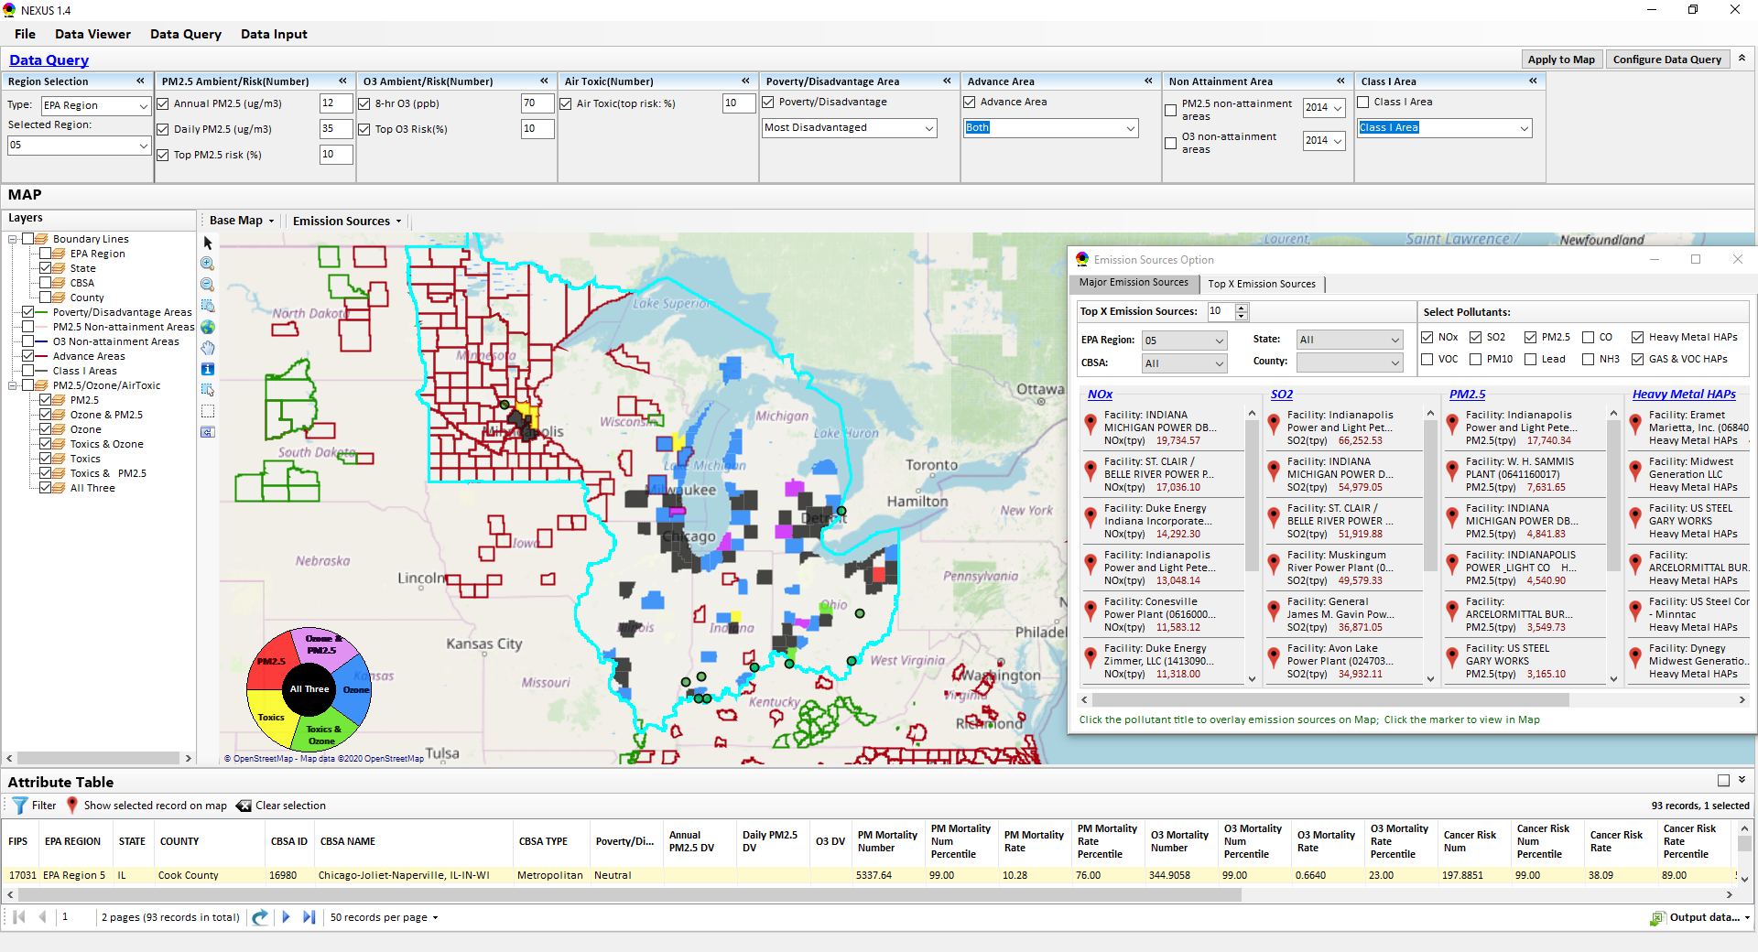
NEXUS: Three Key Modules
Data Viewer Module
Data Input Module
Data Query Module
View and create interactive Map/Data/Chart/Table
Provide flexible selections & mapping of “Ambient” and/or “Risk” levels of PM_{2.5}, O₃ and Air Toxics
Provide regional analysis for “EPA region”, “States”, “CBSA”, and “County”
Display major point emission locations and monitoring sites/data by pollutants
Integrate all MP data - emissions, monitoring, modeling, health risk, and EJ/demographic data into a single platform
Currently use10 publicly available input datasets
Provide data preview, search, filter and output functions
Allow to update/change input data files and then run/save to a new “project”
Expand data field selections and flexibility for exploratory & advanced users
Provide map overlaying and summary table for data query results
Current data query based on selected data fields: “Ambient & Risk for PM, O3 & Air toxics”, “EJ/demographic indicator”, “Advance area”, “NA Area”, “Tribal area”, Class I area”

Slide 11
NEXUS - Examples
How can NEXUS be used to identify highest risk areas across O₃, PM_{2.5}, and Air Toxics, summarize the source(s) contributing to communities with possible EJ concerns, and review specific industrial sources for potential impacts?
  Example 1 → Detroit
How can NEXUS be used to understand the nature of multi-pollutant risks in Advance areas?
  Example 2 → Louisville

Slide 12
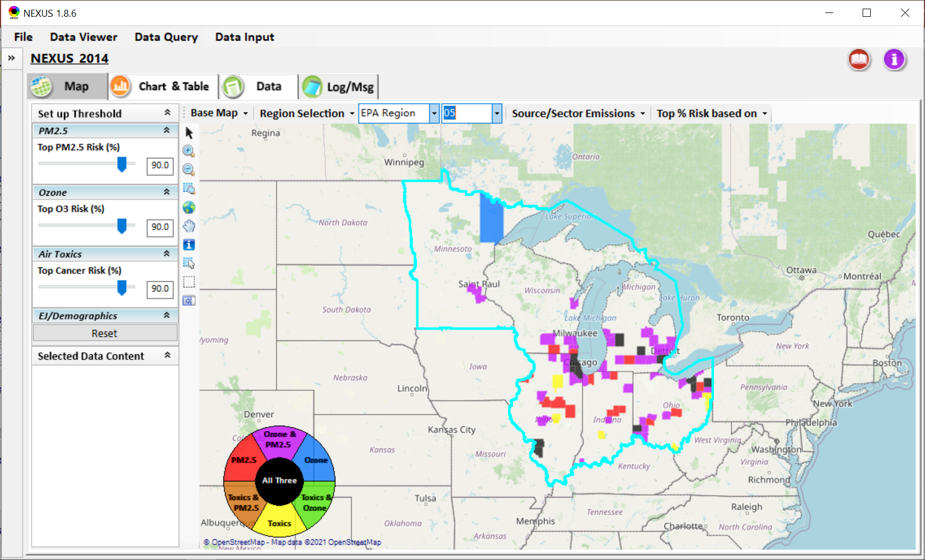
NEXUS – Detroit Example
NEXUS can be used to identify highest risk areas across O₃, PM_{2.5}, and Air Toxics.
Example map above is for Region 5

Slide 13
NEXUS - Highest MP Risk Areas in R5
(Data Query Module)
STATE | COUNTY | CBSA | Annual PM_{2.5} DV | Daily PM_{2.5} DV | O₃ DV | PM Mortality Number% | O₃ Mortality Number% | Cancer Risk Rate (max)%
IL | Cook County | Chicago-Naperville-Elgin, IL-IN-WI |  |  | 73 | 99.97 | 99.97 | 99.00
OH | Cuyahoga County | Cleveland-Elyria, OH | 11.7 | 25 | 70 | 99.78 | 99.53 | 97.00
IL | DuPage County | Chicago-Naperville-Elgin, IL-IN-WI |  |  | 70 | 98.73 | 97.70 | 99.00
MI | Wayne County | Detroit-Warren-Dearborn, MI | 11.2 | 28 | 73 | 99.91 | 99.84 | 95.00
MI | Kent County | Grand Rapids-Wyoming, MI | 9.1 | 25 | 68 | 97.92 | 96.71 | 99.00
IL | Lake County | Chicago-Naperville-Elgin, IL-IN-WI |  |  | 73 | 97.83 | 96.56 | 99.00
NEXUS can be used to identify highest risk areas across O₃, PM_{2.5}, and Air Toxics. Information above was generated in Data Query for Region 5 and exported into excel where rankings were applied.
Top CBSAs (using this approach) – Chicago, Cleveland, Detroit and Grand Rapids

Slide 14
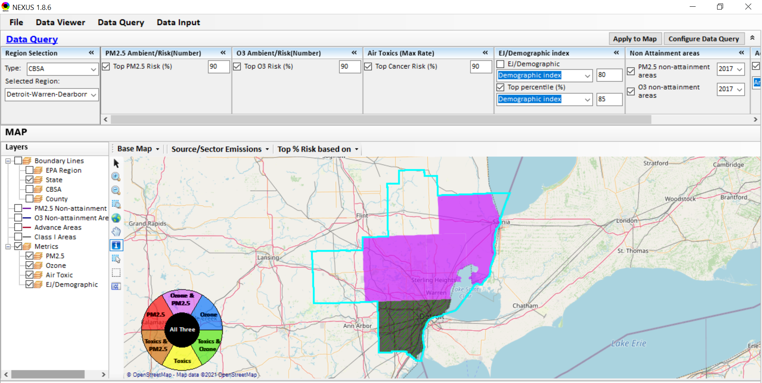
NEXUS - Detroit CBSA
NEXUS can be used to explore CBSAs with MP concerns. This information was generated in Data Query for the Detroit CBSA. Wayne County has dashed green lines, showing that the demographic index percentile is ≥ 85%. Let’s see where the major sources are located…
14

Slide 15
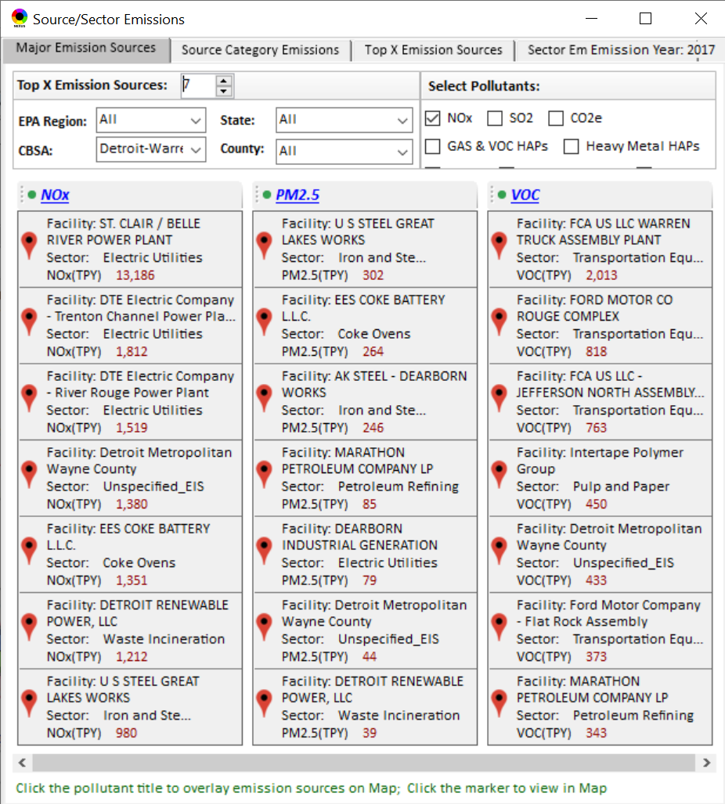
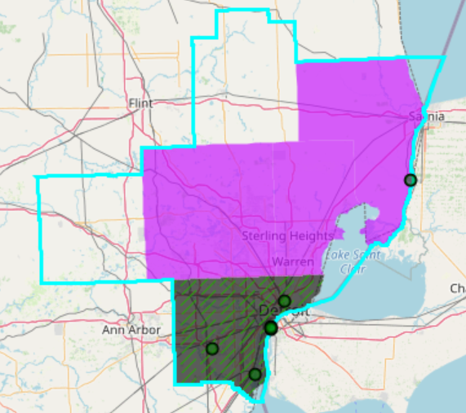
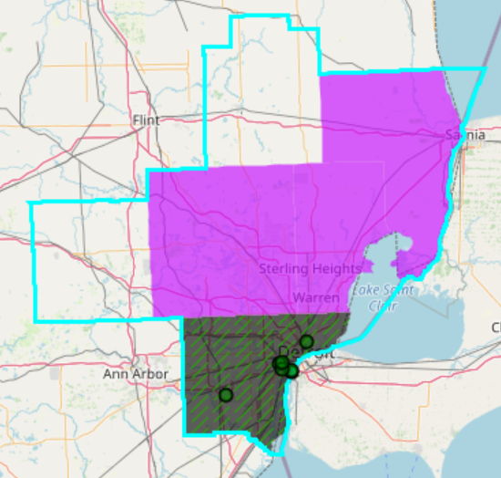
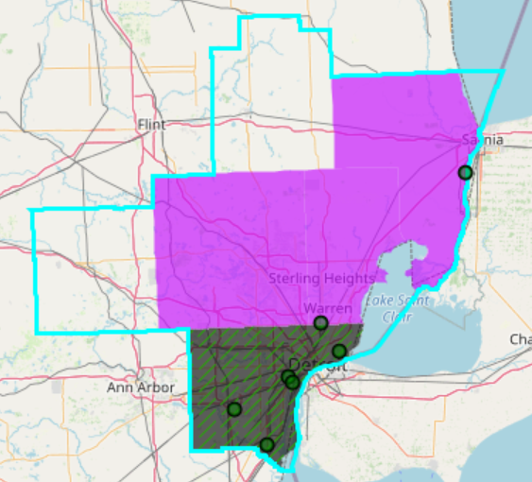
NEXUS - Emissions Sources in Detroit CBSA
Top NOx Emission Sources
Top PM_{2.5} Emission Sources
Top VOC Emission Sources
NEXUS can be used to identify top emission sources. The information above was generated in Data Query for the Detroit CBSA . We can quickly see that the majority of the NOx, PM_{2.5} and VOC & emission sources are located in Wayne County. Let’s explore the Wayne County sources further…
15

Slide 16
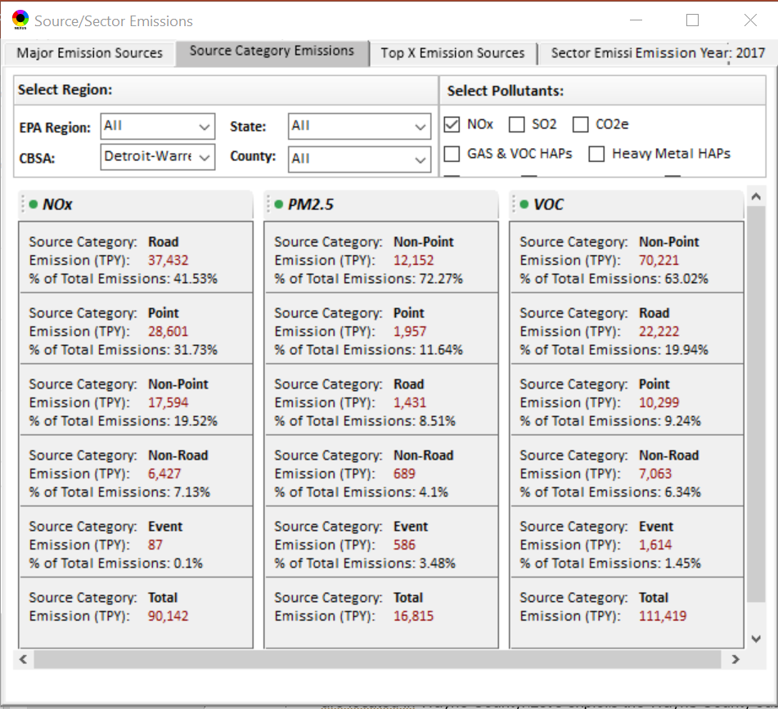
NEXUS – Source Category Emissions in Detroit CBSA
NEXUS can display source category emissions. This information above was generated in the Data Query module for the Detroit CBSA.
16

Slide 17
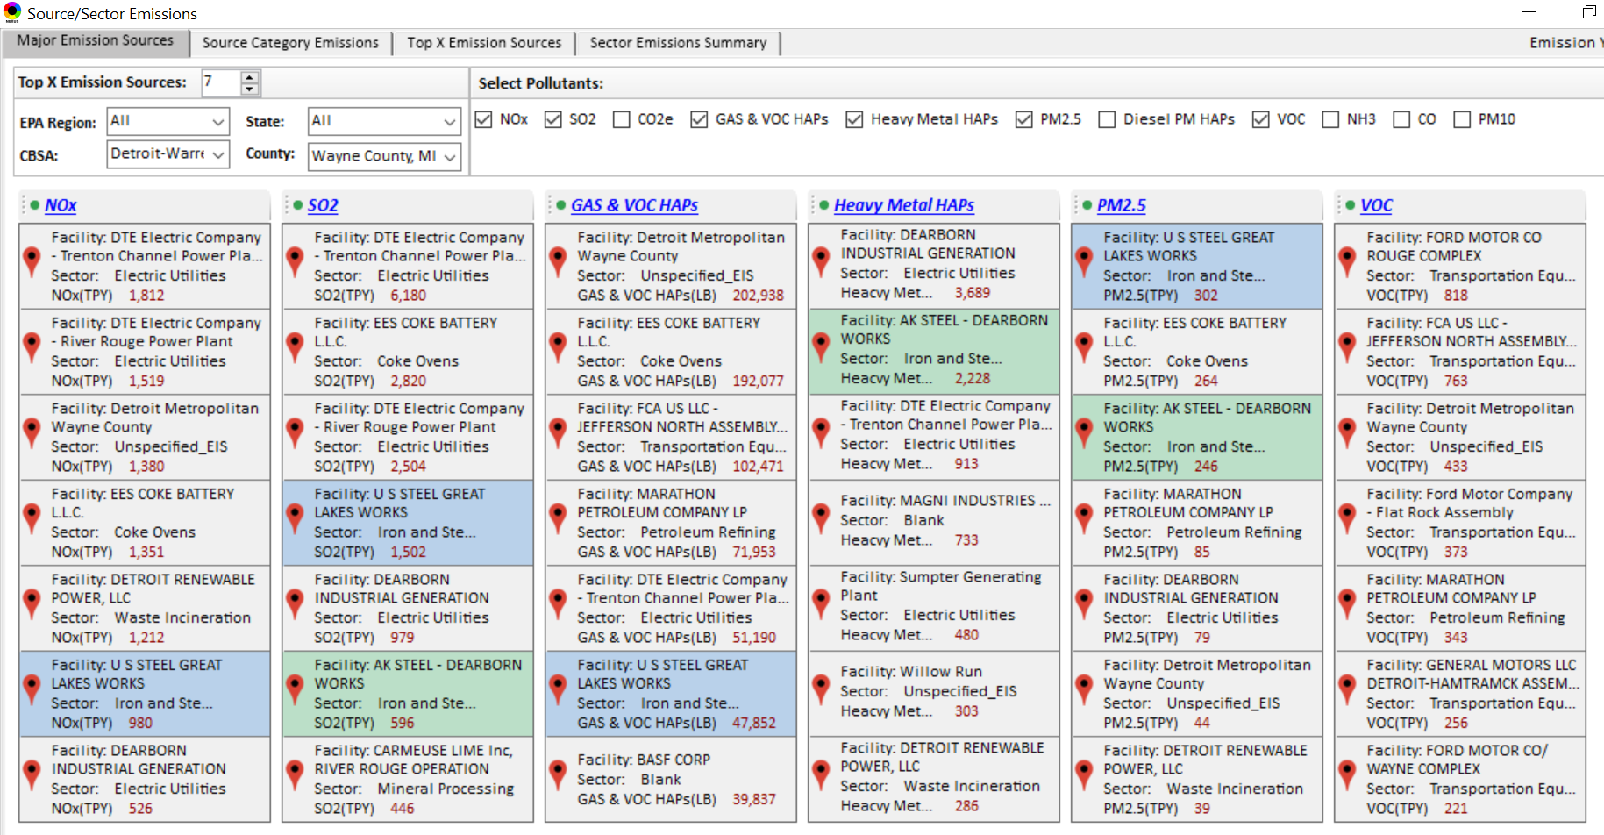
NEXUS Tool - Emissions Sources in Wayne County
NEXUS can be used to identify top emission sources. The information above was generated in Data Query for Wayne County, MI. This can help identify the potential co-benefits of controls. Let’s explore AK Steel and US Steel further...
17

Slide 18
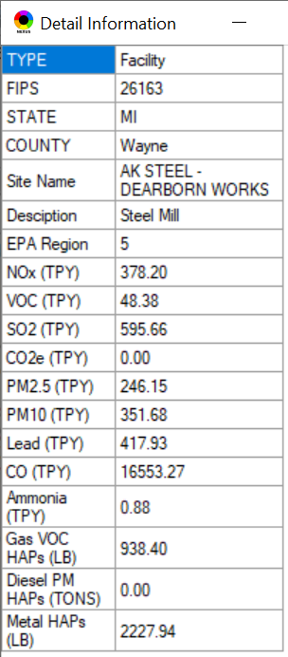
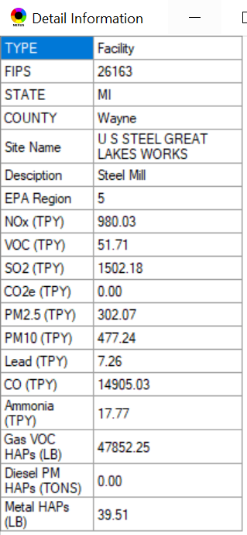
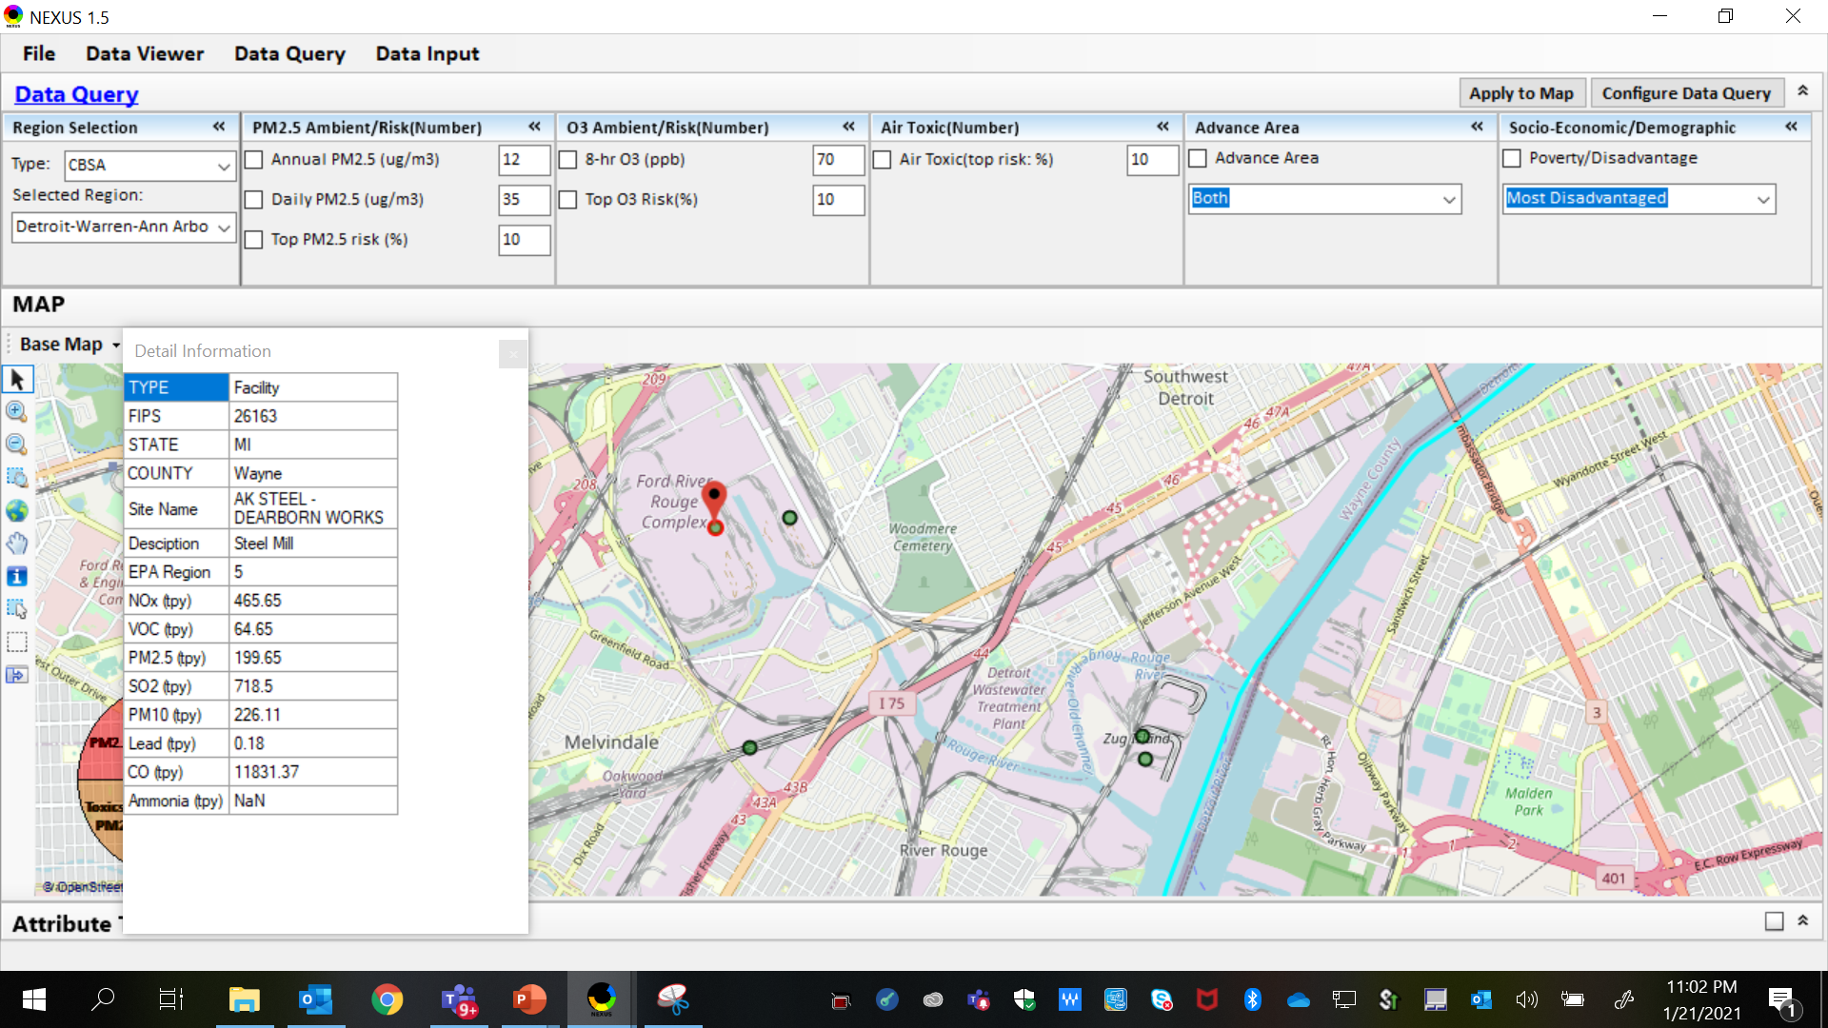
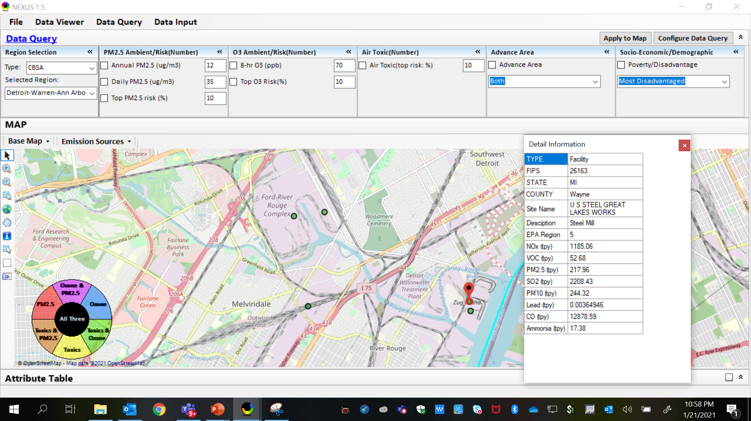
NEXUS Tool - Steel Mills in Wayne County
AK Steel & US Steel were identified as top emitters for NOx, SO₂, Gas and VOC HAPs, Heavy Metal HAPs and PM_{2.5}, highlighting the potential co-benefits of controls in these steel mills. The above map was generated in NEXUS Data Query. Let’s see the proximity of these steel mills to communities with potential EJ concerns…
AK Steel
US Steel
18

Slide 19
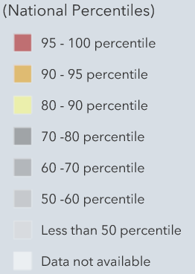
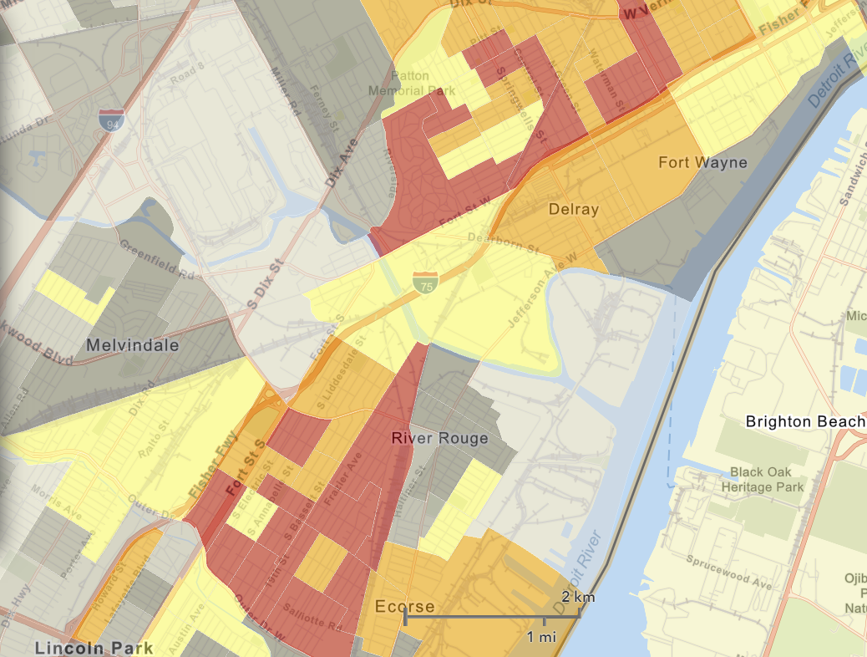
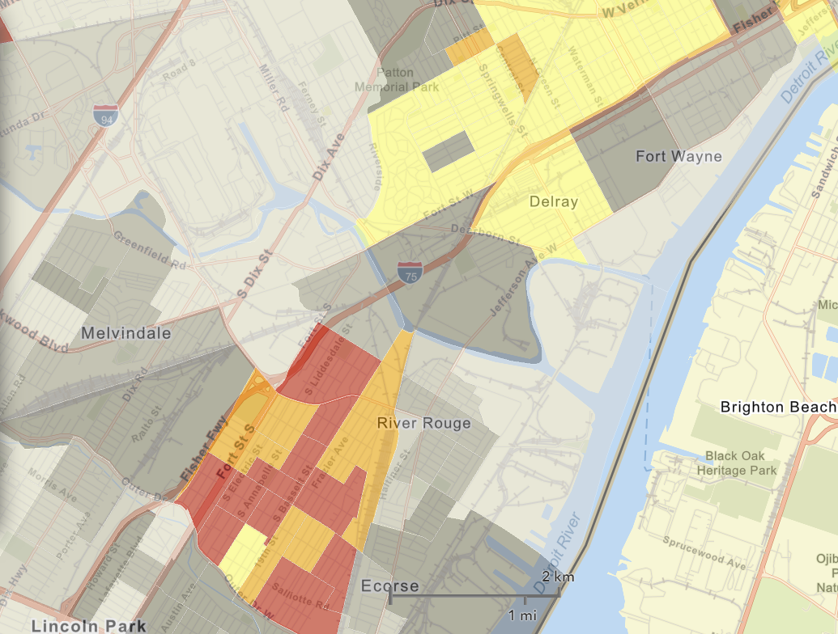
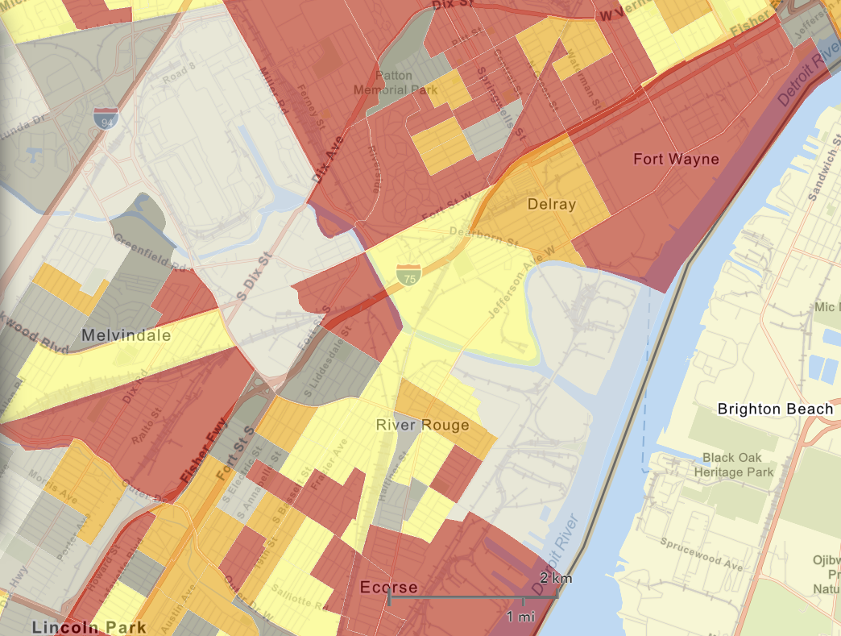

NEXUS Tool - EJ Indices in Wayne County
NEXUS Map
NEXUS can determine the presence or absence of environmental justice concerns in communities in areas with MP concerns. We are incorporating additional EJ metrics such as the data inputs below from EJSCREEN. These indices show the close proximity of AK Steel & US Steel to EJ communities.
AK Steel
US Steel
EJSCREEN Demographic Index
EJSCREEN Minority Population
EJSCREEN Low Income Population
19

Slide 20
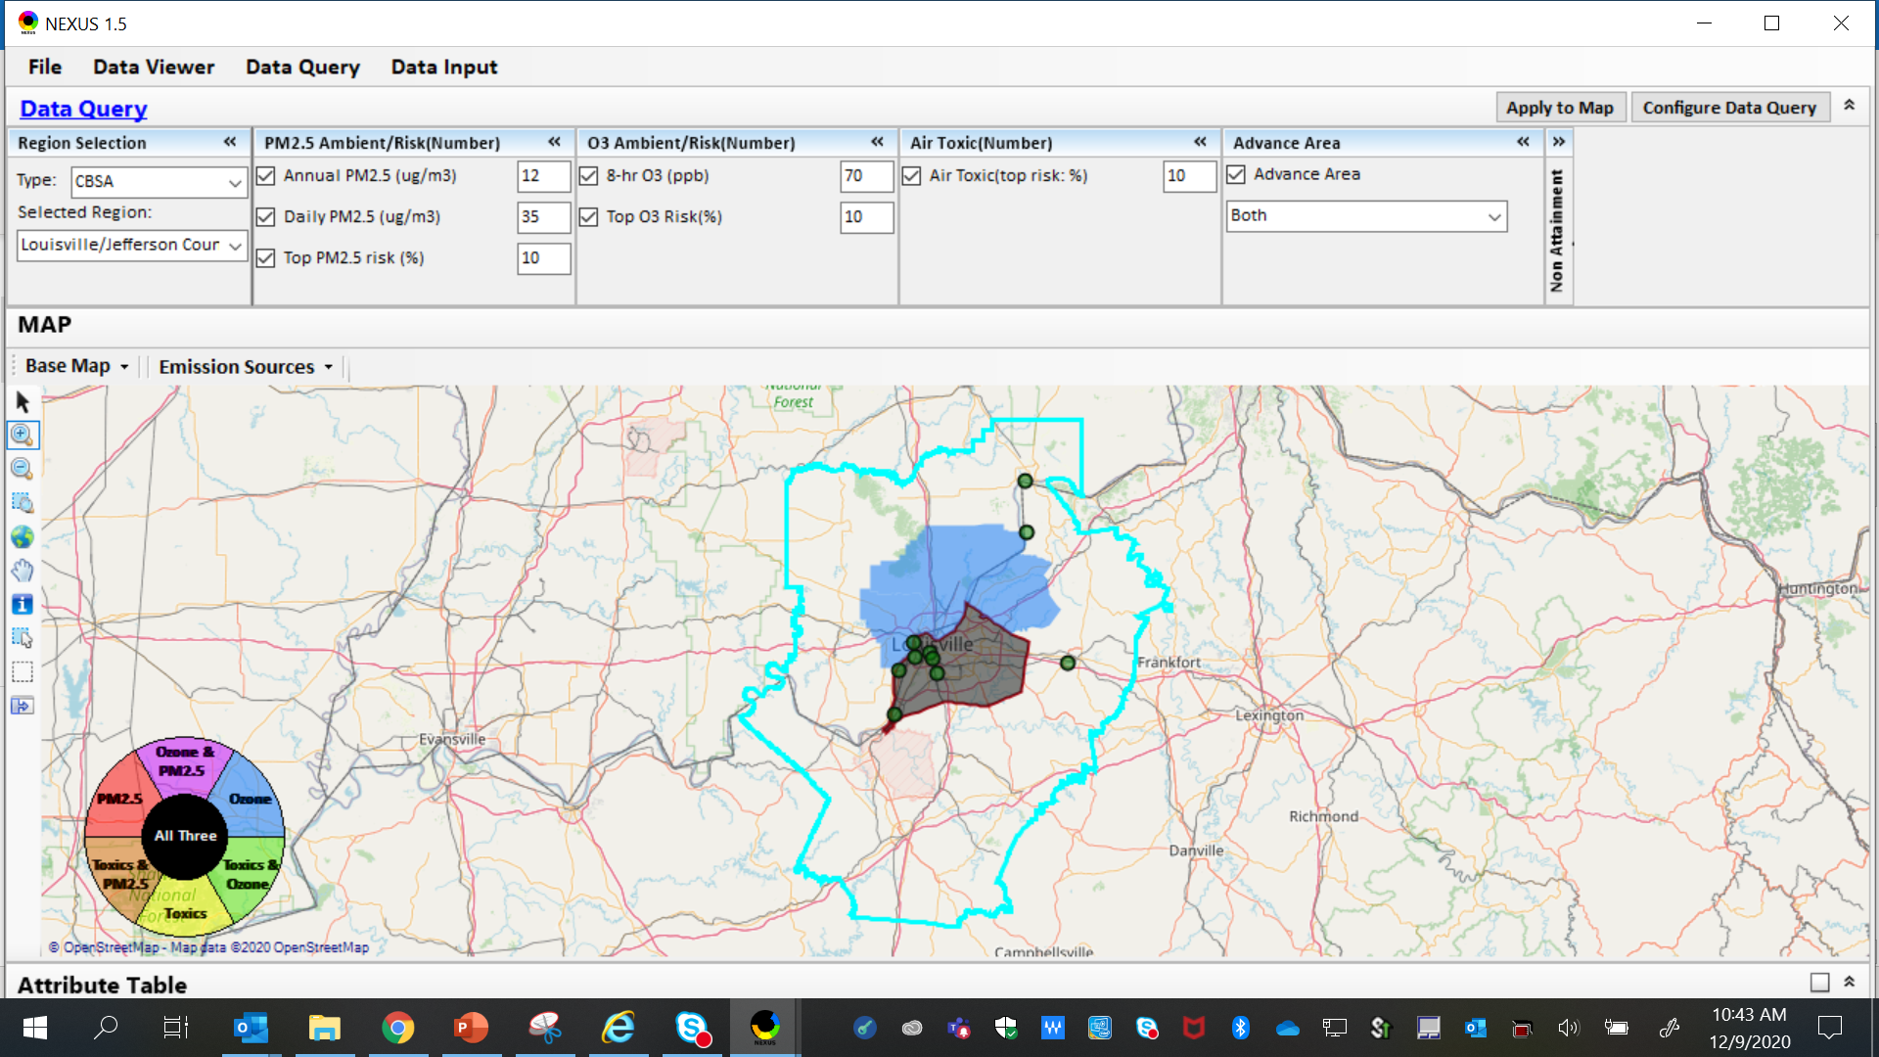
NEXUS Example - Louisville
The map above was generated for the Louisville/Jefferson County - Elizabethtown - Madison, KY-IN CBSA (2014 O₃ NAA), using the data query module. The top 10 Gas & VOC HAPS emission sources are identified.
20

Slide 21
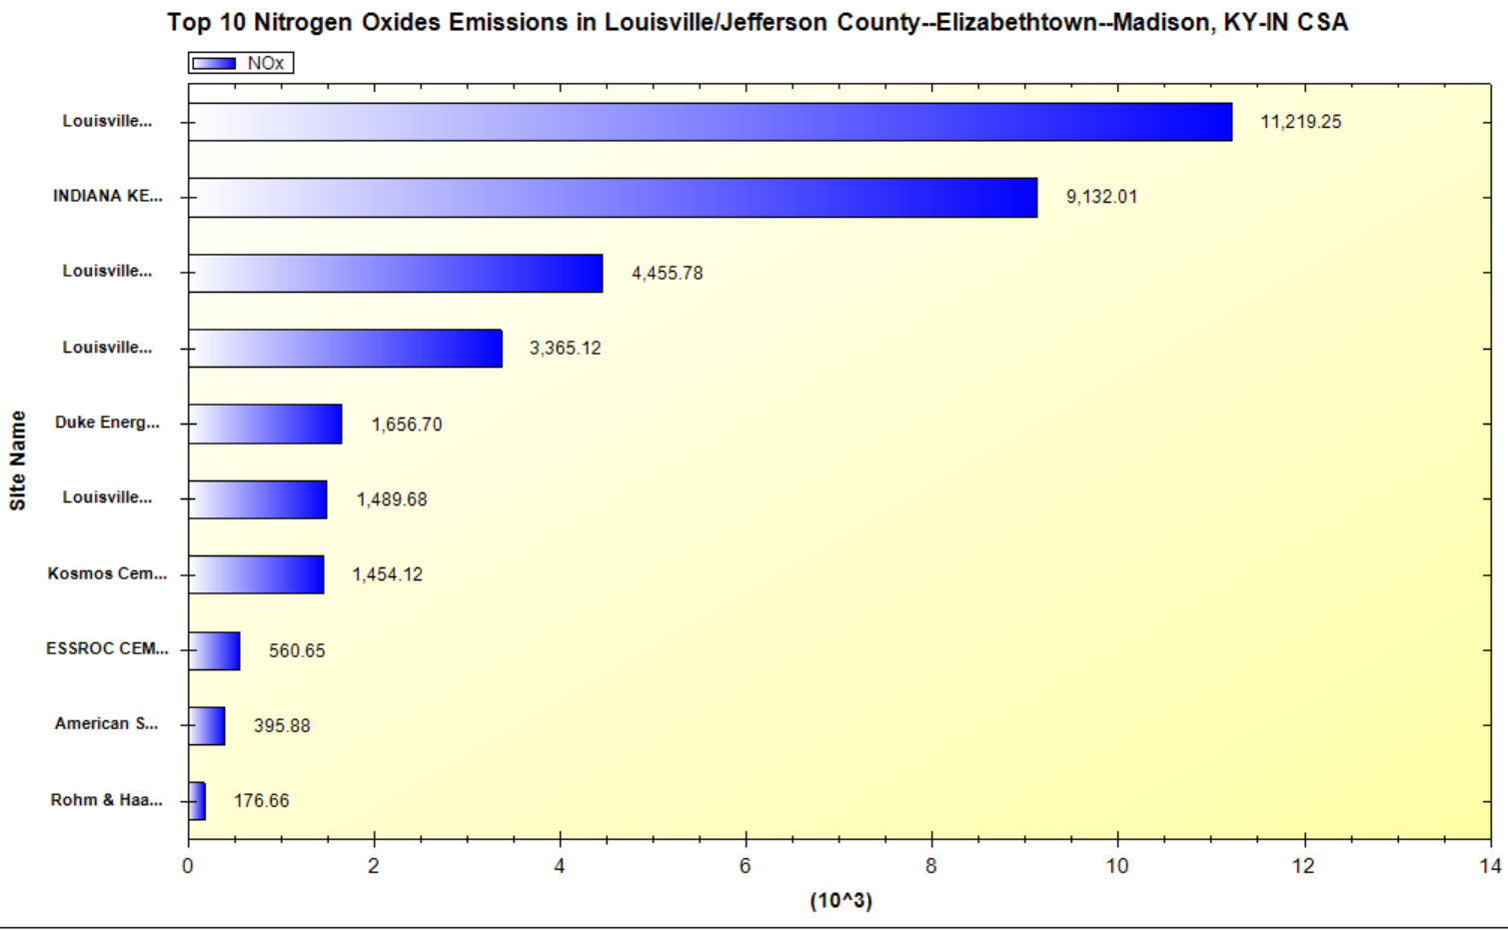
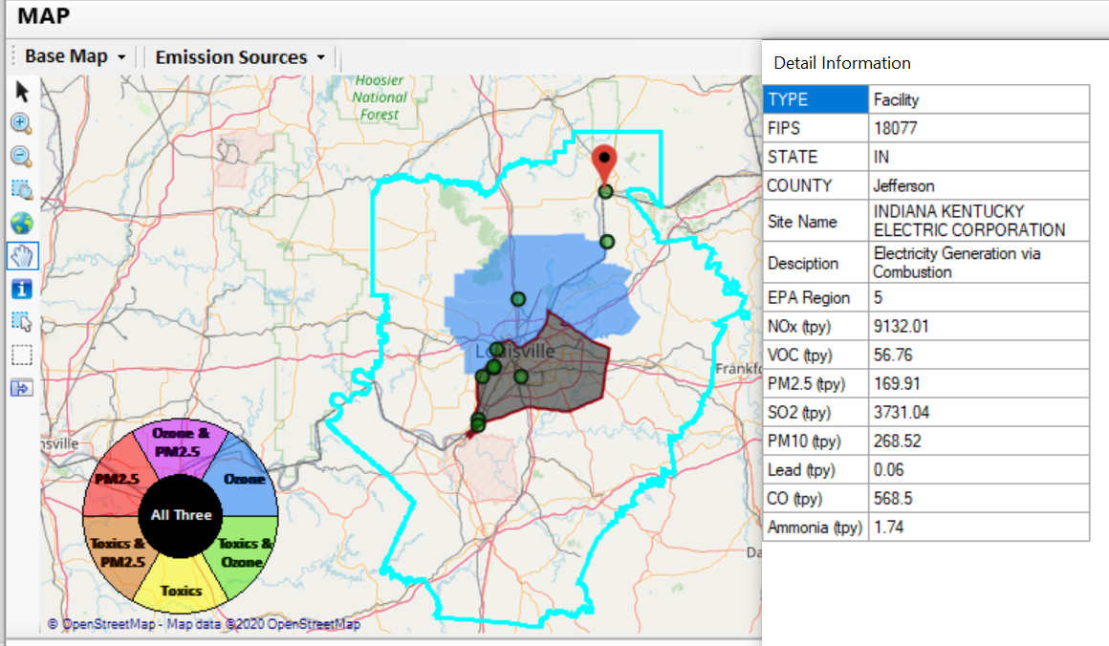
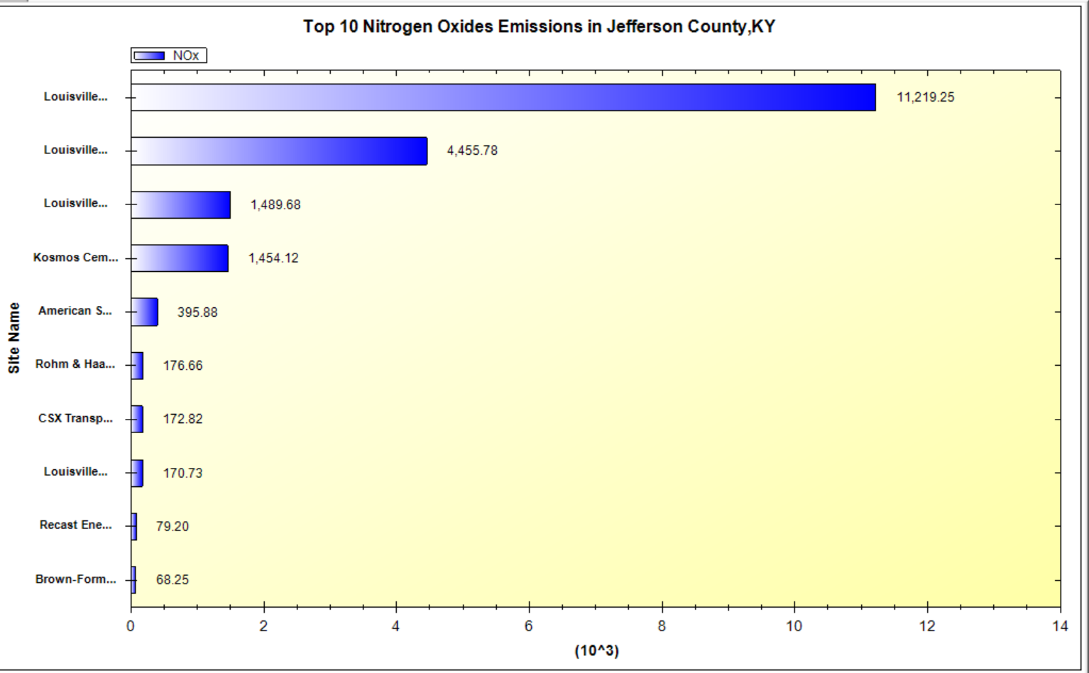
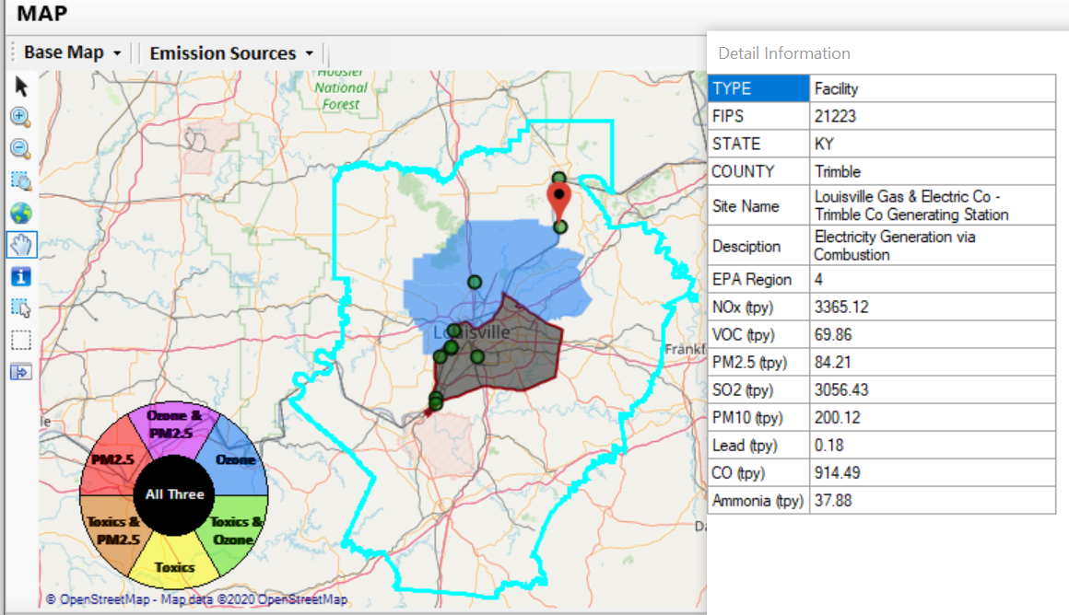
NEXUS Example - Louisville
2 of the top 4 NOx emission sources outside Jefferson County, KY (Jefferson County, IN & Tremble, KY)
21

Slide 22
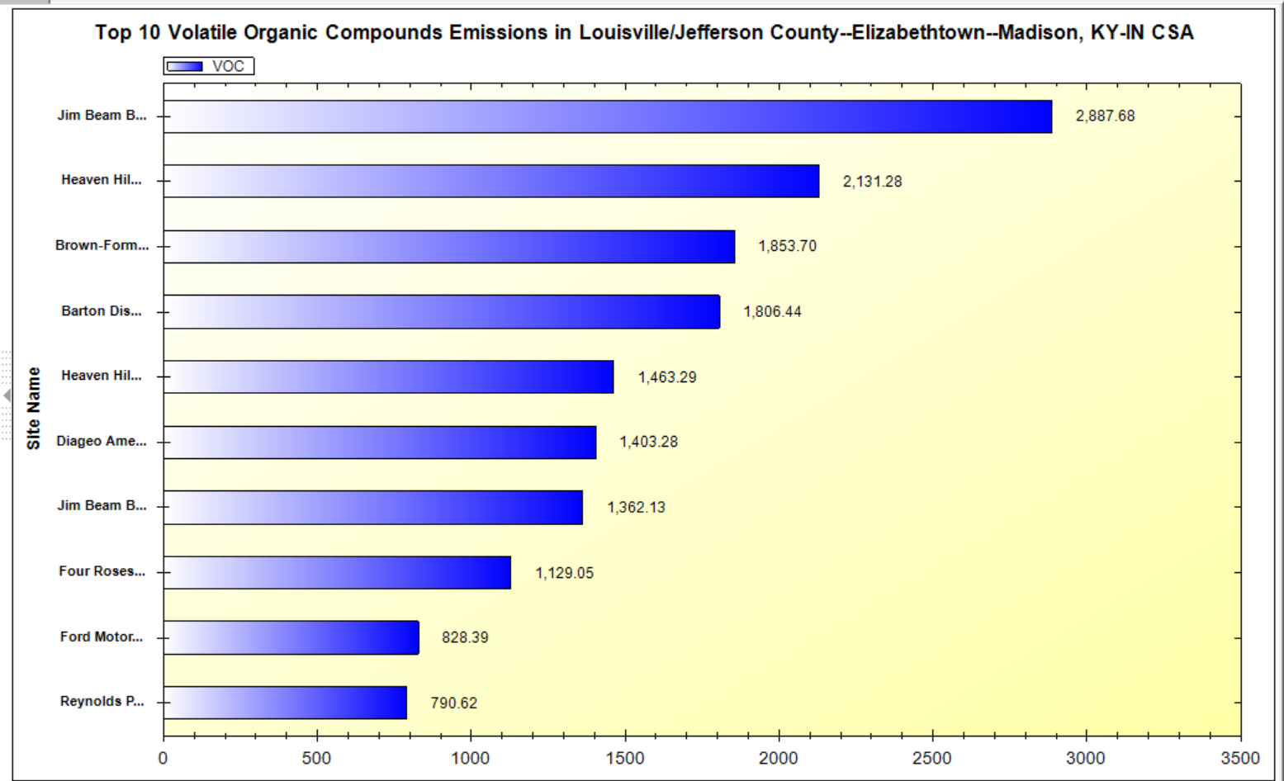
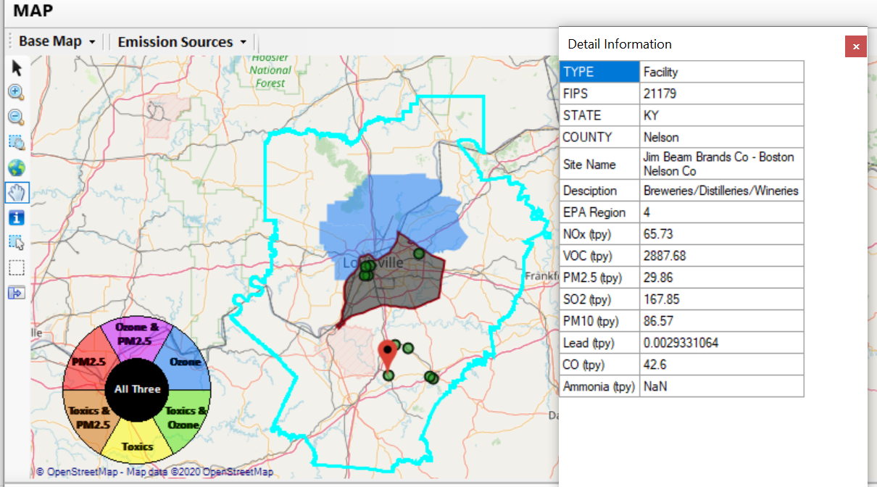
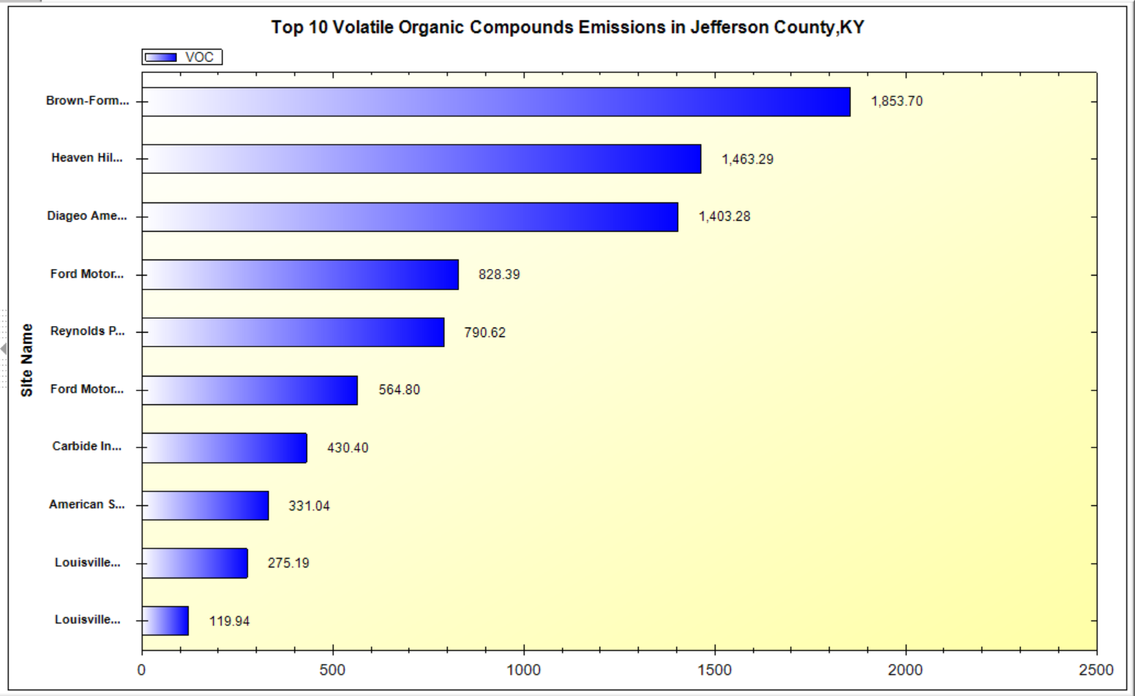
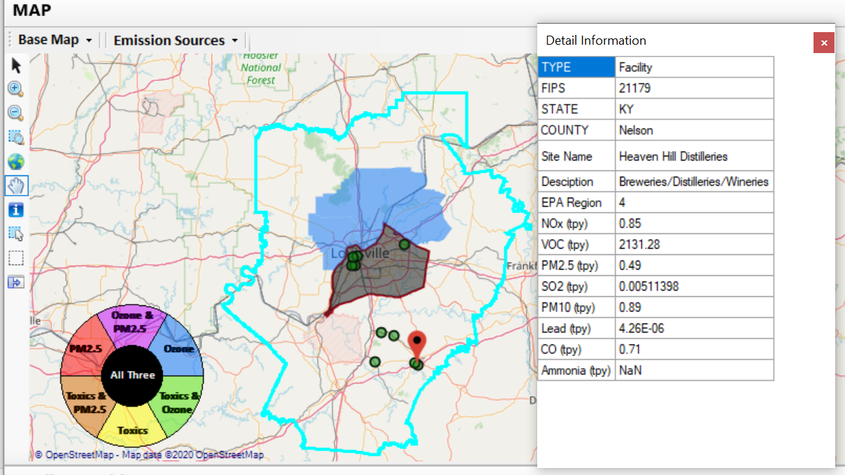
NEXUS Example - Louisville
Top 2 VOC emission sources are in Nelson County, KY
22

Slide 23
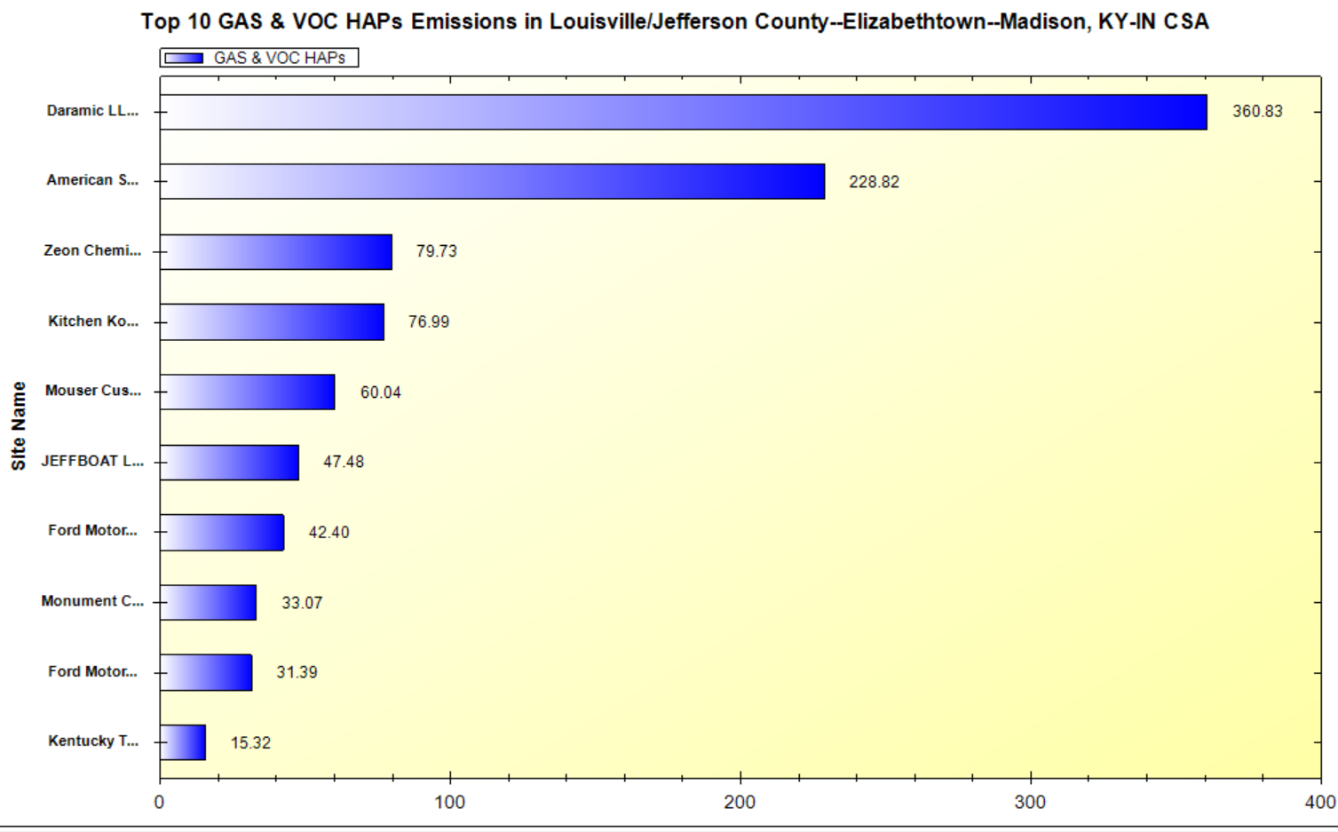
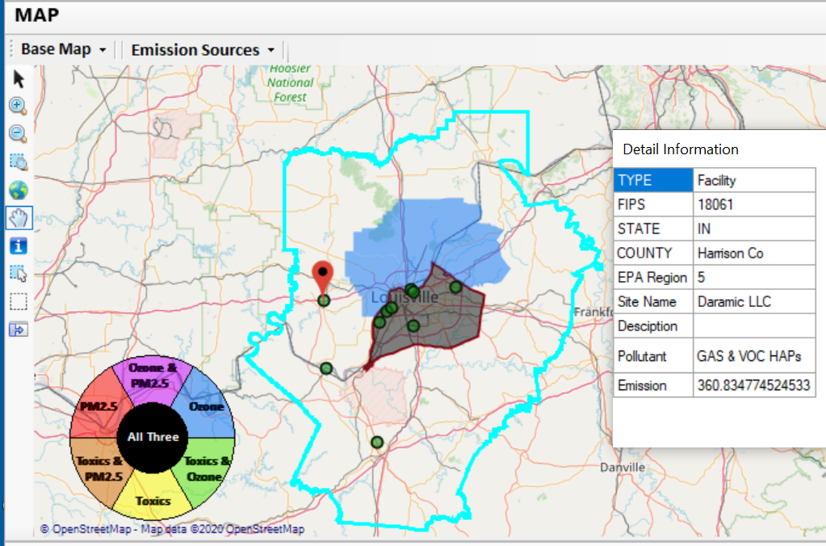
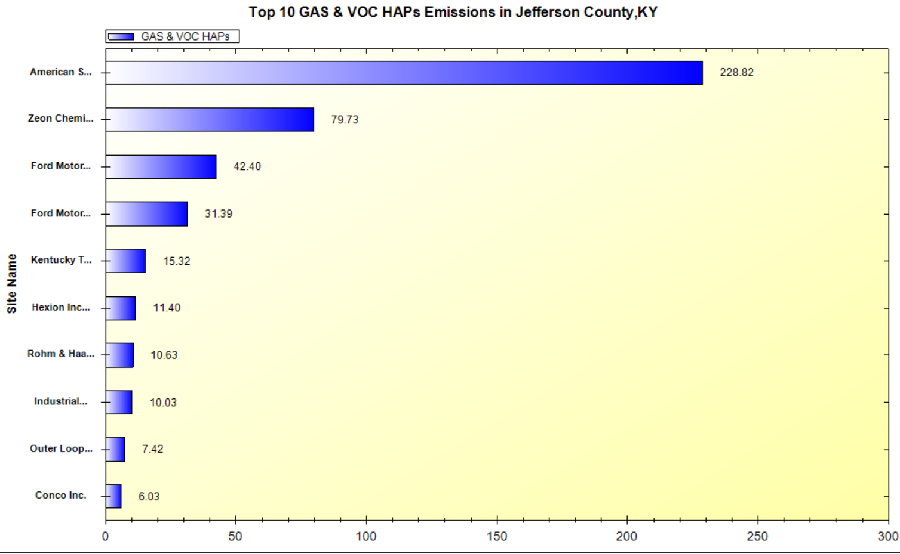
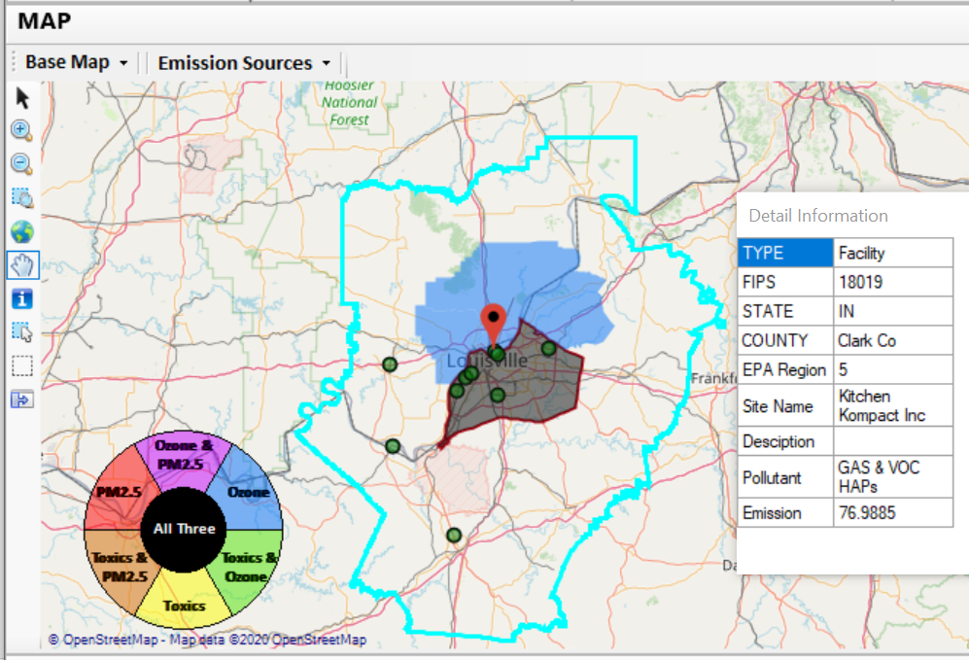
NEXUS Example - Louisville
2 of the top 4 gas & VOC HAPs emission sources in Indiana (Harrison & Clark County)
23

Slide 24
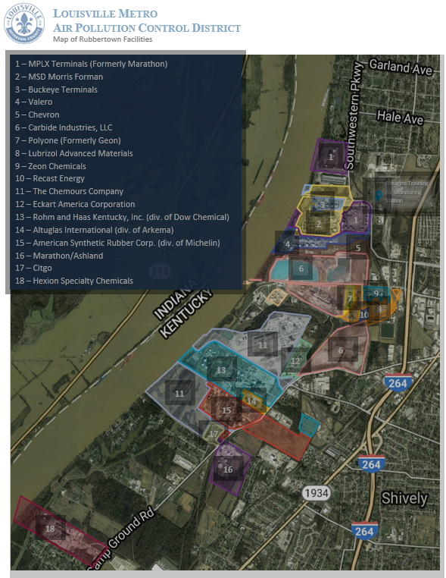
NEXUS Example - Louisville
“Rubbertown is the nickname given to an industrial area along the Ohio River at the southwest corner of the pre-merger City of Louisville. It gets its name from tire and synthetic rubber plants that were built there during World War II near existing refineries. Factories in Rubbertown now produce a wide variety of chemicals and materials…”
“For many years, residents of western Louisville and nearby areas in Jefferson County had complained of health problems they attributed to air pollutant emissions from the many industrial facilities in Rubbertown.”
https://louisvilleky.gov/government/air-pollution-control-district/rubbertown-air-toxics-risk-assessment
Image provided by LMAPCD

Slide 25
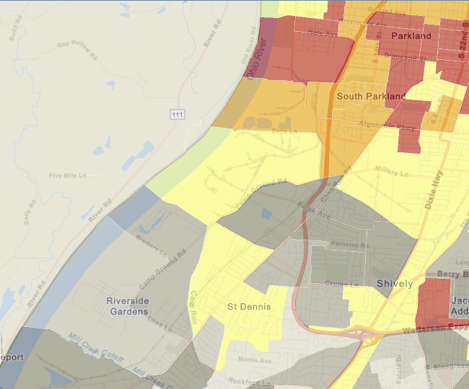
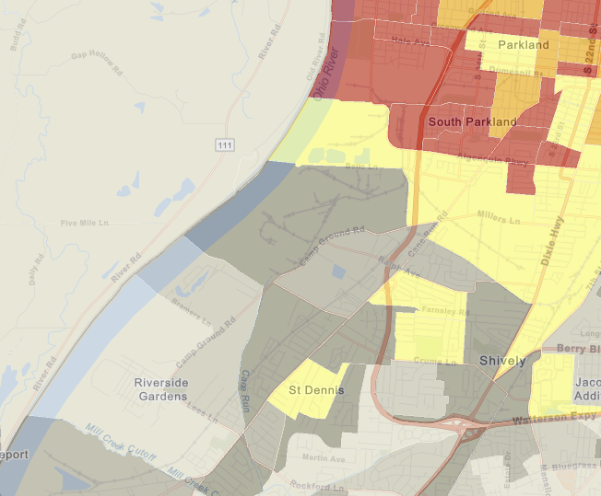
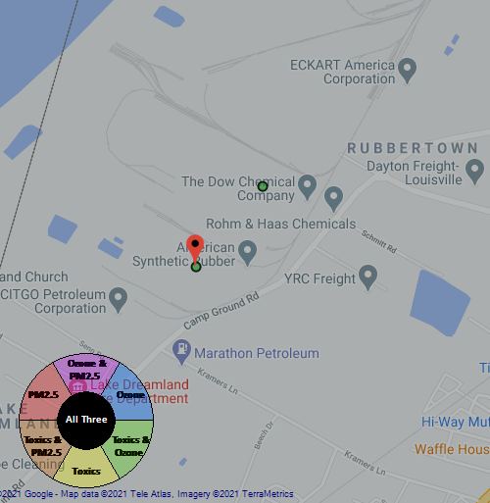
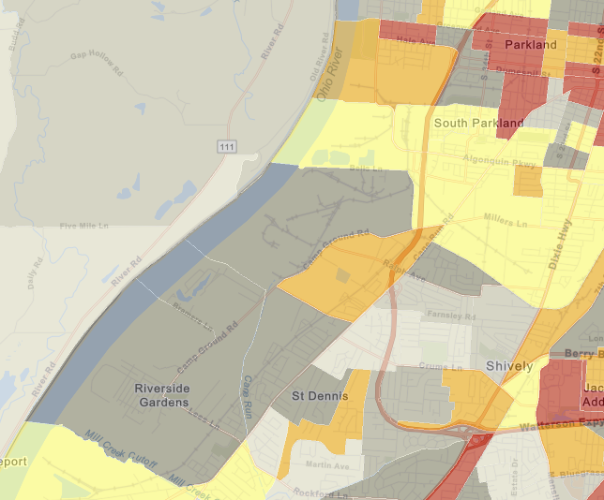
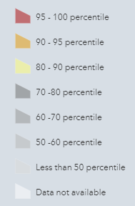













NEXUS Example - Louisville
Rubbertown Map Generated in NEXUS
Demographic Index
Generated in EJSCREEN
People of Color Population
Generated in EJSCREEN
Rubbertown
Rubbertown
Low Income
Generated in EJSCREEN
National Percentiles
Rubbertown

Slide 26
NEXUS & EJSCREEN
NEXUS
EJSCREEN
  EJ Layers
    Hazardous waste
    EJ Grants
    Water features
    Places
    Schools & Parks
    Transportation
    Boundaries
    Prisons
    Public Housing
    Subsidized Housing
    Climate
    Sites reporting to the EPA
    Superfund (NPL)
    RSEI
  Environmental Indicators
    Wastewater Discharge Indicator
    Hazardous Waste Proximity
    Superfund Proximity
    Lead Paint Indicator
    Traffic Proximity
    RMP Proximity
  Environmental Indicators*
    NATA Respiratory HI
    NATA Cancer Risk
    NATA Diesel PM
    Ozone Model Concentrations
    PM_{2.5} Model Concentrations
Demographic Indicators
    Demographic Index
    Minority Population
    Low Income Population
    Less Than HS Educated
    Linguistically Isolated
    Under Age 5
    Over Age 64
EJ Layers
Nonattainment Areas
Tribal Areas
Ozone and PM_{2.5}
Emissions and source data
Mortality Risk data
Monitoring data
Air Toxics
Emissions and source data
Modeled concentration data
Risk data
Monitoring data
GHG emissions
*Provided to OEJ by OAQPS (AQAD & HEID)
26

Slide 27
NEXUS and EJSCREEN
NEXUS specifically designed for AQ planning: overlays publicly available air quality information to identify geographic areas where health risks related to O₃, PM_{2.5} and air toxics overlap
EJSCREEN specifically designed for EJ screening: combines environmental & demographic data to highlight areas where vulnerable populations may be disproportionately impacted by pollution
NEXUS contains air data not available in EJSCREEN: detailed emissions and source characterization, O₃ and PM_{2.5} risk data, NATA cancer and non-cancer risk by pollutant and source)
NEXUS relevance for OAQPS EJ screening and outreach efforts: By incorporating EJ indicators and data from EJSCREEN, it can highlight the nature of multi-pollutant AQ issues for communities with EJ concerns
Enhanced NEXUS screening capabilities: We plan to update NEXUS to incorporate proximity screening capabilities similar to EJSCREEN & the OAP/CAMD tool

Slide 28
Multi-Pollutant Team
Next Steps
Louisville - Develop MP AQMP
Based on Office wide engagements, continue to update NEXUS tool and use it to inform Multi-pollutant, Air Toxics, NAA/Advance controls, and EJ efforts as appropriate
Incorporate climate considerations into MP process
Use NEXUS to develop packets for regions regarding MP areas of concern
  Continue exploring MP partnerships

Slide 29
Briefings, Demos & Planned Outreach
9/25/2020– AQAD & HEID
11/3/2020 – MP Team
11/4/2020 – Air Toxics Group
12/10/2020 – AQPD
1/25/2021 – OID
1/28/2021 – SPPD
2/1/2021 – Peter/SMT
4/12/2021 – HEID & AQAD
5/17/2021 – Peter/SMT
5/24/2021 – MP Team
6/29/2021 – ORD
7/12/2021– HEID & AQAD
7/19/2021 – OID
8/10/2021– OAP
8/26/2021 – OAR
8/30/2021 – OEJ
8/30/2021 - Region 4/Louisville
9/7/2021 – RO Air Division Directors
9/20/2021 – OAR Demo
11/2/2021 & 11/8/2021 – RO APMs
TBD – MJOs
Outreach with EPA Regional Offices
  Goals of Multi-Pollutant Air Quality Management approach
  Purpose of NEXUS Advance Screening Tool
  Examples using NEXUS for MP & EJ purposes
  NEXUS Demo
  Request for Feedback
“Fascinating… phenomenal… I’m blown away!”
- Caroline Freeman (R4 ADD)

Slide 30
NEXUS: Recent & Ongoing Development
NEXUS “1.5” (Jan. 2021) → NEXUS “2.0” (Sep. 2021)
  New/revised Metrics (PM_{2.5}, O₃, Air Toxics + EJ/Demographics as 4th metric)
  New/updated data inputs and functions:
    EJ/Demographic data (from EJSCREEN)
    Tribal areas, Advance areas, Attainment/DVs data, etc.
    2017 emissions data (including GHG & Sector mapping) (updated from 2014)
    “Sector Emissions Summary” module to support “Sector prioritization” effort
    “Source Category Emissions” module (point, non-point, on-road, non-road, event)
Near-term (Ongoing) Updates/Improvements
  Updating to 2017 fused PM_{2.5} & O₃ and health risk data (Sep.) and fused air toxics and risk data (Nov./Dec.) from current 2014 data
  Including monitoring sites/data (PM_{2.5}, O₃ and Air Toxics) (Sep./Oct.)
  Developing “Proximity analysis for MP risks and EJ” module (Dec.)

Slide 31
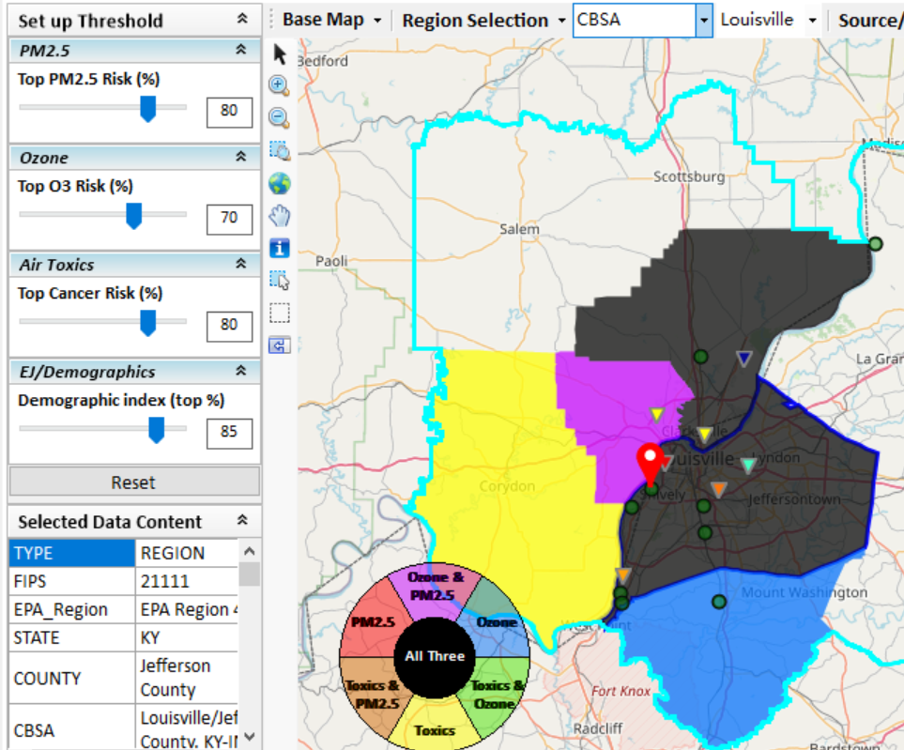
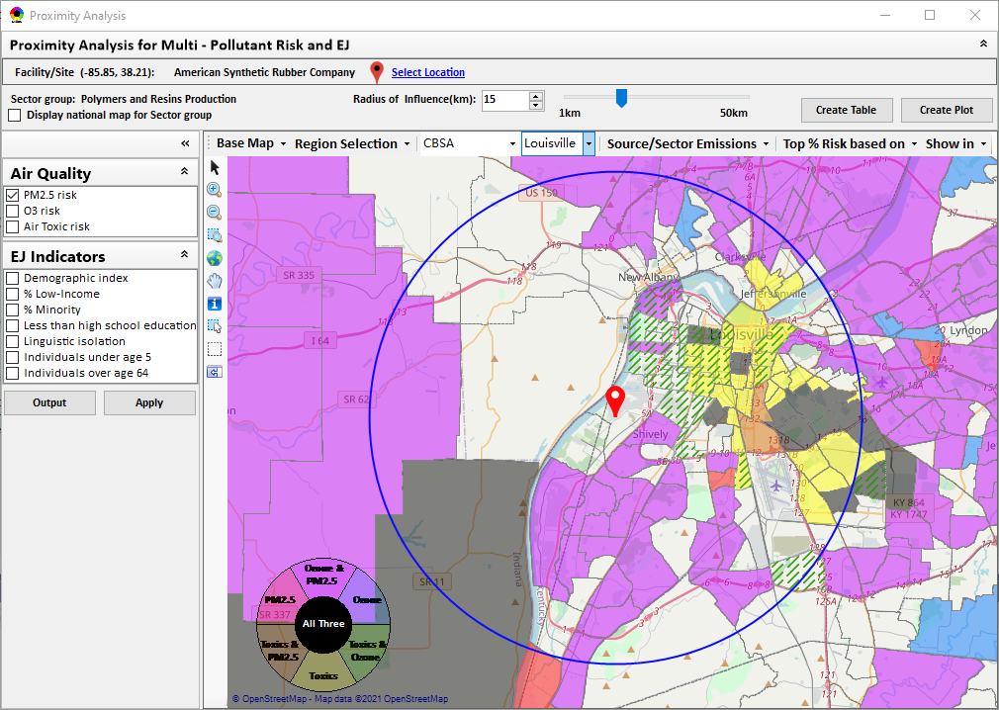
New “Proximity Analysis” Module (under development)
Currently in NEXUS
Proximity Analysis for MP Risks and EJ
County – level (current)
Community (Census Tract) - level
31

Slide 32
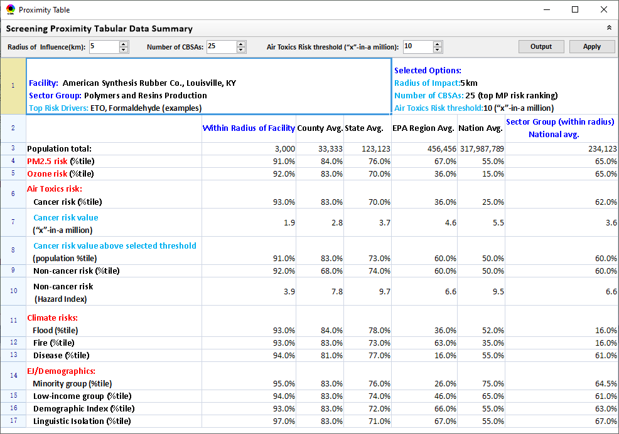
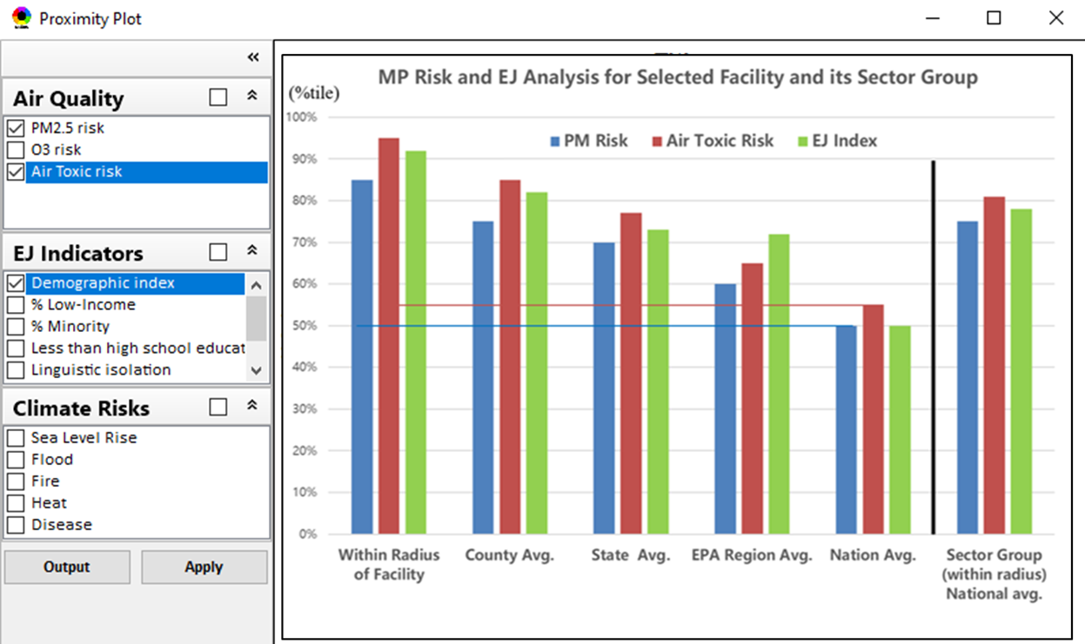
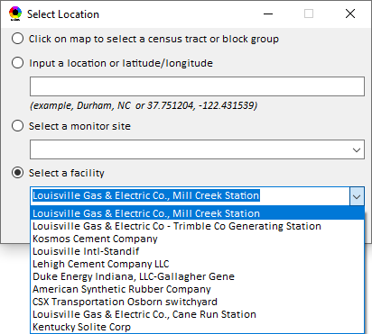
Proximity Analysis: Select “Location” & “Radius”
Select “Radius”
Choice of
Selecting a Location
32

Slide 33
“NEXUS 2.0”Demo
NEXUS 2.0 “Quick Tutorial” slides attached
Download “NEXUS” tool at: https://gaftp.epa.gov/aqmg/cjang/NEXUS/NEXUS 2.0/*
Carey Jang
OAR/OAQPS/AQAD/Air Quality Modeling Group, September 2021
33

Slide 34
“NEXUS 2.0” Demo: 2017 NEXUS Case
Launching Page
2008
Roadmap for Demo:
(Use example cases)
National View: Use “NEXUS” across pollutants to provide an initial “SCREEN” at the national level by providing an indicator where there may be a common set of sources contributing to multi-pollutant issues.
Regional View: Dial into a region or area of interest to understand the pollutant/source connections, and potential for more effective and efficient multi-pollutant solution.
34

Slide 35
“NEXUS 2.0”:
Quick Tutorial
Appendix
Download “NEXUS” tool: The “NEXUS 2.0” package (“NEXUS 2.0 Setup.exe” & “NEXUS 2.0 Data.exe”: run both “*.exe” files to install) can be downloaded at EPA’s new FTP site:
https://gaftp.epa.gov/aqmg/cjang/NEXUS/NEXUS 2.0/*
Note: Require software installation privilege or “Power Broker” (limited elevated privilege) to install “NEXUS tool” at EPA’s PC; Check “This PC\Documents\My NEXUS files\data\* (\tool\*, \result\*)” to see if NEXUS program & input dataset are installed successfully
35

Slide 36
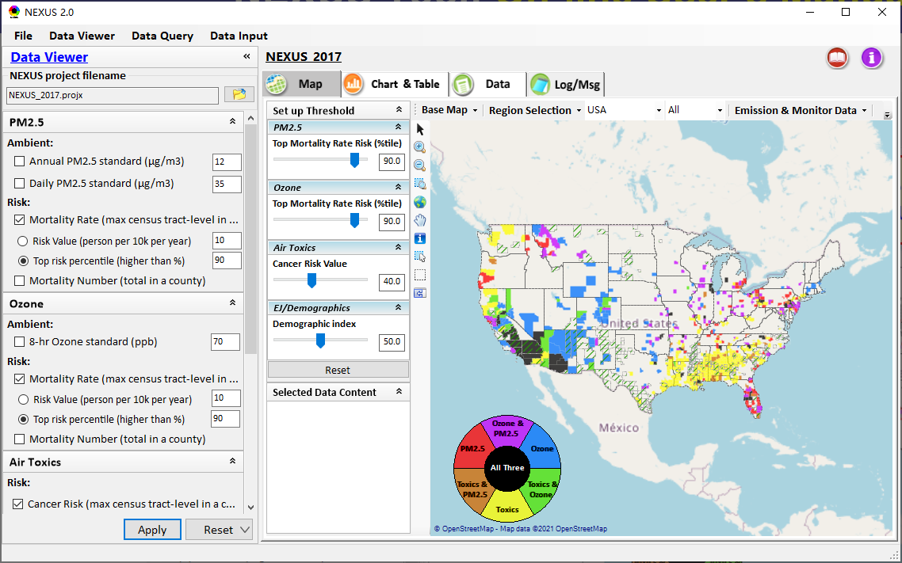
NEXUS Tool: On-line User’s Manual
Click “book” icon to launch “User’s manual”
Hot link to User’s manual’s “Data Viewer” chapter (same for “Data Input” module & “Data Query” model)
36

Slide 37
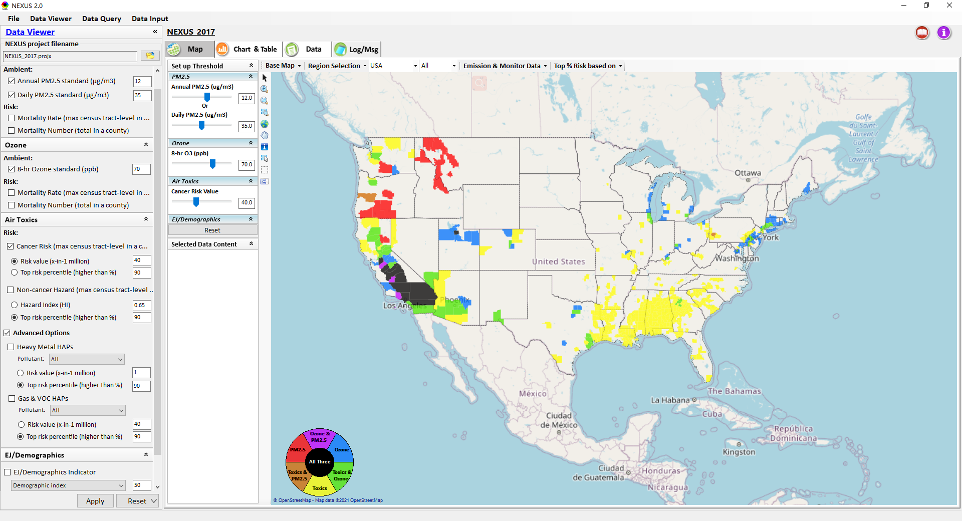
NEXUS Tool: Data Viewer Module
Click “File” to open or save a project
Switch between 3 key modules
NEXUS project file name
Select & adjust “Ambient” or “Risk” levels
“Advanced Option”: provide HAPs & species selections
37

Slide 38
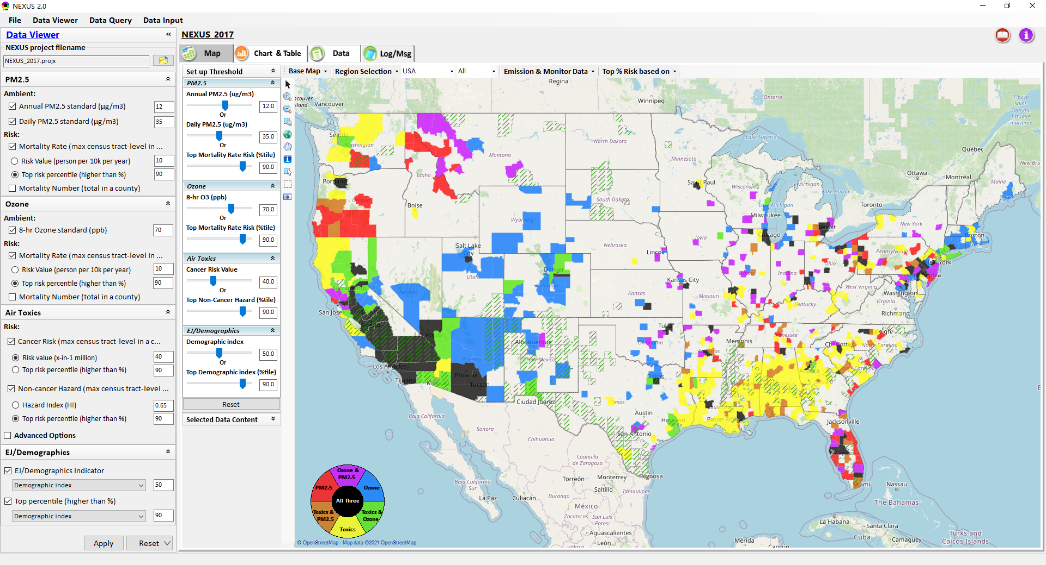
Data Viewer: “Apply” New Selections
“Check” boxes to change/add selections
New selections will appear in “Slider bars” panel and map display
“Slider bars” allow to select & adjust “Ambient” and/or “Risk” threshold levels and displaying color map
“Apply” new selections
38

Slide 39
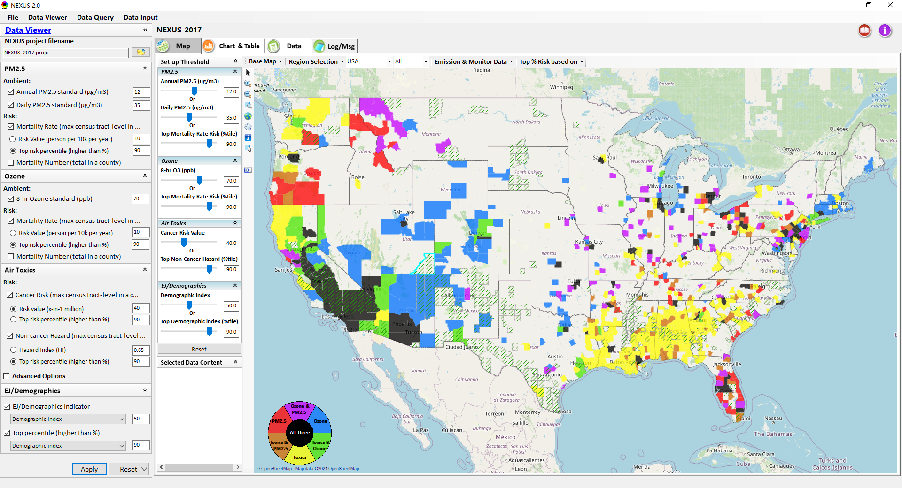
NEXUS Update: New EJ Metric and Data
New EJ/Demographic metric is added to display in “Green dash” for counties exceeding selected threshold
39

Slide 40
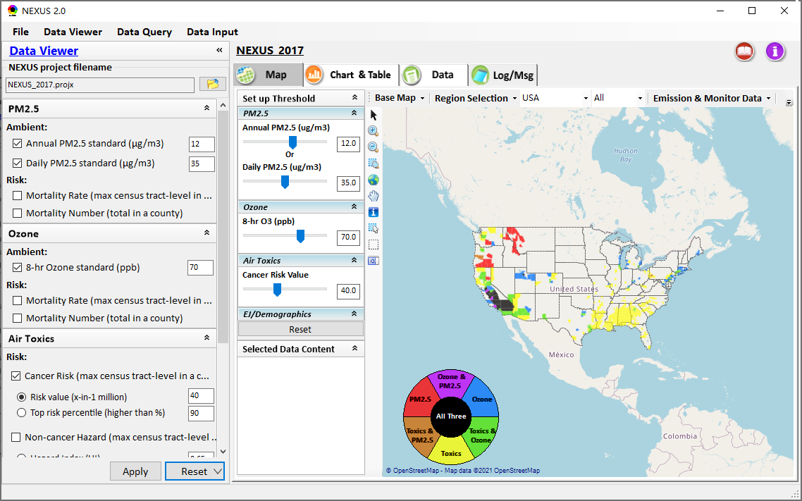



Data Viewer: “Reset” New Selections
default configuration
risk-based
“Reset” new selections
risk-based in %tile
40

Slide 41



Data Viewer Module: Configure Base Map & Color
“Base Map”: Change boundary lines and background map (e.g., “Google Map”)
“Right-click” map to save map image
Click “color map” to change color & transparency
41

Slide 42


Data Viewer Module: MP Risk Ranking
“CBSA Risk Ranking”: provide MP risk ranking by CBSA or County
42

Slide 43




Data Viewer: “Region Selection”
Allow to select “EPA regions”, “States”, or “CBSA”
43

Slide 44



Data Viewer: Select EPA Region/State/CBSA
Examples:
EPA Region 4
NC State
Louisville CBSA
44

Slide 45

Data Viewer: Major Emission Sources
Click “Display Emission Sources” tab to display emission sources and launch new window
Click any “facility” to link & display source location and emission information. Same facility emitting various pollutants can be easily identified with the highlighted color
45

Slide 46

Data Viewer: Major Emission Sources
Allow to scroll down to CBSA-level (e.g., Durham CH CBSA ) or County-level
Durham CH CBSA
46

Slide 47




Data Viewer: Top “x” Emission Sources
Provide selection of Facility & Source Category
Provide selection of Facility & Source Category
Durham county, NC
47

Slide 48

NEXUS Update: “Source Category Emissions”
“Source Category Emissions” module provide five source categories, including “point”, “non-point”, “on-road”, “non-road”, and “event” emissions for the selected region, CBSA, or county.
48

Slide 49

NEXUS Update: “Sector Emissions Summary”
“Sector Emission Summary” function allow to select major CBSAs and provides source and sector emissions summary to support OAQPS’s “Sector Prioritization” project effort
49

Slide 50




NEXUS Update: “Sector Emissions Summary”
Summary table
Summary plot
Emissions
Frequency & Rank
50

Slide 51




NEXUS Update: “Monitoring Data/Site” Module
AQ trend
Right-click to invoke
Click to display
AQ trend at monitor site
Monitor Site/Data
Click to select monitor site
& pollutant
51

Slide 52

Data Viewer: EPA Region Table Generator
“EPA Region Table Generator” provides attainment status of O3 and PM2.5 and their DVs; also allows to select any EPA region based on data updated to 2020.
52

Slide 53

Data Viewer: Data Search & Filter
Click “+” to add filters; Click “x” to remove current filter;
Click “Output data…” to output current page records or all records
Show specified records per page.
53

Slide 54

Data Input Module: Data Preview
“Transparency” & “Open-Source”:
All NEXUS input/output data files are available under:
“This PC\Documents\My NEXUS files\Data (\Result)”
Check to use filter to query data
Select a table to view if there are multiple tables in the selected data source file
Click to change input data file
Click to view data
Click to run & save project
54

Slide 55

Data Query Module: Overlaying Map
Region Selection
Data Query Configuration
Data Query qualifier selection
Overlaying Map selection
55

Slide 56

Data Query Module: Configure Data Query
“Data Query Filter” allows to select “qualifiers” for query
“Data Query Preview” displays the selected “qualifiers” at the same time
56

Slide 57

Data Query Module: Attribute Table
Filter/search/export functions
Detachable “Attribute Table”
57

Slide 58


Data Query Module: Attribute Table
Click a “record” to link and display its location & info.
58

Slide 59
Quick Tutorial Slides
End
59

