Slide 1
Multi-Pollutant (MP) OAP Briefing
OAQPS’s Multi-Pollutant Team:
Beth Landis, Carey Jang, etc.
August 10, 2021

Slide 2
MP Team Members
HEID
  Beth Landis / Kimber Scavo
  Robin Langdon / Darryl Weatherhead
  Matt Woody/ Kelly Rimer
  Sara Terry
  Carrie Wheeler
  Ben Gibson
  Rob Pinder
  Scott Voorhees
  Chris Davis
AQPD
  Rich Damberg / Megan Brachtl
AQAD
  Carey Jang / Tyler Fox
  Jim Kelly
  Joe Mangino
  Jeanette Reyes
OID
  Amanda Kaufman
  James Payne
SPPD
  Lisa Conner

Slide 3
Outline
MP Background
  MP Assessment Process
  MP Projects (Detroit, SC & Louisville)
NEXUS MP Tool
  Expected Use
  Examples
  NEXUS and EJSCREEN
Next Steps
NEXUS Improvements and Updates
NEXUS Demo

Slide 4
MP Background
Support a comprehensive, MP treatment of air quality problems to effectively improve air quality and make the most efficient use of available resources
  Primary Goal - identify & evaluate local control strategies targeting emissions of O₃ & PM_{2.5} and their precursors while at the same time reducing Air Toxics of concern for communities to maximize both health benefits and air quality improvements
MP planning has the potential to reduce the costs and increase benefits associated with air quality management (AQM)
Supports S/L/T air agencies in developing MP, risk-based AQM plans and implementing strategies that reduce air pollution emissions & improve public health
Success has been demonstrated in Detroit and SC; another project is currently underway in Louisville, KY
Tools needed to analyze MP data are either available currently or being developed in OAQPS (e.g., NEXUS)

Slide 5
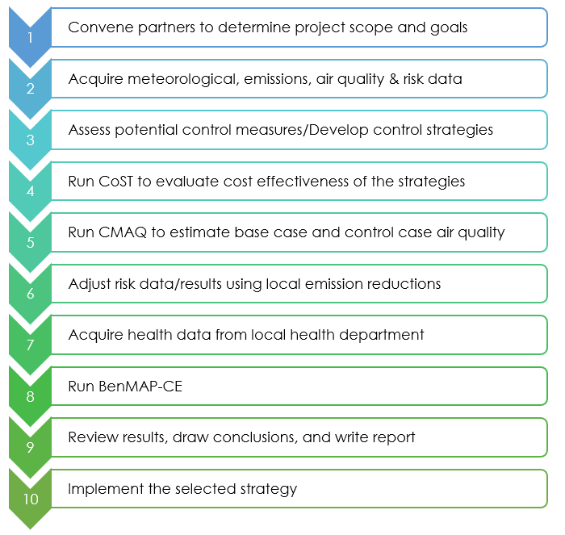
MP Assessment Process
Adapted from the SC Report (pages 23-24) - https://www.epa.gov/sites/production/files/2016-05/documents/usepa-south_carolina_final_report_may_26_16_2.pdf

Slide 6
Detroit – MP Case Study
Partners: EPA, MDEQ, SEMCOG & LADCO
Goals: Assess and compare two contrasting air quality control strategies
“Status Quo” approach – controls selected separately to address O₃ & PM nonattainment
“Multi-pollutant, risk-based” approach – aimed at further reducing population risk from exposure to O₃, PM and select air toxics while still addressing ozone and PM nonattainment
Results showed the multi-pollutant approach:
Achieved the same or greater reductions of PM and O₃
Improved air quality regionally and across the Detroit urban core for multiple pollutants
Produced ~2x greater monetized benefits for PM and O₃
Reduced non-cancer risk
Resulted in greater net benefits & was more cost effective

Slide 7



South Carolina MP Project
Partners: EPA, SC DHEC & local community and business leaders in 10 upstate South Carolina counties
Goals:
Develop and analyze a multi-pollutant, risk based AQM strategy
Maximize both health benefits and air quality improvements, identify and evaluate a local control strategy targeting emissions of O₃, PM & their precursors while also reducing air toxics of concern for communities
Results demonstrated improving air quality in areas already attaining the NAAQS can yield significant health benefits

Slide 8
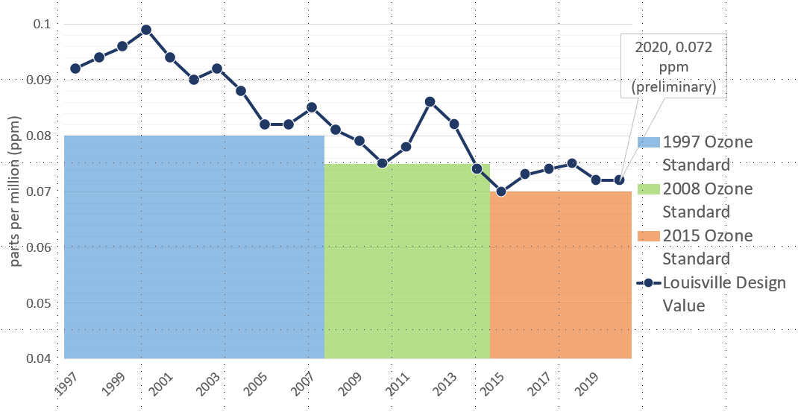
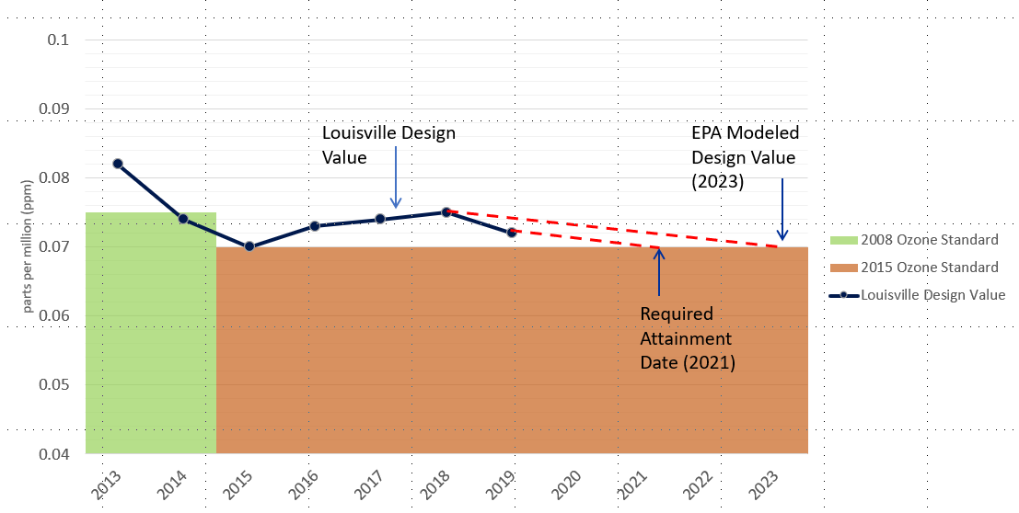
Louisville MP Project
Partners: EPA, Louisville Metro Air Pollution Control District (LMAPCD) & Louisville Metro Department of Public Health and Wellness (LMPHW)
Goals:
Identify local- and state-level emission reduction measures that address multiple pollutants, with a focus on attainment of the 2015 O₃ NAAQS
Build a plan to achieve and maintain compliance of all NAAQS
Demonstrate that the selected strategies can reduce health risk from exposure to O₃, PM and selected air toxics
Integrate existing health risk-based pollution control programs into a multi-pollutant air quality management plan
Build institutional capacity among LMAPCD and LMPHW to perform air quality modeling and health benefit analysis projects
Results pending
Graphics provided by LMAPCD

Slide 9
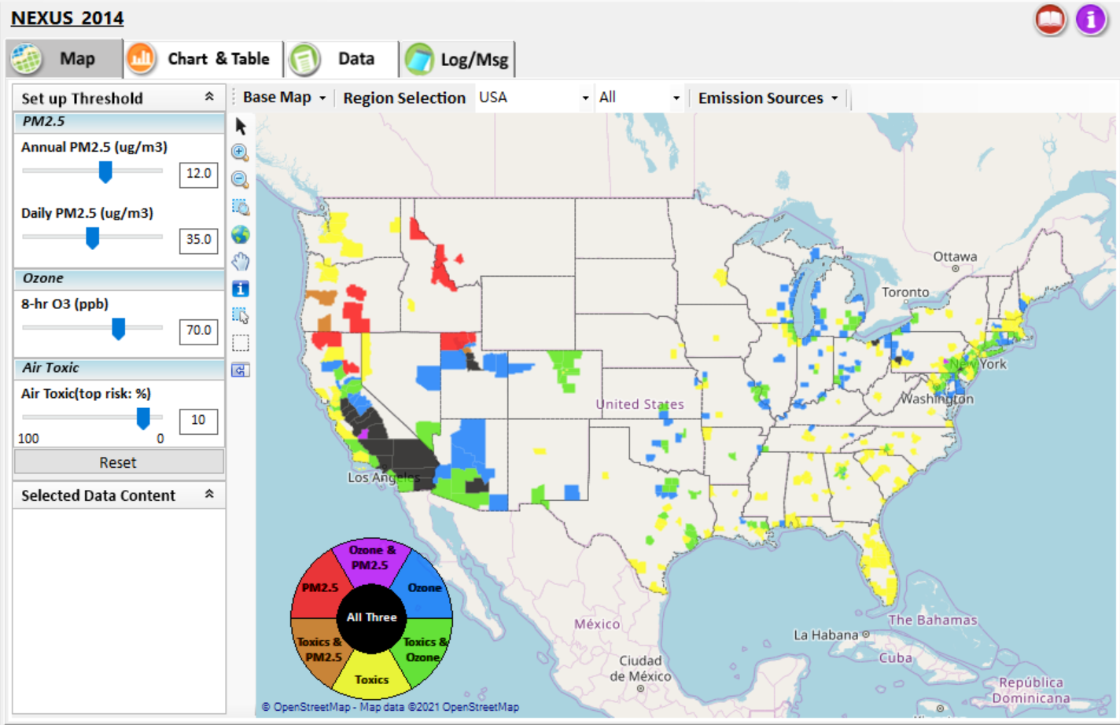
NEXUS - Tool Development
A new NEXUS Advanced Screening Tool is being developed to identify geographic areas where health risks related to O₃, PM_{2.5} and air toxics overlap and will be used to identify additional areas for MP collaboration

Slide 10
NEXUS - Expected Use
The NEXUS tool will allow users to do the following:
  National screening for areas with MP issues: Phase 1 development provides ability to quickly screen areas across nation that have combination of high air quality and/or risk levels for O₃, PM_{2.5} and Air Toxics.
  Area screening to understand nature of MP problem: Phase 2 development provides ability to ‘dial-into’ specific areas to determine extent to which common emissions sources are causing the MP issues.
We expect to use this tool to engage with Regions and identify areas that would potentially benefit most from MP approaches to reduce emissions (including current NA areas).
The NEXUS tool will essentially provide a ‘conceptual model’ of MP issues to facilitate engagement with state/local/tribal agencies and community stakeholder groups.
We also expect that it can have additional uses across the Office for Air Toxics, Environmental Justice and other programs.

Slide 11
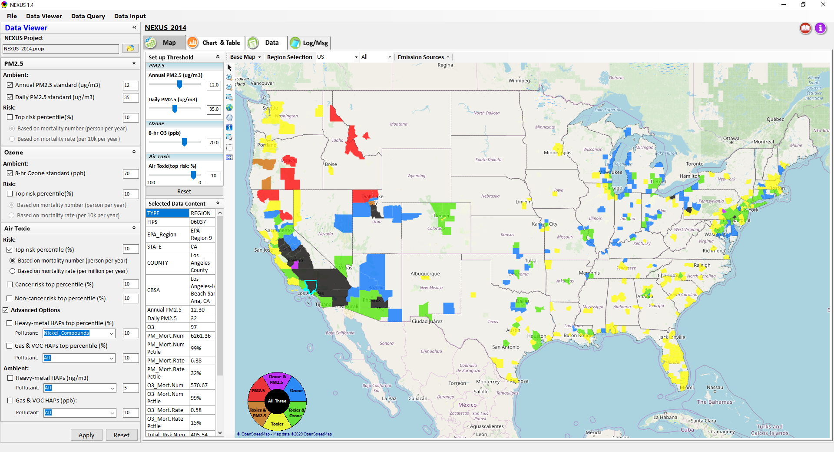
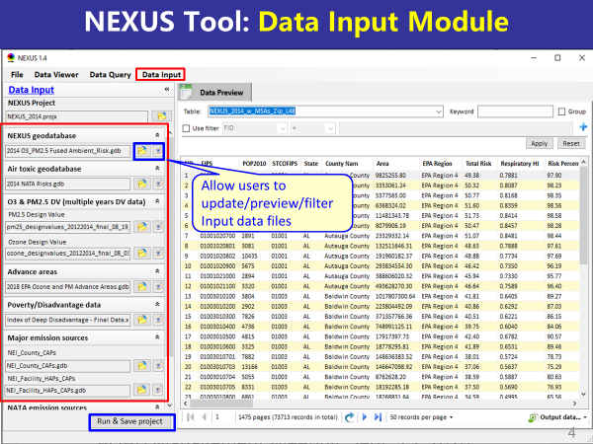
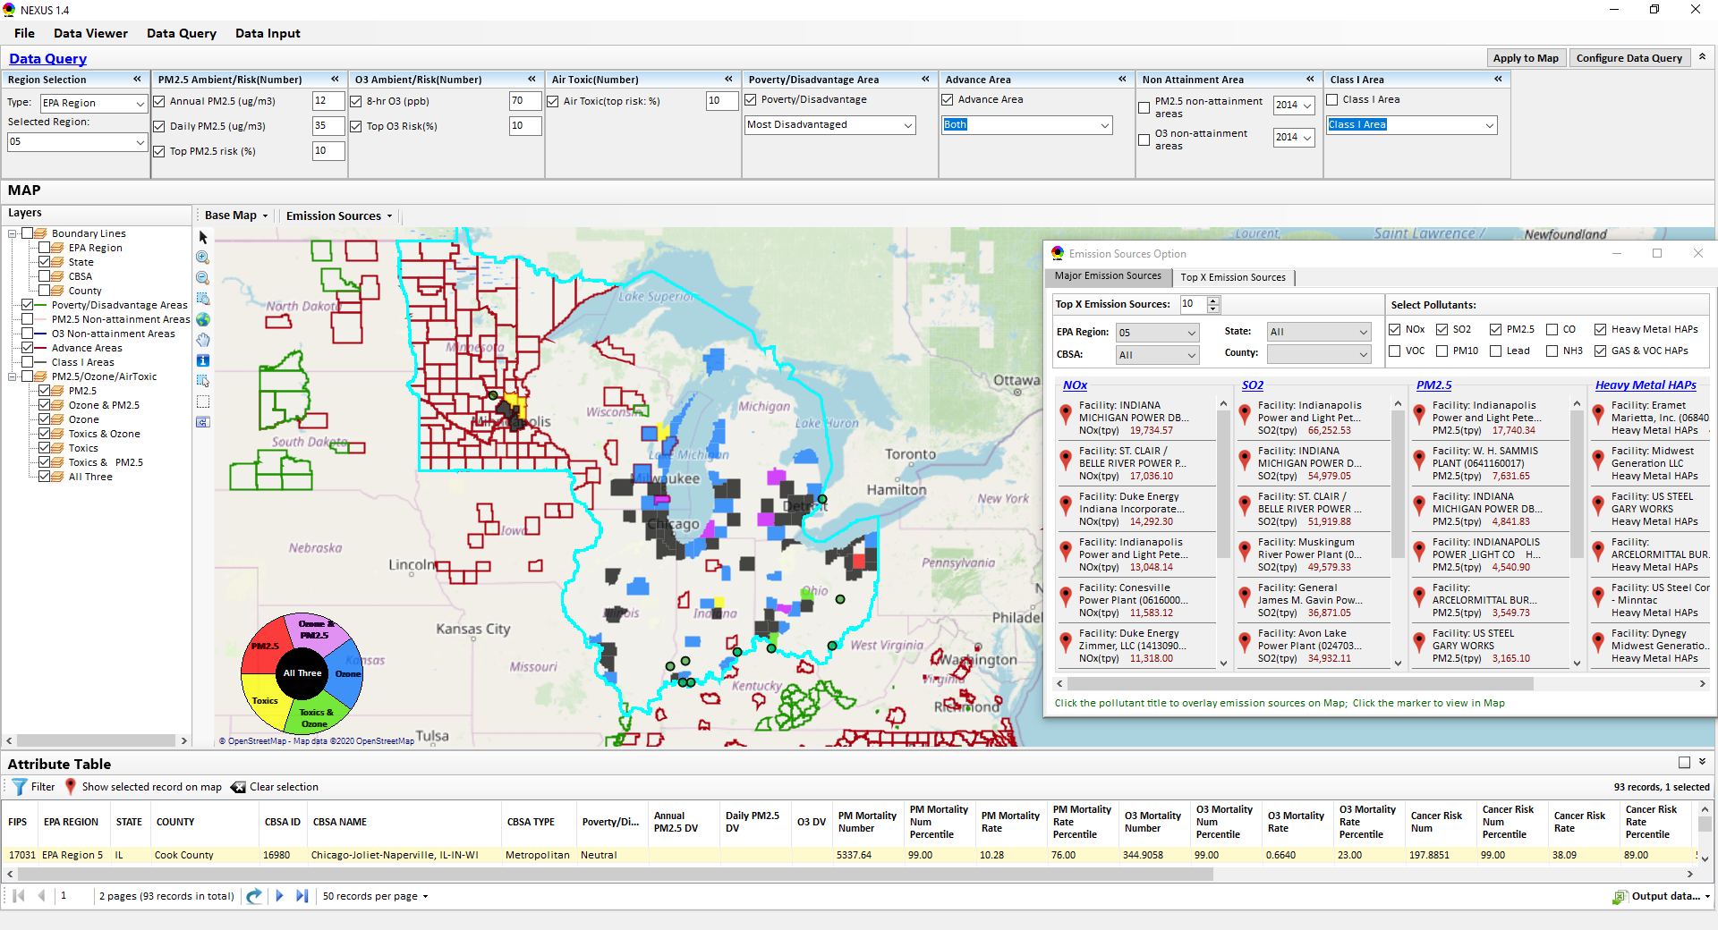
NEXUS - Three Key Modules
Data Viewer module
Data Input module
Data Query module
View and create interactive Map/Data/Chart/Table
Provide flexible selections & mapping of “Ambient” and/or “Risk” levels of PM_{2.5}, O₃ and Air Toxics
Provide regional analysis for “EPA region”, “States”, “CBSA”, and “County”
Link and display major emission sources locations & emitted pollutants info.
Expand data field selections and flexibility for exploratory/advanced users
Provide overlaying map and summary table for data query results
Current data query based on selected data fields: “Ambient/Risk, Advance area, Socio-demographic (EJ) area, NA Area, Class I area”
Allow to update & change input data files
Provide data preview and filter functions
Currently uses 10 publicly available input data files (~4GB)
Quick turnaround to run & save to a new “project” using new input data files

Slide 12
NEXUS - Examples
How can NEXUS be used to identify highest risk areas across O₃, PM_{2.5}, and Air Toxics, summarize the source(s) contributing to communities with possible EJ concerns, and review specific industrial sources for potential impacts?
  Example 1 → Detroit
How can NEXUS be used to identify the nature of multi-pollutant risks in Advance areas?
  Example 2 → Louisville

Slide 13
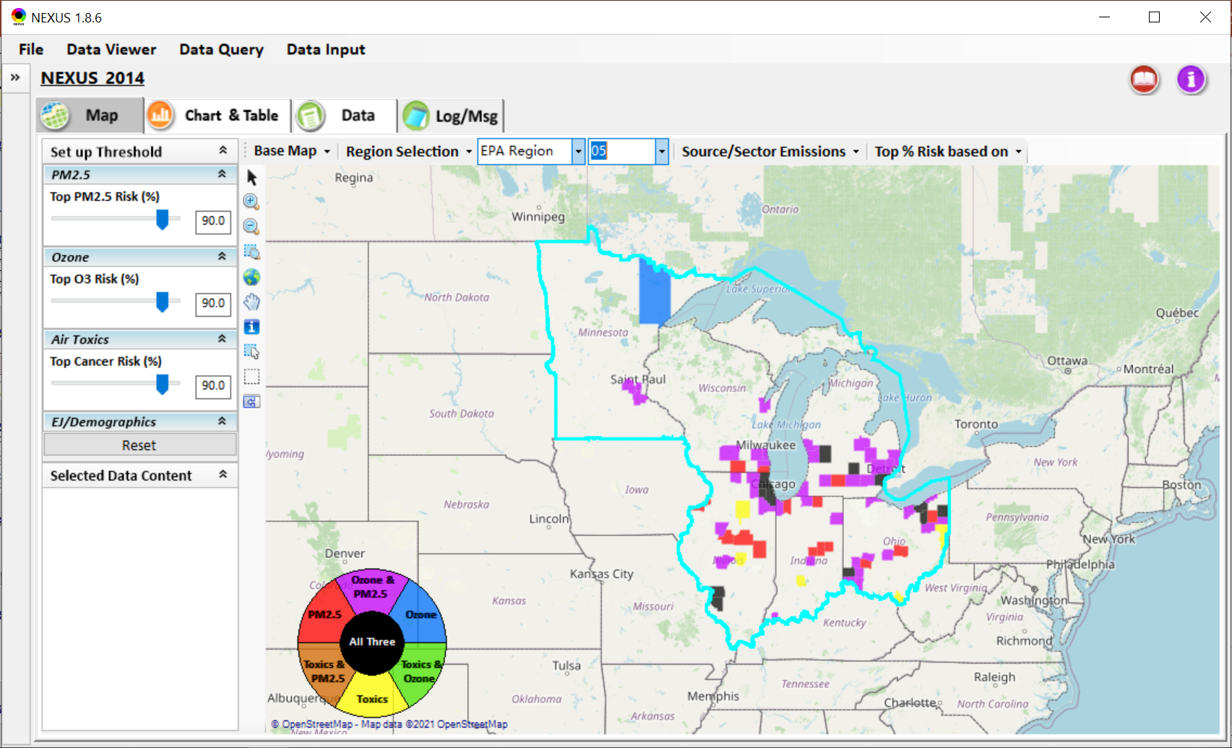
NEXUS – Detroit Example
NEXUS can be used to identify highest risk areas across O₃, PM_{2.5}, and Air Toxics.
Example map above is for Region 5

Slide 14
NEXUS - Highest MP Risk Areas in R5
(Data Query Module)
STATE | COUNTY | CBSA | Annual PM2.5 DV | Daily PM2.5 DV | O3 DV | PM Mortality Number% | O3 Mortality Number% | Cancer Risk Rate (max)%
IL | Cook County | Chicago-Naperville-Elgin, IL-IN-WI |  |  | 73 | 99.97 | 99.97 | 99.00
OH | Cuyahoga County | Cleveland-Elyria, OH | 11.7 | 25 | 70 | 99.78 | 99.53 | 97.00
IL | DuPage County | Chicago-Naperville-Elgin, IL-IN-WI |  |  | 70 | 98.73 | 97.70 | 99.00
MI | Wayne County | Detroit-Warren-Dearborn, MI | 11.2 | 28 | 73 | 99.91 | 99.84 | 95.00
MI | Kent County | Grand Rapids-Wyoming, MI | 9.1 | 25 | 68 | 97.92 | 96.71 | 99.00
IL | Lake County | Chicago-Naperville-Elgin, IL-IN-WI |  |  | 73 | 97.83 | 96.56 | 99.00
NEXUS can be used to identify highest risk areas across O₃, PM_{2.5}, and Air Toxics. Information above was generated in Data Query for Region 5 and exported into excel where rankings were applied.
Top CBSAs (using this approach) – Chicago, Cleveland, Detroit and Grand Rapids

Slide 15
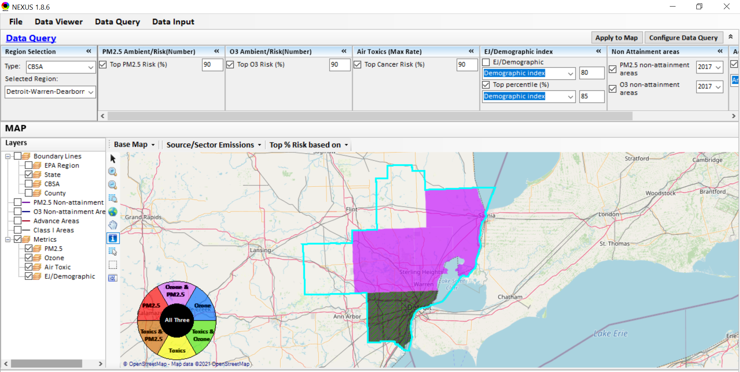
NEXUS - Detroit CBSA
NEXUS can be used to explore CBSAs with MP concerns. This information was generated in Data Query for the Detroit CBSA. Wayne County has dashed green lines, showing that the demographic index percentile is ≥ 85%. Let’s see where the major sources are located…
15

Slide 16
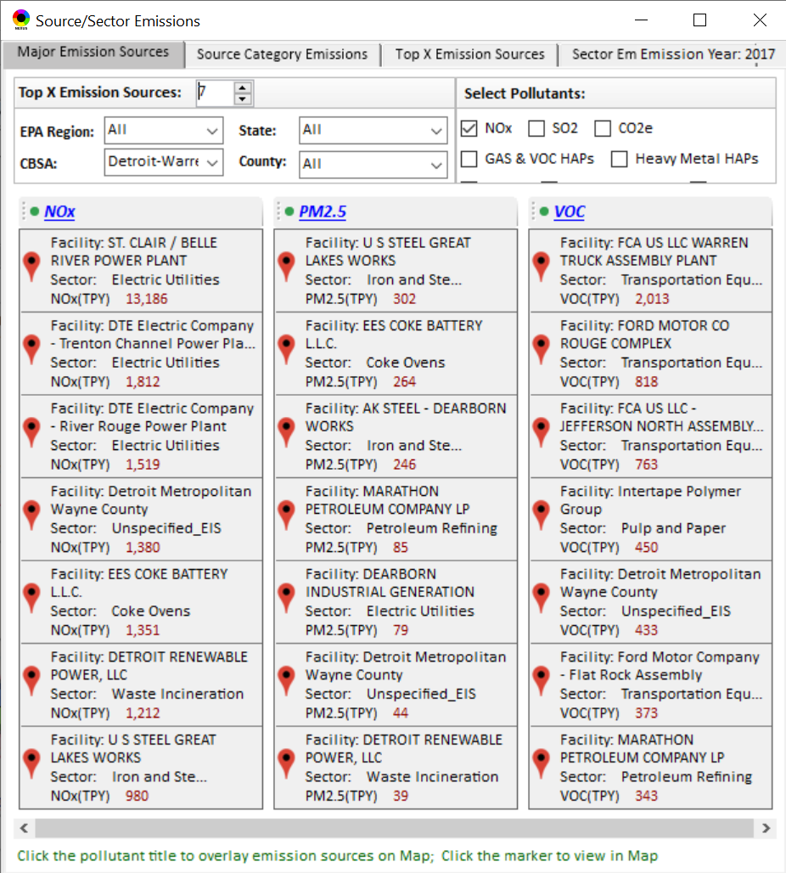
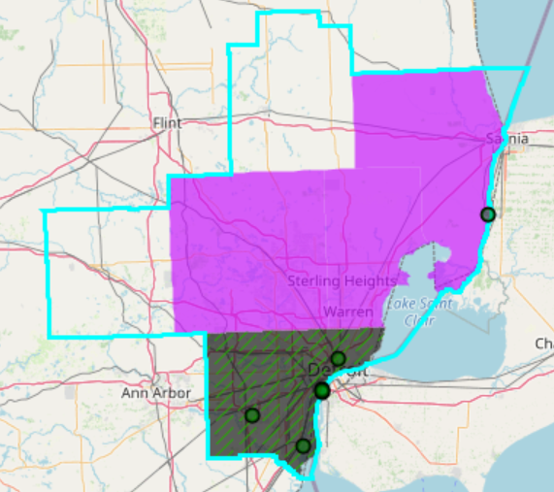
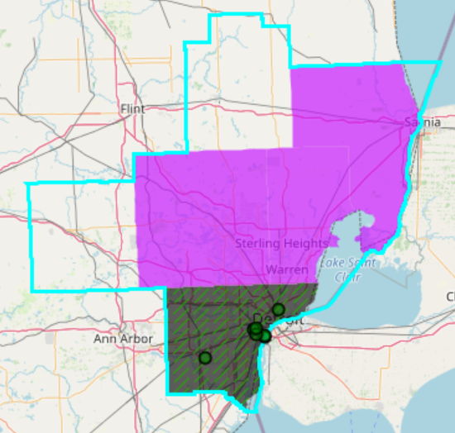
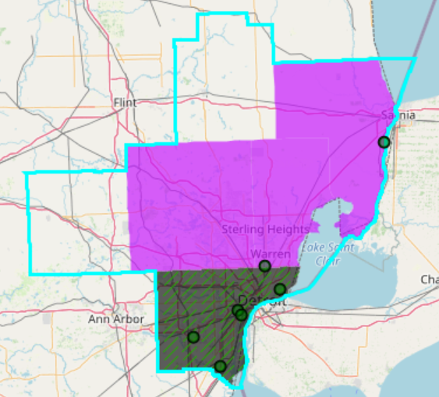
NEXUS - Emissions Sources in Detroit CBSA
Top NOx Emission Sources
Top PM_{2.5} Emission Sources
Top VOC Emission Sources
NEXUS can be used to identify top emission sources. The information above was generated in Data Query for the Detroit CBSA . We can quickly see that the majority of the NOx, PM_{2.5} and VOC & emission sources are located in Wayne County. Let’s explore the Wayne County sources further…
16

Slide 17
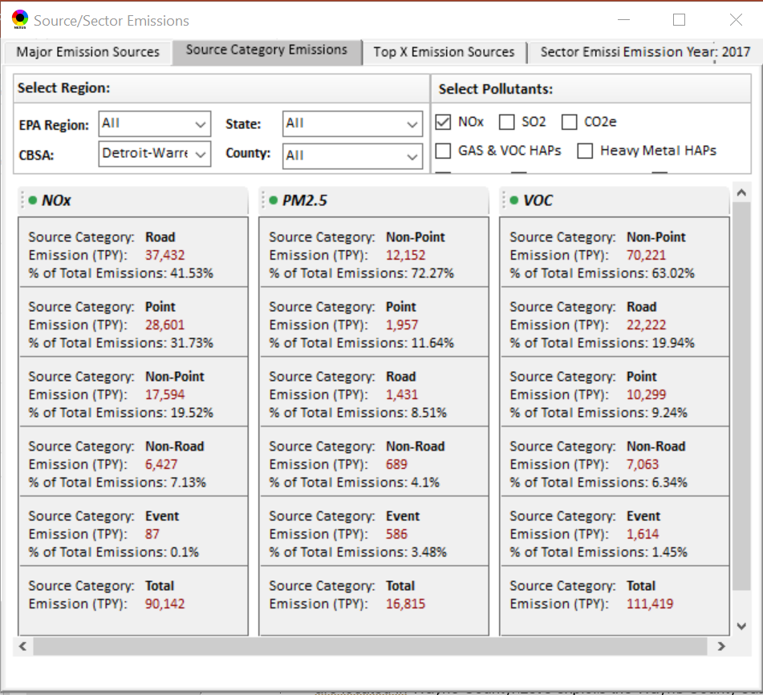
NEXUS – Source Category Emissions in Detroit CBSA
NEXUS can display source category emissions. This information above was generated in the Data Query module for the Detroit CBSA.
17

Slide 18
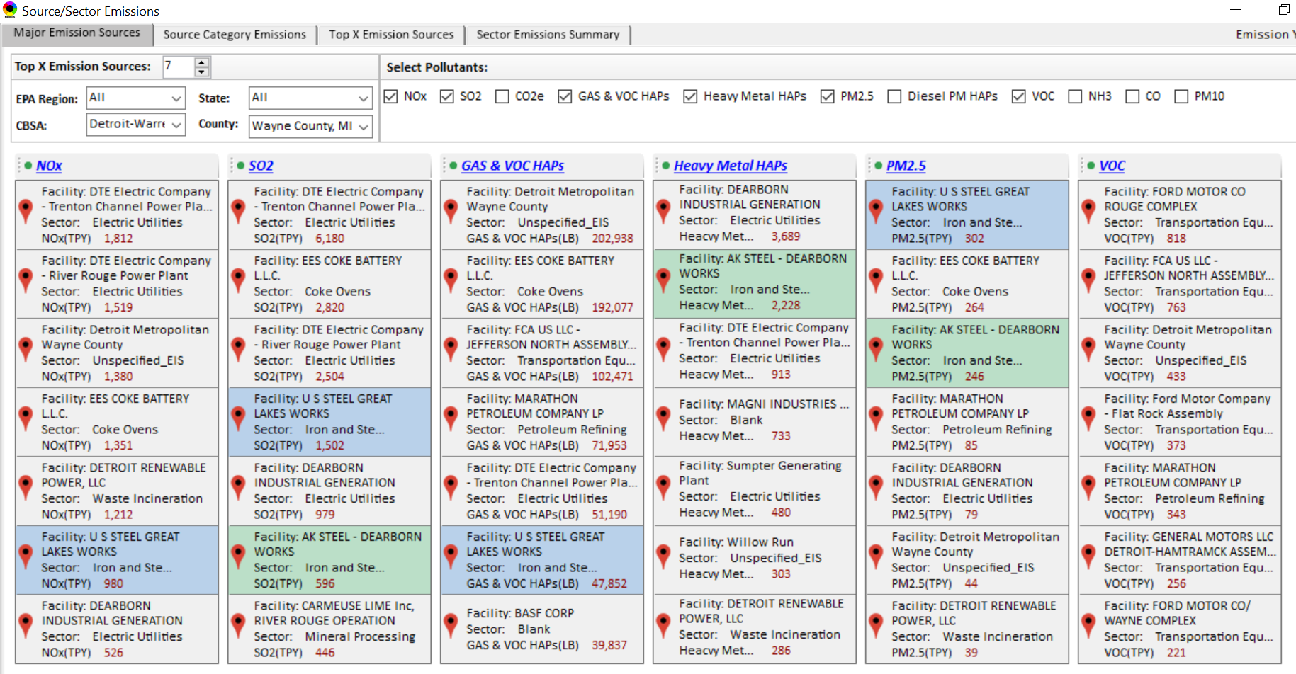
NEXUS Tool - Emissions Sources in Wayne County
NEXUS can be used to identify top emission sources. The information above was generated in Data Query for Wayne County, MI. This can help identify the potential co-benefits of controls. Let’s explore AK Steel and US Steel further...
18

Slide 19
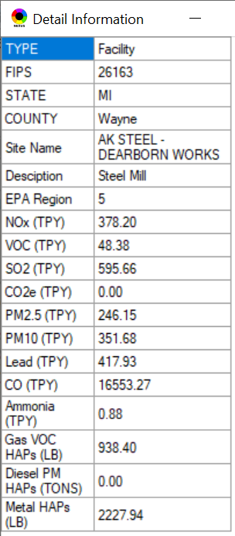
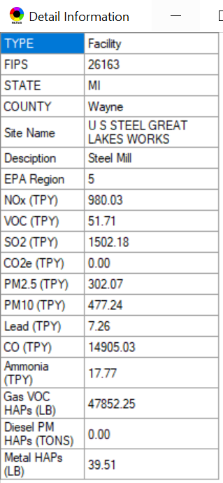
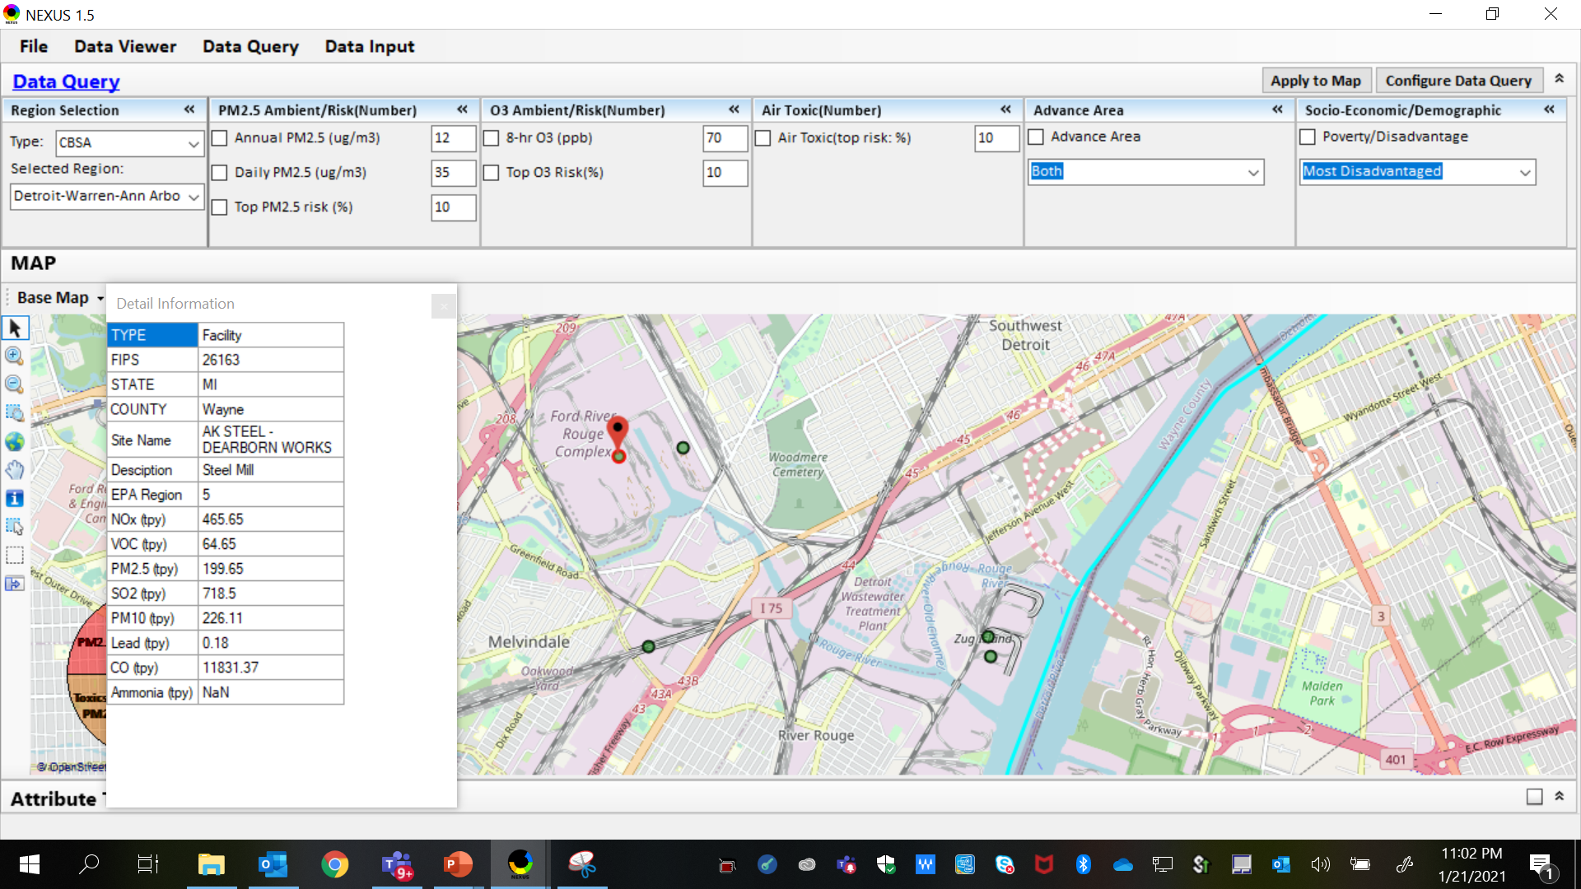
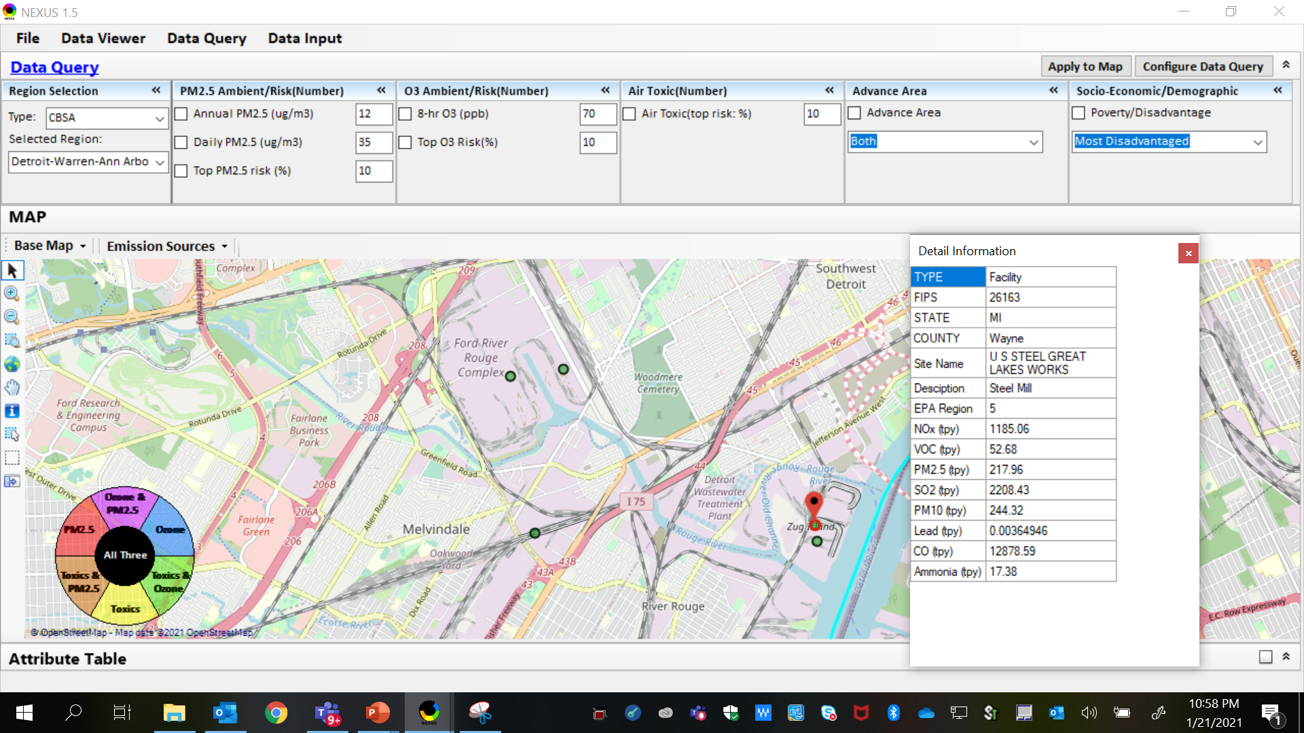
NEXUS Tool - Steel Mills in Wayne County
AK Steel & US Steel were identified as top emitters for NOx, SO₂, Gas and VOC HAPs, Heavy Metal HAPs and PM_{2.5}, highlighting the potential co-benefits of controls in these steel mills. The above map was generated in NEXUS Data Query. Let’s see the proximity of these steel mills to communities with potential EJ concerns…
AK Steel
US Steel
19

Slide 20
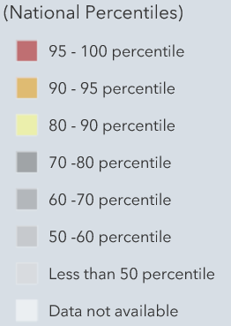
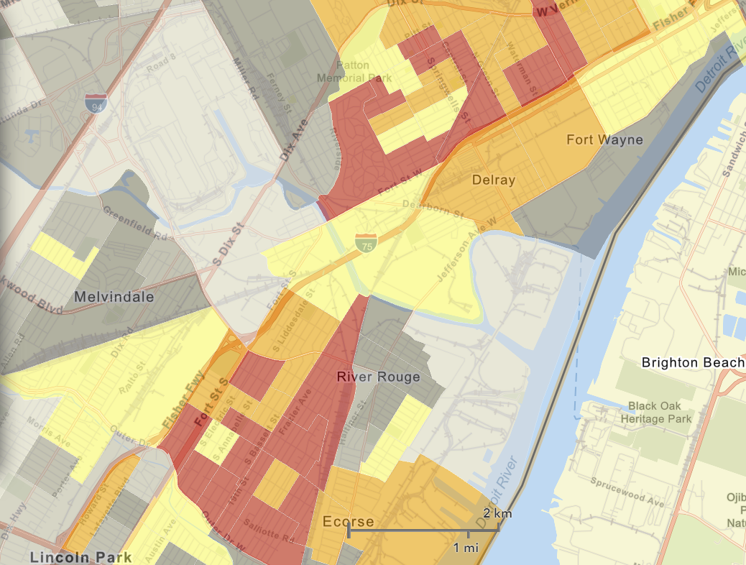
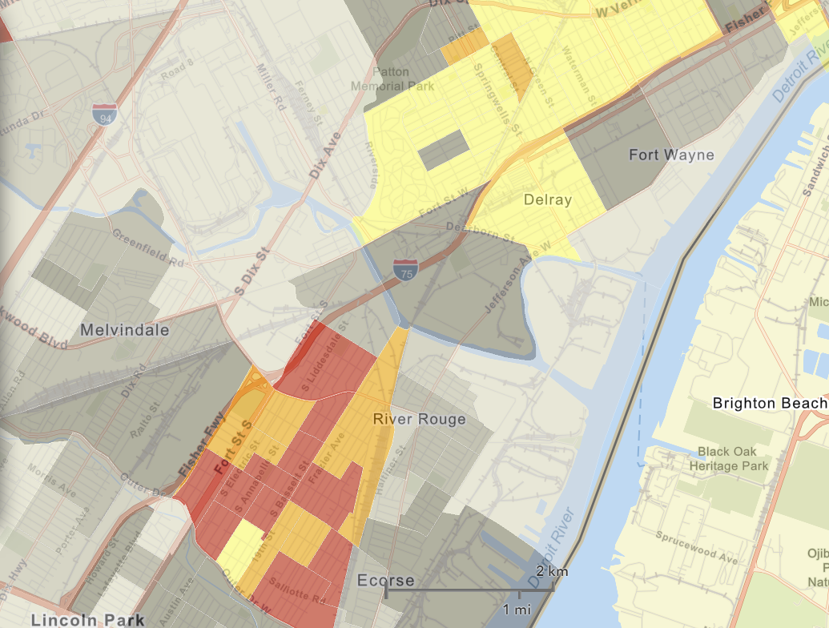
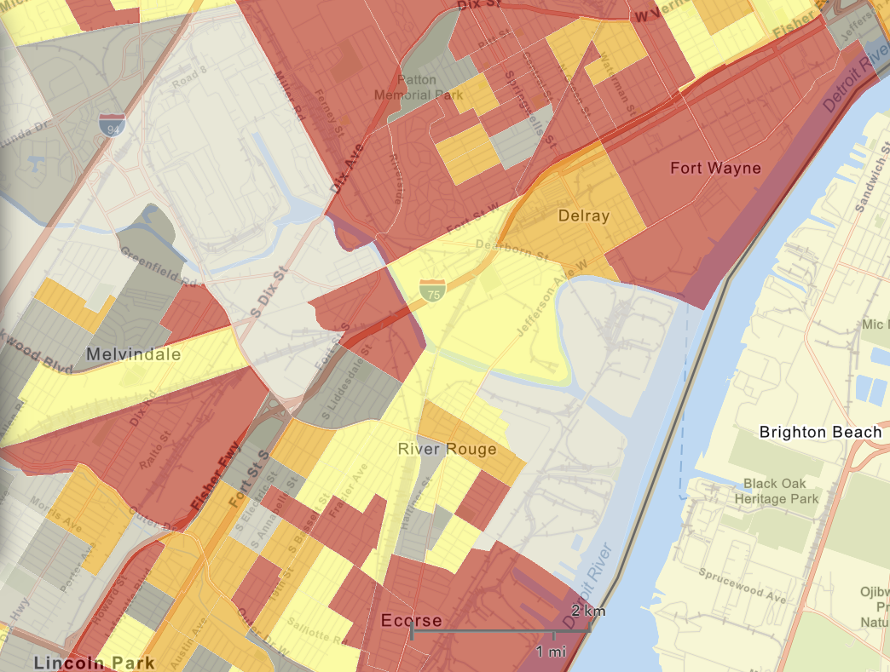

NEXUS Tool - EJ Indices in Wayne County
NEXUS Map
NEXUS can determine the presence or absence of environmental justice concerns in communities in areas with MP concerns. We are incorporating additional EJ metrics such as the data inputs below from EJSCREEN. These indices show the close proximity of AK Steel & US Steel to EJ communities.
AK Steel
US Steel
EJSCREEN Demographic Index
EJSCREEN People of Color Population
EJSCREEN Low Income Population
20

Slide 21
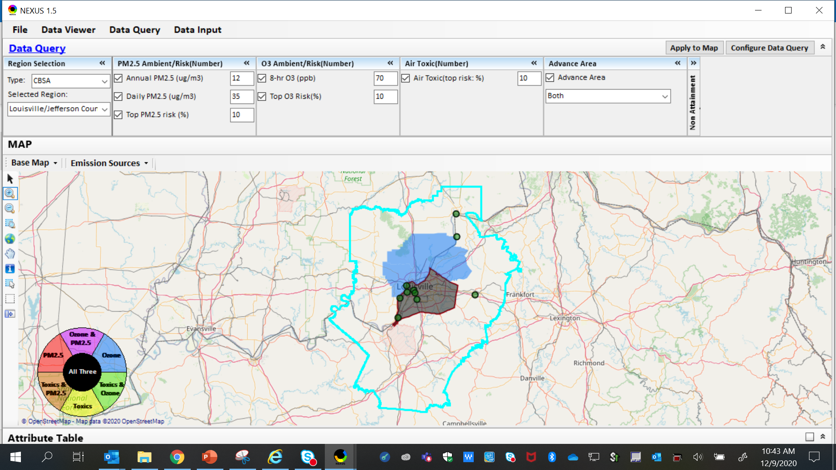
NEXUS Example - Louisville
The map above was generated for the Louisville/Jefferson County - Elizabethtown - Madison, KY-IN CBSA (2014 O₃ NAA), using the data query module. The top 10 Gas & VOC HAPS emission sources are identified.
21

Slide 22
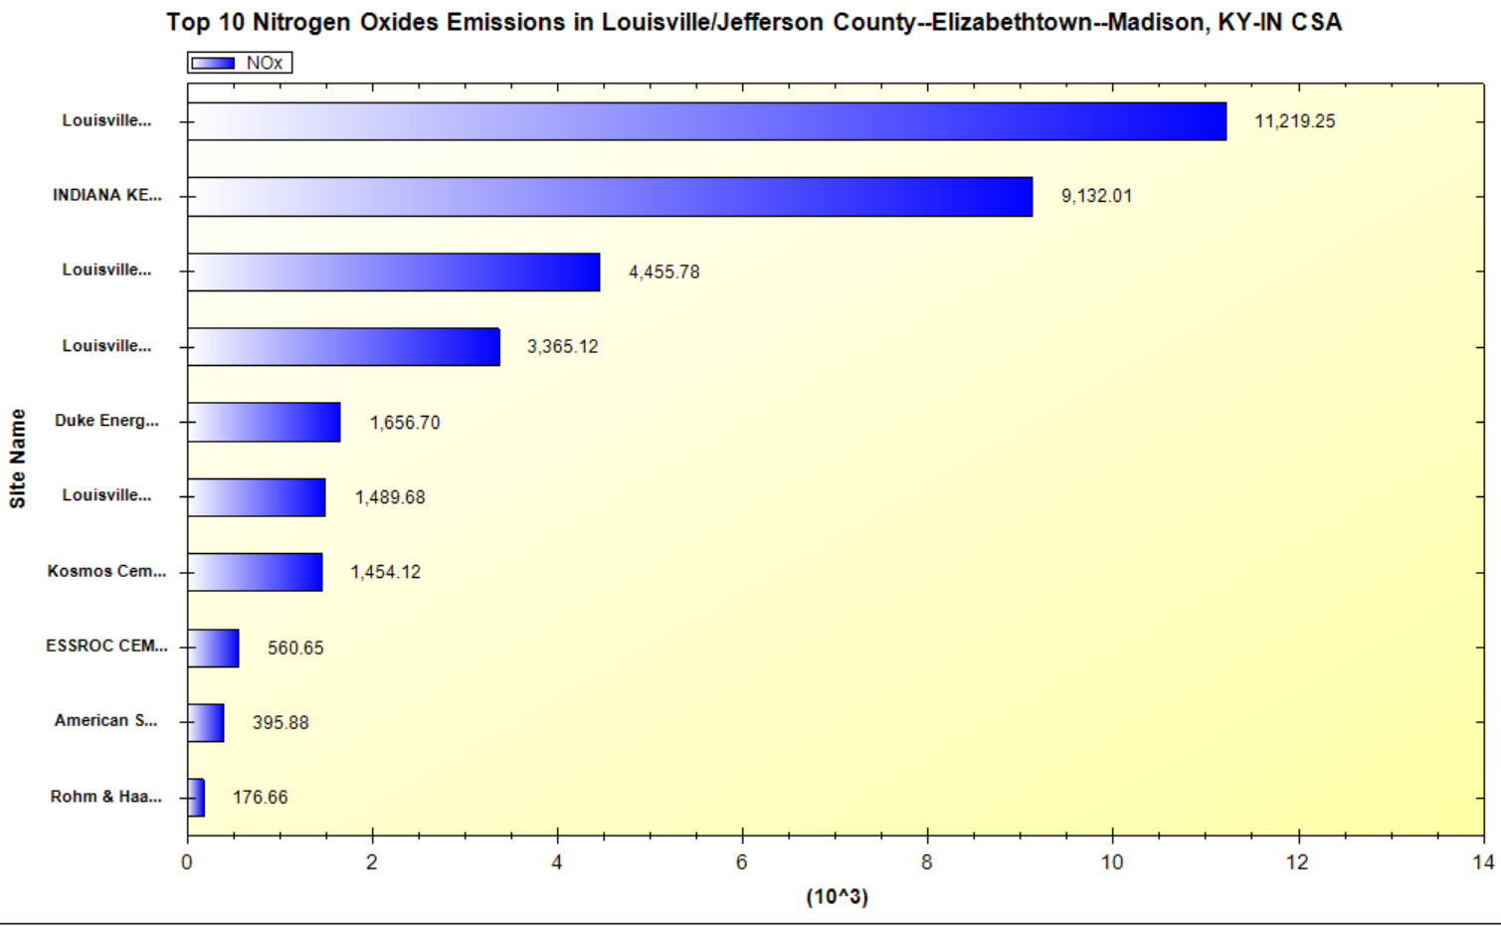
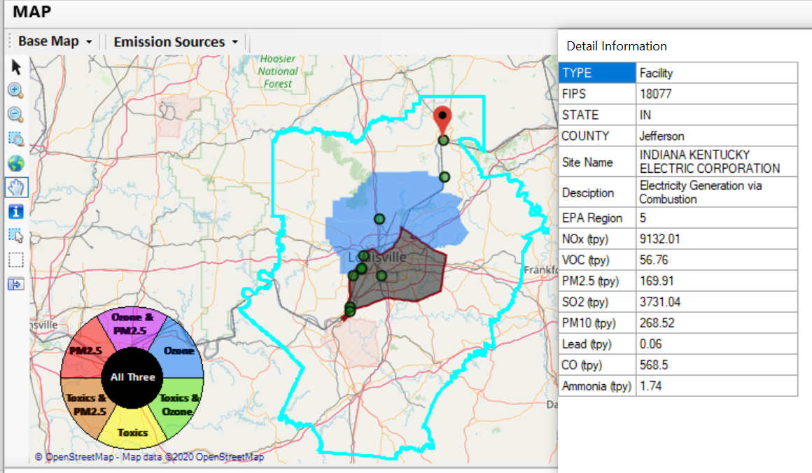
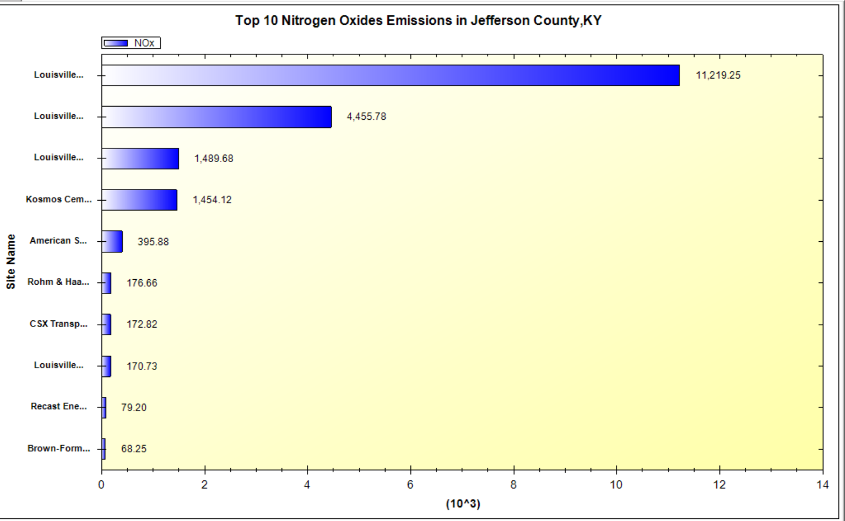
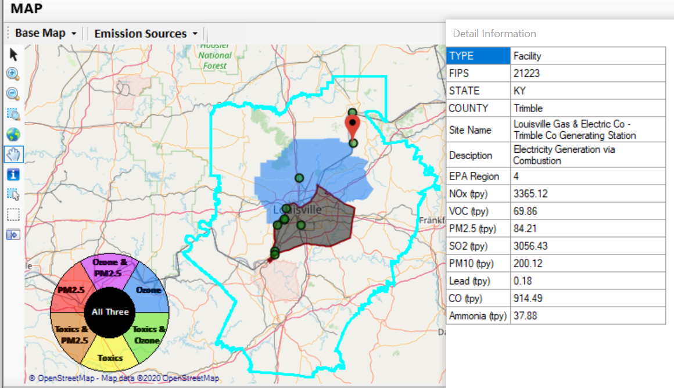
NEXUS Example - Louisville
2 of the top 4 NOx emission sources outside Jefferson County, KY (Jefferson County, IN & Tremble, KY)
22

Slide 23
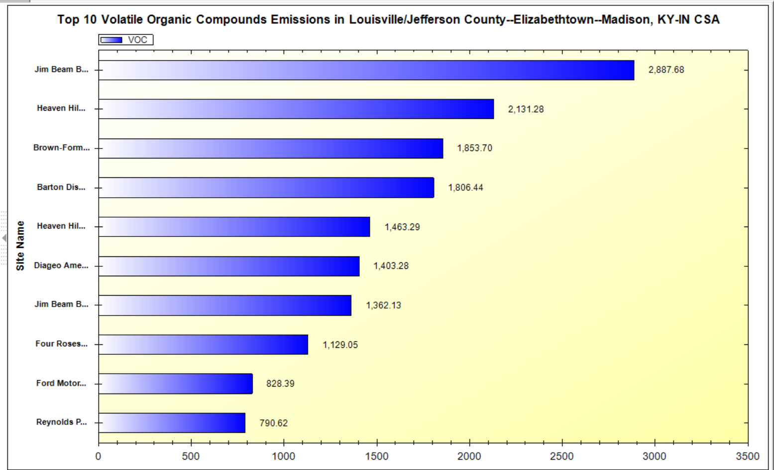
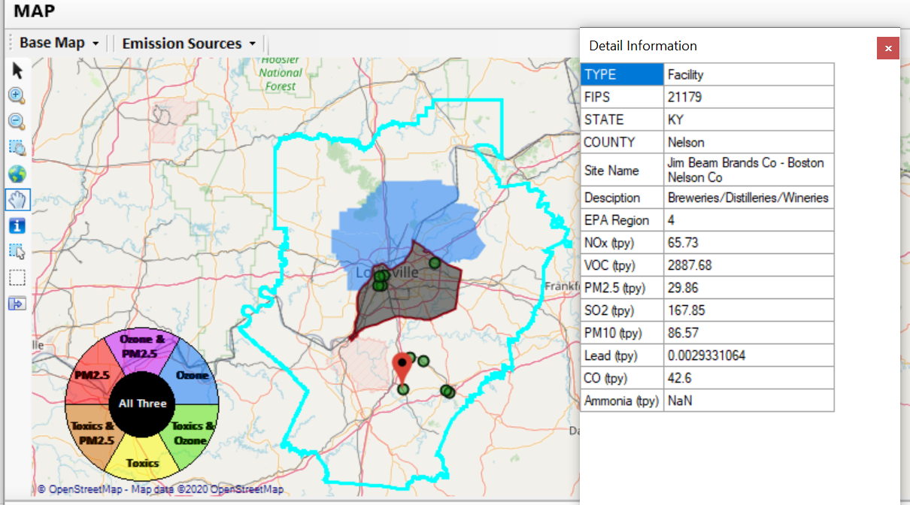
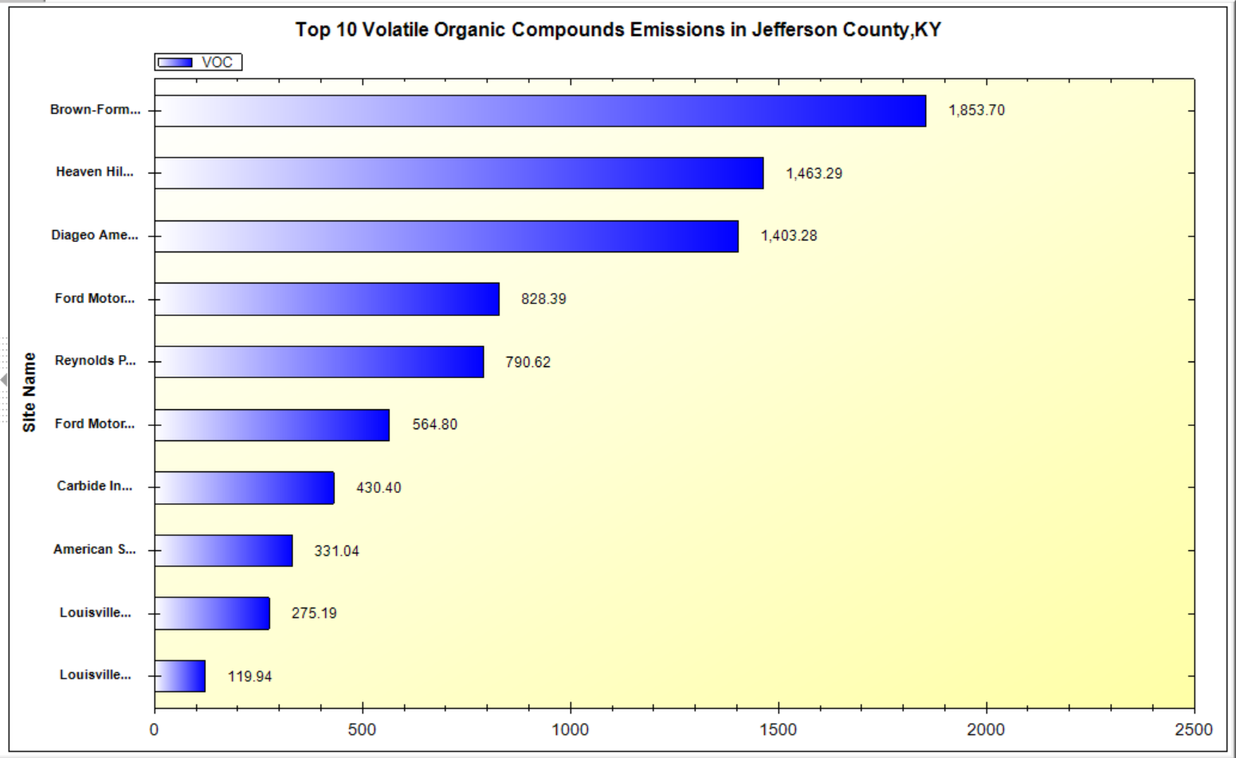
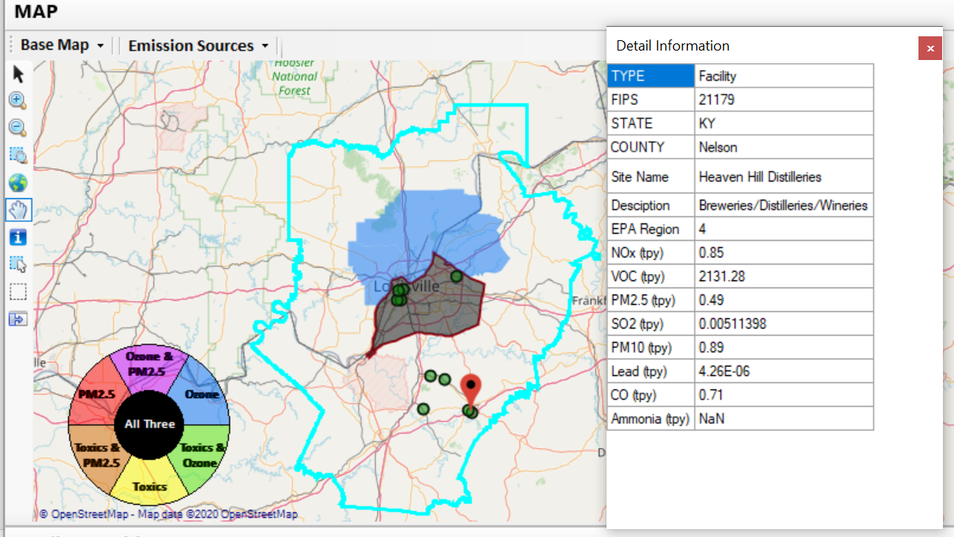
NEXUS Example - Louisville
Top 2 VOC emission sources are in Nelson County, KY
23

Slide 24
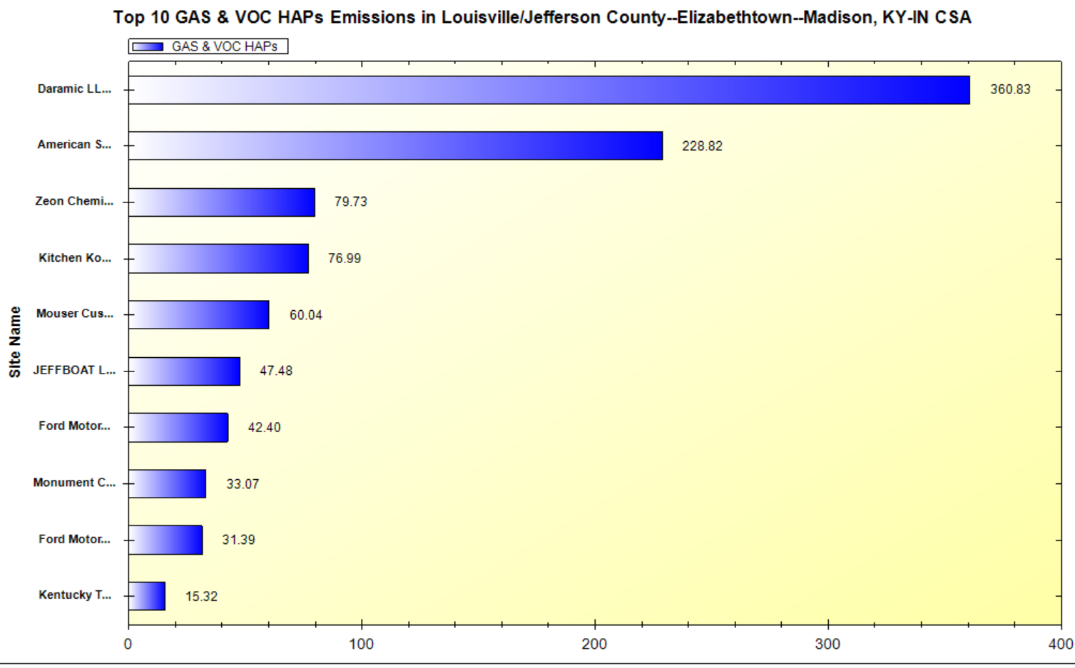
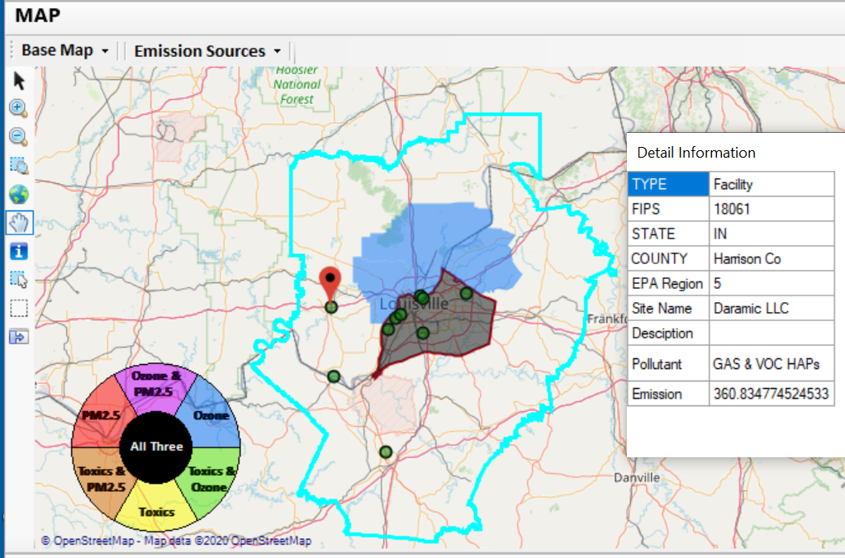
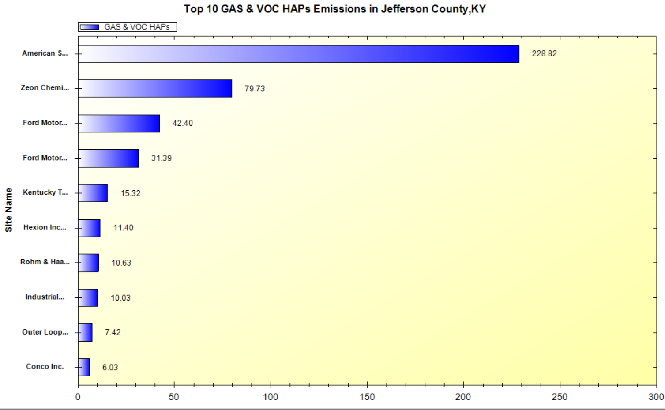
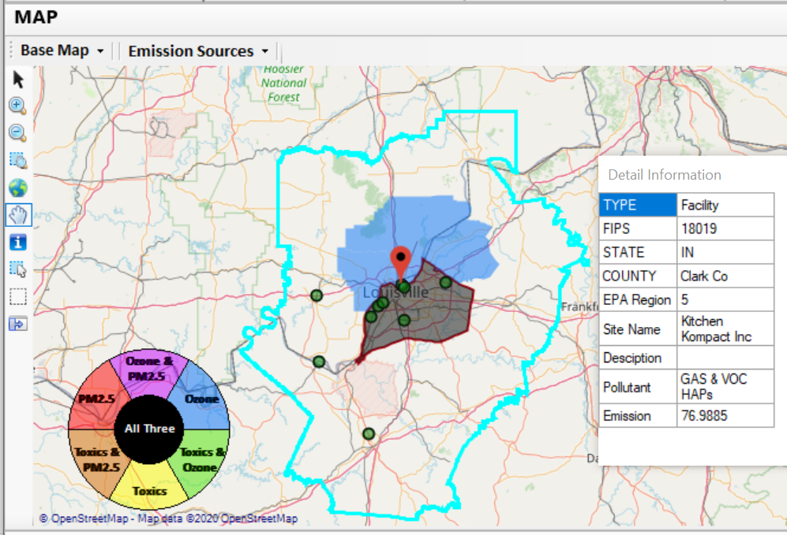
NEXUS Example - Louisville
2 of the top 4 gas & VOC HAPs emission sources in Indiana (Harrison & Clark County)
24

Slide 25
NEXUS & EJSCREEN
  EJ Layers
    Hazardous waste
    EJ Grants
    Water features
    Places
    Schools & Parks
    Transportation
    Boundaries
    Prisons
    Public Housing
    Subsidized Housing
    Climate
    Sites reporting to the EPA
    Superfund (NPL)
    RSEI
  Environmental Indicators
    Wastewater Discharge Indicator
    Hazardous Waste Proximity
    Superfund Proximity
    Lead Paint Indicator
    Traffic Proximity
    RMP Proximity
EJ Layers
Tribal Areas
Nonattainment Areas
  Environmental Indicators*
    NATA Respiratory HI
    NATA Cancer Risk
    NATA Diesel PM
    Ozone Model Concentrations
    PM_{2.5} Model Concentrations
Demographic Indicators
    People of Color Population
    Less Than HS Educated
    Low Income Population
    Linguistically Isolated
    Demographic Index
    Under Age 5
    Over Age 64
Ozone and PM_{2.5}
Emissions and source data
Risk data
Monitoring data
Air Toxics
Emissions and source data
Modeled concentration data
Risk data
Monitoring data
GHG emissions
*Provided to OEJ by OAQPS (AQAD & HEID)
25

Slide 26
Multi-Pollutant Team
Next Steps
Louisville - Develop MP AQMP
Based on Office wide engagements, continue to update NEXUS tool and use it to inform Multi-pollutant, Air Toxics, NAA/Advance controls, and EJ efforts as appropriate
Incorporate climate into MP process
Use NEXUS to develop packets for regions regarding MP areas of concern
  Continue exploring MP partnerships

Slide 27
NEXUS - Recent Improvements and Planned Updates
NEXUS “1.5” (December 2020) → “1.8.6” (July 2021)
  New/revised Metrics (PM_{2.5}, O₃, Air Toxics & EJ)
  New/updated data inputs and functions:
    EJ/Demographic data (from EJSCREEN)
    Tribal areas & Advance areas
    2017 emissions data (including GHG & sector mapping) (updated from 2014)
  “Source & Sector emissions” module to support “Sector prioritization” effort
  “Source Category emissions” module (point, non-point, on-road, non-road, event)
On-going Improvements and Upgrades
  Update to 2017 fused PM_{2.5} and O₃ health risk data (Sept) and air toxic and risk data (Nov/Dec) from current 2014 data
  Include and display monitoring sites/data (PM_{2.5}, O₃ and Air Toxics) (Sept/Oct)
  Develop prototype for “Proximity analysis for MP risks and EJ” module (Nov/Dec)
27

Slide 28

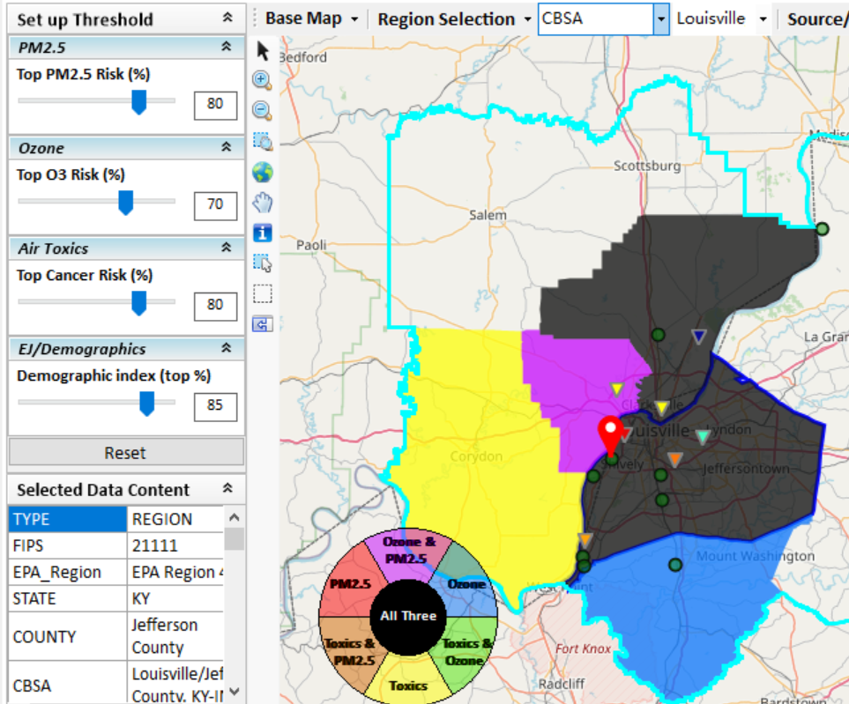
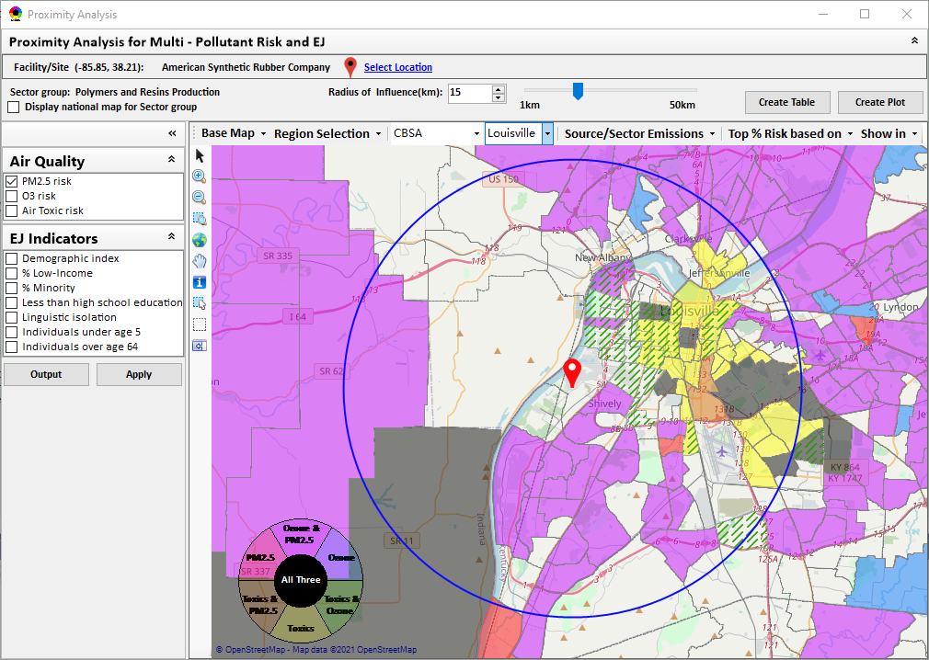
New “Proximity Analysis” Module (under development)
Proximity Analysis for MP Risks and EJ
Right-click to invoke
County – level (current)
Census Tract - level
28

Slide 29
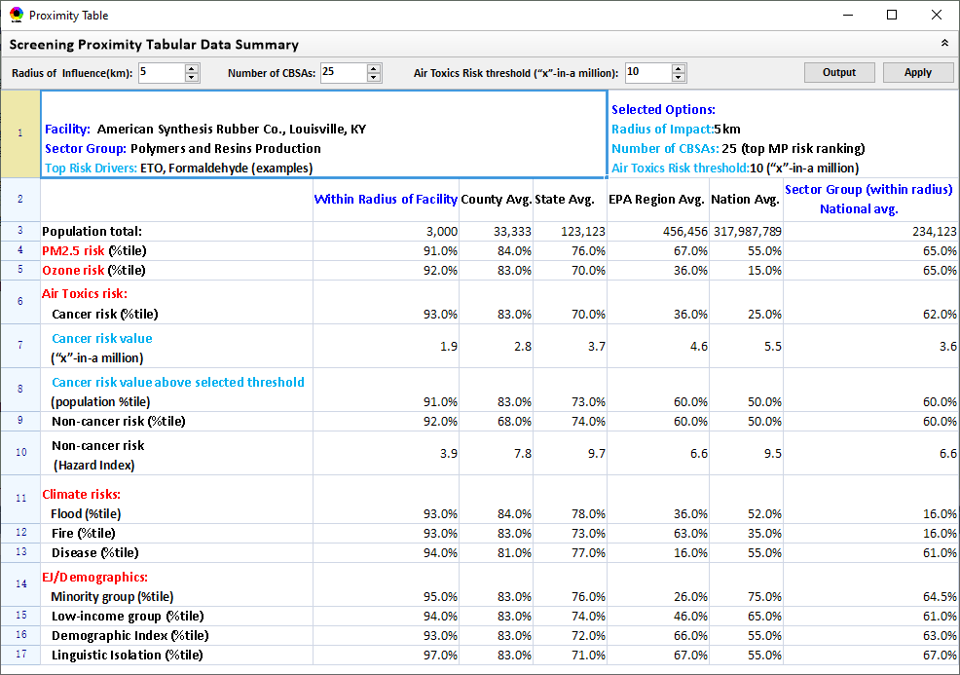
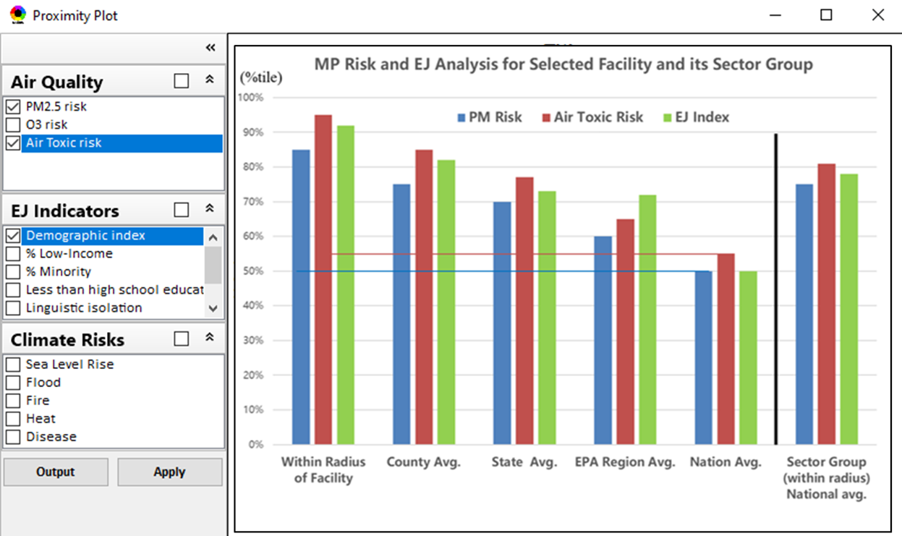
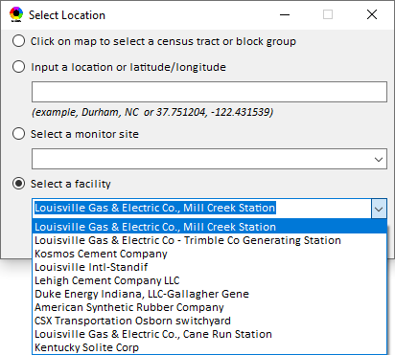
Proximity Analysis: Select “Location” & “Radius”
Select “Radius”
Choice of
Selecting a Location
29

Slide 30
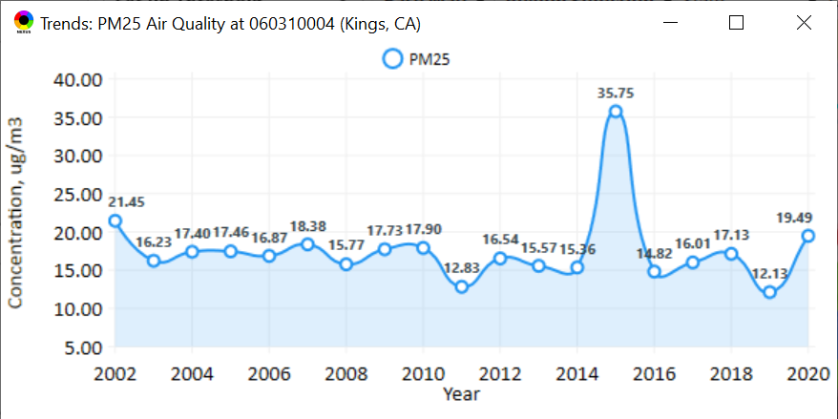
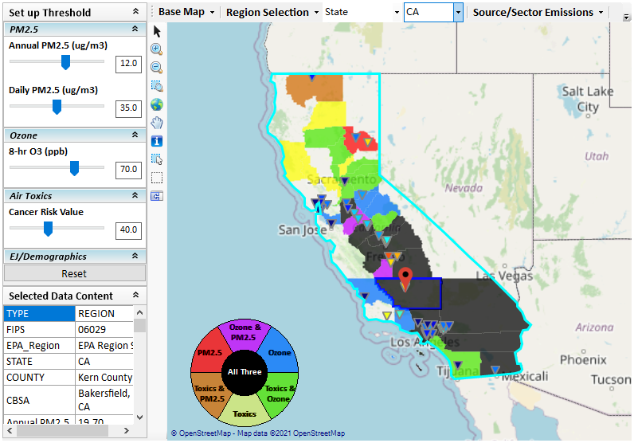
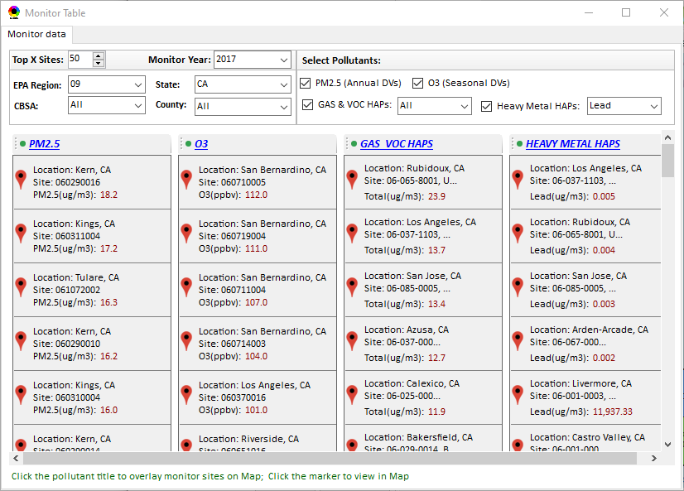
New “Monitoring Data/Site” Module (under development)
Right-click to invoke
AQ trend
Click to display
AQ trend at monitor site
Monitor Site/Data
Click to select monitor site
& pollutant
30

Slide 31
“NEXUS 1.8.6”Demo
NEXUS 1.8.6 “Quick Tutorial” slides attached
Download “NEXUS” tool at: https://gaftp.epa.gov/aqmg/cjang/NEXUS/NEXUS 1.8.6/*
Carey Jang
31

Slide 32
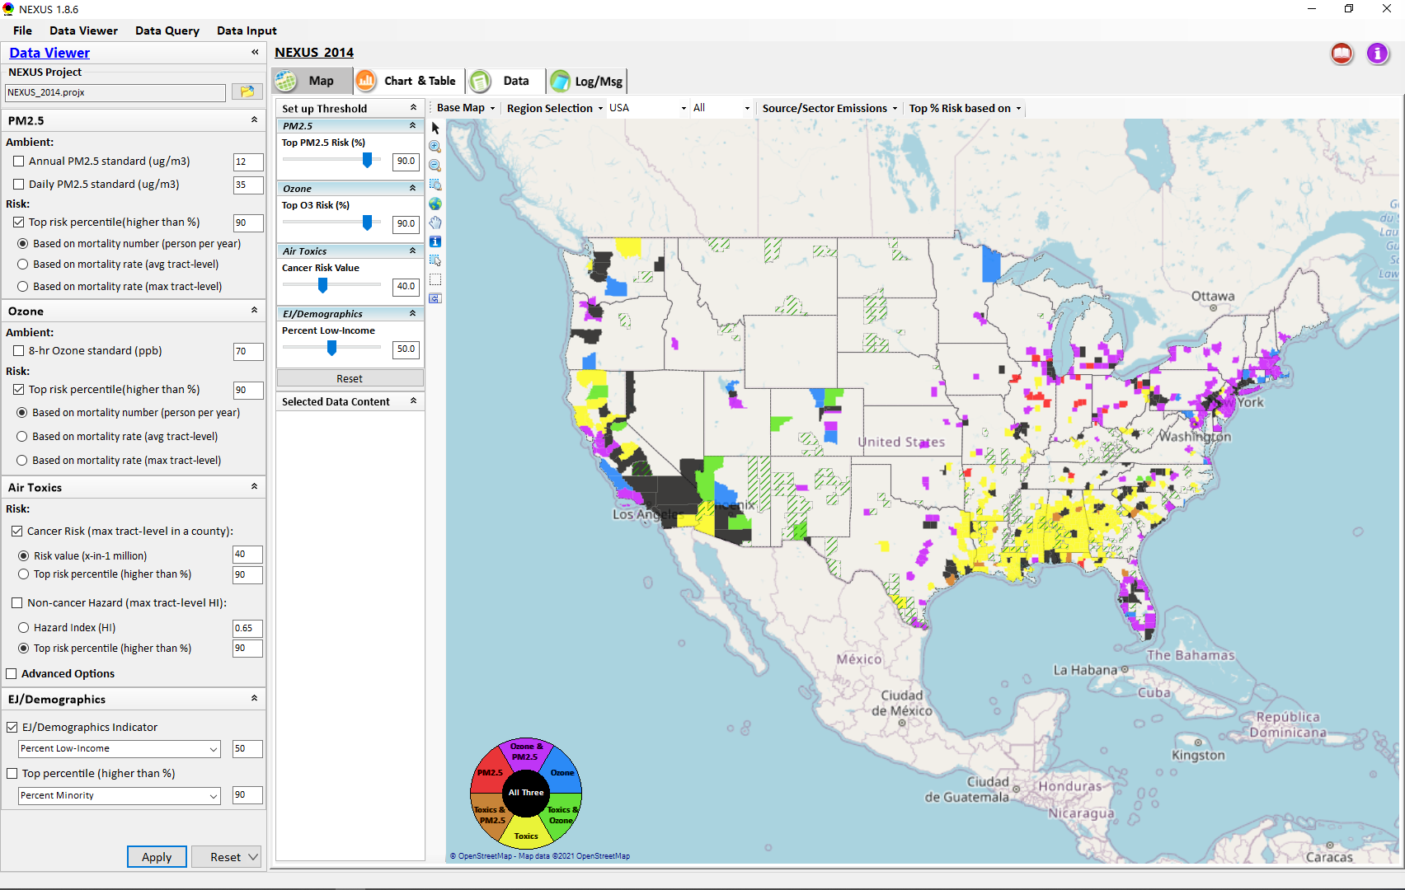
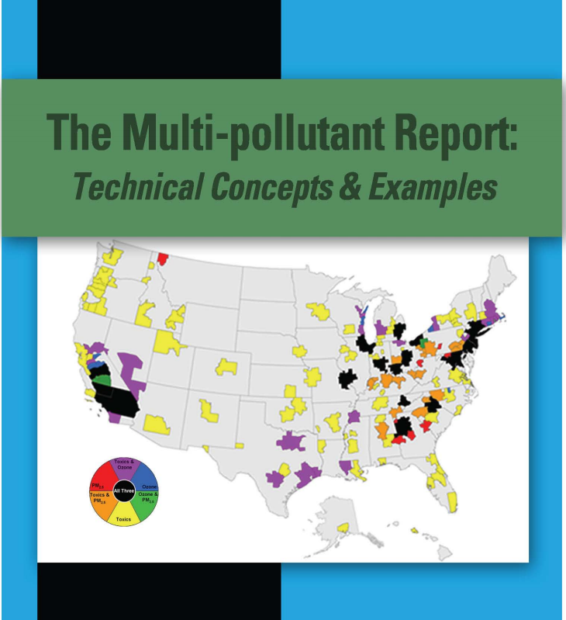
“NEXUS 1.8.6” Demo: 2014 NEXUS Case
Launching Page
2008
Roadmap for Demo:
(Use example cases)
National View: Use “NEXUS” across pollutants to provide an initial “SCREEN” at the national level by providing an indicator where there may be a common set of sources contributing to Multi-pollutant issues.
Regional View: Dial into a region or area of interest to understand the pollutant/source connections, and potential for more effective and efficient multi-pollutant solution.
32

Slide 33
“NEXUS 1.8.6”:
Quick Tutorial
Download “NEXUS” tool: The “NEXUS 1.8.6” package (“NEXUS 1.8.6 Setup.exe” & “NEXUS 1.8.6 Data.exe”: run both “*.exe” files to install) can be downloaded at EPA’s new FTP site:
https://gaftp.epa.gov/aqmg/cjang/NEXUS/NEXUS 1.8.6/*
Note: Require software installation privilege or “Power Broker” (limited elevated privilege) to install “NEXUS tool” at EPA’s PC; Check “This PC\Documents\My NEXUS files\data\* (\tool\*, \result\*)” to see if NEXUS program & input dataset are installed successfully
Carey Jang
33

Slide 34
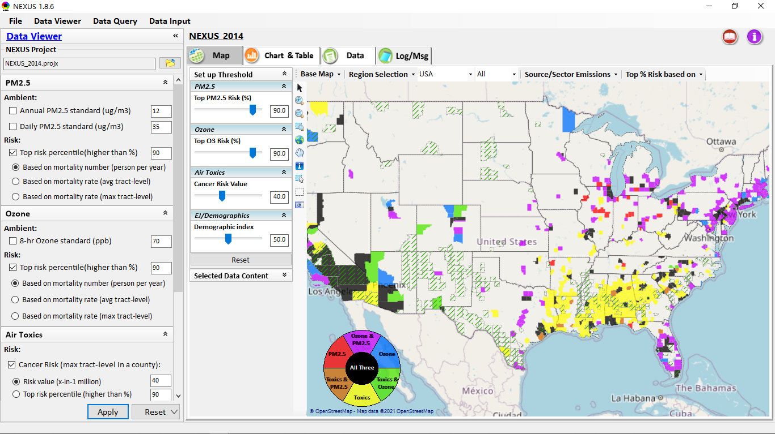
NEXUS Tool: On-line User’s Manual
Click “book” icon to launch “User’s manual”
Hot link to User’s manual’s “Data Viewer” chapter (same for “Data Input” module & “Data Query” model)
34

Slide 35
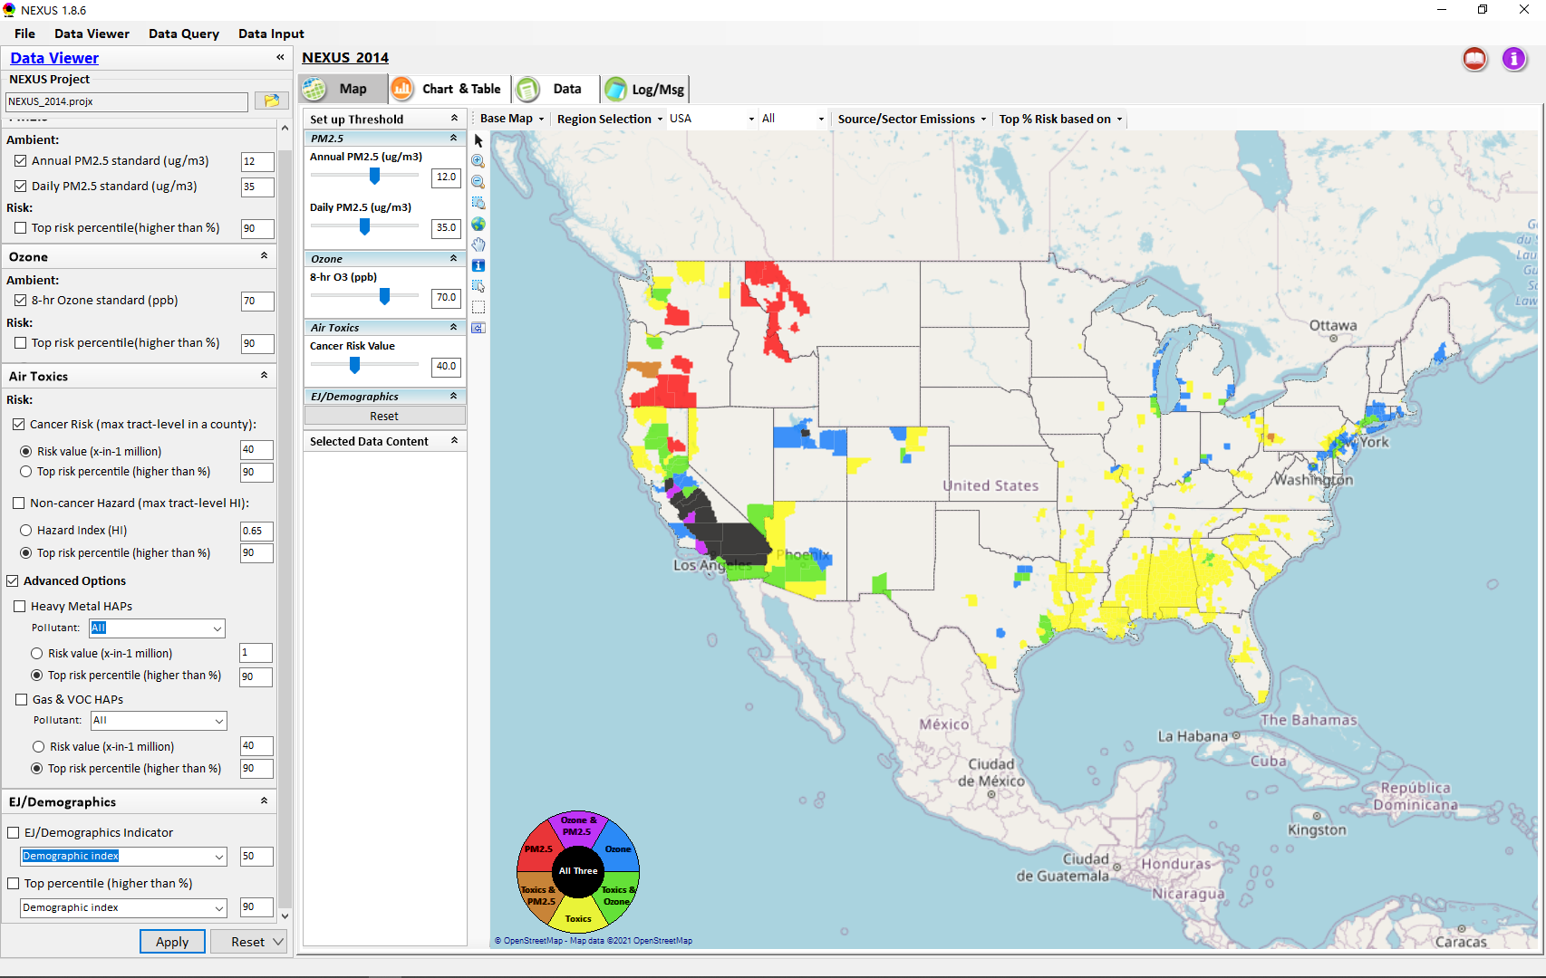

NEXUS Tool: Data Viewer Module
Click “File” to open or save a project
Switch between 3 key modules
NEXUS project file name
Select & adjust “Ambient” or “Risk” levels
“Advanced Option”: provide HAPs & species selections
35

Slide 36
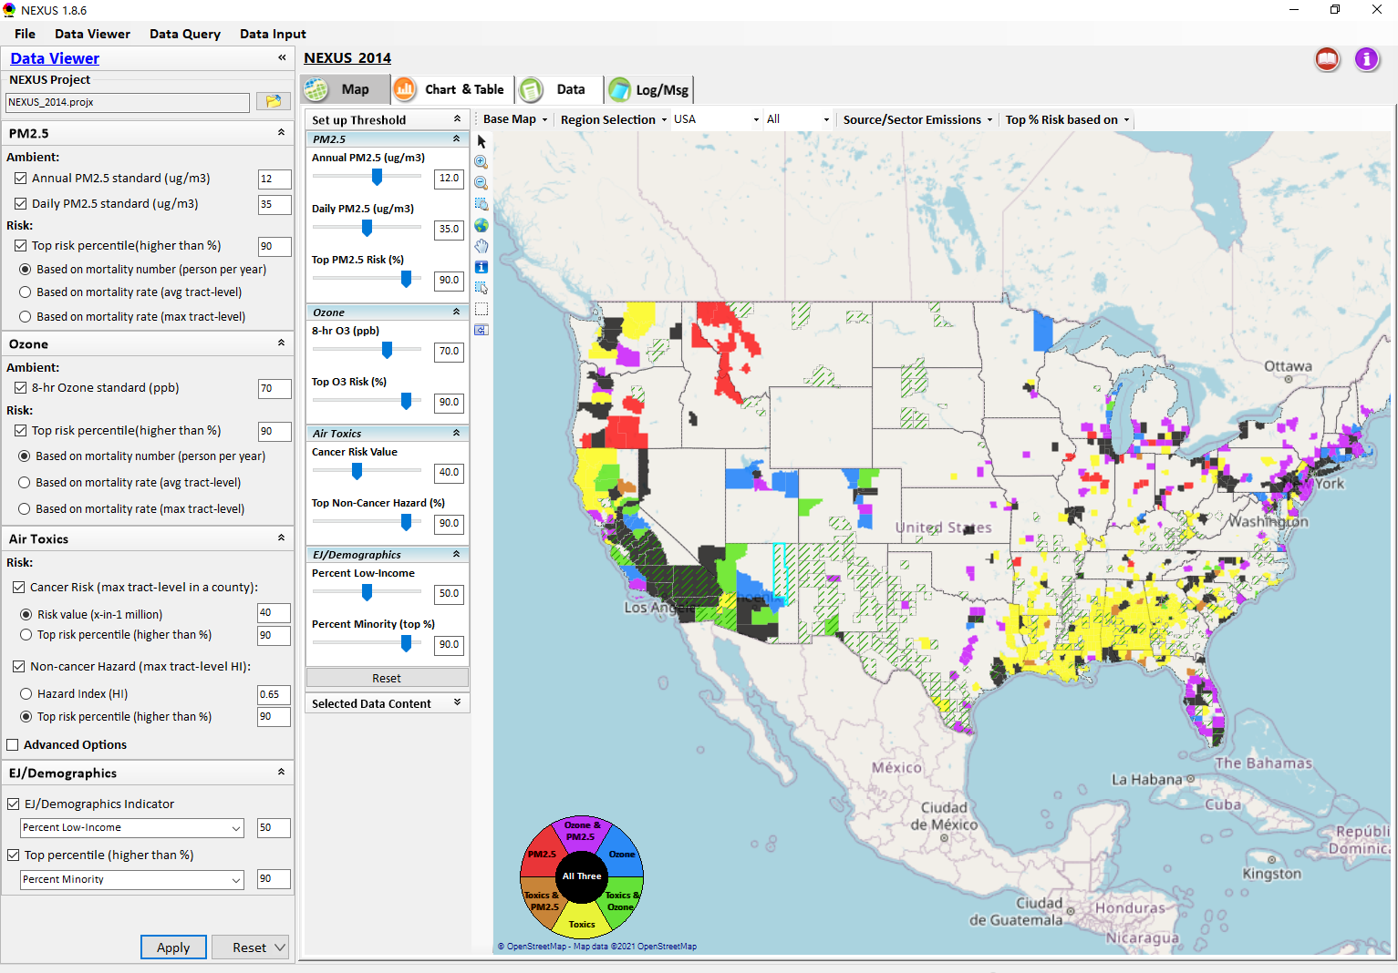
Data Viewer: “Apply” New Selections
“Check” boxes to change/add selections
New selections will appear in “Slider bars” panel and map display
“Slider bars” allow to select & adjust “Ambient” and/or “Risk” threshold levels and displaying color map
“Apply” new selections
36

Slide 37
NEXUS Update: New EJ Metric and Data
37

Slide 38
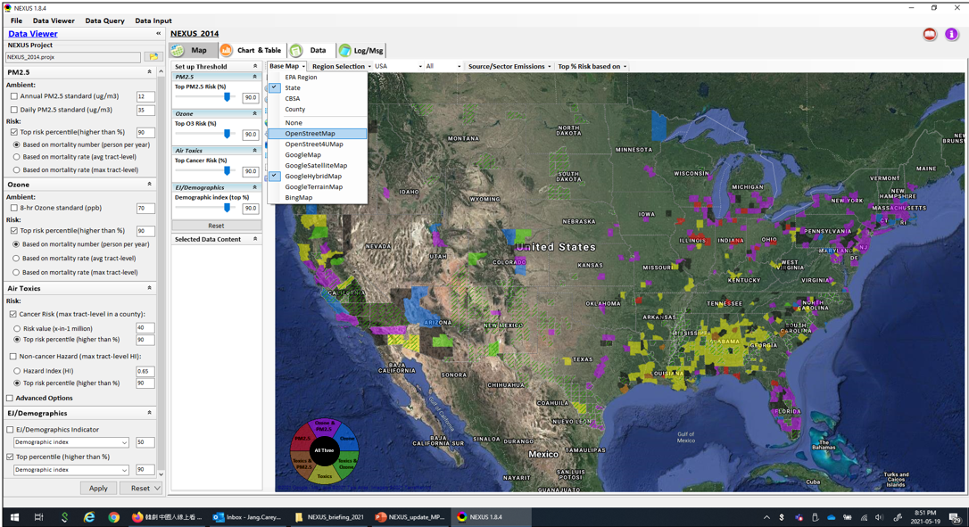


Data Viewer Module: Base Map & Color
“Base Map”: Change boundary lines and background map
“Right-click” map to save image
Click to change color & transparency
38

Slide 39




Data Viewer: “Region Selection”
Allow to select “EPA regions”, “States”, or “CBSA”
39

Slide 40



Data Viewer: Select EPA Region/State/CBSA
Examples:
EPA Region 4
NC State
Louisville CBSA
40

Slide 41

Data Viewer: Major Emission Sources
Click “Emission Sources” tab to display emission sources (green dots) and launch new window
Click any “facility” to link & display source location and emission information
41

Slide 42

Data Viewer: Major Emission Sources
Allow to scroll down to county-level (e.g., Wake County, NC)
Wake county, NC
42

Slide 43



Data Viewer: Top “x” Emission Sources
Provide selection of CAPs precursors & HAPs species
Durham county, NC
43

Slide 44

NEXUS Update: “Source/Sector” Emissions Summary
“Source/Sector Emission Summary” function allow to select major CBSAs and provides source and sector emissions summary to support OAQPS’s “Sector Prioritization” project effort
44

Slide 45

Data Viewer: EPA Region Table Generator
“EPA Region Table Generator” provides attainment status of O3 and PM2.5 and their DVs; also allows to select any EPA region based on data updated to 2018.
45

Slide 46

Data Viewer: Data Search & Filter
Click “+” to add filters; Click “x” to remove current filter;
Show specified records per page.
Click “Output data…” to output current page records or all records
46

Slide 47

Data Query Module: Overlaying Map
Region Selection
Data Query Configuration
Data Query qualifier selection
Overlaying Map selection
47

Slide 48

Data Query Module: Configure Data Query
“Data Query Filter” allows to select “qualifiers” for query
“Data Query Preview” displays the selected “qualifiers” at the same time
48

Slide 49


Data Query Module: Attribute Table
Filter/search/export functions
Detachable “Attribute Table”
49

Slide 50



Data Query Module: Attribute Table
Click a “record” to link and display its location & info.
50

Slide 51

Data Input Module: Data Preview
“Transparency” & “Open-Source”:
All NEXUS input/output data files are available under:
“This PC\Documents\My NEXUS files\Data (\Result)”
Check to use filter to query data
Select a table to view if there are multiple tables in the selected data source file
Click to change input data file
Click to view data
Click to run & save project
51

Slide 52
End
52

