Slide 1
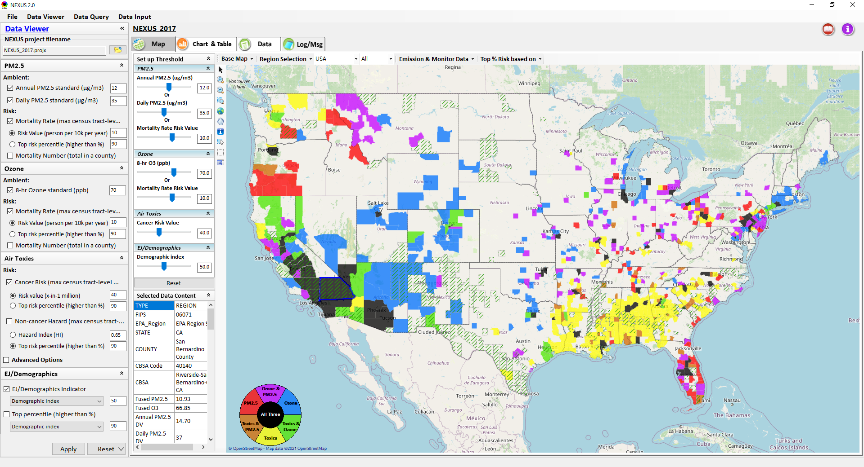
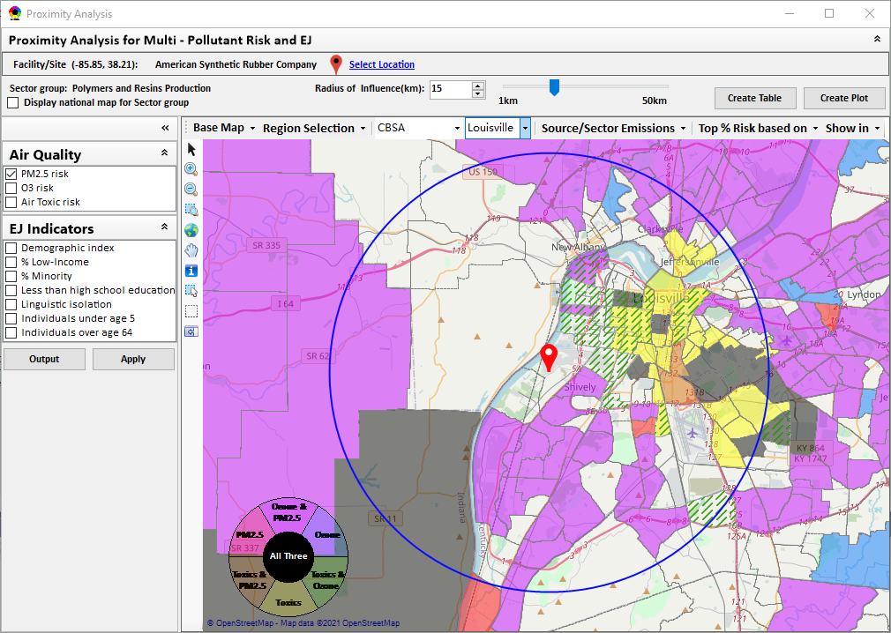
“NEXUS” Multi-Pollutant Advanced Screening Tool: Briefing & Live Demo
Data Viewer: National/Regional Level
Proximity Analysis: Community Level
Beth Landis, HEID/Climate, International, & Multi-Media Group
Carey Jang, AQAD/Air Quality Modeling Group
ADVANCE Regional Workgroup – 5/10/22
1

Slide 2
Multi-Pollutant Team Members
HEID
  Beth Landis / Kimber Scavo
  Matt Woody / Kelly Rimer
  Robin Langdon / Darryl Weatherhead
  Sara Terry
  Carrie Wheeler
  Rob Pinder
  Chris Davis
OID
  Amanda Kaufman
  James Payne
  Loren Fox
AQAD
  Carey Jang / Tyler Fox
  Jim Kelly
  Shannon Koplitz
  Joe Mangino
  Jeanette Reyes
AQPD
  Rich Damberg / Megan Brachtl
  Mia South
SPPD
  Lisa Conner
2

Slide 3
Overview
Multi-Pollutant (MP) Background
Detroit, SC & Louisville MP Projects
NEXUS 3.0
  Overview
  Data Inputs and Major Functions
  Briefings/Demos
  Recent Updates
  EPA Regional Beta Testing Team
  Current and Potential Uses
  Next Steps
Live Demo
3

Slide 4
Multi-Pollutant Background
Support a comprehensive, MP treatment of air quality problems to effectively improve air quality and make the most efficient use of available resources
  Primary Goal - identify & evaluate local control strategies targeting emissions of O₃ & PM_{2.5} and their precursors while at the same time reducing Air Toxics of concern for communities to maximize both health benefits and air quality improvements
MP planning has the potential to reduce the costs and increase benefits associated with air quality management (AQM)
Supports S/L/T air agencies in developing MP, risk-based AQM plans and implementing strategies that reduce air pollution emissions & improve public health
Success has been demonstrated in Detroit and SC; another project is currently underway in Louisville, KY
Tools needed to analyze MP data are either available currently or being developed in OAQPS (e.g., NEXUS)
4

Slide 5
Detroit MP Case Study
Partners: EPA, MDEQ, SEMCOG & LADCO
Goals: Assess and compare two contrasting air quality control strategies
“Status Quo” approach – controls selected separately to address O₃ & PM nonattainment
“Multi-pollutant, risk-based” approach – aimed at further reducing population risk from exposure to O₃, PM and select air toxics while still addressing ozone and PM nonattainment
Results showed the multi-pollutant approach:
Achieved the same or greater reductions of PM and O₃
Improved air quality regionally and across the Detroit urban core for multiple pollutants
Produced ~2x greater monetized benefits for PM and O₃
Reduced non-cancer risk
Resulted in greater net benefits & was more cost effective
5

Slide 6



South Carolina MP Project
Partners: EPA, SC DHEC & local community and business leaders in 10 upstate South Carolina counties
Goals:
Develop and analyze a multi-pollutant, risk based AQM strategy
Maximize both health benefits and air quality improvements, identify and evaluate a local control strategy targeting emissions of O₃, PM & their precursors while also reducing air toxics of concern for communities
Results demonstrated improving air quality in areas already attaining the NAAQS can yield significant health benefits
6

Slide 7
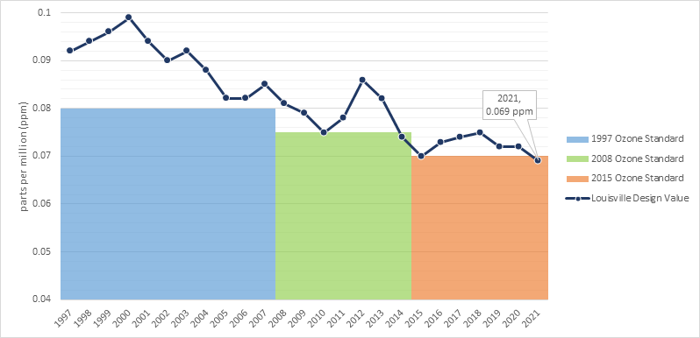
Louisville MP Project
Goals:
Identify local- and state-level emission reduction measures that address multiple pollutants, with a focus on attainment of the 2015 O₃ NAAQS
Build a plan to achieve and maintain compliance of all NAAQS
Demonstrate that the selected strategies can reduce health risk from exposure to O₃, PM and selected air toxics
Integrate existing health risk-based pollution control programs into a multi-pollutant air quality management plan
Build institutional capacity among LMAPCD and LMPHW to perform air quality modeling and health benefit analysis projects
Results pending
Partners: EPA, Louisville Metro Air Pollution Control District (LMAPCD) & Louisville Metro Department of Public Health and Wellness (LMPHW)
Graphic provided by LMAPCD
7

Slide 8
NEXUS: Overview
“NEXUS” is an advanced screening tool for multi-pollutant (MP) risks and EJ/Demographic analysis developed by OAQPS’s MP team (further details see attached “NEXUS Overview” doc)
“NEXUS” integrates a suite of MP data, including emissions, monitoring, modeling, fused AQ data and health risk data for PM_{2.5}, O₃ & air toxics as well as EJ/demographic data, into one single platform to allow national and areal overlay mapping & analysis of MP ambient & risk data
“NEXUS” provides MP analysis across from national level “Phase 1” to regional (EPA region/State/CBSA) level “Phase 2”, and now down to community level “Phase 3” (Proximity analysis” in census tract-level)
We expect to use this tool in conjunction with Regions and identify areas that would potentially benefit most from MP approaches to reduce emissions (including current NA areas)
We also expect that it can have additional value-added uses across the Office for Air Toxics, Environmental Justice and other programs
The NEXUS tool will essentially provide a ‘conceptual model’ of an area’s MP issues to facilitate engagement with state/local/tribal agencies & community stakeholder groups
8

Slide 9
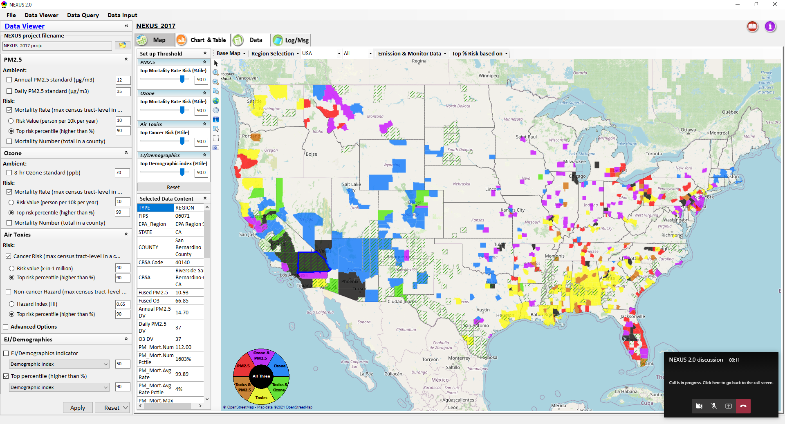
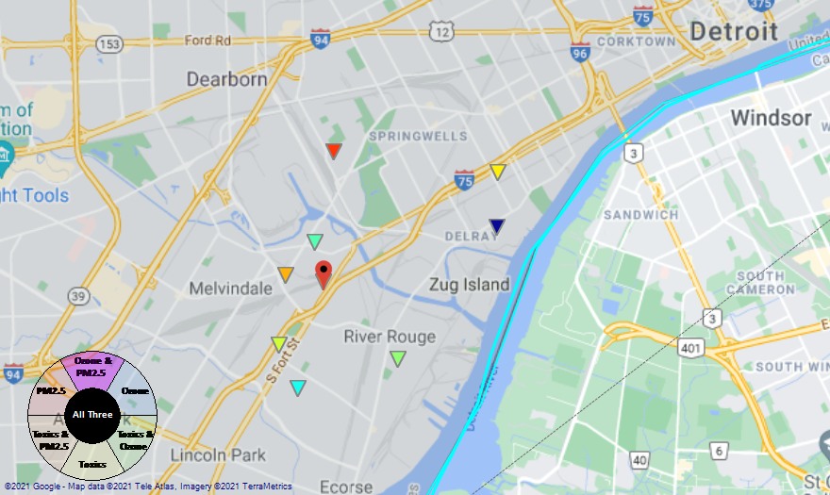
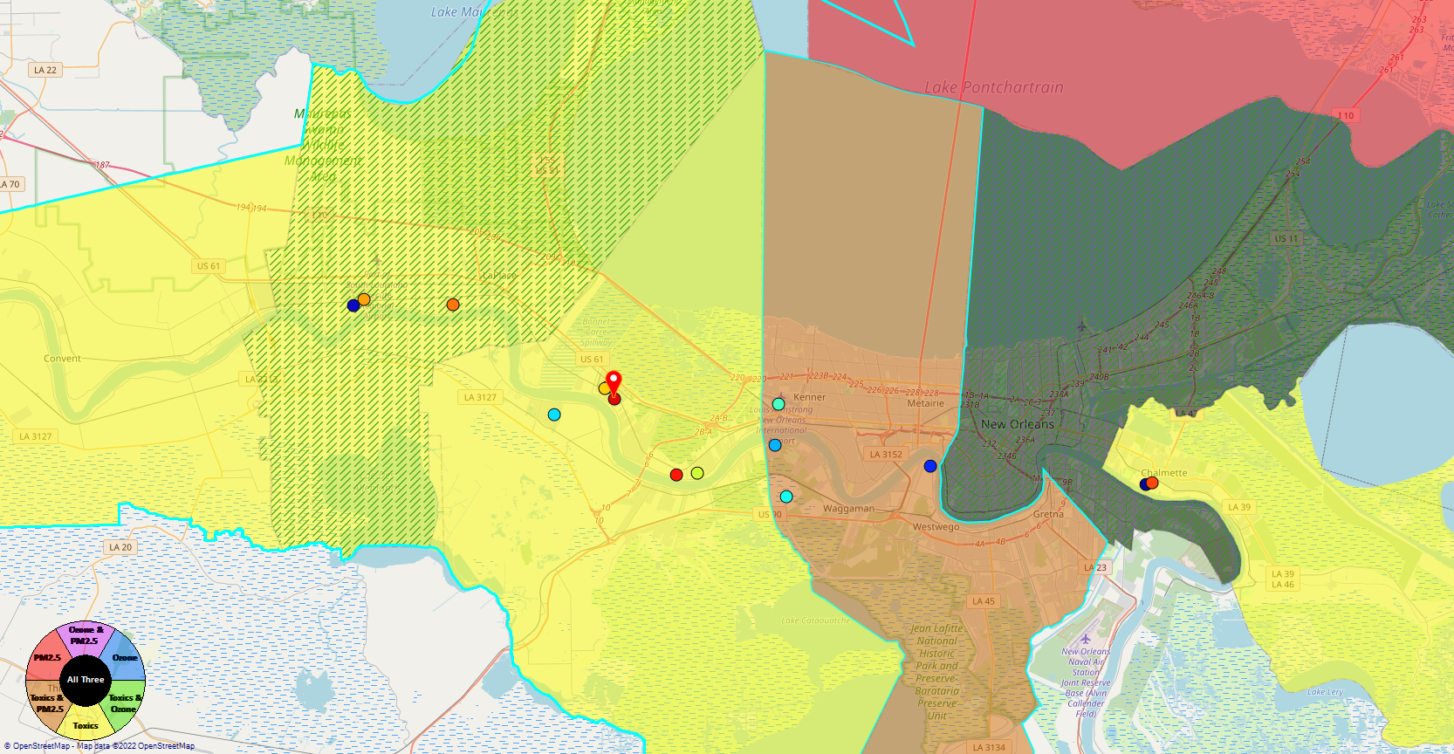
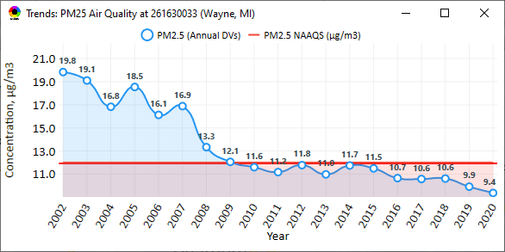
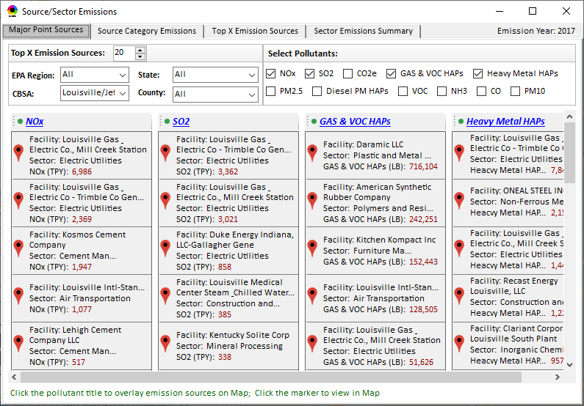
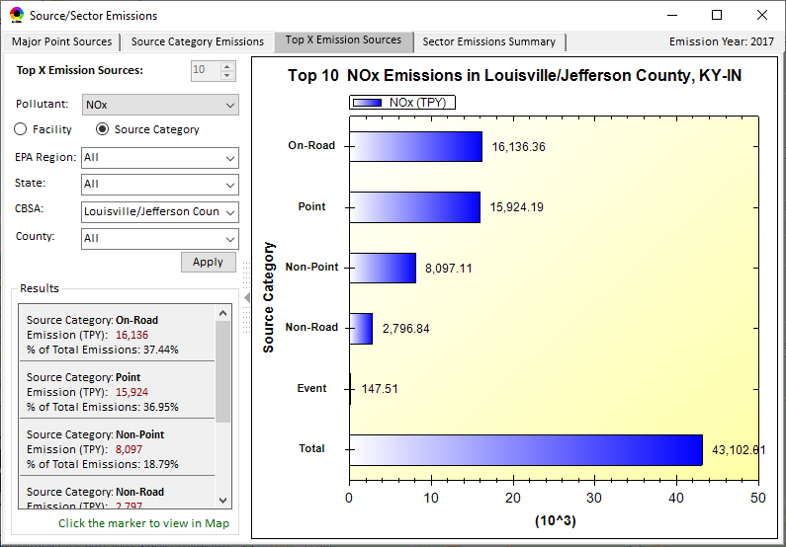
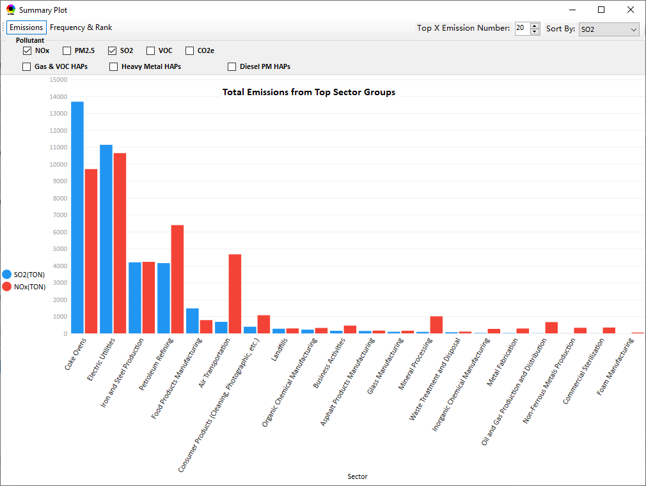
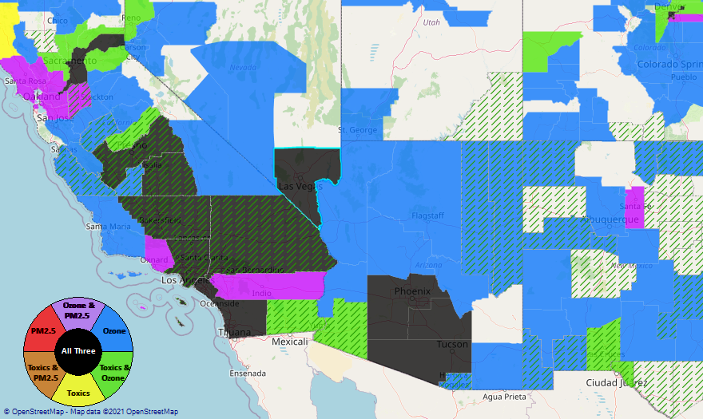
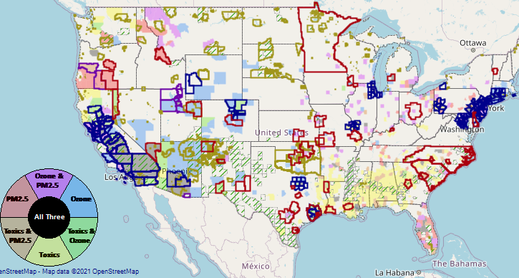
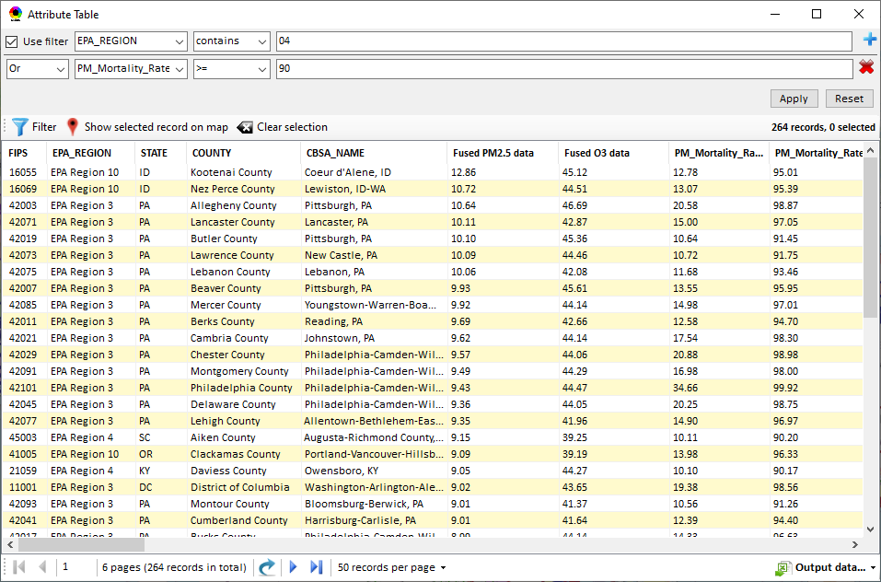
NEXUS: Data Inputs and Major Functions
O₃ & PM_{2.5}
Ambient/Design Value
(2012-2020)
(County-level)
Multi-Pollutant
Ambient and/or Risk National & Areal Mapping
Display Monitoring Sites & Trend Data
O₃, PM_{2.5} & Air Toxics Risk Data &
Conc. (fused AQ) Data
(2017 & 2014)
(Census tract-level)
Display Major Point Emissions Sites/Data
Provide Source Category Emissions
NEXUS
O₃, PM_{2.5} & Air Toxics Monitoring Data
(2002-2020 & -2018)
Provide Sector Emissions Summary
NEI County &
Facility Emissions
(2017 & 2014)
Include EJ/Demographic Indicators
Map Overlay with NAA, Advance Area, Class-I Area, or Tribal Area
Environmental Justice & Demographic Data
(from EJSCREEN)
Data Query, Search, Filter & Export
Advance Area
Class-I Area
Tribal Area
Proximity Screening Analysis
9

Slide 10
NEXUS/MP: Briefings and Demos
9/25/2020– AQAD & HEID
11/3/2020 – MP Team
11/4/2020 – Air Toxics Group
12/10/2020 – AQPD
1/25/2021 – OID
1/28/2021 – SPPD
2/1/2021 – Peter/SMT
4/12/2021 – HEID & AQAD
5/17/2021 – Peter/SMT
5/24/2021 – MP Team
6/29/2021 – ORD
7/12/2021– HEID & AQAD
7/19/2021 – OID
8/10/2021– OAP
8/26/2021 – OAR
8/27/2021 - OP
8/30/2021 – OEJ
8/30/2021 - Region 4/Louisville
9/7/2021 – RO Air Division Directors
9/20/2021 – OAR Demo
10/14/2021 – OP/NCEE
11/2/2021 – RO APMs
11/8/2021- RO APMs Demo
11/16/2021 – R1 (RARE) Project
11/28/2021 – AQAD All-Hands
11/23/2021 – R3 NEXUS Beta Testers
2/15/22 – AQPD (NSRG, OPG & SLPG)
2/17/22 – AT Strategy Mgmt & Mitigation Team
3/15/22 – OID (CTPG)
4/26/22 – EPA NEXUS Beta Testing Team
4/28/22 – AQAD (AAMG)
5/3/22 – HEID & AQAD
5/4/22 – Air Toxics Data Analysis Team
5/10/22 – ADVANCE Workgroup
5/26/22 - OAP/CCD
TBD – SPPD, MJOs
“Breathtaking… incredibly powerful… I feel like we discovered nuclear fusion!”
- Joe Goffman (OAR Acting AA)
“Fascinating… phenomenal… I’m blown away!”
- Caroline Freeman (R4 ADD)
10

Slide 11
NEXUS: Recent Updates
NEXUS “2.2” (Dec. 2021)
  Updated 2017 BenMAP risk and fused concentration data for PM & O₃
  Upgraded “Monitoring sites/data” module
  “Proximity analysis module” prototype for MP risks and EJ screening
NEXUS “2.3” (Jan. 2022)
  Includes updated 2017 air toxics risk data (received in Dec. 2021)
  Improved “Proximity analysis module” for MP risks and EJ screening
NEXUS “2.4” (March 2022)
  Includes “Morbidity risk” in summary table and summary plot in “proximity analysis” module
  Added “Map layers” tab in “Data Viewer” module to provide map overlaying for MP risks & EJ indicators, PM_{2.5} & O₃ NA areas, Advance areas, Tribal areas, Class I areas, etc.
NEXUS “2.5” (April 2022)
  Added “Select Sites” functions for user-defined locations (census tracts), monitoring sites, and emissions sector group under “Proximity Analysis” module
  Consolidated “Data Query” module into “Data Viewer” module and added “Attribute Table” to view census tracts information of MP risk & EJ attributes
11

Slide 12
NEXUS: EPA Beta Testing Team
Vision
  We envision the EPA Beta Testing Team as a group of OAR and regional office members that see the benefit of NEXUS and plan to use it on a routine basis to assist in their job duties.
  We would like feedback to help shape the direction of future tool development and ensure we are making updates and additions that are most beneficial to those Regions who are encouraging a multi-pollutant approach to air quality management.
  We would like to identify specific applications to collaborate on with Regions, e.g.:
    Select area with MP and potential EJ concerns and explore a MP approach using NEXUS.
    Support EJ screening and related analysis for Federal permit or related action.
Participants from R1, R2, R3, R4, R5, R6, R8, R9 & OAQPS
12

Slide 13
NEXUS: EPA Beta Testing Team Timeline
5/9/22 – release NEXUS 3.0 and Quick Tutorial
5/18/22 - demo NEXUS 3.0 to EPA Beta Testing Team
6/17/22 - review and provide written comments on NEXUS 3.0
6/29/22 - meet to discuss NEXUS 3.0 comments
Fall – release updated version of NEXUS incorporating comments from EPA Beta Testing Team (assuming funding available)
Fall/Winter 2022 - update NEXUS with 2018 data, when available
13

Slide 14
NEXUS: Current and Potential Uses
AAMG exploring use of NEXUS to inform assessment of the nation’s PM_{2.5} monitoring network and determine if sites located in/near communities with potential EJ concerns (driven by current PM NAAQS review)
  AAMG noted that NEXUS could be useful in Regional review of their states’ Annual Monitoring Network Plans
MP Risk Priority Areas: develop a list of high MP risk areas to share with Regions and engage in potential MP area projects/efforts
  “Regional packets”— tabular and graphical data for each high MP risk area to discuss with Regions and determine which may be most ‘ripe’ for MP solutions
Advance area/Regional SIP planning efforts: develop conceptual model information consistent with EPA’s SIP modeling guidance that addresses nature of air quality within the area
  “Conceptual model” area packet—tabular and graphical data for each planning area to discuss with AQPD and/or Regions to be value added in AQ planning efforts and identify potential for MP considerations as part of these efforts.
EJ Screening with OID and AQPD: inform programs with an emphasis on Federal permitting
  Possible EPA Regional Beta tester project
Engage with EPA Beta Testing Team to define additional uses of need/value to Regions
14

Slide 15
NEXUS: Next Steps
EPA Beta Testing Team review and provide comments on NEXUS 3.0
Determine if funding available for requested updates:
  Address comments and feedback from EPA Beta Testing Team
  Include “Climate risk” indicators (as 5th metric)
  Update EJ/demographics data to be consistent with new “EJScreen 2.0” dataset
  Include top air toxic cancer risk drivers in the “proximity analysis” module
  Update to 2018 MP platform (O₃, PM_{2.5}, and Air Toxics data)
  Explore the feasibility of developing a web-based NEXUS version (similar to EJScreen)
Briefings for OAQPS and OAR Management
15

Slide 16
NEXUS: Next Engagement for Advance Program
Provide feedback and recommendations regarding the following:
  What are the products/deliverables that each area develops as part of the Advance Program?
  Are areas expected to develop, gather or track emissions, air quality or other data as part of the Advance Program?
  What information is gathered or used by the Advance program and areas to inform discussions across areas on their emissions reduction efforts?
  Does AQPD partner with particular areas to gather data and conduct assessments to inform their voluntary or other emissions reduction efforts?
16

Slide 17
“NEXUS 3.0” Live Demo
17

Slide 18
“NEXUS 3.0”Beta Release Version:
Quick Tutorial
Download “NEXUS” tool: The “NEXUS 3.0” package (“NEXUS 3.0 Setup.exe” & “NEXUS 3.0 Data.exe”: run both “*.exe” files to install) can be downloaded at EPA’s new FTP site:
https://gaftp.epa.gov/aqmg/cjang/NEXUS/NEXUS-3.0/*
Note: Require software installation privilege or “Power Broker” (limited installation privilege) to install “NEXUS tool” at EPA’s PCs; Please check “This PC\Documents\My NEXUS files\data\* (\tool\*, \result\*)” to see if NEXUS tool & input dataset have been installed successfully. If feasible, please un-install previous version first to ensure a successful installation.
OAQPS Multi-Pollutant team, 5/03/2022
18

Slide 19
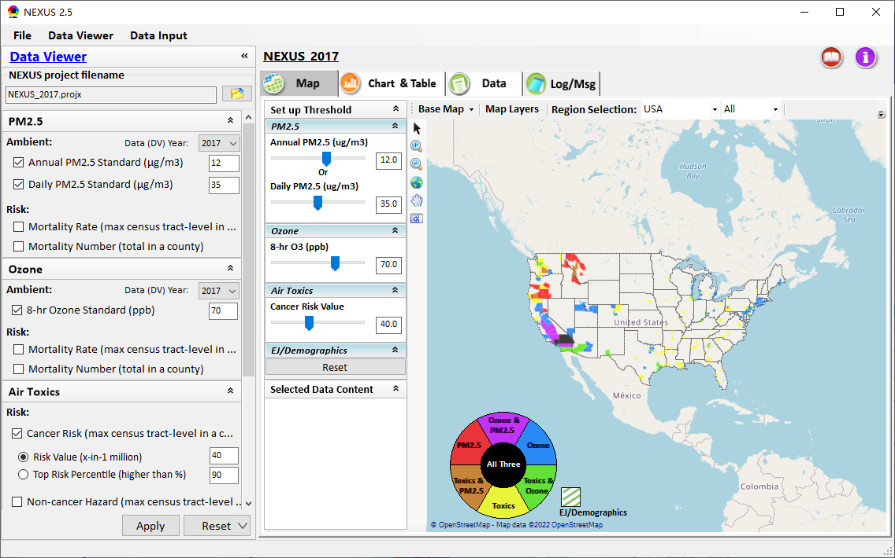
NEXUS Tool: On-line User’s Manual
Click “book” icon to launch “User’s manual”
Hot link to User’s manual’s “Data Viewer” chapter (same for “Data Input” module)
19

Slide 20
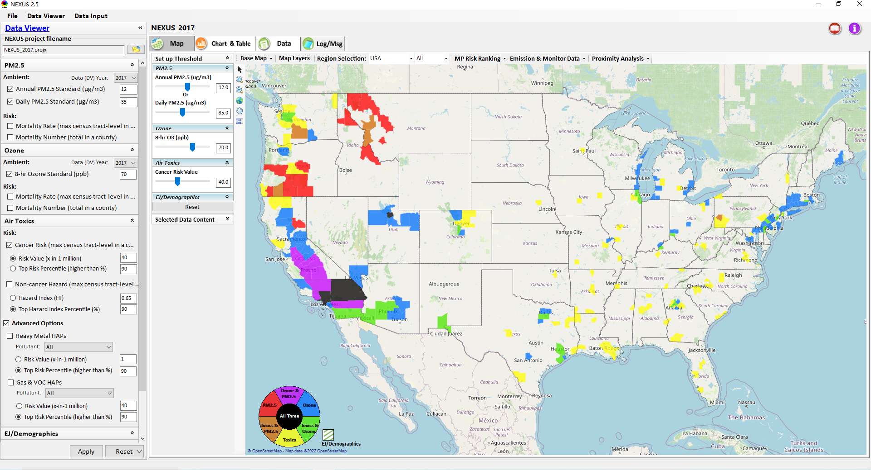
NEXUS Tool: Data Viewer Module
Click “File” to open or save a project
Switch between 2 key modules
NEXUS project file name
Select desired ambient data (DV) year (2013-2020)
Select & adjust “Ambient” or “Risk” levels
“Advanced Option”: provide HAPs & species selections
20

Slide 21
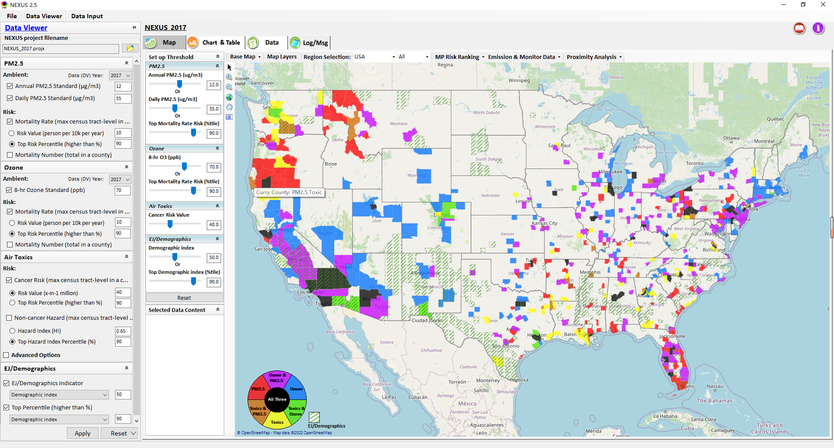
Data Viewer: “Apply” New Selections
“Check” boxes to add or remove “Ambient” and/or “Risk” selections
New selections will appear in “Slider bars” panel and map display
“Slider bars” allow to select & adjust “Ambient” and/or “Risk” threshold levels to display corresponding color map
“Apply” new selections
21

Slide 22
NEXUS Update: EJ/Demographics Metric and Data
EJ/Demographic metric is displayed with “green dash” for counties exceeding selected threshold
22

Slide 23
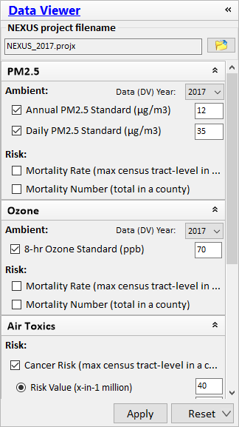
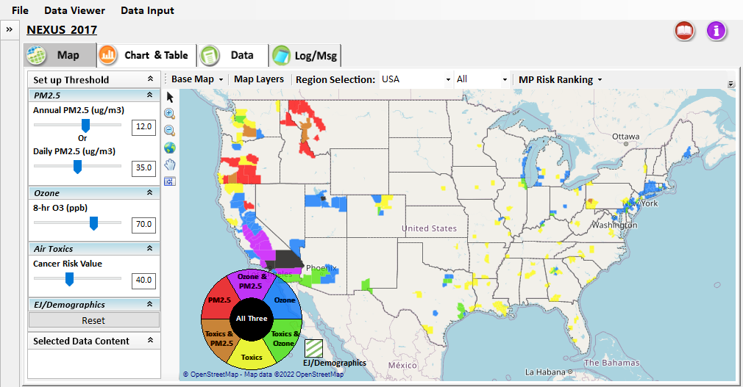
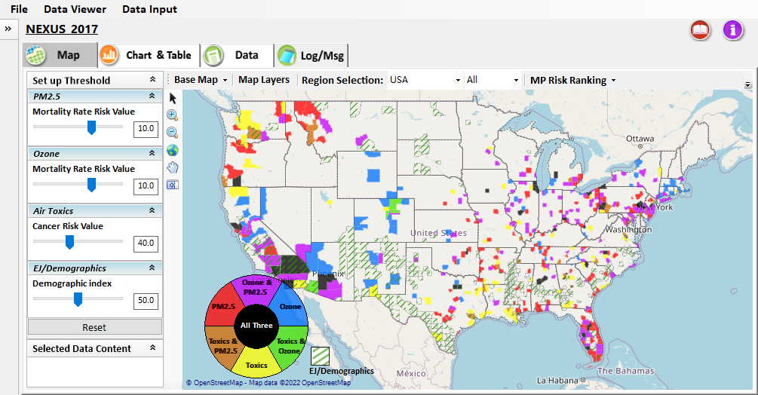
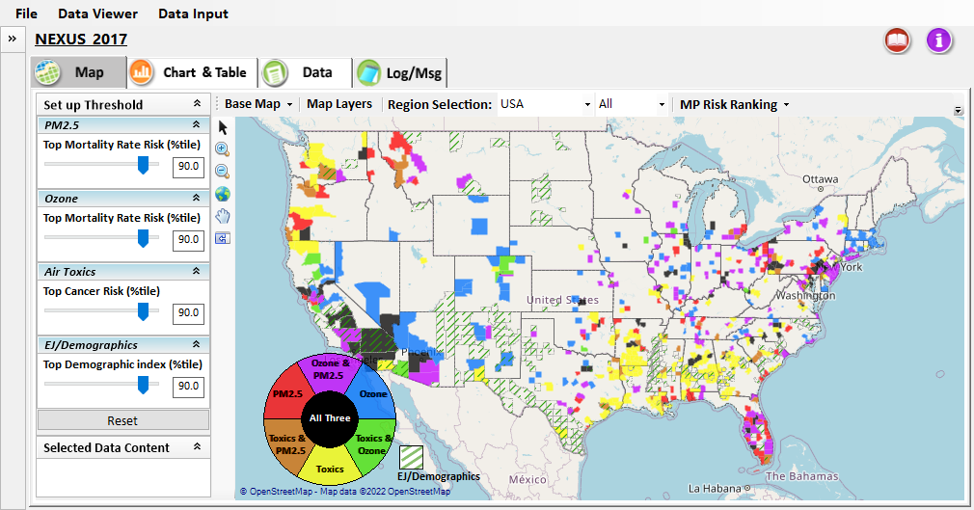
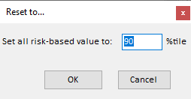

Data Viewer: “Reset” New Selections
default configuration
risk-based value
risk-based in %tile
“Reset” new selections
risk-based in desired %tile
23

Slide 24
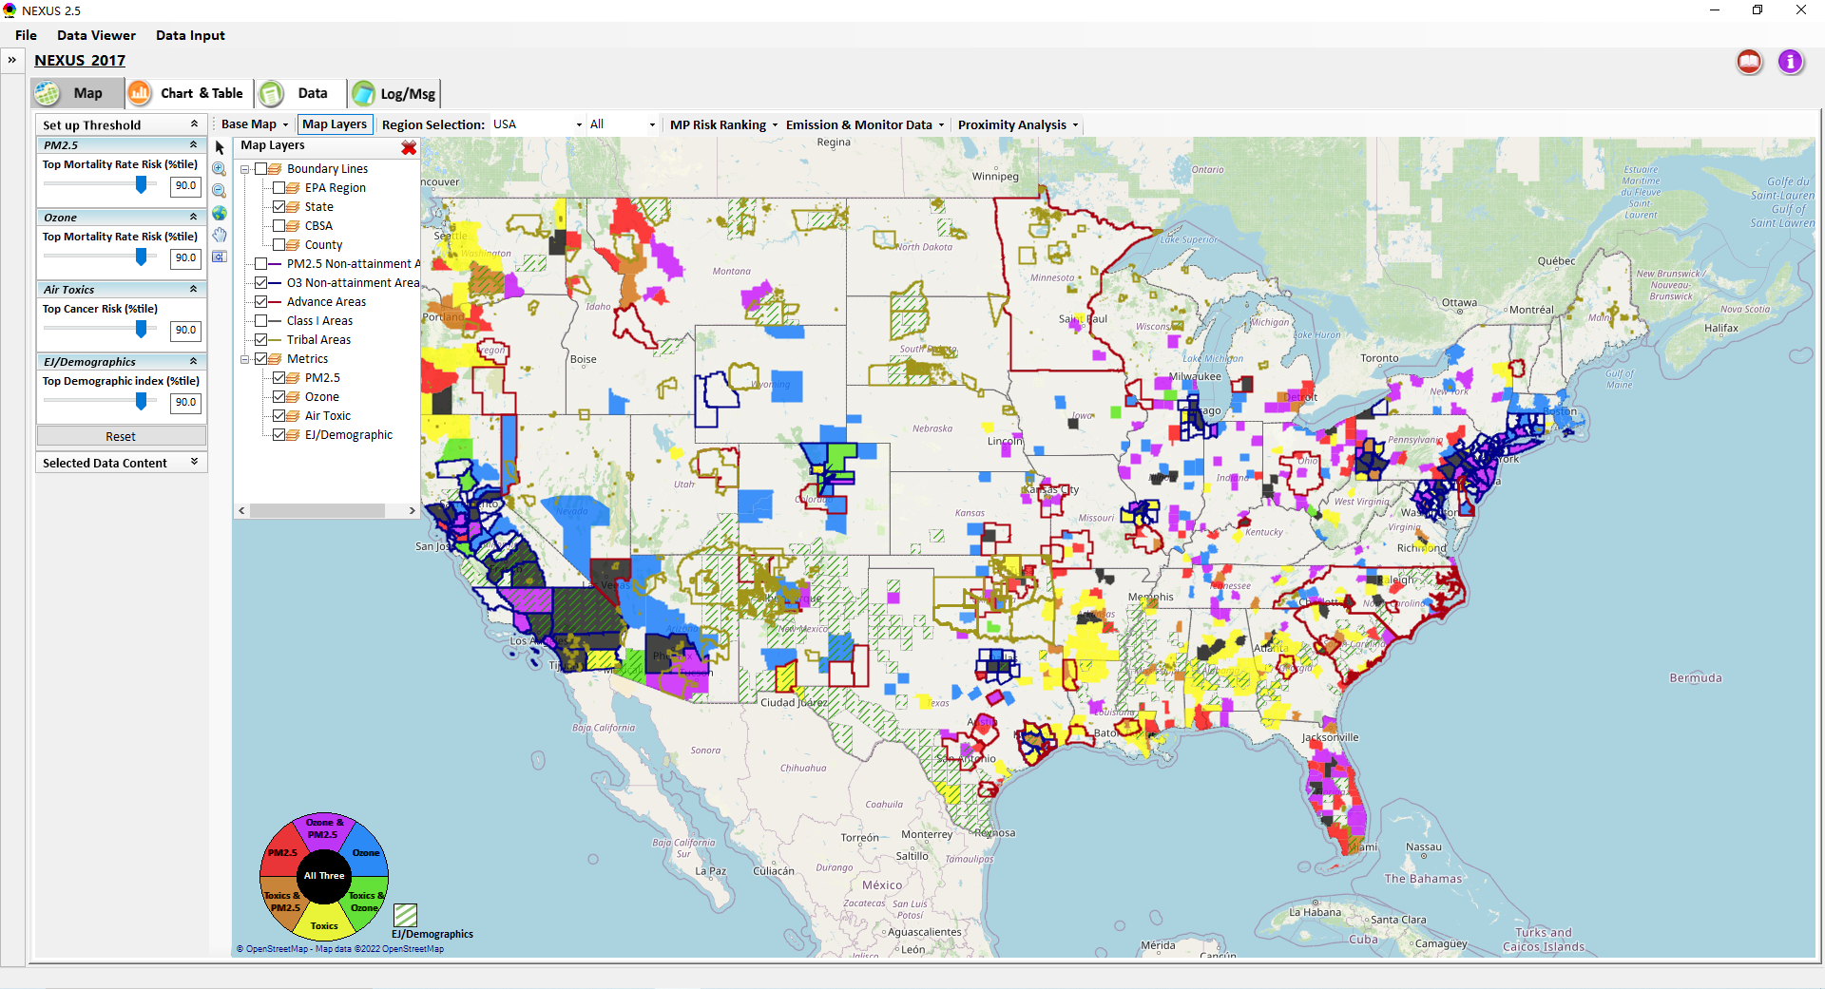
Data Viewer Module: Map Layers menu
Click “X” to close “Map Layers” menu
“Map Layers” menu: Provide (show/hide) map overlaps of various areas, AQ metrics and boundary lines
24

Slide 25
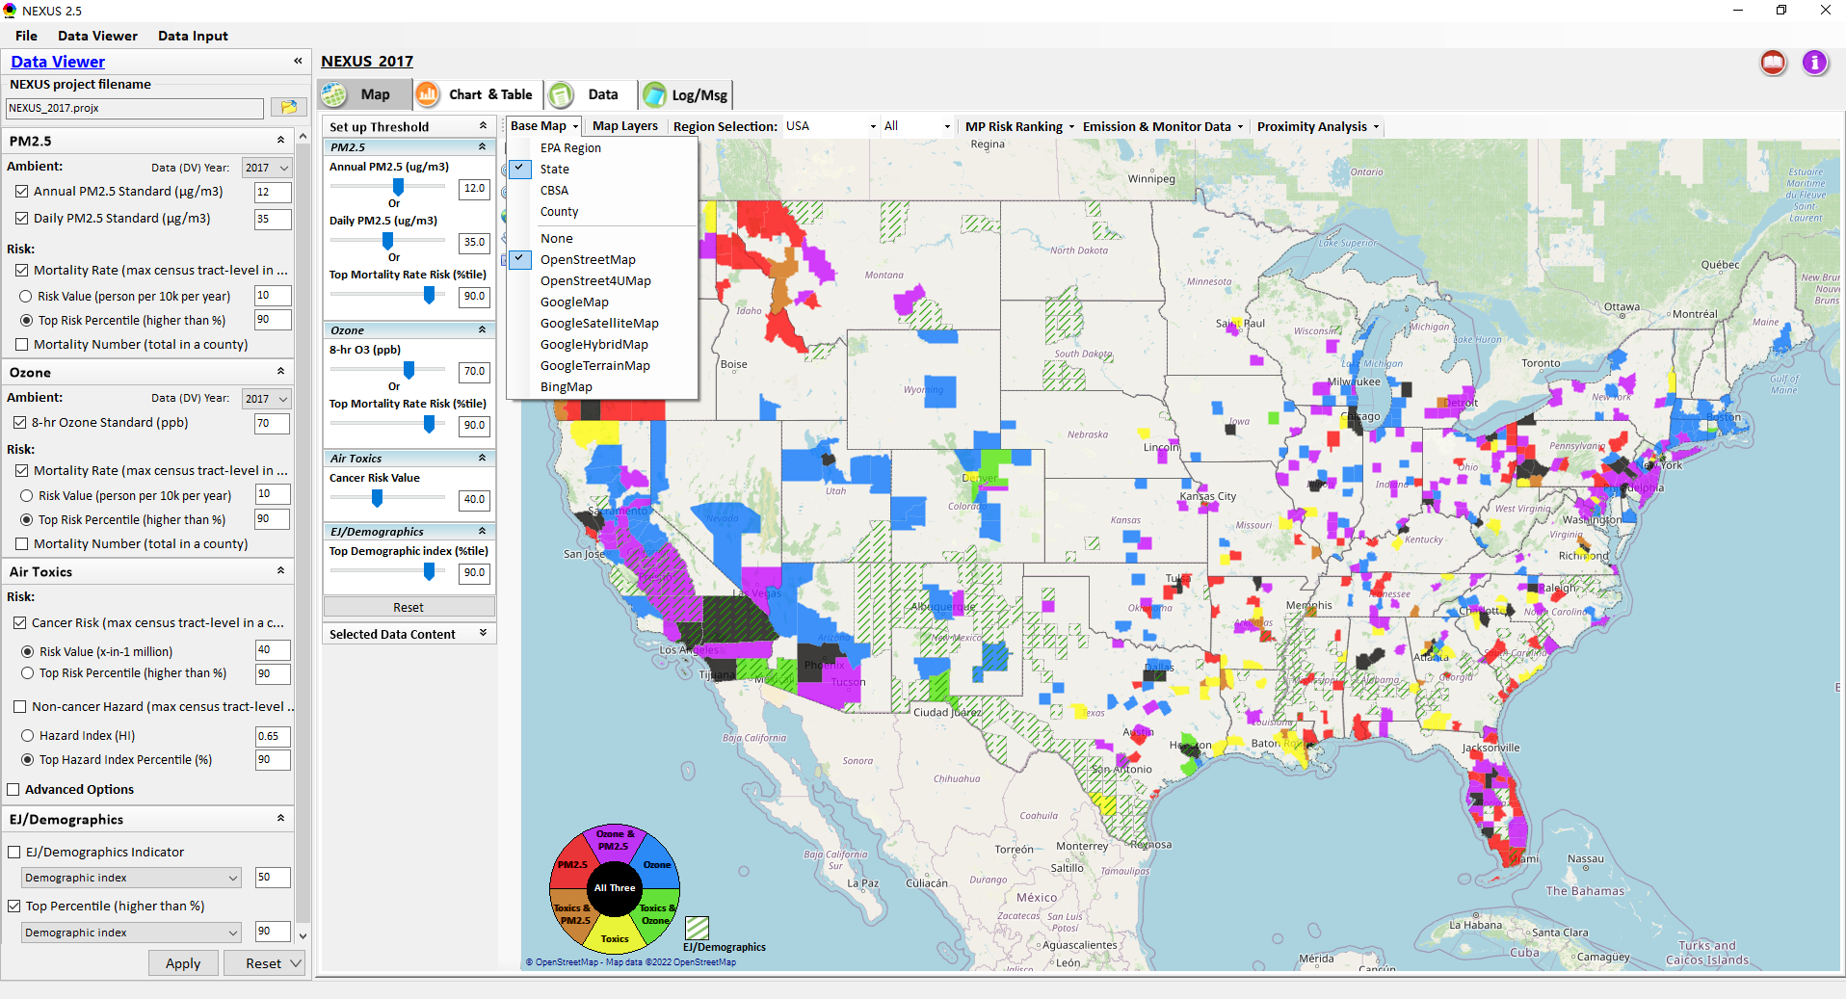
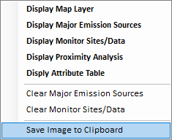
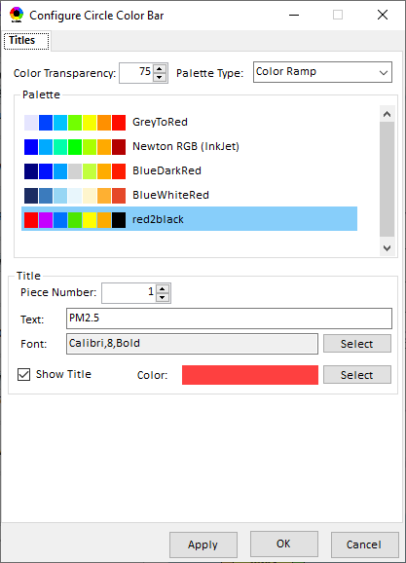
Data Viewer Module: Configure Base Map & Color
“Base Map” menu: Change boundary lines and background map (e.g., “Google Map”)
“Right-click” map to save map image
Click “color map” to change color & transparency
25

Slide 26
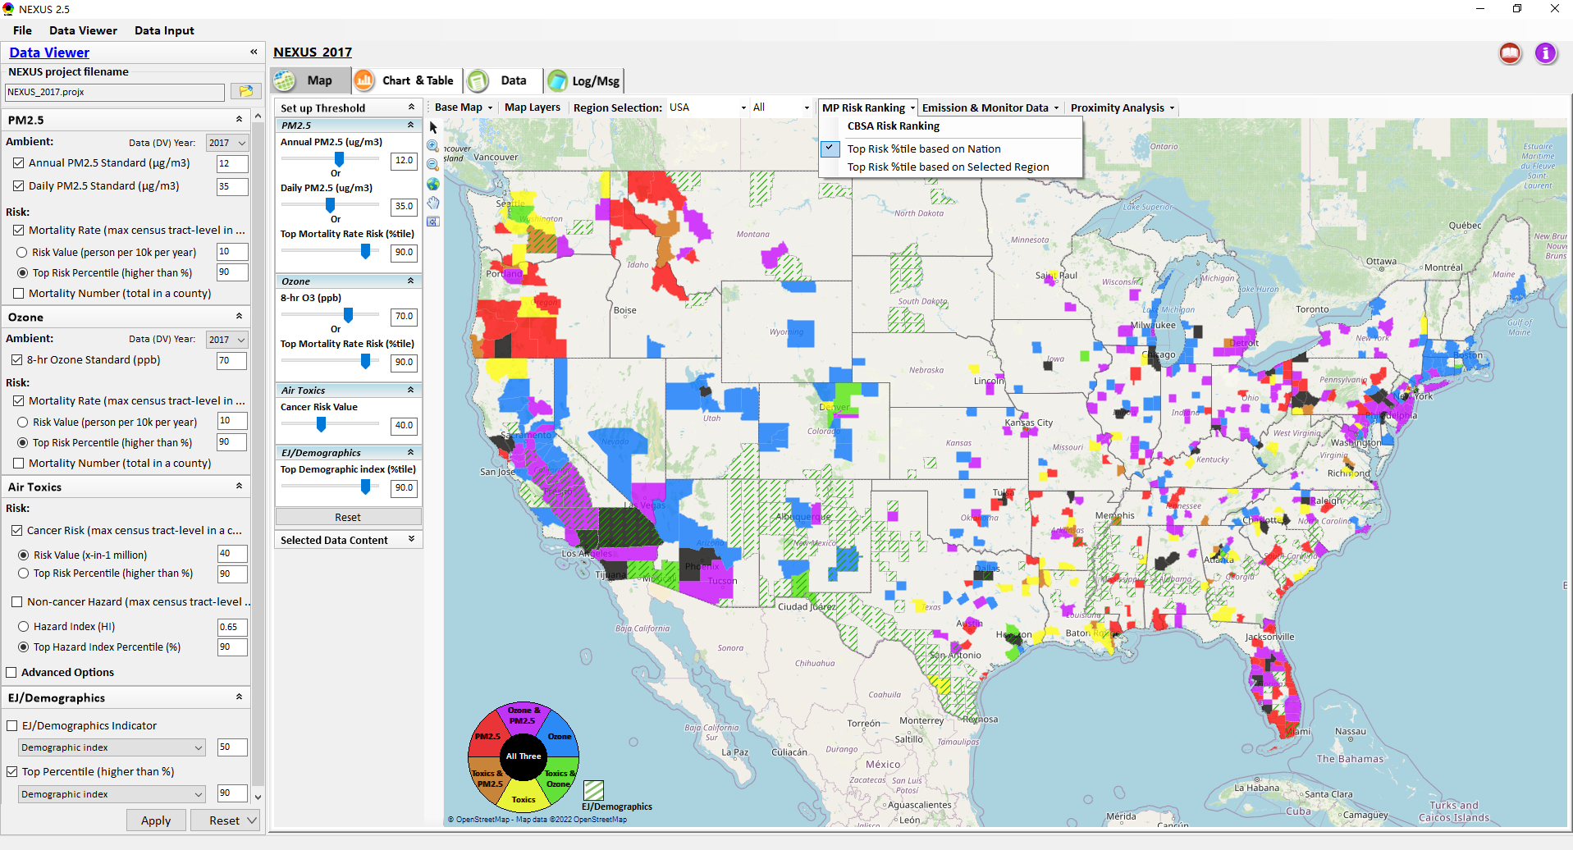
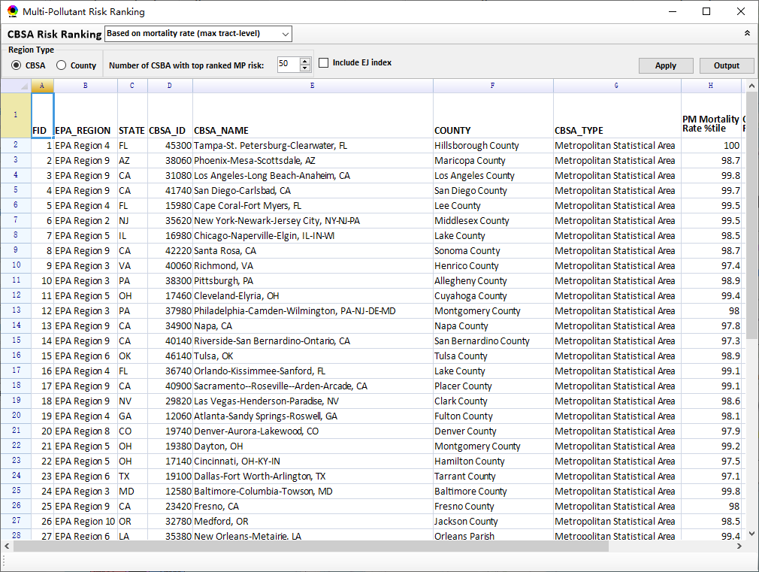
Data Viewer Module: MP Risk Ranking
“CBSA Risk Ranking”: provide MP risk ranking by CBSA or County
Check box to include EJ index as part of CBSA ranking
26

Slide 27
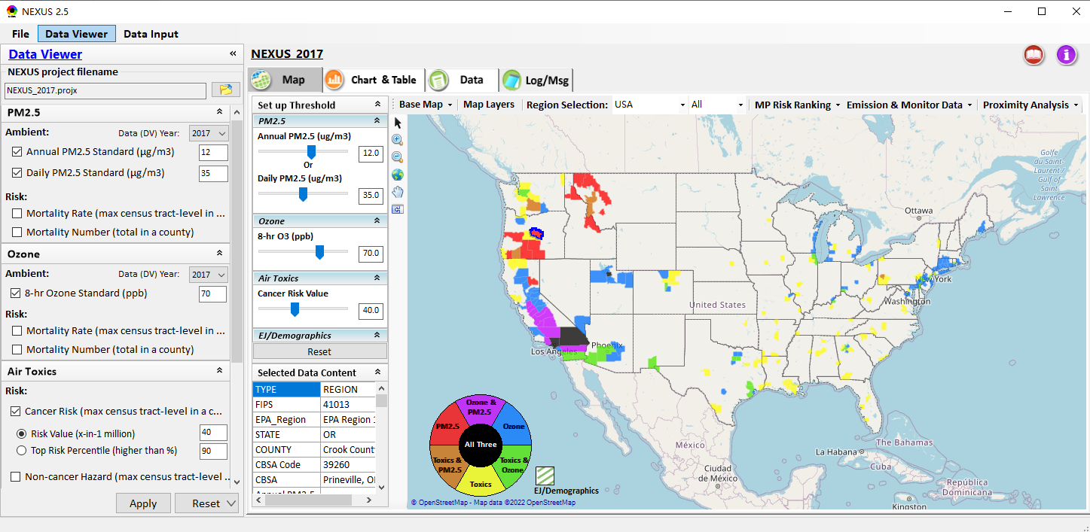
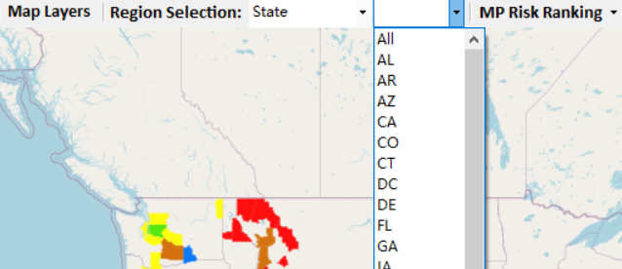
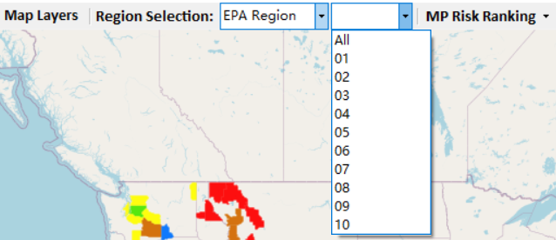
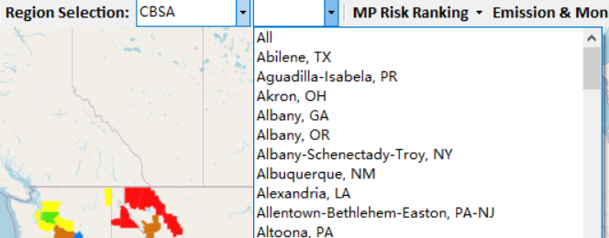
Data Viewer: “Region Selection”
Allow to select “EPA regions”, “States”, or “CBSA”
27

Slide 28
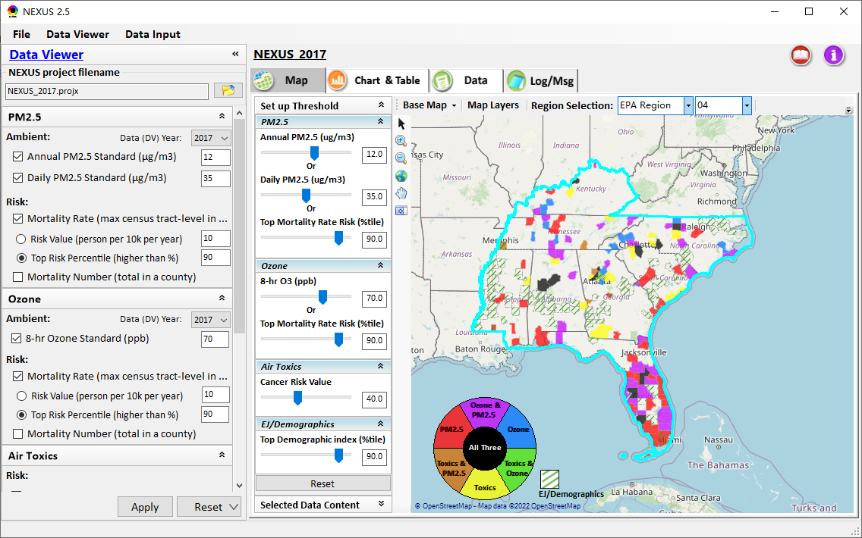
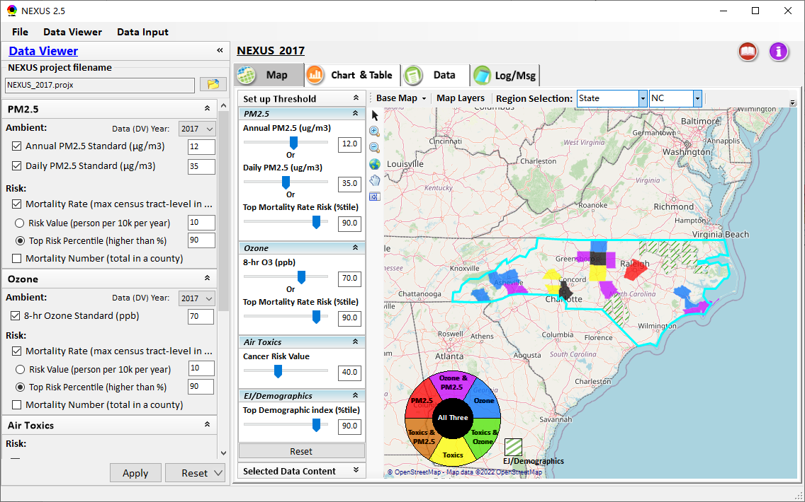
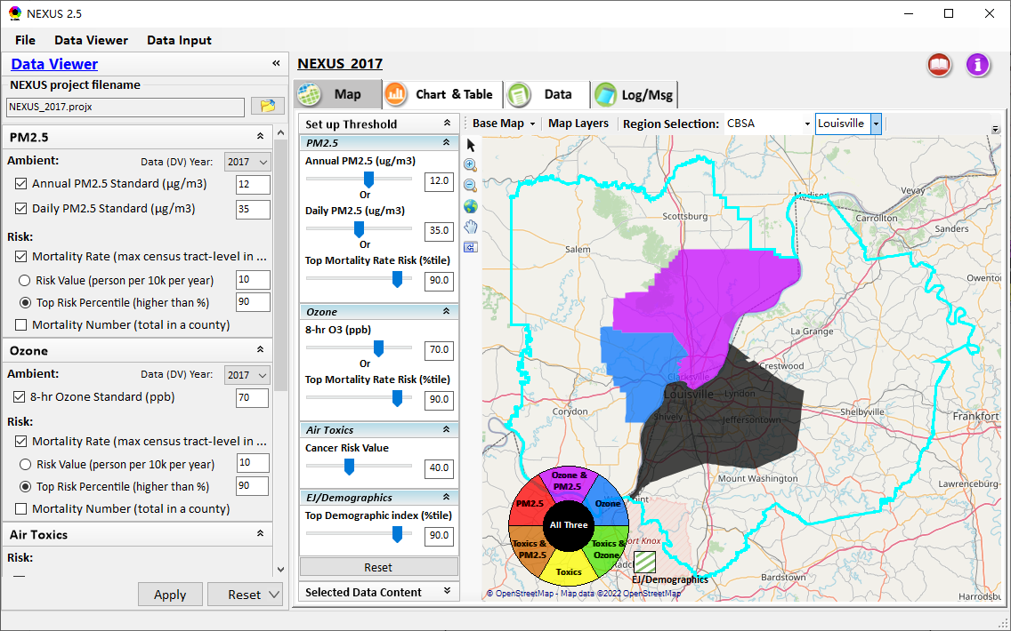
Data Viewer: Select EPA Region/State/CBSA
Examples:
EPA Region 4
State: NC
Louisville CBSA (KY/IN)
28

Slide 29
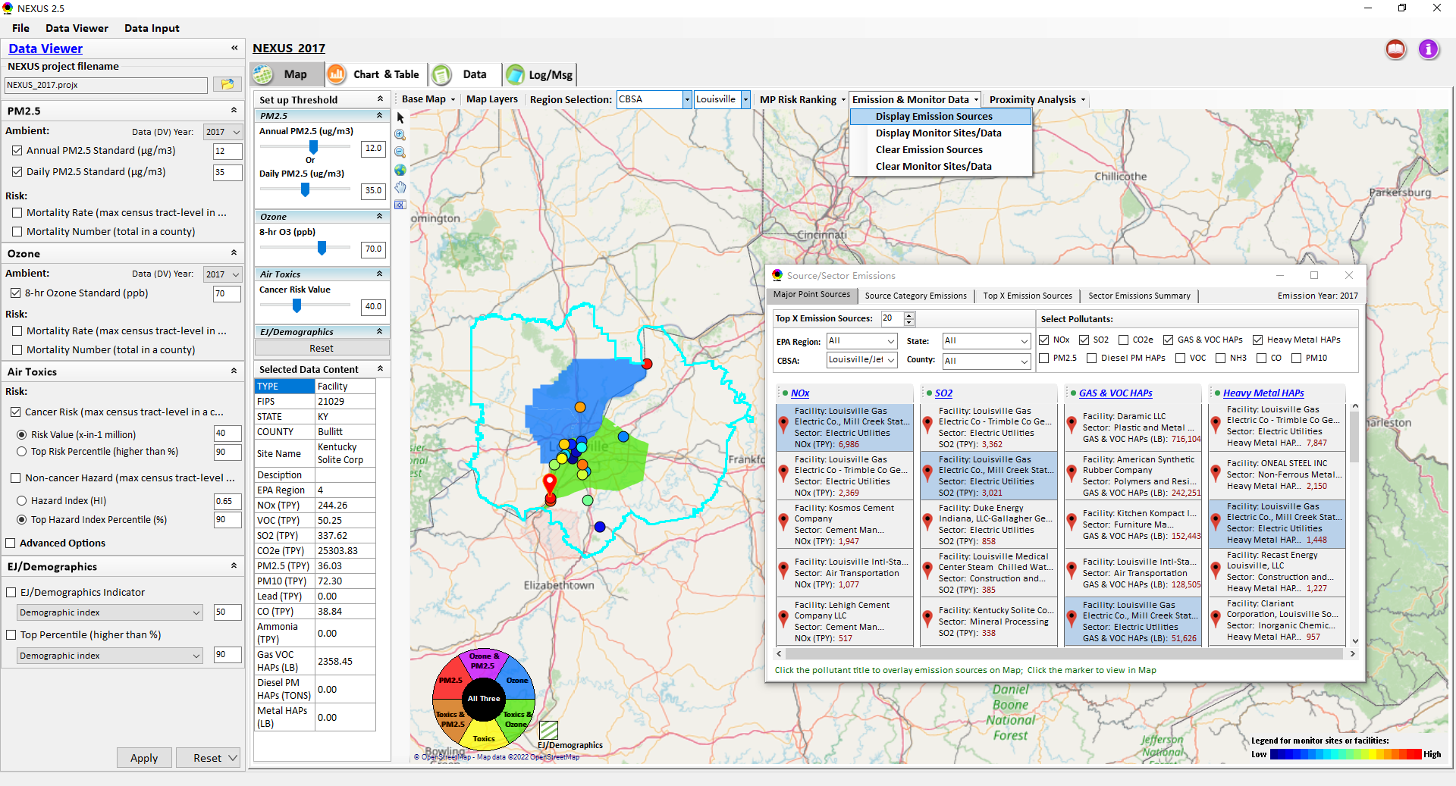
Data Viewer: Major Emission Sources
Click “Display Emission Sources” tab (or “right-click”) to display emission sources and launch new window
Click any “facility” to link & display source location and emitted pollutants information. Same facility emitting various pollutants can be identified with the same highlighted color.
29

Slide 30
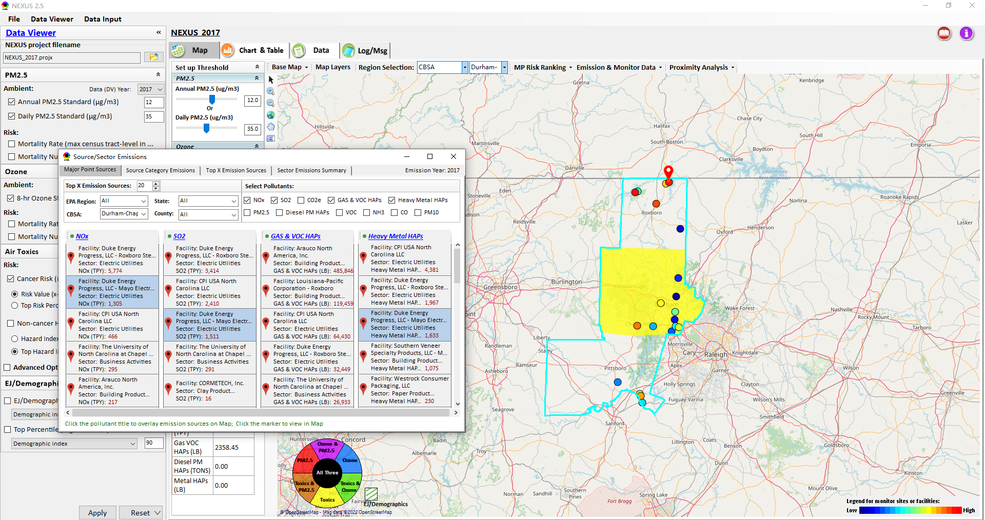
Data Viewer: Major Emission Sources
Allow to scroll down to CBSA-level (e.g., Durham CH CBSA ) or County-level
Durham CH CBSA
Emissions ranking by “color” of circles from red (higher) to blue (lower)
Color Legend for facilities emissions
30

Slide 31
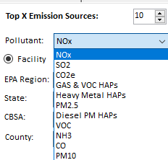
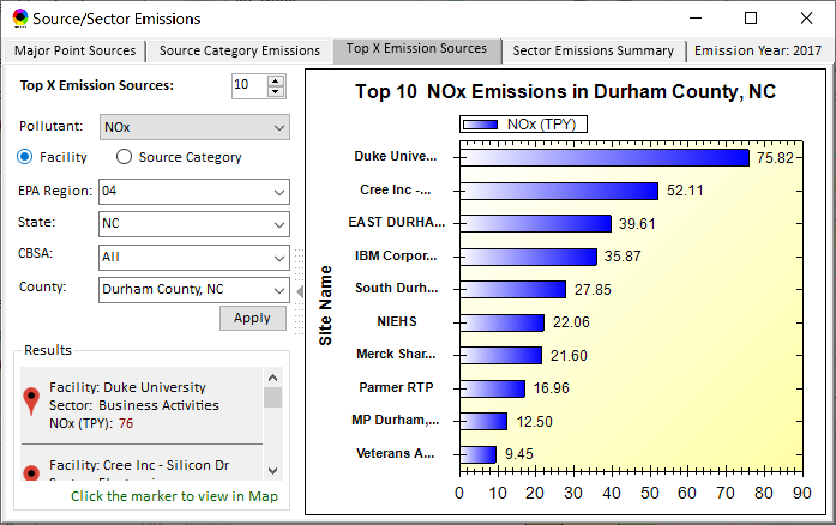
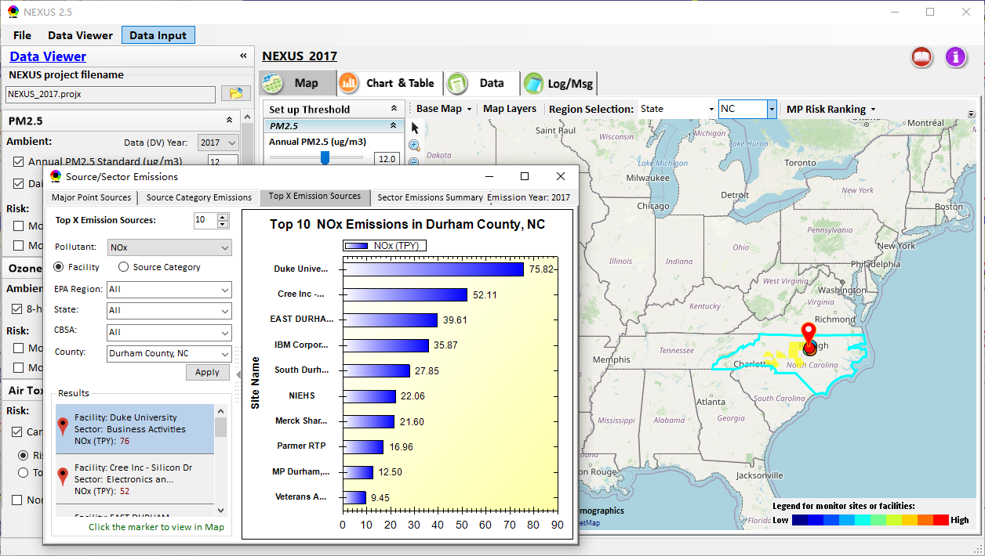
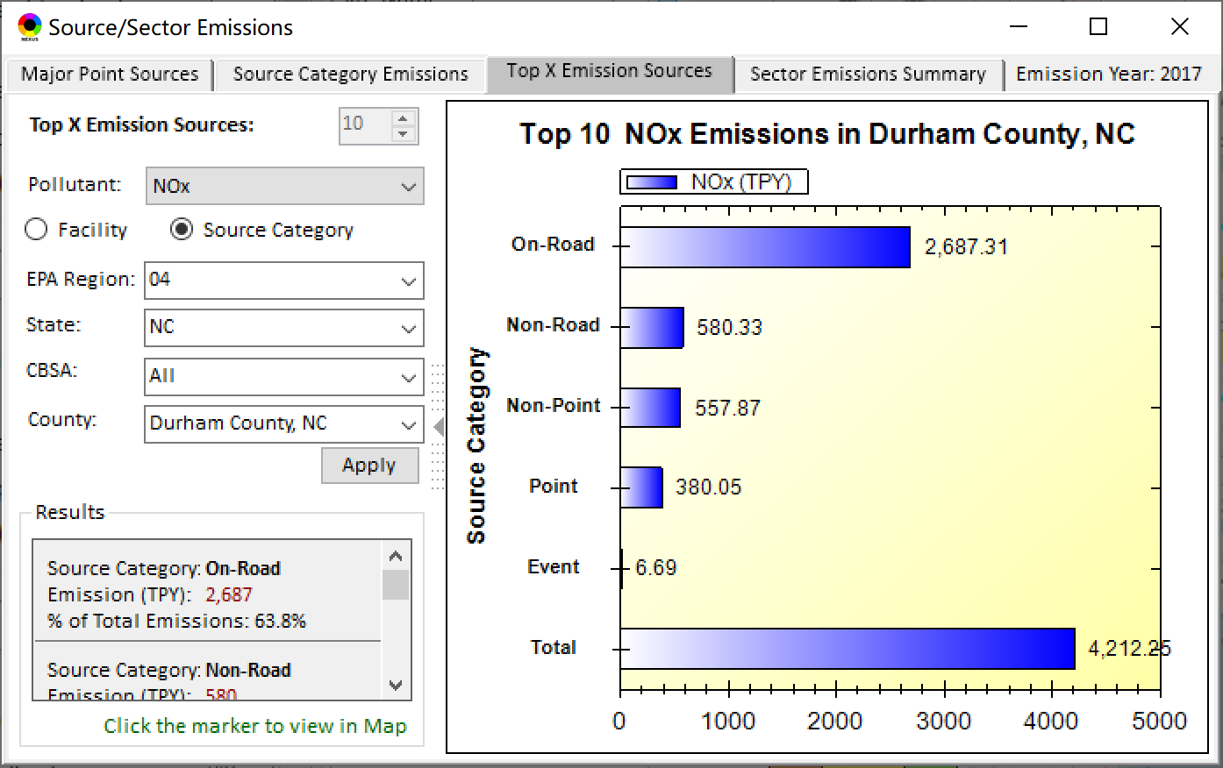
Data Viewer: Top “x” Emission Sources
Provide selection of Facility & Source Category
Provide selection of Facility or Source Category
Durham county, NC
31

Slide 32
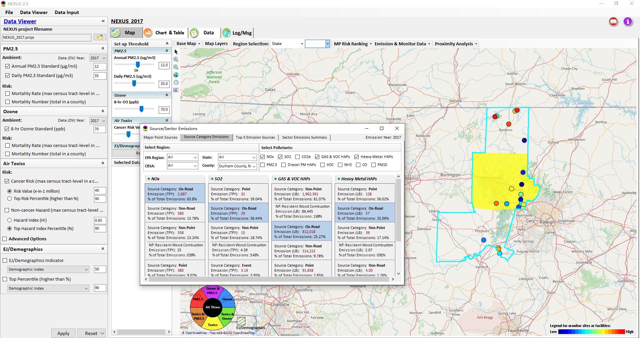
Data Viewer: “Source Category Emissions”
“Source Category Emissions” module provide five source categories, including “Point”, “Non-Point”, “On-Road”, “Non-Road”, and “Event” emissions for the selected region, CBSA, or county.
For “Non-Point”, including Resident Wood Combustion (RWC) emissions.
32

Slide 33
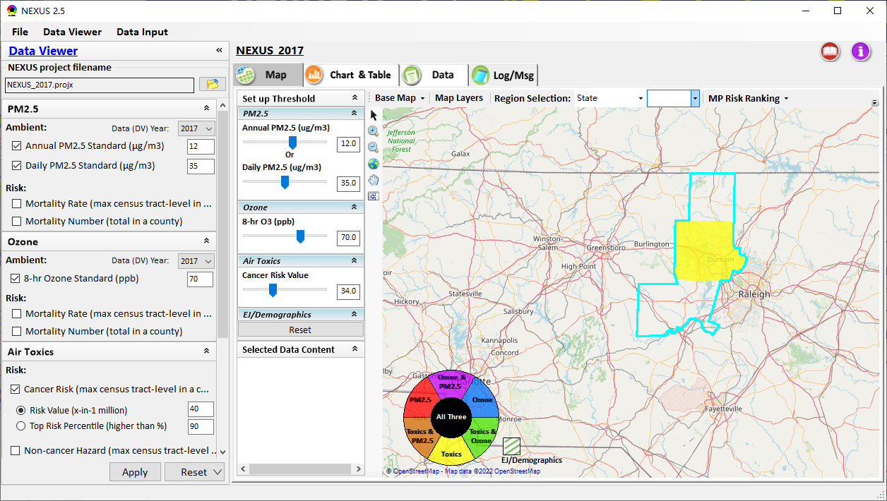
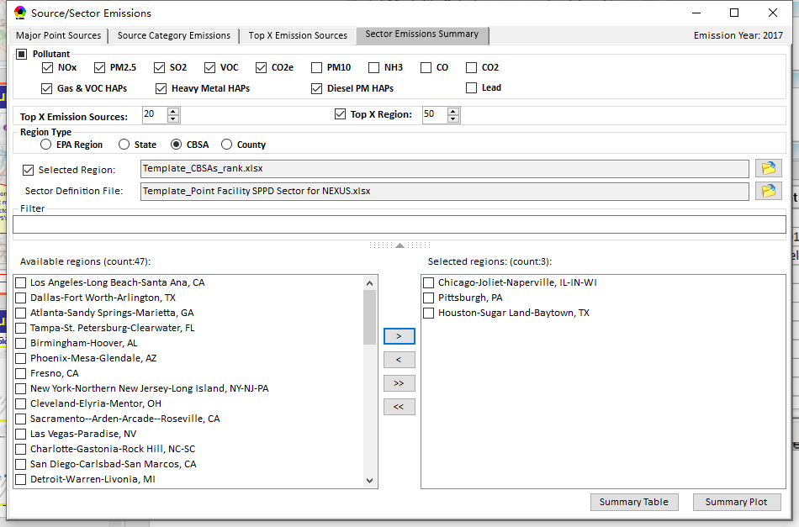
Data Viewer: “Sector Emissions Summary”
“Sector Emission Summary” function allow to select major CBSAs and provides source and sector emissions summary to support “Sector Prioritization” effort
33

Slide 34
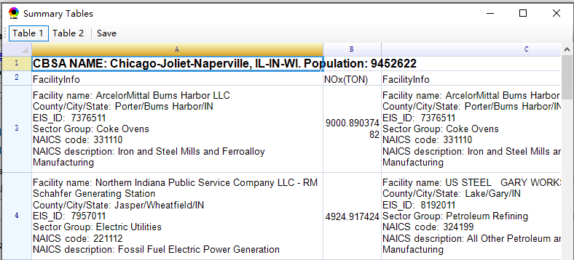
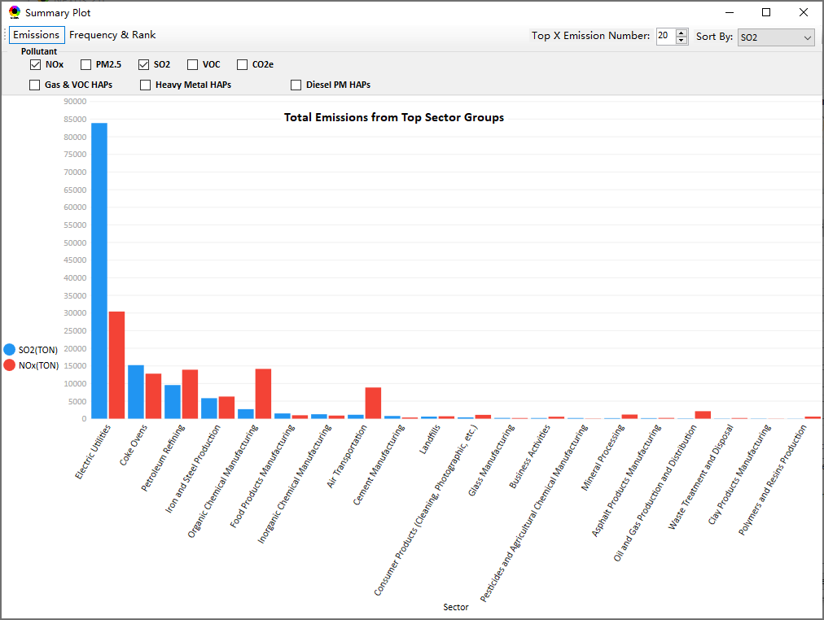
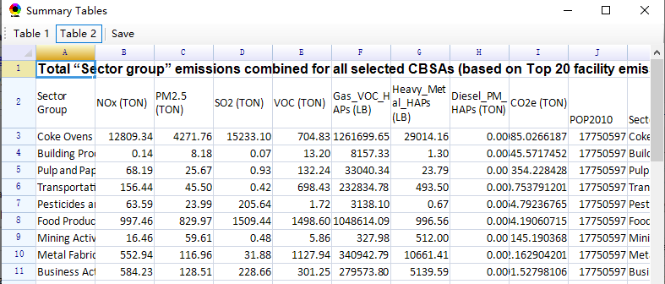
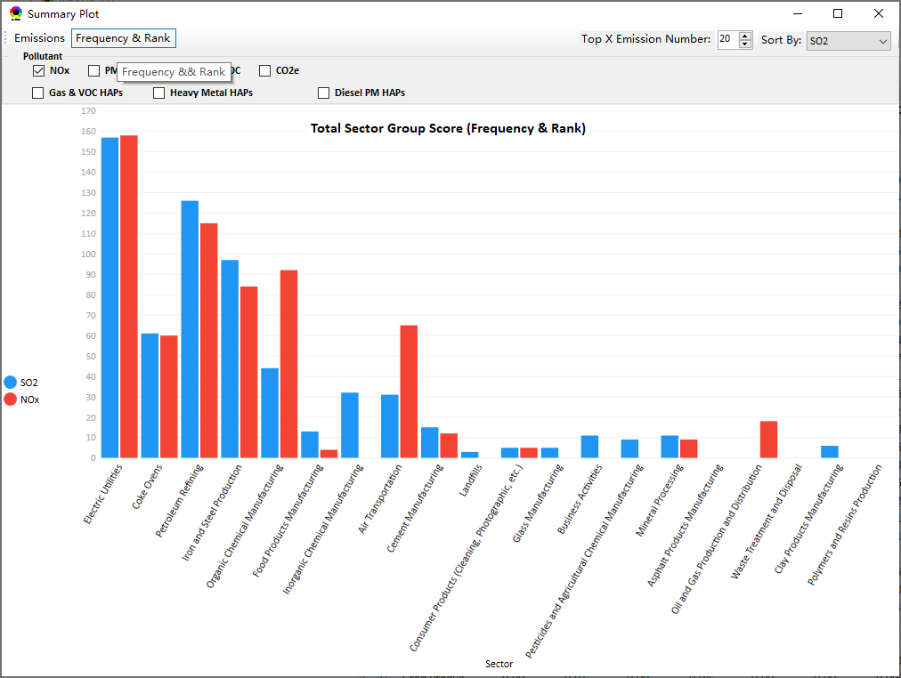
Data Viewer: “Sector Emissions Summary”
Summary table
Summary plot
Emissions
Frequency & Rank
34

Slide 35
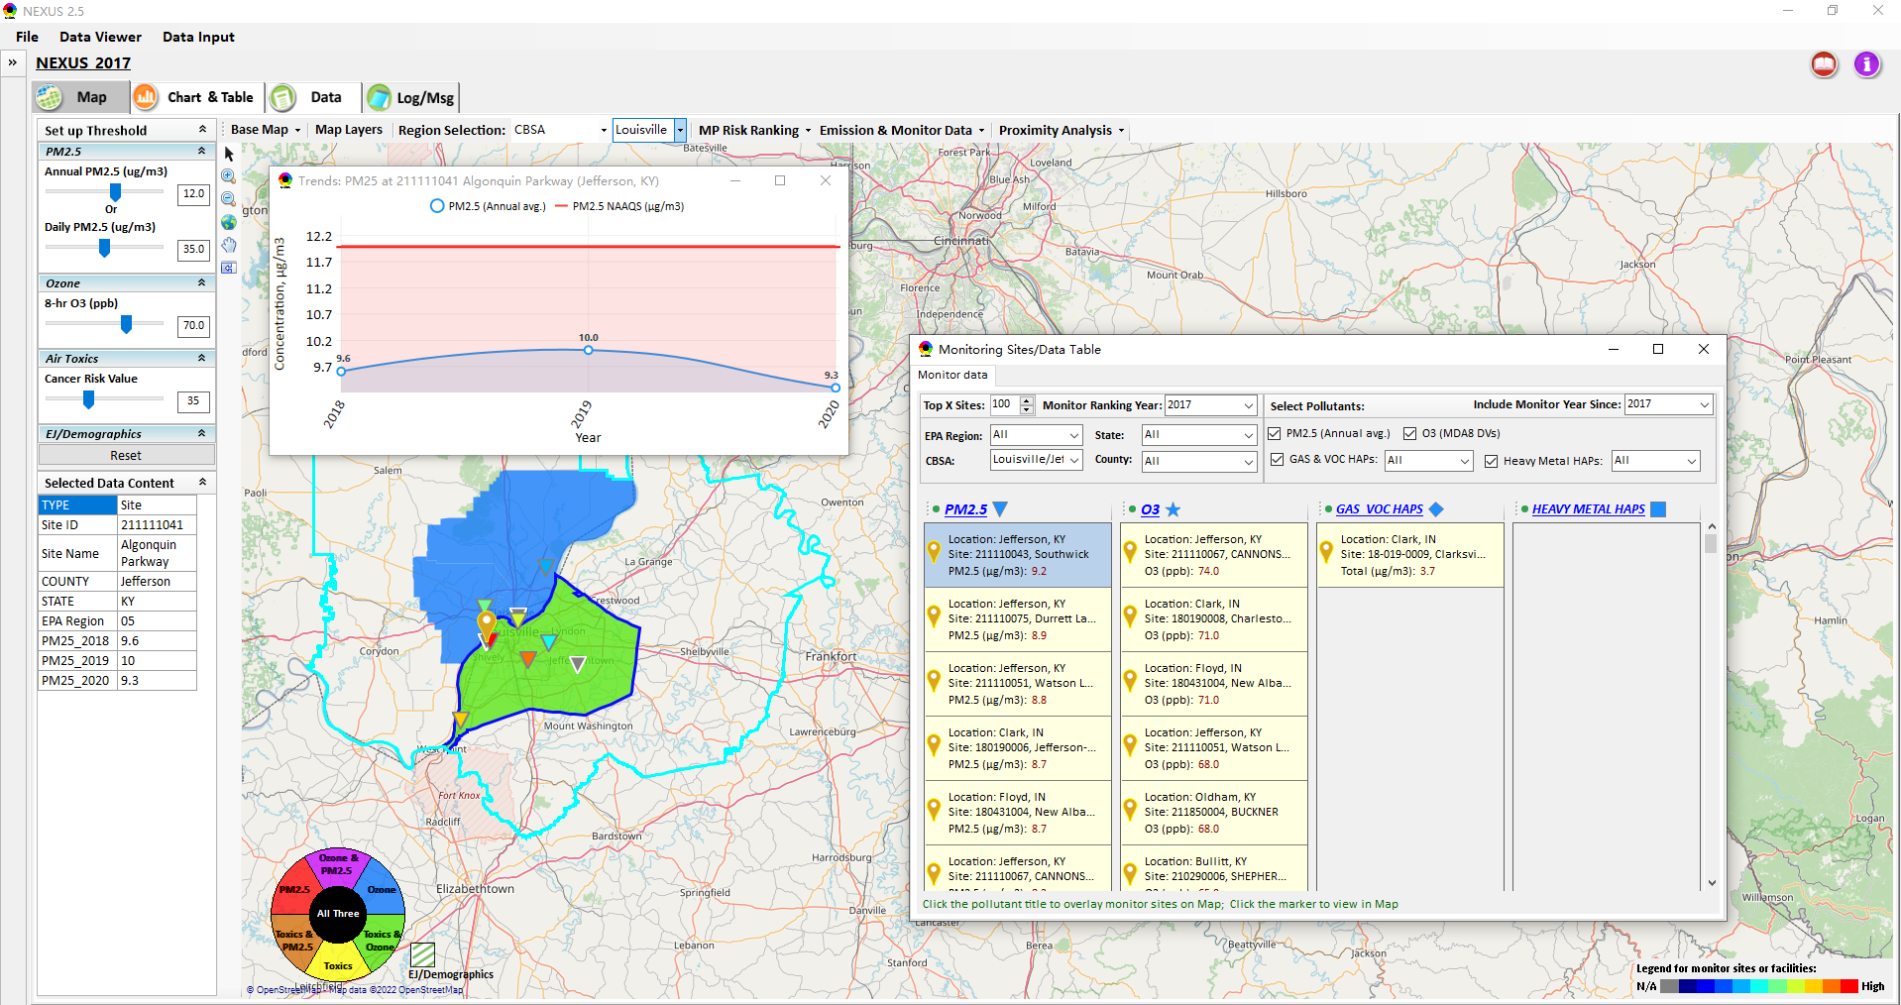
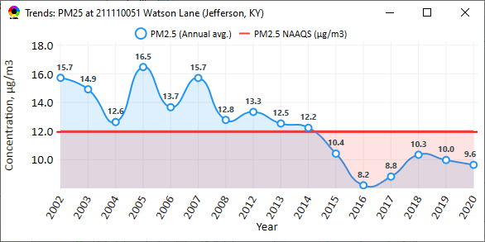
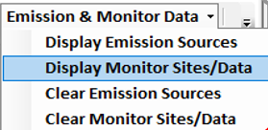
NEXUS Update: “Monitoring Data/Sites”
Click menu (or right-click) to display “Monitor Sites/Data”
List the monitor sites by ranking the data based on selected year
AQ trend
Include only those monitor sites with data since selected year
Monitor Site/Data
Click to display
AQ trend at monitor site
Use different symbol to display each pollutant’s “monitoring sites” e.g., PM_{2.5} (triangle), O₃ (star), etc.
Click to select monitor site & pollutant
Color Legend for monitor sites
35

Slide 36


NEXUS Update: “Attribute Table” (1)
“Attribute Table” provides information of “counties” displayed. This table will display “census tract” information under “Proximity analysis” module.
“Right-click” map to select “Display Attribute Table ” to launch “Attribute Table”
36

Slide 37

NEXUS Update: “Attribute Table” (2)
Provide “filter/search/export functions
Click “+” to add filters; Click “x” to remove current filter;
Click to show/hide Filter settings
Click to show selected record on map
Click a “record” to link and display its location & info.
Click “Reset” to clear all filter criteria
Show specified records per page.
Click to output data as Excel file
37

Slide 38

Data Viewer: EPA Region Table Generator
“EPA Region Table Generator” provides attainment status of O3 and PM2.5 and their DVs; also allows to select any EPA region based on data updated to 2020.
38

Slide 39

Data Viewer: Data Search & Filter
Click “+” to add filters; Click “x” to remove current filter;
Click the “Select by map” to get the information of counties which are displayed on “Map” module
Show specified records per page.
Click “Output data…” to output current page records or all records
39

Slide 40

Data Input Module: Data Preview
“Transparency” & “Open-Source”:
All NEXUS input/output data files are available under:
“This PC\Documents\My NEXUS files\Data (\Result)”
Check to use filter to query data
Select a table to view if there are multiple tables in the selected data source file
Click to change input data file
Click to view data
Click to run & save project
40

Slide 41
NEXUS update:
Proximity Analysis
Module
(Census tract-level)
41

Slide 42


Two ways navigate to Proximity Analysis Module
Click any monitor site, facility or county, and then “right-click” to select “Display Proximity Analysis”.
Or double click any monitor site or facility to launch “Proximity Analysis” module.
42

Slide 43

Proximity Analysis Module: Overlaying Map
“Set up Threshold” panel (similar to Data Viewer module) allows to identity those geographic areas exceeding the selected thresholds.
Check/un-check to display/hide overlaying map of selected metrics
Allow to select AQ mortality or morbidity risks, AQ concentration and EJ/demographic indicators and display overlaying map.
43

Slide 44
Proximity Analysis Module: Overlaying Map
Click “Reset” button to reset all values to default (or to a specified %tile if all indicators are selected in %tile)
Provide a “toggle” choice to select “Risk %tile” or “Risk value”
44

Slide 45


Proximity Analysis Module: Configure Color & Transparency
Move “Slider bar” to select desired “Radius of analysis”
Click any “color tile” to configure color legend & transparency
45

Slide 46


Proximity Analysis Module: Summary Plot & Summary Table (1)
Create “Summary Plot” and “Summary Table” for a selected census tract, monitor site or emitting facility
Summary Plot
Summary Table
46

Slide 47


Proximity Analysis Module: Summary Plot & Summary Table (2)
Summary table
Summary plot
Set “Radius of analysis” and threshold of air toxics to show summary results for selected site(s) within radius
Click to select the desired scale of highlighted numbers
Click “Output” button to export summary table to an Excel file (*.xlsx)
List top 3 risk drivers within radius of sites
Select one or more indicators to plot summary results for selected site(s) within radius, county/CBSA/State/EPA Region and Nation avg.
47

Slide 48





Proximity Analysis Module: “Select Sites” Functions (1)
Click “Select Sites” to select one or a group of monitor sites, facilities, census tracts, or user-defined locations under “Select Sites” pop-up window
48

Slide 49




Proximity Analysis Module: “Select Sites” Functions (2)
Click the “Output” button to export to an Excel file.
Include only census tracts falling within the area of specified radius, with an area ratio larger than x% (10% by default)
Select all
Click the “Create individual Sites” or “Create National Sites Table” to provide proximity analysis for individual sites
National & State avg. table
National table for all selected individual sites
49

Slide 50


Proximity Analysis Module: “Select Sites” Functions (3)
Configure
color legend:
1. Click to select the desired scale of highlighted numbers
2. Set max. & min. values and then click the “Rebuild” button to rebuild the color legend
3. Customize the numerical range for each color legend
Check/uncheck to display/ hide highlighted colors
4. Click “Apply” or “OK” button to apply new setting
50

Slide 51




Proximity Analysis Module: “Group” Summary Plot & Table
Summary plot & table for a group of census tracts, monitor sites, facilities or locations (latitude/longitude)
Summary table
①Click “Select Sites”
④Click “Summary Table” or “Summary Plot”
Select sites
② Select a group of sites
③Click “Apply”
Summary Plot
51

Slide 52


Proximity Analysis Module: Display Site information
Click a facility or monitoring site or a census tract to show the detail information
52

Slide 53
NEXUS 3.0
Quick Tutorial Slides
End
53

