Slide 1
MP & NEXUS
1/9/23

Slide 2
Background/Timeline
The 2004 National Research Council (NRC) report recommended EPA transition from a pollutant-by-pollutant approach to a multi-pollutant, risk-based approach to managing air quality
2005 Memo from Steve Page (former OAQPS Office Director) titled “Consideration of Multiple Pollutants in Control Strategy Development”
Pilot Projects began around 2008 in NC, NY and the City of St. Louis (both Missouri and Illinois) to develop multi-pollutant air quality management plans
Our office supports a comprehensive, MP treatment of air quality problems to effectively improve air quality and make the most efficient use of available resources
  Primary Goal - identify & evaluate local control strategies targeting emissions of O3 & PM2.5 and their precursors while at the same time reducing Air Toxics of concern for communities to maximize both health benefits and air quality improvements
MP planning has the potential to reduce the costs and increase benefits associated with air quality management (AQM)
Supports S/L/T air agencies in developing MP, risk-based AQM plans and implementing strategies that reduce air pollution emissions & improve public health
Success has been demonstrated in Detroit and SC; another project is currently underway in Louisville, KY
Tools needed to analyze MP data are either available currently or being developed in OAQPS (e.g., NEXUS)
2

Slide 3
2010 Detroit MP Case Study
Partners: EPA, MDEQ, SEMCOG & LADCO
Goals: Assess and compare two contrasting air quality control strategies
“Status Quo” approach – controls selected separately to address O₃ & PM nonattainment
“Multi-pollutant, risk-based” approach – aimed at further reducing population risk from exposure to O₃, PM and select air toxics while still addressing ozone and PM nonattainment
Results showed the multi-pollutant approach:
Achieved the same or greater reductions of PM and O₃
Improved air quality regionally and across the Detroit urban core for multiple pollutants
Produced ~2x greater monetized benefits for PM and O₃
Reduced non-cancer risk
Resulted in greater net benefits & was more cost effective
3

Slide 4



2016 SC MP Project
Partners: EPA, SC DHEC & local community and business leaders in 10 upstate South Carolina counties
Goals:
Develop and analyze a multi-pollutant, risk based AQM strategy
Maximize both health benefits and air quality improvements, identify and evaluate a local control strategy targeting emissions of O₃, PM & their precursors while also reducing air toxics of concern for communities
Results demonstrated improving air quality in areas already attaining the NAAQS can yield significant health benefits
4

Slide 5
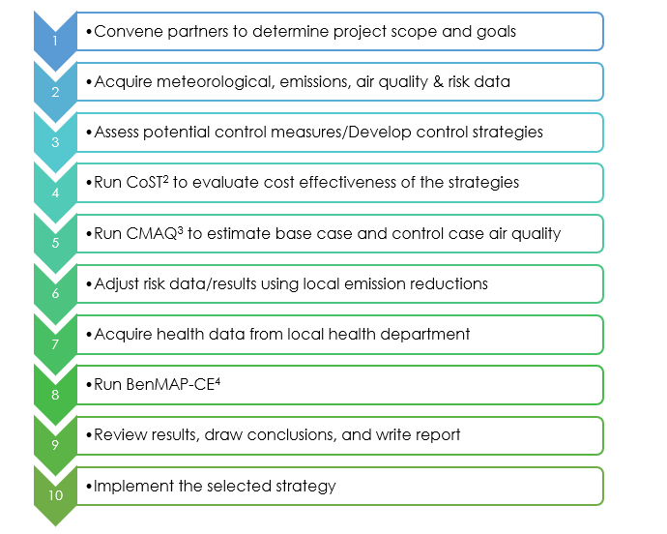
Multi-Pollutant Assessment Process
¹Adapted from the SC Report (pages 23-24) - https://www.epa.gov/sites/production/files/2016-05/documents/usepa-south_carolina_final_report_may_26_16_2.pdf
²CoST - the purpose of the Control Strategy Tool (CoST) is to model the emission reductions and engineering costs associated with control strategies applied to point, area, and mobile sources of air pollutant emissions to support the analyses of air pollution policies and regulations. CoST is a client-server system and is part of EPA's Emissions Modeling Framework (EMF). https://www.epa.gov/economic-and-cost-analysis-air-pollution-regulations/cost-analysis-modelstools-air-pollution
³CMAQ - the Community Multiscale Air Quality Modeling System (CMAQ) combines current knowledge in atmospheric science and air quality modeling, multi-processor computing techniques, and an open-source framework to deliver fast, technically sound estimates of ozone, particulates, toxics and acid deposition. CMAQ is an active open-source development project of the U.S. EPA that consists of a suite of programs for conducting air quality model simulations. https://www.epa.gov/cmaq
⁴BenMAP-CE – the Environmental Benefits Mapping and Analysis Program - Community Edition (BenMAP-CE) is an open-source computer program that calculates the number and economic value of air pollution-related deaths and illnesses. The software incorporates a database that includes many of the concentration-response relationships, population files, and health and economic data needed to quantify these impacts. https://www.epa.gov/benmap
5

Slide 6
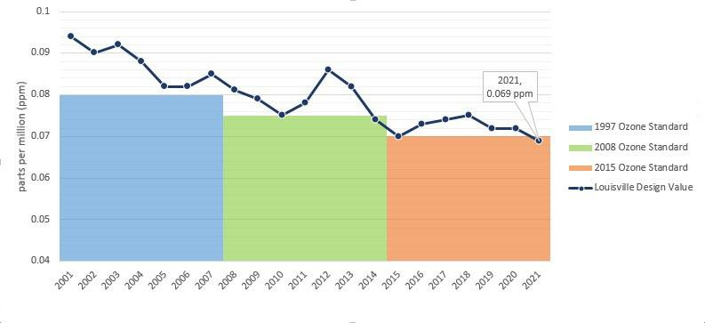
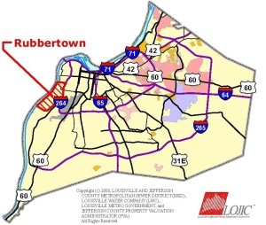
Louisville MP Project
Partners: EPA, Louisville Metro Air Pollution Control District (LMAPCD) & Louisville Metro Department of Public Health and Wellness (LMPHW)
Goals:
Identify local- and state-level emission reduction measures that address multiple pollutants, with a focus on attainment of the 2015 O₃ NAAQS
Build a plan to achieve and maintain compliance of all NAAQS
Demonstrate that the selected strategies can reduce health risk from exposure to O₃, PM and selected air toxics
Integrate existing health risk-based pollution control programs into a multi-pollutant air quality management plan
Build institutional capacity among LMAPCD and LMPHW to perform air quality modeling and health benefit analysis projects
Results pending
2019 Ozone Formation Study Report
2019 MP Stakeholder Group
2021 BenMAP Presentation
https://louisvilleky.gov/government/air-pollution-control-district/ozone-louisville
https://louisvilleky.gov/government/air-pollution-control-district/rubbertown-air-toxics-risk-assessment
6

Slide 7
NEXUS
“NEXUS” is an advanced screening tool for multi-pollutant (MP) risks and EJ/Demographic analysis developed by OAQPS’s MP team
“NEXUS” integrates a suite of MP data, including emissions, monitoring, modeling, fused AQ data and health risk data for PM_{2.5}, O₃ & air toxics as well as EJ/demographic data, into one single platform to allow national and areal overlay mapping & analysis of MP ambient & risk data
“NEXUS” provides MP analysis across from national level “Phase 1” to regional (EPA region/State/CBSA) level “Phase 2”, and now down to community level “Phase 3” (Proximity analysis” in census tract-level)
We expect to use this tool in conjunction with Regions and identify areas that would potentially benefit most from MP approaches to reduce emissions (including current NA areas)
We also expect that it can have additional value-added uses across the Office for Air Toxics, Environmental Justice and other programs, including IRA
The NEXUS tool will essentially provide a ‘conceptual model’ of an area’s MP issues to facilitate engagement with state/local/tribal agencies & community stakeholder groups
7

Slide 8
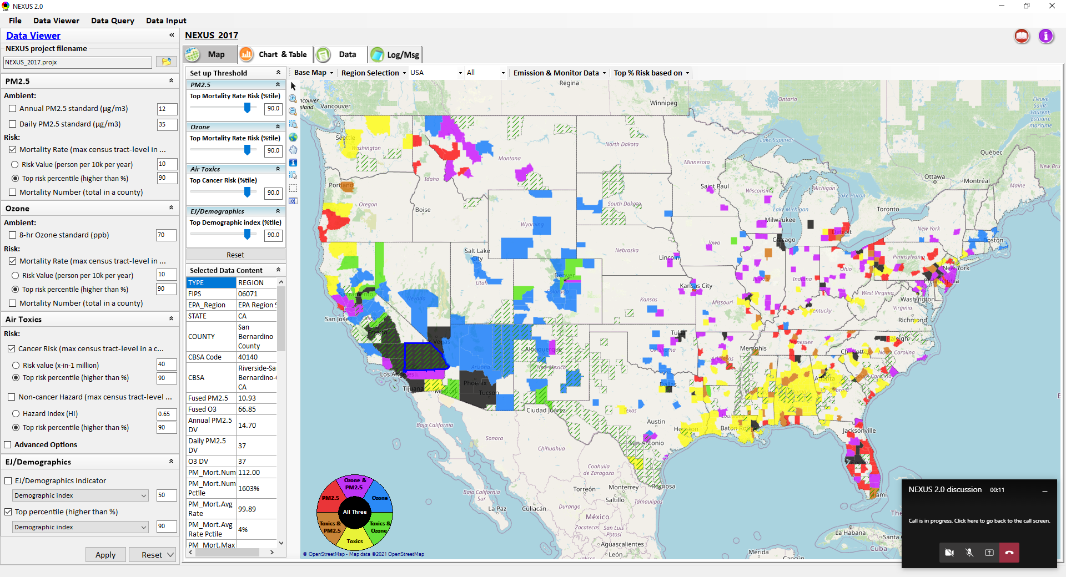
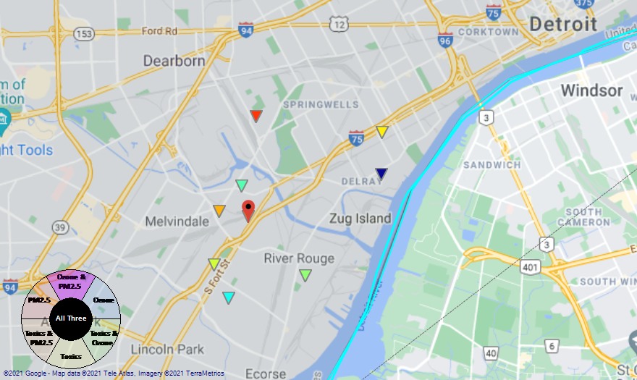
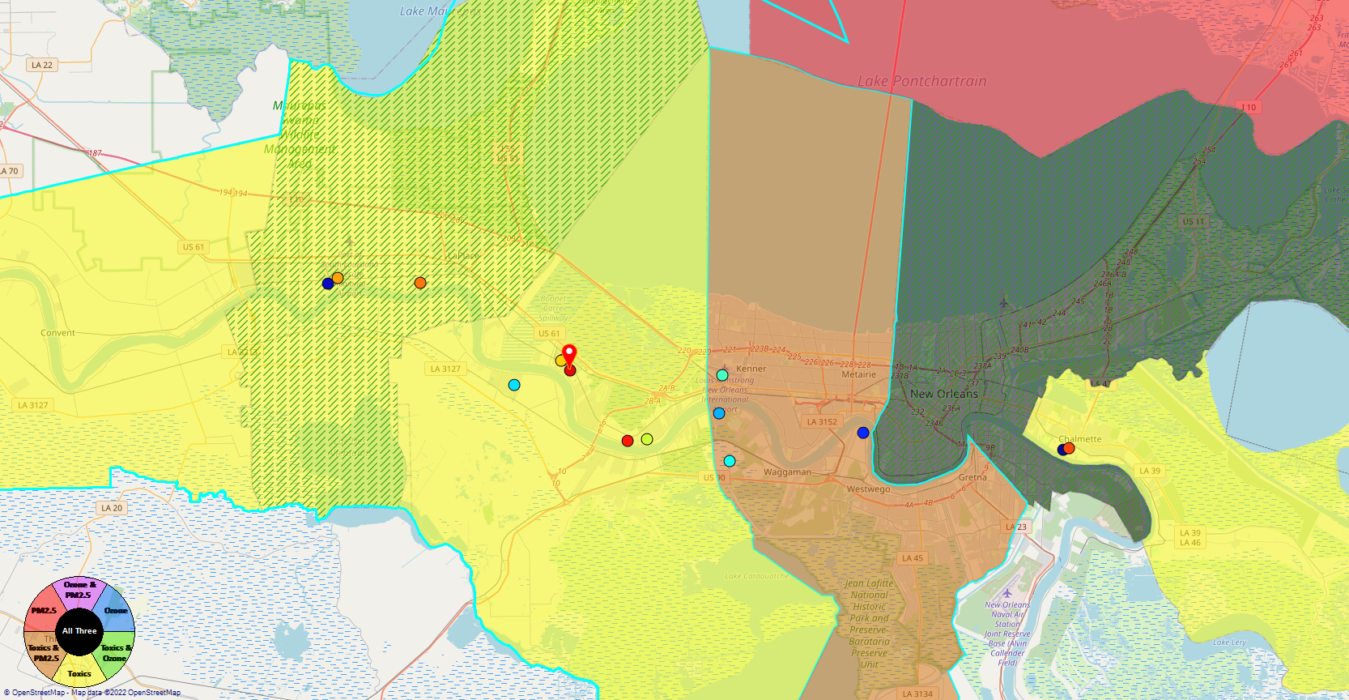
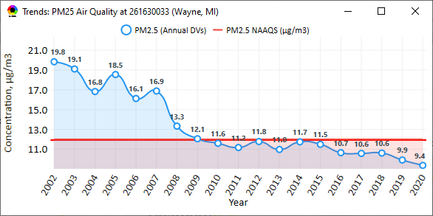
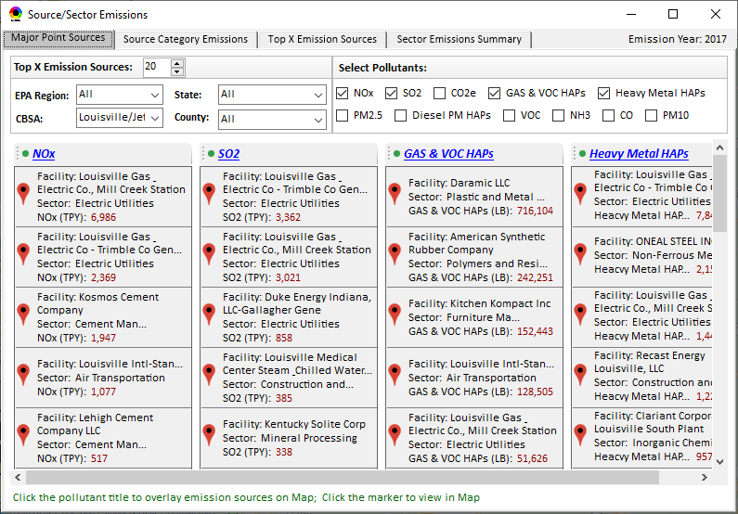
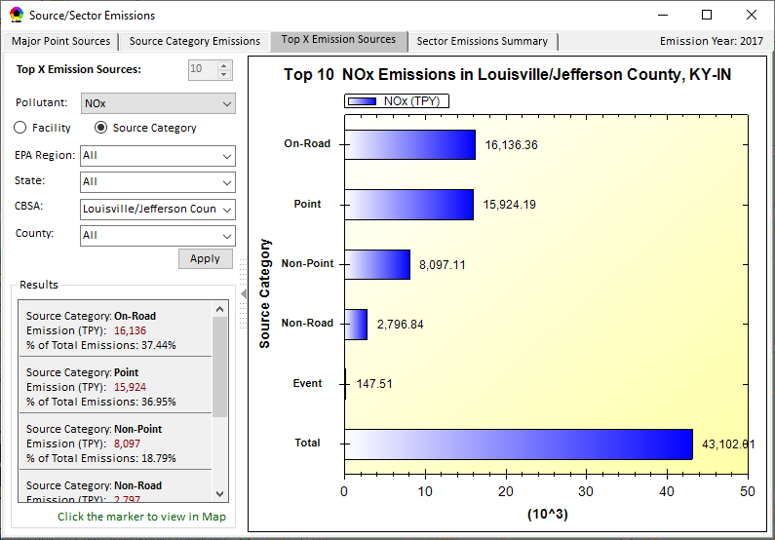
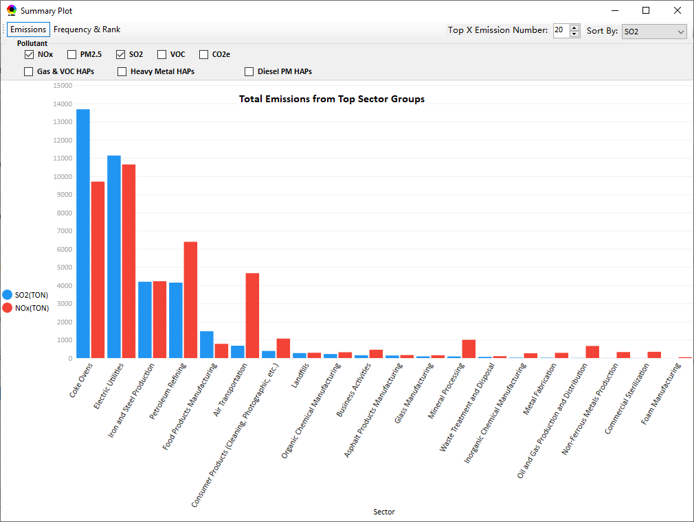
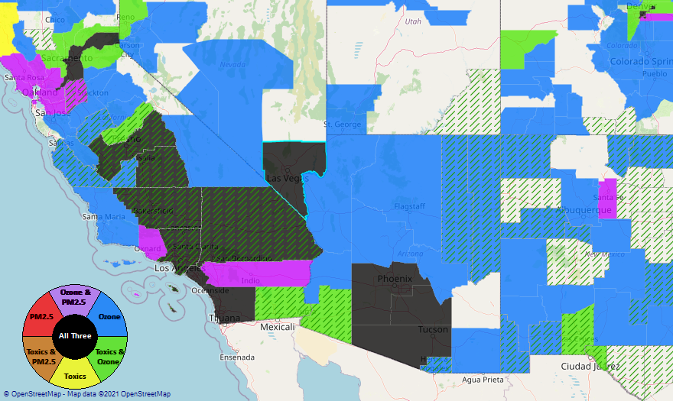
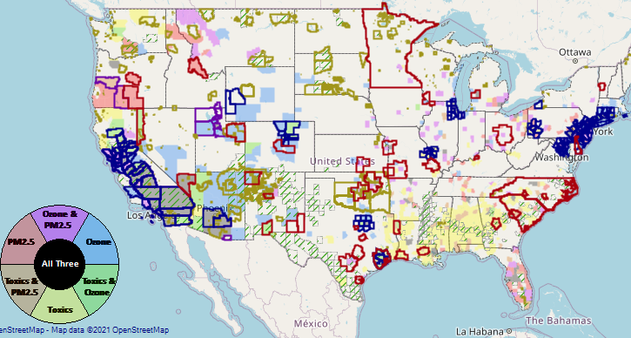
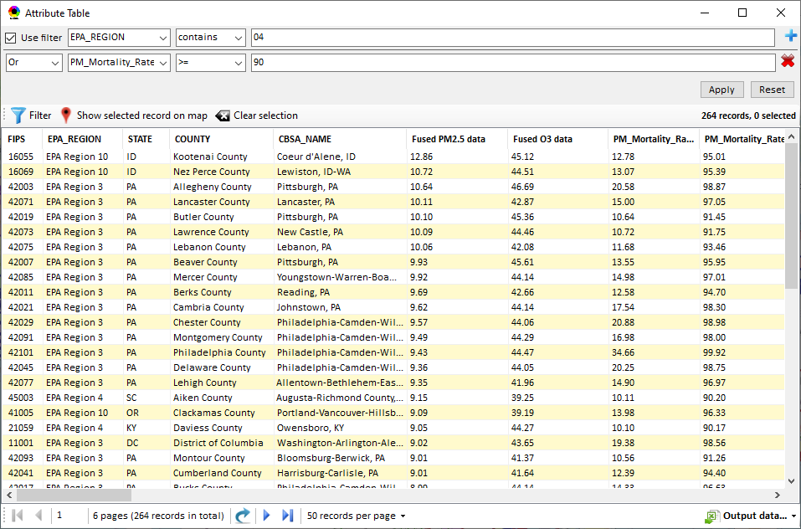
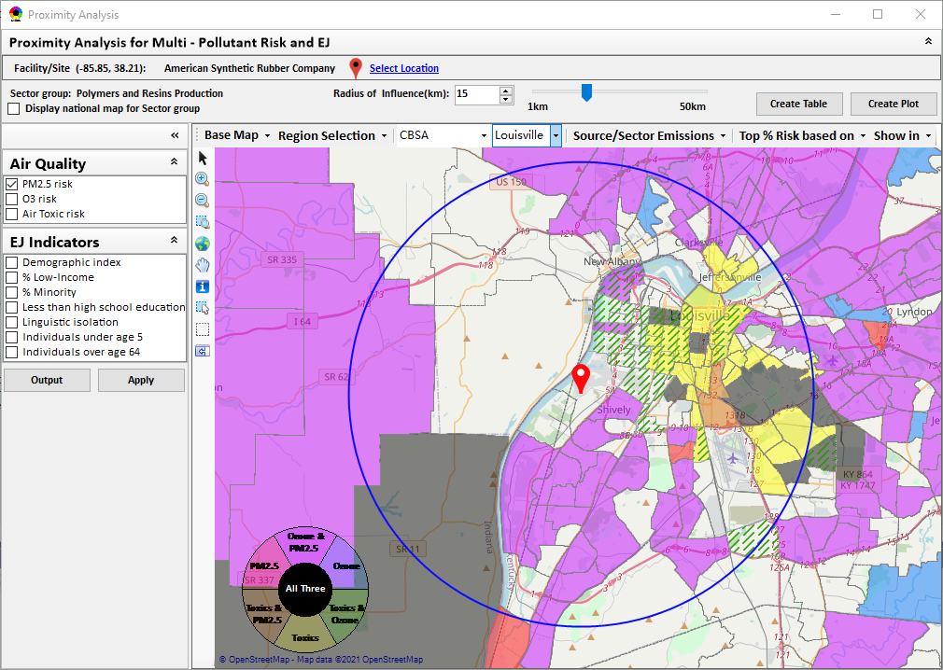
NEXUS Data Inputs and Major Functions
O₃ & PM_{2.5}
Ambient/Design Value
(2012-2020)
(County-level)
Multi-Pollutant
Ambient and/or Risk National & Areal Mapping
Display Monitoring Sites & Trend Data
O₃, PM_{2.5} & Air Toxics Risk Data &
Conc. (fused AQ) Data
(2017 & 2014)
(Census tract-level)
Display Major Point Emissions Sites/Data
Provide Source Category Emissions
NEXUS
O₃, PM_{2.5} & Air Toxics Monitoring Data
(2002-2020 & -2018)
Provide Sector Emissions Summary
NEI County &
Facility Emissions
(2017 & 2014)
Include EJ/Demographic Indicators
Map Overlay with NAA, Advance Area, Class-I Area, or Tribal Area
Environmental Justice & Demographic Data
(from EJSCREEN)
Data Query, Search, Filter & Export
NAA, Advance
Area, Class-I Area &
Tribal Area
Proximity Screening Analysis
8

Slide 9
NEXUS: EPA Regional Beta Testing Team
Convened a group of OAR and regional office members that see the benefit of NEXUS and plan to use it on a routine basis to assist in their job duties.
Requested feedback to help shape the direction of future tool development and ensure we are making updates and additions that are most beneficial to those Regions who are encouraging a multi-pollutant approach to air quality management.
Working to identify specific applications to collaborate on with Regions, e.g.:
  Select area with MP and potential EJ concerns and explore a MP approach using NEXUS.
  Support EJ screening and related analysis for Federal permit or related action.
9

Slide 10
NEXUS: EPA Regional Beta Team Members
Region 1
  Shutsu Wong
  Emily Bolger
Region 2
  Ysabel Barron
Region 3
  Cynthia Stahl
  Carol Ann Gross-Davis
  Jessie Fry
  Angus Welch
  Alice Chow
Region 4
  Rick Gillam
  Byron Gary (LMAPCD)
Region 5
  Alexis Cain
  Margaret Sieffert
  Rae Trine
  Yana Genchanok
Region 6
  Nia Riddick
Region 7
  Adam Zachary
  Allie Donohue
Region 8
  Ethan Brown
  Adam Eisele
Region 9
  Julia Carlstad
Region 10
  Claudia Vaupel
OAQPS
  Rob Pinder
  Matt Woody
  Beth Landis
  Carey Jang
  Joe Mangino
  Mia South
  Shomik Ghosh
  Kimber Scavo
  Tyler Fox
10

Slide 11
NEXUS Beta Team Feedback - Uses
SIP Related Activities
  Address NAAs and areas close to NAAQS
  Develop conceptual models
  Areas preparing path forward document to join Advance program
  Future weight-of-evidence analysis
Air Quality Planning Activities
  Identity areas to focus reduction efforts with possible lowering of NAAQs
  Evaluate permit applications
  Visually understand MP issues
  Visualize areas of concern, run reports & focus efforts
  Response to citizen complaints about sources
  Determine where to focus emission reduction efforts
Environmental Justice
  Generate maps and reports for EJ workgroup
  Identify areas with air quality and EJ concerns
  Review Tribal areas
  Ensuring MP cumulative impacts are considered
  Robust evaluation of potential EJ concerns and plans to address community needs
Outreach
  Support AQ planning conversations with SLT air agencies
  EtO community outreach
  Briefings with RAs and management
Monitoring Activities
  Review Annual Monitoring Network Plans and site/monitor relocation requests
  Review new development proposals
  Ongoing network assessments
Assessments
  Evaluate air quality impacts in local communities
  Supplement AirToxScreen Assessments
  Assess burden of individual or combination of air pollutants
  Complement existing techniques for emissions, modeling, monitoring & risk assessment
  Identity air quality and human health focus areas
Other
  Help new employees learn about areas with O₃, PM_{2.5}, toxics and/or EJ concerns
  Assist with determining distribution of grant funding
11

Slide 12
NEXUS Beta Team Feedback - Asks
Common Requests
Access issues - web-based / cloud-based application is preferable
More recent data
Addition of available Pb data
Ability to filter emissions, monitor data, and drop downs selections by map extent or user defined boundaries (e.g., boundary box or lasso)
Addition of GHG reporting program data
Report capabilities: Automated 1–2-page summary document
Unique Requests
Ability to layer multiple years of data
Ability to see all monitors in a selected area
Ability to see all facilities within proximity analysis selected area versus county-wide
Ability to see modeled concentrations from AirToxScreen
Ability to import air dispersion modeling results in .kmz format
Ability to filter facilities by industry/NAICS
Ability to adjust the data value year in proximity analysis
See individual HAP/VOC emissions
Add driving pollutant for elevated cancer risk and HI for census block
Add data for Hawaii and Alaska
Wind roses to help assess monitor siting
12

Slide 13
NEXUS Current and Potential Uses
MP Risk Prioritization (current)
  Develop list of high MP risk areas to share with Regions and engage in potential MP area projects/efforts to reduce air emissions/exposure in these communities
Monitoring Assessments (current & potential)
  Assess monitoring networks to determine where sites are located in/near communities with potential EJ concerns
  Identifying gaps in monitoring network near overburdened communities
  Input and review state’s Annual Monitoring Network Plans
Informing outreach and new source permitting (potential)
  EJ screening for outreach purposes and for EJ assessments in federal permitting
ADVANCE Area/Regional SIP Planning (potential)
  Develop conceptual model information consistent with EPA’s SIP modeling guidance that lays out the nature of air quality within the area
Inform IRA planning efforts (potential)
13

Slide 14
NEXUS FAQs
14

Slide 15
Is NEXUS publicly available?
Currently, NEXUS is only available for download by EPA staff. We are working on developing a “web-based” or “cloud-based” NEXUS platform to provide an “easy access” (no installation required) and “cross-platform” (not limited to Window-OS) version of the NEXUS tool in the future, dependent on resource availability.
15

Slide 16
How can I access NEXUS?
To download NEXUS, a request must be submitted with EISD via ServiceNow (even if you have PowerBroker/Administrative privileges)
  Access ServiceNow by clicking on the URL: https://usepa.servicenowservices.com/
  Click on the ‘Service Catalog’ box on the left-hand side
  Scroll down and click on the ‘Software Request’ box. Click ‘Software Request’ again when the screen refreshes.
  Since NEXUS will not be listed under the ‘ *Please select the name of the software application needed:’, click the box for ‘Software Application Not Found.’
  The page will refresh. User will need to fill out the form includes filling in the following fields outside of what is already pre-filled:
    *Supervisor/Approver.
    *Machine Name (Instructions provided on where to find)
    *Describe the business need & justification for this software license - “NEXUS is a multi-pollutant screening analysis tool for providing multi-pollutant risks and EJ analysis developed by EPA and contractors under a GSA contract with UNC-CH. This tool is needed to complete my work duties”
    *Software Company - “EPA”
    *Software Title - “NEXUS Tool”
    *Software Version - “3.3”
    *Software URL - If you have Power Broker privilege, type “Self-install with Power Broker privilege”… if you do not have Power Broker privilege, type “NEXUS 3.3 – please install NEXUS_3.3_Data.exe and NEXUS_3.3_Setup.exe”
    *What type of license will this likely be? (Dropdown: Licensed, Freeware/Shareware, Unknown) – “Unknown”
    Approximate price – “Free”
    Click on Submit.
See additional install tips in Rob Pinder’s 1/4/23 email
16

Slide 17
What are the similarities/differences between EJSCREEN, CEJEST, and NEXUS?
EJSCREEN (Environmental Justice Screening and Mapping Tool)
  EJ screening and mapping tool that combines environmental and demographic data to highlight areas where vulnerable populations may be disproportionately impacted by pollution
CEJEST (Climate & Economic Justice Screening Tool)
  An interactive map with indicators of burdens to identify communities that are overburdened and underserved
NEXUS
  Advanced multi-pollutant screening tool for air quality planning
  Has the unique ability to identify overburdened communities affected by multiple pollutants and/or health risks
  Ability to view the combination of demographics and specific air related health risks
  Data relevant for air quality planning purposes –
    Emissions and source data for O₃, PM_{2.5}, air toxics and GHGs
    Modeled concentration data for O3, PM2.5 and air toxics
    Risk data for O₃, PM_{2.5} and air toxics
    Monitoring data for O₃, PM_{2.5} and air toxics
17

Slide 18
NEXUS & EJSCREEN
  EJ Layers
    Hazardous waste
    EJ Grants
    Water features
    Places
    Schools & Parks
    Transportation
    Boundaries
    Prisons
    Public Housing
    Subsidized Housing
    Climate
    Sites reporting to the EPA
    Superfund (NPL)
    RSEI
  Environmental Indicators
    Wastewater Discharge Indicator
    Hazardous Waste Proximity
    Superfund Proximity
    Lead Paint Indicator
    Traffic Proximity
    RMP Proximity
Ozone and PM_{2.5}
Emissions and source data
Monitoring data
Fused concentration data
Mortality & morbidity risk data
Air Toxics
Emissions and source data
Monitoring data
Modeled concentration data
AirToxScreen cancer & noncancer risk data for air toxic species
GHG emissions
NEI’s GHG (CO2e) emissions
Facilities and county level
Source categories (point, on-road, non-road, etc.)
Common Information
Tribal Areas
Nonattainment Areas
  Environmental Indicators*
    AirToxScreen Cancer Risk
    AirToxScreen Noncancer Risk
    Ozone Fused Concentrations
    PM_{2.5} Fused Concentrations
Demographic Indicators
    People of Color Population
    Less Than HS Educated
    Low Income Population
    Linguistically Isolated
    Demographic Index
    Under Age 5
    Over Age 64
*Provided to OEJ by OAQPS (AQAD & HEID)
18

Slide 19
NEXUS Data Information
Data | Source | Level of Data | Vintage in NEXUS 3.3 | Plans for Update/Inclusion
O₃ and PM_{2.5} emissions and source data | NEI | County and facility-level | 2017 | 2018 and 2019 data in NEXUS 3.5
Air Toxics emissions and source data | NEI | County and facility-level | 2017 | 2018 and 2019 data in NEXUS 3.5
O₃ and PM_{2.5} modeled concentration data | Fused air quality surfaces | County/Census tract level | 2017 | 2018 and 2019 data in NEXUS 3.5
Air Toxics modeled concentration data | Hybrid CMAQ/AERMOD output for toxics | County/Census tract level | 2017 | 2018 and 2019 data in NEXUS 3.5
O₃ and PM_{2.5} risk data | BenMAP | County/Census Tract Level | Old 2017 (includes a bug) | New 2017, 2018 and 2019 data in NEXUS 3.5
Air Toxics risk data | AirToxScreen | County/Census Tract Level | 2017 | 2018 and 2019 data in NEXUS 3.5
Advance Areas | OAQPS/AQPD | County level | 2021 | -
Nonattainment Areas and Design Values | EPA Greenbook Air Trends | County level | 2012-2020 | -
Tribal Boundaries | EPA Public Website |  | 2018 | -
Socio-economic & demographic data | EJSCREEN |  | 2020 | -
O₃ and PM_{2.5} monitoring data (DVs) | OAQPS/AQAD | Site-level | 2002-2020 | -
Air toxics monitoring data (22 HAPs) | Air Toxics Data Archive | Site-level | 2003-2018
GHG emissions | NEI & GHG Inventory | County and facility-level | 2017 | -
Class I Areas | EPA Class 1 Federal Areas Website |  | 2016
19

Slide 20
NEXUS Briefings and Demos
9/25/2020– AQAD & HEID
11/3/2020 – MP Team
11/4/2020 – Air Toxics Group
12/10/2020 – AQPD
1/25/2021 – OID
1/28/2021 – SPPD
2/1/2021 – Peter/SMT
4/12/2021 – HEID & AQAD
5/17/2021 – Peter/SMT
5/24/2021 – MP Team
6/29/2021 – ORD
7/12/2021– HEID & AQAD
7/19/2021 – OID
8/10/2021– OAP
8/26/2021 – OAR
8/27/2021 - OP
8/30/2021 – OEJ
8/30/2021 - Region 4/Louisville
9/7/2021 – RO ADDs
9/20/2021 – OAR Demo
10/14/2021 – OP/NCEE
11/2/2021 – RO APMs
11/8/2021- RO APMs Demo
11/16/2021 – R1 (RARE) Project
11/28/2021 – AQAD All-Hands
11/23/2021 – R3 NEXUS Beta Testers
2/15/22 – AQPD (NSRG, OPG & SLPG)
2/17/22 – AT Strategy Mgmt & Mitigation Team
3/15/22 – OID (CTPG)
4/26/22 – EPA Regional NEXUS Beta Testing Team
4/28/22 – AQAD (AAMG)
5/3/22 – HEID & AQAD
5/4/22 – Air Toxics Data Analysis Team
5/10/22 – ADVANCE Workgroup
5/26/22 - OAP/CCD
6/15/22 – Regional Ambient Air Monitoring
6/23/22 – SPPD All-Hands
7/21/22 – EJ in Rulemaking Comm. Of Practice
8/15/22 – OGC & ECRCO – Title VI
8/16/22 – Pre-brief for HEID & AQAD
8/17/22 – Peter
8/22/22 – OID/CTPG – Liz
8/31/22 – BenMAP Team
9/12/22 – OAPPS/AAOP (Economists)
9/14/22 – CAAAC
9/15/22 – Title VI / SIP Workgroup
9/29/22 – AAPCA
10/6/22 – OAP Pre-Brief
10/19/22 – OTAQ Pre-Brief
10/19/22 – RO APMs
10/31/22 – OEJ
11/1/22 – Regional Air Division Directors
12/1/22 – Region 1 - Packet Discussion
12/1/22 - OAR
12/1/22 - OAR IT/IM Coordination Council
12/14/22 – Stephanie G.
1/3/23 – OAP/OTAQ/OAQPS
TBD –MJOs
20

Slide 21
NEXUS: Feedback from Briefings & Demos
“Fascinating… phenomenal… I’m blown away!”
- Caroline Freeman (R4 ADD)
“The R3 air program has evaluated 18 web tools … NEXUS overall has been the most useful to our air program”
- Cynthia Stahl, PhD
(R3 Integrated Assessment Analyst)
“Your presentation of the NEXUS tool was absolutely awesome!!! … The NEXUS tool looks very promising”
- Osmond Lindo (OAPPS Lead Economist)
“Breathtaking… incredibly powerful… I feel like we discovered nuclear fusion!”
- Joe Goffman
(OAR Acting AA)
“The tool is well designed and provides a wealth of information that is useful for evaluating air quality impacts in local communities”
- Rick Gillam
(R4 Air Modeling Team Lead)
“Dr. Nance [R6 RA] will be thrilled with the NEXUS tool and excited with its capabilities.”
- Fran Verhalen
(recently retired R6 Monitoring Section Chief)
21

Slide 22
Next Steps
Continue discussions across OAR on NEXUS, particularly with OAP on incorporating climate risk indicators
  Focus on climate indicators most relevant to air quality planning
  Could inform IRA Grants Programs (TBD)
Update to 2018/2019 MP platform (O₃, PM_{2.5}, and Air Toxics data)
Begin development of a web-based NEXUS version
Work towards making NEXUS publicly available
Partner within EPA on use of NEXUS for programmatic purposes
22

Slide 23
Important Caveats
NEXUS Caveat
The NEXUS screening tool uses data from a variety of sources. This data is publicly available, except for the BenMAP data at the tract level. EPA is currently still in an internal review process and is not using this tool to support regulatory analyses.
BenMAP Caveat
The estimated number of PM and ozone-attributable deaths and illnesses reported at each tract are subject to important uncertainties and should be interpreted with caution. When using the BenMAP-CE tool to calculate these tract-level results, EPA lacked information regarding the baseline health status of individuals living at each tract; these data are a key input to the calculation of benefits. EPA instead used data available at the county- or state-level, which does not account for differences in baseline health between tracts. Estimating benefits in this way is not consistent with the peer-reviewed methods EPA follows when estimating air quality benefits in a Regulatory Impact Analysis. EPA will continue to refine its methods with the goal of reporting tract-level health benefits with confidence.
23

