Slide 1
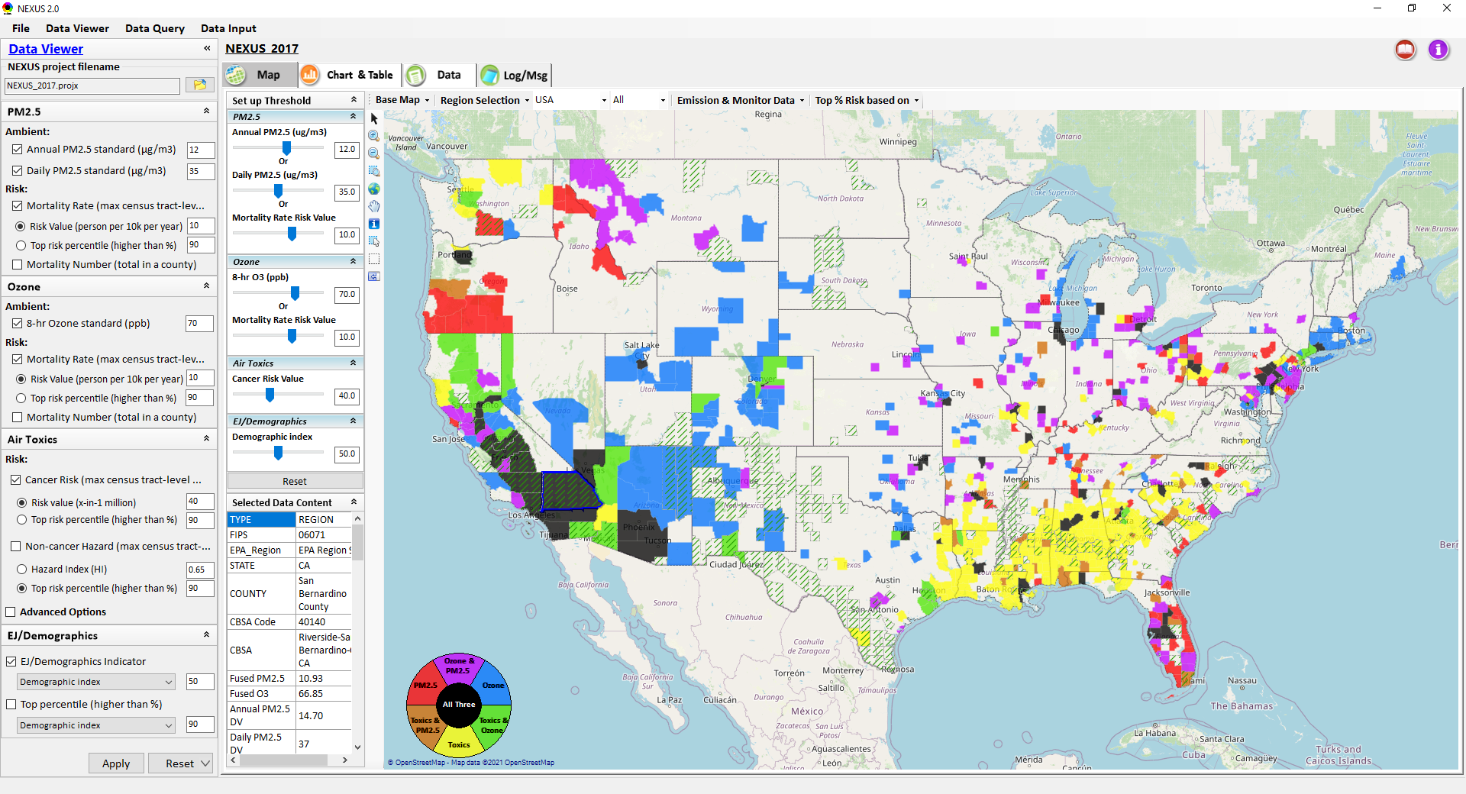
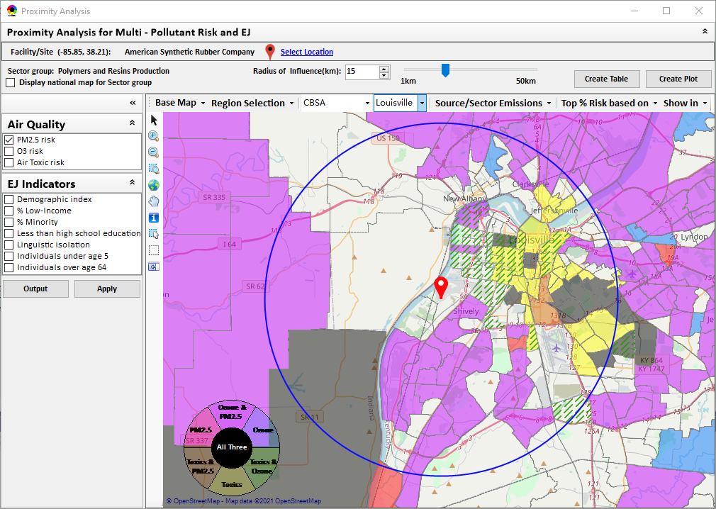
“NEXUS” Multi-Pollutant Advanced Screening Tool: Briefing & Live Demo
Data Viewer: National/Regional Level
Proximity Analysis: Community Level
“NEXUS 2.3” can be downloaded at
EPA’s new FTP site: https://gaftp.epa.gov/aqmg/cjang/NEXUS/MP_Team/NEXUS 2.3/*
Beth Landis, HEID/Climate, International, & Multi-Media Group
Carey Jang, AQAD/Air Quality Modeling Group
AQPD (NSRG, OPG, & SLPG) Briefing & Demo – 2/15/22
1

Slide 2
Multi-Pollutant Team Members
HEID
  Beth Landis / Kimber Scavo
  Matt Woody/ Kelly Rimer
  Robin Langdon / Darryl Weatherhead
  Sara Terry
  Carrie Wheeler
  Ben Gibson
  Rob Pinder
  Chris Davis
SPPD
  Lisa Conner
AQAD
  Carey Jang / Tyler Fox
  Jim Kelly
  Shannon Koplitz
  Joe Mangino
  Jeanette Reyes
AQPD
  Rich Damberg / Megan Brachtl
  Mia South
OID
  Amanda Kaufman
  James Payne
2

Slide 3
Overview
Multi-Pollutant (MP) Background
NEXUS 2.3
  Overview
  Potential NEXUS Application by AQPD
  Data Inputs and Major Functions
  Briefings/Demos/Planned Outreach
  Recent & Ongoing Development
    Proximity Analysis Module
  Examples of Potential NEXUS Applications
Live Demo
3

Slide 4
Multi-Pollutant Background
Support a comprehensive, MP treatment of air quality problems to effectively improve air quality and make the most efficient use of available resources
  Primary Goal - identify & evaluate local control strategies targeting emissions of O₃ & PM_{2.5} and their precursors while at the same time reducing Air Toxics of concern for communities to maximize both health benefits and air quality improvements
MP planning has the potential to reduce the costs and increase benefits associated with air quality management (AQM)
Supports S/L/T air agencies in developing MP, risk-based AQM plans and implementing strategies that reduce air pollution emissions & improve public health
Success has been demonstrated in Detroit and SC; another project is currently underway in Louisville, KY
Tools needed to analyze MP data are either available currently or being developed in OAQPS (e.g., NEXUS)
4

Slide 5
NEXUS Overview
“NEXUS” is an advanced screening tool for multi-pollutant (MP) risks and EJ/Demographic analysis developed by OAQPS’s MP team (further details see attached “NEXUS Overview” doc)
“NEXUS” integrates a suite of MP data, including emissions, monitoring, modeling, fused AQ data and health risk data for PM_{2.5}, O₃ & air toxics as well as EJ/demographic data, into one single platform to allow national and areal overlay mapping & analysis of MP ambient & risk data
“NEXUS” provides MP analysis across from national level “Phase 1” to regional (EPA region/State/CBSA) level “Phase 2”, and now down to community level “Phase 3” (Proximity analysis” in census tract-level)
We expect to use this tool in conjunction with Regions and identify areas that would potentially benefit most from MP approaches to reduce emissions (including current NA areas)
We also expect that it can have additional value-added uses across the Office for Air Toxics, Environmental Justice and other programs
The NEXUS tool will essentially provide a ‘conceptual model’ of an area’s MP issues to facilitate engagement with state/local/tribal agencies & community stakeholder groups
5

Slide 6
Potential NEXUS Application by AQPD
SIP/Advance Areas*
EPA’s O₃/PM_{2.5}/RH Modeling Guidance discusses the need to develop a “conceptual model”, i.e., characterization of the area’s air quality problem
  NEXUS can help characterize nature of sources, emissions, air quality (monitored & modeled) to define sources & pollutants of interest in defining controls necessary to attain/maintain air quality standards
  NEXUS can facilitate MP control considerations by bringing data related to sources & emissions that can reduce multiple air quality issues:
    PM focus might bring about NOx reductions that also reduce O₃
    O₃ focus might bring about VOC reductions that may also address VOC HAPs
    PM focus might bring about direct PM reductions that may also address metal HAPs
Demographic Proximity Screening capabilities allows for “EJSCREEN”-like screening of population demographics near sources or monitors within these areas to consider potential for disparate EJ impacts & also provides such screening for ‘unmonitored areas’
*MP Team welcomes discussion across OAQPS and with the Regions to facilitate use of NEXUS to support these programs
6

Slide 7
Modeling Guidance for Demonstrating Air Quality Goals for Ozone, PM2.5, and Regional Haze (2018)
“2.0 Building a Model Platform” and “2.1 Conceptual Description (Building a Conceptual Model Platform)”
Introduce the general nature of the air quality problem addressed by the conceptual model:
  o What are the pollutants of concern in the area?
  o What are the current air quality levels in the area?
  o What is the attainment/nonattainment status of the area?
  o What is the geographical scope of poor air quality?
  o What is the temporal scope of poor air quality?
  o What are the air quality trends in the area? Is the problem getting better or worse?
  o What are the suspected mechanisms for formation of poor air quality levels?
  o What are the sources of emissions that may contribute to poor air quality?
  o Are there unique meteorological influences on local air quality levels?
  Describe the ambient monitoring network used for the conceptual model:
  o Develop a map of monitor sites and types (e.g., FRM, FEM, CSN, IMPROVE, CASTNET,
  etc.).
  o Describe characteristics of individual monitoring sites (scale, frequency, etc.).
• Describe the status and trends of air quality in the area:
o Summarize the relevant monitoring data for the air quality problem being studied.
o Identify locations that are in violation of the NAAQS.
o Describe the spatial pattern in pollutant and precursor pollutant levels.
o Describe the temporal pattern in pollutant and precursor pollutant levels.
o Describe the annual trends in concentrations over the period of interest.
o If appropriate, develop fused ambient/model surfaces to fill any gaps within the
monitoring network.
Investigate possible relationships between emissions and air quality:
o Examine emissions estimates for the main sector/source categories.
o Compare emission trends for annual and or seasonal/episodic periods to
corresponding air quality trends.
o Identify key emission sources or source categories.
o Assess the historical effectiveness of control programs.
o Consider how future emissions growth or reductions may affect air quality.
o List control programs that are in place, or will soon be implemented, that may
impact emissions sources in the area.
Synthesize all the relevant information into a detailed conceptual model:
o Aggregate all elements of the conceptual model and provide the key findings
resulting from the analyses completed.
o Characterize the potential factors that influence air quality in the area and where
possible rank the importance of those influences.
o Identify issues that require further investigation, either in terms of data collection or
chemical transport modeling.
o Discuss how the subsequent SIP modeling and associated protocol is impacted by
this conceptual description.
Investigate possible relationships between meteorology and air quality (AQ):
o Describe meteorological characteristics on poor air quality days (e.g., wind speed/direction, temperatures, relative humidity levels, inversion indicators, etc.).
o Identify any distinct meteorological phenomena that coincide with poor air quality days.
o Prepare pollution roses, HYSPLIT back-trajectories (Draxler, 1998), or any other relevant analysis needed to link poor air quality days to specific meteorological patterns and sources of transported pollutants.
o Assess the impact from pollutant transport into area based on meteorological data and ambient air quality data.
In Line with NEXUS Tool’s Current
Objectives & Capabilities
7

Slide 8
Potential NEXUS Application by AQPD
New Source Permitting*
PSD and/or state minor source efforts require a demonstration of the new source not ‘causing or contributing to NAAQS violations’ and increasingly need to address potential for EJ concerns
NEXUS can provide valuable information and insights on new source location, nearby sources, and background air quality to assist Regions (and possibly SLTs) as part of permitting process
The Demographic Proximity Screening capabilities, allows for “EJSCREEN-like” screening of population demographics near new source location to consider potential for disparate EJ impacts including the current cumulative burden/risks from current air quality levels in the area
*MP Team welcomes discussion across OAQPS and with the Regions to facilitate use of NEXUS to support these programs
8

Slide 9
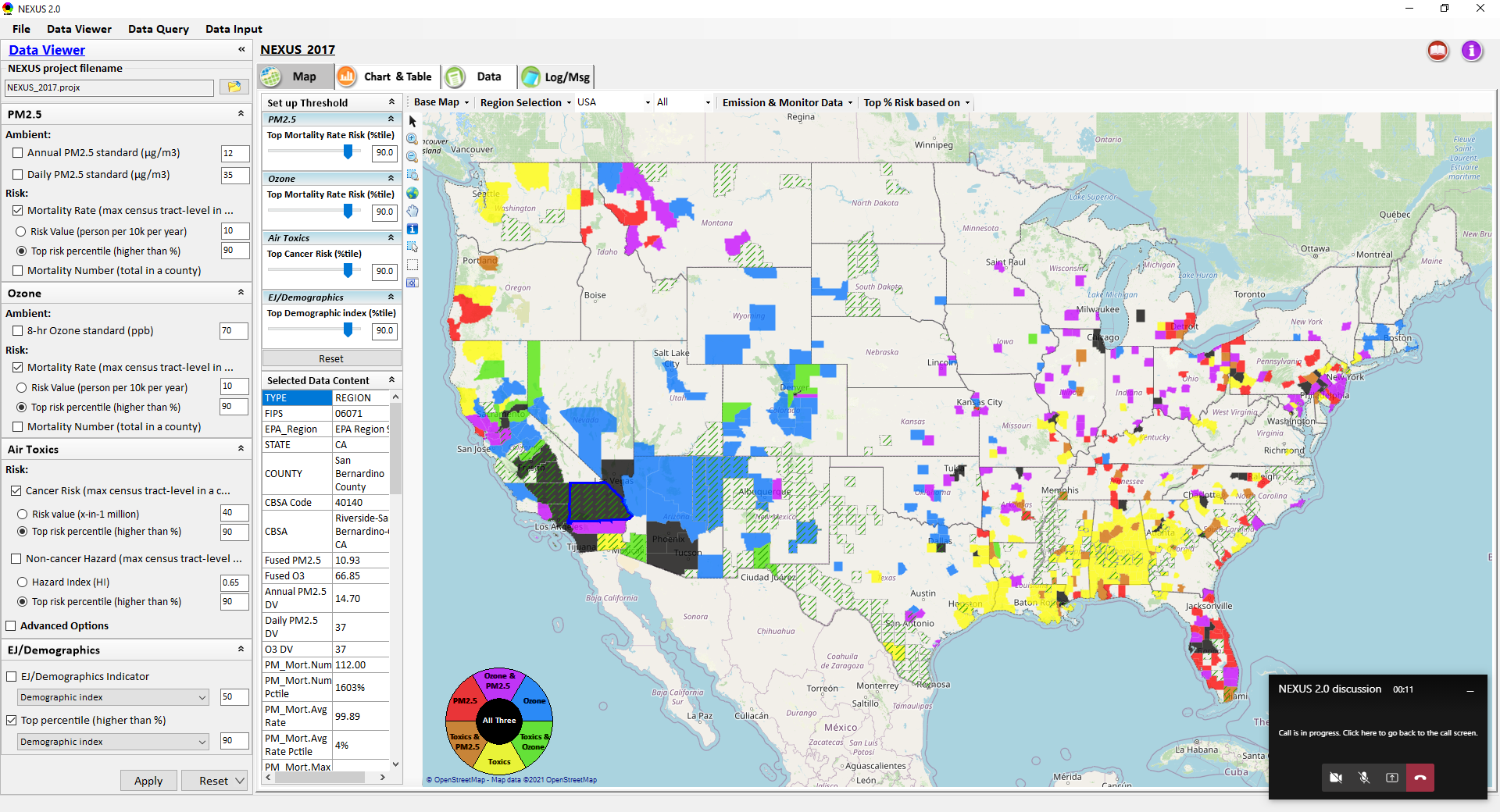
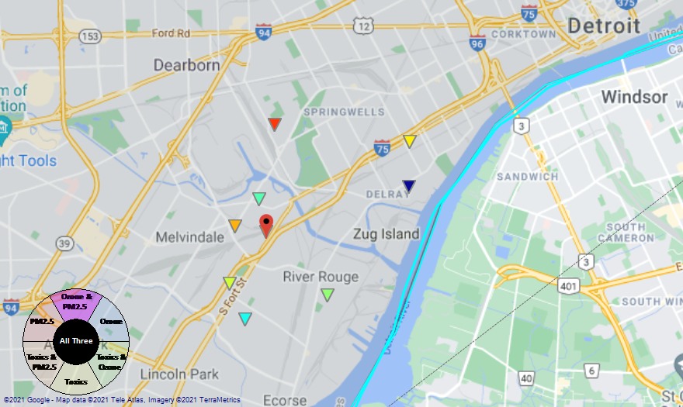
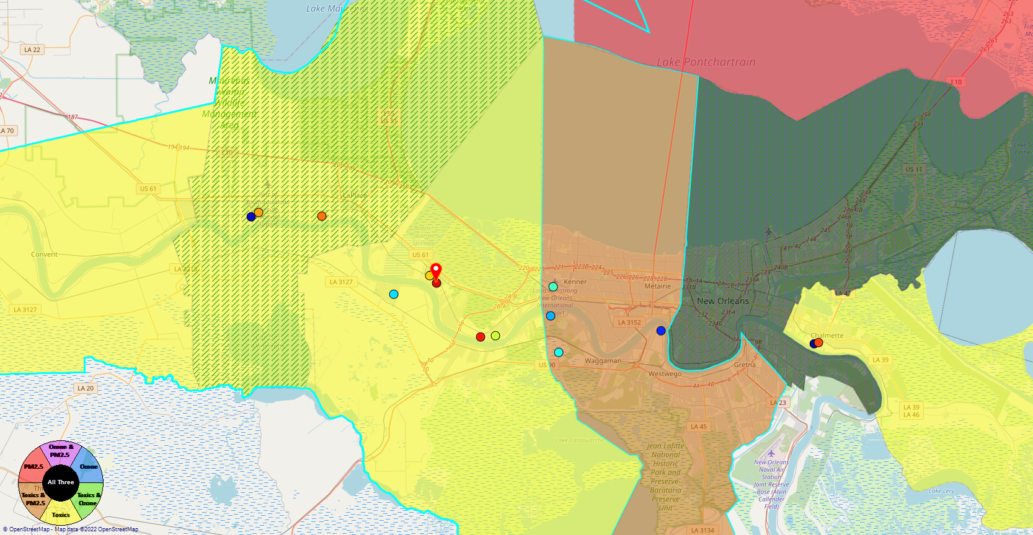
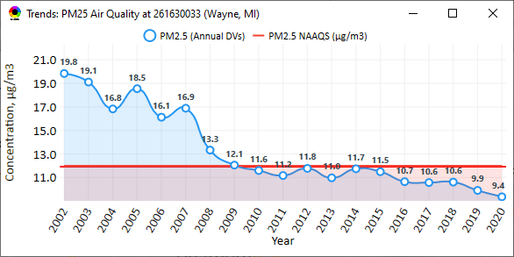
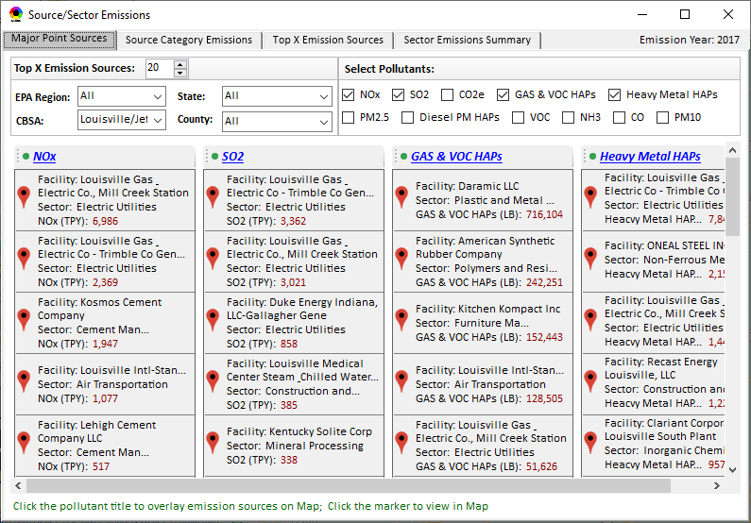
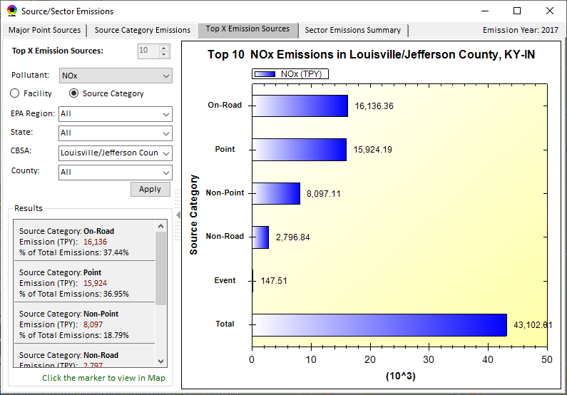
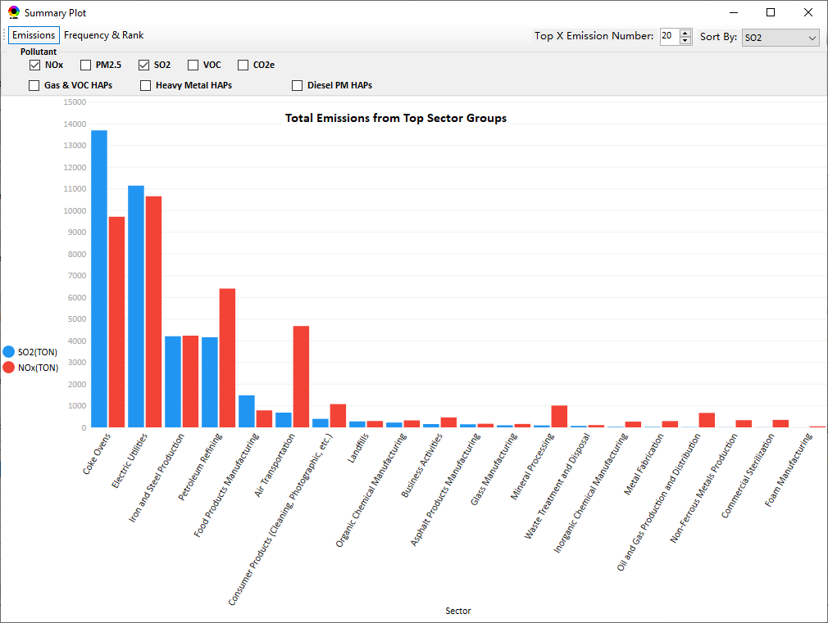
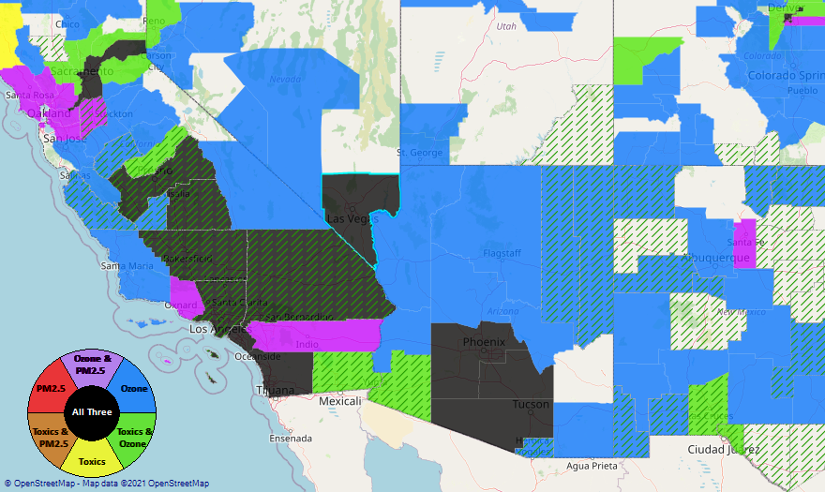
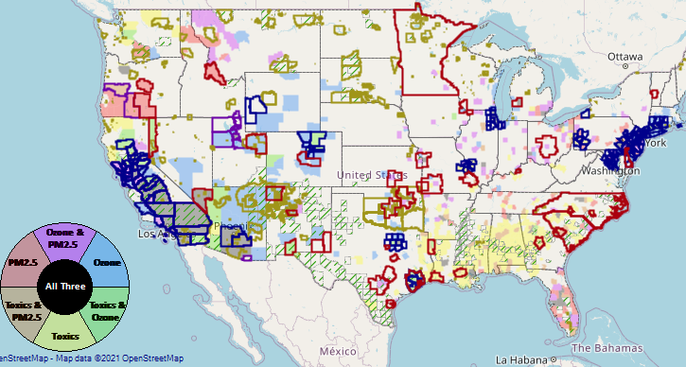
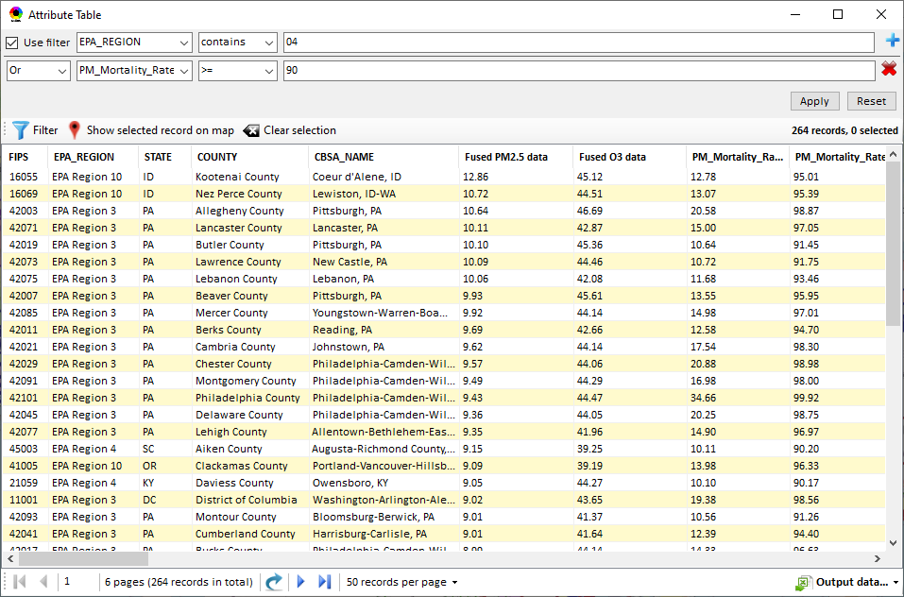
NEXUS: Data Inputs and Major Functions
O₃ & PM_{2.5}
Ambient/Design Value
(2012-2020)
(County-level)
Multi-Pollutant
Ambient and/or Risk National & Areal Mapping
Display Monitoring Sites & Trend Data
O₃, PM_{2.5} & Air Toxics Risk Data &
Conc. (fused AQ) Data
(2017 & 2014)
(Census tract-level)
Display Major Point Emissions Sites/Data
Provide Source Category Emissions
NEXUS
O₃, PM_{2.5} & Air Toxics Monitoring Data
(2002-2020 & -2018)
Provide Sector Emissions Summary
NEI County &
Facility Emissions
(2017 & 2014)
Include EJ/Demographic Indicators
Map Overlay with NAA, Advance Area, Class-I Area, or Tribal Area
Environmental Justice & Demographic Data
(from EJSCREEN)
Data Query, Search, Filter & Export
Advance Area
Class-I Area
Tribal Area
Proximity Screening Analysis
9

Slide 10
Briefings, Demos & Planned Outreach
Outreach with EPA Regional Offices
  Feedback on NEXUS 2.0 received by late January
  Forming a beta-testing group
Based on feedback received to date:
  Update air quality risk data to 2017 (from 2014)
  Develop proximity analysis module for community-based MP & EJ analysis
  Plan to include climate risk indicators
9/25/2020– AQAD & HEID
11/3/2020 – MP Team
11/4/2020 – Air Toxics Group
12/10/2020 – AQPD
1/25/2021 – OID
1/28/2021 – SPPD
2/1/2021 – Peter/SMT
4/12/2021 – HEID & AQAD
5/17/2021 – Peter/SMT
5/24/2021 – MP Team
6/29/2021 – ORD
7/12/2021– HEID & AQAD
7/19/2021 – OID
8/10/2021– OAP
8/26/2021 – OAR
8/27/2021 - OP
8/30/2021 – OEJ
8/30/2021 - Region 4/Louisville
9/7/2021 – RO Air Division Directors
9/20/2021 – OAR Demo
10/14/2021 – OP/NCEE
11/2/2021 – RO APMs
11/8/2021- RO APMs Demo
11/16/2021 – R1 (RARE) Project
11/28/2021 – AQAD All-Hands
11/23/2021 – R3 NEXUS Beta Testers
TBD – MJOs
“Fascinating… phenomenal… I’m blown away!”
- Caroline Freeman (R4 ADD)
“Breathtaking… incredibly powerful… I feel like we discovered nuclear fusion!”
- Joe Goffman (OAR Acting AA)
10

Slide 11
NEXUS: Recent & Ongoing Development
NEXUS “1.5” (Jan. 2021) → NEXUS “2.0” (Sep. 2021) (version sent to APMs)
  Upgraded Metrics (PM_{2.5}, O₃, Air Toxics + EJ/Demographics as 4th metric)
  New/updated data inputs and functions:
    EJ/Demographic data (from EJSCREEN), Advance areas, Tribal areas, Class-I areas, Attainment/DVs data, etc.
    Updated 2017 emissions data (including GHG & Sector mapping)
    “Source Category Emissions” module and “Sector Emissions Summary” module
    Preliminary 2017 BenMAP risk data & draft “Monitoring sites/data” module
→ NEXUS “2.3” (Jan. 2022) (Demo version today)
(Download at: https://gaftp.epa.gov/Air/aqmg/cjang/NEXUS/MP_Team/NEXUS 2.3/ with quick tutorial PPT)
  2017 updated BenMAP risk and fused data for PM & O3
  2017 updated air toxics risk data
  Upgraded “Monitoring sites/data” module
  New “Proximity analysis module” for MP risk and EJ analysis
11

Slide 12
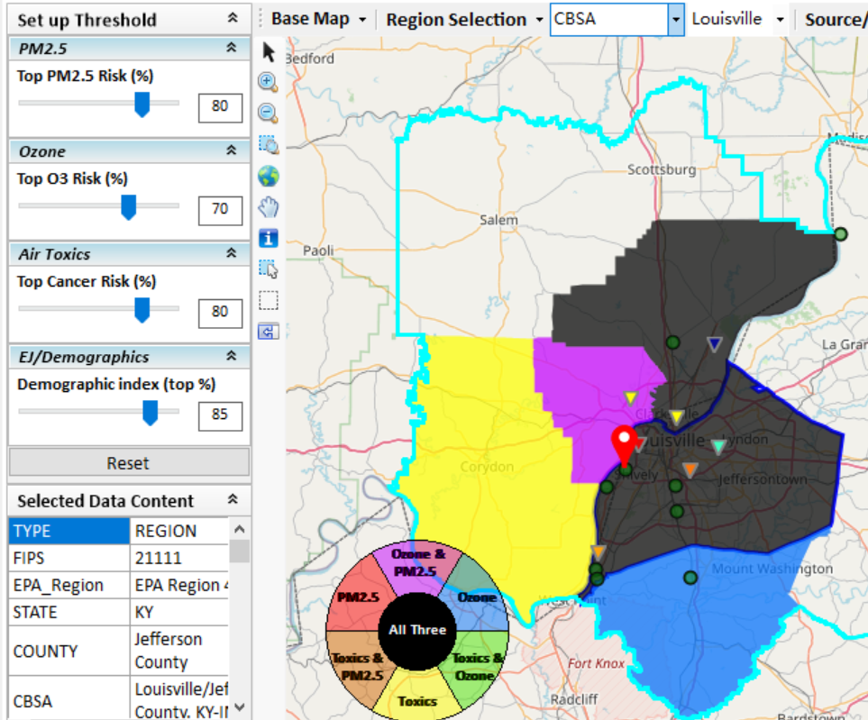
New “Proximity Analysis” Module in NEXUS
Previously in NEXUS
Proximity Analysis for MP Risks and EJ
County – level
Community (Census Tract) - level
12

Slide 13
Need for Proximity Screening in NEXUS
Proximity Screening Analysis Helps Answer:
What are the source(s) in close proximity to my monitor and/or community of interest?
What are the risks in close proximity to my monitor and/or community of interest?
  How do the risks compare within communities near my monitor/source to area/state/national average?
What are the demographics of communities in close proximity to monitor(s) and/or source(s) of interest?
  How do the demographics compare of communities near my monitor/source to area/state/national averages?
13

Slide 14
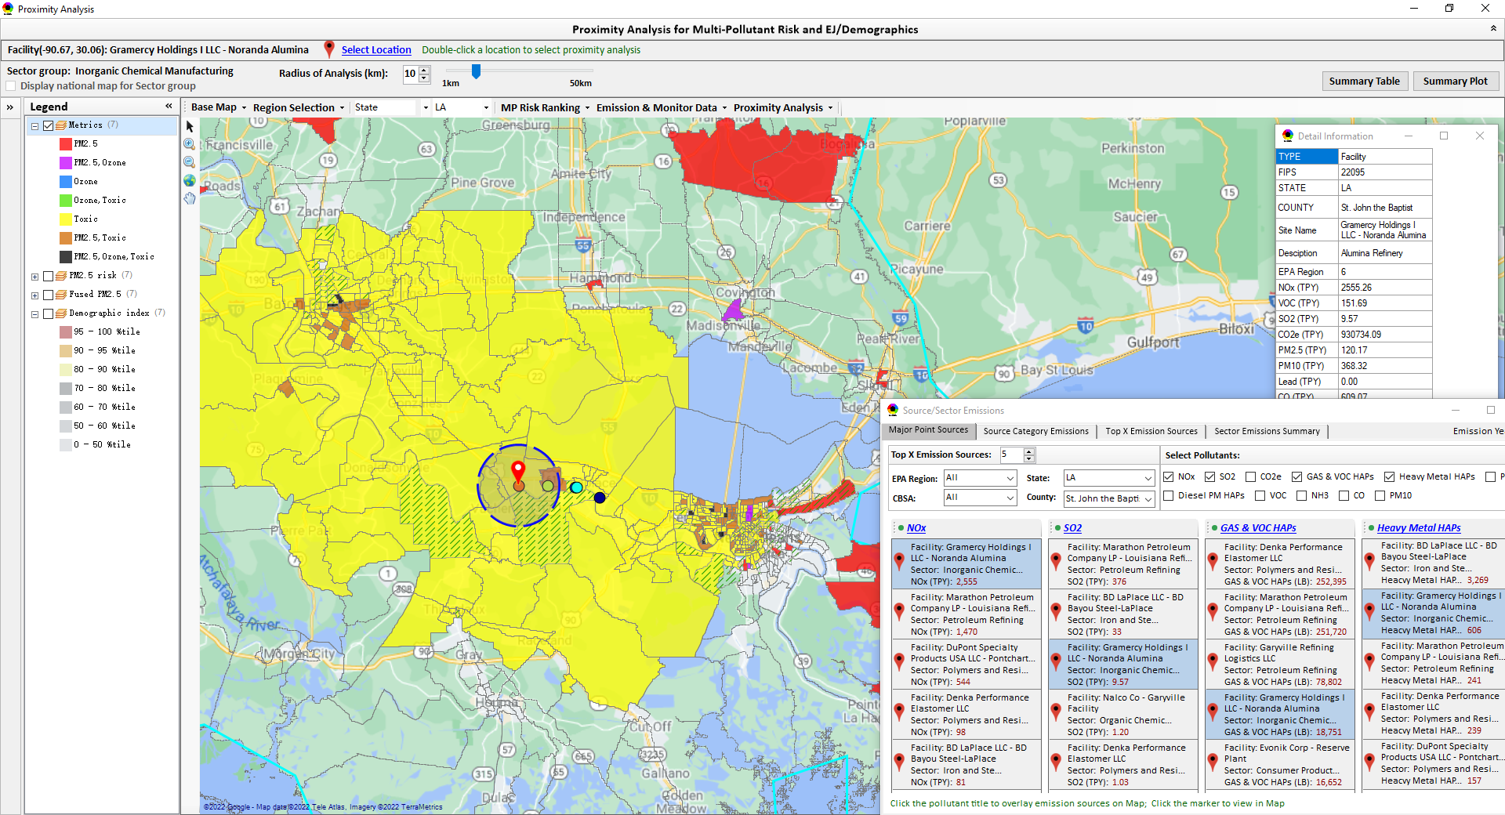
Example of Potential NEXUS Application:
Assessment of Existing Source for SIP/Advance Area
Baton Rouge
“Noranda Alumina” Facility
Gramercy, Louisiana
Assessment of existing source: Atlantic Alumina
(formerly Noranda Alumina) Gramercy, Louisiana
Assessment of existing source: Atlantic Alumina
(formerly Noranda Alumina) Gramercy, Louisiana
New Orleans
14
14

Slide 15
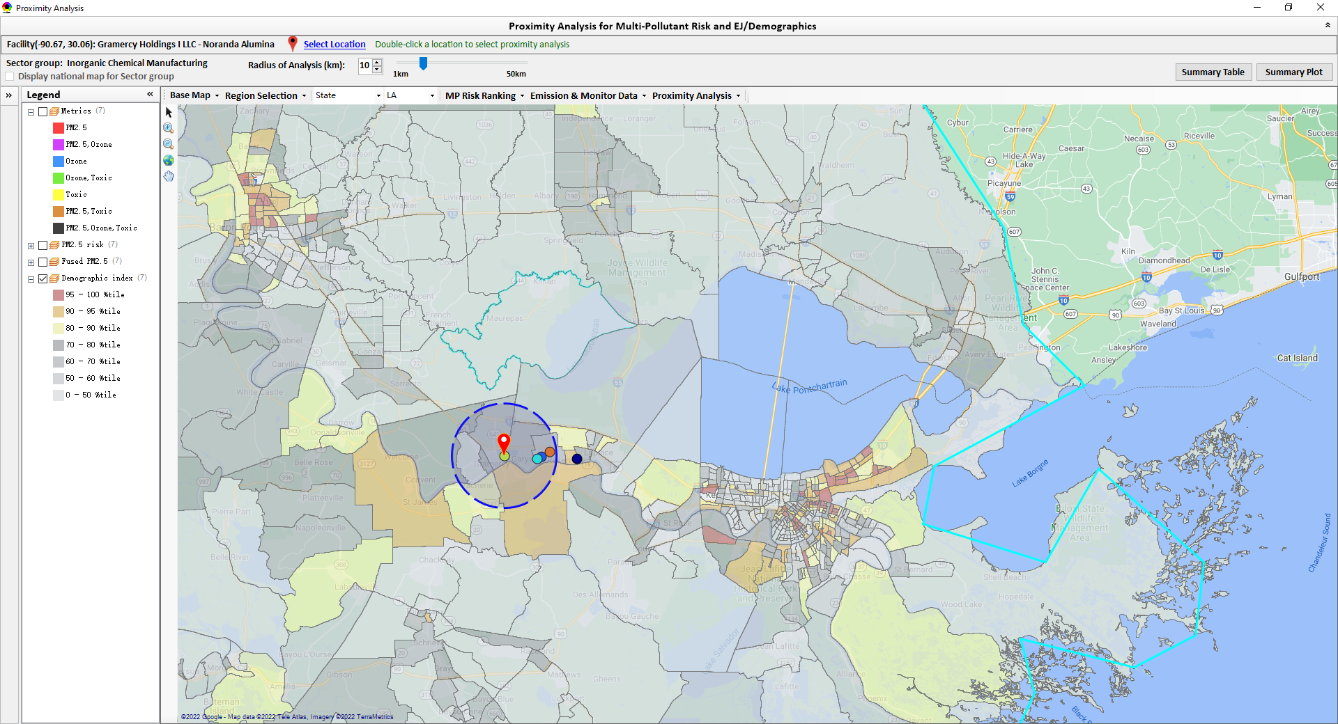
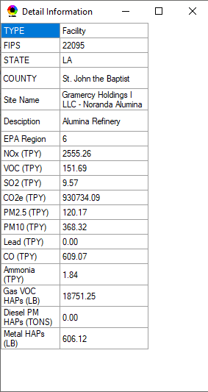
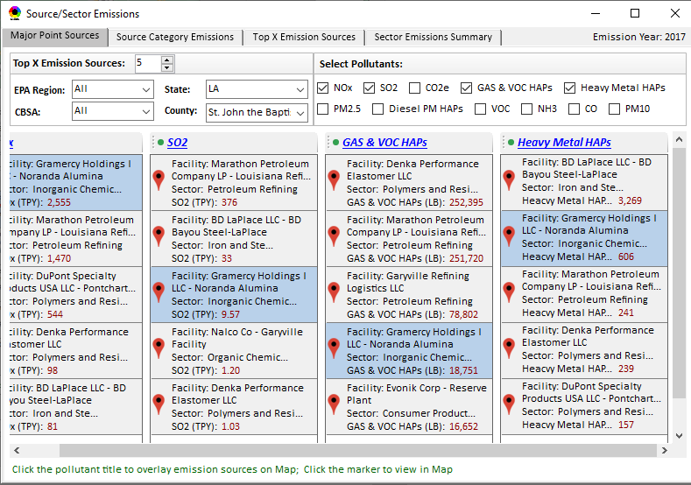
“Proximity Analysis”: EJ/demographics analysis (EJSCREEN data)
Baton Rouge
“Noranda Alumina” Facility
Gramercy, Louisiana
New Orleans
15

Slide 16
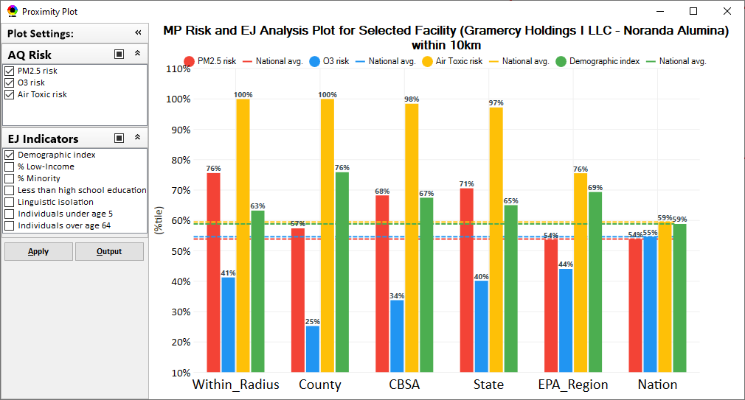
“Proximity Analysis” (Radius of Analysis) : Summary Plot
16

Slide 17
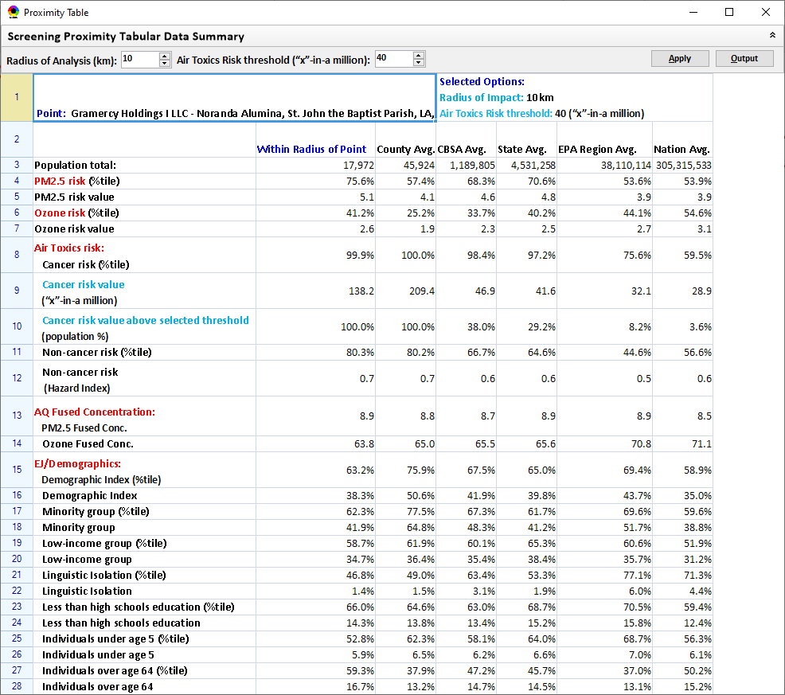
“Proximity Analysis” (Radius of Analysis) : Summary Table
17

Slide 18
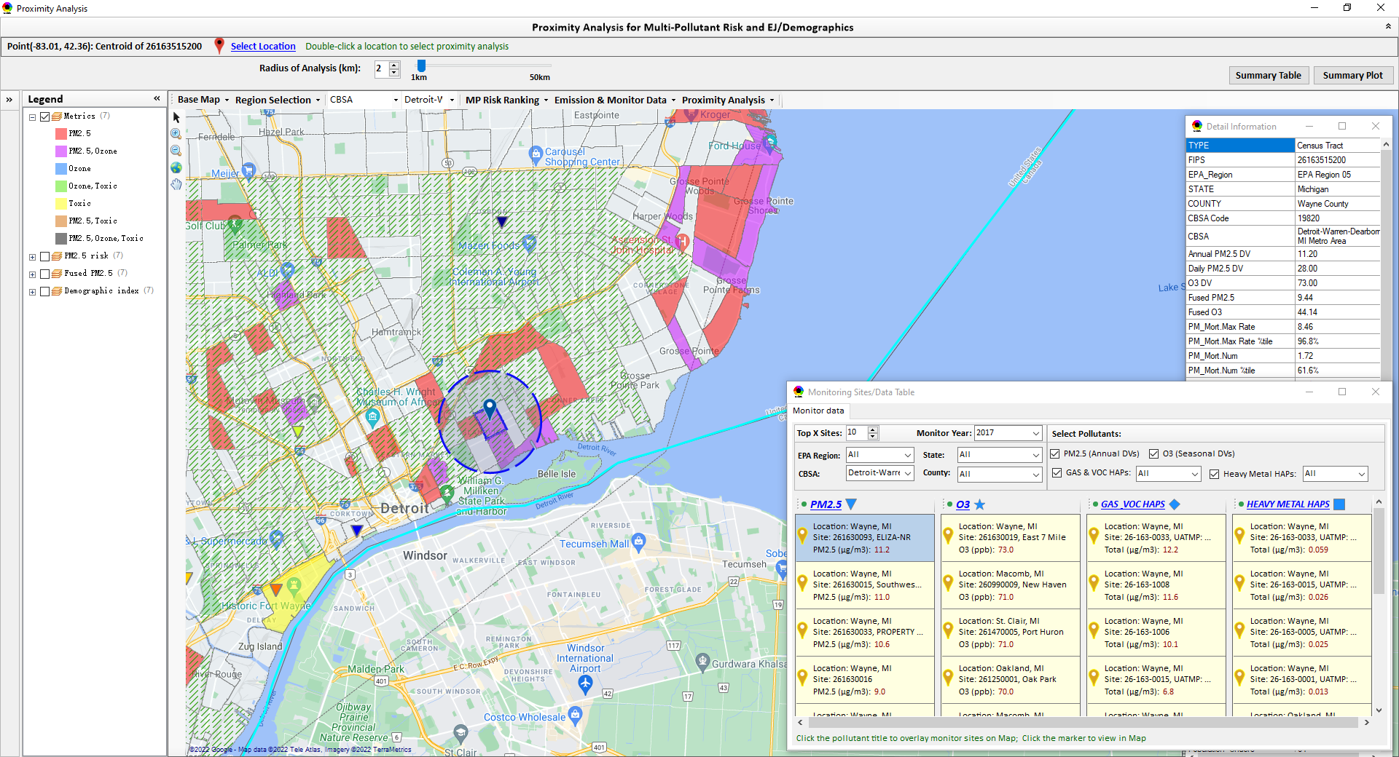
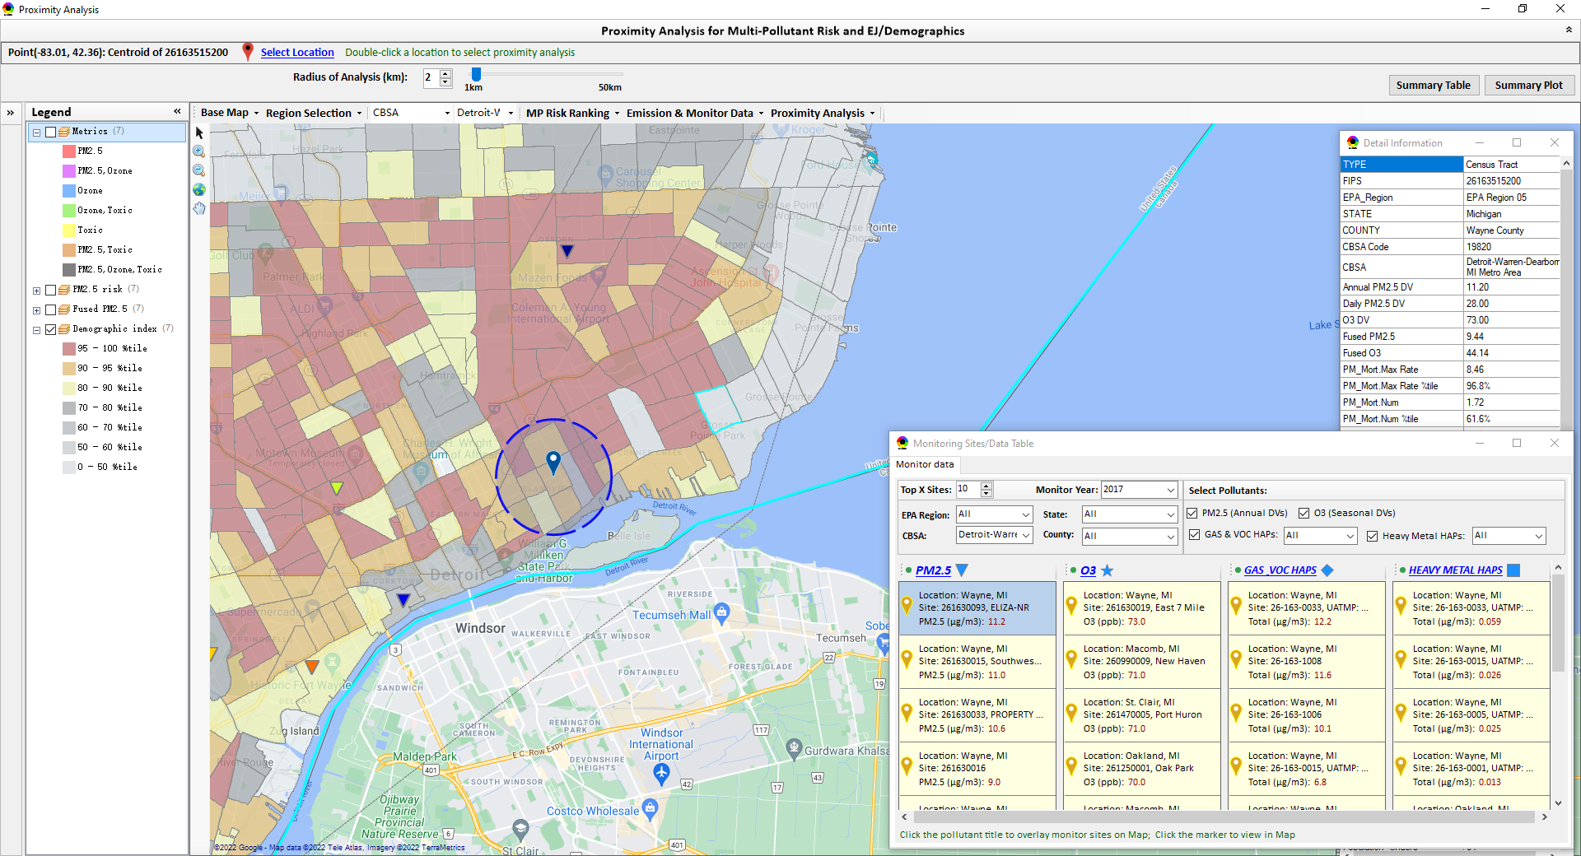
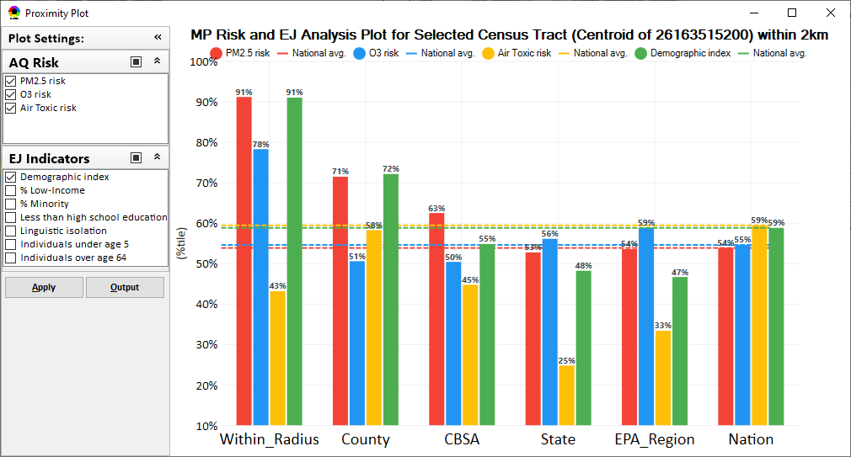
Example of Potential NEXUS Application:
Assessment of New Source Location for Permitting
Detroit
Detroit
Assessment of potential new source or monitoring site,
Detroit, MI
18

Slide 19
“NEXUS 2.3” Live Demo
19

Slide 20
“NEXUS 2.3”:
Quick Tutorial
Download “NEXUS” tool: The “NEXUS 2.3” package (“NEXUS 2.3 Setup.exe” & “NEXUS 2.3 Data.exe”: run both “*.exe” files to install) can be downloaded at EPA’s new FTP site:
https://gaftp.epa.gov/aqmg/cjang/NEXUS/MP_Team/NEXUS 2.3/*
Note: Require software installation privilege or “Power Broker” (limited elevated privilege) to install “NEXUS tool” at EPA’s PC; Check “This PC\Documents\My NEXUS files\data\* (\tool\*, \result\*)” to see if NEXUS program & input dataset are installed successfully
20

Slide 21
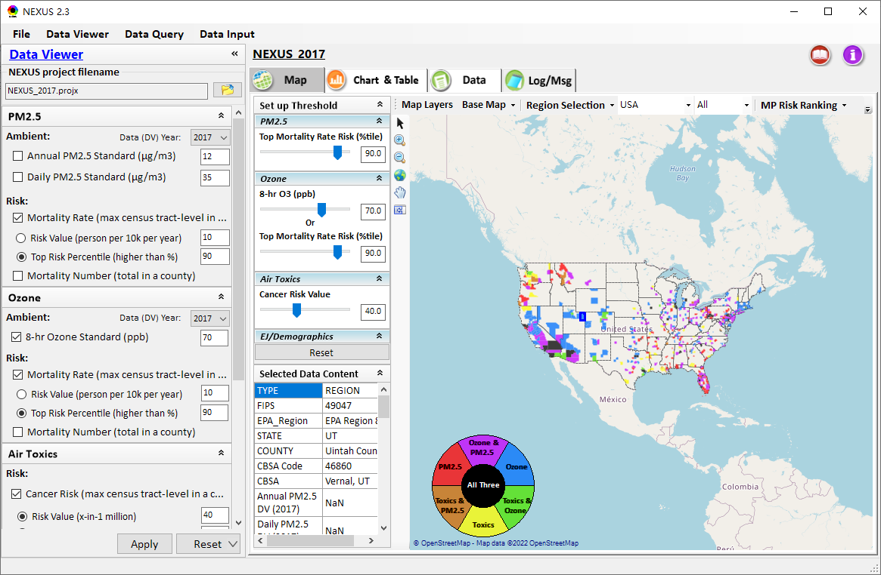
NEXUS Tool: On-line User’s Manual
Click “book” icon to launch “User’s manual”
Hot link to User’s manual’s “Data Viewer” chapter (same for “Data Input” module & “Data Query” model)
21

Slide 22
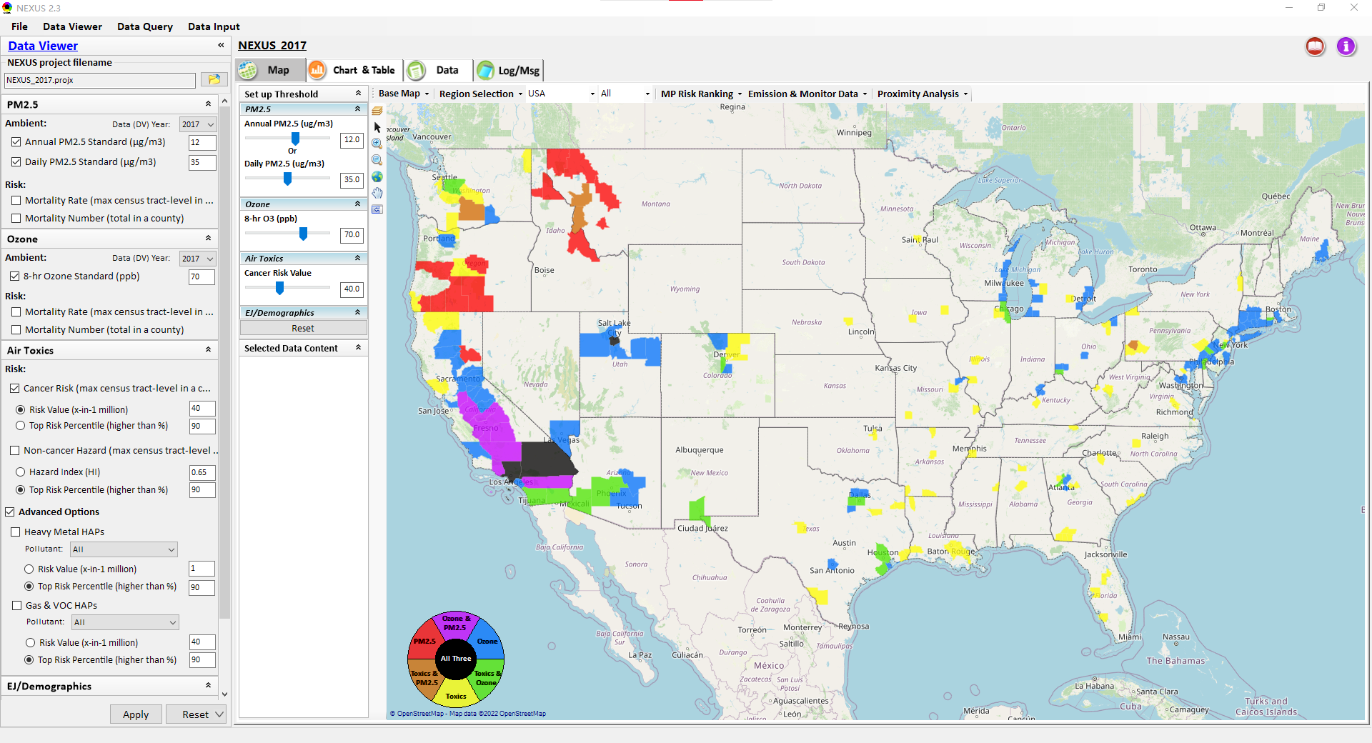
NEXUS Tool: Data Viewer Module
Click “File” to open or save a project
Switch between 3 key modules
NEXUS project file name
Select desired ambient data (DV) year (2013-2020)
Select & adjust “Ambient” or “Risk” levels
“Advanced Option”: provide HAPs & species selections
22

Slide 23
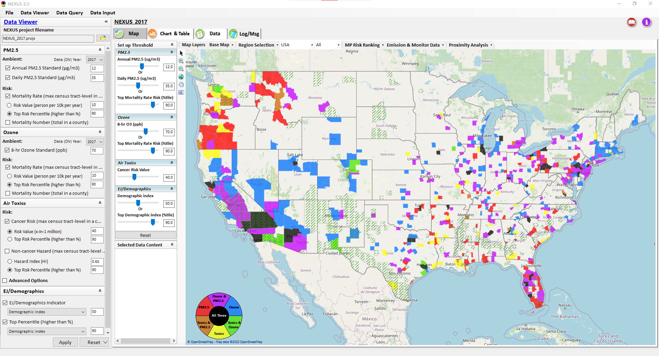
Data Viewer: “Apply” New Selections
“Check” boxes to add/remove selections
New selections will appear in “Slider bars” panel and map display
“Slider bars” allow to select & adjust “Ambient” and/or “Risk” threshold levels to display corresponding color map
“Apply” new selections
23

Slide 24

NEXUS Update: New EJ Metric and Data
New EJ/Demographic metric is displayed with “green dash” for counties exceeding selected threshold
24

Slide 25
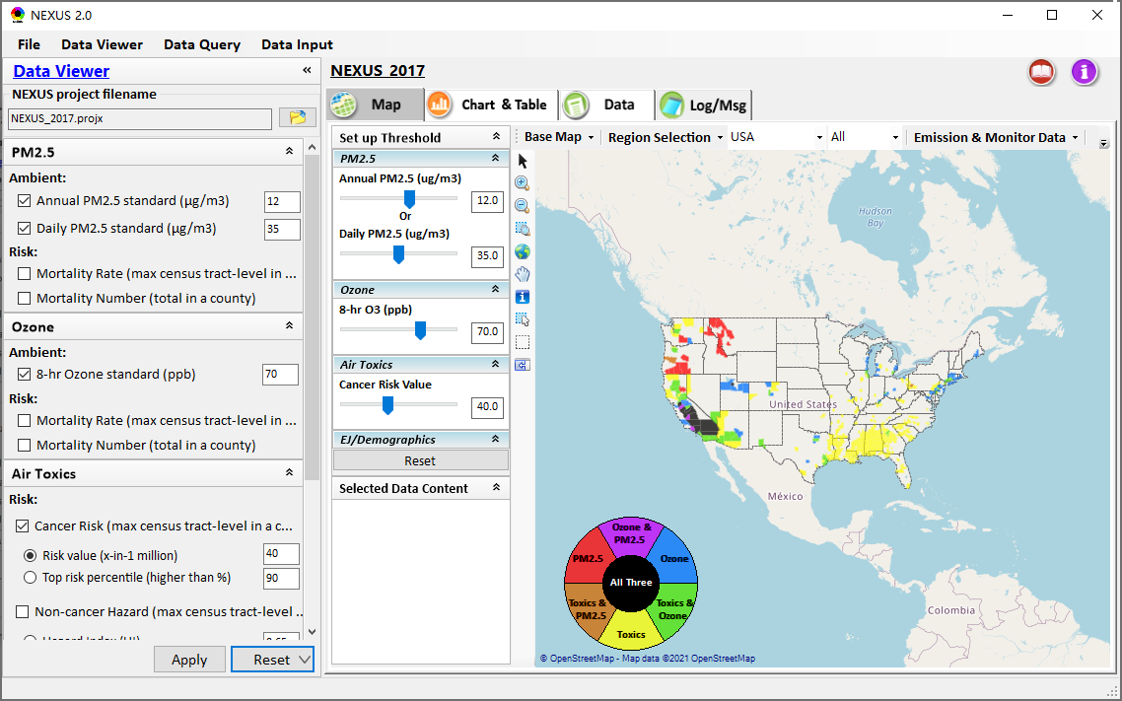
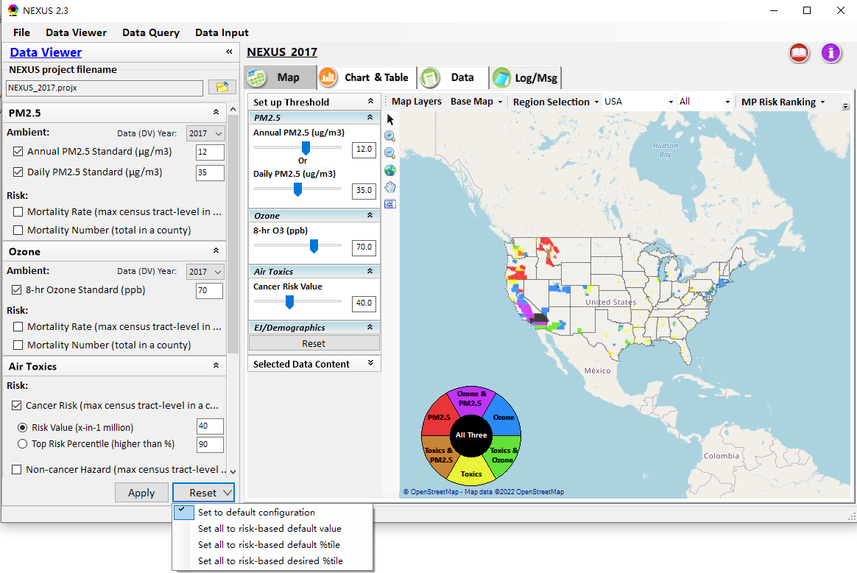
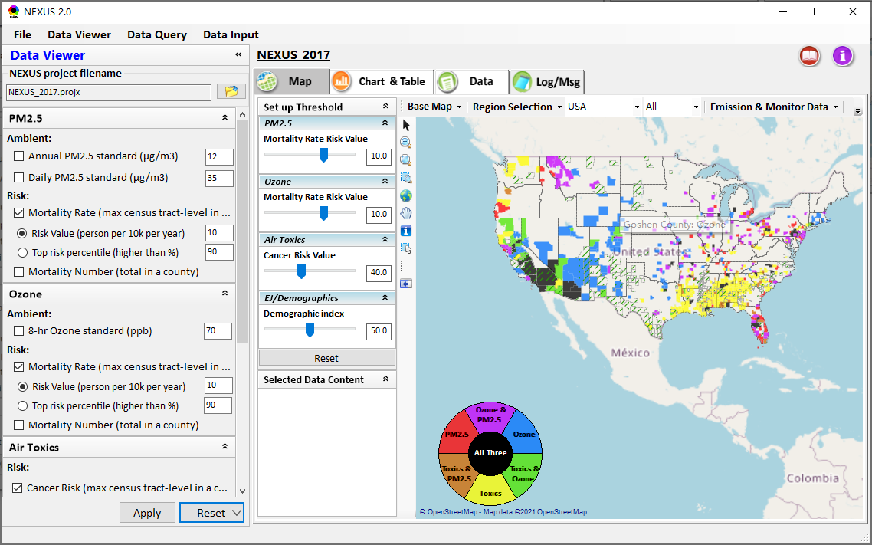
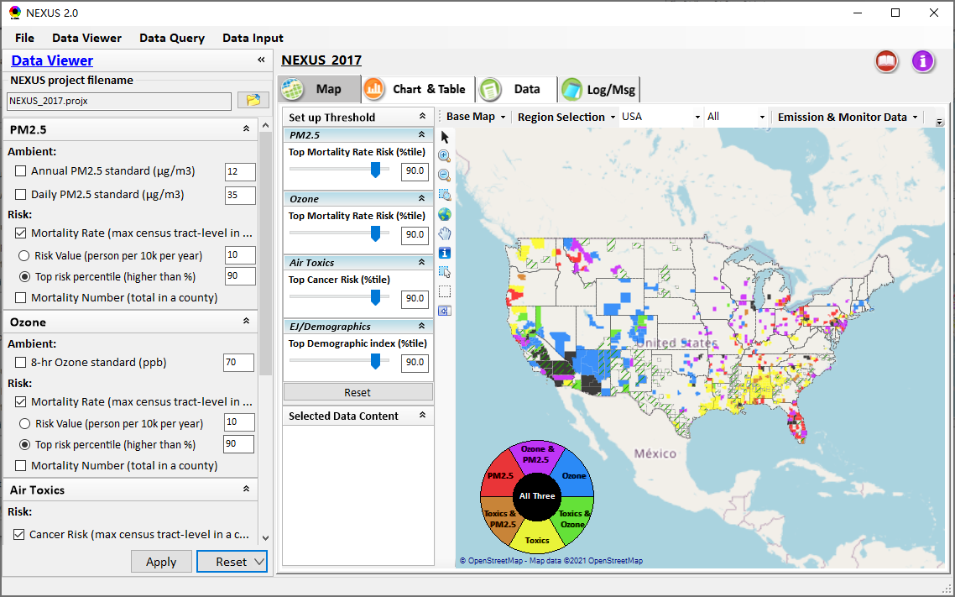
Data Viewer: “Reset” New Selections
default configuration
risk-based
“Reset” new selections
risk-based in %tile
25

Slide 26
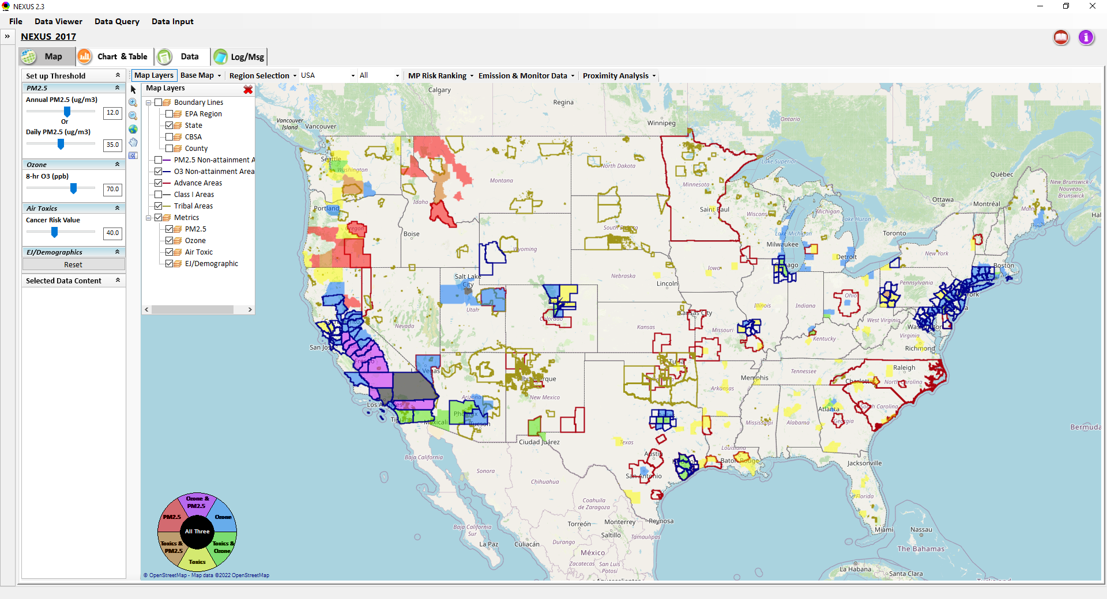
Data Viewer Module: Map Layers menu
Click “X” to close “Map Layers” menu
“Map Layers” menu: Provide (show/hide) map overlaps of various areas, AQ metrics and boundary lines
26

Slide 27
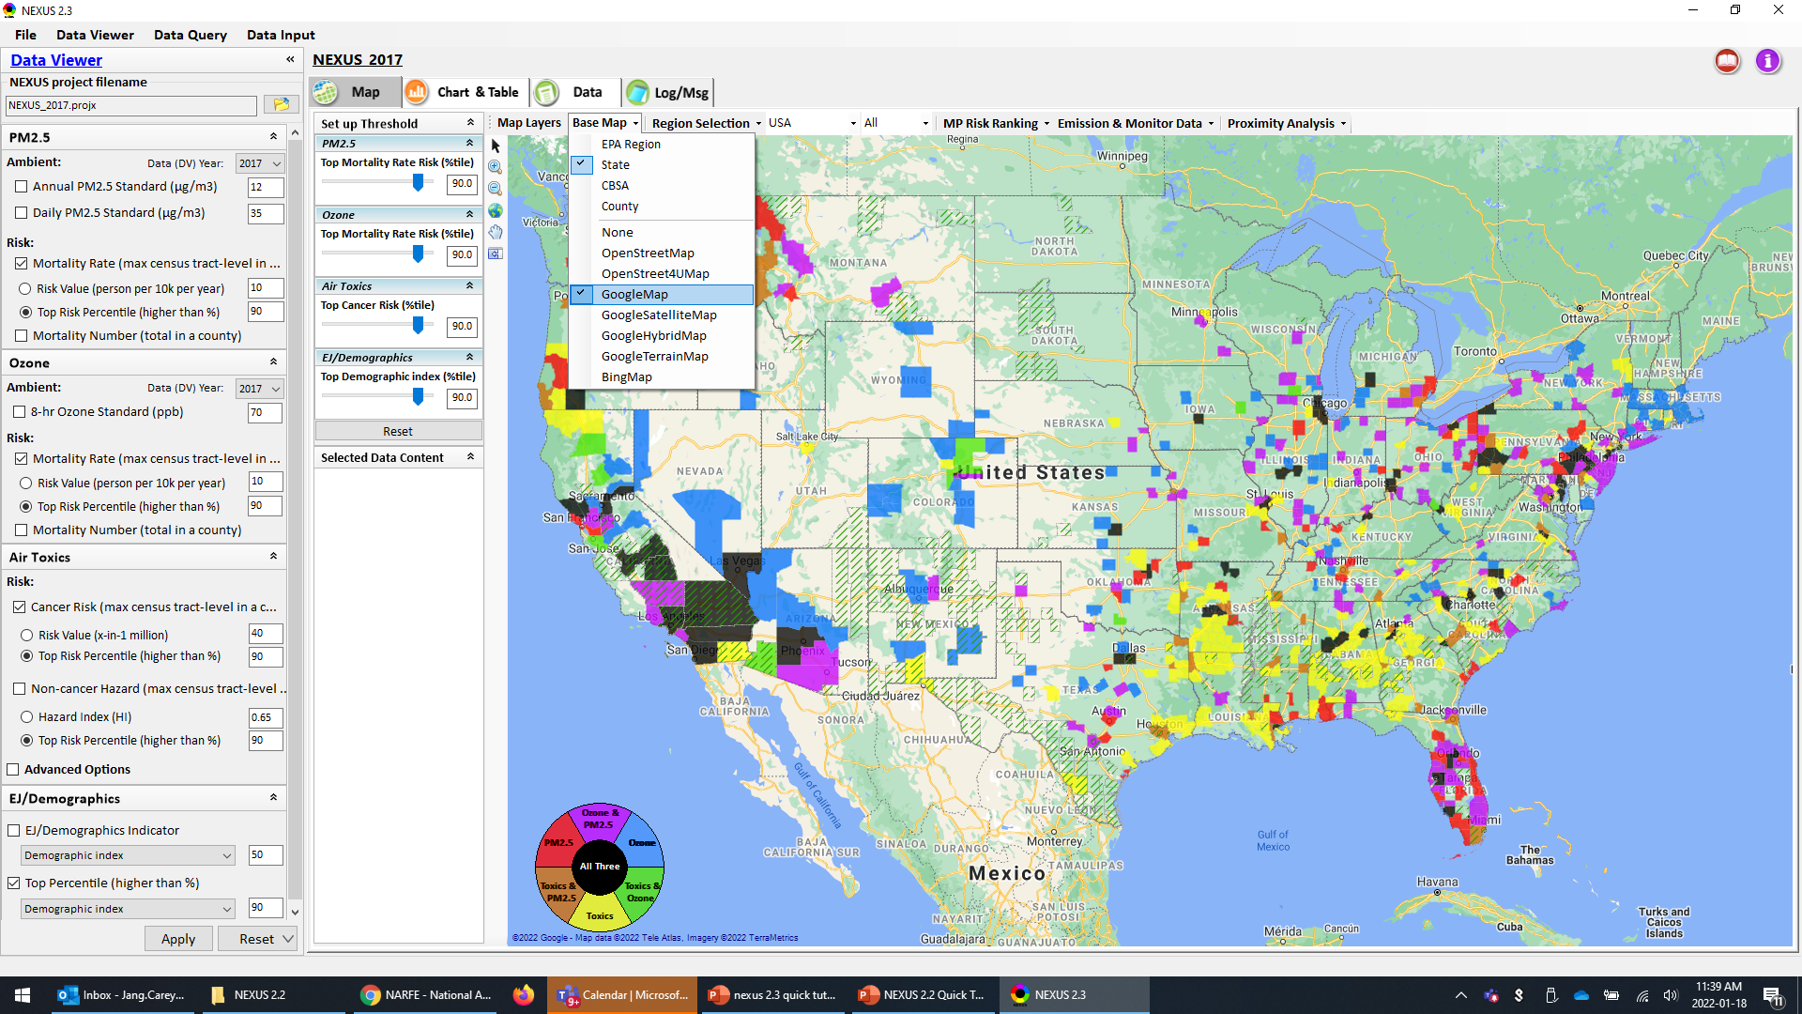
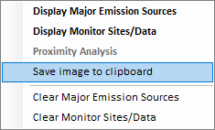
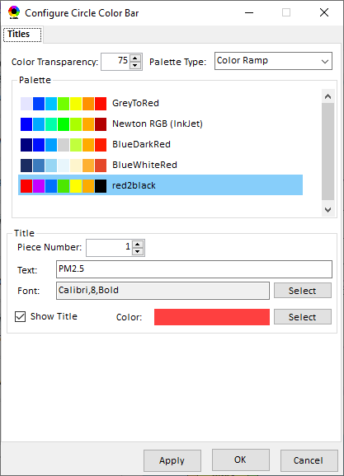
Data Viewer Module: Configure Base Map & Color
“Base Map” menu: Change boundary lines and background map (e.g., “Google Map”)
“Right-click” map to save map image
Click “color map” to change color & transparency
27

Slide 28
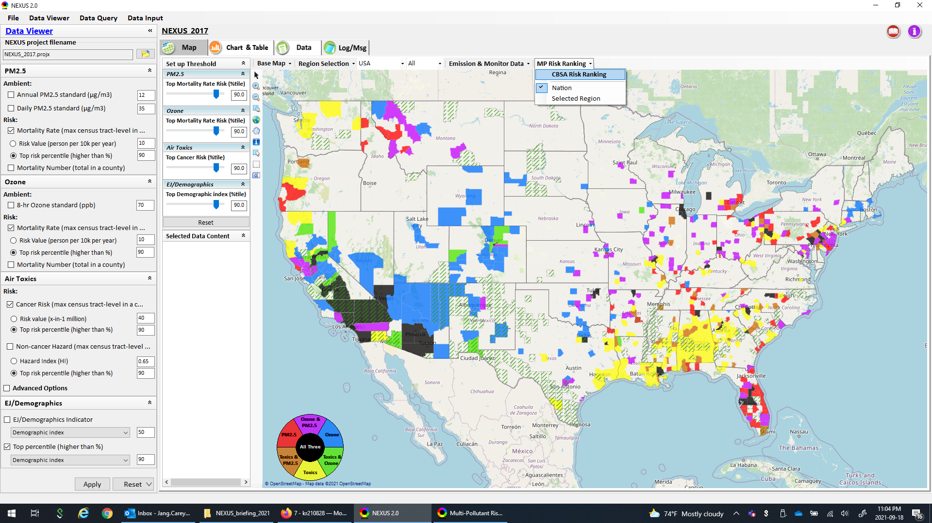
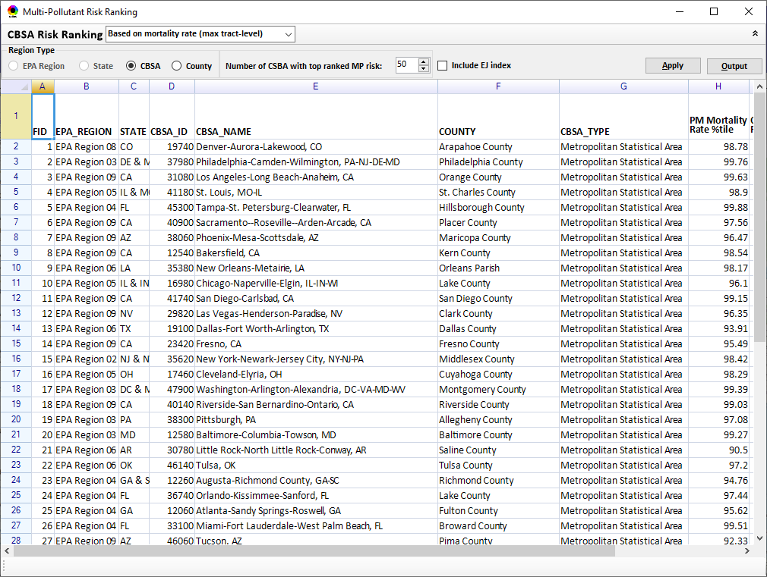
Data Viewer Module: MP Risk Ranking
“CBSA Risk Ranking”: provide MP risk ranking by CBSA or County
28

Slide 29
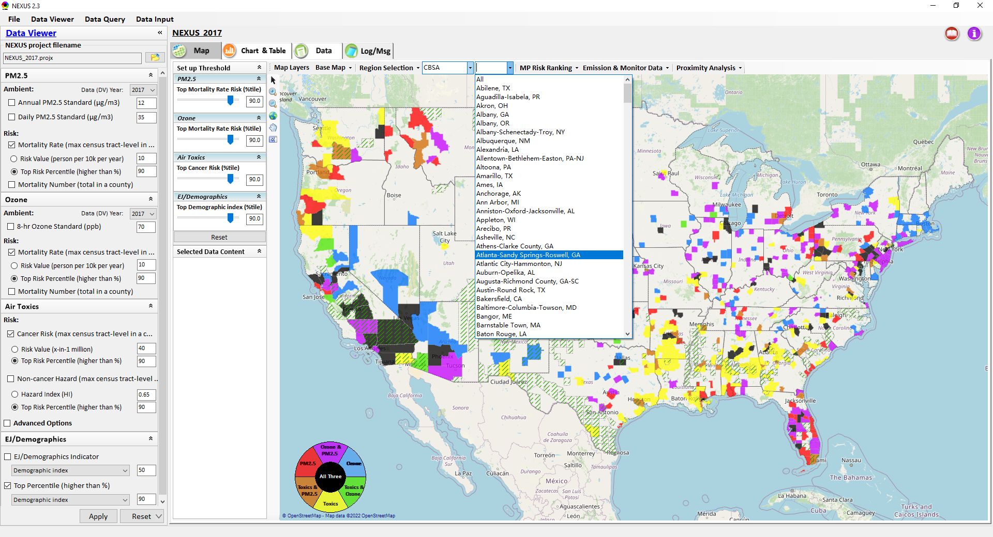
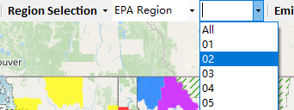
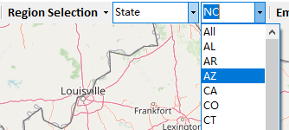
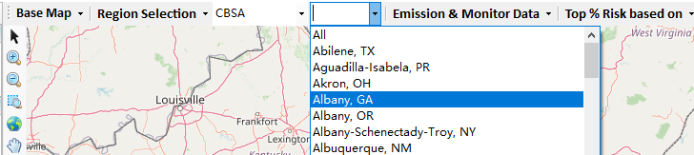
Data Viewer: “Region Selection”
Allow to select “EPA regions”, “States”, or “CBSA”
29

Slide 30
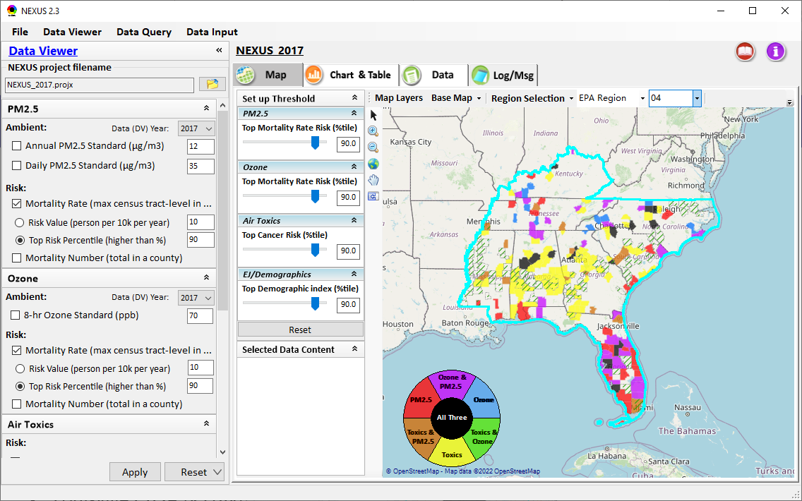
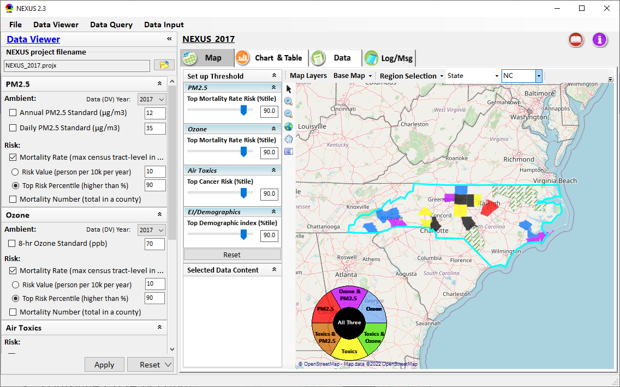
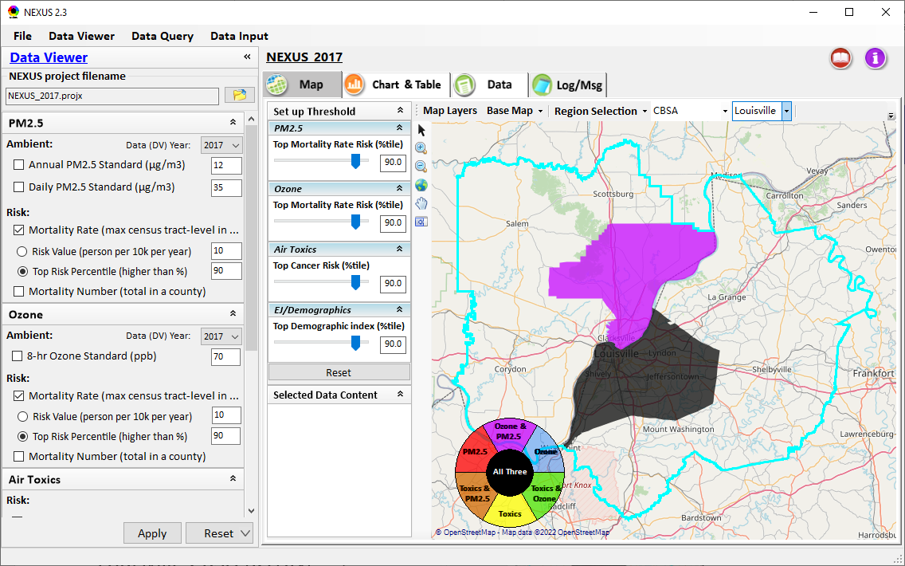
Data Viewer: Select EPA Region/State/CBSA
Examples:
EPA Region 4
State: NC
Louisville CBSA (KY/IN)
30

Slide 31
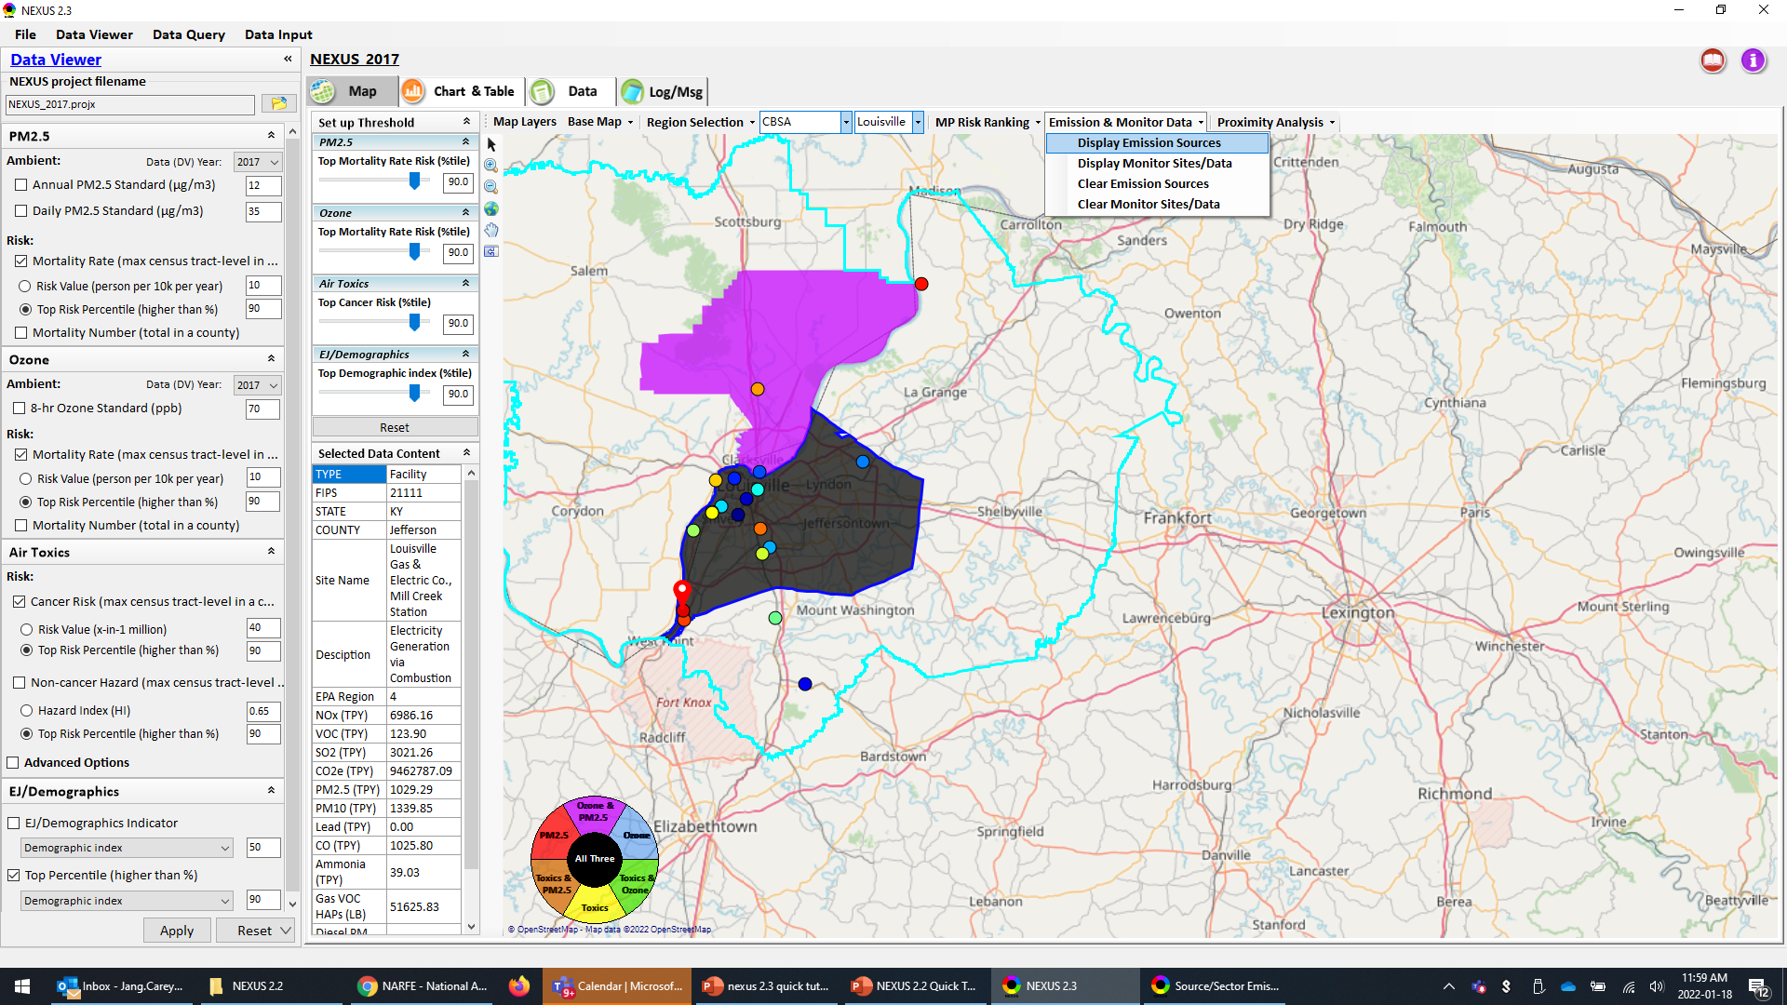
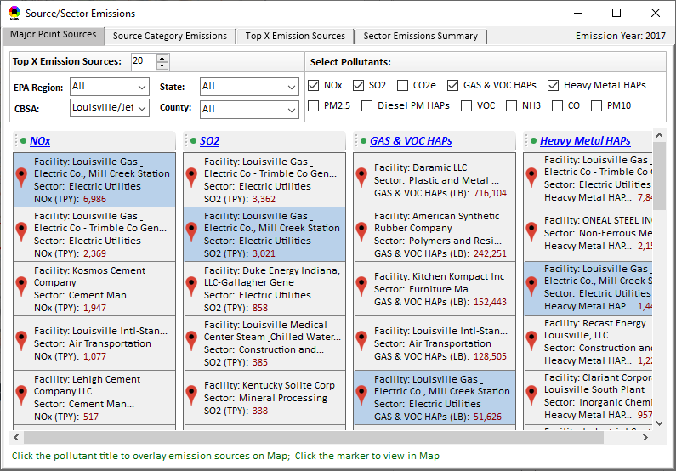
Data Viewer: Major Emission Sources
Click “Display Emission Sources” tab (or right-click) to display emission sources and launch new window
Click any “facility” to link & display source location and emitted pollutants information. Same facility emitting various pollutants can be identified with the same highlighted color.
31

Slide 32
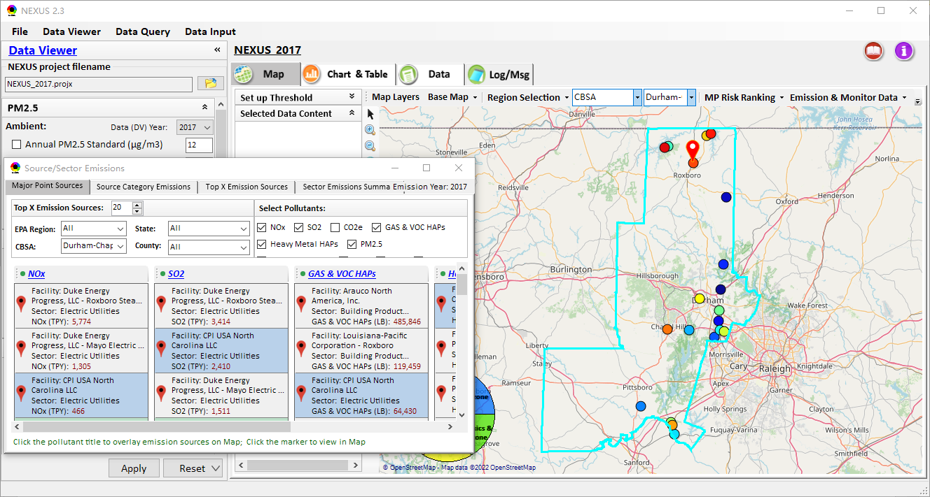
Data Viewer: Major Emission Sources
Allow to scroll down to CBSA-level (e.g., Durham CH CBSA ) or County-level
Durham CH CBSA
Emissions ranking by “color” of circles from red (higher) to blue (lower)
32

Slide 33
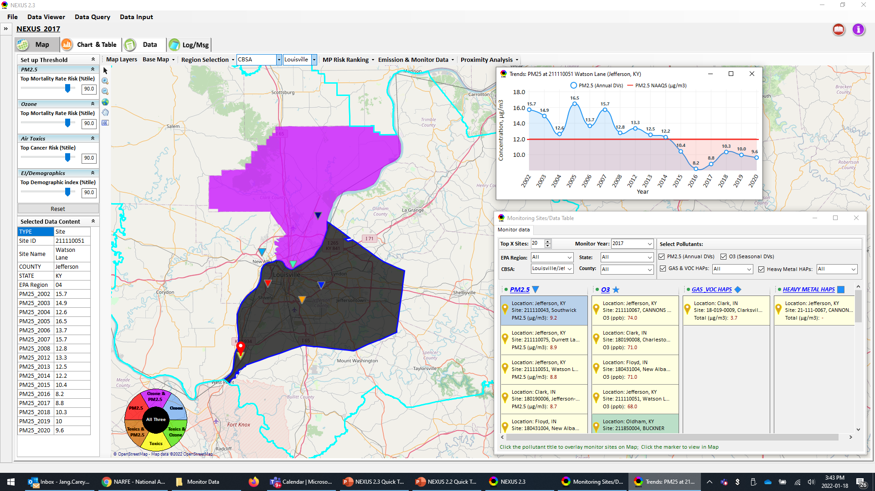
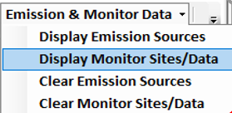
NEXUS: “Monitoring Data/Site” Module
Click menu (or right-click) to display “Monitor Sites/Data”
AQ trend
Monitor Site/Data
Click to display
AQ trend at monitor site
Use different symbol to display each pollutant’s “monitoring sites” e.g., PM_{2.5} (triangle), O₃ (star), etc.
Click to select monitor site & pollutant
33

Slide 34
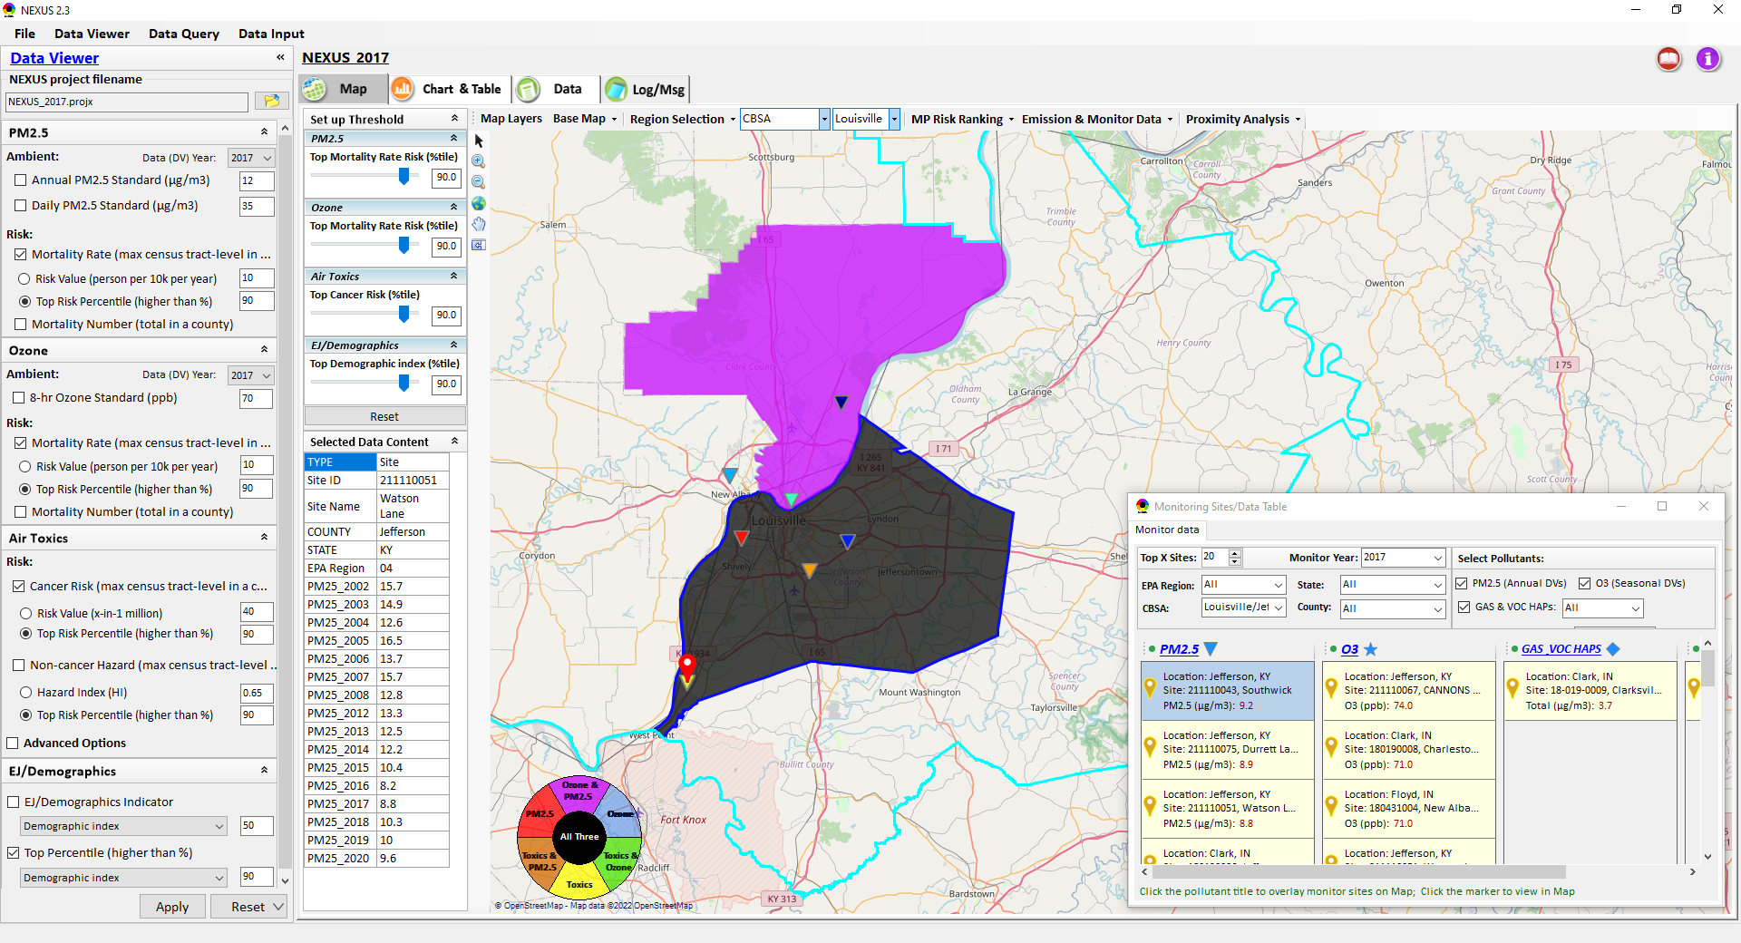
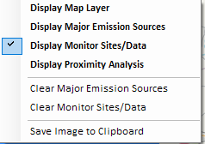
Two ways navigate to Proximity Analysis Module
Click menu (or right-click) to display “Proximity Analysis” module
Or click any facility, monitor site or a county, and then right-click on map and select “Display Proximity Analysis”.
34

Slide 35
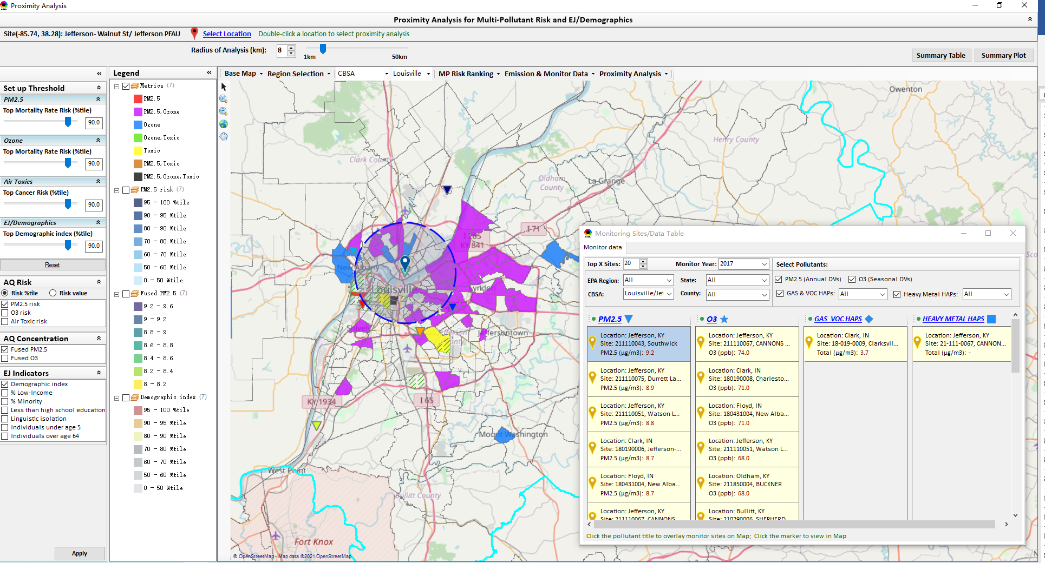
Proximity Analysis Module: Overlaying Map
“Set up Threshold” panel (similar to Data Viewer module) allows to identity those geographic areas exceeding the selected thresholds.
Check (Uncheck) to show (hide) an overlaying map
The AQ Risk/Concentration and EJ indicators configurations provide metric selections to overlay the MP and/or EJ analysis map.
35

Slide 36
Proximity Analysis Module: Overlaying Map
Click “Reset” button to reset all values to default (or to a specified %tile if all indicators are selected in %tile)
Provide a “toggle” choice to select “Risk %tile” or “Risk value”
36

Slide 37

Proximity Analysis Module: Legend Configure
Click any color tile to config the legend color & transparency
37

Slide 38






Proximity Analysis Module: Set the “Radius of Analysis”
Adjust the analysis radius
Click the “Select Location” and select a census tract, a monitor site or a facility in “Select Location” dialog
(b) Or Double-click a facility or monitoring site or a census tract to select proximity analysis center point
38

Slide 39


Proximity Analysis Module: Show Detail information
Click a facility or monitoring site or a census tract to show the detail information
39

Slide 40


Proximity Analysis Module: Summary Table/Plot
Summary table
Summary plot
Set the radius of analysis and the threshold of air toxics to show the summary results for selected point within radius
Emissions
Support to output the summary table as excel file (*.xlsx)
Select one or more indicators to plot the summary results for selected point within radius, county/CBSA/State/EPA Region and Nation avg.
40

Slide 41




Data Viewer: Top “x” Emission Sources
Provide selection of Facility & Source Category
Provide selection of Facility or Source Category
Durham county, NC
41

Slide 42

NEXUS Update: “Source Category Emissions”
“Source Category Emissions” module provide five source categories, including “Point”, “Non-Point”, “On-Road”, “Non-Road”, and “Event” emissions for the selected region, CBSA, or county.
For “Non-Point”, including Resident Wood Combustion emissions.
42

Slide 43


NEXUS Update: “Sector Emissions Summary”
“Sector Emission Summary” function allow to select major CBSAs and provides source and sector emissions summary to support “Sector Prioritization” effort
43

Slide 44




NEXUS Update: “Sector Emissions Summary”
Summary table
Summary plot
Emissions
Frequency & Rank
44

Slide 45

Data Viewer: EPA Region Table Generator
“EPA Region Table Generator” provides attainment status of O3 and PM2.5 and their DVs; also allows to select any EPA region based on data updated to 2020.
45

Slide 46

Data Viewer: Data Search & Filter
Click “+” to add filters; Click “x” to remove current filter;
Show specified records per page.
Click “Output data…” to output current page records or all records
46

Slide 47

Data Input Module: Data Preview
“Transparency” & “Open-Source”:
All NEXUS input/output data files are available under:
“This PC\Documents\My NEXUS files\Data (\Result)”
Check to use filter to query data
Select a table to view if there are multiple tables in the selected data source file
Click to change input data file
Click to view data
Click to run & save project
47

Slide 48

Data Query Module: Overlaying Map
Region Selection
Data Query Configuration
Data Query qualifier selection
Overlaying Map selection
48

Slide 49

Data Query Module: Configure Data Query
“Data Query Filter” allows to select “qualifiers” for query
“Data Query Preview” displays the selected “qualifiers” at the same time
49

Slide 50


Data Query Module: Attribute Table
Filter/search/export functions
Detachable “Attribute Table”
50

Slide 51


Data Query Module: Attribute Table
Click a “record” to link and display its location & info.
51

Slide 52
Quick Tutorial Slides
End
52

