Slide 1
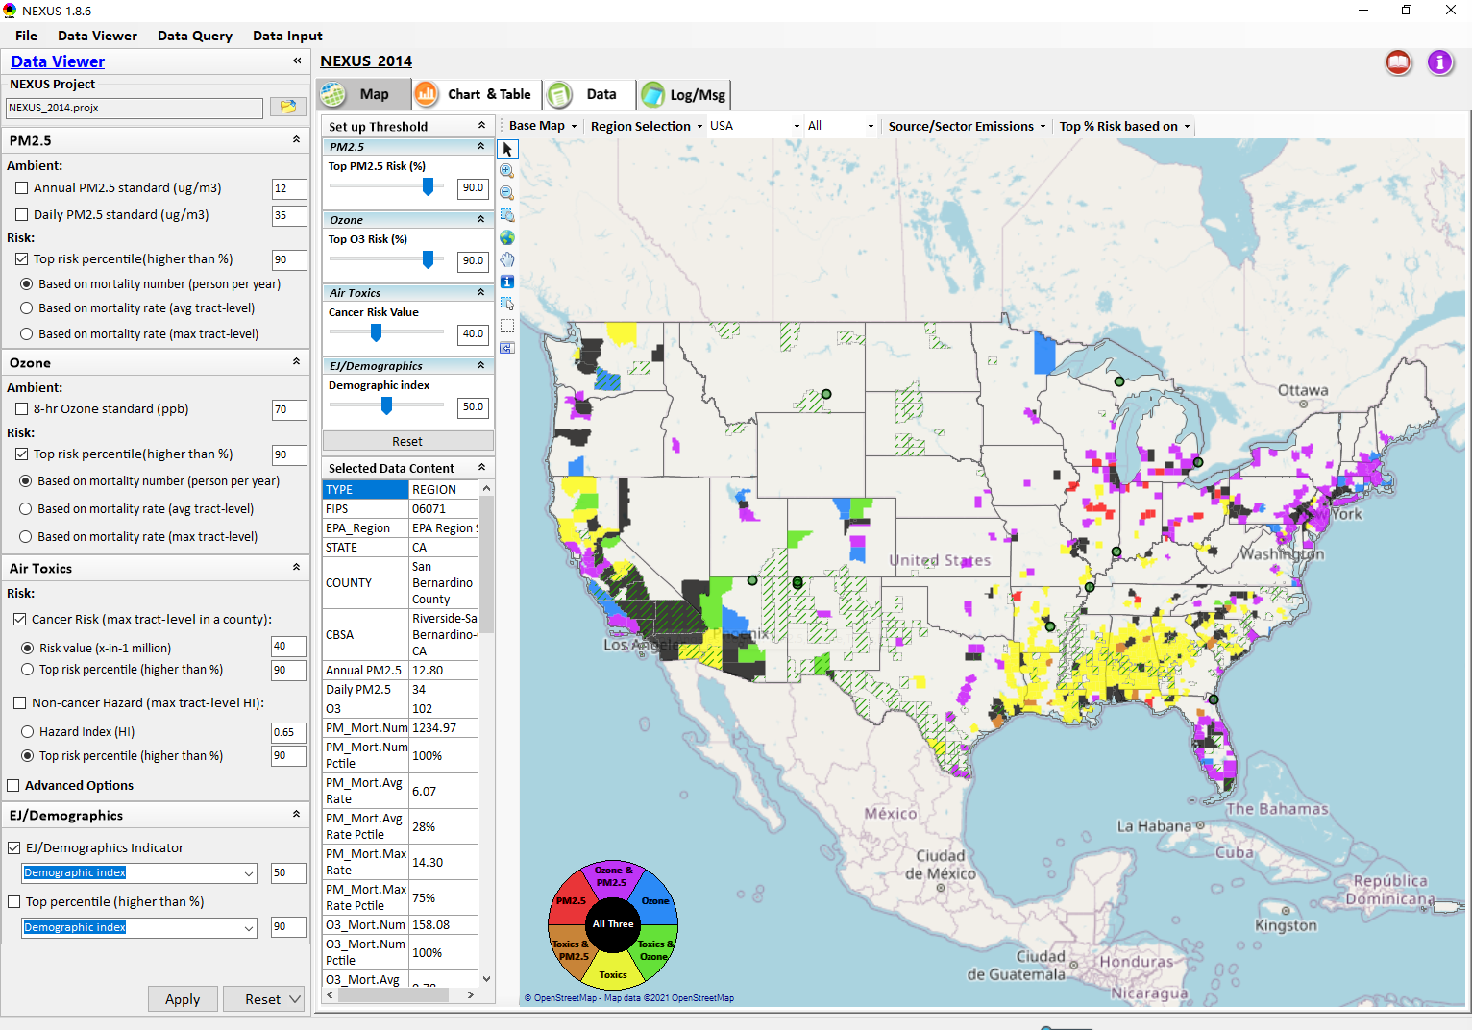
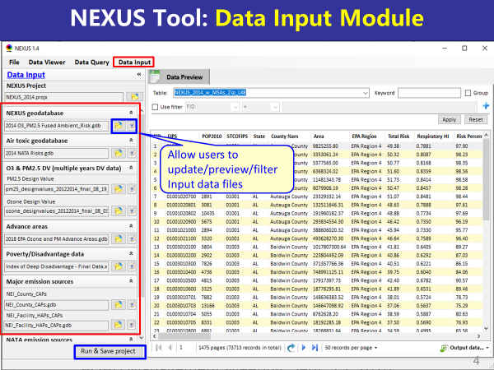
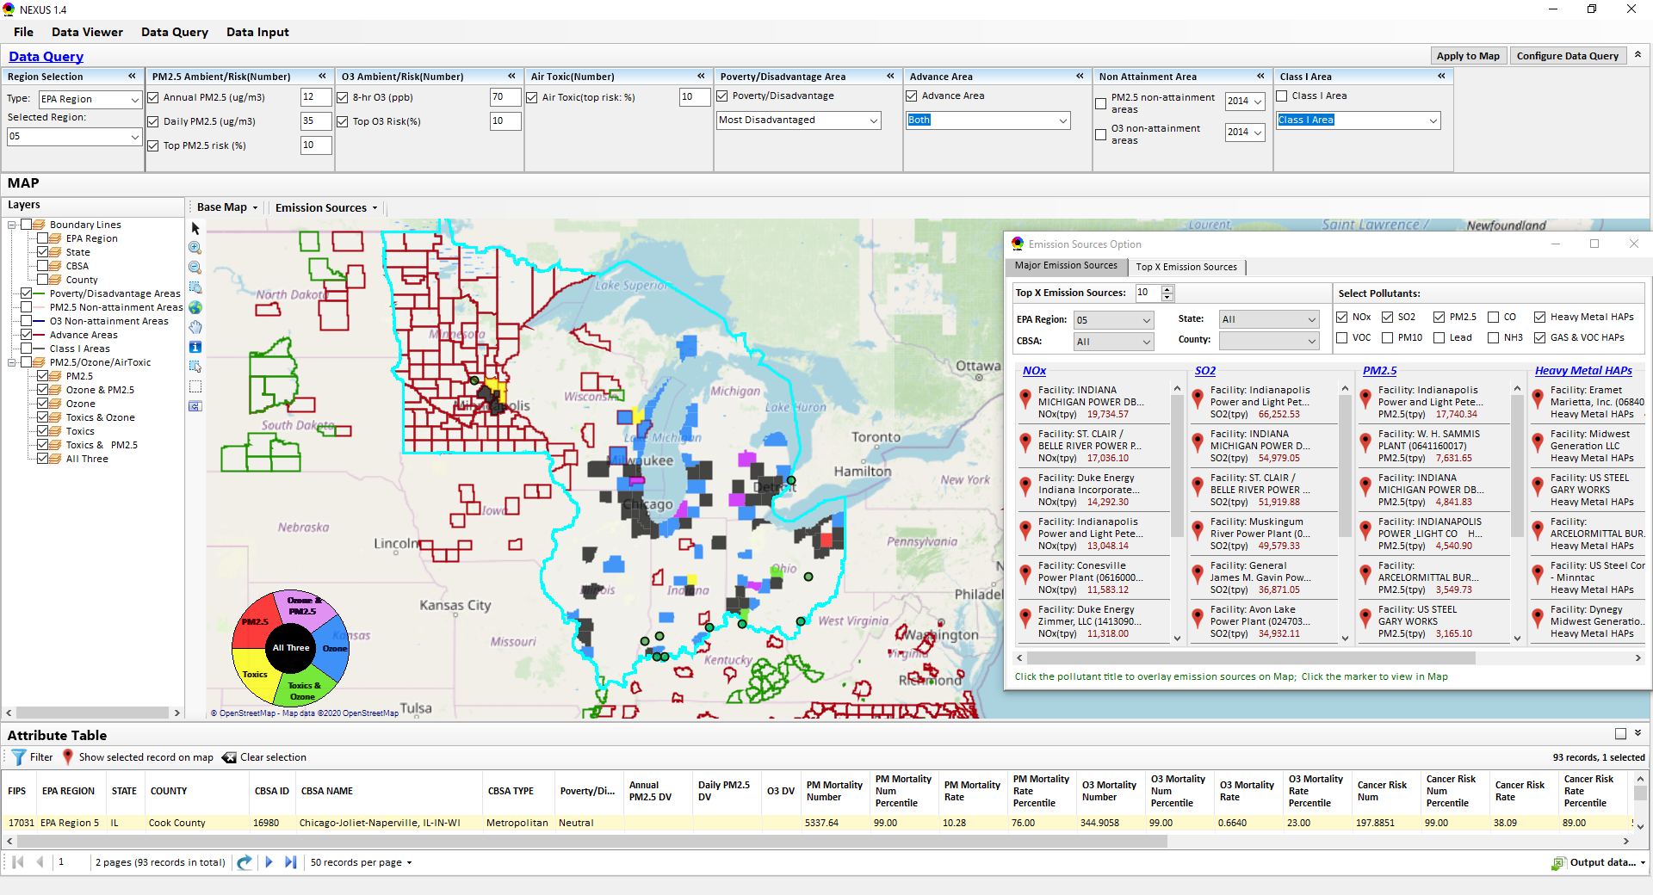
“NEXUS” Multi-Pollutant Analysis Tool:
Development Status and Progress
Data Viewer Module
Data Input Module
Data Query Module
“NEXUS 1.8.6” available at:
https://gaftp.epa.gov/Air/aqmg/cjang/NEXUS/
OID Briefing
July 19, 2021
OAQPS’s Multi-Pollutant Team: Beth Landis, Carey Jang, etc.
1

Slide 2
Overview
Multi-Pollutant Background
NEXUS
  Tool Development
  Expected Use
  Key Modules
  Examples
NEXUS and EJSCREEN
Proximity Screening Analysis
Recent Updates & Next Steps
NEXUS Tool (v. 1.8.6) Demo
2

Slide 3
Multi-Pollutant (MP) Background
Support a comprehensive, MP treatment of air quality problems to effectively improve air quality and make the most efficient use of available resources
  Primary Goal - identify & evaluate local control strategies targeting emissions of O₃ & PM_{2.5} and their precursors while at the same time reducing Air Toxics of concern for communities to maximize both health benefits and air quality improvements
MP planning has the potential to reduce the costs and increase benefits associated with air quality management (AQM)
Supports S/L/T air agencies in developing MP, risk-based AQM plans and implementing strategies that reduce air pollution emissions & improve public health
Success has been demonstrated in Detroit and SC; another project is currently underway in Louisville, KY
Tools needed to analyze MP data are either available currently or being developed in OAQPS (e.g., NEXUS)
3

Slide 4
NEXUS Tool Development
Motivation: Develop a new multi-pollutant analysis tool to identify and assess areas with high ambient levels and/or health risks associated with PM_{2.5}, O₃ and Air Toxics
Phase-1: Develop a GIS-based NEXUS prototype with a user-friendly graphical interface to provide analysis and visualization functions of potential multi-pollutant AQ issues at national level (continental US)
Phase-2: Expand the NEXUS tool to allow users to dial into an EPA region, State, or metropolitan area and provide data query and visualization functions for “emissions and air quality” information over the selected region of interest
4

Slide 5
Expected Use of NEXUS Tool
The NEXUS tool will allow users to do the following:
  National screening for areas with MP issues: Phase 1 development provides ability to quickly screen areas across nation that have combination of high air quality and/or risk levels for O₃, PM_{2.5} and Air Toxics.
  Area screening to understand nature of MP problem: Phase 2 development provides ability to ‘dial-into’ specific areas to determine extent to which common emissions sources are causing the MP issues.
We expect to use this tool to engage with Regions and identify areas that would potentially benefit most from MP approaches to reduce emissions (including current NA areas).
The NEXUS tool will essentially provide a ‘conceptual model’ of MP issues to facilitate engagement with state/local/tribal agencies and community stakeholder groups.
We also expect that it can have additional uses across the Office for Air Toxics, Environmental Justice and other programs.
5

Slide 6
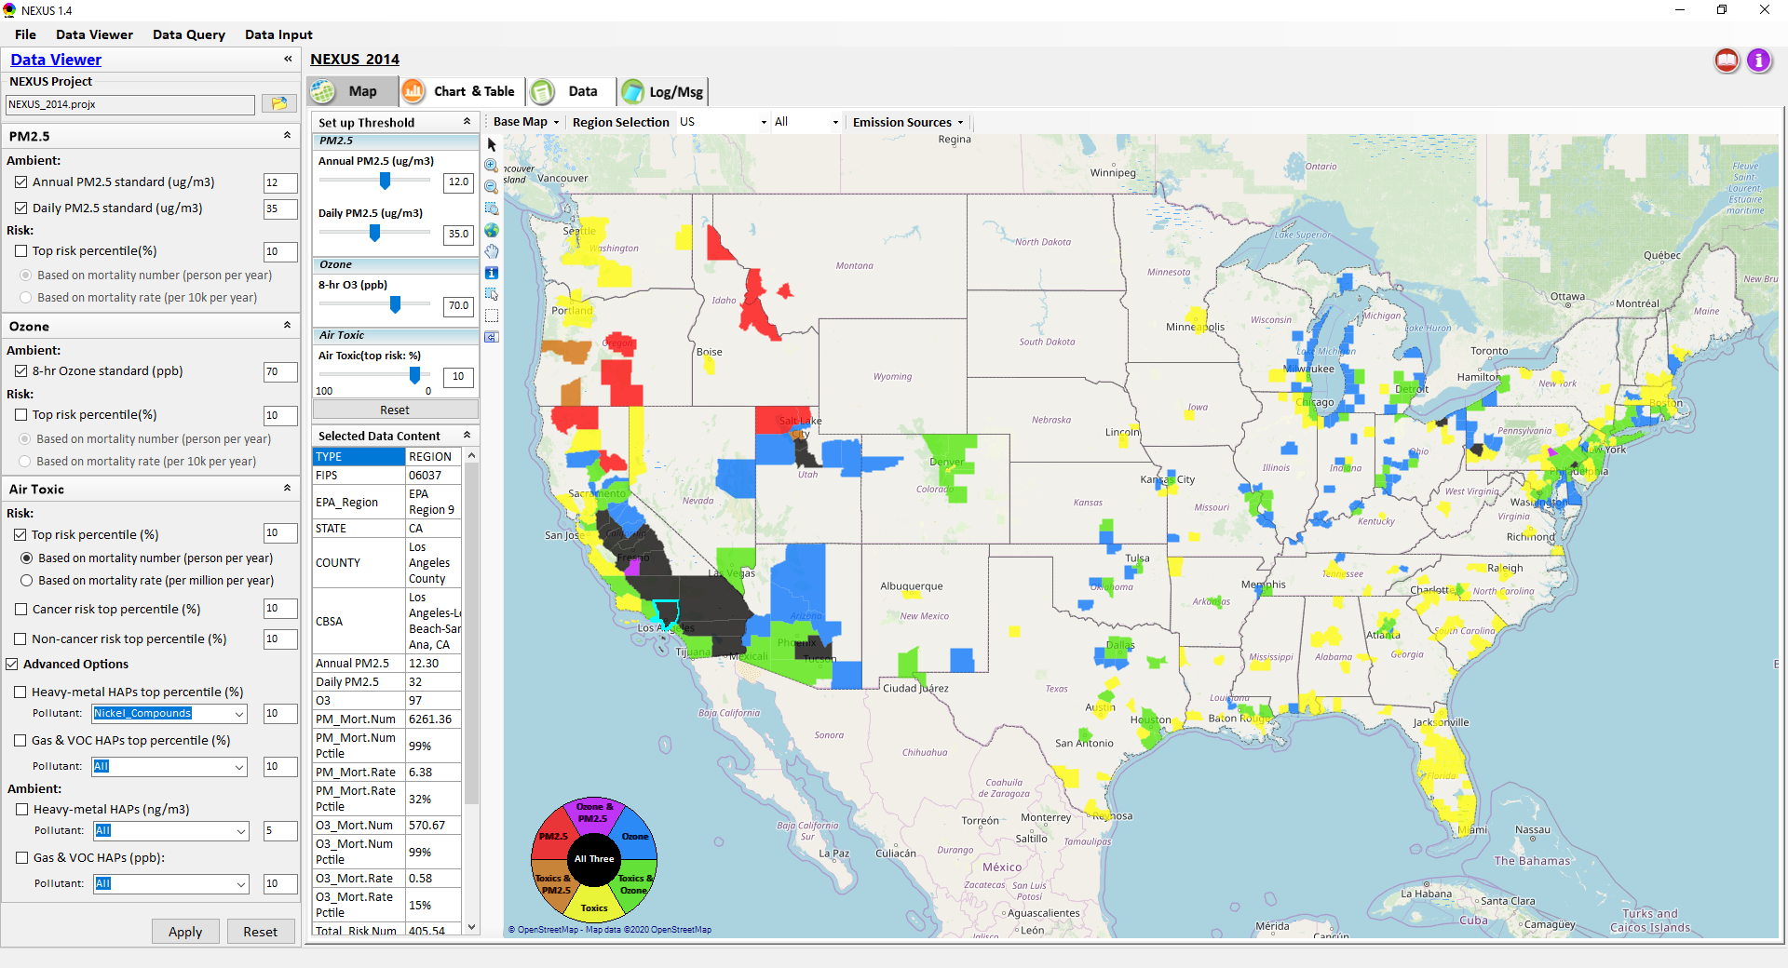
NEXUS Tool: Three Key Modules
Data Viewer module
Data Input module
Data Query module
View and create interactive Map/Data/Chart/Table
Provide flexible selections & mapping of “Ambient” and/or “Risk” levels of PM_{2.5}, O₃ and Air Toxics
Provide regional analysis for “EPA region”, “States”, “CBSA”, and “County”
Link and display major emission sources locations & emitted pollutants info.
Allow to update & change input data files
Provide data preview and filter functions
Currently uses 10 publicly available input data files (~4GB)
Quick turnaround to run & save to a new “project” using new input data files
Expand data field selections and flexibility for exploratory/advanced users
Provide overlaying map and summary table for data query results
Current data query based on selected data fields: “Ambient/Risk, Advance area, Socio-demographic (EJ) area, NA Area, Class I area”
6

Slide 7
NEXUS Tool: Examples
How can NEXUS be used to identify highest risk areas across O₃, PM_{2.5}, and Air Toxics, summarize the source(s) contributing to communities with possible EJ concerns, and review specific industrial sources for potential impacts?
  Example 1 → Detroit
How can NEXUS be used to identify the nature of multi-pollutant risks in areas with EJ concerns?
  Example 2 → Memphis
7

Slide 8
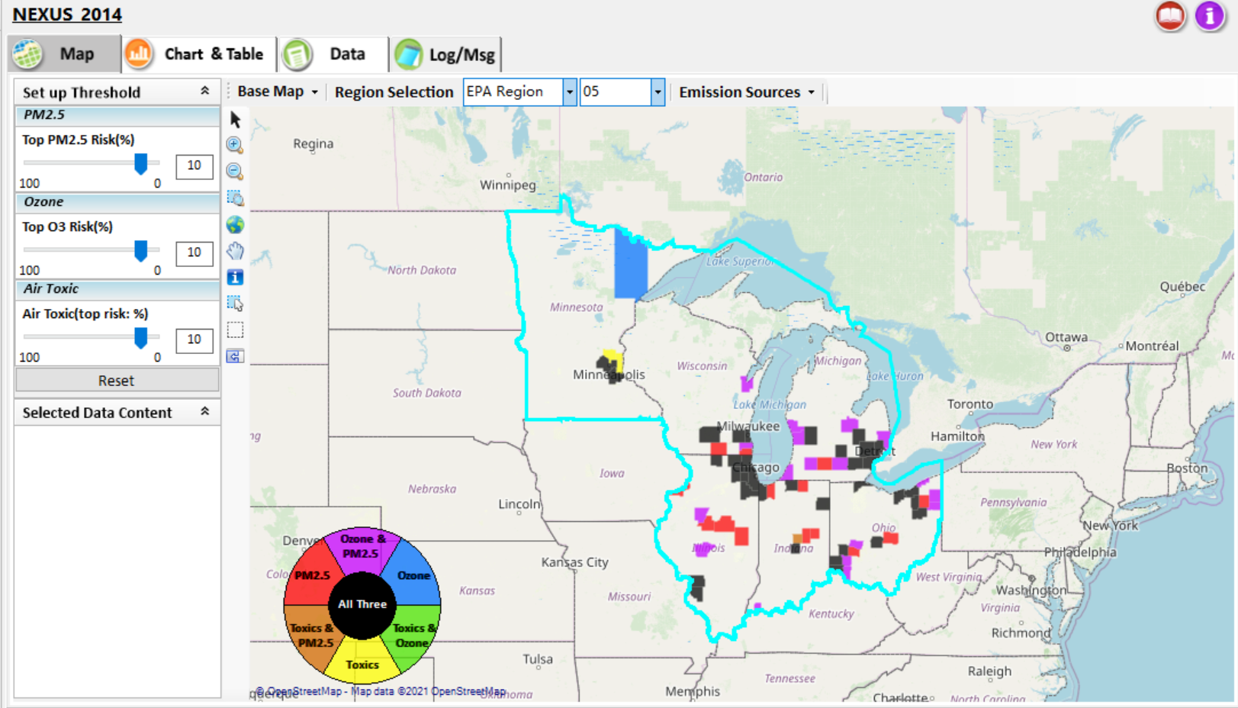
NEXUS Tool: Example 1 - Identify High MP Risk Areas, Contributing Source(s) & Potential Impact to Communities with EJ concerns
NEXUS can be used to identify highest risk areas across O₃, PM_{2.5}, and Air Toxics.
Example map above is for Region 5
8

Slide 9
NEXUS Tool: Highest MP Risk Areas in R5
(Data Query Module)
STATE | COUNTY | CBSA NAME | PM Mortality Num % | O3 Mortality Num % | Total Risk Num % | Overall Rank | Poverty / Disadvantage | Advance Area Type
IL | Cook County | Chicago-Joliet-Naperville, IL-IN-WI | 99 | 99 | 99 | 1 | Neutral
MI | Wayne County | Detroit-Warren-Livonia, MI | 99 | 99 | 99 | 1 | Disadvantaged
MI | Oakland County | Detroit-Warren-Livonia, MI | 99 | 99 | 98 | 2 | Advantaged
OH | Cuyahoga County | Cleveland-Elyria-Mentor, OH | 99 | 99 | 98 | 2 | Disadvantaged
OH | Franklin County | Columbus, OH | 99 | 99 | 98 | 2 | Neutral
IN | Marion County | Indianapolis-Carmel, IN | 99 | 98 | 98 | 3 | Disadvantaged
OH | Hamilton County | Cincinnati-Middletown, OH-KY-IN | 99 | 98 | 97 | 4 | Disadvantaged
WI | Milwaukee County | Milwaukee-Waukesha-West Allis, WI | 99 | 98 | 97 | 4 | Disadvantaged | PM
MN | Hennepin County | Minneapolis-St. Paul-Bloomington, MN-WI | 98 | 98 | 98 | 4 | Advantaged | Both
IL | DuPage County | Chicago-Joliet-Naperville, IL-IN-WI | 98 | 97 | 98 | 5 | Most Advantaged
MI | Macomb County | Detroit-Warren-Livonia, MI | 98 | 98 | 97 | 5 | Advantaged
OH | Montgomery County | Dayton, OH | 98 | 98 | 95 | 6 | Disadvantaged
IN | Lake County | Chicago-Joliet-Naperville, IL-IN-WI | 98 | 97 | 95 | 7 | Neutral
OH | Summit County | Akron, OH | 98 | 97 | 95 | 7 | Neutral
IL | Lake County | Chicago-Joliet-Naperville, IL-IN-WI | 97 | 96 | 97 | 7 | Advantaged
NEXUS can be used to identify highest risk areas across O₃, PM_{2.5}, and Air Toxics. Information above was generated in Data Query for Region 5 and exported into excel where rankings were applied.
Top CBSAs (using this approach) – Chicago, Detroit, Cleveland, Columbus, Indianapolis, Cincinnati, Milwaukee, Minneapolis, Dayton & Akron
9

Slide 10
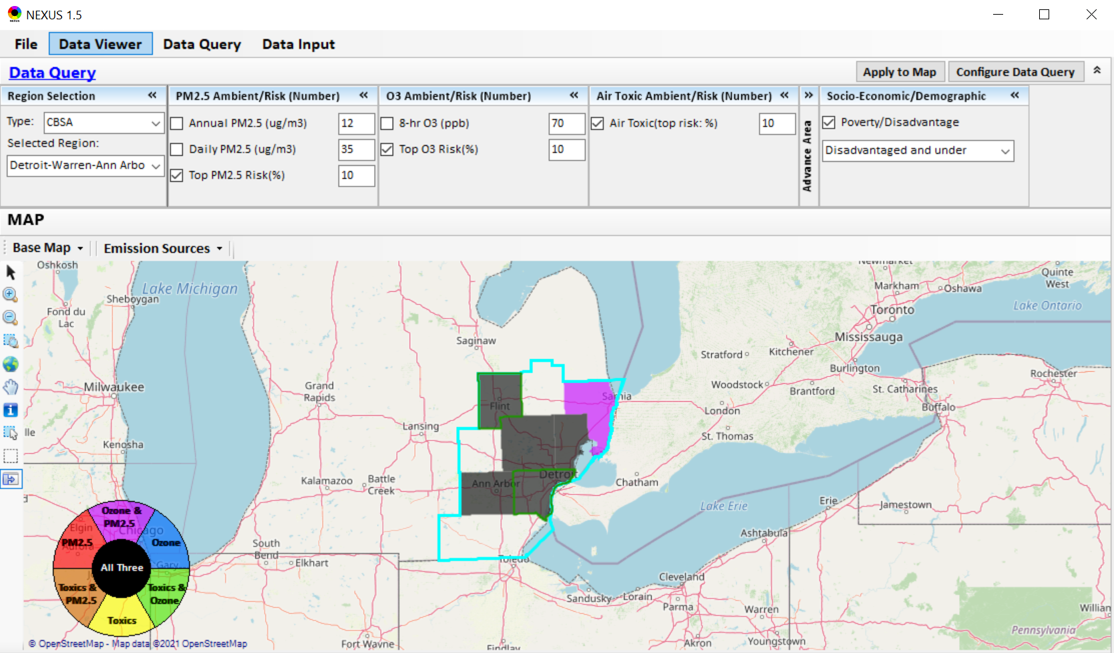
NEXUS Tool: Detroit CBSA
NEXUS can be used to explore CBSAs with multi-pollutant concerns. This information was generated in Data Viewer for the Detroit CBSA. Two counties (Wayne & Genessee) are outlined in green, showing that they are “disadvantaged or under”. Let’s explore where the major sources are located in the CBSA…
10

Slide 11
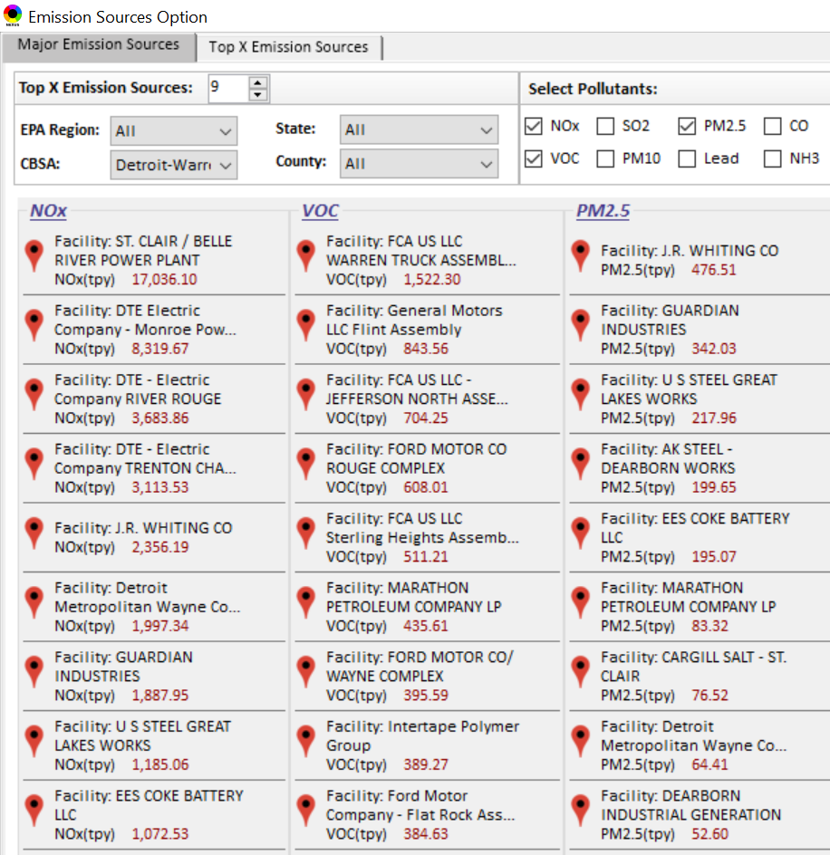
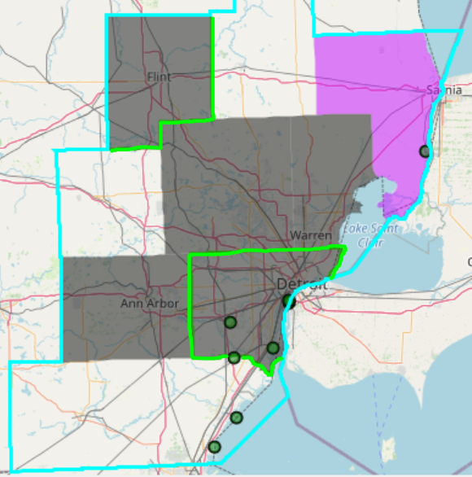

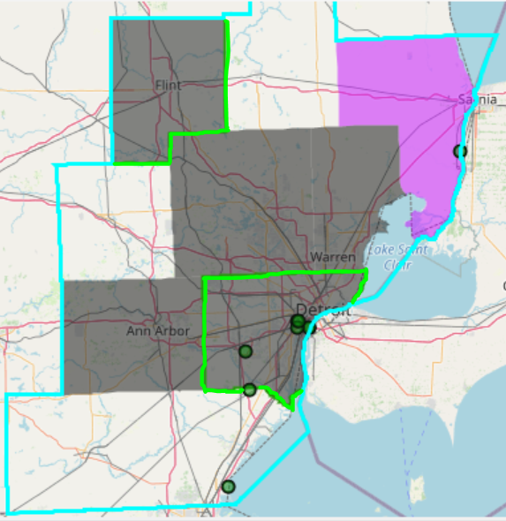
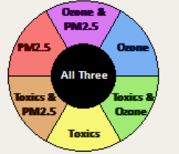
NEXUS Tool: Emissions Sources in Detroit CBSA
G
S
G
S
Ma
Ma
S
Ma
M
W
W
M
G
M
M
M
W
W
W
Top NOx Emission Sources
Top VOC Emission Sources
W
W
W
M
Ma
W
G
S
W
W
W
Ma
M
W
S
W
W
S
W
W
W
W
M
G = Genessee Co., Ma= Macomb Co., M= Monroe Co., S = St. Clair Co., W = Wayne Co.
Top PM_{2.5} Emission Sources
NEXUS can be used to identify top emission sources. The information above was generated in Data Query for the Detroit CBSA . We can quickly see that the majority of the NOx, VOC & PM_{2.5} emission sources are located in Wayne County. Let’s explore the Wayne County sources further…
11

Slide 12
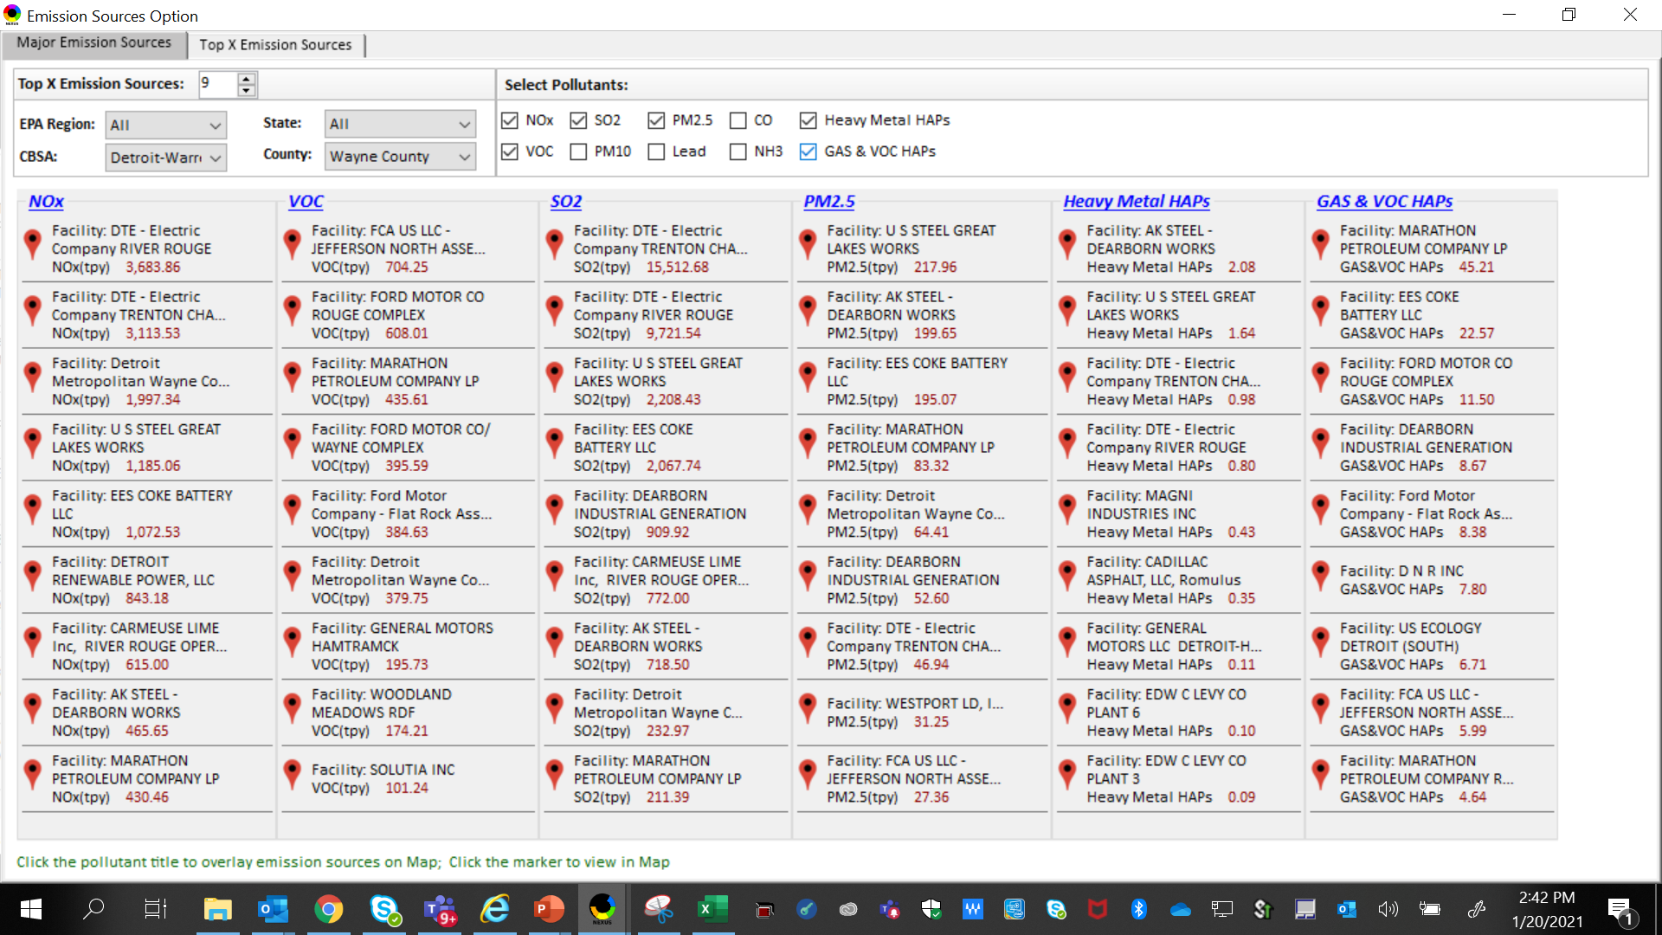
NEXUS Tool: Emissions Sources in Wayne County
NEXUS can be used to identify top emission sources. The information above was generated in Data Query for Wayne County, MI. This can help identify the potential co-benefits of controls. Let’s explore AK Steel and US Steel further...
12

Slide 13
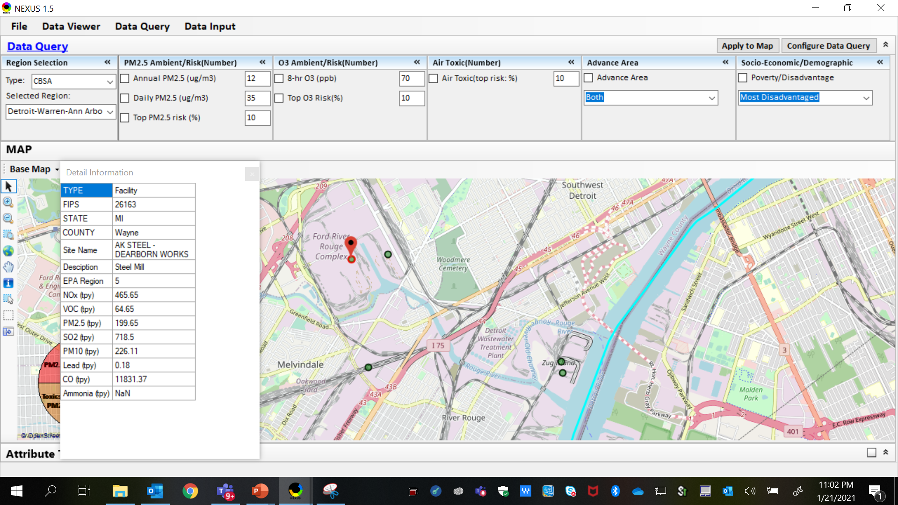
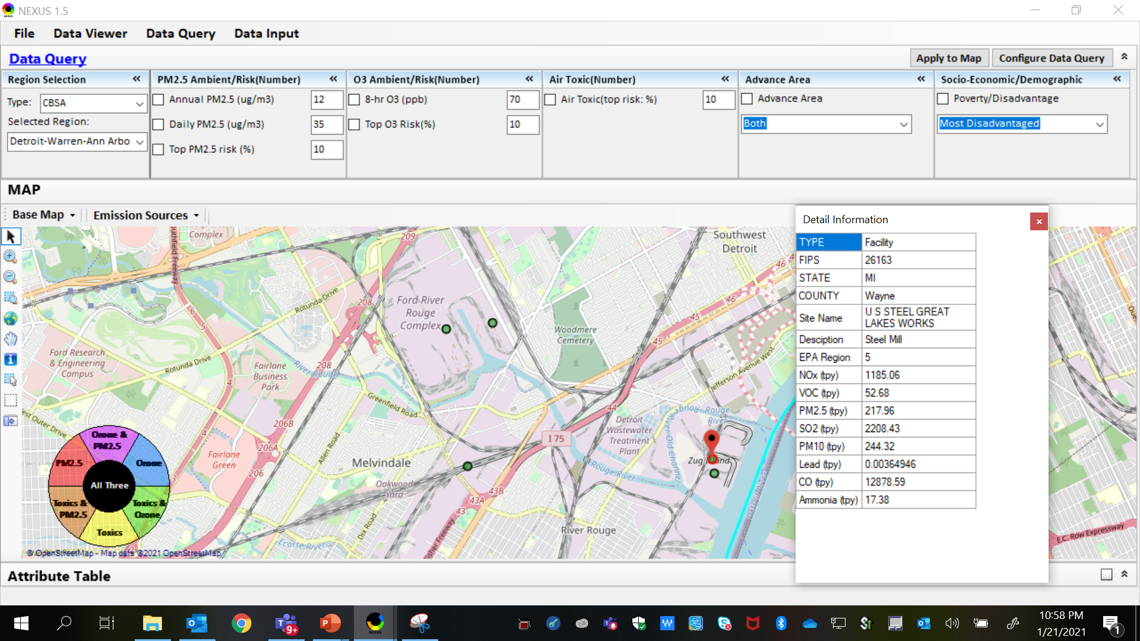
NEXUS Tool: Steel Mills in Wayne County
AK Steel
US Steel
AK Steel & US Steel were both identified as top emitters for NOx, SO₂, PM_{2.5} and Heavy Metal HAPs, highlighting the potential co-benefits of controls in these steel mills. The above map was generated in NEXUS Data Query. Let’s see the proximity of these steel mills to communities with potential EJ concerns…
13

Slide 14
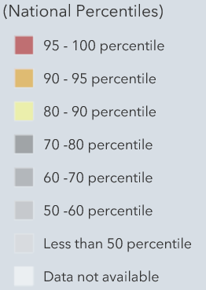
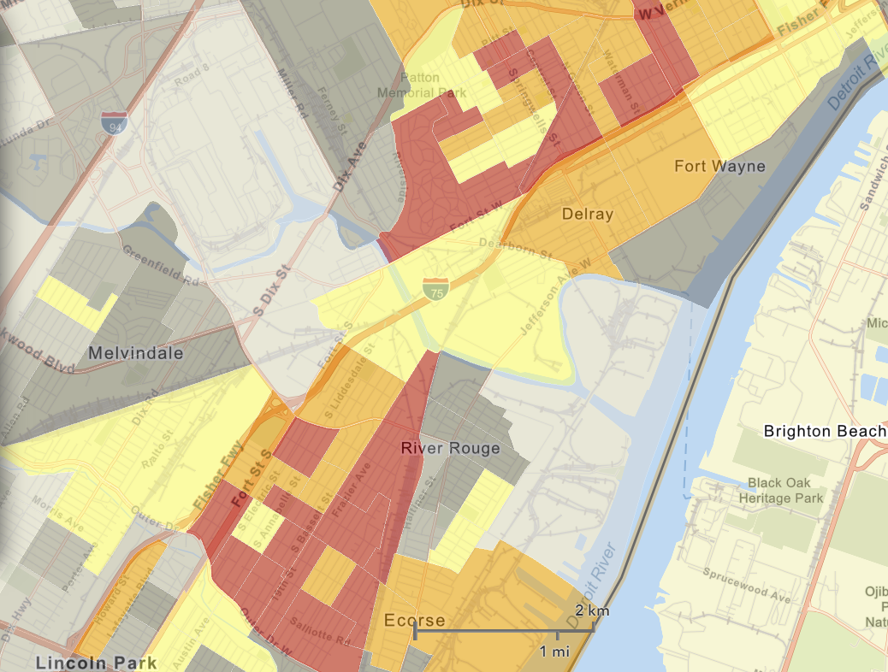
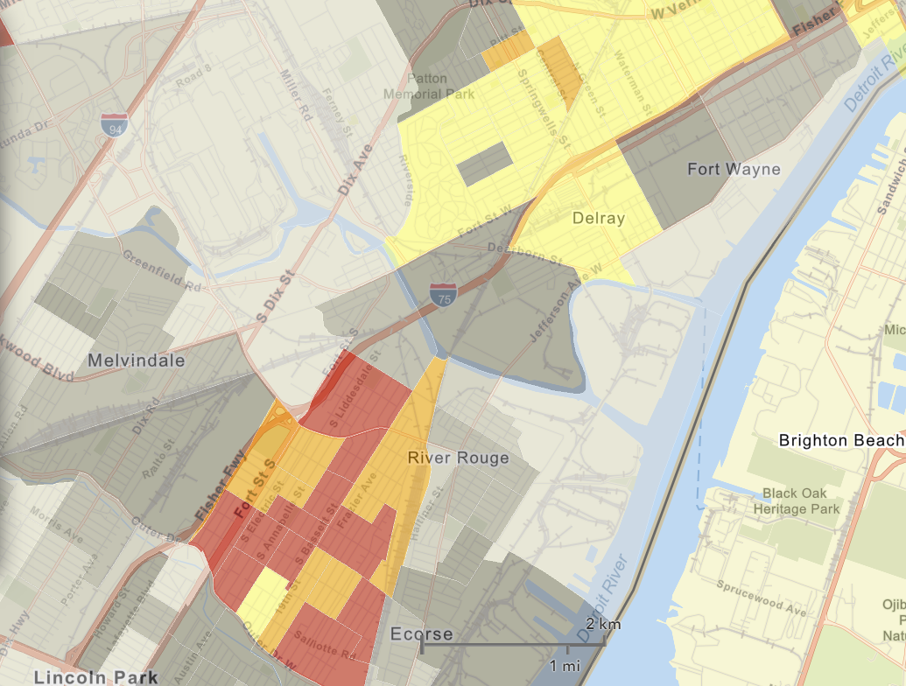
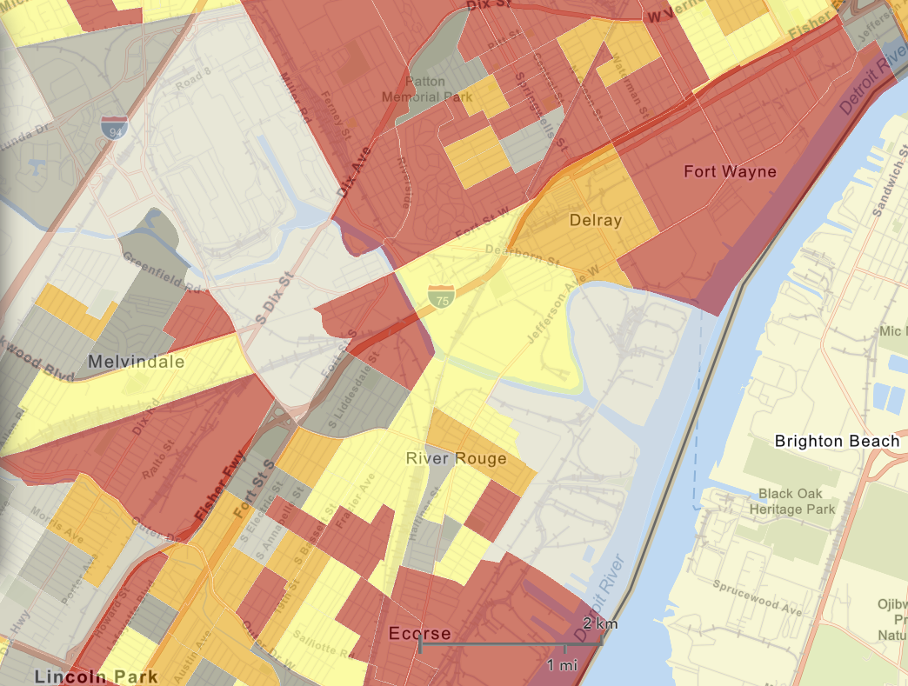

NEXUS Tool: EJ Indices in Wayne County
NEXUS Map
NEXUS can determine the presence or absence of environmental justice concerns in communities in areas with MP concerns. NEXUS currently includes a poverty/disadvantage index, and we are incorporating additional EJ metrics such as the data inputs below from EJSCREEN. These indices show the close proximity of AK Steel & US Steel to EJ communities.
AK Steel
US Steel
EJSCREEN Demographic Index
EJSCREEN People of Color Population
EJSCREEN Low Income Population
14

Slide 15
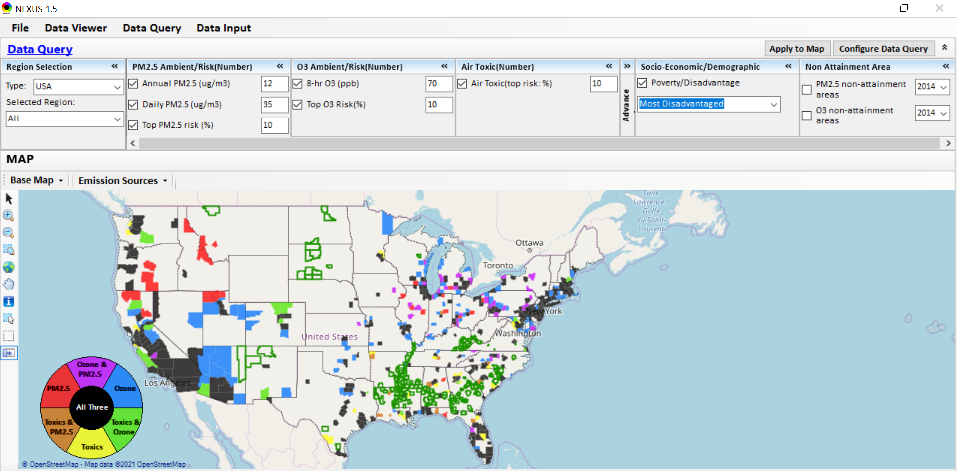
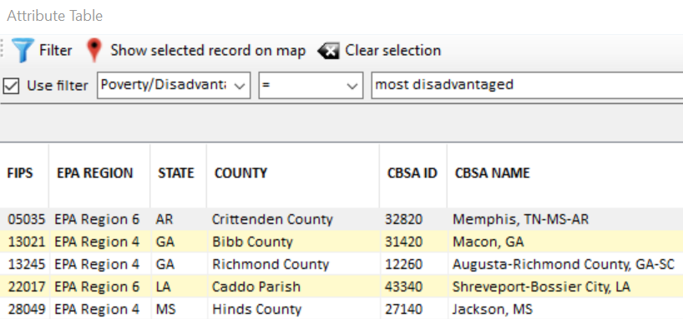
NEXUS Tool: Example 2 - MP Risks in Communities with EJ Concerns
NEXUS can determine the presence or absence of environmental justice concerns in communities in areas with multi-pollutant concerns. The information above was generated in Data Query. NEXUS currently includes a poverty/disadvantage index & we are incorporating additional EJ metrics. Let’s explore the Memphis CBSA further…
15

Slide 16
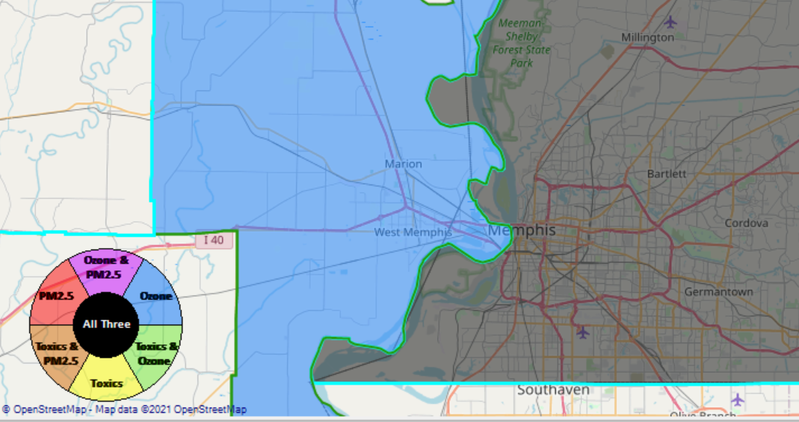
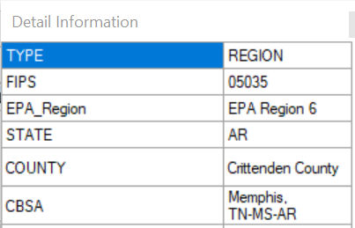

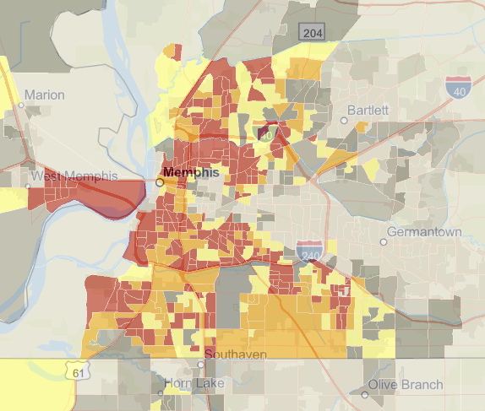
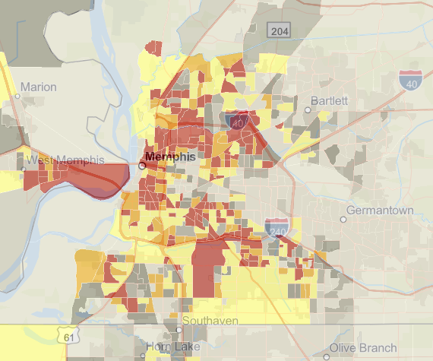
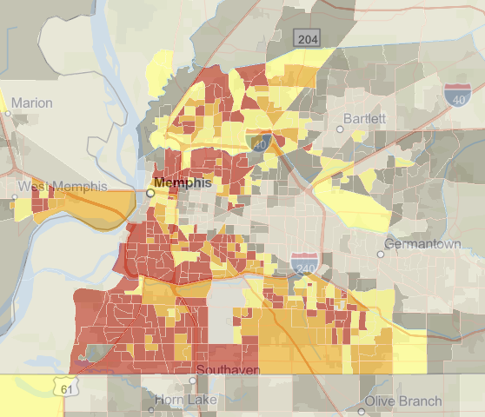
NEXUS Tool: MP Risk Screening for EJ Purpose with Data Query Module
Memphis CBSA using the NEXUS data query module
EJSCREEN Demographic Index
EJSCREEN Low Income Population
EJSCREEN People of Color Population
NEXUS can determine the presence or absence of environmental justice concerns in communities in areas with multi-pollutant concerns. NEXUS currently includes a poverty/disadvantage index, and we plan to incorporate additional EJ metrics such as the data inputs above from EJSCREEN.
16

Slide 17
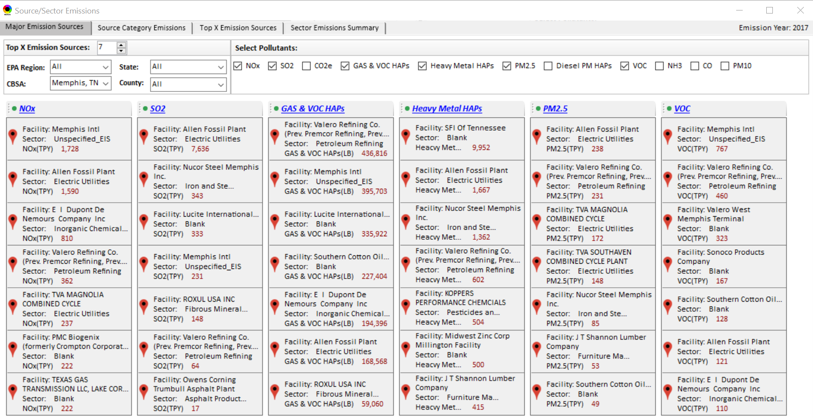
NEXUS Tool: Emissions Sources in Memphis
17

Slide 18
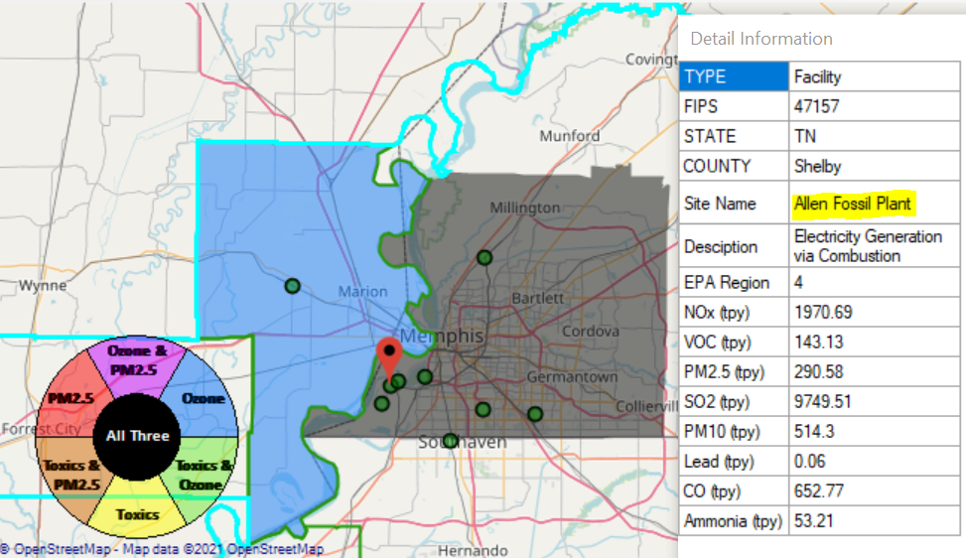
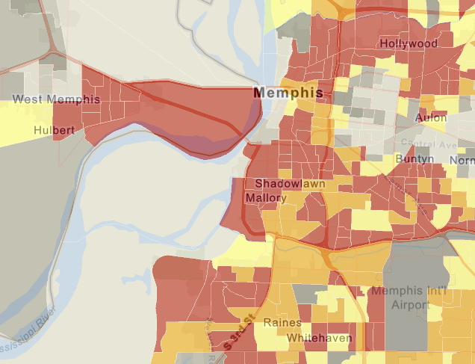
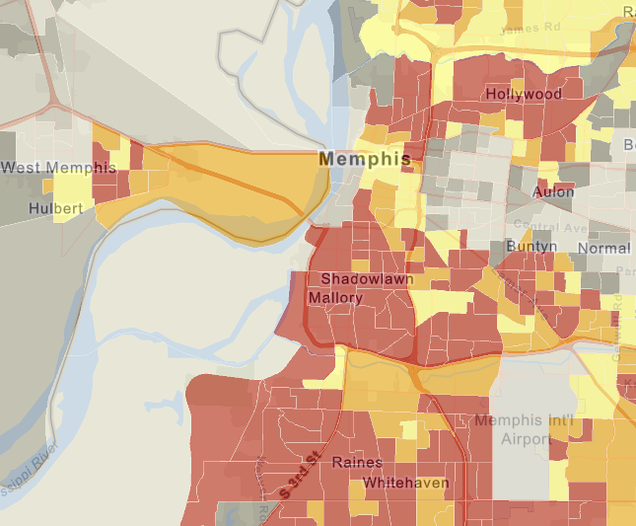
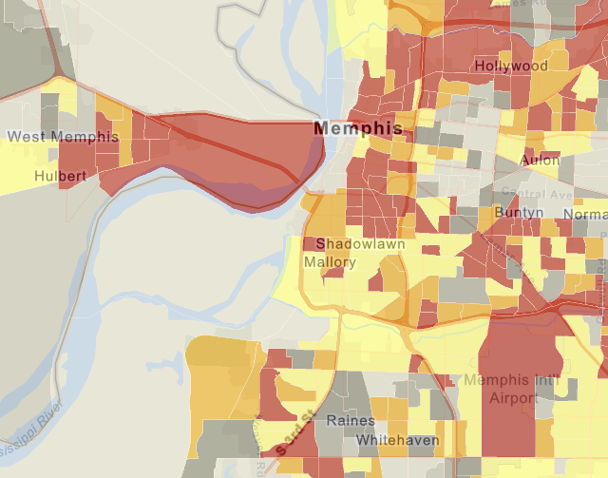
NEXUS Tool: EJ Screening in Memphis
Map Generated in NEXUS
EJSCREEN indices in NEXUS allow us to determine when facilities, such as Allen Fossil Plant, are near communities that may have EJ concerns
EJSCREEN Demographic Index
18
EJSCREEN Minority Population
EJSCREEN Low Income Population

Slide 19
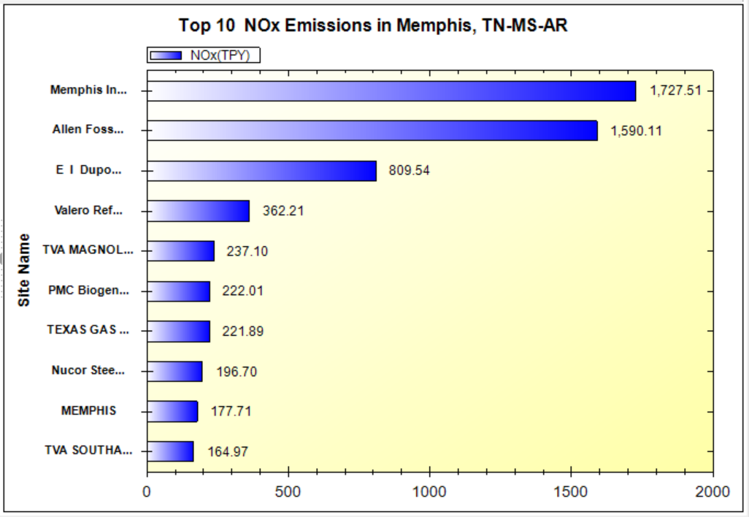
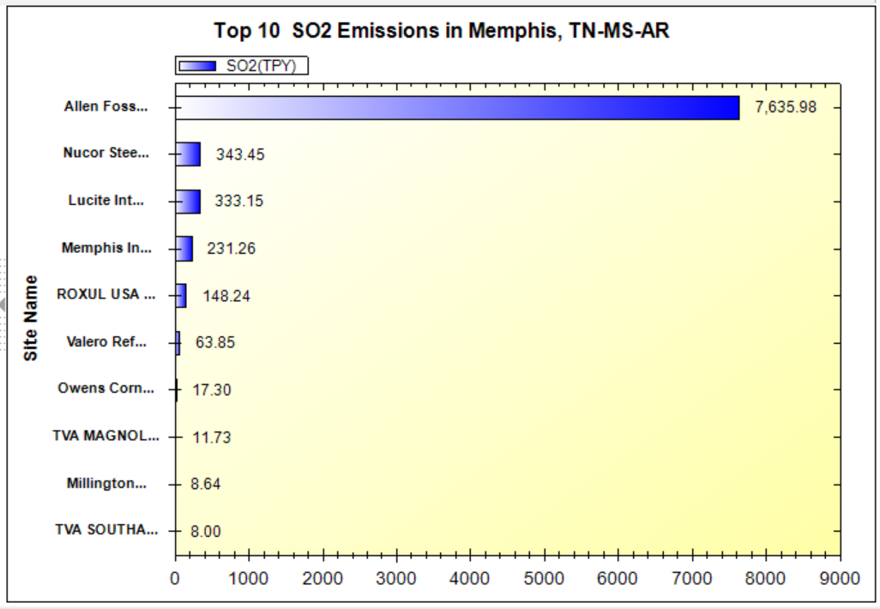
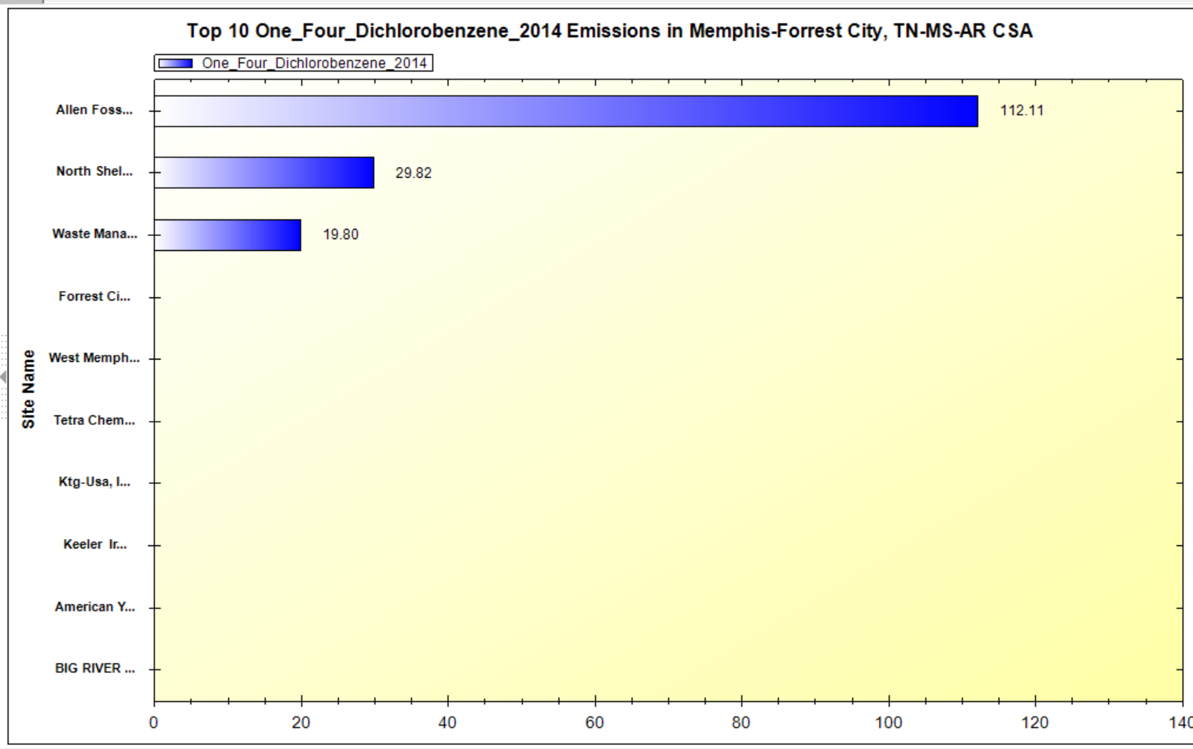
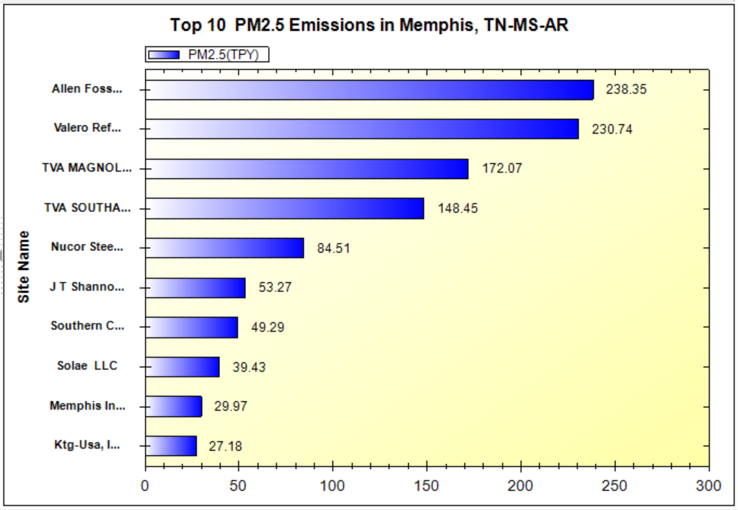
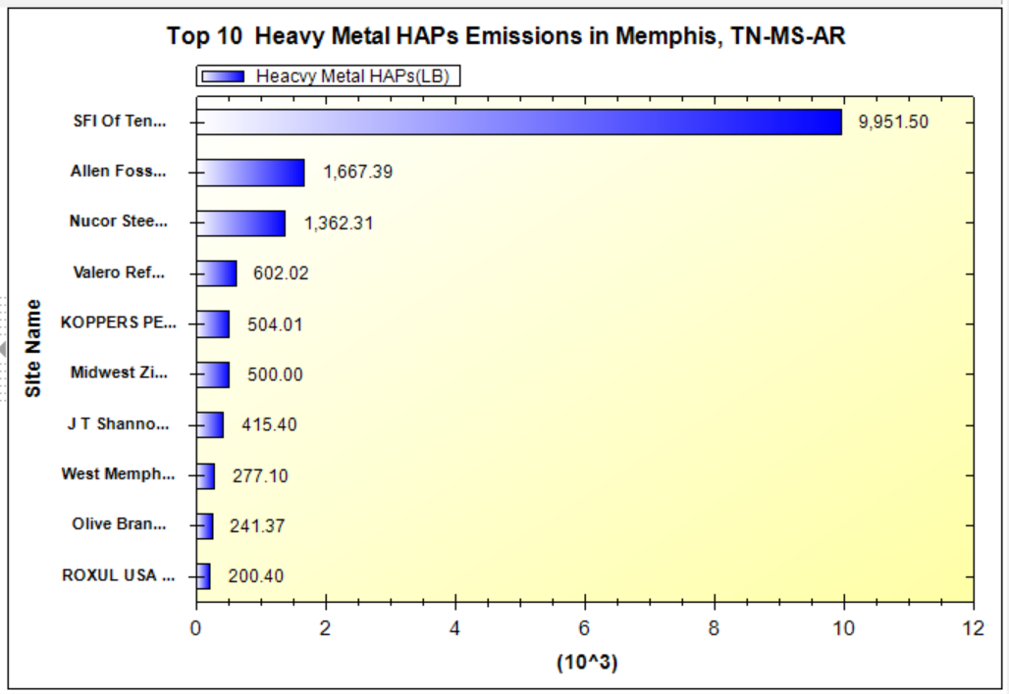
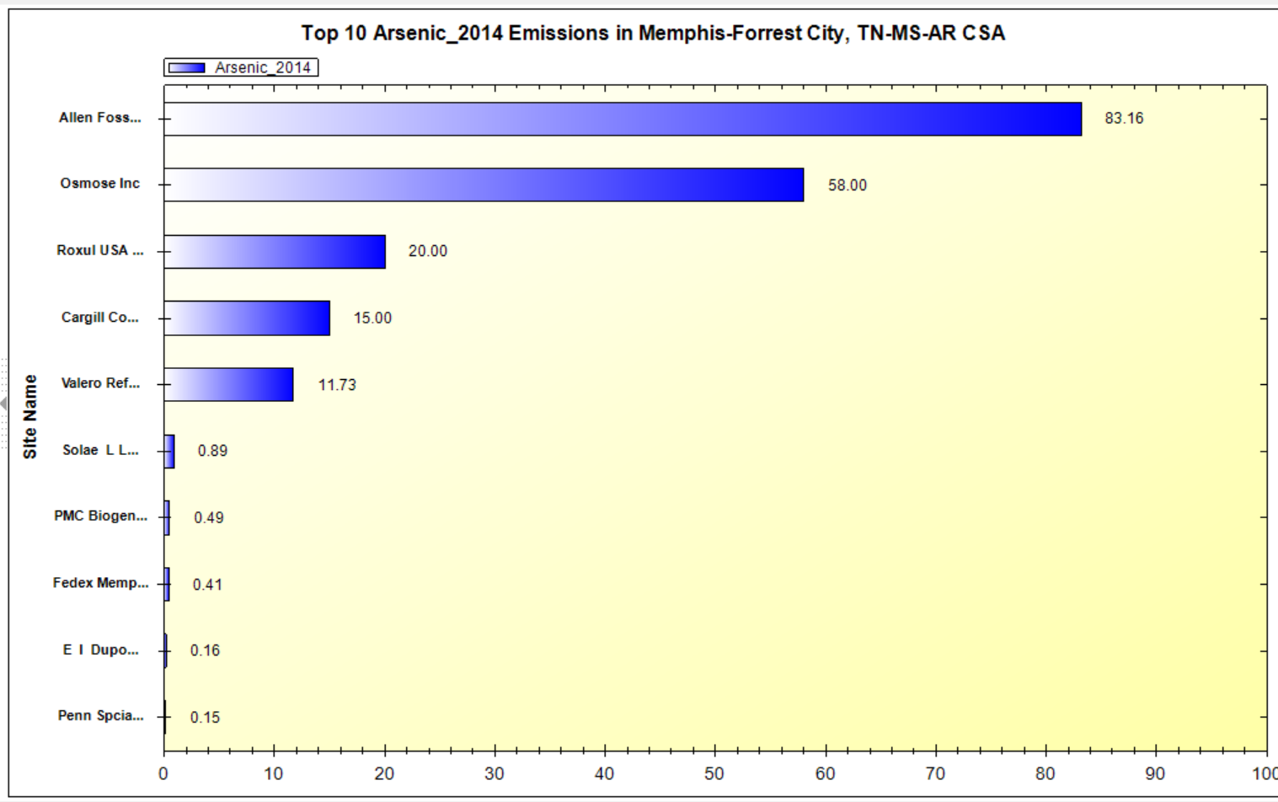
NEXUS Tool: Emissions Sources in Memphis
NOx
SO₂
1,4-Dichlorobenzene
Arsenic
PM_{2.5}
Heavy Metal HAPs
NEXUS can create bar charts of major emission sources. The bar charts above show the Allen Fossil Plant as a top 2 emitter for NOx, PM_{2.5}, SO₂, Heavy Metal HAPS, 1,4-Dichlorobenzene & Arsenic, demonstrating the potential co-benefits of controls at this facility.
19
Notes:
NOx, SO2, PM2.5 and heavy metal HAPS from 2017 emissions data
1,4-Dichlorobenzene & arsenic from 2014 emissions data

Slide 20
NEXUS & EJSCREEN
  EJ Layers
    Hazardous waste
    EJ Grants
    Water features
    Places
    Schools & Parks
    Transportation
    Boundaries
    Prisons
    Public Housing
    Subsidized Housing
    Climate
    Sites reporting to the EPA
    Superfund (NPL)
    RSEI
  Environmental Indicators
    Wastewater Discharge Indicator
    Hazardous Waste Proximity
    Superfund Proximity
    Lead Paint Indicator
    Traffic Proximity
    RMP Proximity
EJ Layers
Tribal Areas
Nonattainment Areas
  Environmental Indicators*
    NATA Respiratory HI
    NATA Cancer Risk
    NATA Diesel PM
    Ozone Model Concentrations
    PM_{2.5} Model Concentrations
Demographic Indicators
    People of Color Population
    Less Than HS Educated
    Low Income Population
    Linguistically Isolated
    Demographic Index
    Under Age 5
    Over Age 64
Ozone and PM_{2.5}
Emissions and source data
Risk data
Monitoring data
Air Toxics
Emissions and source data
Modeled concentration data
Risk data
Monitoring data
GHG emissions
*Provided to OEJ by OAQPS (AQAD & HEID)
20

Slide 21
NEXUS and EJSCREEN
NEXUS specifically designed for AQ planning: overlays publicly available air quality information to identify geographic areas where health risks related to O₃, PM_{2.5} and air toxics overlap
EJSCREEN specifically designed for EJ screening: combines environmental & demographic data to highlight areas where vulnerable populations may be disproportionately impacted by pollution
NEXUS contains air data not available in EJSCREEN: detailed emissions and source characterization, O₃ and PM_{2.5} risk data, NATA cancer and non-cancer risk by pollutant and source)
NEXUS relevance for OAQPS EJ screening and outreach efforts: By incorporating EJ indicators and data from EJSCREEN, it can highlight the nature of multi-pollutant AQ issues for communities with EJ concerns
Enhanced NEXUS screening capabilities: We plan to update NEXUS to incorporate proximity screening capabilities similar to EJSCREEN & the OAP/CAMD tool
21

Slide 22
Benefits of Proximity Screening for Air Quality Planning
Proximity Screening Analysis helps answer…
What are the risks in close proximity to my monitor and/or community of interest?
What source(s) are in close proximity to my monitor and/or community of interest?
What are the demographics of communities in close proximity to monitor(s) and/or source(s) of interest?
How do the demographics of communities near my monitor/source compare to area/state/national averages?
How do the risks within communities near my monitor/source compare to area/state/national averages?
22

Slide 23
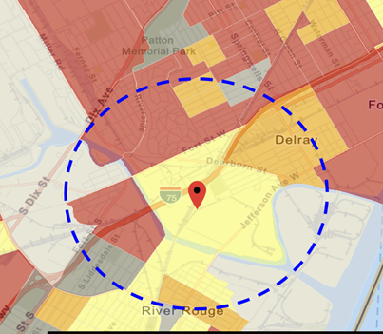
Current Practice for Proximity Screening: EJ Example
“Proximity analysis” is the primary EJ screening approach
  Comparisons of demographic distributions near source(s) to those for the state/region/nation
Types of Proximity Analysis
  Demographic analysis
  Risk-based demographic analysis
  Can consider other factors for use
Current Tools Used in OAR
  OID use of EJSCREEN for initial screening and rules (with added GIS scripting)
  CAMD (EJ) tool by OAP for EGUs impact & EJ screening analysis
  Project specific efforts for criteria and toxic rules (in-house or contractor)
23

Slide 24
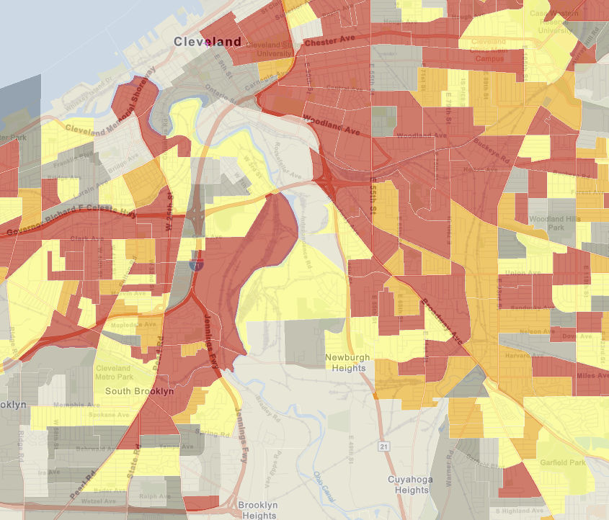
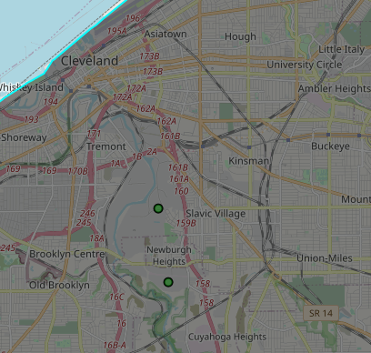
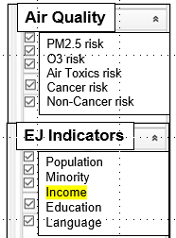
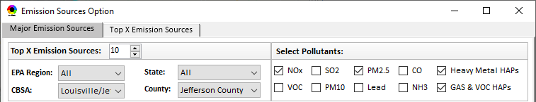
Benefit of Proximity Screening: Demographics & MP Risks Near Monitors/Sources (To Be Developed)
Proximity Screening Analysis helps answer…
What are the demographics of communities in close proximity to monitor(s) and/or (sources) of interest?
Adding proximity analysis capabilities would allow the user to set a flexible Radius of Interest for a selected monitoring site or facility and determine air quality and EJ indicators within the selected radius
Proximity and Spatial Analysis for MP Risk and EJ
Proximity Analysis
Spatial Analysis
GT Craig NCore Monitoring Site
Harvard Yards Monitoring Site
Major PM_{2.5} Emission Sources
MP Risk
Air Toxics
EJ Indicator
Income
Facility: ArcelorMittal Cleveland Sector group: Iron and Steel
24

Slide 25
Benefit of Proximity Screening: Demographic Comparison (To Be Developed)
Proximity Screening Analysis helps answer…
How do the demographics of communities near my monitor/source compare to area/state/national averages?
Example Graphic – this capability is not yet available in NEXUS
(%tile)
Adding proximity analysis capabilities would allow the user to set a flexible Radius of Interest for a selected monitoring site or facility, determine air quality and EJ indicators within the selected radius and see how they compare to the county, state, region, nation and sector group (if applicable)
25

Slide 26
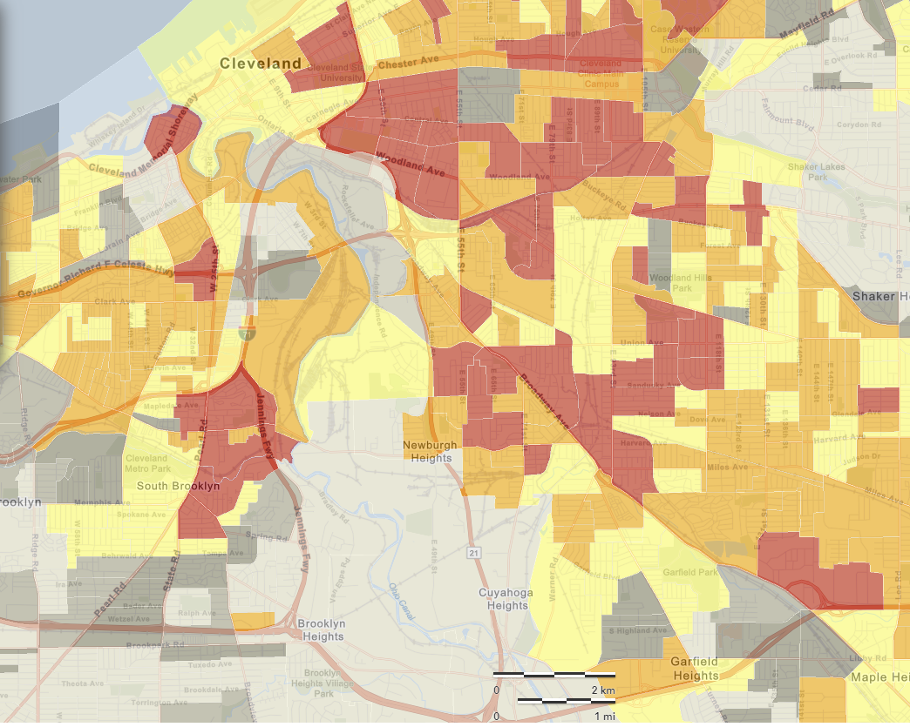
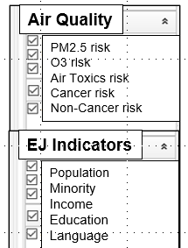
Benefit of Proximity Screening: Risk Near Monitor/Source (To Be Developed)
Proximity Screening Analysis helps answer…
What are the risks in close proximity to my monitor and/or community of interest?
Adding proximity analysis capabilities would allow the user to set a flexible Radius of Interest for a selected monitoring site or facility, and visually see air quality risk and EJ indicators within the selected radius
GT Craig NCore Monitoring Site
Harvard Yards Monitoring Site
Major PM_{2.5} Emission Sources
26

Slide 27
NEXUS: Recent Upgrades & Improvements
Recent Upgrades & Improvements (NEXUS “1.5” → “1.8.6”)
  New/revised Metrics (Air Toxics, PM_{2.5}, O₃ & EJ)
  New/updated data inputs and functions:
    EJ/Demographic data (from EJSCREEN)
    Tribal areas & Advance areas
    2017 emissions data (including GHG & sector mapping) (updated from 2014)
  “Source & Sector” emissions summary to support “Sector prioritization” effort
  “Source Category” emissions analysis (point, non-point, road, non-road, event)
  Complete EPA region “Table Generator”
  Upgrade “Data Query” module & “Data Input” module
Next Steps and Work Plan
  2017 fused PM_{2.5} & O₃ and risk data (Aug.) and 2017 fused air toxic and risk data (Oct.)
  Include Monitoring sites/data (PM_{2.5} & O₃ first, then AT) (Aug.)
  Develop screening capabilities for “Proximity analysis of MP risks and EJ” (TBD)
27

Slide 28
“NEXUS 1.8.6”Demo
NEXUS 1.8.6 “Quick Tutorial” slides attached
Carey Jang
28

Slide 29
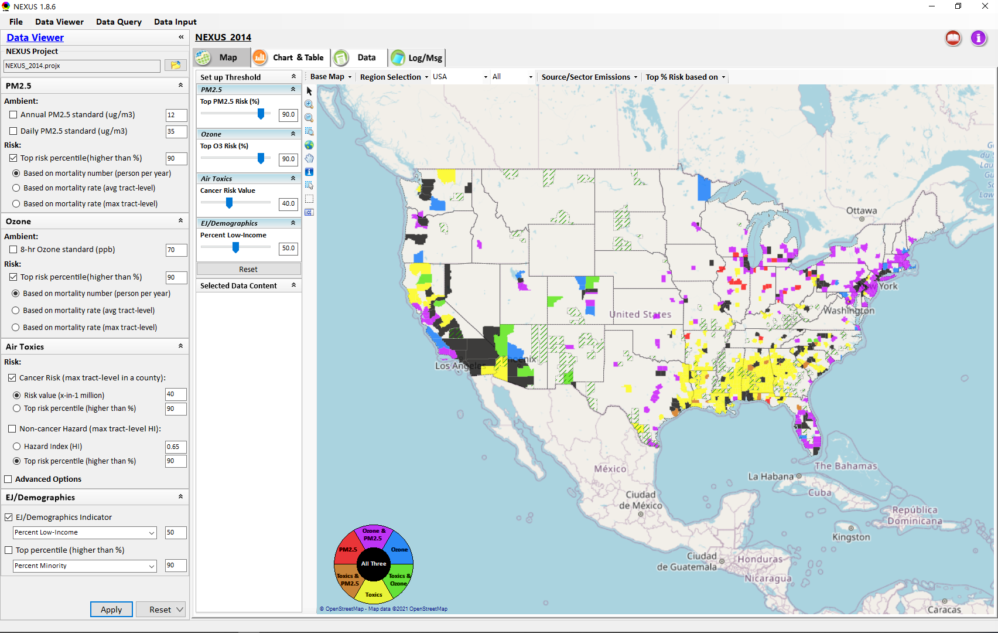
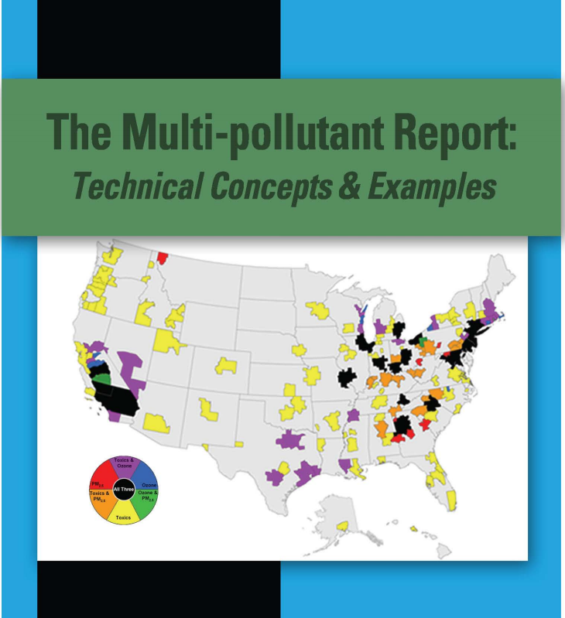
“NEXUS 1.8.6” Demo: 2014 NEXUS Case
Launching Page
2008
Roadmap for Demo:
(Use example cases)
National View: Use “NEXUS” across pollutants to provide an initial “SCREEN” at the national level by providing an indicator where there may be a common set of sources contributing to Multi-pollutant issues.
Regional View: Dial into a region or area of interest to understand the pollutant/source connections, and potential for more effective and efficient multi-pollutant solution.
29

Slide 30
“NEXUS 1.8.6”:
Quick Tutorial
Download “NEXUS” tool: The “NEXUS 1.8.6” package (“NEXUS 1.8.6 Setup.exe” & “NEXUS 1.8.6 Data.exe”: run both “*.exe” files to install) can be downloaded at EPA’s new FTP site:
https://gaftp.epa.gov/aqmg/cjang/NEXUS/NEXUS 1.8.6/*
Note: Require software installation privilege or “Power Broker” (limited elevated privilege) to install “NEXUS tool” at EPA’s PC;
Check “This PC\Documents\My NEXUS files\data\* (\tool\*, \result\*)” to see if NEXUS program & input dataset are installed successfully
Carey Jang
30

Slide 31
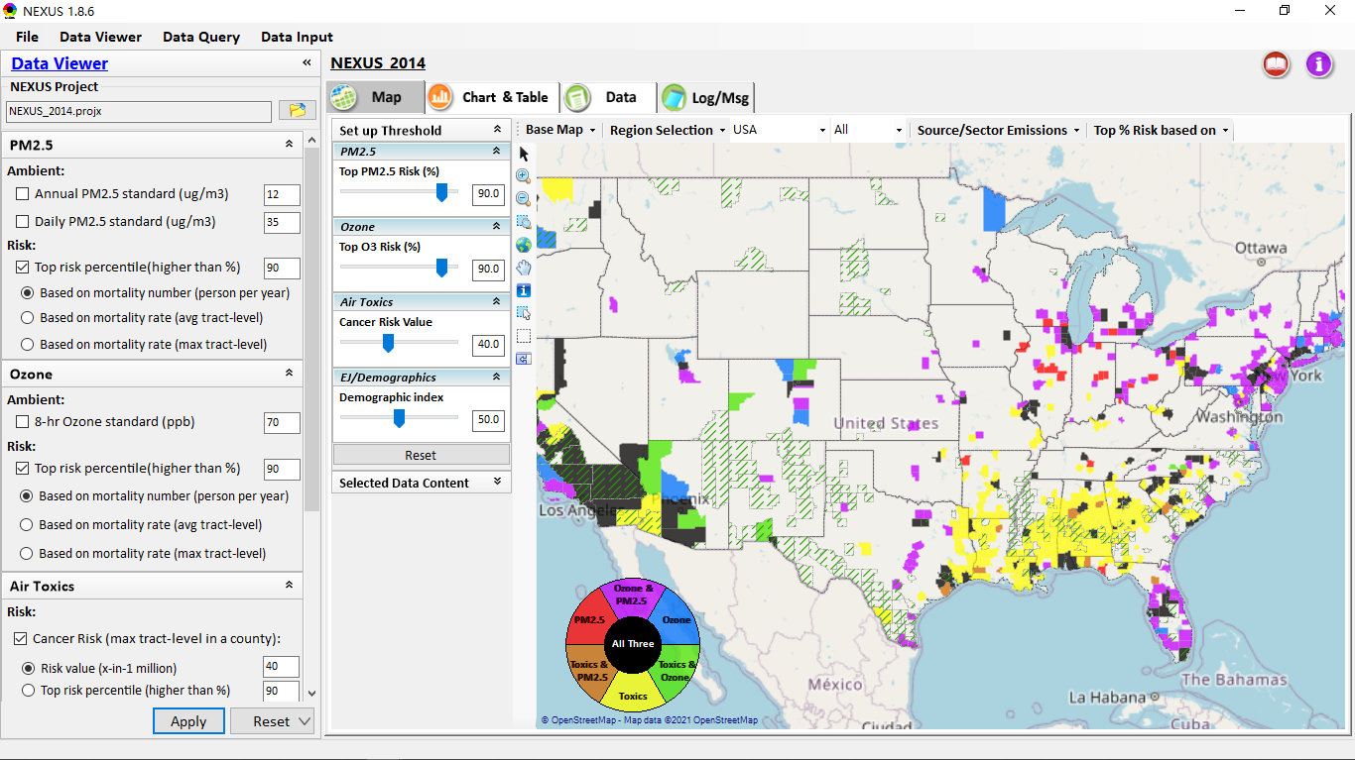
NEXUS Tool: On-line User’s Manual
Click “book” icon to launch “User’s manual”
Hot link to User’s manual’s “Data Viewer” chapter (same for “Data Input” module & “Data Query” model)
31

Slide 32
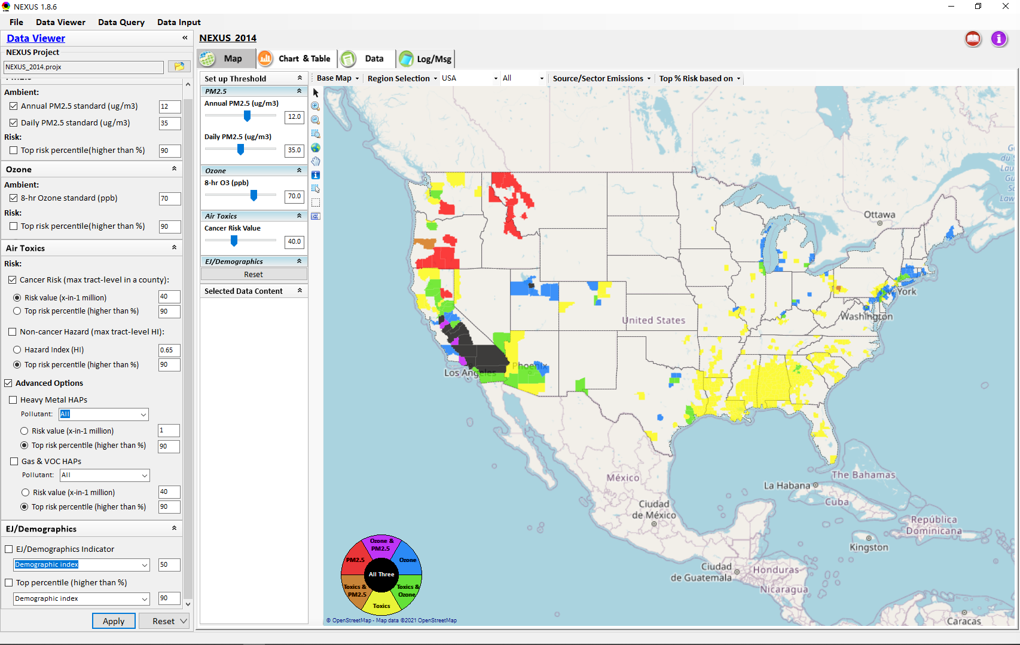

NEXUS Tool: Data Viewer Module
Click “File” to open or save a project
Switch between 3 key modules
NEXUS project file name
Select & adjust “Ambient” or “Risk” levels
“Advanced Option”: provide HAPs & species selections
32

Slide 33
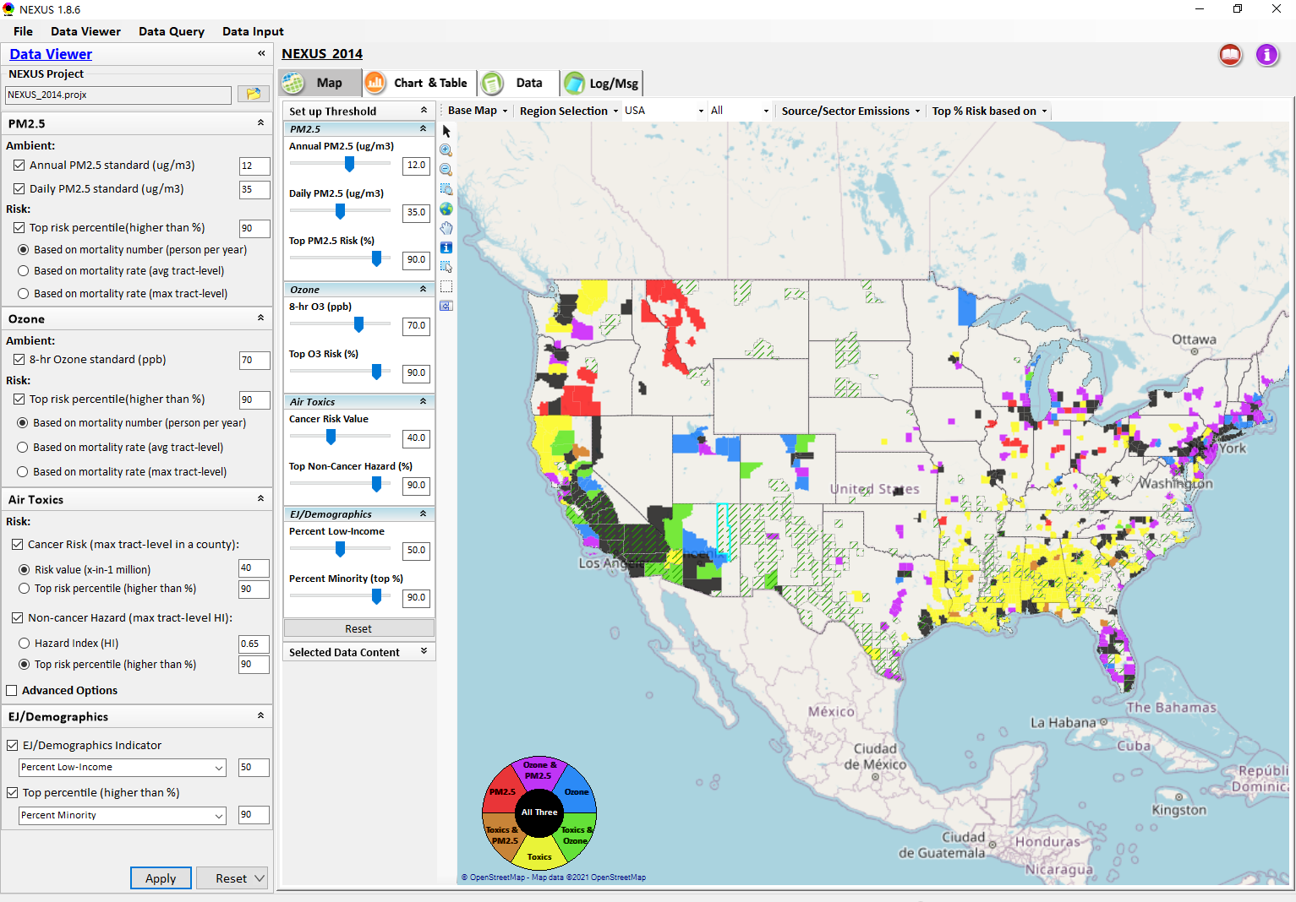
Data Viewer: “Apply” New Selections
“Check” boxes to change/add selections
New selections will appear in “Slider bars” panel and map display
“Slider bars” allow to select & adjust “Ambient” and/or “Risk” threshold levels and displaying color map
“Apply” new selections
33

Slide 34
NEXUS Update: New EJ Metric and Data
34

Slide 35
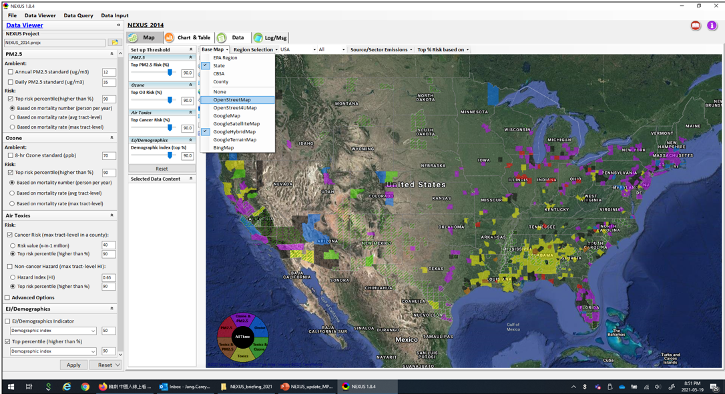
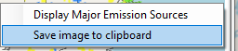
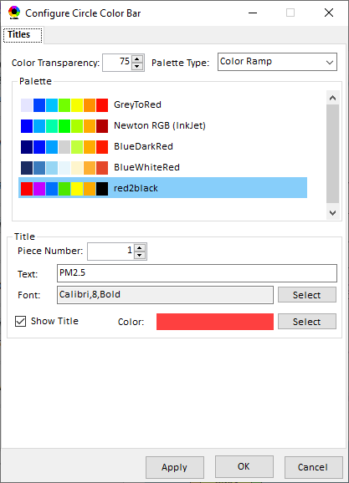
Data Viewer Module: Base Map & Color
“Base Map”: Change boundary lines and background map
“Right-click” map to save image
Click to change color & transparency
35

Slide 36




Data Viewer: “Region Selection”
Allow to select “EPA regions”, “States”, or “CBSA”
36

Slide 37



Data Viewer: Select EPA Region/State/CBSA
Examples:
EPA Region 4
NC State
Louisville CBSA
37

Slide 38

Data Viewer: Major Emission Sources
Click “Emission Sources” tab to display emission sources (green dots) and launch new window
Click any “facility” to link & display source location and emission information
38

Slide 39

Data Viewer: Major Emission Sources
Allow to scroll down to county-level (e.g., Wake County, NC)
Wake county, NC
39

Slide 40



Data Viewer: Top “x” Emission Sources
Provide selection of CAPs precursors & HAPs species
Durham county, NC
40

Slide 41

NEXUS Update: “Source/Sector” Emissions Summary
“Source/Sector Emission Summary” function allow to select major CBSAs and provides source and sector emissions summary to support OAQPS’s “Sector Prioritization” project effort
41

Slide 42

Data Viewer: EPA Region Table Generator
“EPA Region Table Generator” provides attainment status of O3 and PM2.5 and their DVs; also allows to select any EPA region based on data updated to 2018.
42

Slide 43

Data Viewer: Data Search & Filter
Click “+” to add filters; Click “x” to remove current filter;
Show specified records per page.
Click “Output data…” to output current page records or all records
43

Slide 44

Data Query Module: Overlaying Map
Region Selection
Data Query Configuration
Data Query qualifier selection
Overlaying Map selection
44

Slide 45

Data Query Module: Configure Data Query
“Data Query Filter” allows to select “qualifiers” for query
“Data Query Preview” displays the selected “qualifiers” at the same time
45

Slide 46


Data Query Module: Attribute Table
Filter/search/export functions
Detachable “Attribute Table”
46

Slide 47



Data Query Module: Attribute Table
Click a “record” to link and display its location & info.
47

Slide 48

Data Input Module: Data Preview
“Transparency” & “Open-Source”:
All NEXUS input/output data files are available under:
“This PC\Documents\My NEXUS files\Data (\Result)”
Check to use filter to query data
Select a table to view if there are multiple tables in the selected data source file
Click to change input data file
Click to view data
Click to run & save project
48

Slide 49
End
49

