Slide 1
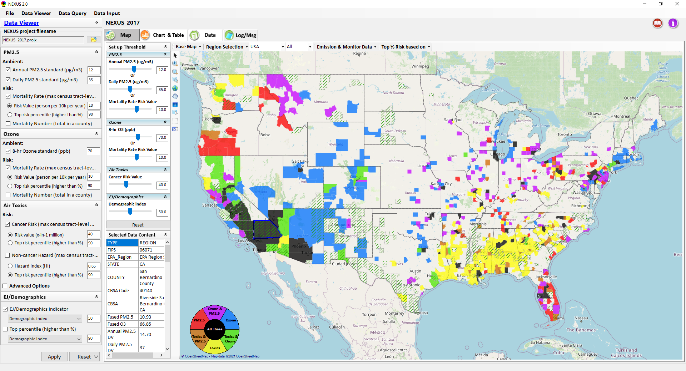
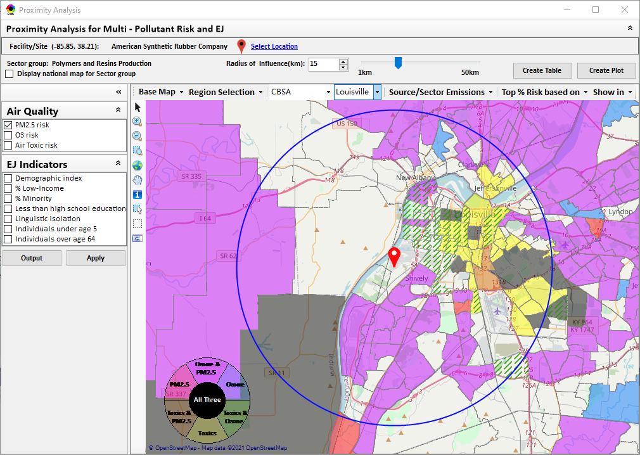
“NEXUS” Multi-Pollutant Advanced Screening Tool
AAPCA Briefing
Data Viewer: National/Regional Level
Proximity Analysis: Community Level
Beth Landis, HEID/Climate, International, & Multi-Media Group
Carey Jang, AQAD/Air Quality Modeling Group
9/29/22
1

Slide 2
Overview
Multi-Pollutant Background
NEXUS Background
Live Demo
2

Slide 3
Multi-Pollutant Background
Support a comprehensive, MP treatment of air quality problems to effectively improve air quality and make the most efficient use of available resources
  Primary Goal - identify & evaluate local control strategies targeting emissions of O₃ & PM_{2.5} and their precursors while at the same time reducing Air Toxics of concern for communities to maximize both health benefits and air quality improvements
MP planning has the potential to reduce the costs and increase benefits associated with air quality management (AQM)
Supports S/L/T air agencies in developing MP, risk-based AQM plans and implementing strategies that reduce air pollution emissions & improve public health
Success has been demonstrated in Detroit and SC; another project is currently underway in Louisville, KY
Tools needed to analyze MP data are either available currently or being developed in OAQPS (e.g., NEXUS)
3

Slide 4
NEXUS Background
“NEXUS” is an advanced screening tool for multi-pollutant (MP) risks and EJ/Demographic analysis developed by OAQPS’s MP team
“NEXUS” integrates a suite of MP data, including emissions, monitoring, modeling, fused AQ data and health risk data for PM_{2.5}, O₃ & air toxics as well as EJ/demographic data, into one single platform to allow national and areal overlay mapping & analysis of MP ambient & risk data
The NEXUS tool will essentially provide a ‘conceptual model’ of an area’s MP issues to facilitate engagement with state/local/tribal agencies & community stakeholder groups
NEXUS is currently for internal EPA use. A beta version is available for EPA staff to use and provide feedback on for improvement. Additional updates/improvements are necessary before the NEXUS tool is ready to be released to the public.
4

Slide 5
“NEXUS 3.0” Live Demo
5

