Slide 1
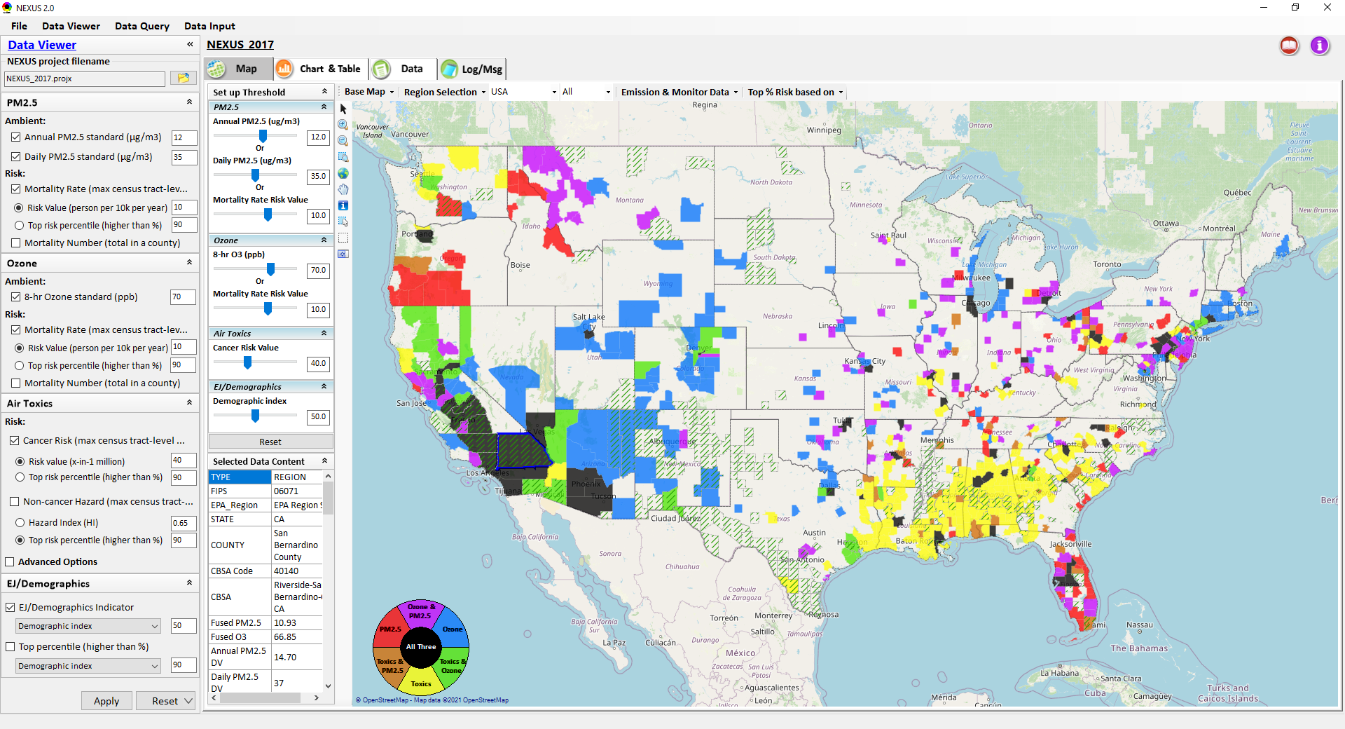
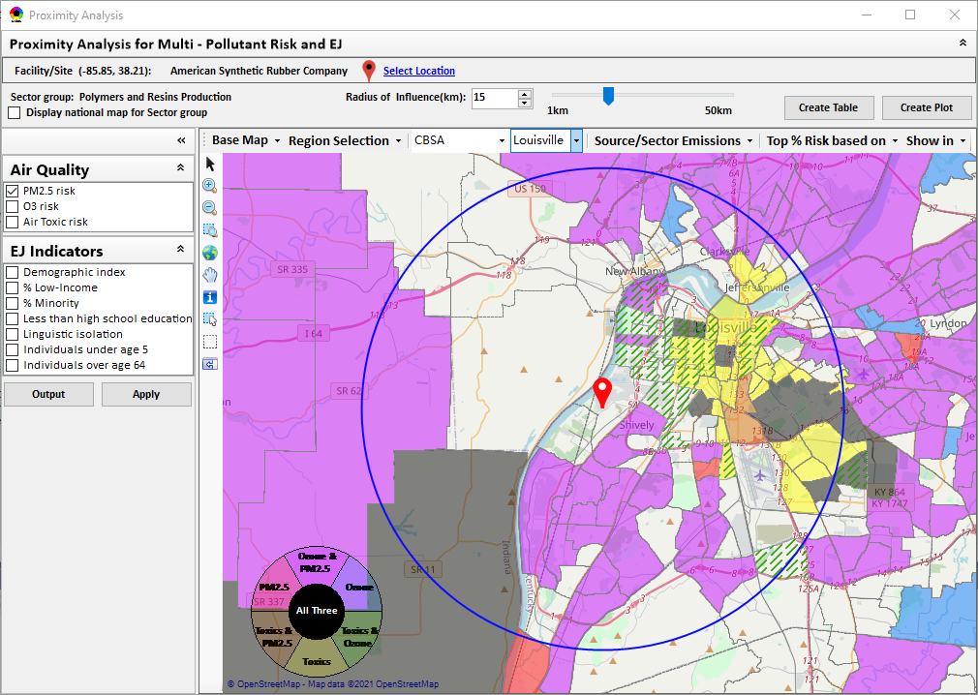
“NEXUS” Multi-Pollutant Advanced Screening Tool Special Purpose Call for APMs
Data Viewer: National/Regional Level
Proximity Analysis: Community Level
Beth Landis, HEID/Climate, International, & Multi-Media Group
Carey Jang, AQAD/Air Quality Modeling Group
10/19/22
1

Slide 2
Multi-Pollutant Team Members
HEID
Beth Landis / Kimber Scavo
Matt Woody / Kelly Rimer
Robin Langdon / Darryl Weatherhead
Sara Terry
Carrie Wheeler
Rob Pinder
Chris Davis
Conor Mulderrig
Kayla McCauley
OID
Amanda Kaufman
James Payne
Loren Fox
AQAD
Carey Jang / Tyler Fox
Jim Kelly
Shannon Koplitz
Joe Mangino
Jeanette Reyes
AQPD
Rich Damberg / Megan Brachtl
Mia South
SPPD
Lisa Conner
2

Slide 3
Overview
Multi-Pollutant (MP) Background
NEXUS 3.0
Overview
Data Inputs and Major Functions
Current and Potential Uses
Examples
Briefings/Demos
Feedback
Example Multi-Pollutant Packet for Region 1
Boston
Next Steps
Live Demo
3

Slide 4
Multi-Pollutant Background
Support a comprehensive, MP treatment of air quality problems to effectively improve air quality and make the most efficient use of available resources
Primary Goal - identify & evaluate local control strategies targeting emissions of O₃ & PM_{2.5} and their precursors while at the same time reducing Air Toxics of concern for communities to maximize both health benefits and air quality improvements
MP planning has the potential to reduce the costs and increase benefits associated with air quality management (AQM)
Supports S/L/T air agencies in developing MP, risk-based AQM plans and implementing strategies that reduce air pollution emissions & improve public health
Success has been demonstrated in Detroit and SC; another project is currently underway in Louisville, KY
Tools needed to analyze MP data are either available currently or being developed in OAQPS (e.g., NEXUS)
4

Slide 5
NEXUS: Overview
“NEXUS” is an advanced screening tool for multi-pollutant (MP) risks and EJ/Demographic analysis developed by OAQPS’s MP team
“NEXUS” integrates a suite of MP data, including emissions, monitoring, modeling, fused AQ data and health risk data for PM_{2.5}, O₃ & air toxics as well as EJ/demographic data, into one single platform to allow national and areal overlay mapping & analysis of MP ambient & risk data
“NEXUS” provides MP analysis across from national level “Phase 1” to regional (EPA region/State/CBSA) level “Phase 2”, and now down to community level “Phase 3” (Proximity analysis” in census tract-level)
We expect to use this tool in conjunction with Regions and identify areas that would potentially benefit most from MP approaches to reduce emissions (including current NA areas)
We also expect that it can have additional value-added uses across the Office for Air Toxics, Environmental Justice and other programs
The NEXUS tool will essentially provide a ‘conceptual model’ of an area’s MP issues to facilitate engagement with state/local/tribal agencies & community stakeholder groups
5

Slide 6
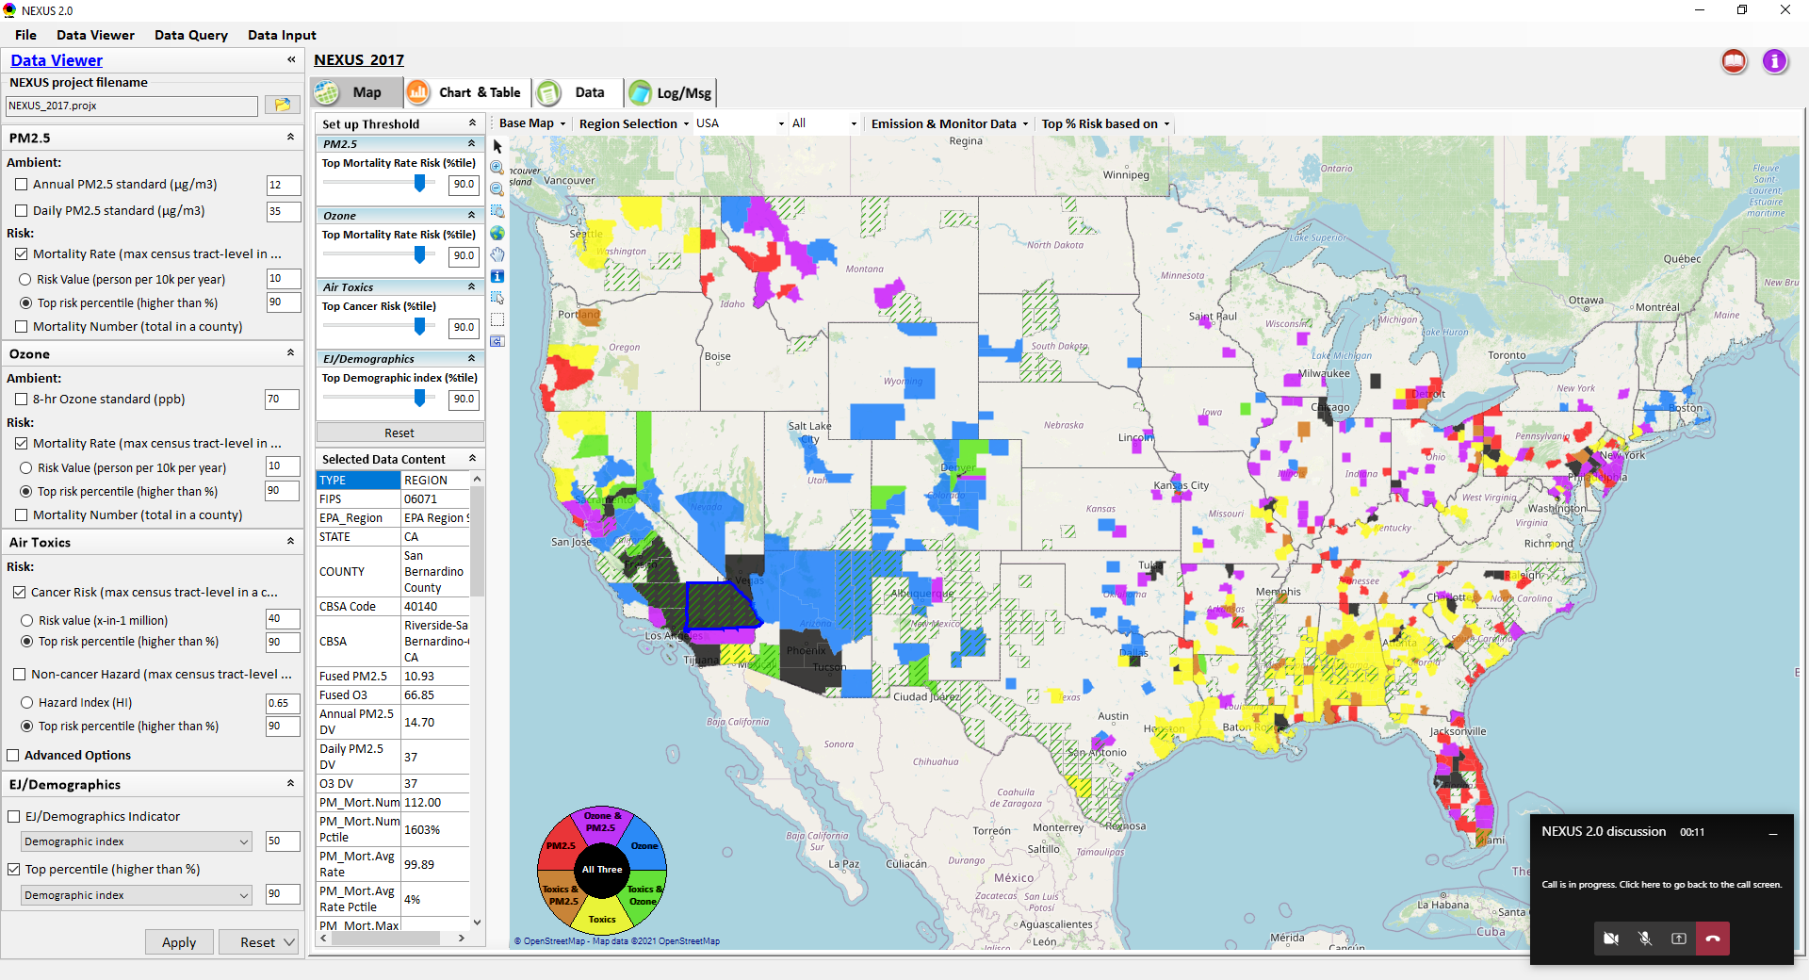
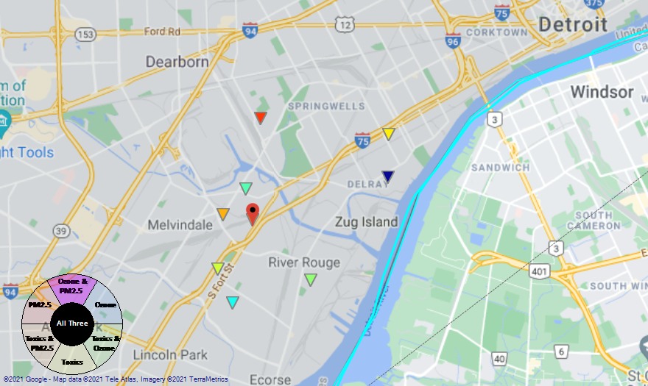
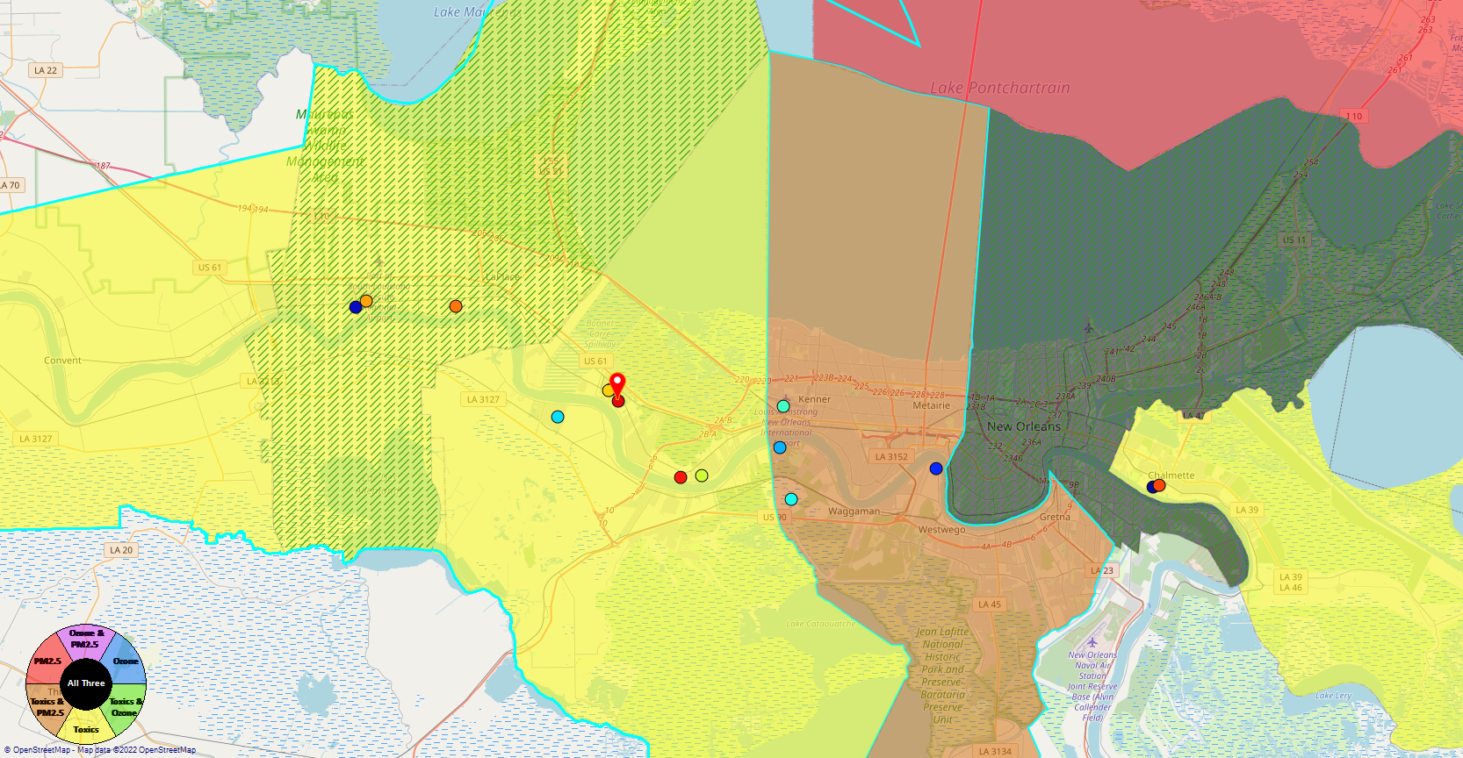
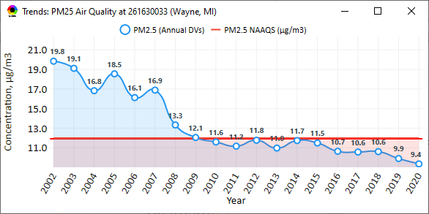
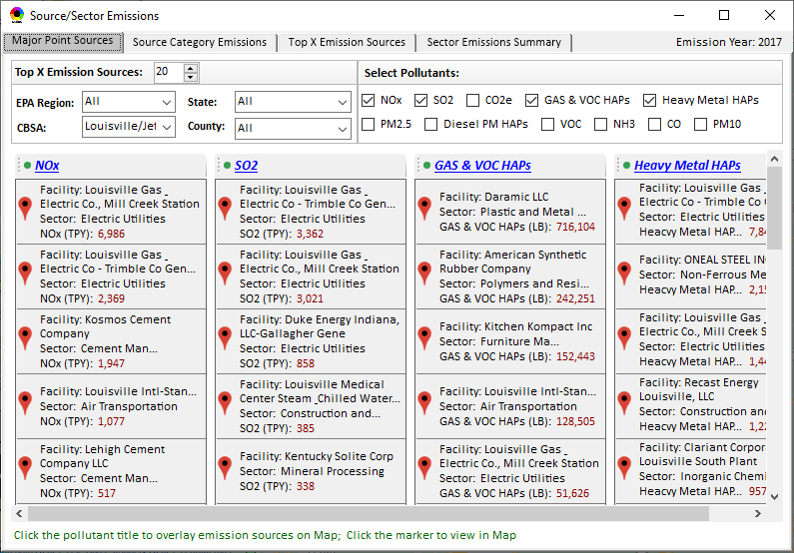
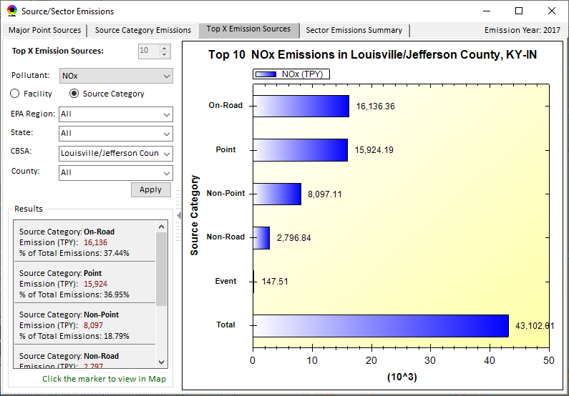
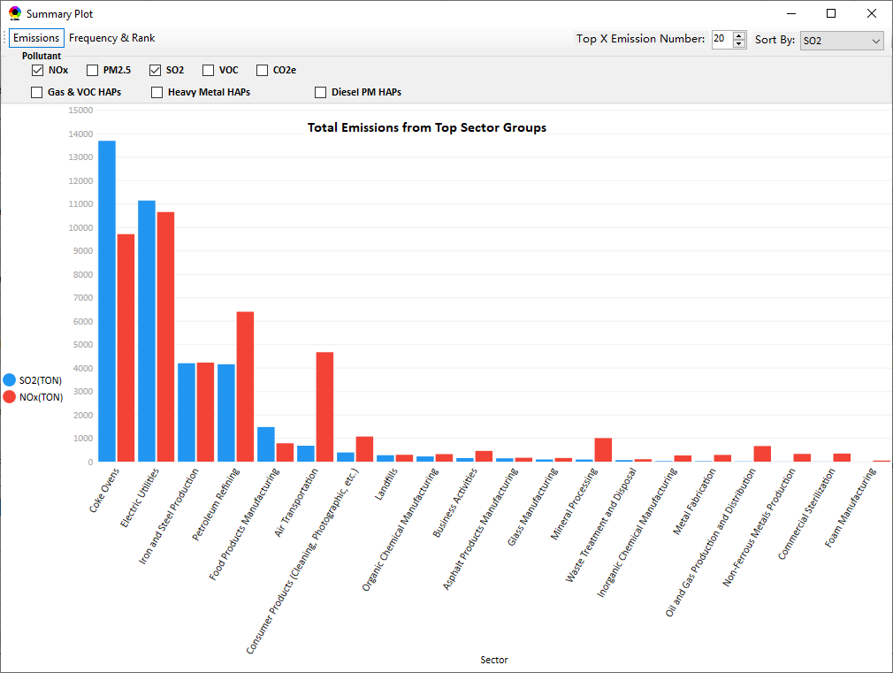
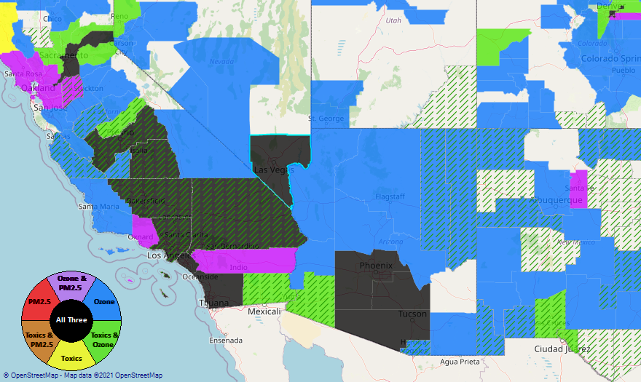
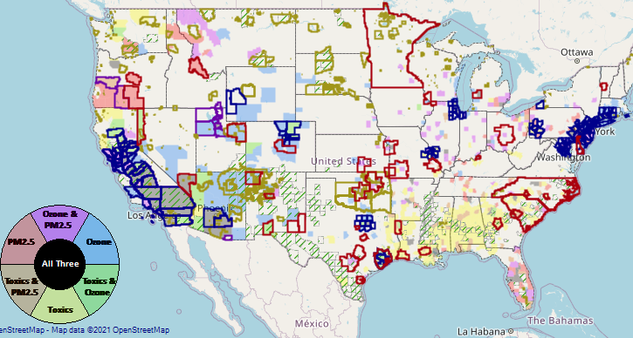
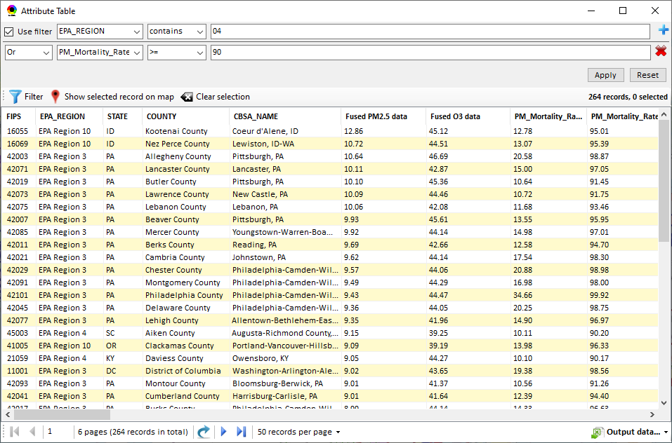
NEXUS: Data Inputs and Major Functions
O₃ & PM_{2.5}
Ambient/Design Value
(2012-2020)
(County-level)
Multi-Pollutant
Ambient and/or Risk National & Areal Mapping
Display Monitoring Sites & Trend Data
O₃, PM_{2.5} & Air Toxics Risk Data &
Conc. (fused AQ) Data
(2017 & 2014)
(Census tract-level)
Display Major Point Emissions Sites/Data
Provide Source Category Emissions
NEXUS
O₃, PM_{2.5} & Air Toxics Monitoring Data
(2002-2020 & -2018)
Provide Sector Emissions Summary
NEI County &
Facility Emissions
(2017 & 2014)
Include EJ/Demographic Indicators
Map Overlay with NAA, Advance Area, Class-I Area, or Tribal Area
Environmental Justice & Demographic Data
(from EJSCREEN)
Data Query, Search, Filter & Export
Advance Area
Class-I Area
Tribal Area
Proximity Screening Analysis
6

Slide 7
NEXUS: Current and Potential Uses
MP Risk Priority Areas: develop a list of high MP risk areas to share with Regions and engage in potential MP area projects/efforts
“Regional packets”— tabular and graphical data for each high MP risk area to discuss with Regions and determine which may be most ‘ripe’ for MP solutions
Advance area/Regional SIP planning efforts: develop conceptual model information consistent with EPA’s SIP modeling guidance that addresses nature of air quality within the area
“Conceptual model” area packet—tabular and graphical data for each planning area to discuss with AQPD and/or Regions to be value added in AQ planning efforts and identify potential for MP considerations as part of these efforts.
OAQPS Monitoring Group exploring use of NEXUS to inform assessment of the nation’s PM_{2.5} monitoring network and determine if sites located in/near communities with potential EJ concerns (driven by current PM NAAQS review)
AAMG noted that NEXUS could be useful in Regional review of their states’ Annual Monitoring Network Plans
EJ Screening for outreach purposes and to inform CAA programs such as Federal permitting
Demographic proximity screening capabilities similar to EJSCREEN but with more air quality data, e.g., O3 and PM2.5 risks
Engage with EPA Beta Testing Team to define additional uses of need/value to Regions
7

Slide 8
NEXUS: Beta Team Feedback - Uses
SIP Related Activities
Address NAAs and areas close to NAAQS
Develop conceptual models
Areas preparing path forward document to join Advance program
Future weight-of-evidence analysis
Air Quality Planning Activities
Identity areas to focus reduction efforts with possible lowering of NAAQs
Evaluate permit applications
Visually understand MP issues
Visualize areas of concern, run reports & focus efforts
Response to citizen complaints about sources
Determine where to focus emission reduction efforts
Environmental Justice
Generate maps and reports for EJ workgroup
Identify areas with air quality and EJ concerns
Review Tribal areas
Ensuring MP cumulative impacts are considered
Robust evaluation of potential EJ concerns and plans to address community needs
Outreach
Support AQ planning conversations with SLT air agencies
EtO community outreach
Briefings with RAs and management
Monitoring Activities
Review Annual Monitoring Network Plans and site/monitor relocation requests
Review new development proposals
Ongoing network assessments
Assessments
Evaluate air quality impacts in local communities
Supplement AirToxScreen Assessments
Assess burden of individual or combination of air pollutants
Complement existing techniques for emissions, modeling, monitoring & risk assessment
Identity air quality and human health focus areas
Other
Help new employees learn about areas with O₃, PM_{2.5}, toxics and/or EJ concerns
Assist with determining distribution of grant funding
8

Slide 9
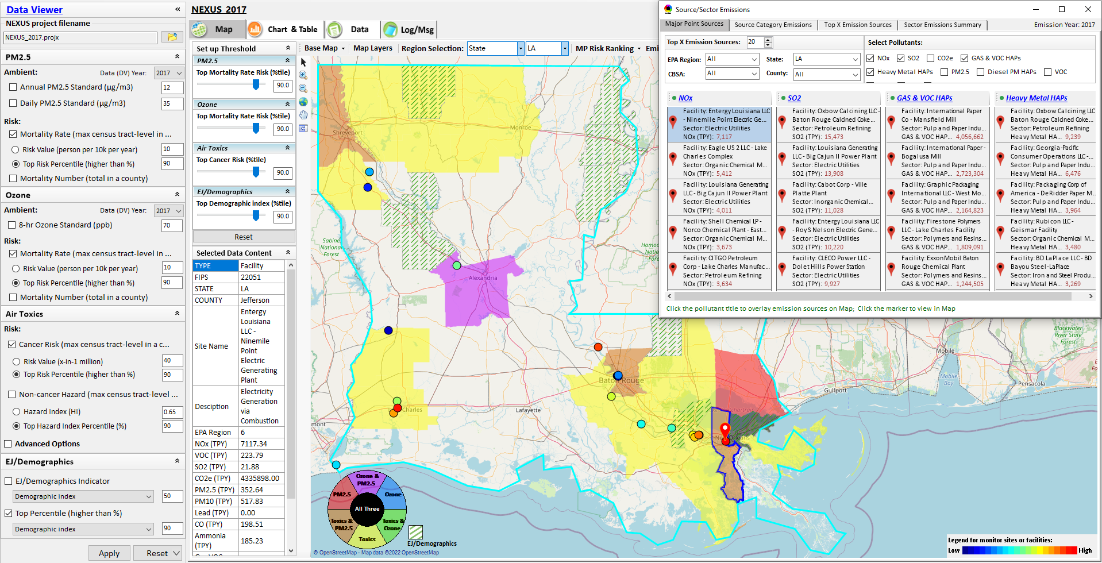
NEXUS Example: Display Major Point Sources
9

Slide 10
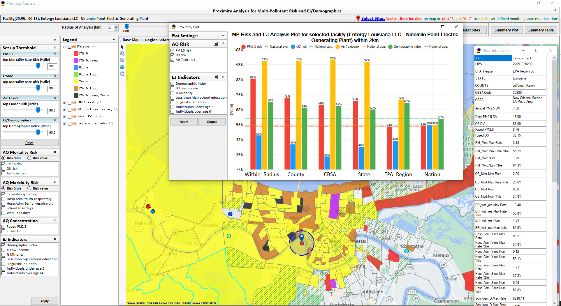
NEXUS Example: Proximity Analysis for Facility
10

Slide 11
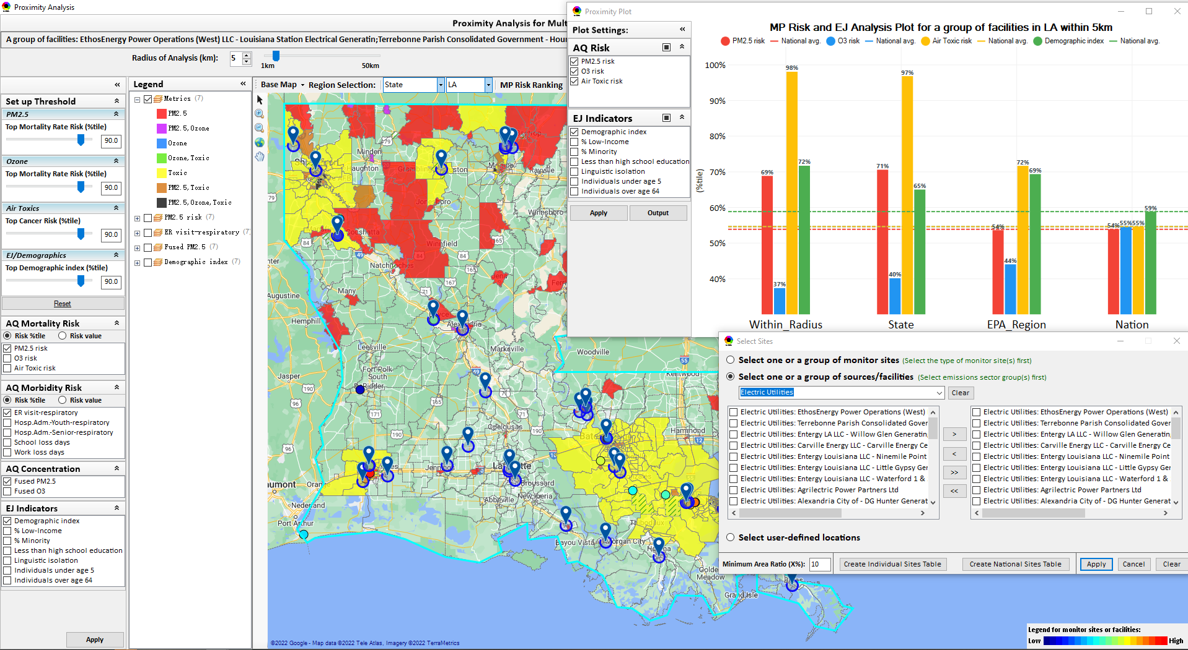
NEXUS Example: Proximity Analysis for Electric Utilities
11

Slide 12
NEXUS: Briefings and Demos
9/25/2020– AQAD & HEID
11/3/2020 – MP Team
11/4/2020 – Air Toxics Group
12/10/2020 – AQPD
1/25/2021 – OID
1/28/2021 – SPPD
2/1/2021 – Peter/SMT
4/12/2021 – HEID & AQAD
5/17/2021 – Peter/SMT
5/24/2021 – MP Team
6/29/2021 – ORD
7/12/2021– HEID & AQAD
7/19/2021 – OID
8/10/2021– OAP
8/26/2021 – OAR
8/27/2021 - OP
8/30/2021 – OEJ
8/30/2021 - Region 4/Louisville
9/7/2021 – RO ADDs
9/20/2021 – OAR Demo
10/14/2021 – OP/NCEE
11/2/2021 – RO APMs
11/8/2021- RO APMs Demo
11/16/2021 – R1 (RARE) Project
11/28/2021 – AQAD All-Hands
11/23/2021 – R3 NEXUS Beta Testers
2/15/22 – AQPD (NSRG, OPG & SLPG)
2/17/22 – AT Strategy Mgmt & Mitigation Team
3/15/22 – OID (CTPG)
4/26/22 – EPA NEXUS Beta Testing Team
4/28/22 – AQAD (AAMG)
5/3/22 – HEID & AQAD
5/4/22 – Air Toxics Data Analysis Team
5/10/22 – ADVANCE Workgroup
5/26/22 - OAP/CCD
6/15/22 – Regional Ambient Air Monitoring
6/23/22 – SPPD All-Hands
7/21/22 – EJ in Rulemaking Comm. Of Practice
8/15/22 – OGC & ECRCO – Title VI
8/16/22 – Pre-brief for HEID & AQAD
8/17/22 – Peter
8/22/22 – OID/CTPG – Liz
8/31/22 – BenMAP Team
9/12/22 – OAPPS/AAOP (Economists)
9/14/22 – CAAAC
9/15/22 – Title VI / SIP Workgroup
9/29/22 – AAPCA
10/6/22 – OAP Pre-Brief
10/19/22 – OTAQ Pre-Brief
10/19/22 – APMs
10/31/22 - OEJ
TBD –MJOs
12

Slide 13
NEXUS: Feedback from Briefings & Demos
“Fascinating… phenomenal… I’m blown away!”
- Caroline Freeman (R4 ADD)
“The R3 air program has evaluated 18 web tools … NEXUS overall has been the most useful to our air program”
- Cynthia Stahl, PhD
(R3 Integrated Assessment Analyst)
“Your presentation of the NEXUS tool was absolutely awesome!!! … The NEXUS tool looks very promising”
- Osmond Lindo (OAPPS Lead Economist)
“Breathtaking… incredibly powerful… I feel like we discovered nuclear fusion!”
- Joe Goffman
(OAR Acting AA)
“The tool is well designed and provides a wealth of information that is useful for evaluating air quality impacts in local communities”
- Rick Gillam
(R4 Air Modeling Team Lead)
“Dr. Nance [R6 RA] will be thrilled with the NEXUS tool and excited with its capabilities.”
- Fran Verhalen
(recently retired R6 Monitoring Section Chief)
13

Slide 14
Example Multi-Pollutant Packet for Region 1: Boston CBSA
14

Slide 15
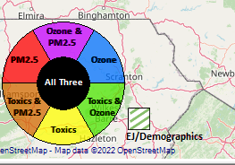
Region 1 Example: Criteria
PM2.5 Top Mortality Rate Risk Percentile ≥ 75%
Ozone Top Mortality Rate Risk Percentile ≥ 75%
Air Toxics Top Cancer Risk Percentile ≥ 75%
EJ/Demographics Top Demographic Index Percentile ≥ 75%
15

Slide 16
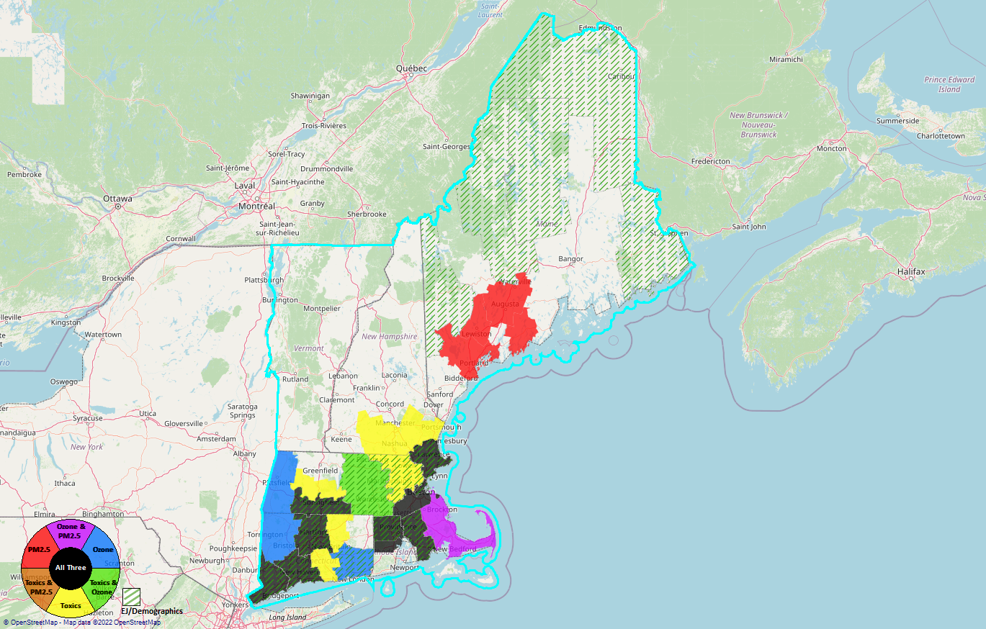
Region 1
PM2.5 Top Mortality Rate Risk Percentile ≥ 75%
Ozone Top Mortality Rate Risk Percentile ≥ 75%
Air Toxics Top Cancer Risk Percentile ≥ 75%
EJ/Demographics Top Demographic Index Percentile ≥ 75%
16

Slide 17
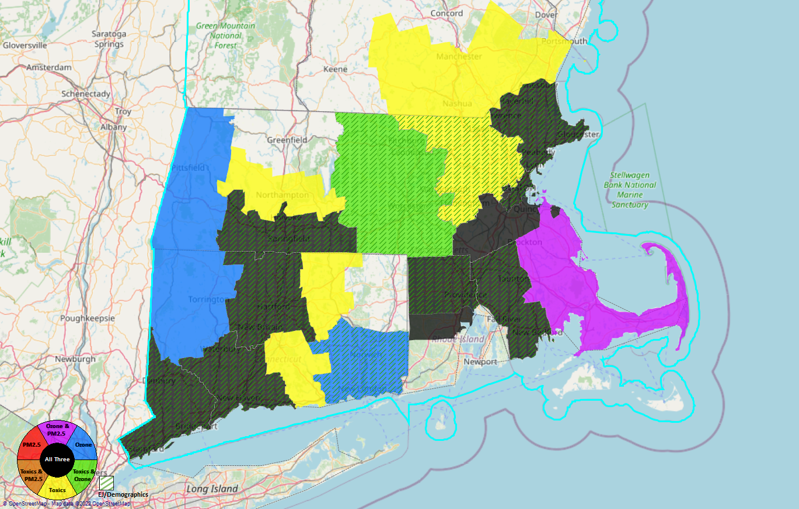
Fairfield County, CT
New Haven County, CT
Hartford County, CT
Hampden County, MA
Providence County, RI
Bristol County, MA
Suffolk County, MA
Essex County, MA
8
7
4
5
6
3
2
1
Region 1
17

Slide 18
Region 1 Example: Counties/CBSAs
County | CBSA
Fairfield County, CT | Bridgeport-Stamford-Norwalk, CT
New Haven County, CT | New Haven-Milford, CT
Hartford County, CT | Hartford-West Hartford-East Hartford, CT
Hampden County, MA | Springfield MA
Providence County, RI | Providence-Warwick, RI-MA
Bristol County, MA
Suffolk County, MA | Boston-Cambridge-Newton, MA-NH
Essex County, MA
18

Slide 19
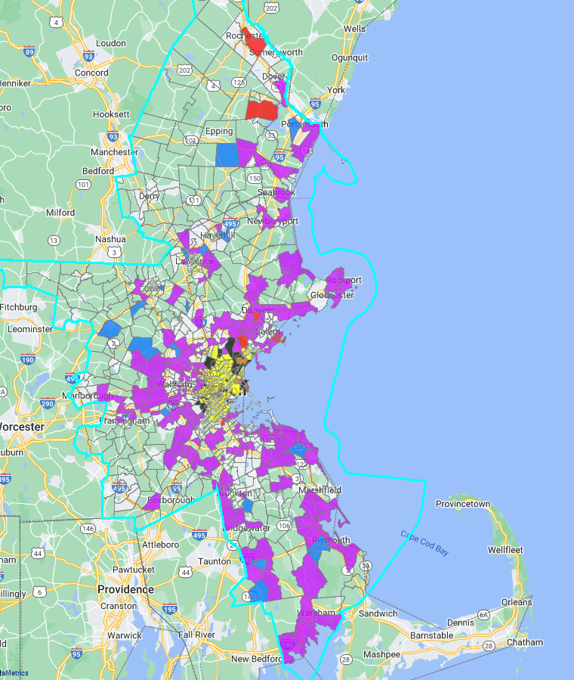
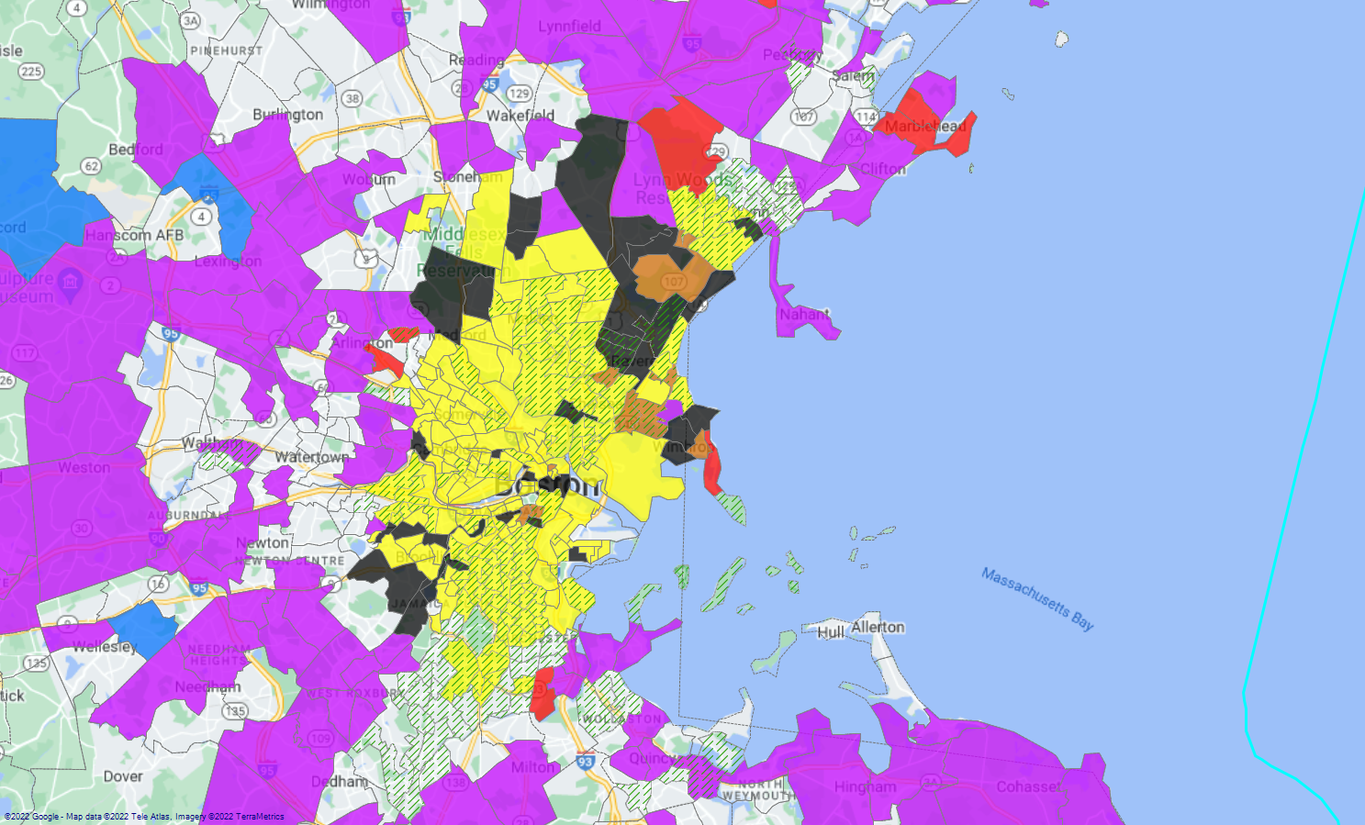
Region 1 Example: Boston-Cambridge-Newton, MA-NH
19

Slide 20
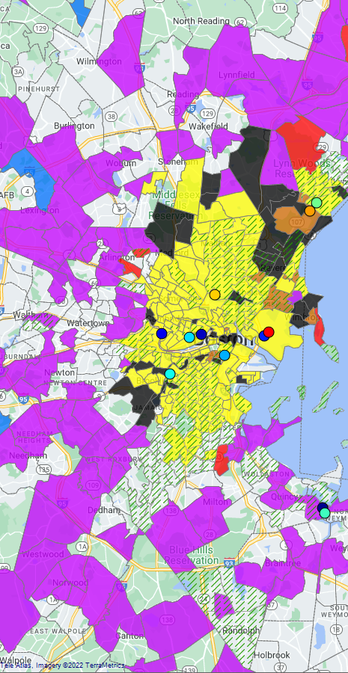
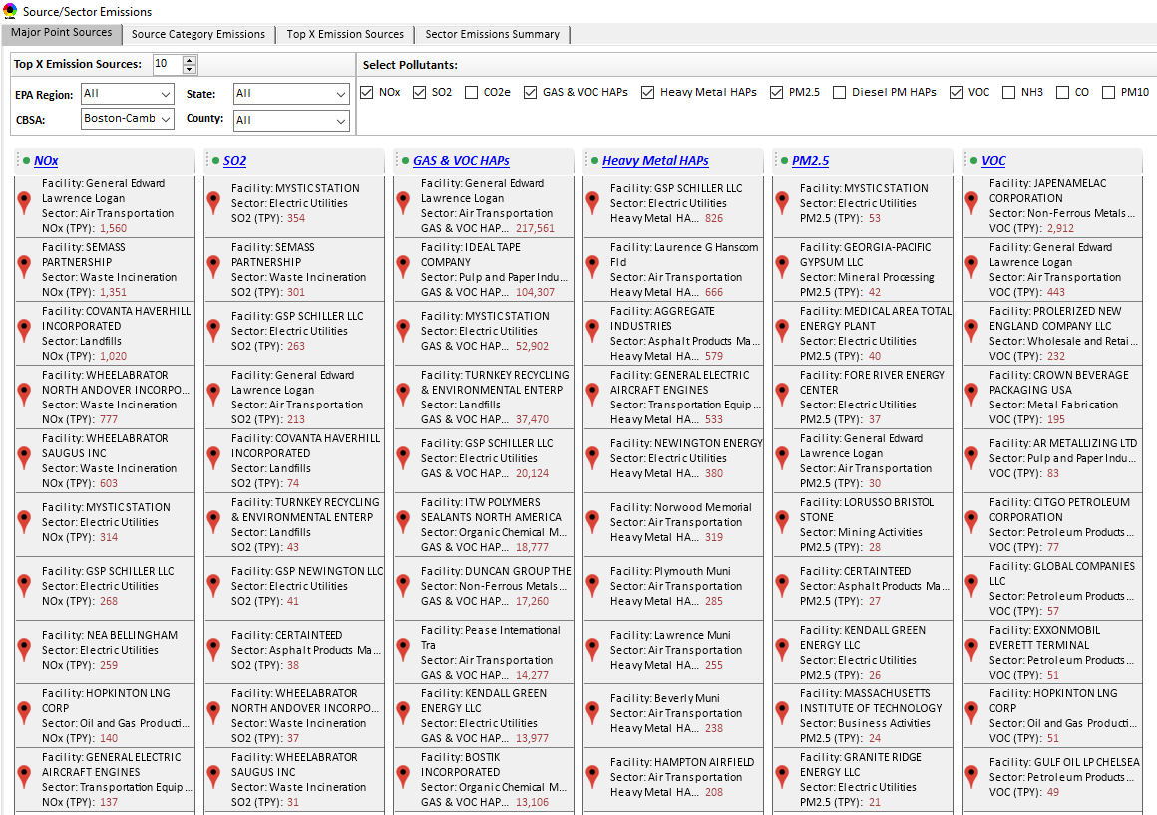
Region 1 Example: Boston CBSA Top Emission Sources
20

Slide 21
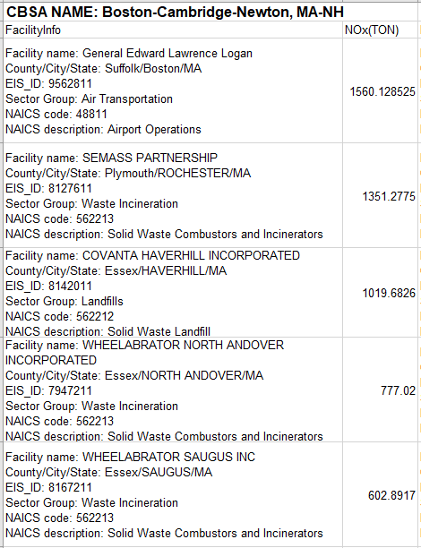
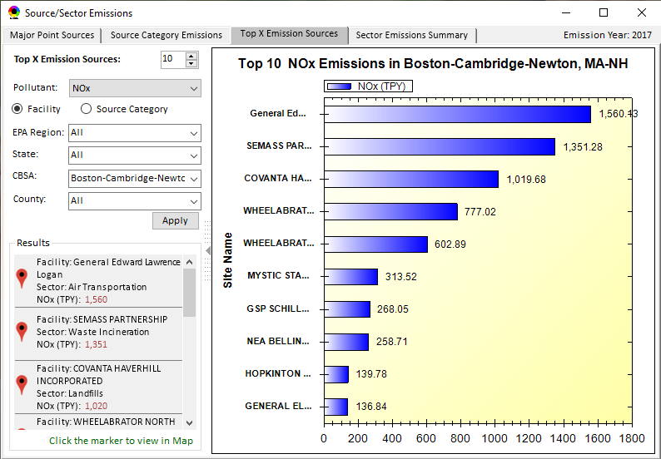
Region 1 Example: Boston-Cambridge-Newton, MA-NH CBSA Top Emission Sources
21

Slide 22
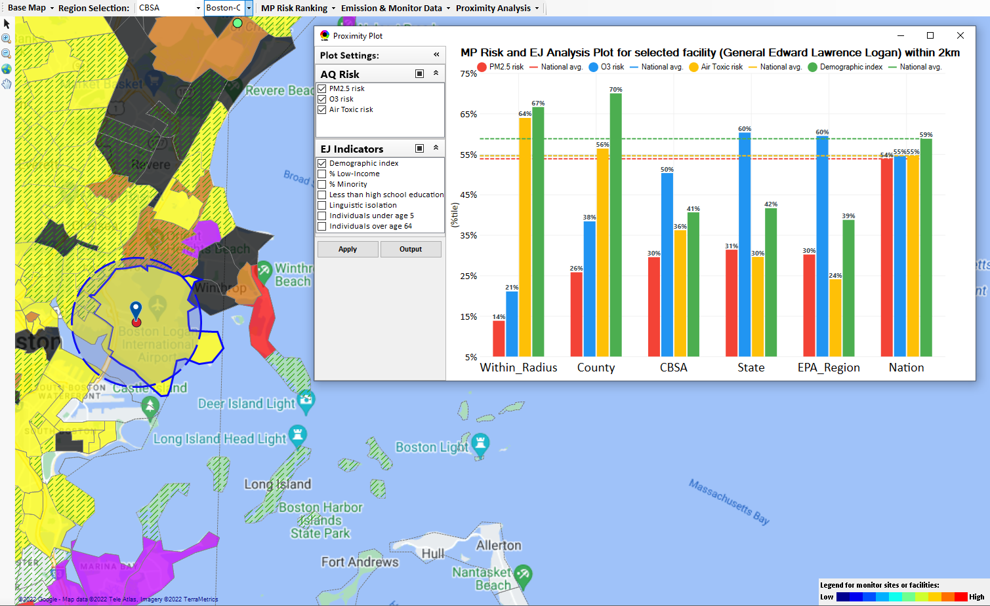
Region 1 Example: Boston-Cambridge-Newton, MA-NH CBSA General Edward Lawrence Logan Airport
Top emitter in CBSA for NOx and Gas & VOC HAPs.
Top 10 emitter in the CBSA for SO2, PM2.5 & VOC
22

Slide 23
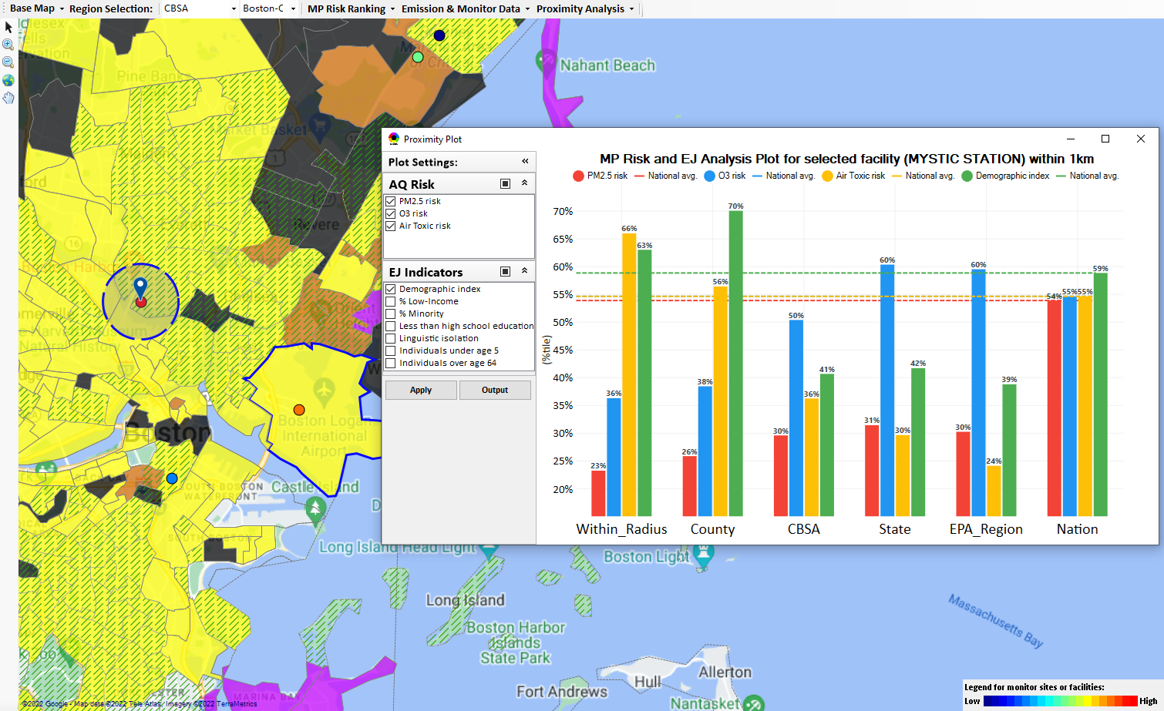
Region 1 Example: Boston-Cambridge-Newton, MA-NH CBSA Mystic Station EGU
Top emitter in CBSA for SO2 & PM2.5
Top 10 emitter in the CBSA for NOx & Gas & VOC HAPs
23

Slide 24
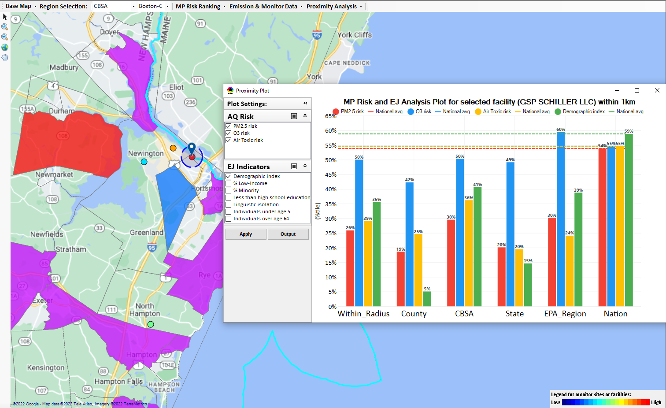
Region 1 Example: Boston-Cambridge-Newton, MA-NH CBSA GSP Schiller LLC EGU
Top emitter in CBSA for Heavy Metal HAPs
Top 10 emitter in the CBSA for NOx, SO2 & Gas & VOC HAPs
24

Slide 25
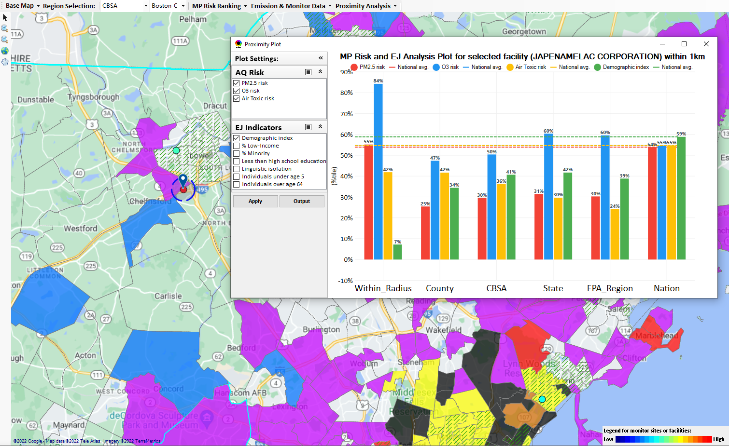
Region 1 Example: Boston-Cambridge-Newton, MA-NH CBSA Japenamelac Corp
Top emitter in CBSA for VOC
25

Slide 26
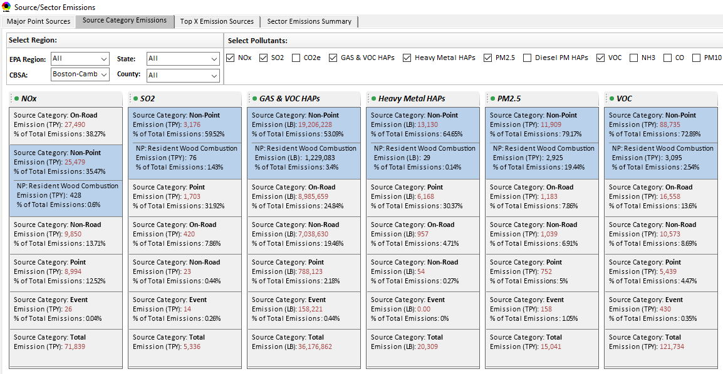
Region 1 Example: Boston-Cambridge-Newton, MA-NH CBSA Top Emission Source Categories
26

Slide 27
Region 1 Example: Boston-Cambridge-Newton, MA-NH CBSA Top Emission Source Categories
27

Slide 28
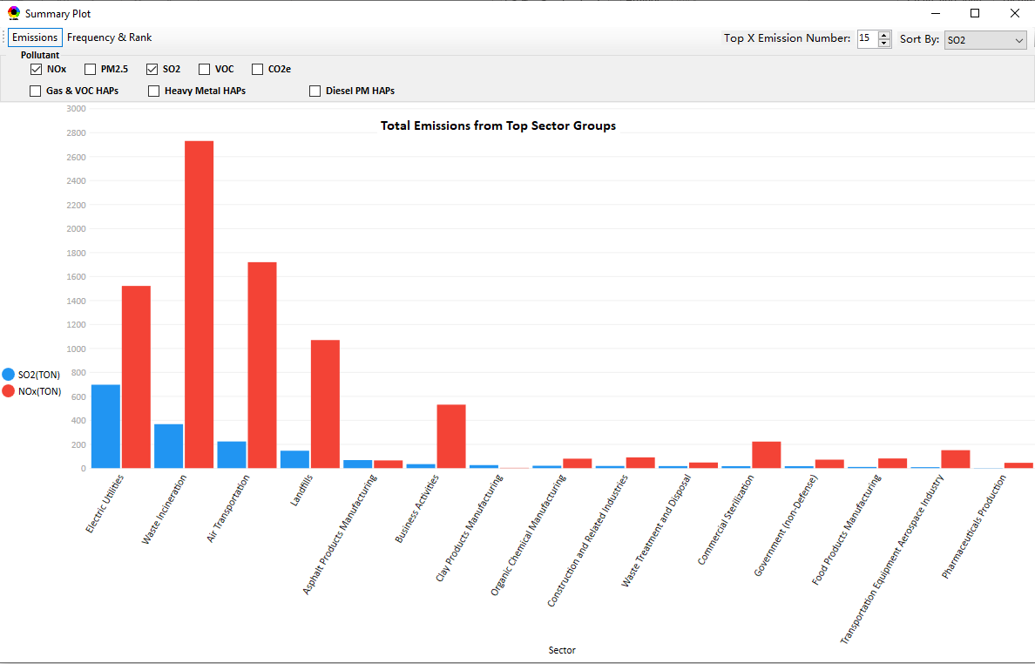
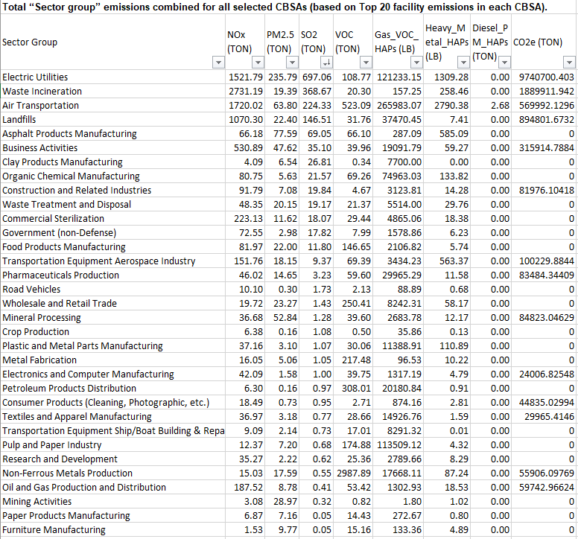
Region 1 Example: Boston-Cambridge-Newton, MA-NH CBSA Total Emissions from Top Sector Groups
28

Slide 29
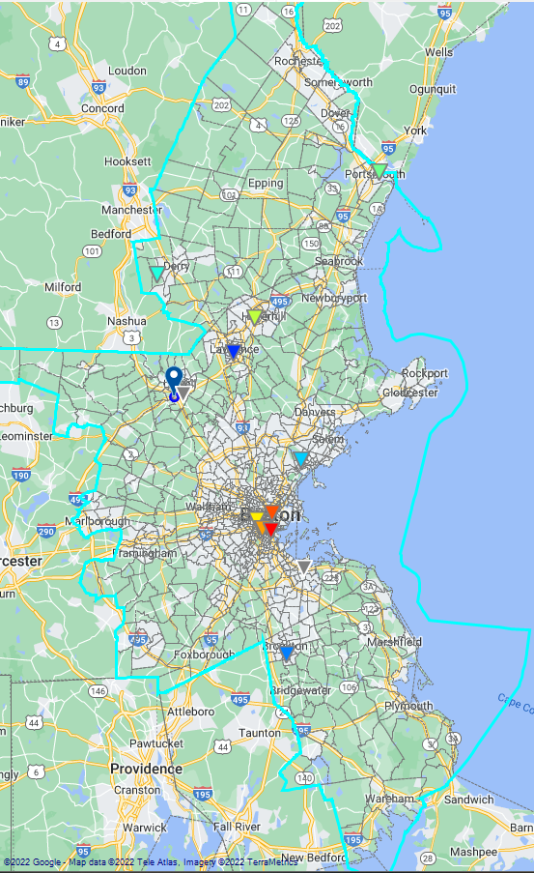
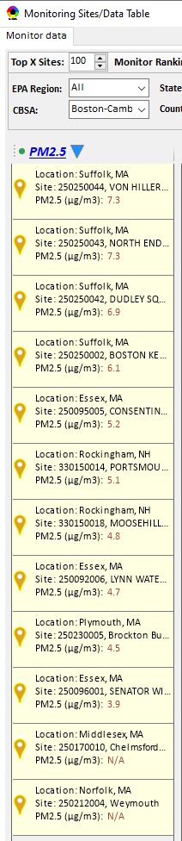
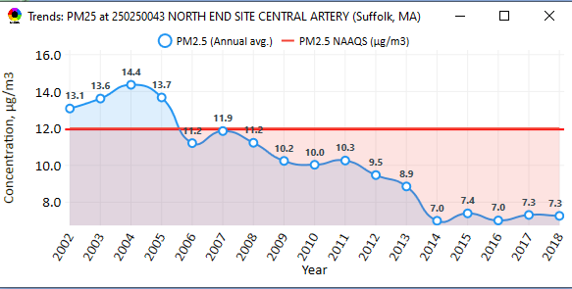
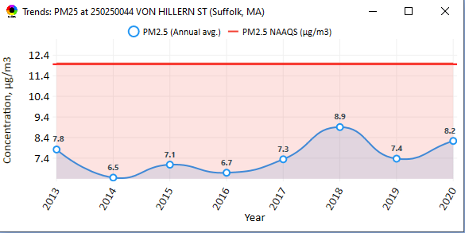
Region 1 Example: Boston CBSA PM_{2.5} Monitoring Sites
29

Slide 30
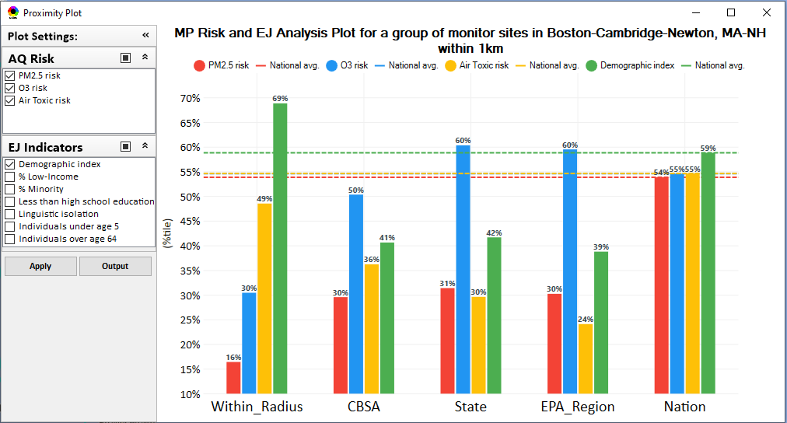
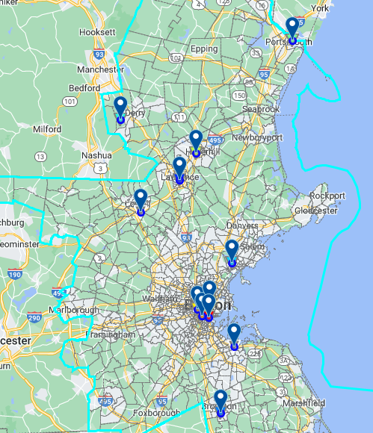
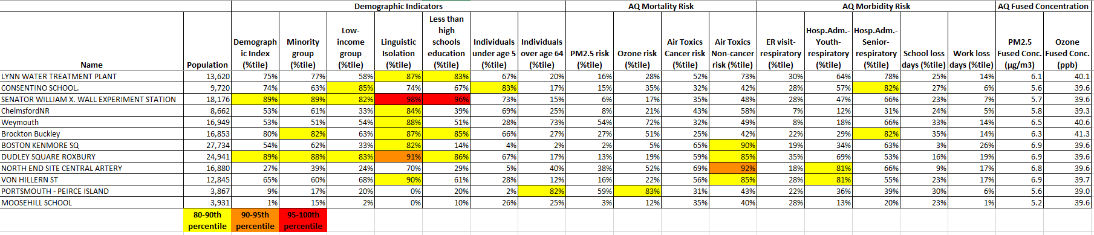
Region 1 Example:
Boston CBSA PM_{2.5} Monitoring Sites
30

Slide 31
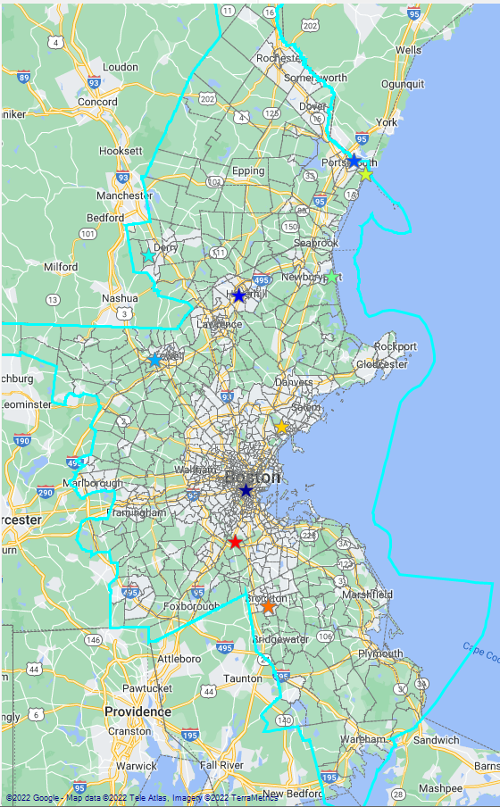
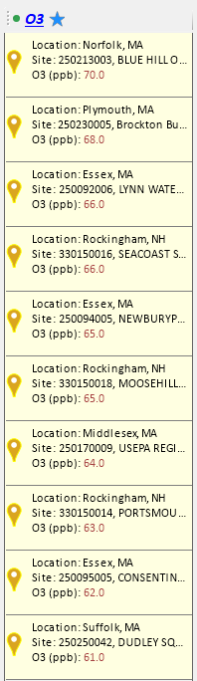
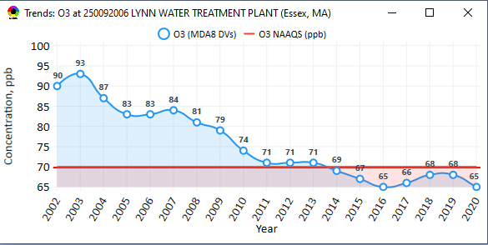
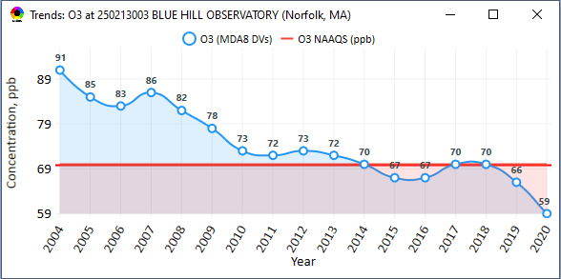
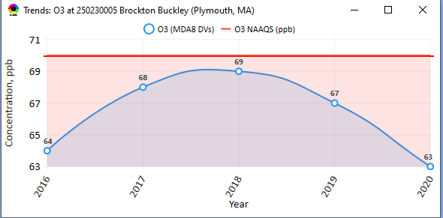
Region 1 Example: Boston CBSA Ozone Monitoring Sites
31

Slide 32
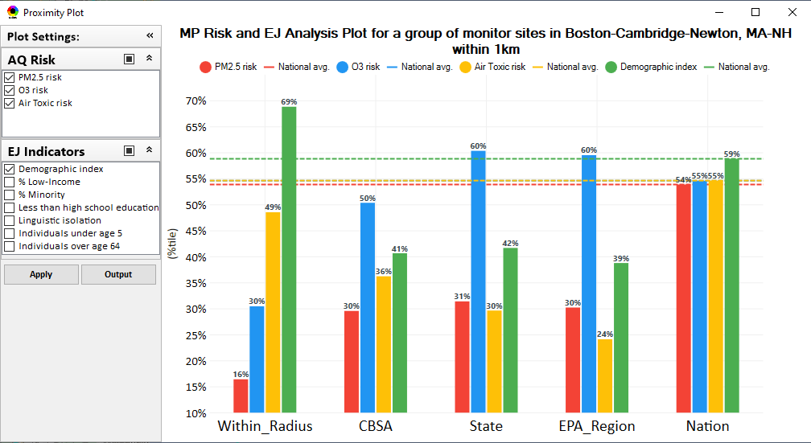
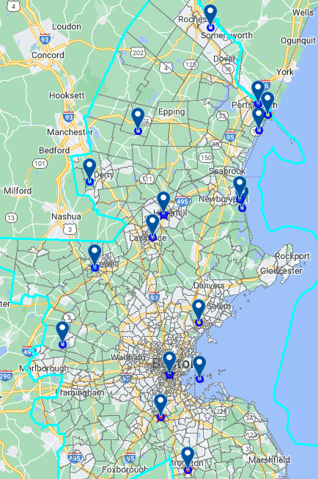
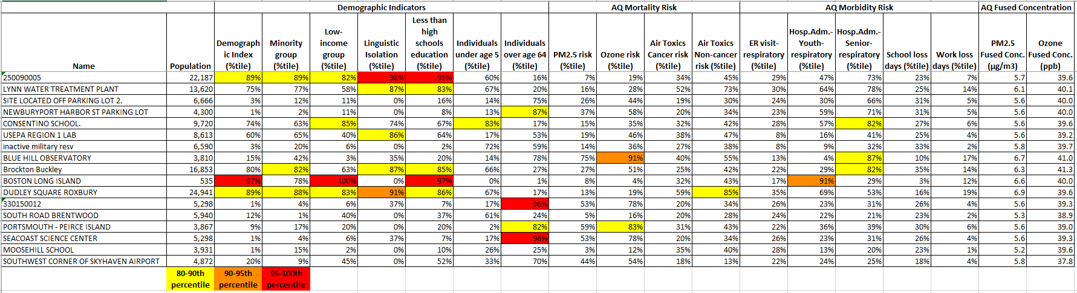
Region 1 Example: Boston CBSA Ozone Monitoring Sites
32

Slide 33
NEXUS: Next Steps
Continue development of Regional Packets using NEXUS to identify:
A location with EJ concerns interested in partnering in the near term
MP areas as candidates for IRA Clean Air Act Grants under 60105(f)
Schedule briefings for OAP, OTAQ & OAR Senior Management (Nov/Dec 2022)
Partner within EPA on use of NEXUS for programmatic purposes
NEXUS Improvements:
Address comments and feedback from EPA Beta Testing Team
Incorporate / revise “Climate risk” indicators (as 5th metric)
Update EJ/demographics data to be consistent with new “EJScreen 2.0” dataset
Include top air toxic cancer risk drivers in the “proximity analysis” module
Update to 2018/2019 MP platform (O₃, PM_{2.5}, and Air Toxics data)
Explore the feasibility of developing a web-based NEXUS version (similar to EJScreen)
Work towards making the tool publicly available
Stay tuned on implications of IRA on MP planning / NEXUS
33

Slide 34
“NEXUS 3.0” Live Demo
**NEXUS is currently an advanced screening tool for internal EPA use. A beta version is available for EPA staff to use and provide feedback on for improvement. Additional updates/improvements are necessary before the NEXUS tool is ready to be released to the public.**
34

Slide 35
Important Caveats
NEXUS Caveat
The NEXUS screening tool uses data from a variety of sources. This data is publicly available, except for the BenMAP data at the tract level. EPA is currently still in an internal review process and is not using this tool to support regulatory analyses.
BenMAP Caveat
The estimated number of PM and ozone-attributable deaths and illnesses reported at each tract are subject to important uncertainties and should be interpreted with caution. When using the BenMAP-CE tool to calculate these tract-level results, EPA lacked information regarding the baseline health status of individuals living at each tract; these data are a key input to the calculation of benefits. EPA instead used data available at the county- or state-level, which does not account for differences in baseline health between tracts. Estimating benefits in this way is not consistent with the peer-reviewed methods EPA follows when estimating air quality benefits in a Regulatory Impact Analysis. EPA will continue to refine its methods with the goal of reporting tract-level health benefits with confidence.
35

