Slide 1
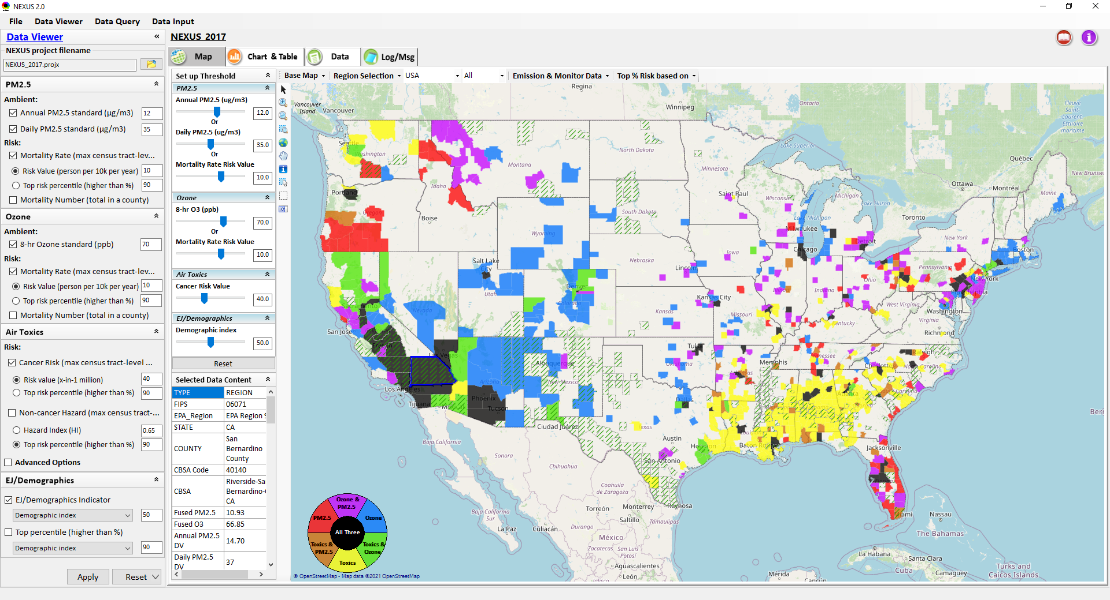
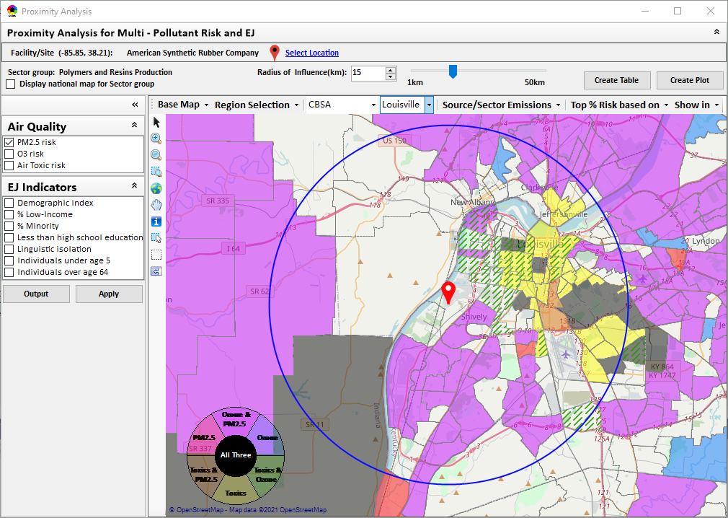
“NEXUS” Multi-Pollutant Advanced Screening Tool BenMAP Briefing
Data Viewer: National/Regional Level
Proximity Analysis: Community Level
Beth Landis, HEID/Climate, International, & Multi-Media Group
Carey Jang, AQAD/Air Quality Modeling Group
8/31/22
1

Slide 2
Multi-Pollutant Team Members
HEID
Beth Landis / Kimber Scavo
Matt Woody / Kelly Rimer
Robin Langdon / Darryl Weatherhead
Sara Terry
Carrie Wheeler
Rob Pinder
Chris Davis
Conor Mulderrig
Kayla McCauley
OID
Amanda Kaufman
James Payne
Loren Fox
AQAD
Carey Jang / Tyler Fox
Jim Kelly
Shannon Koplitz
Joe Mangino
Jeanette Reyes
AQPD
Rich Damberg / Megan Brachtl
Mia South
SPPD
Lisa Conner
2

Slide 3
Overview
Background
Data Inputs and Major Functions
Briefings & Demos
Feedback
EPA Regional Beta Testing Team
Team Members
Feedback (Uses & Asks)
NEXUS & EJSCREEN
Example OAQPS Use for Monitoring
Next Steps
IRA
Live Demo
3

Slide 4
Multi-Pollutant Background
Support a comprehensive, MP treatment of air quality problems to effectively improve air quality and make the most efficient use of available resources
Primary Goal - identify & evaluate local control strategies targeting emissions of O₃ & PM_{2.5} and their precursors while at the same time reducing Air Toxics of concern for communities to maximize both health benefits and air quality improvements
MP planning has the potential to reduce the costs and increase benefits associated with air quality management (AQM)
Supports S/L/T air agencies in developing MP, risk-based AQM plans and implementing strategies that reduce air pollution emissions & improve public health
Success has been demonstrated in Detroit and SC; another project is currently underway in Louisville, KY
Tools needed to analyze MP data are either available currently or being developed in OAQPS (e.g., NEXUS)
4

Slide 5
NEXUS: Background
“NEXUS” is an advanced screening tool for multi-pollutant (MP) risks and EJ/Demographic analysis developed by OAQPS’s MP team
“NEXUS” integrates a suite of MP data, including emissions, monitoring, modeling, fused AQ data and health risk data for PM_{2.5}, O₃ & air toxics as well as EJ/demographic data, into one single platform to allow national and areal overlay mapping & analysis of MP ambient & risk data
“NEXUS” provides MP analysis across from national level “Phase 1” to regional (EPA region/State/CBSA) level “Phase 2”, and now down to community level “Phase 3” (Proximity analysis” in census tract-level)
We expect to use this tool in conjunction with Regions and identify areas that would potentially benefit most from MP approaches to reduce emissions (including current NA areas)
We also expect that it can have additional value-added uses across the Office for Air Toxics, Environmental Justice and other programs
The NEXUS tool will essentially provide a ‘conceptual model’ of an area’s MP issues to facilitate engagement with state/local/tribal agencies & community stakeholder groups
5

Slide 6
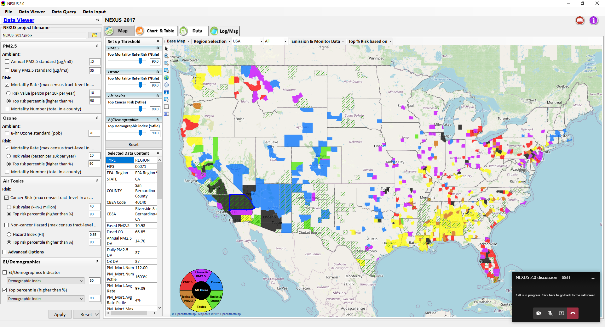
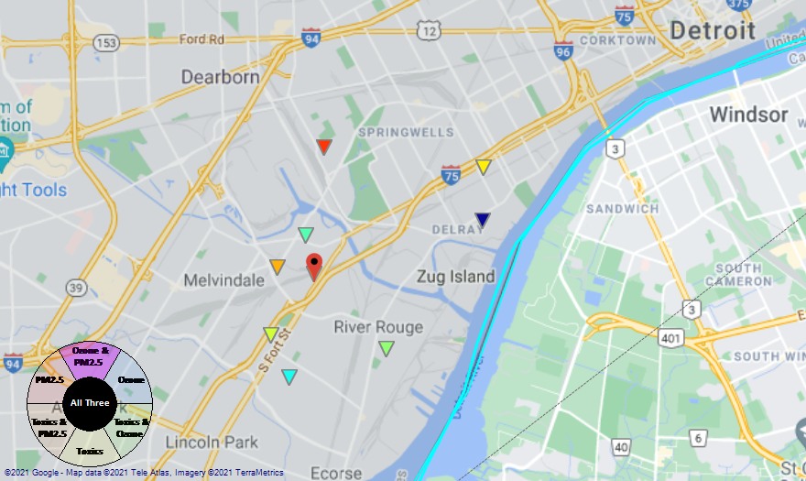
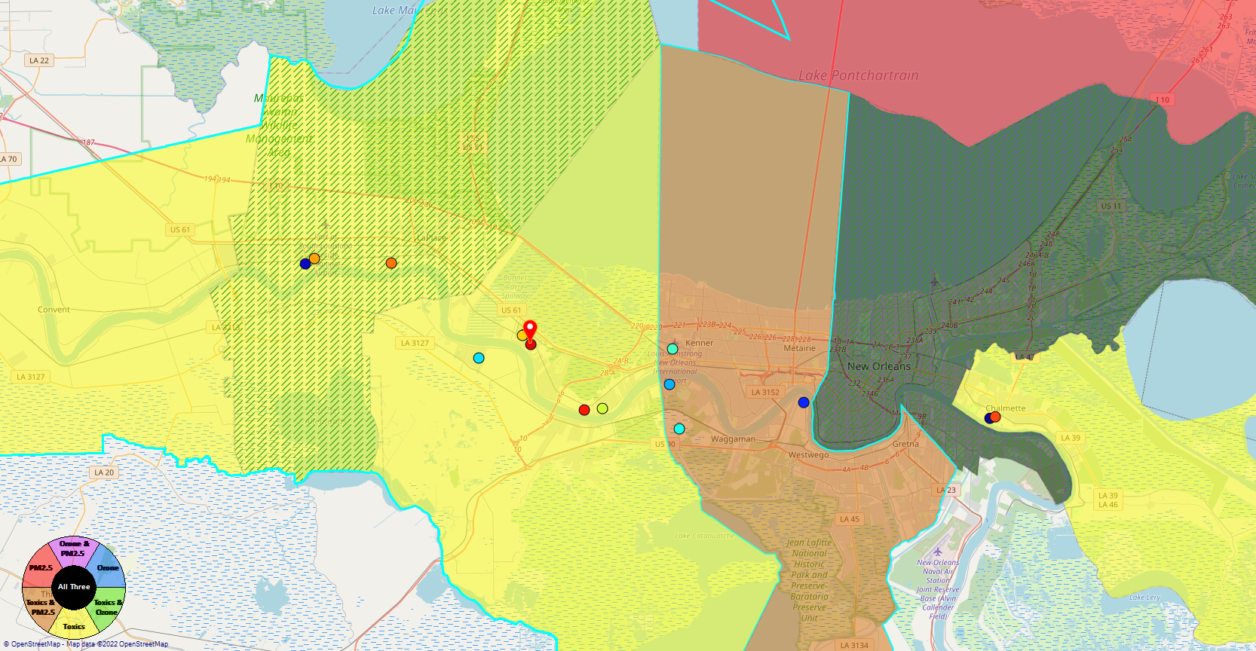
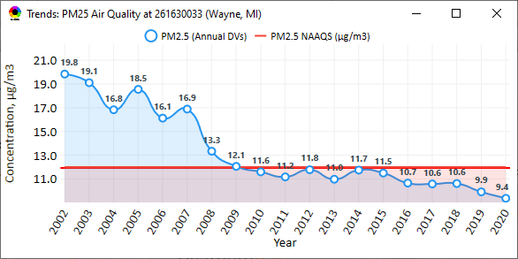
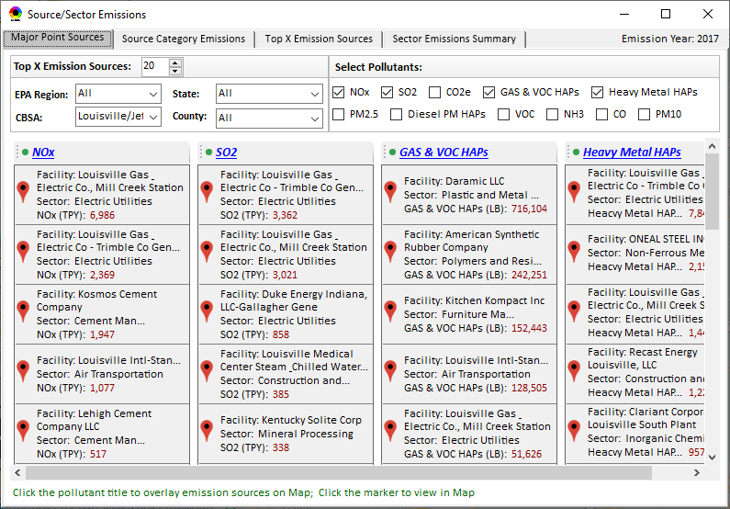
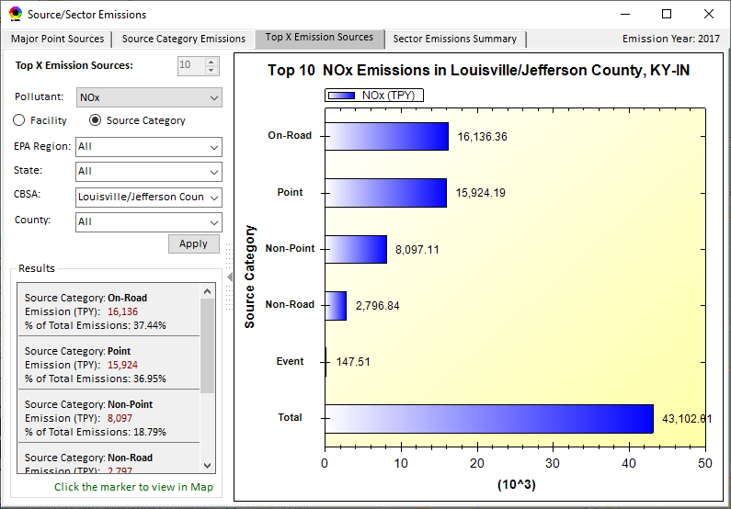
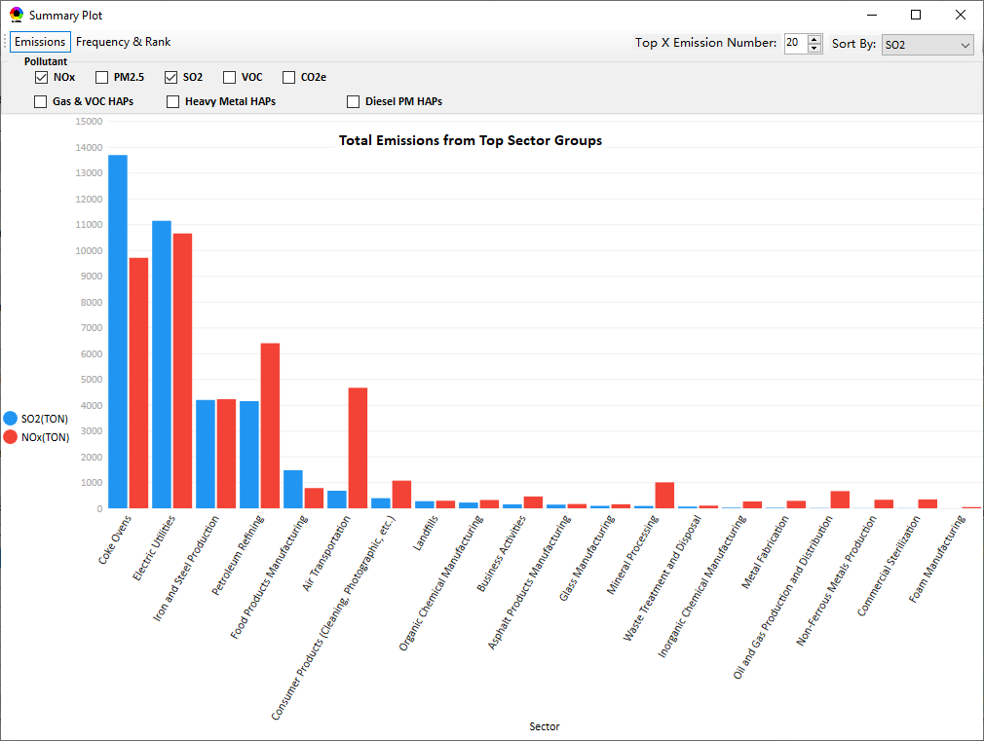
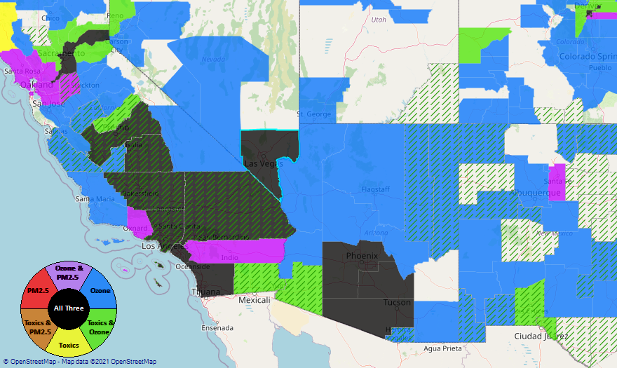
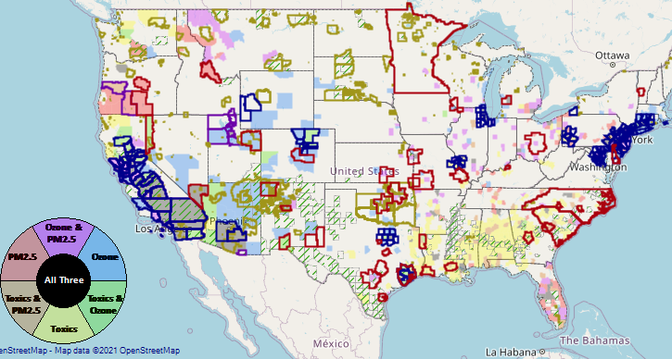
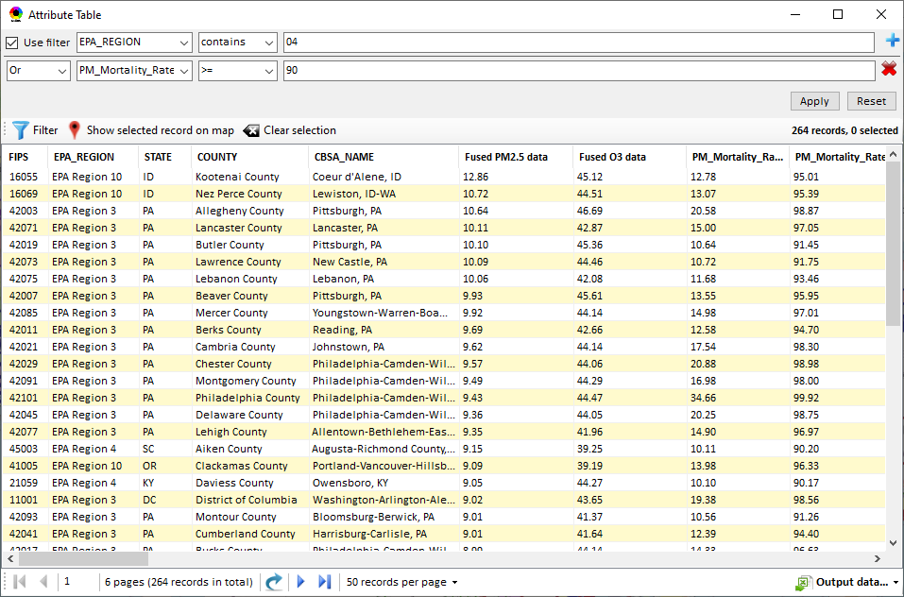
NEXUS: Data Inputs and Major Functions
O₃ & PM_{2.5}
Ambient/Design Value
(2012-2020)
(County-level)
Multi-Pollutant
Ambient and/or Risk National & Areal Mapping
Display Monitoring Sites & Trend Data
O₃, PM_{2.5} & Air Toxics Risk Data &
Conc. (fused AQ) Data
(2017 & 2014)
(Census tract-level)
Display Major Point Emissions Sites/Data
Provide Source Category Emissions
NEXUS
O₃, PM_{2.5} & Air Toxics Monitoring Data
(2002-2020 & -2018)
Provide Sector Emissions Summary
NEI County &
Facility Emissions
(2017 & 2014)
Include EJ/Demographic Indicators
Map Overlay with NAA, Advance Area, Class-I Area, or Tribal Area
Environmental Justice & Demographic Data
(from EJSCREEN)
Data Query, Search, Filter & Export
Advance Area
Class-I Area
Tribal Area
Proximity Screening Analysis
6

Slide 7
NEXUS: Briefings and Demos
9/25/2020– AQAD & HEID
11/3/2020 – MP Team
11/4/2020 – Air Toxics Group
12/10/2020 – AQPD
1/25/2021 – OID
1/28/2021 – SPPD
2/1/2021 – Peter/SMT
4/12/2021 – HEID & AQAD
5/17/2021 – Peter/SMT
5/24/2021 – MP Team
6/29/2021 – ORD
7/12/2021– HEID & AQAD
7/19/2021 – OID
8/10/2021– OAP
8/26/2021 – OAR
8/27/2021 - OP
8/30/2021 – OEJ
8/30/2021 - Region 4/Louisville
9/7/2021 – RO ADDs
9/20/2021 – OAR Demo
10/14/2021 – OP/NCEE
11/2/2021 – RO APMs
11/8/2021- RO APMs Demo
11/16/2021 – R1 (RARE) Project
11/28/2021 – AQAD All-Hands
11/23/2021 – R3 NEXUS Beta Testers
2/15/22 – AQPD (NSRG, OPG & SLPG)
2/17/22 – AT Strategy Mgmt & Mitigation Team
3/15/22 – OID (CTPG)
4/26/22 – EPA NEXUS Beta Testing Team
4/28/22 – AQAD (AAMG)
5/3/22 – HEID & AQAD
5/4/22 – Air Toxics Data Analysis Team
5/10/22 – ADVANCE Workgroup
5/26/22 - OAP/CCD
6/15/22 – Regional Ambient Air Monitoring
6/23/22 – SPPD All-Hands
7/21/22 – EJ in Rulemaking Comm. Of Practice
8/15/22 – OGC & ECRCO – Title VI
8/16/22 – Pre-brief for HEID & AQAD
8/17/22 – Peter
8/22/22 – OID/CTPG – Liz
9/31/22 – BenMAP Team
9/12/22 – OAPPS/AAOP (Economists)
9/14/22 – CAAAC
10/4/22 – RO APMs
TBD –MJOs
7

Slide 8
NEXUS: Feedback from Briefings & Demos
“Fascinating… phenomenal… I’m blown away!”
- Caroline Freeman (R4 ADD)
“The R3 air program has evaluated 18 web tools … NEXUS overall has been the most useful to our air program”
- Cynthia Stahl, PhD
(R3 Integrated Assessment Analyst)
“Your presentation of the NEXUS tool was absolutely awesome!!! … The NEXUS tool looks very promising”
- Osmond Lindo (OAPPS Lead Economist)
“Breathtaking… incredibly powerful… I feel like we discovered nuclear fusion!”
- Joe Goffman
(OAR Acting AA)
“The tool is well designed and provides a wealth of information that is useful for evaluating air quality impacts in local communities”
- Rick Gillam
(R4 Air Modeling Team Lead)
“Dr. Nance [R6 RA] will be thrilled with the NEXUS tool and excited with its capabilities.”
- Fran Verhalen
(recently retired R6 Monitoring Section Chief)
8

Slide 9
NEXUS: EPA Regional Beta Testing Team
Convened a group of OAR and regional office members that see the benefit of NEXUS and plan to use it on a routine basis to assist in their job duties.
Requested feedback to help shape the direction of future tool development and ensure we are making updates and additions that are most beneficial to those Regions who are encouraging a multi-pollutant approach to air quality management.
Working to identify specific applications to collaborate on with Regions, e.g.:
Select area with MP and potential EJ concerns and explore a MP approach using NEXUS.
Support EJ screening and related analysis for Federal permit or related action.
9

Slide 10
NEXUS: EPA Regional Beta Team Members
Region 1
Shutsu Wong
Emily Bolger
Region 2
Ysabel Barron
Region 3
Cynthia Stahl
Carol Ann Gross-Davis
Jessie Fry
Angus Welch
Alice Chow
Region 4
Rick Gillam
Byron Gary (LMAPCD)
Region 5
Alexis Cain
Margaret Sieffert
Rae Trine
Yana Genchanok
Region 6
Nia Riddick
Region 7
Adam Zachary
Allie Donohue
Region 8
Ethan Brown
Adam Eisele
Region 9
Julia Carlstad
Region 10
Claudia Vaupel
OAQPS
Rob Pinder
Matt Woody
Beth Landis
Carey Jang
Joe Mangino
Mia South
Shomik Ghosh
Kimber Scavo
Tyler Fox
10

Slide 11
NEXUS: Beta Team Feedback - Uses
SIP Related Activities
Address NAAs and areas close to NAAQS
Develop conceptual models
Areas preparing path forward document to join Advance program
Future weight-of-evidence analysis
Air Quality Planning Activities
Identity areas to focus reduction efforts with possible lowering of NAAQs
Evaluate permit applications
Visually understand MP issues
Visualize areas of concern, run reports & focus efforts
Response to citizen complaints about sources
Determine where to focus emission reduction efforts
Environmental Justice
Generate maps and reports for EJ workgroup
Identify areas with air quality and EJ concerns
Review Tribal areas
Ensuring MP cumulative impacts are considered
Robust evaluation of potential EJ concerns and plans to address community needs
Outreach
Support AQ planning conversations with SLT air agencies
EtO community outreach
Briefings with RAs and management
Monitoring Activities
Review Annual Monitoring Network Plans and site/monitor relocation requests
Review new development proposals
Ongoing network assessments
Assessments
Evaluate air quality impacts in local communities
Supplement AirToxScreen Assessments
Assess burden of individual or combination of air pollutants
Complement existing techniques for emissions, modeling, monitoring & risk assessment
Identity air quality and human health focus areas
Other
Help new employees learn about areas with O₃, PM_{2.5}, toxics and/or EJ concerns
Assist with determining distribution of grant funding
11

Slide 12
NEXUS: Beta Team Feedback - Asks
Common Requests
Access issues - web-based / cloud-based application is preferable
More recent data
Addition of available Pb data
Ability to filter emissions, monitor data, and drop downs selections by map extent or user defined boundaries (e.g., boundary box or lasso)
Addition of GHG reporting program data
Report capabilities: Automated 1–2-page summary document
Unique Requests
Ability to layer multiple years of data
Ability to see all monitors in a selected area
Ability to see all facilities within proximity analysis selected area versus county-wide
Ability to see modeled concentrations from AirToxScreen
Ability to import air dispersion modeling results in .kmz format
Ability to filter facilities by industry/NAICS
Ability to adjust the data value year in proximity analysis
See individual HAP/VOC emissions
Add driving pollutant for elevated cancer risk and HI for census block
Add data for Hawaii and Alaska
Wind roses to help assess monitor siting
12

Slide 13
NEXUS & EJSCREEN
EJ Layers
Hazardous waste
EJ Grants
Water features
Places
Schools & Parks
Transportation
Boundaries
Prisons
Public Housing
Subsidized Housing
Climate
Sites reporting to the EPA
Superfund (NPL)
RSEI
Environmental Indicators
Wastewater Discharge Indicator
Hazardous Waste Proximity
Superfund Proximity
Lead Paint Indicator
Traffic Proximity
RMP Proximity
Ozone and PM_{2.5}
Emissions and source data
Monitoring data
Fused concentration data
Mortality & morbidity risk data
Air Toxics
Emissions and source data
Monitoring data
Modeled concentration data
Cancer & noncancer risk data
GHG emissions
NEI’s GHG (CO2e) emissions
Facilities and county level
Source categories (pt, on-road, non-road, etc.)
EJ Layers
Tribal Areas
Nonattainment Areas
Environmental Indicators*
NATA Respiratory HI
NATA Cancer Risk
NATA Diesel PM
Ozone Model Concentrations
PM_{2.5} Model Concentrations
Demographic Indicators
People of Color Population
Less Than HS Educated
Low Income Population
Linguistically Isolated
Demographic Index
Under Age 5
Over Age 64
*Provided to OEJ by OAQPS (AQAD & HEID)
13

Slide 14
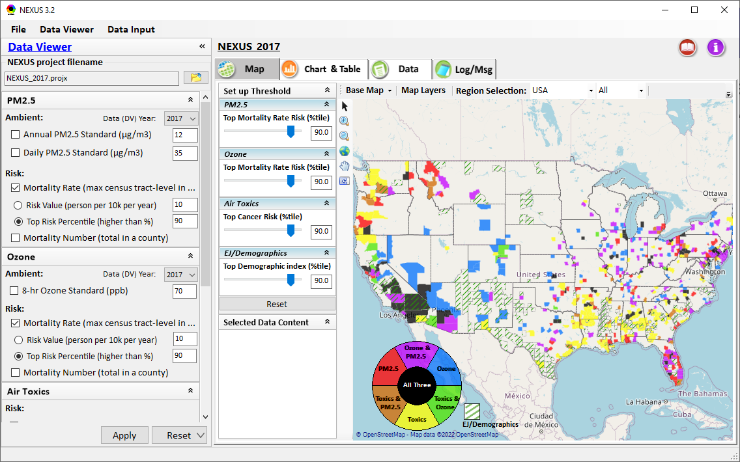
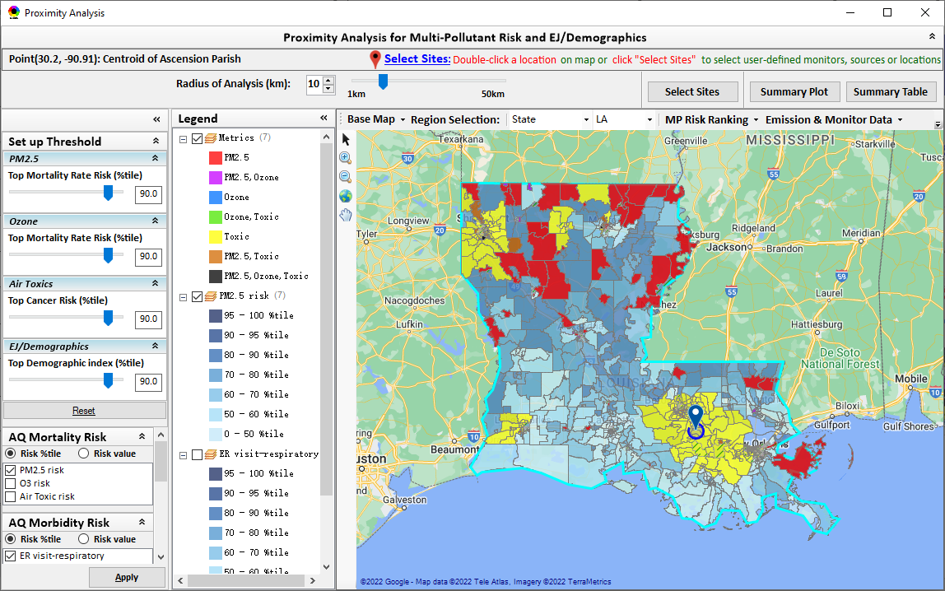
NEXUS: BenMAP Risk Data and Usage
BenMAP team provided 2017 & 2014 mortality and morbidity risk data (in census tract level) based on fused O3 & PM2.5 conc. (provided by AQAD/AQAG using Downscaler, same AQ dataset delivered to CDC and EJScreen), and currently working on providing 2018 BenMAP risk data
NEXUS processes the BenMAP risk data into two optional metrics:
mortality rate (max census tract level in a county): “person per 10k per year”
mortality number (total mortality in a county): “person in total per year”
NEXUS also allows users to select metrics based on “risk value” or “percentile%”
The new “Proximity Analysis” module provides the BenMAP mortality & morbidity risk data directly in census tract level
14

Slide 15
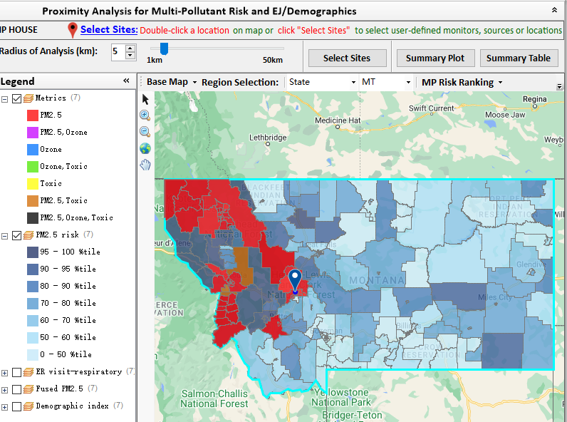
NEXUS: Example OAQPS Use for Monitoring
AQAD/AAMG summer intern (Tom Agger) used NEXUS to provide Justice40 criteria recommendations for the National PM_{2.5} Monitoring Network
Goal: Determine if at least 40% of the current PM_{2.5} monitoring network serves EJ/At-Risk communities
Process: Used NEXUS proximity analysis tool to analyze geographic areas around monitors or pollutions sources to determine demographics and pollutant risk in those areas
Outcome:
Examined numerous combinations of demographic index, low income, minority, and PM_{2.5} risk criteria
Preliminary findings suggest that the current National PM_{2.5} Network meets the Justice 40 goals
AAMG will share the findings with the Regions
This analysis can be used for future monitor siting purposes, but must be combined with other considerations
15

Slide 16
NEXUS: OAQPS Next Steps
NEXUS Updates Underway
Update EJ/demographics data to be consistent with new “EJScreen 2.0” dataset
Add preliminary “Climate risk” indicators
Add “flood, fire, drought, sea level rise” map layers thru API (similar to EJScreen 2.0)
Add “heat index” developed by OAQPS & ORD based on Global climate models’ predictions as 5th metric
FY’23 NEXUS Budget Request ($150K)
Address major comments and feedback from Beta Testing Team ($25K)
Update to 2018 & 2019 MP platform & QA ($25K)
Develop web-based NEXUS version ($100K)
Web-based NEXUS Development ($75K)
Deployment and Information Security ($25K)
Regional Engagement
Provide list of MP areas to regions and identify areas with MP and potential EJ concerns to consider partnering with
Identify areas that may be NAAs or close to new PM_{2.5} std levels for Advance Program
Follow up on other Regional uses identified by Beta test team
Partner within EPA/OAR on use of NEXUS for programmatic purposes
Briefing for OAR Management (Fall 2022)
Propose Requesting an additional $50K:
$25K for climate risk indicators and metric
Additional $25K for Web-based NEXUS Development
16

Slide 17
NEXUS: Inflation Recovery Act 60114
IRA 60114. Climate Pollution Reduction Grants ($5B)
Provide grants for states, air pollution control agencies, municipalities, Tribes, and groups of one or more of these entities to develop ($250M) and implement ($4.75B) GHG emission reduction plans.
Of the $4.75B, 3% ($142.5M), can be used for administrative costs, including technical assistance
Propose to provide technical assistance for grantees to integrate multi-pollutant planning and program implementation with programs to reduce GHG emissions, with the recognition that many actions to reduce GHG emissions also provide important co-benefits in criteria and toxic air pollutant reductions and associated health benefits for local communities.
Encourages expansion to MP air quality management planning that addresses climate and EJ
References deployment of advanced screening tools, such as NEXUS, in support of SLT and community-focused multipollutant air and climate strategies
17

Slide 18
NEXUS: Inflation Recovery Act 60105(f)
IRA 60105(f). Clean Air Act Grants ($25M)
Available for grants & other activities authorized under subsections A-C of section 103 & 105 of the CAA
Propose supporting SLT efforts to reduce AQ risks in overburdened communities through federally assisted grants
Funding could be targeted toward addressing MP air quality challenges in at-risk communities, focusing on low-income, disadvantaged communities (LI/DC)
Assisting SLTs in identifying locations suitable for investment to address MP challenges that drive public health risks will promote air quality improvements in target areas
Notes that NEXUS could be applied to assist with responding to EPA regulatory requirements like siting of new air pollution monitors/stations and permit approvals, as well as assessing municipal-level policies
Of the $25M, 5% ($1.25M) can be used for administrative costs, including technical assistance:
New technical capacities to better assist SLTs in integrating MP strategies into AQM, e.g., NEXUS expansion and updates such as:
NEXUS packets for each region mapping specific areas of concern and opportunities for engagement with ADVANCE partners
Updating air pollutant datasets
Integrating more comprehensive EJ metrics in conjunction with further EJScreen developments
Inclusion of GHG pollutants and climate impacts
Increasing tool accessibility and speed of updates through web-based access
This could include OAQPS technical work to develop MP case studies and regional NEXUS packets, providing technical assistance to SLTs conducting MP analysis and examples of best practices to support the grants program
18

Slide 19
“NEXUS 3.0” Live Demo
19

