Slide 1
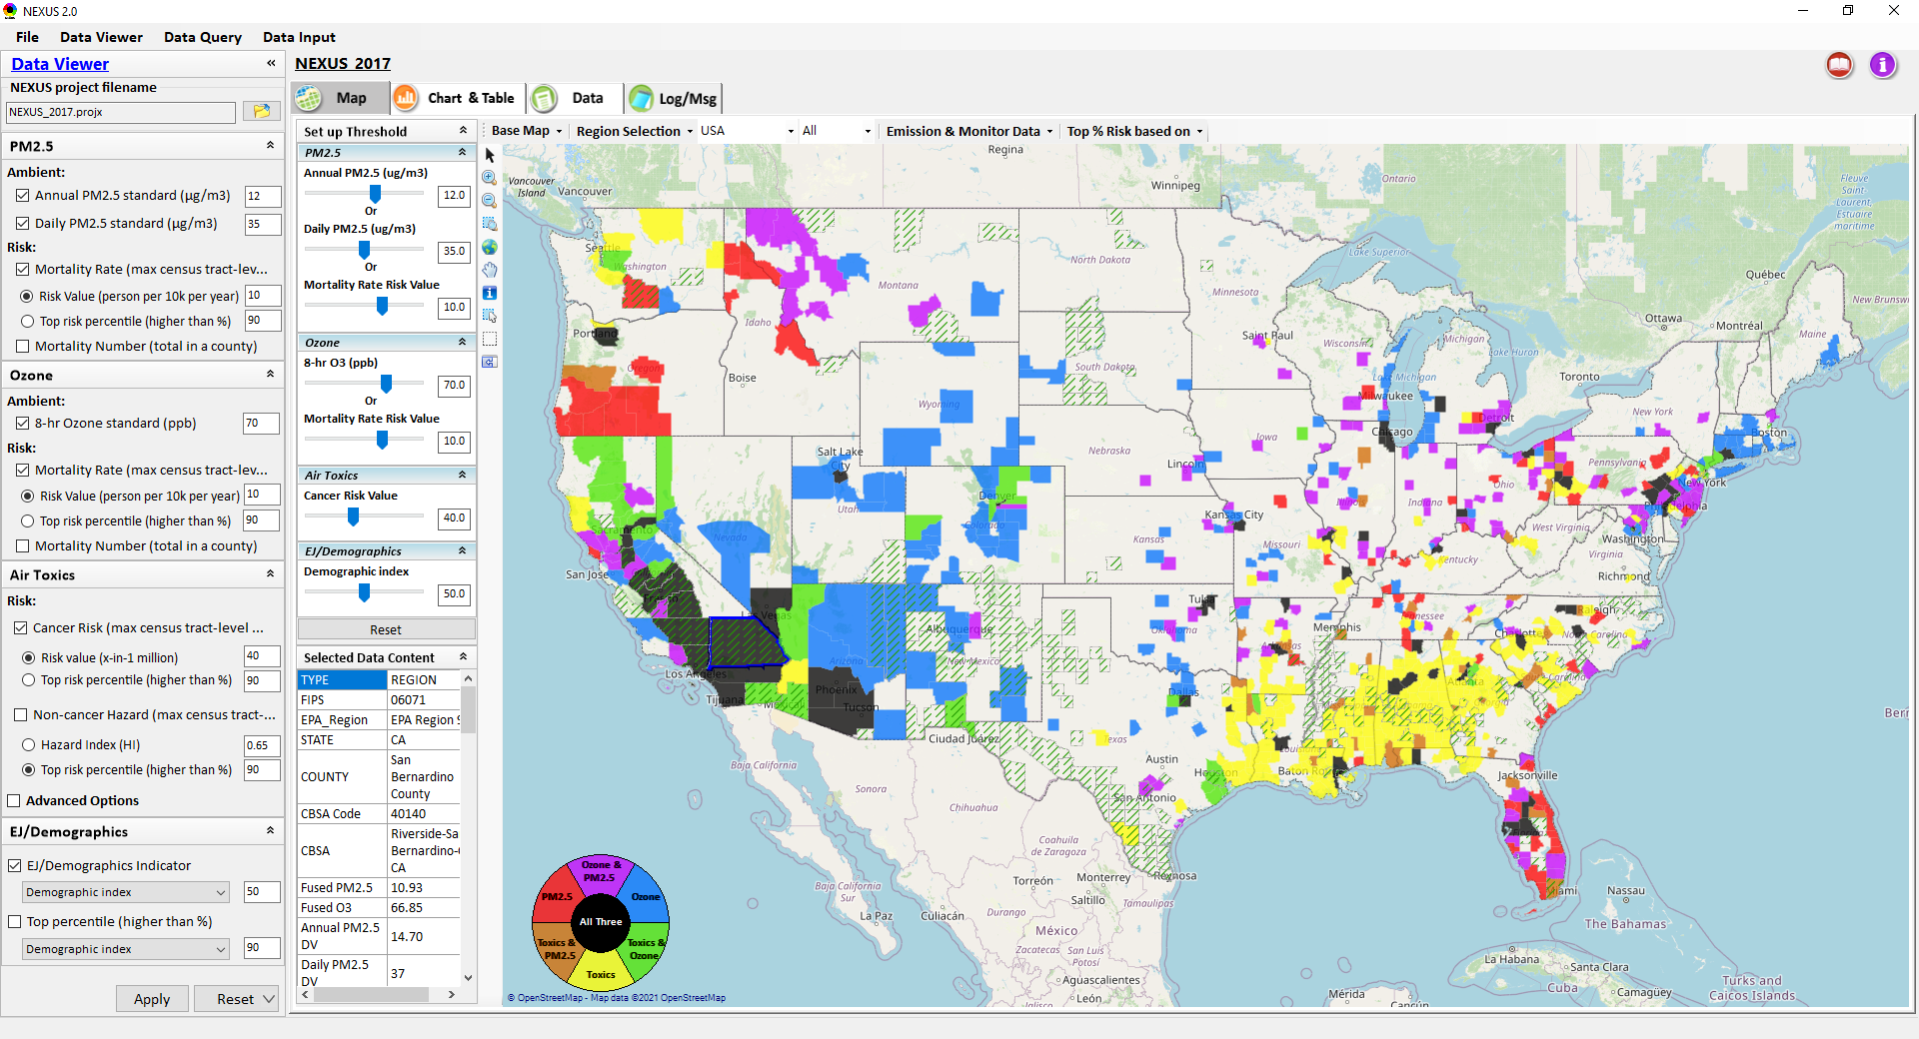
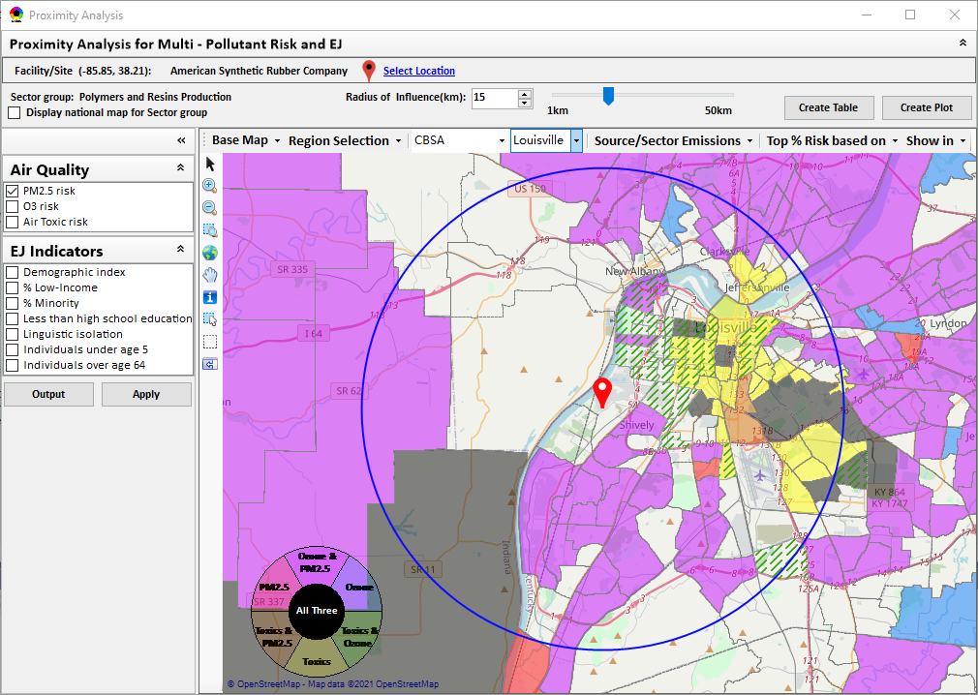
“NEXUS” Multi-Pollutant Advanced Screening Tool
OAPPS/AAOP Briefing
Data Viewer: National/Regional Level
Proximity Analysis: Community Level
Beth Landis, HEID/Climate, International, & Multi-Media Group
Carey Jang, AQAD/Air Quality Modeling Group
9/12/22
1

Slide 2
Multi-Pollutant Team Members
HEID
  Beth Landis / Kimber Scavo
  Matt Woody / Kelly Rimer
  Robin Langdon / Darryl Weatherhead
  Sara Terry
  Carrie Wheeler
  Rob Pinder
  Chris Davis
  Conor Mulderrig
  Kayla McCauley
OID
  Amanda Kaufman
  James Payne
  Loren Fox
AQAD
  Carey Jang / Tyler Fox
  Jim Kelly
  Shannon Koplitz
  Joe Mangino
  Jeanette Reyes
AQPD
  Rich Damberg / Megan Brachtl
  Mia South
SPPD
  Lisa Conner
2

Slide 3
Overview
Multi-Pollutant Background
NEXUS Background
Data Inputs and Major Functions
Briefings & Demos
  Feedback
NEXUS & EJSCREEN
Important Caveats
Live Demo
3

Slide 4
Multi-Pollutant Background
Support a comprehensive, MP treatment of air quality problems to effectively improve air quality and make the most efficient use of available resources
  Primary Goal - identify & evaluate local control strategies targeting emissions of O₃ & PM_{2.5} and their precursors while at the same time reducing Air Toxics of concern for communities to maximize both health benefits and air quality improvements
MP planning has the potential to reduce the costs and increase benefits associated with air quality management (AQM)
Supports S/L/T air agencies in developing MP, risk-based AQM plans and implementing strategies that reduce air pollution emissions & improve public health
Success has been demonstrated in Detroit and SC; another project is currently underway in Louisville, KY
Tools needed to analyze MP data are either available currently or being developed in OAQPS (e.g., NEXUS)
4

Slide 5
NEXUS: Background
“NEXUS” is an advanced screening tool for multi-pollutant (MP) risks and EJ/Demographic analysis developed by OAQPS’s MP team
“NEXUS” integrates a suite of MP data, including emissions, monitoring, modeling, fused AQ data and health risk data for PM_{2.5}, O₃ & air toxics as well as EJ/demographic data, into one single platform to allow national and areal overlay mapping & analysis of MP ambient & risk data
“NEXUS” provides MP analysis across from national level “Phase 1” to regional (EPA region/State/CBSA) level “Phase 2”, and now down to community level “Phase 3” (Proximity analysis” in census tract-level)
We expect to use this tool in conjunction with Regions and identify areas that would potentially benefit most from MP approaches to reduce emissions (including current NA areas)
We also expect that it can have additional value-added uses across the Office for Air Toxics, Environmental Justice and other programs
The NEXUS tool will essentially provide a ‘conceptual model’ of an area’s MP issues to facilitate engagement with state/local/tribal agencies & community stakeholder groups
5

Slide 6
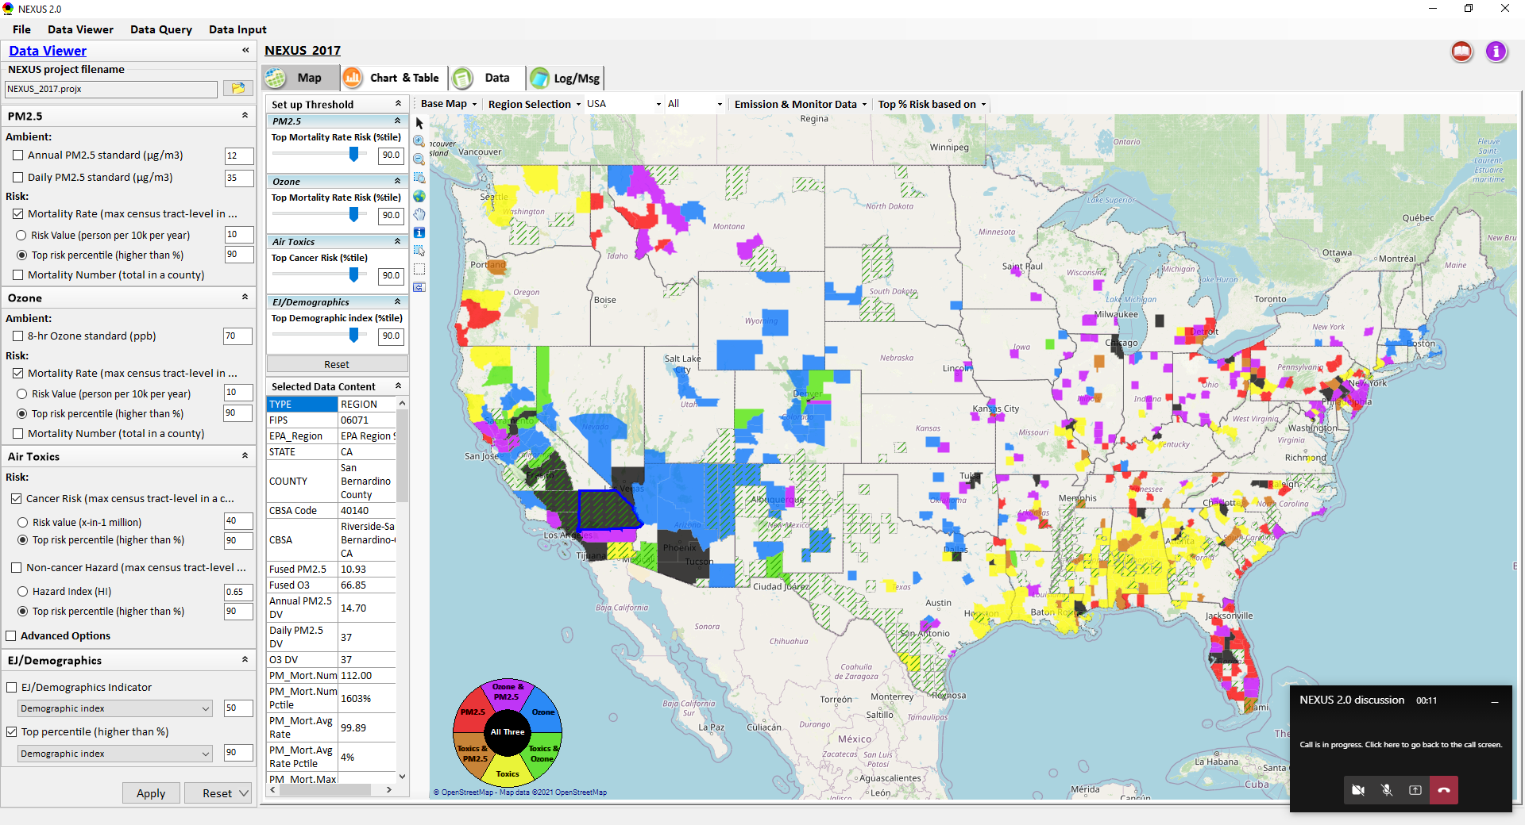
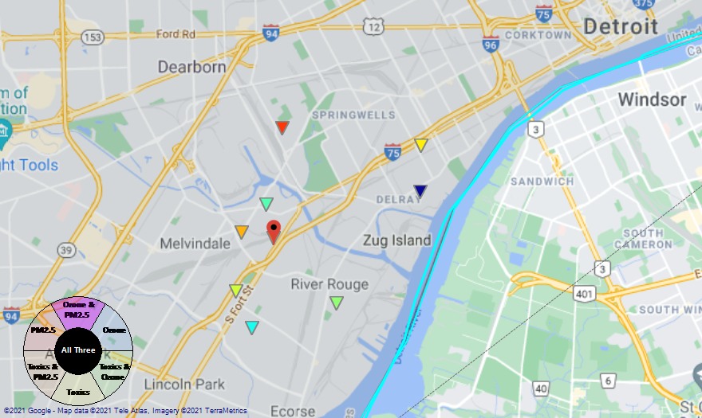
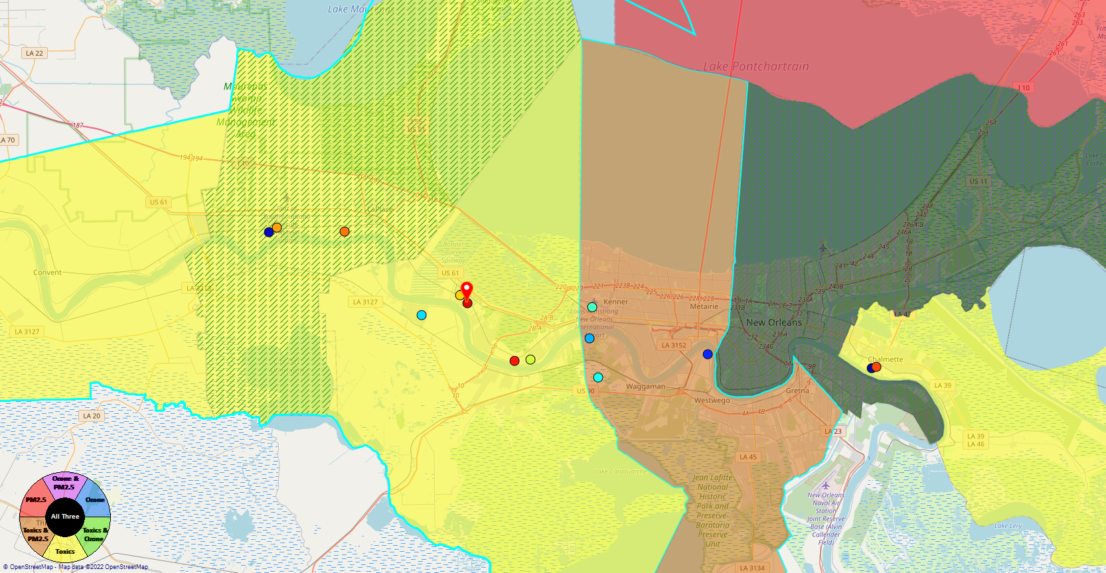
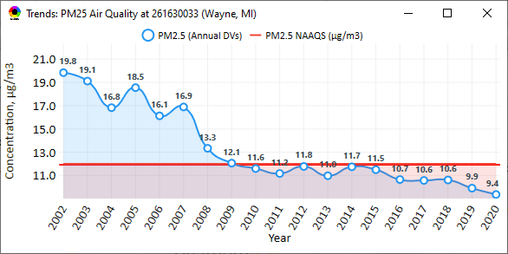
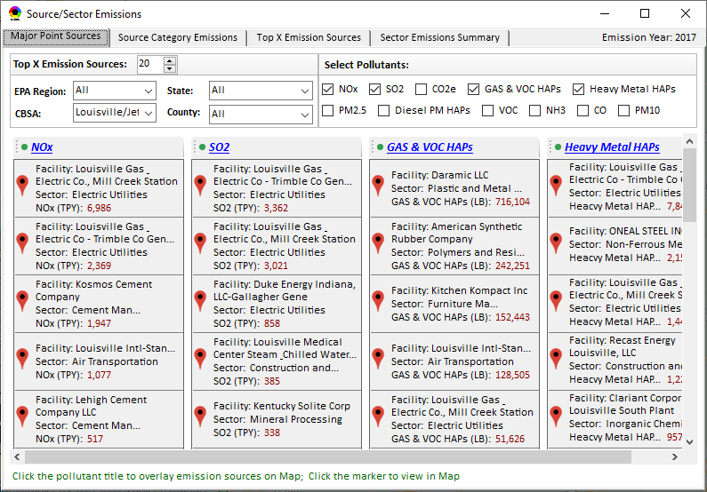
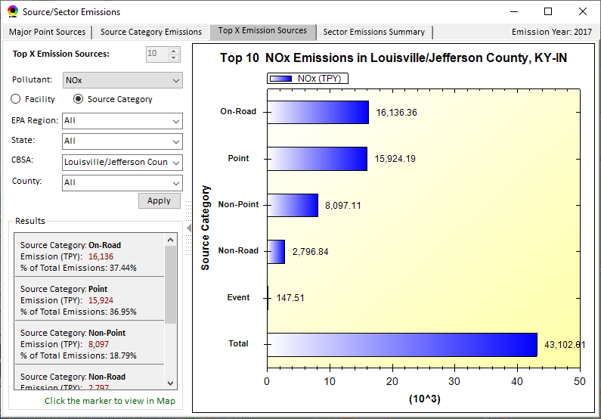
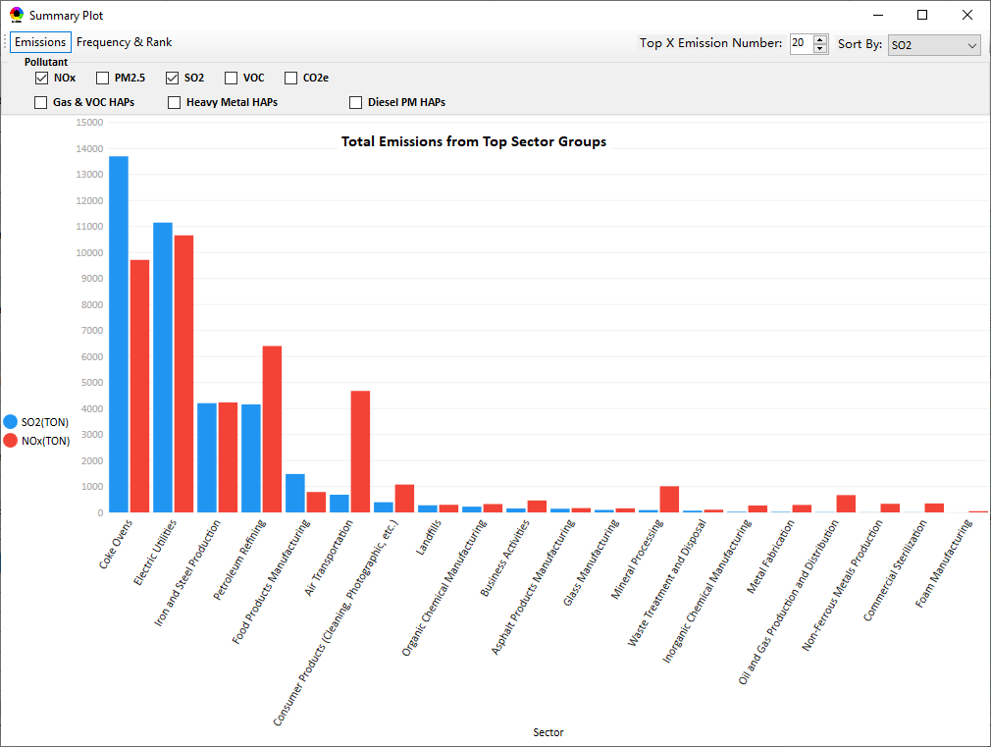
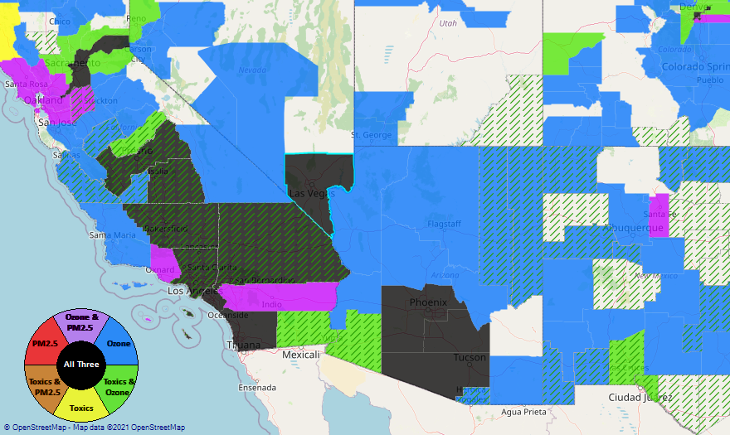
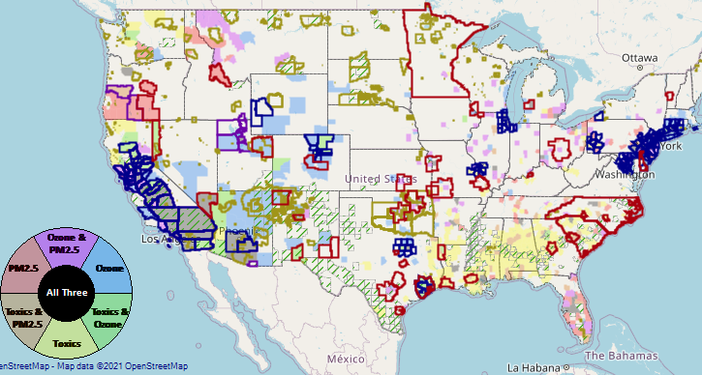
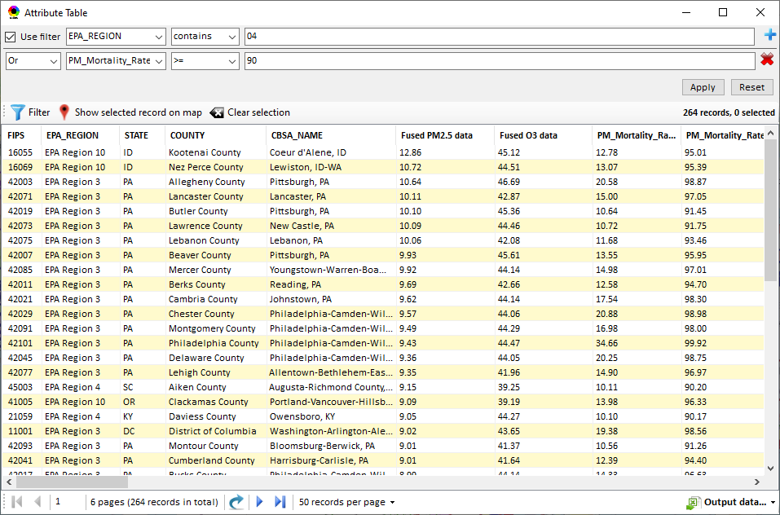
NEXUS: Data Inputs and Major Functions
O₃ & PM_{2.5}
Ambient/Design Value
(2012-2020)
(County-level)
Multi-Pollutant
Ambient and/or Risk National & Areal Mapping
Display Monitoring Sites & Trend Data
O₃, PM_{2.5} & Air Toxics Risk Data &
Conc. (fused AQ) Data
(2017 & 2014)
(Census tract-level)
Display Major Point Emissions Sites/Data
Provide Source Category Emissions
NEXUS
O₃, PM_{2.5} & Air Toxics Monitoring Data
(2002-2020 & -2018)
Provide Sector Emissions Summary
NEI County &
Facility Emissions
(2017 & 2014)
Include EJ/Demographic Indicators
Map Overlay with NAA, Advance Area, Class-I Area, or Tribal Area
Environmental Justice & Demographic Data
(from EJSCREEN)
Data Query, Search, Filter & Export
Advance Area
Class-I Area
Tribal Area
Proximity Screening Analysis
6

Slide 7
NEXUS: Briefings and Demos
9/25/2020– AQAD & HEID
11/3/2020 – MP Team
11/4/2020 – Air Toxics Group
12/10/2020 – AQPD
1/25/2021 – OID
1/28/2021 – SPPD
2/1/2021 – Peter/SMT
4/12/2021 – HEID & AQAD
5/17/2021 – Peter/SMT
5/24/2021 – MP Team
6/29/2021 – ORD
7/12/2021– HEID & AQAD
7/19/2021 – OID
8/10/2021– OAP
8/26/2021 – OAR
8/27/2021 - OP
8/30/2021 – OEJ
8/30/2021 - Region 4/Louisville
9/7/2021 – RO ADDs
9/20/2021 – OAR Demo
10/14/2021 – OP/NCEE
11/2/2021 – RO APMs
11/8/2021- RO APMs Demo
11/16/2021 – R1 (RARE) Project
11/28/2021 – AQAD All-Hands
11/23/2021 – R3 NEXUS Beta Testers
2/15/22 – AQPD (NSRG, OPG & SLPG)
2/17/22 – AT Strategy Mgmt & Mitigation Team
3/15/22 – OID (CTPG)
4/26/22 – EPA NEXUS Beta Testing Team
4/28/22 – AQAD (AAMG)
5/3/22 – HEID & AQAD
5/4/22 – Air Toxics Data Analysis Team
5/10/22 – ADVANCE Workgroup
5/26/22 - OAP/CCD
6/15/22 – Regional Ambient Air Monitoring
6/23/22 – SPPD All-Hands
7/21/22 – EJ in Rulemaking Comm. Of Practice
8/15/22 – OGC & ECRCO – Title VI
8/16/22 – Pre-brief for HEID & AQAD
8/17/22 – Peter
8/22/22 – OID/CTPG – Liz
8/31/22 – BenMAP Team
9/12/22 – OAPPS/AAOP (Economists)
9/14/22 – CAAAC
10/4/22 – RO APMs
TBD –MJOs
7

Slide 8
NEXUS: Feedback from Briefings & Demos
“Fascinating… phenomenal… I’m blown away!”
- Caroline Freeman (R4 ADD)
“The R3 air program has evaluated 18 web tools … NEXUS overall has been the most useful to our air program”
- Cynthia Stahl, PhD
(R3 Integrated Assessment Analyst)
“Your presentation of the NEXUS tool was absolutely awesome!!! … The NEXUS tool looks very promising”
- Osmond Lindo (OAPPS Lead Economist)
“Breathtaking… incredibly powerful… I feel like we discovered nuclear fusion!”
- Joe Goffman
(OAR Acting AA)
“The tool is well designed and provides a wealth of information that is useful for evaluating air quality impacts in local communities”
- Rick Gillam
(R4 Air Modeling Team Lead)
“Dr. Nance [R6 RA] will be thrilled with the NEXUS tool and excited with its capabilities.”
- Fran Verhalen
(recently retired R6 Monitoring Section Chief)
8

Slide 9
NEXUS & EJSCREEN
  EJ Layers
    Hazardous waste
    EJ Grants
    Water features
    Places
    Schools & Parks
    Transportation
    Boundaries
    Prisons
    Public Housing
    Subsidized Housing
    Climate
    Sites reporting to the EPA
    Superfund (NPL)
    RSEI
  Environmental Indicators
    Wastewater Discharge Indicator
    Hazardous Waste Proximity
    Superfund Proximity
    Lead Paint Indicator
    Traffic Proximity
    RMP Proximity
Ozone and PM_{2.5}
Emissions and source data
Monitoring data
Fused concentration data
Mortality & morbidity risk data
Air Toxics
Emissions and source data
Monitoring data
Modeled concentration data
Cancer & noncancer risk data
GHG emissions
NEI’s GHG (CO2e) emissions
Facilities and county level
Source categories (pt, on-road, non-road, etc.)
EJ Layers
Tribal Areas
Nonattainment Areas
  Environmental Indicators*
    NATA Respiratory HI
    NATA Cancer Risk
    NATA Diesel PM
    Ozone Model Concentrations
    PM_{2.5} Model Concentrations
Demographic Indicators
    People of Color Population
    Less Than HS Educated
    Low Income Population
    Linguistically Isolated
    Demographic Index
    Under Age 5
    Over Age 64
*Provided to OEJ by OAQPS (AQAD & HEID)
9

Slide 10
NEXUS: Important Caveats
NEXUS is currently an advanced screening tool for internal EPA use. A beta version is available for EPA staff to use and provide feedback on for improvement. Additional updates/improvements are necessary before the NEXUS tool is ready to be released to the public.
NEXUS Caveat
The NEXUS screening tool uses data from a variety of sources. This data is publicly available, except for the BenMAP data at the tract level. EPA is currently still in an internal review process and is not using this tool to support regulatory analyses.
BenMAP Caveat
The estimated number of PM and ozone-attributable deaths and illnesses reported at each tract are subject to important uncertainties and should be interpreted with caution. When using the BenMAP-CE tool to calculate these tract-level results, EPA lacked information regarding the baseline health status of individuals living at each tract; these data are a key input to the calculation of benefits. EPA instead used data available at the county- or state-level, which does not account for differences in baseline health between tracts. Estimating benefits in this way is not consistent with the peer-reviewed methods EPA follows when estimating air quality benefits in a Regulatory Impact Analysis. EPA will continue to refine its methods with the goal of reporting tract-level health benefits with confidence.

Slide 11
“NEXUS 3.0” Live Demo
11

