Slide 1
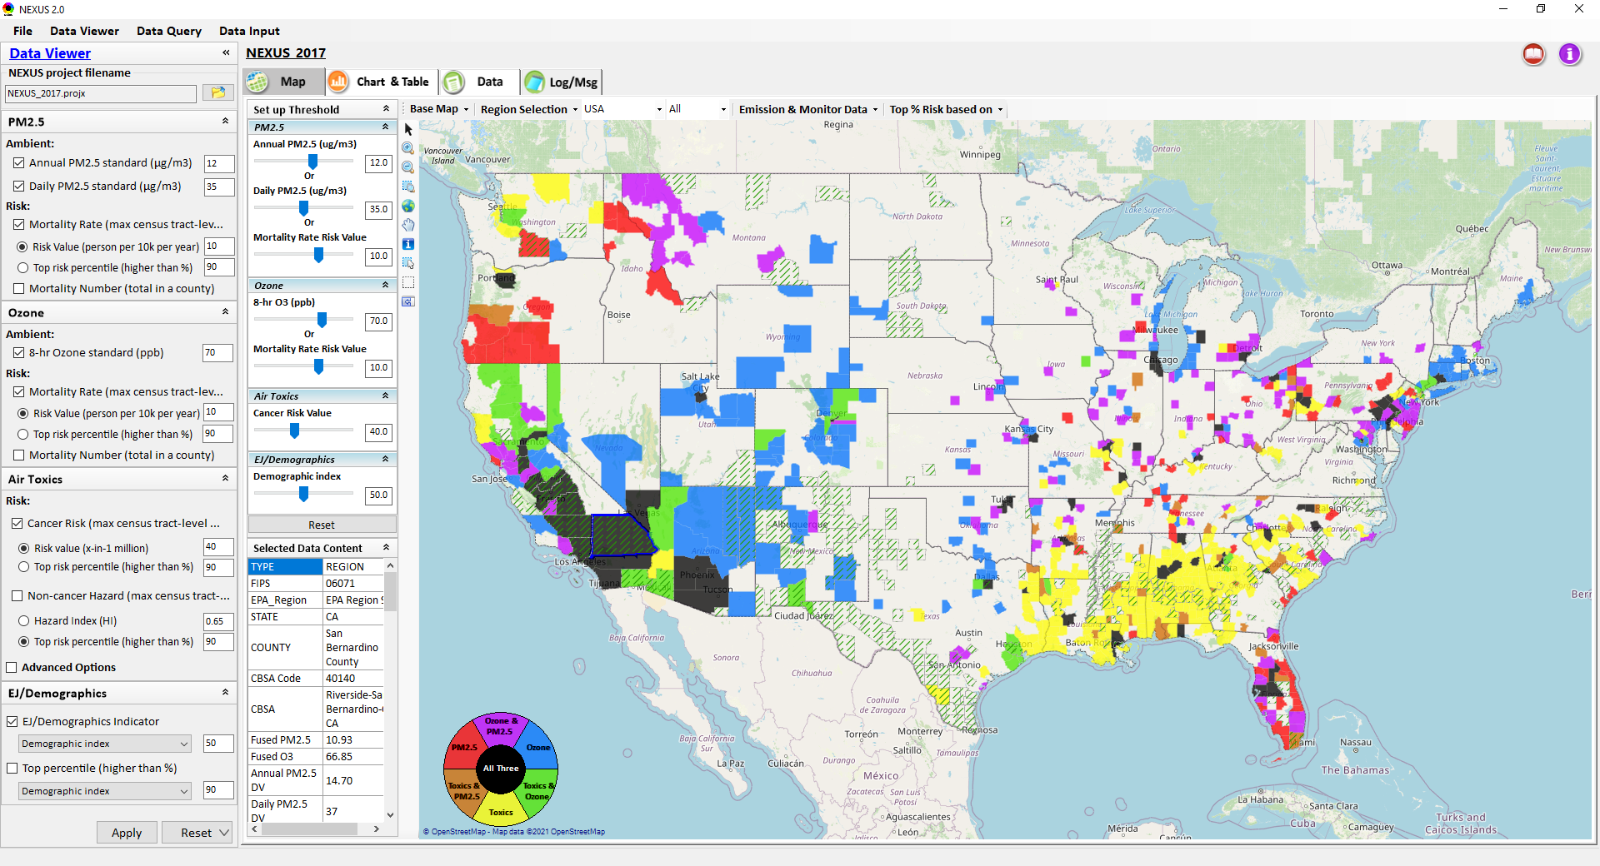
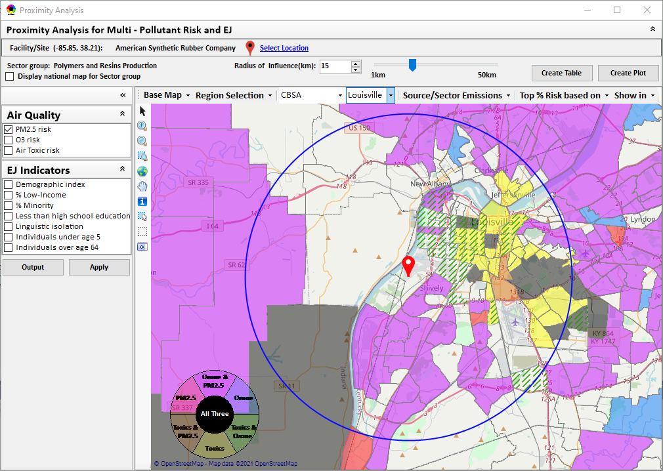
“NEXUS” Multi-Pollutant Advanced Screening Tool
OID / CTPG Briefing
Data Viewer: National/Regional Level
Proximity Analysis: Community Level
Beth Landis, HEID/Climate, International, & Multi-Media Group
Carey Jang, AQAD/Air Quality Modeling Group
8/22/22
1

Slide 2
Multi-Pollutant Team Members
HEID
  Beth Landis / Kimber Scavo
  Matt Woody / Kelly Rimer
  Robin Langdon / Darryl Weatherhead
  Sara Terry
  Carrie Wheeler
  Rob Pinder
  Chris Davis
  Conor Mulderrig
  Kayla McCauley
OID
  Amanda Kaufman
  James Payne
  Loren Fox
AQAD
  Carey Jang / Tyler Fox
  Jim Kelly
  Shannon Koplitz
  Joe Mangino
  Jeanette Reyes
AQPD
  Rich Damberg / Megan Brachtl
  Mia South
SPPD
  Lisa Conner
2

Slide 3
Overview
Background
Data Inputs and Major Functions
Briefings & Demos
  Feedback
EPA Regional Beta Testing Team
  Team Members
  Feedback (Uses & Asks)
NEXUS & EJSCREEN
Example OAQPS Use for Monitoring
Next Steps
Live Demo
3

Slide 4
Multi-Pollutant Background
Support a comprehensive, MP treatment of air quality problems to effectively improve air quality and make the most efficient use of available resources
  Primary Goal - identify & evaluate local control strategies targeting emissions of O₃ & PM_{2.5} and their precursors while at the same time reducing Air Toxics of concern for communities to maximize both health benefits and air quality improvements
MP planning has the potential to reduce the costs and increase benefits associated with air quality management (AQM)
Supports S/L/T air agencies in developing MP, risk-based AQM plans and implementing strategies that reduce air pollution emissions & improve public health
Success has been demonstrated in Detroit and SC; another project is currently underway in Louisville, KY
Tools needed to analyze MP data are either available currently or being developed in OAQPS (e.g., NEXUS)
4

Slide 5
NEXUS: Background
“NEXUS” is an advanced screening tool for multi-pollutant (MP) risks and EJ/Demographic analysis developed by OAQPS’s MP team
“NEXUS” integrates a suite of MP data, including emissions, monitoring, modeling, fused AQ data and health risk data for PM_{2.5}, O₃ & air toxics as well as EJ/demographic data, into one single platform to allow national and areal overlay mapping & analysis of MP ambient & risk data
“NEXUS” provides MP analysis across from national level “Phase 1” to regional (EPA region/State/CBSA) level “Phase 2”, and now down to community level “Phase 3” (Proximity analysis” in census tract-level)
We expect to use this tool in conjunction with Regions and identify areas that would potentially benefit most from MP approaches to reduce emissions (including current NA areas)
We also expect that it can have additional value-added uses across the Office for Air Toxics, Environmental Justice and other programs
The NEXUS tool will essentially provide a ‘conceptual model’ of an area’s MP issues to facilitate engagement with state/local/tribal agencies & community stakeholder groups
5

Slide 6
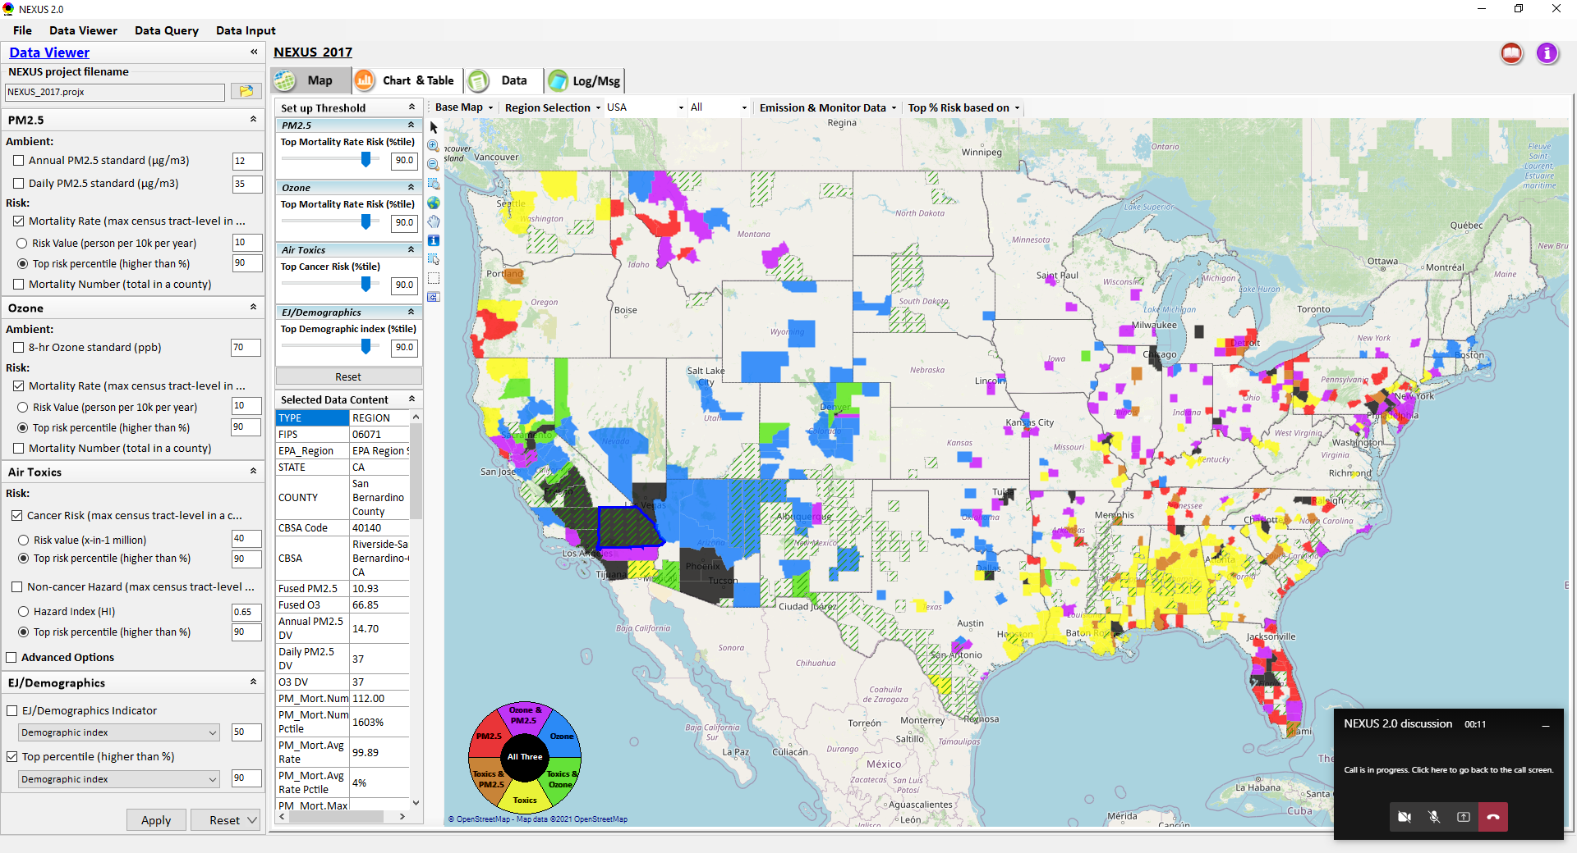
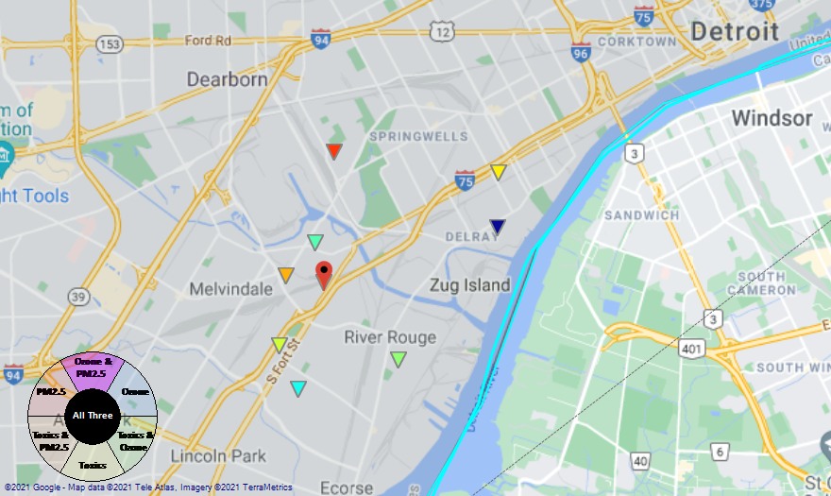
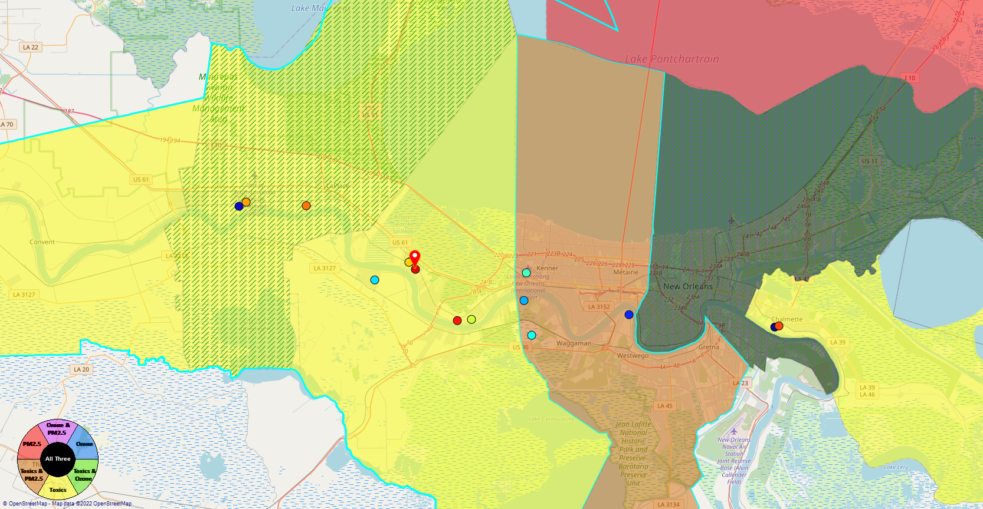
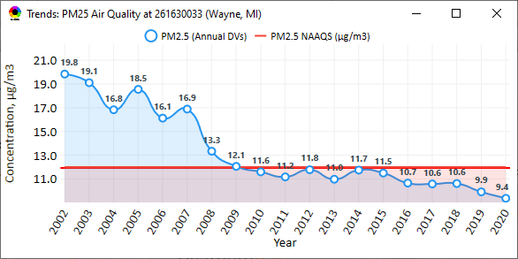
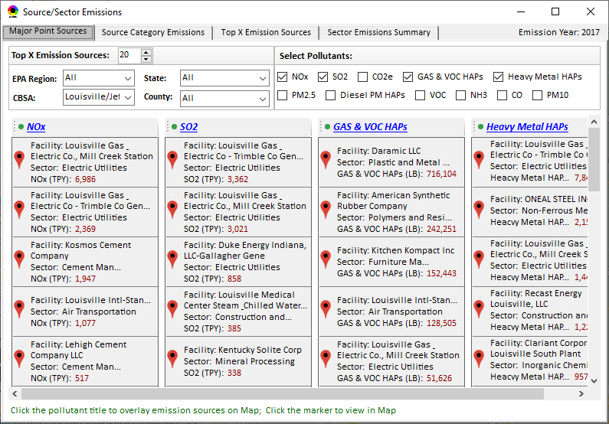
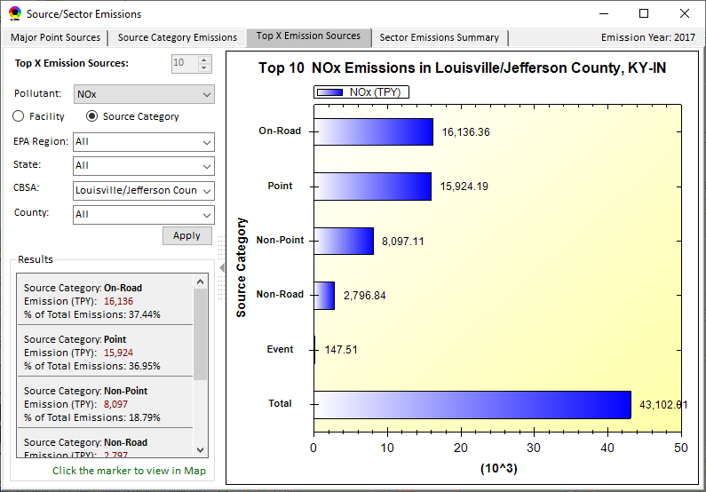
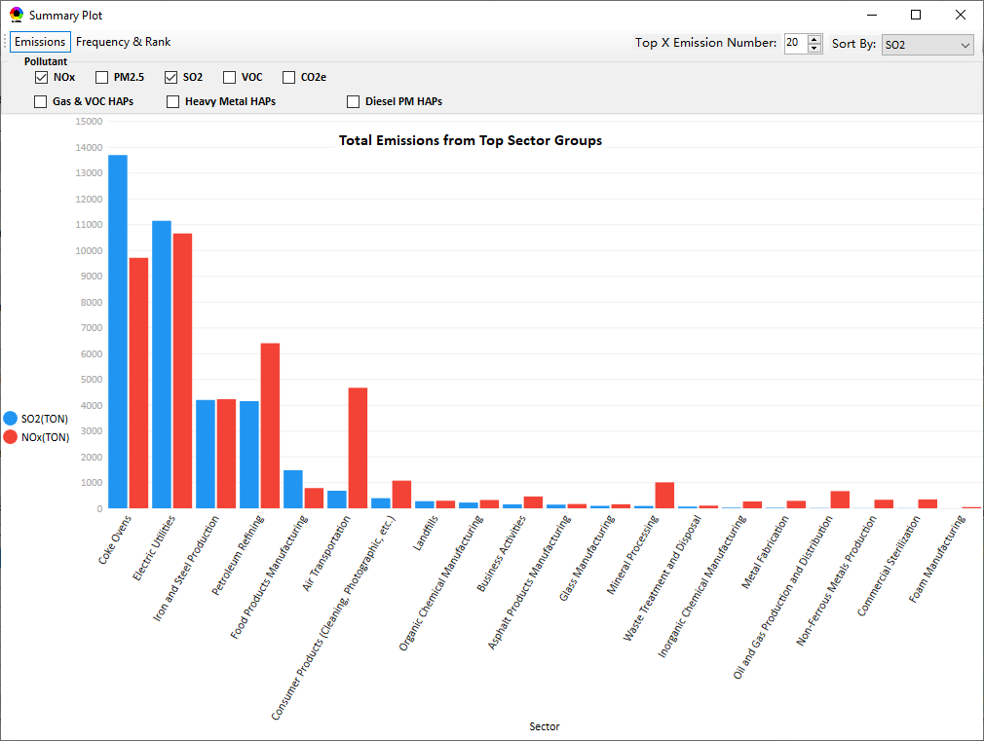
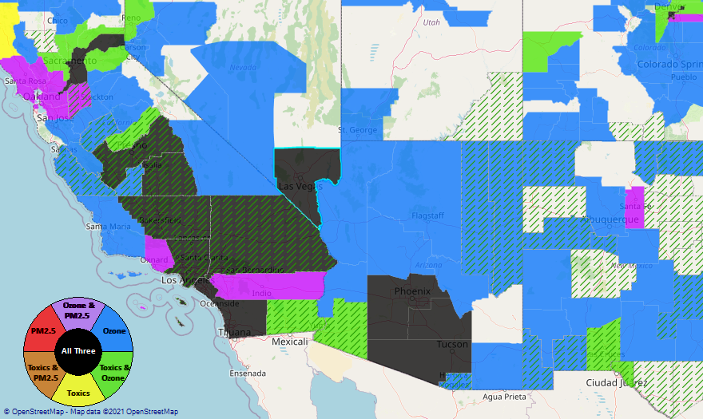
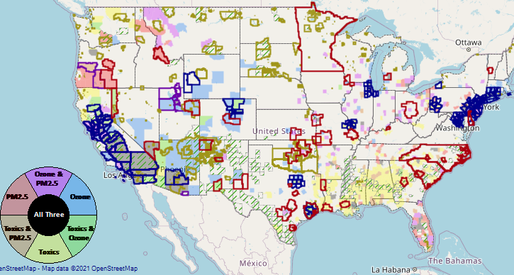
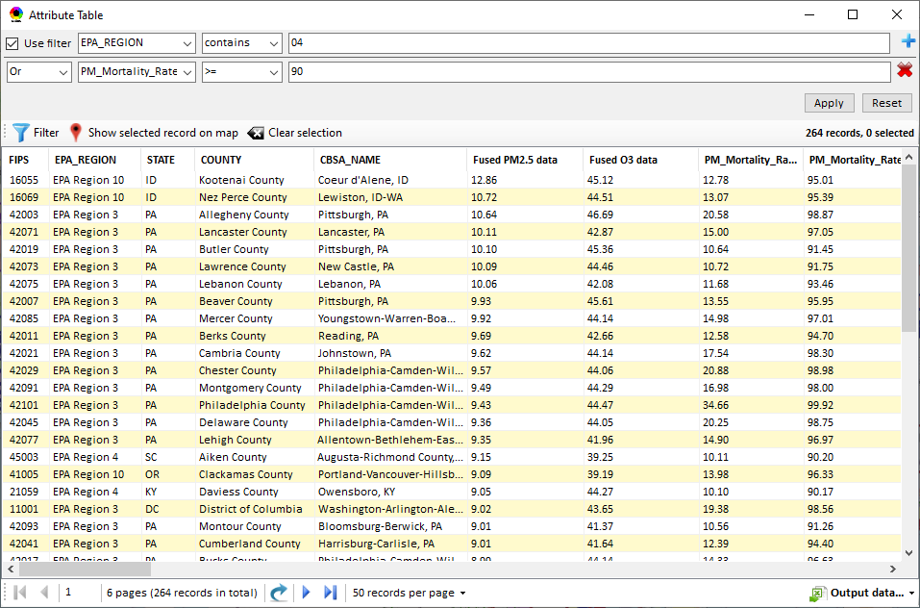
NEXUS: Data Inputs and Major Functions
O₃ & PM_{2.5}
Ambient/Design Value
(2012-2020)
(County-level)
Multi-Pollutant
Ambient and/or Risk National & Areal Mapping
Display Monitoring Sites & Trend Data
O₃, PM_{2.5} & Air Toxics Risk Data &
Conc. (fused AQ) Data
(2017 & 2014)
(Census tract-level)
Display Major Point Emissions Sites/Data
Provide Source Category Emissions
NEXUS
O₃, PM_{2.5} & Air Toxics Monitoring Data
(2002-2020 & -2018)
Provide Sector Emissions Summary
NEI County &
Facility Emissions
(2017 & 2014)
Include EJ/Demographic Indicators
Map Overlay with NAA, Advance Area, Class-I Area, or Tribal Area
Environmental Justice & Demographic Data
(from EJSCREEN)
Data Query, Search, Filter & Export
Advance Area
Class-I Area
Tribal Area
Proximity Screening Analysis
6

Slide 7
NEXUS: Briefings and Demos
9/25/2020– AQAD & HEID
11/3/2020 – MP Team
11/4/2020 – Air Toxics Group
12/10/2020 – AQPD
1/25/2021 – OID
1/28/2021 – SPPD
2/1/2021 – Peter/SMT
4/12/2021 – HEID & AQAD
5/17/2021 – Peter/SMT
5/24/2021 – MP Team
6/29/2021 – ORD
7/12/2021– HEID & AQAD
7/19/2021 – OID
8/10/2021– OAP
8/26/2021 – OAR
8/27/2021 - OP
8/30/2021 – OEJ
8/30/2021 - Region 4/Louisville
9/7/2021 – RO ADDs
9/20/2021 – OAR Demo
10/14/2021 – OP/NCEE
11/2/2021 – RO APMs
11/8/2021- RO APMs Demo
11/16/2021 – R1 (RARE) Project
11/28/2021 – AQAD All-Hands
11/23/2021 – R3 NEXUS Beta Testers
2/15/22 – AQPD (NSRG, OPG & SLPG)
2/17/22 – AT Strategy Mgmt & Mitigation Team
3/15/22 – OID (CTPG)
4/26/22 – EPA NEXUS Beta Testing Team
4/28/22 – AQAD (AAMG)
5/3/22 – HEID & AQAD
5/4/22 – Air Toxics Data Analysis Team
5/10/22 – ADVANCE Workgroup
5/26/22 - OAP/CCD
6/15/22 – Regional Ambient Air Monitoring
6/23/22 – SPPD All-Hands
7/21/22 – EJ in Rulemaking Comm. Of Practice
8/15/22 – OGC & ECRCO – Title VI
8/16/22 – Pre-brief for HEID & AQAD
8/17/22 – Peter
8/22/22 – OID/CTPG – Liz
9/6/22 – RO APMs
9/13/22 – CAAAC
TBD –MJOs
7

Slide 8
NEXUS: Feedback from Briefings & Demos
“Fascinating… phenomenal… I’m blown away!”
- Caroline Freeman (R4 ADD)
“The R3 air program has evaluated 18 web tools … NEXUS overall has been the most useful to our air program”
- Cynthia Stahl, PhD
(R3 Integrated Assessment Analyst)
“Your presentation of the NEXUS tool was absolutely awesome!!! … The NEXUS tool looks very promising”
- Osmond Lindo (OAPPS Lead Economist)
“Breathtaking… incredibly powerful… I feel like we discovered nuclear fusion!”
- Joe Goffman
(OAR Acting AA)
“The tool is well designed and provides a wealth of information that is useful for evaluating air quality impacts in local communities”
- Rick Gillam
(R4 Air Modeling Team Lead)
“Dr. Nance [R6 RA] will be thrilled with the NEXUS tool and excited with its capabilities.”
- Fran Verhalen
(recently retired R6 Monitoring Section Chief)
8

Slide 9
NEXUS: EPA Regional Beta Testing Team
Convened a group of OAR and regional office members that see the benefit of NEXUS and plan to use it on a routine basis to assist in their job duties.
Requested feedback to help shape the direction of future tool development and ensure we are making updates and additions that are most beneficial to those Regions who are encouraging a multi-pollutant approach to air quality management.
Working to identify specific applications to collaborate on with Regions, e.g.:
  Select area with MP and potential EJ concerns and explore a MP approach using NEXUS.
  Support EJ screening and related analysis for Federal permit or related action.
9

Slide 10
NEXUS: EPA Regional Beta Team Members
Region 1
  Shutsu Wong
  Emily Bolger
Region 2
  Ysabel Barron
Region 3
  Cynthia Stahl
  Carol Ann Gross-Davis
  Jessie Fry
  Angus Welch
  Alice Chow
Region 4
  Rick Gillam
  Byron Gary (LMAPCD)
Region 5
  Alexis Cain
  Margaret Sieffert
  Rae Trine
  Yana Genchanok
Region 6
  Nia Riddick
Region 7
  Adam Zachary
  Allie Donohue
Region 8
  Ethan Brown
  Adam Eisele
Region 9
  Julia Carlstad
Region 10
  Claudia Vaupel
OAQPS
  Rob Pinder
  Matt Woody
  Beth Landis
  Carey Jang
  Joe Mangino
  Mia South
  Shomik Ghosh
  Kimber Scavo
  Tyler Fox
10

Slide 11
NEXUS: Beta Team Feedback - Uses
SIP Related Activities
  Address NAAs and areas close to NAAQS
  Develop conceptual models
  Areas preparing path forward document to join Advance program
  Future weight-of-evidence analysis
Air Quality Planning Activities
  Identity areas to focus reduction efforts with possible lowering of NAAQs
  Evaluate permit applications
  Visually understand MP issues
  Visualize areas of concern, run reports & focus efforts
  Response to citizen complaints about sources
  Determine where to focus emission reduction efforts
Environmental Justice
  Generate maps and reports for EJ workgroup
  Identify areas with air quality and EJ concerns
  Review Tribal areas
  Ensuring MP cumulative impacts are considered
  Robust evaluation of potential EJ concerns and plans to address community needs
Outreach
  Support AQ planning conversations with SLT air agencies
  EtO community outreach
  Briefings with RAs and management
Monitoring Activities
  Review Annual Monitoring Network Plans and site/monitor relocation requests
  Review new development proposals
  Ongoing network assessments
Assessments
  Evaluate air quality impacts in local communities
  Supplement AirToxScreen Assessments
  Assess burden of individual or combination of air pollutants
  Complement existing techniques for emissions, modeling, monitoring & risk assessment
  Identity air quality and human health focus areas
Other
  Help new employees learn about areas with O₃, PM_{2.5}, toxics and/or EJ concerns
  Assist with determining distribution of grant funding
11

Slide 12
NEXUS: Beta Team Feedback - Asks
Common Requests
Access issues - web-based / cloud-based application is preferable
More recent data
Addition of available Pb data
Ability to filter emissions, monitor data, and drop downs selections by map extent or user defined boundaries (e.g., boundary box or lasso)
Addition of GHG reporting program data
Report capabilities: Automated 1–2-page summary document
Unique Requests
Ability to layer multiple years of data
Ability to see all monitors in a selected area
Ability to see all facilities within proximity analysis selected area versus county-wide
Ability to see modeled concentrations from AirToxScreen
Ability to import air dispersion modeling results in .kmz format
Ability to filter facilities by industry/NAICS
Ability to adjust the data value year in proximity analysis
See individual HAP/VOC emissions
Add driving pollutant for elevated cancer risk and HI for census block
Add data for Hawaii and Alaska
Wind roses to help assess monitor siting
12

Slide 13
NEXUS & EJSCREEN
  EJ Layers
    Hazardous waste
    EJ Grants
    Water features
    Places
    Schools & Parks
    Transportation
    Boundaries
    Prisons
    Public Housing
    Subsidized Housing
    Climate
    Sites reporting to the EPA
    Superfund (NPL)
    RSEI
  Environmental Indicators
    Wastewater Discharge Indicator
    Hazardous Waste Proximity
    Superfund Proximity
    Lead Paint Indicator
    Traffic Proximity
    RMP Proximity
EJ Layers
Tribal Areas
Nonattainment Areas
  Environmental Indicators*
    NATA Respiratory HI
    NATA Cancer Risk
    NATA Diesel PM
    Ozone Model Concentrations
    PM_{2.5} Model Concentrations
Demographic Indicators
    People of Color Population
    Less Than HS Educated
    Low Income Population
    Linguistically Isolated
    Demographic Index
    Under Age 5
    Over Age 64
Ozone and PM_{2.5}
Emissions and source data
Risk data
Monitoring data
Air Toxics
Emissions and source data
Modeled concentration data
Risk data
Monitoring data
GHG emissions
*Provided to OEJ by OAQPS (AQAD & HEID)
13

Slide 14
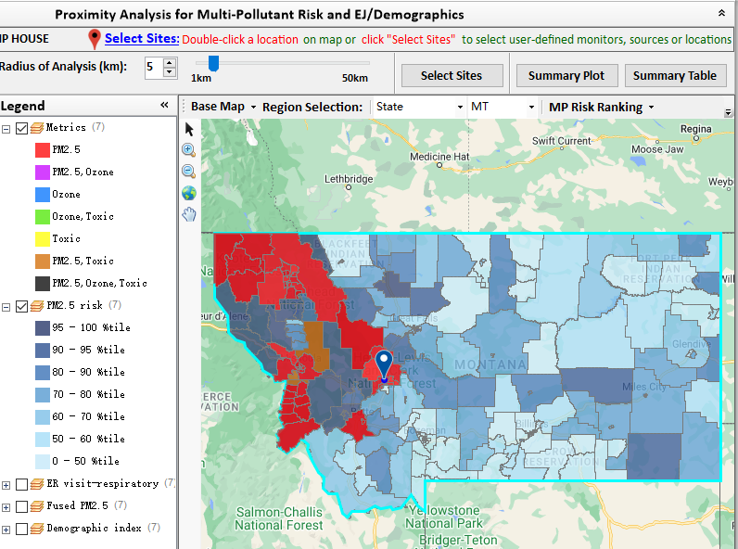
NEXUS: Example OAQPS Use for Monitoring
AQAD/AAMG summer intern (Tom Agger) used NEXUS to provide Justice40 criteria recommendations for the National PM_{2.5} Monitoring Network
  Goal: Determine if at least 40% of the current PM_{2.5} monitoring network serves EJ/At-Risk communities
  Process: Used NEXUS proximity analysis tool to analyze geographic areas around monitors or pollutions sources to determine demographics and pollutant risk in those areas
  Outcome:
    Examined numerous combinations of demographic index, low income, minority, and PM_{2.5} risk criteria
    Preliminary findings suggest that the current National PM_{2.5} Network meets the Justice 40 goals
    AAMG will share the findings with the Regions
    This analysis can be used for future monitor siting purposes, but must be combined with other considerations
14

Slide 15
NEXUS: OAQPS Next Steps
NEXUS Updates Underway
  Include “Climate risk” indicators (as 5th metric)
  Update EJ/demographics data to be consistent with new “EJScreen 2.0” dataset
FY23 NEXUS Budget Request ($150K)
  Address major comments and feedback from Beta Testing Team ($25K)
  Update to 2018 & 2019 MP platform & QA ($25K)
  Develop web-based NEXUS version ($100K)
    Web-based NEXUS Development ($75K)
    Deployment and Information Security ($25K)
Regional Engagement
  Provide list of MP areas to regions and identify areas with MP and potential EJ concerns to consider partnering with
  Identify areas that may be NAAs or close to new PM_{2.5} std levels for Advance Program
  Follow up on other Regional uses identified by Beta test team
Partner within EPA/OAR on use of NEXUS for programmatic purposes
Briefing for OAR Management (Fall 2022)
15

Slide 16
“NEXUS 3.0” Live Demo
16

