Slide 1
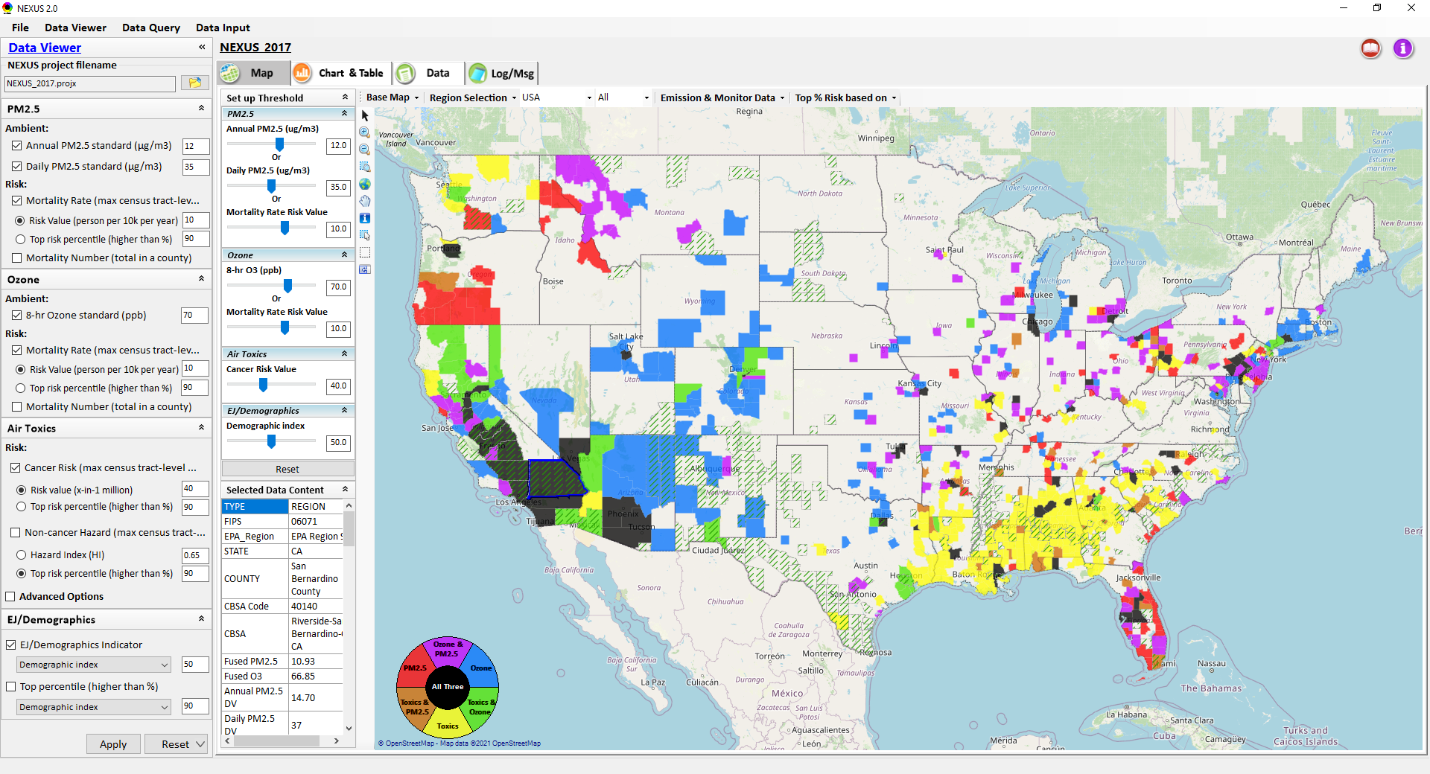
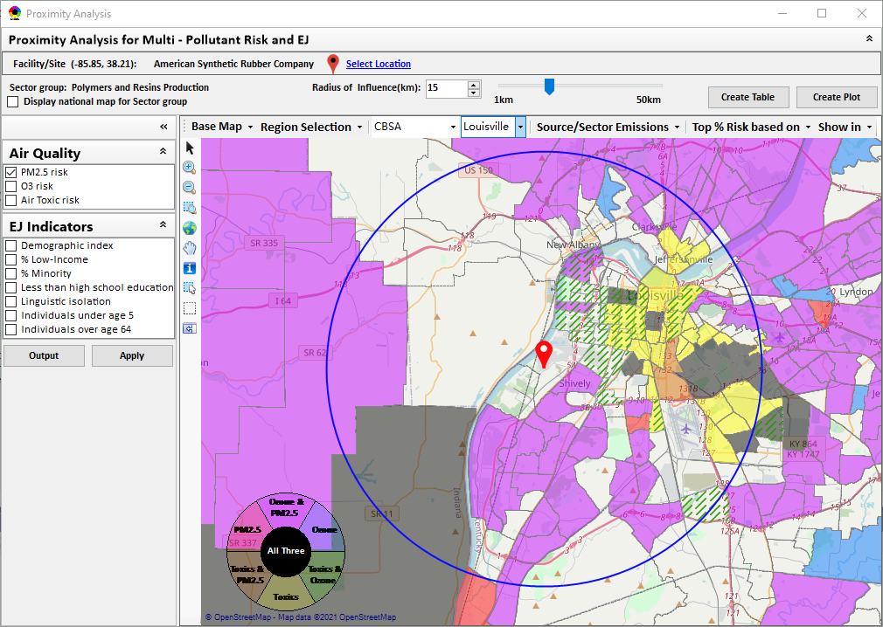
“NEXUS” Multi-Pollutant Advanced Screening Tool
R1 Meeting
Data Viewer: National/Regional Level
Proximity Analysis: Community Level
Beth Landis, HEID/Climate, International, & Multi-Media Group
Carey Jang, AQAD/Air Quality Modeling Group
12/1/22
1

Slide 2
Multi-Pollutant Team Members
HEID
  Beth Landis / Kimber Scavo
  Matt Woody / Kelly Rimer
  Robin Langdon / Darryl Weatherhead
  Sara Terry
  Carrie Wheeler
  Rob Pinder
  Chris Davis
  Conor Mulderrig
  Kayla McCauley
OID
  Amanda Kaufman
  James Payne
  Loren Fox
AQAD
  Carey Jang / Tyler Fox
  Jim Kelly
  Shannon Koplitz
  Joe Mangino
  Jeanette Reyes
AQPD
  Rich Damberg / Megan Brachtl
  Mia South
SPPD
  Lisa Conner
2

Slide 3
Overview
NEXUS Background
Data Inputs and Major Functions
Region 1 Example Packet (Boston)
Next Steps
3

Slide 4
NEXUS Background
“NEXUS” is an advanced screening tool for multi-pollutant (MP) air quality planning developed by OAQPS’s MP team that allows for account of MP risks and EJ/Demographic analysis
The NEXUS tool will essentially provide a ‘conceptual model’ of an area’s MP issues to facilitate engagement with state/local/tribal agencies & community stakeholder groups
“NEXUS” integrates a suite of MP data, including emissions, monitoring, modeling, fused AQ data and health risk data for PM_{2.5}, O₃ & air toxics as well as EJ/demographic data, into one single platform to allow national and areal overlay mapping & analysis of MP ambient & risk data
NEXUS is currently for internal EPA use. A beta version is available for EPA staff to use and provide feedback on for improvement. Additional updates/improvements are necessary before the NEXUS tool is ready to be released to the public.
4

Slide 5
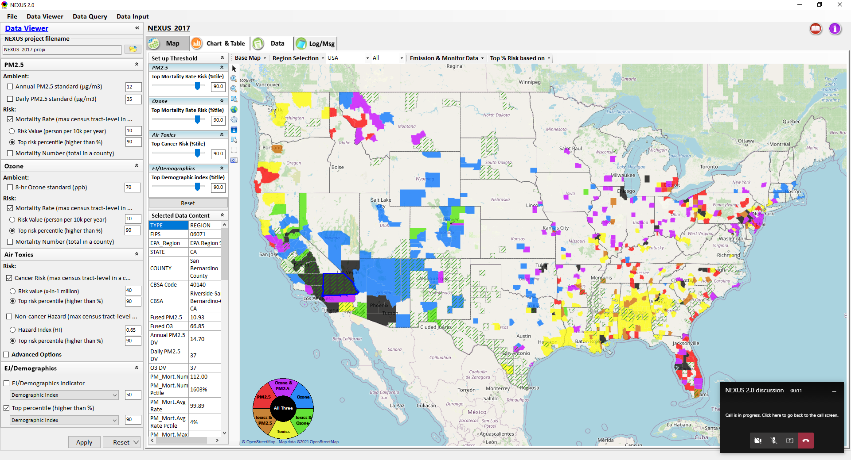
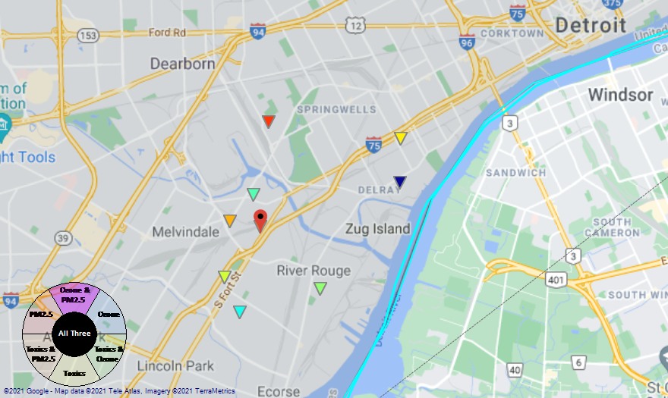
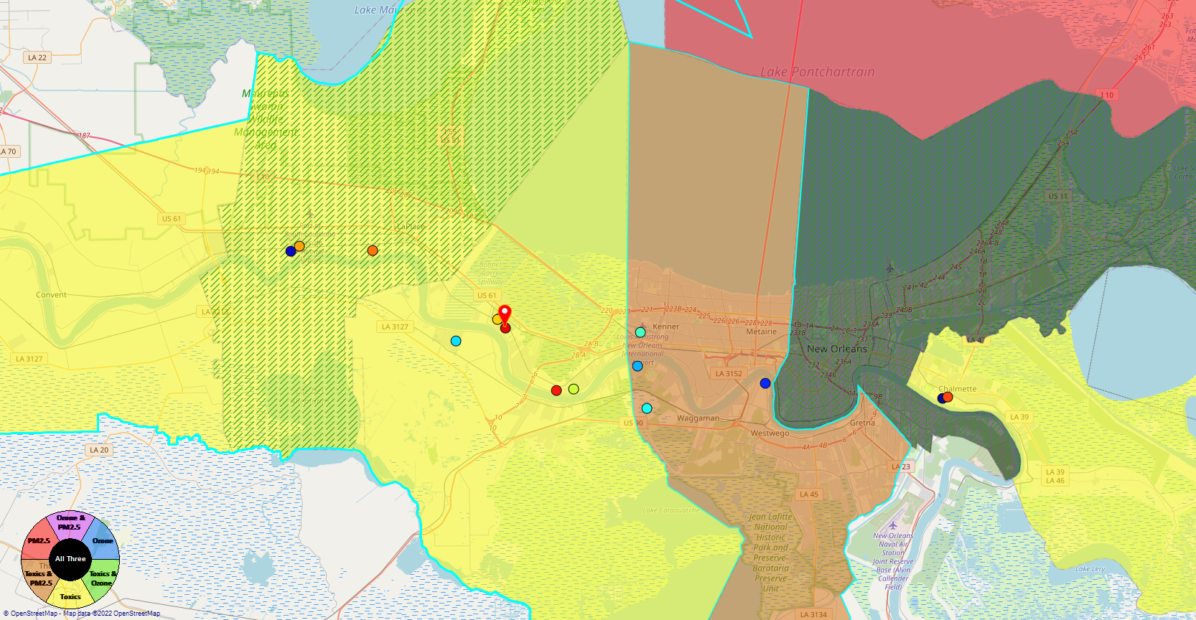
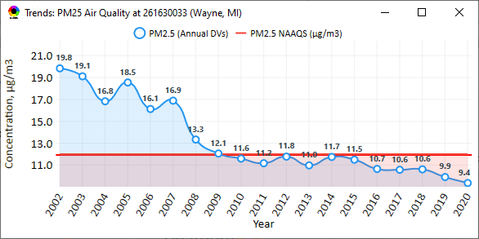
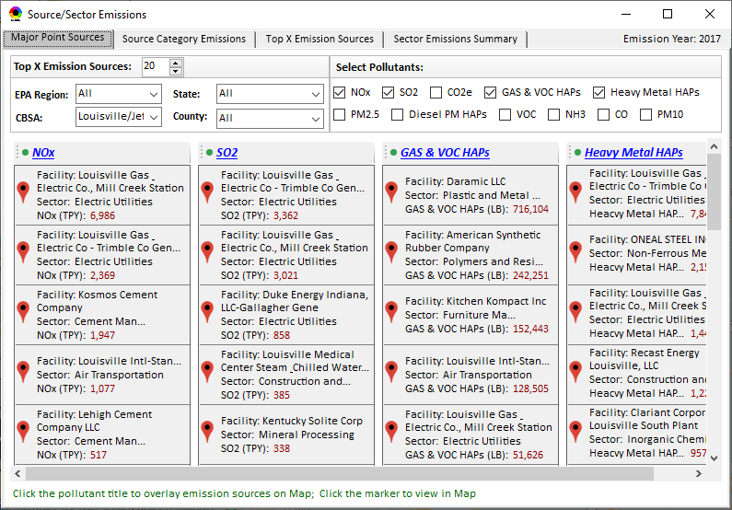
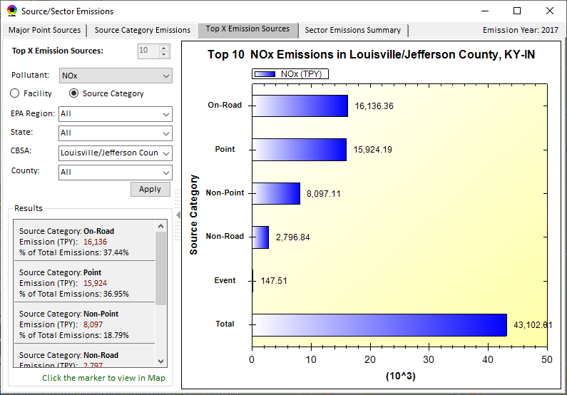
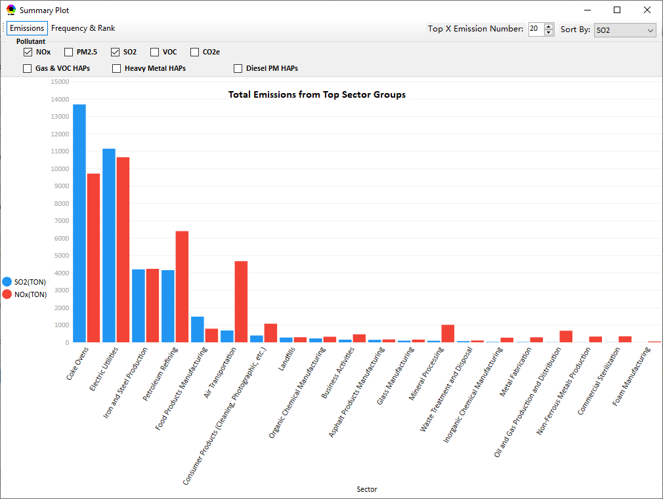
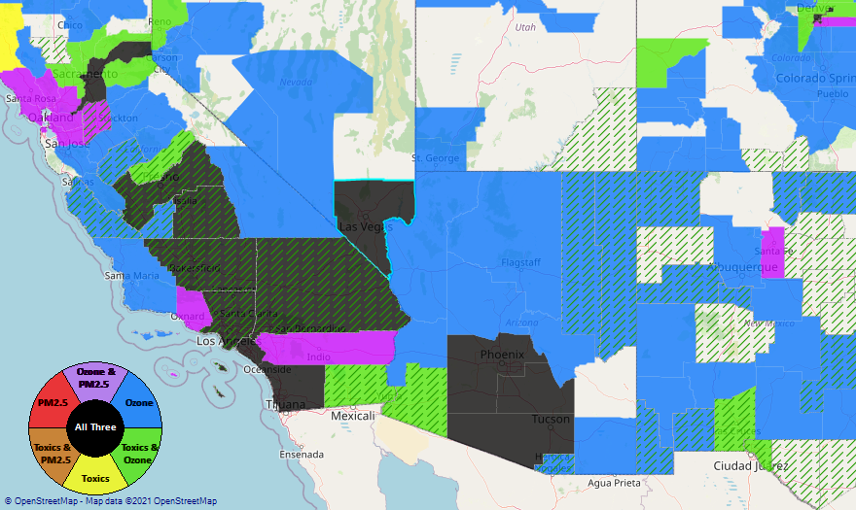
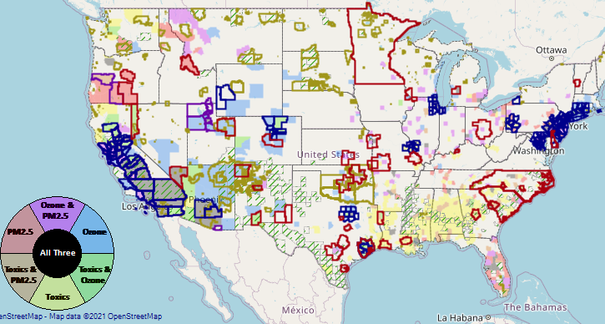
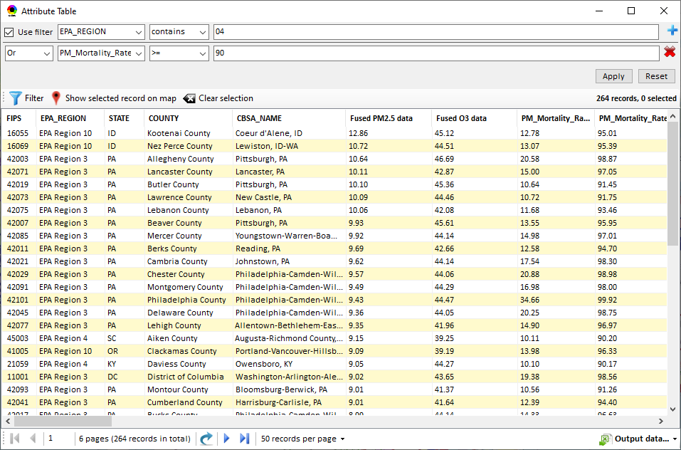
NEXUS: Data Inputs and Major Functions
O₃ & PM_{2.5}
Ambient/Design Value
(2012-2020)
(County-level)
Multi-Pollutant
Ambient and/or Risk National & Areal Mapping
Display Monitoring Sites & Trend Data
O₃, PM_{2.5} & Air Toxics Risk Data &
Conc. (fused AQ) Data
(2017 & 2014)
(Census tract-level)
Display Major Point Emissions Sites/Data
Provide Source Category Emissions
NEXUS
O₃, PM_{2.5} & Air Toxics Monitoring Data
(2002-2020 & -2018)
Provide Sector Emissions Summary
NEI County &
Facility Emissions
(2017 & 2014)
Include EJ/Demographic Indicators
Map Overlay with NAA, Advance Area, Class-I Area, or Tribal Area
Environmental Justice & Demographic Data
(from EJSCREEN)
Data Query, Search, Filter & Export
Advance Area
Class-I Area
Tribal Area
Proximity Screening Analysis
5

Slide 6
Example Multi-Pollutant Packet for Region 1: Boston CBSA
6

Slide 7
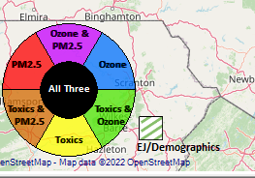
Region 1 Example: Criteria
PM2.5 Top Mortality Rate Risk Percentile ≥ 75%
Ozone Top Mortality Rate Risk Percentile ≥ 75%
Air Toxics Top Cancer Risk Percentile ≥ 75%
EJ/Demographics Top Demographic Index Percentile ≥ 75%
7

Slide 8
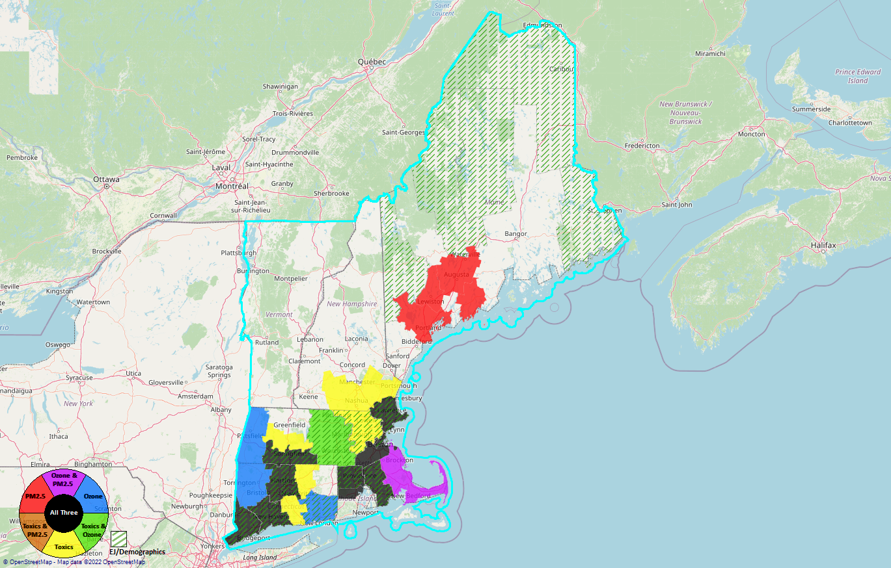
Region 1
PM2.5 Top Mortality Rate Risk Percentile ≥ 75%
Ozone Top Mortality Rate Risk Percentile ≥ 75%
Air Toxics Top Cancer Risk Percentile ≥ 75%
EJ/Demographics Top Demographic Index Percentile ≥ 75%
8

Slide 9
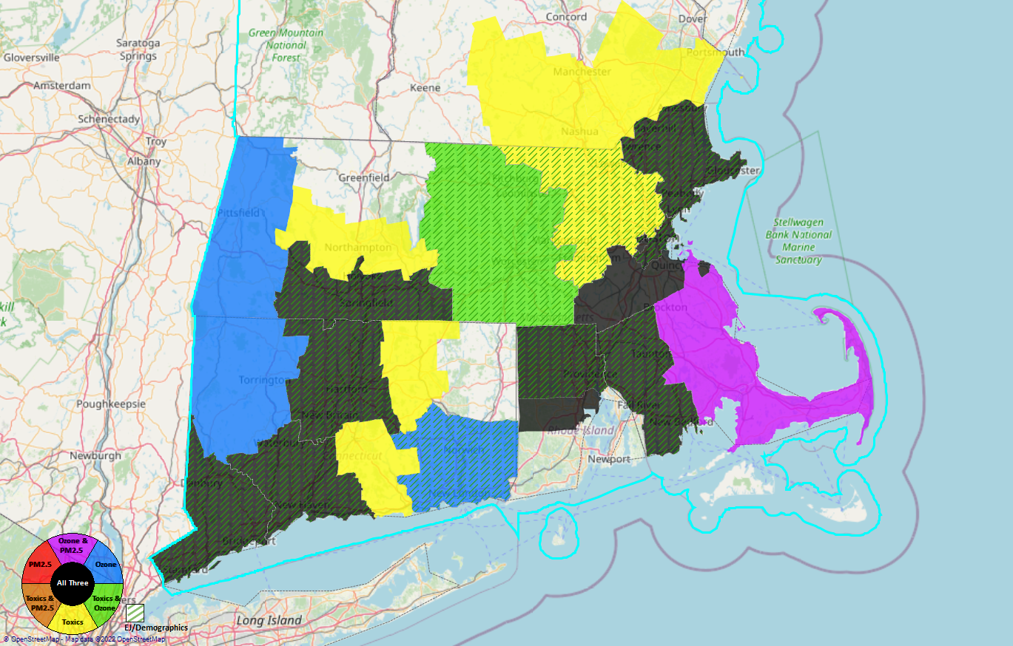
Fairfield County, CT
New Haven County, CT
Hartford County, CT
Hampden County, MA
Providence County, RI
Bristol County, MA
Suffolk County, MA
Essex County, MA
8
7
4
5
6
3
2
1
Region 1
9

Slide 10
Region 1 Example: Counties/CBSAs
County | CBSA
Fairfield County, CT | Bridgeport-Stamford-Norwalk, CT
New Haven County, CT | New Haven-Milford, CT
Hartford County, CT | Hartford-West Hartford-East Hartford, CT
Hampden County, MA | Springfield MA
Providence County, RI | Providence-Warwick, RI-MA
Bristol County, MA
Suffolk County, MA | Boston-Cambridge-Newton, MA-NH
Essex County, MA
10

Slide 11
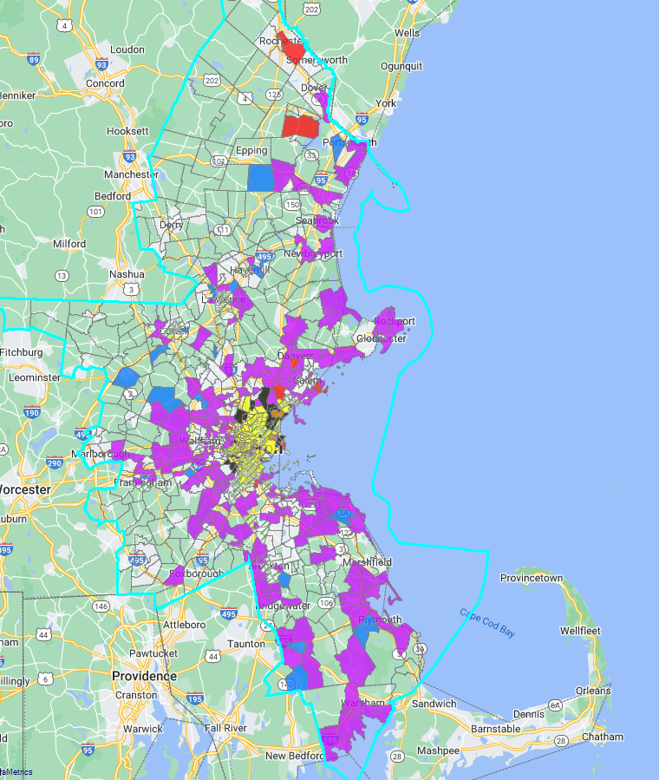
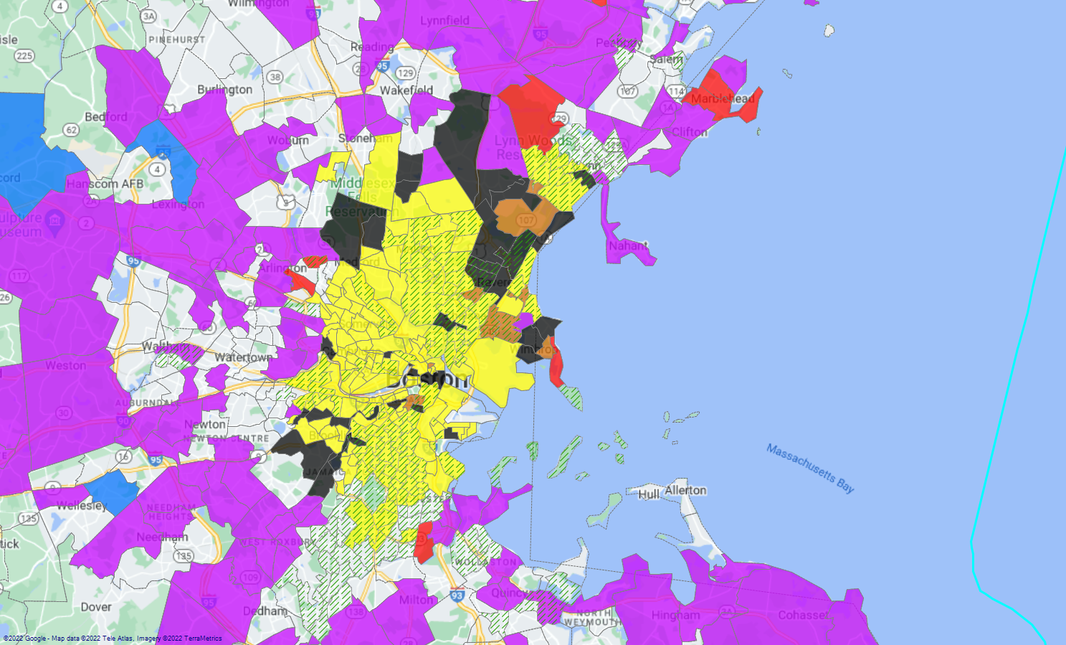
Region 1 Example: Boston-Cambridge-Newton, MA-NH
11

Slide 12
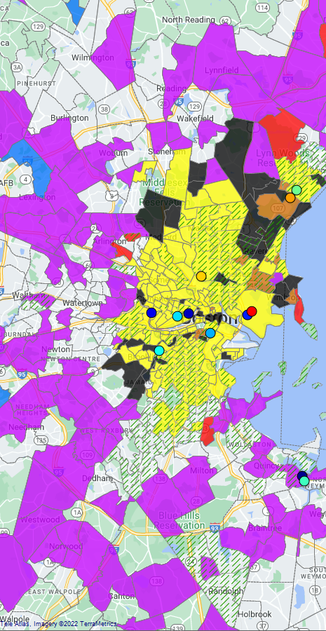
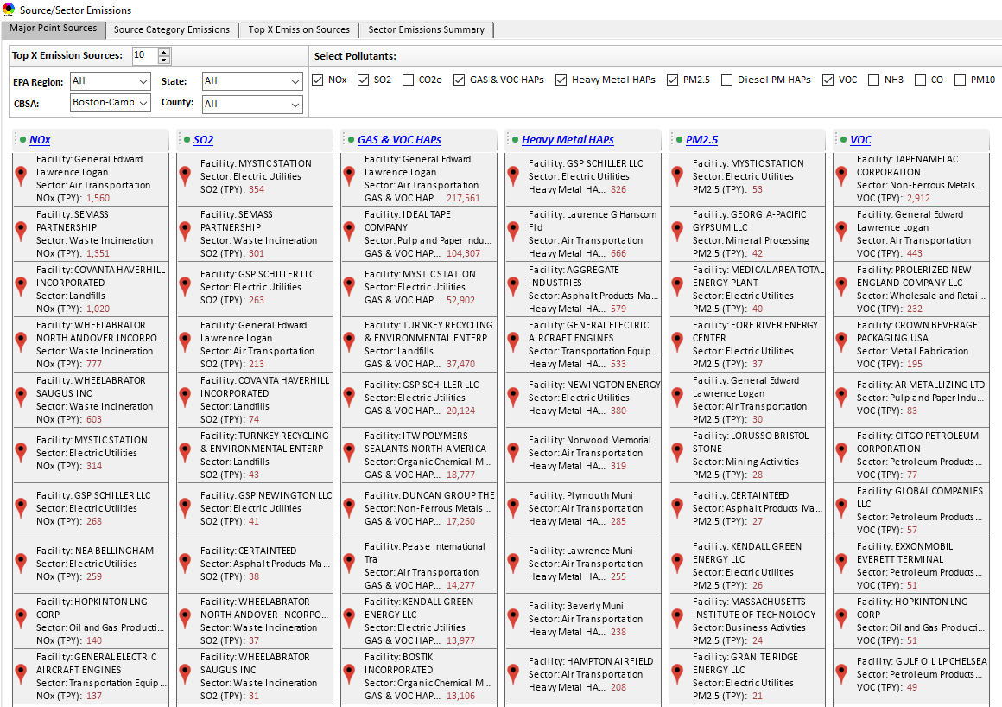
Region 1 Example: Boston CBSA
Top Emission Sources
12

Slide 13
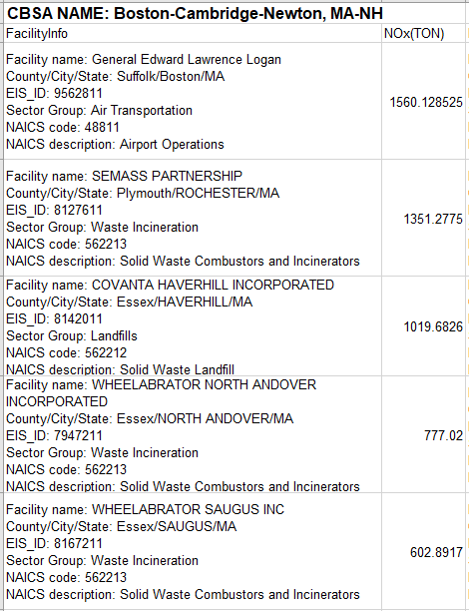
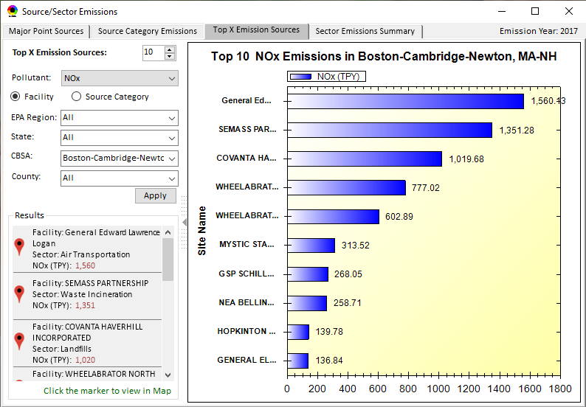
Region 1 Example: Boston-Cambridge-Newton, MA-NH CBSA
Top Emission Sources
13

Slide 14
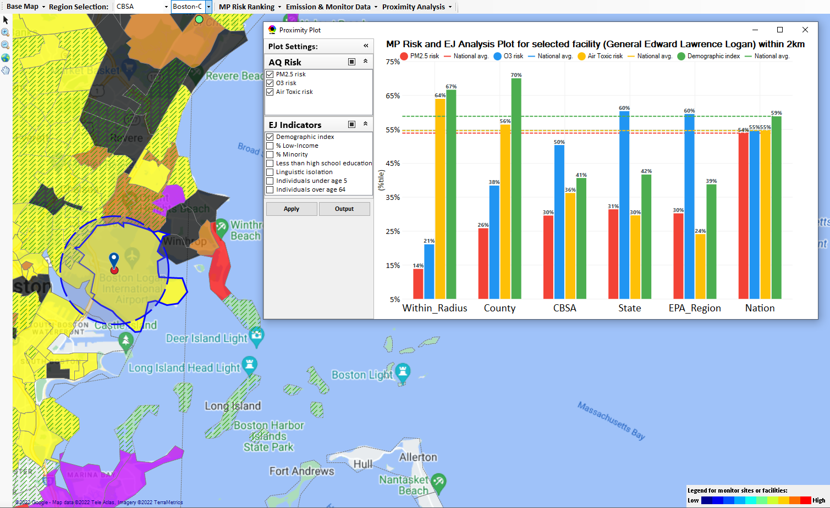
Region 1 Example: Boston-Cambridge-Newton, MA-NH CBSA
General Edward Lawrence Logan Airport
Top emitter in CBSA for NOx and Gas & VOC HAPs.
Top 10 emitter in the CBSA for SO2, PM2.5 & VOC
14

Slide 15
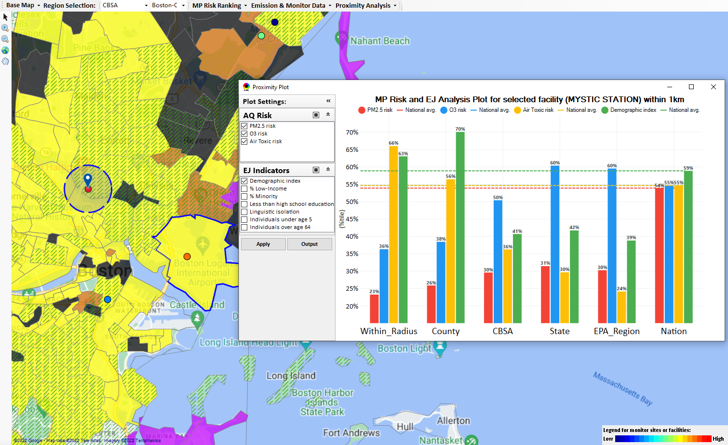
Region 1 Example: Boston-Cambridge-Newton, MA-NH CBSA
Mystic Station EGU
Top emitter in CBSA for SO2 & PM2.5
Top 10 emitter in the CBSA for NOx & Gas & VOC HAPs
15

Slide 16
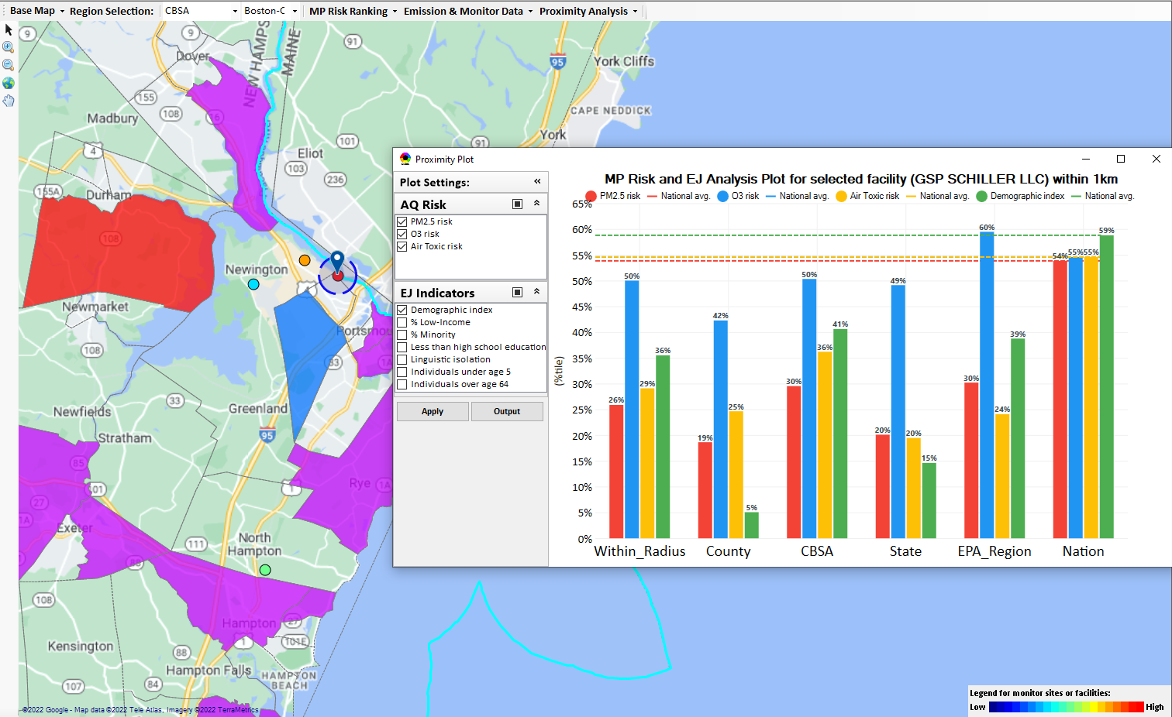
Region 1 Example: Boston-Cambridge-Newton, MA-NH CBSA
GSP Schiller LLC EGU
Top emitter in CBSA for Heavy Metal HAPs
Top 10 emitter in the CBSA for NOx, SO2 & Gas & VOC HAPs
16

Slide 17
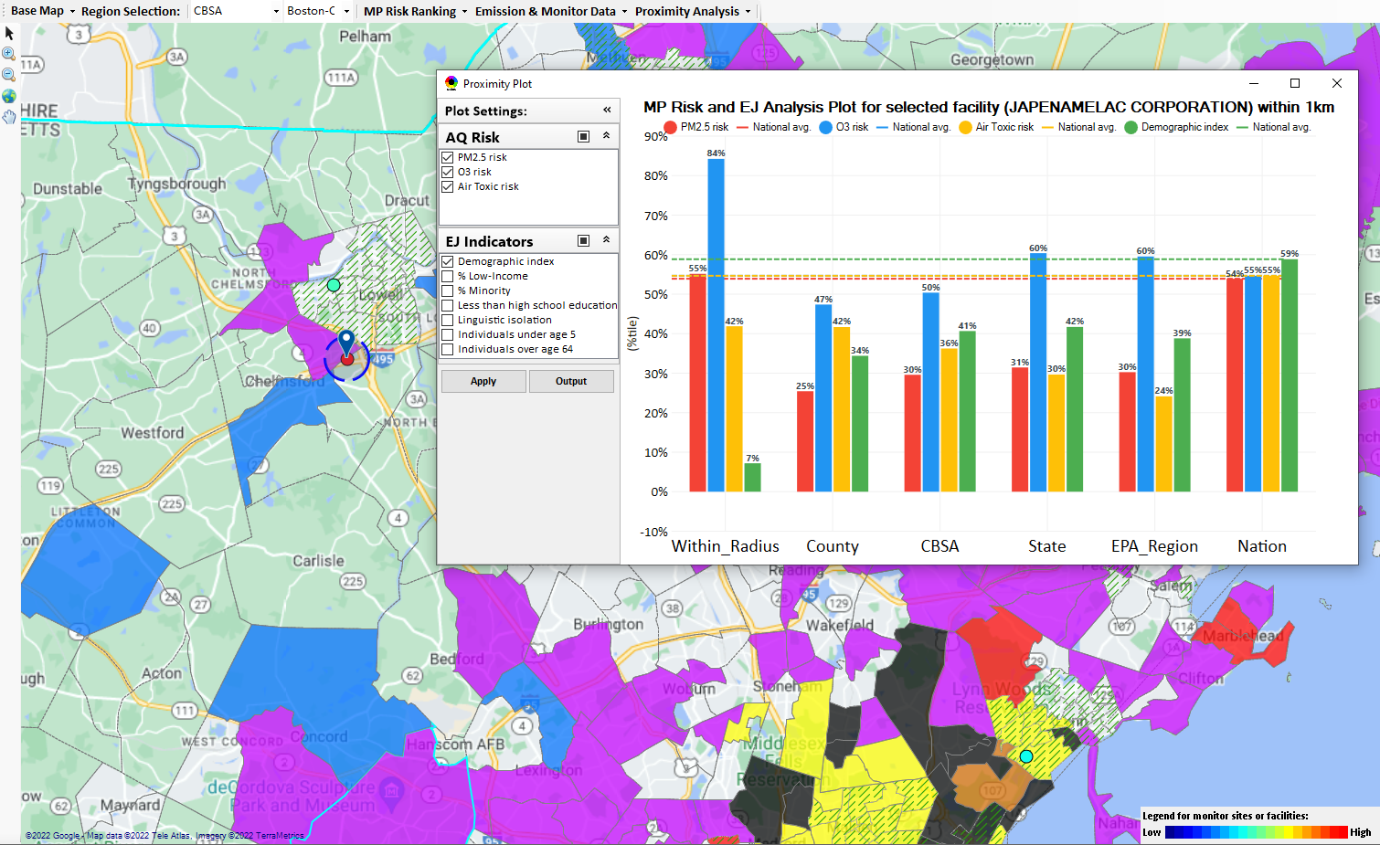
Region 1 Example: Boston-Cambridge-Newton, MA-NH CBSA
Japenamelac Corp
Top emitter in CBSA for VOC
17

Slide 18
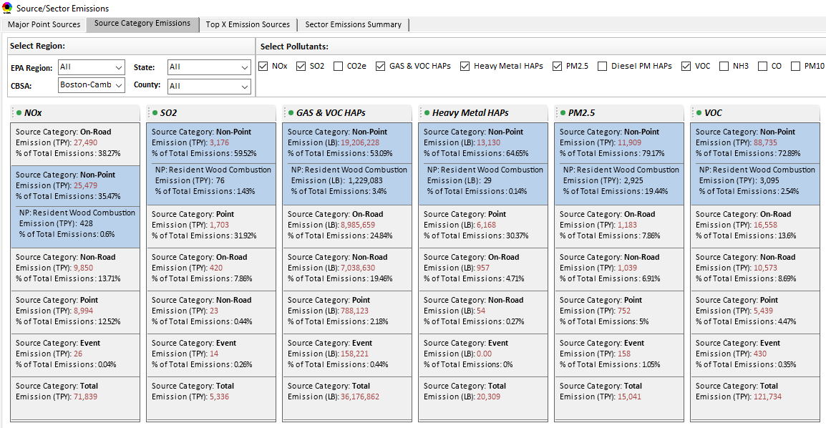
Region 1 Example: Boston-Cambridge-Newton, MA-NH CBSA
Top Emission Source Categories
18

Slide 19
Region 1 Example: Boston-Cambridge-Newton, MA-NH CBSA
Top Emission Source Categories
19

Slide 20
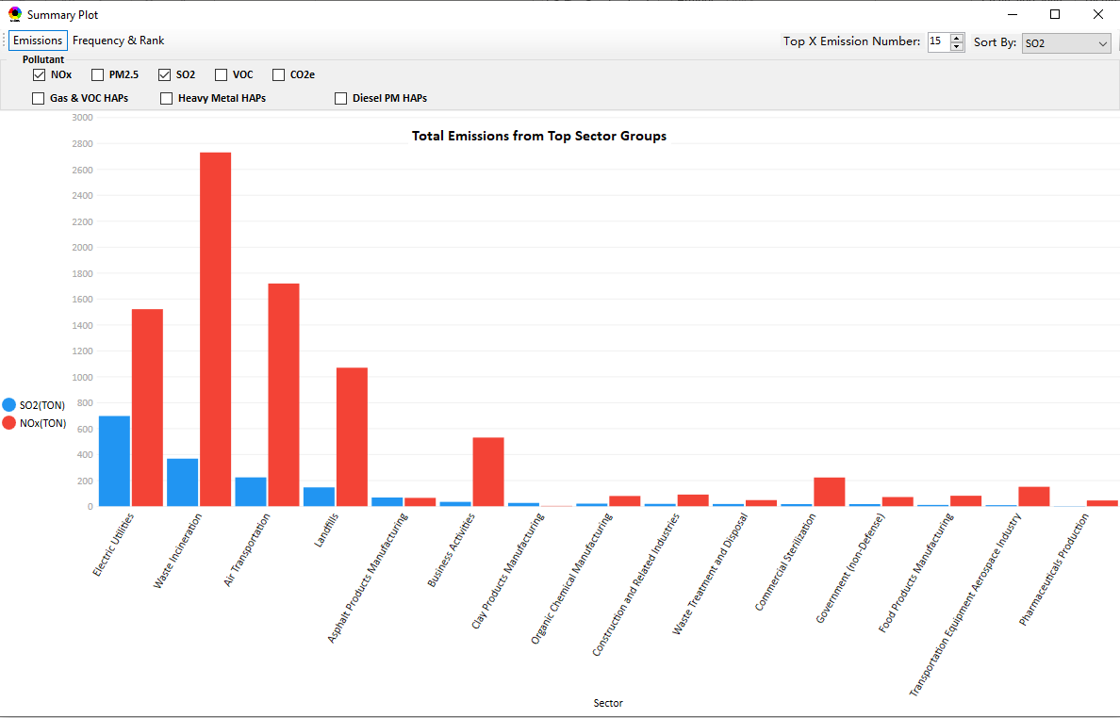
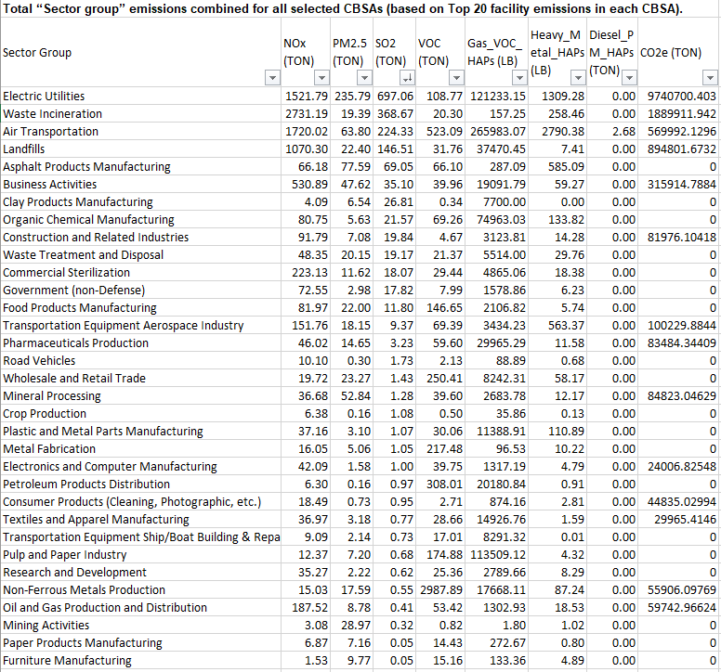
Region 1 Example: Boston-Cambridge-Newton, MA-NH CBSA
Total Emissions from Top Sector Groups
20

Slide 21
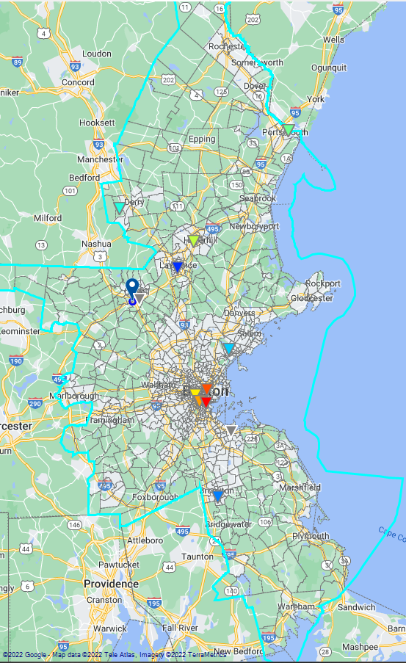
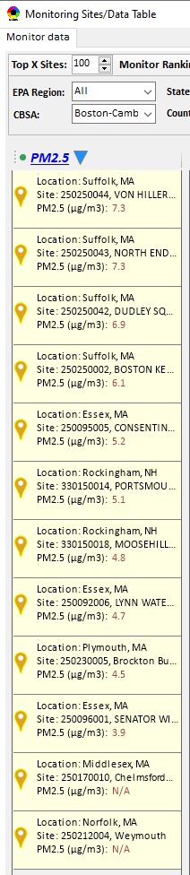
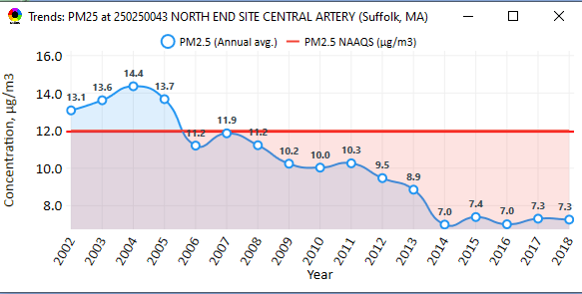
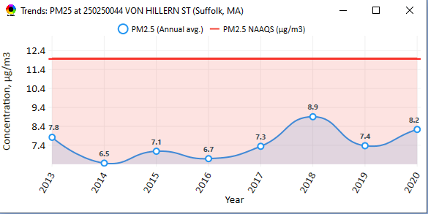
Region 1 Example: Boston CBSA
PM_{2.5} Monitoring Sites
21

Slide 22
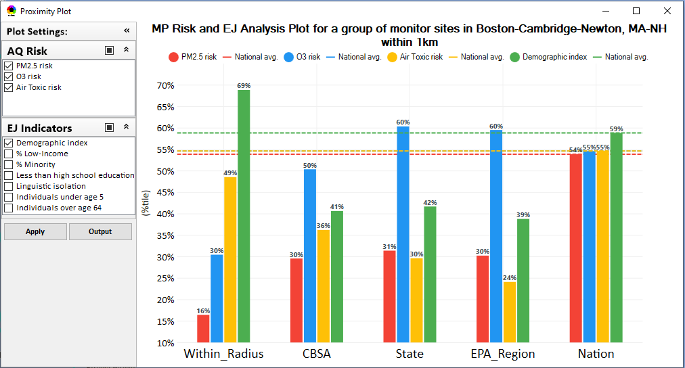
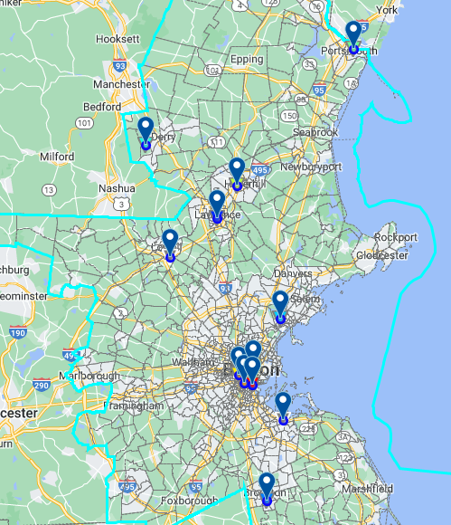
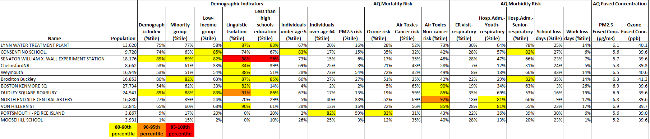
Region 1 Example:
Boston CBSA
PM_{2.5} Monitoring Sites
22

Slide 23
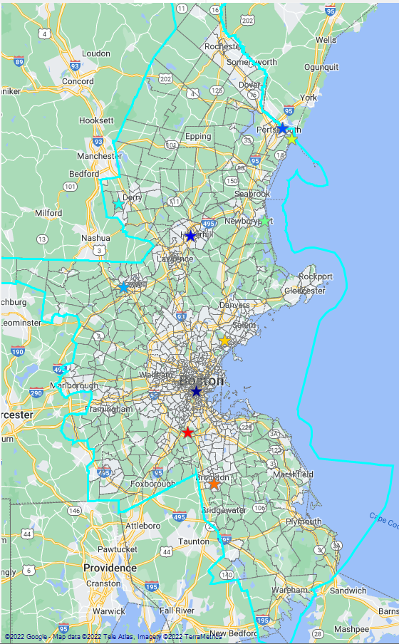
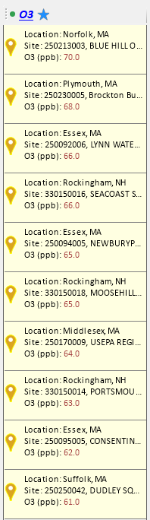
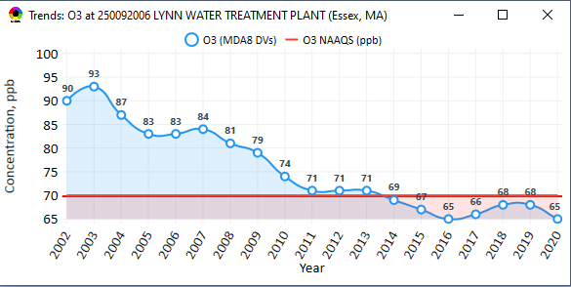
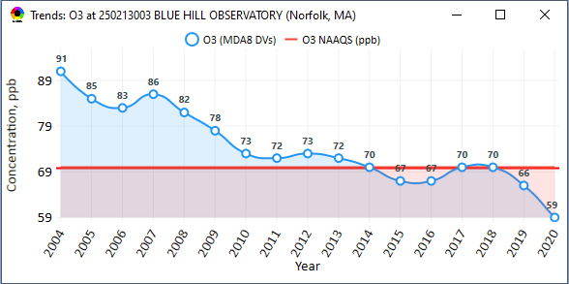
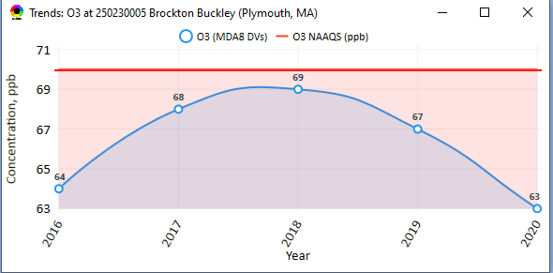
Region 1 Example: Boston CBSA
Ozone Monitoring Sites
23

Slide 24
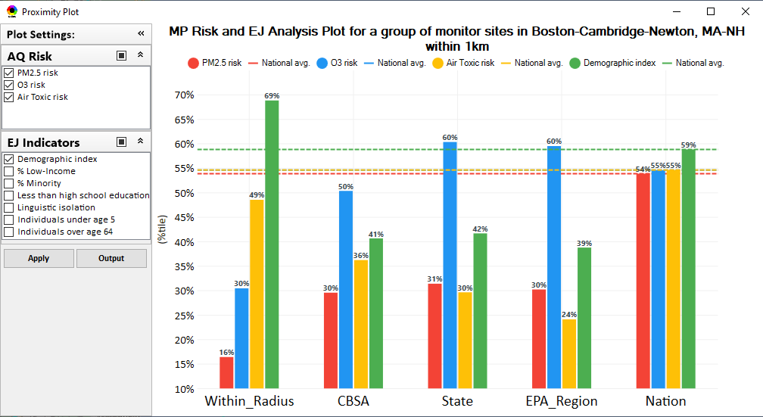
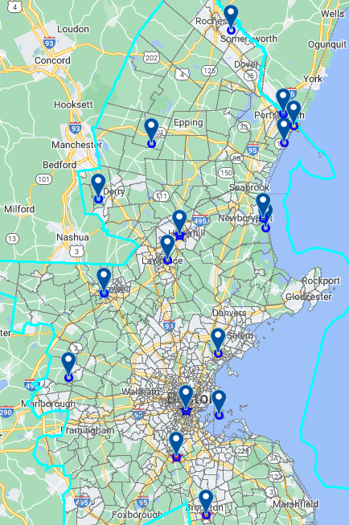
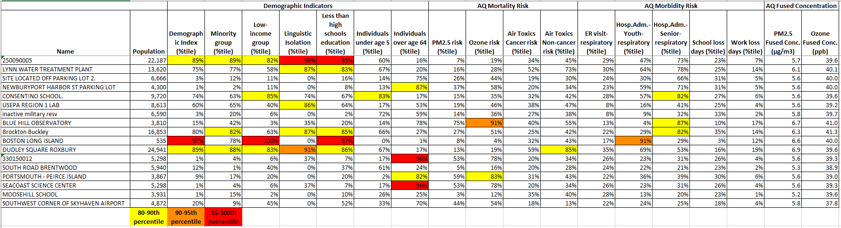
Region 1 Example:
Boston CBSA
Ozone Monitoring Sites
24

Slide 25
NEXUS: Next Steps
Briefing for OAP/OTAQ/OAQPS Senior Management (Dec 2022/Jan 2023)
Partner within EPA on use of NEXUS for programmatic purposes
NEXUS Improvements:
  Address comments and feedback from EPA Beta Testing Team
  Incorporate / revise “Climate risk” indicators (for consideration in AQ planning)
  Update EJ/demographics data to be consistent with new “EJScreen 2.0” dataset
  Include top air toxic cancer risk drivers in the “proximity analysis” module
  Update to 2018/2019 MP platform (O₃, PM_{2.5}, and Air Toxics data)
  Explore feasibility of developing a web-based NEXUS version (similar to EJScreen)
  Explore automation of regional packets
Work towards making NEXUS publicly available
  BenMAP tract level results (PM and O₃ mortality) are the only NEXUS data that are not publicly available – additional work (and possible funding) is necessary before information can be shared publicly.
25

Slide 26
Important Caveats
**NEXUS is currently an advanced screening tool for internal EPA use. A beta version is available for EPA staff to use and provide feedback on for improvement. Additional updates/improvements are necessary before the NEXUS tool is ready to be released to the public.**
NEXUS Caveat
The NEXUS screening tool uses data from a variety of sources. This data is publicly available, except for the BenMAP data at the tract level. EPA is currently still in an internal review process and is not using this tool to support regulatory analyses.
BenMAP Caveat
The estimated number of PM and ozone-attributable deaths and illnesses reported at each tract are subject to important uncertainties and should be interpreted with caution. When using the BenMAP-CE tool to calculate these tract-level results, EPA lacked information regarding the baseline health status of individuals living at each tract; these data are a key input to the calculation of benefits. EPA instead used data available at the county- or state-level, which does not account for differences in baseline health between tracts. Estimating benefits in this way is not consistent with the peer-reviewed methods EPA follows when estimating air quality benefits in a Regulatory Impact Analysis. EPA will continue to refine its methods with the goal of reporting tract-level health benefits with confidence.
26

