Slide 1
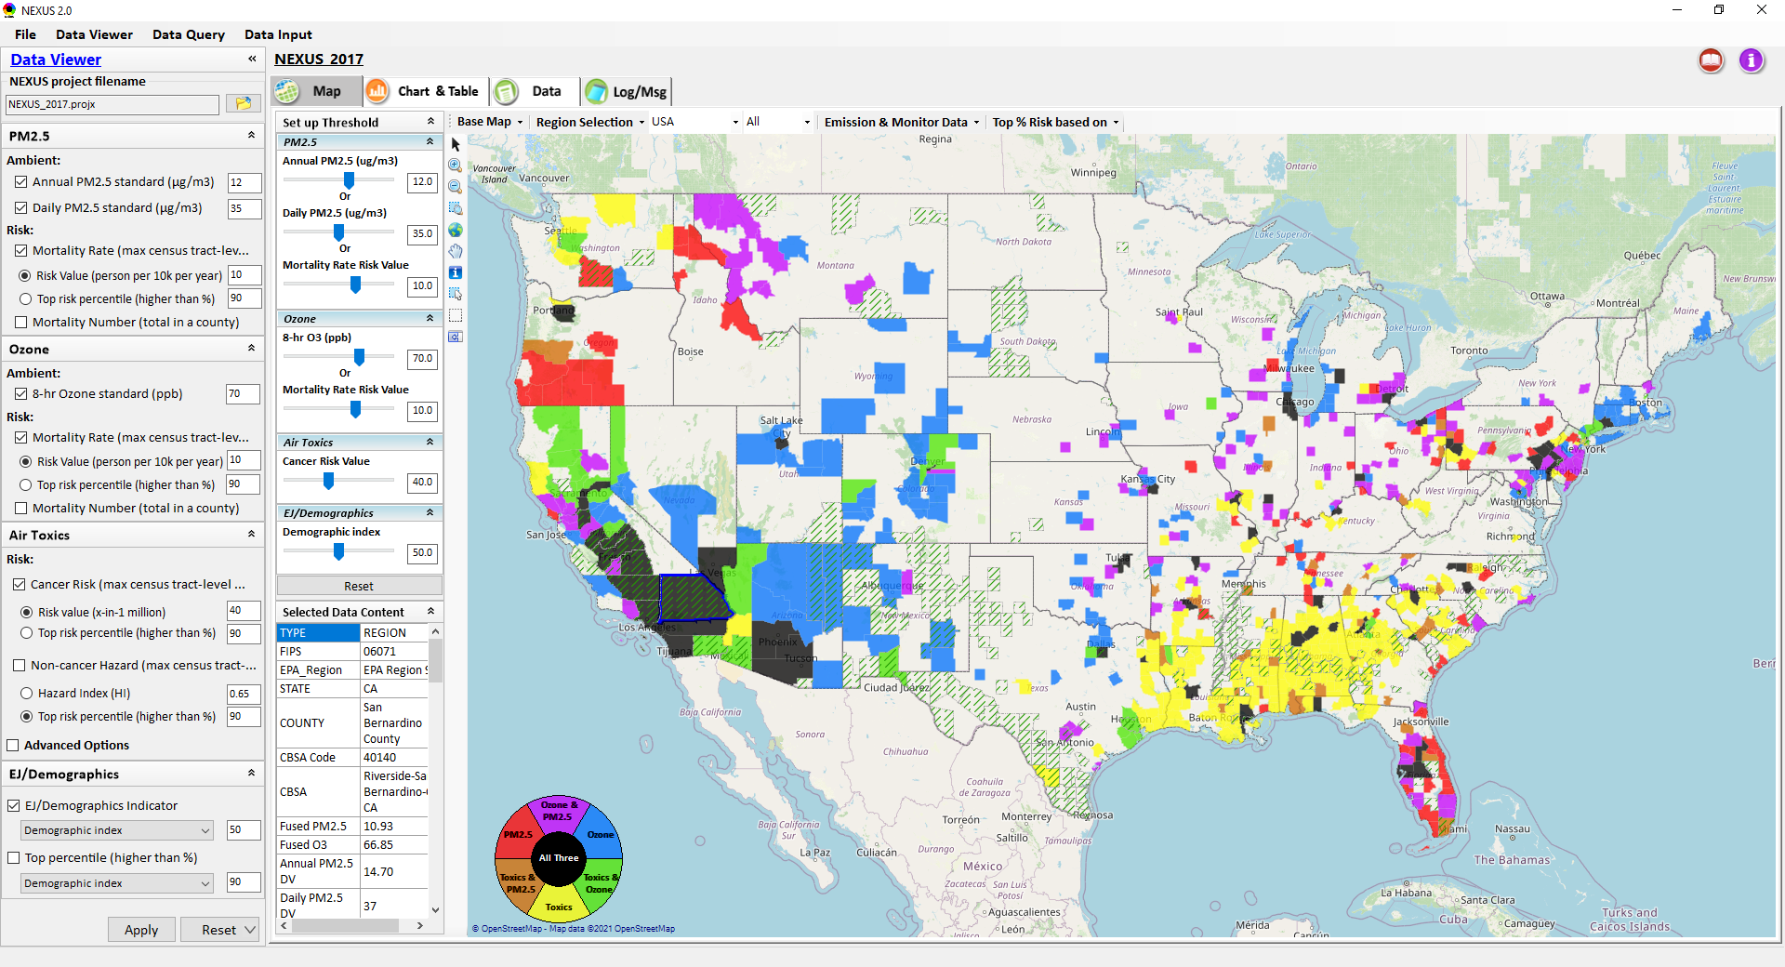
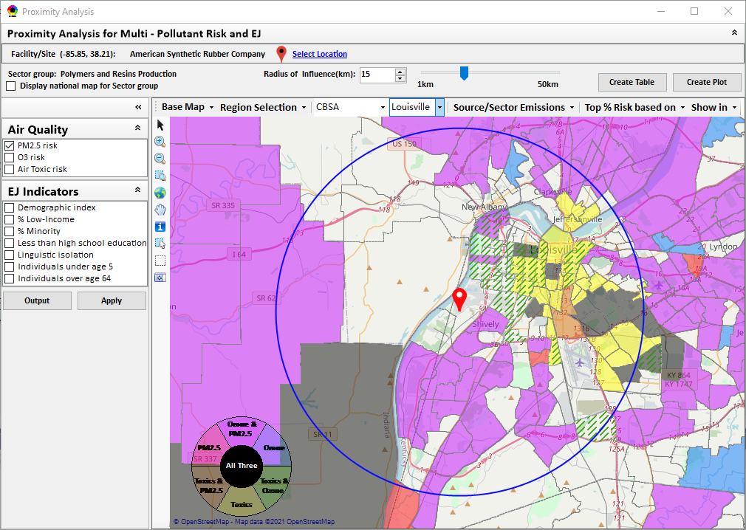
“NEXUS” Multi-Pollutant Advanced Screening Tool SPPD All-Hands
Data Viewer: National/Regional Level
Proximity Analysis: Community Level
Beth Landis, HEID/Climate, International, & Multi-Media Group
Carey Jang, AQAD/Air Quality Modeling Group
06/23/22
1

Slide 2
Multi-Pollutant Team Members
HEID
Beth Landis / Kimber Scavo
Matt Woody / Kelly Rimer
Robin Langdon / Darryl Weatherhead
Sara Terry
Carrie Wheeler
Rob Pinder
Chris Davis
OID
Amanda Kaufman
James Payne
Loren Fox
AQAD
Carey Jang / Tyler Fox
Jim Kelly
Shannon Koplitz
Joe Mangino
Jeanette Reyes
AQPD
Rich Damberg / Megan Brachtl
Mia South
SPPD
Lisa Conner
2

Slide 3
NEXUS: Overview
“NEXUS” is an advanced screening tool for multi-pollutant (MP) risks and EJ/Demographic analysis developed by OAQPS’s MP team
“NEXUS” integrates a suite of MP data, including emissions, monitoring, modeling, fused AQ data and health risk data for PM_{2.5}, O₃ & air toxics as well as EJ/demographic data, into one single platform to allow national and areal overlay mapping & analysis of MP ambient & risk data
“NEXUS” provides MP analysis across from national level “Phase 1” to regional (EPA region/State/CBSA) level “Phase 2”, and now down to community level “Phase 3” (Proximity analysis” in census tract-level)
We expect to use this tool in conjunction with Regions and identify areas that would potentially benefit most from MP approaches to reduce emissions (including current NA areas)
We also expect that it can have additional value-added uses across the Office for Air Toxics, Environmental Justice and other programs
The NEXUS tool will essentially provide a ‘conceptual model’ of an area’s MP issues to facilitate engagement with state/local/tribal agencies & community stakeholder groups
3

Slide 4
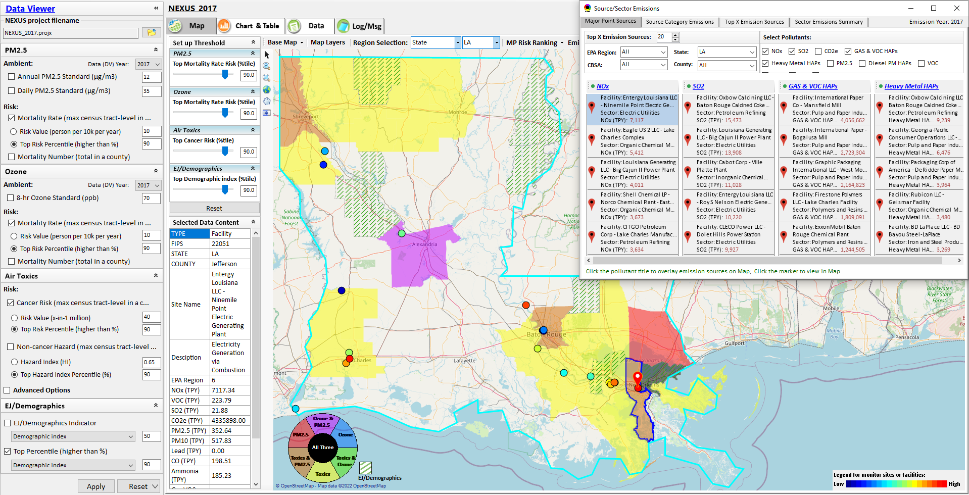
NEXUS Example: Display Major Point Sources

Slide 5
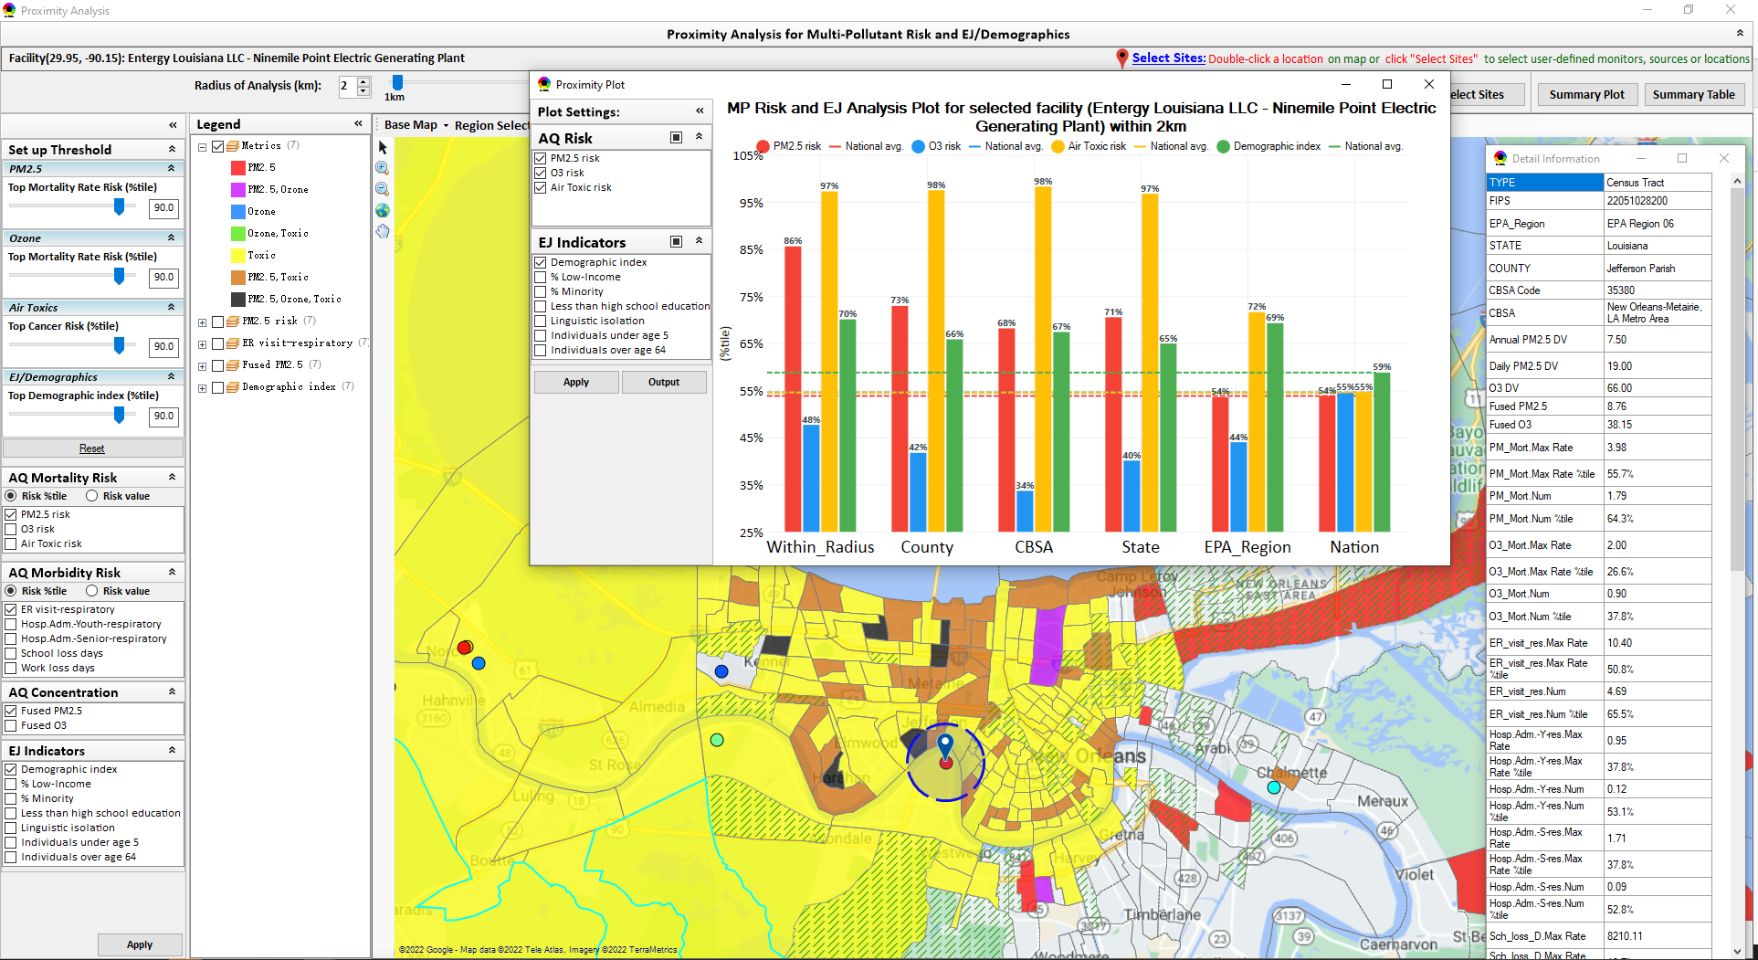
NEXUS Example: Proximity Analysis for Facility

Slide 6
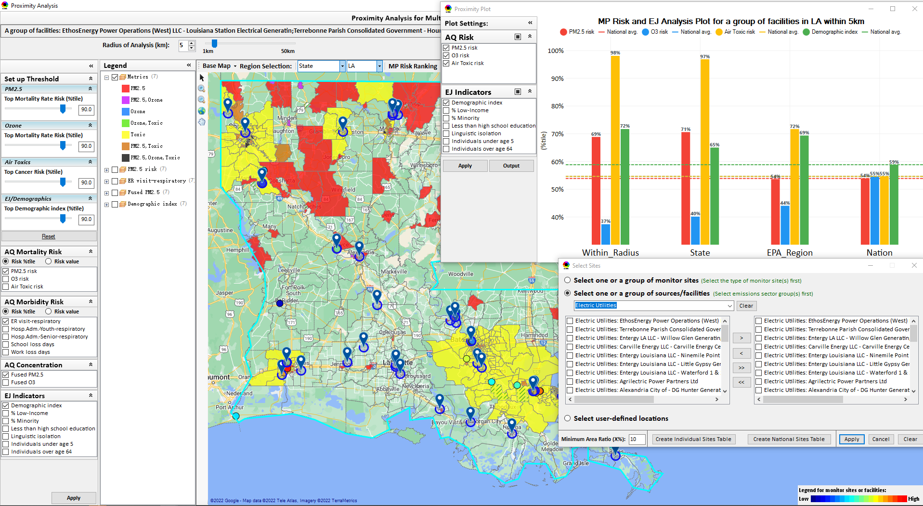
NEXUS Example: Proximity Analysis for Electric Utilities

Slide 7
“NEXUS 3.2” Live Demo
7

Slide 8
“NEXUS 3.2”Beta Release Version: Quick Tutorial
Download “NEXUS” tool: The “NEXUS 3.2” package (“NEXUS 3.2 Setup.exe” & “NEXUS 3.0 Data.exe”: run both “*.exe” files to install) can be downloaded at EPA’s new FTP site:
https://gaftp.epa.gov/aqmg/cjang/NEXUS/NEXUS-3.0/*
Note: Require software installation privilege or “Power Broker” (limited installation privilege) to install “NEXUS tool” at EPA’s PCs; Please check “This PC\Documents\My NEXUS files\data\* (\tool\*, \result\*)” to see if NEXUS tool & input dataset have been installed successfully. If feasible, please un-install previous version first to ensure a successful installation.
OAQPS Multi-Pollutant team, 5/25/2022
8

Slide 9
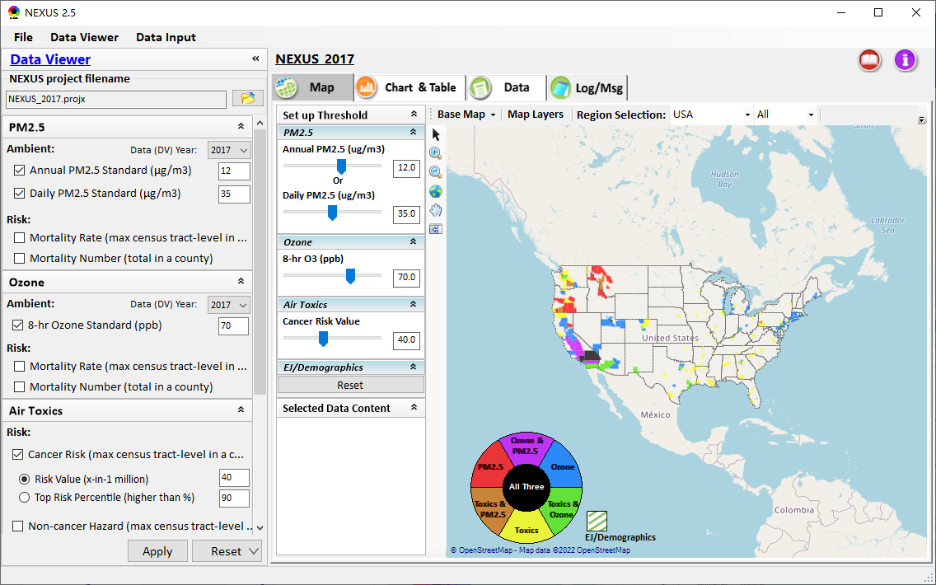
NEXUS Tool: On-line User’s Manual
Click “book” icon to launch “User’s manual”
Hot link to User’s manual’s “Data Viewer” chapter (same for “Data Input” module)
9

Slide 10
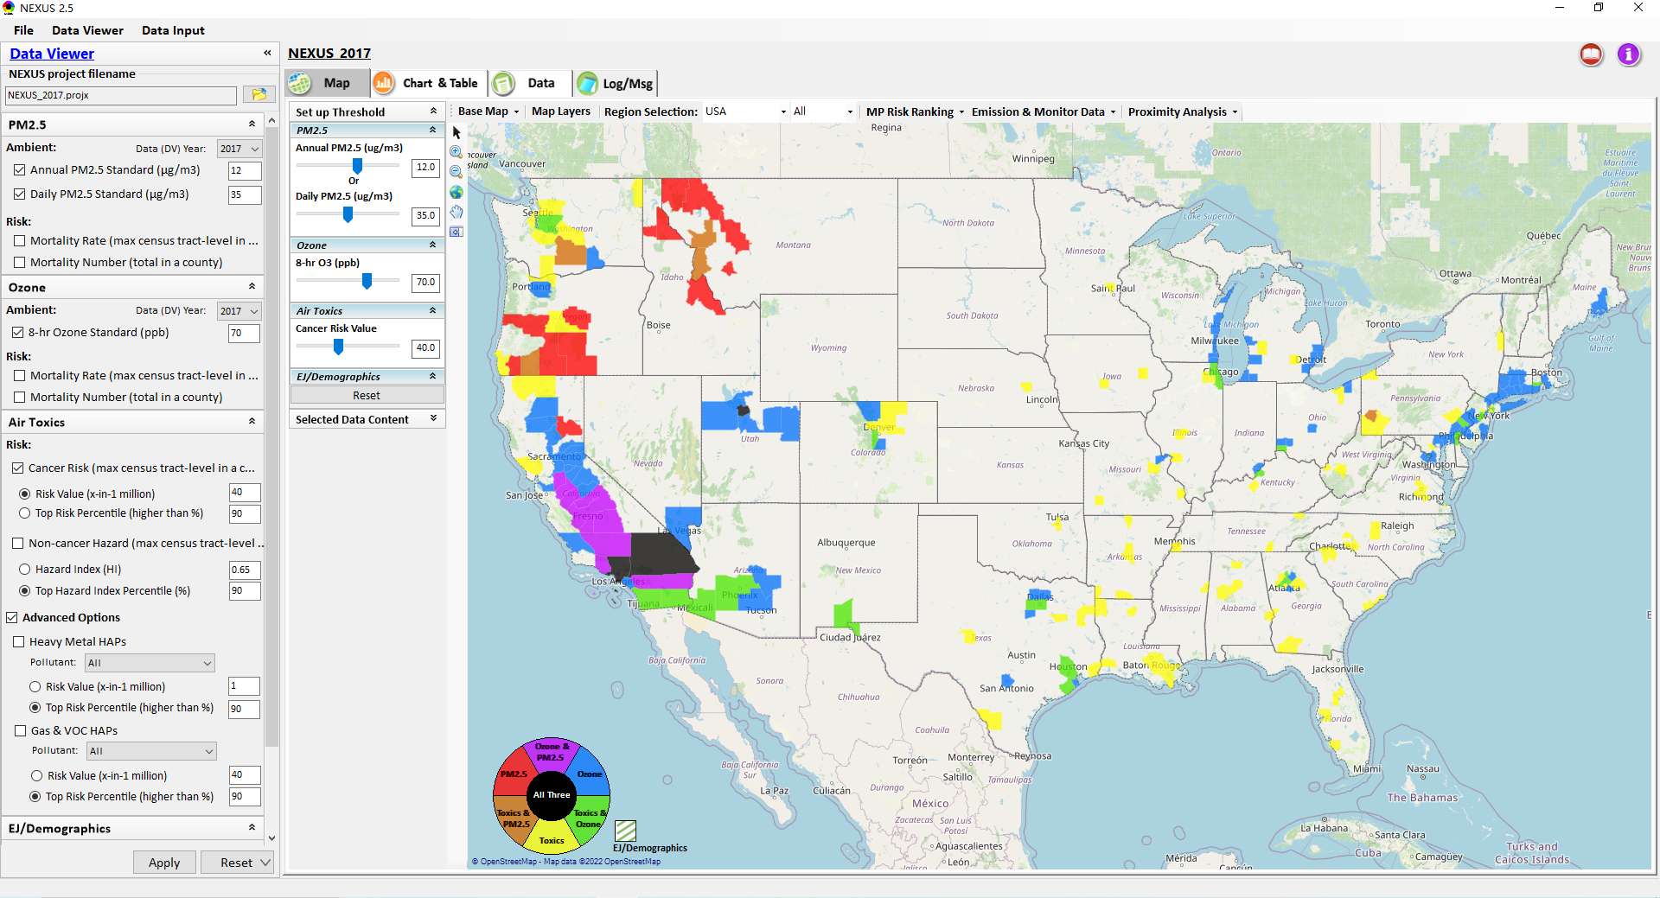
NEXUS Tool: Data Viewer Module
Click “File” to open or save a project
Switch between 2 key modules
NEXUS project file name
Select desired ambient data (DV) year (2013-2020)
Select & adjust “Ambient” or “Risk” levels
“Advanced Option”: provide HAPs & species selections
10

Slide 11
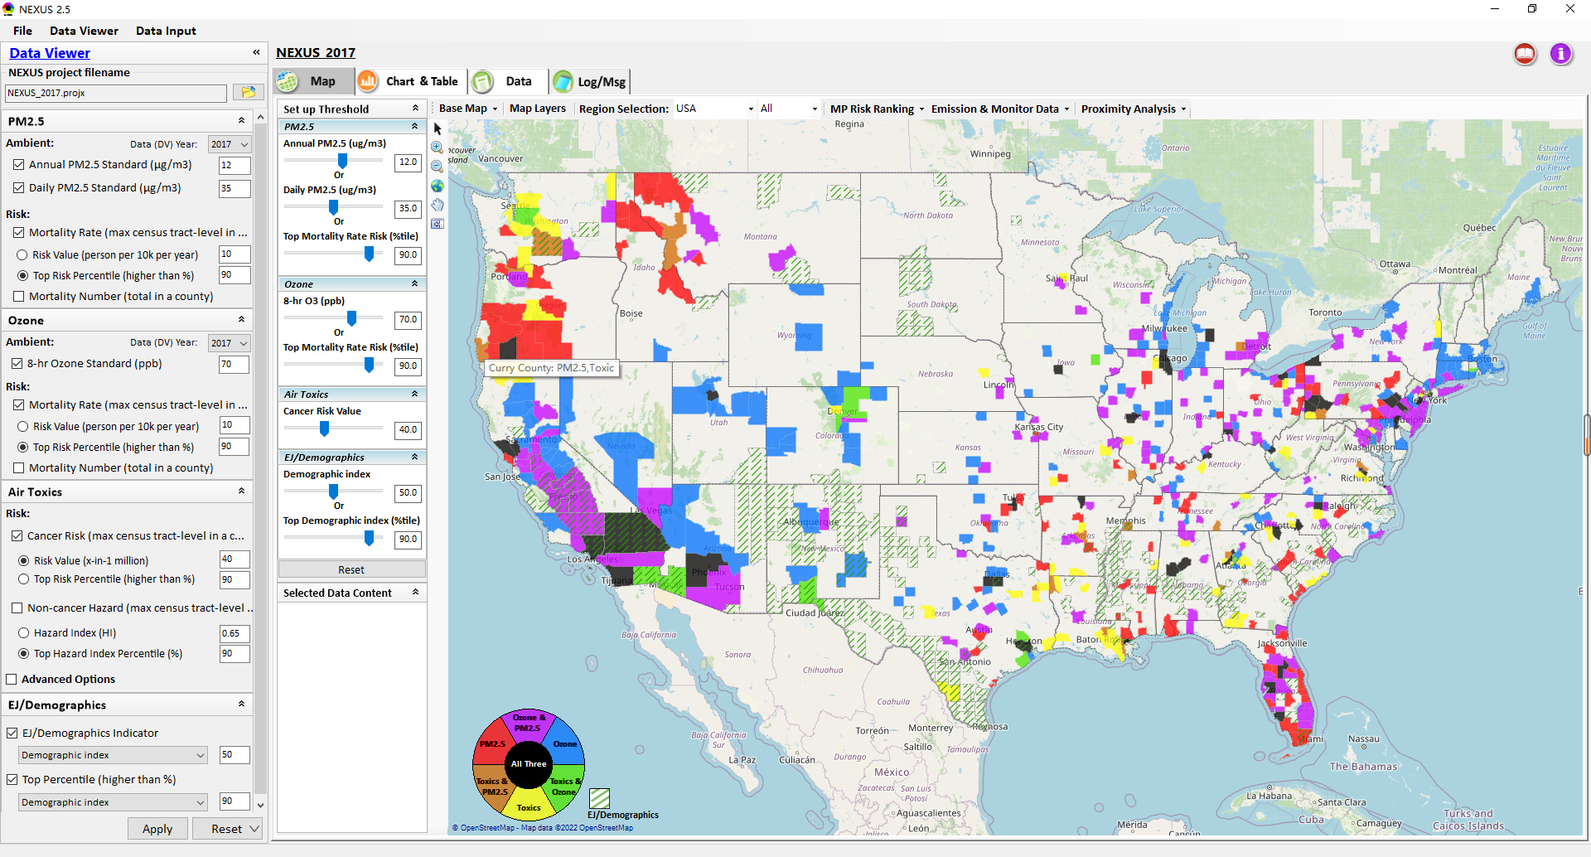
Data Viewer: “Apply” New Selections
“Check” boxes to add or remove “Ambient” and/or “Risk” selections
New selections will appear in “Slider bars” panel and map display
“Slider bars” allow to select & adjust “Ambient” and/or “Risk” threshold levels to display corresponding color map
“Apply” new selections
11

Slide 12
NEXUS Update: EJ/Demographics Metric and Data
EJ/Demographic metric is displayed with “green dash” for counties exceeding selected threshold
12

Slide 13
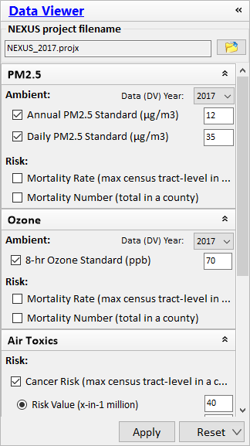
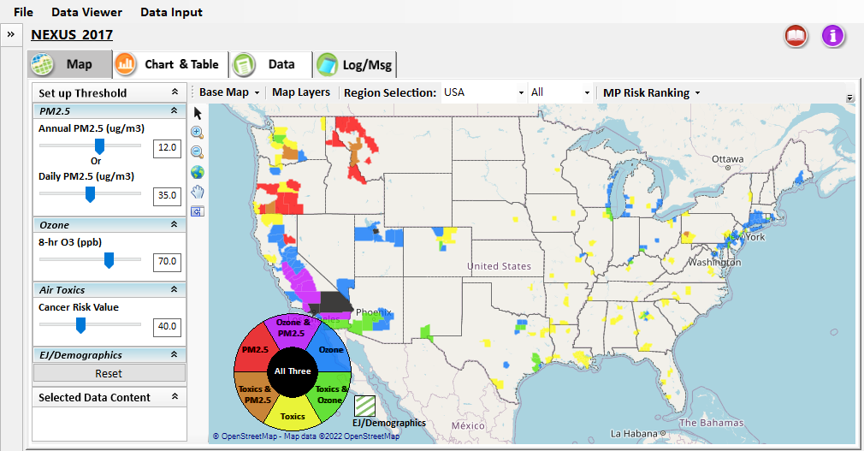
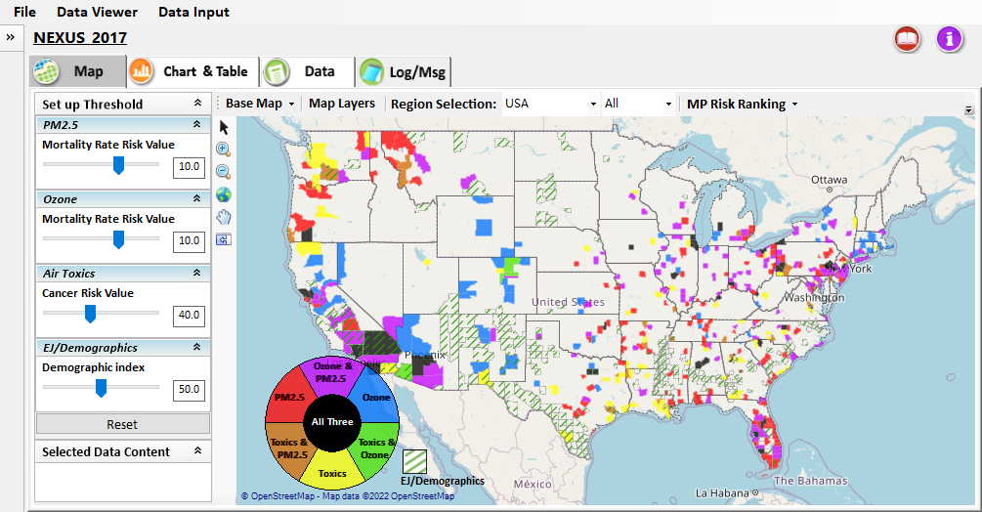
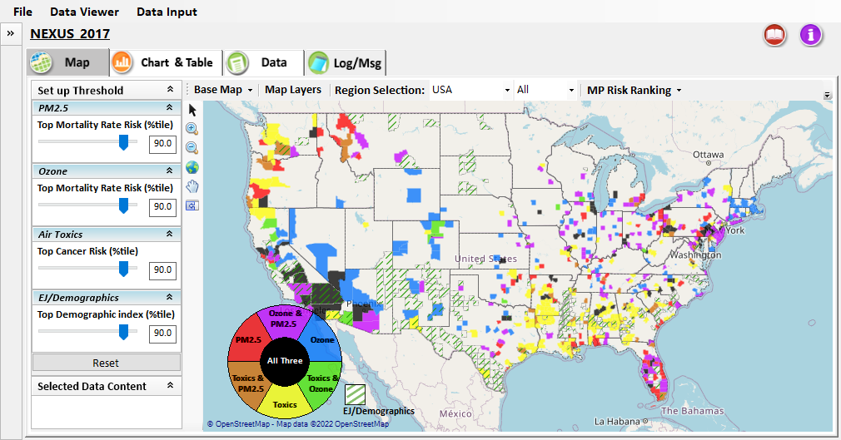
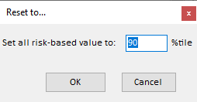

Data Viewer: “Reset” New Selections
default configuration
risk-based value
risk-based in %tile
“Reset” new selections
risk-based in desired %tile
13

Slide 14
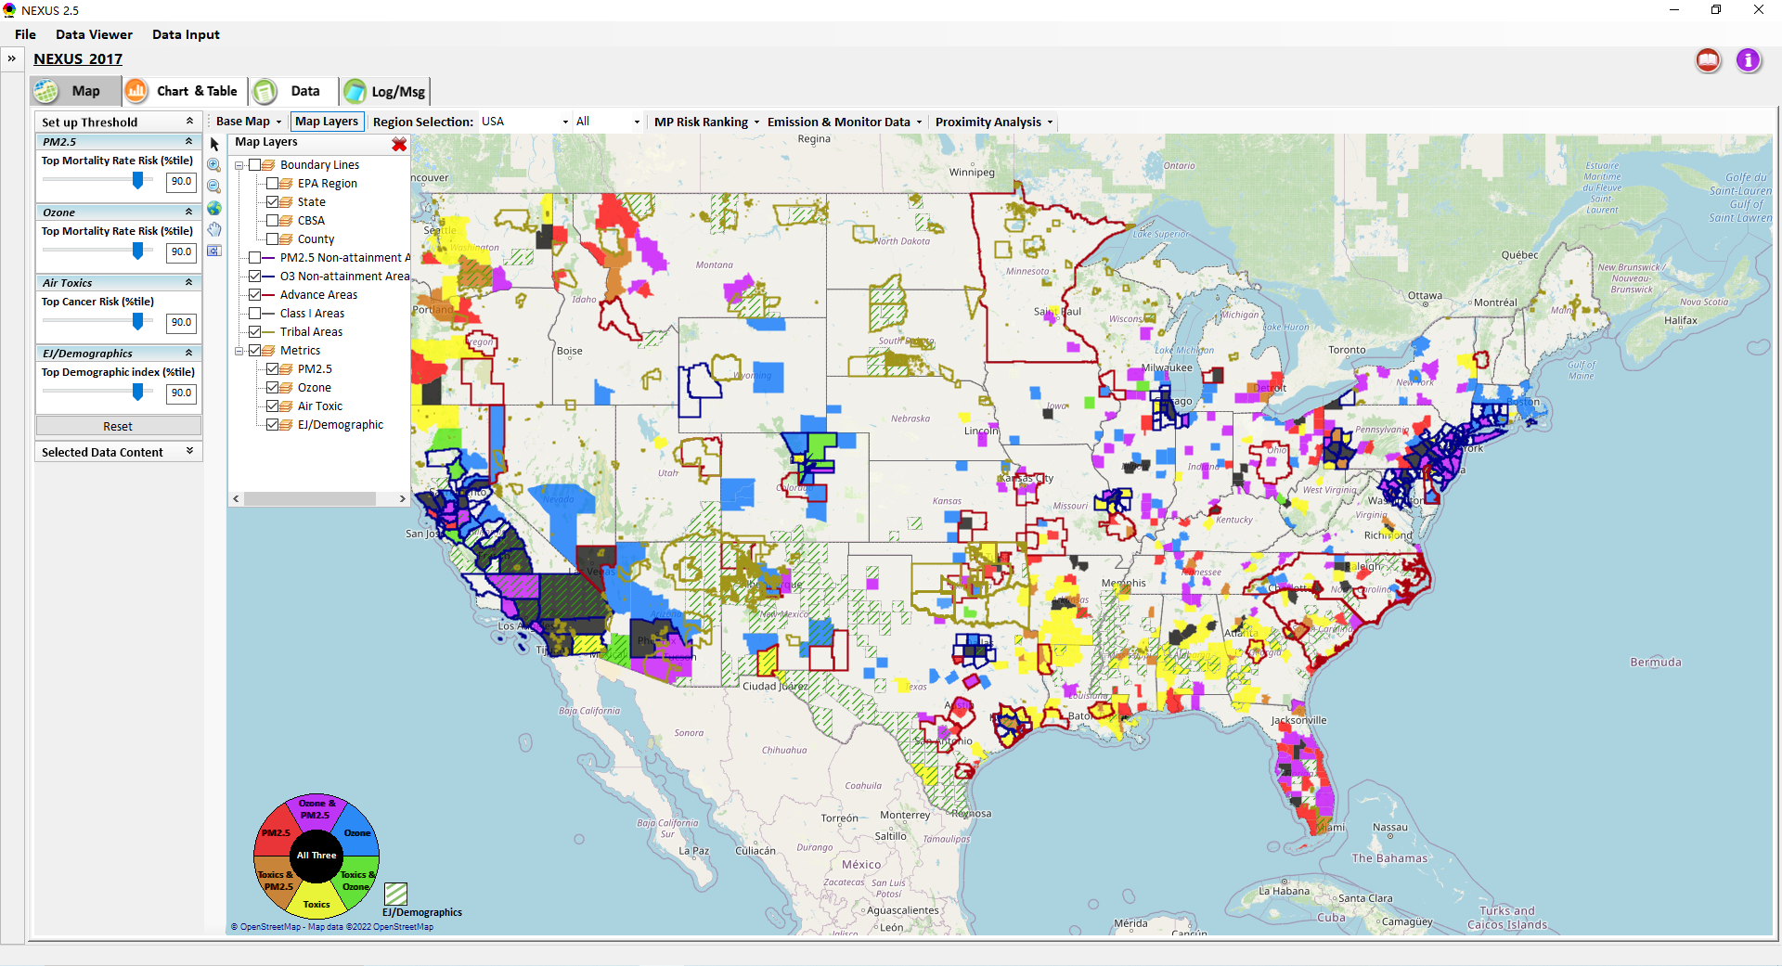
Data Viewer Module: Map Layers menu
Click “X” to close “Map Layers” menu
“Map Layers” menu: Provide (show/hide) map overlaps of various areas, AQ metrics and boundary lines
14

Slide 15
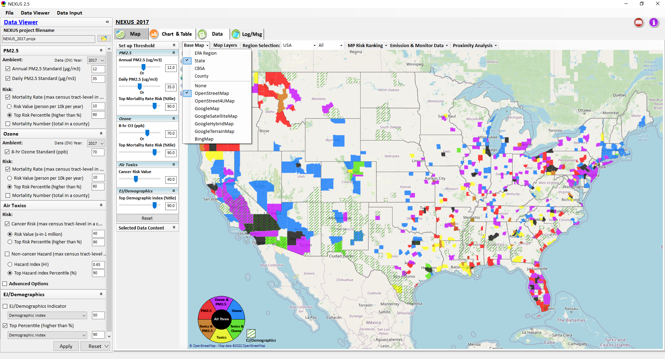
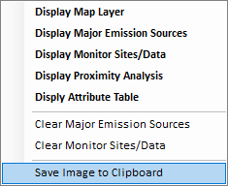
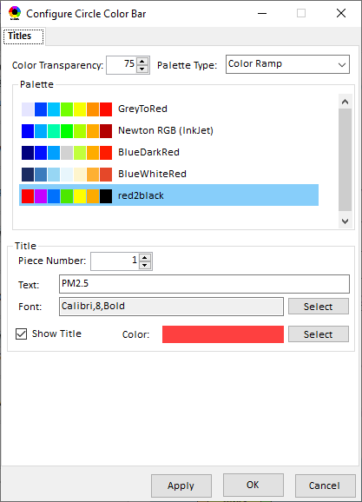
Data Viewer Module: Configure Base Map & Color
“Base Map” menu: Change boundary lines and background map (e.g., “Google Map”)
“Right-click” map to save map image
Click “color map” to change color & transparency
15

Slide 16
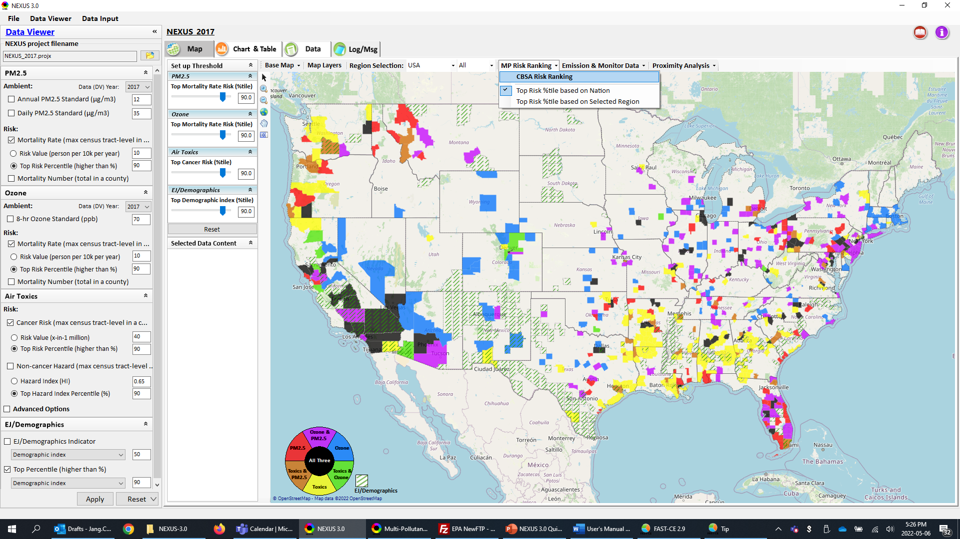
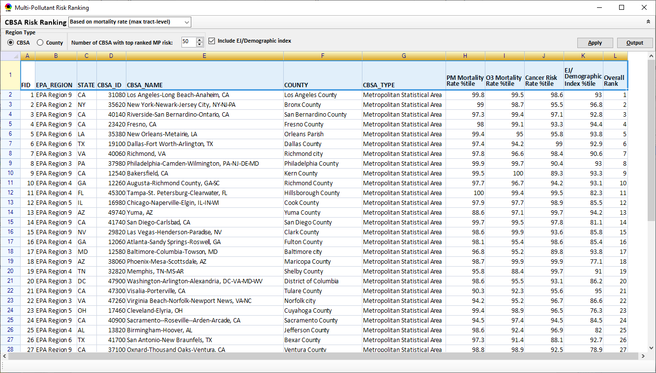
Data Viewer Module: MP Risk Ranking
Check box to include EJ/demographic index as part of CBSA ranking
Click “CBSA Risk Ranking” to provide MP risk ranking by CBSA or County
16

Slide 17
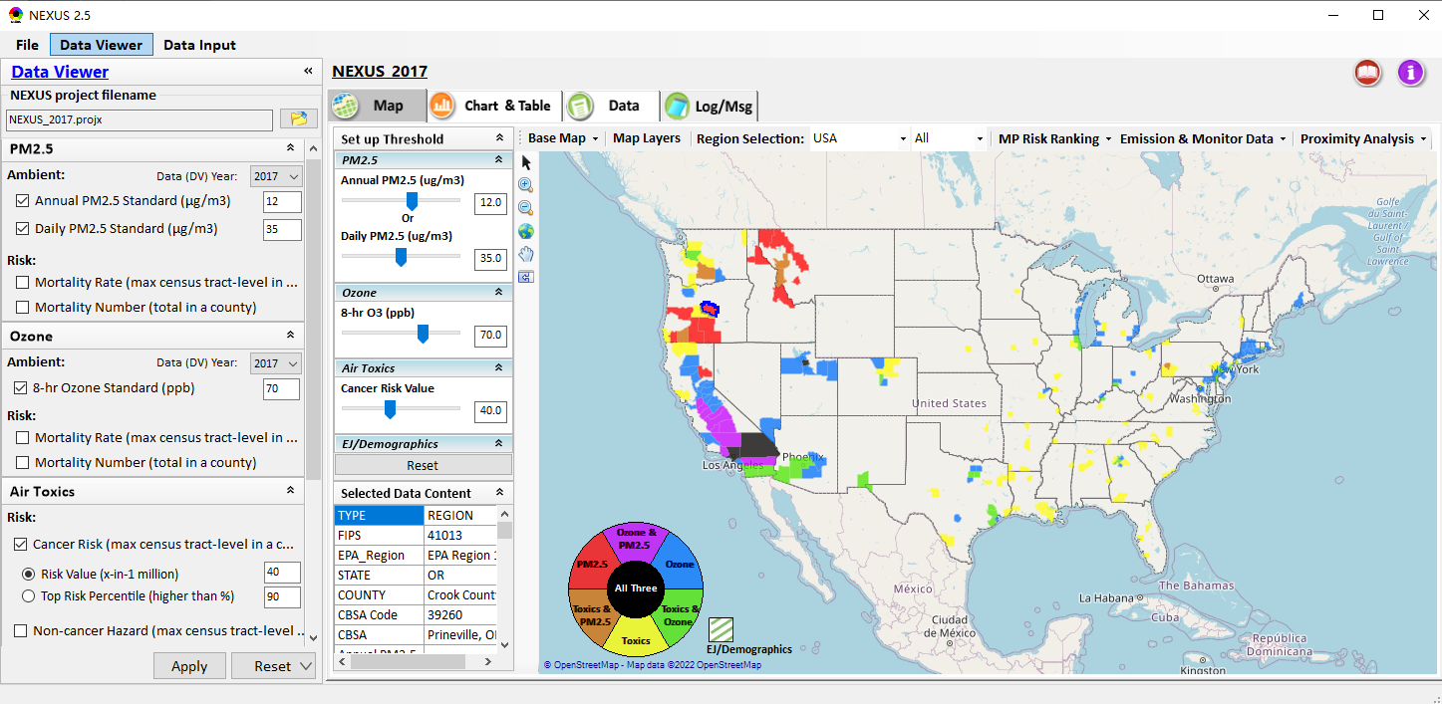
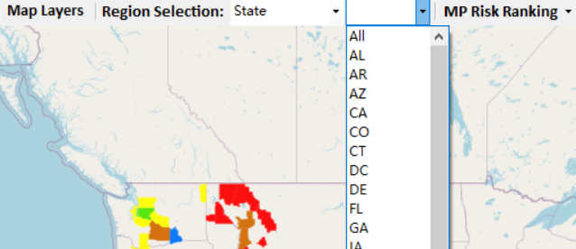
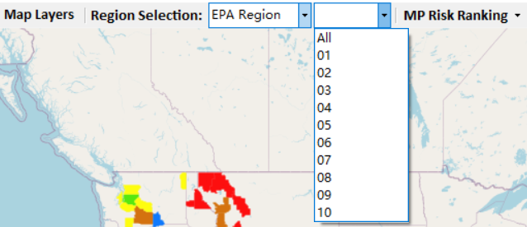
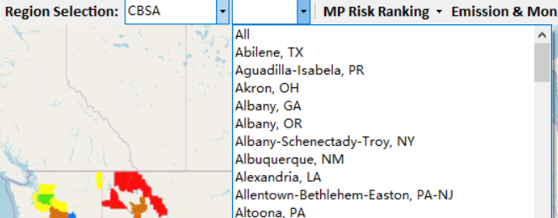
Data Viewer: “Region Selection”
Allow to select “EPA regions”, “States”, or “CBSA”
17

Slide 18
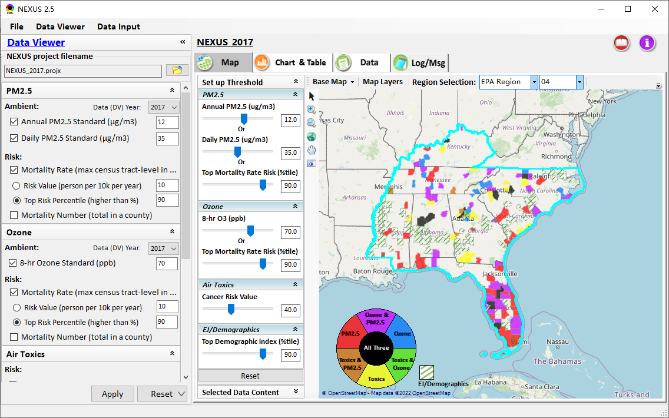
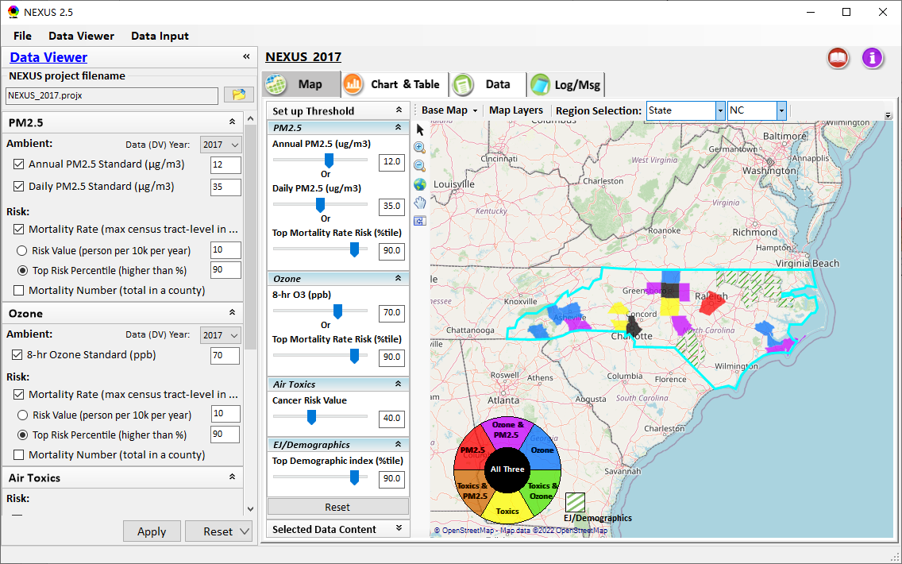
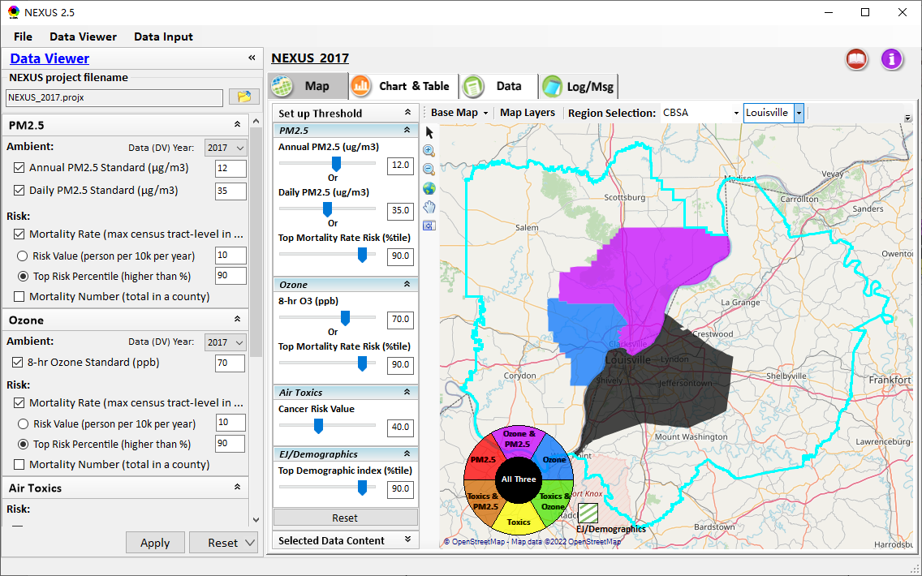
Data Viewer: Select EPA Region/State/CBSA
Examples:
EPA Region 4
State: NC
Louisville CBSA (KY/IN)
18

Slide 19
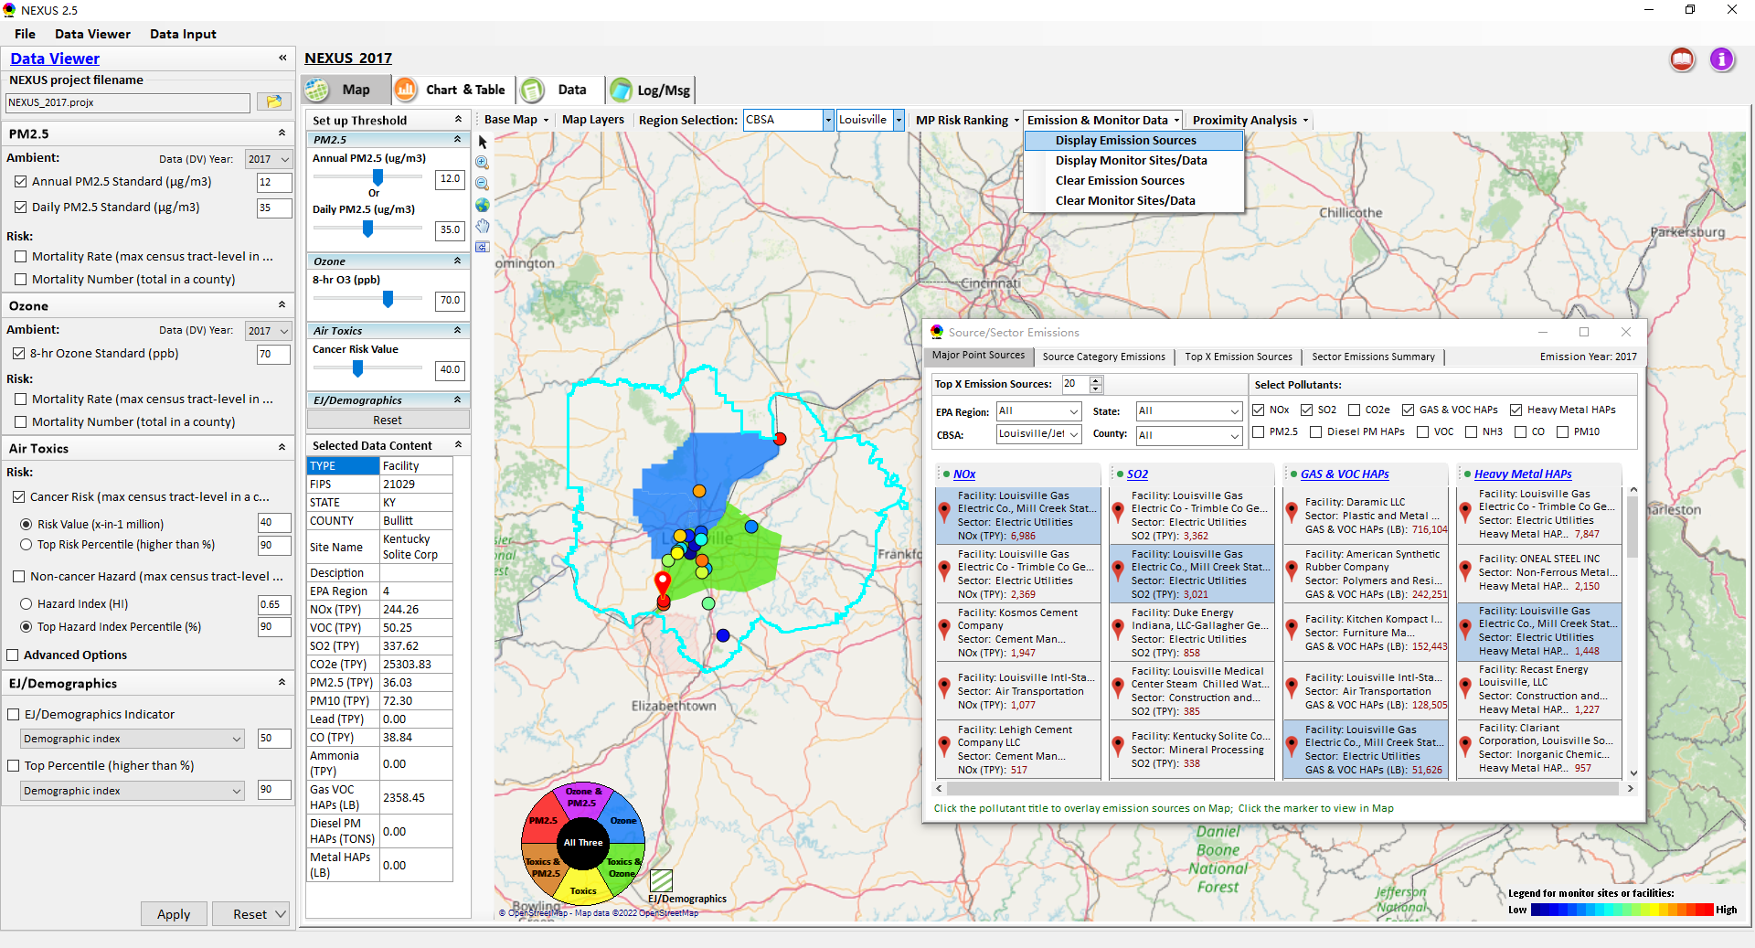
Data Viewer: Major Emission Sources
Click “Display Emission Sources” tab (or “right-click”) to display emission sources and launch new window
Click any “facility” to link & display source location and emitted pollutants information. Same facility emitting various pollutants can be identified with the same highlighted color.
19

Slide 20
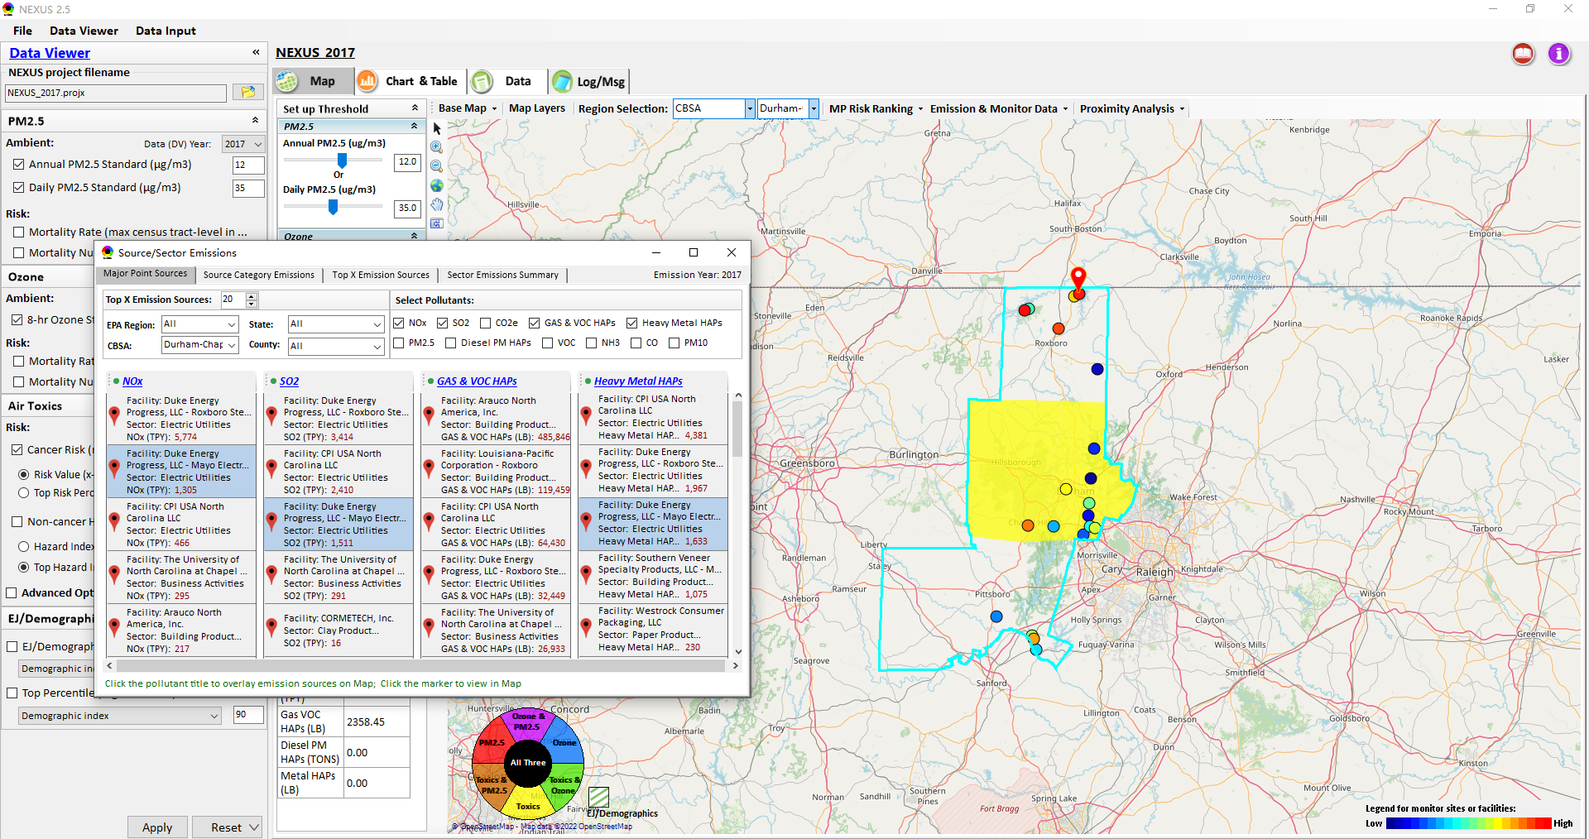
Data Viewer: Major Emission Sources
Allow to scroll down to CBSA-level (e.g., Durham CH CBSA ) or County-level
Durham CH CBSA
Emissions ranking by “color” of circles from red (higher) to blue (lower)
Color Legend for facilities emissions
20

Slide 21
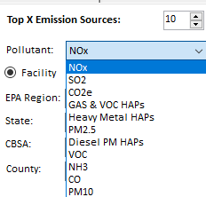
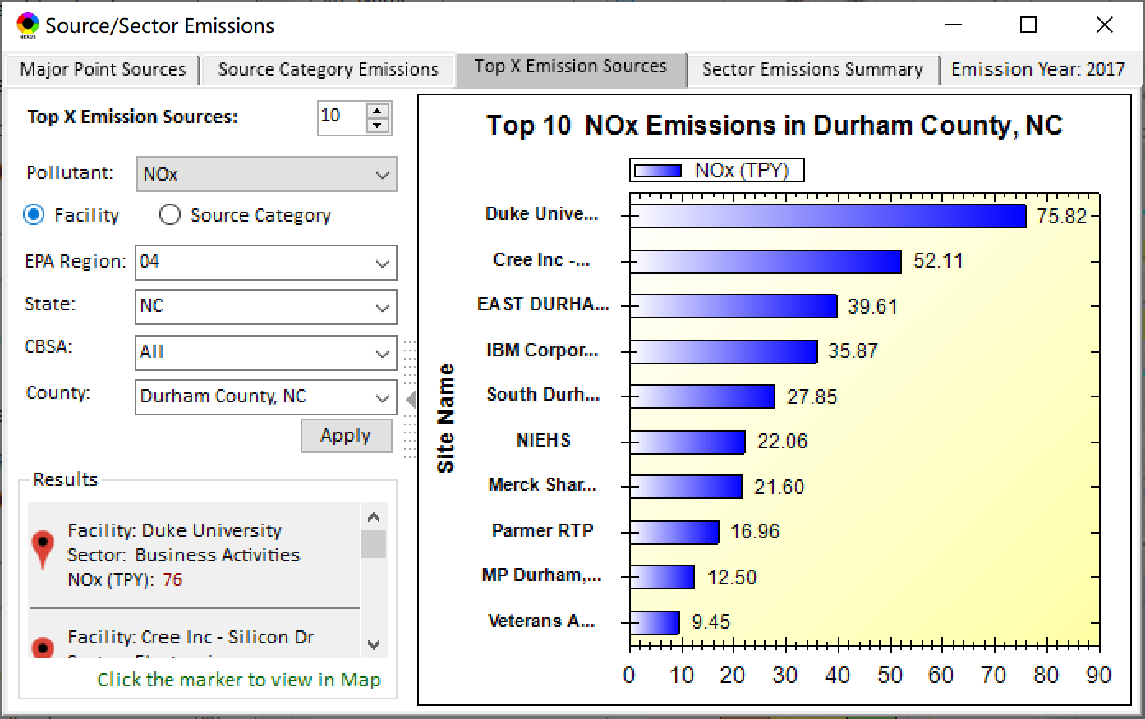
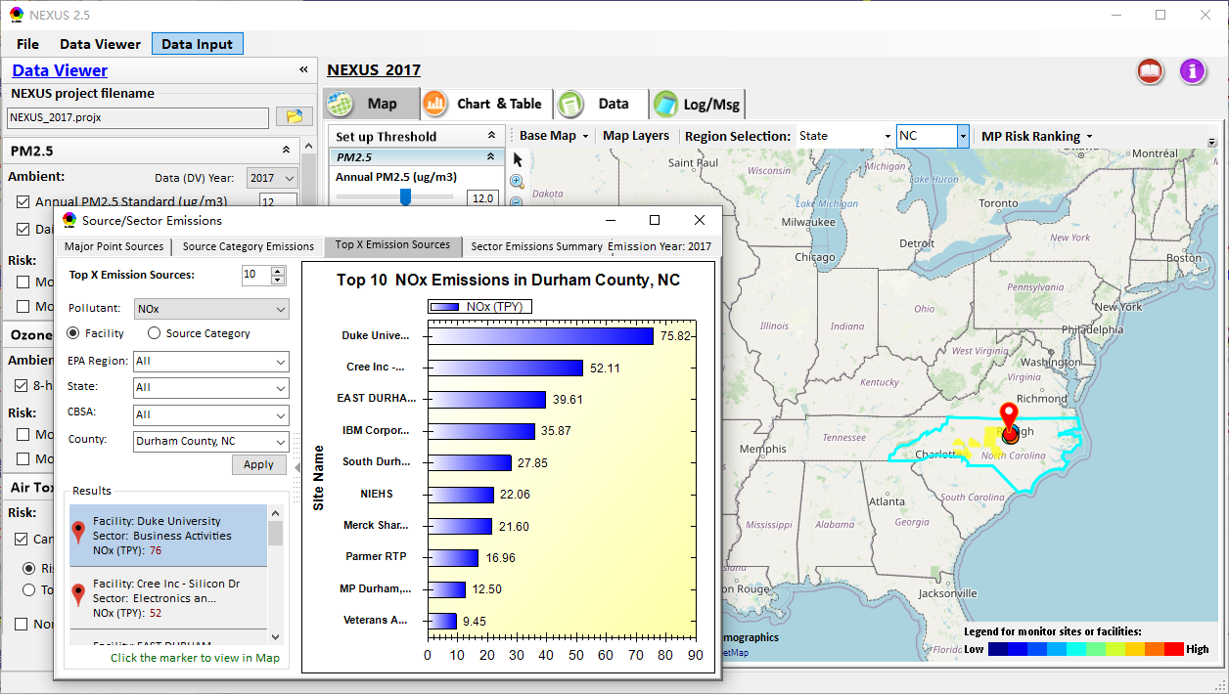
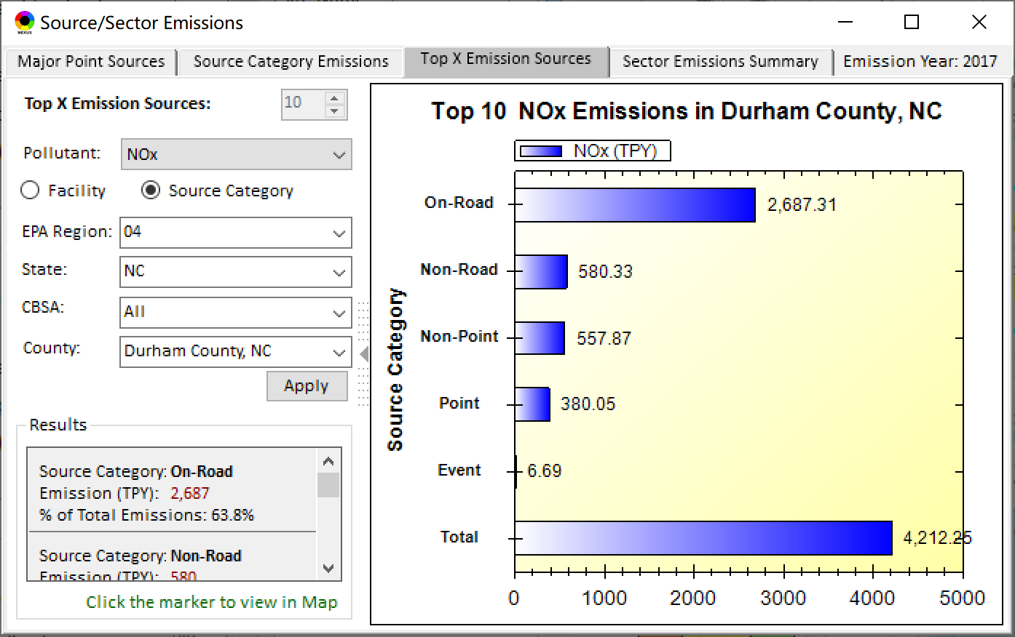
Data Viewer: Top “x” Emission Sources
Provide selection of Facility & Source Category
Provide selection of Facility or Source Category
Durham county, NC
21

Slide 22
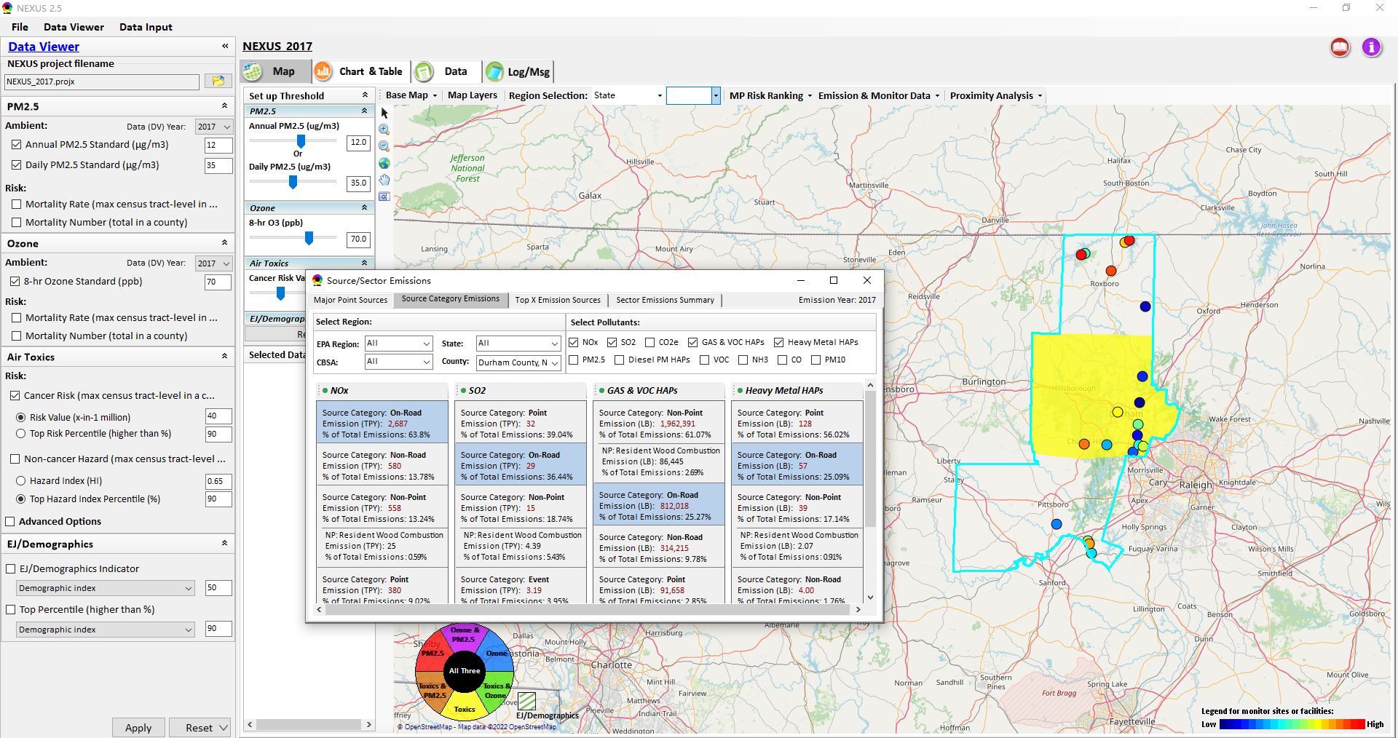
Data Viewer: “Source Category Emissions”
“Source Category Emissions” module provide five source categories, including “Point”, “Non-Point”, “On-Road”, “Non-Road”, and “Event” emissions for the selected region, CBSA, or county.
For “Non-Point”, including Resident Wood Combustion (RWC) emissions.
22

Slide 23
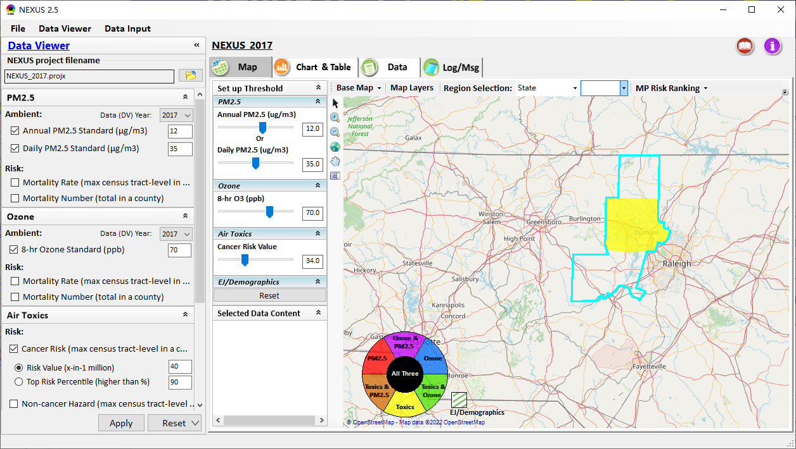
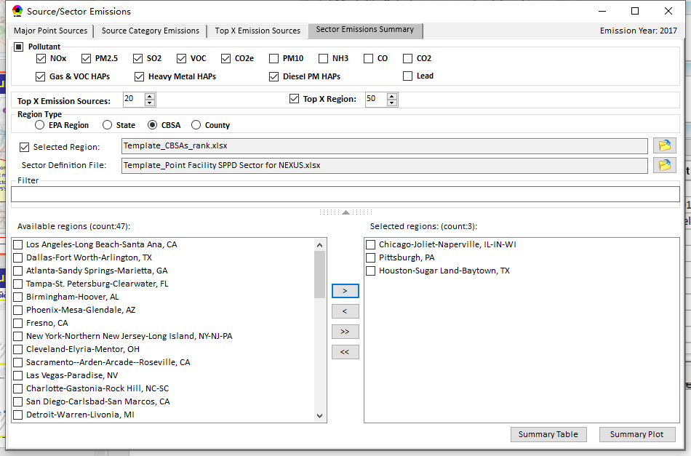
Data Viewer: “Sector Emissions Summary”
“Sector Emission Summary” function allow to select major CBSAs and provides source and sector emissions summary to support “Sector Prioritization” effort
23

Slide 24
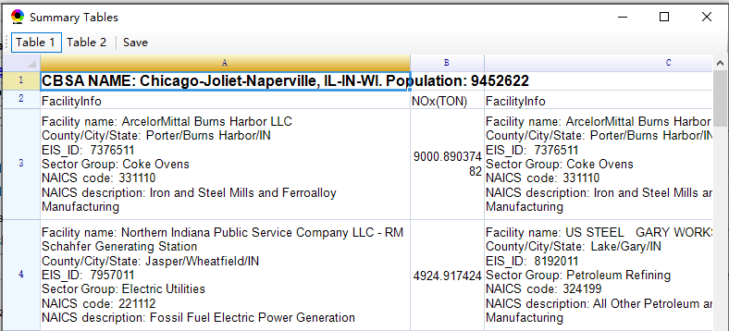
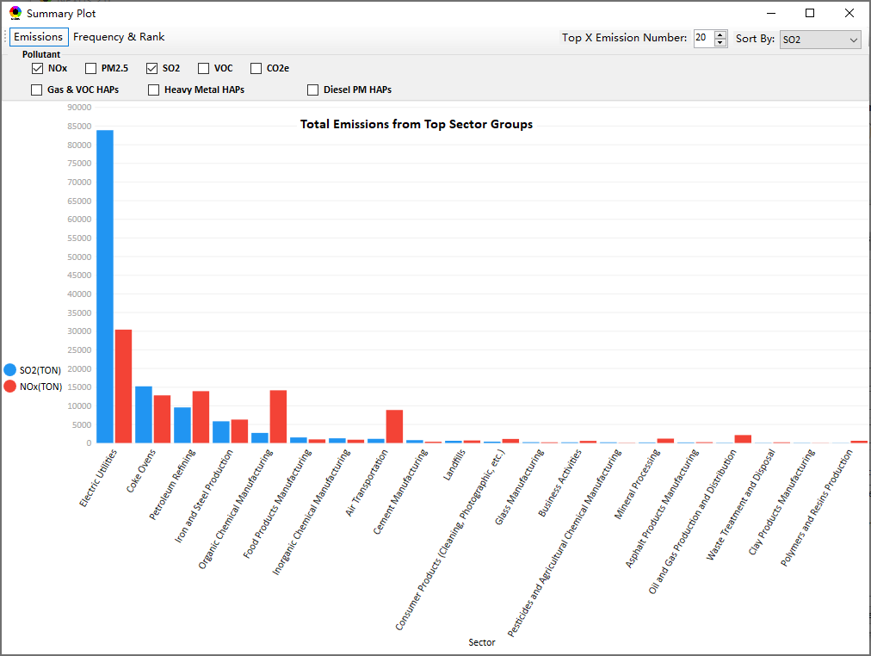
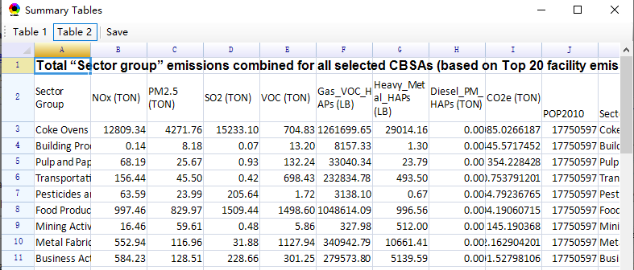
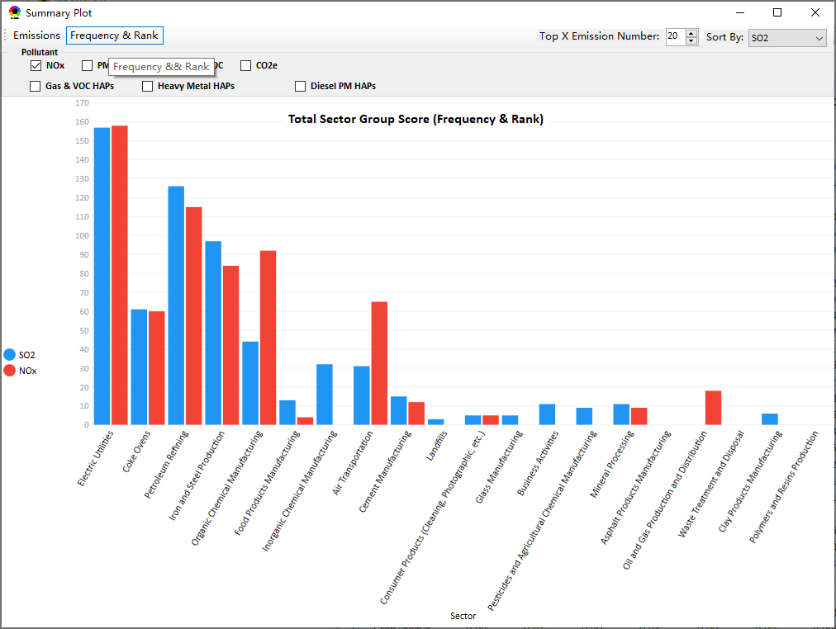
Data Viewer: “Sector Emissions Summary”
Summary table
Summary plot
Emissions
Frequency & Rank
24

Slide 25
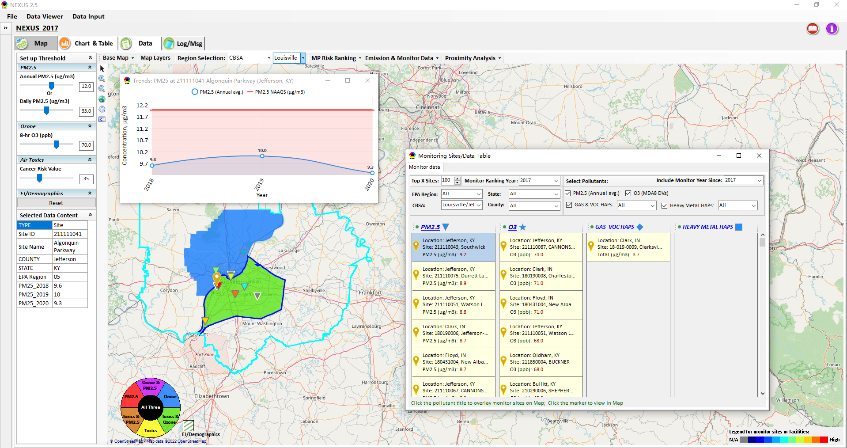
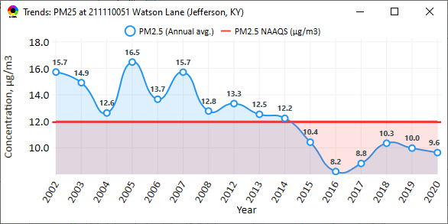
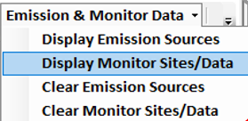
NEXUS Update: “Monitoring Data/Sites”
Click menu (or right-click) to display “Monitor Sites/Data”
List the monitor sites by ranking the data based on selected year
AQ trend
Include only those monitor sites with data since selected year
Monitor Site/Data
Click to display
AQ trend at monitor site
Use different symbol to display each pollutant’s “monitoring sites” e.g., PM_{2.5} (triangle), O₃ (star), etc.
Click to select monitor site & pollutant
Color Legend for monitor sites
25

Slide 26
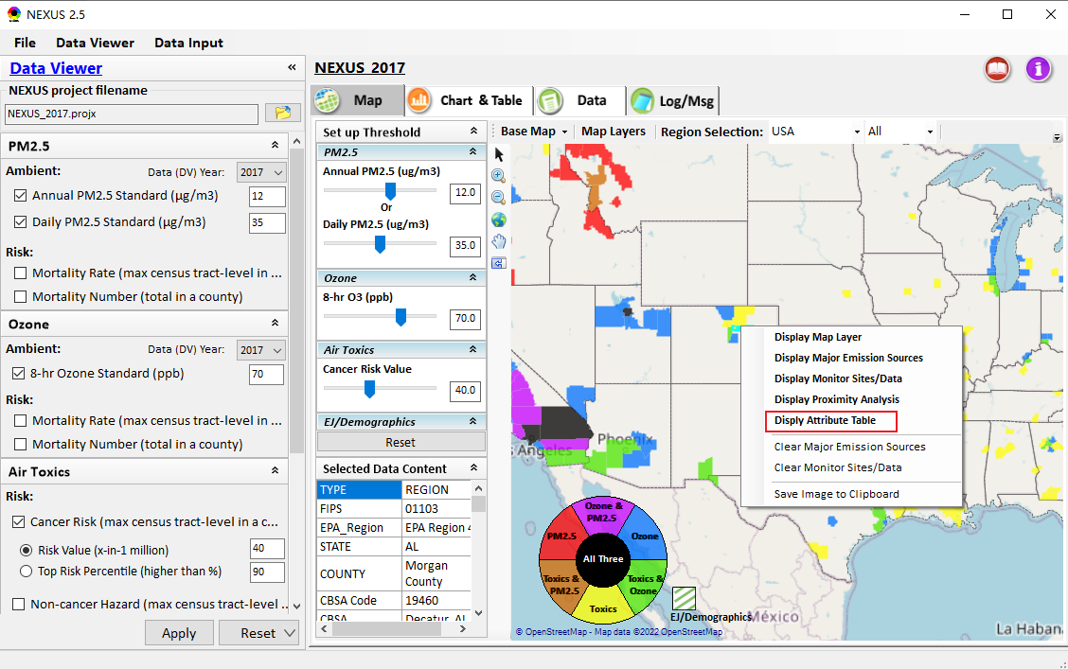
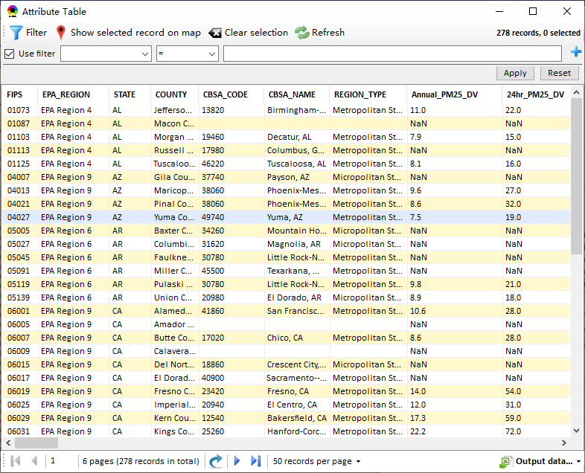
NEXUS Update: “Attribute Table” (1)
“Attribute Table” provides information of “counties” displayed. This table will display “census tract” information under “Proximity analysis” module.
“Right-click” map to select “Display Attribute Table ” to launch “Attribute Table”
26

Slide 27
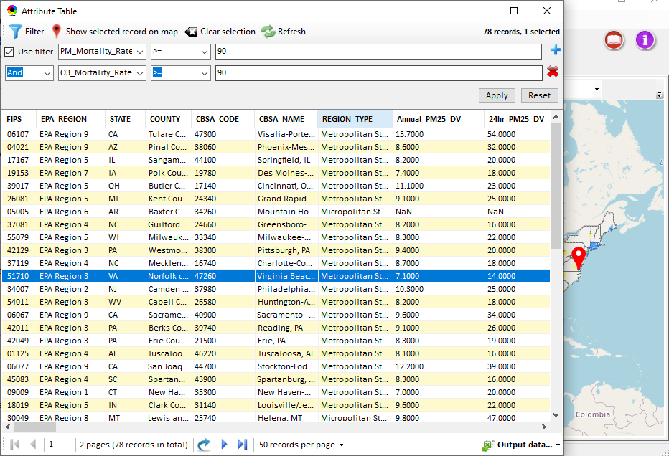
NEXUS Update: “Attribute Table” (2)
Provide “filter/search/export functions
Click “+” to add filters; Click “x” to remove current filter;
Click to show/hide Filter settings
Click to show selected record on map
Click a “record” to link and display its location & info.
Click “Reset” to clear all filter criteria
Show specified records per page.
Click to output data as Excel file
27

Slide 28
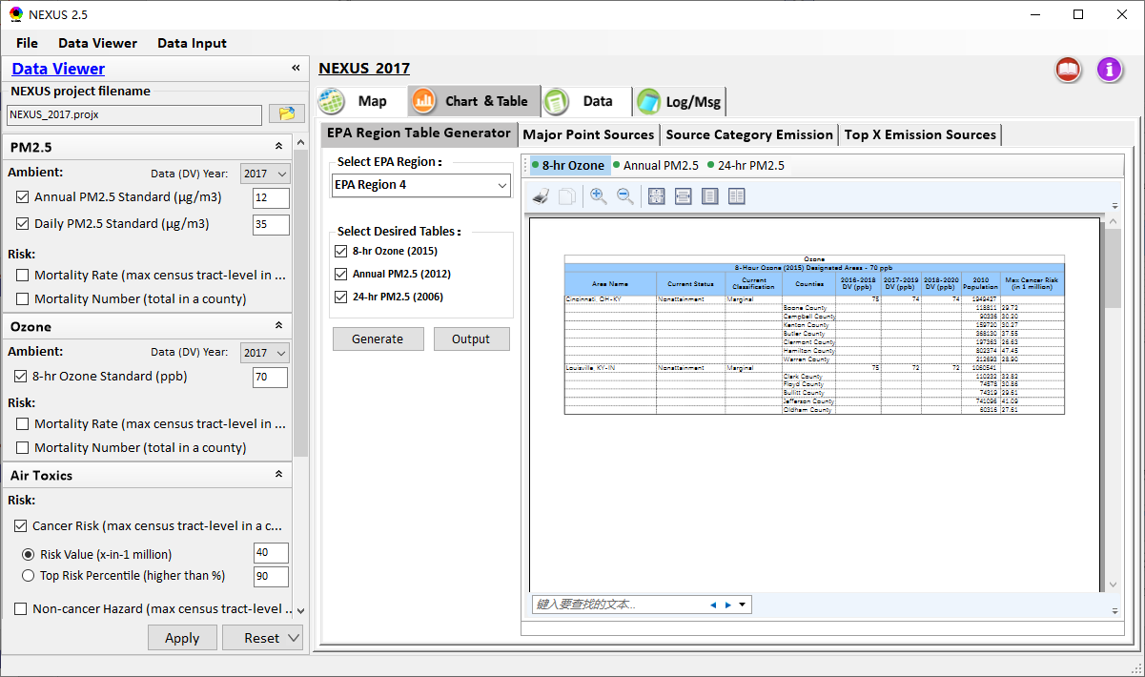
Data Viewer: EPA Region Table Generator
“EPA Region Table Generator” provides attainment status of O3 and PM2.5 and their DVs; also allows to select any EPA region based on data updated to 2020.
28

Slide 29
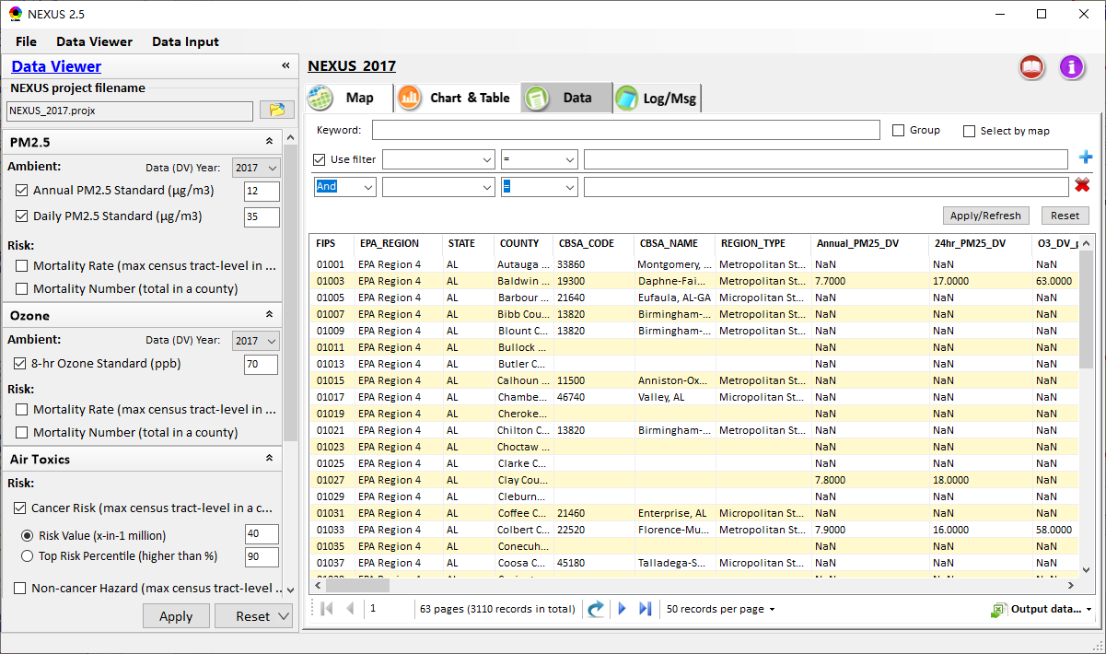
Data Viewer: Data Search & Filter
Click “+” to add filters; Click “x” to remove current filter;
Click the “Select by map” to get the information of counties which are displayed on “Map” module
Show specified records per page.
Click “Output data…” to output current page records or all records
29

Slide 30
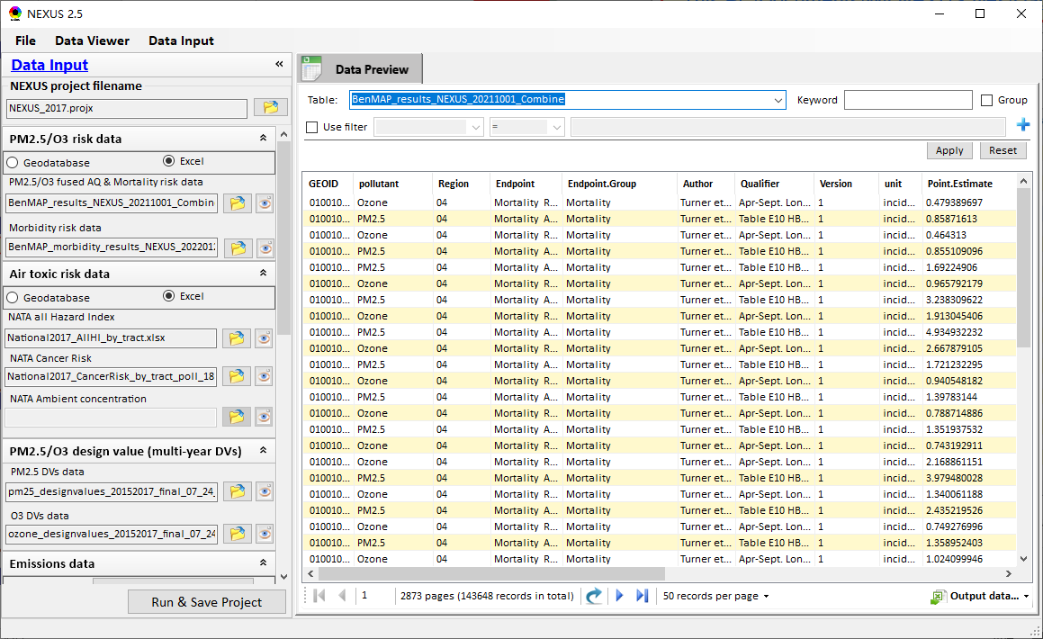
Data Input Module: Data Preview
“Transparency” & “Open-Source”:
All NEXUS input/output data files are available under:
“This PC\Documents\My NEXUS files\Data (\Result)”
Check to use filter to query data
Select a table to view if there are multiple tables in the selected data source file
Click to change input data file
Click to view data
Click to run & save project
30

Slide 31
NEXUS update:
Proximity Analysis
Module
(Census tract-level)
31

Slide 32
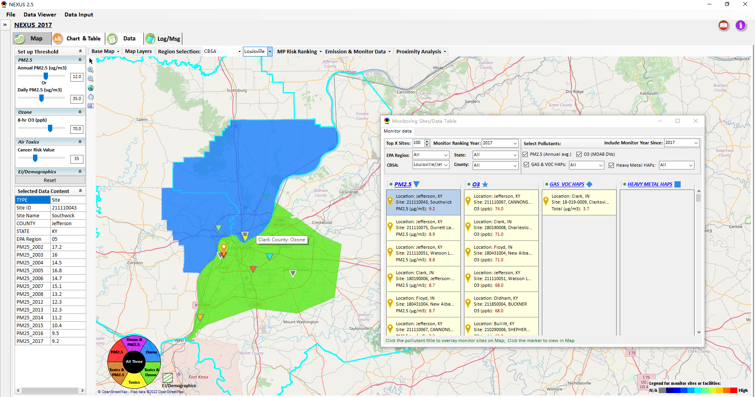
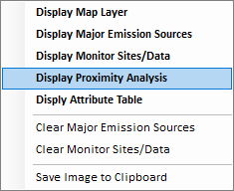
Two ways navigate to Proximity Analysis Module
Click any monitor site, facility or county, and then “right-click” to select “Display Proximity Analysis”.
Or double click any monitor site or facility to launch “Proximity Analysis” module.
32

Slide 33

Proximity Analysis Module: Overlaying Map
“Set up Threshold” panel (similar to Data Viewer module) allows to identity those geographic areas exceeding the selected thresholds.
Check/un-check to display/hide overlaying map of selected metrics
Allow to select AQ mortality or morbidity risks, AQ concentration and EJ/demographic indicators and display overlaying map.
33

Slide 34
Proximity Analysis Module: Overlaying Map
Click “Reset” button to reset all values to default (or to a specified %tile if all indicators are selected in %tile)
Provide a “toggle” choice to select “Risk %tile” or “Risk value”
34

Slide 35


Proximity Analysis Module: Configure Color & Transparency
Move “Slider bar” to select desired “Radius of analysis”
Click any “color tile” to configure color legend & transparency
35

Slide 36


Proximity Analysis Module: Summary Plot & Summary Table (1)
Create “Summary Plot” and “Summary Table” for a selected census tract, monitor site or emitting facility
Summary Plot
Summary Table
36

Slide 37


Proximity Analysis Module: Summary Plot & Summary Table (2)
Summary table
Summary plot
Set “Radius of analysis” and threshold of air toxics to show summary results for selected site(s) within radius
Click to select the desired scale of highlighted numbers
Click “Output” button to export summary table to an Excel file (*.xlsx)
List top 3 risk drivers within radius of sites
Select one or more indicators to plot summary results for selected site(s) within radius, county/CBSA/State/EPA Region and Nation avg.
37

Slide 38





Proximity Analysis Module: “Select Sites” Functions (1)
Click “Select Sites” to select one or a group of monitor sites, facilities, census tracts, or user-defined locations under “Select Sites” pop-up window
38

Slide 39




Proximity Analysis Module: “Select Sites” Functions (2)
Click the “Output” button to export to an Excel file.
Include only census tracts falling within the area of specified radius, with an area ratio larger than x% (10% by default)
Select all
Click the “Create individual Sites” or “Create National Sites Table” to provide proximity analysis for individual sites
National & State avg. table
National table for all selected individual sites
39

Slide 40


Proximity Analysis Module: “Select Sites” Functions (3)
Configure
color legend:
1. Click to select the desired scale of highlighted numbers
2. Set max. & min. values and then click the “Rebuild” button to rebuild the color legend
3. Customize the numerical range for each color legend
Check/uncheck to display/ hide highlighted colors
4. Click “Apply” or “OK” button to apply new setting
40

Slide 41




Proximity Analysis Module: “Group” Summary Plot & Table
Summary plot & table for a group of census tracts, monitor sites, facilities or locations (latitude/longitude)
Summary table
①Click “Select Sites”
④Click “Summary Table” or “Summary Plot”
Select sites
② Select a group of sites
③Click “Apply”
Summary Plot
41

Slide 42


Proximity Analysis Module: Display Site information
Click a facility or monitoring site or a census tract to show the detail information
42

Slide 43
NEXUS 3.0
Quick Tutorial Slides
End
43

