Slide 1
NEXUS Briefing
for
Administrator Regan
January 11, 2023
Internal, Deliberative

Slide 2
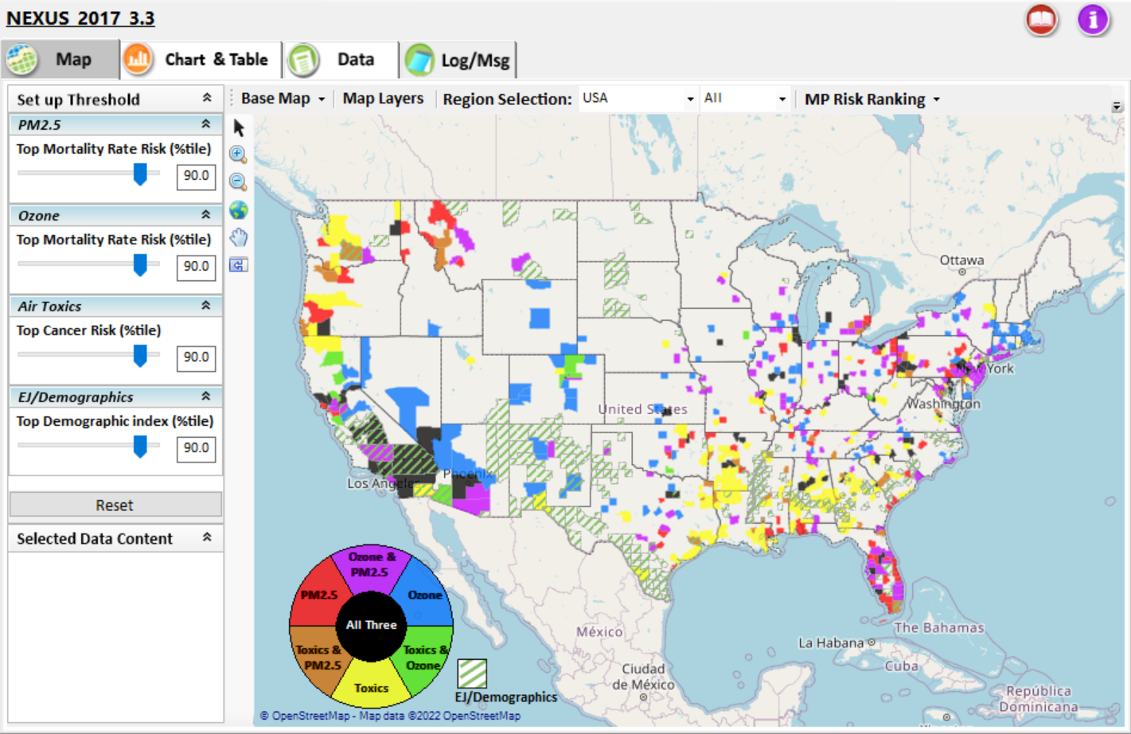
Purpose and Outline
Share the NEXUS Multi-Pollutant Advanced Screening Tool and how it could inform multi-pollutant planning and environmental justice issues generally and in the context of IRA discussions
NEXUS Background
Data Inputs and Major Functions
Current and Potential Uses
Example NEXUS Use
NEXUS Engagement
EJSCREEN, CEJEST & NEXUS
NEXUS and IRA
Climate Pollution Reduction Grants
Air Monitoring & Screening
Next Steps
Demo

Slide 3
NEXUS Background
An advanced screening tool for multi-pollutant (MP) air quality planning that allows for accounting of MP risks and EJ/demographic analysis
Integrates a suite of MP data into a single platform to allow national and areal overlay mapping and analysis of MP ambient and risk data
Currently for internal EPA use only
Beta version being tested by EPA regions
Working on a web-based version that could be released to the public later in 2023
Will finalize necessary updates/improvements before the NEXUS tool is released to the public, e.g., data layers, capabilities, etc
Notes:
Under first sub-bullet, will note additional information about the Regional Beta Testing Team
Convened a group of OAR and regional office members to discuss the benefit of NEXUS and to consider its use on a routine basis to assist in their job duties.
Requested feedback to inform the direction of future tool development and make updates/additions that are most beneficial to the Regions for their purposes with focus on multi-pollutant approaches to air quality management
Will also note 50+ briefings since fall 2020, and a few examples from below:
OAQPS, ORD, OAR, OAP, OP, OEJ, OGC, ECRCO, OAPPS, OTAQ
Regional ADDs & APMs
CAAAC & AAPCA

Slide 4
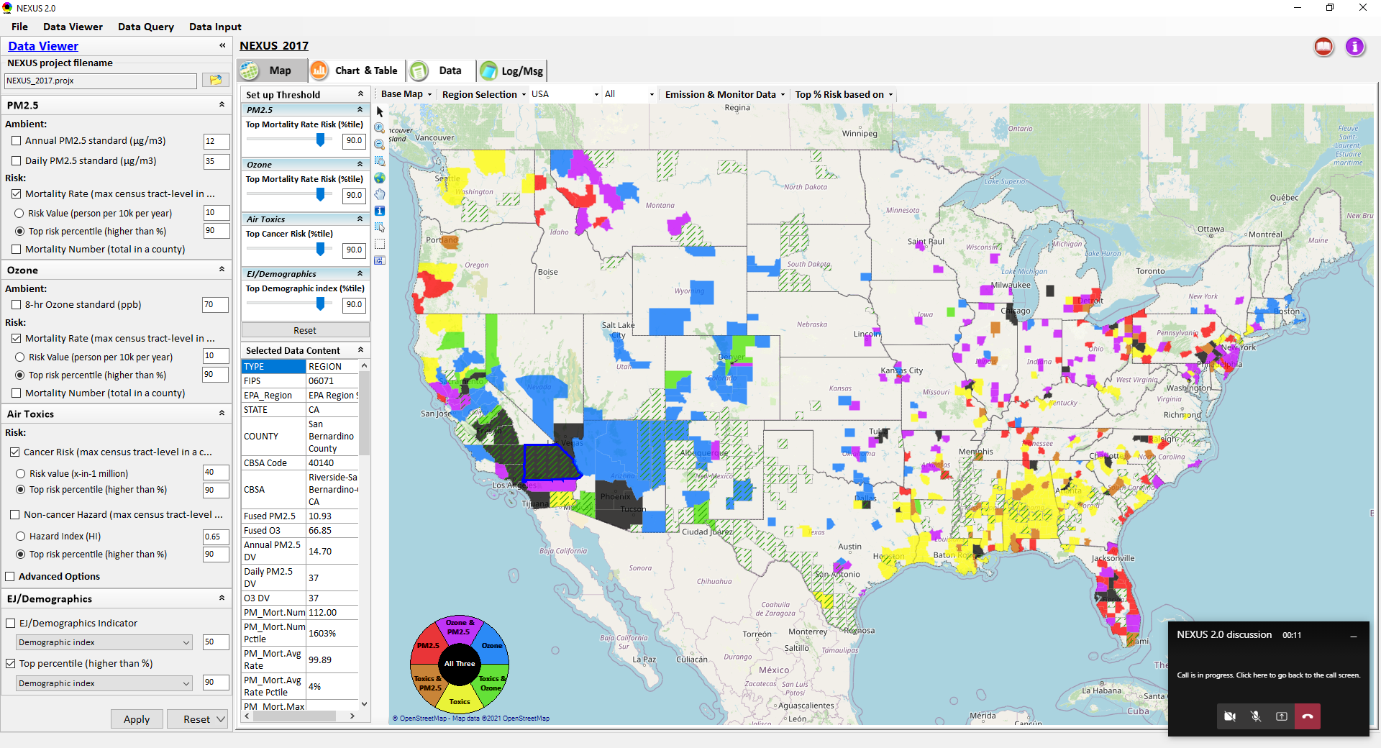
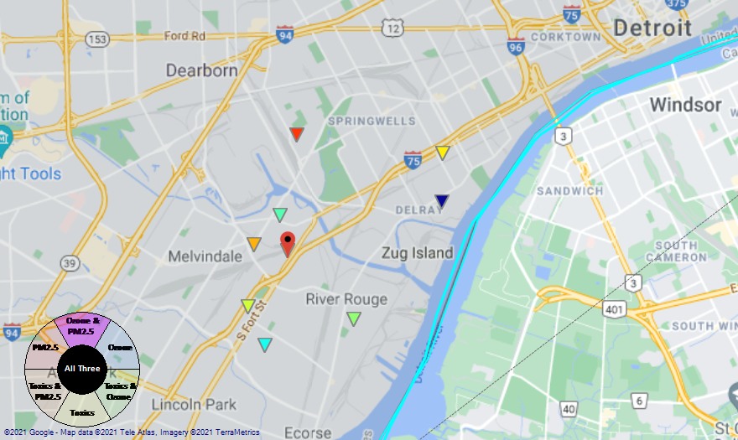
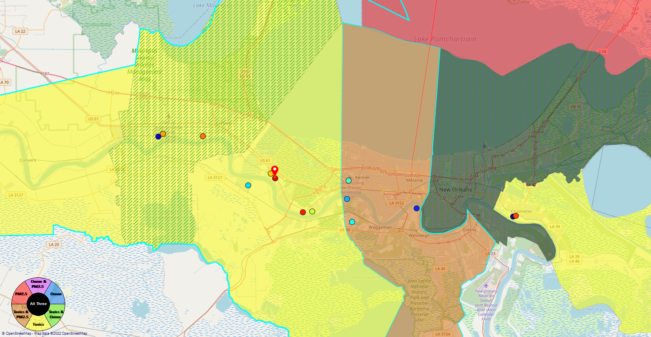
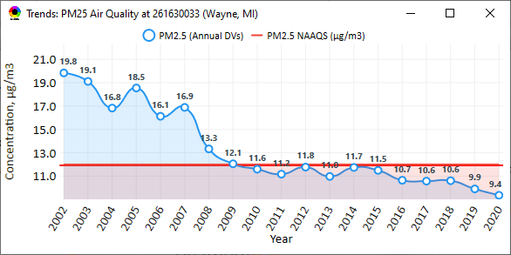
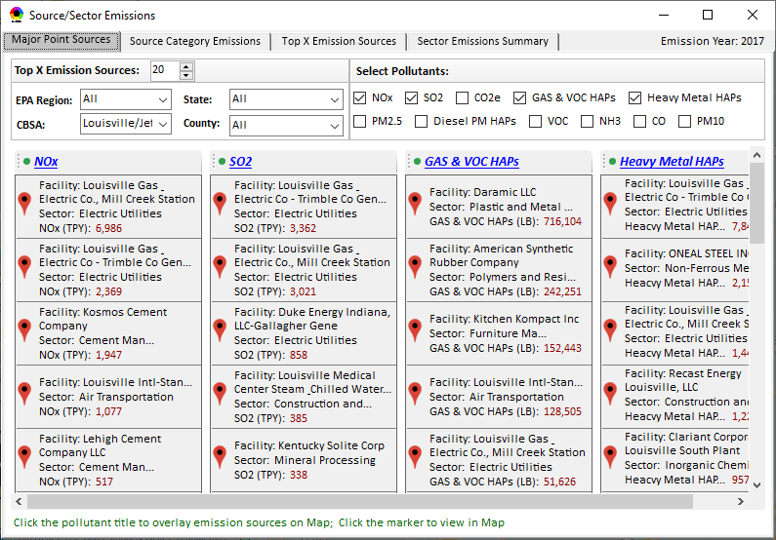
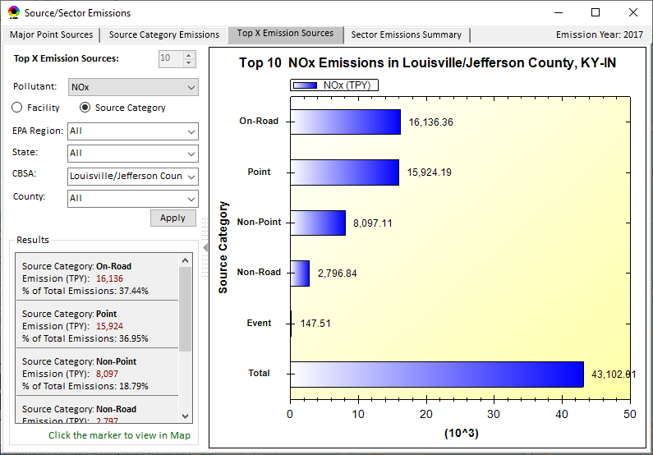
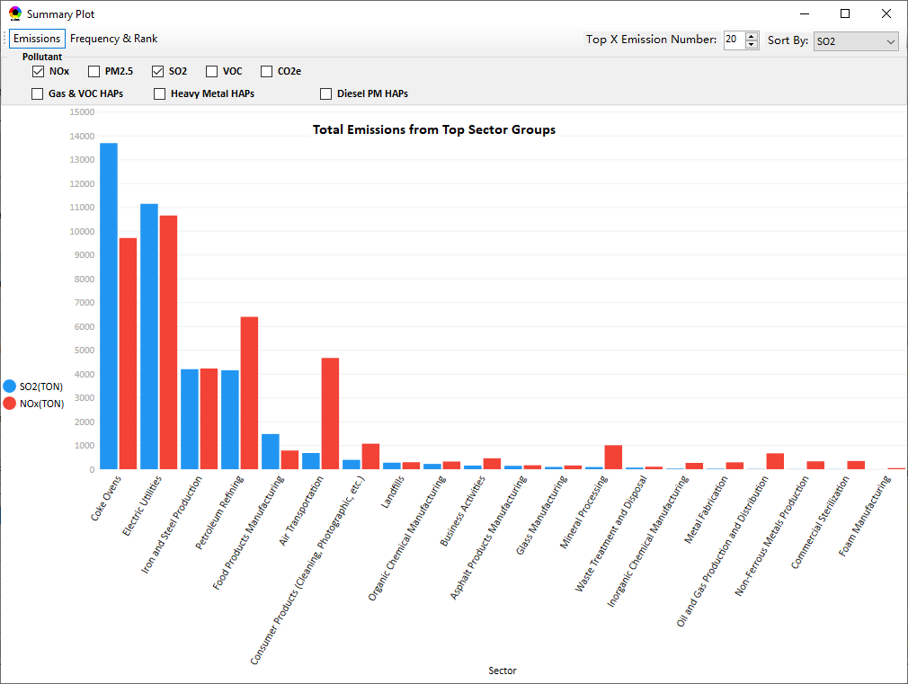
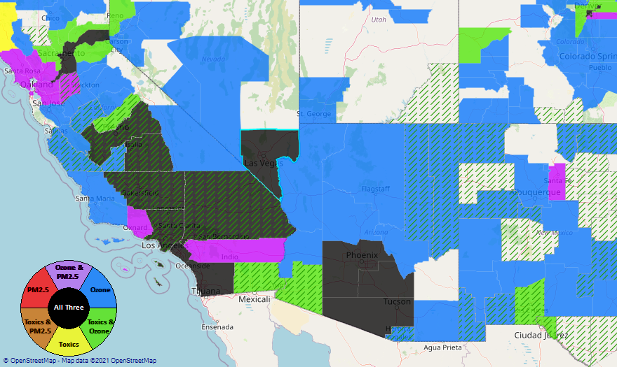
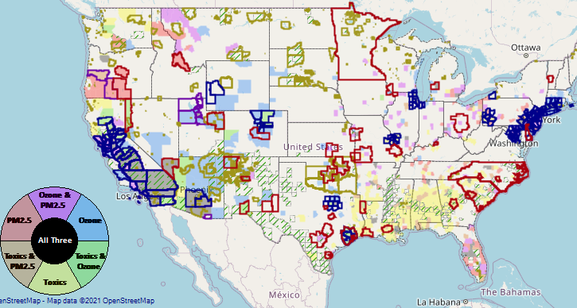
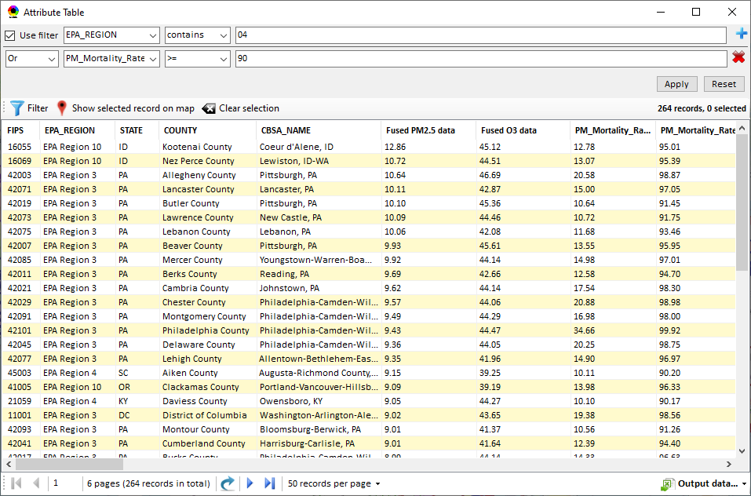
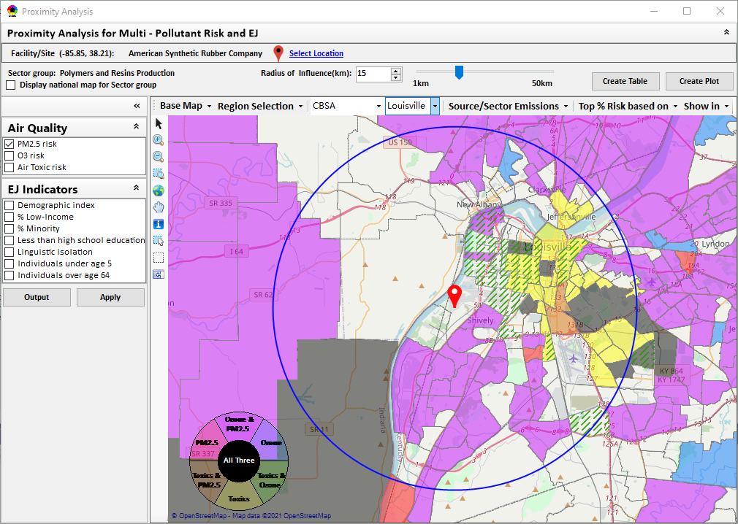
NEXUS: Data Inputs and Major Functions
O₃ & PM_{2.5}
Ambient/Design Value
(2012-2020)
(County-level)
Multi-Pollutant
Ambient and/or Risk National & Areal Mapping
Display Monitoring Sites & Trend Data
O₃, PM_{2.5} & Air Toxics Risk Data &
Conc. (fused AQ) Data
(2019/2018/2017)
(Census tract-level)
Display Major Point Emissions Sites/Data
Provide Source Category Emissions
NEXUS
O₃, PM_{2.5} & Air Toxics Monitoring Data
(2002-2020)
Provide Sector Emissions Summary
NEI County &
Facility Emissions
(2017 & 2014)
Include EJ/Demographic Indicators
Map Overlay w/ NAA, Advance Area, Class-I Area, Tribal Area, CEJST Area
Environmental Justice & Demographic Data
(from EJSCREEN 2.1)
Data Query, Search, Filter & Export
NAA, Advance
Area, Class-I Area,
Tribal Area, CEJST Area
Proximity Screening Analysis
4

Slide 5
Current and Potential Uses of NEXUS
MP Risk Prioritization (current)
Develop list of high MP risk areas to share with Regions and engage in potential MP area projects/efforts to reduce air emissions/exposure in these communities
Monitoring Assessments (current & potential)
Assess monitoring networks to determine where sites are located in/near communities with potential EJ concerns
Identifying gaps in monitoring network near overburdened communities
Input and review state’s Annual Monitoring Network Plans
Informing outreach and new source permitting (potential)
EJ screening for outreach purposes and for EJ assessments in federal permitting
ADVANCE Area/Regional SIP Planning (potential)
Develop conceptual model information consistent with EPA’s SIP modeling guidance that lays out the nature of air quality within the area
Inform IRA planning efforts

Slide 6
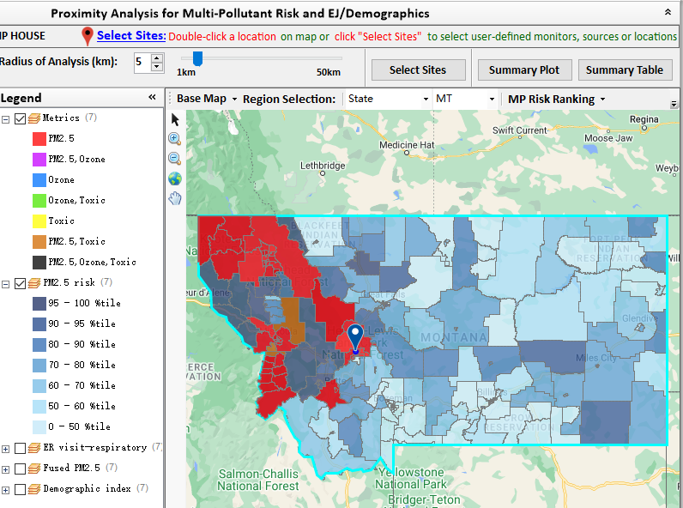
Example NEXUS Use: Assess PM_{2.5} Network
NEXUS used by OAQPS monitoring group to inform Justice40 criteria recommendations for the National PM_{2.5} Monitoring Network
Goal – determine if ≥ 40% of current PM_{2.5} network serves EJ/at-risk communities
Process – used NEXUS proximity analysis to evaluate areas around monitors or sources to determine demographics and pollutant risk
Outcome –
Examined numerous combinations of demographic index, low income, minority, and PM_{2.5} risk criteria
Preliminary findings suggest that the current network meets the Justice 40 goals
Information has been shared with technical staff in Regions
Similar analysis can be used to help inform future monitor siting considerations
Notes:
Note to Erika – confirmed with Tim that this was not used to inform ARP funding

Slide 7
EJ Screening: EJSCREEN, CEJEST & NEXUS
EJSCREEN
EJ screening and mapping tool that combines environmental and demographic data to highlight areas where vulnerable populations may be disproportionately impacted by pollution
CEJEST
An interactive map with indicators of burdens to identify communities that are overburdened and underserved
NEXUS
Advanced multi-pollutant screening tool for air quality planning
Has the unique ability to identify overburdened communities affected by multiple pollutants and/or health risks
Ability to view the combination of demographics and specific air related health risks
Data relevant for air quality planning purposes –
Emissions and source data for O₃, PM_{2.5}, air toxics and GHGs
Modeled concentration data for O3, PM2.5 and air toxics
Risk data for O₃, PM_{2.5} and air toxics
Monitoring data for O₃, PM_{2.5} and air toxics
Notes:
Comparison of 3 analytical tools used for EJ analysis

Slide 8
NEXUS & EJSCREEN
EJ Layers
Hazardous waste
EJ Grants
Water features
Places
Schools & Parks
Transportation
Boundaries
Prisons
Public Housing
Subsidized Housing
Climate
Sites reporting to the EPA
Superfund (NPL)
RSEI
Environmental Indicators
Wastewater Discharge Indicator
Hazardous Waste Proximity
Superfund Proximity
Lead Paint Indicator
Traffic Proximity
RMP Proximity
Ozone and PM_{2.5}
Emissions and source data
Monitoring data
Fused concentration data
Mortality & morbidity risk data
Air Toxics
Emissions and source data
Monitoring data
Modeled concentration data
AirToxScreen cancer & noncancer risk data for air toxic species
GHG emissions
NEI’s GHG (CO2e) emissions
Facilities and county level
Source categories (point, on-road, non-road, etc.)
Common Information
Tribal Areas
Nonattainment Areas
Environmental Indicators*
AirToxScreen Cancer Risk
AirToxScreen Noncancer Risk
Ozone Fused Concentrations
PM_{2.5} Fused Concentrations
Demographic Indicators
People of Color Population
Less Than HS Educated
Low Income Population
Linguistically Isolated
Demographic Index
Under Age 5
Over Age 64
*Provided to OEJ by OAQPS (AQAD & HEID)

Slide 9
NEXUS and IRA
NEXUS could be used internally by the regions and headquarters to evaluate grant applications, particularly those with air quality implications
Once publicly available, NEXUS could be used by SLTs to assist with development of grant applications and plans

Slide 10
NEXUS and IRA – Climate Pollution Reduction Grants
Climate Pollution Reduction Grants
NEXUS could be used to review climate plans and develop/evaluate implementation grant applications
NEXUS could help answer questions such as…
Are there possible environmental justice or overburdened communities in or near the proposed area or sources?
Are there elevated health risks from air pollutants in the area proposed to receive funding?
How have pollutant levels been trending in and around the proposed area?
Are there potential co-benefits of controlling large GHG emitting facilities?
Are sources identified in the plan in or near a current NAA, Advance area, Class I area, or Tribal area?

Slide 11
NEXUS and IRA – Air Monitoring & Screening
Funding to Address Air Pollution
NEXUS could be used to develop/evaluate grant applications
NEXUS could help answer questions such as…
What air monitoring is taking place in or near the community?
How have pollutant levels been trending in and around the proposed area?
Are there increased health risks from pollutants that are not being monitored in the area proposed to receive funding?
Is the proposed area receiving funding an underserved community that does not currently have air monitoring?
Is the area in or near a current NAA, Advance area, Class I area, or Tribal area?

Slide 12
Next Steps
Continue discussions across OAR on NEXUS, particularly with OAP on incorporating climate risk indicators
Focus on climate indicators most relevant to air quality planning
Could advise IRA Climate Pollution Reduction Grants
Update to 2018/2019 MP platform (O₃, PM_{2.5}, and Air Toxics data)
Begin development of a web-based NEXUS version
Work towards making NEXUS publicly available
Partner within EPA on use of NEXUS for programmatic purposes

Slide 13
Live Demo

