Slide 1
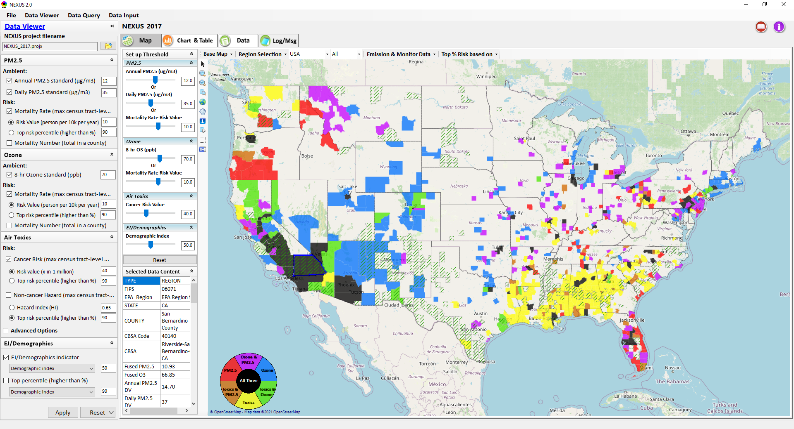
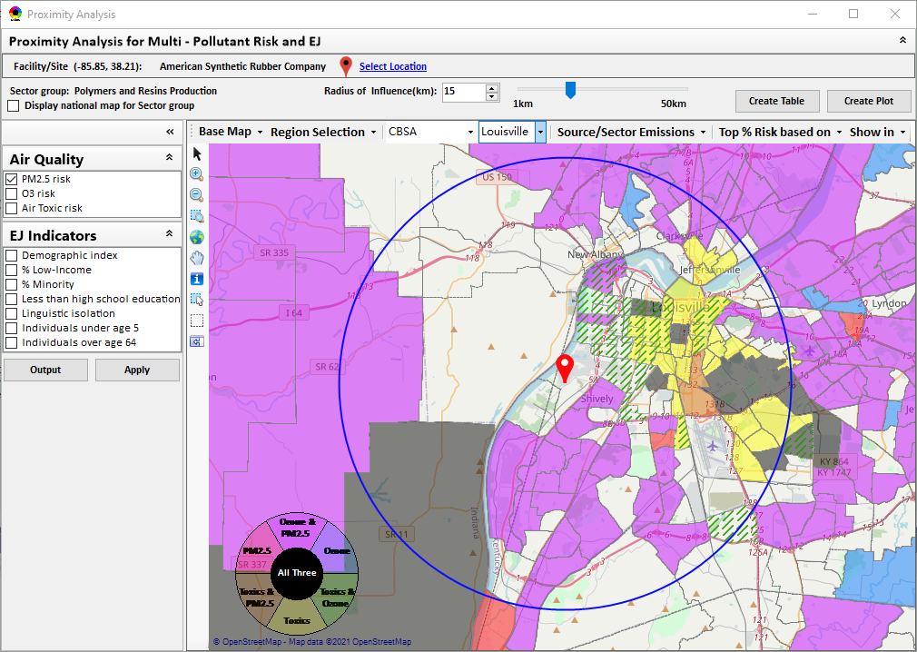
“NEXUS” Multi-Pollutant Advanced Screening Tool Development: Status Update & Live Demo
Data Viewer: National/Regional Level
Proximity Analysis: Community Level
“NEXUS 2.3” can be downloaded at
EPA’s new FTP site: https://gaftp.epa.gov/aqmg/cjang/NEXUS/MP_Team/NEXUS 2.3/*
Carey Jang, AQAD/Air Quality Modeling Group
AQ Model Apps Team meeting, Feb. 9, 2022

Slide 2
NEXUS Overview
“NEXUS” is an advanced screening tool for multi-pollutant (MP) risks and EJ/Demographic analysis developed by OAQPS’s MP team (further details see attached “NEXUS Overview” doc)
“NEXUS” integrates a suite of MP data, including emissions, monitoring, modeling, fused AQ data and health risk data for PM2.5, O3 & air toxics as well as EJ/demographic data, into one single platform to allow national and areal overlay mapping & analysis of MP ambient & risk data
“NEXUS” provides MP analysis across from national level “Phase 1” to regional (EPA region/State/CBSA) level “Phase 2”, and now down to community level “Phase 3” (Proximity analysis” in census tract-level)
We expect to use this tool in conjunction with Regions and identify areas that would potentially benefit most from MP approaches to reduce emissions (including current NA areas)
We also expect that it can have additional value-added uses across the Office for Air Toxics, Environmental Justice and other programs
The NEXUS tool will essentially provide a ‘conceptual model’ of an area’s MP issues to facilitate engagement with state/local/tribal agencies & community stakeholder groups
2

Slide 3
Modeling Guidance for Demonstrating Air Quality Goals for Ozone, PM2.5, and Regional Haze (2018)
“2.0 Building a Model Platform” and “2.1 Conceptual Description (Building a Conceptual Model Platform)”
Introduce the general nature of the air quality problem addressed by the conceptual model:
o What are the pollutants of concern in the area?
o What are the current air quality levels in the area?
o What is the attainment/nonattainment status of the area?
o What is the geographical scope of poor air quality?
o What is the temporal scope of poor air quality?
o What are the air quality trends in the area? Is the problem getting better or worse?
o What are the suspected mechanisms for formation of poor air quality levels?
o What are the sources of emissions that may contribute to poor air quality?
o Are there unique meteorological influences on local air quality levels?
Describe the ambient monitoring network used for the conceptual model:
o Develop a map of monitor sites and types (e.g., FRM, FEM, CSN, IMPROVE, CASTNET,
etc.).
o Describe characteristics of individual monitoring sites (scale, frequency, etc.).
• Describe the status and trends of air quality in the area:
o Summarize the relevant monitoring data for the air quality problem being studied.
o Identify locations that are in violation of the NAAQS.
o Describe the spatial pattern in pollutant and precursor pollutant levels.
o Describe the temporal pattern in pollutant and precursor pollutant levels.
o Describe the annual trends in concentrations over the period of interest.
o If appropriate, develop fused ambient/model surfaces to fill any gaps within the
monitoring network.
Investigate possible relationships between emissions and air quality:
o Examine emissions estimates for the main sector/source categories.
o Compare emission trends for annual and or seasonal/episodic periods to
corresponding air quality trends.
o Identify key emission sources or source categories.
o Assess the historical effectiveness of control programs.
o Consider how future emissions growth or reductions may affect air quality.
o List control programs that are in place, or will soon be implemented, that may
impact emissions sources in the area.
Synthesize all the relevant information into a detailed conceptual model:
o Aggregate all elements of the conceptual model and provide the key findings
resulting from the analyses completed.
o Characterize the potential factors that influence air quality in the area and where
possible rank the importance of those influences.
o Identify issues that require further investigation, either in terms of data collection or
chemical transport modeling.
o Discuss how the subsequent SIP modeling and associated protocol is impacted by
this conceptual description.
Investigate possible relationships between meteorology and air quality (AQ):
o Describe meteorological characteristics on poor air quality days (e.g., wind speed/direction, temperatures, relative humidity levels, inversion indicators, etc.).
o Identify any distinct meteorological phenomena that coincide with poor air quality days.
o Prepare pollution roses, HYSPLIT back-trajectories (Draxler, 1998), or any other relevant analysis needed to link poor air quality days to specific meteorological patterns and sources of transported pollutants.
o Assess the impact from pollutant transport into area based on meteorological data and ambient air quality data.
In Line with NEXUS Tool’s Current
Objectives & Capabilities
3

Slide 4
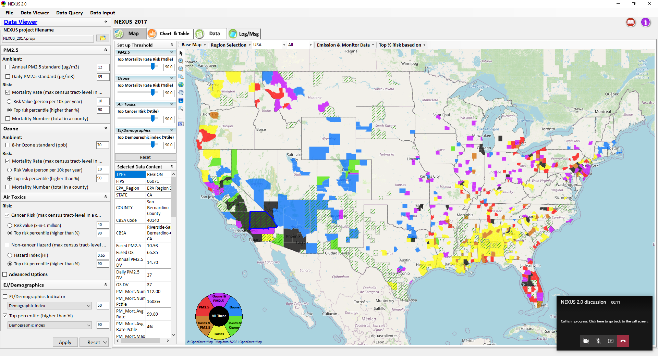
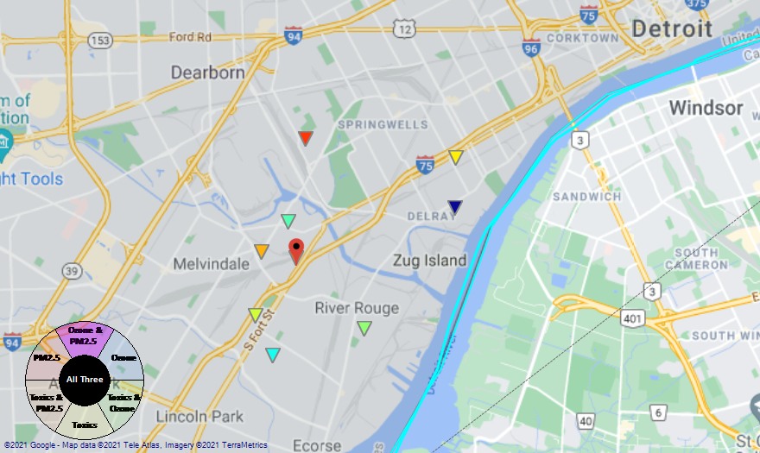
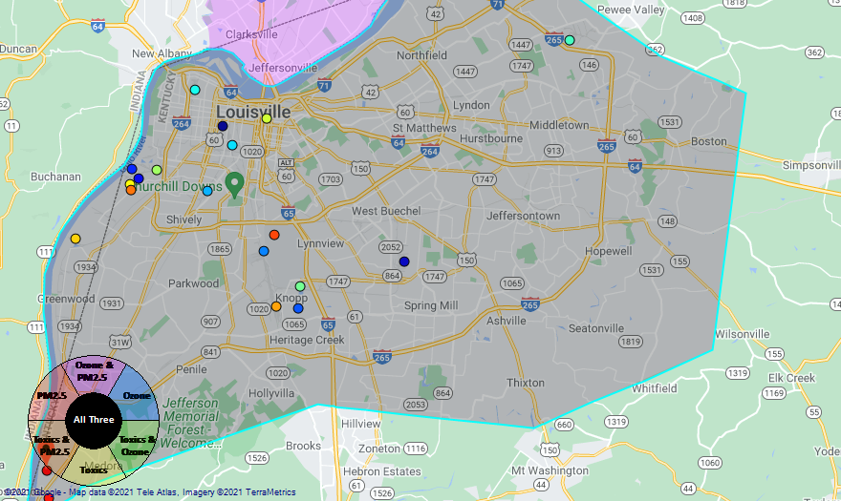
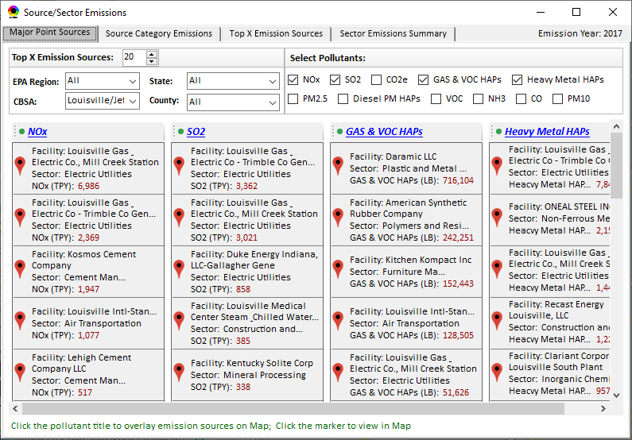
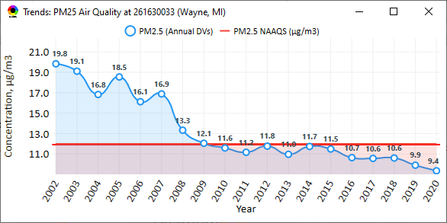
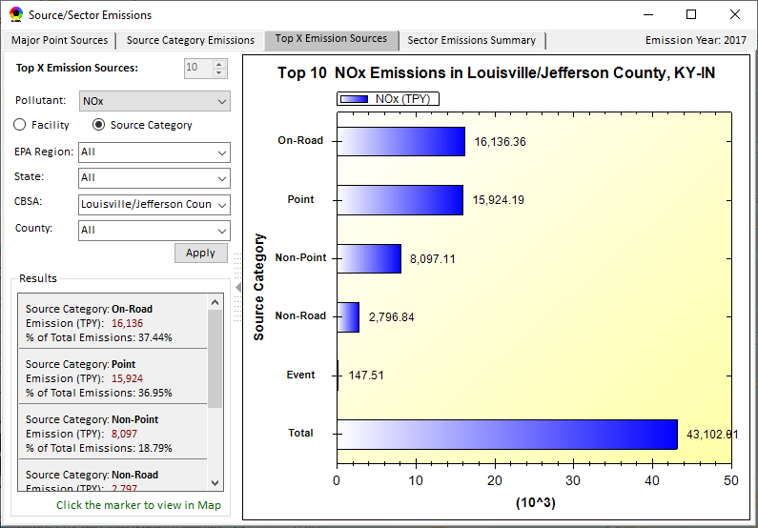
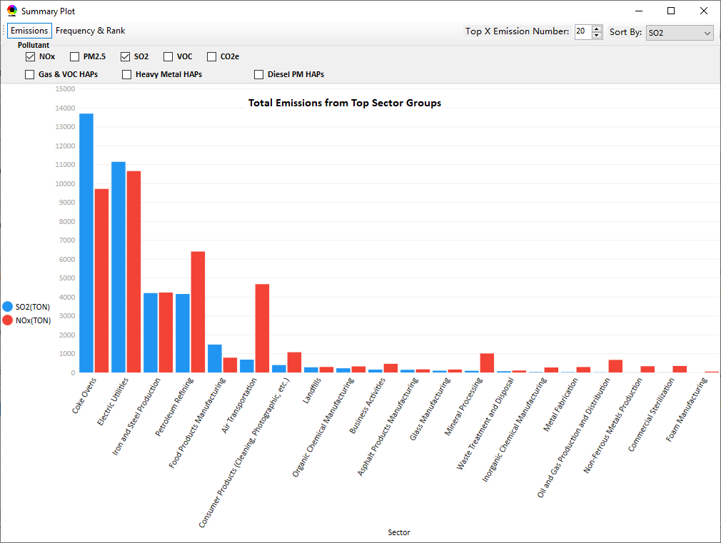
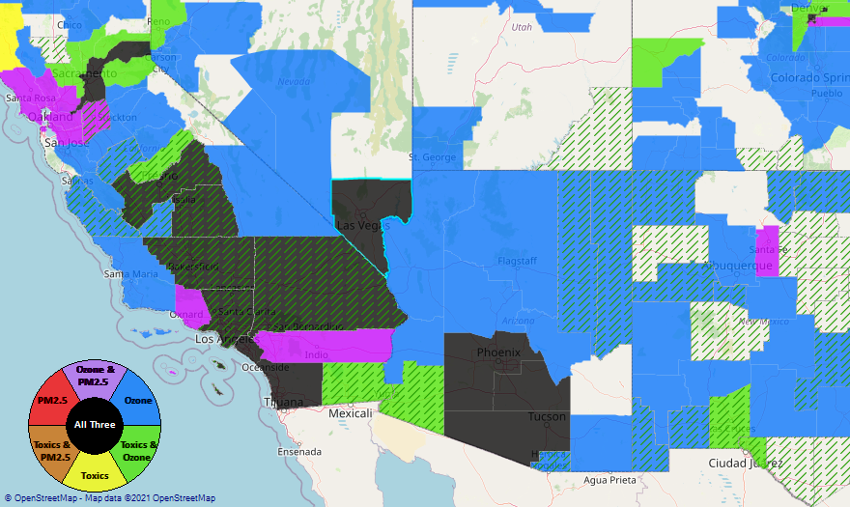
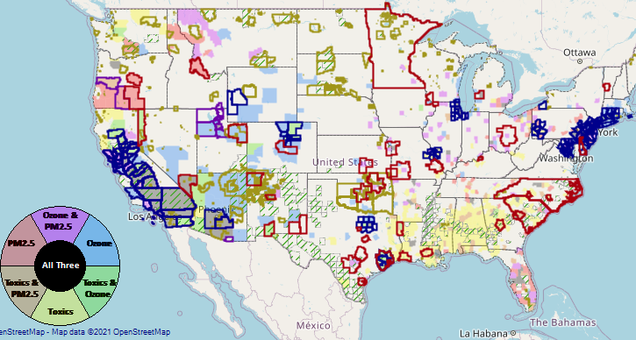
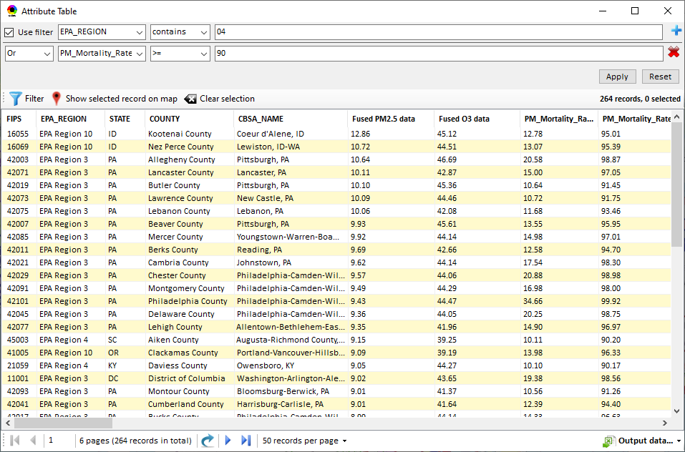
NEXUS: Data Inputs and Major Functions
O₃ & PM_{2.5}
Ambient/Design Value
(2012-2020)
(County-level)
Multi-Pollutant
Ambient and/or Risk National & Areal Mapping
Display Monitoring Sites & Trend Data
O₃, PM_{2.5} & Air Toxics Risk Data &
Conc. (fused AQ) Data
(2017 & 2014)
(Census tract-level)
Display Major Point Emissions Sites/Data
Provide Source Category Emissions
NEXUS
O₃, PM_{2.5} & Air Toxics Monitoring Data
(2002-2020 & -2018)
Provide Sector Emissions Summary
NEI County &
Facility Emissions
(2017 & 2014)
Include EJ/Demographic Indicators
Map Overlay with NAA, Advance Area, Class-I Area, or Tribal Area
Environmental Justice & Demographic Data
(from EJSCREEN)
Data Query, Search, Filter & Export
Advance Area
Class-I Area
Tribal Area
Proximity Screening Analysis (ongoing)

Slide 5
Briefings, Demos & Planned Outreach
Outreach with EPA Regional Offices
Feedback received by late January
Form a beta-testing group
Based on feedback received to date:
Update air quality risk data to 2017 (from 2014)
Plan to include climate risk indicators
Develop proximity analysis module for community-based MP & EJ analysis
9/25/2020– AQAD & HEID
11/3/2020 – MP Team
11/4/2020 – Air Toxics Group
12/10/2020 – AQPD
1/25/2021 – OID
1/28/2021 – SPPD
2/1/2021 – Peter/SMT
4/12/2021 – HEID & AQAD
5/17/2021 – Peter/SMT
5/24/2021 – MP Team
6/29/2021 – ORD
7/12/2021– HEID & AQAD
7/19/2021 – OID
8/10/2021– OAP
8/26/2021 – OAR
8/27/2021 - OP
8/30/2021 – OEJ
8/30/2021 - Region 4/Louisville
9/7/2021 – RO Air Division Directors
9/20/2021 – OAR Demo
10/14/2021 – OP/NCEE
11/2/2021 – RO APMs
11/8/2021- RO APMs Demo
TBD – MJOs
“Fascinating… phenomenal… I’m blown away!”
- Caroline Freeman (R4 ADD)
“Breathtaking… incredibly powerful… I feel like we discovered nuclear fusion!”
- Joe Goffman (OAR Acting AA)

Slide 6
NEXUS: Recent & Ongoing Development
NEXUS “1.5” (Jan. 2021) → NEXUS “2.0” (Sep. 2021) (version sent to APMs)
Upgraded Metrics (PM_{2.5}, O₃, Air Toxics + EJ/Demographics as 4th metric)
New/updated data inputs and functions:
EJ/Demographic data (from EJSCREEN), Advance areas, Tribal areas, Class-I areas, Attainment/DVs data, etc.
Updated 2017 emissions data (including GHG & Sector mapping)
“Source Category Emissions” module and “Sector Emissions Summary” module
Preliminary 2017 BenMAP risk data & draft “Monitoring sites/data” module
→ NEXUS “2.3” (Jan. 2022) (Demo version today: 2/09/2022)
(Download at: https://gaftp.epa.gov/Air/aqmg/cjang/NEXUS/MP_Team/NEXUS_2.2/ w/ quick tutorial PPT)
2017 updated BenMAP risk and fused data for PM & O3
2017 updated air toxics risk data
Upgraded “Monitoring sites/data” module
New “Proximity analysis module” for MP risk and EJ analysis
6

Slide 7
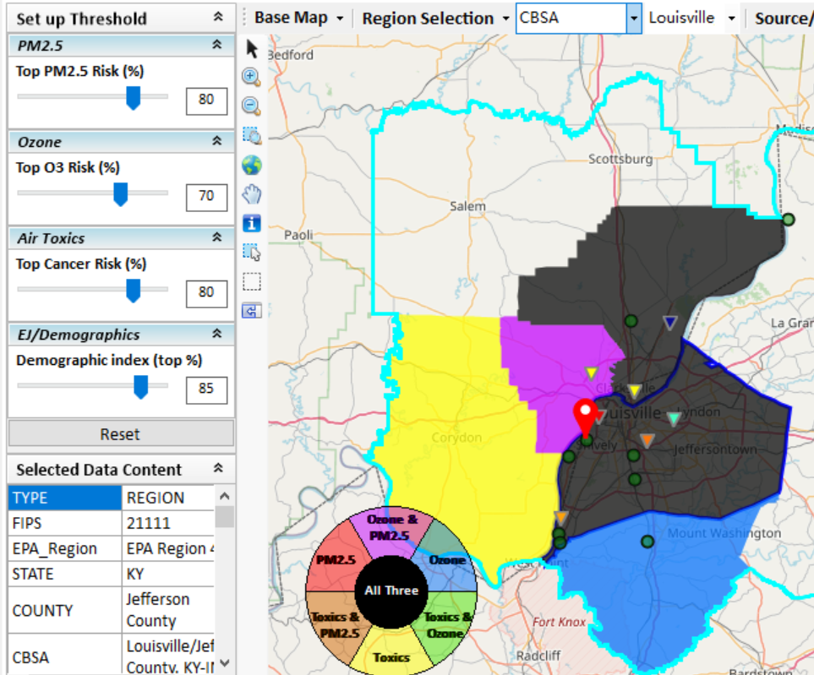
New “Proximity Analysis” Module in NEXUS
Previously in NEXUS
Proximity Analysis for MP Risks and EJ
County – level
Community (Census Tract) - level
7

Slide 8
Need for Proximity Screening in NEXUS
Proximity Screening Analysis helps answer:
What are the risks in close proximity to my monitor and/or community of interest?
What source(s) are in close proximity to my monitor and/or community of interest?
What are the demographics of communities in close proximity to monitor(s) and/or source(s) of interest?
How do the demographics of communities near my monitor/source compare to area/state/national averages?
How do the risks within communities near my monitor/source compare to area/state/national average?

Slide 9
“NEXUS” Advanced Screening Tool (Multi-pollutant risk & EJ analysis) Example of Potential NEXUS Application for Assessment of New Monitoring Sites
Briefing to AQAD/Air Quality Monitoring Group,, 1/11/2022

Slide 10
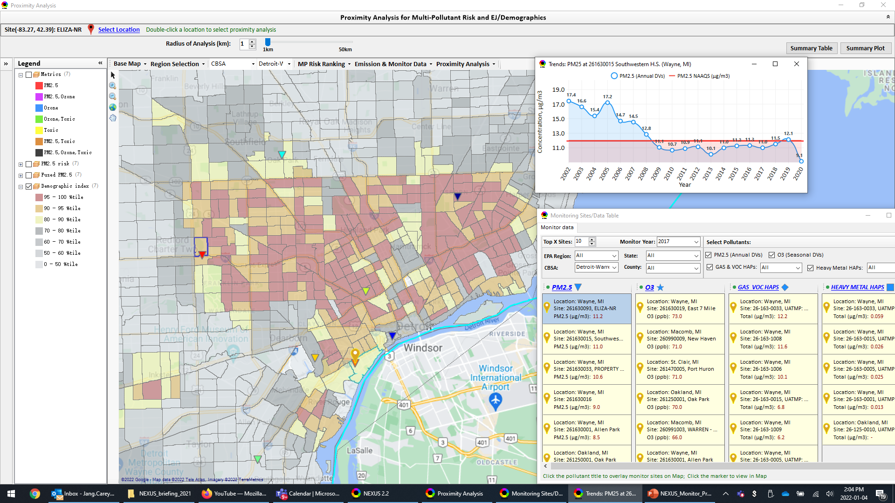
“Monitor Sites/Data” & Proximity Analysis: PM2.5 & EJ
Detroit
10

Slide 11
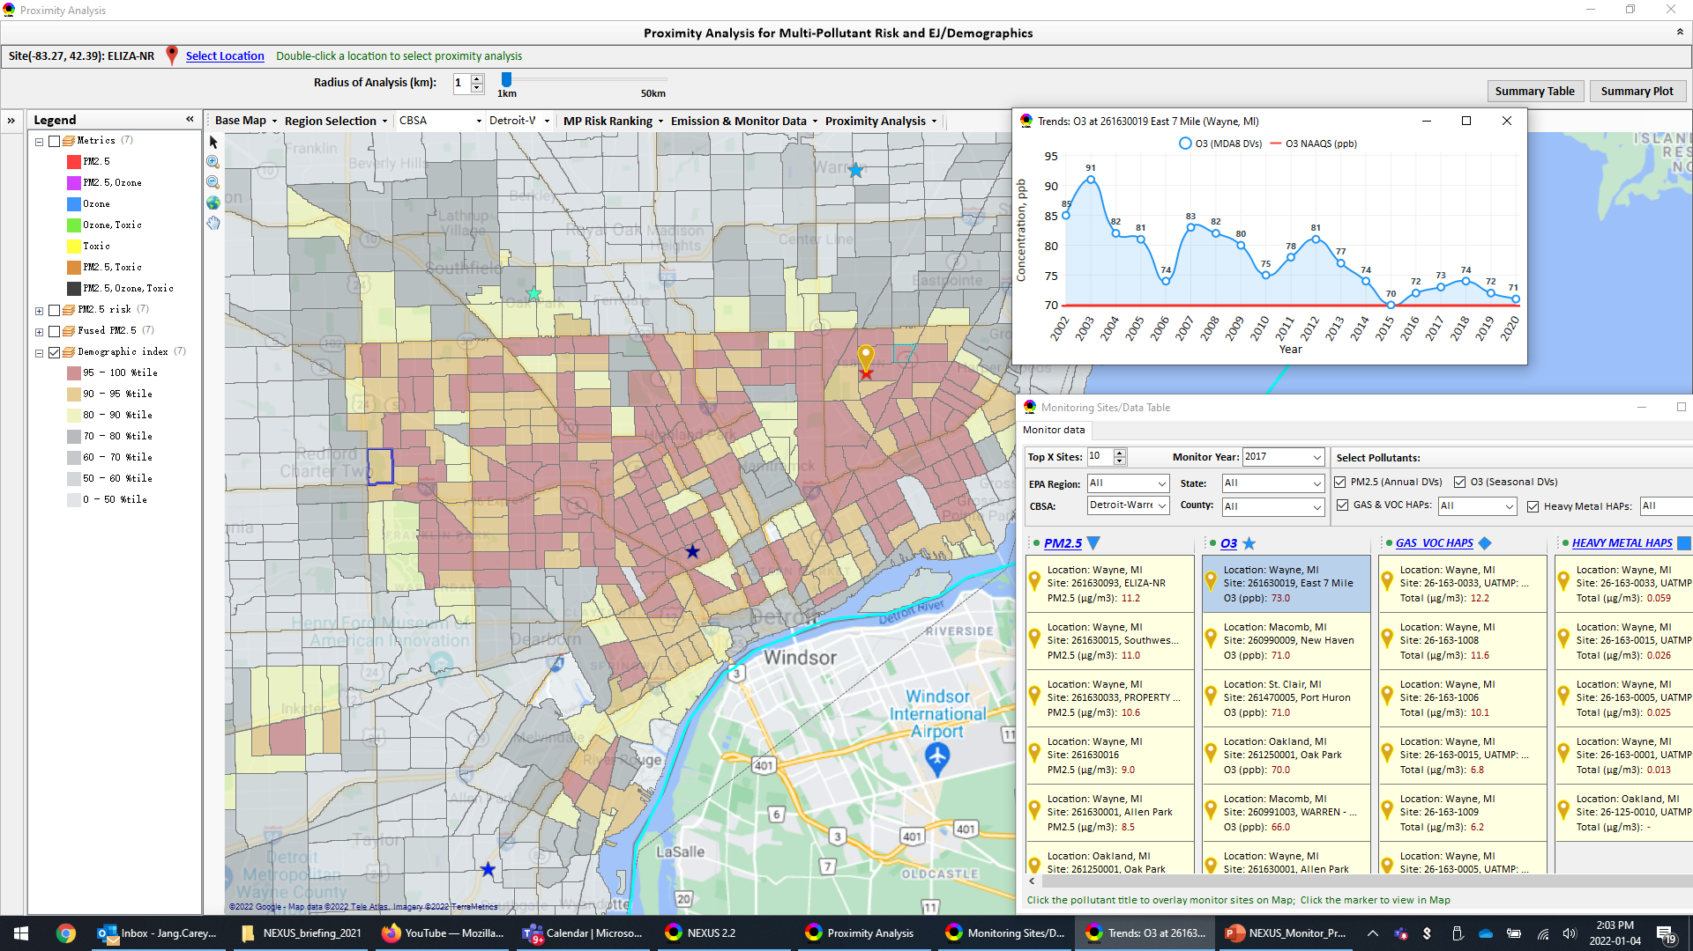
“Monitor Sites/Data” & Proximity Analysis: O3 & EJ
Detroit
11

Slide 12
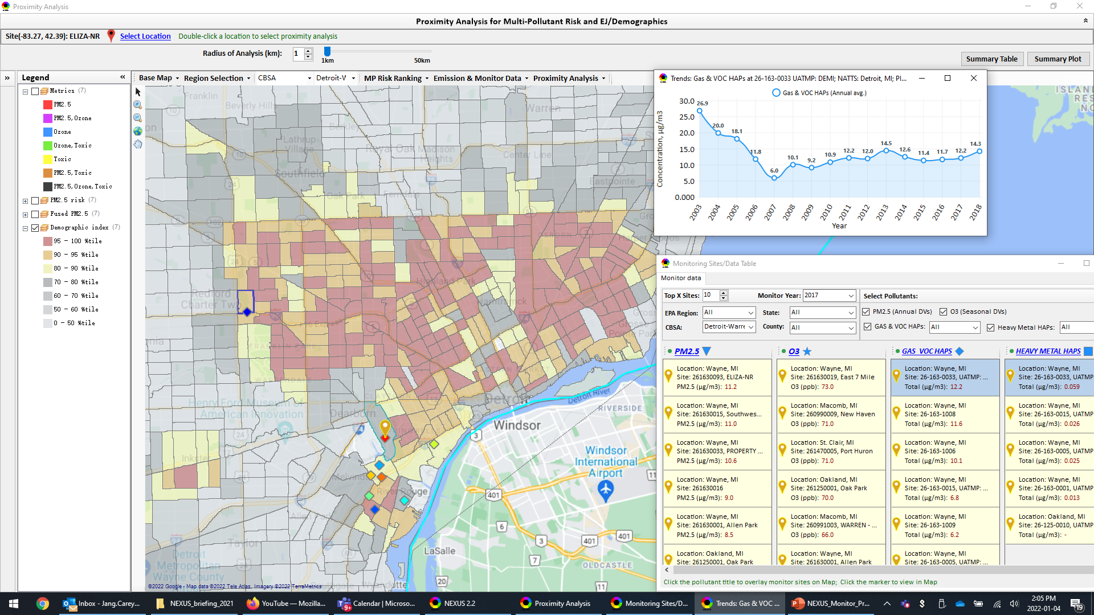
“Monitor Sites/Data” & Proximity A.: GAS & VOC HAPs & EJ
Detroit
12

Slide 13

“Monitor Sites/Data” & Proximity A.: Heavy Metal HAPs & EJ
Detroit
13

Slide 14
“NEXUS” Advanced Screening Tool (Multi-pollutant risk & EJ analysis based on 2017 PM2.5/O3/AT risk data) for Emissions of Air Toxics from Atlantic Alumina (formerly Noranda Alumina) Gramercy, Louisiana
Briefing to AQAD’s Air Toxic Team, 1/31/2022

Slide 15
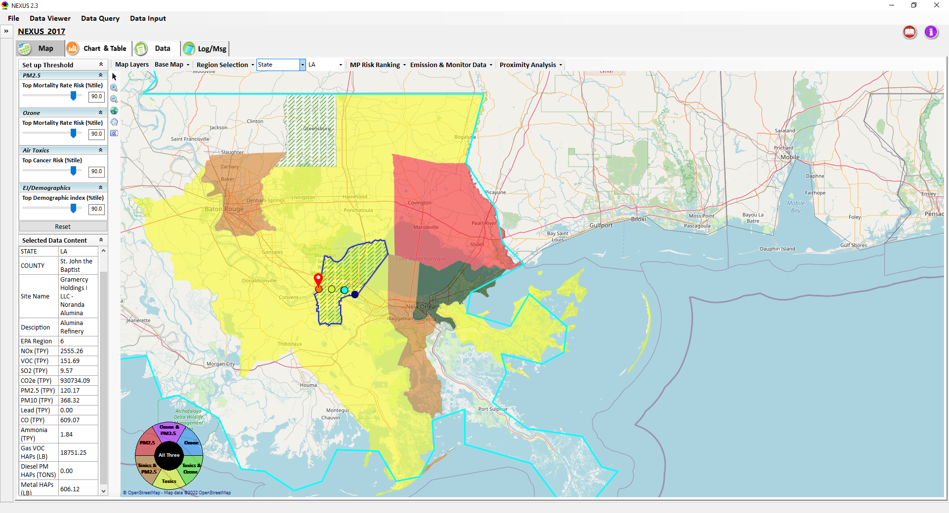
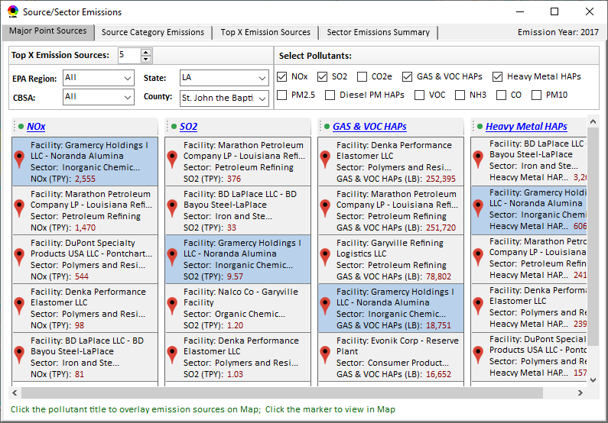
“NEXUS” Advanced Screening Tool: MP & EJ Analysis (County-level)
Baton Rouge
“Noranda Alumina” Facility Gramercy, Louisiana
New Orlean

Slide 16
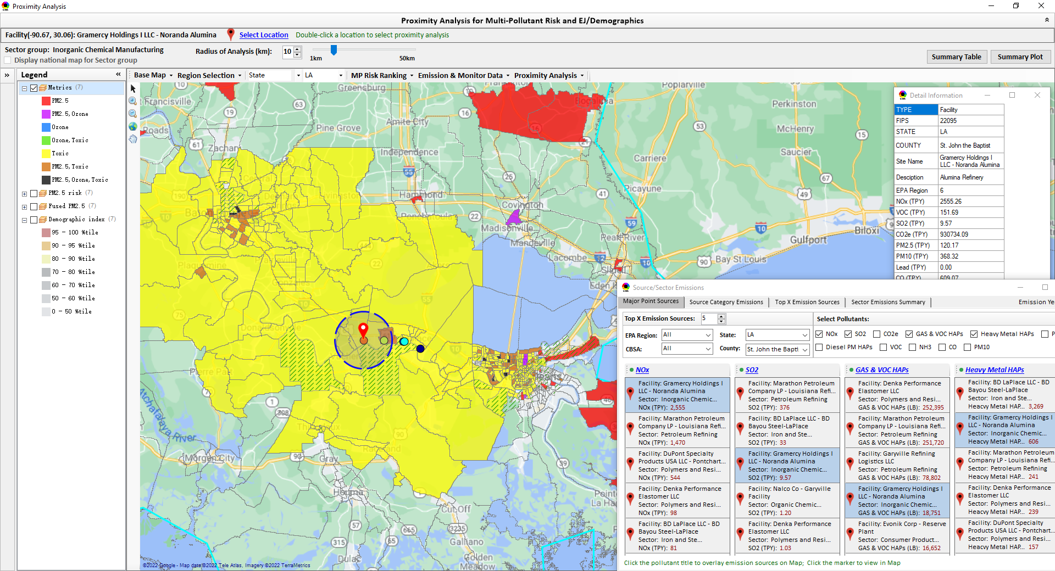
“Proximity Analysis”: Community MP & EJ Analysis (Census tract-level)
Baton Rouge
“Noranda Alumina” Facility Gramercy, Louisiana
New Orlean

Slide 17
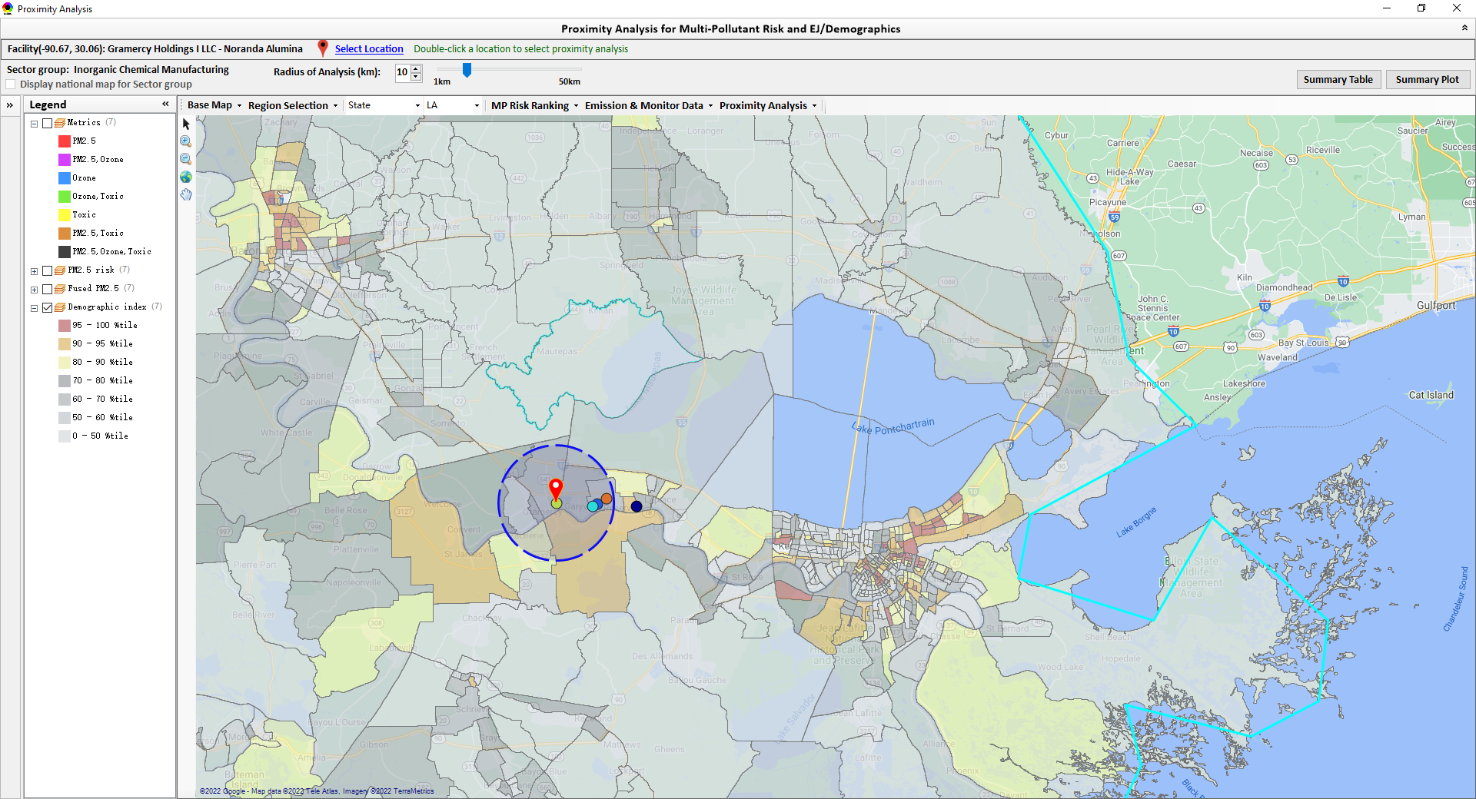
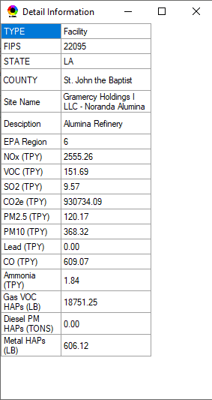
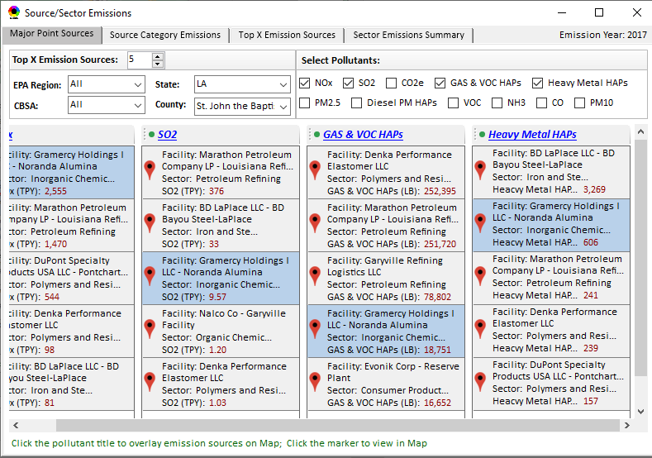
“Proximity Analysis”: EJ/demographics (EJSCREEN data)
Baton Rouge
“Noranda Alumina” Facility Gramercy, Louisiana
New Orlean

Slide 18
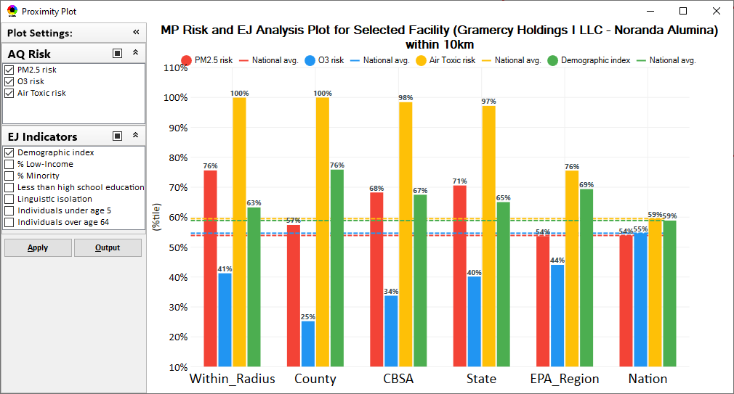
“Proximity Analysis” (Radius of Analysis) : Summary Plot

Slide 19
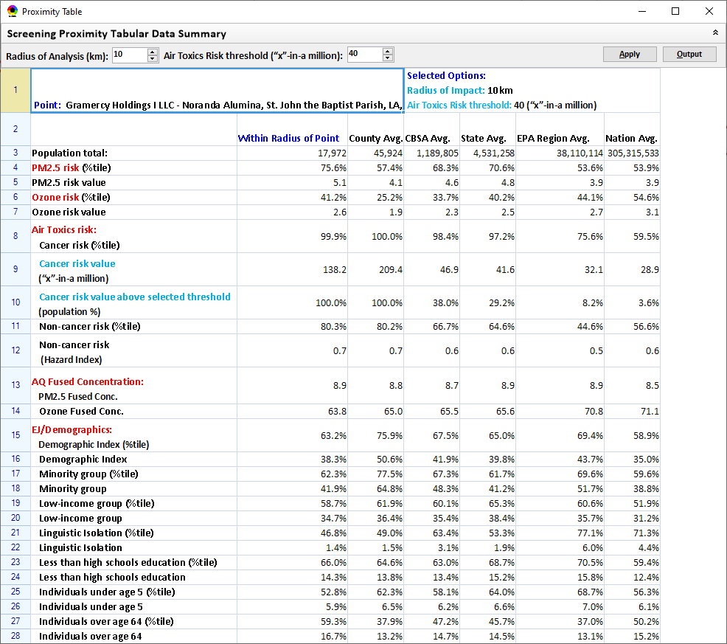
“Proximity Analysis” (Radius of Analysis) : Summary Table

Slide 20
“NEXUS 2.3” Live Demo
20

Slide 21
“NEXUS 2.3”: Quick Tutorial
Download “NEXUS” tool: The “NEXUS 2.3” package (“NEXUS 2.3 Setup.exe” & “NEXUS 2.3 Data.exe”: run both “*.exe” files to install) can be downloaded at EPA’s new FTP site:
https://gaftp.epa.gov/aqmg/cjang/NEXUS/MP_Team/NEXUS 2.3/*
Note: Require software installation privilege or “Power Broker” (limited elevated privilege) to install “NEXUS tool” at EPA’s PC; Check “This PC\Documents\My NEXUS files\data\* (\tool\*, \result\*)” to see if NEXUS program & input dataset are installed successfully
21

Slide 22
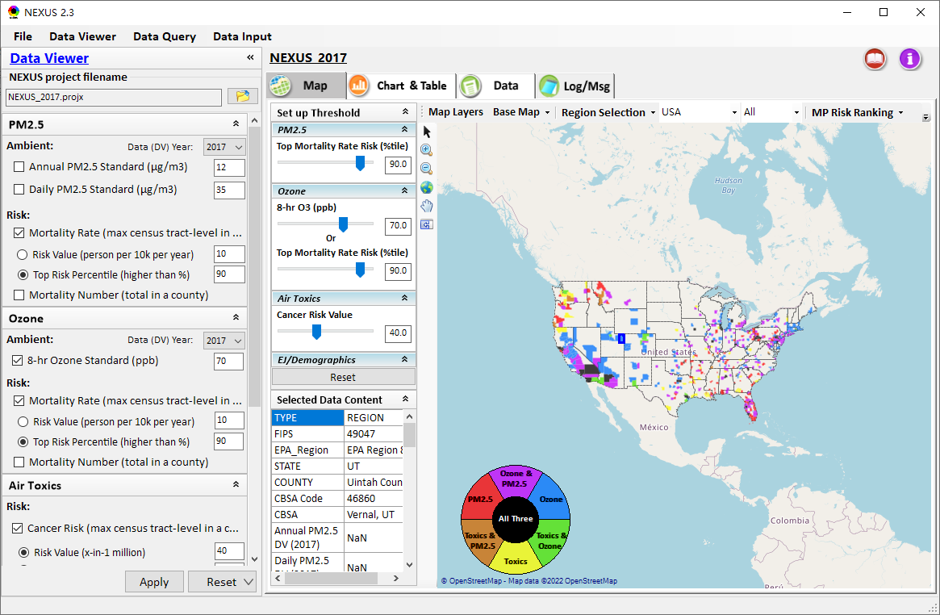
NEXUS Tool: On-line User’s Manual
Click “book” icon to launch “User’s manual”
Hot link to User’s manual’s “Data Viewer” chapter (same for “Data Input” module & “Data Query” model)
22

Slide 23
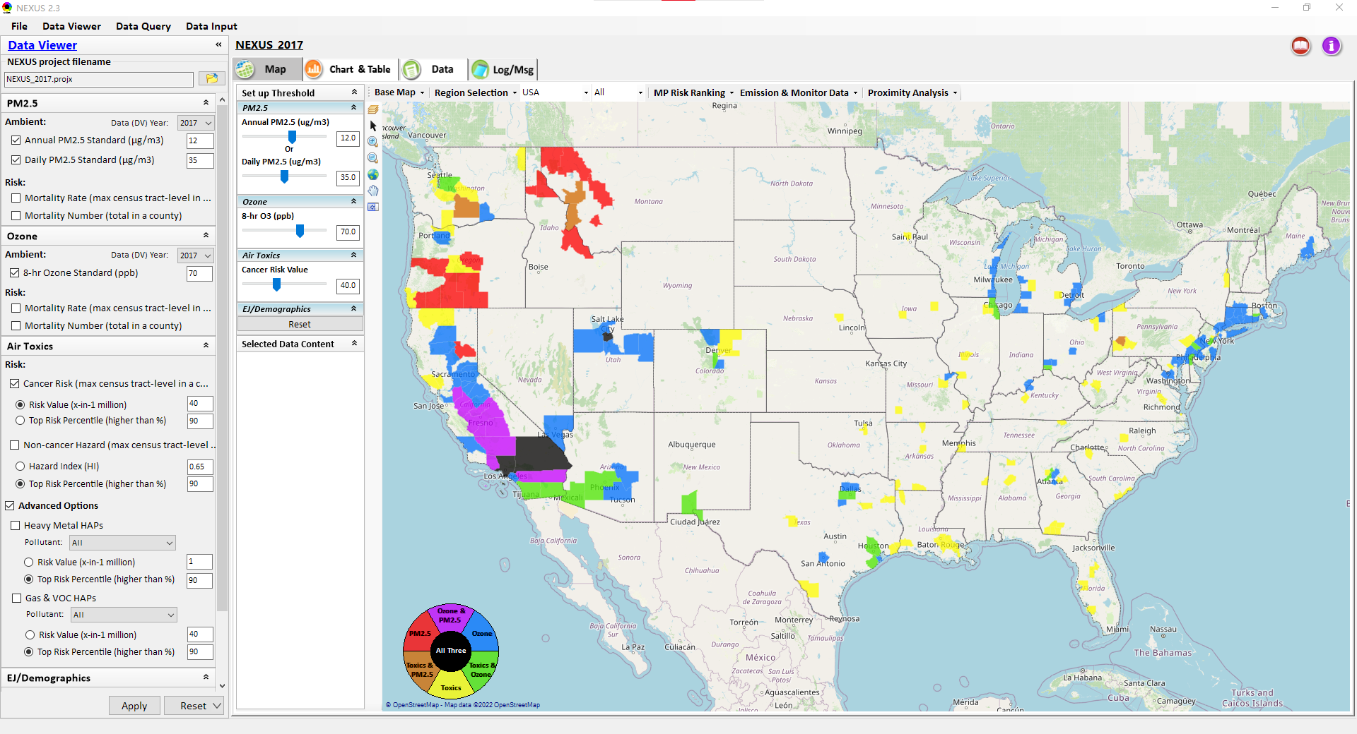
NEXUS Tool: Data Viewer Module
Click “File” to open or save a project
Switch between 3 key modules
NEXUS project file name
Select desired ambient data (DV) year (2013-2020)
Select & adjust “Ambient” or “Risk” levels
“Advanced Option”: provide HAPs & species selections
23

Slide 24
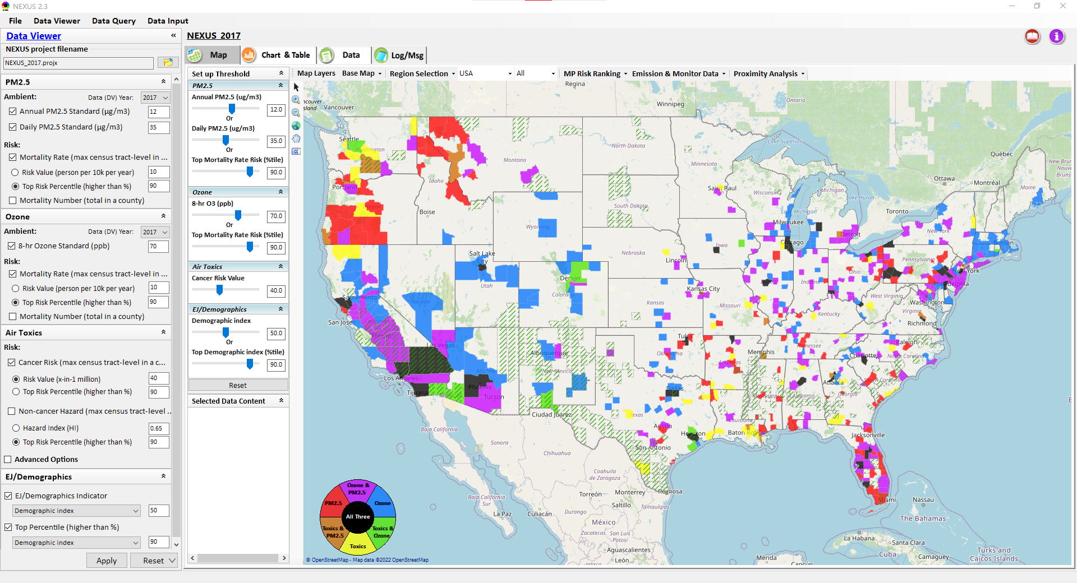
Data Viewer: “Apply” New Selections
“Check” boxes to add/remove selections
New selections will appear in “Slider bars” panel and map display
“Slider bars” allow to select & adjust “Ambient” and/or “Risk” threshold levels to display corresponding color map
“Apply” new selections
24

Slide 25

NEXUS Update: New EJ Metric and Data
New EJ/Demographic metric is displayed with “green dash” for counties exceeding selected threshold
25

Slide 26
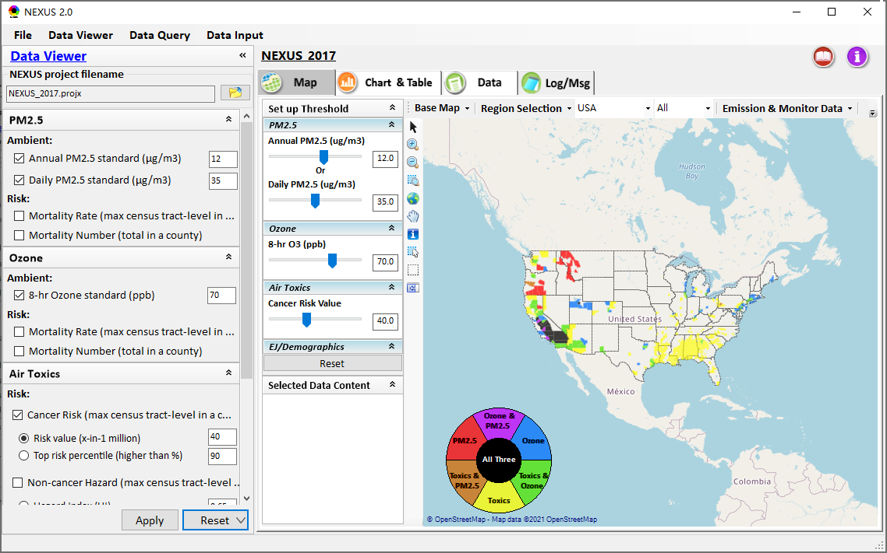
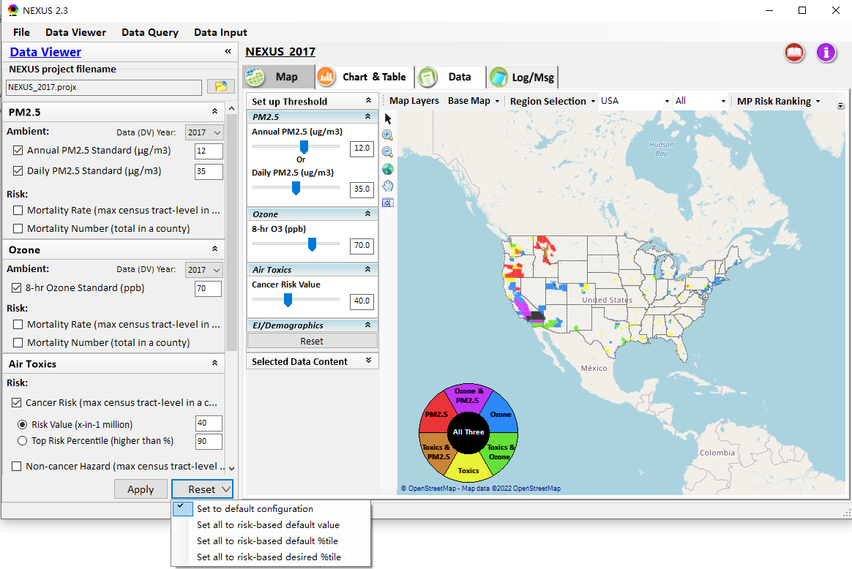
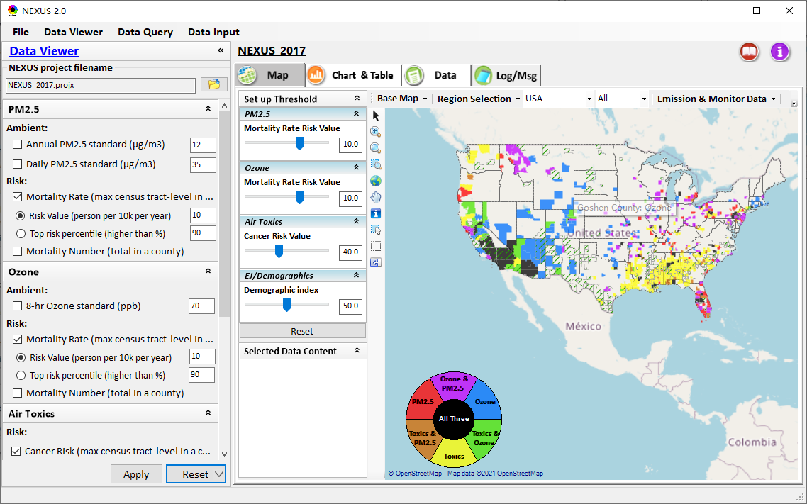
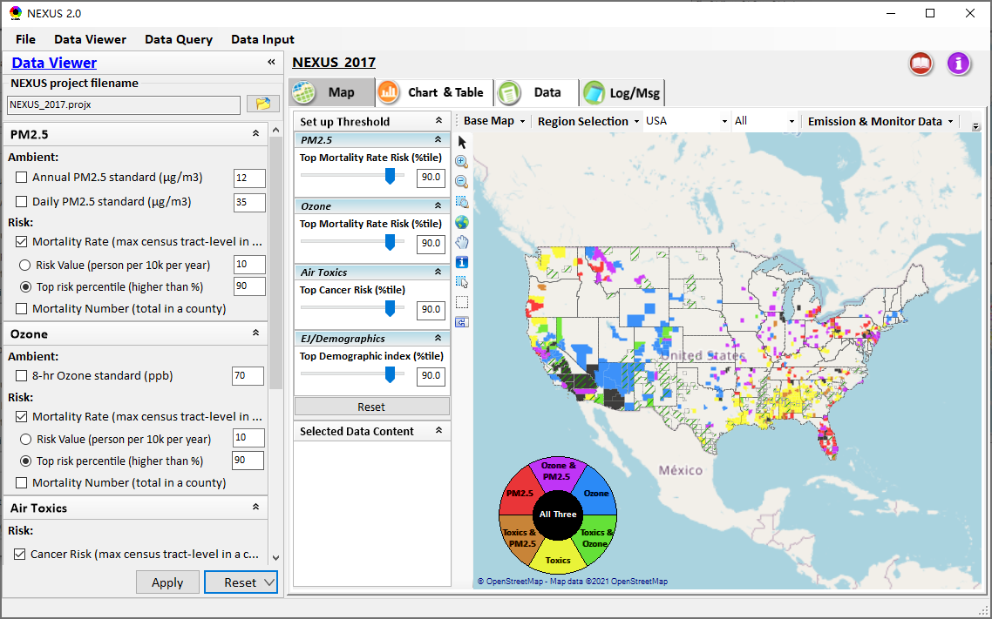
Data Viewer: “Reset” New Selections
default configuration
risk-based
“Reset” new selections
risk-based in %tile
26

Slide 27
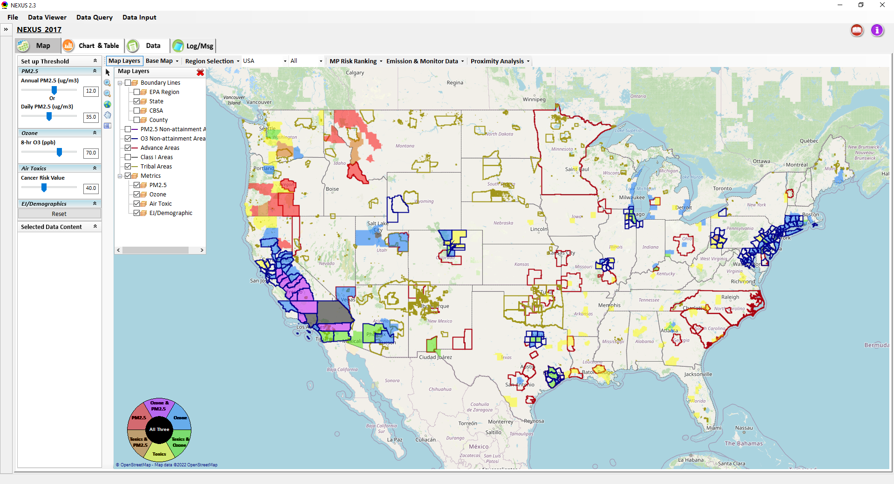
Data Viewer Module: Map Layers menu
Click “X” to close “Map Layers” menu
“Map Layers” menu: Provide (show/hide) map overlaps of various areas, AQ metrics and boundary lines
27

Slide 28
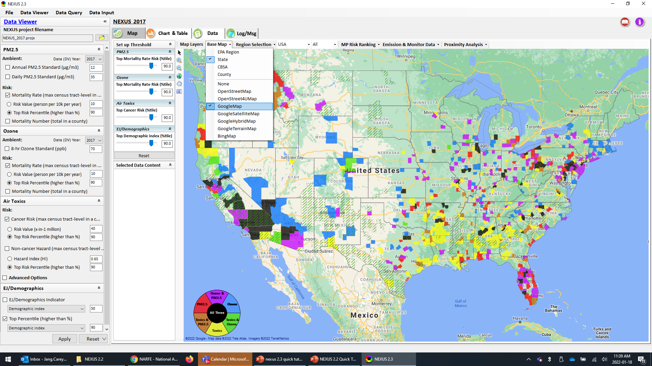
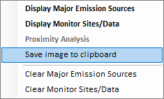
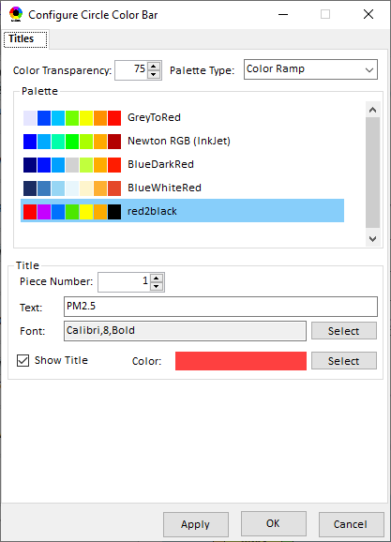
Data Viewer Module: Configure Base Map & Color
“Base Map” menu: Change boundary lines and background map (e.g., “Google Map”)
“Right-click” map to save map image
Click “color map” to change color & transparency
28

Slide 29
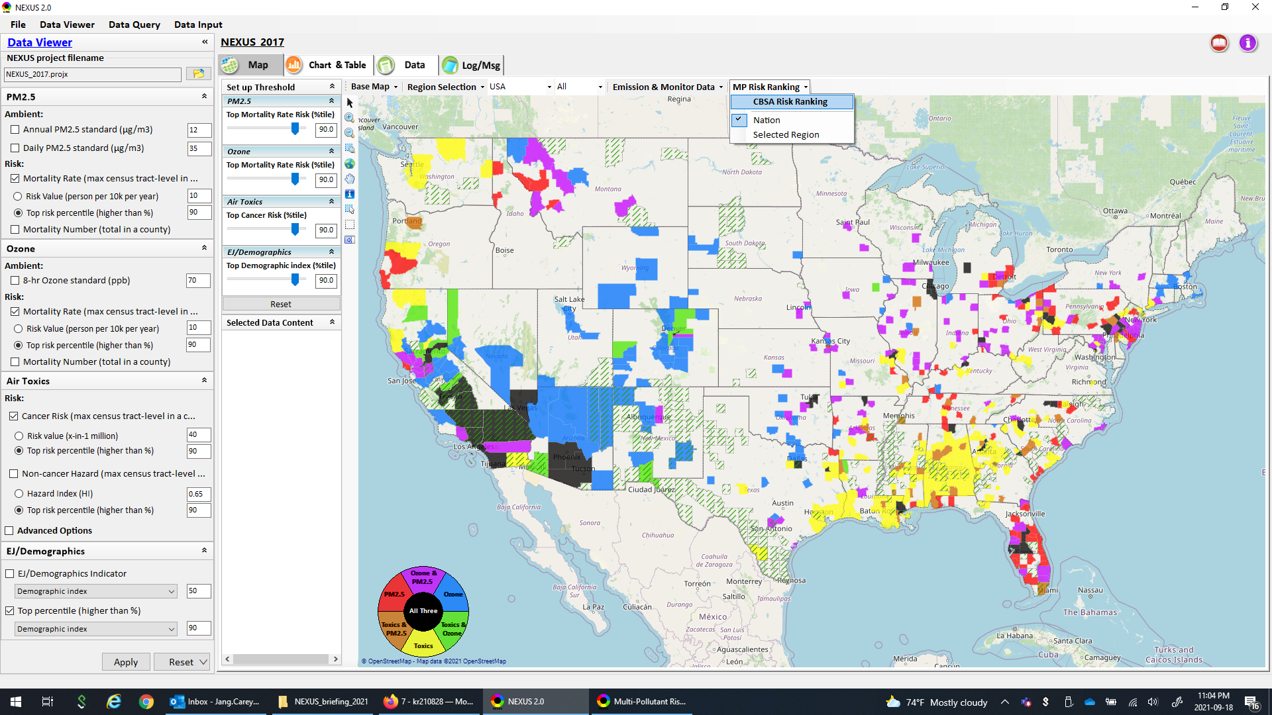
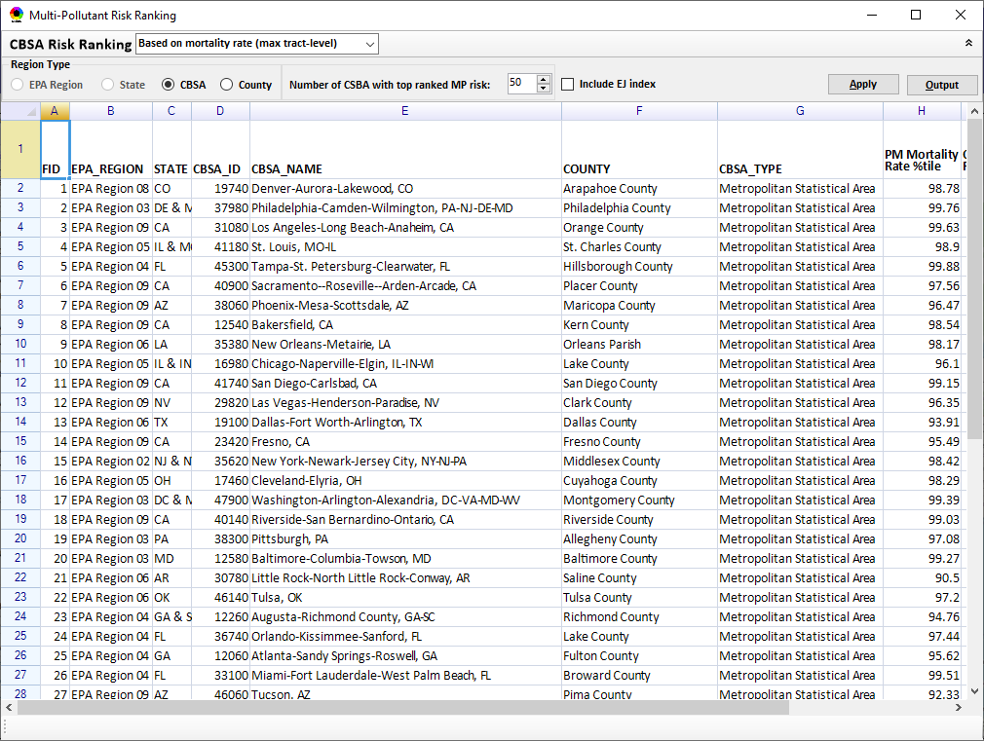
Data Viewer Module: MP Risk Ranking
“CBSA Risk Ranking”: provide MP risk ranking by CBSA or County
29

Slide 30
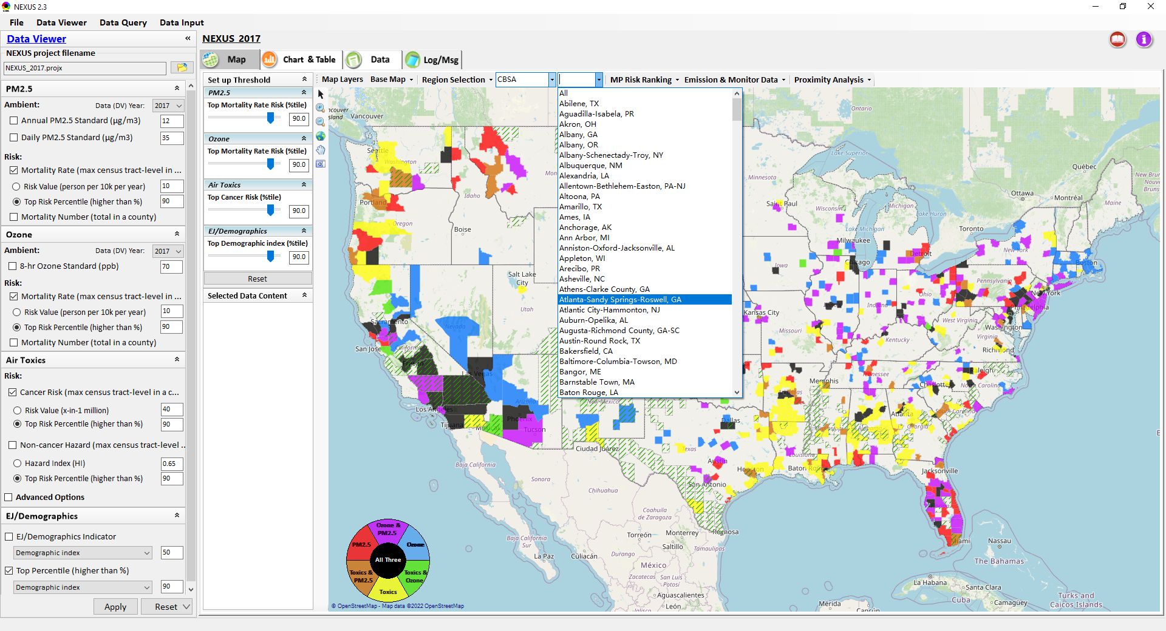
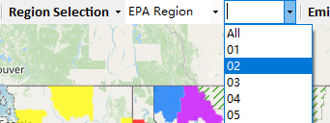
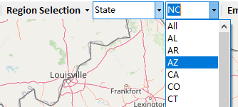
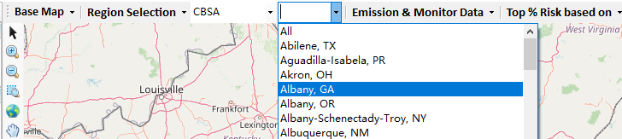
Data Viewer: “Region Selection”
Allow to select “EPA regions”, “States”, or “CBSA”
30

Slide 31
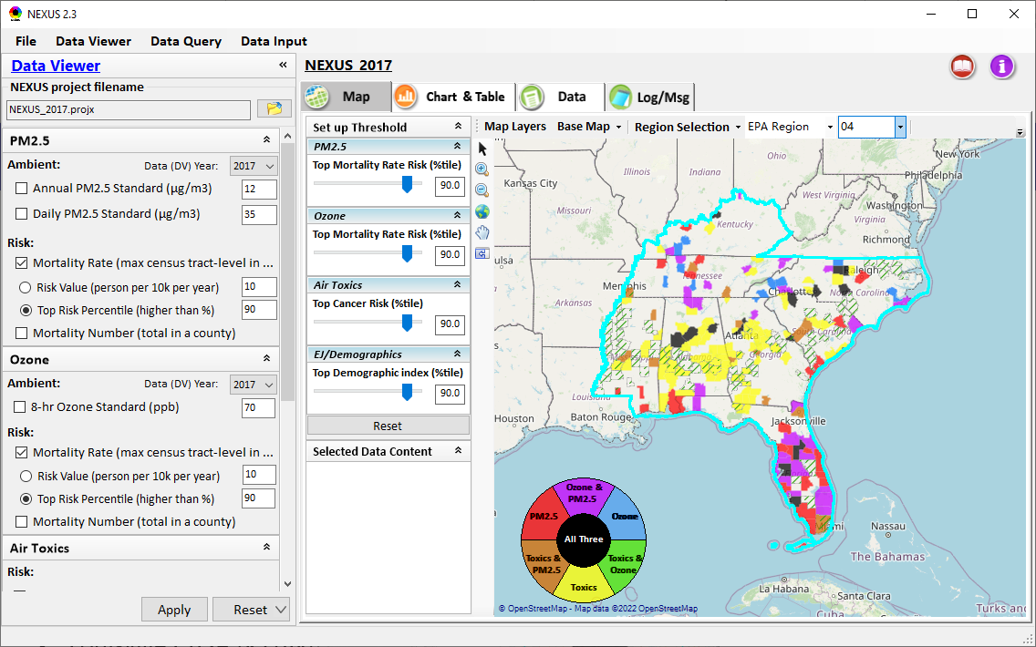
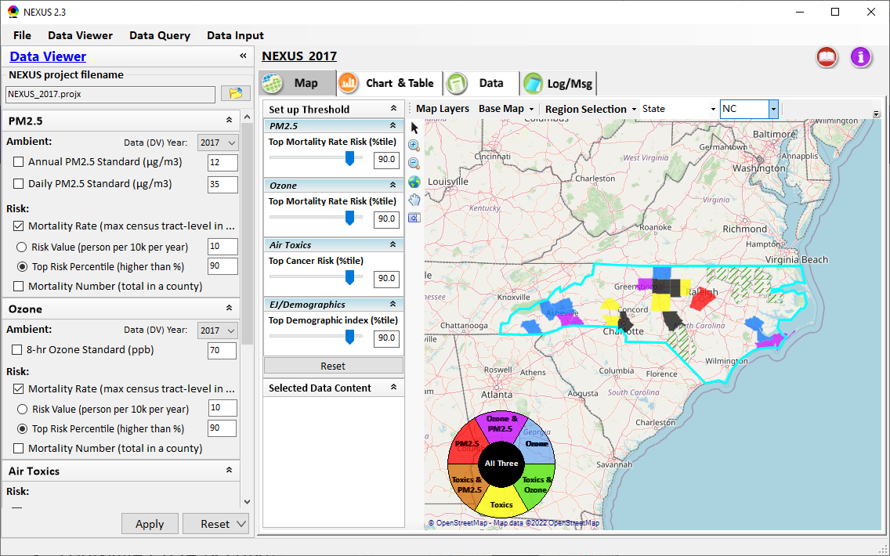
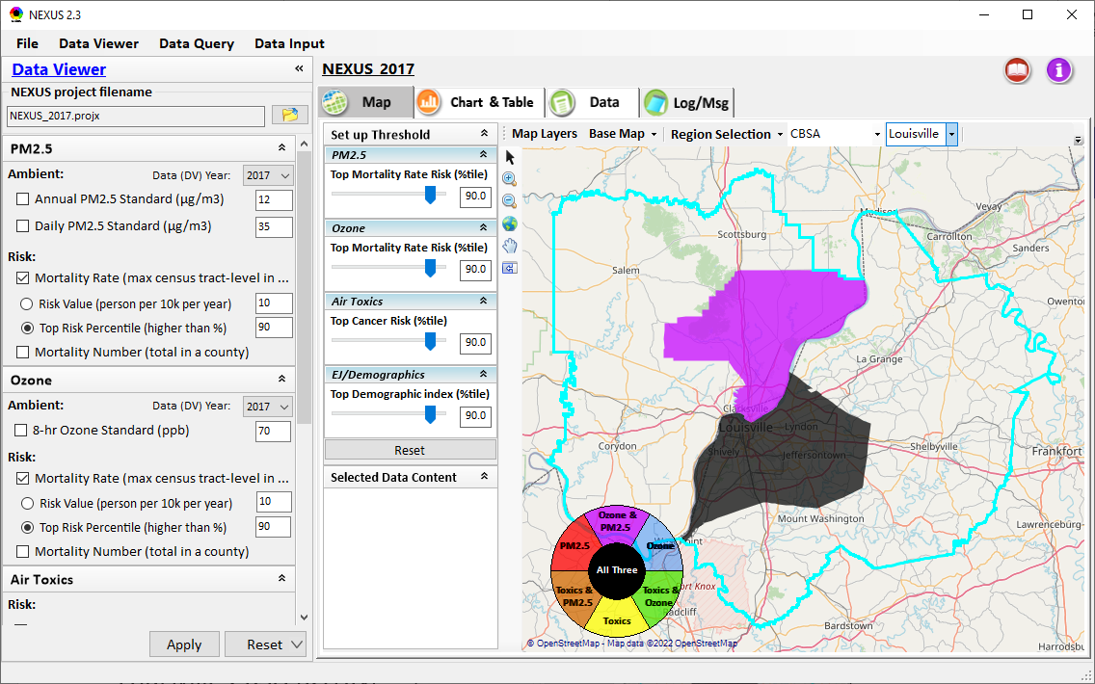
Data Viewer: Select EPA Region/State/CBSA
Examples:
EPA Region 4
State: NC
Louisville CBSA (KY/IN)
31

Slide 32
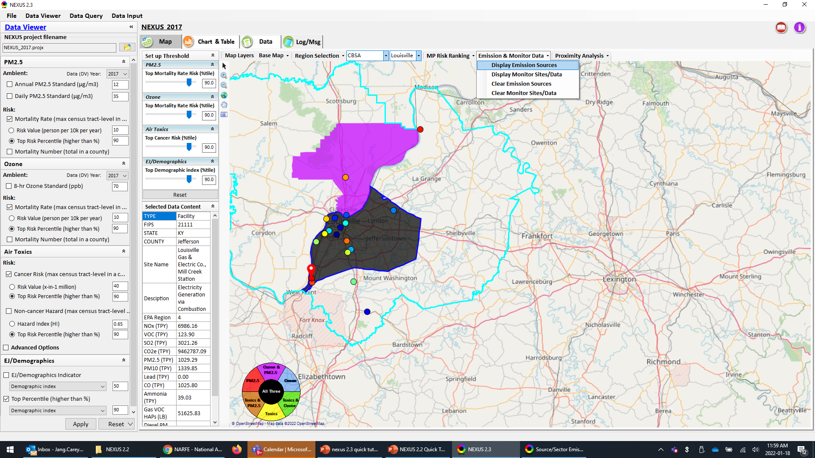
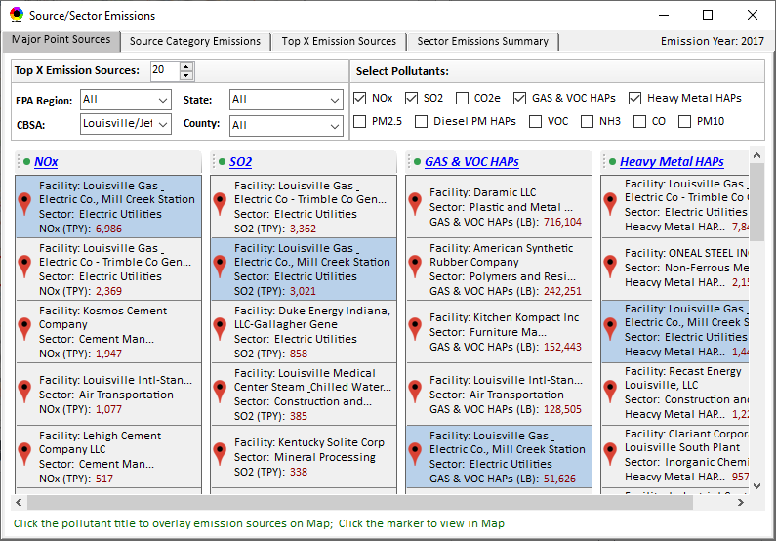
Data Viewer: Major Emission Sources
Click “Display Emission Sources” tab (or right-click) to display emission sources and launch new window
Click any “facility” to link & display source location and emitted pollutants information. Same facility emitting various pollutants can be identified with the same highlighted color.

Slide 33
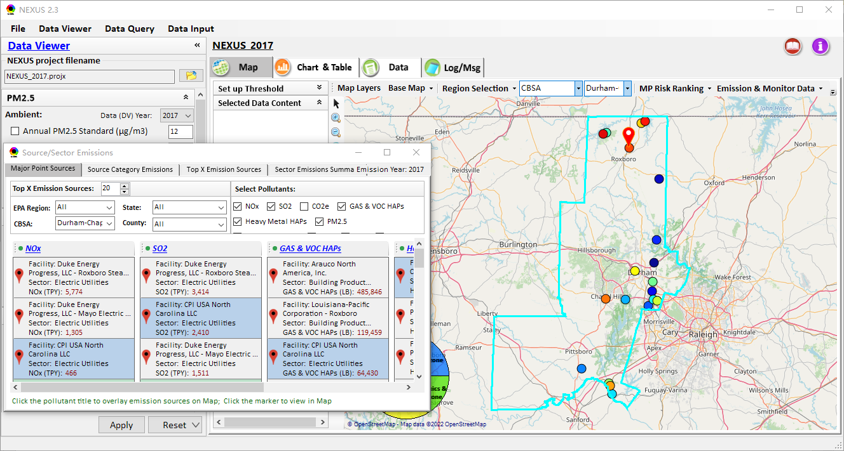
Data Viewer: Major Emission Sources
Allow to scroll down to CBSA-level (e.g., Durham CH CBSA ) or County-level
Durham CH CBSA
Emissions ranking by “color” of circles from red (higher) to blue (lower)
33

Slide 34
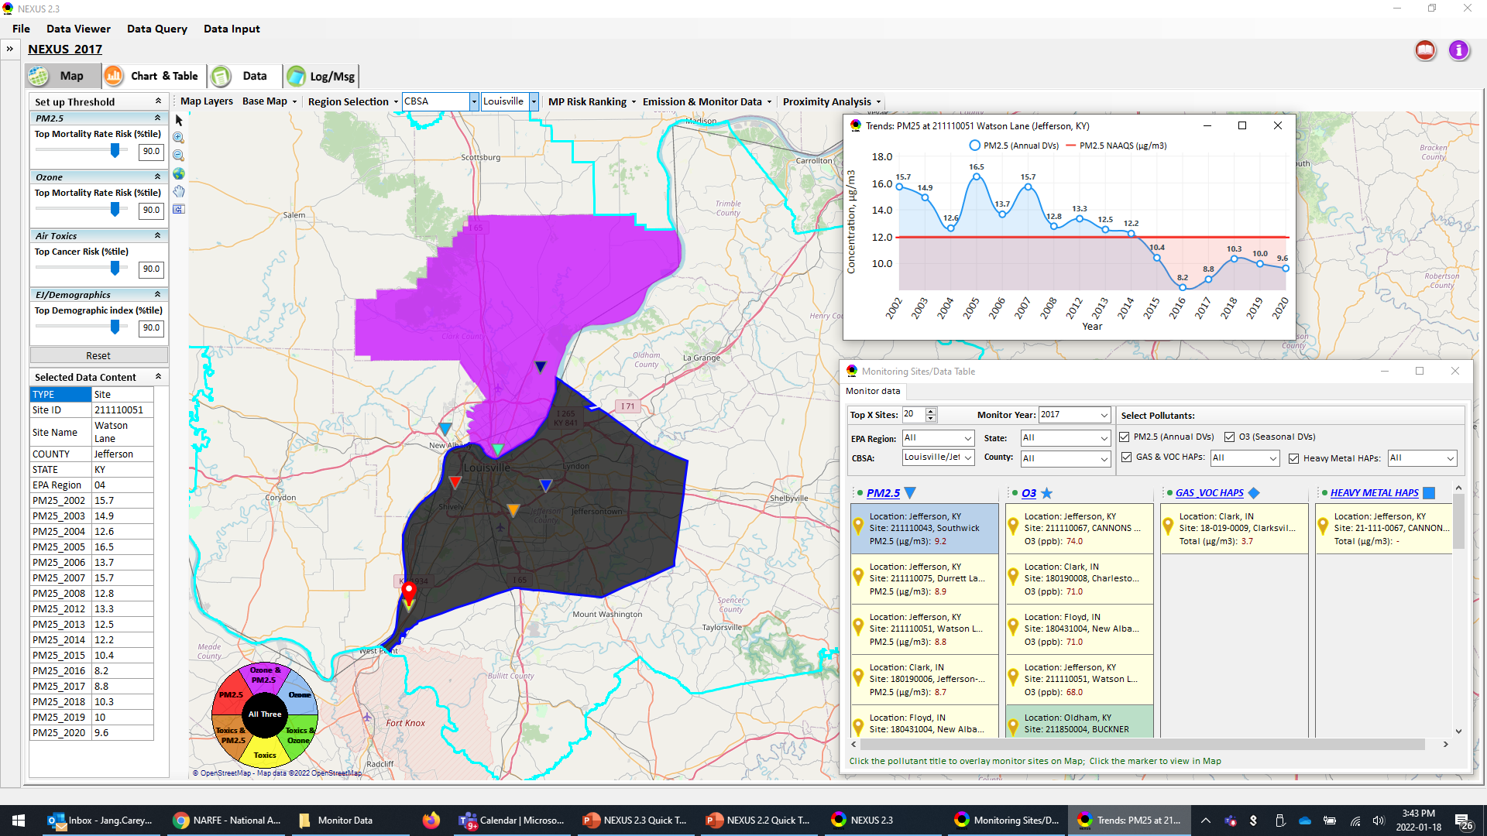
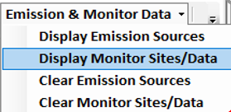
NEXUS: “Monitoring Data/Site” Module
Click menu (or right-click) to display “Monitor Sites/Data”
AQ trend
Monitor Site/Data
Click to display
AQ trend at monitor site
Use different symbol to display each pollutant’s “monitoring sites” e.g., PM_{2.5} (triangle), O₃ (star), etc.
Click to select monitor site & pollutant
34

Slide 35
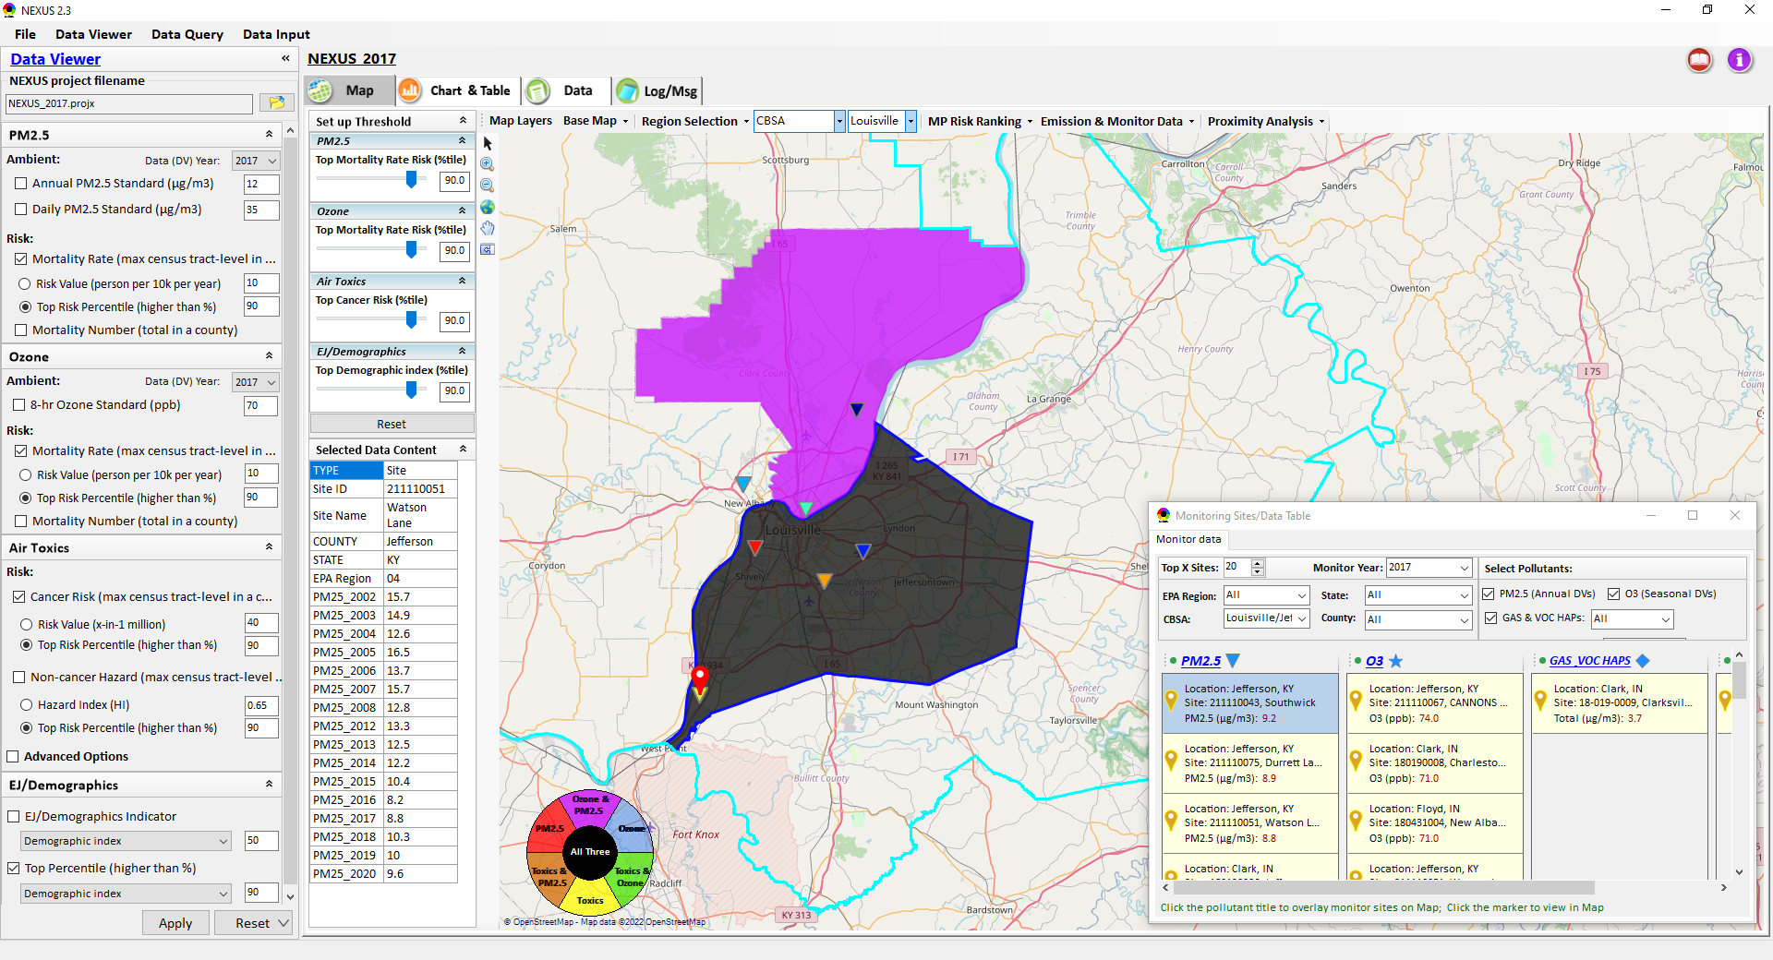

Two ways navigate to Proximity Analysis Module
Click menu (or right-click) to display “Proximity Analysis” module
Or click any facility, monitor site or a county, and then right-click on map and select “Display Proximity Analysis”.

Slide 36

Proximity Analysis Module: Overlaying Map
“Set up Threshold” panel (similar to Data Viewer module) allows to identity those geographic areas exceeding the selected thresholds.
Check (Uncheck) to show (hide) an overlaying map
The AQ Risk/Concentration and EJ indicators configurations provide metric selections to overlay the MP and/or EJ analysis map.

Slide 37
Proximity Analysis Module: Overlaying Map
Click “Reset” button to reset all values to default (or to a specified %tile if all indicators are selected in %tile)
Provide a “toggle” choice to select “Risk %tile” or “Risk value”

Slide 38

Proximity Analysis Module: Legend Configure
Click nay color tile to to config the legend color & transparency

Slide 39






Proximity Analysis Module: Set the “Radius of Analysis”
Adjust the analysis radius
Click the “Select Location” and select a census tract, a monitor site or a facility in “Select Location” dialog
(b) Or Double-click a facility or monitoring site or a census tract to select proximity analysis center point

Slide 40


Proximity Analysis Module: Show Detail information
Click a facility or monitoring site or a census tract to show the detail information

Slide 41


Proximity Analysis Module: Summary Table/Plot
Summary table
Summary plot
Set the radius of analysis and the threshold of air toxics to show the summary results for selected point within radius
Emissions
Support to output the summary table as excel file (*.xlsx)
Select one or more indicators to plot the summary results for selected point within radius, county/CBSA/State/EPA Region and Nation avg.

Slide 42




Data Viewer: Top “x” Emission Sources
Provide selection of Facility & Source Category
Provide selection of Facility or Source Category
Durham county, NC
42

Slide 43

NEXUS Update: “Source Category Emissions”
“Source Category Emissions” module provide five source categories, including “Point”, “Non-Point”, “On-Road”, “Non-Eoad”, and “Wvent” emissions for the selected region, CBSA, or county.
For “Non-Point”, including Resident Wood Combustion emissions.
43

Slide 44


NEXUS Update: “Sector Emissions Summary”
“Sector Emission Summary” function allow to select major CBSAs and provides source and sector emissions summary to support “Sector Prioritization” effort
44

Slide 45




NEXUS Update: “Sector Emissions Summary”
Summary table
Summary plot
Emissions
Frequency & Rank
45

Slide 46

Data Viewer: EPA Region Table Generator
“EPA Region Table Generator” provides attainment status of O3 and PM2.5 and their DVs; also allows to select any EPA region based on data updated to 2020.
46

Slide 47

Data Viewer: Data Search & Filter
Click “+” to add filters; Click “x” to remove current filter;
Show specified records per page.
Click “Output data…” to output current page records or all records
47

Slide 48

Data Input Module: Data Preview
“Transparency” & “Open-Source”:
All NEXUS input/output data files are available under:
“This PC\Documents\My NEXUS files\Data (\Result)”
Check to use filter to query data
Select a table to view if there are multiple tables in the selected data source file
Click to change input data file
Click to view data
Click to run & save project
48

Slide 49

Data Query Module: Overlaying Map
Region Selection
Data Query Configuration
Data Query qualifier selection
Overlaying Map selection
49

Slide 50

Data Query Module: Configure Data Query
“Data Query Filter” allows to select “qualifiers” for query
“Data Query Preview” displays the selected “qualifiers” at the same time
50

Slide 51


Data Query Module: Attribute Table
Filter/search/export functions
Detachable “Attribute Table”
51

Slide 52


Data Query Module: Attribute Table
Click a “record” to link and display its location & info.
52

Slide 53
Quick Tutorial Slides
End
53

