Slide 1
“NEXUS” Multi-Pollutant Analysis Tool EPA Regional APM Briefing and Live Demo
OAQPS’s Multi-Pollutant Team
November 8th, 2021

Slide 2
Overview
NEXUS Background
Tool Development
Expected Use
Key Modules
Data Inputs
Next Steps
NEXUS 2.0 Live Demo
2

Slide 3
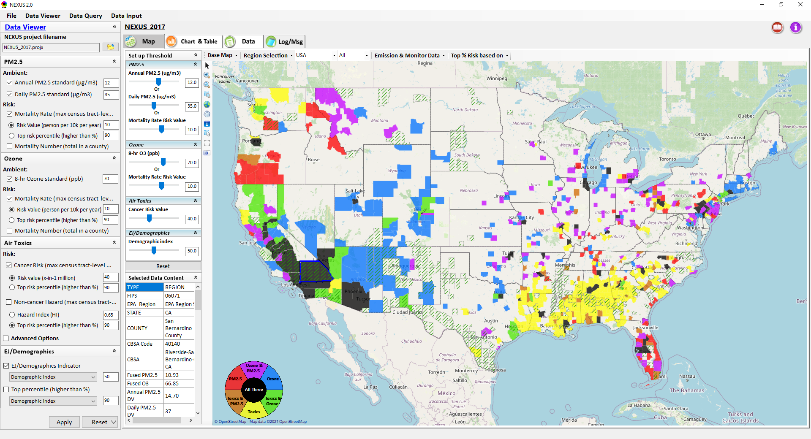
NEXUS: Tool Development
A new Multi-Pollutant (MP) Advanced Screening Tool (NEXUS) is being developed to:
Identify geographic areas where health risks related to O₃, PM_{2.5} and air toxics overlap
Characterize the nature of MP AQ issues for specific areas to consider MP AQ planning
3

Slide 4
NEXUS: Expected Use
The NEXUS tool will allow users to do the following:
National screening to identify areas with MP issues: Phase 1 development provides ability to quickly screen areas across nation that have combination of high air quality and/or risk levels for O₃, PM_{2.5} and Air Toxics.
Area screening to understand nature of MP problem: Phase 2 development provides ability to ‘dial-into’ specific areas to determine extent to which common emissions sources are causing the MP issues.
We expect to use this tool in conjunction with Regions and identify areas that would potentially benefit most from MP approaches to reduce emissions (including current NA areas).
The NEXUS tool will essentially provide a ‘conceptual model’ of an area’s MP issues to facilitate engagement with state/local/tribal agencies and community stakeholder groups.
We also expect that it can have additional value-added uses across the Office for Air Toxics, Environmental Justice and other programs.
4

Slide 5
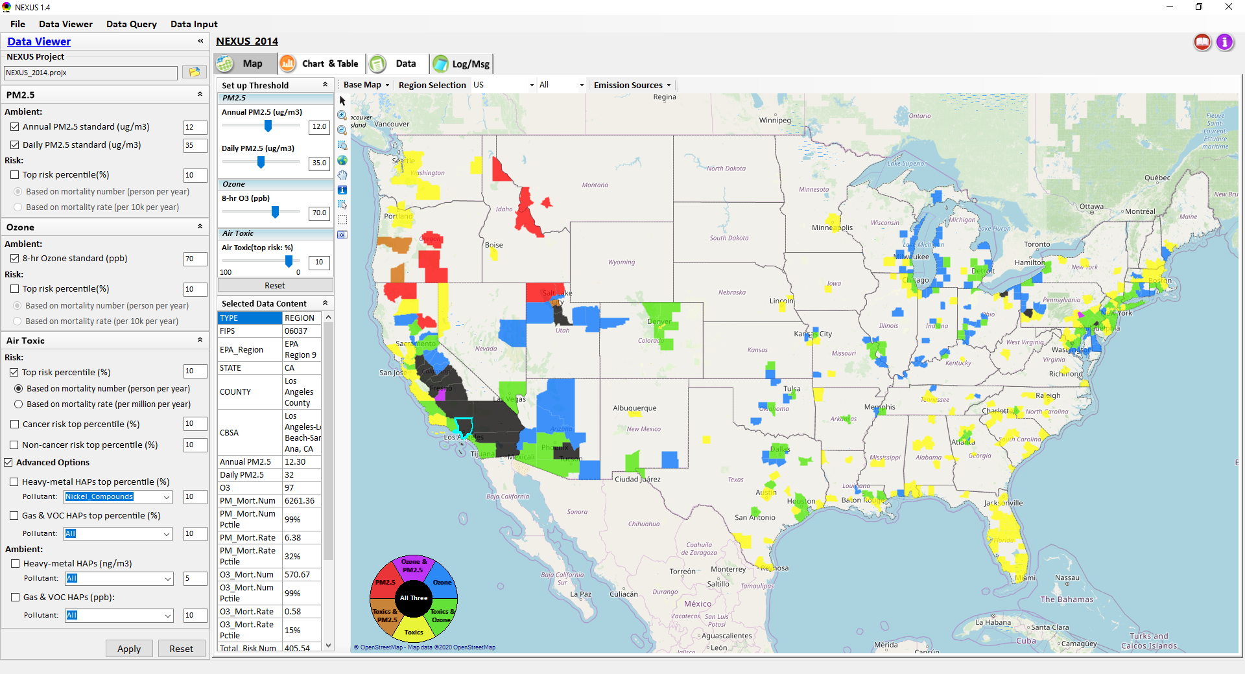
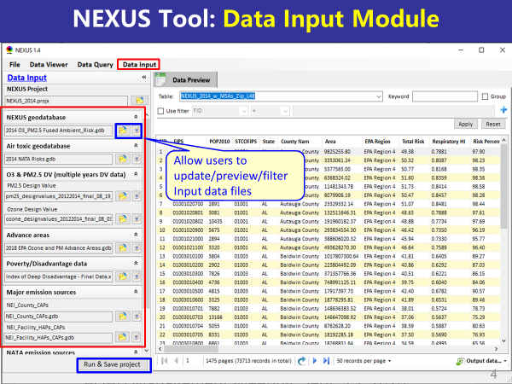
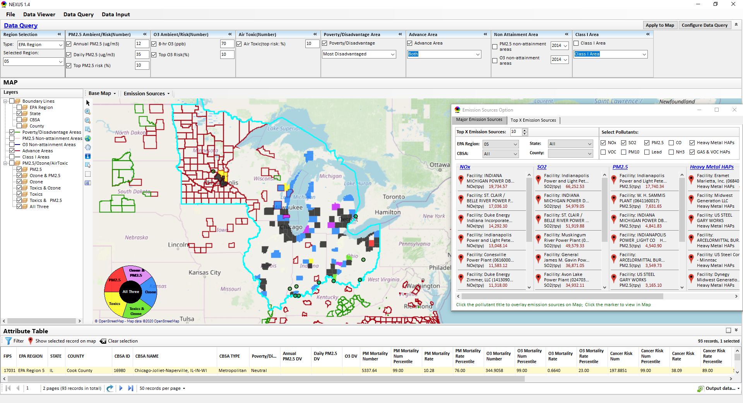
NEXUS: Three Key Modules
Data Viewer Module
Data Input Module
Data Query Module
View and create interactive Map/Data/Chart/Table
Provide flexible selections & mapping of “Ambient” and/or “Risk” levels of PM_{2.5}, O₃ and Air Toxics
Provide regional analysis for “EPA region”, “States”, “CBSA”, and “County”
Display major point emission locations and monitoring sites/data by pollutants
Integrate all MP data - emissions, monitoring, modeling, health risk, and EJ/demographic data into a single platform
Currently use10 publicly available input datasets
Provide data preview, search, filter and output functions
Allow to update/change input data files and then run/save to a new “project”
Expand data field selections and flexibility for exploratory & advanced users
Provide map overlaying and summary table for data query results
Current data query based on selected data fields: “Ambient & Risk for PM, O3 & Air toxics”, “EJ/demographic indicator”, “Advance area”, “NA Area”, “Tribal area”, Class I area”
5

Slide 6
NEXUS 2.0: Input Data Files and Sources
Input Data Files | Data Format | Data Description | Data Source | Data Period
“O₃ & PM_{2.5} Ambient and Risk” | Excel | O₃/PM_{2.5} fused ambient conc & risk data at county/census tract level | from OAQPS MP & BenMAP team | 2017
“Air Toxic Ambient and Risk” | Geodataset | Air toxics fused ambient conc & risk data at county/census tract level | from OAQPS MP & Air Toxic team | 2014*
“O₃ & PM_{2.5} Design Values” | Excel | O₃ & PM_{2.5} design values at county level | From EPA public website: https://www.epa.gov/air-trends/air-quality-design-values | 2012 to 2020
“NEI County Emissions” “NEI Facility Emissions” | Excel | County-level and facility source emissions of CAPs, HAPs & GHGs | From OAQPS public website: https://www.epa.gov/air-emissions-inventories/2017-national-emissions-inventory-nei-data | 2017
“O₃ & PM_{2.5} monitoring data | Excel | O₃ & PM_{2.5} monitoring data (DVs) | From OAQPS public website: https://gispub.epa.gov/arcgis/rest/services/OAR_OAQPS | 2002 to 2020
“Air Toxic monitoring data” | Excel | Air toxics monitoring data (22 HAPs) | From OAQPS public website: https://www.epa.gov/amtic/amtic-air-toxics-data-ambient-monitoring-archive | 2003 to 2018
EJ/Demographics data | Geodataset | Demographic indicators (7) from EJSCREEN | from EJSCREEN: https://www.epa.gov/ejscreen/download-ejscreen-data | 2020
“Advance areas“ | Geodataset | O₃ & PM_{2.5} Advance Areas | from OAQPS MP team | 2021
“Class 1_Areas” | Geodataset | EPA Class 1 Federal Areas | From EPA Class 1 Federal Areas Website: https://edg.epa.gov/data/public/OAR/OAQPS/Class1/Class1Areas.zip | 2016
“Tribal Areas” | Geodataset | EPA Tribal Areas | From EPA public website: https://edg.epa.gov/data/Public/OEI/OIAA/Tribes/EPAtribes.zip | 2018
* Will be updated to 2017 by end of 2021
6

Slide 7
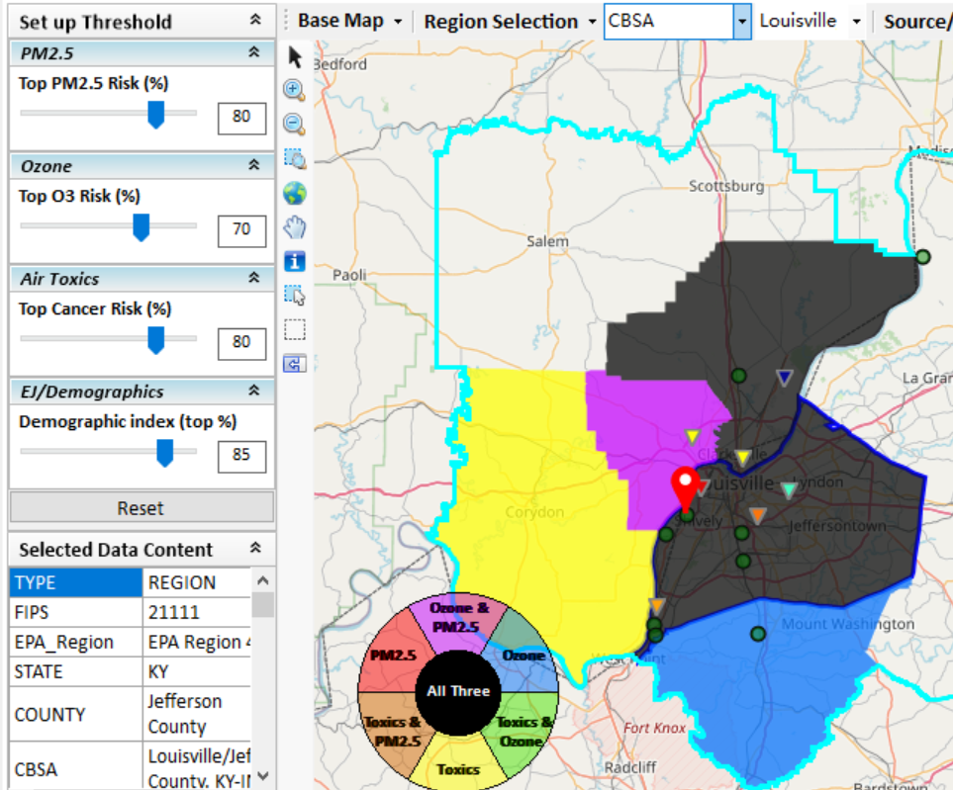
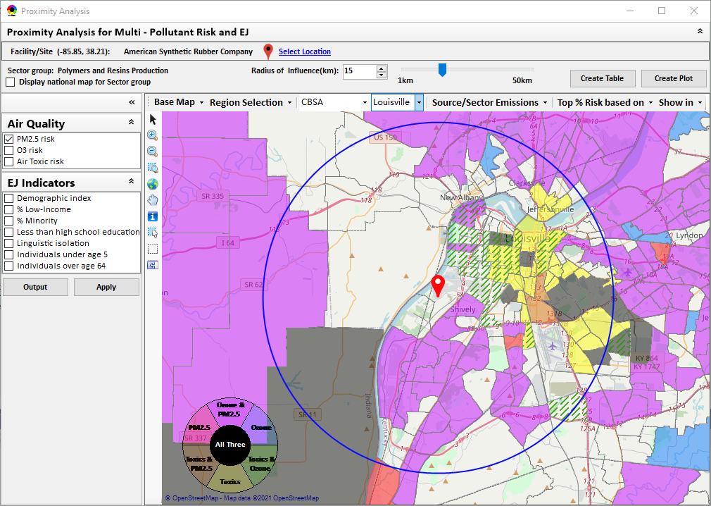
New “Proximity Analysis” Module (under development)
Currently in NEXUS
Proximity Analysis for MP Risks and EJ
County – level (current)
Community (Census Tract) - level
7

Slide 8
Regional Office Feedback Process
Feedback Process
Feedback Requested
Download, install and explore NEXUS 2.0 https://gaftp.epa.gov/Air/aqmg/cjang/NEXUS/NEXUS 2.0/
Provide feedback / questions / concerns to Beth Landis (landis.elizabeth@epa.gov) and Carey Jang (jang.carey@epa.gov) by January 21, 2022
Suitability for air quality planning efforts and engagement with SLTs
Interest in a region-specific discussion regarding NEXUS use
Suggested improvements in NEXUS regarding data, visualization, screening capabilities, etc.
Any errors/bugs/concerns
8

Slide 9
“NEXUS 2.0”Demo
Download “NEXUS” tool at: https://gaftp.epa.gov/aqmg/cjang/NEXUS/NEXUS 2.0/*
Carey Jang
OAR/OAQPS/AQAD/Air Quality Modeling Group, November 2021
9

