Slide 1
“NEXUS” Multi-Pollutant Analysis Tool
EPA R1 & OAQPS Meeting
OAQPS’s Multi-Pollutant Team
November 16th, 2021

Slide 2
Overview
MP Background
NEXUS Background
  Tool Development
  Expected Use
  Key Modules
  Data Inputs
  Detroit Example
  NEXUS and EJSCREEN
  Recent and Ongoing Development
Feedback Process
2

Slide 3
MP Background
Support a comprehensive, MP treatment of air quality problems to effectively improve air quality and make the most efficient use of available resources
  Primary Goal - identify & evaluate local control strategies targeting emissions of O₃ & PM_{2.5} and their precursors while at the same time reducing Air Toxics of concern for communities to maximize both health benefits and air quality improvements
MP planning has the potential to reduce the costs and increase benefits associated with air quality management (AQM)
Supports S/L/T air agencies in developing MP, risk-based AQM plans and implementing strategies that reduce air pollution emissions & improve public health
Success has been demonstrated in Detroit and SC; another project is currently underway in Louisville, KY
Tools needed to analyze MP data are either available currently or being developed in OAQPS (e.g., NEXUS)
3

Slide 4
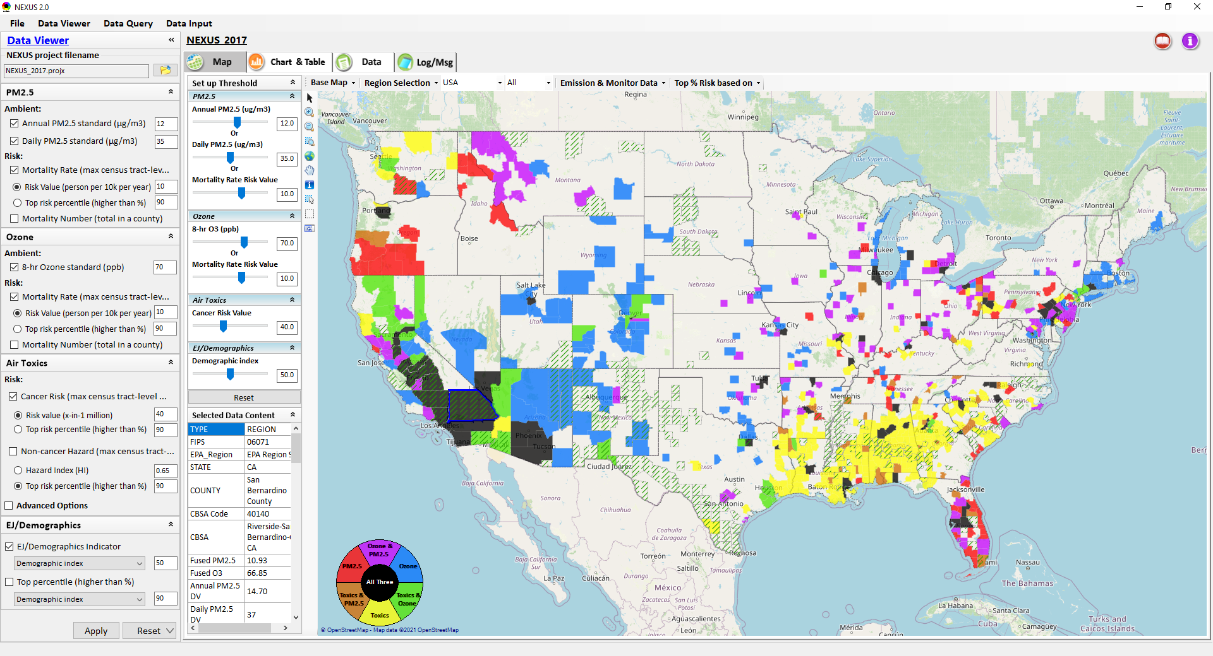
NEXUS: Tool Development
A new Multi-Pollutant (MP) Advanced Screening Tool (NEXUS) is being developed to:
Identify geographic areas where health risks related to O₃, PM_{2.5} and air toxics overlap
Characterize the nature of MP AQ issues for specific areas to consider MP AQ planning
4

Slide 5
NEXUS: Expected Use
The NEXUS tool will allow users to do the following:
  National screening to identify areas with MP issues: Phase 1 development provides ability to quickly screen areas across nation that have combination of high air quality and/or risk levels for O₃, PM_{2.5} and Air Toxics.
  Area screening to understand nature of MP problem: Phase 2 development provides ability to ‘dial-into’ specific areas to determine extent to which common emissions sources are causing the MP issues.
We expect to use this tool in conjunction with Regions and identify areas that would potentially benefit most from MP approaches to reduce emissions (including current NA areas).
The NEXUS tool will essentially provide a ‘conceptual model’ of an area’s MP issues to facilitate engagement with state/local/tribal agencies and community stakeholder groups.
We also expect that it can have additional value-added uses across the Office for Air Toxics, Environmental Justice and other programs.
5

Slide 6
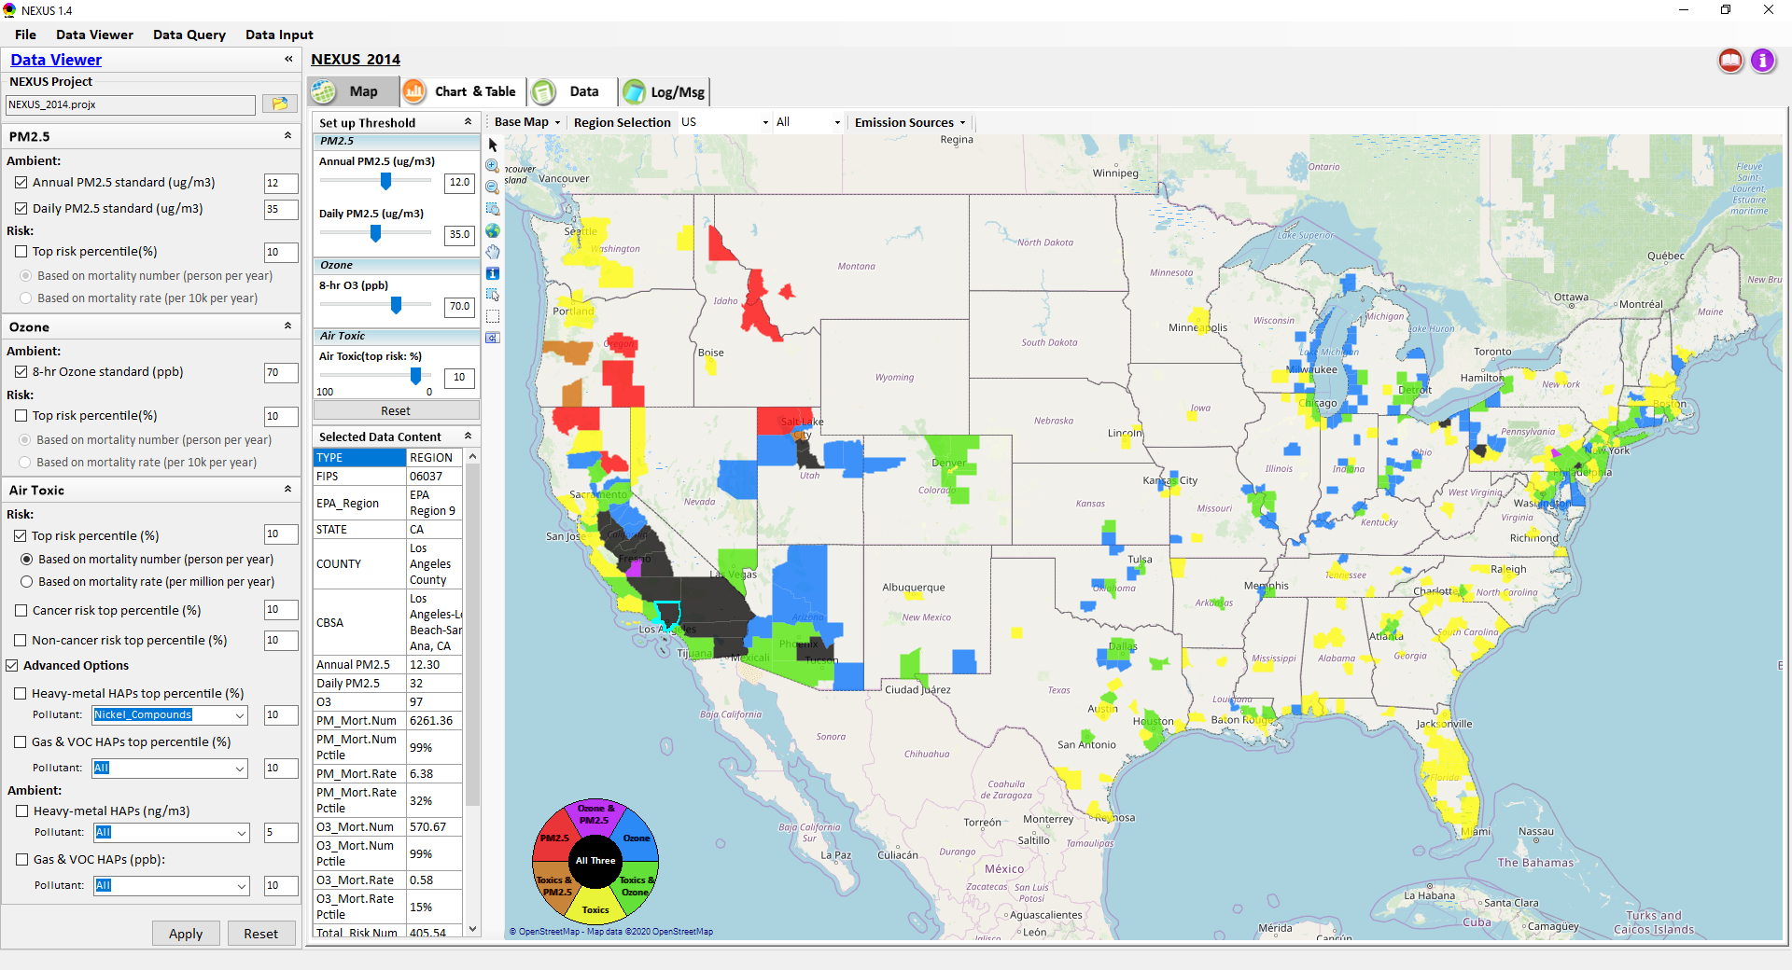
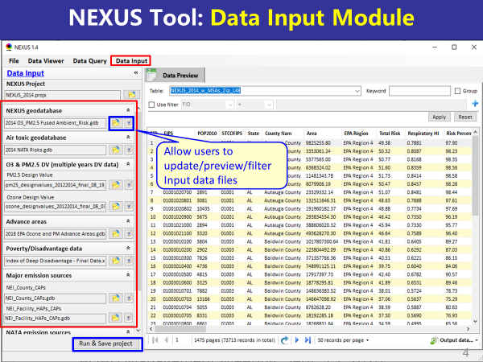
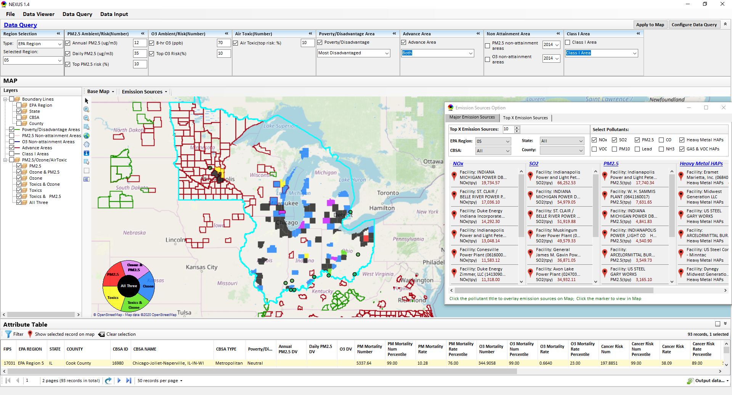
NEXUS: Three Key Modules
Data Viewer Module
Data Input Module
Data Query Module
View and create interactive Map/Data/Chart/Table
Provide flexible selections & mapping of “Ambient” and/or “Risk” levels of PM_{2.5}, O₃ and Air Toxics
Provide regional analysis for “EPA region”, “States”, “CBSA”, and “County”
Display major point emission locations and monitoring sites/data by pollutants
Integrate all MP data - emissions, monitoring, modeling, health risk, and EJ/demographic data into a single platform
Currently use10 publicly available input datasets
Provide data preview, search, filter and output functions
Allow to update/change input data files and then run/save to a new “project”
Expand data field selections and flexibility for exploratory & advanced users
Provide map overlaying and summary table for data query results
Current data query based on selected data fields: “Ambient & Risk for PM, O3 & Air toxics”, “EJ/demographic indicator”, “Advance area”, “NA Area”, “Tribal area”, Class I area”
6

Slide 7
NEXUS 2.0: Input Data Files and Sources
Input Data Files | Data Format | Data Description | Data Source | Data Period
“O₃ & PM_{2.5} Ambient and Risk” | Excel | O₃/PM_{2.5} fused ambient conc & risk data at county/census tract level | from OAQPS MP & BenMAP team | 2017
“Air Toxic Ambient and Risk” | Geodataset | Air toxics fused ambient conc & risk data at county/census tract level | from OAQPS MP & Air Toxic team | 2014*
“O₃ & PM_{2.5} Design Values” | Excel | O₃ & PM_{2.5} design values at county level | From EPA public website: https://www.epa.gov/air-trends/air-quality-design-values | 2012 to 2020
“NEI County Emissions” “NEI Facility Emissions” | Excel | County-level and facility source emissions of CAPs, HAPs & GHGs | From OAQPS public website: https://www.epa.gov/air-emissions-inventories/2017-national-emissions-inventory-nei-data | 2017
“O₃ & PM_{2.5} monitoring data | Excel | O₃ & PM_{2.5} monitoring data (DVs) | From OAQPS public website: https://gispub.epa.gov/arcgis/rest/services/OAR_OAQPS | 2002 to 2020
“Air Toxic monitoring data” | Excel | Air toxics monitoring data (22 HAPs) | From OAQPS public website: https://www.epa.gov/amtic/amtic-air-toxics-data-ambient-monitoring-archive | 2003 to 2018
EJ/Demographics data | Geodataset | Demographic indicators (7) from EJSCREEN | from EJSCREEN: https://www.epa.gov/ejscreen/download-ejscreen-data | 2020
“Advance areas“ | Geodataset | O₃ & PM_{2.5} Advance Areas | from OAQPS MP team | 2021
“Class 1_Areas” | Geodataset | EPA Class 1 Federal Areas | From EPA Class 1 Federal Areas Website: https://edg.epa.gov/data/public/OAR/OAQPS/Class1/Class1Areas.zip | 2016
“Tribal Areas” | Geodataset | EPA Tribal Areas | From EPA public website: https://edg.epa.gov/data/Public/OEI/OIAA/Tribes/EPAtribes.zip | 2018
* Will be updated to 2017 by end of 2021
7

Slide 8
NEXUS: Example
How can NEXUS be used to identify highest risk areas across O₃, PM_{2.5}, and Air Toxics, summarize the source(s) contributing to communities with possible EJ concerns, and review specific industrial sources for potential impacts?
  Example 1 → Detroit
8

Slide 9
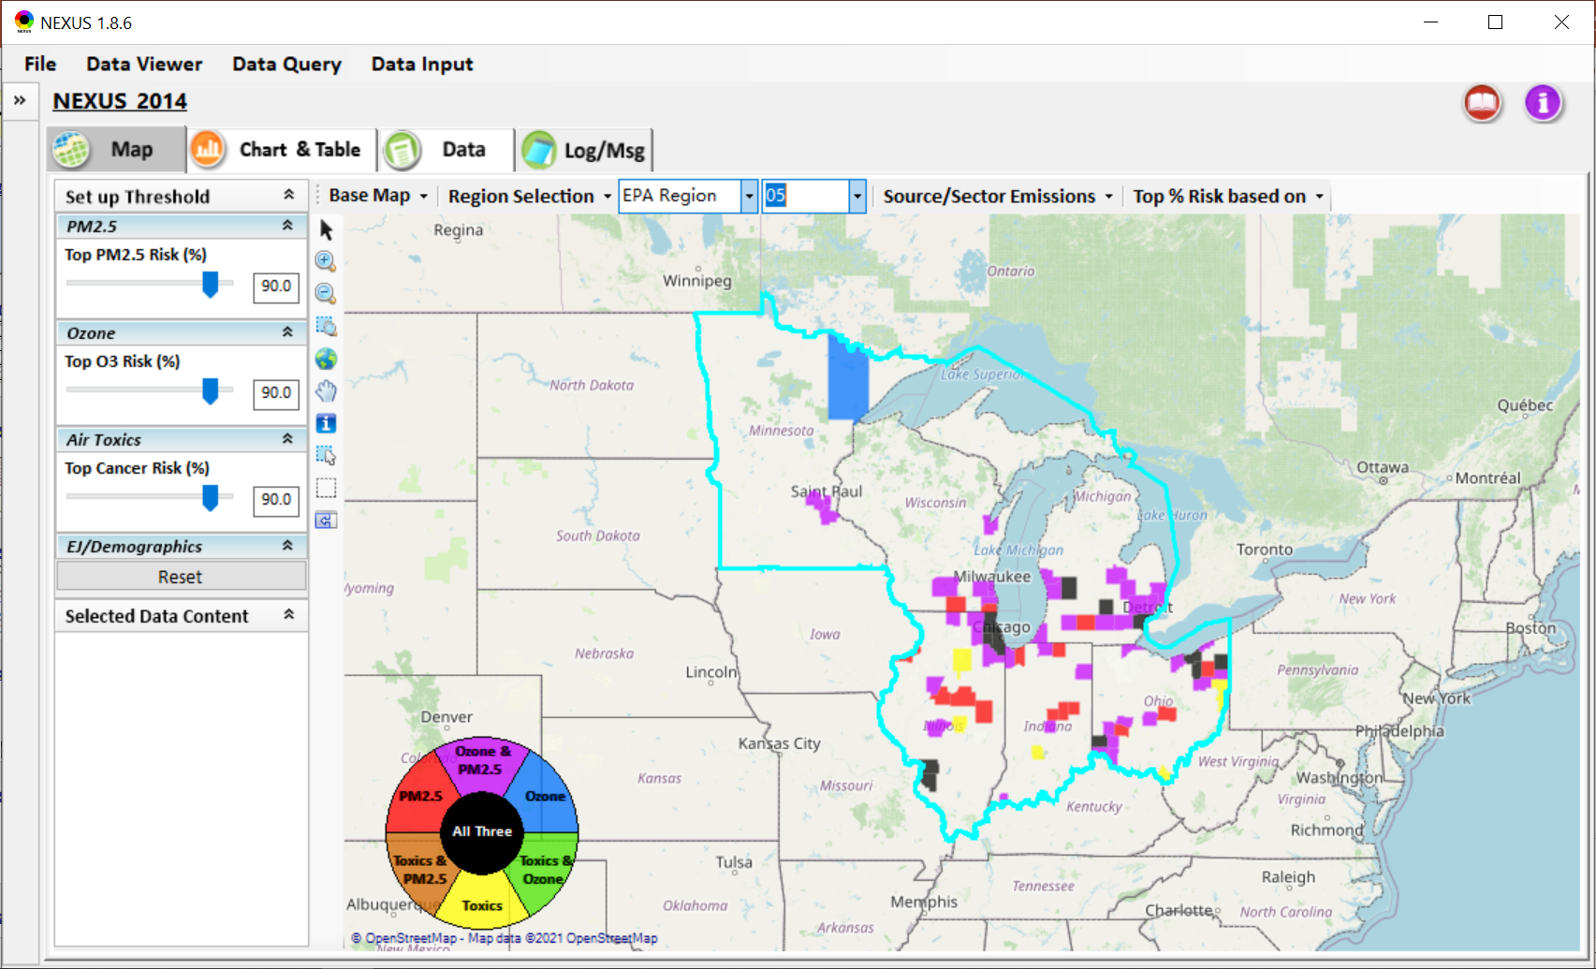
NEXUS: Detroit Example
NEXUS can be used to identify highest risk areas across O₃, PM_{2.5}, and Air Toxics.
Example map above is for Region 5
9

Slide 10
NEXUS: Highest MP Risk Areas in R5 (Data Query Module)
STATE | COUNTY | CBSA | Annual PM_{2.5} DV | Daily PM_{2.5} DV | O₃ DV | PM Mortality Number% | O₃ Mortality Number% | Cancer Risk Rate (max)%
IL | Cook County | Chicago-Naperville-Elgin, IL-IN-WI |  |  | 73 | 99.97 | 99.97 | 99.00
OH | Cuyahoga County | Cleveland-Elyria, OH | 11.7 | 25 | 70 | 99.78 | 99.53 | 97.00
IL | DuPage County | Chicago-Naperville-Elgin, IL-IN-WI |  |  | 70 | 98.73 | 97.70 | 99.00
MI | Wayne County | Detroit-Warren-Dearborn, MI | 11.2 | 28 | 73 | 99.91 | 99.84 | 95.00
MI | Kent County | Grand Rapids-Wyoming, MI | 9.1 | 25 | 68 | 97.92 | 96.71 | 99.00
IL | Lake County | Chicago-Naperville-Elgin, IL-IN-WI |  |  | 73 | 97.83 | 96.56 | 99.00
NEXUS can be used to identify highest risk areas across O₃, PM_{2.5}, and Air Toxics. Information above was generated in Data Query for Region 5 and exported into excel where rankings were applied.
Top CBSAs (using this approach) – Chicago, Cleveland, Detroit and Grand Rapids
10

Slide 11
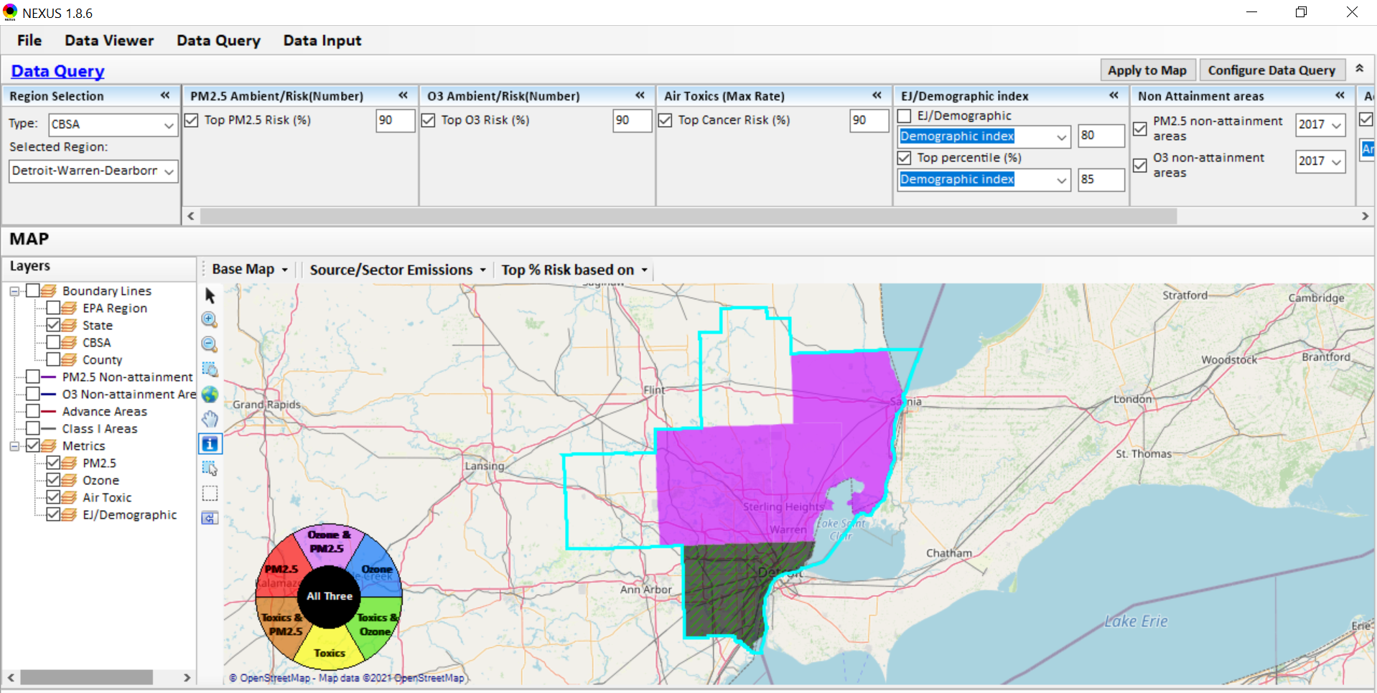
NEXUS: Detroit CBSA
NEXUS can be used to explore CBSAs with MP concerns. This information was generated in Data Query for the Detroit CBSA. Wayne County has dashed green lines, showing that the demographic index percentile is ≥ 85%. Let’s see where the major sources are located…

Slide 12
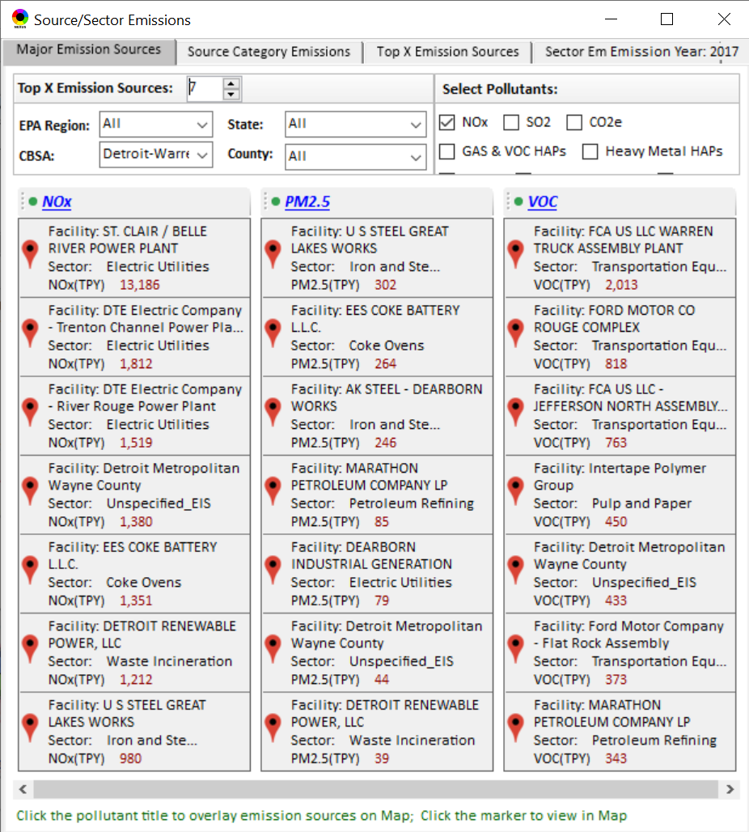
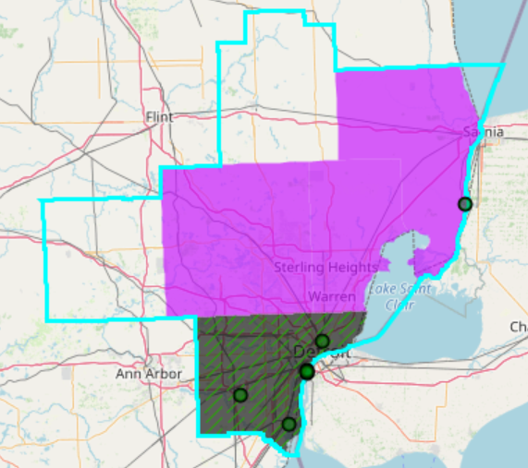
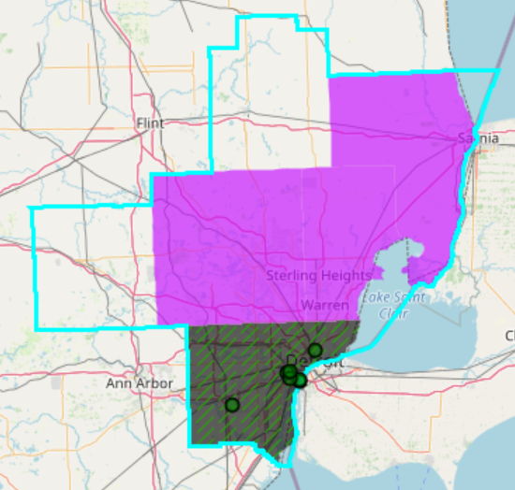
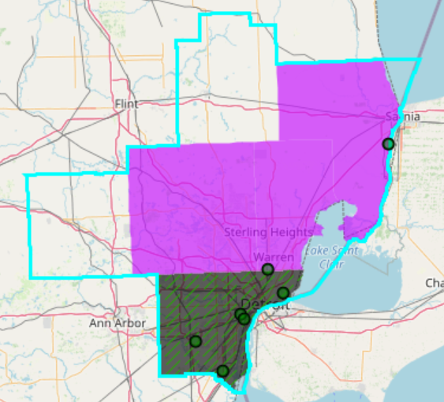
NEXUS: Emissions Sources in Detroit CBSA
Top NOx Emission Sources
Top PM_{2.5} Emission Sources
Top VOC Emission Sources
NEXUS can be used to identify top emission sources. The information above was generated in Data Query for the Detroit CBSA . We can quickly see that the majority of the NOx, PM_{2.5} and VOC & emission sources are located in Wayne County. Let’s explore the Wayne County sources further…
12

Slide 13
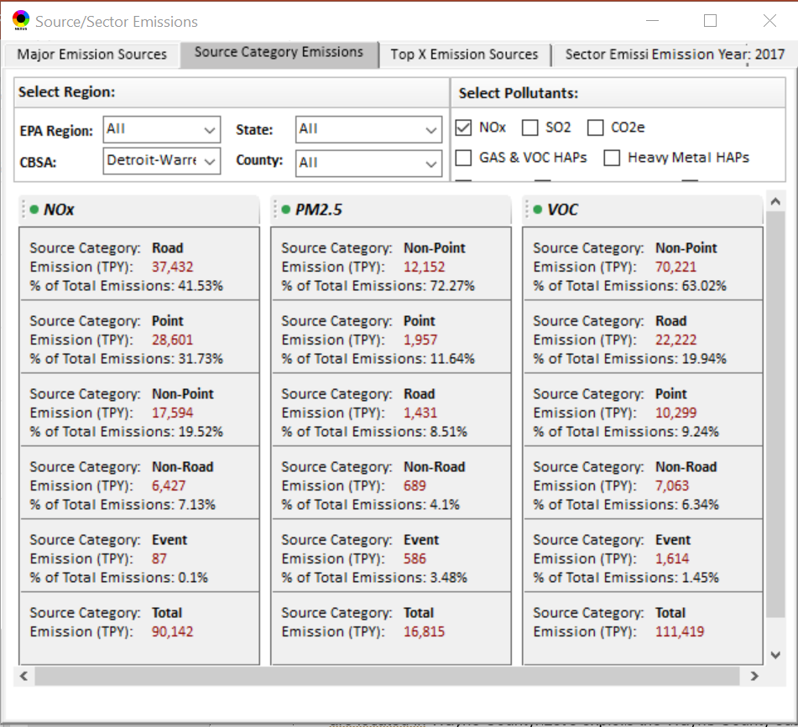
NEXUS: Source Category Emissions in Detroit CBSA
NEXUS can display source category emissions. This information above was generated in the Data Query module for the Detroit CBSA.
13

Slide 14
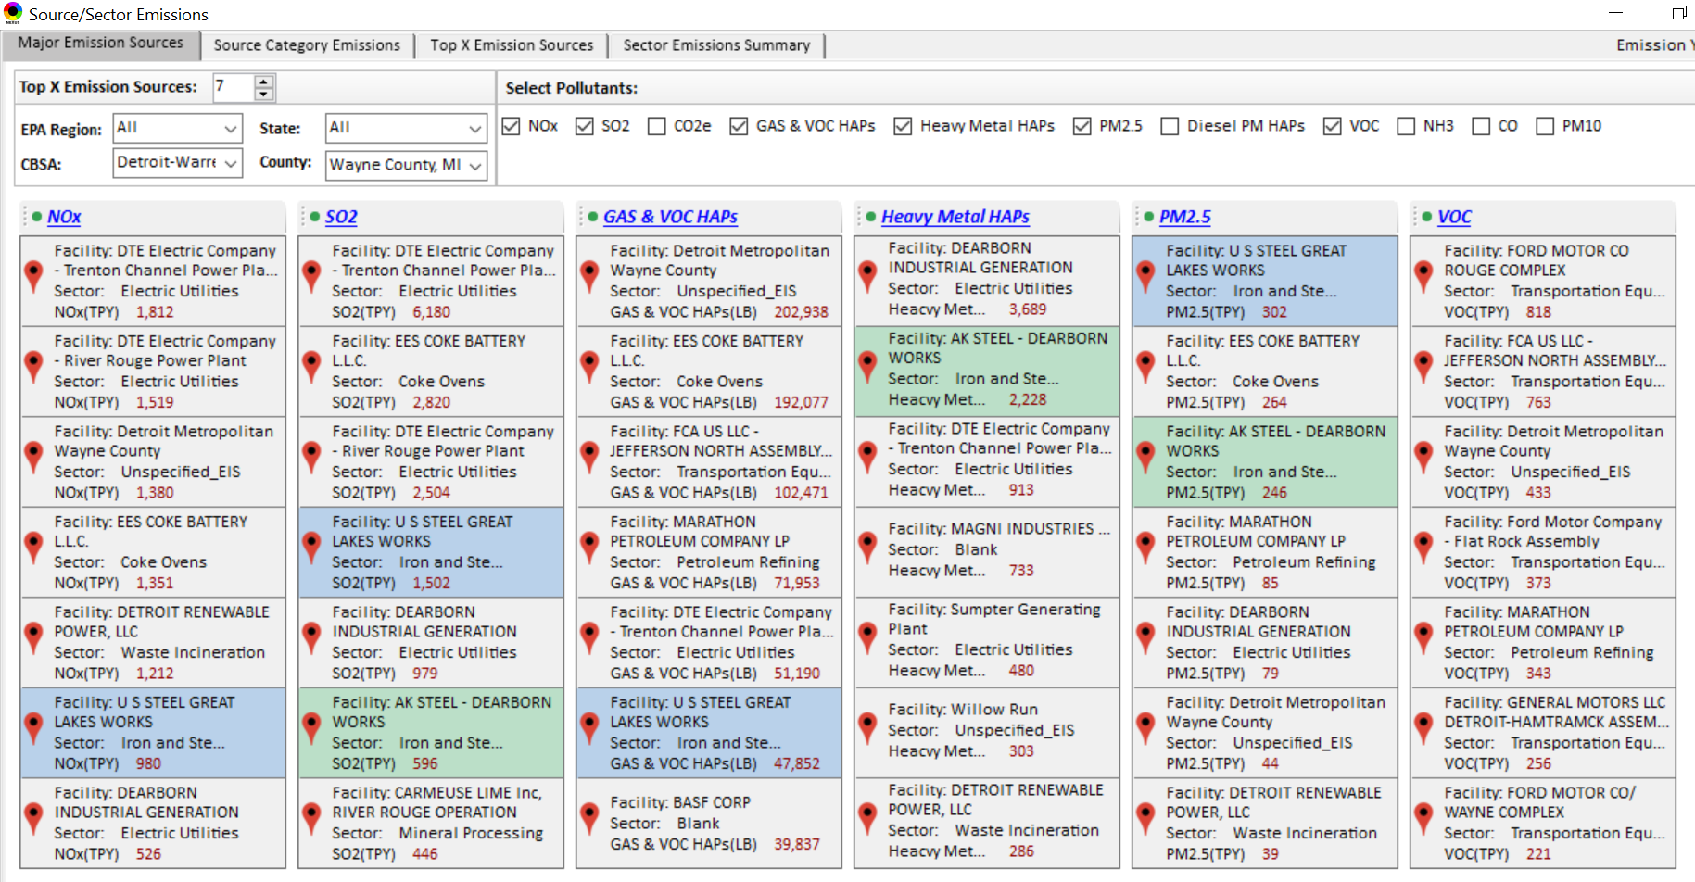
NEXUS Tool: Emissions Sources in Wayne County
NEXUS can be used to identify top emission sources. The information above was generated in Data Query for Wayne County, MI. This can help identify the potential co-benefits of controls. Let’s explore AK Steel and US Steel further...
14

Slide 15
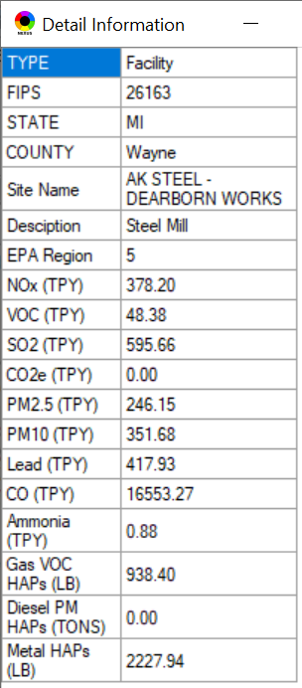
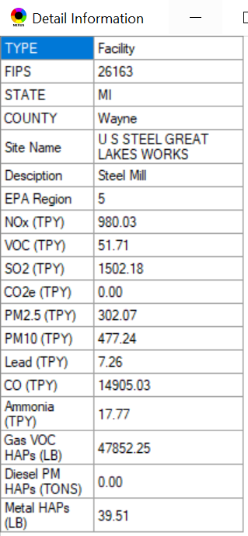
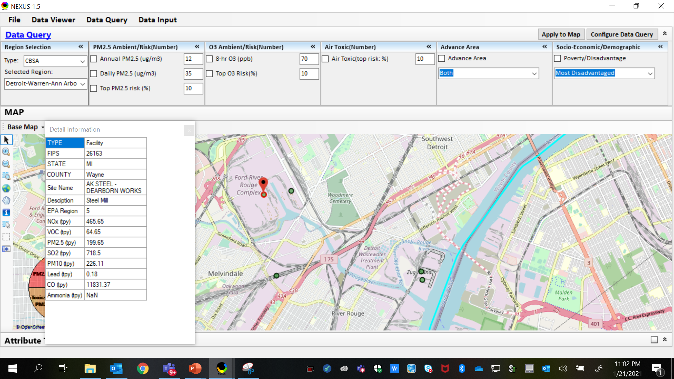
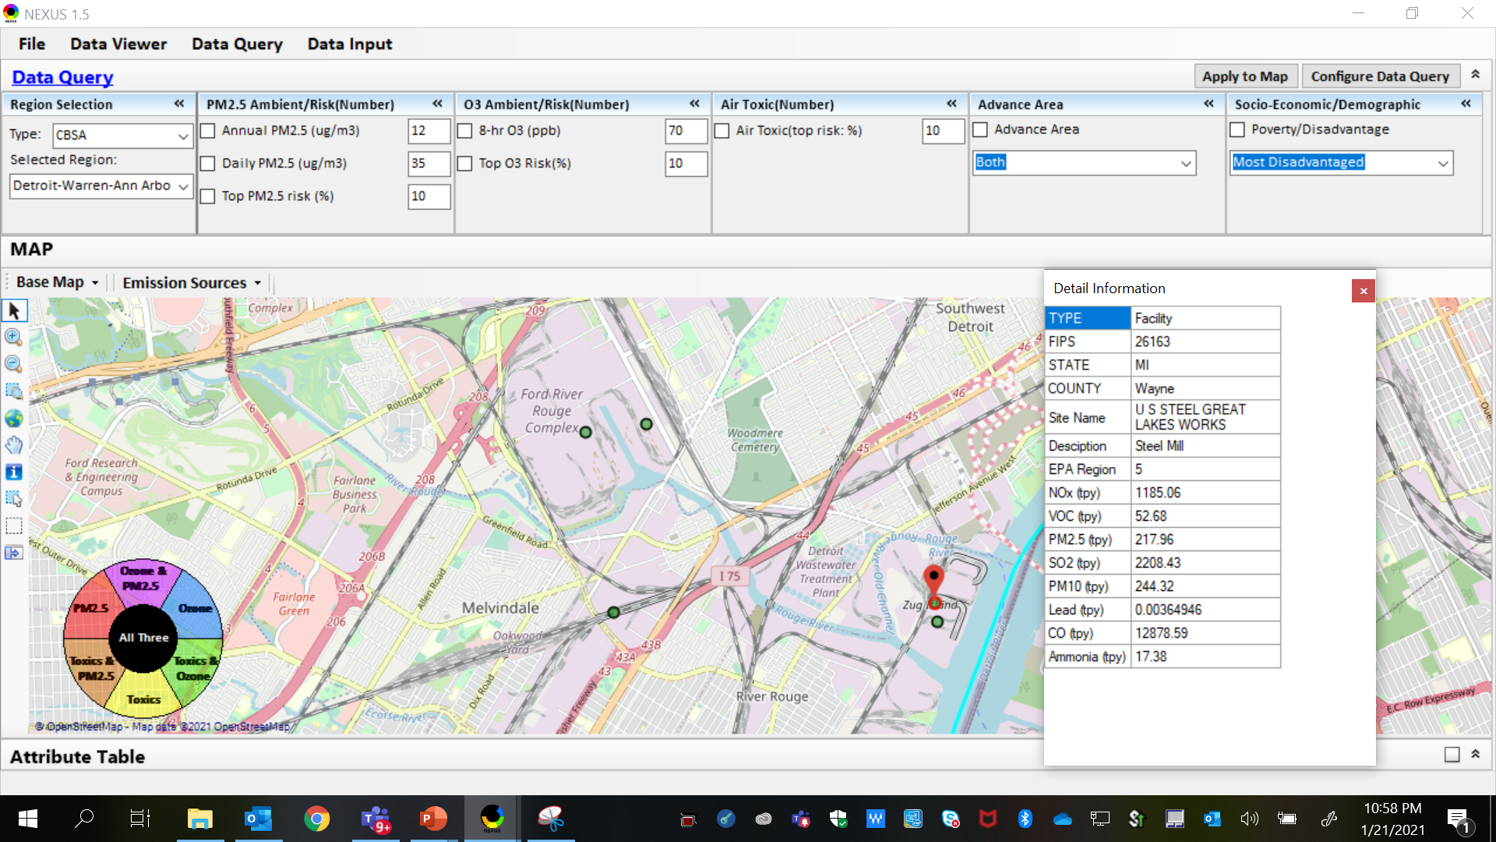
NEXUS Tool: Steel Mills in Wayne County
AK Steel & US Steel were identified as top emitters for NOx, SO₂, Gas and VOC HAPs, Heavy Metal HAPs and PM_{2.5}, highlighting the potential co-benefits of controls in these steel mills. The above map was generated in NEXUS Data Query. Let’s see the proximity of these steel mills to communities with potential EJ concerns…
AK Steel
US Steel
15

Slide 16
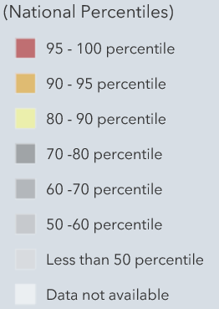
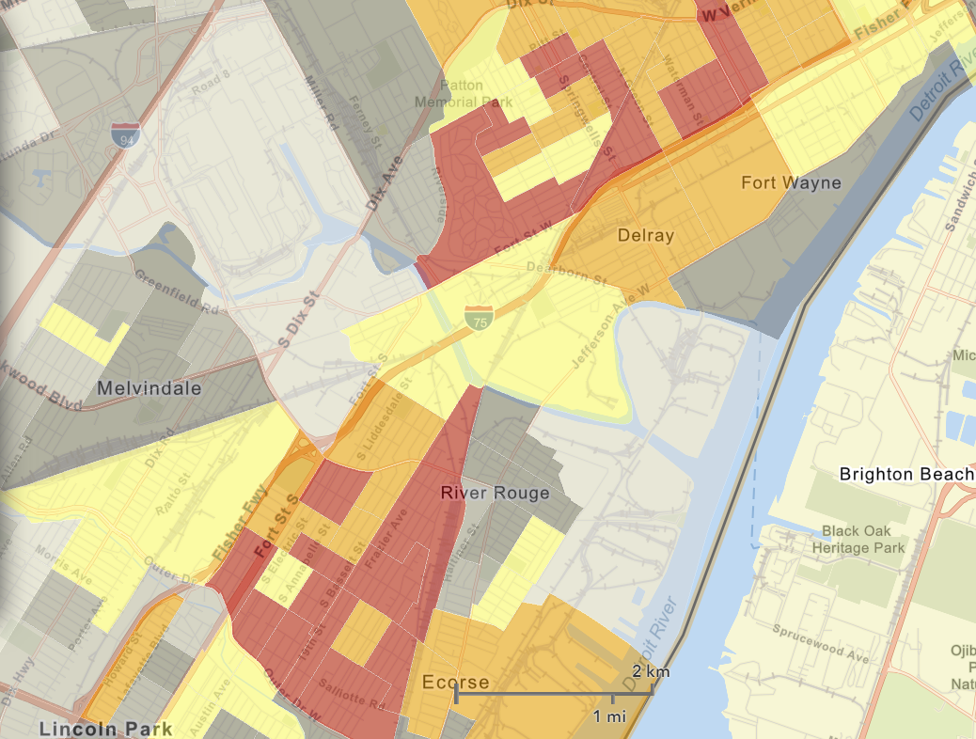
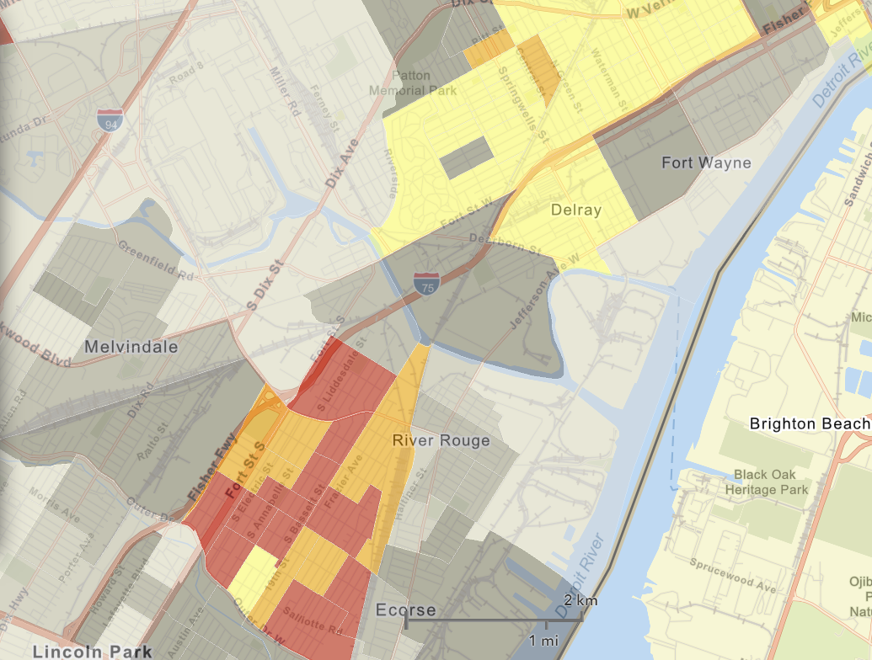
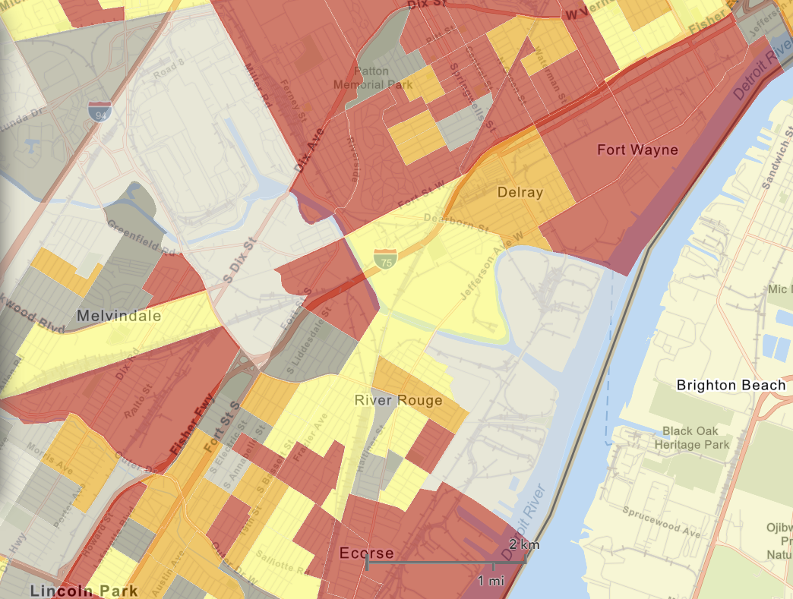

NEXUS Tool: EJ Indices in Wayne County
NEXUS Map
NEXUS can determine the presence or absence of environmental justice concerns in communities in areas with MP concerns. We are incorporating additional EJ metrics such as the data inputs below from EJSCREEN. These indices show the close proximity of AK Steel & US Steel to EJ communities.
AK Steel
US Steel
EJSCREEN Demographic Index
EJSCREEN Minority Population
EJSCREEN Low Income Population
16

Slide 17
NEXUS & EJSCREEN
NEXUS
EJSCREEN
  EJ Layers
    Hazardous waste
    EJ Grants
    Water features
    Places
    Schools & Parks
    Transportation
    Boundaries
    Prisons
    Public Housing
    Subsidized Housing
    Climate
    Sites reporting to the EPA
    Superfund (NPL)
    RSEI
  Environmental Indicators
    Wastewater Discharge Indicator
    Hazardous Waste Proximity
    Superfund Proximity
    Lead Paint Indicator
    Traffic Proximity
    RMP Proximity
  Environmental Indicators*
    NATA Respiratory HI
    NATA Cancer Risk
    NATA Diesel PM
    Ozone Model Concentrations
    PM_{2.5} Model Concentrations
Demographic Indicators
    Demographic Index
    Minority Population
    Low Income Population
    Less Than HS Educated
    Linguistically Isolated
    Under Age 5
    Over Age 64
EJ Layers
Nonattainment Areas
Tribal Areas
Ozone and PM_{2.5}
Emissions and source data
Mortality Risk data
Monitoring data
Air Toxics
Emissions and source data
Modeled concentration data
Risk data
Monitoring data
GHG emissions
*Provided to OEJ by OAQPS (AQAD & HEID)
17

Slide 18
NEXUS and EJSCREEN
NEXUS specifically designed for AQ planning: overlays publicly available air quality information to identify geographic areas where health risks related to O₃, PM_{2.5} and air toxics overlap
EJSCREEN specifically designed for EJ screening: combines environmental & demographic data to highlight areas where vulnerable populations may be disproportionately impacted by pollution
NEXUS contains air data not available in EJSCREEN: detailed emissions and source characterization, O₃ and PM_{2.5} risk data, NATA cancer and non-cancer risk by pollutant and source)
NEXUS relevance for OAQPS EJ screening and outreach efforts: By incorporating EJ indicators and data from EJSCREEN, it can highlight the nature of multi-pollutant AQ issues for communities with EJ concerns
Enhanced NEXUS screening capabilities: We plan to update NEXUS to incorporate proximity screening capabilities similar to EJSCREEN & the OAP/CAMD tool
18

Slide 19
NEXUS: Recent & Ongoing Development
NEXUS “1.5” (Jan. 2021) → NEXUS “2.0” (Sep. 2021)
  New/revised Metrics (PM_{2.5}, O₃, Air Toxics + EJ/Demographics as 4th metric)
  New/updated data inputs and functions:
    EJ/Demographic data (from EJSCREEN)
    Tribal areas, Advance areas, Attainment/DVs data, etc.
    2017 emissions data (including GHG & Sector mapping) (updated from 2014)
    “Sector Emissions Summary” module to support “Sector prioritization” effort
    “Source Category Emissions” module (point, non-point, on-road, non-road, event)
    Monitoring sites/data (PM_{2.5}, O₃ and Air Toxics)
Near-term (Ongoing) Updates/Improvements
  Updating to 2017 fused PM_{2.5} & O₃ and health risk data (Nov.) and fused air toxics and risk data (Dec.) from current 2014 data
  Developing “Proximity analysis for MP risks and EJ” module (Dec.)
19

Slide 20
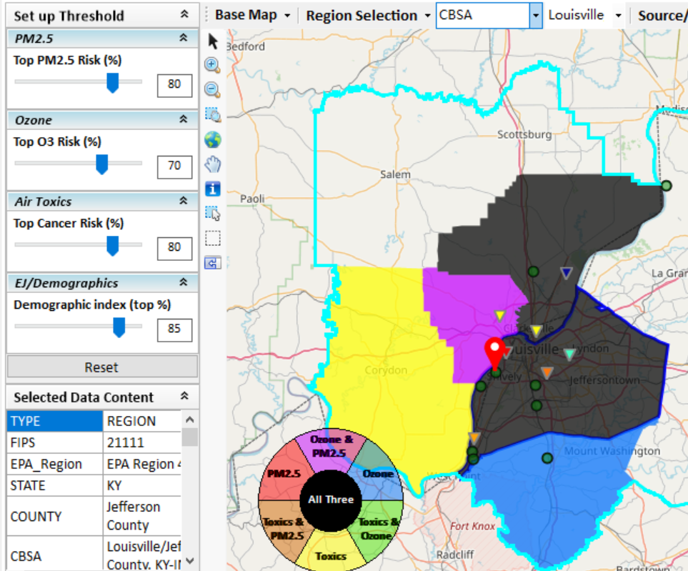
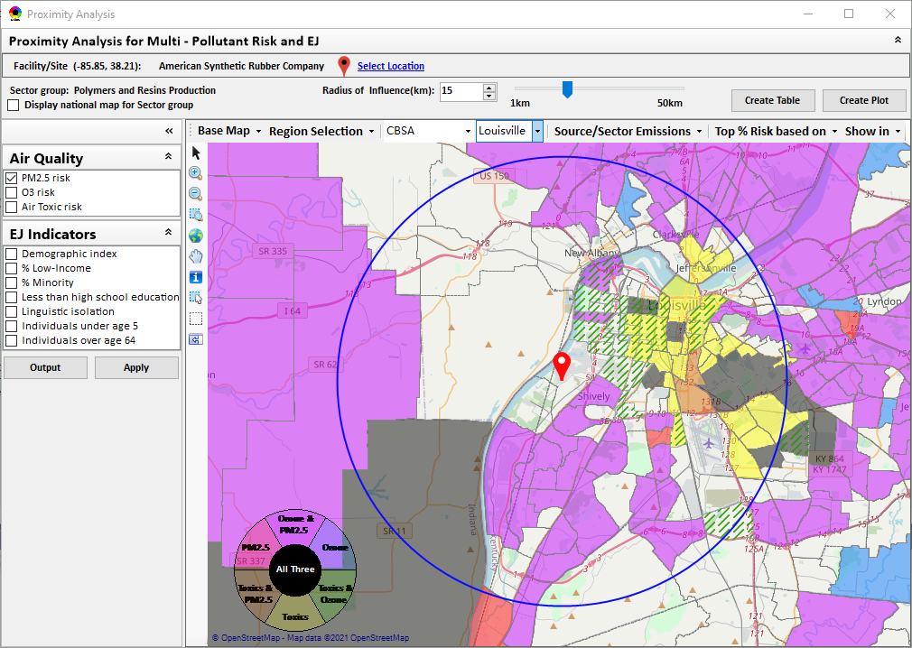
New “Proximity Analysis” Module (under development)
Currently in NEXUS
Proximity Analysis for MP Risks and EJ
County – level (current)
Community (Census Tract) - level
20

Slide 21
Regional Office Feedback Process
Feedback Process
Feedback Requested
Download, install and explore NEXUS 2.0 https://gaftp.epa.gov/Air/aqmg/cjang/NEXUS/NEXUS 2.0/
Provide feedback / questions / concerns to Beth Landis (landis.elizabeth@epa.gov) and Carey Jang (jang.carey@epa.gov) by January 21, 2022
Suitability for air quality planning efforts and engagement with SLTs
Interest in a region-specific discussion regarding NEXUS use
Suggested improvements in NEXUS regarding data, visualization, screening capabilities, etc.
Any errors/bugs/concerns
21

Slide 22
“NEXUS 2.0”
Download “NEXUS” tool at: https://gaftp.epa.gov/aqmg/cjang/NEXUS/NEXUS 2.0/*
Carey Jang
OAR/OAQPS/AQAD/Air Quality Modeling Group, November 2021
22

Slide 23
“NEXUS 2.0”:
Quick Tutorial
Appendix
Download “NEXUS” tool: The “NEXUS 2.0” package (“NEXUS 2.0 Setup.exe” & “NEXUS 2.0 Data.exe”: run both “*.exe” files to install) can be downloaded at EPA’s new FTP site:
https://gaftp.epa.gov/aqmg/cjang/NEXUS/NEXUS 2.0/*
Note: Require software installation privilege or “Power Broker” (limited elevated privilege) to install “NEXUS tool” at EPA’s PC; Check “This PC\Documents\My NEXUS files\data\* (\tool\*, \result\*)” to see if NEXUS program & input dataset are installed successfully
23

Slide 24
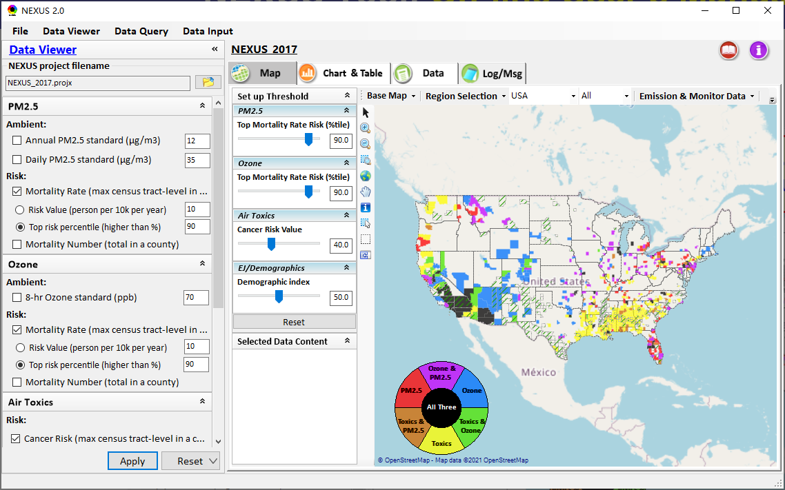
NEXUS Tool: On-line User’s Manual
Click “book” icon to launch “User’s manual”
Hot link to User’s manual’s “Data Viewer” chapter (same for “Data Input” module & “Data Query” model)
24

Slide 25
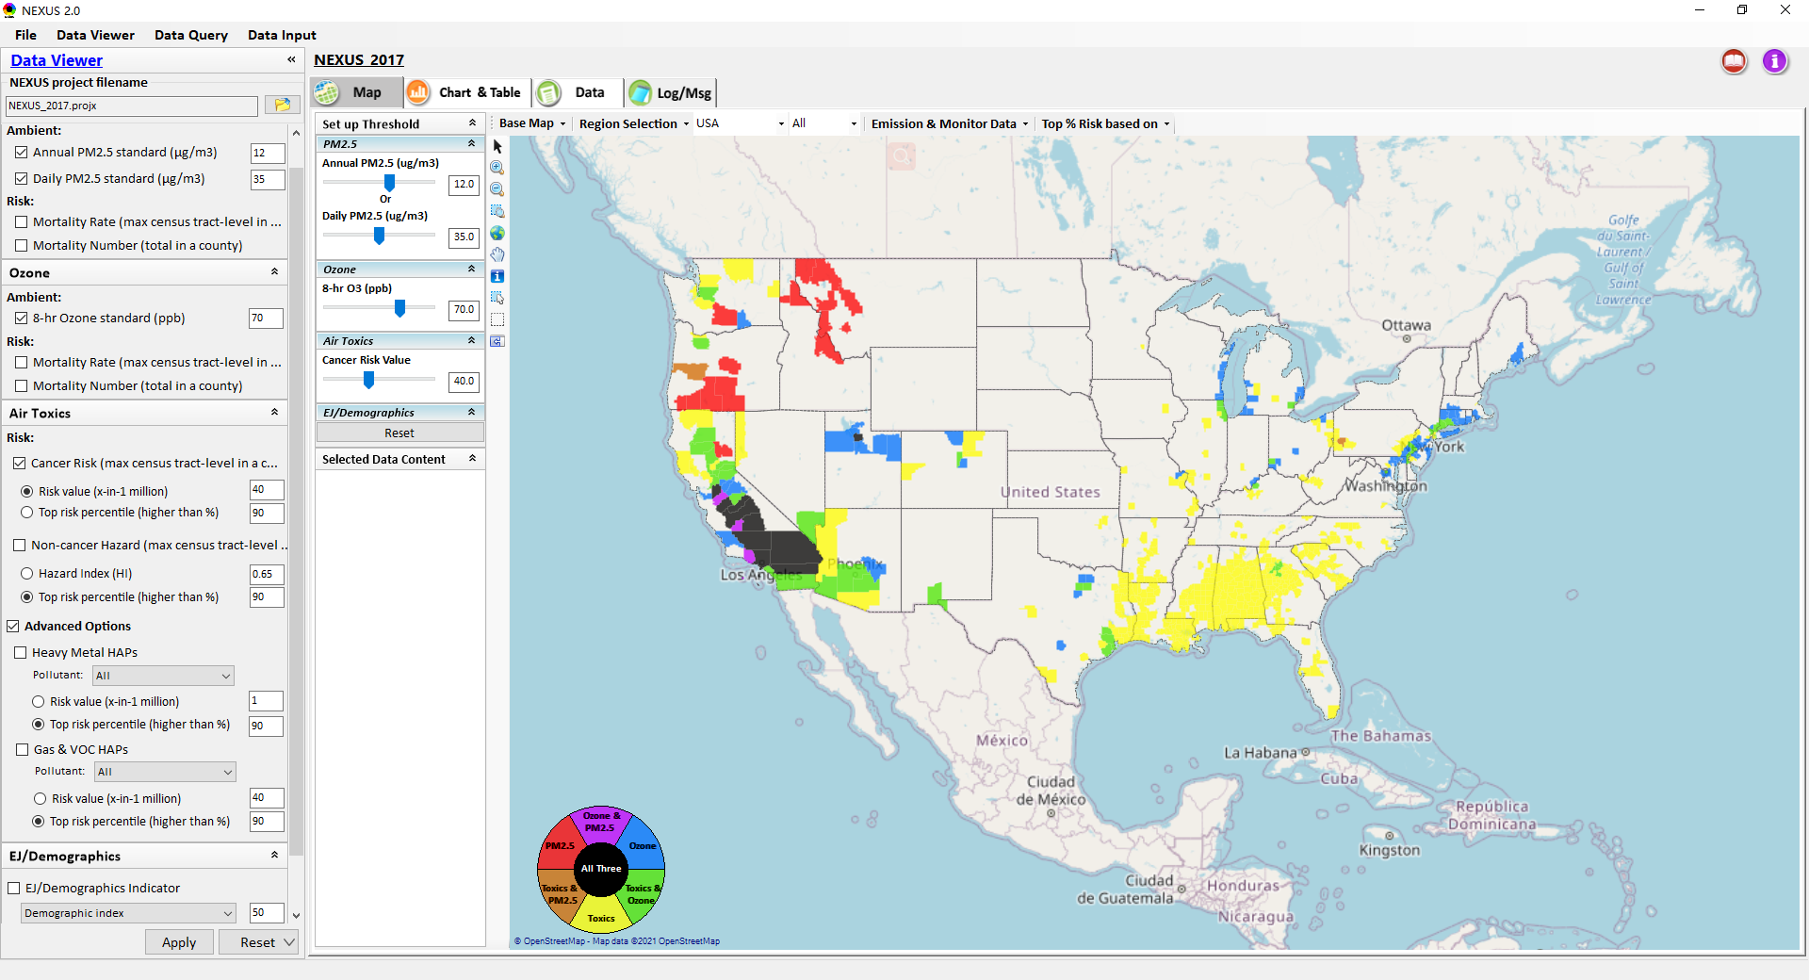
NEXUS Tool: Data Viewer Module
Click “File” to open or save a project
Switch between 3 key modules
NEXUS project file name
Select & adjust “Ambient” or “Risk” levels
“Advanced Option”: provide HAPs & species selections
25

Slide 26
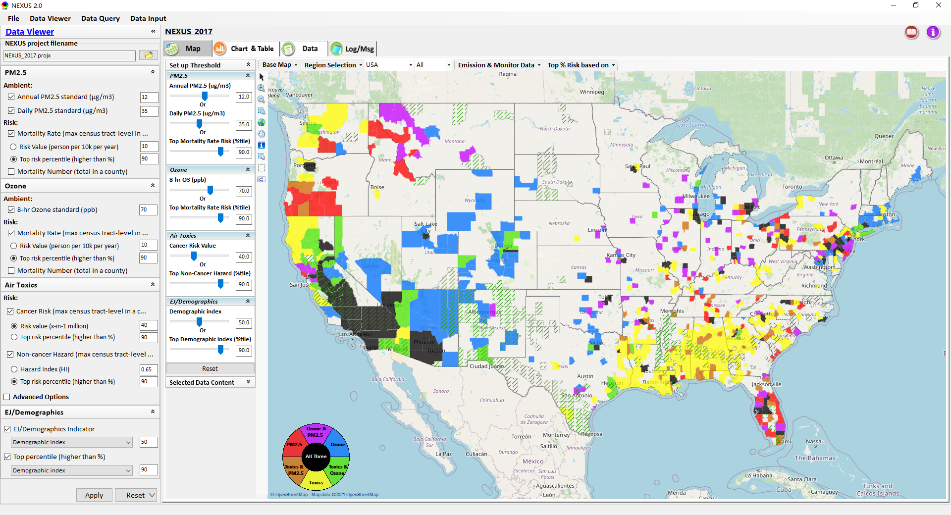
Data Viewer: “Apply” New Selections
“Check” boxes to change/add selections
New selections will appear in “Slider bars” panel and map display
“Slider bars” allow to select & adjust “Ambient” and/or “Risk” threshold levels and displaying color map
“Apply” new selections
26

Slide 27
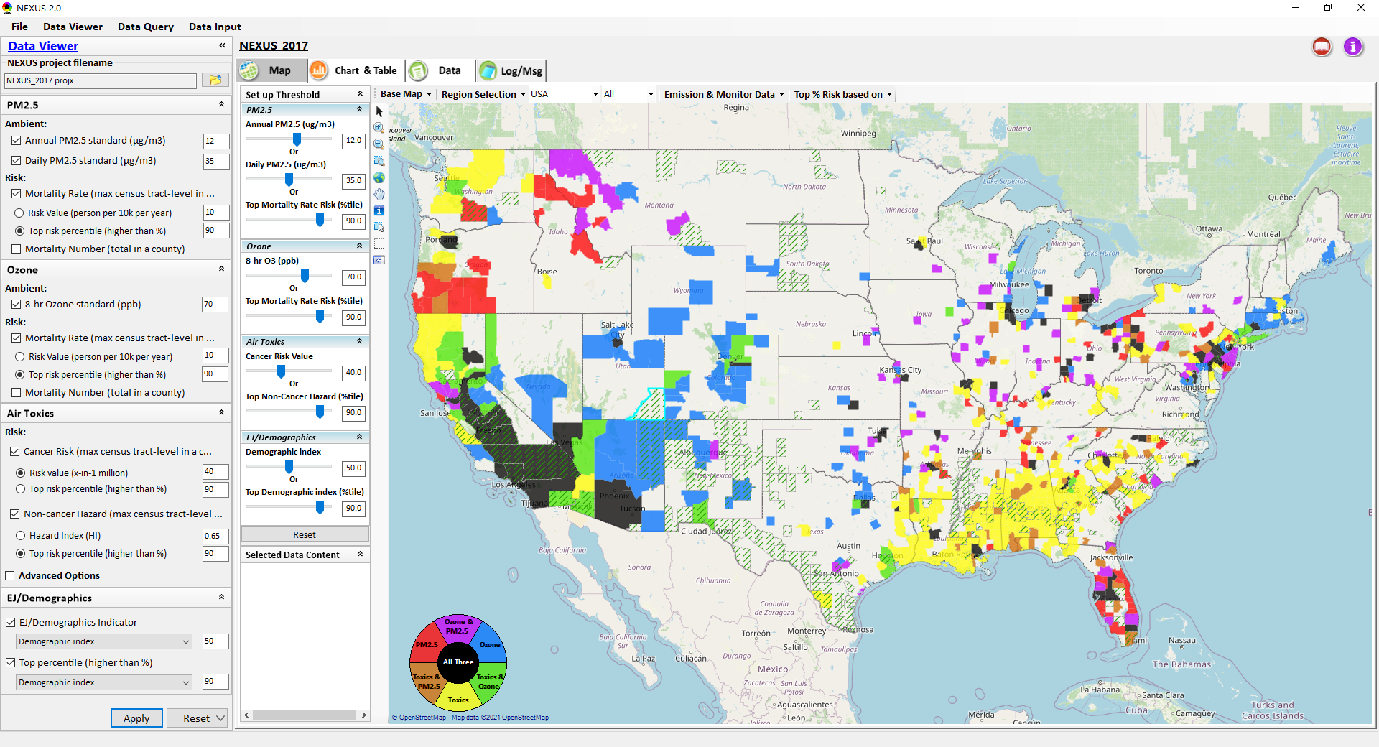
NEXUS Update: New EJ Metric and Data
New EJ/Demographic metric is added to display in “Green dash” for counties exceeding selected threshold
27

Slide 28
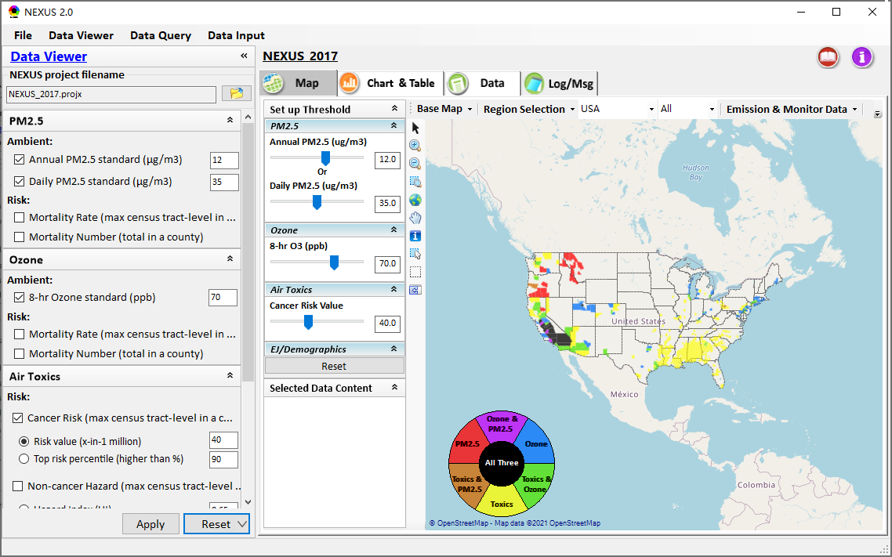
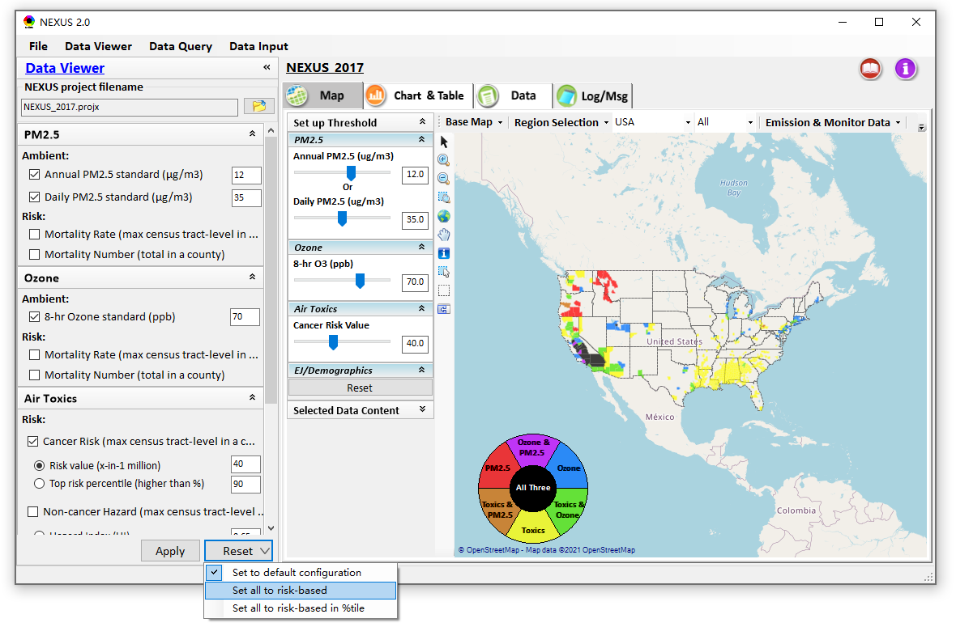
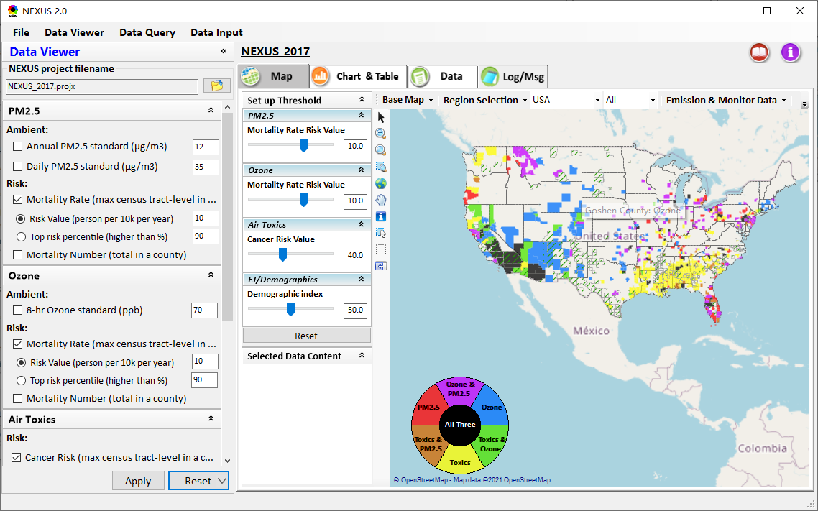
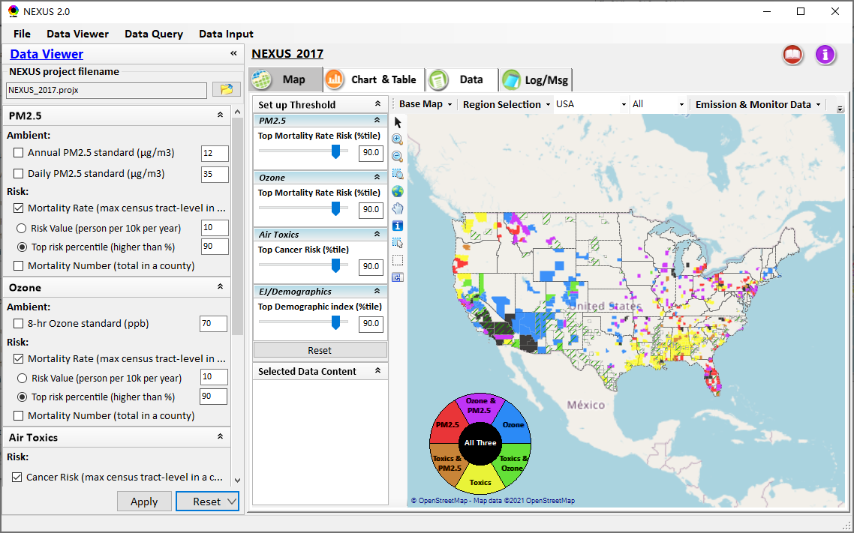
Data Viewer: “Reset” New Selections
default configuration
risk-based
“Reset” new selections
risk-based in %tile
28

Slide 29
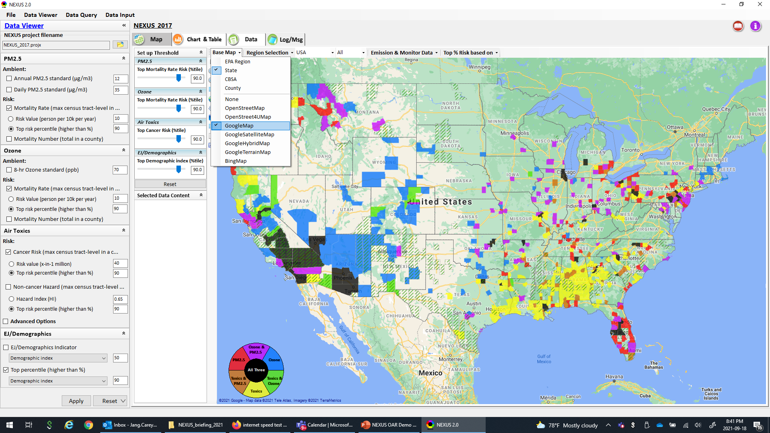
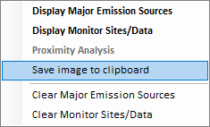
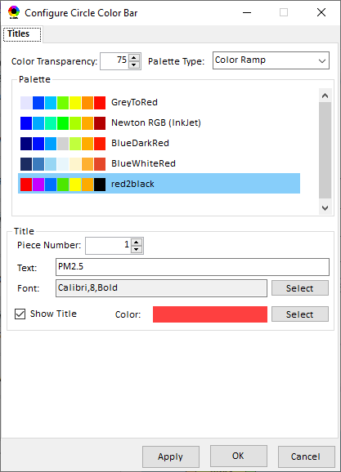
Data Viewer Module: Configure Base Map & Color
“Base Map”: Change boundary lines and background map (e.g., “Google Map”)
“Right-click” map to save map image
Click “color map” to change color & transparency
29

Slide 30
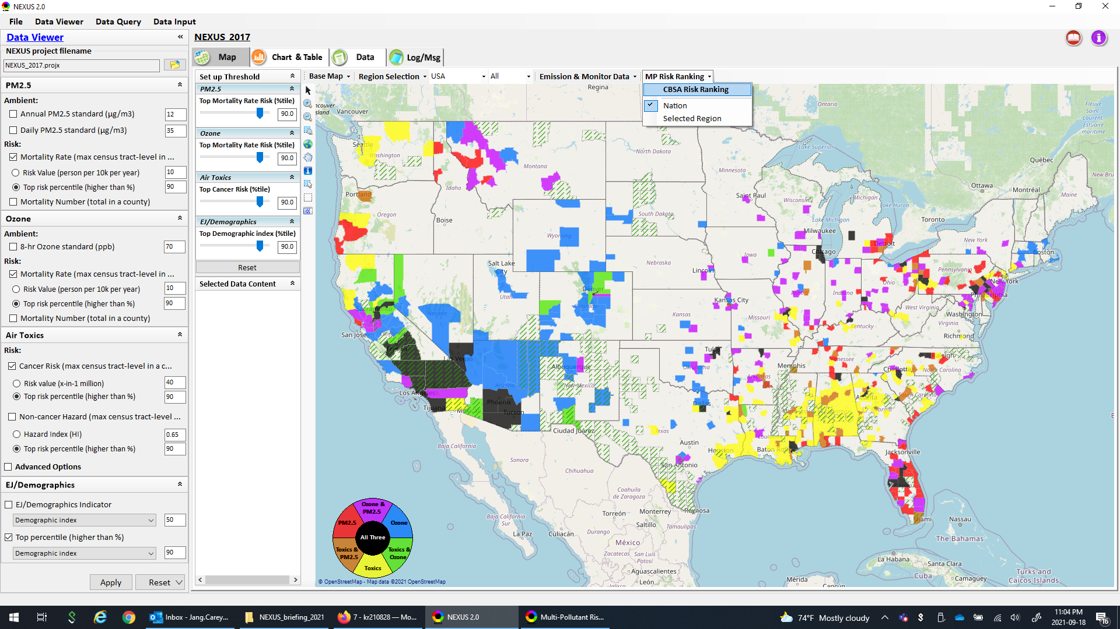
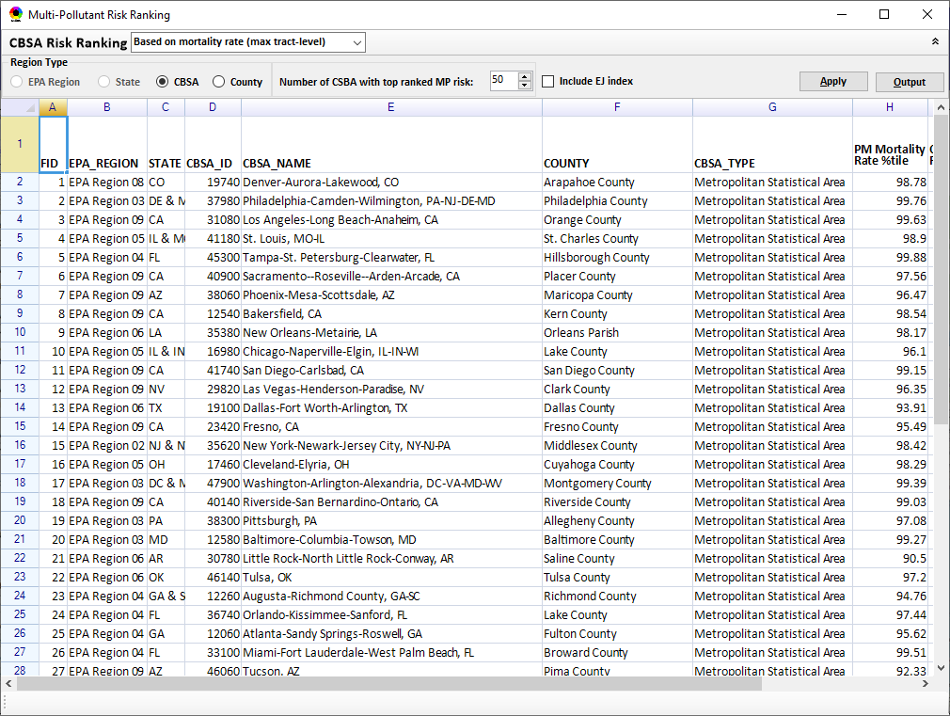
Data Viewer Module: MP Risk Ranking
“CBSA Risk Ranking”: provide MP risk ranking by CBSA or County
30

Slide 31
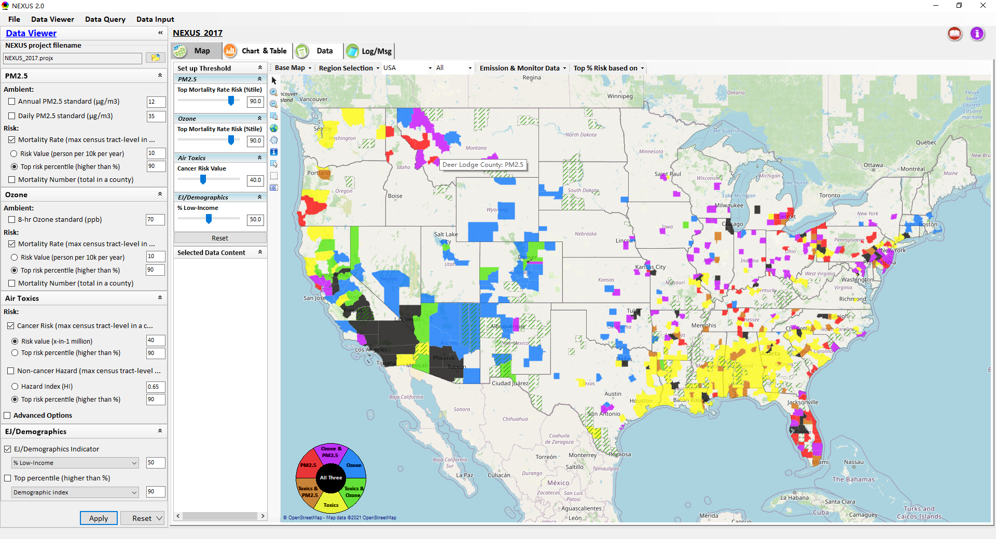
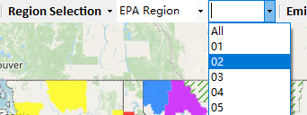
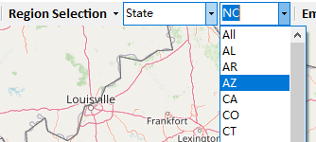
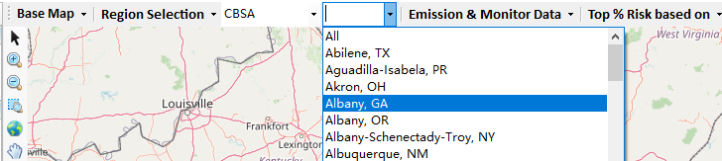
Data Viewer: “Region Selection”
Allow to select “EPA regions”, “States”, or “CBSA”
31

Slide 32
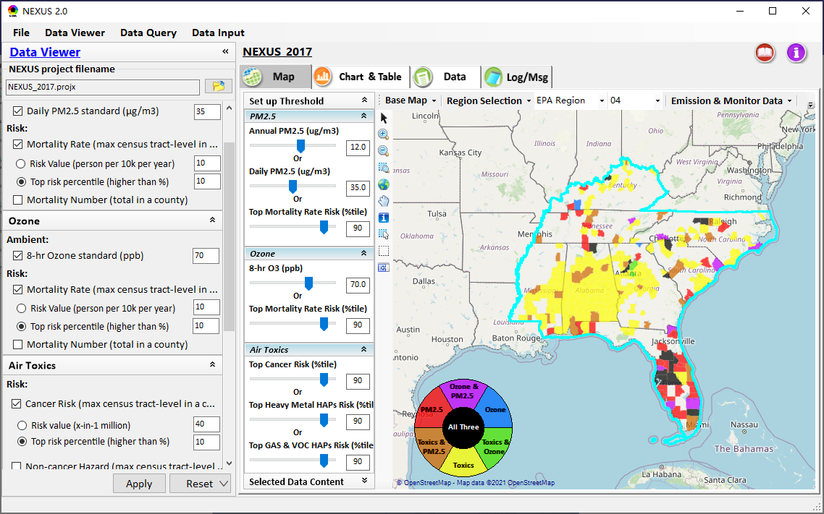
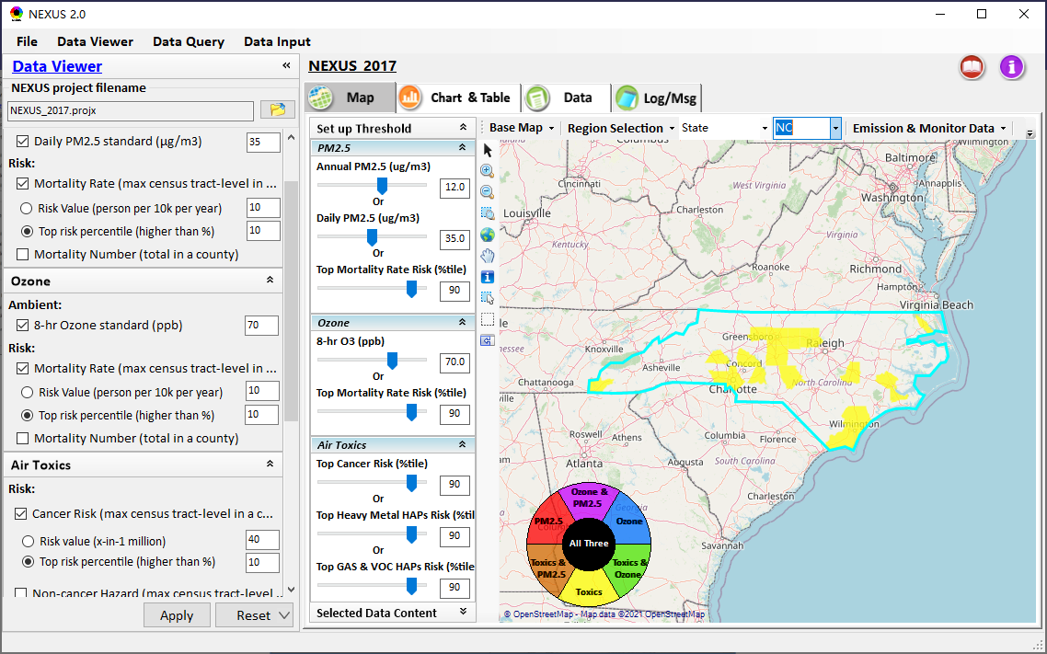
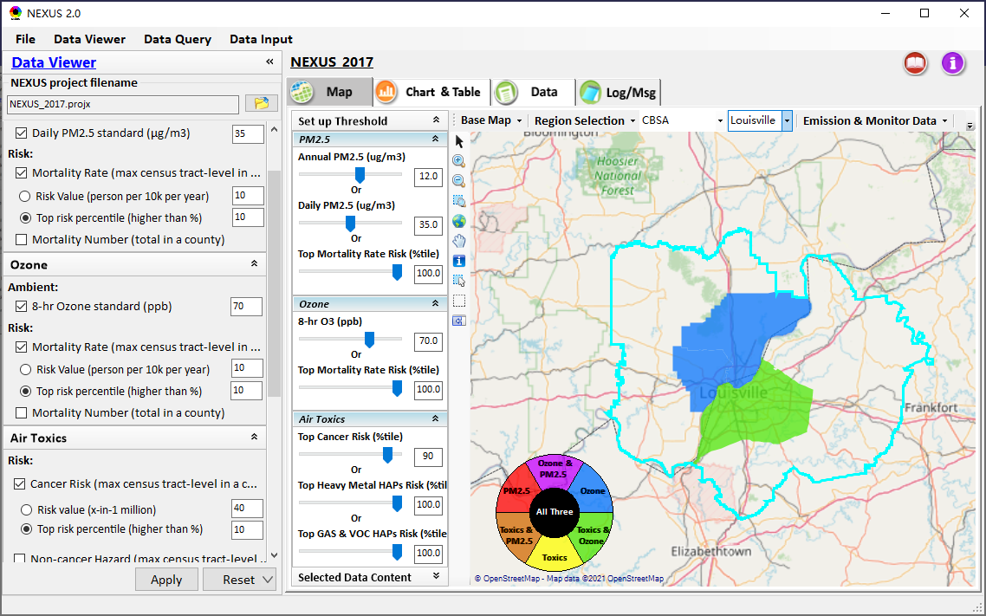
Data Viewer: Select EPA Region/State/CBSA
Examples:
EPA Region 4
NC State
Louisville CBSA
32

Slide 33
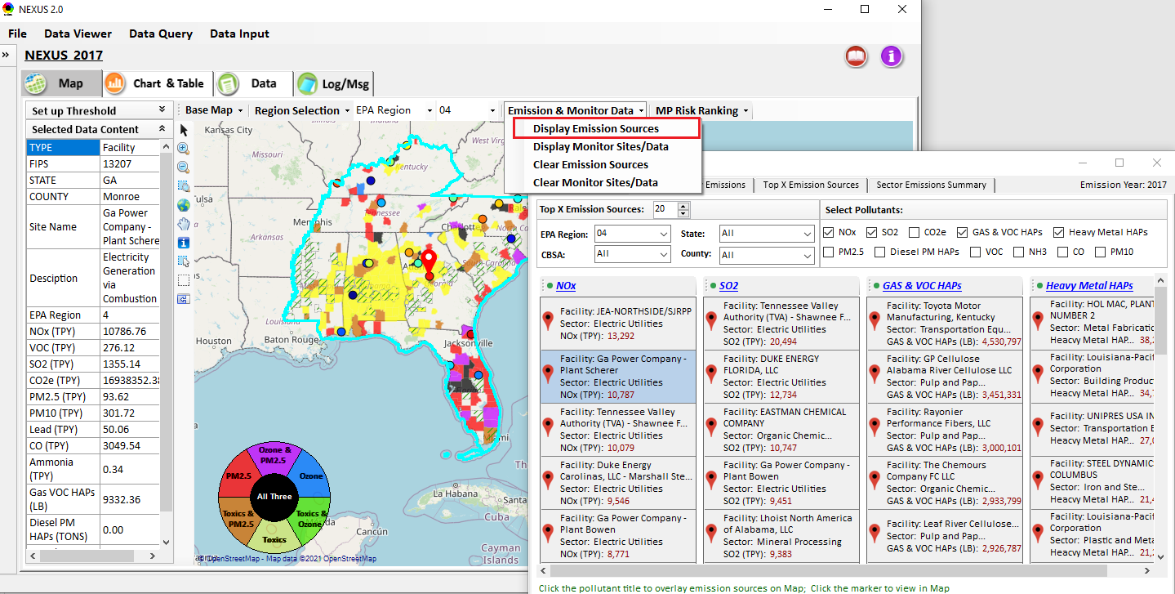
Data Viewer: Major Emission Sources
Click “Display Emission Sources” tab to display emission sources and launch new window
Click any “facility” to link & display source location and emission information. Same facility emitting various pollutants can be easily identified with the highlighted color
33

Slide 34
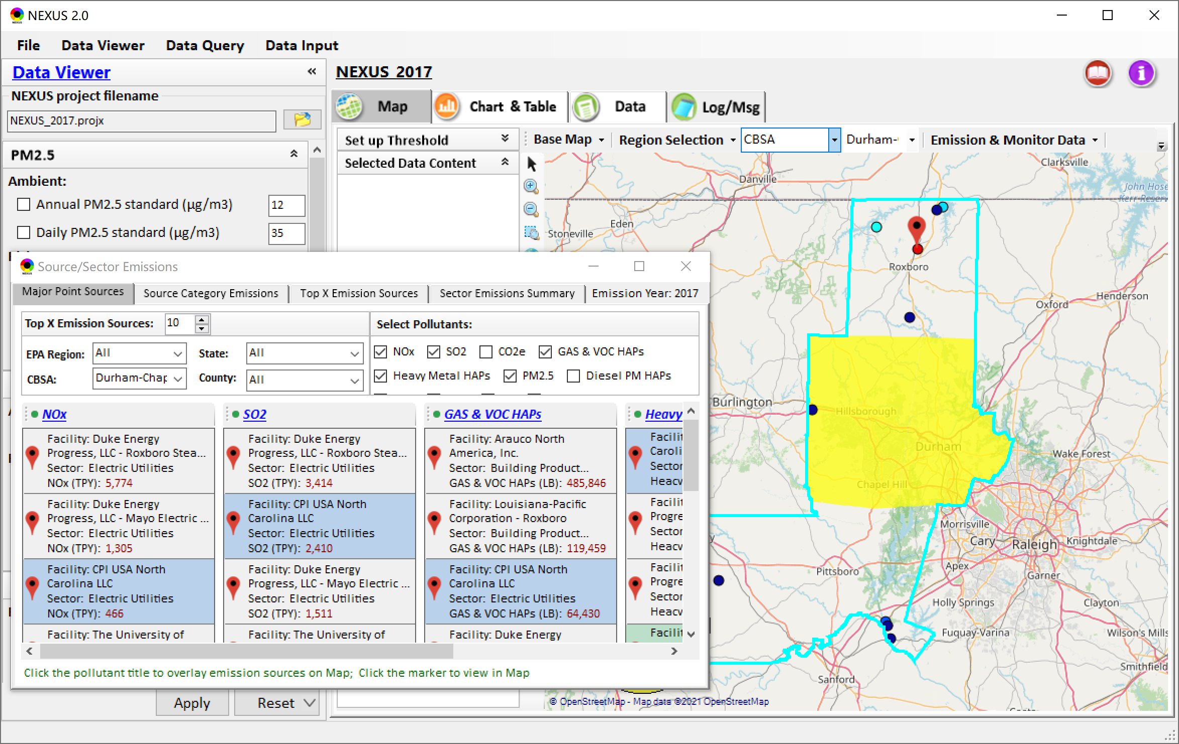
Data Viewer: Major Emission Sources
Allow to scroll down to CBSA-level (e.g., Durham CH CBSA ) or County-level
Durham CH CBSA
34

Slide 35
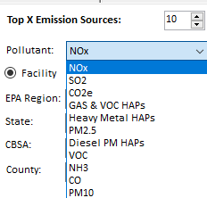
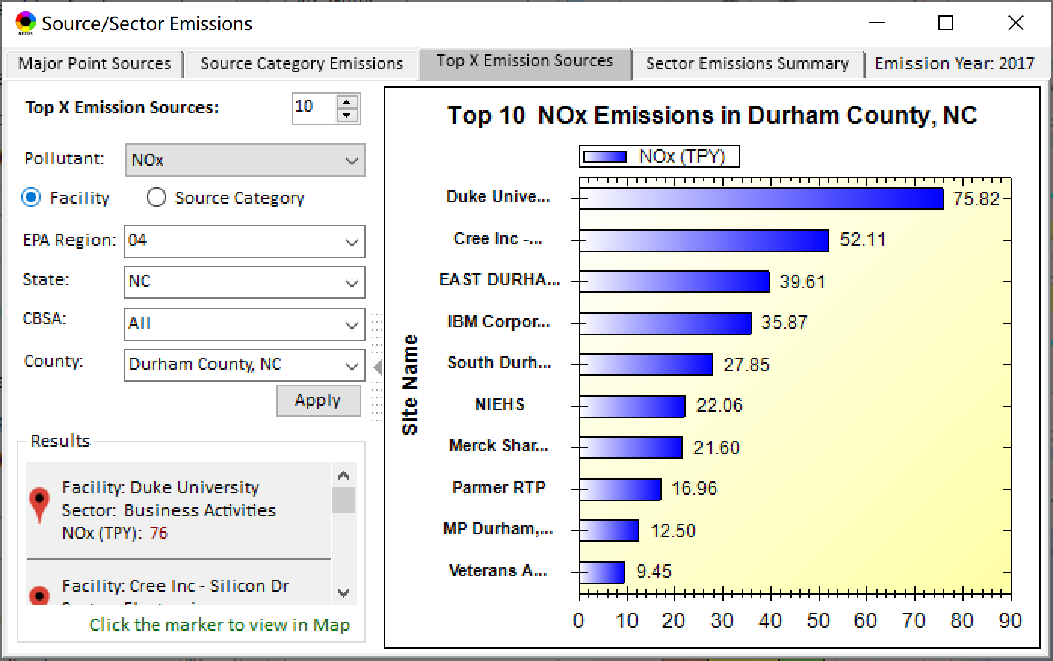
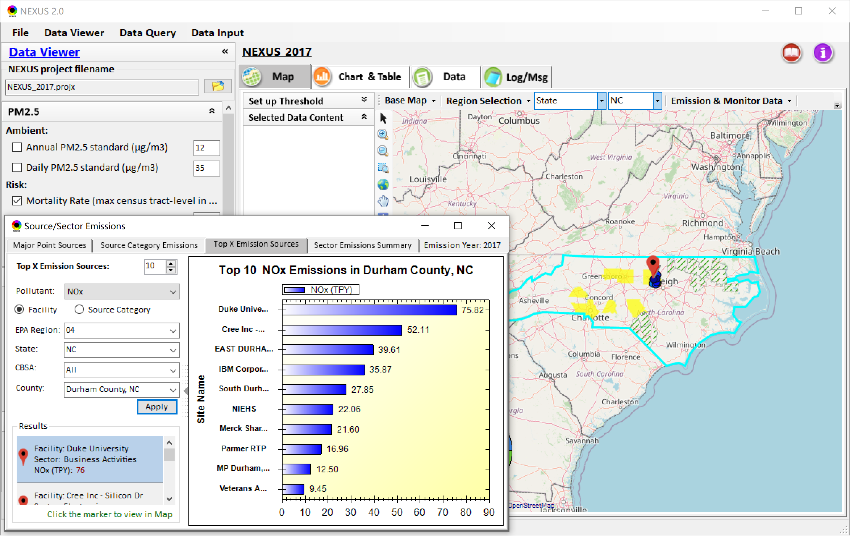
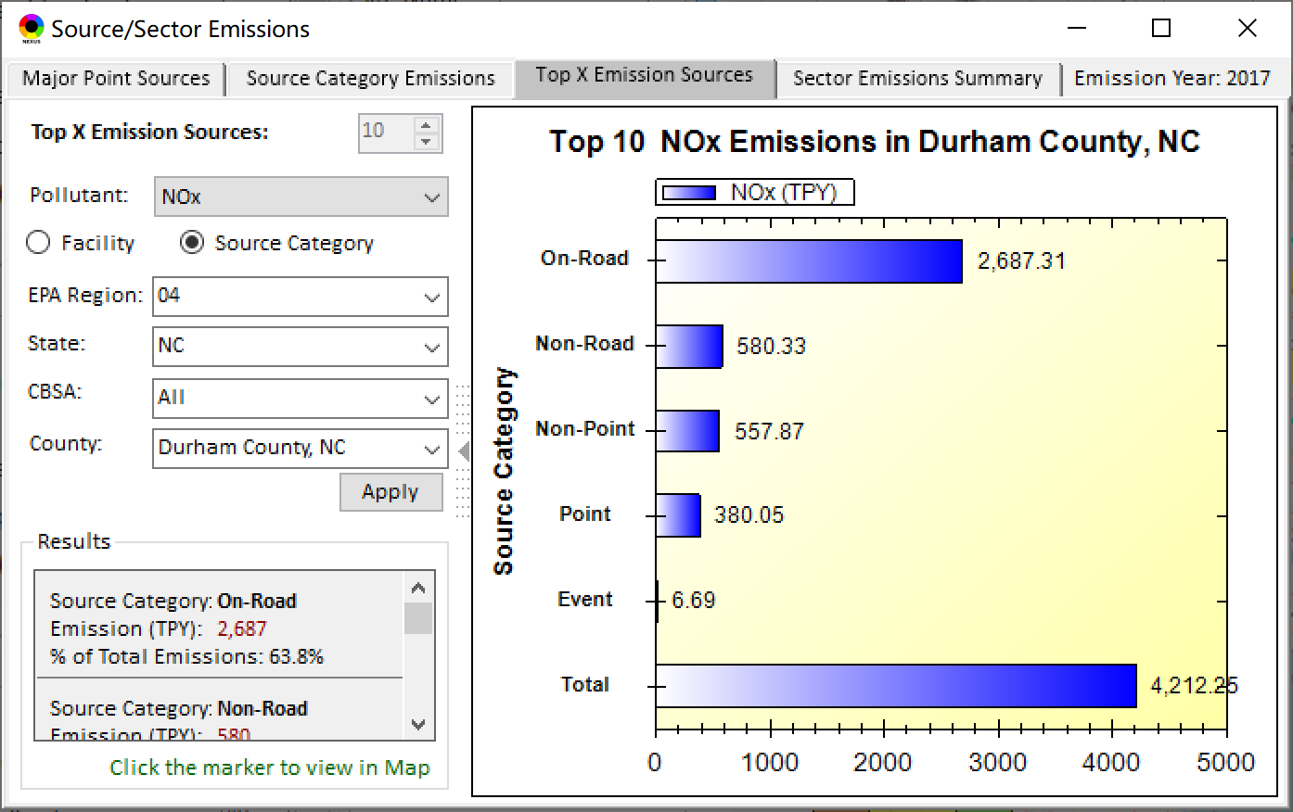
Data Viewer: Top “x” Emission Sources
Provide selection of Facility & Source Category
Provide selection of Facility & Source Category
Durham county, NC
35

Slide 36
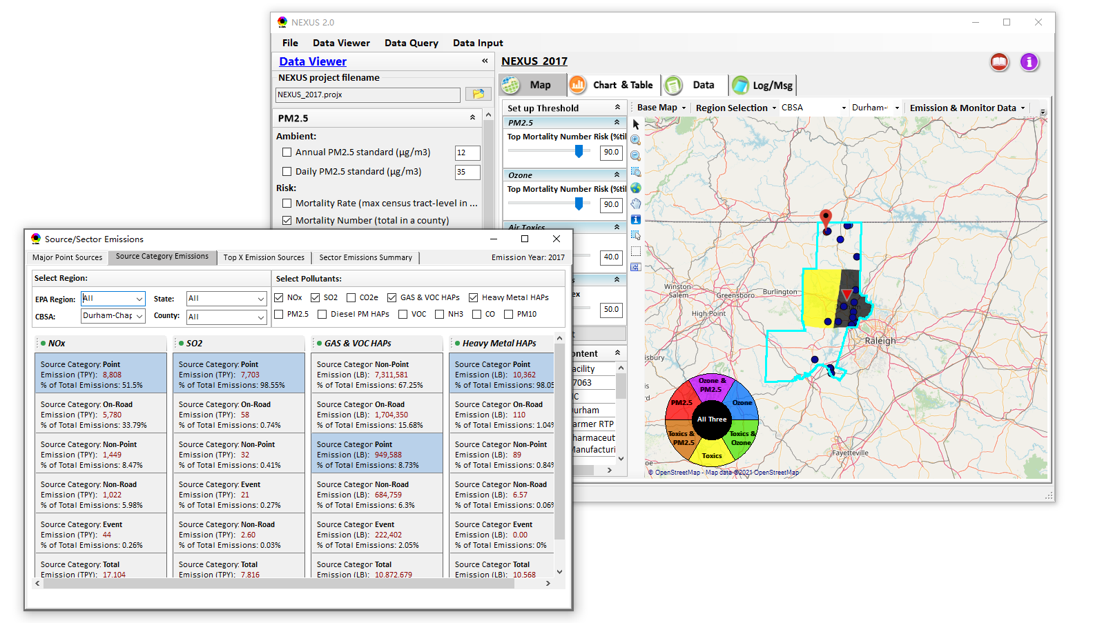
NEXUS Update: “Source Category Emissions”
“Source Category Emissions” module provide five source categories, including “point”, “non-point”, “on-road”, “non-road”, and “event” emissions for the selected region, CBSA, or county.
36

Slide 37
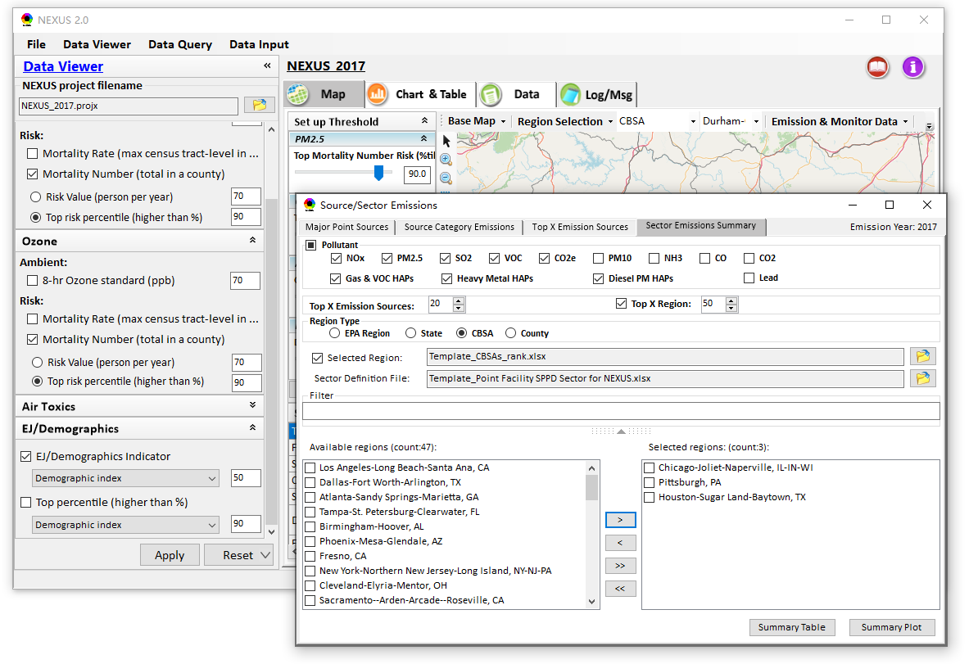
NEXUS Update: “Sector Emissions Summary”
“Sector Emission Summary” function allow to select major CBSAs and provides source and sector emissions summary to support OAQPS’s “Sector Prioritization” project effort
37

Slide 38




NEXUS Update: “Sector Emissions Summary”
Summary table
Summary plot
Emissions
Frequency & Rank
38

Slide 39




NEXUS Update: “Monitoring Data/Site” Module
AQ trend
Right-click to invoke
Click to display
AQ trend at monitor site
Monitor Site/Data
Click to select monitor site
& pollutant
39

Slide 40

Data Viewer: EPA Region Table Generator
“EPA Region Table Generator” provides attainment status of O3 and PM2.5 and their DVs; also allows to select any EPA region based on data updated to 2020.
40

Slide 41

Data Viewer: Data Search & Filter
Click “+” to add filters; Click “x” to remove current filter;
Click “Output data…” to output current page records or all records
Show specified records per page.
41

Slide 42

Data Input Module: Data Preview
“Transparency” & “Open-Source”:
All NEXUS input/output data files are available under:
“This PC\Documents\My NEXUS files\Data (\Result)”
Check to use filter to query data
Select a table to view if there are multiple tables in the selected data source file
Click to change input data file
Click to view data
Click to run & save project
42

Slide 43

Data Query Module: Overlaying Map
Region Selection
Data Query Configuration
Data Query qualifier selection
Overlaying Map selection
43

Slide 44

Data Query Module: Configure Data Query
“Data Query Filter” allows to select “qualifiers” for query
“Data Query Preview” displays the selected “qualifiers” at the same time
44

Slide 45

Data Query Module: Attribute Table
Filter/search/export functions
Detachable “Attribute Table”
45

Slide 46


Data Query Module: Attribute Table
Click a “record” to link and display its location & info.
46

Slide 47
Quick Tutorial Slides
End
47

