Slide 1
“NEXUS” Multi-Pollutant Analysis Tool OAR Briefing and Live Demo
OAQPS’s Multi-Pollutant Team
September 22, 2021

Slide 2
Overview
NEXUS Background
Tool Development
Expected Use
Key Modules
Data Inputs
Roadmap for Demo
Next Steps
NEXUS 2.0 Live Demo
2

Slide 3
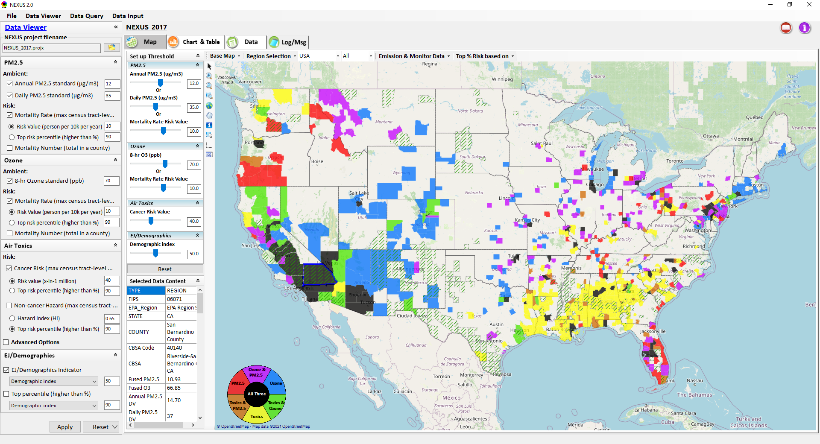
NEXUS: Tool Development
A new Multi-Pollutant (MP) Advanced Screening Tool (NEXUS) is being developed to:
Identify geographic areas where health risks related to O₃, PM_{2.5} and air toxics overlap
Identify areas for MP collaboration
3

Slide 4
NEXUS: Expected Use
The NEXUS tool will allow users to do the following:
National screening to identify areas with MP issues: Phase 1 development provides ability to quickly screen areas across nation that have combination of high air quality and/or risk levels for O₃, PM_{2.5} and Air Toxics.
Area screening to understand nature of MP problem: Phase 2 development provides ability to ‘dial-into’ specific areas to determine extent to which common emissions sources are causing the MP issues.
We expect to use this tool in conjunction with Regions and identify areas that would potentially benefit most from MP approaches to reduce emissions (including current NA areas).
The NEXUS tool will essentially provide a ‘conceptual model’ of an area’s MP issues to facilitate engagement with state/local/tribal agencies and community stakeholder groups.
We also expect that it can have additional value-added uses across the Office for Air Toxics, Environmental Justice and other programs.
4

Slide 5
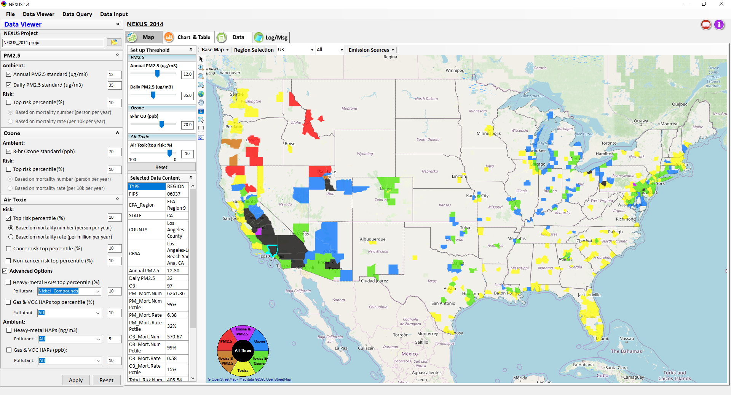
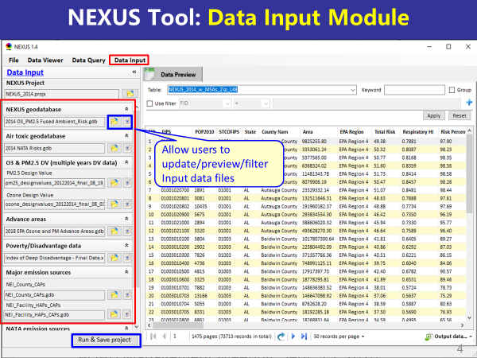
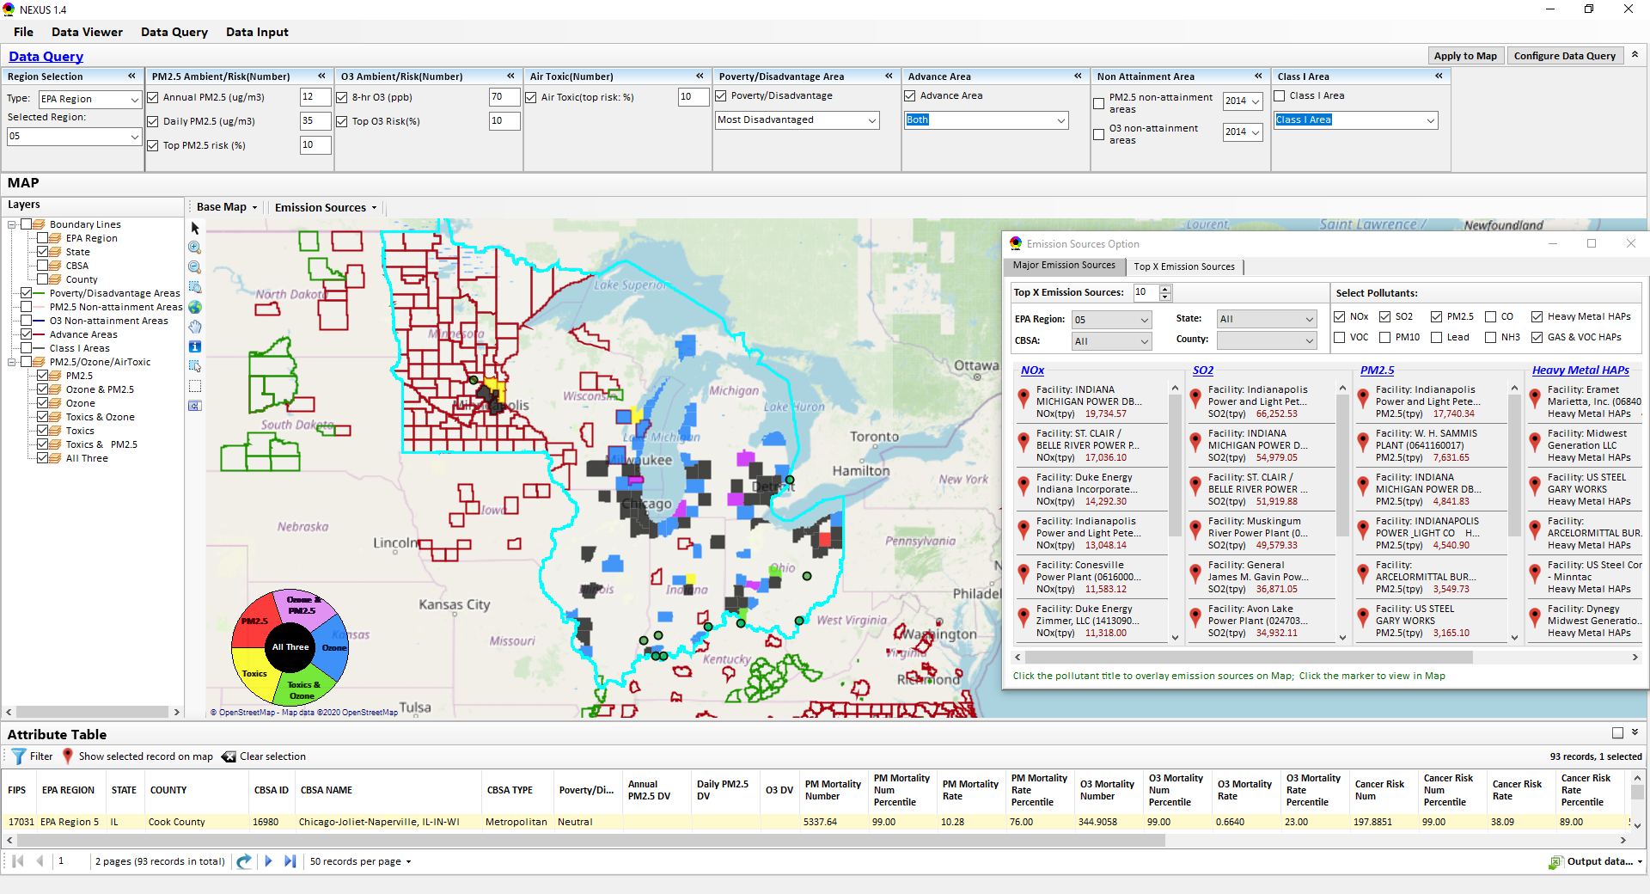
NEXUS: Three Key Modules
Data Viewer Module
Data Input Module
Data Query Module
View and create interactive Map/Data/Chart/Table
Provide flexible selections & mapping of “Ambient” and/or “Risk” levels of PM_{2.5}, O₃ and Air Toxics
Provide regional analysis for “EPA region”, “States”, “CBSA”, and “County”
Display major point emission locations and monitoring sites/data by pollutants
Integrate all MP data - emissions, monitoring, modeling, health risk, and EJ/demographic data into a single platform
Currently use10 publicly available input datasets
Provide data preview, search, filter and output functions
Allow to update/change input data files and then run/save to a new “project”
Expand data field selections and flexibility for exploratory & advanced users
Provide map overlaying and summary table for data query results
Current data query based on selected data fields: “Ambient & Risk for PM, O3 & Air toxics”, “EJ/demographic indicator”, “Advance area”, “NA Area”, “Tribal area”, Class I area”
5

Slide 6
NEXUS 2.0: Input Data Files and Sources
Input Data Files | Data Format | Data Description | Data Source | Data Period
“O₃ & PM_{2.5} Ambient and Risk” | Excel | O₃/PM_{2.5} fused ambient & risk data at county/census tract level | from OAQPS MP & BenMAP team | 2017
“Air Toxic Ambient and Risk” | Geodataset | Air toxics fused ambient & risk data at county/census tract level | from OAQPS MP & Air Toxic team | 2014*
“O₃ & PM_{2.5} Design Values” | Excel | O₃ & PM_{2.5} design values at county level | From EPA public website: https://www.epa.gov/air-trends/air-quality-design-values | 2012 to 2020
“NEI County Emissions” “NEI Facility Emissions” | Excel | County-level and facility source emissions of CAPs, HAPs & GHGs | From OAQPS public website: https://www.epa.gov/air-emissions-inventories/2017-national-emissions-inventory-nei-data | 2017
“O₃ & PM_{2.5} monitoring data | Excel | O₃ & PM_{2.5} monitoring data (DVs) | From OAQPS public website: https://gispub.epa.gov/arcgis/rest/services/OAR_OAQPS | 2002 to 2020
“Air Toxic monitoring data” | Excel | Air toxics monitoring data (22 HAPs) | From OAQPS public website: https://www.epa.gov/amtic/amtic-air-toxics-data-ambient-monitoring-archive | 2003 to 2018
EJ/Demographics data | Geodataset | Demographic indicators (7) from EJSCREEN | from EJSCREEN: https://www.epa.gov/ejscreen/download-ejscreen-data | 2020
“Advance areas“ | Geodataset | O₃ & PM_{2.5} Advance Areas | from OAQPS MP team | 2021
“Class 1_Areas” | Geodataset | EPA Class 1 Federal Areas | From EPA Class 1 Federal Areas Website: https://edg.epa.gov/data/public/OAR/OAQPS/Class1/Class1Areas.zip | 2016
“Tribal Areas” | Geodataset | EPA Tribal Areas | From EPA public website: https://edg.epa.gov/data/Public/OEI/OIAA/Tribes/EPAtribes.zip | 2018
* Will be updated to 2017 by end of 2021
6

Slide 7
“NEXUS 2.0” Demo: 2017 NEXUS Case
Launching Page
2008
Roadmap for Demo:
(Use example cases)
National View: Use “NEXUS” across pollutants to provide an initial “SCREEN” at the national level by providing an indicator where there may be a common set of sources contributing to multi-pollutant issues.
Regional View: Dial into a region or area of interest to understand the pollutant/source connections, and potential for more effective and efficient multi-pollutant solution.
7

Slide 8
RoadMap for NEXUS Tool Demo (1)
National Screening (2017 Data)
Replicate “2008 MP Report” map with O₃/PM_{2.5} concentrations above NAAQS and air toxics risk* estimates of top risk value & percentile
What happens to areas at lower O₃/PM_{2.5} NAAQS levels?
What happens to areas in nonattainment if we change HAP risk value & %tile?
Provide NEXUS map on risk basis: O₃/PM_{2.5} BenMAP mortality risk and air toxics risk estimates above top risk value & %tile for all pollutants
What happens to MP areas if changes 90th %tile to 80th %tile or lower?
What are the relationships between “Heavy Metal HAPs risk and PM_{2.5} risk” and between “Gas/VOC HAPs risk and O₃ risk” to identify potential co-pollutant issues?
Determine the presence or absence of EJ concerns in communities with MP risk
What is the ranking of MP risk and EJ index by CBSA or County?
*Note: Currently, air toxics risk data only available for “2014” but will be updated to “2017” by Dec. 2021
8

Slide 9
RoadMap for NEXUS Tool Demo (2)
Regional/State/CBSA/County Screening
EPA Region & State Examples
Areas with MP risk in top 10% (90%^{th} tile) across O₃, PM_{2.5} and HAPs
CBSA Example
Louisville CBSA: General view and then dial into “Jefferson County”
What is the nature of the area’s multi-pollutant air quality issues?
What are the top emissions sources (facilities) in county by pollutant?
What sources are common across pollutants that may indicate co-control potential?
What are the monitoring sites & data available for PM_{2.5}, O₃ and air toxics?
What communities are potentially impacted near these facilities and monitors?
9

Slide 10
RoadMap for NEXUS Tool Demo (3)
MP Risks and EJ/Demographic Screening
Initial view of CBSA level information using the EJ/Demographic indicators to show overlay with MP areas
Detroit Example: General view and then dial into Wayne County
What is the nature of the area’s multi-pollutant air quality issues?
What are the top emissions sources (facilities) in county by pollutant?
What sources are common across pollutants that may indicate co-control potential?
What are the monitoring sites & data available for PM_{2.5}, O₃ and air toxics?
What communities are potentially impacted near these facilities and monitors?
10

Slide 11
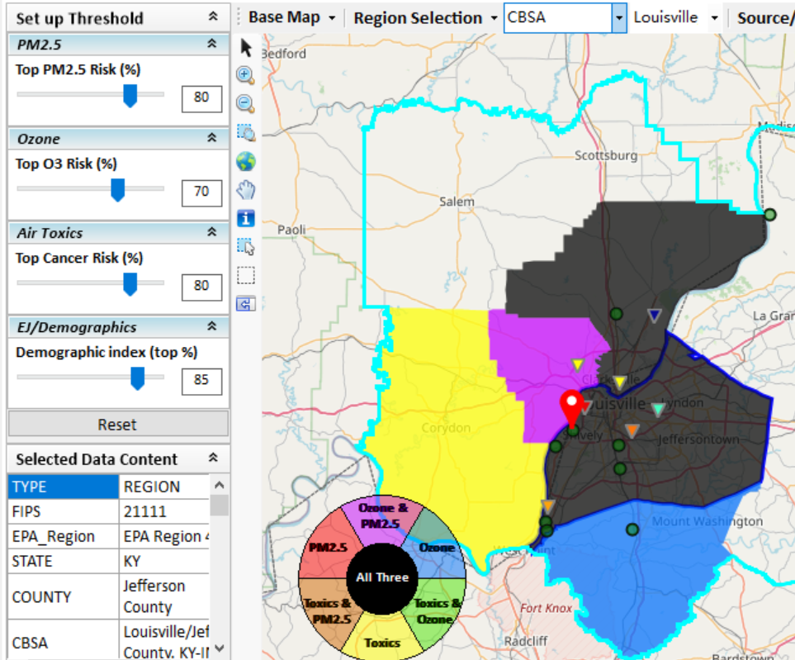
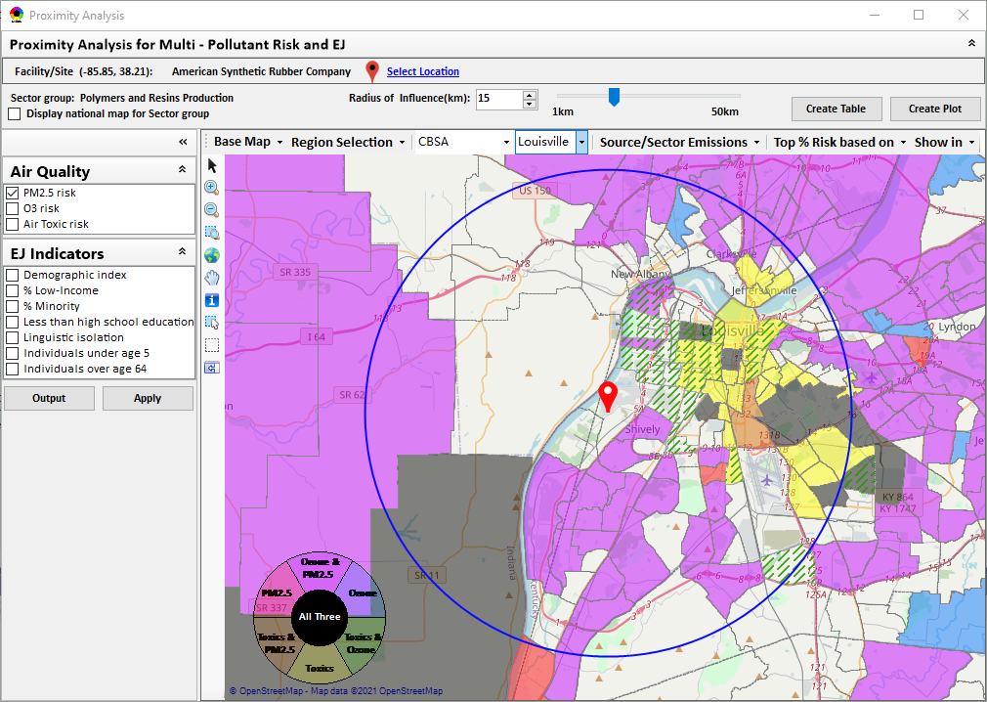
New “Proximity Analysis” Module (under development)
Currently in NEXUS
Proximity Analysis for MP Risks and EJ
County – level (current)
Community (Census Tract) - level
11

Slide 12
Next Steps
Outreach with EPA Regional Offices
Goals of Multi-Pollutant Air Quality Management approach
Purpose of NEXUS Advance Screening Tool
Examples using NEXUS for MP & EJ purposes
NEXUS Demo
Request for Feedback
9/25/2020– AQAD & HEID
11/3/2020 – MP Team
11/4/2020 – Air Toxics Group
12/10/2020 – AQPD
1/25/2021 – OID
1/28/2021 – SPPD
2/1/2021 – Peter/SMT
4/12/2021 – HEID & AQAD
5/17/2021 – Peter/SMT
5/24/2021 – MP Team
6/29/2021 – ORD
7/12/2021– HEID & AQAD
7/19/2021 – OID
8/10/2021– OAP
8/26/2021 – OAR
8/30/2021 – OEJ
8/30/2021 - Region 4/Louisville
9/7/2021 – RO Air Division Directors
9/20/2021 – OAR Demo
10/5/2021 – RO APMs
TBD – MJOs
“Fascinating… phenomenal… I’m blown away!”
- Caroline Freeman (R4 ADD)
12

Slide 13
“NEXUS 2.0”Demo
NEXUS 2.0 “Quick Tutorial” slides attached
Download “NEXUS” tool at: https://gaftp.epa.gov/aqmg/cjang/NEXUS/NEXUS 2.0/*
Carey Jang
OAR/OAQPS/AQAD/Air Quality Modeling Group, September 2021
13

