Slide 1
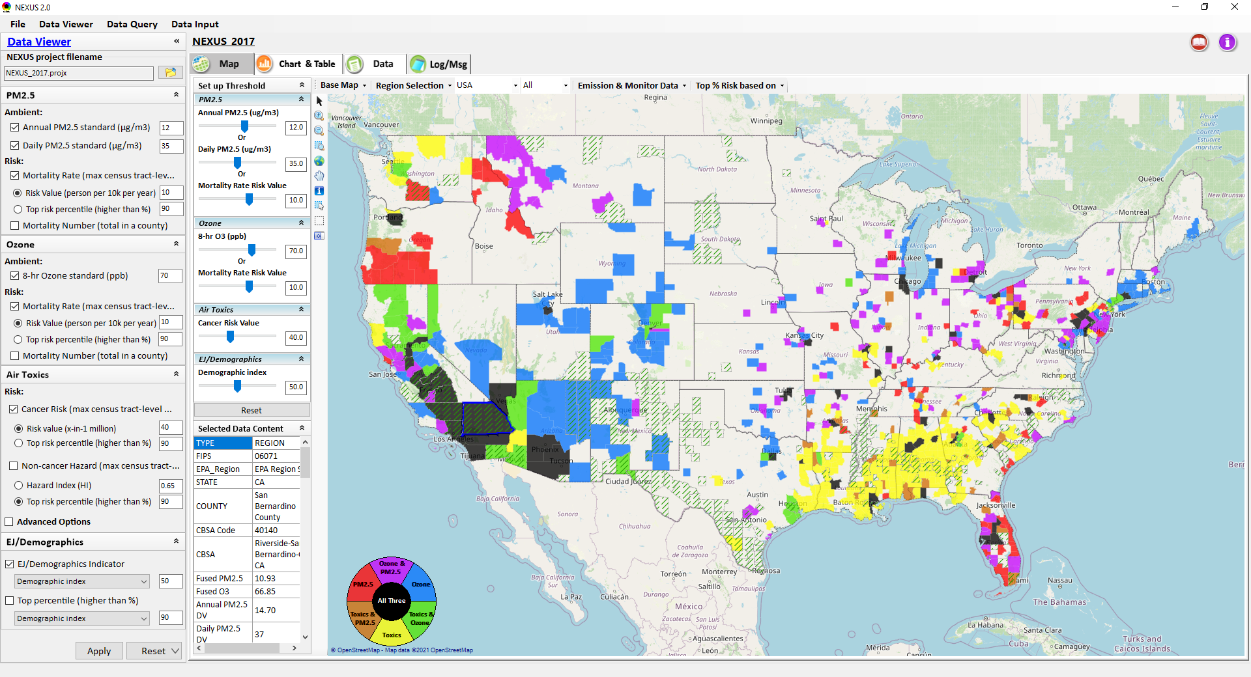
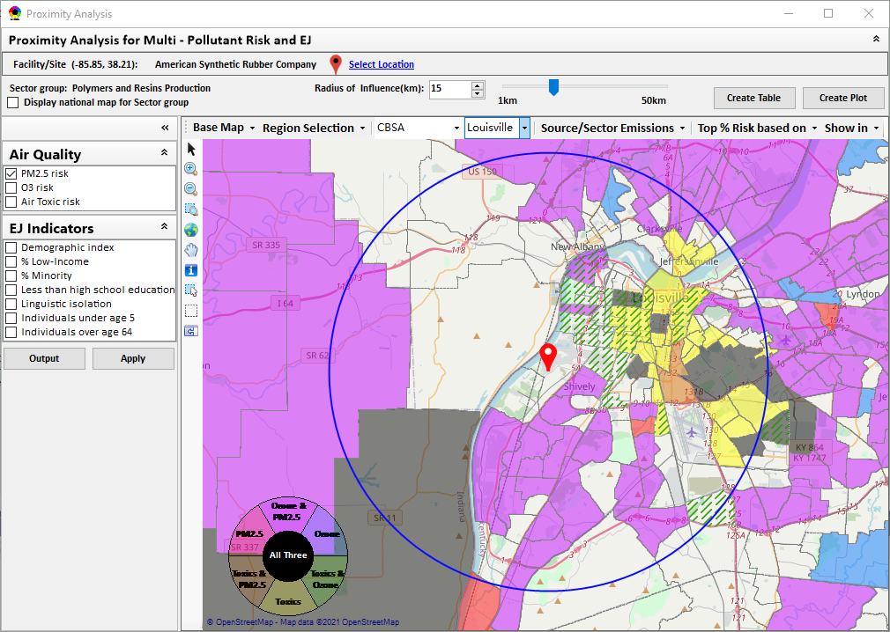
“NEXUS” Multi-Pollutant Advanced Screening Tool OAP Pre-Brief
Data Viewer: National/Regional Level
Proximity Analysis: Community Level
Beth Landis, HEID/Climate, International, & Multi-Media Group
Carey Jang, AQAD/Air Quality Modeling Group
10/6/22
1

Slide 2
Multi-Pollutant Team Members
HEID
Beth Landis / Kimber Scavo
Matt Woody / Kelly Rimer
Robin Langdon / Darryl Weatherhead
Sara Terry
Carrie Wheeler
Rob Pinder
Chris Davis
Conor Mulderrig
Kayla McCauley
OID
Amanda Kaufman
James Payne
Loren Fox
AQAD
Carey Jang / Tyler Fox
Jim Kelly
Shannon Koplitz
Joe Mangino
Jeanette Reyes
AQPD
Rich Damberg / Megan Brachtl
Mia South
SPPD
Lisa Conner
2

Slide 3
Overview
Multi-Pollutant (MP) Background
NEXUS 3.0
Overview
Climate
Data Inputs and Major Functions
Briefings/Demos
Feedback
Next Steps
Live Demo
3

Slide 4
Multi-Pollutant Background
Support a comprehensive, MP treatment of air quality problems to effectively improve air quality and make the most efficient use of available resources
Primary Goal - identify & evaluate local control strategies targeting emissions of O₃ & PM_{2.5} and their precursors while at the same time reducing Air Toxics of concern for communities to maximize both health benefits and air quality improvements
MP planning has the potential to reduce the costs and increase benefits associated with air quality management (AQM)
Supports S/L/T air agencies in developing MP, risk-based AQM plans and implementing strategies that reduce air pollution emissions & improve public health
Success has been demonstrated in Detroit and SC; another project is currently underway in Louisville, KY
Tools needed to analyze MP data are either available currently or being developed in OAQPS (e.g., NEXUS)
4

Slide 5
NEXUS: Overview
“NEXUS” is an advanced screening tool for multi-pollutant (MP) risks and EJ/Demographic analysis developed by OAQPS’s MP team
“NEXUS” integrates a suite of MP data, including emissions, monitoring, modeling, fused AQ data and health risk data for PM_{2.5}, O₃ & air toxics as well as EJ/demographic data, into one single platform to allow national and areal overlay mapping & analysis of MP ambient & risk data
“NEXUS” provides MP analysis across from national level “Phase 1” to regional (EPA region/State/CBSA) level “Phase 2”, and now down to community level “Phase 3” (Proximity analysis” in census tract-level)
We expect to use this tool in conjunction with Regions and identify areas that would potentially benefit most from MP approaches to reduce emissions (including current NA areas)
We also expect that it can have additional value-added uses across the Office for Air Toxics, Environmental Justice and other programs
The NEXUS tool will essentially provide a ‘conceptual model’ of an area’s MP issues to facilitate engagement with state/local/tribal agencies & community stakeholder groups
5

Slide 6
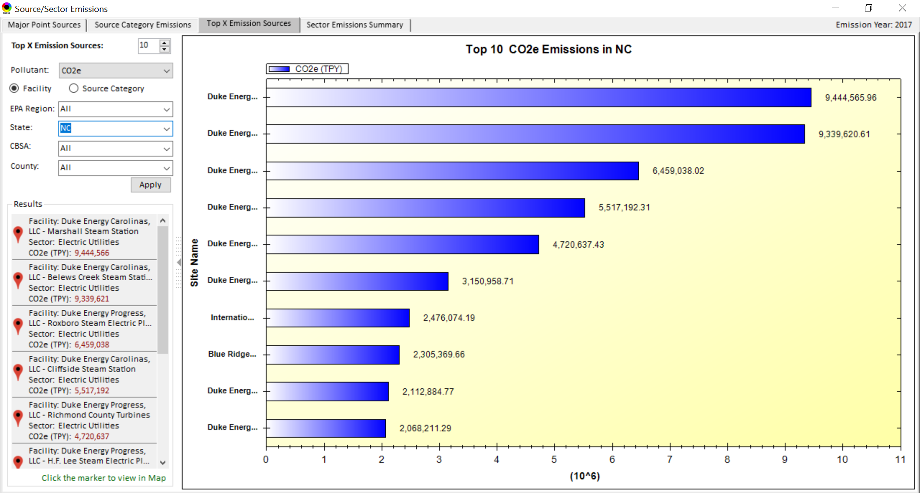
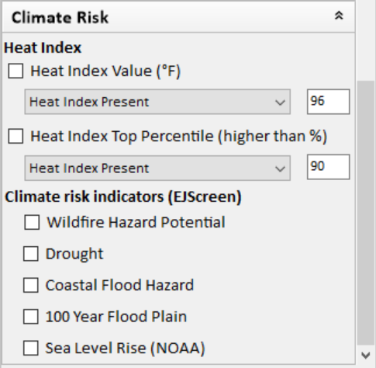
NEXUS: Climate
NEXUS originally developed as an air quality planning tool; however, we recognize the importance of climate considerations in that context
Currently includes CO2e emissions information
Working to incorporate EPA indices for climate that are developed and available in other tools (if resources available):
EJSCREEN
Justice40 Climate and Economic Justice Screening Tool
Heat indices & stressors (OAQPS & ORD)
Climate Related Social Vulnerability Indicators (OAP)
6

Slide 7
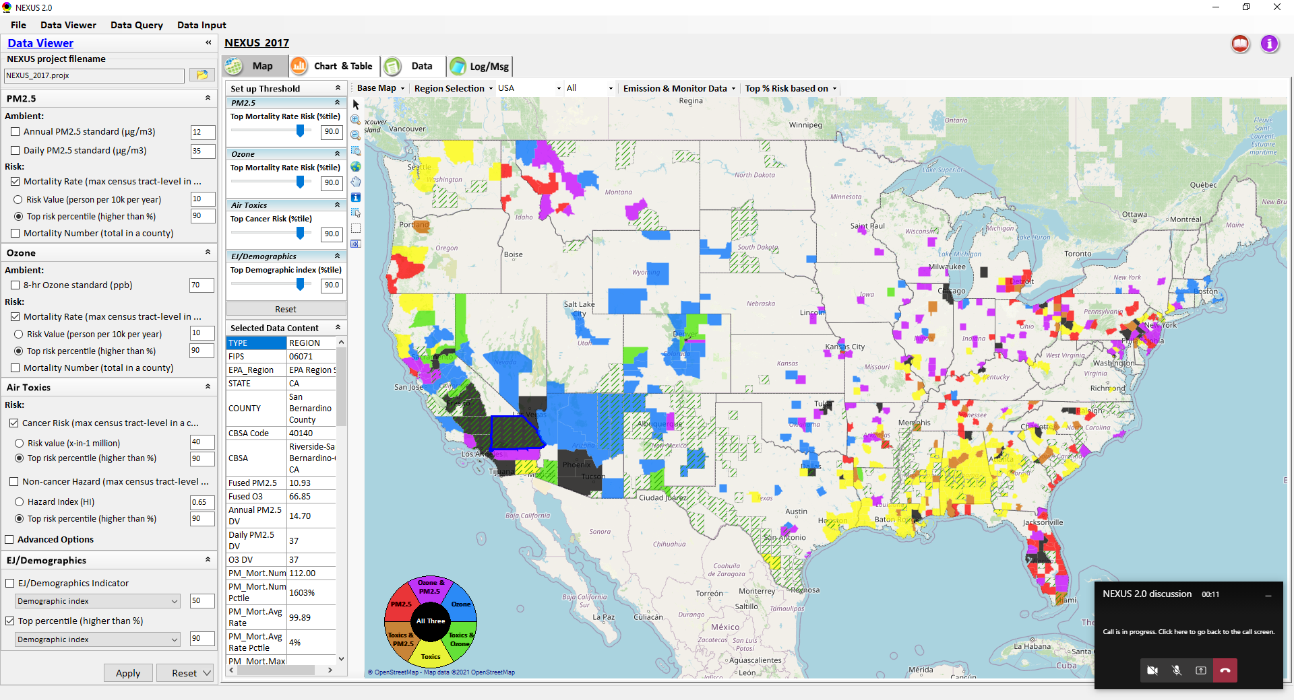
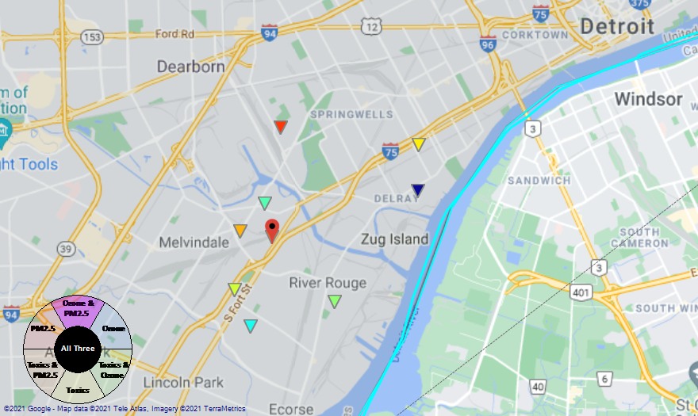
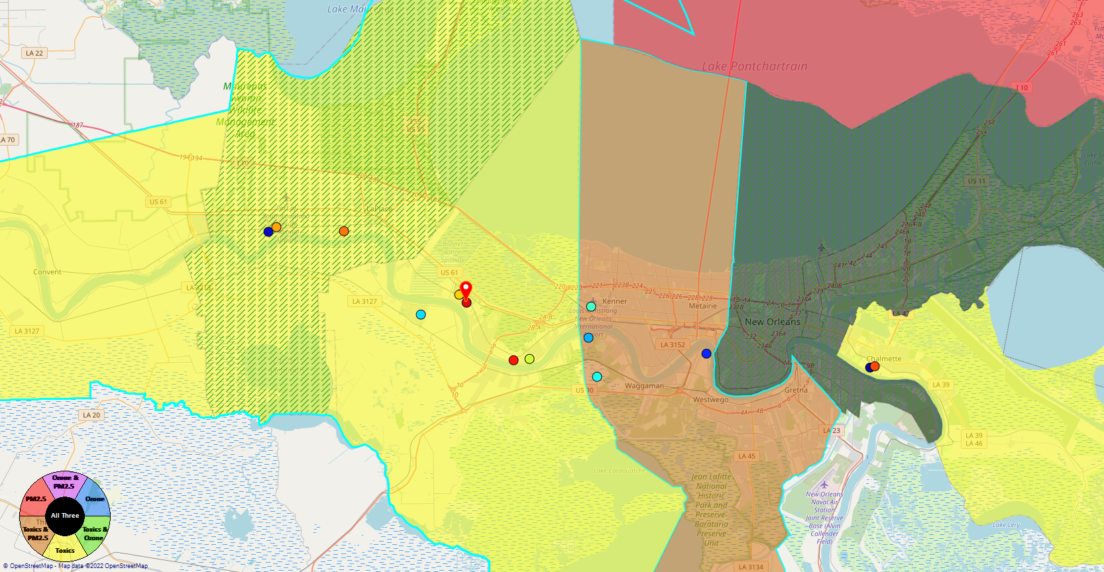
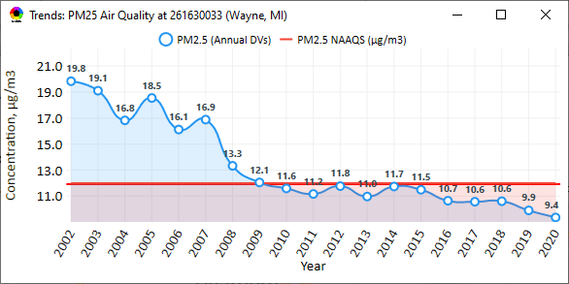
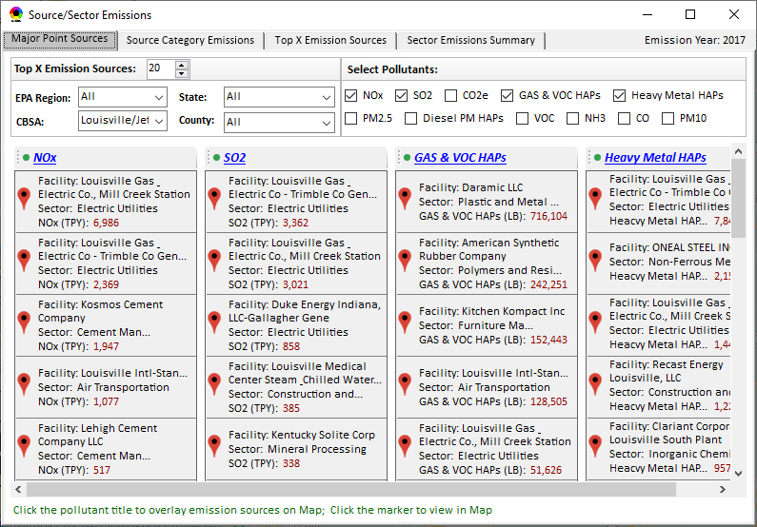
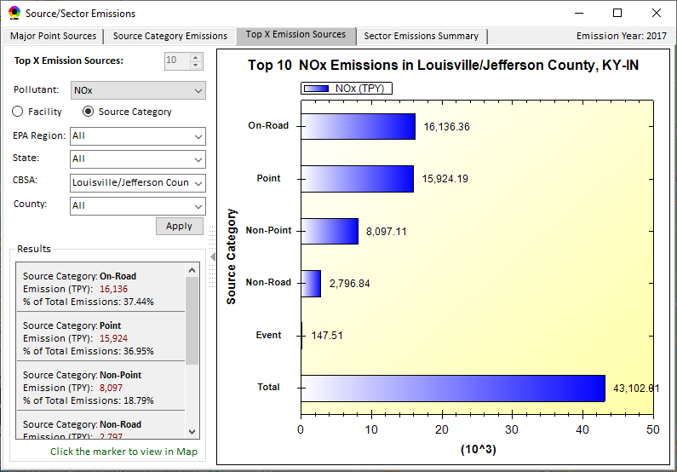
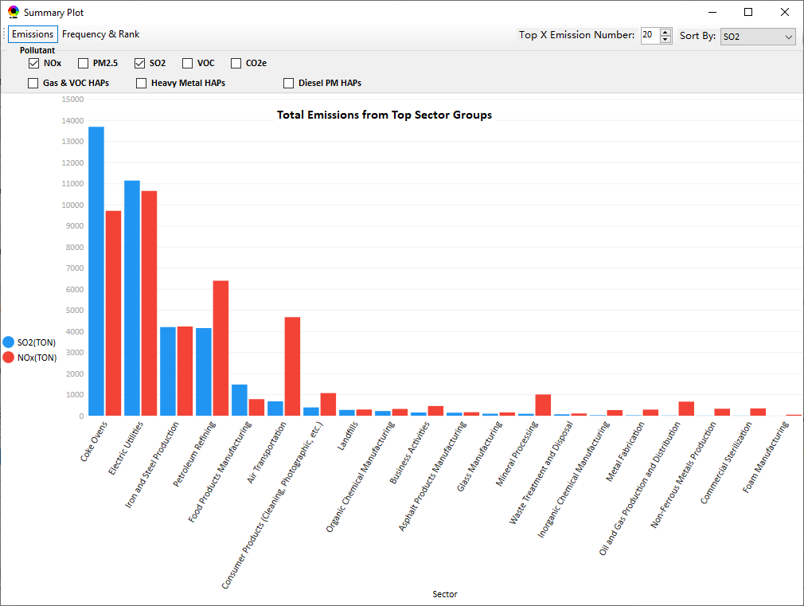
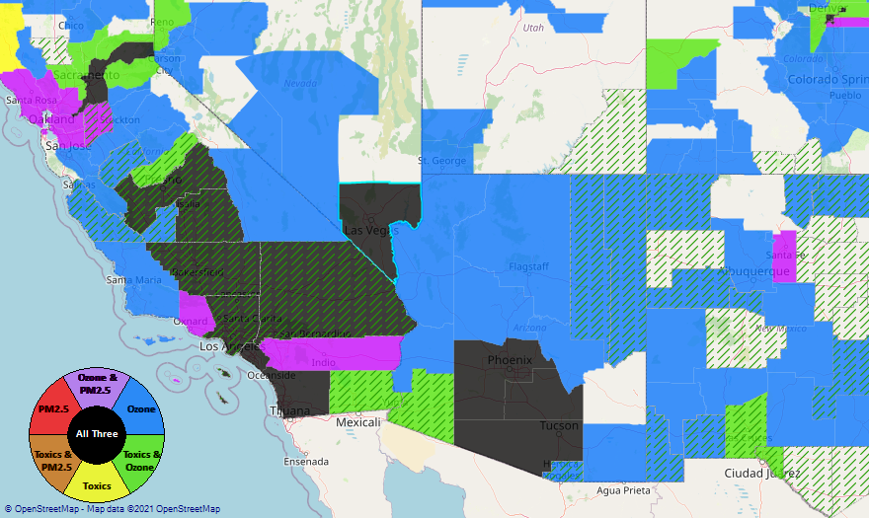
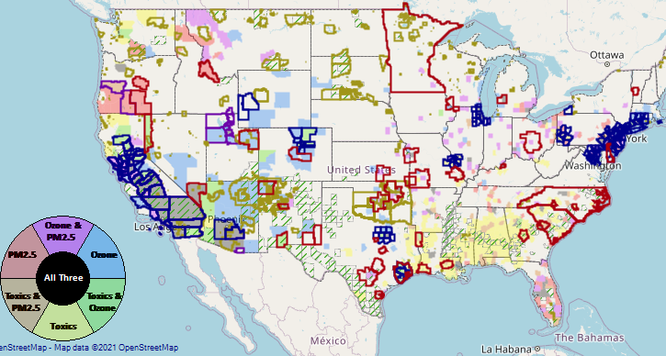
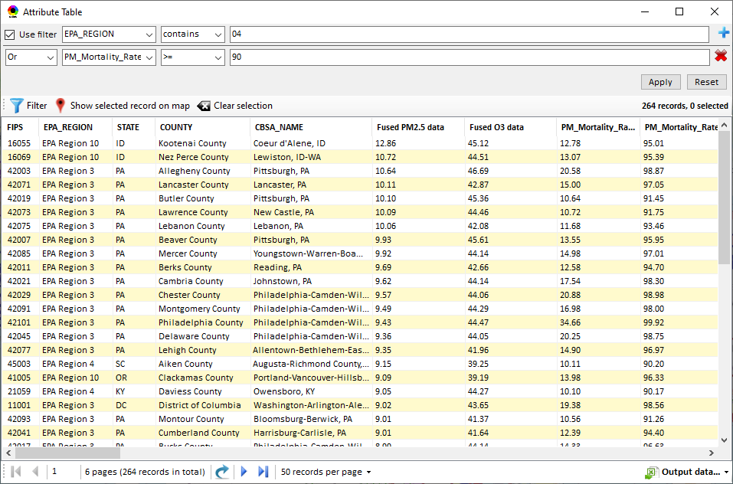
NEXUS: Data Inputs and Major Functions
O₃ & PM_{2.5}
Ambient/Design Value
(2012-2020)
(County-level)
Multi-Pollutant
Ambient and/or Risk National & Areal Mapping
Display Monitoring Sites & Trend Data
O₃, PM_{2.5} & Air Toxics Risk Data &
Conc. (fused AQ) Data
(2017 & 2014)
(Census tract-level)
Display Major Point Emissions Sites/Data
Provide Source Category Emissions
NEXUS
O₃, PM_{2.5} & Air Toxics Monitoring Data
(2002-2020 & -2018)
Provide Sector Emissions Summary
NEI County &
Facility Emissions
(2017 & 2014)
Include EJ/Demographic Indicators
Map Overlay with NAA, Advance Area, Class-I Area, or Tribal Area
Environmental Justice & Demographic Data
(from EJSCREEN)
Data Query, Search, Filter & Export
Advance Area
Class-I Area
Tribal Area
Proximity Screening Analysis
7

Slide 8
NEXUS: Briefings and Demos
9/25/2020– AQAD & HEID
11/3/2020 – MP Team
11/4/2020 – Air Toxics Group
12/10/2020 – AQPD
1/25/2021 – OID
1/28/2021 – SPPD
2/1/2021 – Peter/SMT
4/12/2021 – HEID & AQAD
5/17/2021 – Peter/SMT
5/24/2021 – MP Team
6/29/2021 – ORD
7/12/2021– HEID & AQAD
7/19/2021 – OID
8/10/2021– OAP
8/26/2021 – OAR
8/27/2021 - OP
8/30/2021 – OEJ
8/30/2021 - Region 4/Louisville
9/7/2021 – RO ADDs
9/20/2021 – OAR Demo
10/14/2021 – OP/NCEE
11/2/2021 – RO APMs
11/8/2021- RO APMs Demo
11/16/2021 – R1 (RARE) Project
11/28/2021 – AQAD All-Hands
11/23/2021 – R3 NEXUS Beta Testers
2/15/22 – AQPD (NSRG, OPG & SLPG)
2/17/22 – AT Strategy Mgmt & Mitigation Team
3/15/22 – OID (CTPG)
4/26/22 – EPA NEXUS Beta Testing Team
4/28/22 – AQAD (AAMG)
5/3/22 – HEID & AQAD
5/4/22 – Air Toxics Data Analysis Team
5/10/22 – ADVANCE Workgroup
5/26/22 - OAP/CCD
6/15/22 – Regional Ambient Air Monitoring
6/23/22 – SPPD All-Hands
7/21/22 – EJ in Rulemaking Comm. Of Practice
8/15/22 – OGC & ECRCO – Title VI
8/16/22 – Pre-brief for HEID & AQAD
8/17/22 – Peter
8/22/22 – OID/CTPG – Liz
8/31/22 – BenMAP Team
9/12/22 – OAPPS/AAOP (Economists)
9/14/22 – CAAAC
9/15/22 – Title VI / SIP Workgroup
9/29/22 – AAPCA
10/6/22 – OAP Pre-Brief
10/19/22 – OTAQ Pre-Brief
10/19/22 – APMs
10/31/22 - OEJ
TBD –MJOs
8

Slide 9
NEXUS: Feedback from Briefings & Demos
“Fascinating… phenomenal… I’m blown away!”
- Caroline Freeman (R4 ADD)
“The R3 air program has evaluated 18 web tools … NEXUS overall has been the most useful to our air program”
- Cynthia Stahl, PhD
(R3 Integrated Assessment Analyst)
“Your presentation of the NEXUS tool was absolutely awesome!!! … The NEXUS tool looks very promising”
- Osmond Lindo (OAPPS Lead Economist)
“Breathtaking… incredibly powerful… I feel like we discovered nuclear fusion!”
- Joe Goffman
(OAR Acting AA)
“The tool is well designed and provides a wealth of information that is useful for evaluating air quality impacts in local communities”
- Rick Gillam
(R4 Air Modeling Team Lead)
“Dr. Nance [R6 RA] will be thrilled with the NEXUS tool and excited with its capabilities.”
- Fran Verhalen
(recently retired R6 Monitoring Section Chief)
9

Slide 10
NEXUS: Next Steps
Following pre-briefs, schedule briefings for OAP, OTAQ & OAR Senior Management (Nov/Dec 2022)
Partner within EPA on use of NEXUS for programmatic purposes
NEXUS Improvements (assuming funding available):
Address comments and feedback from EPA Beta Testing Team
Incorporate / revise “Climate risk” indicators (as 5th metric)
Update EJ/demographics data to be consistent with new “EJScreen 2.0” dataset
Include top air toxic cancer risk drivers in the “proximity analysis” module
Update to 2018/2019 MP platform (O₃, PM_{2.5}, and Air Toxics data)
Explore the feasibility of developing a web-based NEXUS version (similar to EJScreen)
Work towards making the tool publicly available
Stay tuned on implications of IRA on MP planning / NEXUS
10

Slide 11
“NEXUS 3.0” Live Demo
**NEXUS is currently an advanced screening tool for internal EPA use. A beta version is available for EPA staff to use and provide feedback on for improvement. Additional updates/improvements are necessary before the NEXUS tool is ready to be released to the public.**
11

Slide 12
Important Caveats
NEXUS Caveat
The NEXUS screening tool uses data from a variety of sources. This data is publicly available, except for the BenMAP data at the tract level. EPA is currently still in an internal review process and is not using this tool to support regulatory analyses.
BenMAP Caveat
The estimated number of PM and ozone-attributable deaths and illnesses reported at each tract are subject to important uncertainties and should be interpreted with caution. When using the BenMAP-CE tool to calculate these tract-level results, EPA lacked information regarding the baseline health status of individuals living at each tract; these data are a key input to the calculation of benefits. EPA instead used data available at the county- or state-level, which does not account for differences in baseline health between tracts. Estimating benefits in this way is not consistent with the peer-reviewed methods EPA follows when estimating air quality benefits in a Regulatory Impact Analysis. EPA will continue to refine its methods with the goal of reporting tract-level health benefits with confidence.

