Slide 1
NEXUS Discussion
National Screening Capabilities and Communications Plan
HEID & AQAD Briefing
Kimber Scavo, Tyler Fox, Beth Landis & Carey Jang
July 12, 2021

Slide 2
Background
NEXUS assembles a variety of air pollution data in one easily accessible place to inform MP air quality planning efforts
  Identifies pollutant emissions and sources/sectors of potential interest within an area
Addition of screening analysis capabilities is recommended to best utilize the tool for AQ planning purposes:
  Screening allows for identification and better understanding of the key source(s)/pollutant(s) to focus efforts on:
    Nonattainment & Advance areas: Identify pollutant and source emissions that may be most effective to reduce through MP control strategies in order to reach/maintain attainment and/or reduce harmful exposures to air pollution
    Prioritization efforts: Informs OAQPS and EPA Region efforts by allowing more full account of multi-pollutant exposures (e.g., O3, PM2.5 and Air Toxics) for outreach and working with areas/communities of interest
  Consistency in data, approach, tool for use in screening for our outreach efforts and in potentially in regulatory/policy context
2
Notes:
NEXUS assembles a variety of air pollution related data across pollutants and programs in one easily accessible place to inform multi-pollutant air quality planning efforts by EPA and ultimately state/local/tribal air agencies.
It supports these efforts by identifying important emissions sources/sectors within a particular area; however, users need screening analysis capabilities to best utilize the tool for their planning purposes.
Proximity screening analysis is a recommended capability within NEXUS to assist users in better understanding the source(s)/pollutant(s) to focus their efforts on, i.e., identify emissions reductions to reach attainment and/or reduce harmful exposures to air pollution.

Slide 3
Need for Proximity Screening for Air Quality Planning
Proximity Screening Analysis helps answer…
What are the risks in close proximity to my monitor and/or community of interest?
What source(s) are in close proximity to my monitor and/or community of interest?
What are the demographics of communities in close proximity to monitor(s) and/or source(s) of interest?
How do the demographics of communities near my monitor/source compare to area/state/national averages?
How do the risks within communities near my monitor/source compare to area/state/national averages?
3

Slide 4
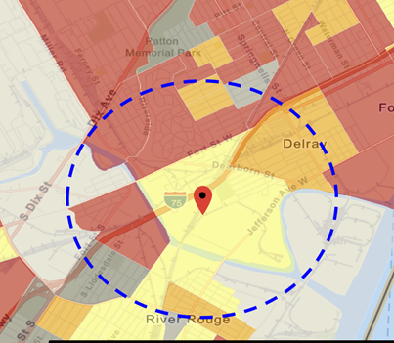
Current Practice for Proximity Screening: EJ Example
“Proximity analysis” is the primary EJ screening approach
  Comparisons of demographic distributions near source(s) to those for the state/region/nation
Types of Proximity Analysis
  Demographic analysis
  Risk-based demographic analysis
  Can consider other factors for use (next slide)
Current Tools Used in OAR
  OID use of EJSCREEN for initial screening and rules (with added GIS scripting)
  PER CAREY, PLEASE ADD CAMD TOOL
  Project specific efforts for criteria and toxic rules (in-house or contractor)
4
Notes:
“Proximity analysis” is the primary EJ screening approach because close proximity to air pollutant sources, such as industrial plants and major highways, is correlated with exposure and adverse health risks.
Involves comparison of demographic distributions near source(s) (e.g., within 5, 10, 50 km) to those for the state, region, and nation

Slide 5
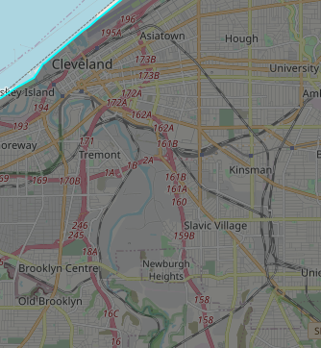
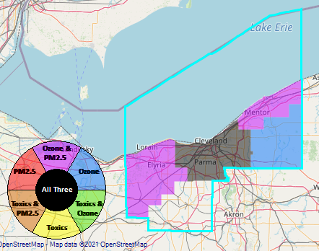
Benefit of Proximity Screening – Sources Near Monitor
Proximity Screening Analysis helps answer…
What source(s) are in close proximity to my monitor and/or community of interest?
Cleveland, Ohio is a maintenance area for the 2012 PM_{2.5} annual NAAQS
The GT Craig and Harvard Yards Monitoring Sites have DVs near the standard
GT Craig NCore Monitoring Site
Harvard Yards Monitoring Site
5

Slide 6

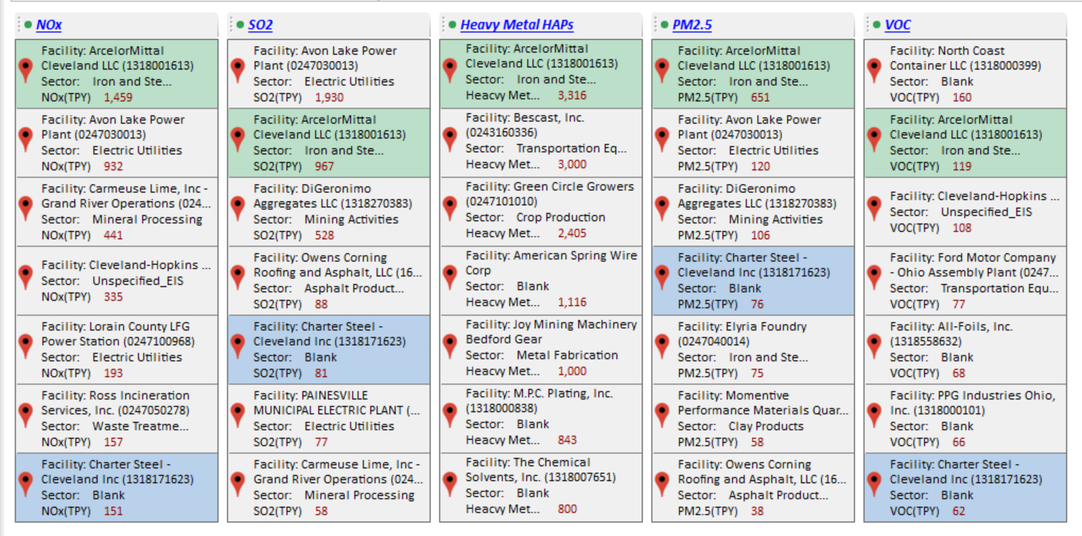
Benefit of Proximity Screening – Sources Near Monitor
We can currently see the major emission sources for a CBSA in NEXUS and plan to add in locations of monitoring sites
GT Craig NCore Monitoring Site
Harvard Yards Monitoring Site
Major PM_{2.5} Emission Sources
6

Slide 7
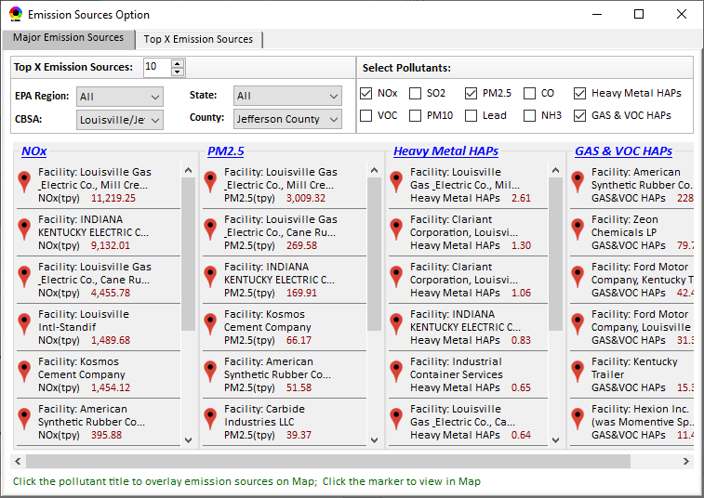
Benefit of Proximity Screening – Sources Near Monitor
Adding proximity analysis capabilities would allow the user to set a flexible Radius of Interest for a selected monitoring site to then determine what sources are within that radius and most likely contributors to monitored concentrations
Example Graphic – this capability is not yet available in NEXUS
Proximity and Spatial Analysis for MP Risks and EJ
Proximity Analysis
Spatial Analysis
Monitoring Site: Harvard Yards
GT Craig NCore Monitoring Site
Harvard Yards Monitoring Site
Major PM_{2.5} Emission Sources
Radius of Influence
5
50km
Create Table
Create Plot
7

Slide 8
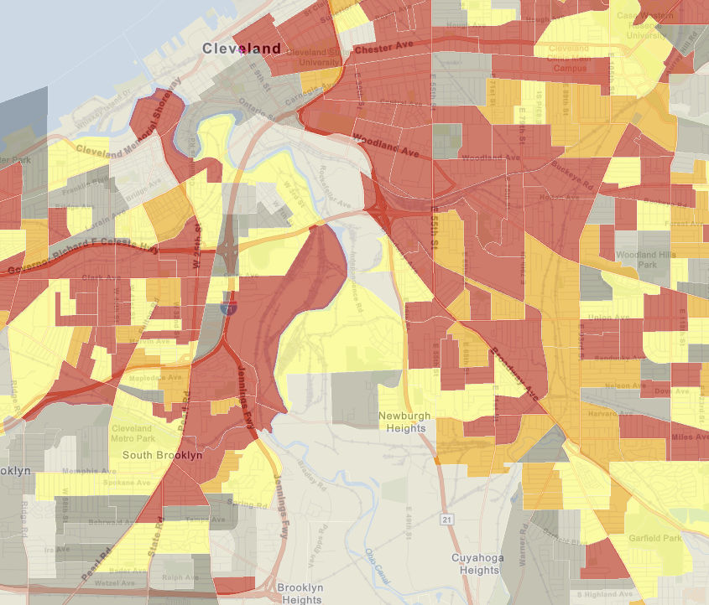
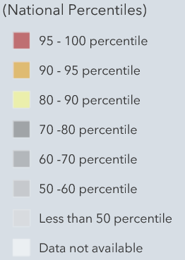
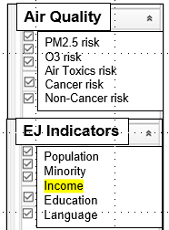
Benefit of Proximity Screening – Demographics & MP Risks Near Monitors/Sources
Proximity Screening Analysis helps answer…
What are the demographics of communities in close proximity to monitor(s) and/or (sources) of interest?
Adding proximity analysis capabilities would allow the user to set a flexible Radius of Interest for a selected monitoring site or facility and determine air quality and EJ indicators within the selected radius
Proximity and Spatial Analysis for MP Risk and EJ
Proximity Analysis
Spatial Analysis
GT Craig NCore Monitoring Site
Harvard Yards Monitoring Site
Major PM_{2.5} Emission Sources
MP Risk
Air Toxics
EJ Indicator
Income
Facility: ArcelorMittal Cleveland Sector group: Iron and Steel
8
Notes:
This example is for Low income population

Slide 9
Benefit of Proximity Screening – Demographic Comparison
Proximity Screening Analysis helps answer…
How do the demographics of communities near my monitor/source compare to area/state/national averages?
Example Graphic – this capability is not yet available in NEXUS
(%tile)
Adding proximity analysis capabilities would allow the user to set a flexible Radius of Interest for a selected monitoring site or facility, determine air quality and EJ indicators within the selected radius and see how they compare to the county, state, region, nation and sector group (if applicable)
9
Notes:
Example – we could create a bar chart like this for the AcrelorMittal Steel Mill (Iron and Steel Sector Group) for Low Income Populations

Slide 10
Benefit of Proximity Screening – Demographic Comparison
Proximity Screening Analysis helps answer…
How do the risks within communities near my monitor/source compare to area/state/national averages?
Example Graphic – this capability is not yet available in NEXUS
(%tile)
Adding proximity analysis capabilities would allow the user to set a flexible Radius of Interest for a selected monitoring site or facility, determine air quality and EJ indicators within the selected radius and see how they compare to the county, state, region, nation and sector group (if applicable)
10
Notes:
Example – we could create a bar chart like this for the AcrelorMittal Steel Mill (Iron and Steel Sector Group) for PM_{2.5} Risk

Slide 11
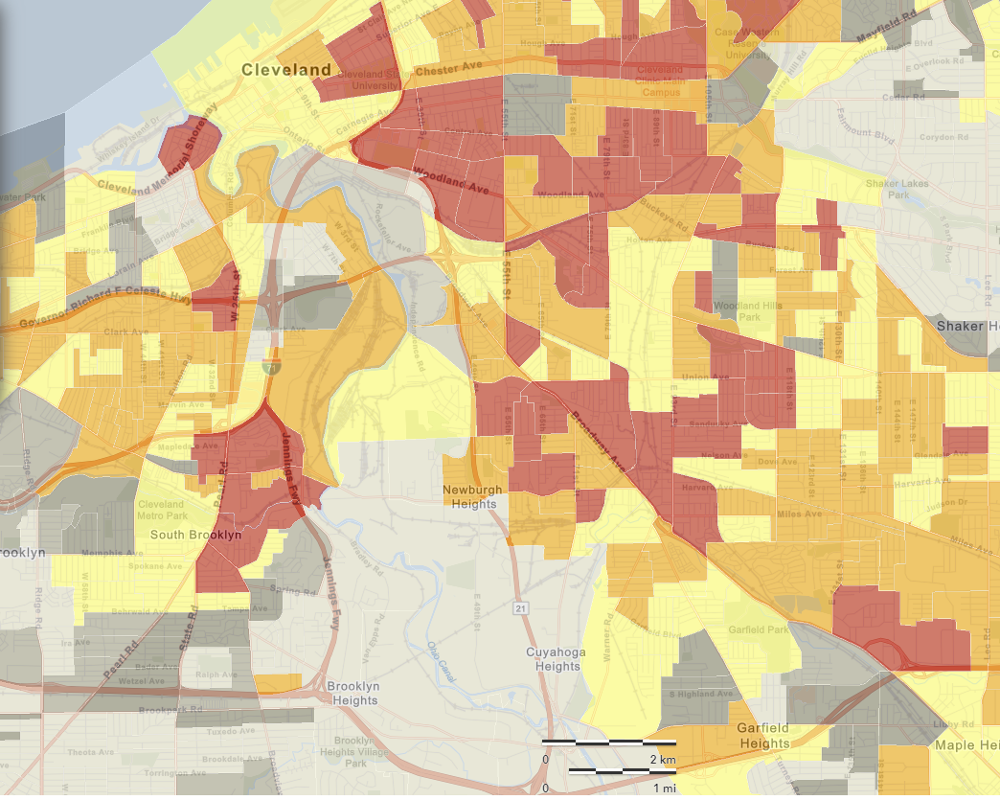
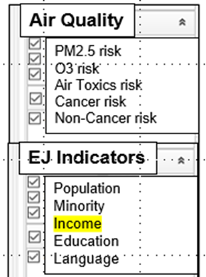
Benefit of Proximity Screening – Risk Near Monitor/Source
Proximity Screening Analysis helps answer…
What are the risks in close proximity to my monitor and/or community of interest?
Adding proximity analysis capabilities would allow the user to set a flexible Radius of Interest for a selected monitoring site or facility, and visually see air quality risk and EJ indicators within the selected radius
GT Craig NCore Monitoring Site
Harvard Yards Monitoring Site
Major PM_{2.5} Emission Sources
11

Slide 12
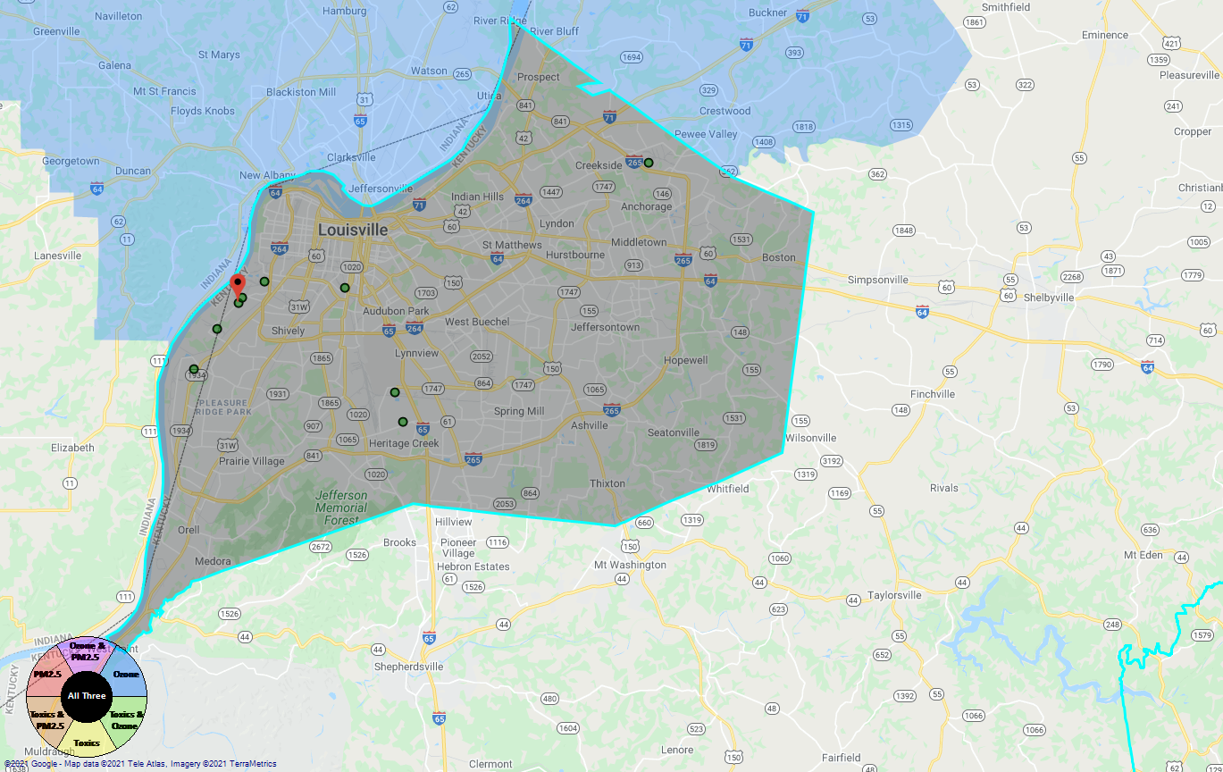
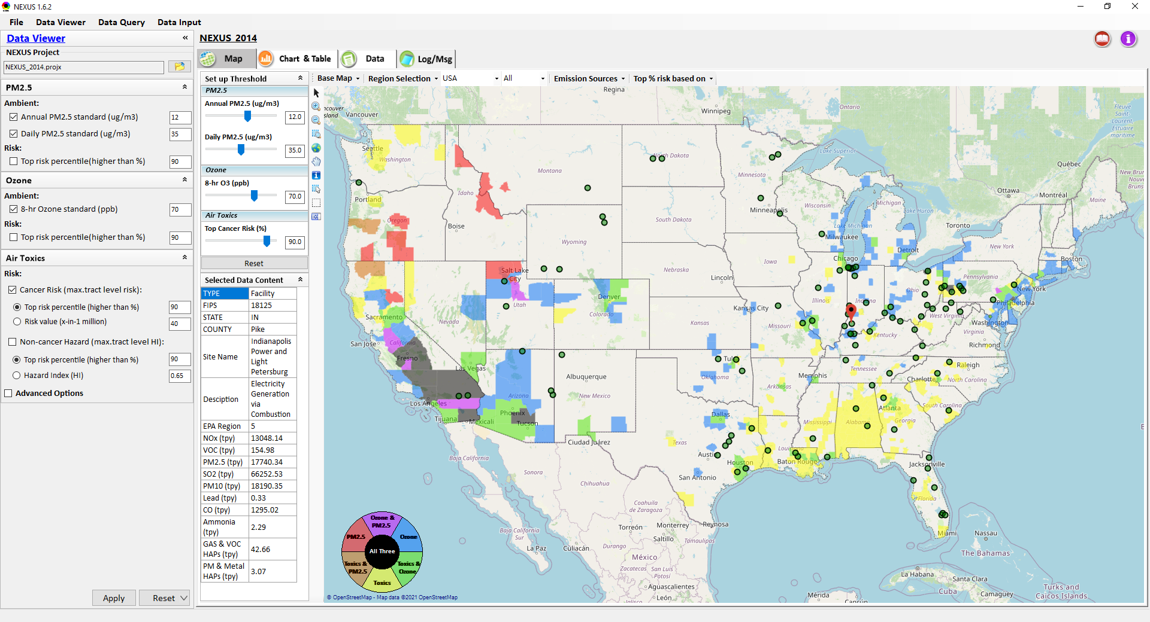
Proximity & Spatial Analysis: Allow to “Zoom-out” & “Zoom-in” Nationally for all Sources under same “Sector Group”
Display all facilities within same “Sector group”
Allow to “zoom out” nationally and “zoom-in” back to facility level
Provide color scale for selected MP risk value (e.g., red w/ high MP risk)
Proximity Analysis for Source/Sector
Zoom-out
Proximity and Spatial Analysis for MP Risks and EJ
Proximity Analysis
Spatial Analysis
Zoom-in
Facility: American Synthesis Rubber Co., KY Sector group: Polymers and Resins Production
[ x Display national map for Sector group
Radius of Influence
5
50km
Create Table
Create Plot
12

Slide 13
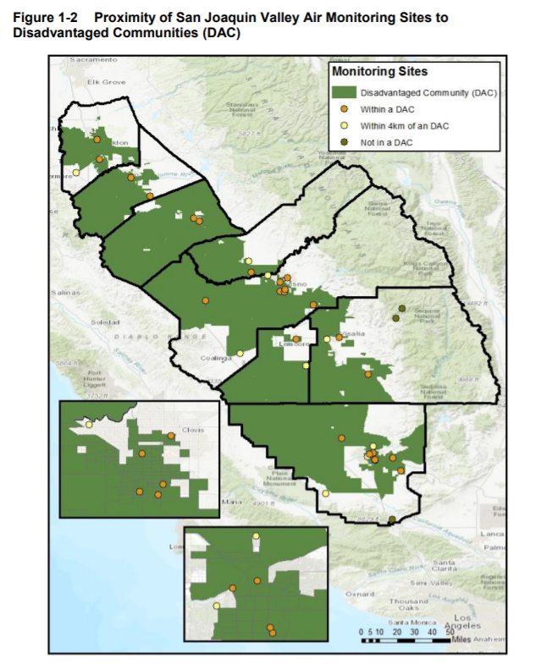
Additional Considerations for Use within NEXUS
SLTs prepare Annual Air Monitoring Network Plans and are required to conduct a Network Assessment once every 5 years
  Graphics such as this in San Joaquin Valley’s 2020 Air Monitoring Network Assessment are common
  NEXUS could enable monitor-based proximity analysis to augment these plans and network assessments
NEXUS can be very informative for air quality planners and others interested in better understanding the nature of air quality issues for a particular area
  Identify sources and the associated MP risk in proximity to monitors
  Account for multi-pollutant exposure/risk to EJ communities rather than single pollutant to better measure harm from air pollution exposures
13
http://valleyair.org/aqinfo/Docs/2020-Air-Monitoring-Network-Assessment.pdf

