Slide 1
NEXUS Discussion
National Screening Capabilities and Communications Plan
HEID & AQAD Briefing
Kimber Scavo, Tyler Fox, Beth Landis & Carey Jang
July 12, 2021

Slide 2
Overview
Background
Need for Proximity Screening
Current Practice for Proximity Screening
Benefits of Proximity Screening
Proximity Screening for Source/Sector
Additional Considerations for Use within NEXUS
NEXUS Communications Plan
2

Slide 3
Background
NEXUS assembles a variety of air pollution data in one easily accessible place to inform MP air quality planning efforts
  Identifies pollutant emissions and sources/sectors of potential interest within an area
Addition of screening analysis capabilities is recommended to best utilize the tool for AQ planning purposes:
  Screening allows for identification and better understanding of the key source(s)/pollutant(s) to focus efforts on:
    Nonattainment & Advance areas: Identify pollutant and source emissions that may be most effective to reduce through MP control strategies in order to reach/maintain attainment and/or reduce harmful exposures to air pollution
    Prioritization efforts: Informs OAQPS and EPA Region efforts by allowing more full account of multi-pollutant exposures (e.g., O₃, PM_{2.5} and Air Toxics) for outreach and working with areas/communities of interest
  Consistency in data, approach, tool for use in screening for our outreach efforts and potentially in regulatory/policy context
3

Slide 4
Need for Proximity Screening for Air Quality Planning
Proximity Screening Analysis helps answer…
What are the risks in close proximity to my monitor and/or community of interest?
What source(s) are in close proximity to my monitor and/or community of interest?
What are the demographics of communities in close proximity to monitor(s) and/or source(s) of interest?
How do the demographics of communities near my monitor/source compare to area/state/national averages?
How do the risks within communities near my monitor/source compare to area/state/national averages?
4

Slide 5
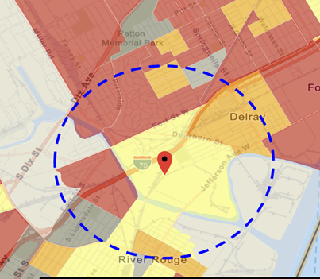
Current Practice for Proximity Screening: EJ Example
“Proximity analysis” is the primary EJ screening approach
  Comparisons of demographic distributions near source(s) to those for the state/region/nation
Types of Proximity Analysis
  Demographic analysis
  Risk-based demographic analysis
  Can consider other factors for use (next slide)
Current Tools Used in OAR
  OID use of EJSCREEN for initial screening and rules (with added GIS scripting)
  CAMD (EJ) tool by OAP for EGUs impact & EJ screening analysis
  Project specific efforts for criteria and toxic rules (in-house or contractor)
5

Slide 6
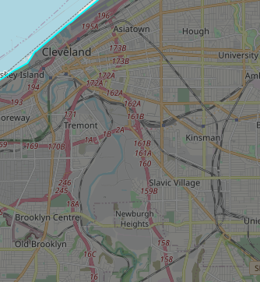
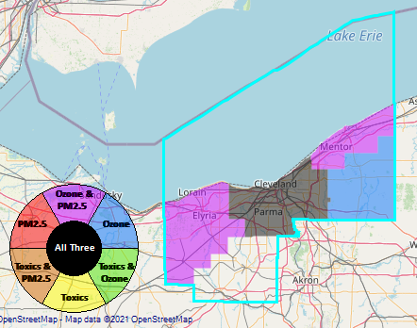
Benefit of Proximity Screening – Sources Near Monitor
Proximity Screening Analysis helps answer…
What source(s) are in close proximity to my monitor and/or community of interest?
Cleveland, Ohio is a maintenance area for the 2012 PM_{2.5} annual NAAQS
The GT Craig and Harvard Yards Monitoring Sites have DVs near the standard
GT Craig NCore Monitoring Site
Harvard Yards Monitoring Site
6

Slide 7

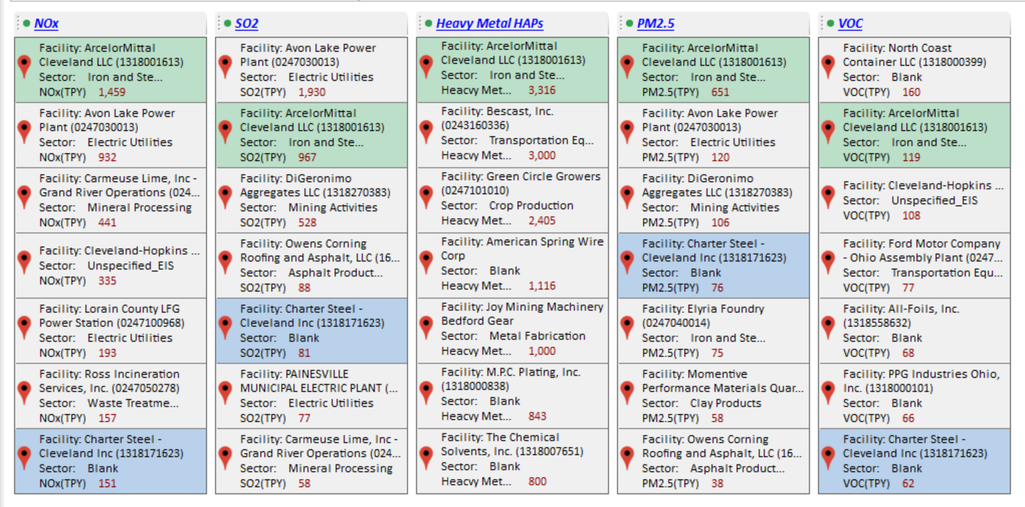
Benefit of Proximity Screening – Sources Near Monitor
We can currently see the major emission sources for a CBSA in NEXUS and plan to add in locations of monitoring sites
GT Craig NCore Monitoring Site
Harvard Yards Monitoring Site
Major PM_{2.5} Emission Sources
7

Slide 8
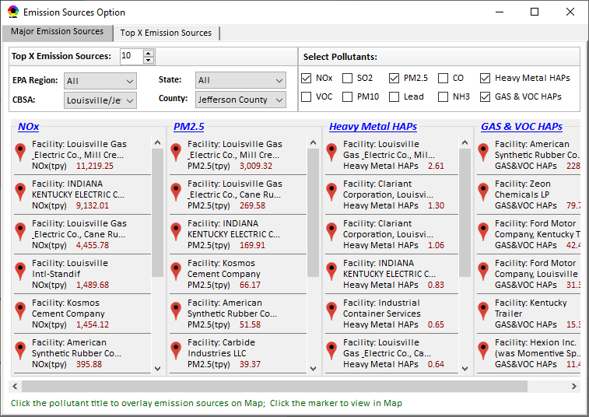
Benefit of Proximity Screening – Sources Near Monitor
Adding proximity analysis capabilities would allow the user to set a flexible Radius of Interest for a selected monitoring site to then determine what sources are within that radius and most likely contributors to monitored concentrations
Example Graphic – this capability is not yet available in NEXUS
Proximity and Spatial Analysis for MP Risks and EJ
Proximity Analysis
Spatial Analysis
Monitoring Site: Harvard Yards
GT Craig NCore Monitoring Site
Harvard Yards Monitoring Site
Major PM_{2.5} Emission Sources
Radius of Influence
5
50km
Create Table
Create Plot
8

Slide 9
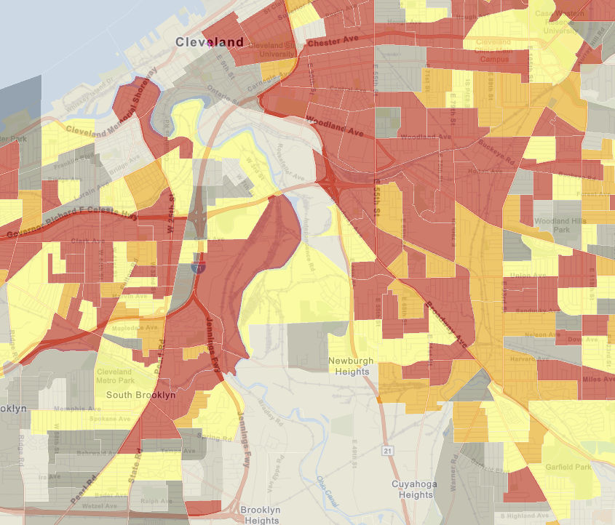
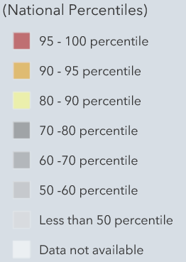
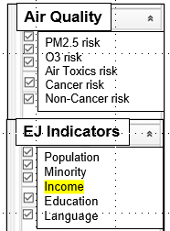
Benefit of Proximity Screening – Demographics & MP Risks Near Monitors/Sources
Proximity Screening Analysis helps answer…
What are the demographics of communities in close proximity to monitor(s) and/or (sources) of interest?
Adding proximity analysis capabilities would allow the user to set a flexible Radius of Interest for a selected monitoring site or facility and determine air quality and EJ indicators within the selected radius
Proximity and Spatial Analysis for MP Risk and EJ
Proximity Analysis
Spatial Analysis
GT Craig NCore Monitoring Site
Harvard Yards Monitoring Site
Major PM_{2.5} Emission Sources
MP Risk
Air Toxics
EJ Indicator
Income
Facility: ArcelorMittal Cleveland Sector group: Iron and Steel
9

Slide 10
Benefit of Proximity Screening – Demographic Comparison
Proximity Screening Analysis helps answer…
How do the demographics of communities near my monitor/source compare to area/state/national averages?
Example Graphic – this capability is not yet available in NEXUS
(%tile)
Adding proximity analysis capabilities would allow the user to set a flexible Radius of Interest for a selected monitoring site or facility, determine air quality and EJ indicators within the selected radius and see how they compare to the county, state, region, nation and sector group (if applicable)
10

Slide 11
Benefit of Proximity Screening – Risk Comparison
Proximity Screening Analysis helps answer…
How do the risks within communities near my monitor/source compare to area/state/national averages?
Example Graphic – this capability is not yet available in NEXUS
(%tile)
Adding proximity analysis capabilities would allow the user to set a flexible Radius of Interest for a selected monitoring site or facility, determine air quality and EJ indicators within the selected radius and see how they compare to the county, state, region, nation and sector group (if applicable)
11

Slide 12
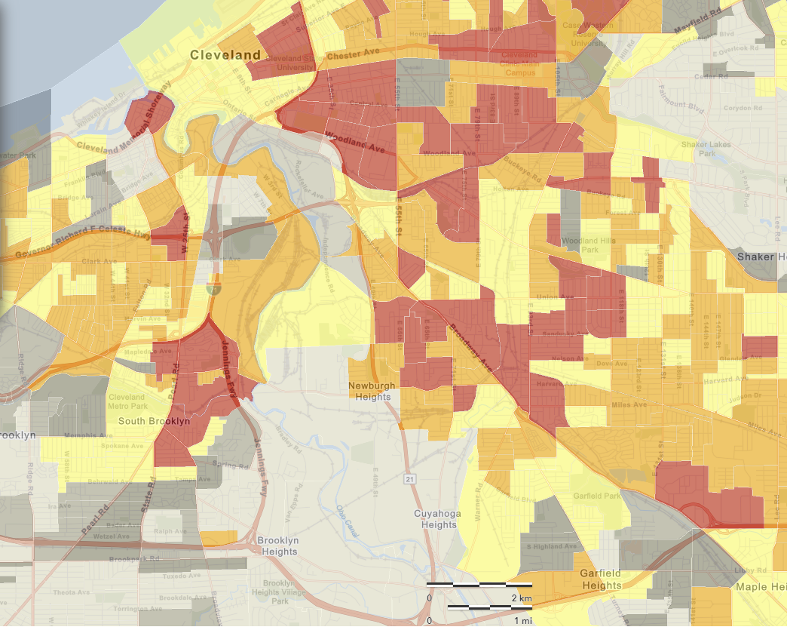
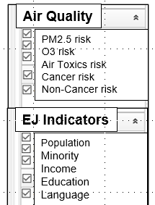
Benefit of Proximity Screening – Risk Near Monitor/Source
Proximity Screening Analysis helps answer…
What are the risks in close proximity to my monitor and/or community of interest?
Adding proximity analysis capabilities would allow the user to set a flexible Radius of Interest for a selected monitoring site or facility, and visually see air quality risk and EJ indicators within the selected radius
GT Craig NCore Monitoring Site
Harvard Yards Monitoring Site
Major PM_{2.5} Emission Sources
12

Slide 13
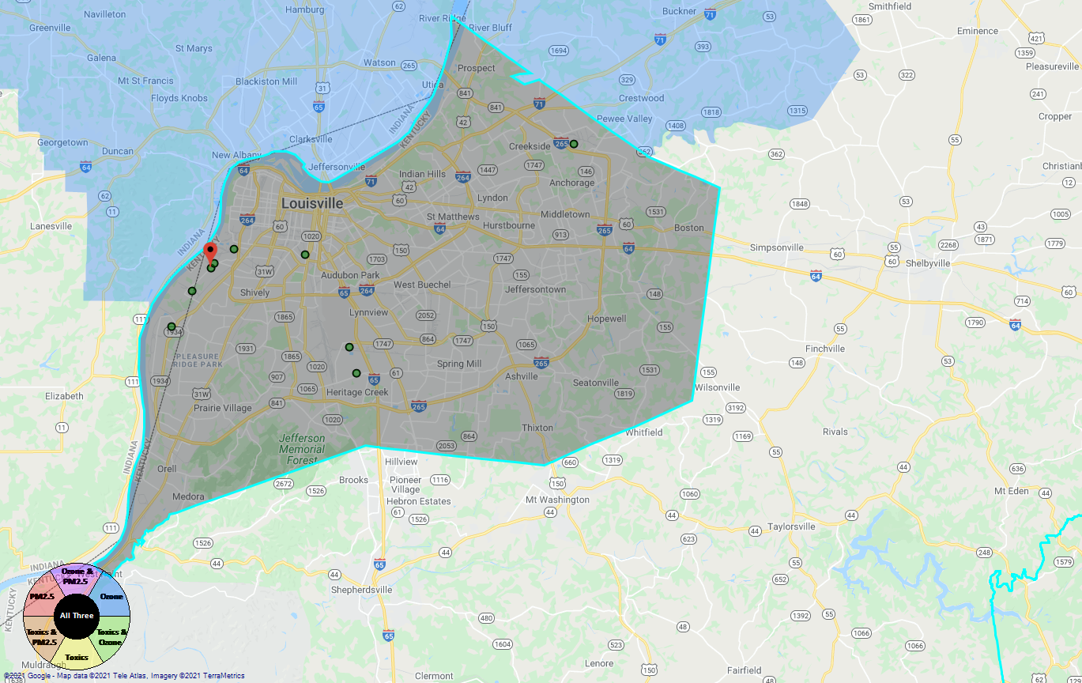
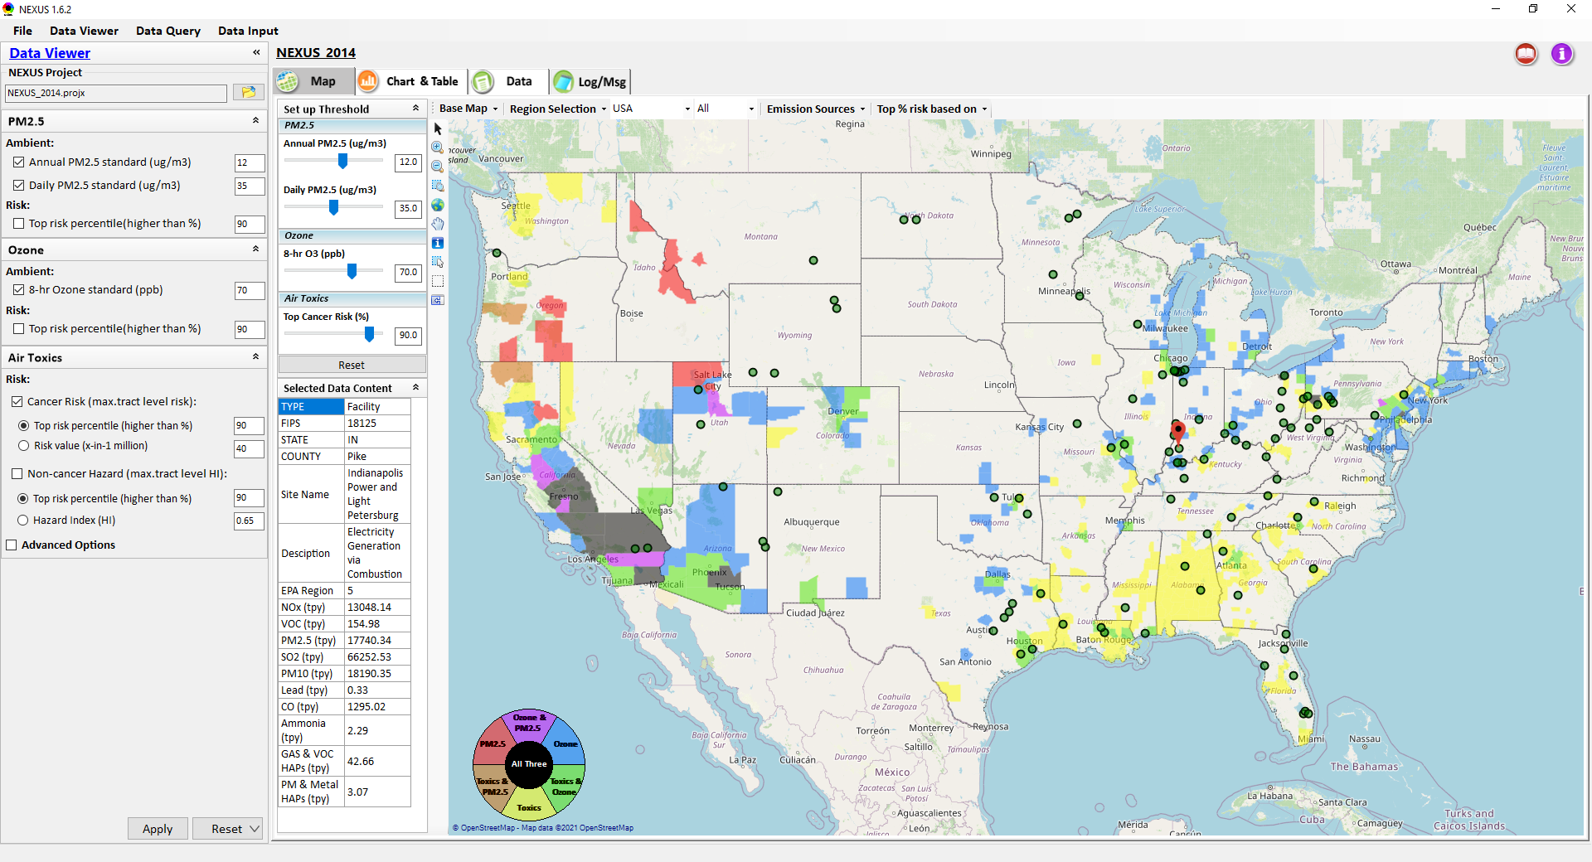
Proximity Screening for Source/Sector
Display all facilities within same “Sector group”
Allow to “zoom out” nationally and “zoom-in” back to facility level
Provide color scale for selected MP risk value (e.g., red w/ high MP risk)
Zoom-out
Proximity and Spatial Analysis for MP Risks and EJ
Proximity Analysis
Spatial Analysis
Zoom-in
Facility: American Synthesis Rubber Co., KY Sector group: Polymers and Resins Production
[ x Display national map for Sector group
Radius of Influence
5
50km
Create Table
Create Plot
13

Slide 14
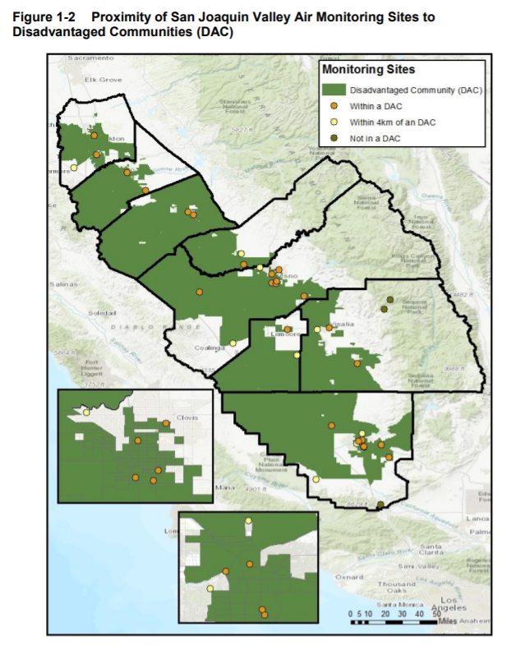
Additional Considerations for Use within NEXUS
SLTs prepare Annual Air Monitoring Network Plans and are required to conduct a Network Assessment once every 5 years
  Graphics such as this in San Joaquin Valley’s 2020 Air Monitoring Network Assessment are common
  NEXUS could enable monitor-based proximity analysis to augment these plans and network assessments
Consistent with AQ planning use, NEXUS can inform outreach efforts to help communities/stakeholders better understand the nature of air quality issues for their area
14
http://valleyair.org/aqinfo/Docs/2020-Air-Monitoring-Network-Assessment.pdf

Slide 15
Communications Plan Discussion
Stakeholder / Stakeholder Group | Content | Objectives | Approximate Date
OEJ (EJSCREEN Team) | MP planning NEXUS tool – focusing on similarities & differences with EJSCREEN | Awareness of the NEXUS tool Feedback for improvements Define capabilities of each tool and complimentary nature | July
OAR (Joe Goffman, Tomas) | MP planning, Detroit, SC & Louisville Projects NEXUS tool capabilities | General awareness of MP efforts Support of NEXUS tool development | July 26
OAP (CAMD EJ Tool Development Team) | MP planning NEXUS tool capabilities | Awareness of the NEXUS tool Feedback for use & improvements | July/August
Region 4 / Louisville | NEXUS tool use– focusing on the Louisville area | Awareness of the NEXUS tool Feedback for use in NAA & Advance areas | August
APMs (SIP and air toxics) | NEXUS – identify the highest risk areas across O₃, PM_{2.5}, and Air Toxics; illustrative use in select areas such as Chicago, Houston & Atlanta | Awareness of the NEXUS tool Feedback for use & improvements Determine interest in area profile packets for Regions to discuss nature of MP issues and possible avenues to address or conduct more refined analyses (e.g., R9 → Phoenix) | August
MJOs (NACAA & AAPCA) | TBD post regional discussions and feedback | Present latest MP projects (Louisville) TBD post regional discussions and feedback | TBD
15

Slide 16
Questions?
16

Slide 17
Appendix
CAMD EJ Tool & Proximity Analysis
Adapted from Update on OAP EJ Analytic & Mapping Tool Development Briefing (3/30/21)
17

Slide 18
How to determine whether an EGU might negatively impact a community?
Proximity Analysis
Identifies all communities within a given radius of each EGU
Captures potential air, water, waste, and other impacts
Transport modeling
Identifies all communities to which each EGU might impact air quality
Captures downwind air pollution impacts
18

Slide 19
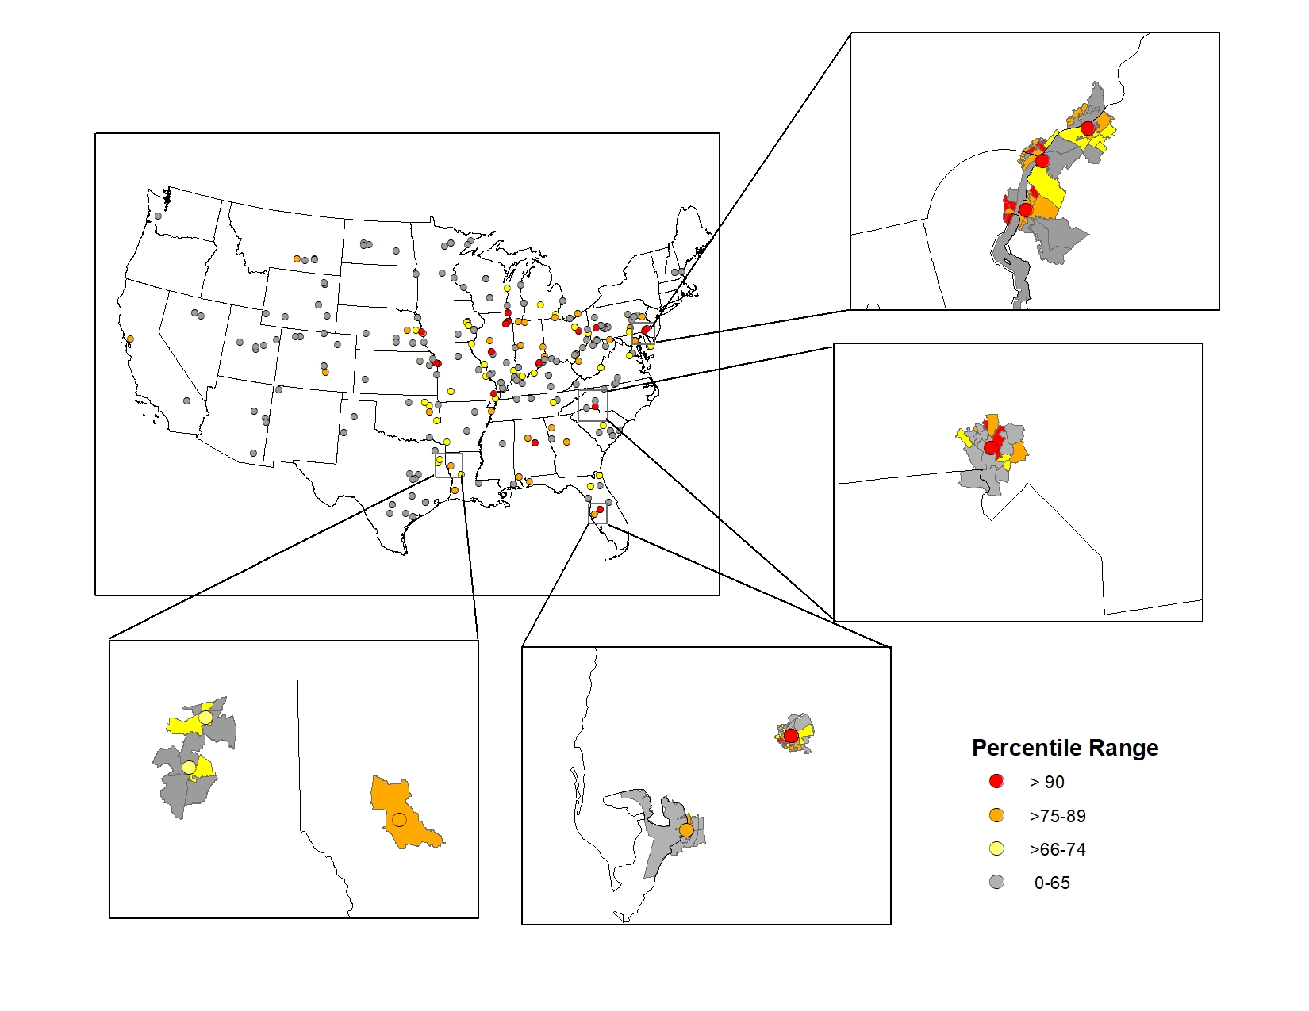
Proximity Analysis
Proximity Analysis
All EGUs linked to the census block groups that are within a 5km radius
Able to quickly filter EGUs based on nearby census block group ranking
19

Slide 20
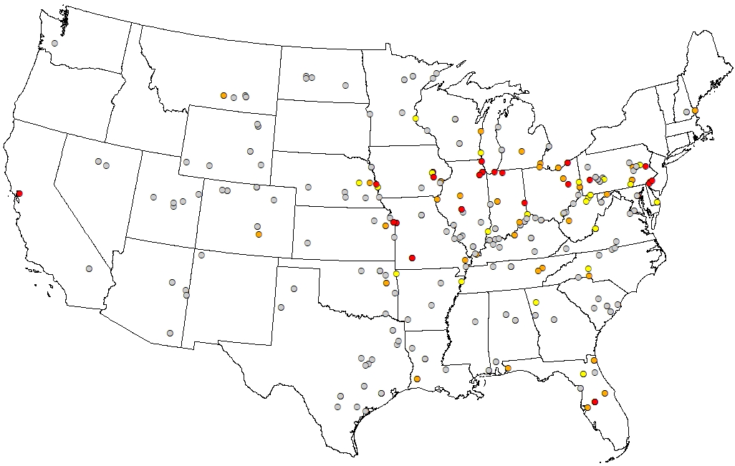
Proximity Analysis: Ranking EGUs
Proximity Analysis – Ranking EGUs
Account for EGUs located near many disproportionately-impacted communities
Considers:
  Number of nearby disproportionally-impacted communities
  Relative difference in disproportionate impacts that communities face
  Total population
Next step: consider emissions
20

