Slide 1
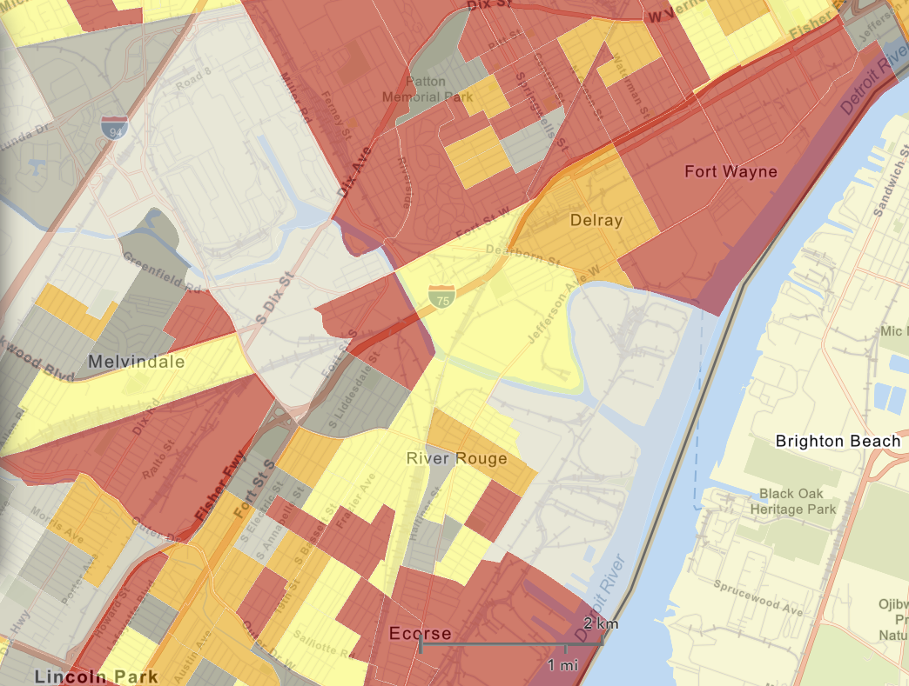
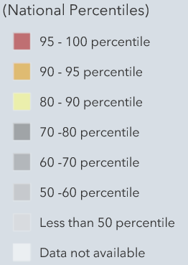
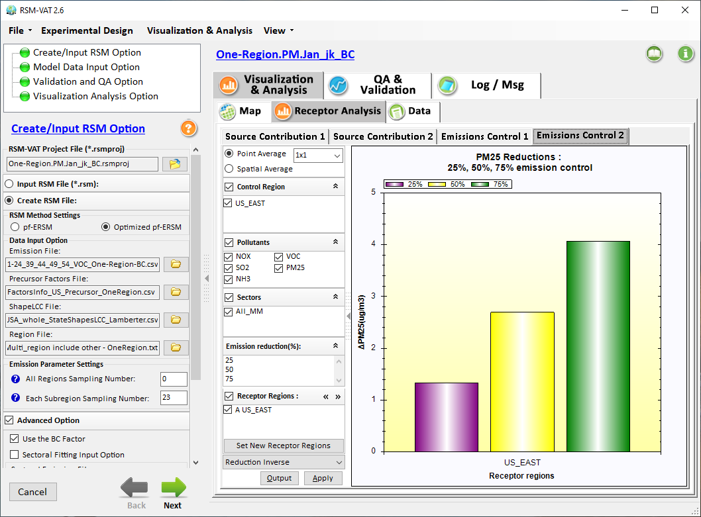

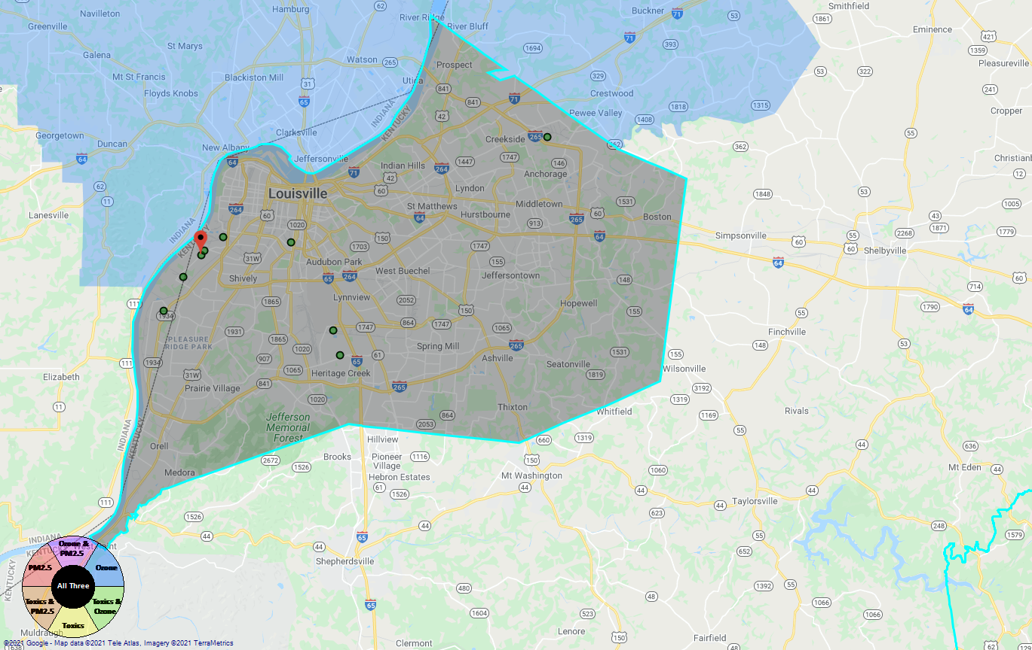
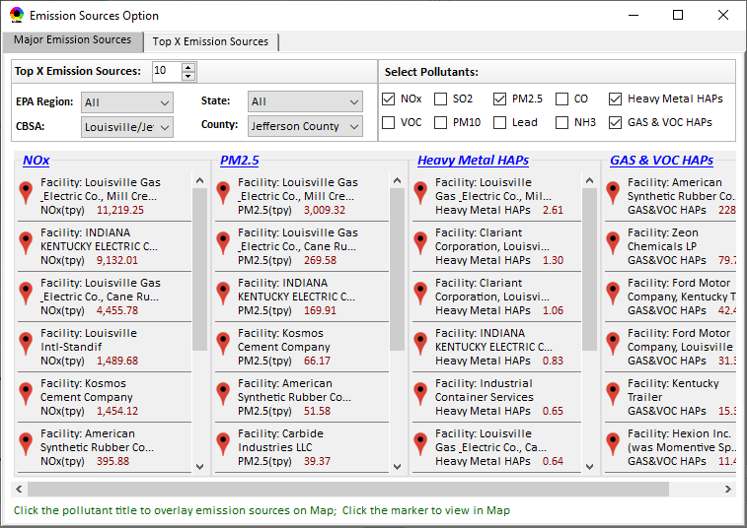
Developing Screening Capabilities for
“Proximity & Spatial Analysis for MP Risks & EJ”
NEXUS now can be used to quickly identify top emitters of NOx, SO₂, PM_{2.5}, and heavy-metal & VOCs HAPs near EJ areas of concern; plan to develop proximity & spatial analysis capabilities
Spatial
Analysis
Air Quality
PM2.5 risk
O3 risk
Air Toxics risk
Cancer risk
Non-Cancer risk
EJ Indicators
Proximity Analysis
(Selected Facility or Monitoring Site)
Climate Risks
Population
Minority
Income
Education
Language
Flood
Fire
Sea Level Rise
Heat
Disease
Climate Risks
Flood
Fire
Sea Level Rise
Heat
Disease
Proximity and Spatial Analysis for MP Risk and EJ
Proximity Analysis
Spatial Analysis
MP Risk
Air Toxics
EJ Indicator
Minority
Facility: American Synthesis Rubber Co., Louisville, KY Sector Group: Polymers and Resins Production Top Risk Drivers: ETO, Formaldehyde (examples) |  |  |  |  | Selected Options: Radius of Impact: 10km Number of CBSAs: 25 (top MP risk ranking) Air Toxics Risk threshold: 10 (“x”-in-a million)
 | Within Radius of Facility | County Avg. | State Avg. | EPA Region Avg. |  | Nation Avg. | Sector Group (within radius) National avg. | Sector Group (within radius) Top 25 CBSAs
Population total | x,xxx | xx,xxx | xxx,xxx | xxx,xxx |  | 317,xxx,xxx | xxx,xxx | xxx,xxx
PM2.5 risk (%tile) | x% | x% | x% | x% |  | x% | x% | x%
Ozone risk (%tile) | x% | x% | x% | x% |  | x% | x% | x%
Air Toxics risk: Cancer risk (%tile) | x% | x% | x% | x% |  | x% | x% | x%
Cancer risk value (“x”-in-a million)) | x.x | x.x | x.x | x.x |  | x.x | x.x | x.x
Cancer risk value above selected threshold (population %tile) | x% | x% | x% | x% |  | x% | x% | x%
Non-cancer risk (%tile) | x% | x% | x% | x% |  | x% | x% | x%
Non-cancer risk (Hazard Index) | x.x | x.x | x.x | x.x |  | x.x | x.x | x.x
Climate risks: Flood (%tile) | x% | x% | x% | x% |  | x% | x% | x%
Sea level rise (%tile) | x% | x% | x% | x% |  | x% | x% | x%
Fire (%tile) | x% | x% | x% | x% |  | x% | x% | x%
Disease (%tile) | x% | x% | x% | x% |  | x% | x% | x%
EJ/Demographics: Minority group (%tile) | x% | x% | x% | x% |  | x% | x% | x%
Low-income group (%tile) | x% | x% | x% | x% |  | x% | x% | x%
Demographic Index (%tile) | x% | x% | x% | x% |  | x% | x% | x%
Linguistic Isolation (%tile) | x% | x% | x% | x% |  | x% |  | x%
Proximity and Spatial Analysis for MP Risks and EJ
Proximity Analysis
Spatial Analysis
Graphical
& Tabular
Analysis
Facility: American Synthesis Rubber Co., KY Sector group: Polymers and Resins Production
[ x Display national map for Sector group
Radius of Influence
5
50km
Create Table
Create Plot
1

Slide 2
Developing Capabilities for Proximity and Spatial Analysis
Proximity analysis will allow to set a flexible “Radius of Influence” for a selected facility or monitoring site (based on census tract- and/or block group-level)
NEXUS now can quickly identify top emitters of CAPs & HAPs; Plan to develop proximity screening capabilities to include EJ/demographic indicators
Proximity and Spatial Analysis for MP Risks and EJ
Proximity Analysis
Spatial Analysis
Facility: American Synthesis Rubber Co., KY Sector group: Polymers and Resins Production
[ x Display national map for Sector group
Radius of Influence
5
50km
Create Table
Create Plot
2

Slide 3

Developing Capabilities for Proximity and Spatial Analysis
Air Quality
PM2.5 risk
O3 risk
Air Toxics risk
Cancer risk
Non-Cancer risk
EJ Indicators
Climate Risks
Population
Minority
Income
Education
Language
Flood
Fire
Sea Level Rise
Heat
Disease
Climate Risks
Flood
Fire
Sea Level Rise
Heat
Disease
Proximity and Spatial Analysis for MP Risk and EJ
Proximity Analysis
Spatial Analysis
MP Risk
Air Toxics
EJ Indicator
Minority
3

Slide 4
Proximity Analysis for Selected Facility/Sector or Monitoring Site: Example Chart
Air Quality
PM2.5 risk
O3 risk
Air Toxics risk
Cancer risk
Non-Cancer risk
(%tile)
EJ Indicators
Climate Risks
Population
Minority
Income
Education
Language
Flood
Fire
Sea Level Rise
Heat
Disease
Climate Risks
Flood
Fire
Sea Level Rise
Heat
Disease

Slide 5
Screening Proximity Analysis in NEXUS:
Example Tabular Data Summary
Facility: American Synthesis Rubber Co., Louisville, KY Sector Group: Polymers and Resins Production Top Risk Drivers: ETO, Formaldehyde (examples) |  |  |  |  | Selected Options: Radius of Impact: 10km Number of CBSAs: 25 (top MP risk ranking) Air Toxics Risk threshold: 10 (“x”-in-a million)
 | Within Radius of Facility | County Avg. | State Avg. | EPA Region Avg. |  | Nation Avg. | Sector Group (within radius) National avg. | Sector Group (within radius) Top 25 CBSAs
Population total | x,xxx | xx,xxx | xxx,xxx | xxx,xxx |  | 317,xxx,xxx | xxx,xxx | xxx,xxx
PM2.5 risk (%tile) | x% | x% | x% | x% |  | x% | x% | x%
Ozone risk (%tile) | x% | x% | x% | x% |  | x% | x% | x%
Air Toxics risk: Cancer risk (%tile) | x% | x% | x% | x% |  | x% | x% | x%
Cancer risk value (“x”-in-a million)) | x.x | x.x | x.x | x.x |  | x.x | x.x | x.x
Cancer risk value above selected threshold (population %tile) | x% | x% | x% | x% |  | x% | x% | x%
Non-cancer risk (%tile) | x% | x% | x% | x% |  | x% | x% | x%
Non-cancer risk (Hazard Index) | x.x | x.x | x.x | x.x |  | x.x | x.x | x.x
Climate risks: Flood (%tile) | x% | x% | x% | x% |  | x% | x% | x%
Sea level rise (%tile) | x% | x% | x% | x% |  | x% | x% | x%
Fire (%tile) | x% | x% | x% | x% |  | x% | x% | x%
Disease (%tile) | x% | x% | x% | x% |  | x% | x% | x%
EJ/Demographics: Minority group (%tile) | x% | x% | x% | x% |  | x% | x% | x%
Low-income group (%tile) | x% | x% | x% | x% |  | x% | x% | x%
Demographic Index (%tile) | x% | x% | x% | x% |  | x% | x% | x%
Linguistic Isolation (%tile) | x% | x% | x% | x% |  | x% |  | x%
5

Slide 6
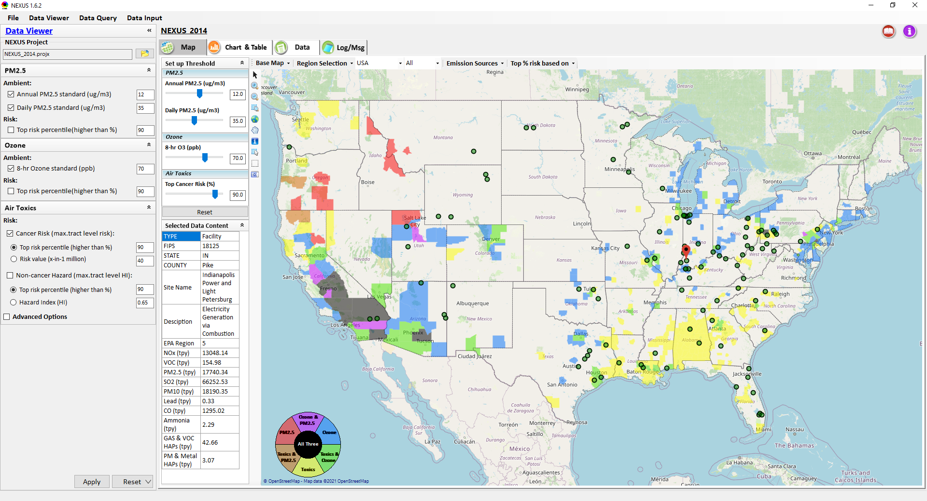
Proximity & Spatial Analysis: Allow to “Zoom-out” & “Zoom-in” Nationally for all Facilities under same “Sector Group”
Display all facilities within same “Sector group”
Allow to “zoom out” nationally and “zoom-in” back to facility level
Provide color scale for selected MP risk value (e.g., red w/ high MP risk)
Proximity Analysis for Source/Sector
Zoom-out
Proximity and Spatial Analysis for MP Risks and EJ
Proximity Analysis
Spatial Analysis
Zoom-in
Facility: American Synthesis Rubber Co., KY Sector group: Polymers and Resins Production
[ x Display national map for Sector group
Radius of Influence
5
50km
Create Table
Create Plot
6

