Slide 1
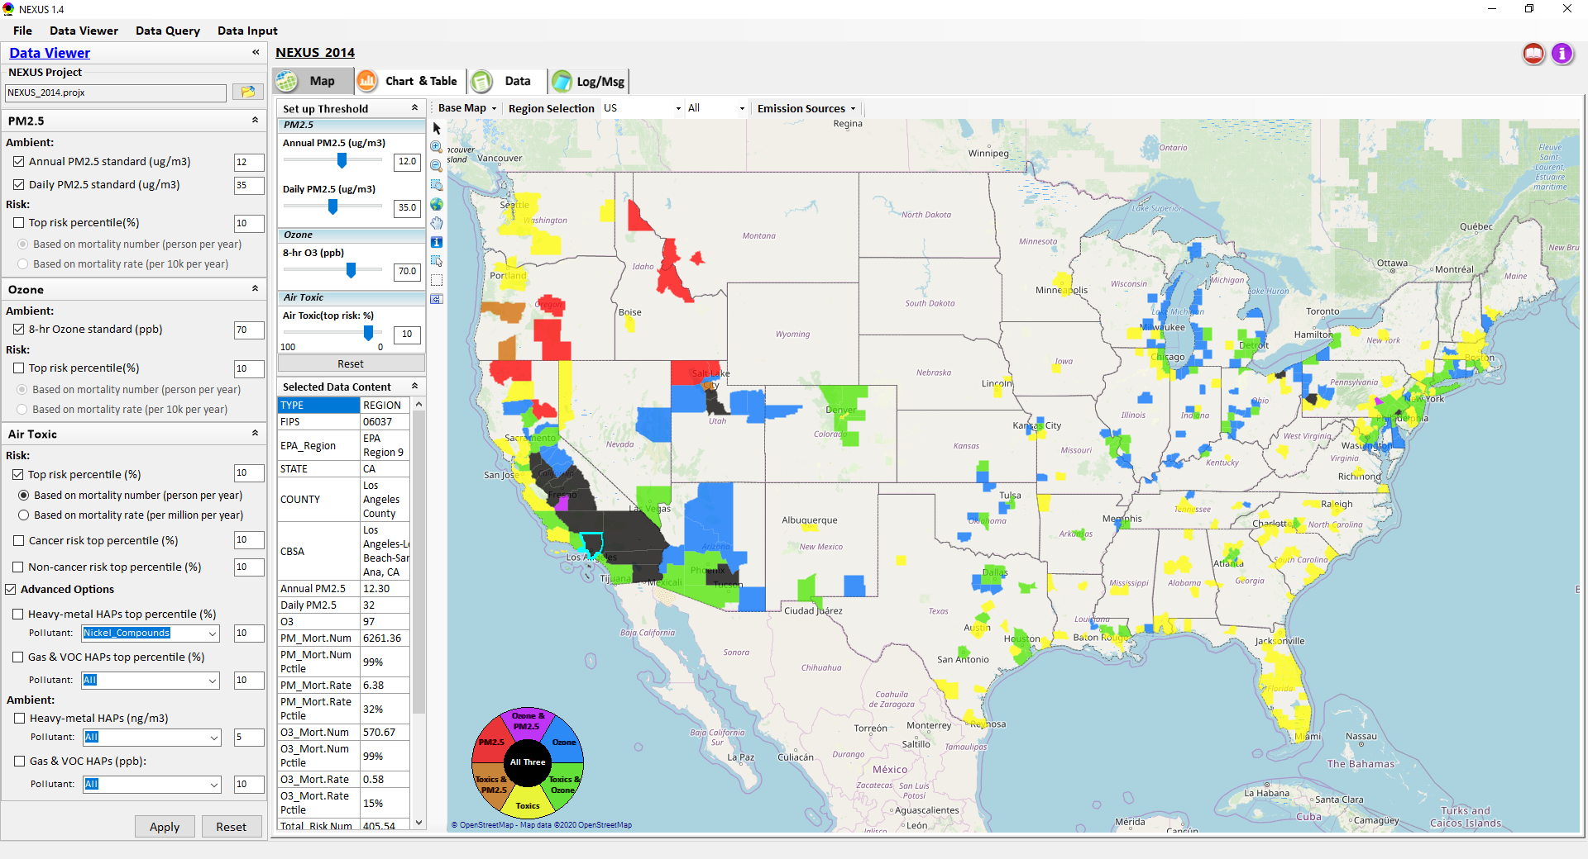
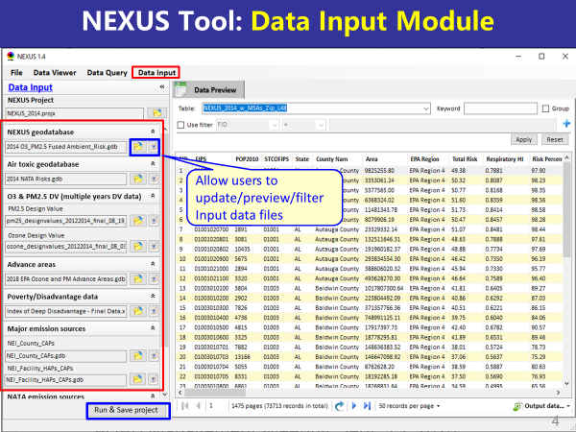
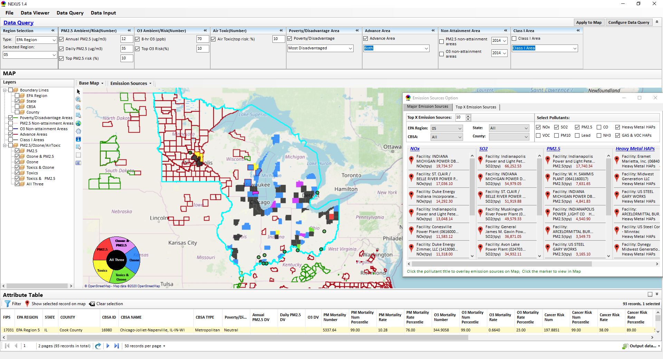
“NEXUS” Multi-Pollutant Analysis Tool:
Recent Updates and Improvements
Data Viewer Module
Data Input Module
Data Query Module
“NEXUS 1.5” available on OAQPS’s Shared Drive at: “G:\SHARE\NEXUS\NEXUS 1.5\”
or at EPA’s new FTP site: ftp://newftp.epa.gov/aqmg/cjang/NEXUS/NEXUS 1.5/
NEXUS Briefing
April 29, 2021
Carey Jang and Jim Kelly

Slide 2
NEXUS Tool Development
Motivation: Develop a new multi-pollutant analysis tool to identify and assess areas with high ambient levels and/or health risks associated with PM_{2.5}, O₃ and Air Toxics
Phase-1: Develop a GIS-based NEXUS prototype with a user-friendly graphical interface to provide analysis and visualization functions of potential multi-pollutant AQ issues at national level (continental US)
Phase-2: Expand the NEXUS tool to allow users to dial into an EPA region, State, or metropolitan area and provide data query and visualization functions for “emissions and air quality” information over the selected region of interest
2

Slide 3
NEXUS Tool: Engagement Across OAQPS
Audience | Date
AQAD & HEID – DD & Management Team | Sept. 25, 2020
Air Toxics Team | Nov. 3, 2020
AQPD – DD & Management Team | Dec. 10, 2020
OID – DD & Management Team | Jan. 25, 2021
SPPD – DD & Management Team | Jan 28, 2021
OAQPS – Office Director | Feb 1, 2021
3

Slide 4
NEXUS Tool: Three Key Modules
Data Viewer module
Data Input module
Data Query module
View and create interactive Map/Data/Chart/Table
Provide flexible selections & mapping of “Ambient” and/or “Risk” levels of PM_{2.5}, O₃ and Air Toxics
Provide regional analysis for “EPA region”, “States”, “CBSA”, and “County”
Link and display major emission sources locations & emitted pollutants info.
Allow to update & change input data files
Provide data preview and filter functions
Currently uses 10 publicly available input data files (~4GB)
Quick turnaround to run & save to a new “project” using new input data files
Expand data field selections and flexibility for exploratory/advanced users
Provide overlaying map and summary table for data query results
Current data query based on selected data fields: “Ambient/Risk, Advance area, Socio-demographic (EJ) area, NA Area, Class I area”
4

Slide 5
Feedback from OAQPS & SMT Briefing
Improve the national screening metrics for air toxics to reduce possible ‘false-negatives’
Augment current “area” orientation of tool to provide national and area-specific screening capabilities for sectors in multi-pollutant context
Within high-risk areas, provide multi-pollutant proximity-based screening capabilities for sources/sectors so accounts for both criteria and toxic pollutants
5

Slide 6
NEXUS 2.0 (Under Development)
Near-term Priorities for 2021 NEXUS development:
Upgrade NEXUS (metrics/EJ indicators) for EPA beta testing
  Revising national air toxic (AT) metrics based on AT team’s suggestions
  Include EJ/demographic index from EJSCREEN & Tribal areas
Update to 2017 emissions data (including GHG & Sector mapping)
Update to 2017 AQ fused data (PM_{2.5}, O₃, AT) and risk data (Note: need separate discussion on air toxics risk effort with SMT)
include AQ monitoring data (PM_{2.5}, O₃, AT)
Develop screening capabilities for “Proximity & spatial analysis for MP risks & EJ” (at census tract- and block group-level)
Ongoing
Planned
6

Slide 7
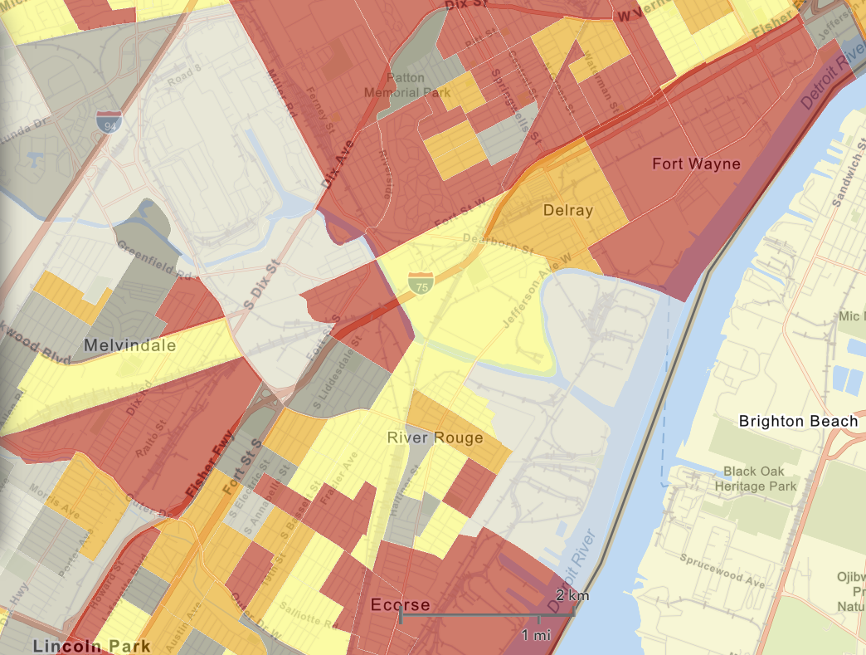
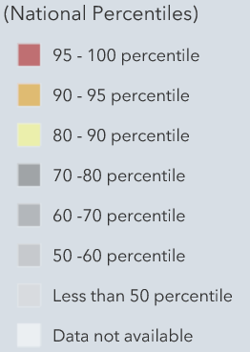
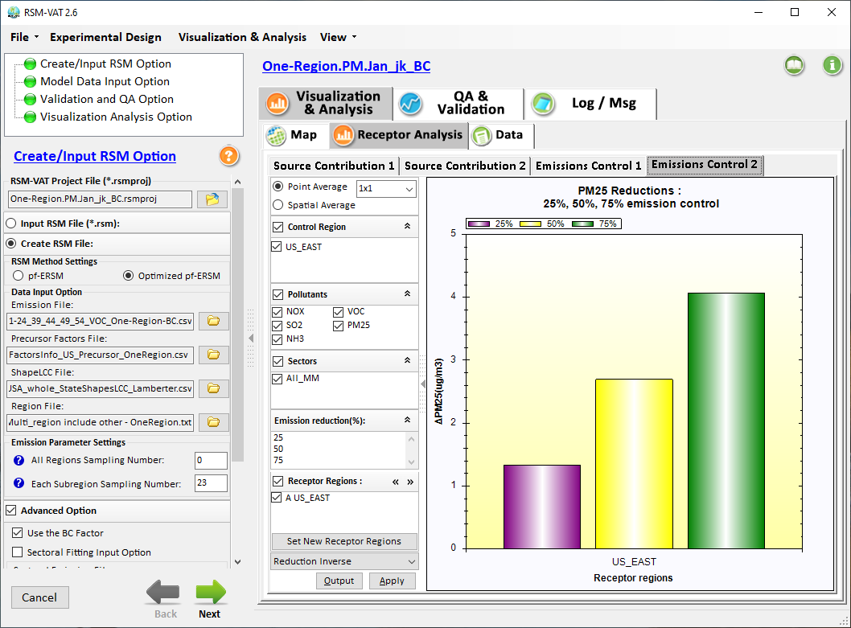

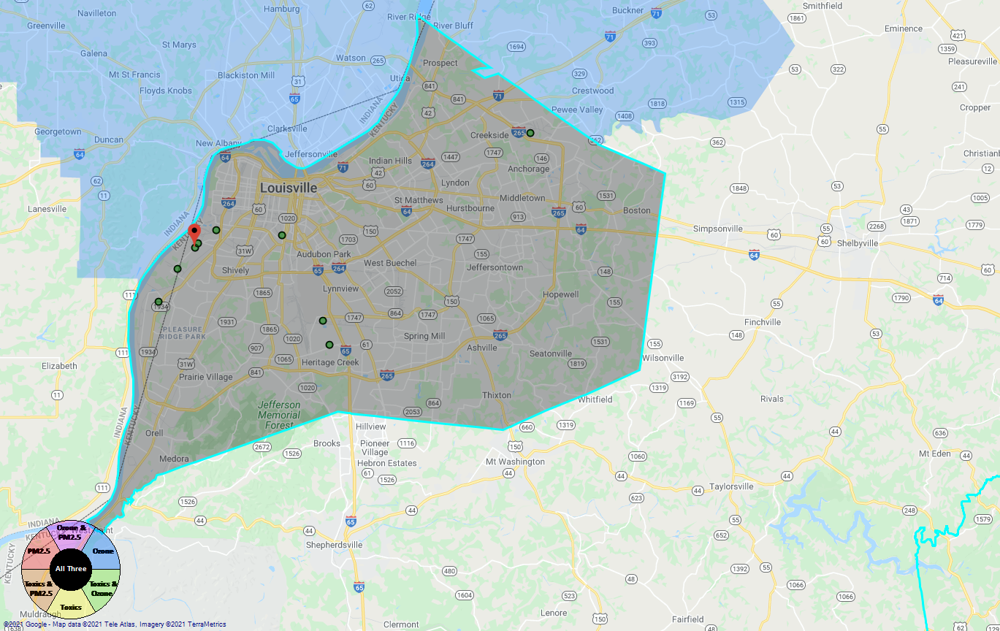
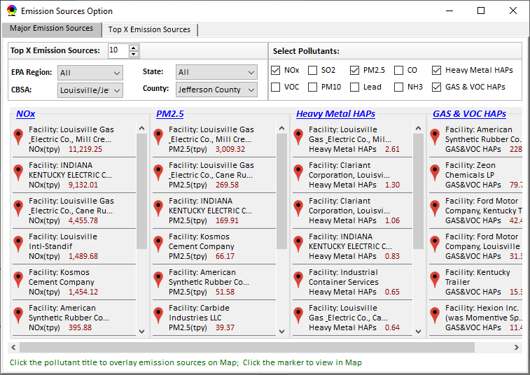
Developing Screening Capabilities for
“Proximity & Spatial Analysis for MP Risks & EJ”
NEXUS now can be used to quickly identify top emitters of NOx, SO₂, PM_{2.5}, and heavy-metal & VOCs HAPs near EJ areas of concern; plan to develop proximity & spatial analysis capabilities
Spatial
Analysis
Air Quality
PM2.5 risk
O3 risk
Air Toxics risk
Cancer risk
Non-Cancer risk
EJ Indicators
Proximity Analysis
(Selected Facility or Monitoring Site)
Climate Risks
Population
Minority
Income
Education
Language
Flood
Fire
Sea Level Rise
Heat
Disease
Climate Risks
Flood
Fire
Sea Level Rise
Heat
Disease
Proximity and Spatial Analysis for MP Risk and EJ
Proximity Analysis
Spatial Analysis
MP Risk
Air Toxics
EJ Indicator
Minority
Facility: American Synthesis Rubber Co., Louisville, KY Sector Group: Polymers and Resins Production Top Risk Drivers: ETO, Formaldehyde (examples) |  |  |  |  | Selected Options: Radius of Impact: 10km Number of CBSAs: 25 (top MP risk ranking) Air Toxics Risk threshold: 10 (“x”-in-a million)
 | Within Radius of Facility | County Avg. | State Avg. | EPA Region Avg. |  | Nation Avg. | Sector Group (within radius) National avg. | Sector Group (within radius) Top 25 CBSAs
Population total | x,xxx | xx,xxx | xxx,xxx | xxx,xxx |  | 317,xxx,xxx | xxx,xxx | xxx,xxx
PM2.5 risk (%tile) | x% | x% | x% | x% |  | x% | x% | x%
Ozone risk (%tile) | x% | x% | x% | x% |  | x% | x% | x%
Air Toxics risk: Cancer risk (%tile) | x% | x% | x% | x% |  | x% | x% | x%
Cancer risk value (“x”-in-a million)) | x.x | x.x | x.x | x.x |  | x.x | x.x | x.x
Cancer risk value above selected threshold (population %tile) | x% | x% | x% | x% |  | x% | x% | x%
Non-cancer risk (%tile) | x% | x% | x% | x% |  | x% | x% | x%
Non-cancer risk (Hazard Index) | x.x | x.x | x.x | x.x |  | x.x | x.x | x.x
Climate risks: Flood (%tile) | x% | x% | x% | x% |  | x% | x% | x%
Sea level rise (%tile) | x% | x% | x% | x% |  | x% | x% | x%
Fire (%tile) | x% | x% | x% | x% |  | x% | x% | x%
Disease (%tile) | x% | x% | x% | x% |  | x% | x% | x%
EJ/Demographics: Minority group (%tile) | x% | x% | x% | x% |  | x% | x% | x%
Low-income group (%tile) | x% | x% | x% | x% |  | x% | x% | x%
Demographic Index (%tile) | x% | x% | x% | x% |  | x% | x% | x%
Linguistic Isolation (%tile) | x% | x% | x% | x% |  | x% |  | x%
Proximity and Spatial Analysis for MP Risks and EJ
Proximity Analysis
Spatial Analysis
Graphical
& Tabular
Analysis
Facility: American Synthesis Rubber Co., KY Sector group: Polymers and Resins Production
[ x Display national map for Sector group
Radius of Influence
5
50km
Create Table
Create Plot
7

Slide 8
Developing Capabilities for Proximity and Spatial Analysis
Proximity analysis will allow to set a flexible “Radius of Influence” for a selected facility or monitoring site
NEXUS now can quickly identify top emitters of CAPs & HAPs; Plan to develop proximity capabilities to include EJ/demographic index
Proximity and Spatial Analysis for MP Risks and EJ
Proximity Analysis
Spatial Analysis
Facility: American Synthesis Rubber Co., KY Sector group: Polymers and Resins Production
[ x Display national map for Sector group
Radius of Influence
5
50km
Create Table
Create Plot
8

Slide 9

Developing Capabilities for Proximity and Spatial Analysis
Air Quality
PM2.5 risk
O3 risk
Air Toxics risk
Cancer risk
Non-Cancer risk
EJ Indicators
Climate Risks
Population
Minority
Income
Education
Language
Flood
Fire
Sea Level Rise
Heat
Disease
Climate Risks
Flood
Fire
Sea Level Rise
Heat
Disease
Proximity and Spatial Analysis for MP Risk and EJ
Proximity Analysis
Spatial Analysis
MP Risk
Air Toxics
EJ Indicator
Minority
9

Slide 10
Proximity Analysis for Selected Facility/Sector or Monitoring Site: Example Chart
Air Quality
PM2.5 risk
O3 risk
Air Toxics risk
Cancer risk
Non-Cancer risk
(%tile)
EJ Indicators
Climate Risks
Population
Minority
Income
Education
Language
Flood
Fire
Sea Level Rise
Heat
Disease
Climate Risks
Flood
Fire
Sea Level Rise
Heat
Disease

Slide 11
Screening Proximity Analysis in NEXUS:
Example Tabular Data Summary
Facility: American Synthesis Rubber Co., Louisville, KY Sector Group: Polymers and Resins Production Top Risk Drivers: ETO, Formaldehyde (examples) |  |  |  |  | Selected Options: Radius of Impact: 10km Number of CBSAs: 25 (top MP risk ranking) Air Toxics Risk threshold: 10 (“x”-in-a million)
 | Within Radius of Facility | County Avg. | State Avg. | EPA Region Avg. |  | Nation Avg. | Sector Group (within radius) National avg. | Sector Group (within radius) Top 25 CBSAs
Population total | x,xxx | xx,xxx | xxx,xxx | xxx,xxx |  | 317,xxx,xxx | xxx,xxx | xxx,xxx
PM2.5 risk (%tile) | x% | x% | x% | x% |  | x% | x% | x%
Ozone risk (%tile) | x% | x% | x% | x% |  | x% | x% | x%
Air Toxics risk: Cancer risk (%tile) | x% | x% | x% | x% |  | x% | x% | x%
Cancer risk value (“x”-in-a million)) | x.x | x.x | x.x | x.x |  | x.x | x.x | x.x
Cancer risk value above selected threshold (population %tile) | x% | x% | x% | x% |  | x% | x% | x%
Non-cancer risk (%tile) | x% | x% | x% | x% |  | x% | x% | x%
Non-cancer risk (Hazard Index) | x.x | x.x | x.x | x.x |  | x.x | x.x | x.x
Climate risks: Flood (%tile) | x% | x% | x% | x% |  | x% | x% | x%
Sea level rise (%tile) | x% | x% | x% | x% |  | x% | x% | x%
Fire (%tile) | x% | x% | x% | x% |  | x% | x% | x%
Disease (%tile) | x% | x% | x% | x% |  | x% | x% | x%
EJ/Demographics: Minority group (%tile) | x% | x% | x% | x% |  | x% | x% | x%
Low-income group (%tile) | x% | x% | x% | x% |  | x% | x% | x%
Demographic Index (%tile) | x% | x% | x% | x% |  | x% | x% | x%
Linguistic Isolation (%tile) | x% | x% | x% | x% |  | x% |  | x%
11

Slide 12
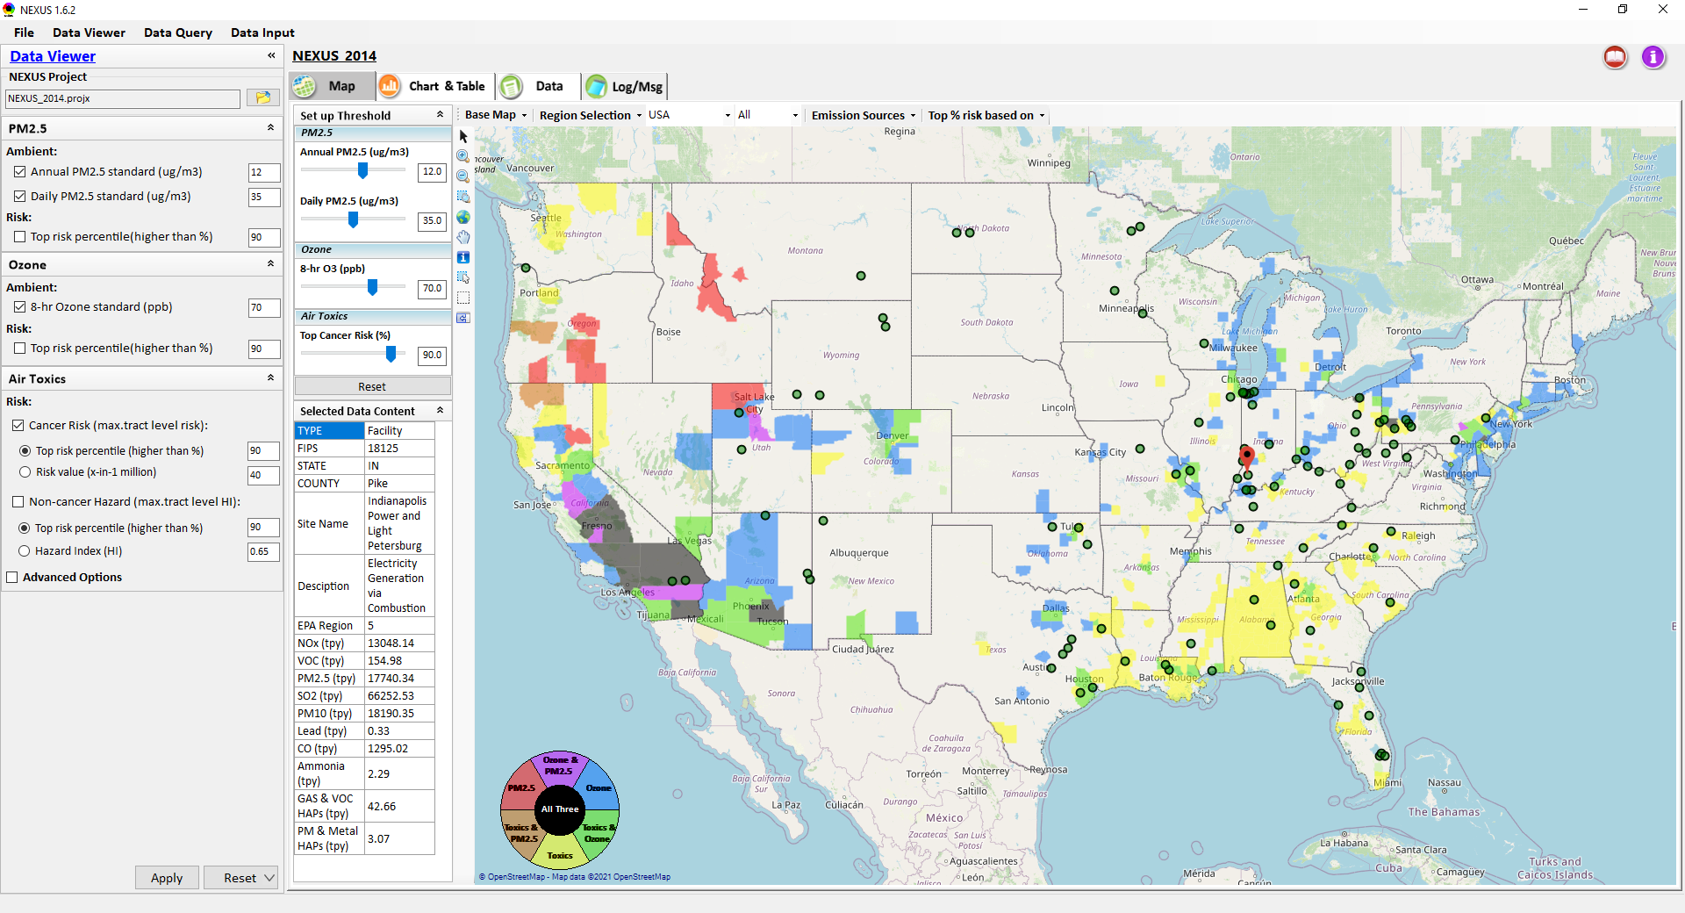
Proximity & Spatial Analysis: Allow to “Zoom-out” & “Zoom-in” Nationally for all Facilities under same “Sector Group”
Display all facilities within same “Sector group”
Allow to “zoom out” nationally and “zoom-in” back to facility level
Provide color scale for selected MP risk value (e.g., red w/ high MP risk)
Proximity Analysis for Source/Sector
Zoom-out
Proximity and Spatial Analysis for MP Risks and EJ
Proximity Analysis
Spatial Analysis
Zoom-in
Facility: American Synthesis Rubber Co., KY Sector group: Polymers and Resins Production
[ x Display national map for Sector group
Radius of Influence
5
50km
Create Table
Create Plot
12

Slide 13
End
13

