Slide 1
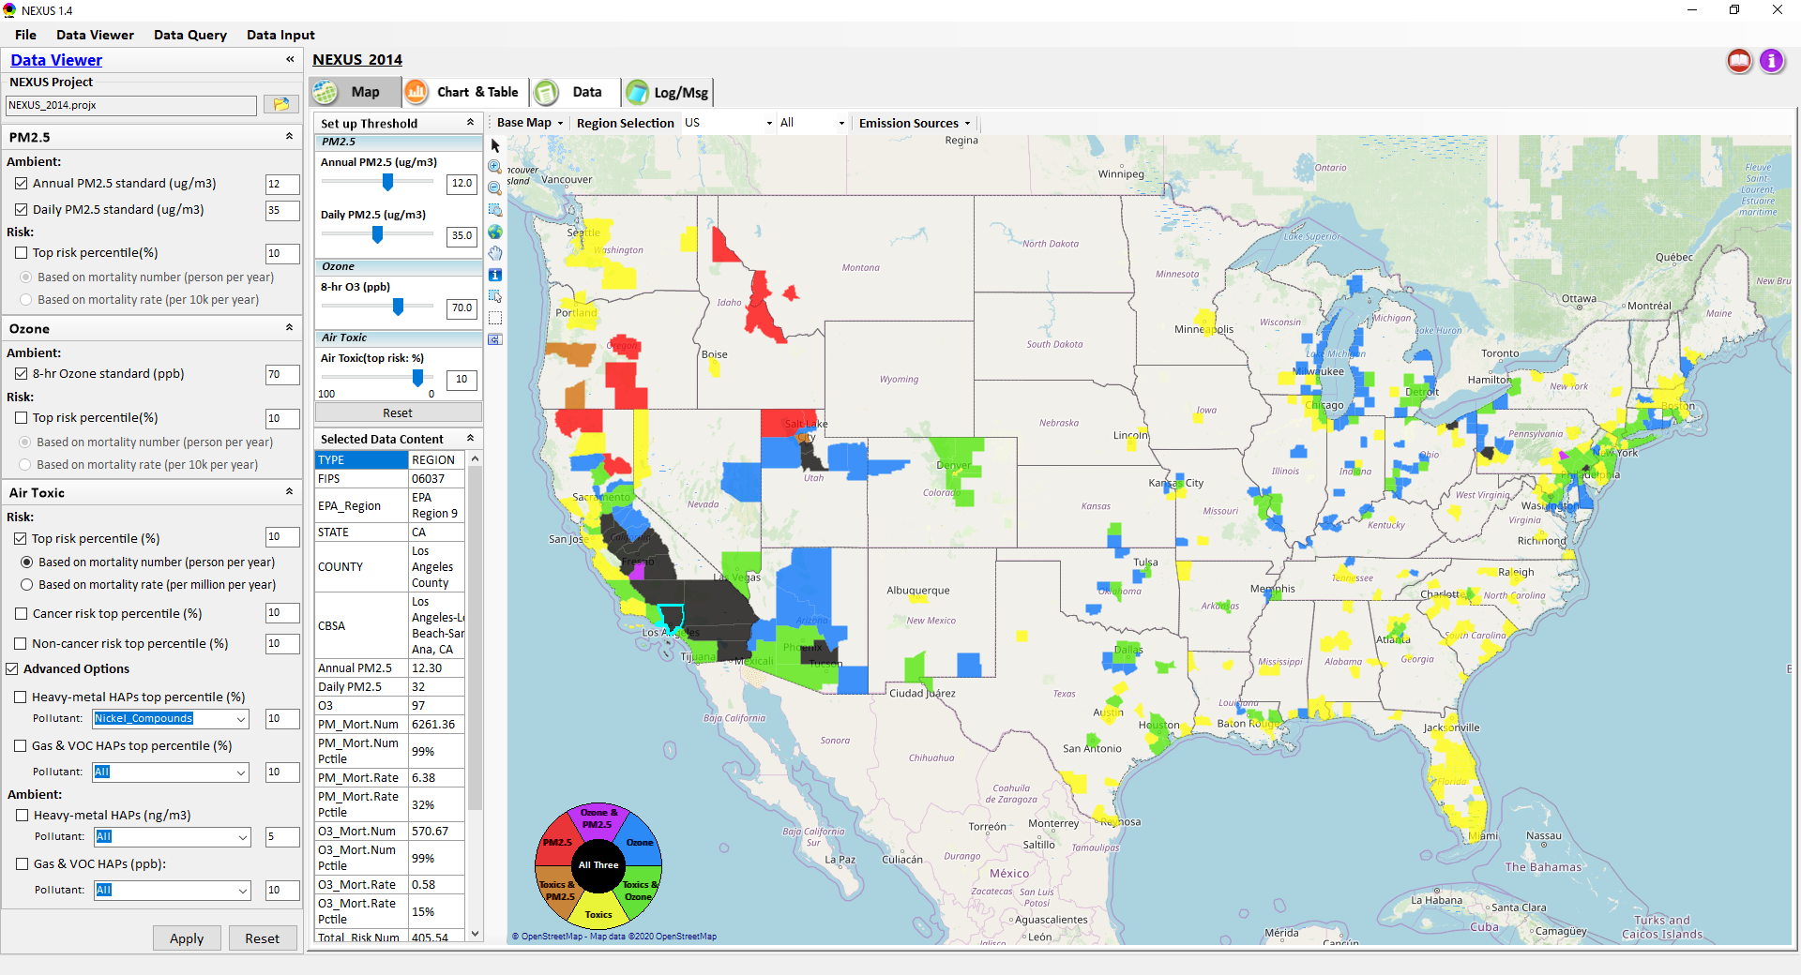
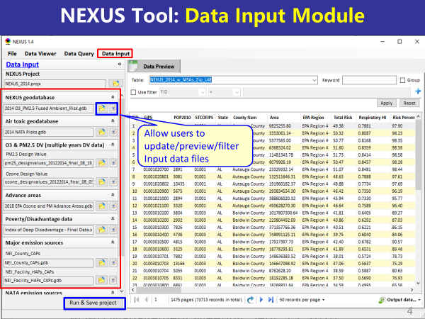
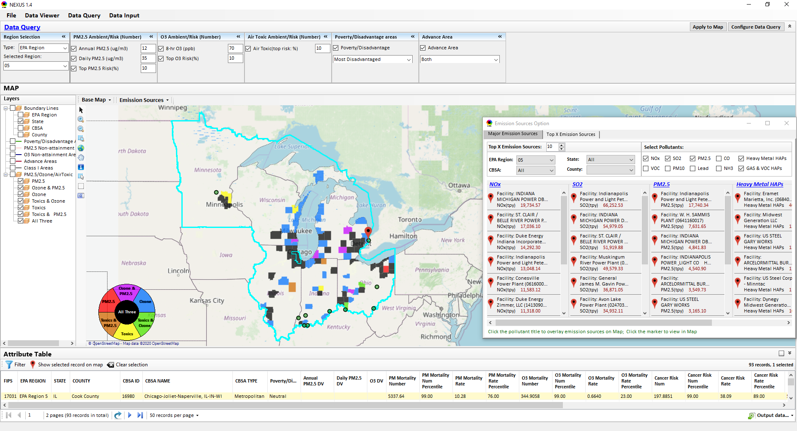
“NEXUS” Multi-Pollutant Analysis Tool Development: Status and Progress
“NEXUS 1.4”
Data Viewer Module
Data Input Module
Data Query Module
OAQPS/AQAD/Air Quality Modeling Group
AQAD Management Meeting, Sept. 25, 2020

Slide 2
NEXUS Tool Development
Motivation: Develop a new multi-pollutant analysis tool to identify and assess areas with high ambient levels and/or health risks associated with PM2.5, O3, and air toxics
Phase-1: Develop a GIS-based NEXUS prototype with a user-friendly graphical interface to provide analysis and visualization functions of potential multi-pollutant AQ issues at national level (continental US)
Phase-2: Expand the NEXUS tool to allow users to zoom into an EPA region, State, or metropolitan area and provide data query and V/A functions for “AQ and emissions” information over the selected region of interest
2

Slide 3
Expected Use of NEXUS Tool
The NEXUS tool will allow users to do the following:
National screening for areas with MP issues: Phase 1 development will provide ability to quickly screen areas across nation that have combination of high air quality and/or risk levels for O3, PM2.5 and air toxics.
Area screening to understand nature of MP problem: Phase 2 development will provide ability to ‘dial-into’ specific areas to determine extent to which common emissions sources are causing the MP issues.
OAQPS expects to use this tool to engage with Regions and identify areas that would potentially benefit most from MP approaches to reduce emissions (including current NAs and Advance areas).
The NEXUS tool will essentially provide a ‘conceptual model’ of MP issues within an area to facilitate engagement with state/local/tribal agencies and community stakeholder groups.
3

Slide 4
NEXUS Development: Schedule & Download
Work Plan | Date
Developed NEXUS tool prototype and Phase-1 functions | Dec. 2019 ~ April 2020
Developed Phase-2 functions and deliver first working (interim) NEXUS tool | May ~ July 2020
Developing a fully functional NEXUS tool for beta-testing and on-line User’s Manual | Aug. ~ Oct. 2020
Download “NEXUS” tool: The “NEXUS 1.4” package (“NEXUS v1.4 setup.exe” & “NEXUS 1.4 Data.exe”: run both to install) is available at Google Drive link below
(or EPA’s ScienceFTP2 site upon request):
https://drive.google.com/open?id=1Xl3VqtlRXeBt_FrfHpuCZYumxjqMR9hL
(Note: Require software installation privilege to install “NEXUS tool” at EPA’s PCs)
4

Slide 5
NEXUS Tool: Three Key Modules
Data Viewer Module
Data Input Module
Data Query Module
View and create interactive Data/Map/Chart/Table
Provide flexible selections & mapping of “Ambient” and/or “Risk” levels of PM2.5, O3 and air toxics
Provide regional analysis for “EPA region”, “States”. CBSA”, and “County”
Link and display major emission sources locations & emitted pollutants info.
Allow to update & change input data files
Provide data preview and filter functions
Extend to use 10 input data files now (publicly available, ~4 GB)
Quick turnaround to run & save to a new “project” using new input data files
Provide data query based on selected qualifiers: “Ambient, Risk, O3/PM NAA, Advance areas, Poverty/Disadvantage area, Class I area”
Provide overlaying map and detachable table for data query results
Full module functions will be completed in August

Slide 6
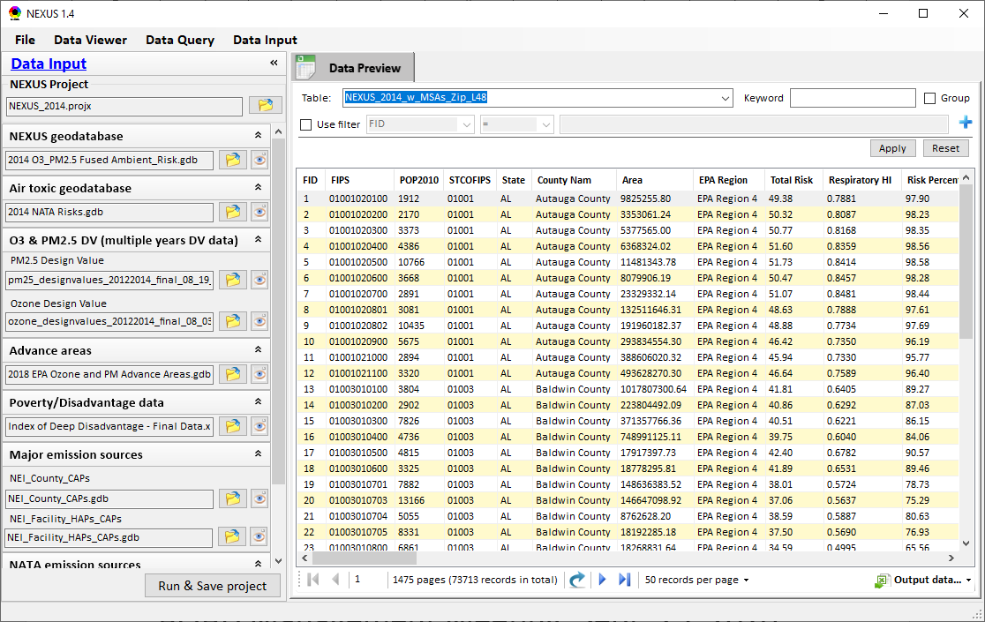
NEXUS Tool: Data Input Module
Allow users to update/preview/filter Input data files
Currently, there are 10 input data files used (publicly available)
Total files size ~4 GB
Run and Save to a new project after loading new input data files
6

Slide 7
Data Input File Names | Data Format | Data Description | Data Source | Data Period
“2014 O3 & PM2.5 Ambient & Risk” | Geodataset | O3/PM2.5 ambient & risk data at county/census tract level | from OAQPS MP team | 2014
“2014 NATA Risk” | Geodataset | Air toxics ambient & risk data at county/census tract level | from OAQPS MP team | 2014
“O3_DV_2009_2018” | Excel | O3 design values at county level | From EPA public website: https://www.epa.gov/air-trends/air-quality-design-values | 2009 to 2018
“PM_DV_2009_2018” | Excel | PM2.5 design values at county level | From EPA public website: https://www.epa.gov/air-trends/air-quality-design-values | 2009 to 2018
“Advance areas O3_PM” | Geodataset | O3 & PM2.5 Advance Areas | from OAQPS MP team | 2018
“Index of Poverty_ Disadvantage” | Excel | Index of poverty/disadvantage at county level | from Univ. of Michigan website: https://poverty.umich.edu/projects/understanding-communities-of-deep-disadvantage/ | 2017
“NEI_Country_CAPs” “NEI_Facility_HAPs_ CAPs” | Geodataset | Major emission sources and facility info. of CAPs & HAPs at county level | From OAQPS public website: ftp://newftp.epa.gov/EPADataCommons/OAR/OAQPS/NEI/NEI_Facility_HAPs_CAPs.zip ftp://newftp.epa.gov/EPADataCommons/OAR/OAQPS/NEI/NEI_County_CAP.zip | 2008, 2011, 2014
“2014 NATA Emissions” | Access Database (*. accdb) | NATA emissions data from 2014 NEI database, including various source groups | From EPA public website: https://www.epa.gov/national-air-toxics-assessment/2014-nata-assessment-results#emissions | 2014
“Class1_FederalAreas” | Geodataset | Mandatory Class 1 Federal Areas | From Mandatory Class 1 Federal Areas Web Service: https://edg.epa.gov/data/public/OAR/OAQPS/Class1/Class1Areas.zip | —
Data Input Module: Input Files & Attributes
7

Slide 8
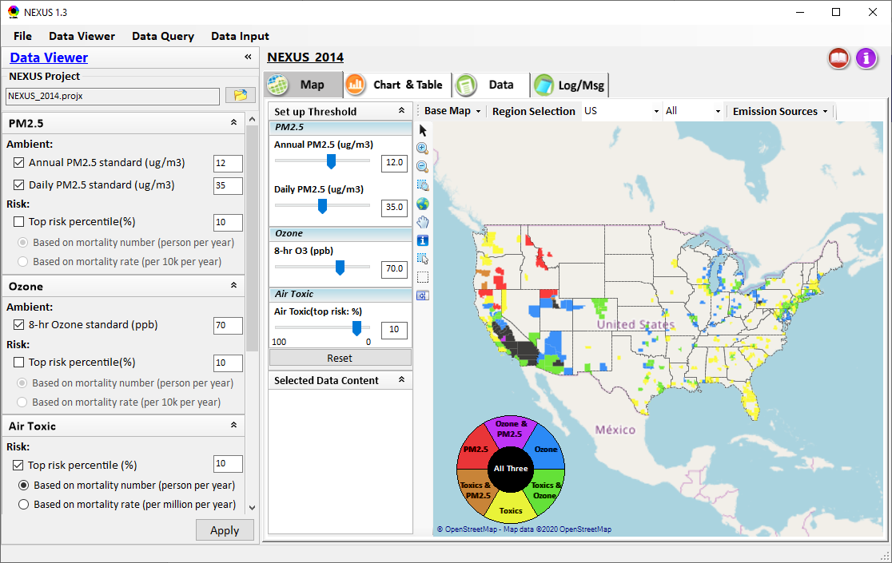
NEXUS Tool Demo: 2014 NEXUS Example Case
Launching Page
Roadmap for Demo:
(We may like to know “xxx”)
National View: Use “NEXUS” across pollutants to provide an initial “SCREEN” at the national level by providing an indicator where there may be a common set of sources contributing to Multi-pollutant issues.
Regional View: Dial into a region or area of interest to understand the pollutant/source connections, and potential for more effective and efficient multi-pollutant solution.
8

Slide 9
Discussion and Next Steps
Short-term:
Develop a fully functional version and continue to improve NEXUS based on MP team’s suggestions
Develop draft NEXUS User’s Manual
Long-term:
Upgrade and prepare NEXUS for Beta test with EPA Regions followed by public release & training
Update with 2017 fused AQ & air toxic data; Consider addition of screening-level analysis & assessment capabilities based on ours and user needs
Support OAQPS’s Air Toxic Strategy Initiative
Potential Issue:
UNC EMAQ contract ends in Sept., currently no funding to support NEXUS under new GSA contract starting Oct. 1st
9

Slide 10
NEXUS Tool: Tutorial
10

Slide 11
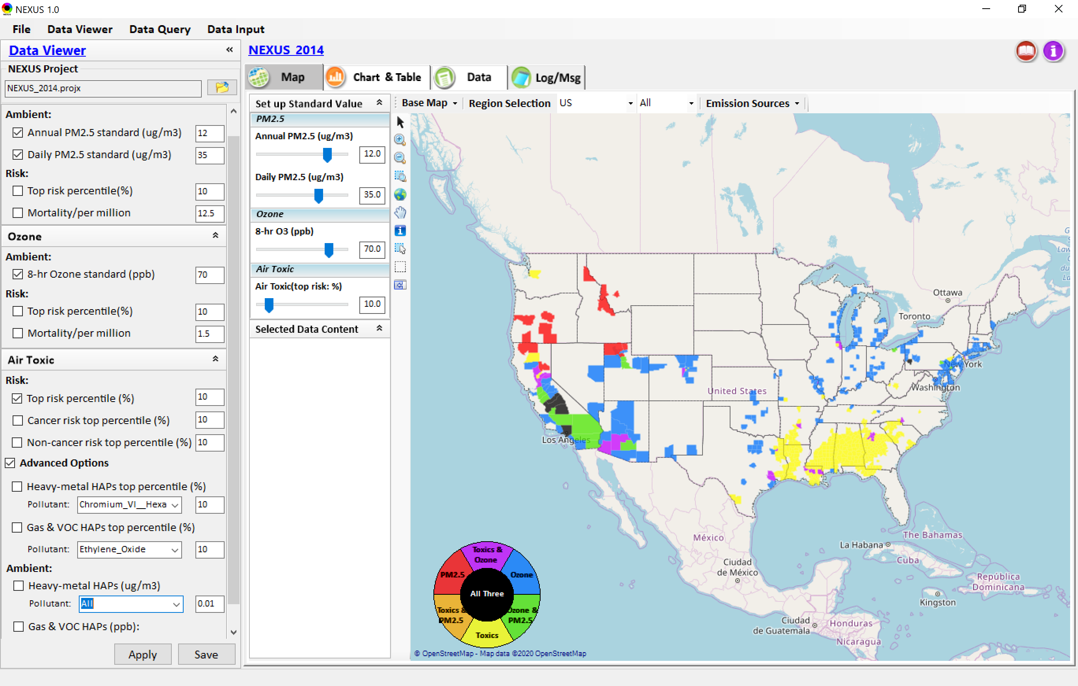
NEXUS Tool: Data Viewer Module
Click “File” to open or save a project
Switch between 3 key modules
Loaded NEXUS project file name & project file loading icon
Select & adjust “Ambient” & “Risk” levels
“Advanced Option”: provide HAPs & species selections
11

Slide 12
Data Viewer Module: Selections & Map Display
Select & adjust “Ambient” & “Risk” levels for color map display
“Apply” new selections to “Radio button” panel
12

Slide 13
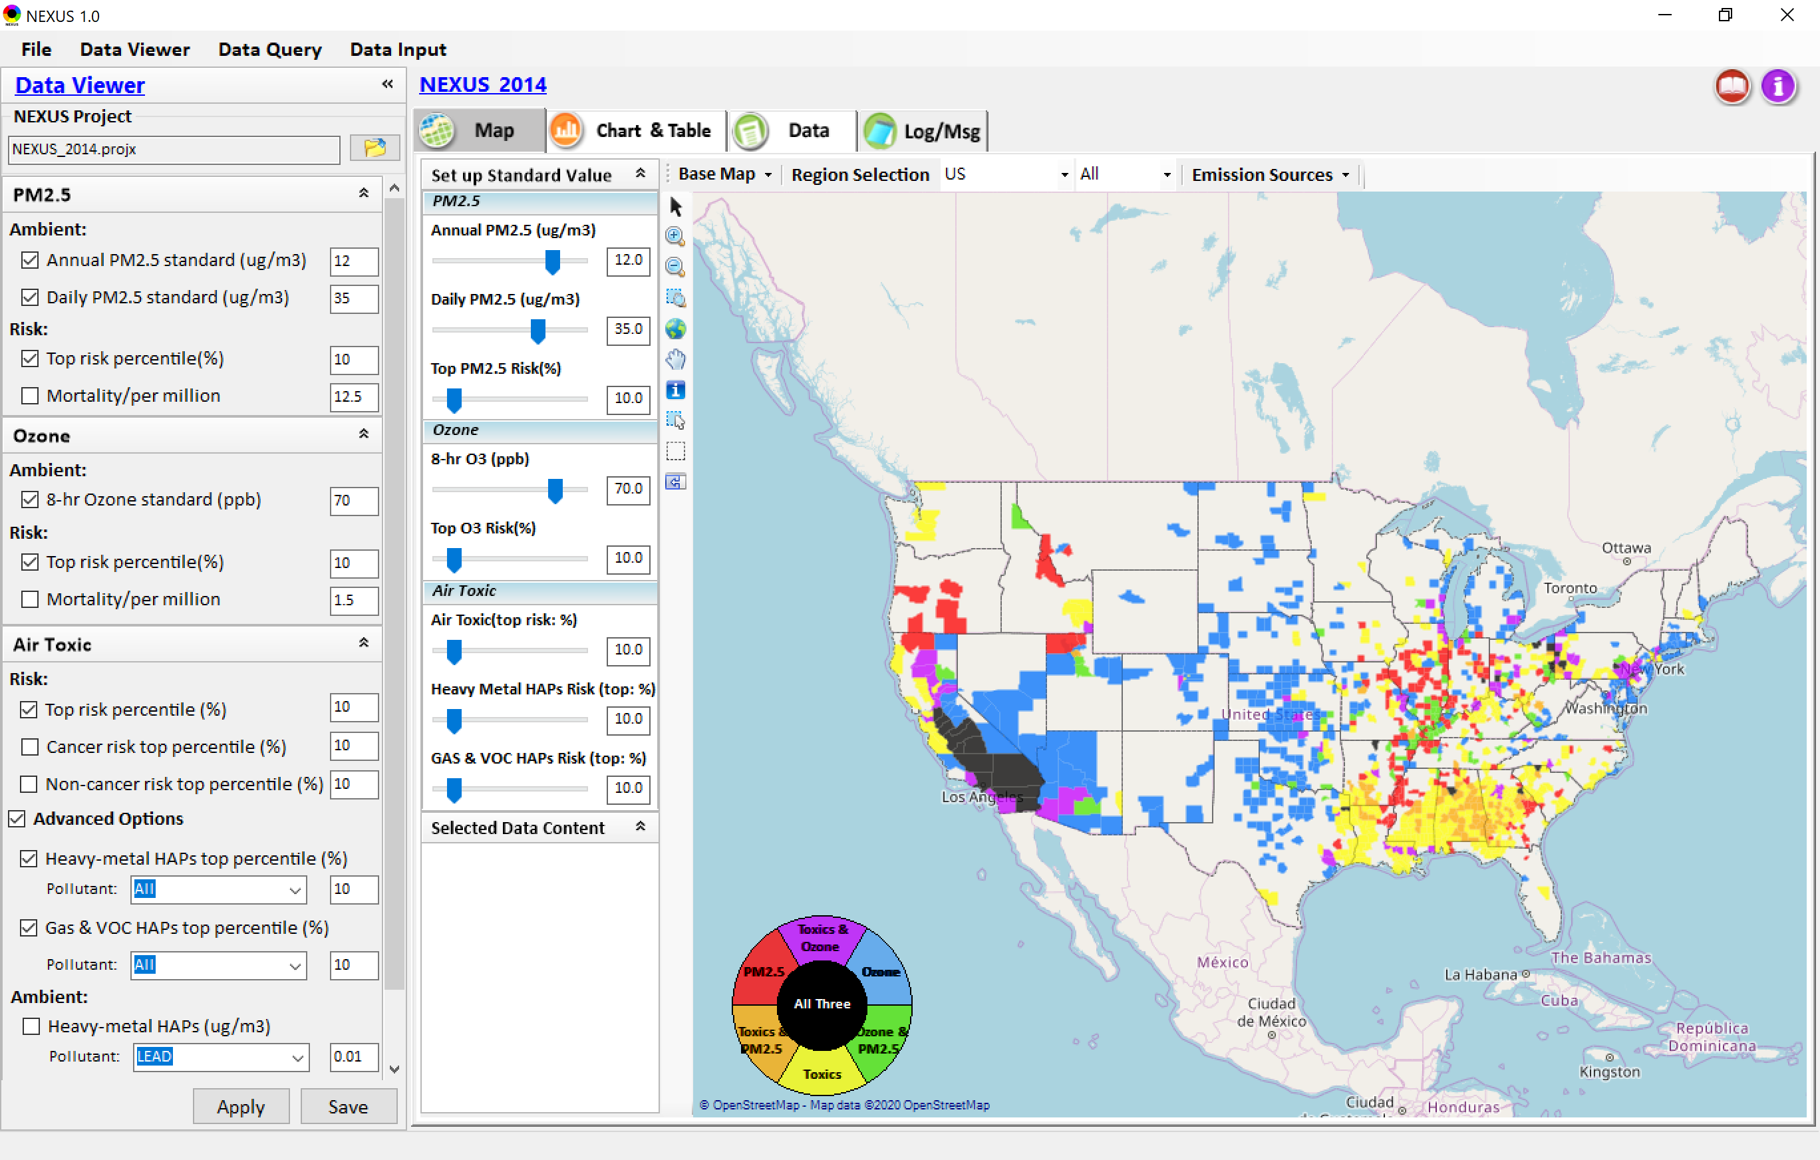
Data Viewer: “Apply” New Selections
“Check” new selections
New selections will appear on-the-fly in “radio button” panel and map display
“Apply” new selections
13

Slide 14
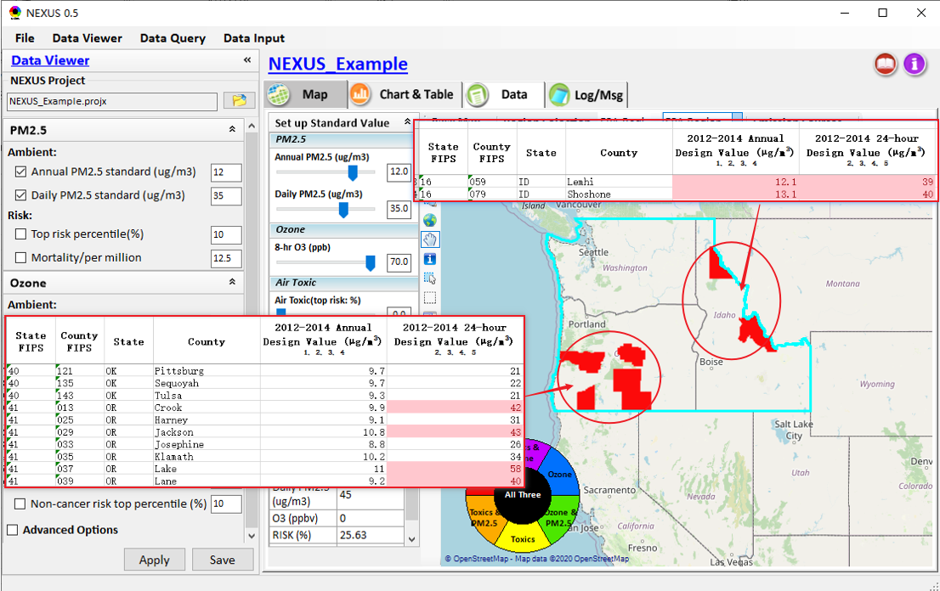
Data Viewer Module: Map & Data QA
High PM2.5 DVs real?
Questionable high PM2.5 DVs in Oregon (daily PM) and Idaho (annual & daily PM) appear to be “real”
14
14

Slide 15
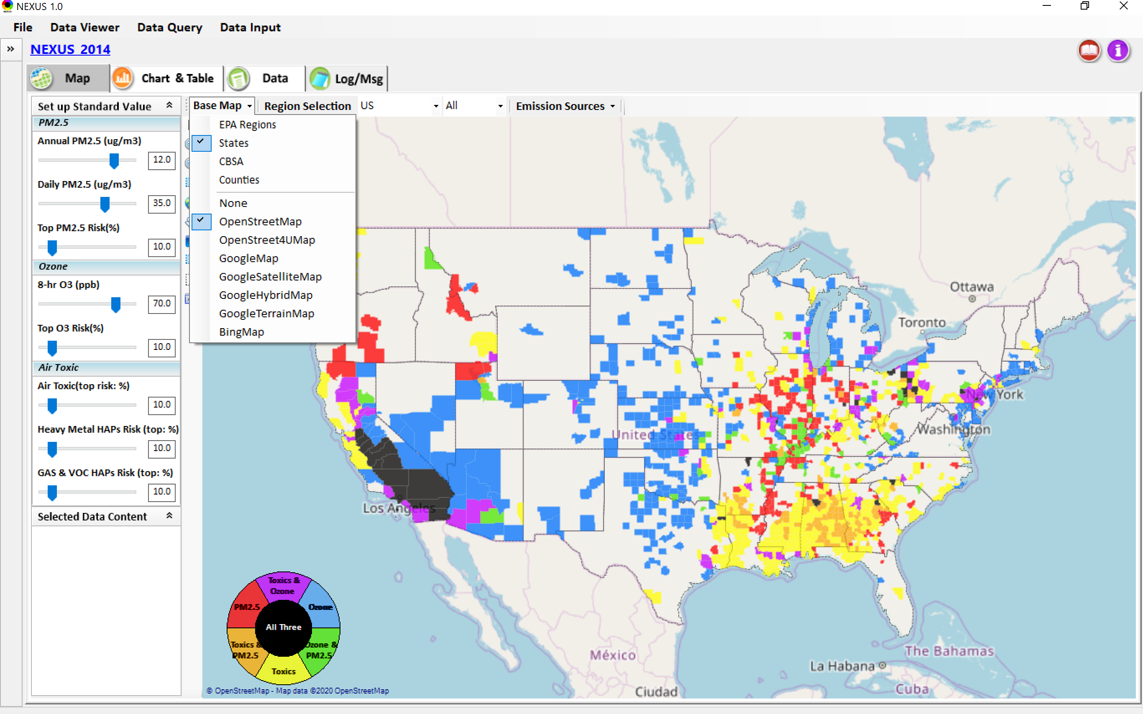
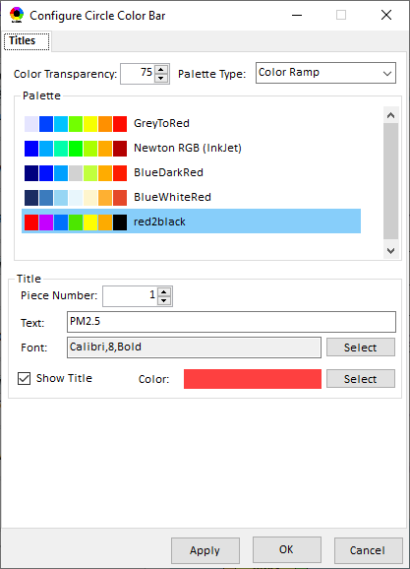
Data Viewer Module: Base Map & Color
“Base Map”: Change boundary lines and background map
Click to change color & transparency
15

Slide 16
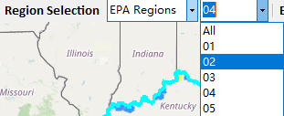
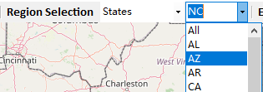
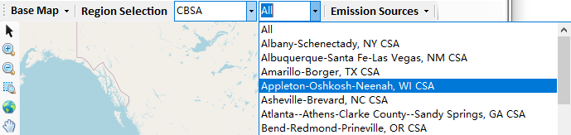
Data Viewer: “Region Selection”
Allow to select “EPA regions”, “States”, or “CBSA”
16

Slide 17
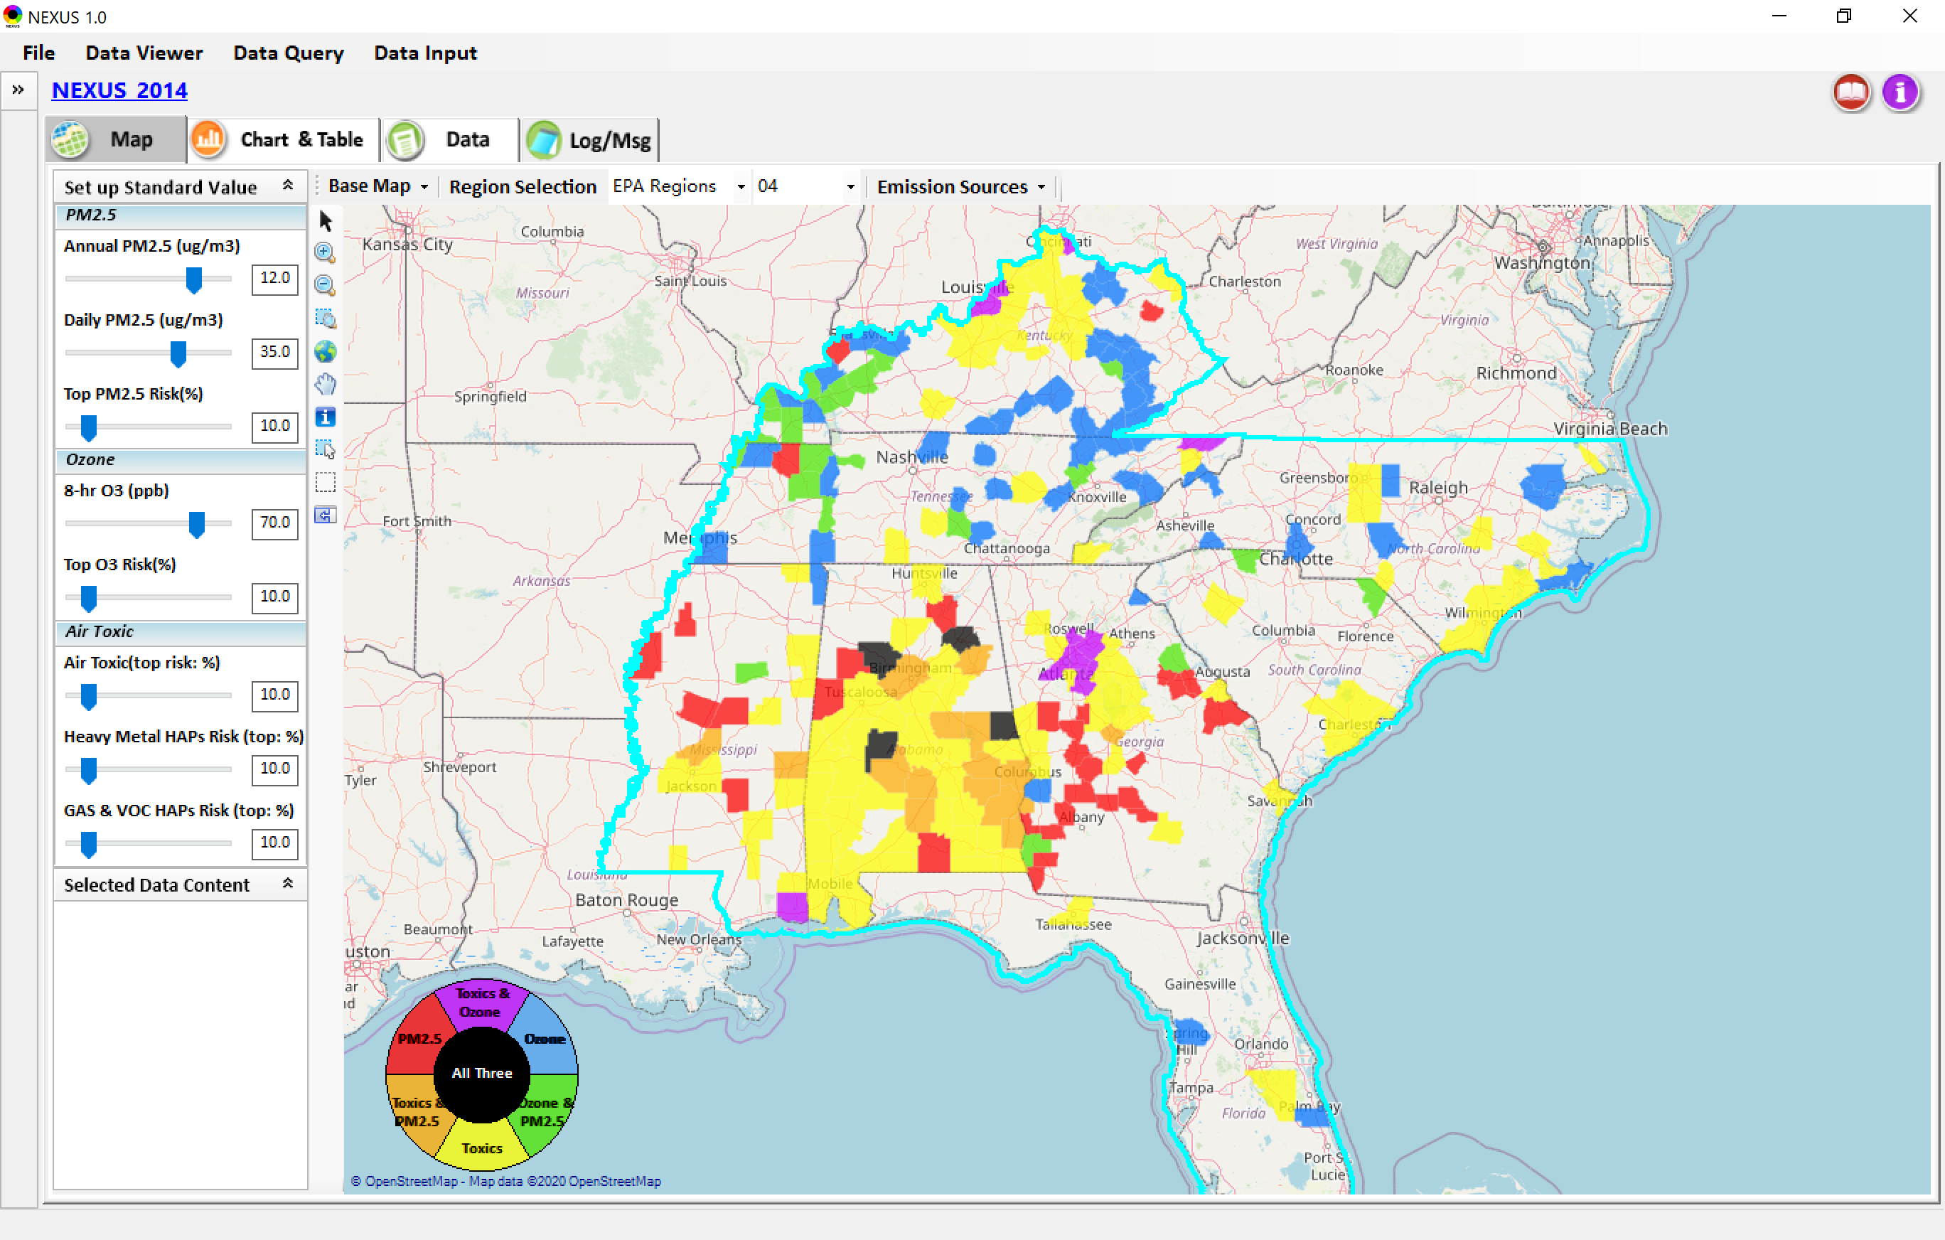
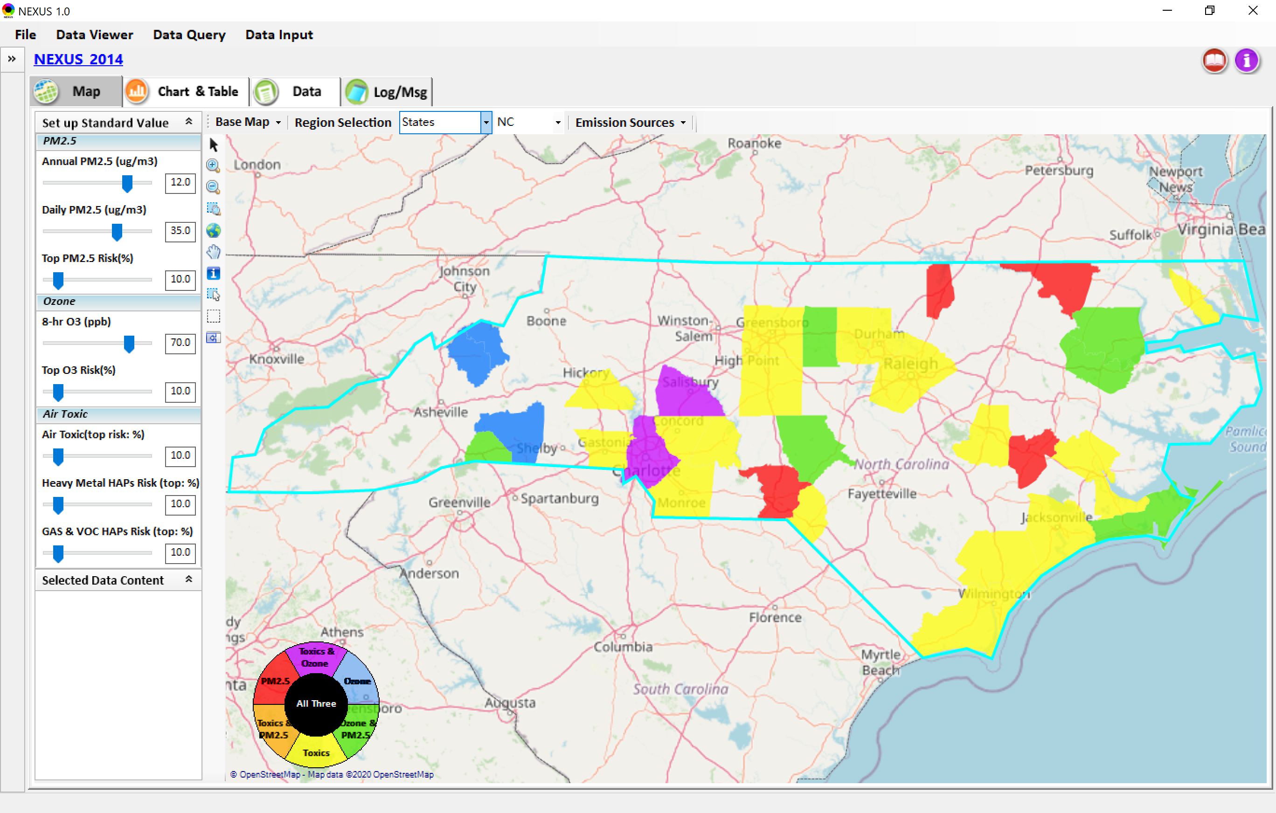
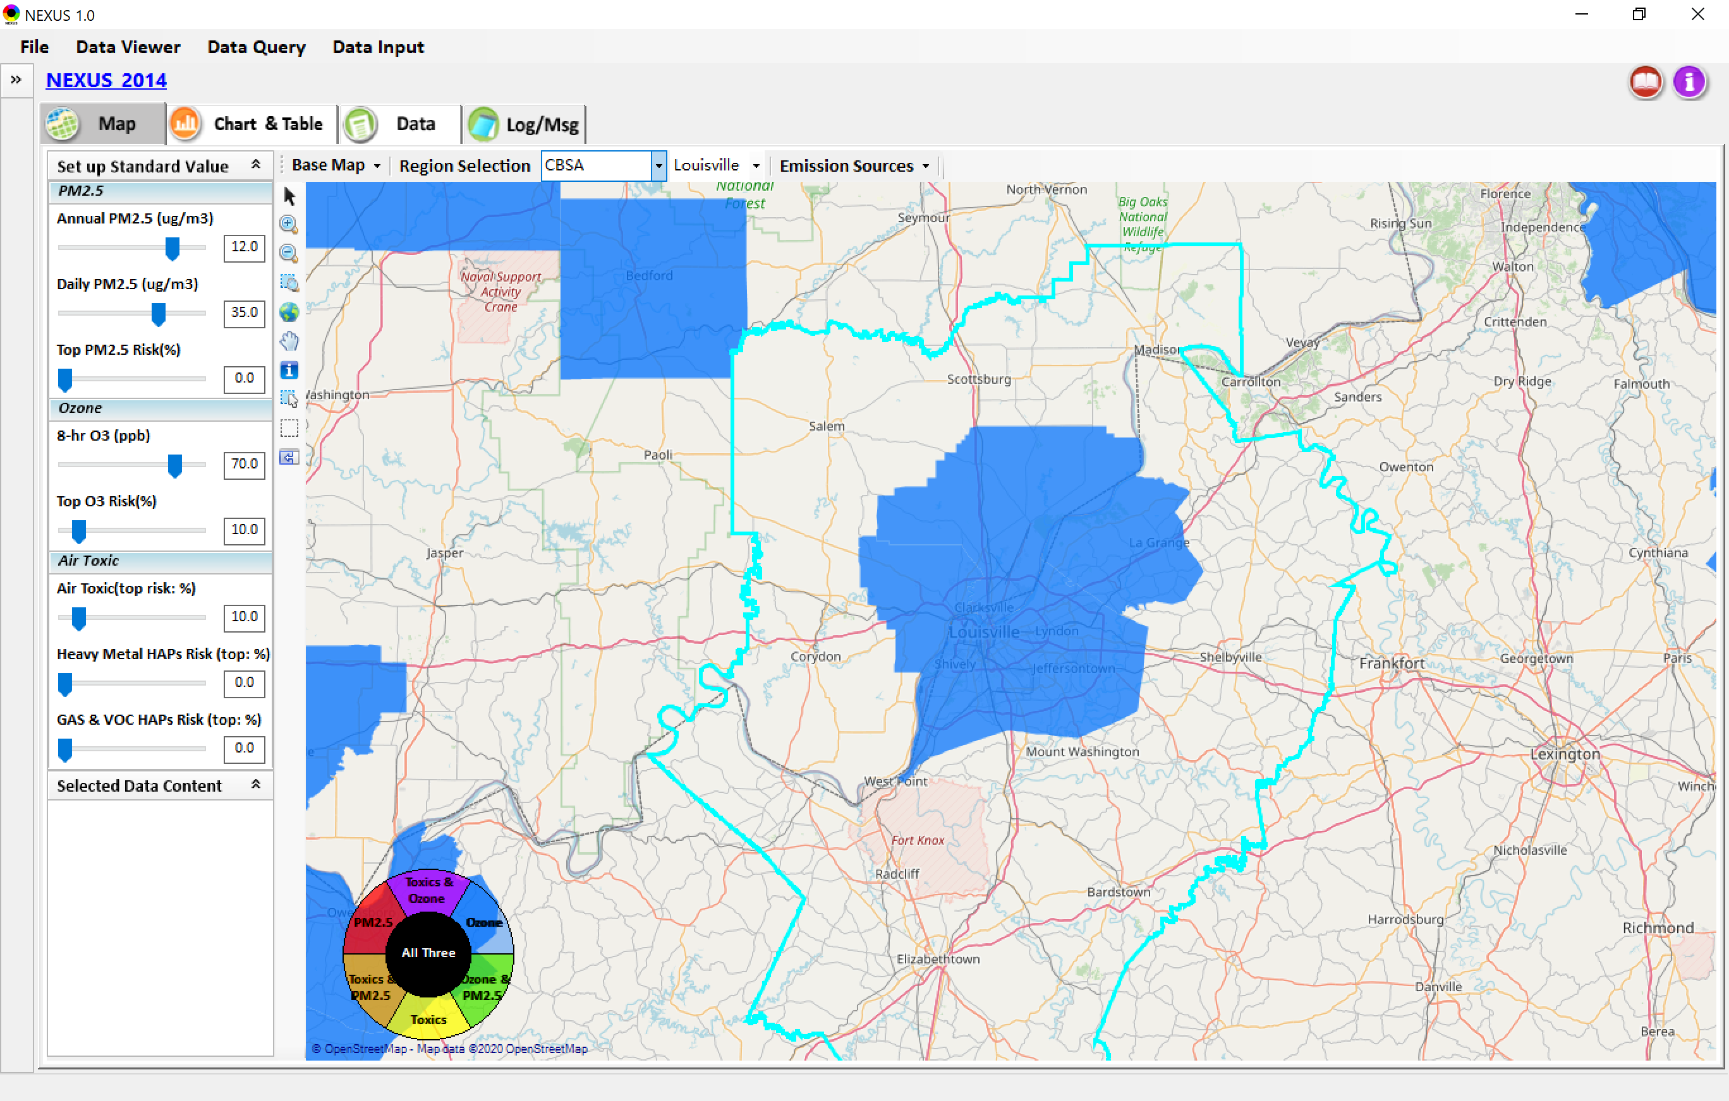
Data Viewer: Select EPA Region/State/CBSA
Examples:
EPA Region 4
NC
Louisville CBSA
17

Slide 18
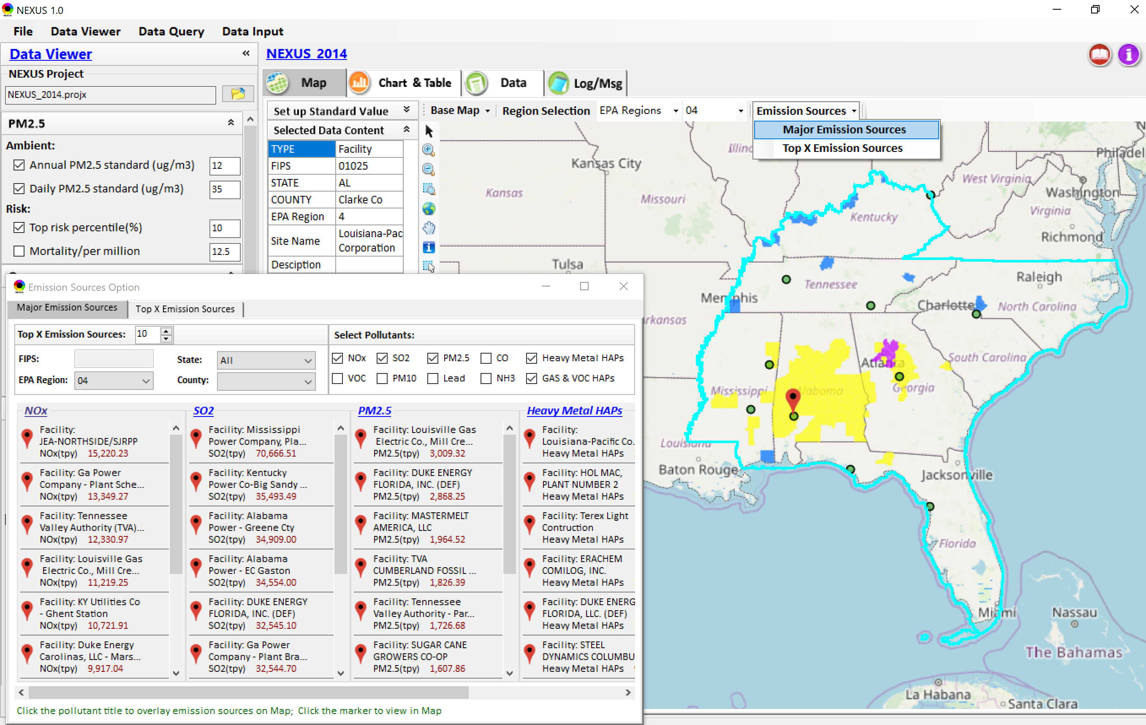
Data Viewer: Major Emission Sources
Click “Emission Sources” tab to display emission sources (green dots) and launch new window
Click any “facility” to link & display source location and emission information
18

Slide 19
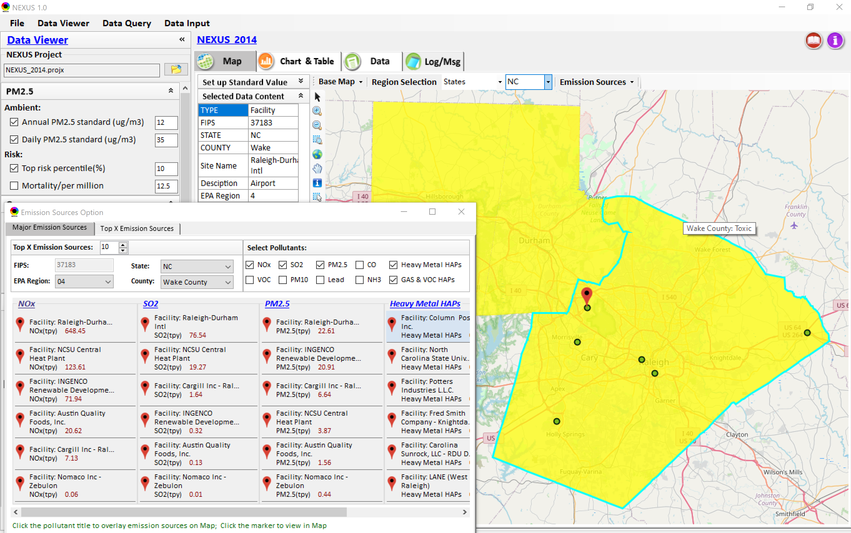
Data Viewer: Major Emission Sources
Allow to scroll down to county-level (e.g., Wake County, NC)
Wake county, NC
19

Slide 20
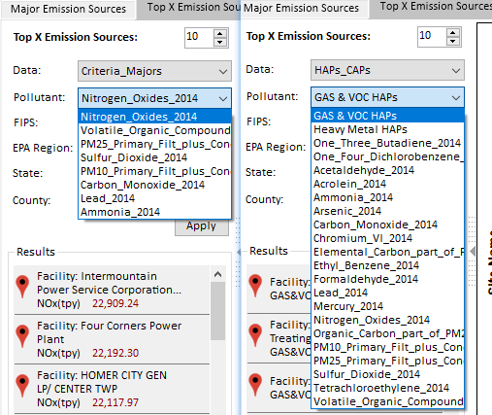
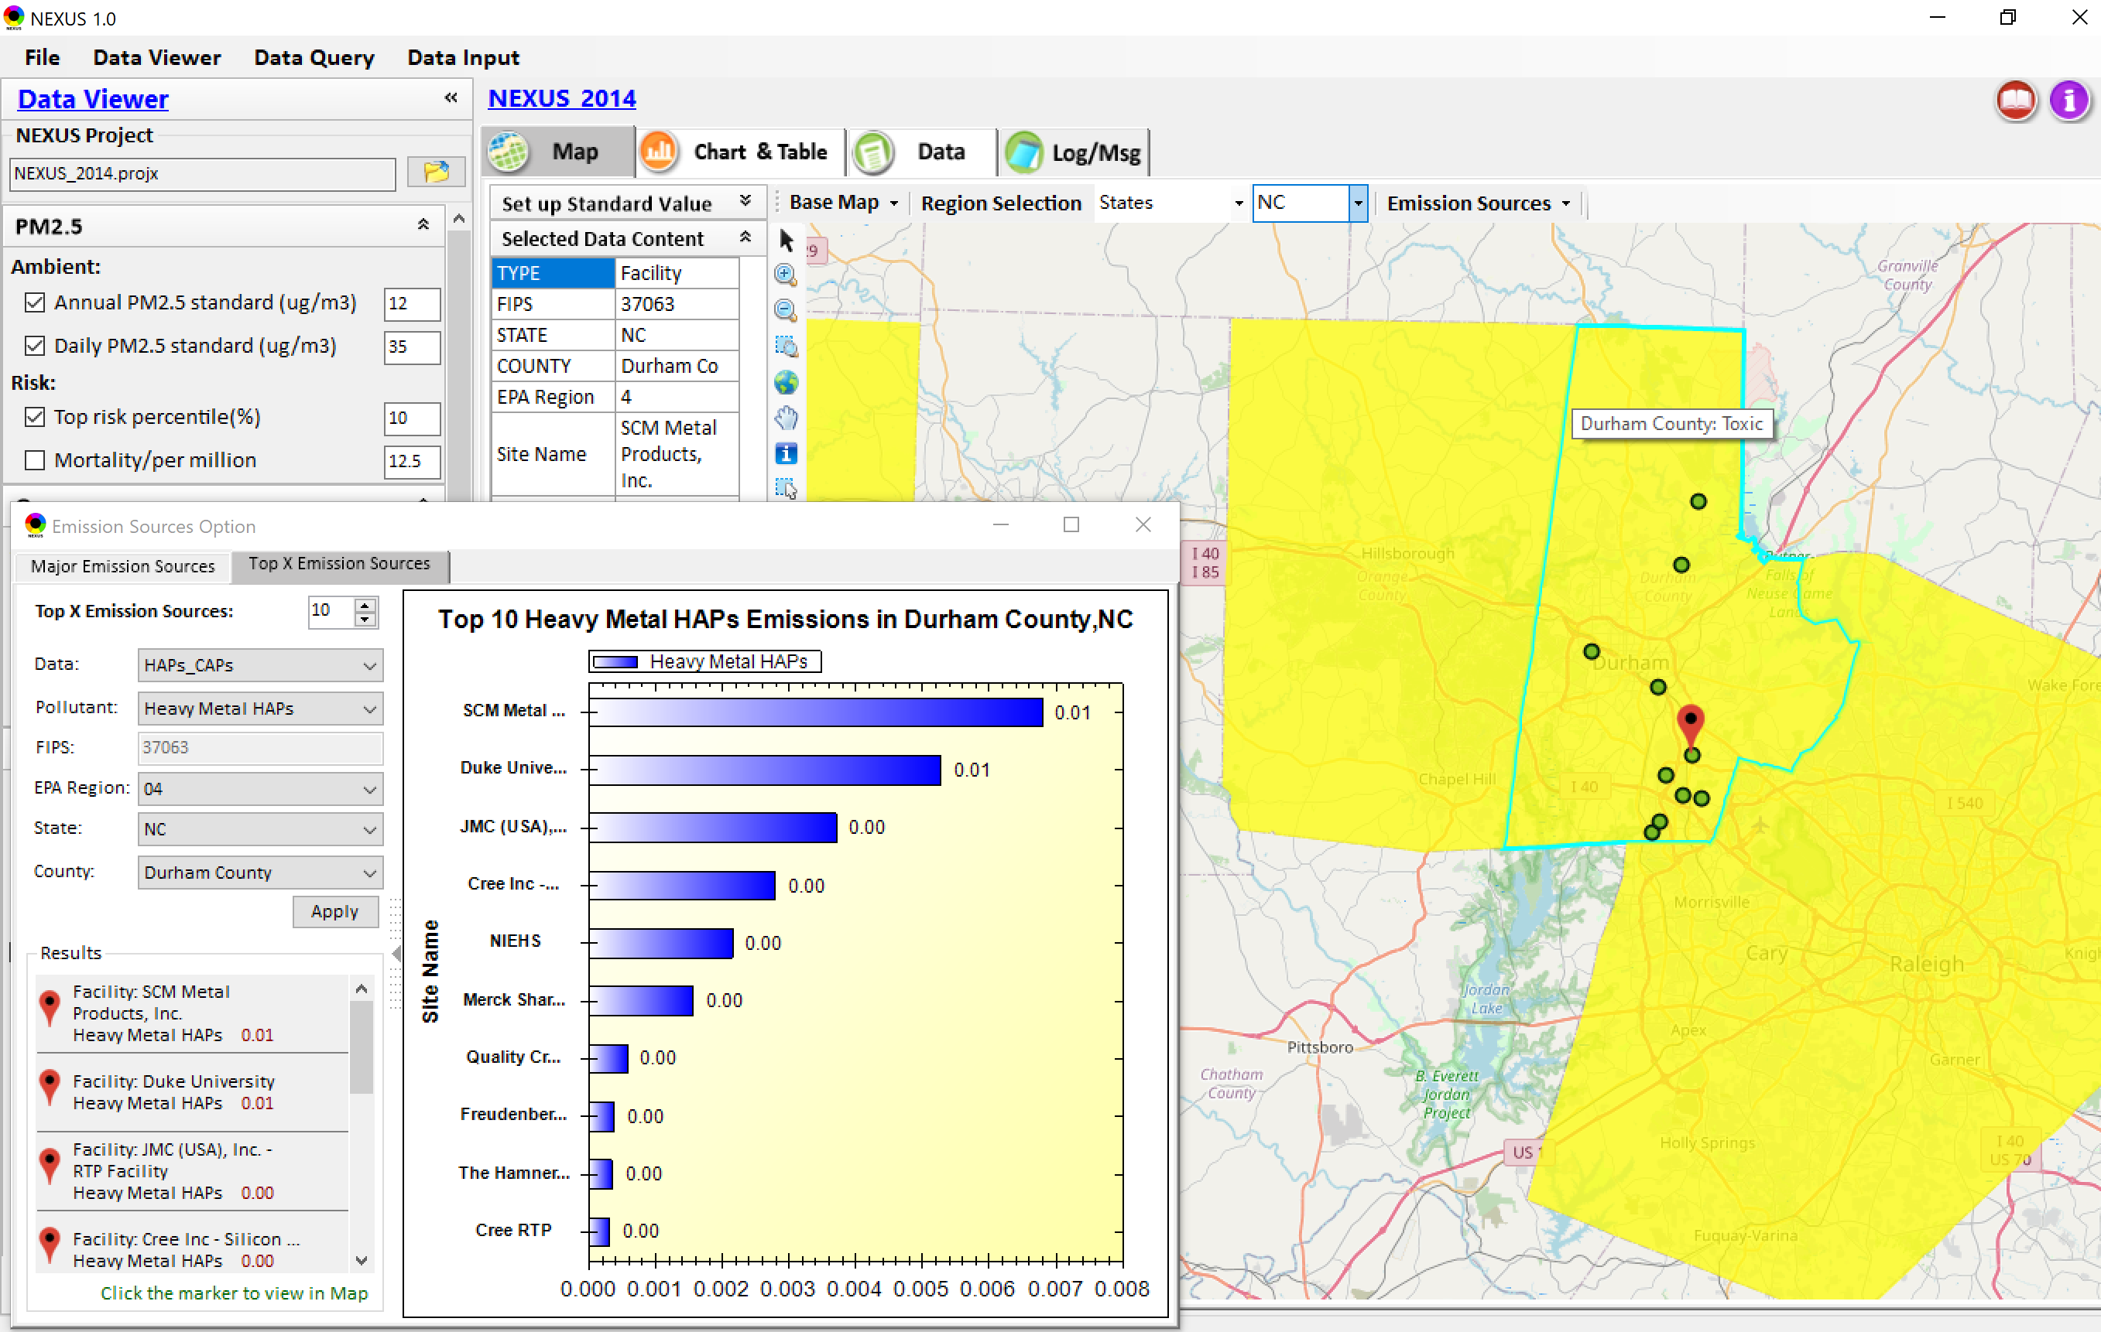
Data Viewer: Top “x” Emission Sources
Provide selection of CAPs precursors & HAPs species
Durham county, NC
20

Slide 21
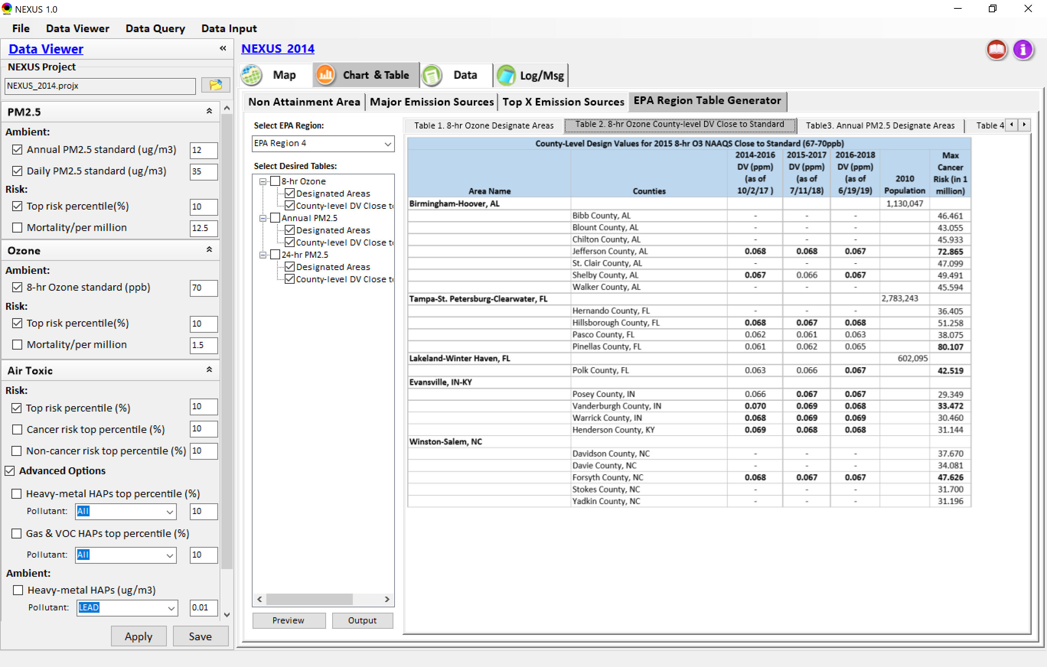
Data Viewer: EPA Region Table Generator
“EPA Region Table Generator” is still under development; the output format & info. needs the MP team’s suggestion (e.g., how the HAPs info. to be added or provided).
21

Slide 22
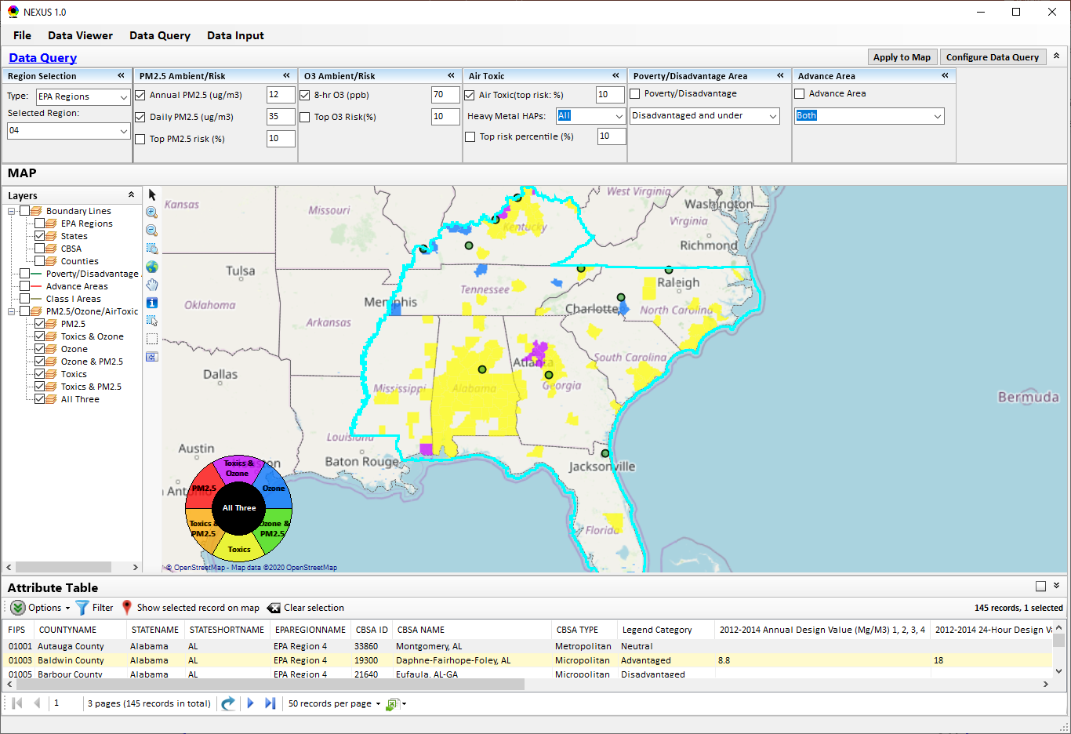
Data Query Module: Main Page
Region Selection
Data Query qualifier selection
Data Query Configuration
Map Overlaying selection
Detachable “Attribute Table”
22

Slide 23
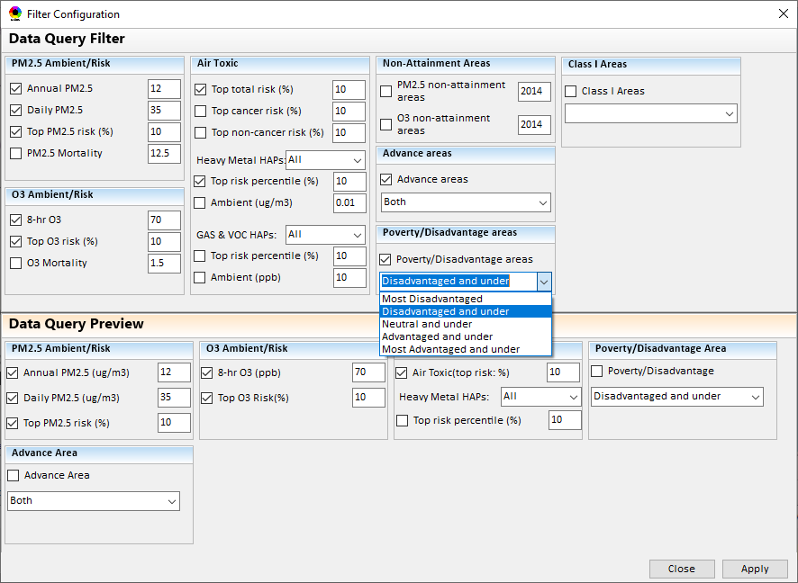
Data Query Module: Configure Data Query
“Data Query Filter” allows to select “qualifiers” for query
“Data Query Preview” displays the selected “qualifiers” at the same time
23

Slide 24
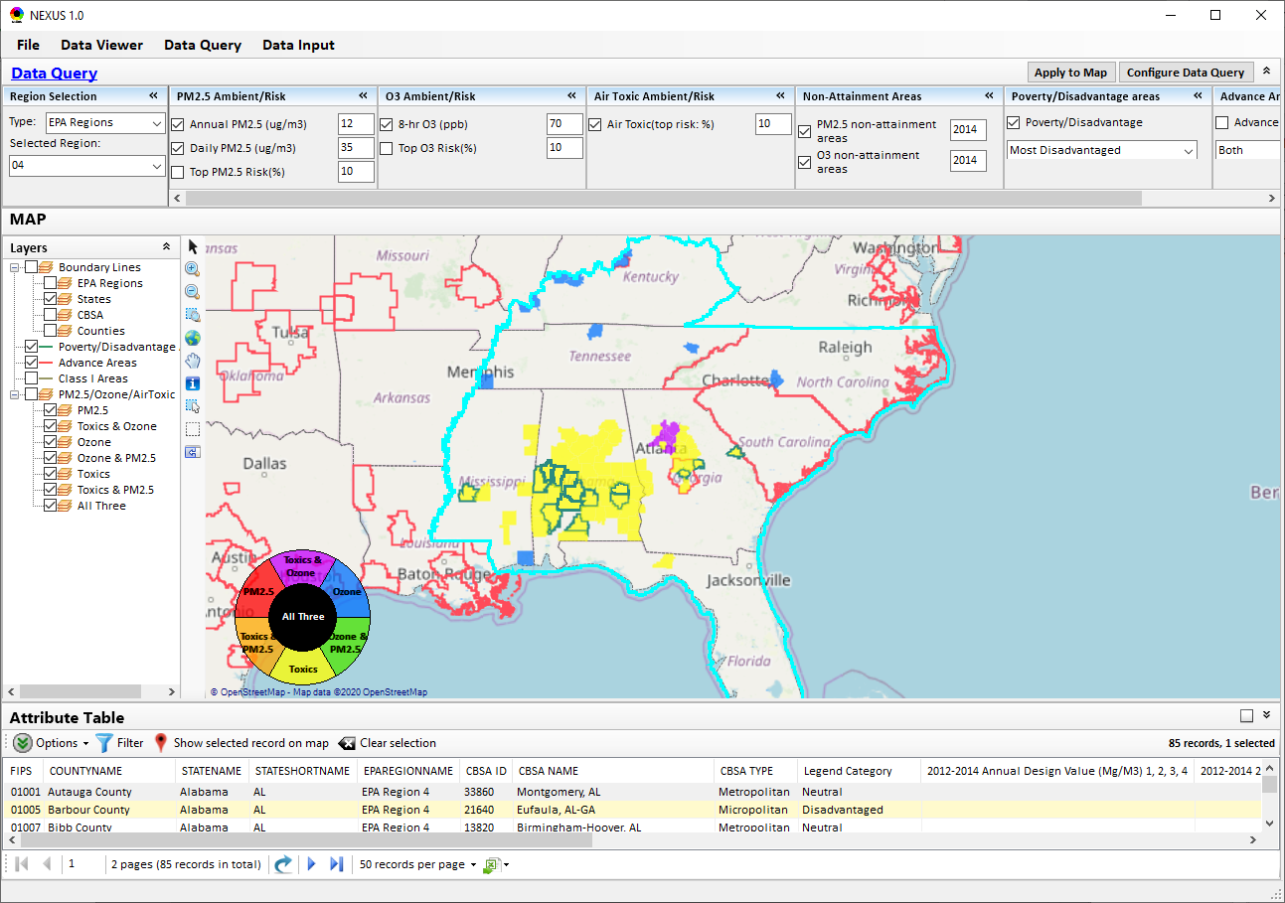
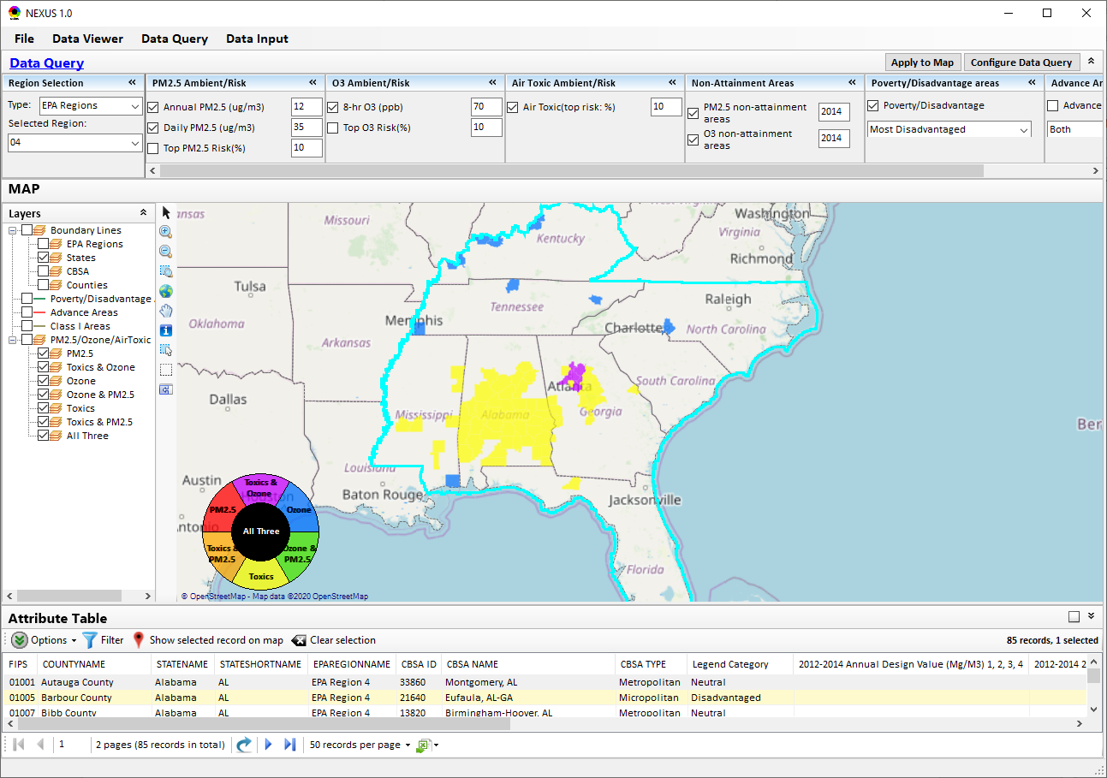
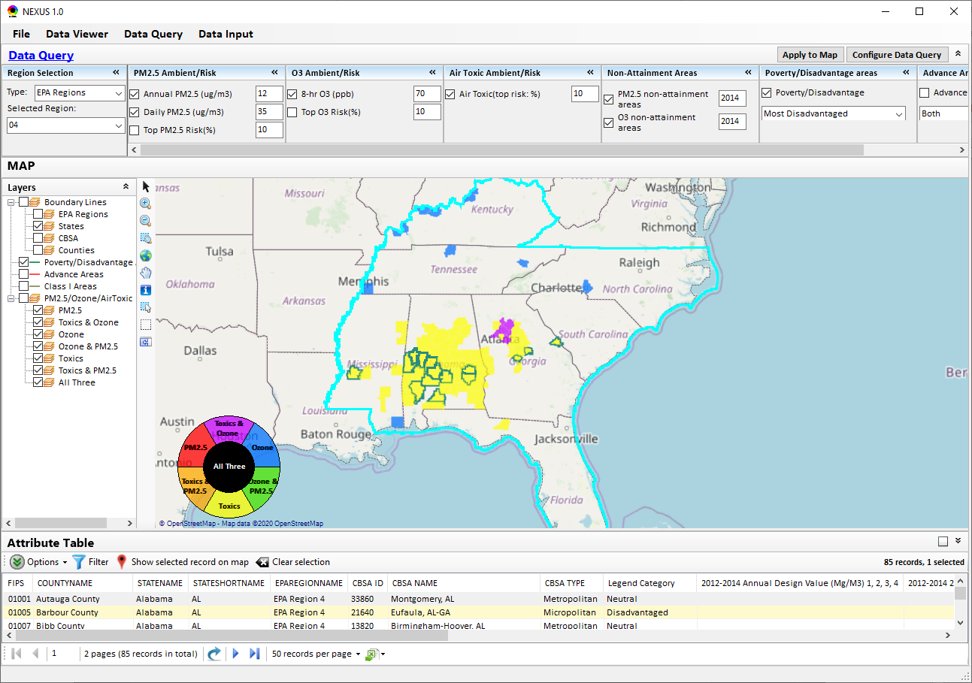
Data Query Module: Overlaying Map
Overlaying Map selection
24

Slide 25
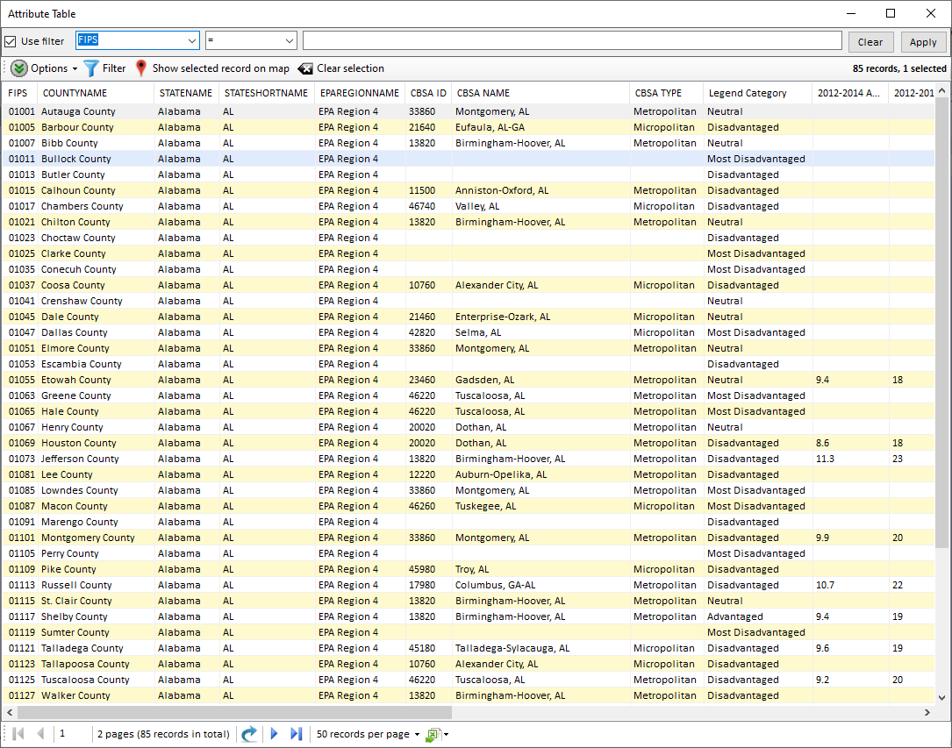
Data Query Module: Attribute Table
Filter/link/export functions (to be completed)
Detachable “Attribute Table”
25

Slide 26
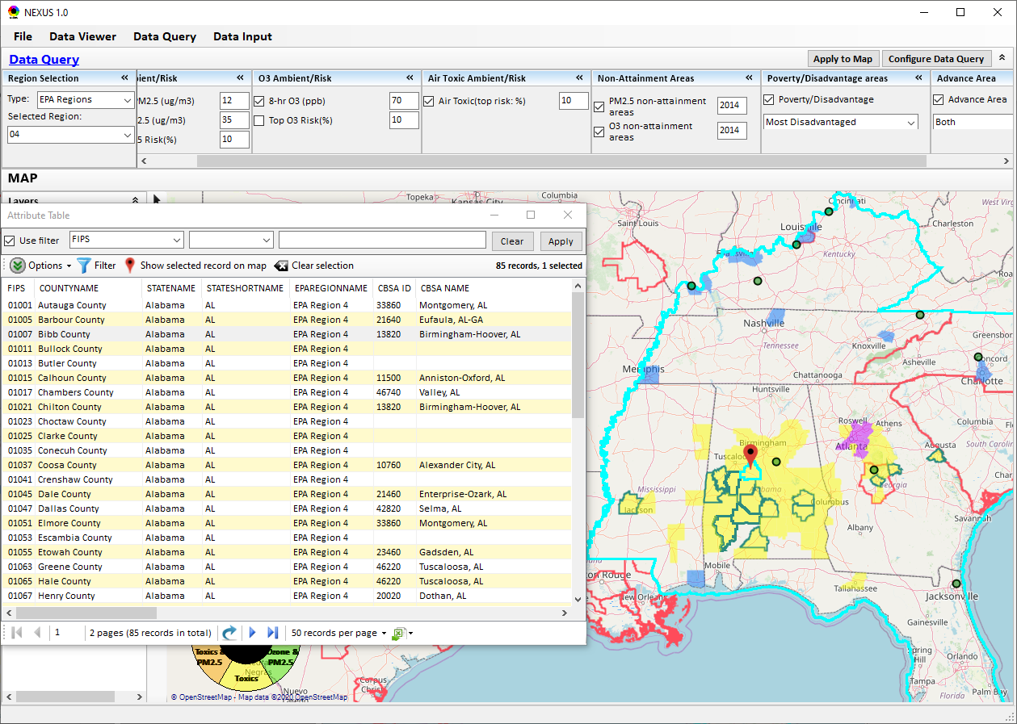
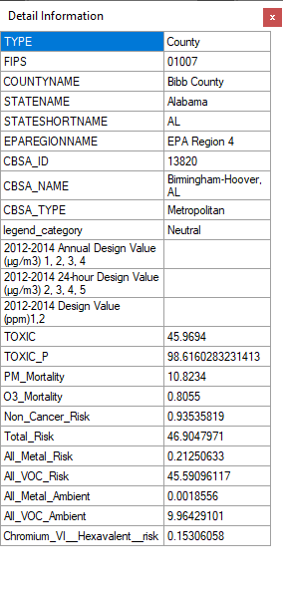
Data Query Module: Attribute Table
Click a “record” to link and display its location & info.
26

Slide 27
End
27

