Slide 1
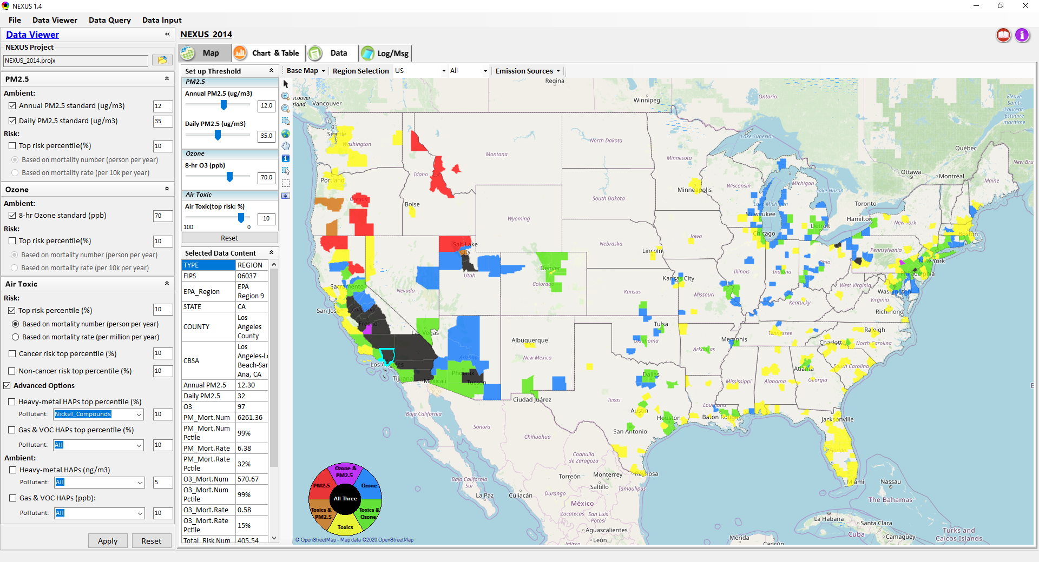
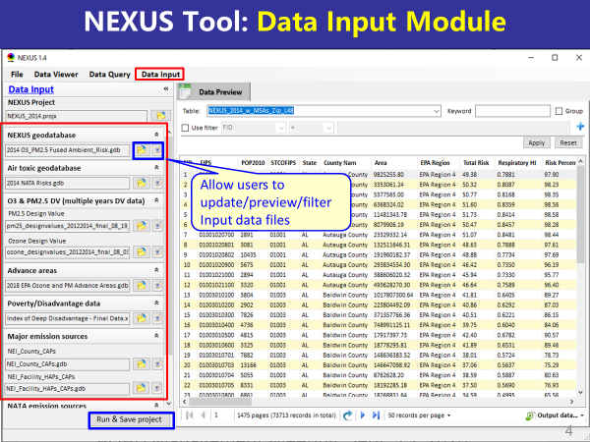
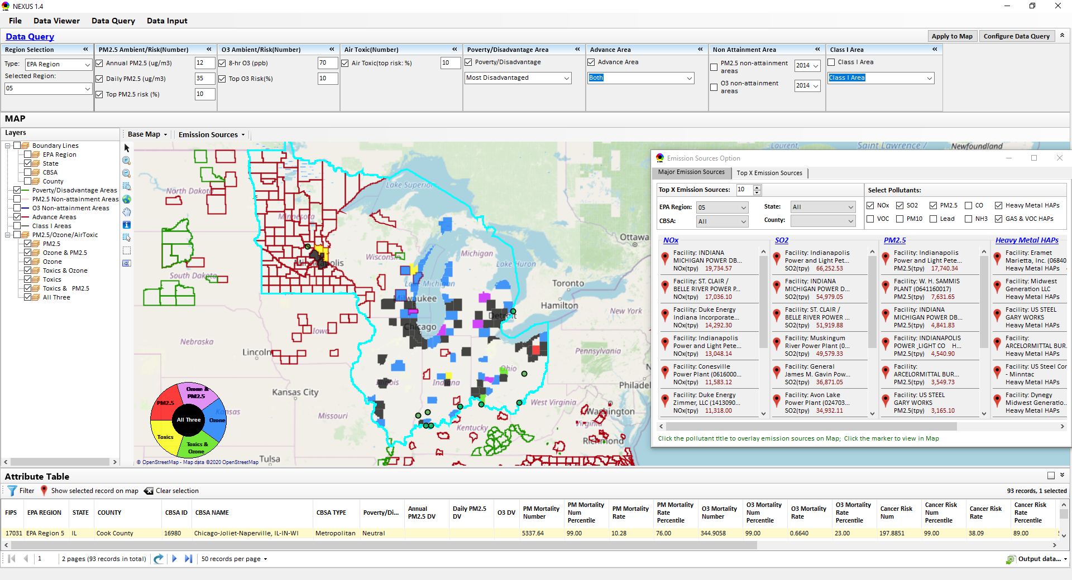
“NEXUS” Multi-Pollutant Analysis Tool Development: Status and Progress
Data Viewer Module
Data Input Module
Data Query Module
“NEXUS 1.5” available on OAQPS’s Shared Drive at: “G:\SHARE\NEXUS\NEXUS 1.5\”
or at EPA’s new FTP site: ftp://newftp.epa.gov/aqmg/cjang/NEXUS/NEXUS 1.5/
OAQPS/AQPD Briefing
December 10, 2020
Carey Jang & Beth Landis
1

Slide 2
Overview
NEXUS Tool Development
Expected Use
Schedule
Key Modules
Questions NEXUS can Answer & Examples: AQPD focused
Live Demo
Discussion & Next Steps

Slide 3
NEXUS Tool Development
Motivation: Develop a new multi-pollutant analysis tool to identify and assess areas with high ambient levels and/or health risks associated with PM_{2.5}, O₃ and air toxics
Phase-1: Develop a GIS-based NEXUS prototype with a user-friendly graphical interface to provide analysis and visualization functions of potential multi-pollutant AQ issues at national level (continental US)
Phase-2: Expand the NEXUS tool to allow users to dial into an EPA region, State, or metropolitan area and provide data query and V/A functions for “AQ and emissions” information over the selected region of interest
3

Slide 4
Expected Use of NEXUS Tool
The NEXUS tool will allow users to do the following:
National screening for areas with MP issues: Phase 1 development will provide ability to quickly screen areas across nation that have combination of high air quality and/or risk levels for O₃, PM_{2.5} and air toxics.
Area screening to understand nature of MP problem: Phase 2 development will provide ability to ‘dial-into’ specific areas to determine extent to which common emissions sources are causing the MP issues.
OAQPS expects to use this tool to engage with Regions and identify areas that would potentially benefit most from MP approaches to reduce emissions (including current NA and Advance areas).
The NEXUS tool will essentially provide a ‘conceptual model’ of MP issues within an area to facilitate engagement with state/local/tribal agencies and community stakeholder groups.
4

Slide 5
NEXUS Tool : Schedule & Installation
Work Plan | Date
Developed NEXUS tool prototype and Phase-1 functions | Dec. 2019 ~ April 2020
Developed Phase-2 functions and deliver first working (interim) NEXUS tool | May ~ July 2020
Developing a fully functional NEXUS tool for beta-testing and on-line User’s Manual | Aug. ~ Dec 2020
Download “NEXUS” tool: The “NEXUS 1.5” package (“NEXUS v1.5 setup.exe” & “NEXUS 1.5 Data.exe”: run both to install) is available at OAQPS’s Shared Drive at G:\SHARE\NEXUS\NEXUS 1.5\ or at EPA’s new FTP site ftp://newftp.epa.gov/aqmg/cjang/NEXUS/NEXUS 1.5/
(Note: Require software installation privilege to install “NEXUS tool” at EPA’s PCs)
5

Slide 6
NEXUS Tool: Three Key Modules
Data Viewer module
View and create interactive Map/Data/Chart/Table
Provide flexible selections & mapping of “Ambient” and/or “Risk” levels of PM_{2.5}, O₃ and air toxics
Provide regional analysis for “EPA region”, “States”. CBSA”, and “County”
Link and display major emission sources locations & emitted pollutants info.
6

Slide 7
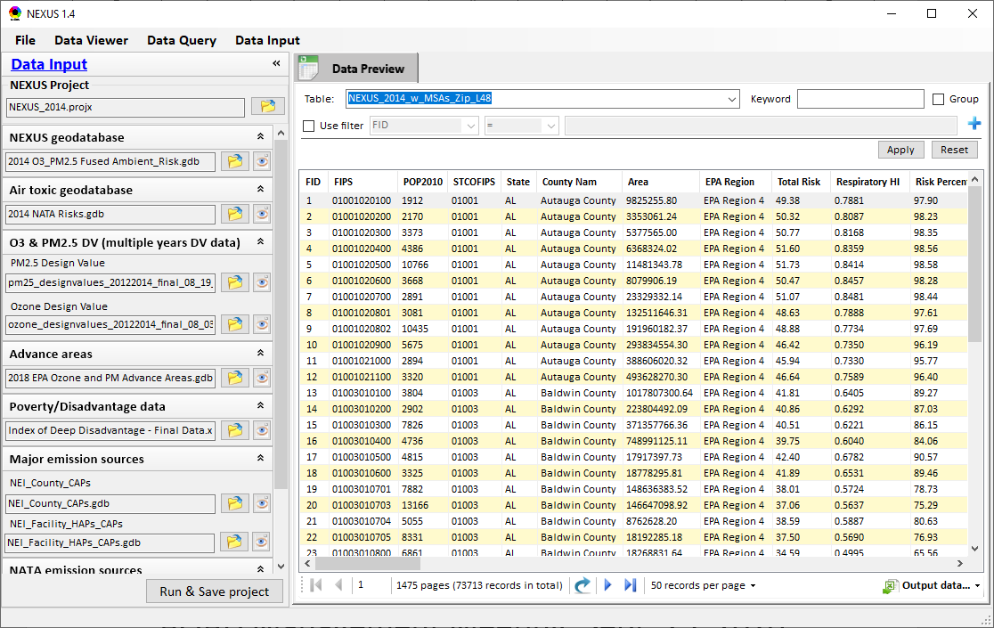
NEXUS Tool: Three Key Modules
Data Input module
Allow users to update/preview/filter Input data files
Currently, there are 10 input data files used (publicly available)
Run and Save to a new project after loading new input data files
Allow to update & change input data files
Provide data preview and filter functions
Extend to use 10 input data files now (publicly available, ~4 GB)
Quick turnaround to run & save to a new “project” using new input data files
7

Slide 8
Data Input File Names | Data Format | Data Description | Data Source | Data Period
“2014 O₃ & PM_{2.5} fused Ambient & Risk” | Geodataset | O₃/PM_{2.5} ambient & risk data at county/census tract level | from OAQPS MP team | 2014
“2014 NATA Risk” | Geodataset | Air toxics ambient & risk data at county/census tract level | from OAQPS MP team | 2014
“O₃_DV_2009_2018” | Excel | O₃ design values at county level | From EPA public website: https://www.epa.gov/air-trends/air-quality-design-values | 2009 to 2018
“PM_DV_2009_2018” | Excel | PM_{2.5} design values at county level | From EPA public website: https://www.epa.gov/air-trends/air-quality-design-values | 2009 to 2018
“Advance areas O₃_PM” | Geodataset | O₃ & PM_{2.5} Advance Areas | from OAQPS MP team | 2018
“Index of Poverty_ Disadvantage” | Excel | Index of poverty/disadvantage at county level | from Univ. of Michigan website: https://poverty.umich.edu/projects/understanding-communities-of-deep-disadvantage/ | 2017
“NEI_County_CAPs” “NEI_Facility_HAPs_ CAPs” | Geodataset | Major emission sources and facility info. of CAPs & HAPs at county level | From OAQPS public website: ftp://newftp.epa.gov/EPADataCommons/OAR/OAQPS/NEI/NEI_Facility_HAPs_CAPs.zip ftp://newftp.epa.gov/EPADataCommons/OAR/OAQPS/NEI/NEI_County_CAP.zip | 2008, 2011, 2014
“2014 NEI_NATA Emissions” | Access Database (*. accdb) | NATA emissions data from 2014 NEI database, including various source groups | From EPA public website: https://www.epa.gov/national-air-toxics-assessment/2014-nata-assessment-results#emissions | 2014
“Class1_FederalAreas” | Geodataset | Mandatory Class 1 Federal Areas | From Mandatory Class 1 Federal Areas Web Service: https://edg.epa.gov/data/public/OAR/OAQPS/Class1/Class1Areas.zip | —
Data Input Module: Input Files & Attributes
8

Slide 9
NEXUS Tool: Three Key Modules
Data Query module
Expand data field selections and flexibility for exploratory/advanced users
Provide overlaying map and summary table for data query results
Current data query based on selected data fields: “Ambient/Risk, Advance area, Socio-demographic (EJ) area, NA Area, Class I area”
9

Slide 10
What Types of Questions May AQPD Ask?
How can NEXUS can be used to identify highest risk areas across O₃, PM_{2.5}, and Air Toxics?
Example 1 for Region 4 → Miami
How can NEXUS be used to identify the nature of multi-pollutant risks within nonattainment areas?
Example 2 for Region 4 → Atlanta
How can NEXUS be used to identify the nature of multi-pollutant risks within Advance areas?
Example 3 for Region 4 → Louisville
10

Slide 11
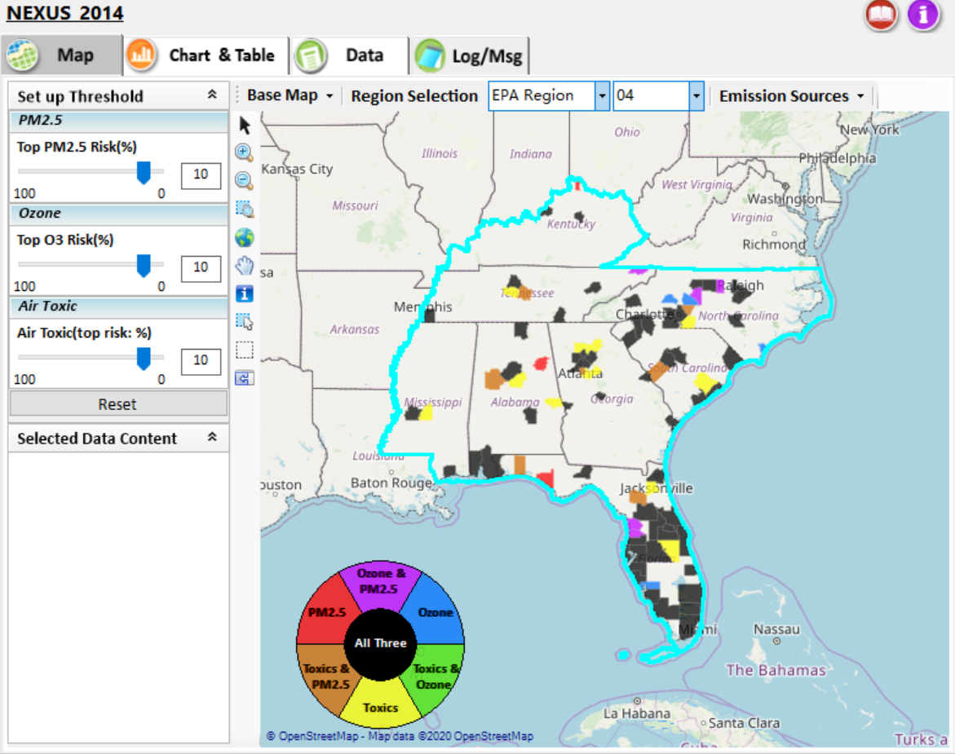
NEXUS Tool: Example 1
NEXUS can be used to identify highest risk areas across O₃, PM_{2.5}, and Air Toxics. Example map above is for Region 4
11

Slide 12
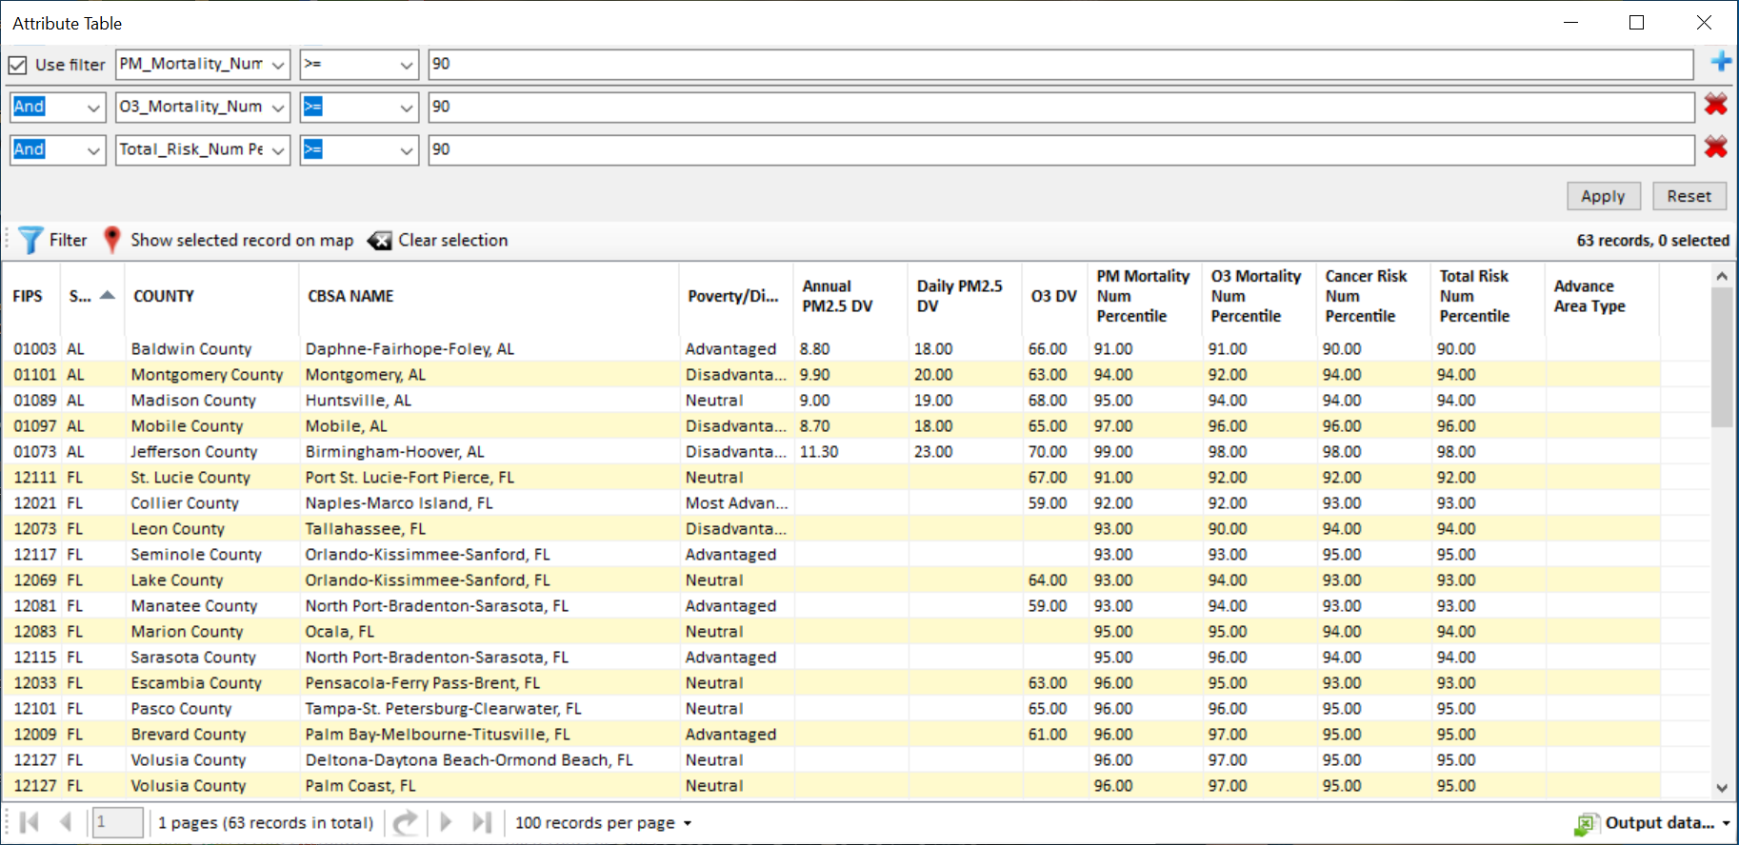
NEXUS Tool: Example 1
NEXUS can be used to identify highest risk areas across O₃, PM_{2.5}, and Air Toxics. Example table above was generated in Data Query for Region 4. Table Generator Module is planned for future development. Currently, data can be exported to Excel.
12

Slide 13
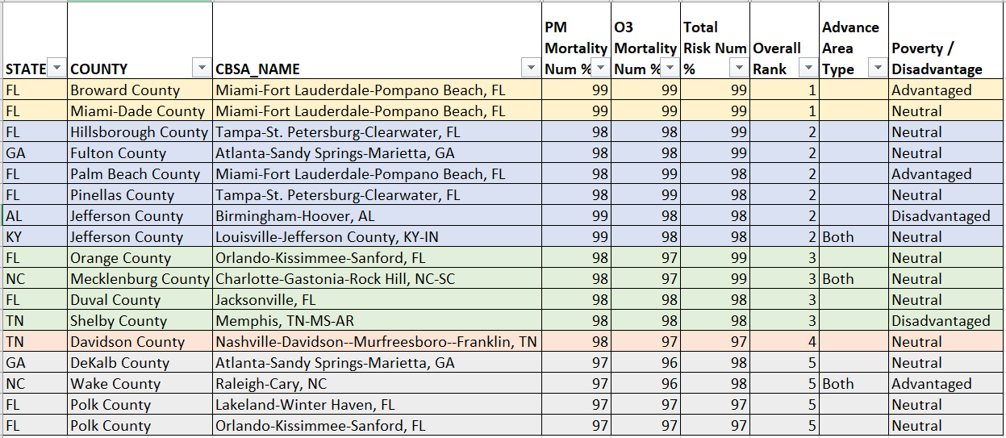
NEXUS Tool: Example 1
NEXUS can be used to identify highest risk areas across O₃, PM_{2.5}, and Air Toxics. Information above was generated in Data Query for Region 4 and exported into excel where rankings were applied.
Top 5 CBSAs (using this approach) – Miami, Tampa, Atlanta, Birmingham, Louisville
13

Slide 14
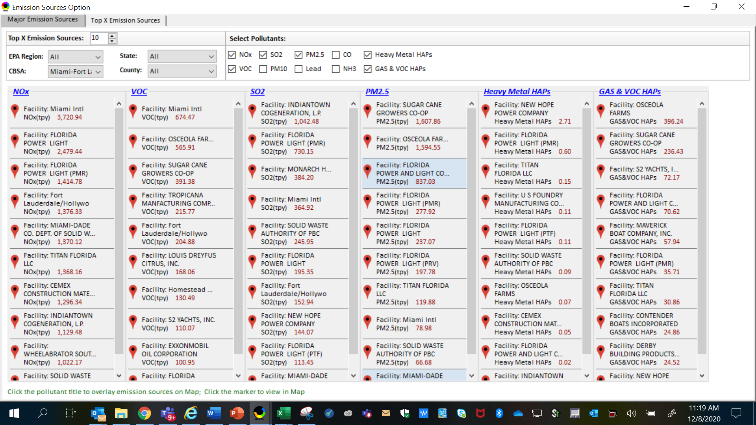
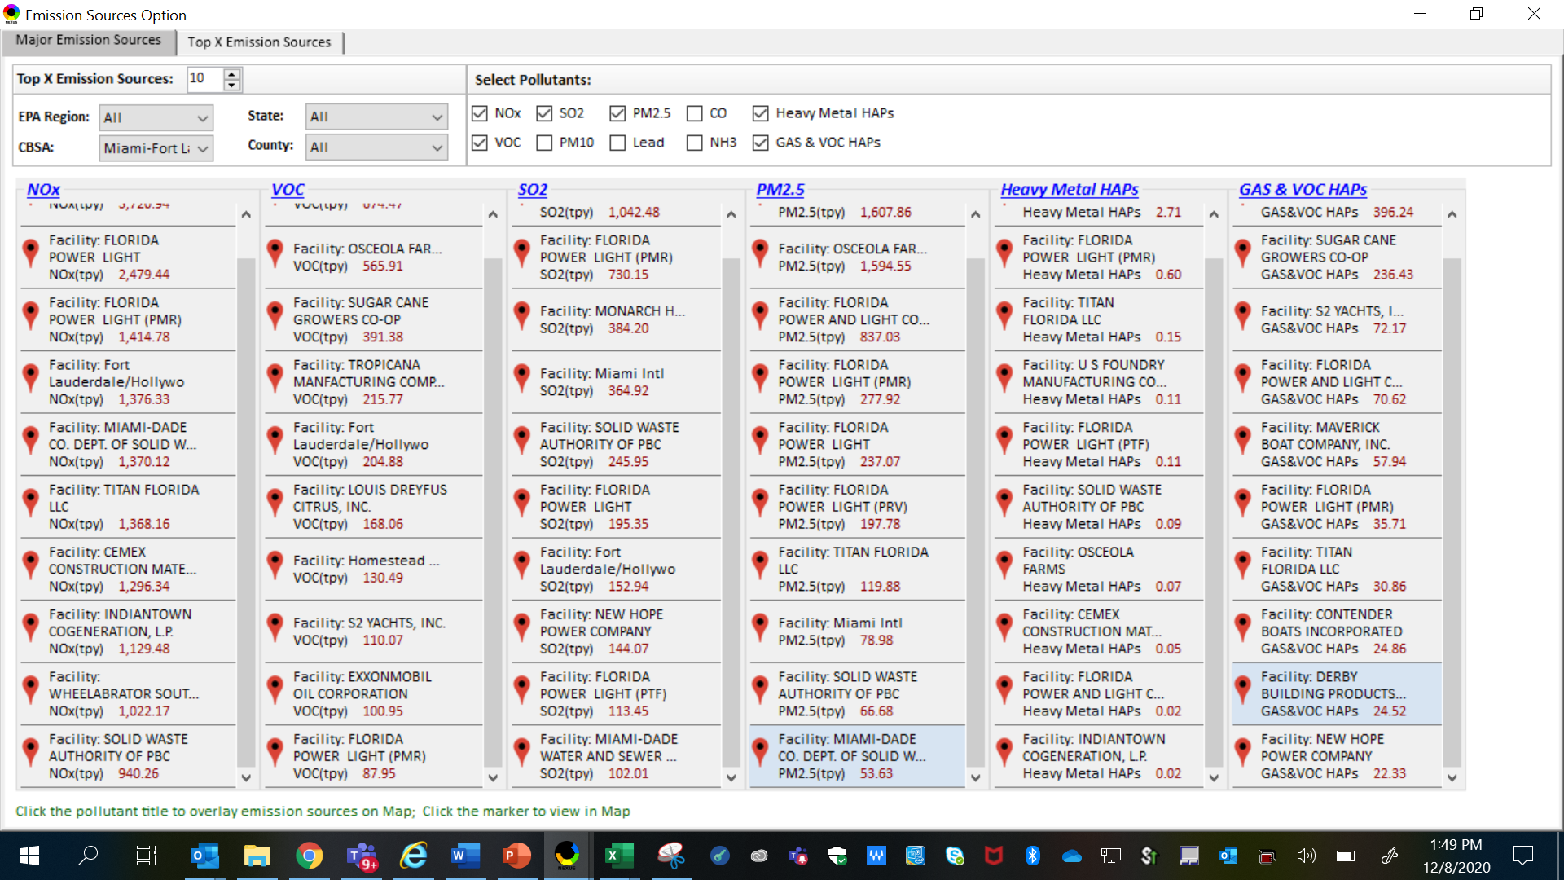
NEXUS Tool: Example 1
NEXUS can be used to identify top emission sources. Information above was generated in Data Query for the Miami CBSA. This can help identify the potential co-benefits of controls.
14

Slide 15
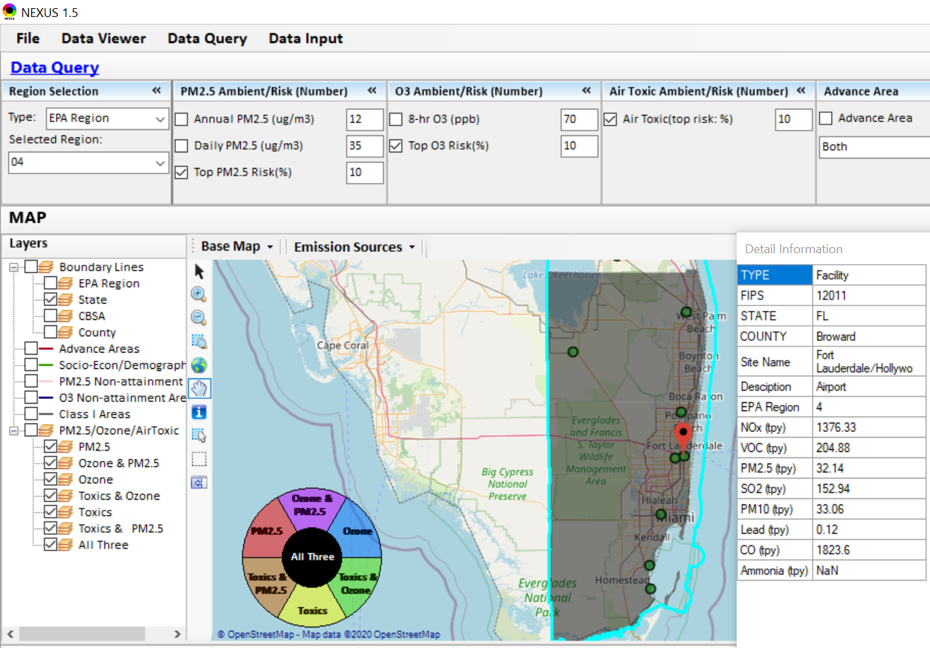
NEXUS Tool: Example 1
What is this and where is it located?
NEXUS can be used to identify top emission sources. Information above was generated in Data Query for the Miami CBSA.
15

Slide 16
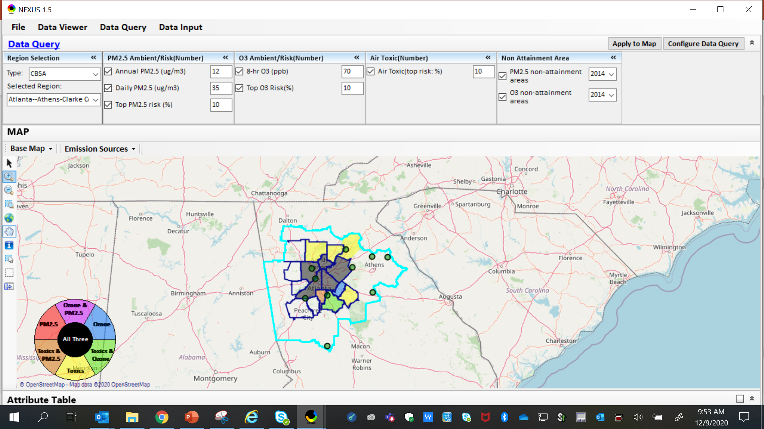
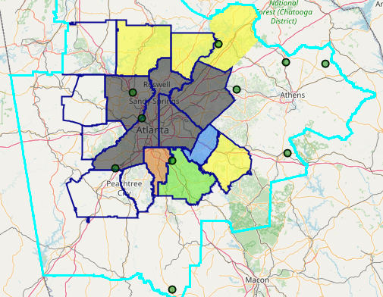
NEXUS Tool: Example 2
The maps above were generated for the Atlanta CBSA (2014 O₃ NAA), using the data query module. The top 10 Gas & VOC HAPS emission sources are plotted.
16

Slide 17
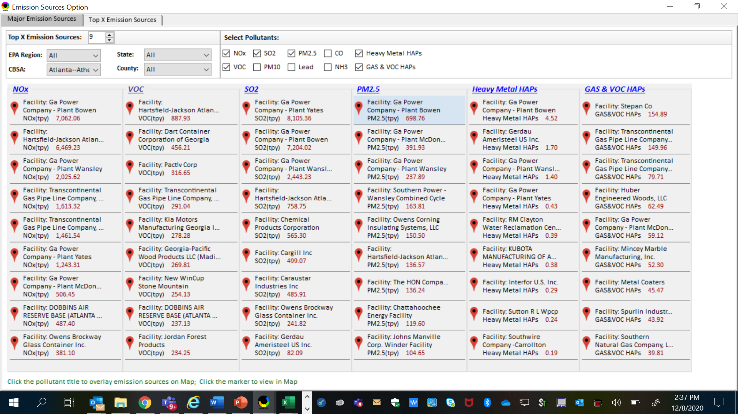
NEXUS Tool: Example 2
NEXUS can be used to identify top emission sources. Information above was generated in Data Query for the Atlanta CBSA. This can help identify the potential co-benefits of controls.
17

Slide 18
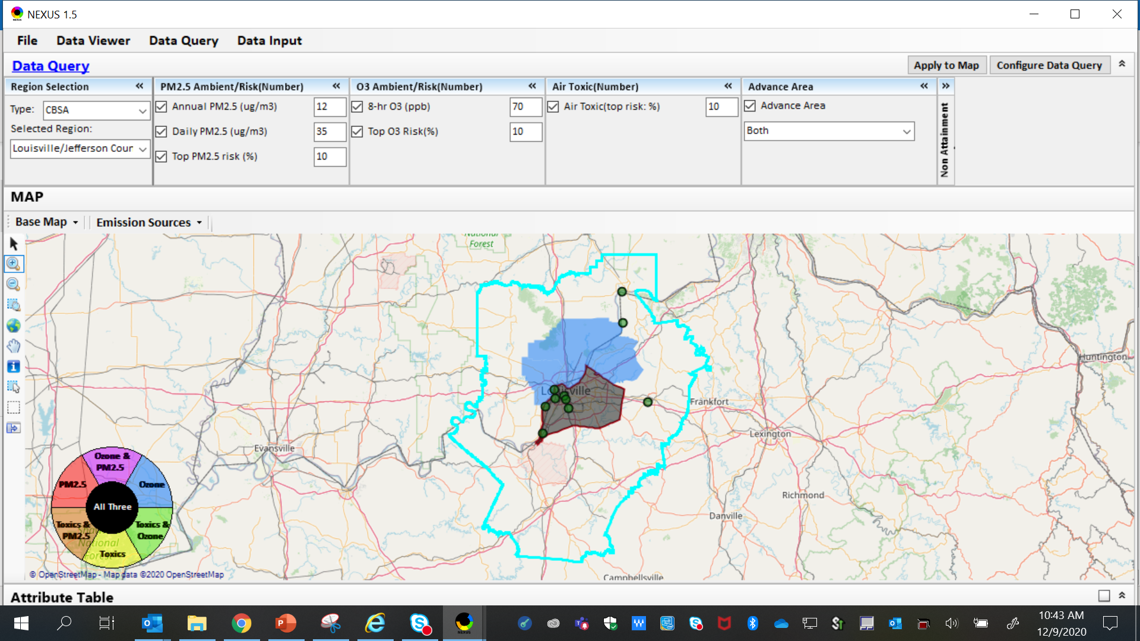
NEXUS Tool: Example 3
The map above was generated for the Louisville/Jefferson County - Elizabethtown - Madison, KY-IN CBSA (2014 O₃ NAA), using the data query module. The top 10 Gas & VOC HAPS emission sources are identified.
18

Slide 19
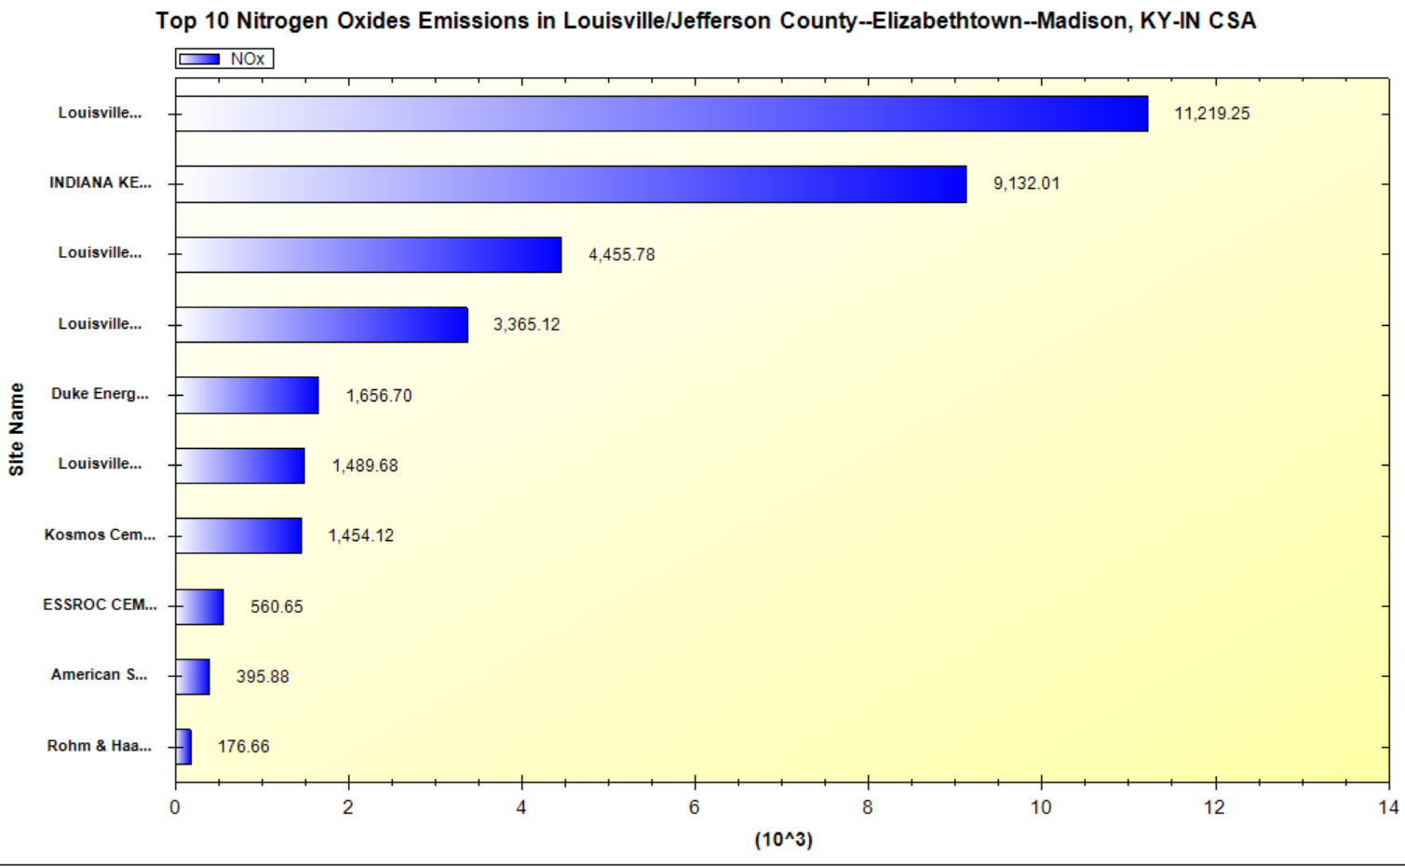
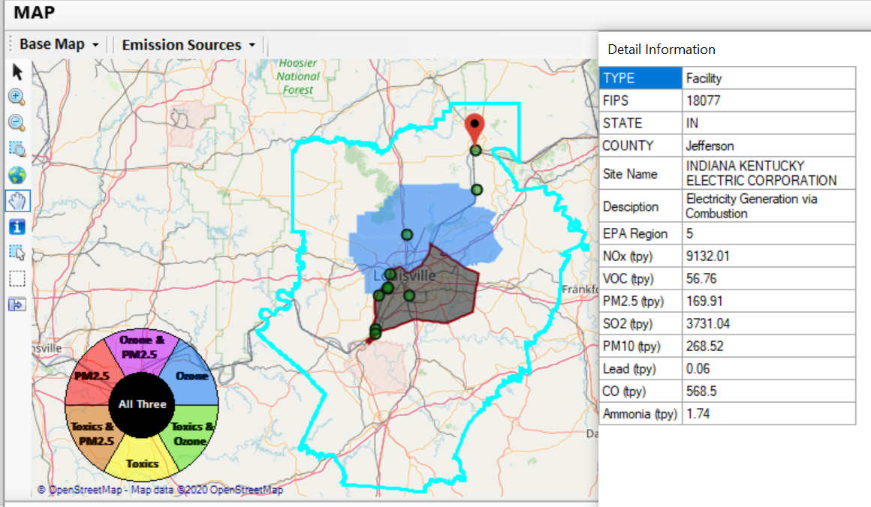
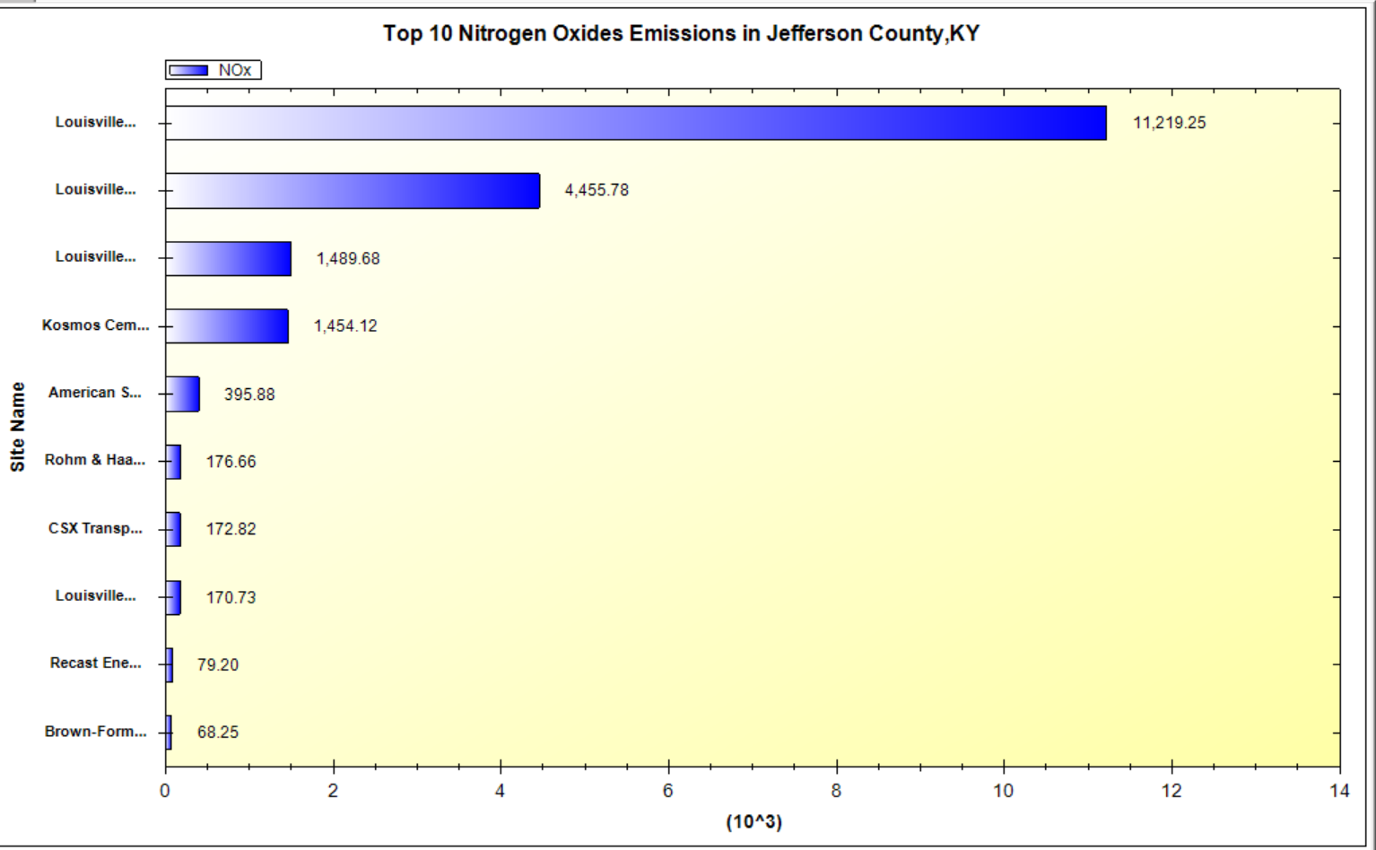
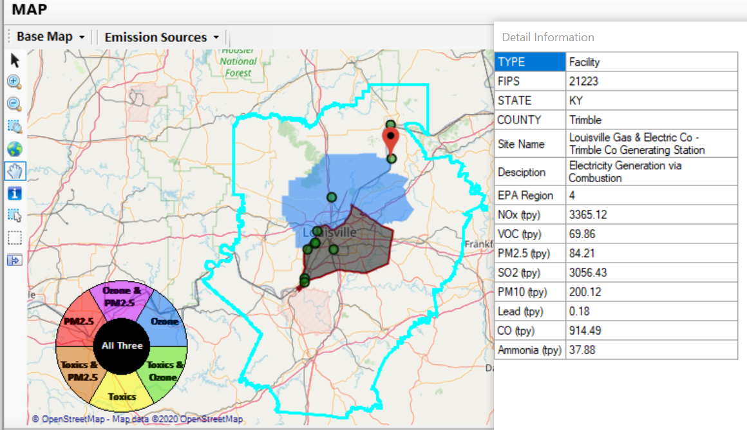
NEXUS Tool: Example 3
2 of the top 4 NOx emission sources outside Jefferson County, KY (Jefferson County, IN & Tremble, KY)
19

Slide 20
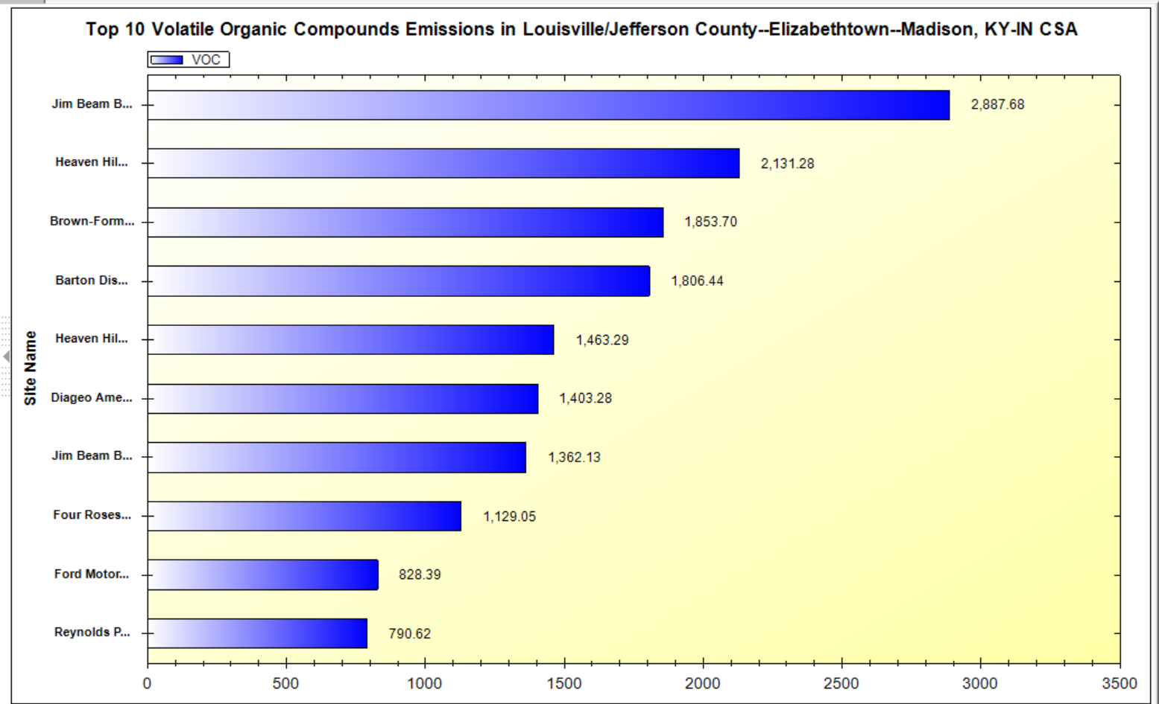
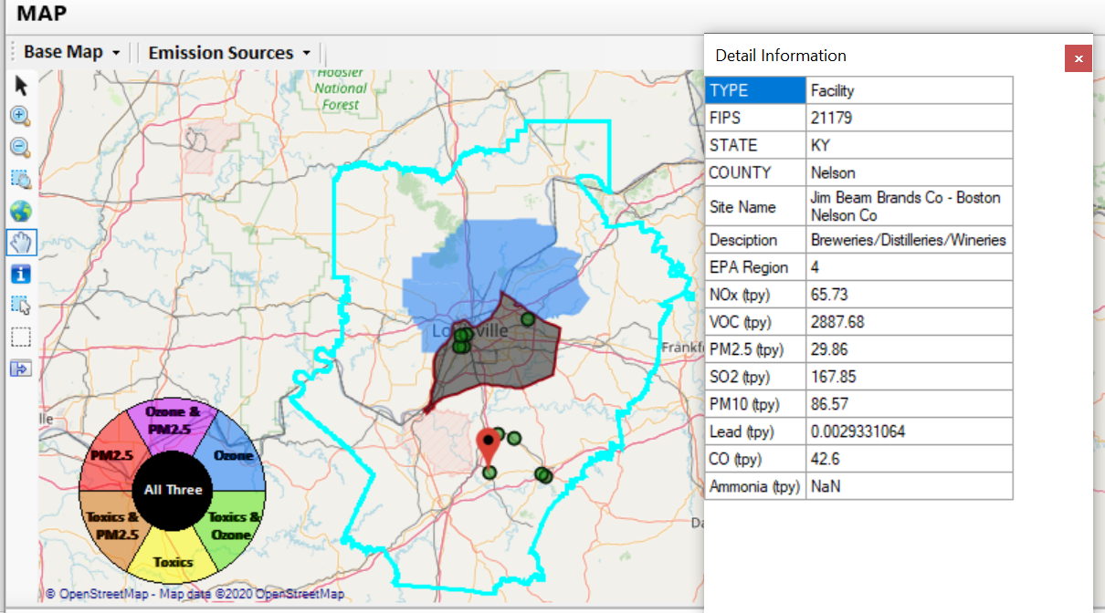
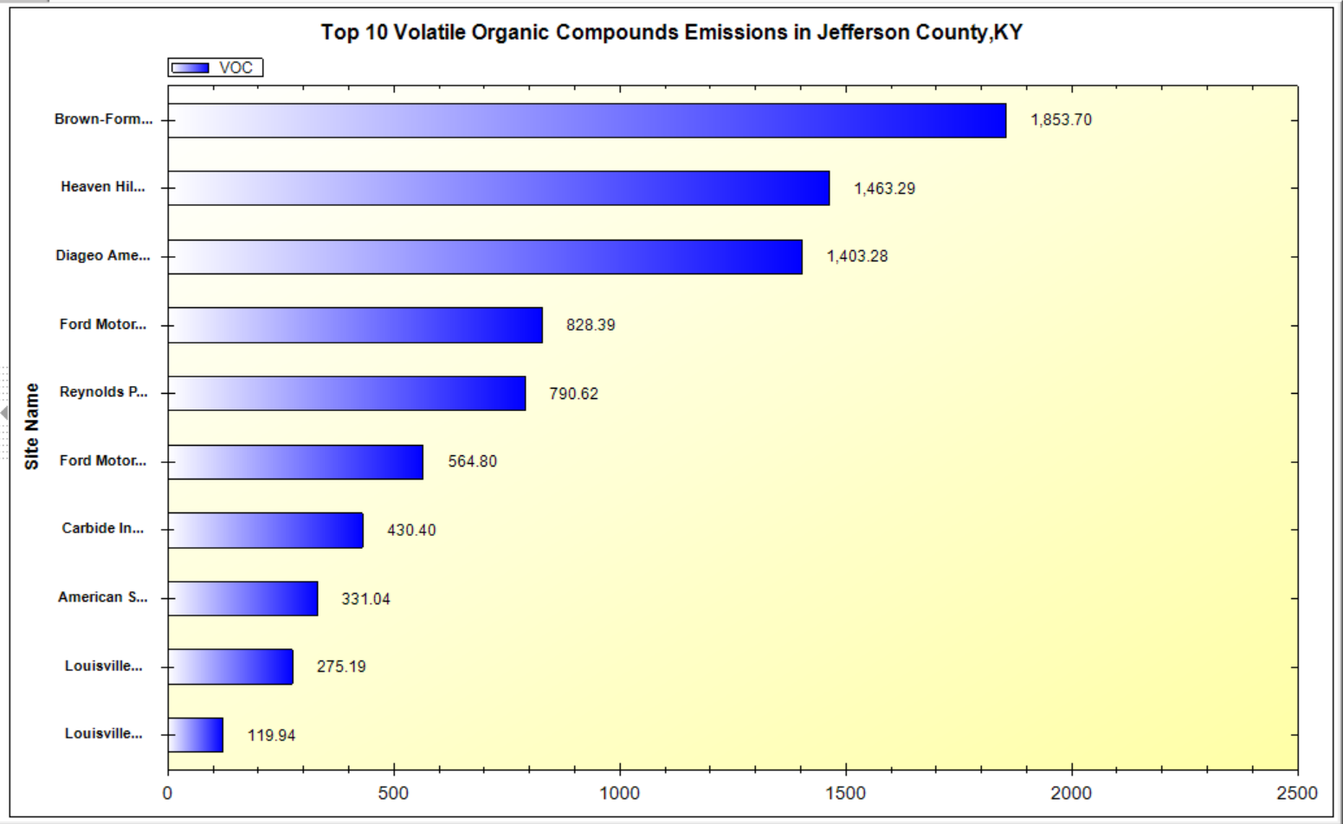
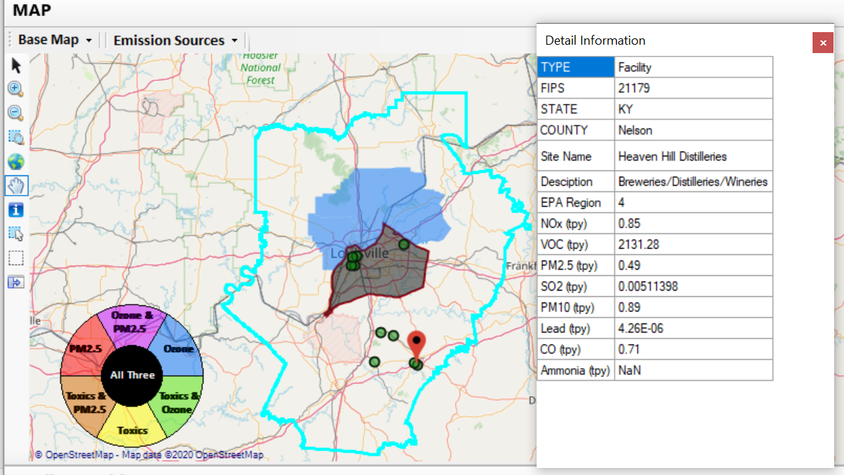
NEXUS Tool: Example 3
Top 2 VOC emission sources are in Nelson County, KY
20

Slide 21
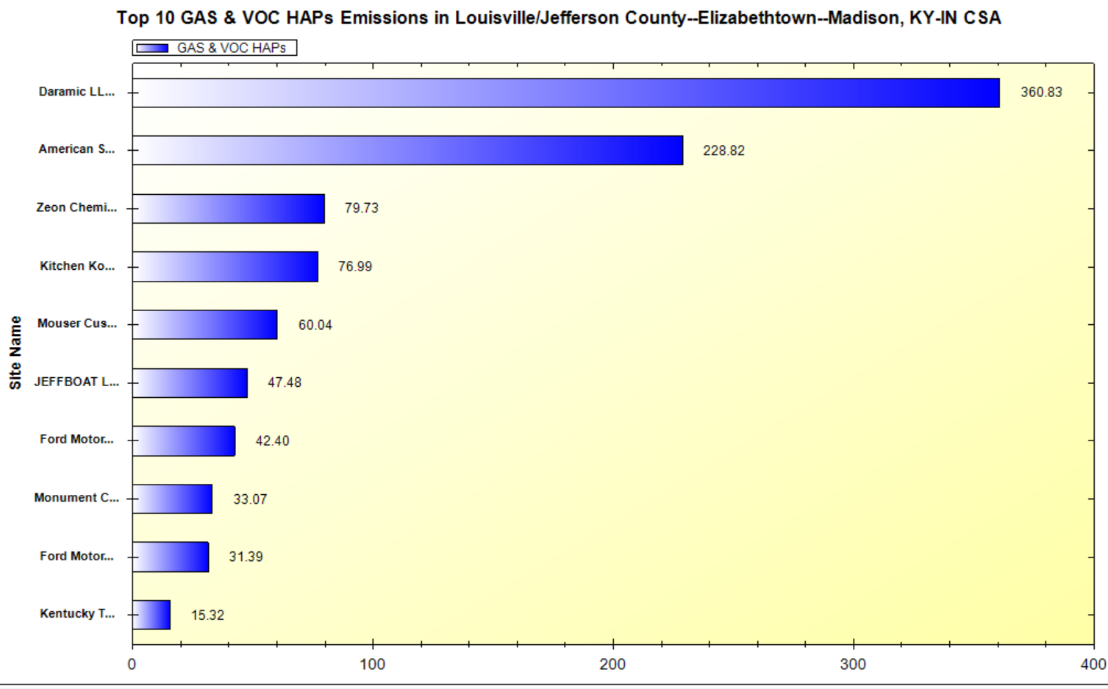
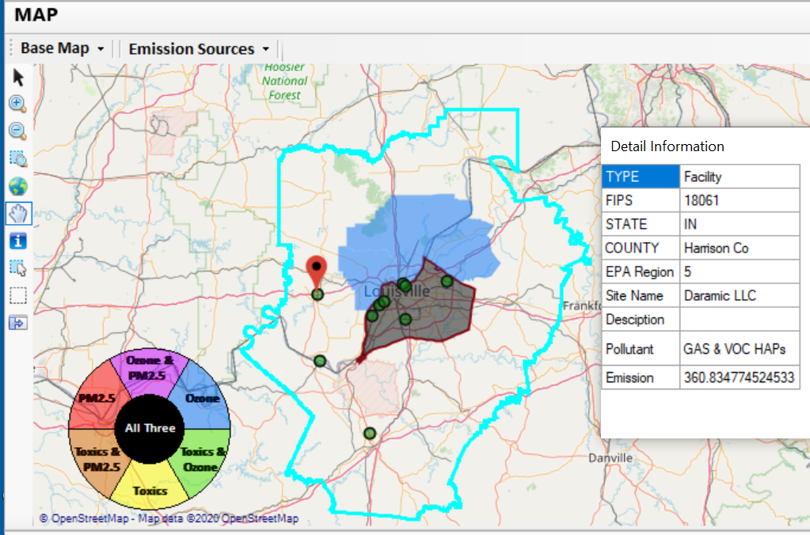
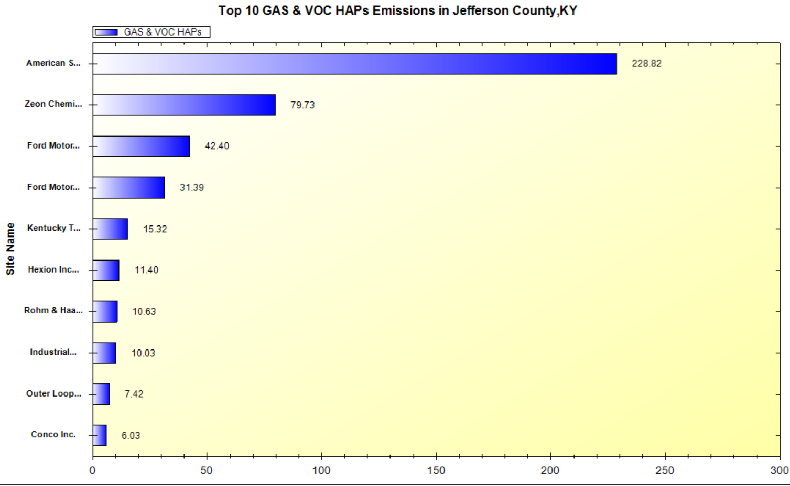
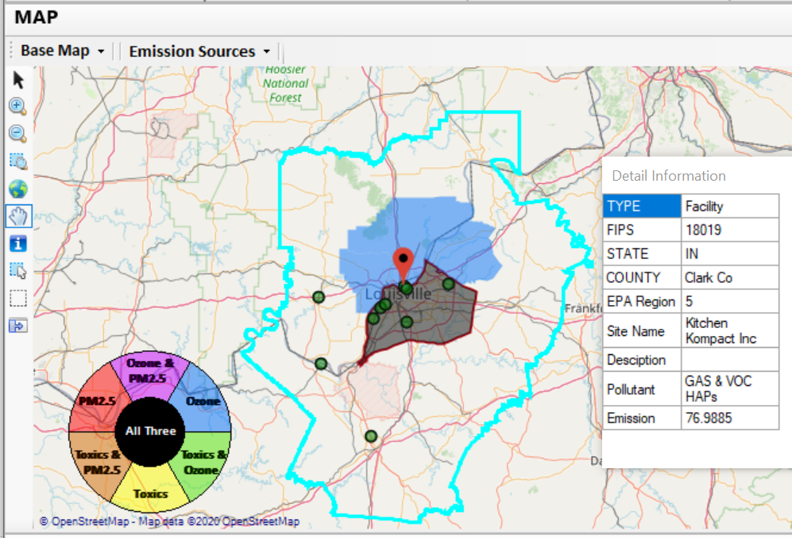
NEXUS Tool: Example 3
21
2 of the top 4 gas & VOC HAPs emission sources in Indiana (Harrison & Clark County)

Slide 22
Live Demo
Carey Jang
22

Slide 23
Discussion and Next Steps (1)
Short-term:
GOAL: Develop a functional version that reflects latest data and information available for internal testing and use
Currently expect limited FY21 funding to support NEXUS —perhaps $50k from AQAD?
Update NEXUS data to 2017
2017 data for O₃, PM_{2.5}, Air Toxics risk, concentrations, & emissions
Tribal boundaries & socioeconomic data for EJ
Add O₃, PM_{2.5}, and Air Toxics monitoring data
Update metrics/indicators (e.g., risk metrics, EJ indicators)
Engage across Office to determine how this tool may best inform or be used for OAQPS’s Air Toxic Strategy programs
Consider addition of screening-level analysis & assessment capabilities (e.g., proximity EJ analysis)
23

Slide 24
Discussion and Next Steps (2)
Long-term:
Upgrade and prepare NEXUS for Beta test with EPA Regions followed by public release & training
Based on Office wide engagements, use updated NEXUS tool with 2017 data to inform Multi-pollutant, Air Toxics, Advance, and EJ efforts as appropriate
Develop plan for routine updates and maintenance of the NEXUS tool to best support OAR/OAQPS programs and determine appropriate extensions as need and resources provide.
24

Slide 25
Additional Information
25

Slide 26
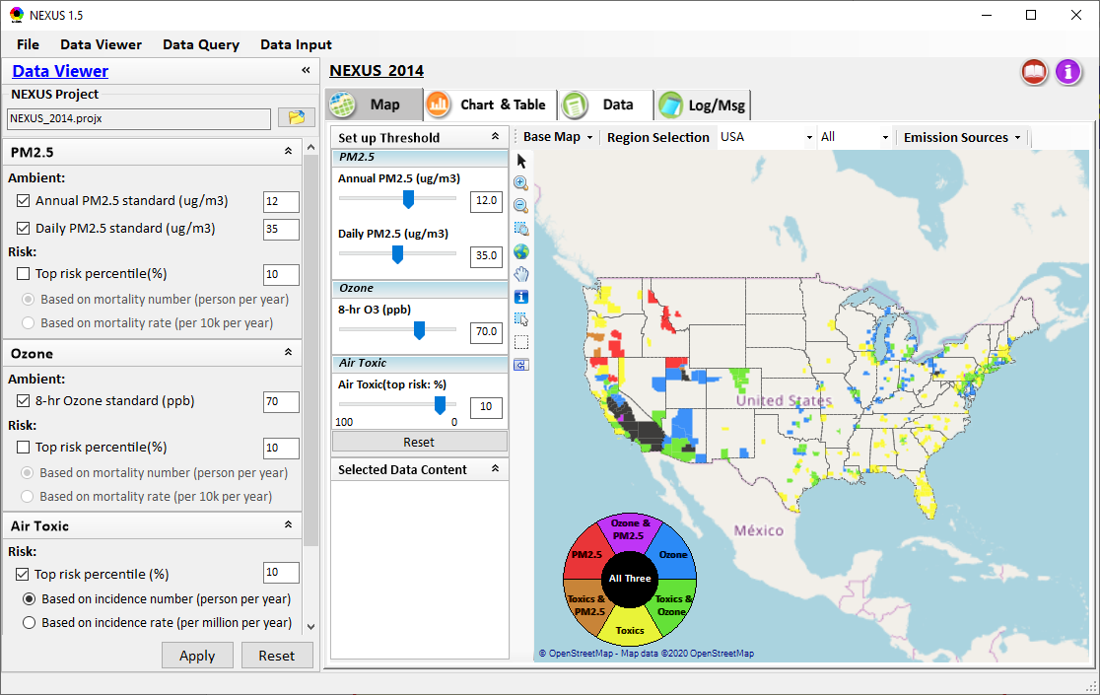
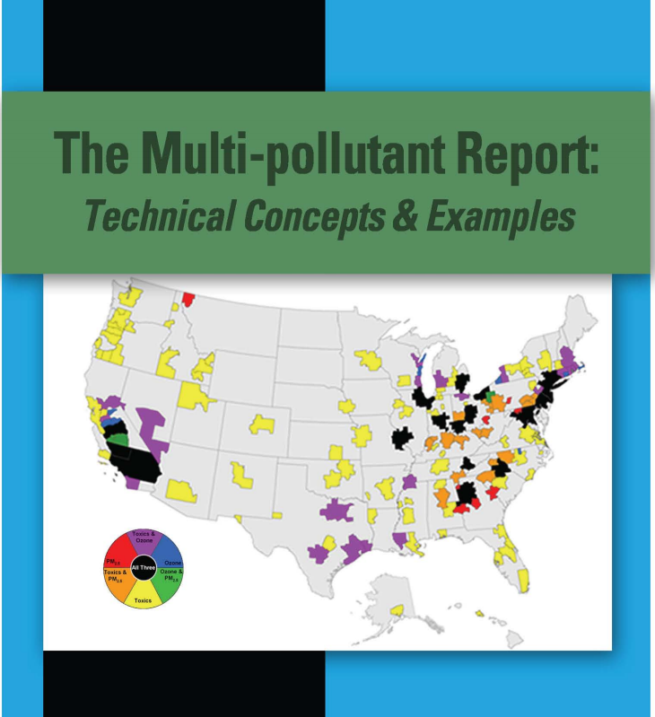
NEXUS Tool Demo: 2014 NEXUS Case
Launching Page
Roadmap for Demo:
(Use example cases)
National View: Use “NEXUS” across pollutants to provide an initial “SCREEN” at the national level by providing an indicator where there may be a common set of sources contributing to Multi-pollutant issues.
Regional View: Dial into a region or area of interest to understand the pollutant/source connections, and potential for more effective and efficient multi-pollutant solution.
2008
26

Slide 27
RoadMap for NEXUS Tool Demo (1)
National Screening (2014 Data)
Replicate 2008 NEXUS map with O₃/PM_{2.5} concentrations above NAAQS and NATA risk estimates above selected percentile of top 10%
What happens to areas at lower O₃/PM_{2.5} NAAQS levels?
What happens to areas current over O₃/PM_{2.5} NAAQS if change HAP risk percentile?
Provide NEXUS map on risk basis: O₃/PM_{2.5} BenMAP mortality risk based on fused surfaces and NATA risk estimates above selected percentile of top 10% for all pollutants
What happens to MP areas as one changes percentile to top 20% or others?
What is relationship between Heavy Metal HAPs risk (top 10%) and PM_{2.5} risk to identify potential co-pollutant issues?
What is relationship between Gas/VOC HAPs risk (top 10%) and O₃ risk to identify potential co-pollutant issues?
27

Slide 28
RoadMap for NEXUS Tool Demo (2)
Regional/State/CBSA/County Screening
EPA Region 4 Example
Areas with MP risk in top 10% across O3, PM2.5 and HAPs
Louisville CBSA: General view and then dial into “Jefferson County” with transparent map color
What are the top 10 emissions sources in county by pollutant?
What specific sources are common across pollutants that may indicate co-control potential?
Can view these sources on the map with summary data available.
28

Slide 29
RoadMap for NEXUS Tool Demo (3)
Data Query: State/CBSA/County Views
Advance Areas
Initial view of national level information using the Advance Area definition to show overlay with MP areas
Region 5 => Minneapolis Example: General view and then dial into “Dakota County” with transparent map color
What are the top 10 emissions sources in county by pollutant?
What specific sources are common across pollutants that may indicate co-control potential?
Can view these sources on the map with summary data available.
29

Slide 30
RoadMap for NEXUS Tool Demo (4)
Data Query: State/CBSA/County Views
Socio-Economic/Demographic (EJ) Areas
Initial view of national level information using the Poverty/Disadvantaged indicator to show overlay with MP areas
Region 5 => Detroit Example: General view and then dial into “Wayne County” with transparent map color
What are the top 10 emissions sources in county by pollutant?
What specific sources are common across pollutants that may indicate co-control potential?
Can view these sources on the map with summary data available.
30

Slide 31
“NEXUS 1.5”: Quick Tutorial
Carey Jang, 12/10/2020
Download “NEXUS” tool: The “NEXUS 1.5” package (“NEXUS v1.5 setup.exe” & “NEXUS 1.5 Data.exe”: run both to install) is available at OAQPS’s Shared Drive at: G:\SHARE\NEXUS\NEXUS 1.5\
or at EPA’s new FTP site:
ftp://newftp.epa.gov/aqmg/cjang/NEXUS/NEXUS 1.5/
(Note: Require software installation privilege to install “NEXUS tool” at EPA’s; Older EPA PCs may be less efficient in running “NEXUS tool”) PCs
31

Slide 32

NEXUS Tool: On-line User’s Manual
Click “book” icon to launch “User’s manual”
Hot link to User’s manual’s “Data Viewer” chapter (same for “Data Input” & “Data Query”
32

Slide 33
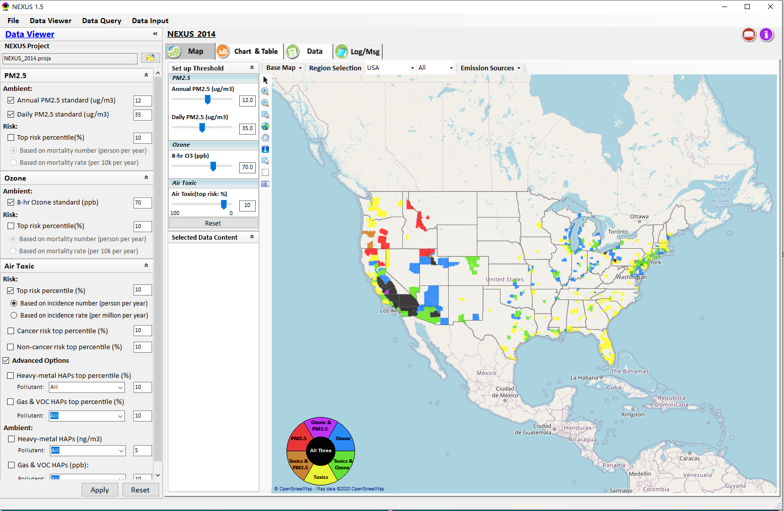

NEXUS Tool: Data Viewer Module
Click “File” to open or save a project
Switch between 3 key modules
Loaded NEXUS project file name
Select & adjust “Ambient” & “Risk” levels
“Advanced Option”: provide HAPs & species selections
33

Slide 34
Data Viewer Module: Selections & Map Display
Select & adjust “Ambient” & “Risk” threshold levels for color map display
“Apply” new selections to “Radio button” panel
34

Slide 35
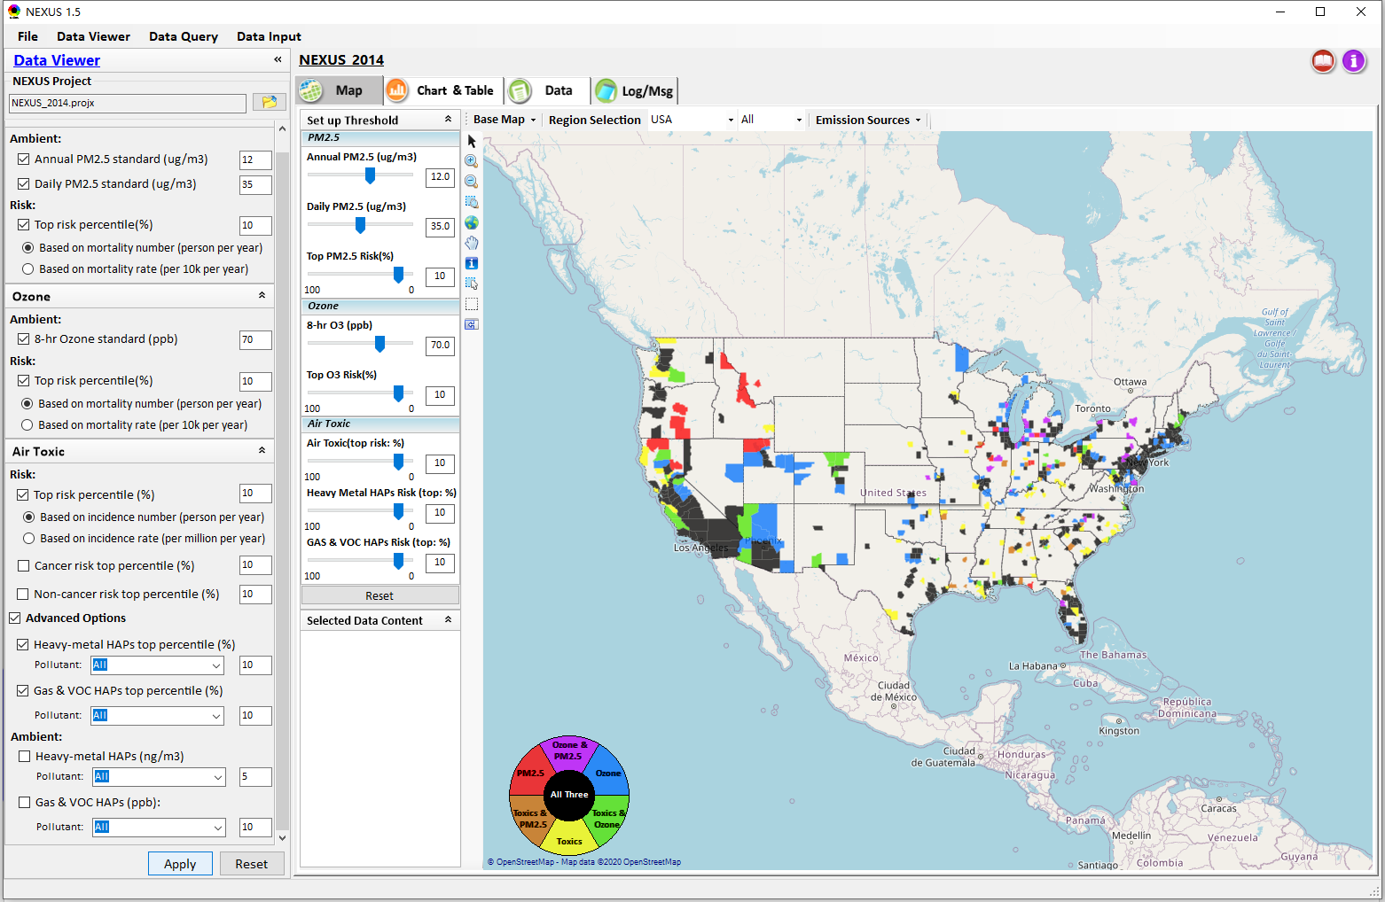
Data Viewer: “Apply” New Selections
“Check” new selections
New selections will appear on-the-fly in “radio button” panel and map display
“Apply” new selections
35

Slide 36
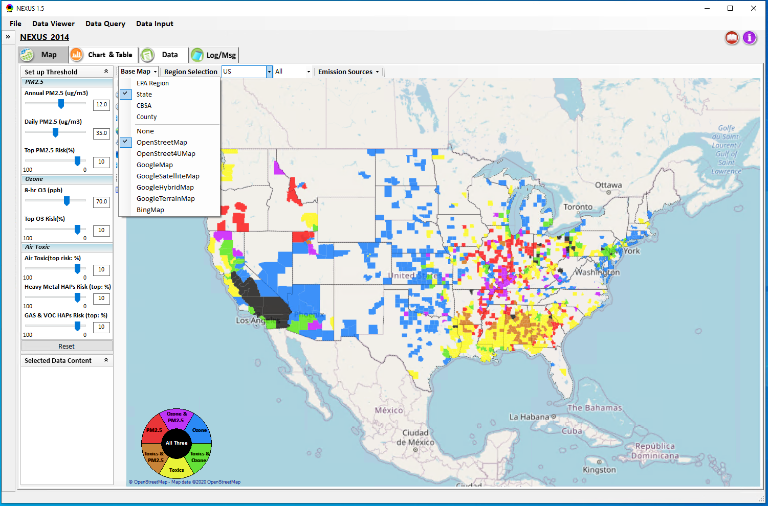
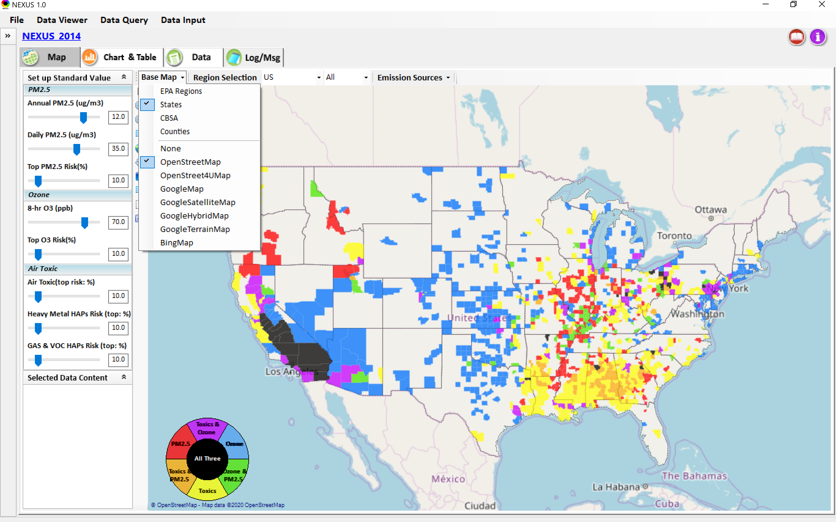
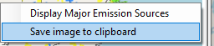
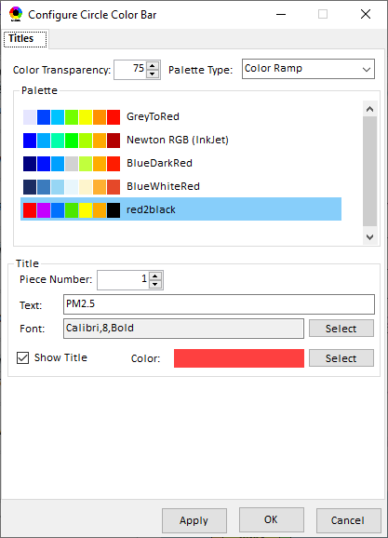
Data Viewer Module: Base Map & Color
“Base Map”: Change boundary lines and background map
“Right-click” map to save image
Click to change color & transparency
36

Slide 37
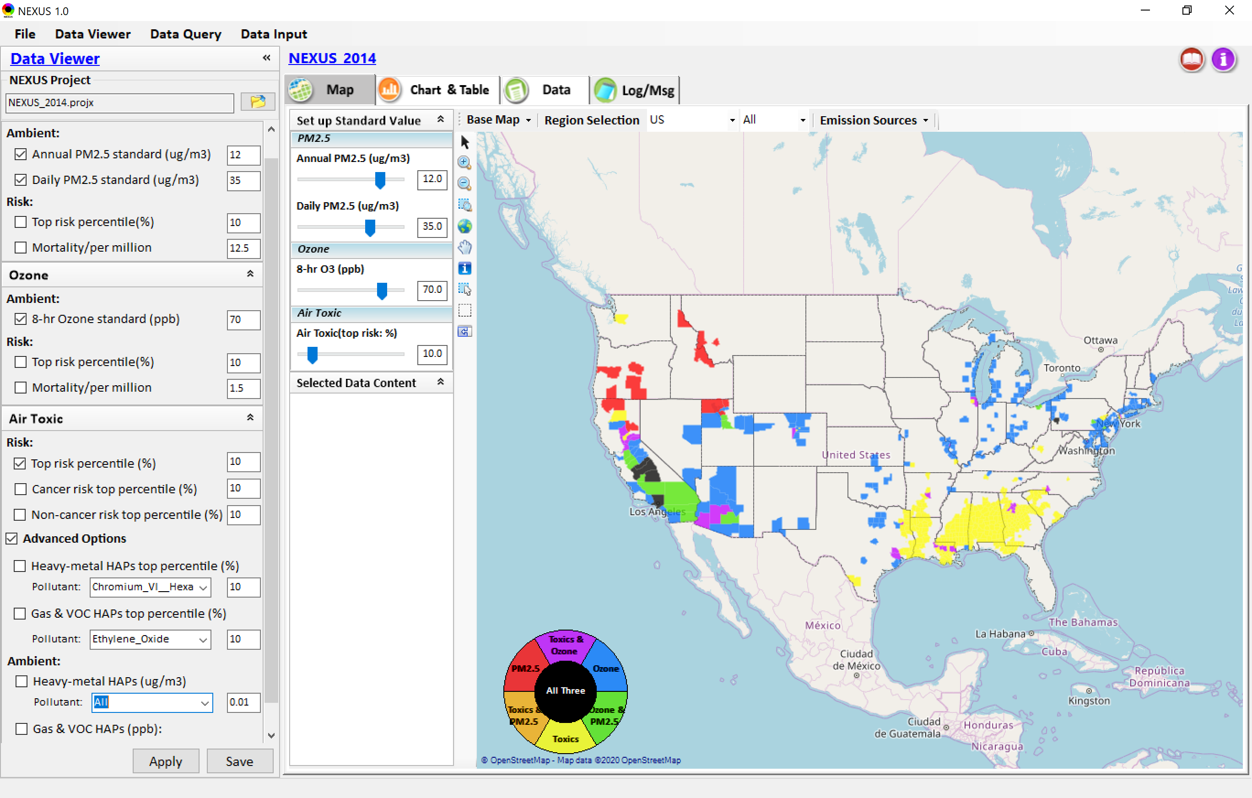

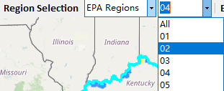
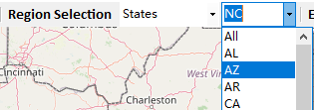
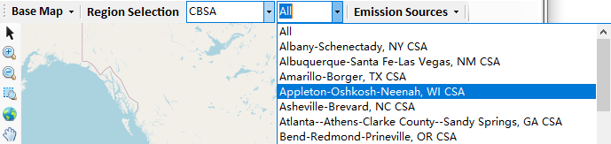
Data Viewer: “Region Selection”
Allow to select “EPA regions”, “States”, or “CBSA”
37

Slide 38
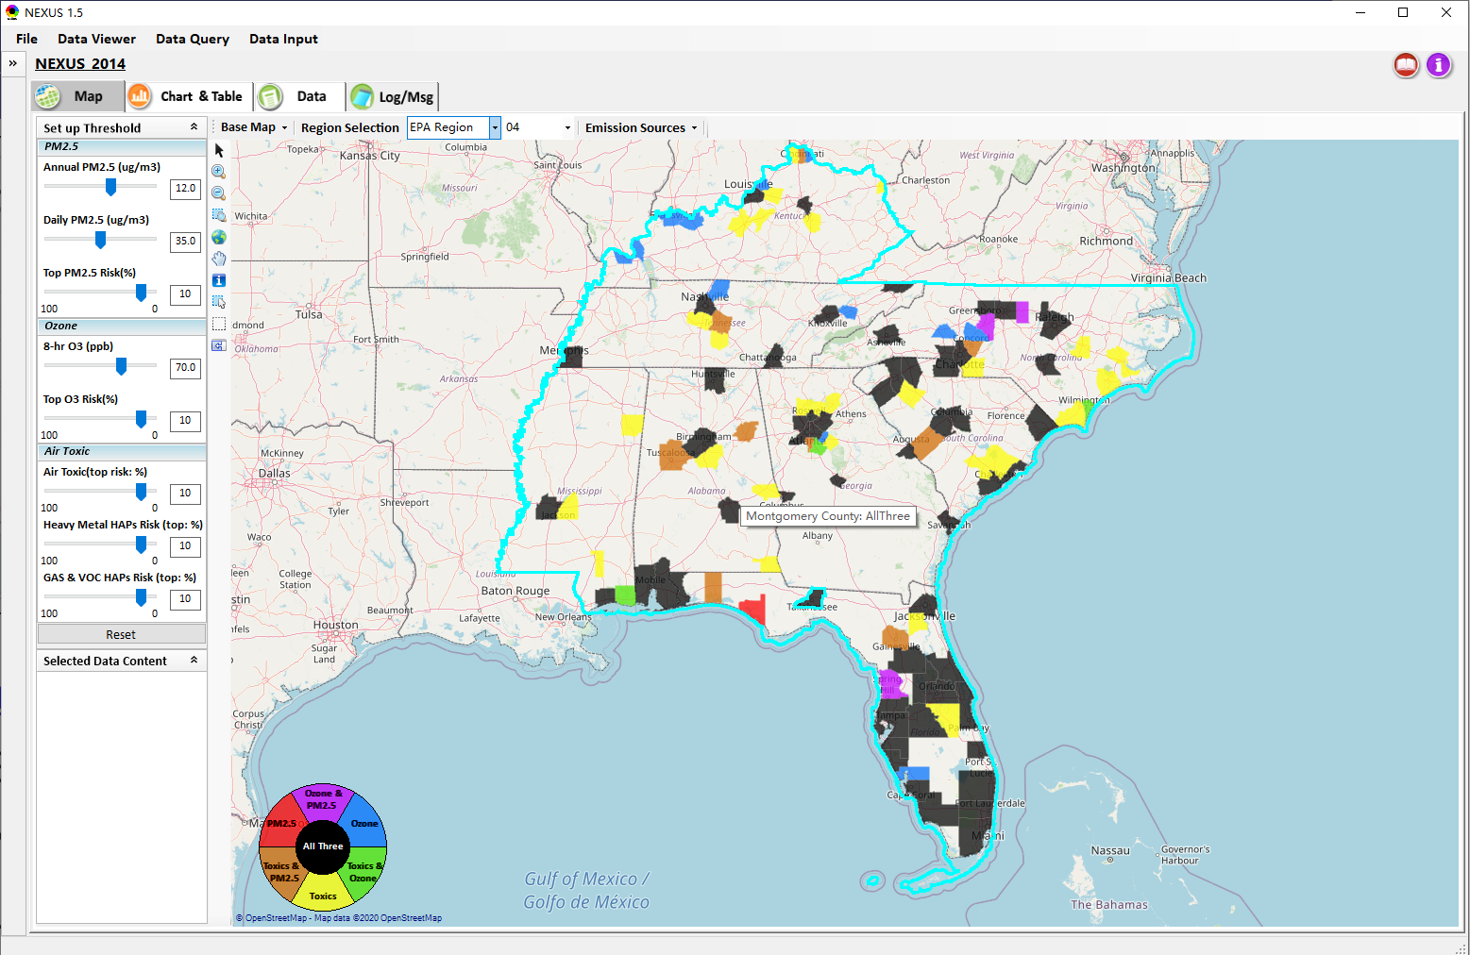
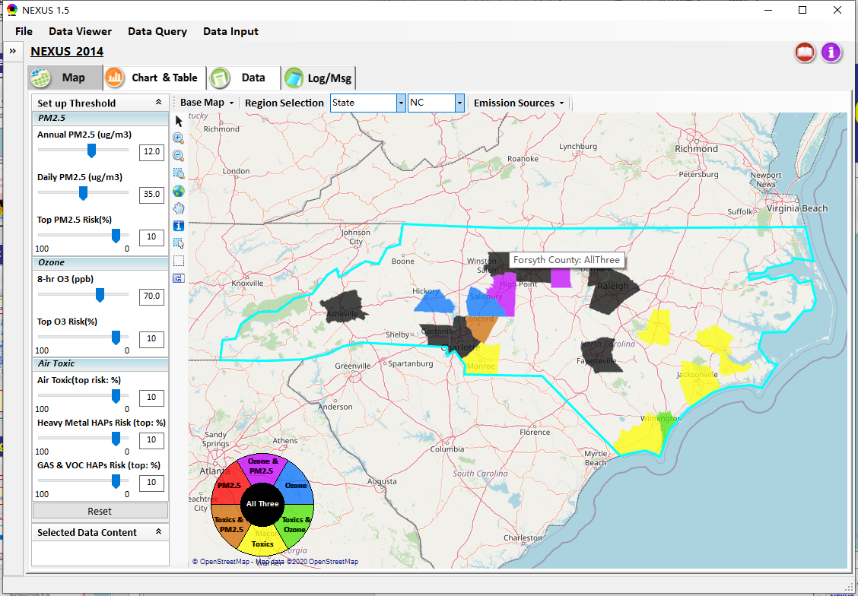
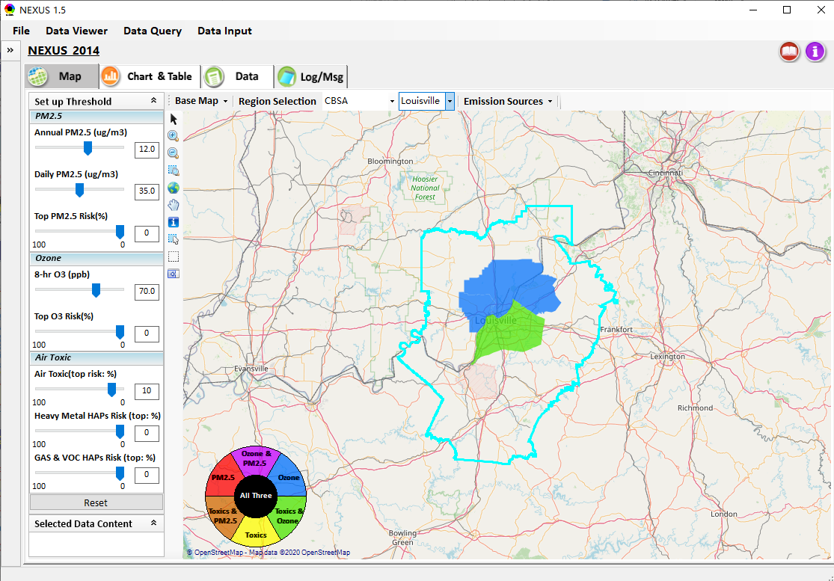
Data Viewer: Select EPA Region/State/CBSA
Examples:
EPA Region 4
NC
Louisville CBSA
38

Slide 39
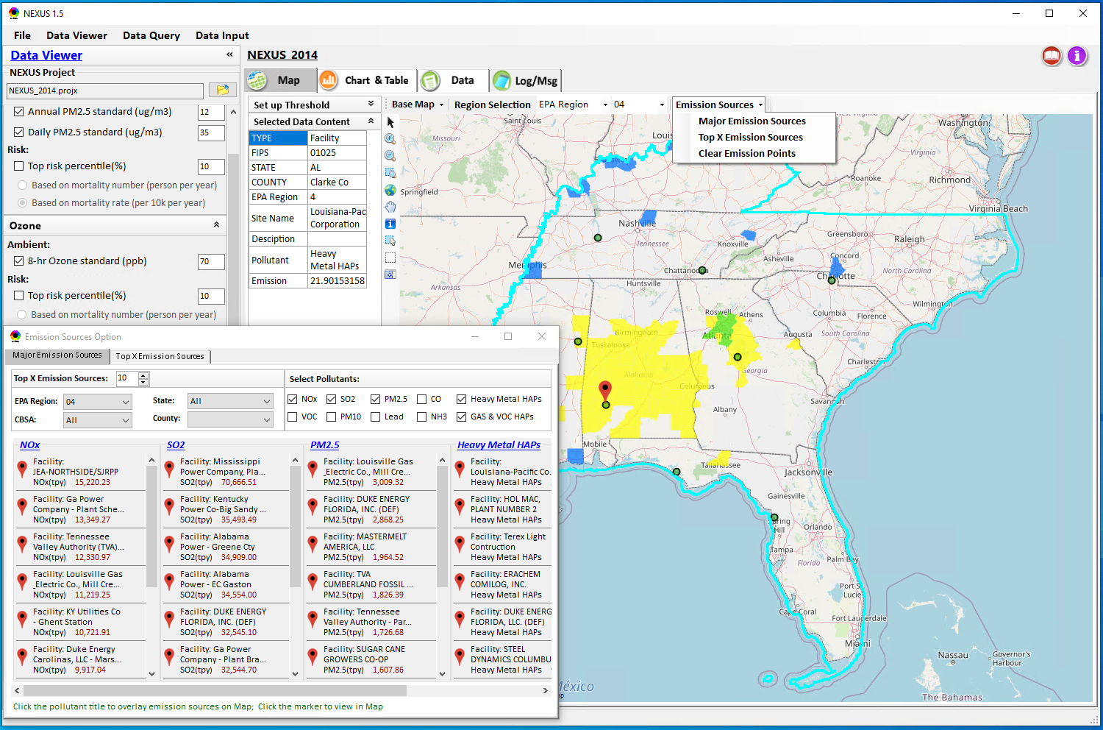
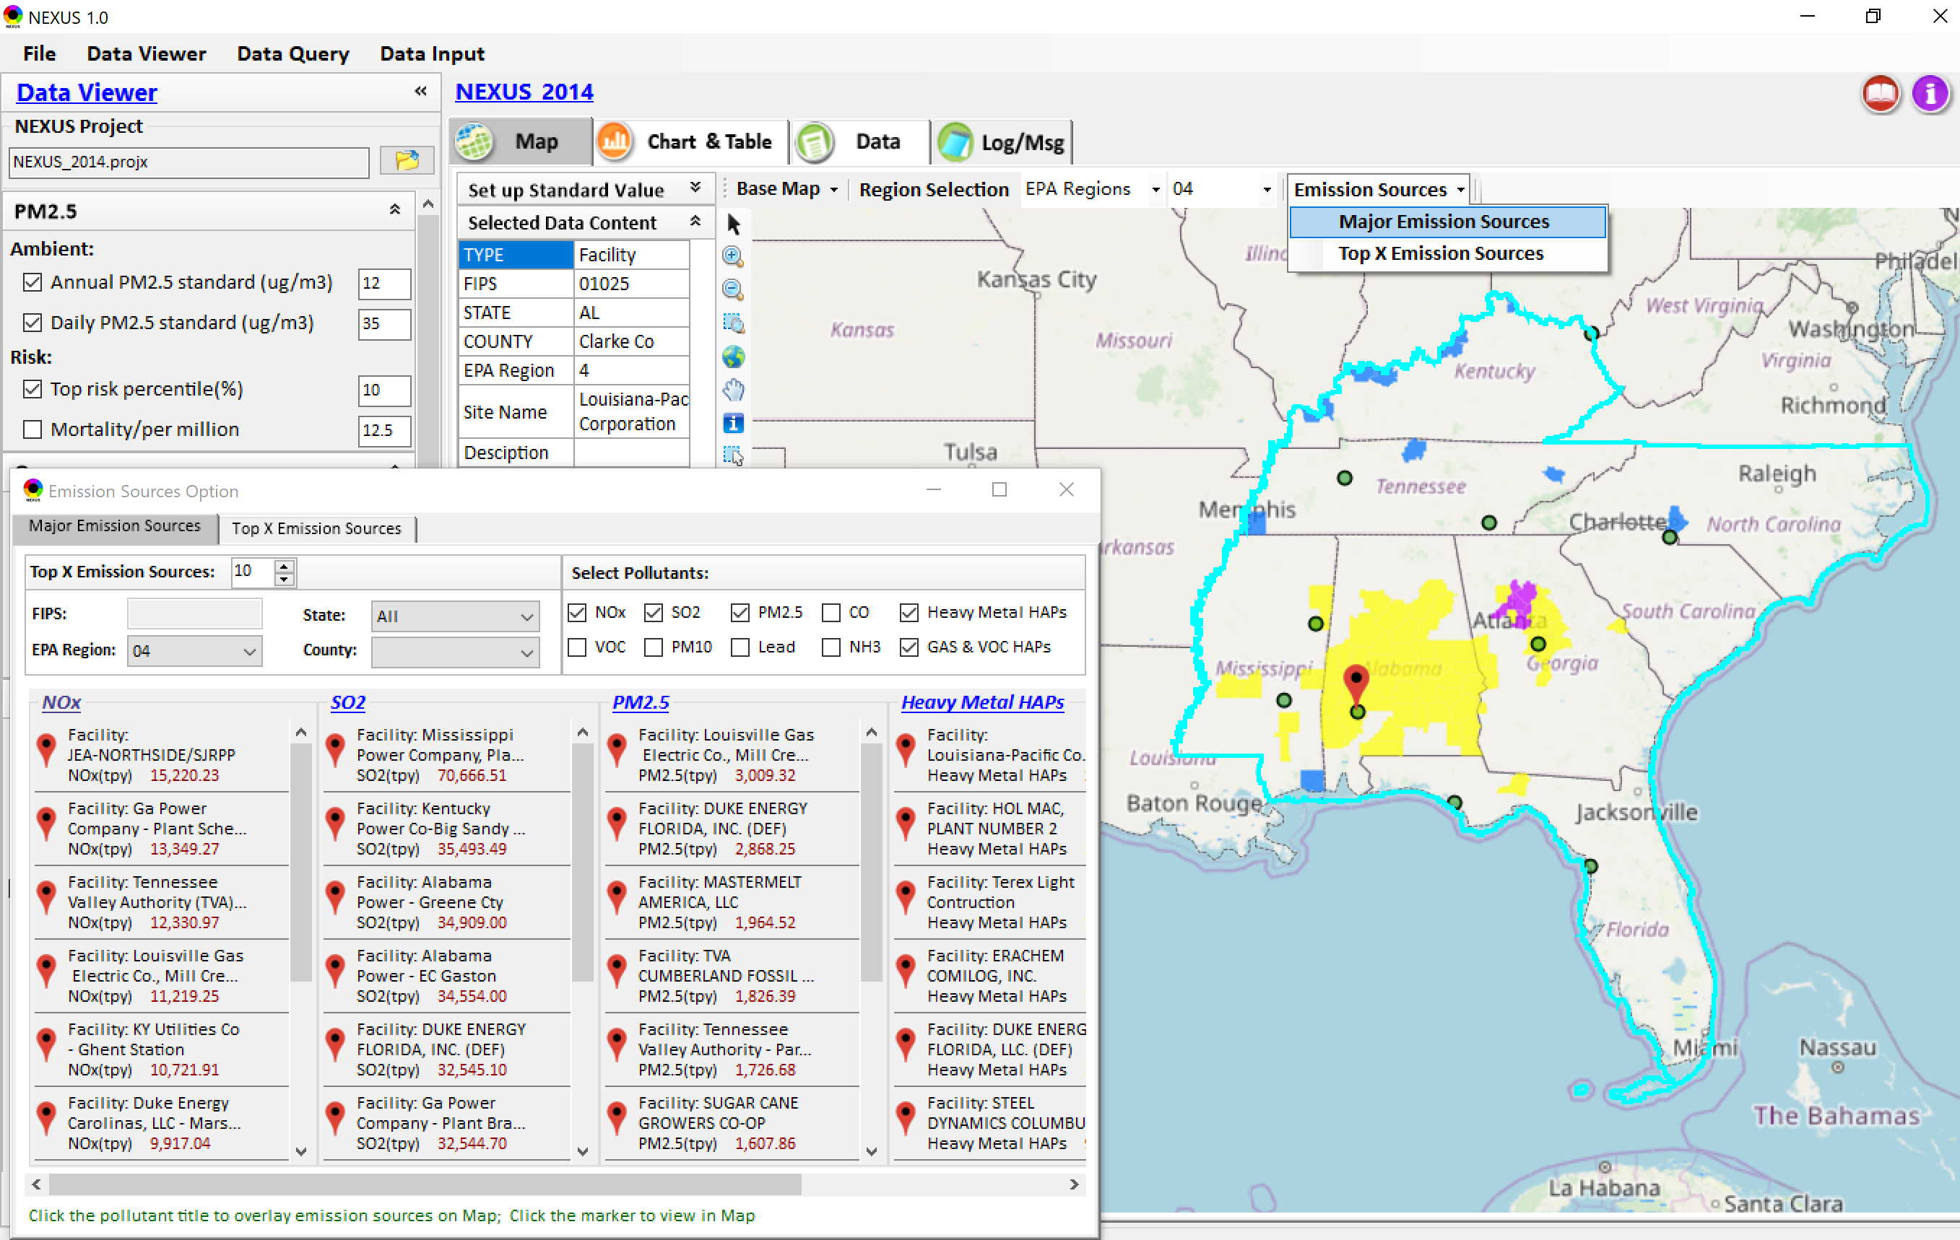
Data Viewer: Major Emission Sources
Click “Emission Sources” tab to display emission sources (green dots) and launch new window
Click any “facility” to link & display source location and emission information
39

Slide 40
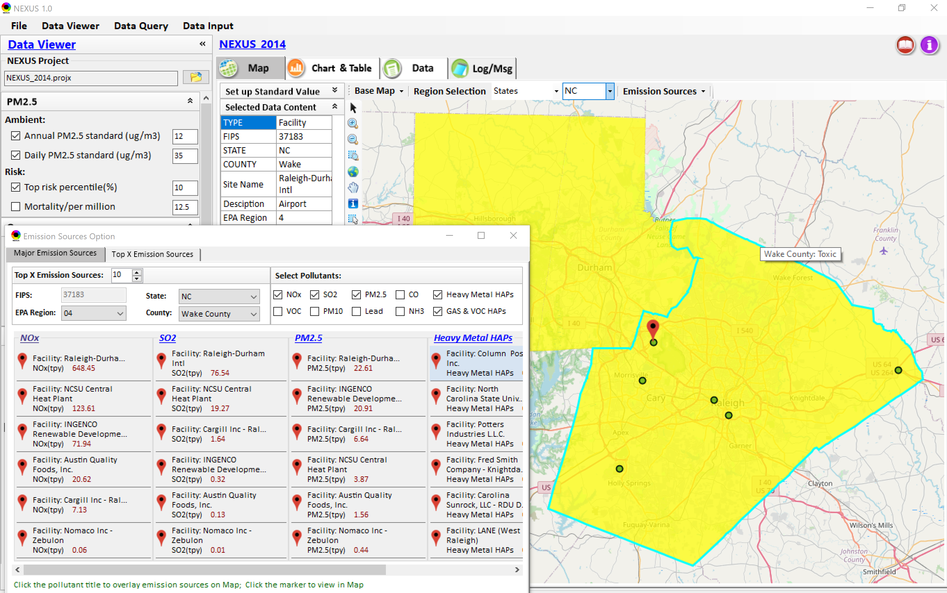
Data Viewer: Major Emission Sources
Allow to scroll down to county-level (e.g., Wake County, NC)
Wake county, NC
40

Slide 41
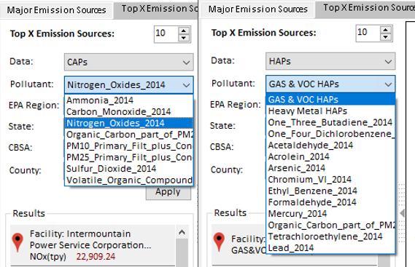
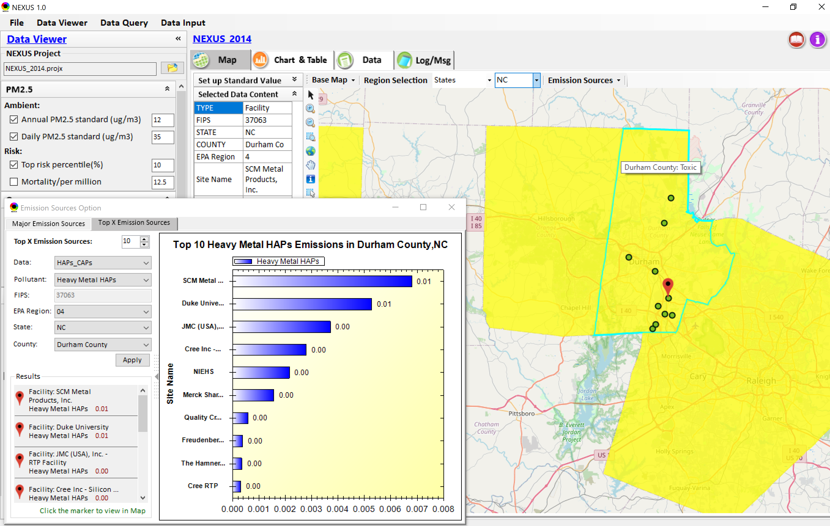
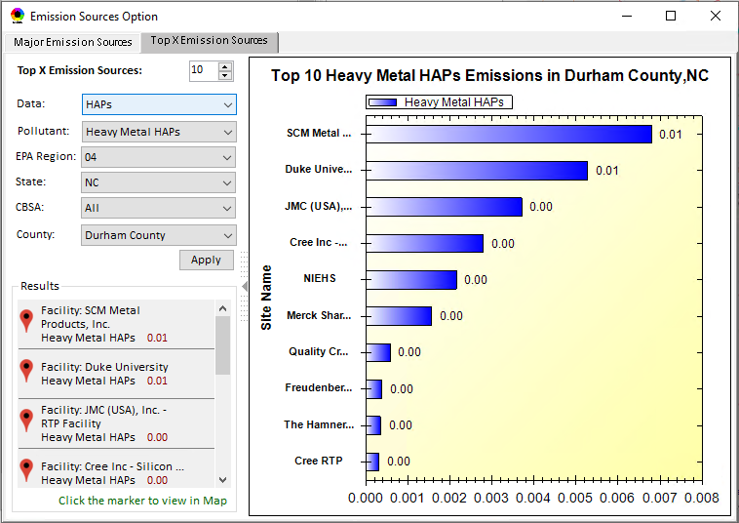
Data Viewer: Top “x” Emission Sources
Provide selection of CAPs precursors & HAPs species
Durham county, NC
41

Slide 42
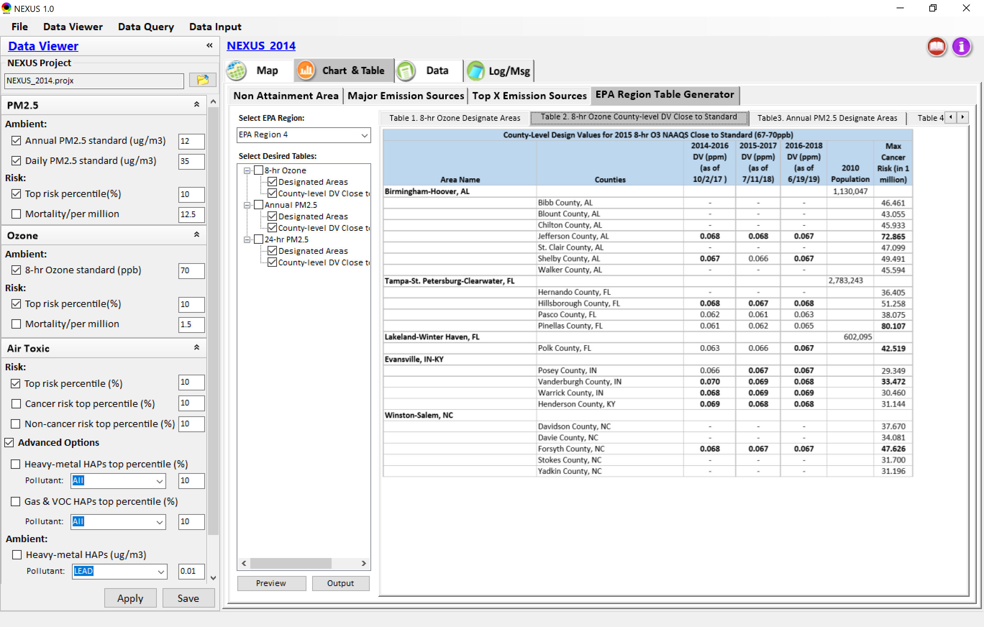
Data Viewer: EPA Region Table Generator
“EPA Region Table Generator” is still under development, but a preview of example “EPA Region 4” tables can be provided
42

Slide 43
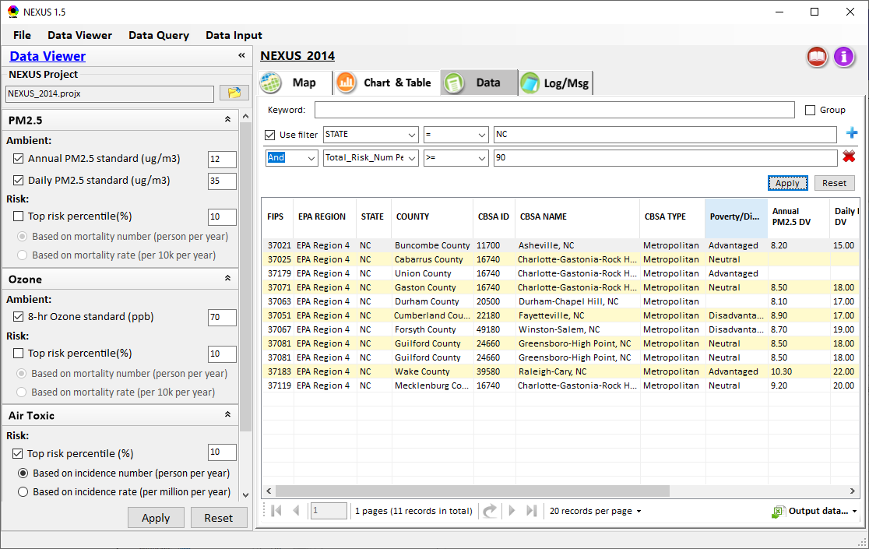
Data Viewer: Data Search & Filter
Click “+” to add filters; Click “x” to remove current filter;
Show specified records per page.
Click “Output data…” to output current page records or all records
43

Slide 44
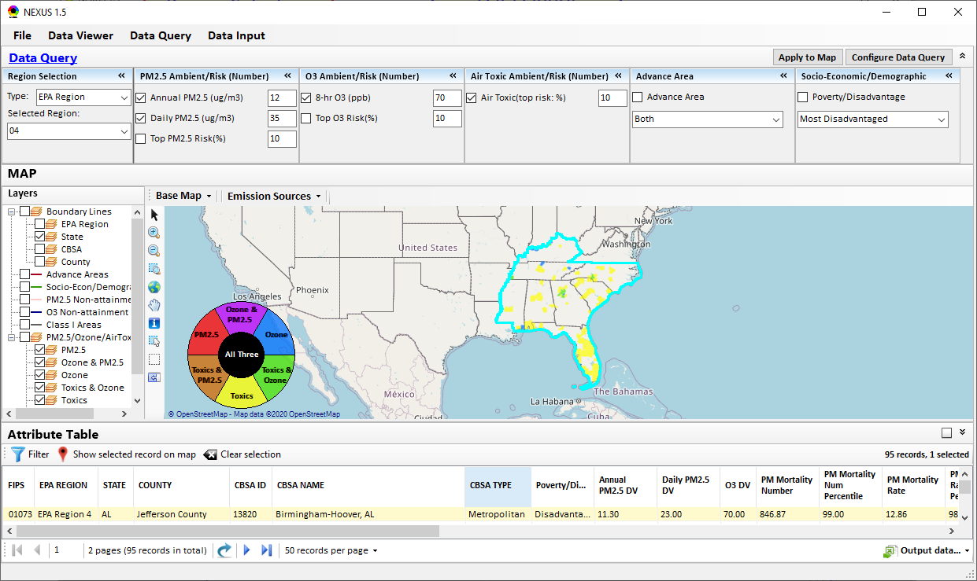
Data Query Module: Main Page
Region Selection
Data Query qualifier selection
Data Query Configuration
Map Overlaying selection
Detachable “Attribute Table”
11111111
44

Slide 45


Data Query Module: Configure Data Query
“Data Query Filter” allows to select “qualifiers” for query
“Data Query Preview” displays the selected “qualifiers” at the same time
45

Slide 46




Data Query Module: Overlaying Map
Overlaying Map selection
46
46

Slide 47


Data Query Module: Attribute Table
Filter/link/export functions (to be completed)
Detachable “Attribute Table”
47

Slide 48



Data Query Module: Attribute Table
Click a “record” to link and display its location & info.
48

Slide 49

Data Input Module: Data Preview
Click to view data
Click to change input data file
Click to view data
Select a table to view if there are multiple tables in the selected data source file
Check to use filter to query data
Click to run & save project
49

Slide 50
End
50

